Slide 1
Riunione di Servizio per CIF
Emiliano Dané
06/12/2021

Slide 2
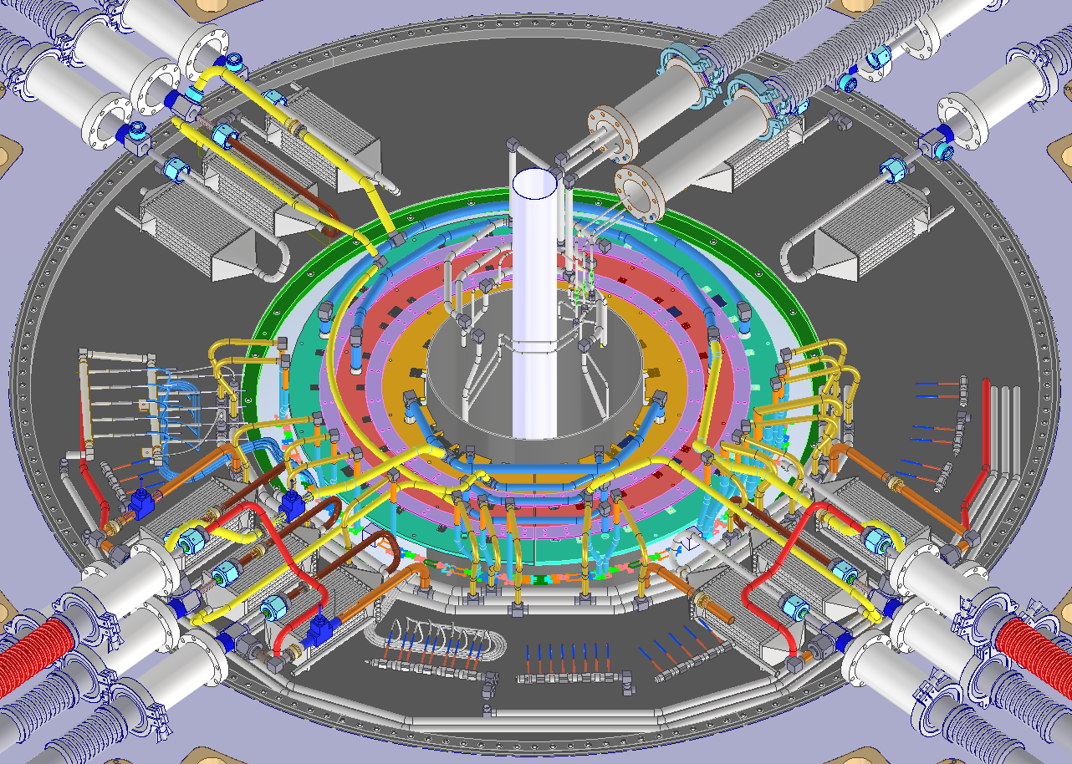
PP1 Cooling Overview
Inner System
15 cooling loops in total for 1 side:
Inner System: 3 loops
Outer System: 12 loops
  Warm Nose: 1 loop: 2 IN -> 1 OUT
  Outer Barrel: 8 loops
  End Cap: 3 loops
Modeling is at good point, but something is under decision due the power distribution issue.
Outer Endcap
Outer Barrel
Warm Nose

Slide 3
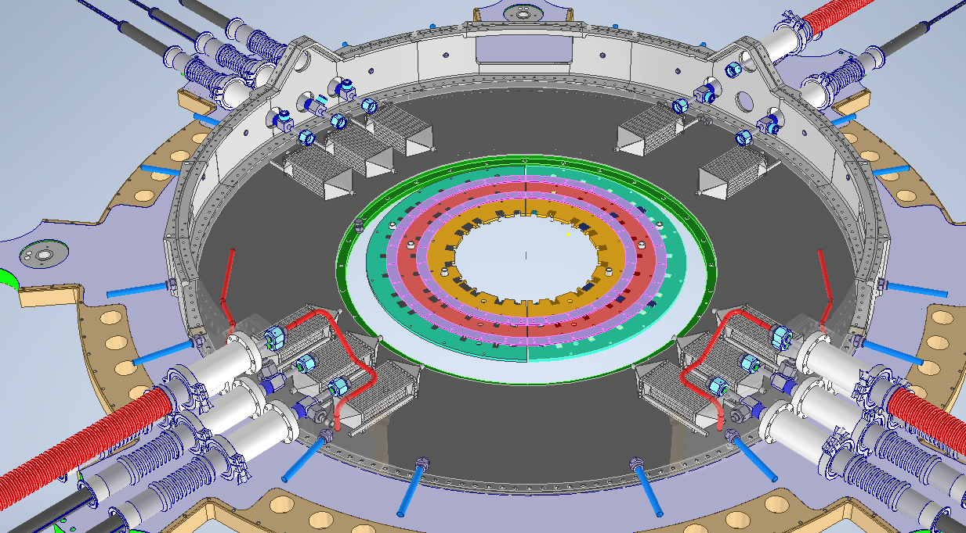
WN OUT
empty slot
A side
empty slot
WN IN W
WN IN V

Slide 4
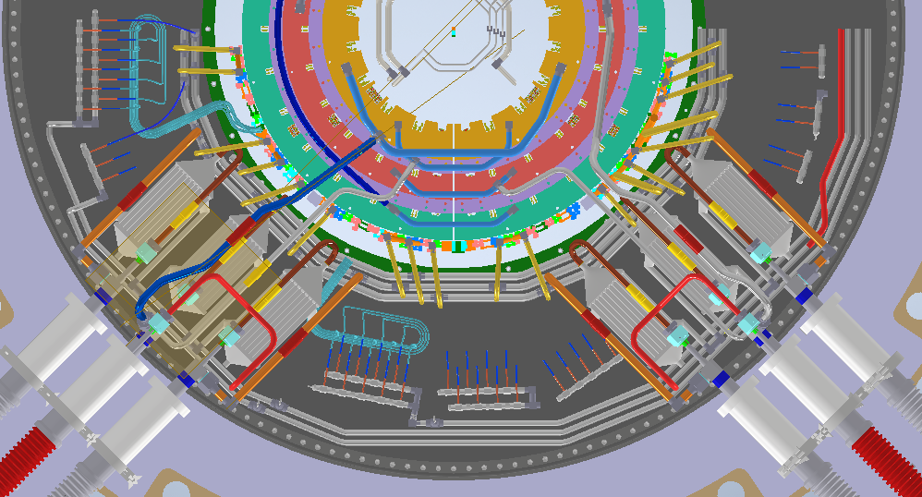
A SIDE
By pass
ManIN 4 (9)
ManIN 4 (2)
ManOUT 4
ManOUT 7
ManIN 2
ManOUT 8
ManOUT 2
ManIN 8 (2)
ManIN 8
Electric break..
FLOB CG8
FLOB CG7
FLEC L2
FLEC L3
FLOB CG2
FLOB CG4
ManIN 7
ManIN 2
(3) ManIN 8
(2) ManIN4
Modify Manifold

Slide 5
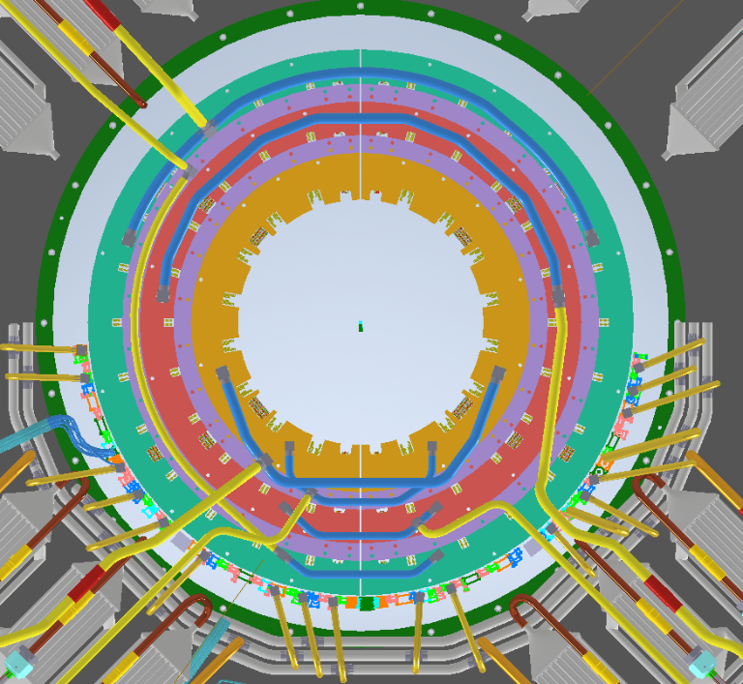
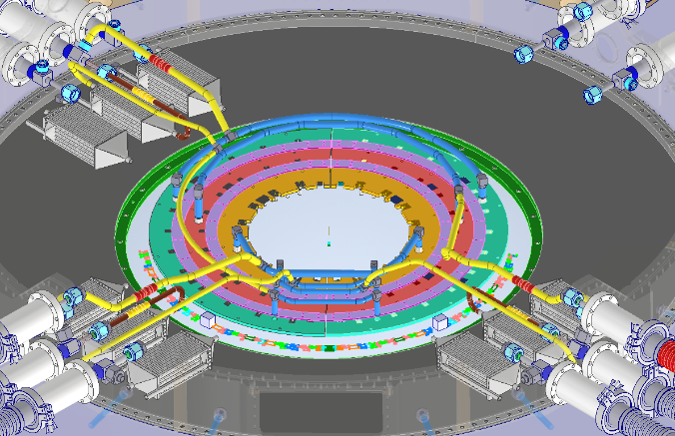
EndCap Manifolds
EC-L4
1/2 in.
EC-L3
EC-L2
3/8 in.

Slide 6
Update after meeting with Bart Verlaat Nov-5th-21
H1
H2 | H1
1-A | 2-A
3-A | 4-A
5-A | 7-A
6-A | 8-A
H2
OB H1-H2 CG correspondence
L3
L2
Constraints:
Lines length as short as possible: OB-CG7, OB-CG5, EC-L4
Conditions:
OBH2 should be rotated (π) respect global Z axis to obtain OBH1
OB A-side should be rotated (π) respect global Y axis to obtain C-side
EC should be symmetric respect global XY plane to obtain C-side
All constraints complied (OB-CG7, OB-CG5, EC-L4)
OB lines not complaining the OB conditions:
  Side AH1: OB-CG1 <-> OB-CG3
  Side CH1: OB-CG1 <-> OB-CG3
  Side CH2: OB-CG4 <-> OB-CG2
EC completely symmetric

Slide 7
Update after meeting with Bart Nov-5th-21

Slide 8
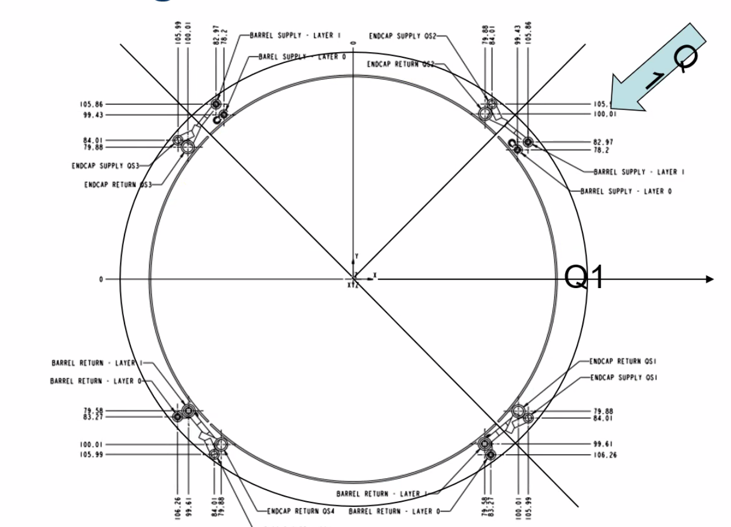

Slide 9
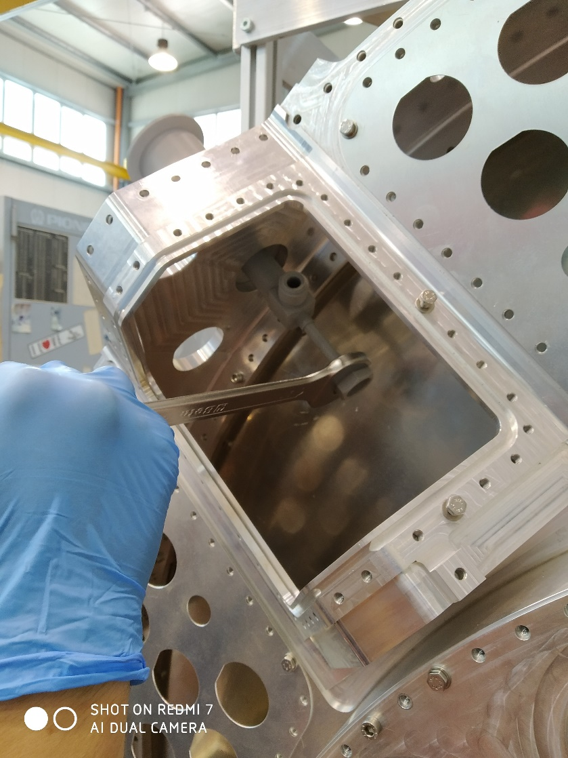
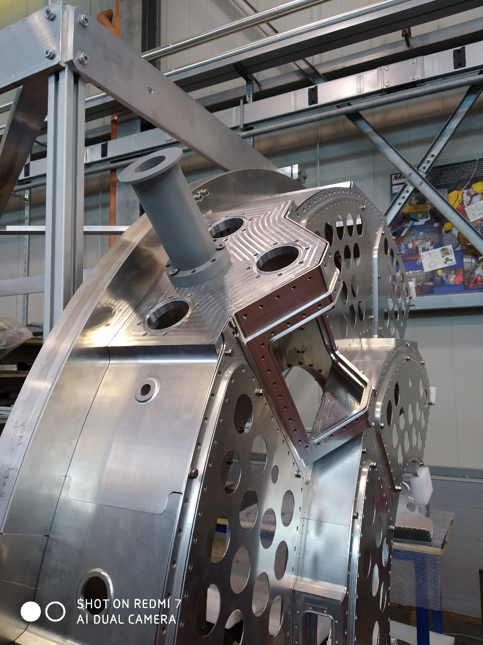
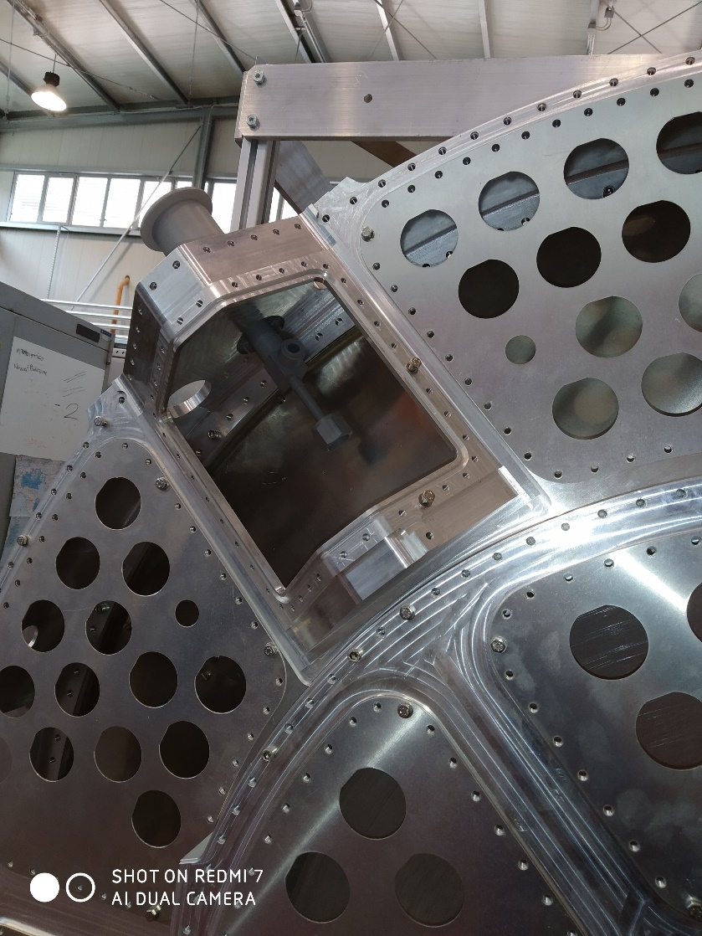
Mockup

Slide 10
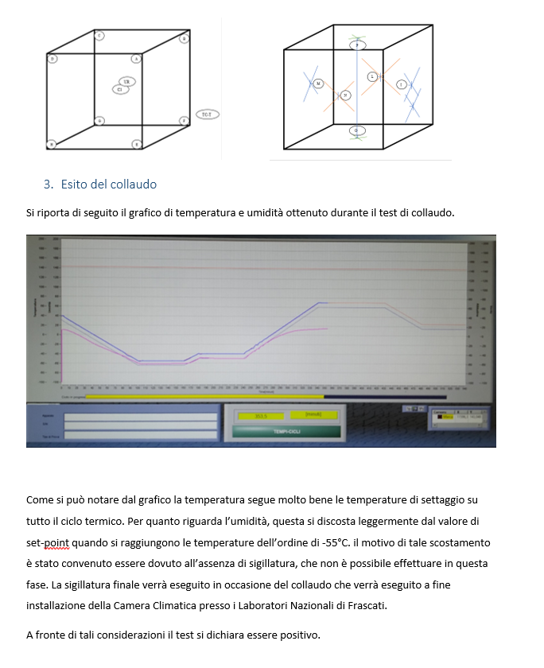
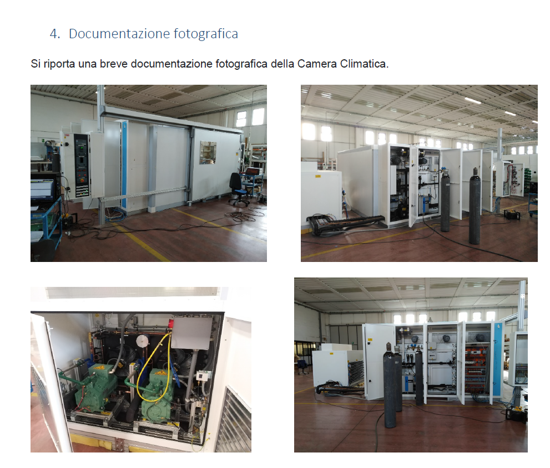
CAMERA CLIMATICA

Slide 11
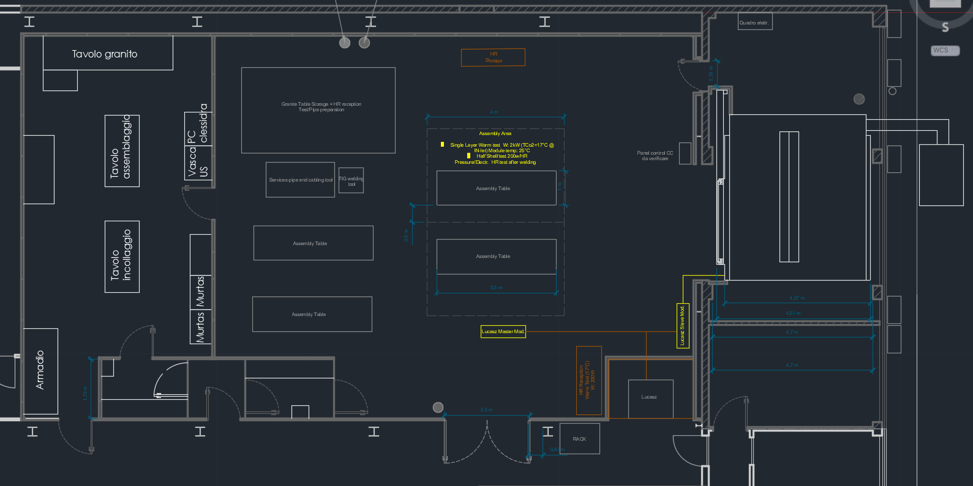
CAMERA PULITA

