Slide 1
SEM Meeting
INFN-LNF
Filippo Rosatelli
06/12/2021

Slide 2
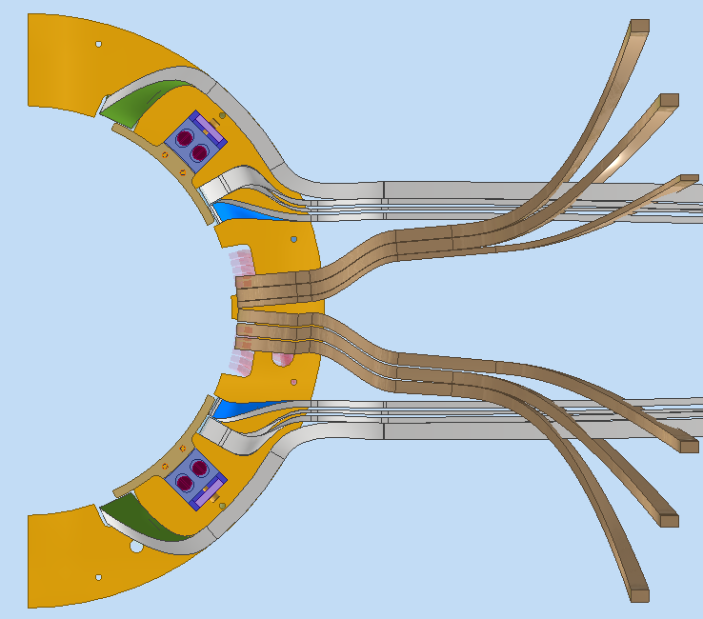
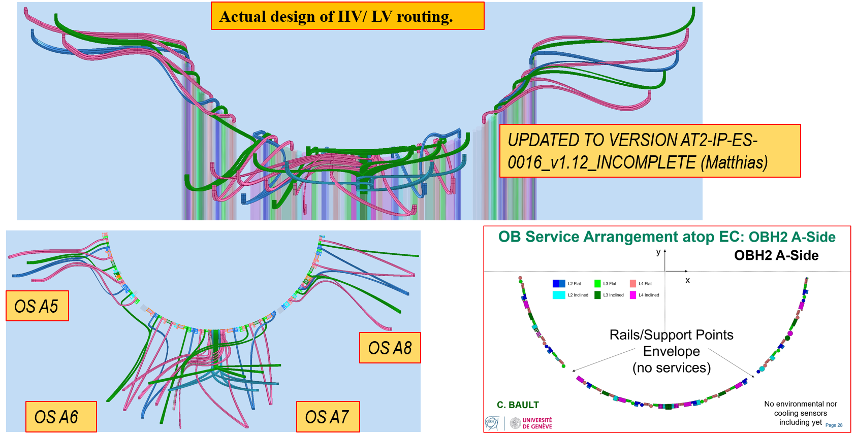
ATLAS ITk – Cabling
EC L2 NOW
DATA
HV/LV
Activities:
Update the Layer 2 routing in End caps (WIP). Waiting news from ATLAS collaboration.

Slide 3
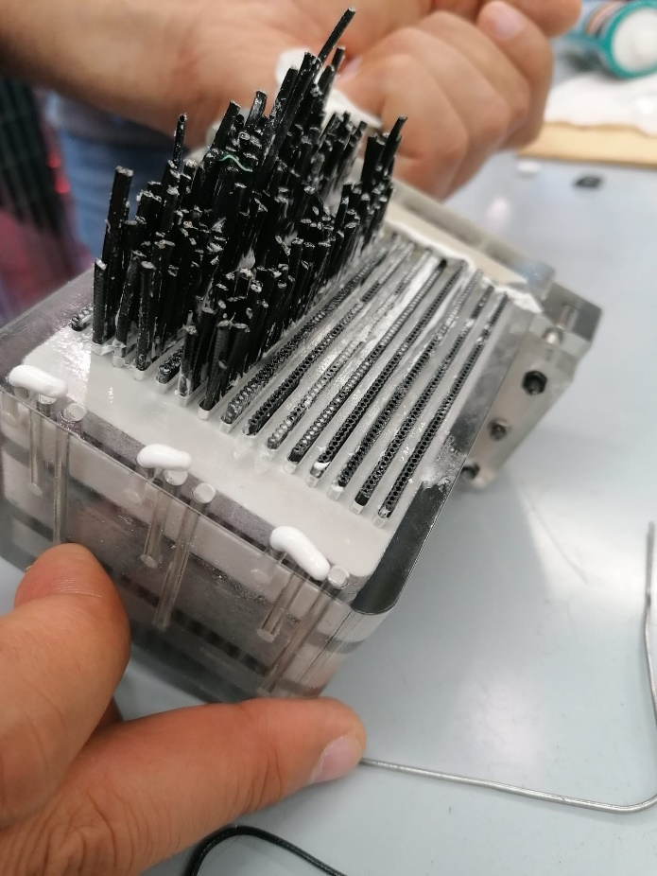
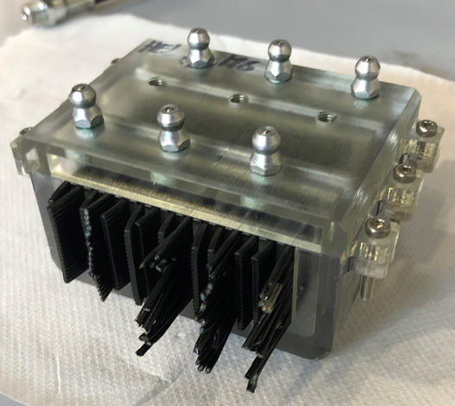
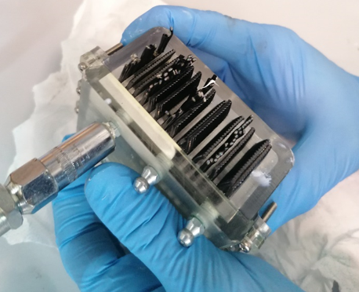
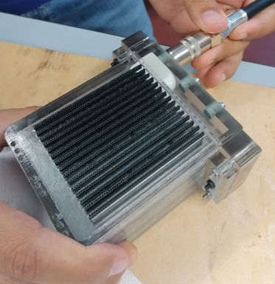
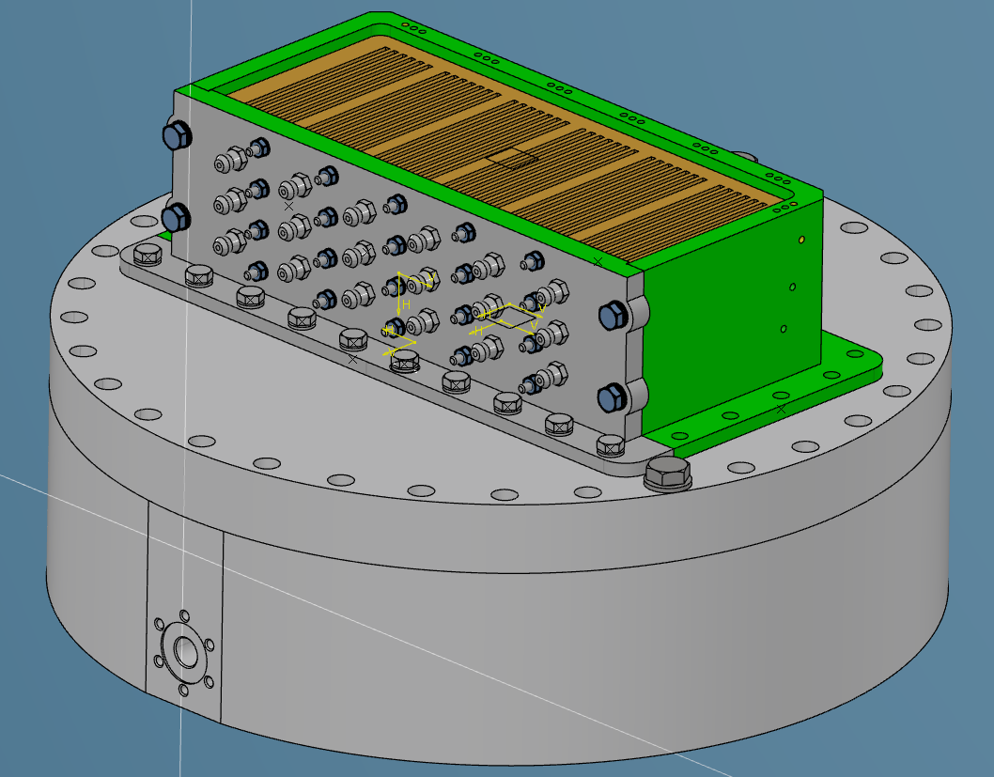
ATLAS ITk –Data feedthrough
Activities:
Test on different prototypes to verify the issues connected on filling process.
Improve the solution adopted.
Design the new 1:1 scale prototype for test (WIP)

Slide 4
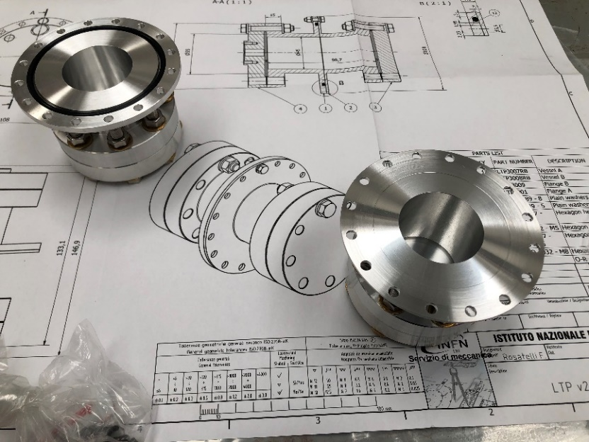
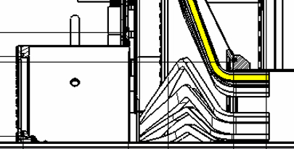
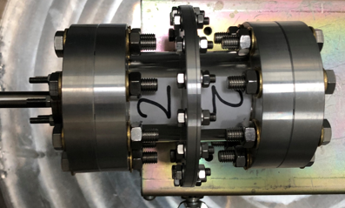
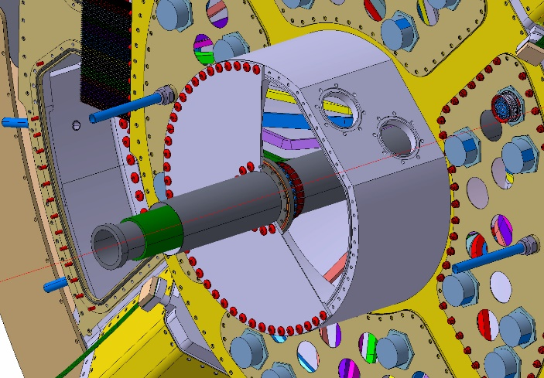
ATLAS ITk –Leak test
Prototype tested
4MGy
6MGy
4MGy
6MGy
Activities:
Production of samples for test O-ring leak.
O-ring Leak check test performed.
Sent the three samples to US facility for irradiation up to 6 MGy.
Migration to 3D experience.

Slide 5
LEAK TEST RESULTS
Sample n° | Leak rate [mbar l/s] He std after 6 h
1 | 5,2E-06
2 | 4,28E-06
3 | 4,31E-06
Sample n° | Leak rate [mbar l/s] He std after 24 h
1 | 5,42E-06
2 | 4,6E-06
3 | 4,62E-6

Slide 6
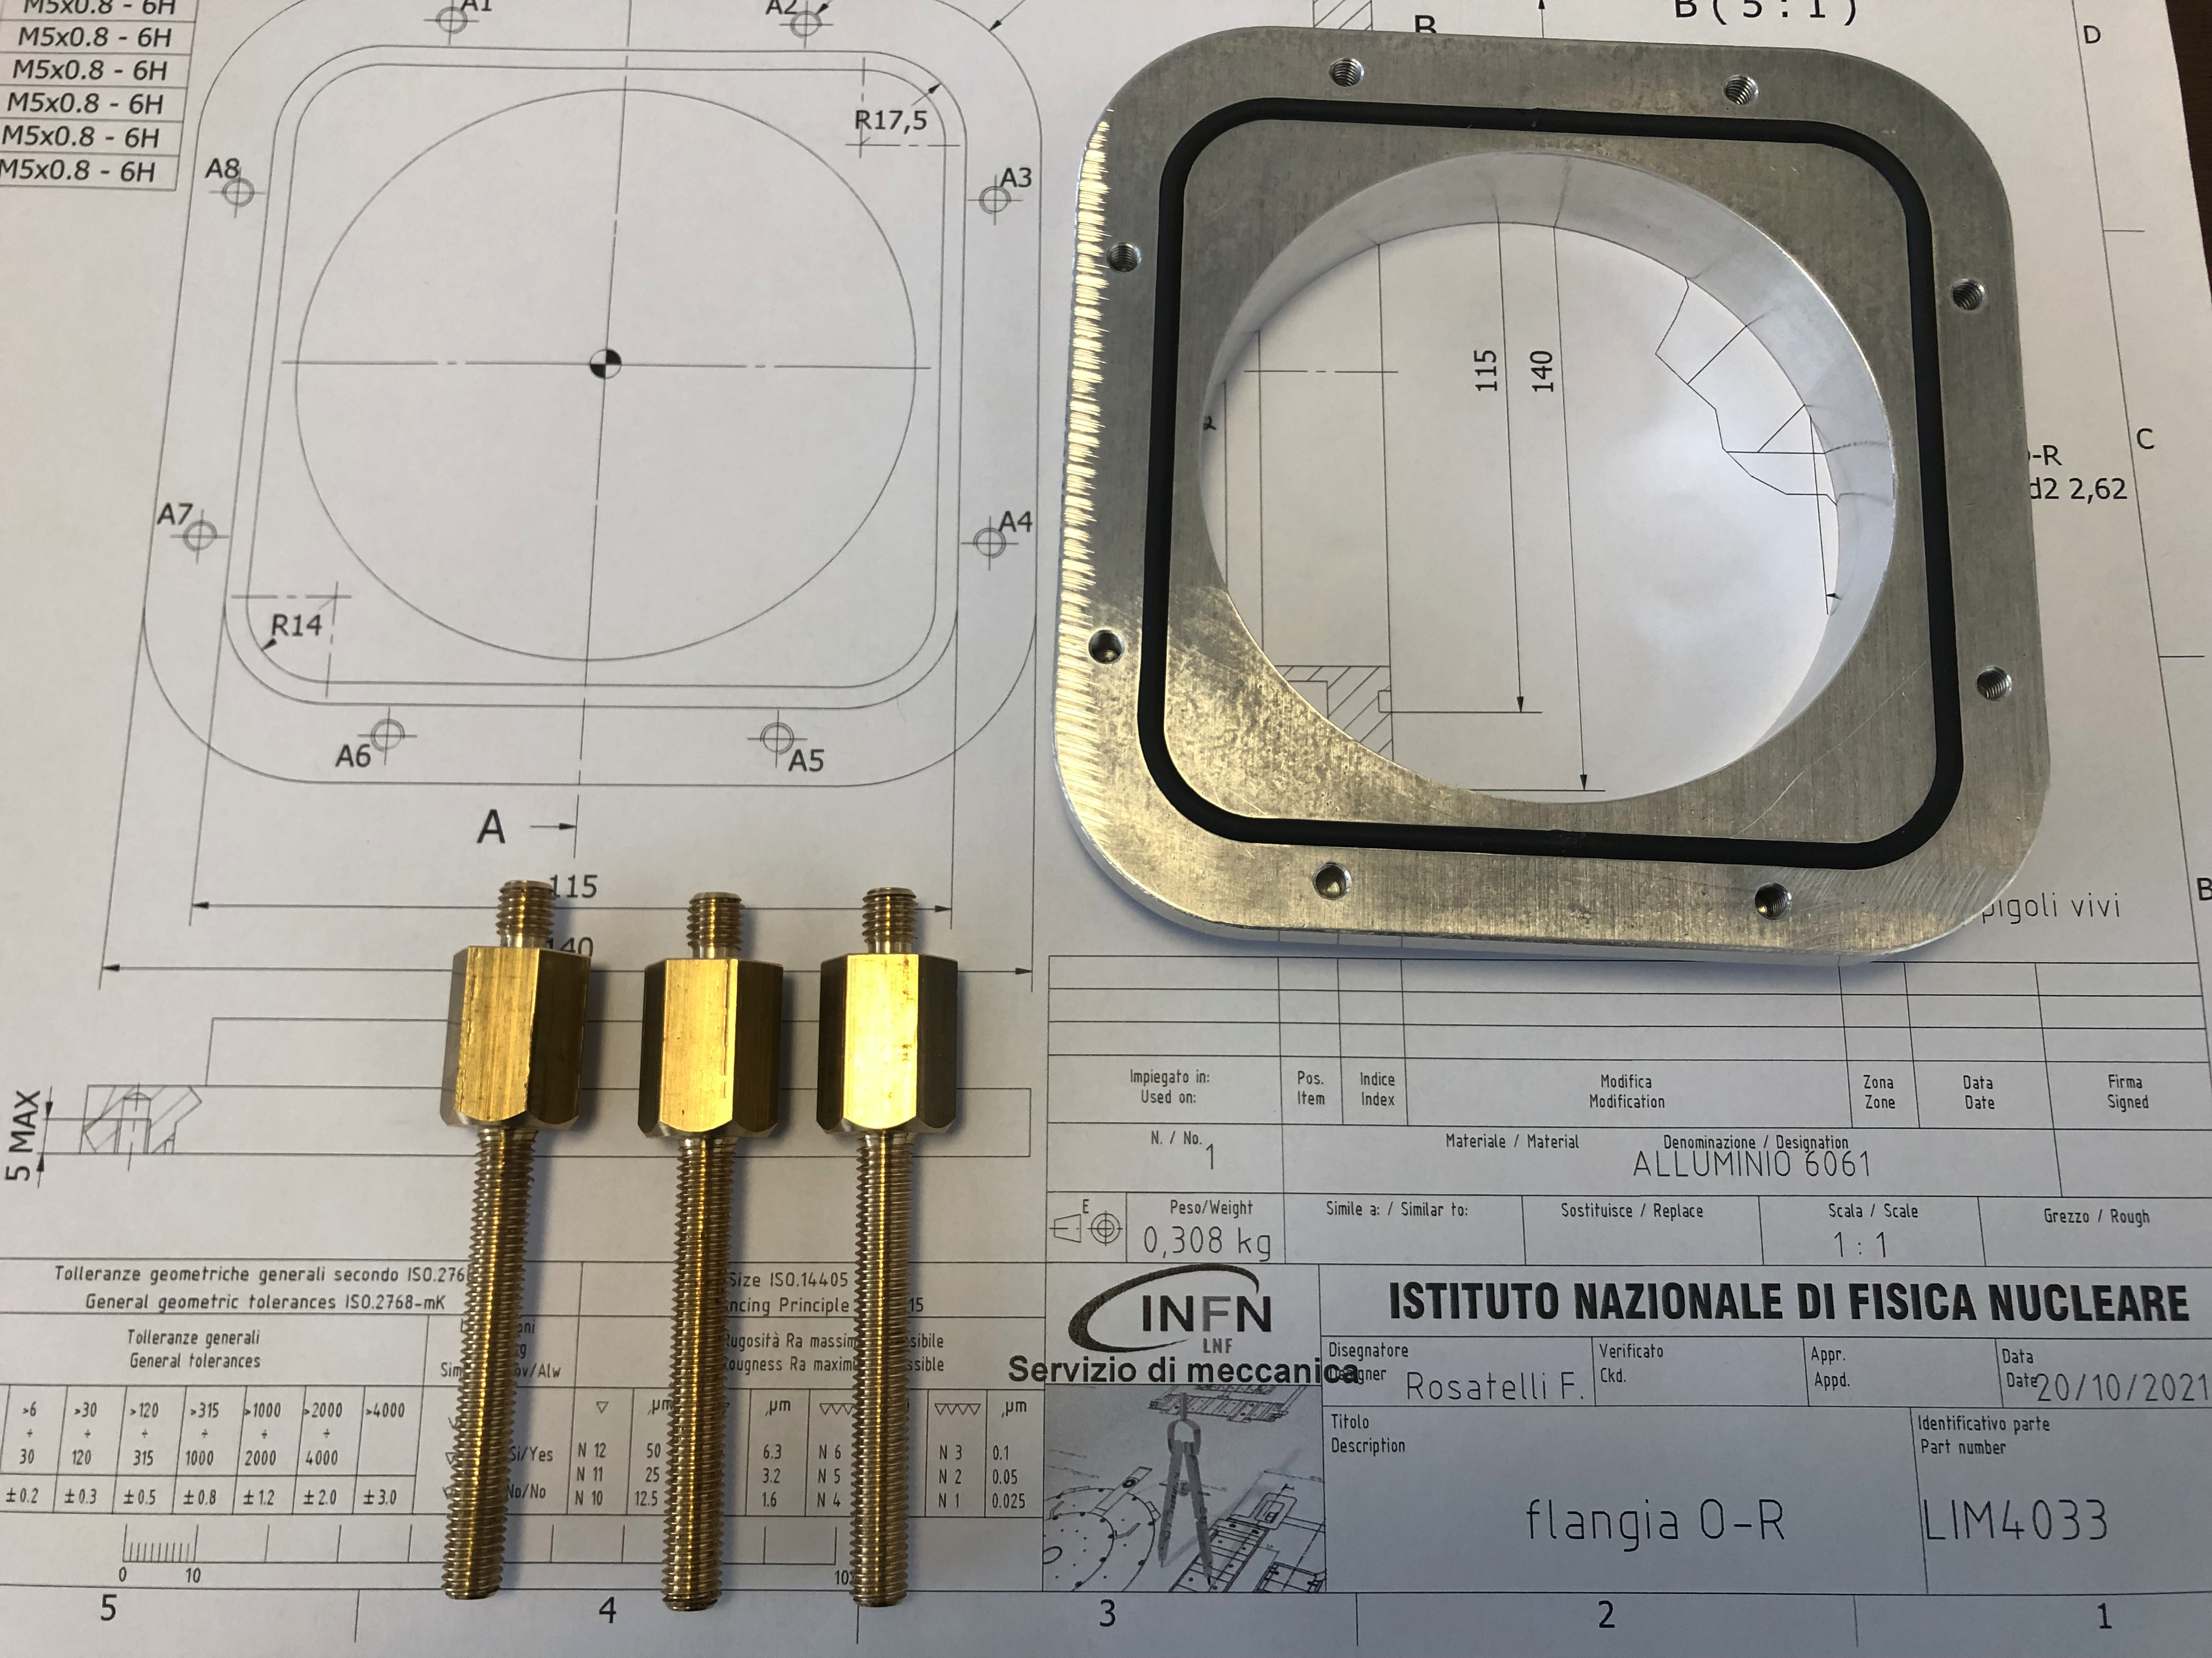
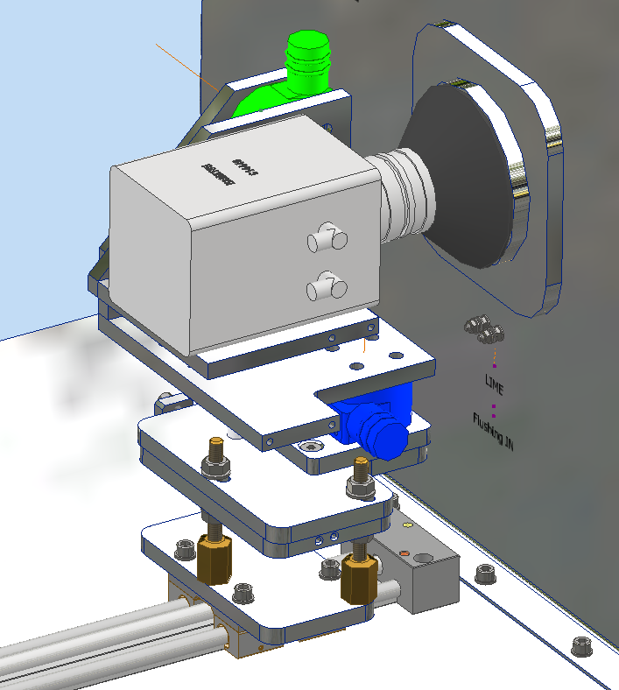
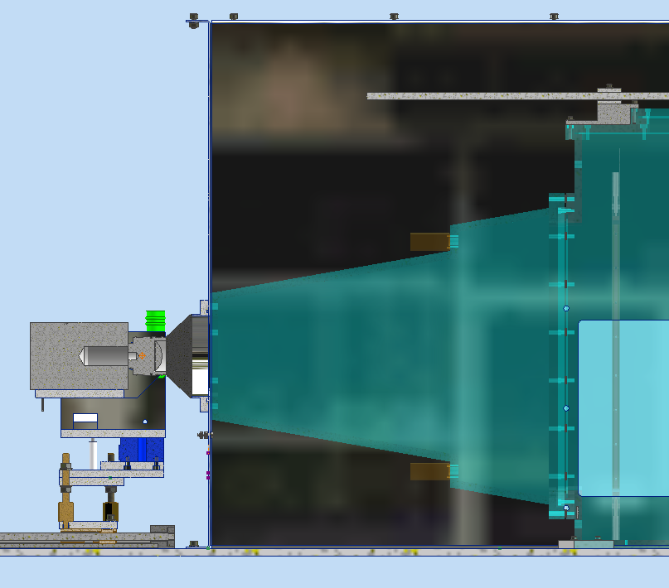
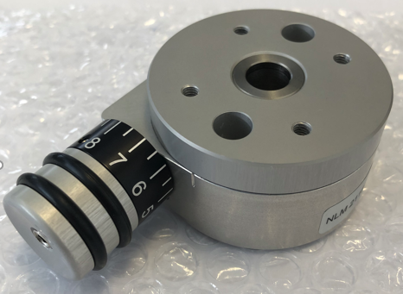
CYGNO - LIME
GEM
Activities:
Design a new regulation system for CMOS camera.
Production of components (WIP)
Support to the experiment.
Order of commercial part.

Slide 7
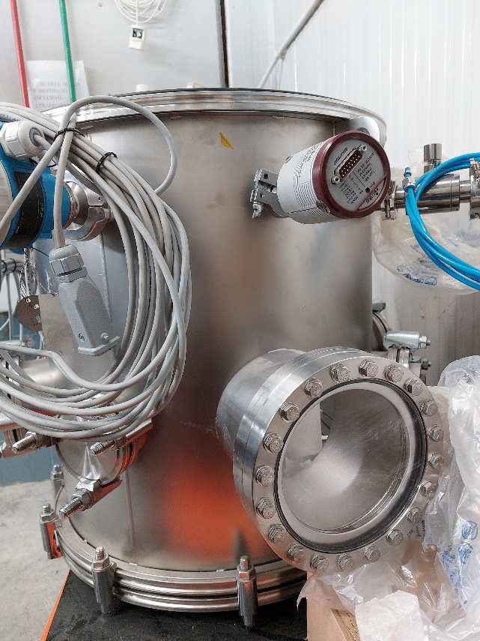
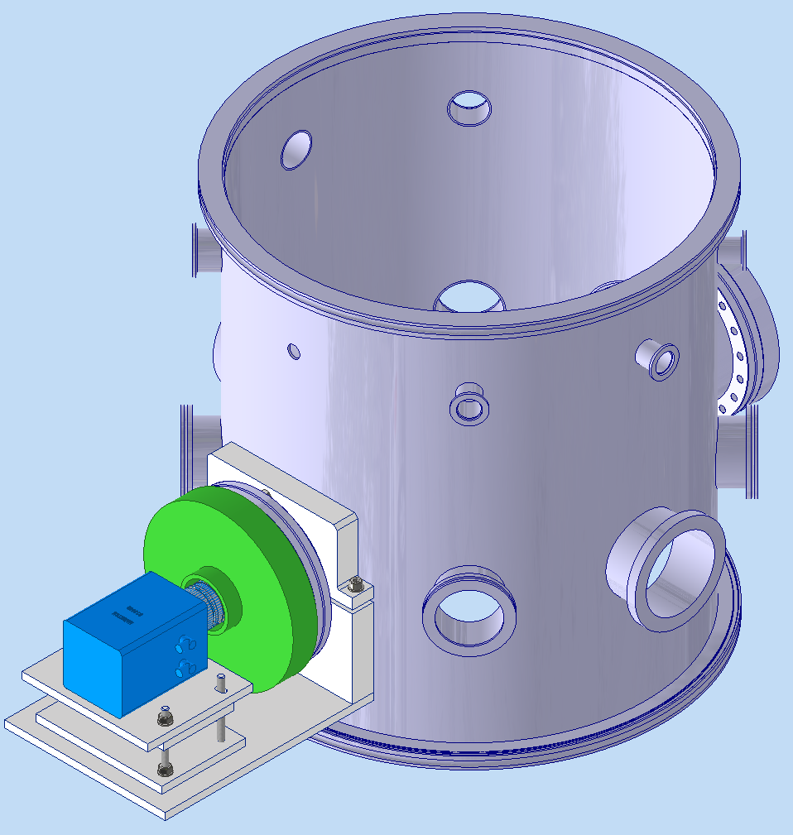
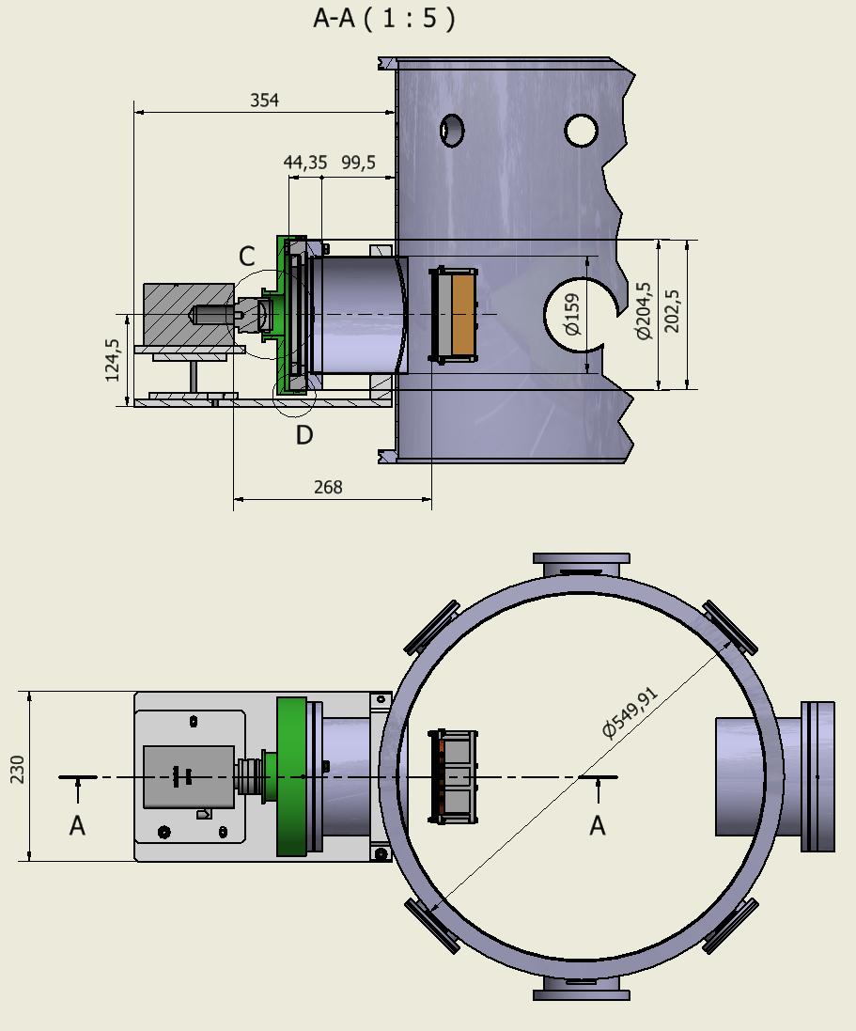
CYGNO - MANGO
Activities:
Design the support system for CMOS camera placed in front of the vacuum window .
Production of components (WIP)

