Slide 1
WP4 - TWJPA Test and Characterization
C Gatti
General Meeting 1/12/2021

Slide 2
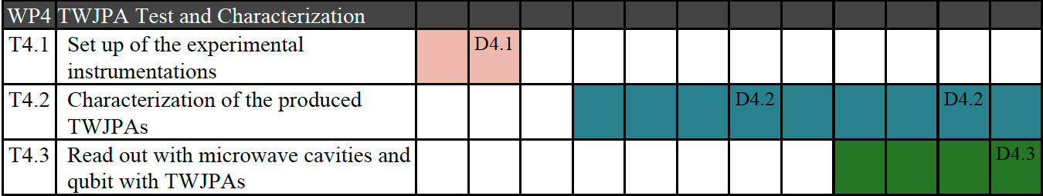
WP4 Milestones and Deliverables
WP Main Goal
INFN-LNF and IBS-CAPP: application to axion searches in two different frequency ranges: 8-12 GHz and 1-4 GHz, respectively.
INFN-LE: readout of transmon qubits coupled to magnetostatic modes in Yttrium Iron Garnet (YIG) single crystals in strong-coupling regime.
2021
2022
2023
Task 4.1: Set up of the experimental instrumentations (M1-M6)
Task 4.2: Experimental characterization of the performances of produced TWJPAs (M12-30);
Task 4.3: Test of produced TWJPAs and read out demonstration with detectors (M24-36);

Slide 3
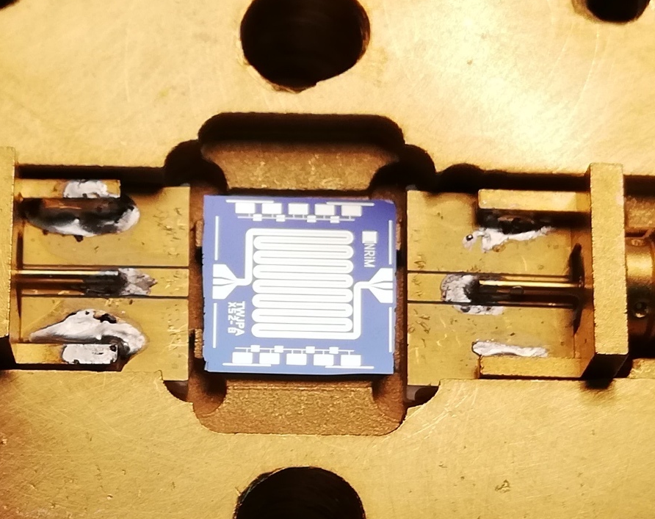
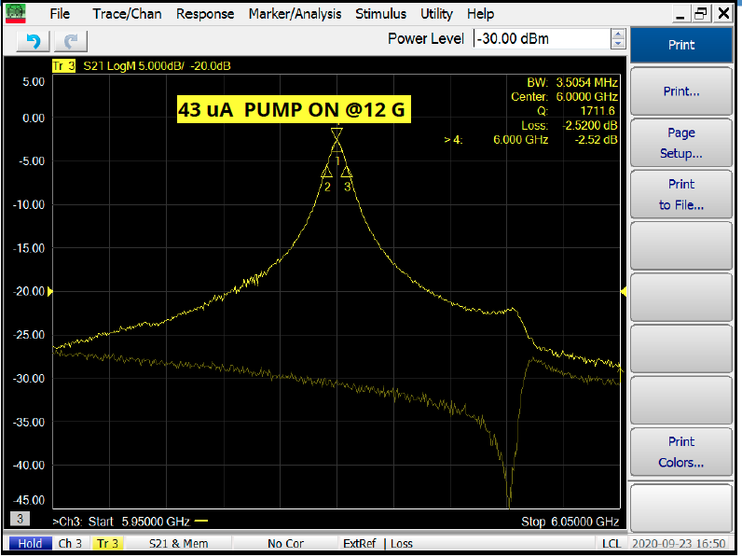
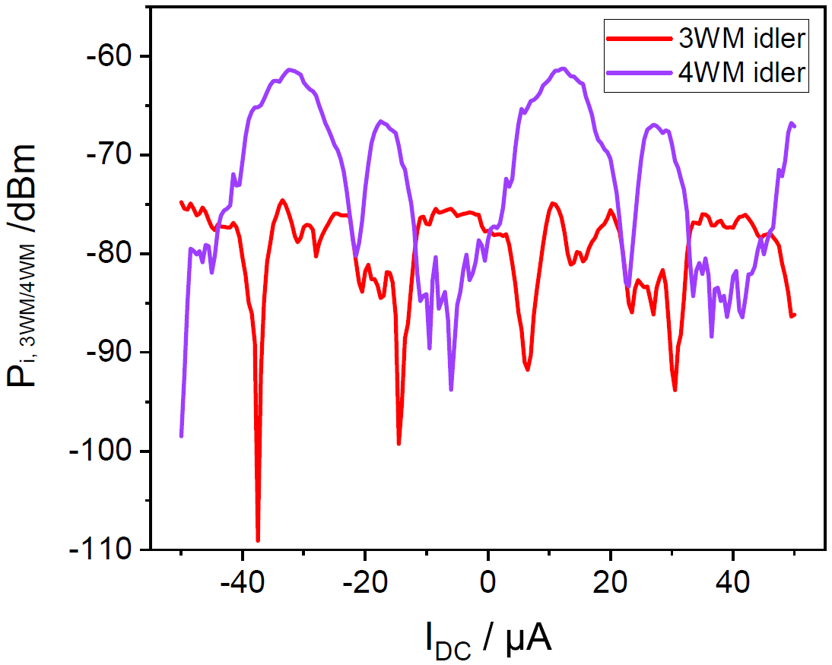
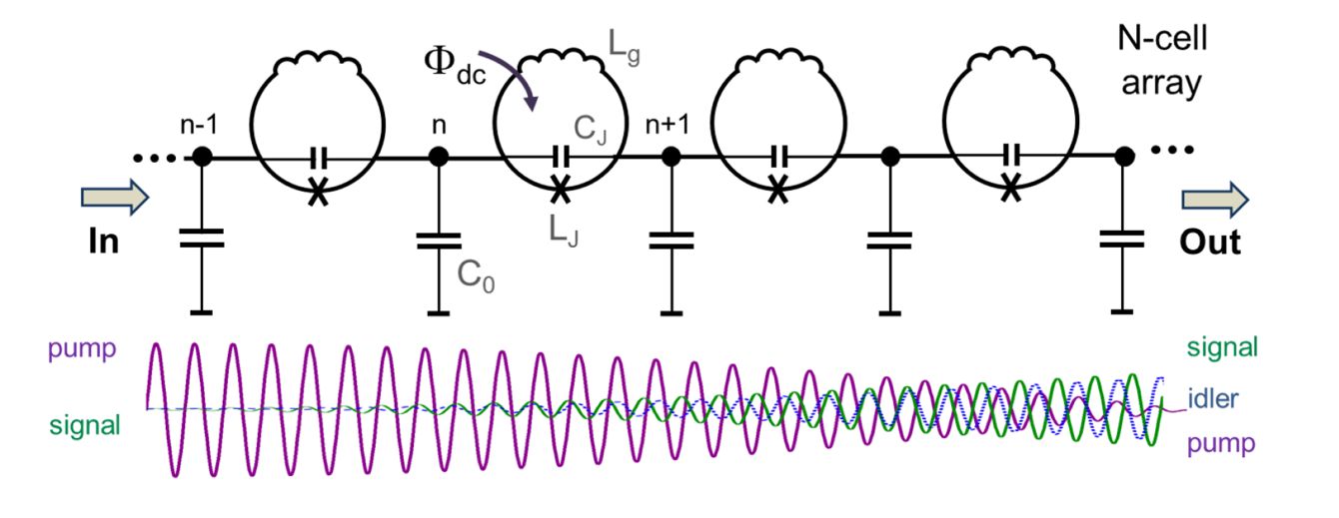
TWJPA Test during first year
First TWJPA samples characterized at LNF and IBS-CAPP at end of 2020. Parametric amplification observed only for single frequencies at 3, 6 and 9 GHz (!?). Modulation of 4/3 wave-mixing behaviour observed.
Measurements at LNF
Measurements at IBS-CAPP (Çağlar Kutlu)

Slide 4
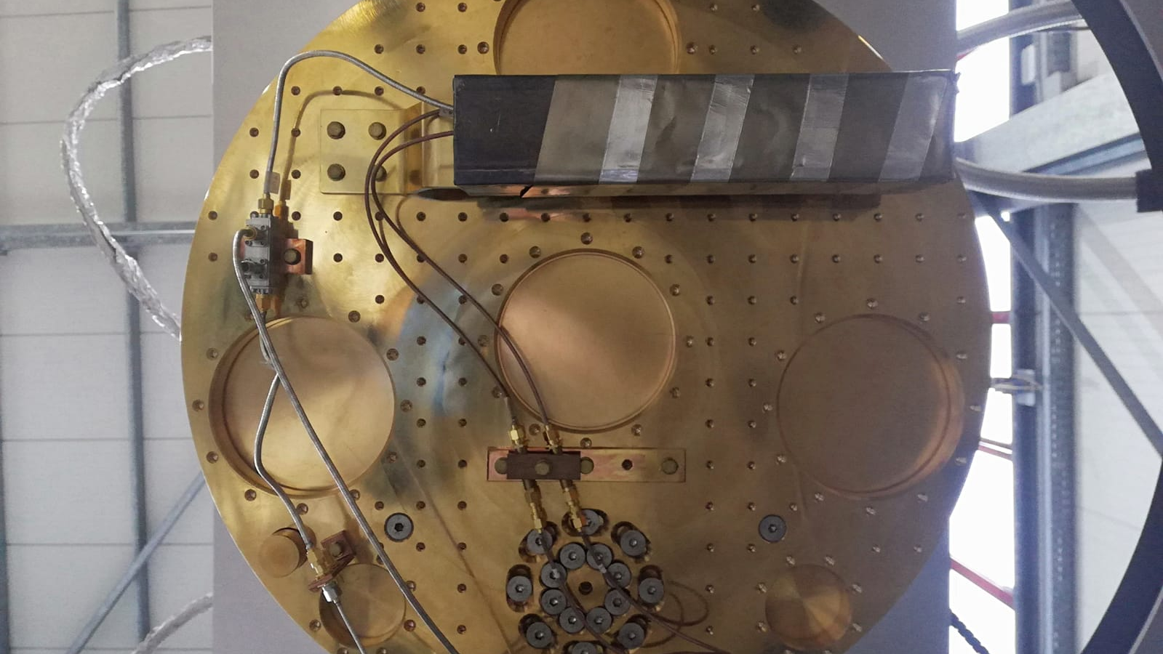
D4.1 setup of labs

Slide 5
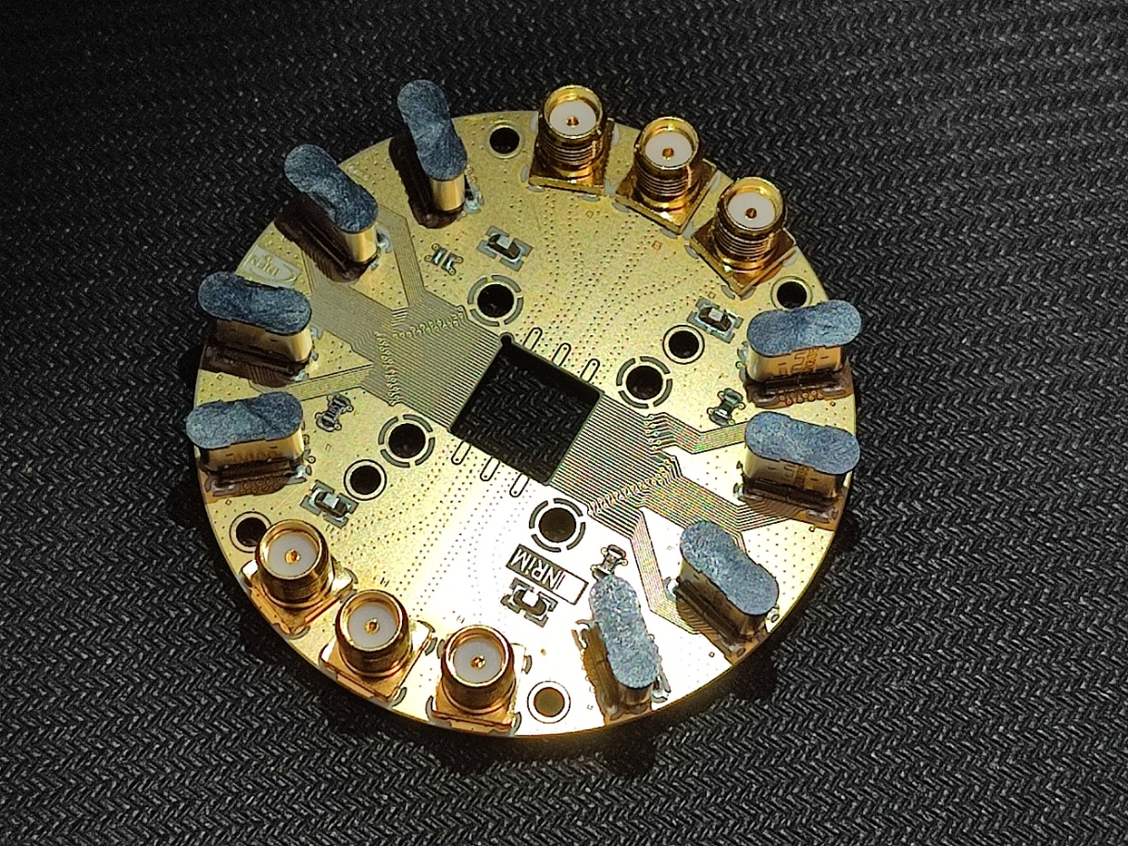
LNF Lab: Sample holder
PCB and holder based on INRiM design
Adapted by S.Lauciani
Adapted by M. Gatta
Sample holder now in fabrication at LNF workshop. Ready in 1-2 weeks.
New PCB ready

Slide 6
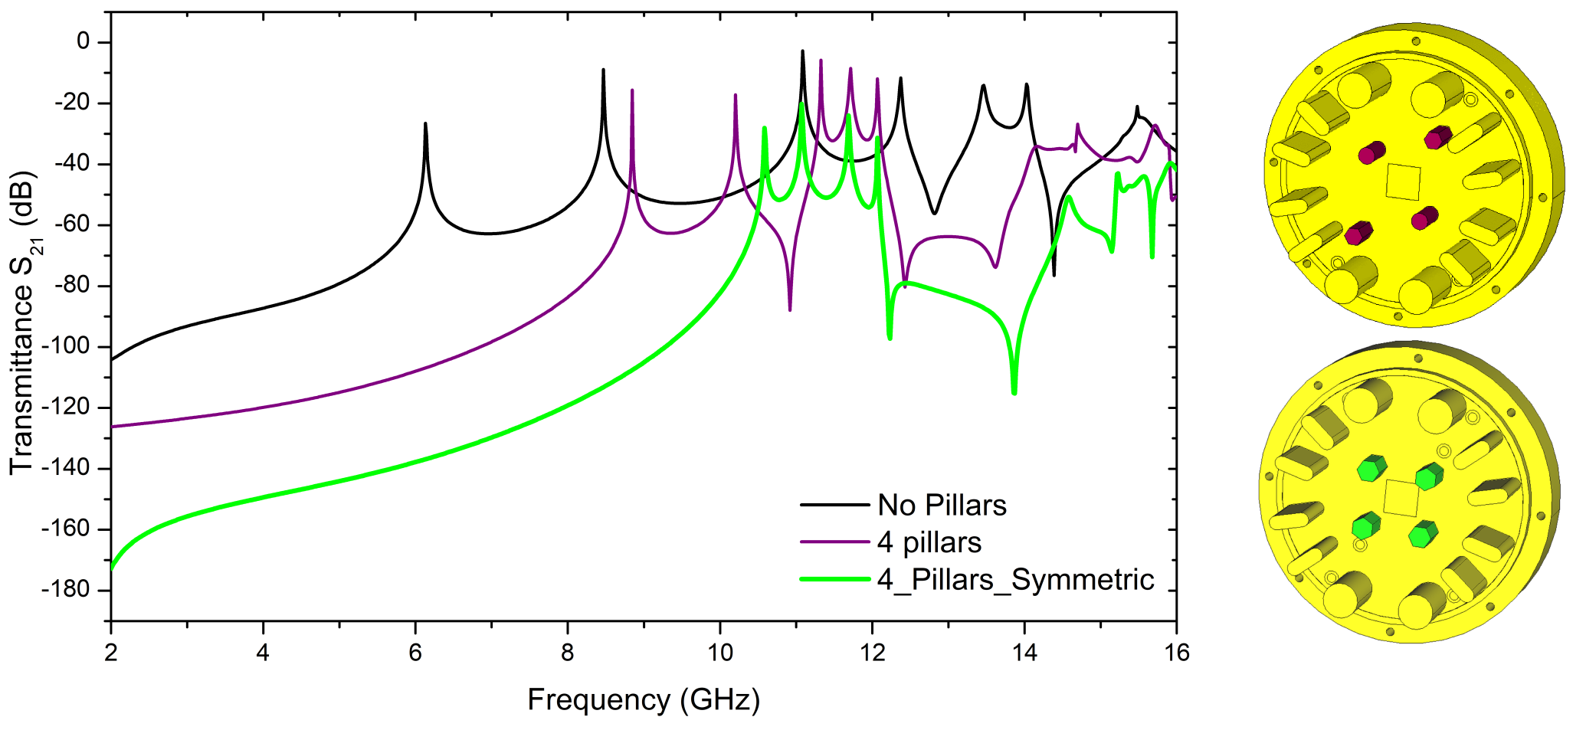
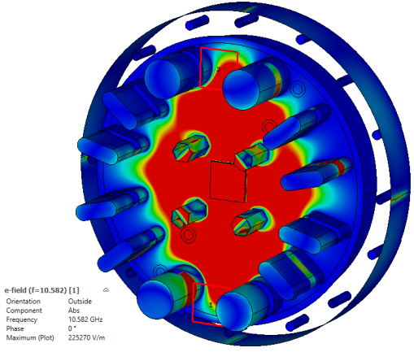
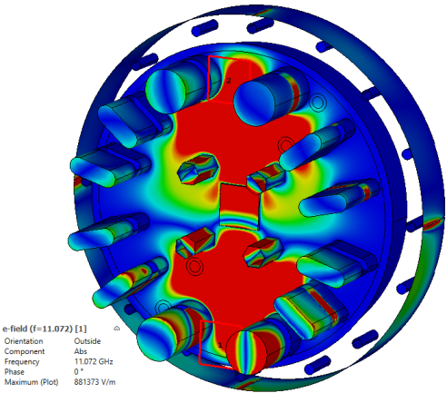
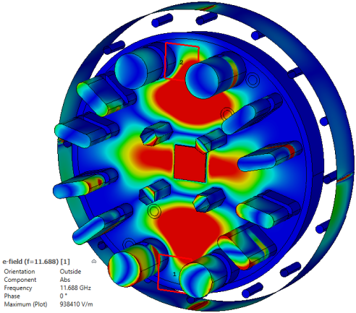
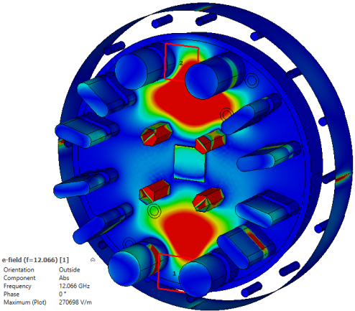
Simulations from
Nassim Chikhi
From CNR-Spin
Pzzuoli (within Supergalax collaboration)
Field maps for the 4 picks on the green curve

Slide 7
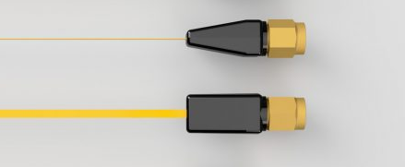
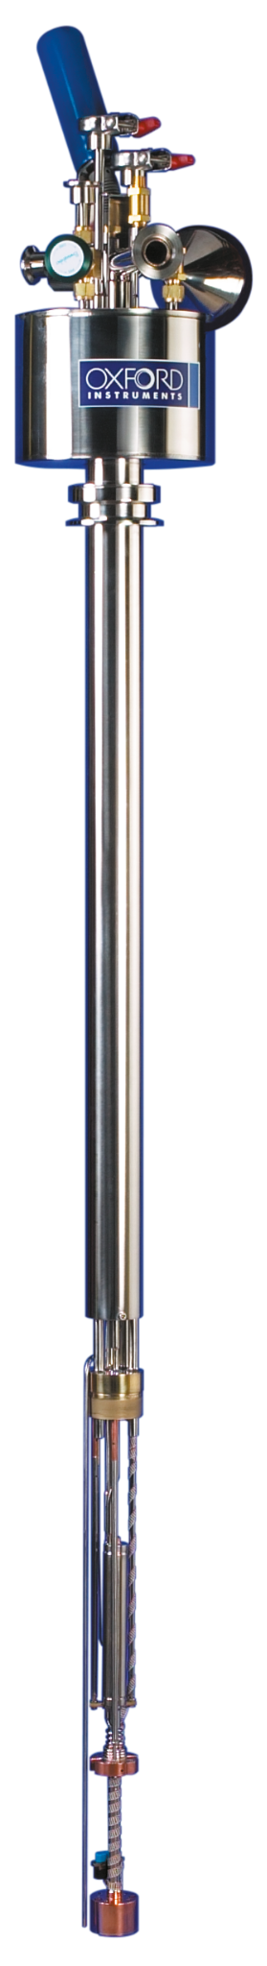
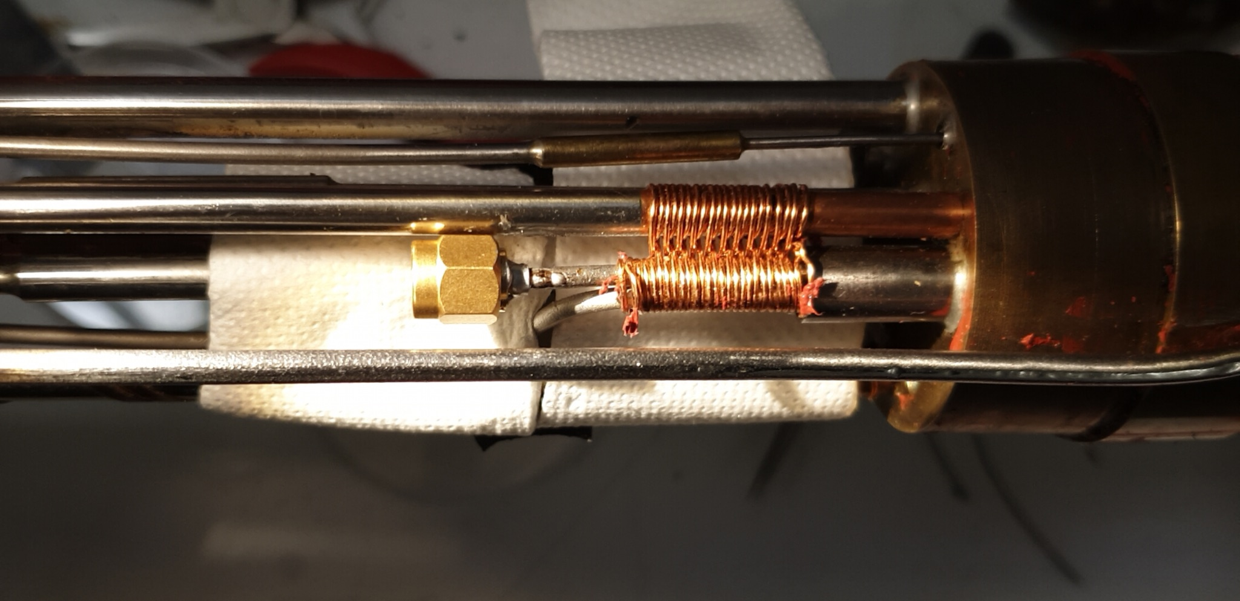
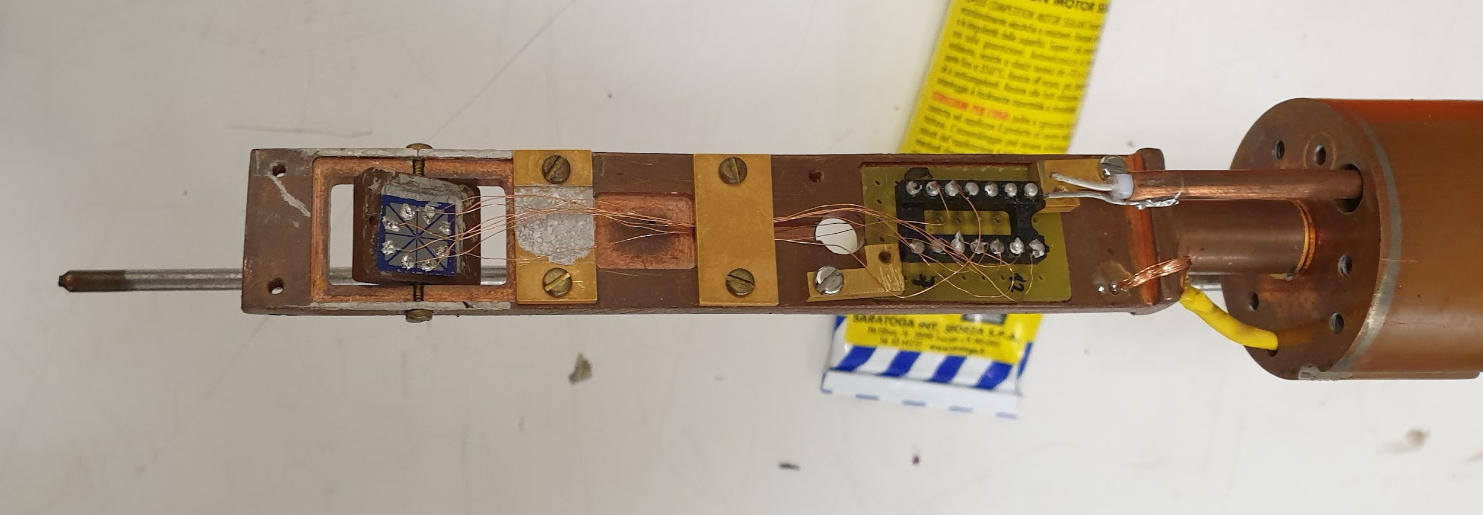
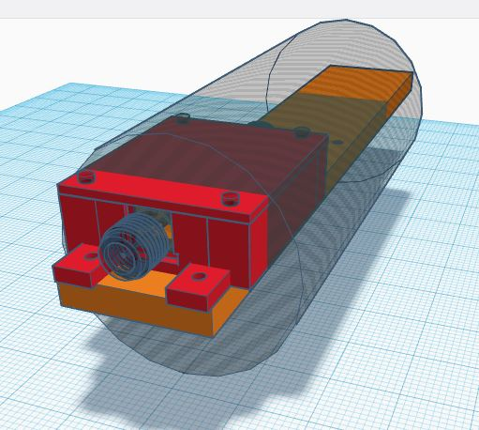
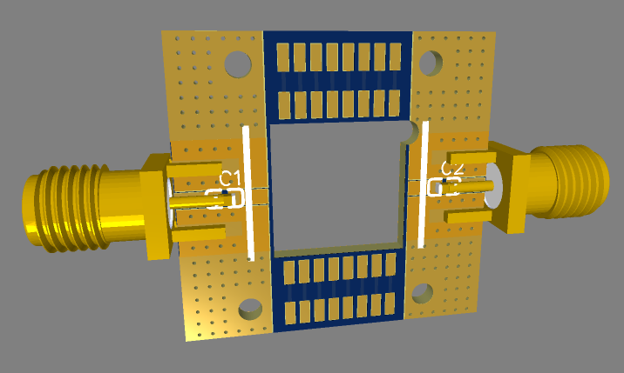
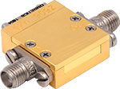
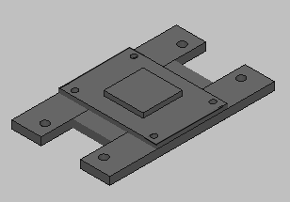
Test setup @ UNISA (Salerno)
Heliox VL 300 mK insert with 12 DC lines and 2 MW lines (coax+flex lines)
Home made DC JJ I-V curve tracer
MW source Rohde&Schwarz 0.1-26GHz
Hp source 8-12 and 12-16 GHz
2 x chinese source 0.1-20 GHz
GPS disciplined 10MHz reference
HP spectrum analyzer HP8563E 26 GHz
Cryogenic Low Noise Amplifier 0.3-14 GHz
Low noise amplifier room temp. 1-15 GHz
Low noise Isolator 4-12 GHz
Magnetic shielding (Cryoperm)
MW OFHC Cu/Au box with PCB
Status as by December 1st:
PCB in Europe at Customs since 2 weeks
MW box designed and commissioned to local INFN facility (2 weeks)
Au plating system (ordered)
DC measurements OK (1 week setup) need to order LHe (1-2 weeks)
RF measurements (testing BW of transmission lines, waiting for LNF delivery) (1 month)

Slide 8
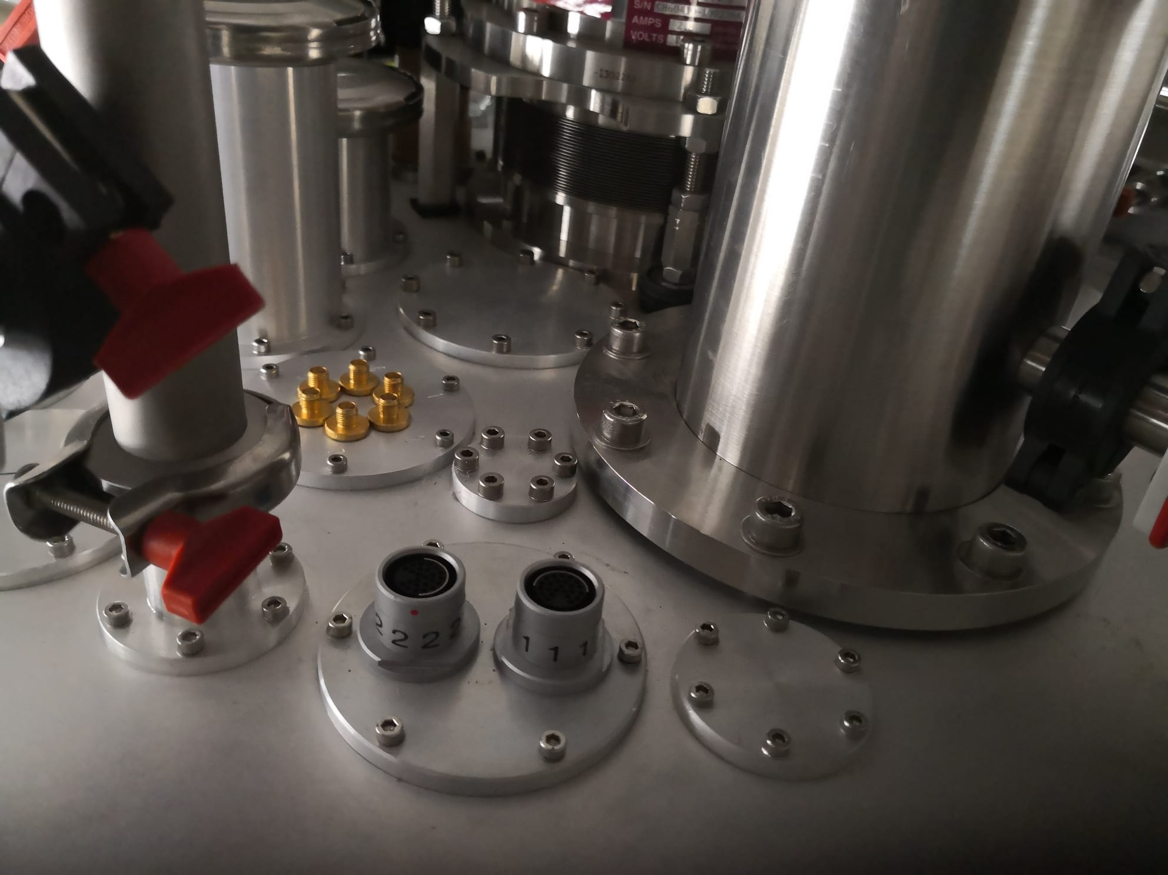
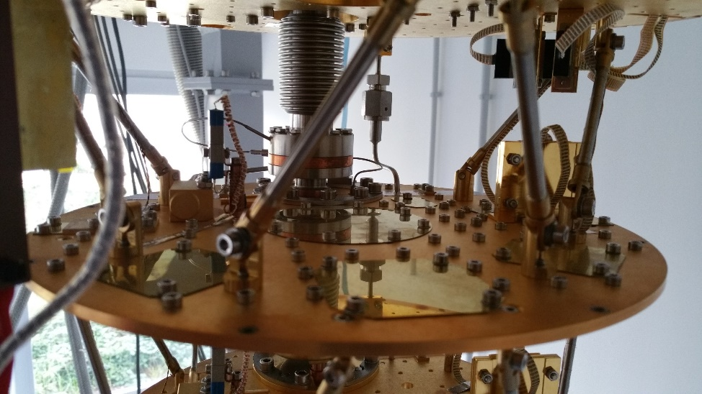
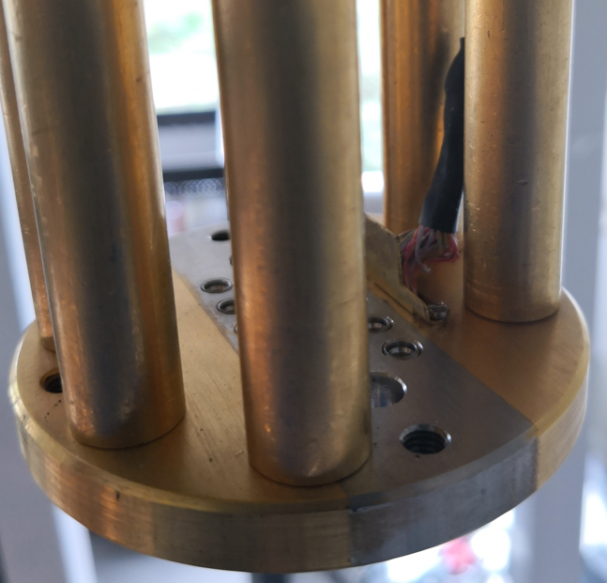
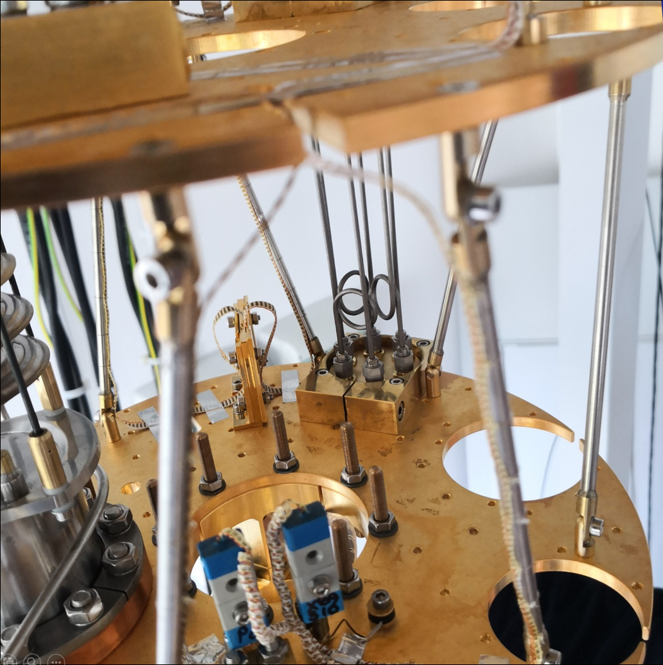
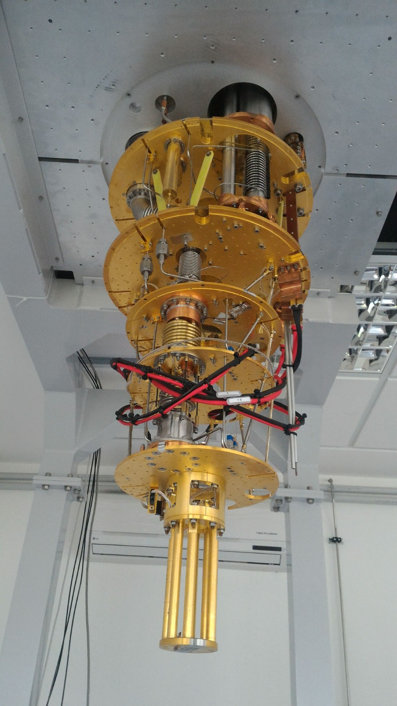
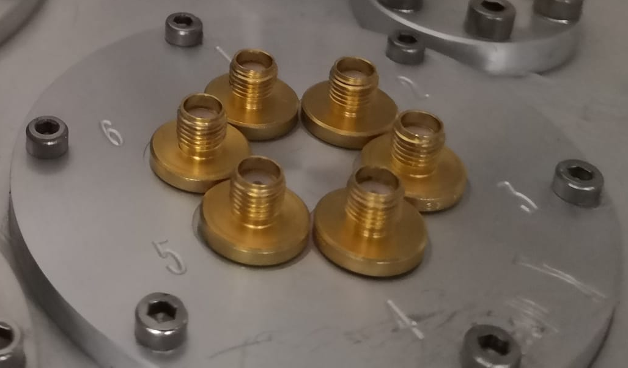
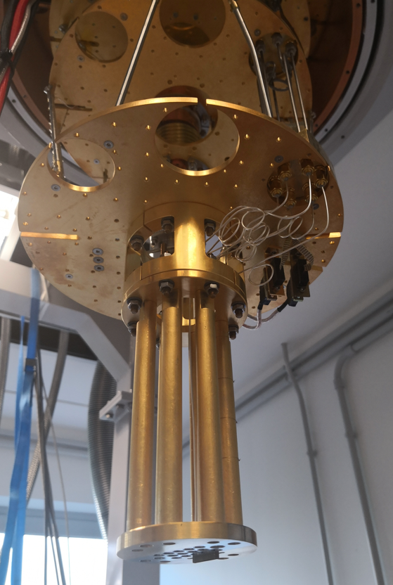
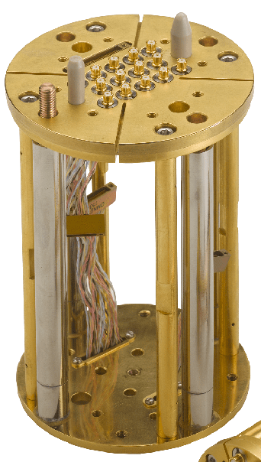
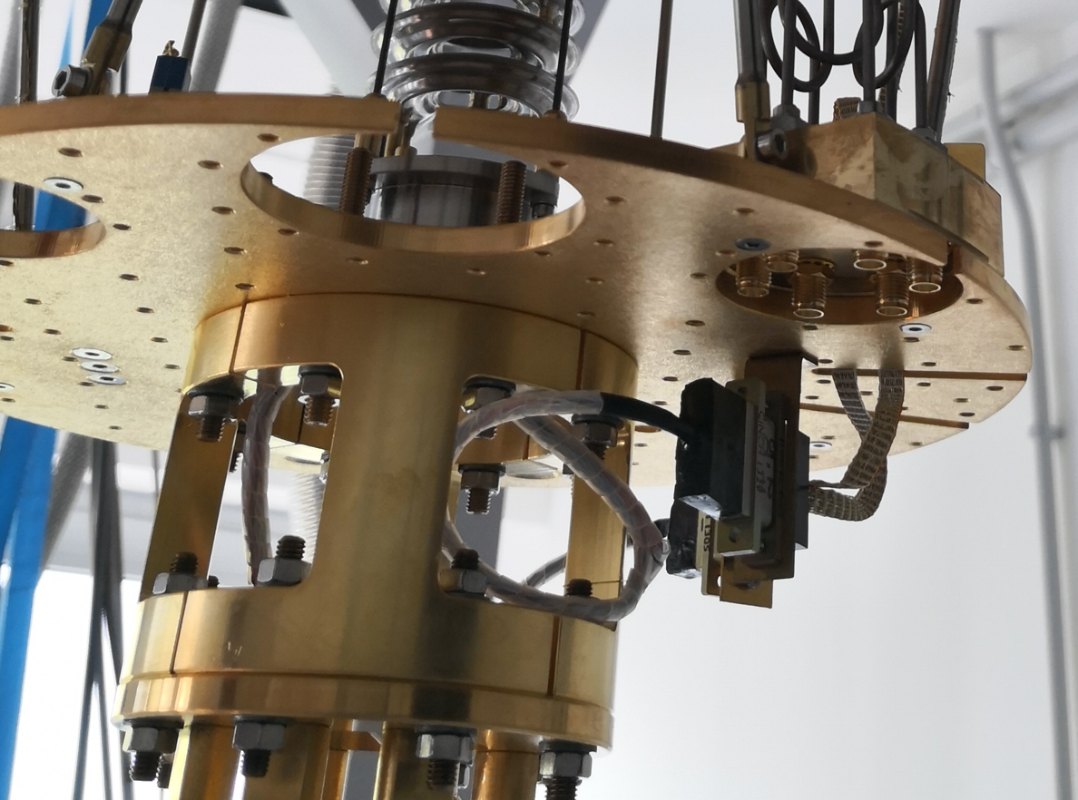
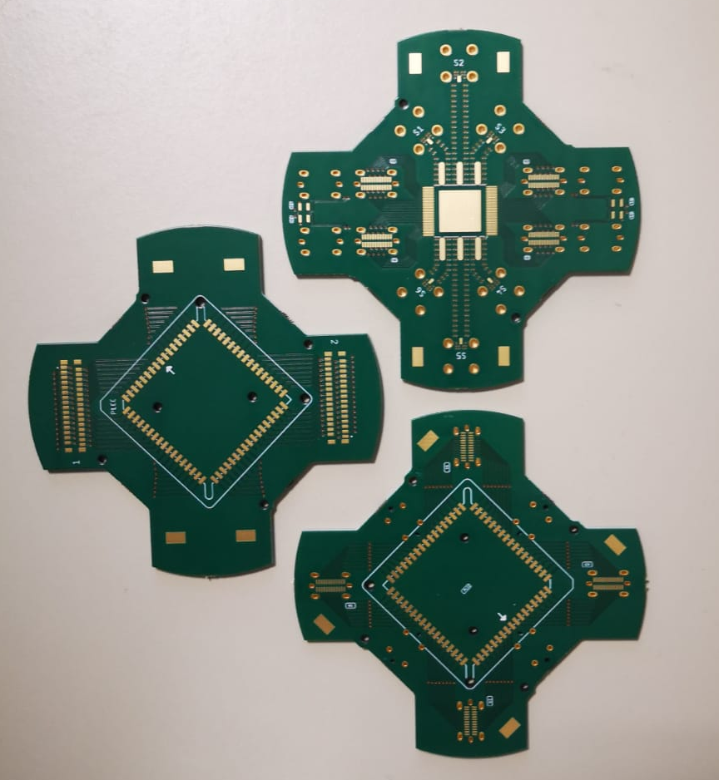
Cryo-amplilier
Purchased. It will be shipped soon
DC lines
RF lines
Lecce Laboratory
Oxford Triton dilution fridge 12 mk with 6 RF lines
PCB for DC&RF
DC –Omn.
PCB Space
DC -USB
+adapt.

Slide 9
D4.3 detector Array readout

Slide 10
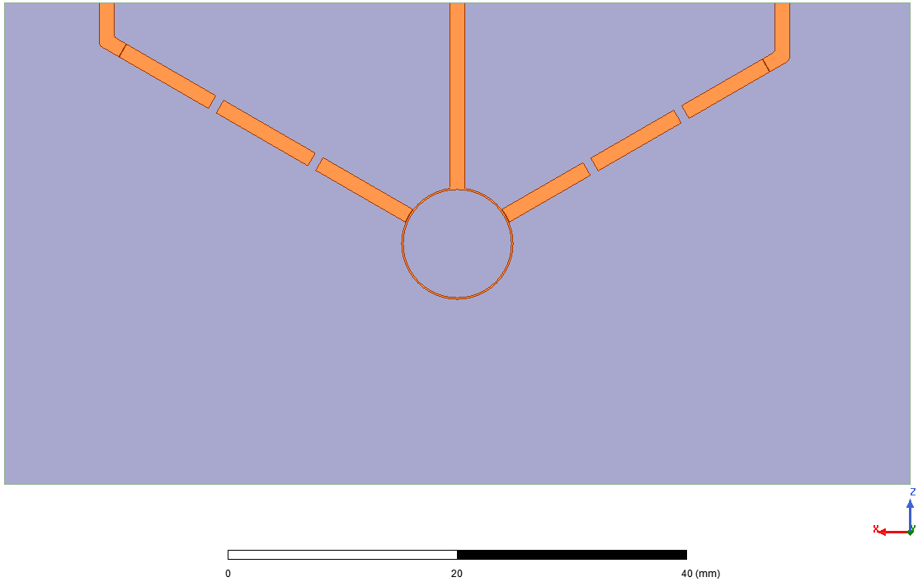
DIPLExer design for combined cavity readout
Cavity 1
TWJPA
Cavity 2
λ/4
5λ/4
Diplexer obtained by combining pass band filters on a 6λ/4 hybrid
Simone Tocci

Slide 11
Conclusion
First TWJPA production tested
All the labs are ready for DC tests of JJ
Waiting for delivery of amplifiers/MW components to finalize RF setup
Design of array readout ongoing

