Slide 1

KI-TWPA Devices Fabrication
Optimization of the NbTiN thin film deposition
DARYWARS WP2 KI-TWPA
Benno Margesin
Fondazione Bruno Kessler
DARTWARS General Meeting – Dec 1, 2021

Slide 2
Outline
Introduction
Niobium film deposition
NbTiN film by reactive sputtering
Etch recipes and process flow
Outlook

Slide 3
Introduction
The main task of WP2 is the study and definition of the fabrication procedures.
  Optimization of Nb and NbTiN films
  Development of etching recipes for this films
  Design of the fabrication process.
FBK has a past experience with TiN and Al as superconductors.
  On TiN FBK has gained a lot of experience, also in tailoring the Tc with the proximity effect in multilayer Ti/TiN films
  Werthamer theory extended to four layers

Slide 4
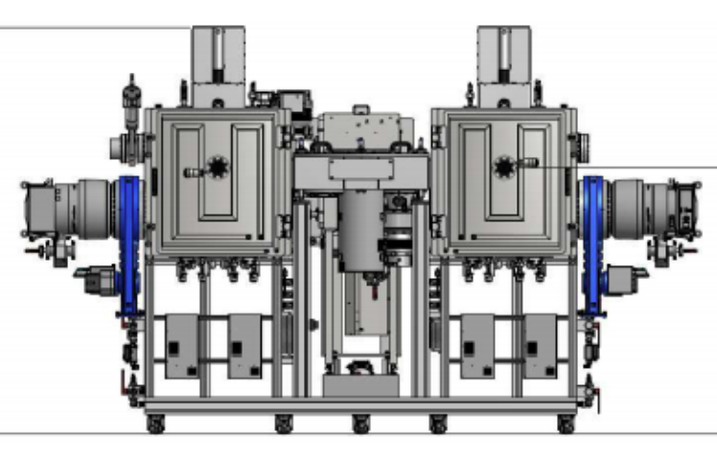
Introduction
Sputtering KS 800 C Cluster
Two chambers, 8 targets & guns
Co-sputtering
Reactive sputtering (N)
Materials: Nb, Ti, Au, Pt, Pd, etc
Multilayers: Ti/TiN, Ti/Au etc
Nb and NbTiN film optimization
NbTiN is the mostly used film for KITWPA’s
Two routes:
  Reactive co-sputtering of Nb and Ti
  Reactive sputtering of Nb_{0.66}Ti_{0.34}

Slide 5
Nb film optimization
Nb film deposition and characterization
Conditions:
  500 W, 3x10⁻³ mbar, 40 sccm Ar, 15 min
  Different substrate temperatures
Best result
  T_{c}: 9,13°K, ΔT: 10mK
  RRR: 4,7
  I_{c}: ̴8 MΩ/cm² ( coarse measurement )
For sharp transitions the substrate has to be heated to 300 °C
  On silicon even higher temperatures are required
RT
300°C
200°C
100°C

Slide 6
Reactive sputtering tests
NbN film deposition and characterization
Conditions:
  Reactive sputtering with Ar (50 sccm) and N₂
  500 W, 3x10⁻³ mbar, 400°C, 40 min
  Different nitrogen flows (10-15 sccm)
Max Tc (9.91 °K) obtained with 15 sccm
With 700 W and 15 sccm of N2 the Tc is 12.44 ± 0.05 °K
TiN film deposition
In parallel the deposition of stoichiometric TiN films in the new machine has been optimized
17.5 sccm
12.5 sccm
10 sccm
15 sccm

Slide 7
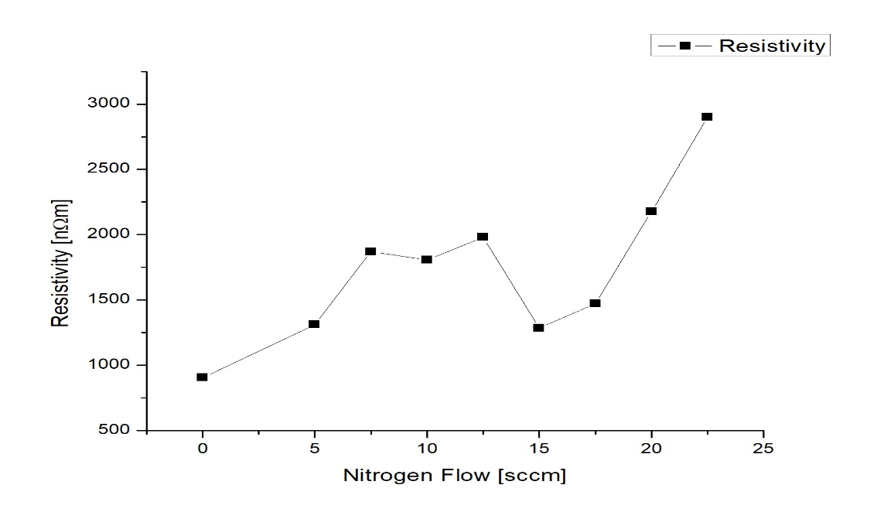
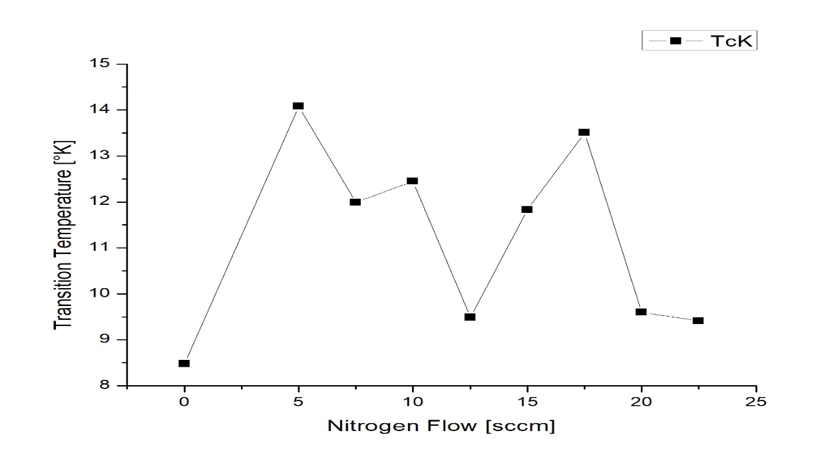
NbTiN films for parametric amplifiers
NbTiN film deposition and characterization
NbTiN film deposition with reactive co-sputtering
Conditions:
  700W(Nb), 150W(Ti), 400°C, 3x10⁻³mbar, Ar 50 sccm, N₂ 15 sccm,
T_{c}: 13,19°K, ΔT: 22mK
NbTiN film deposition with reactive sputtering of a Nb_{0.66}Ti_{0.34} target; wide N₂ flow scan
Conditions:
  700W, 400°C, 3x10⁻³mbar, Ar 50 sccm, N₂ 5 – 22,5 sccm
Highest Tc so far
  T_{c}: 14,08°K, ΔT: 4mK RRR=0,99 @5 sccm N₂
  T_{c}: 13,52°K, ΔT: 49mK RRR=1,1 @17,5 sccm N₂
  I_{c}: ̴1,22 MΩ/cm²
NB all films are in the range of 100 – 200 nm

Slide 8
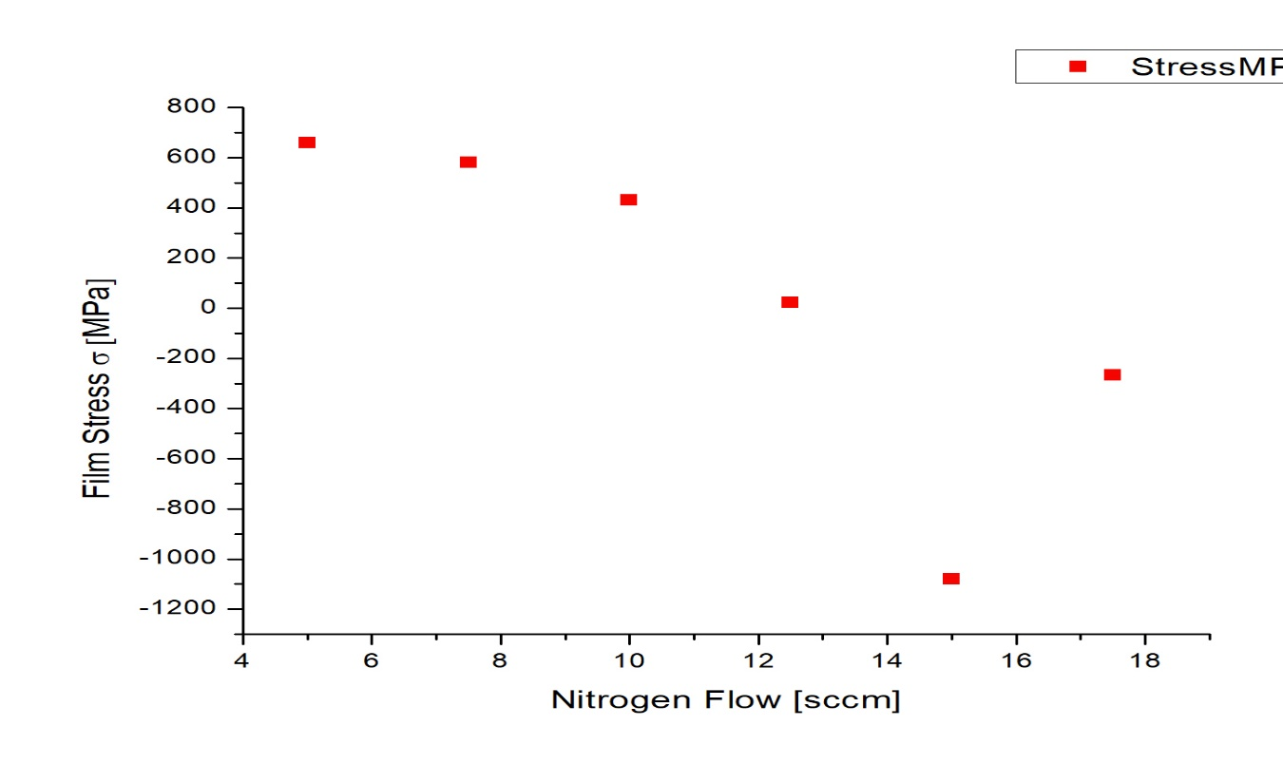
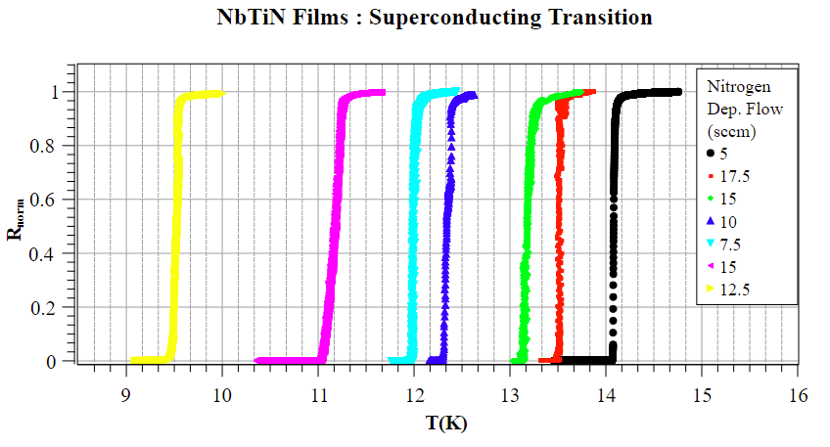
NbTiN films for parametric amplifiers
NbTiN film deposition cont.
The film stress has a minimum at 15 sccm of nitrogen flow
The transitions are very sharp
Co-sputtering

Slide 9
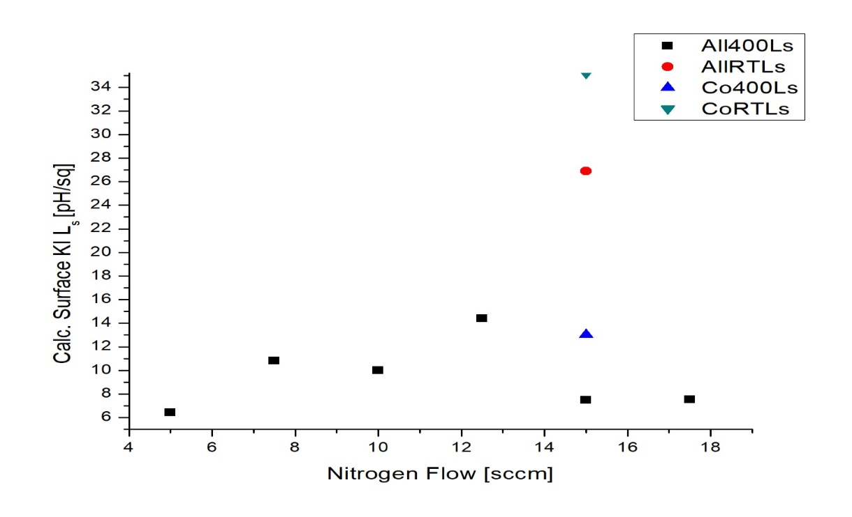
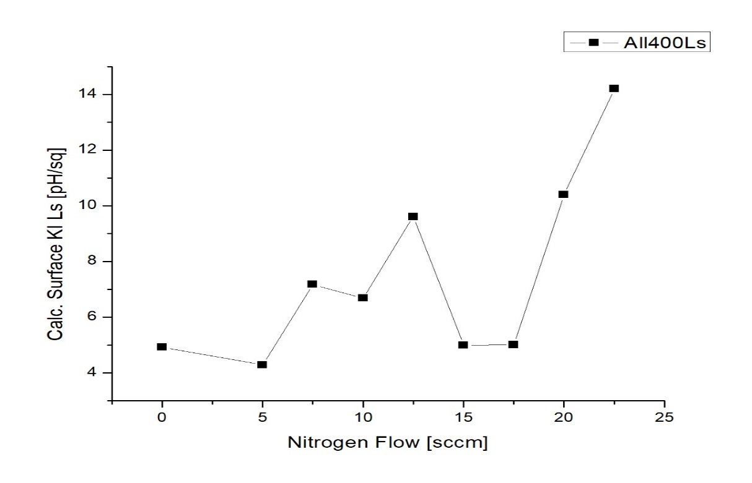

NbTiN films for parametric amplifiers
20 nm
NbTiN film deposition cont.
Calculated Surface kinetic inductance for a 20 nm film is in the pH/sq range
2nd test series with 30 nm thick films and test structures
  The test structures will allow the measurement of L_{s} and the critical current
  Hints from NIST (Vissers)
    Optimum N₂ flow when the target is partially nitrated
    The films should be compressive
$$L_{s}=\frac{h}{2π^{2}}\frac{R_{sn}}{∆_{0}}=\frac{h}{1,764π^{2}k}\frac{ρ_{n}}{T_{c}t}$$
30 nm

Slide 10
NbTiN films for parametric amplifiers
NbTiN film deposition cont.
Characterization of the plasma discharge; Nitrogen sweep at 700 W and 50 sccm Argon flow
  Around the onset of the voltage rise the high T_{c} films are expected
    Test is limited by the equipment
2 series of films were planned
  At 3x10⁻³ mbar: N₂ 4, 5 and 6 sccm
  At 7x10⁻³ mbar: N₂ 3, 4 and 5 sccm
  Deposition times have been chosen to obtain for all films about 30 nm
  At lower pressure ~ 20 nm
  At higher pressure ~ 30 nm

Slide 11
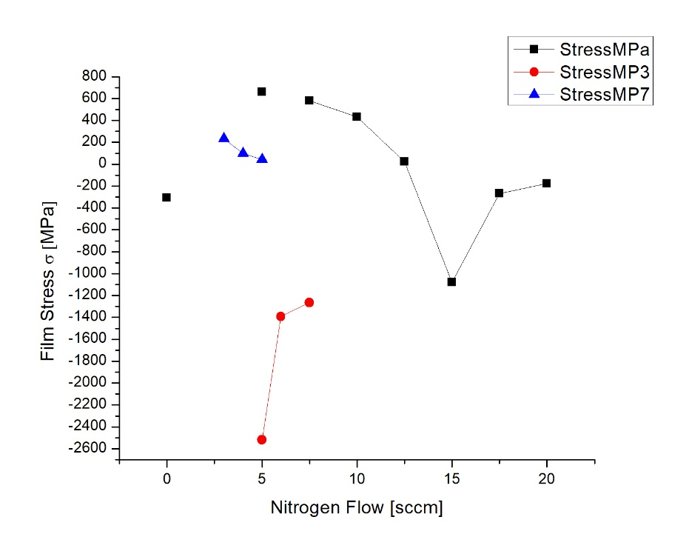
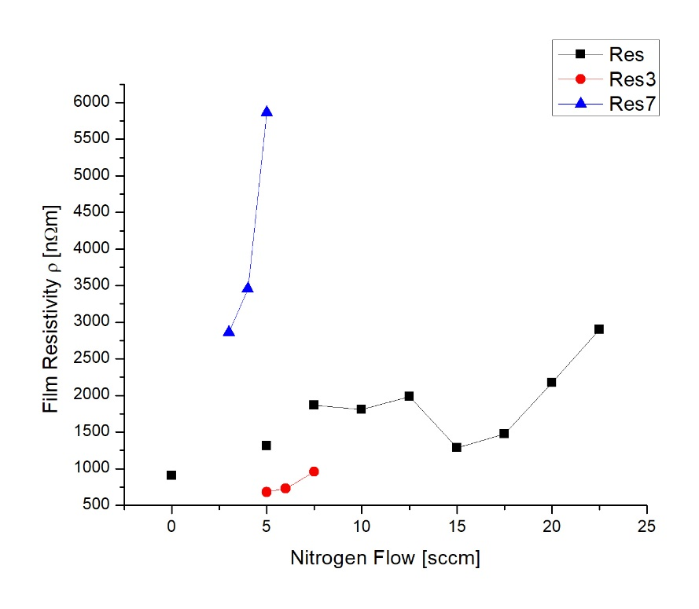
NbTiN films for parametric amplifiers
NbTiN film deposition cont.
The films deposited at 3x10⁻³ mbar resulted compressive
The films deposited at 7x10⁻³ mbar resulted tensile
The resistivity of the films resulted much higher at high total pressure
The film resistivity at low pressure resulted lower than the thicker films deposited previously

Slide 12
NbTiN films for parametric amplifiers
NbTiN film deposition cont.
Microanalytical characterization with SEM-EDS (Phenom)
Fast technique but with limitations
  Reduced thickness of the films
  Light elements are a challenge
Samples 1 - 3 show an increase of nitrogen content with flow
Samples 4 – 5 have less titanium and are contaminated with oxygen

Slide 13


Etching of the Nb and NbTiN films
Etching of Nb and NbTiN films
TEGAL 901 plasma etcher
Fluorine based etch recipes (CF₄ or SF₆)
First recipes with SF₆ allow minimum features of < 3 µm
Recipe with SF₆ & Ar:
  150W, 300 mTorr, Ar 80 sccm, SF₆ 20 sccm
    Etch rate on Nb 33 nm/min
    Etch rate on resist 157 nm/min, r(PR/Nb) ≅ 4,8
    Etch rate on oxide 120 – 170 nm/min, r(ox/Nb) ≅ 4,4
Recipe with SF₆ only:
  150 W, 150 mTorr, SF₆ 10 sccm
    Etch rate on Nb 47 nm/min
    Etch rate on resist 192 nm/min, r(PR/Nb) ≅ 4
    Etch rate on oxide ̴81 nm/min, r(ox/Nb) ≅ 1,7
4 µm line
3 µm line

Slide 14
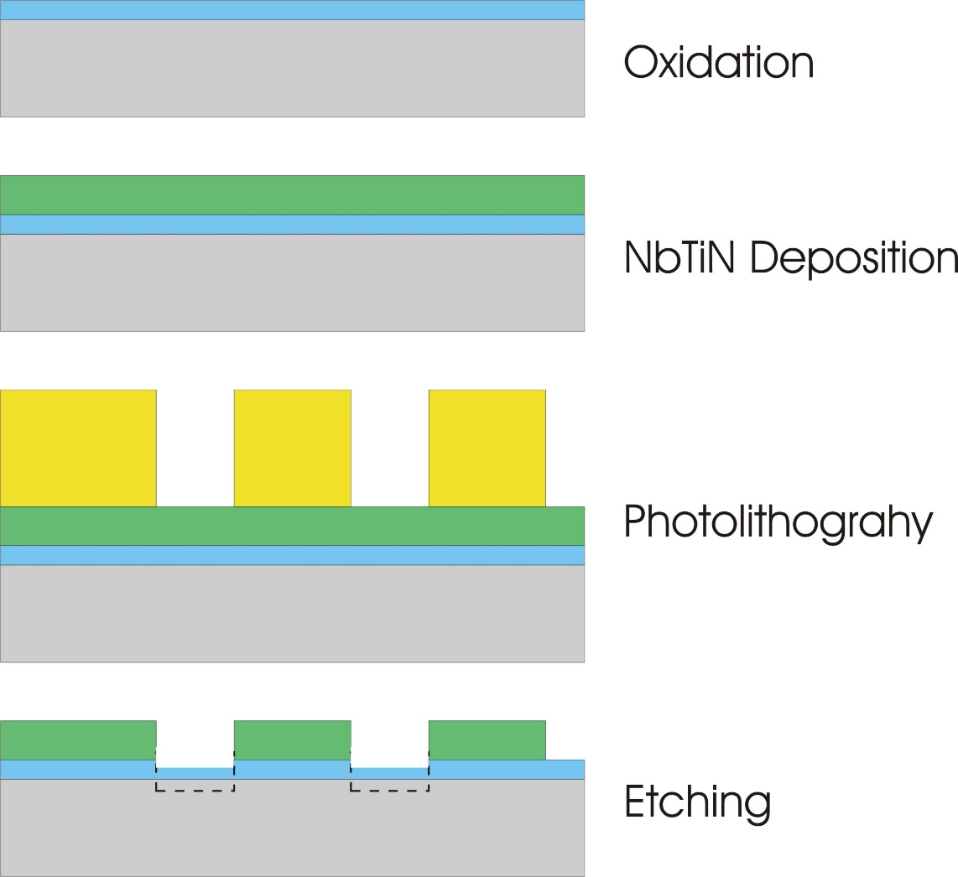
Device fabrication
Fabrication process
In its basic version it is a one mask process
  Dry oxidation and annealing
  Superconductor film deposition
  Photolithography
  Etching
  Ashing
  Dicing
Attention on oxide over-etching!
With a 2nd mask thick bonding pads could be added as well

Slide 15

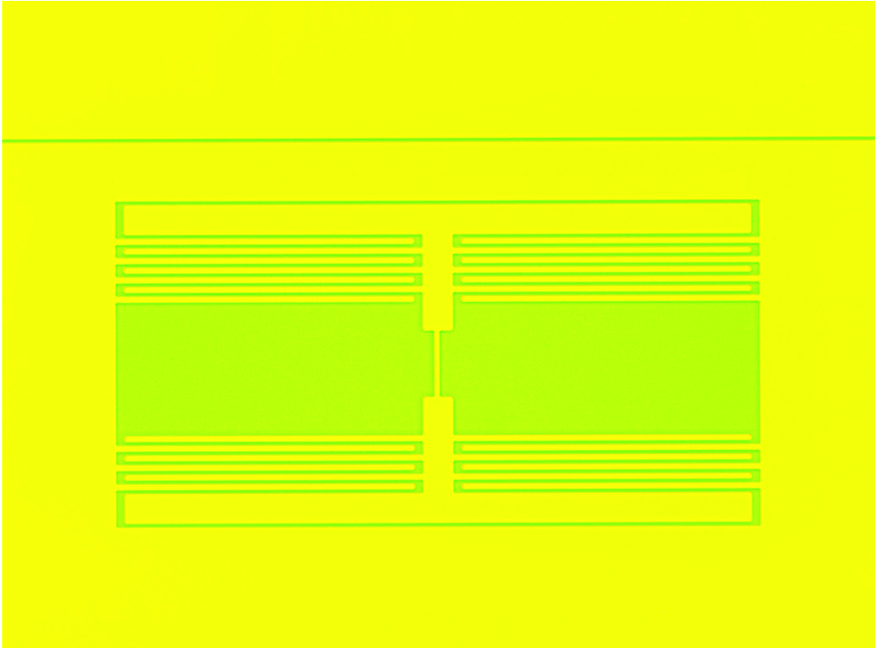
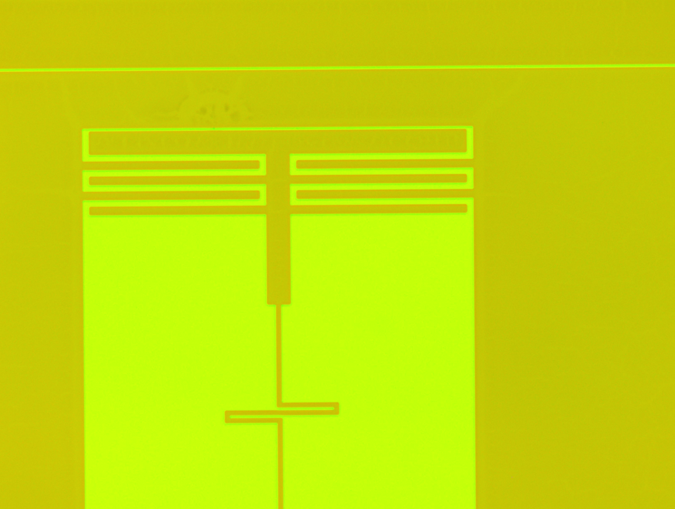
NbTiN films for parametric amplifiers
Etching of Nb and NbTiN films
The samples where etched with the SF₆ only recipe
  Etching was flawless and precise
  In most cases a thin residual oxide layer was left in the slots
  Film thickness could be measured and corrected for over-etching of the substrate
Cryogenic characterization of these films is underway
Preliminary results will be shown by Andrea Vinante in the next talk
wfr2
wfr3
wfr6

Slide 16
Conclusions & Outlook
Conclusions
Nb film deposition produced films with very high T_{c} and sharp transitions
The transition temperatures are in line with literature data
NbTiN films: a large sweep of nitrogen flows has been made
Sputtering conditions investigated to better pinpoint the best deposition conditions for high T_{c} films
Thin samples have been prepared
Test structures have been fabricated and are ready to be characterized

