Slide 1
Next Steps for FLASH
Galactic axion search at 100 MHz (0.4-1.2 μev)

Slide 2
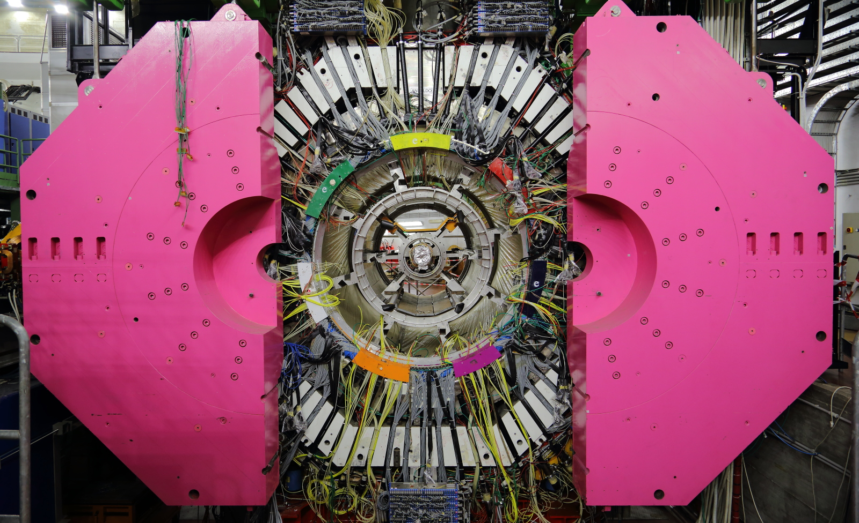
FLASH
Length | 1764 mm
Diameter | 2118 mm
V | 6.2 m³
Field | 1.1 T
B² V | 7.5 T²m³
frequency | 110–270 MHz

Slide 3
Expected sensitivity of FLASH

Slide 4
Dark Photons (KLASH)

Slide 5
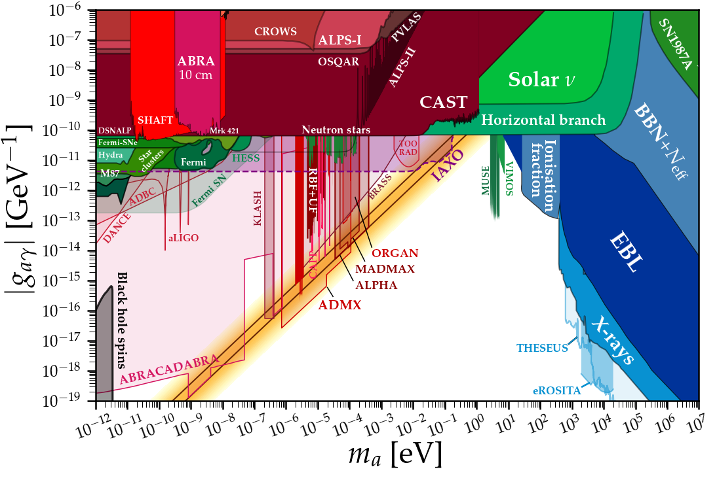

Slide 6
Mini Workshop on Physics Opportunities at 100-500 Mhz Haloscopes
In collaboration with Rades/Baby Yaxo group we are organizing a Mini Workshop on physics opportunities at 100-500 MHz Haloscopes. To be held online between February and March.
Topics:
Theoretical aspects of Axions at 100-500 MHz
The Flash Haloscope
The Baby Yaxo Haloscope (Rades group)
Other axion searches at low mass (DMRadio, Abracadabra, Casper)
HF-GW detection with Axion detectors
Cryogenics and Detector
Invitation will be addressed to experimental and theoretical physicists working in the field of axion/alps and GWs, as well as to the community involved in the Physics Beyond Collider studies, with the aim of investigating physics opportunities at O(100 MHz) Haloscopes.

Slide 7
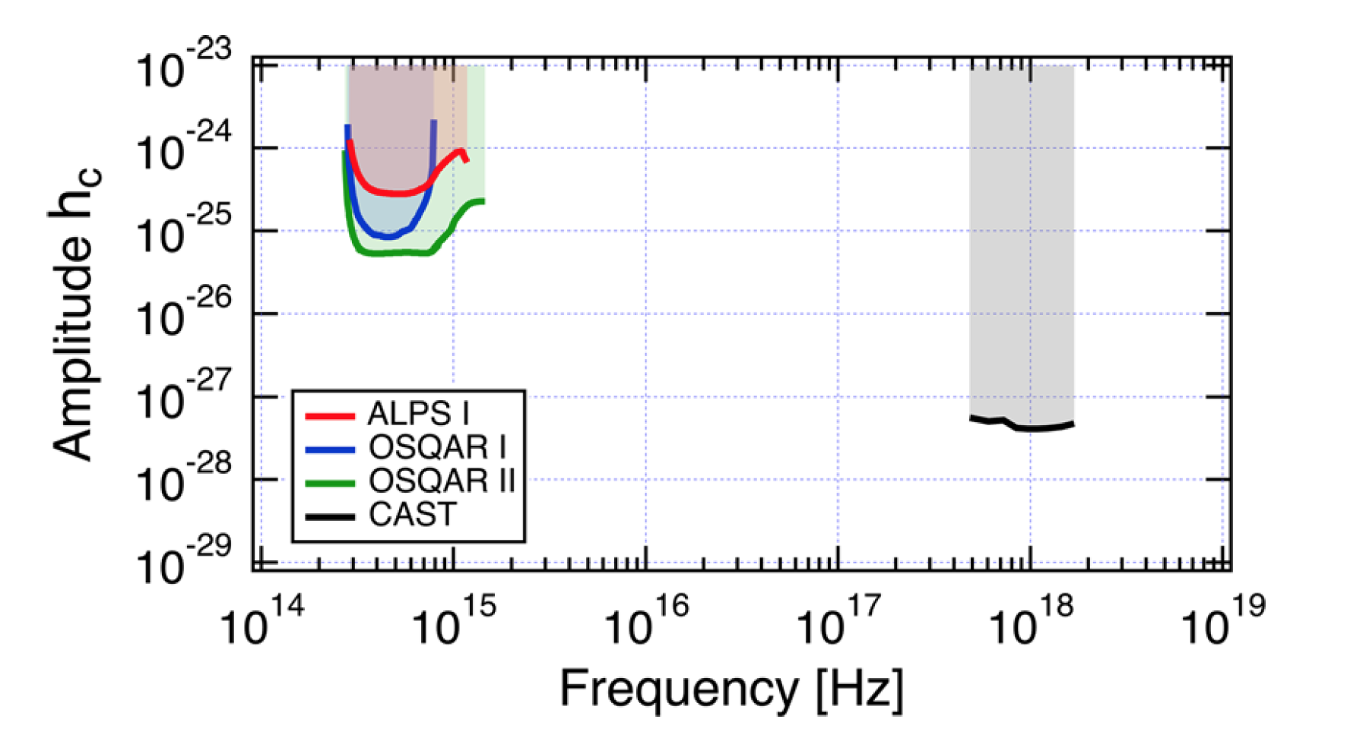
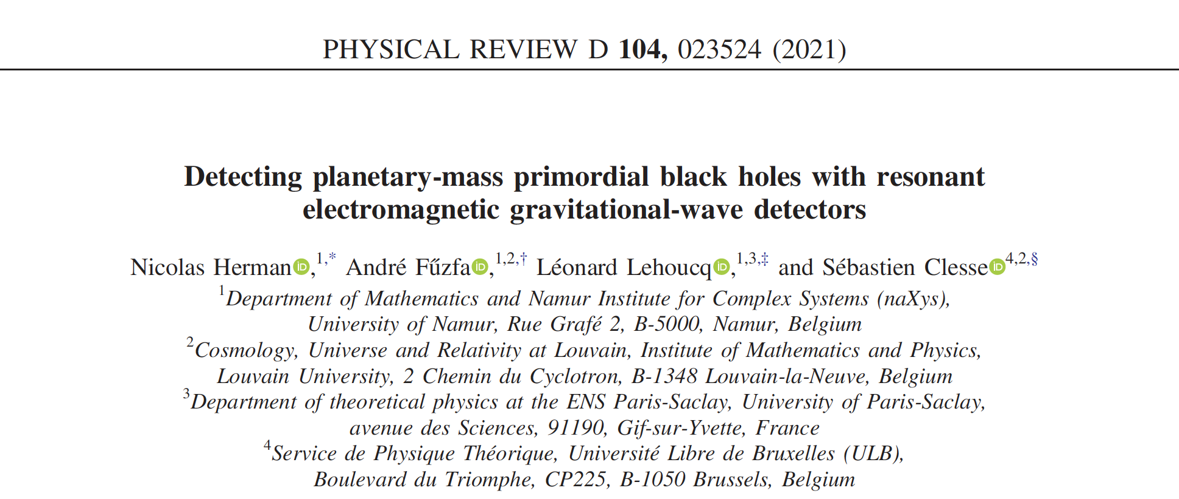
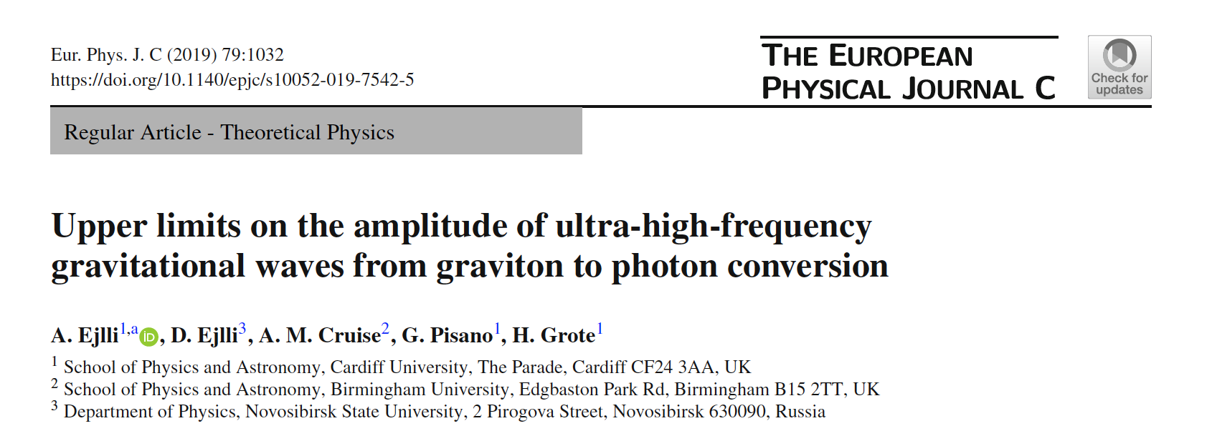
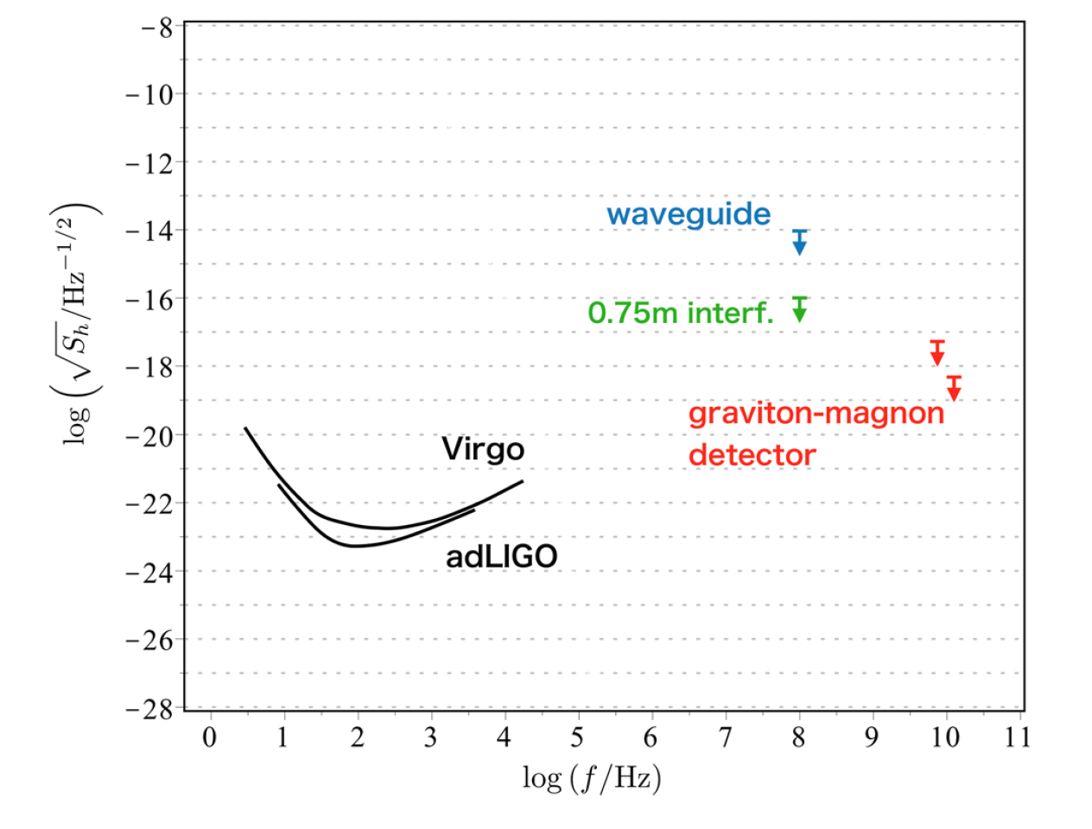
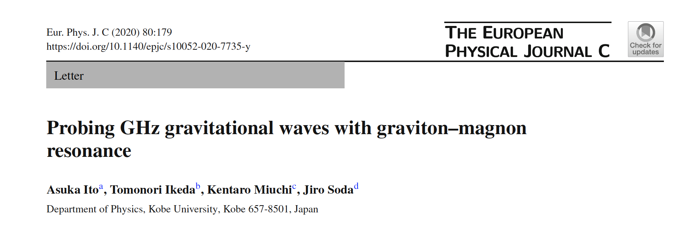
High Frequency Gravitational Waves
Graviton-photon conversion EPJC (2019) 79
Graviton-magnon conversion EPJC (2020) 80
Data from
Quax-ae
See also Workshop on “Ultra-High-Frequency GWs: A Theory and Technology Roadmap” https://indico.cern.ch/event/1074510/

Slide 8
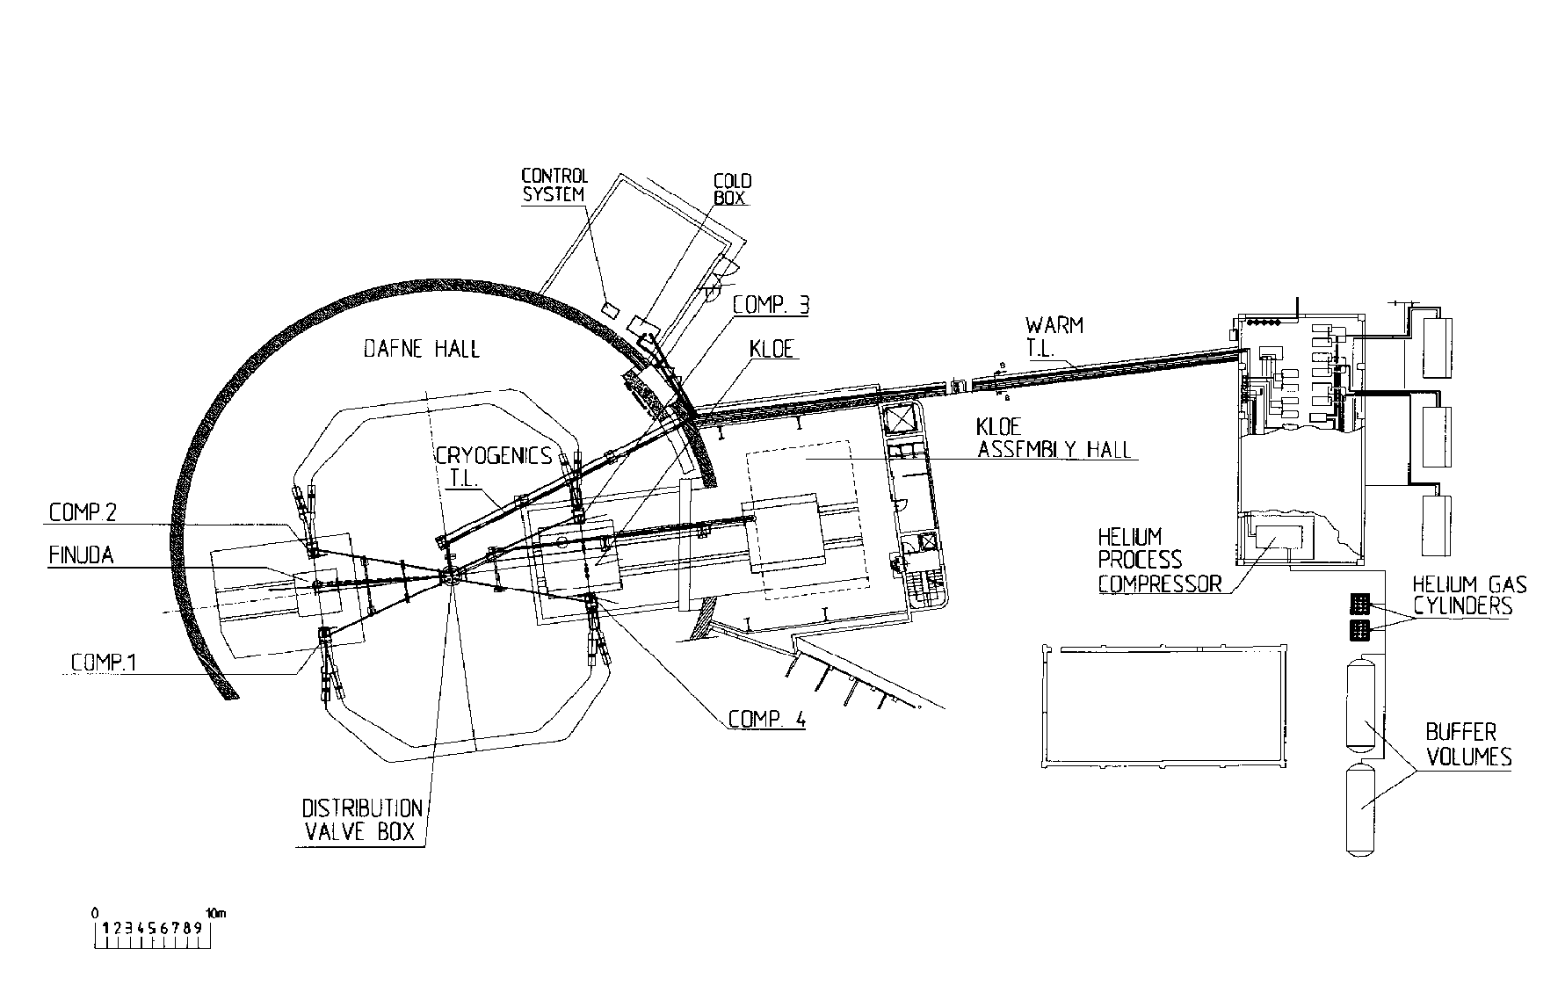
FLASH Timeline and Next Steps
2021 | 2022 | 2023 | 2024 | 2025 | 2026 | 2027
Inspection of Finuda
1st option: run in Dafne Hall
2nd option: Run in KLOE Hall
Test of magnet
New CDR
TDR (approval)
Construction
Data Taking
Preparation of test of the Finuda magnet (contact companies, site inspection, cost evaluation).
Contact ASG Superconductors (https://www.asgsuperconductors.com/progetto/finuda) about mode to move the magnet.
Refurbishing of the control panel and other hardware parts.

Slide 9
Operating FLASH in Dafne Hall
We received the following comments from the Radiation Protection Expert of LNF on two main scenarios :
Access to the Dafne Hall only when no beams are circulating in Dafne
  Easier solution in terms of radiation protection. No particular changes needed for shieldings, control system and authorizations. Limited access to the detector. Impact on noise induced inside the detector or on the electronics must be evaluated.
Access to the Dafne Hall with beam accumulated in Dafne
  Full access to the detector and no concern about induced noise. It requires new shieldings, new access control system and new authorizations (estimated time 2 years).

