Slide 1
TIPP2023 Cape Town, September 4-8 2023 Bruce Mellado Wits/iThemba LABS
Meeting IUPAP-C11 – 10/07/22

Slide 2
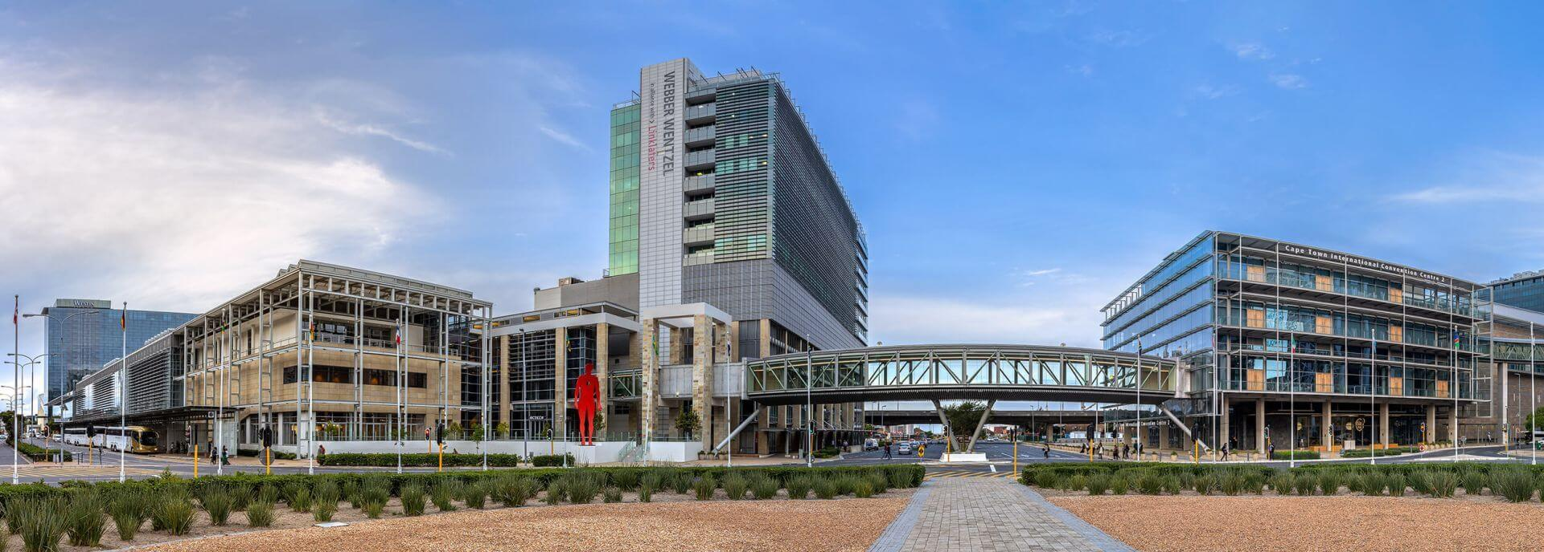
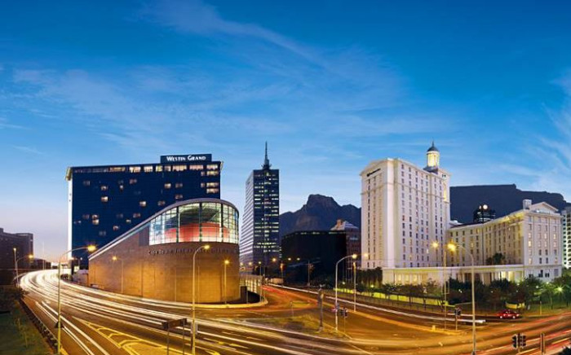
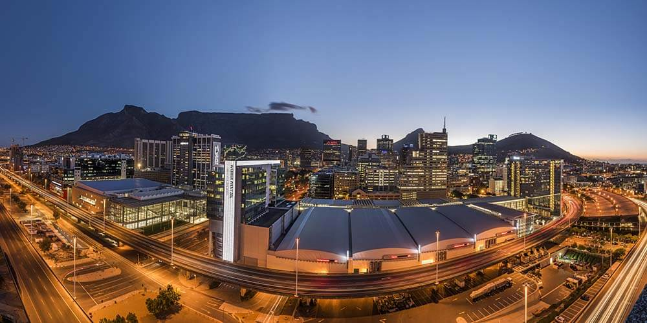
https://www.cticc.co.za
Cape Town International Convention Centre

Slide 3
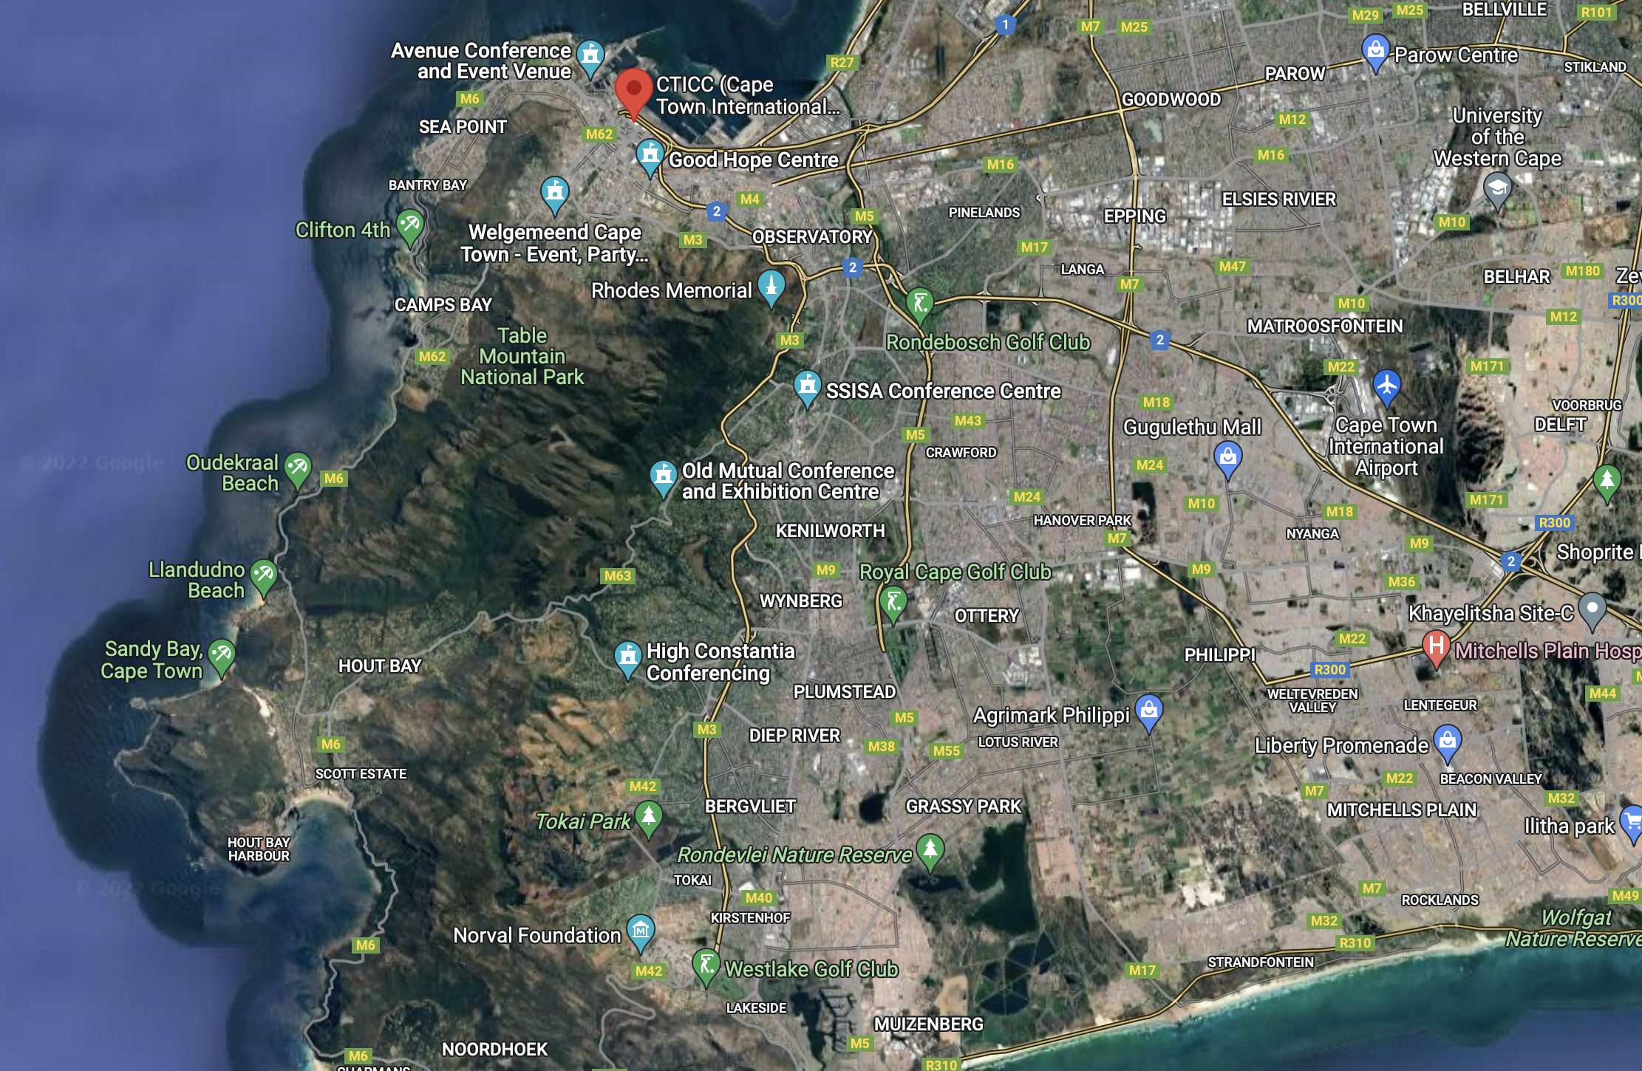

Slide 4
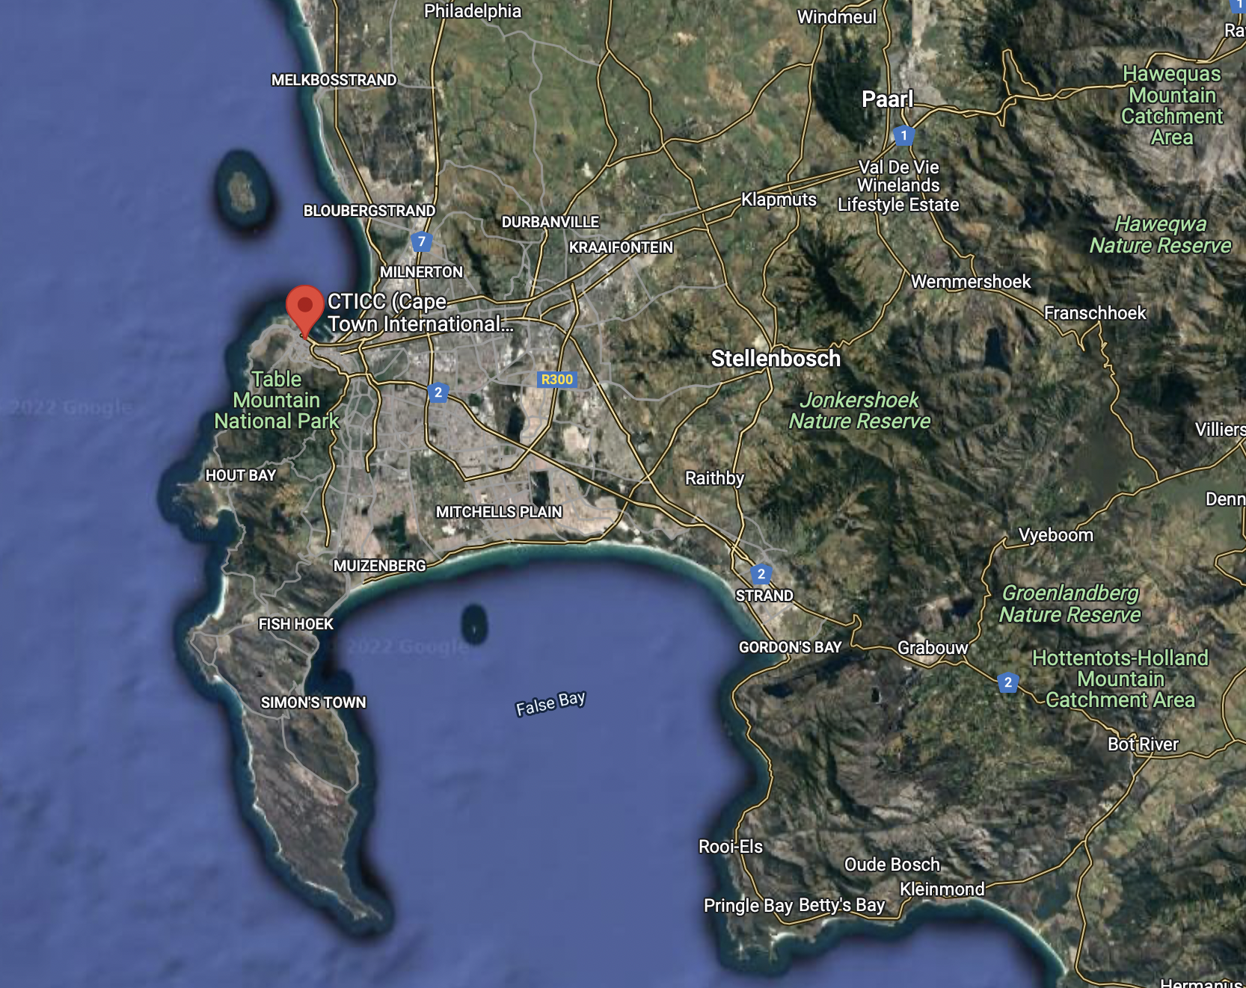
https://www.cticc.co.za
Roben Island
Cape of Good Hope

Slide 5
Composition of the LOC
Name | Institution | Country | Gender
Shimaa AbuZeid | Ain Shams University / INFN | Egypt | F
Imane Azzouzi | Moroccan Foundation for Advanced Science | Morocco | F
Raja Cherkaoui El Moursli | Mohammad V University of Rabat | Morocco | F
Serigne Bira Gueye | Cheikh Anta Diop University | Senegal | F
Peter Jones | iThemba LABS | SA | M
Naima El Khayati | Mohammad V University of Rabat | Morocco | F
Betty Kibirige | University of Zululand | SA | F
Oscar Kureba | Botswana International University of Science and Technology | Botswana | M
Bruce Mellado | Wits University & iThemba LABS | SA | M
Peane Maleka | iThemba LABS | SA | M
Amr Radi | Ain Shams University | Egypt | M
Yahya Tayalati | Mohammad V University of Rabat | Morocco | M
Michelle Van Der Ventel-Bark | iThemba LABS (logistics) | SA | F
Sahal Yacoob | University of Cape Town | SA | M

Slide 6
Highlights
All necessary paperwork has been submitted related to the appointment of a provider for the organisation. The latter includes venue, catering and registration of participants. According to the rules of the National Research Foundation the process of appointment has to conform with the rules of regulations of procurement. I expect the provider will be appointed within the next 3 months.
Technical person at iThemba LABS has been assigned to the conference to help with web management and logistics.

Slide 7
Highlights (cont)
A website has been setup using the indico system of iThemba LABS: https://indico.tlabs.ac.za/event/112/
Funding from the provincial government of the Western Cape has been procured. This funding will be used to support attendance of local students
The SA-CERN program, funded by the Department of Science and Innovation and hosted at iThemba LABS, acts as a guarantor of the conference
Also will provide student support
Expect Minister of Science and Innovation to open conference

Slide 8
The South Africa National Convention Bureau, supports the conference with ~28K USD

Slide 9
https://sa-cern.tlabs.ac.za

Slide 10
Regarding IAC/IOC
Have a list of candidates for the IAC/IOC
Geographical inclusivity
Gender equity
Representation of young researchers
Seniority and broad impact
Discussion regarding the participation of colleagues from Russian and Byelorussian colleagues
Expect to converge soon, with participation of the SA funding agency
Will propose scheme adopted at ICHEP
Communication with Michel Spiro

Slide 12
CERN Instrumentation School
Maxim and me had interactions with CERN
Interactions with Manfred Krammer
Interactions with Emmanuel Tsesmelis
Once CERN support secured, it will be easy to get support from the SA-CERN program and the funding agency
Suggest that iThemba LABS be the host of the school (see next slide)
Organised a similar school with about 50 students sponsored by the IEEE NPSS and SA-CERN

Slide 13
https://indico.cern.ch/event/661919/

