Slide 1
Present accelerators (non-LHC) and approved facilities (LHC presentation by Mike Lamont)
Wolfram Fischer Brookhaven National Laboratory
11 July 2022
Notes:
17:00 – 17:30, 25+5 min => 25 – 30 slides; show full-screen

Slide 2
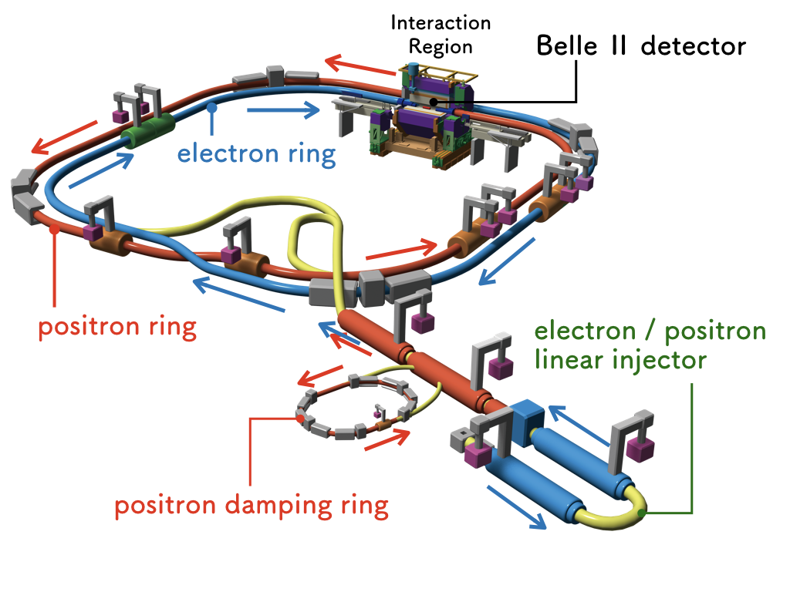
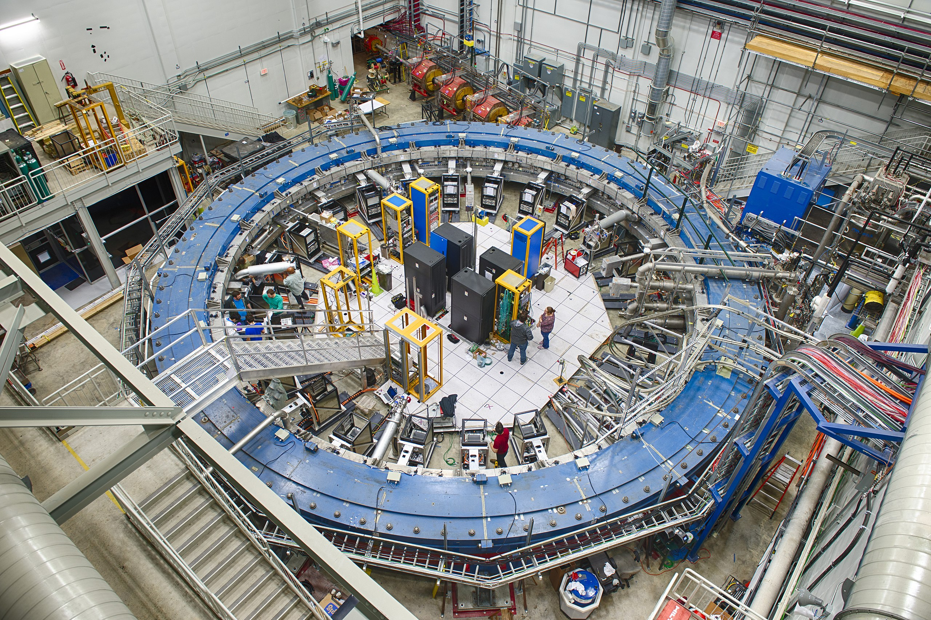
Content
Example: SuperKEKB
Colliders
High-intensity accelerators
Beams also used in storage ring experiments like g-2 and pEDM
Example:

Slide 3
Colliders
For factories and high-energy collisions
e⁺e–, hh, eh

Slide 4
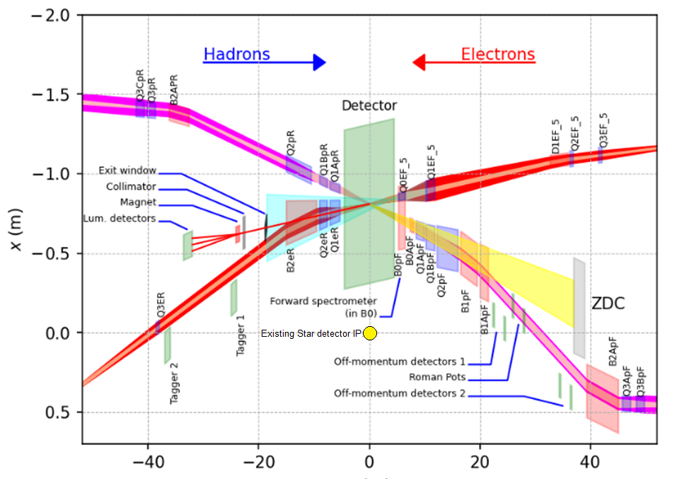
Colliders – Important considerations
Energy
Luminosity
Target density in collider >10 orders of magnitude lower than in fixed target
Interaction Region design
Detector space
Experimental background
Forward particles
…
Also
Cost
Reliability
Flexibility (energy, species for ion colliders)
Energy efficiency / operating cost
…
Example: Electron-Ion Collider IR layout

Slide 5
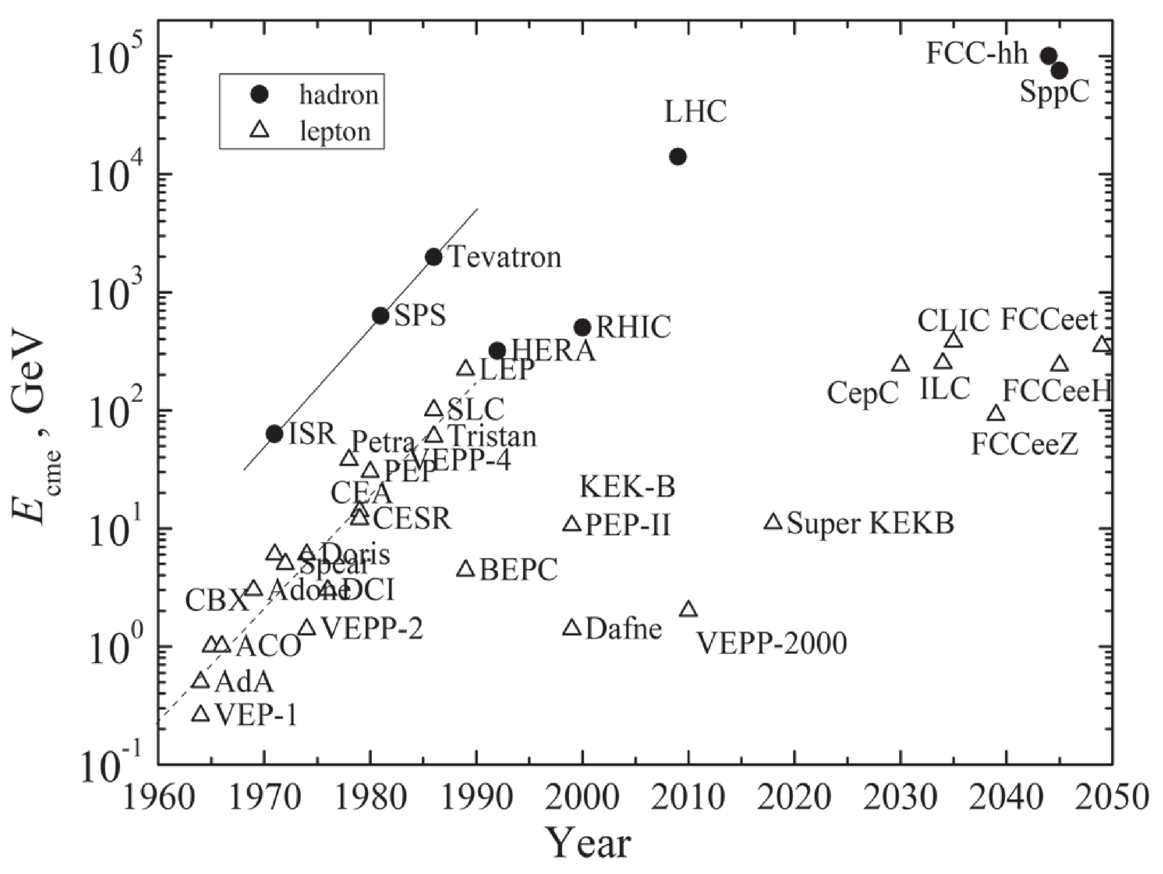
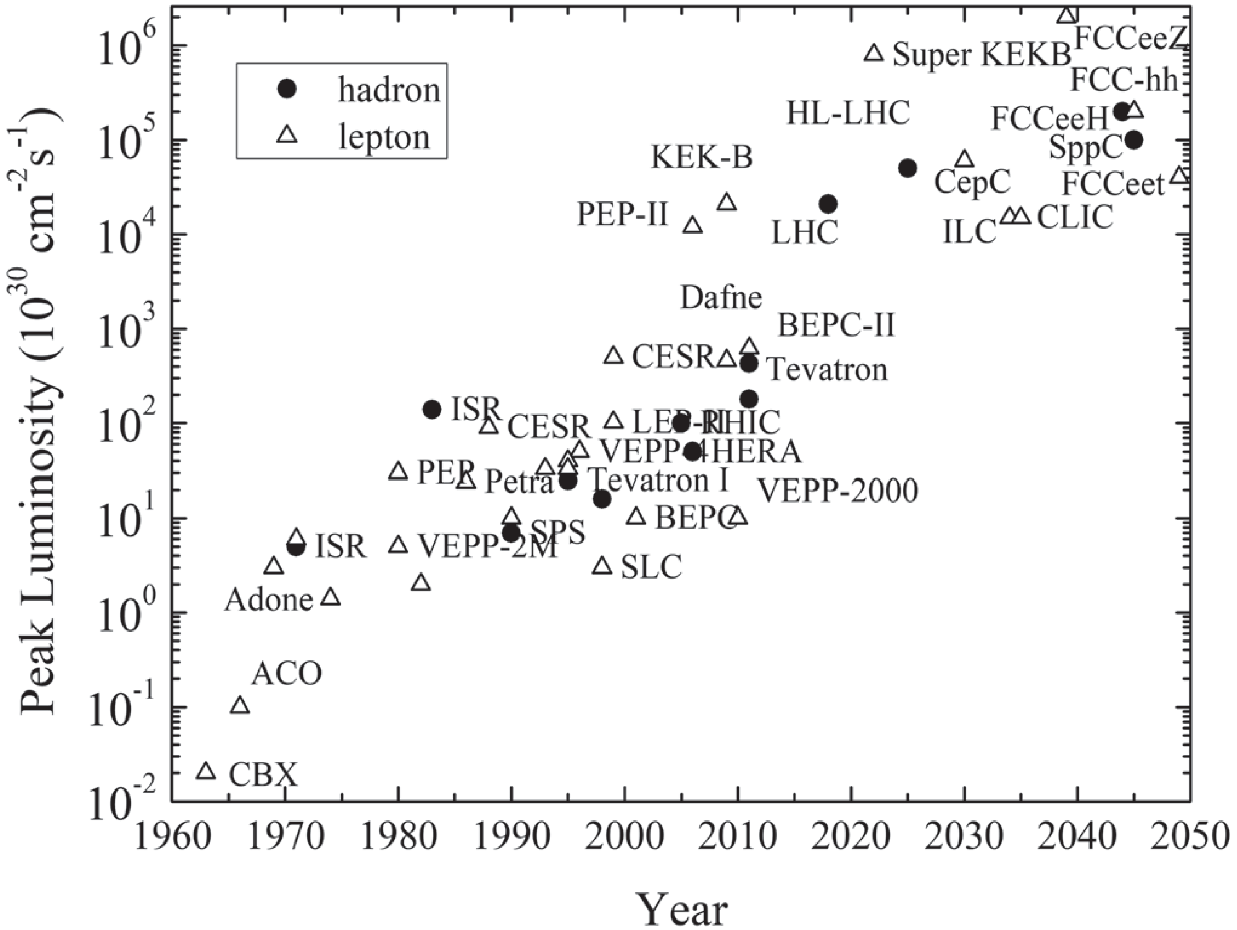
Collider Livingston plots
hadron
lepton
hadron
lepton
[V. Shiltsev and F. Zimmermann, Rev. Mod. Phys. 93, 015006 (2021); V. Shiltsev, Phys. Usp. 55, 965 (2012)]

Slide 6
Colliders e⁺e– (factories): VEPP-2000, VEPP-4M, BEPC-II, DAΦNE, SuperKEKB
[Reported numbers, not design]
 | DAΦNE | VEPP-2000 | BEPC-II | VEPP-4M | SuperKEKB
Start of operation [year] | 1999 | 2010 | 2008 | 1994 | 2018
Species | e⁺e– | e⁺e– | e⁺e– | e⁺e– | e⁺e–
Circumference [m] | 97 | 24 | 238 | 366 | 3016
Beam energy [GeV] | 0.51 | 1 | 1.89 (2.474 max) | 6 | 4 / 7
CoM energy [GeV] | 1.02 | 2 | 3.78 (5.56 max) | 12 | 10.58
Average beam current [mA] | 800 / 1250 | 160 | 851 | 80 | 819 / 640
Peak luminosity [10³⁰ cm⁻²s⁻¹] | 453 | 50 | 1000 | 20 | 3810
Factory output | Φ meson | u,d,s interactions | tau-charm | Y(1S) meson | B meson
[PDG, Tables 32.1, 32.3;
Q. Qin, ”Overview of the low energy colliders”, proceedings eeFACT2016, Daresbury (2016)]

Slide 7
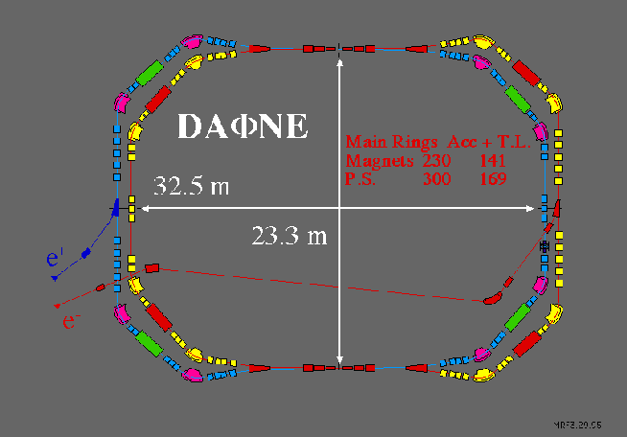
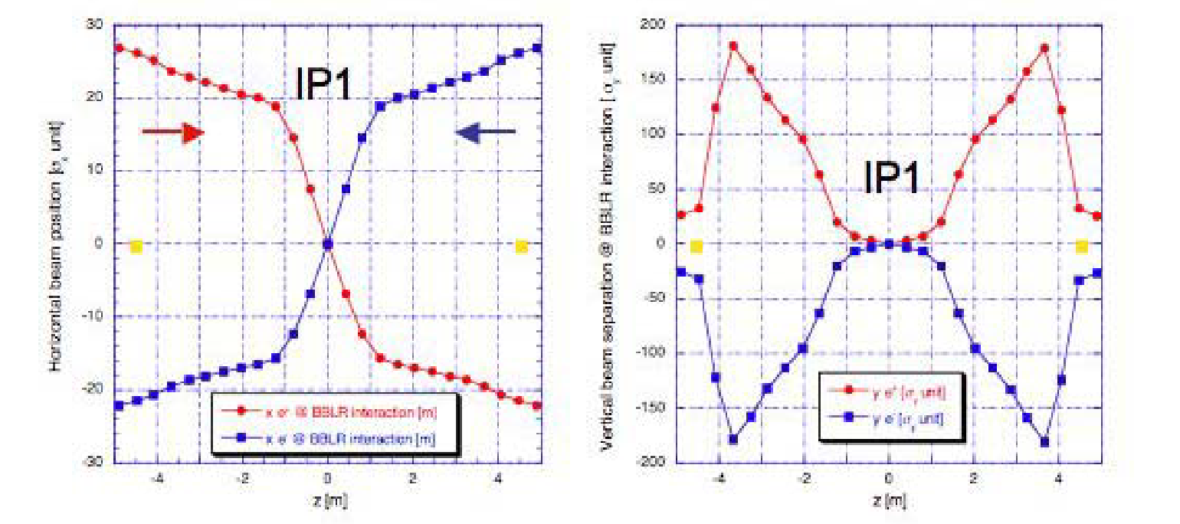
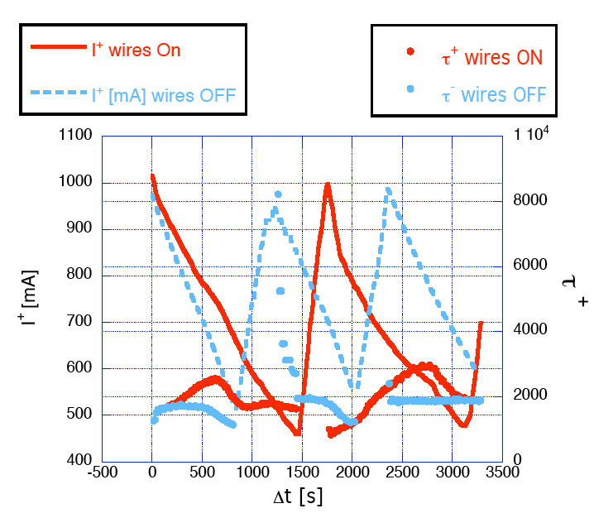
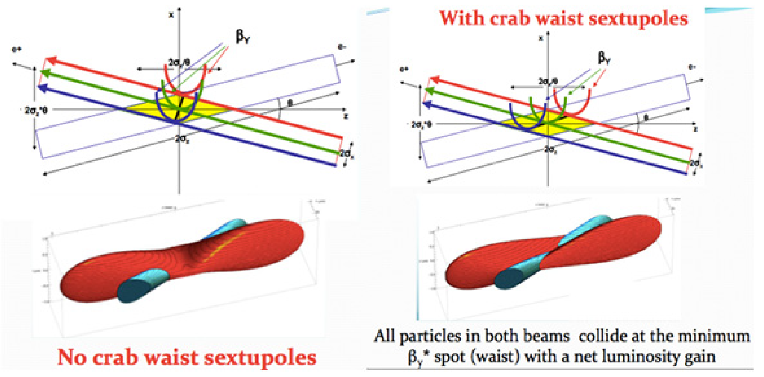
Innovation at low-energy colliders – INFN DAΦNE
Long-range beam-beam compensation with wires improves beam lifetime
Crab waist increases luminosity by 59%
wire locations
[C. Milardi et al, “DAΦNE lifetime optimization with octupoles and compensating wires”, CARE-HHH-APD IR'07 Workshop, Frascati (2007); C. Milardi et al, IPAC 2018; P. Raimondi, Proceedings of the 2nd SuperB Workshop, Frascati, Italy (2006);
Q. Qin, ”Overview of the low energy colliders”, proceedings eeFACT2016, Daresbury (2016)]
Notes:
Picture: Wikipedia

Slide 8
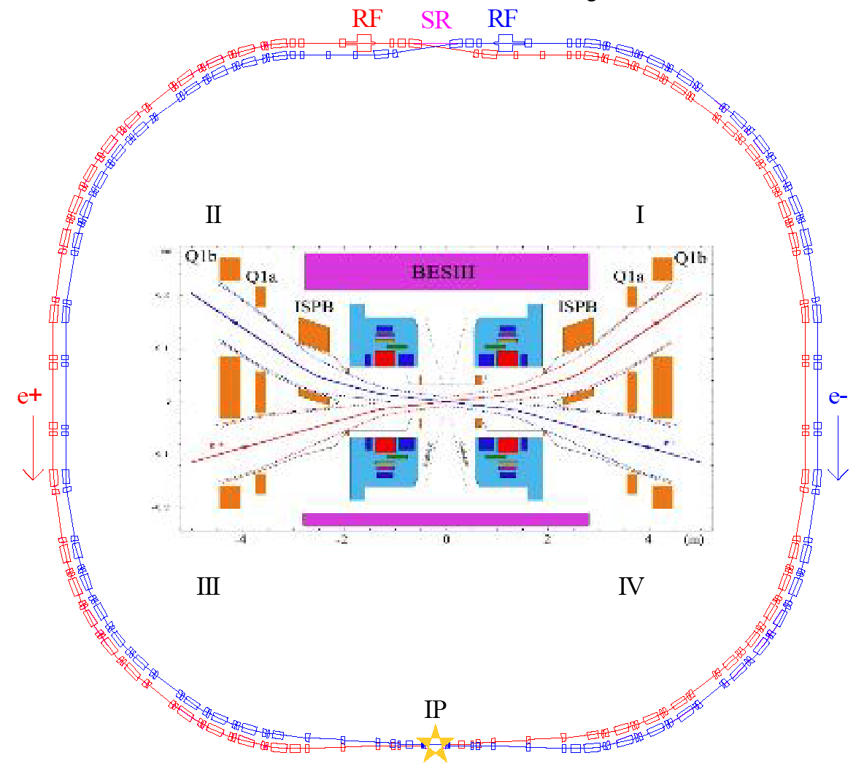
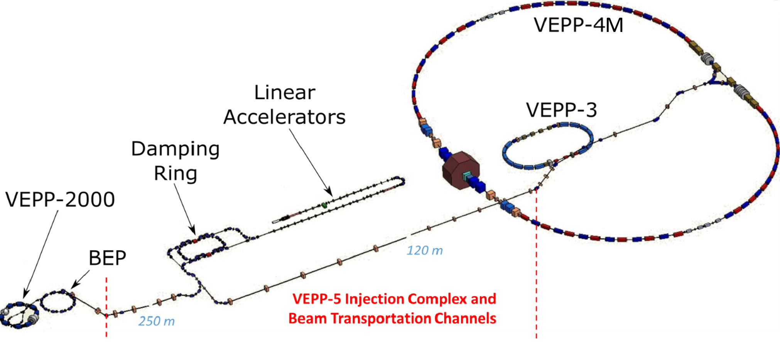
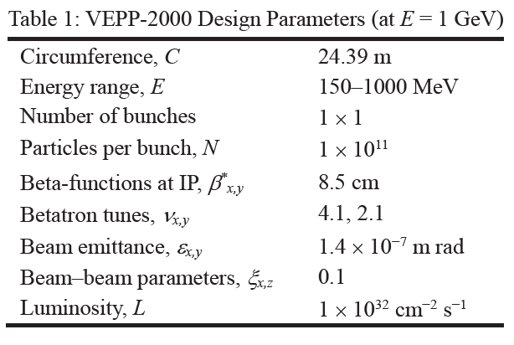
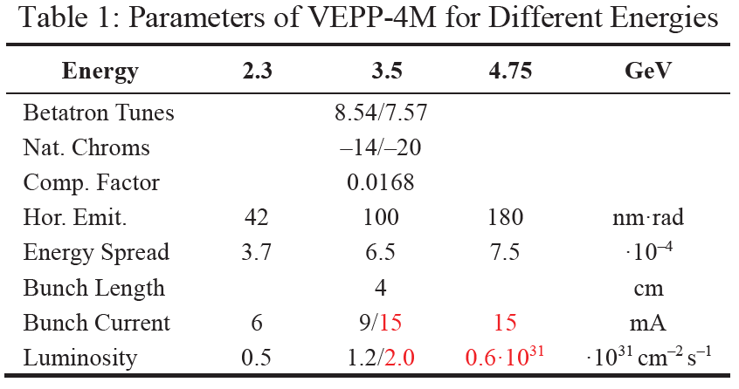
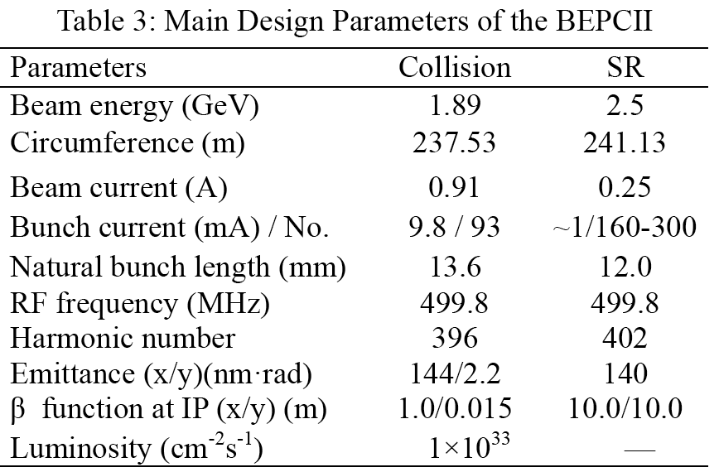
BINP VEPP-2000/4M IHEP BEPC-II
Round beams to mitigate beam-beam
Beam shaking to avoids beam size flip-flip
Also configurable as light source
[Y. Maltseva, RuPAC 2018; D.B. Shwartz, IPAC2021;
P.A. Piminov, IPAC2021]
[Q. Qin, eeFACT2016]

Slide 9
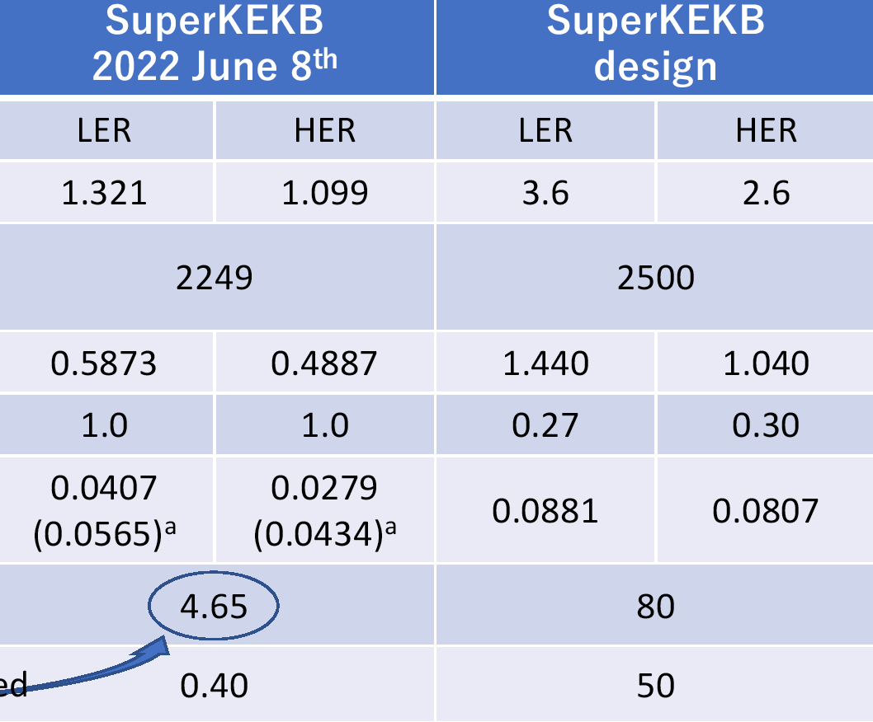
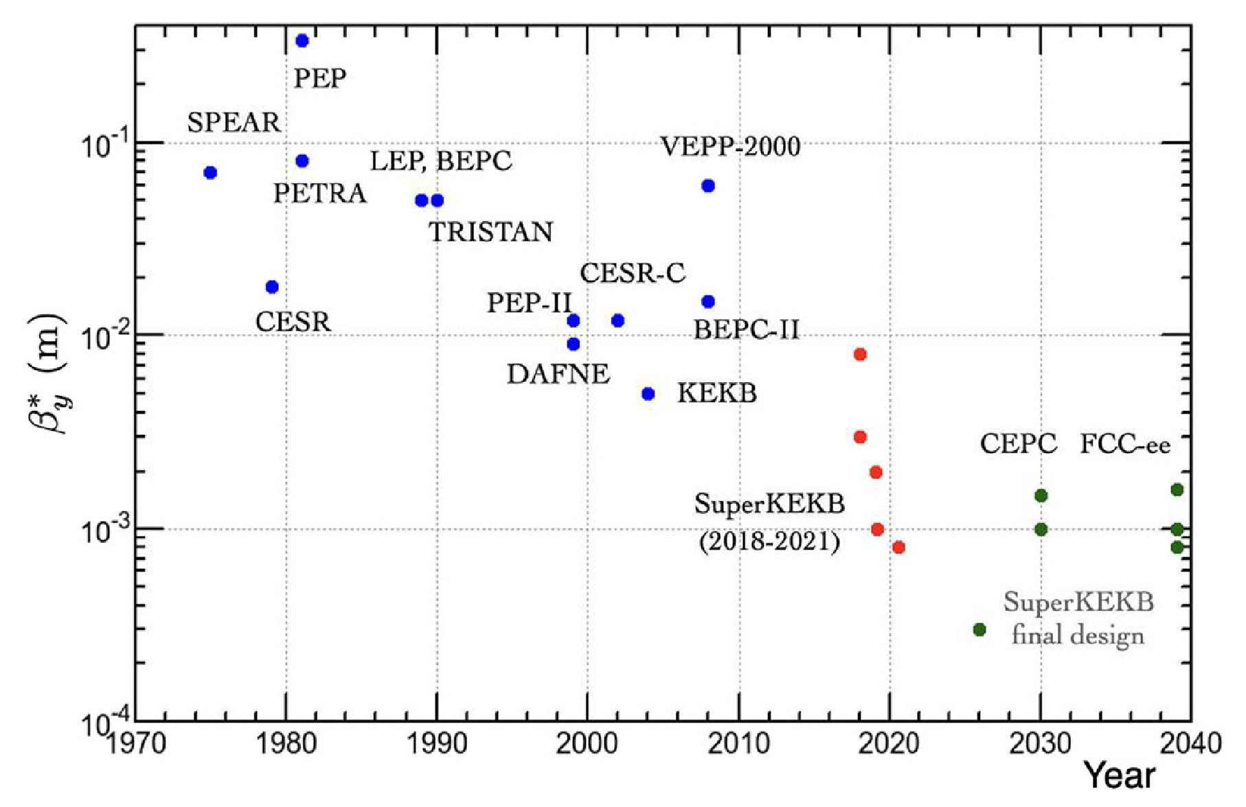
SuperKEKB - design
40x KEKB luminosity
“Nano-beam” collision scheme with
Low emittance, new e⁺ damping ring
Large Piwinski angle (β_{y} < σ_{s})
Crab waist
[Y. Ohnishi, et al., Eur. Phys. J. Plus, 136:1023 (2021)
Y. Funakoshi et al., “The SuperKEKB has broken the world record of the luminosity” IPAC 2022 (2022)]

Slide 10
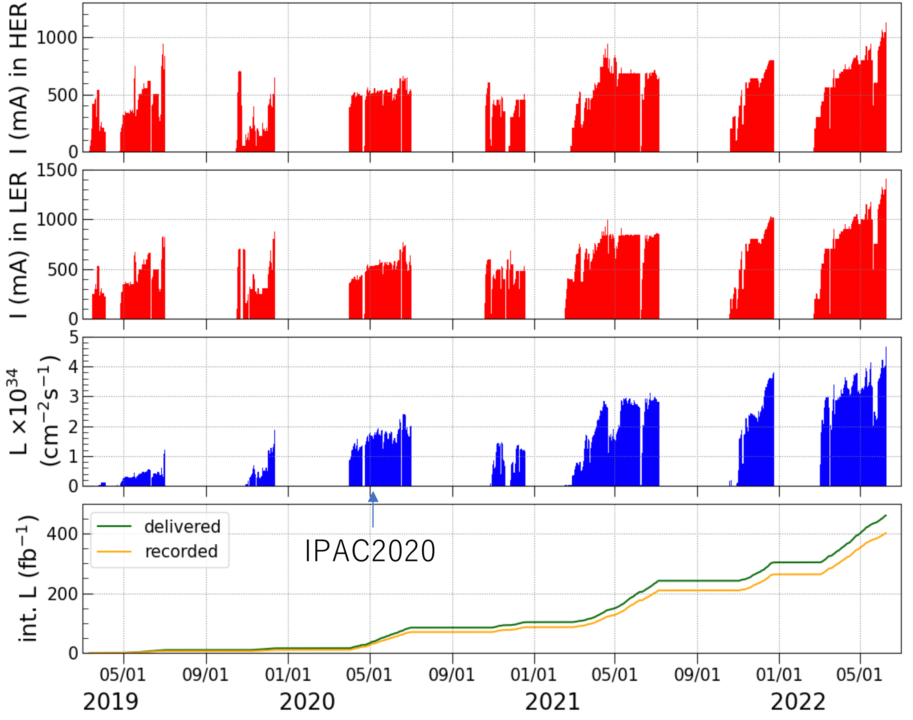
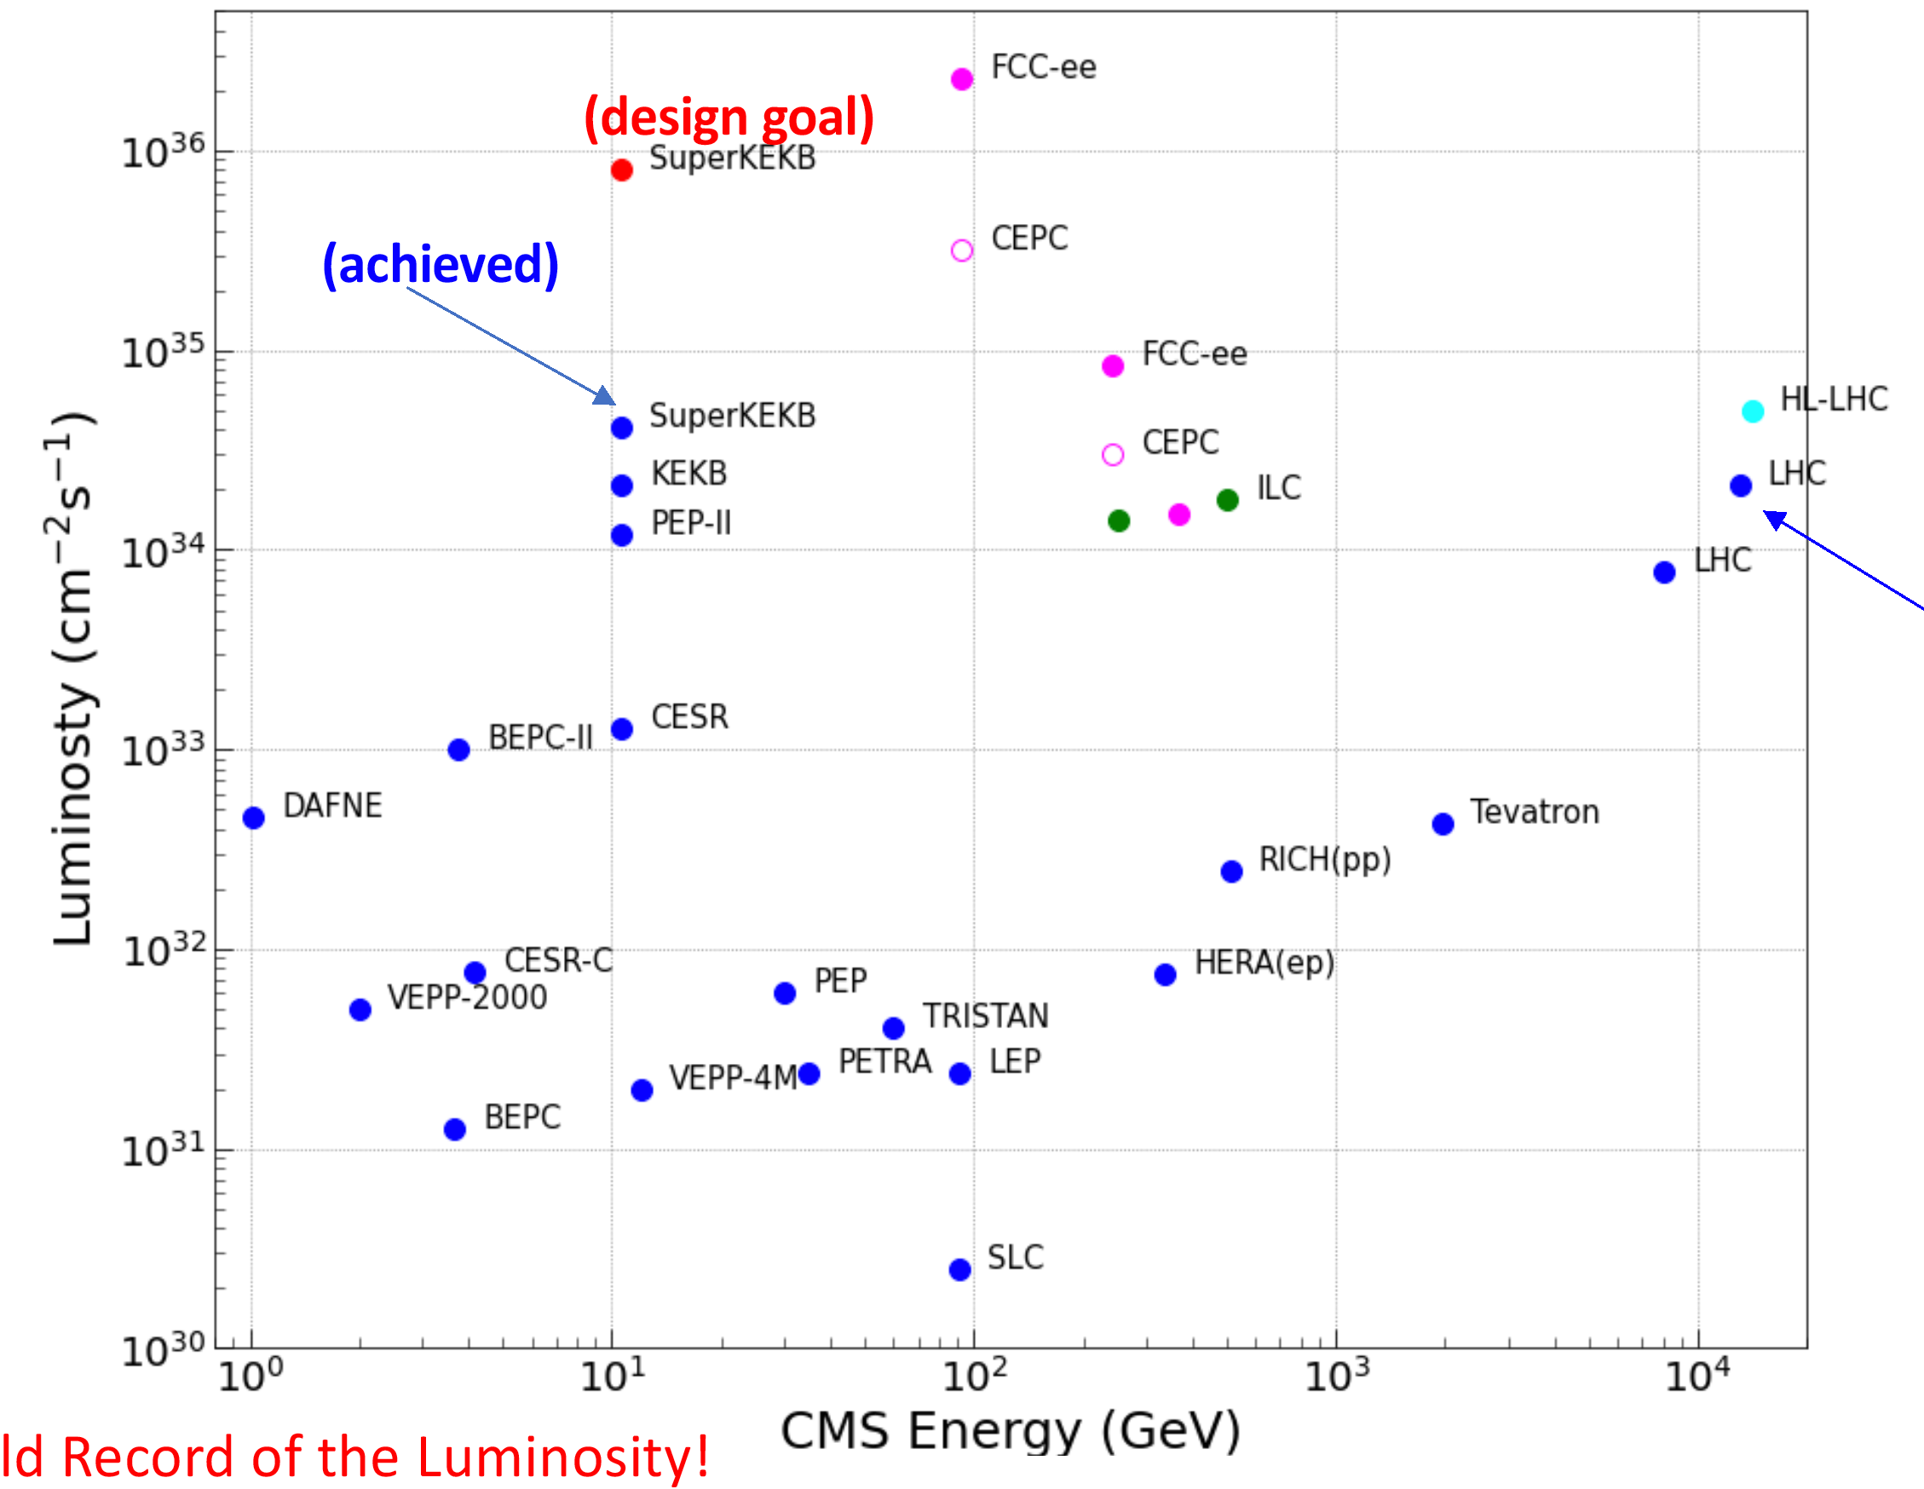
SuperKEKB – operation to date
Phase 1: Feb-Jun 2016 – vacuum scrubbing w/o Belle II
Phase 2: Mar-Jul 2018 – e+ damping ring, Belle II (w/o pixel), collisions, nano-beams, background studies
Phase 3: from Mar 2019 (below)
10³⁵
L = 4.65x10³⁴ cm⁻²s⁻¹
(world record)
[Y. Funakoshi et al., “The SuperKEKB has broken the world record of the luminosity” IPAC 2022 (2022)]

Slide 11
Colliders hh and eh: RHIC, LHC, EIC (project since 2020)
[Reported numbers, EIC – design]
 | RHIC pp (actual) | LHC pp (actual) | RHIC AA (actual) | LHC AA (actual) | EIC ep, eA (design)
Start of operation [year] | 2001 | 2009 | 2000 | 2010 | 2032 (planned)
Species | ph+ph (polarized p) | p+p | ph+Al, ph+Au, d+Au, h+Au, O+O, Cu+Cu, Cu+Au, Zr+Zr, Ru+Ru, Au+Au, U+U | Pb+Pb, p+Pb, Xe+Xe | eh+ph to eh+U (polarized e,p, He-3)
Circumference [km] | 3.8 | 26.7 | 3.8 | 26.7 | 3.8
Beam energy [GeV] | 255 | 6500 | 100 A | 2560 A | 5-18 / 40-275
CoM energy [GeV] | 510 | 13000 | 200 A | 5120 A | 28-140 (eh+ph)
Average beam current [mA] | 257 | 510 | 224 (Au+Au) | 24 (Pb+Pb) | 2500 / 1000
Peak luminosity [10³⁰ cm⁻²s⁻¹] | 245 | 2100 | 0.015 (Au+Au) | 0.006 (Pb+Pb) | 10000 (eh+ph)
Spin polarization | 55-60% | 0 | 0 | 0 | 70% e,p,h
[PDG, Tables 32.4, 32.5; EIC]
Notes:
LHC data for end of Run 2; Energy for LHC Run 3 starting 5 July 2022: 13.6 TeV

Slide 12
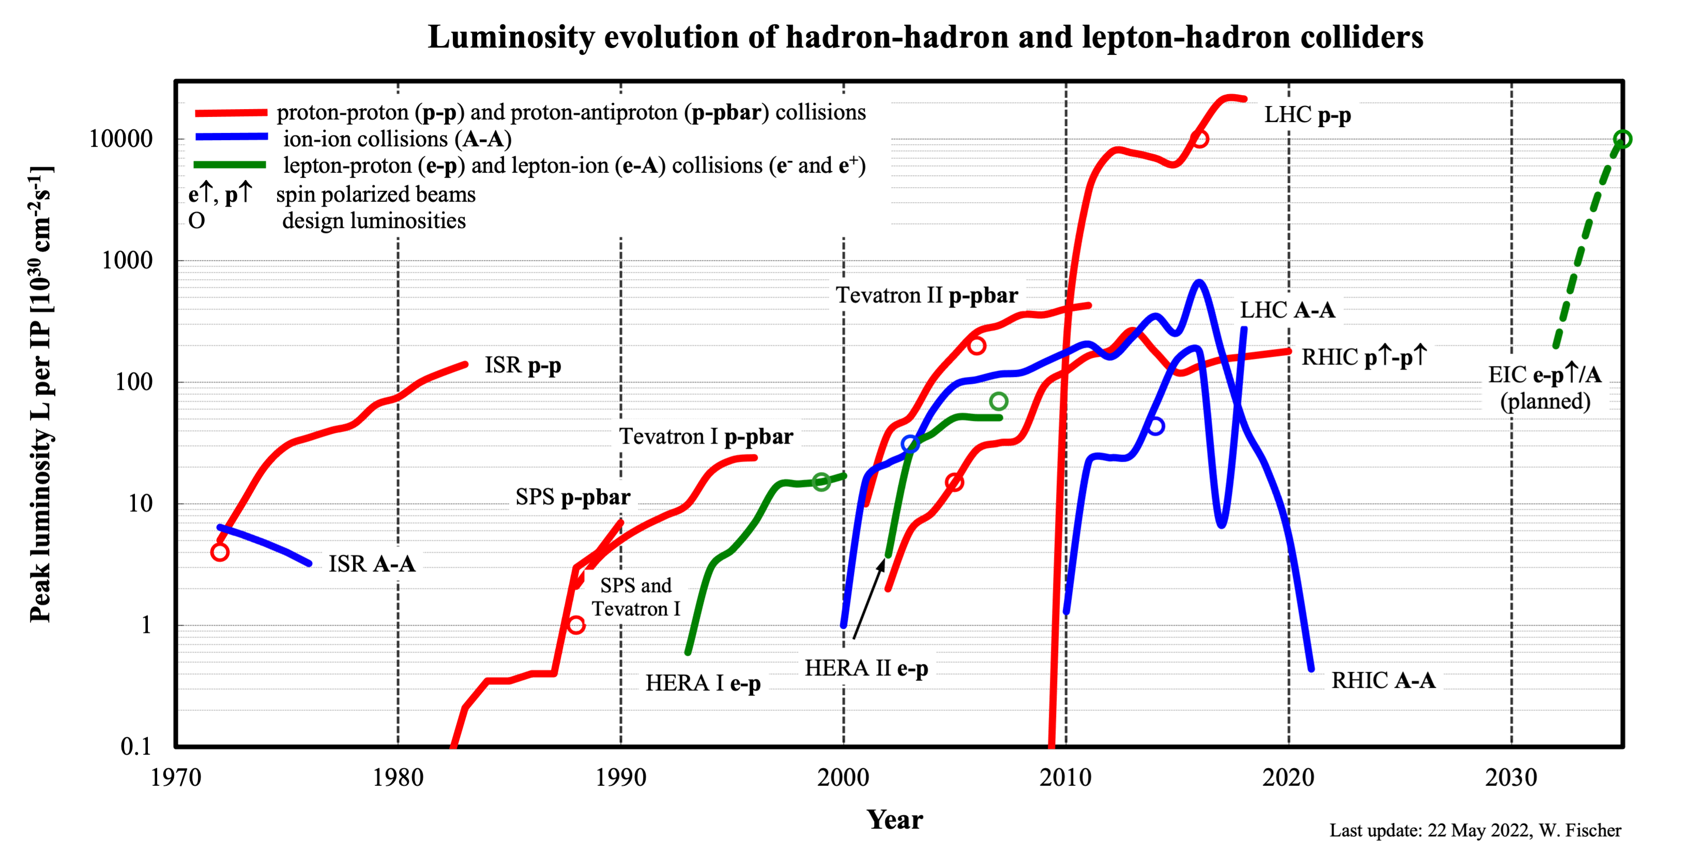
variations in AA luminosity due to energy/species

Slide 13
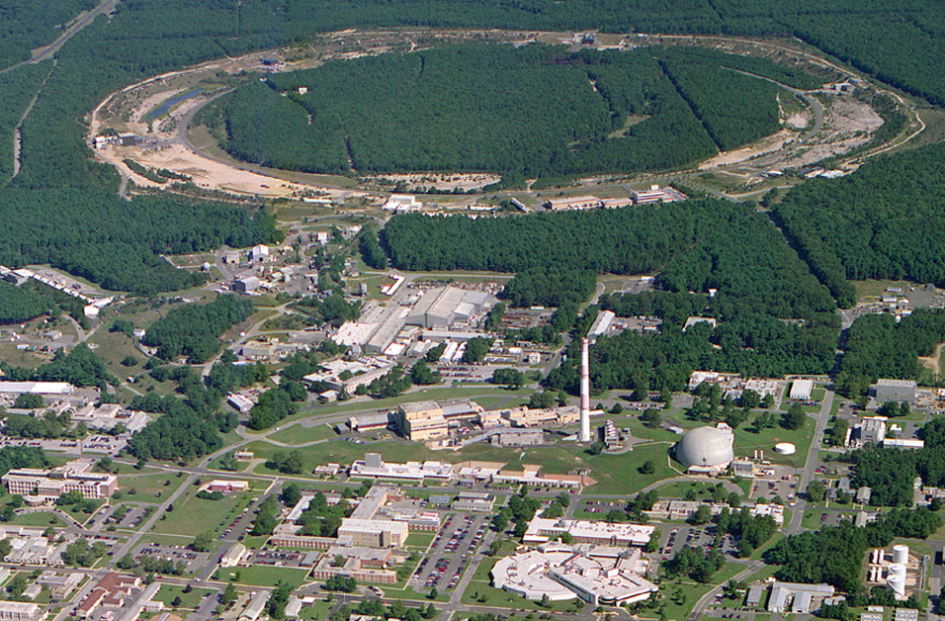
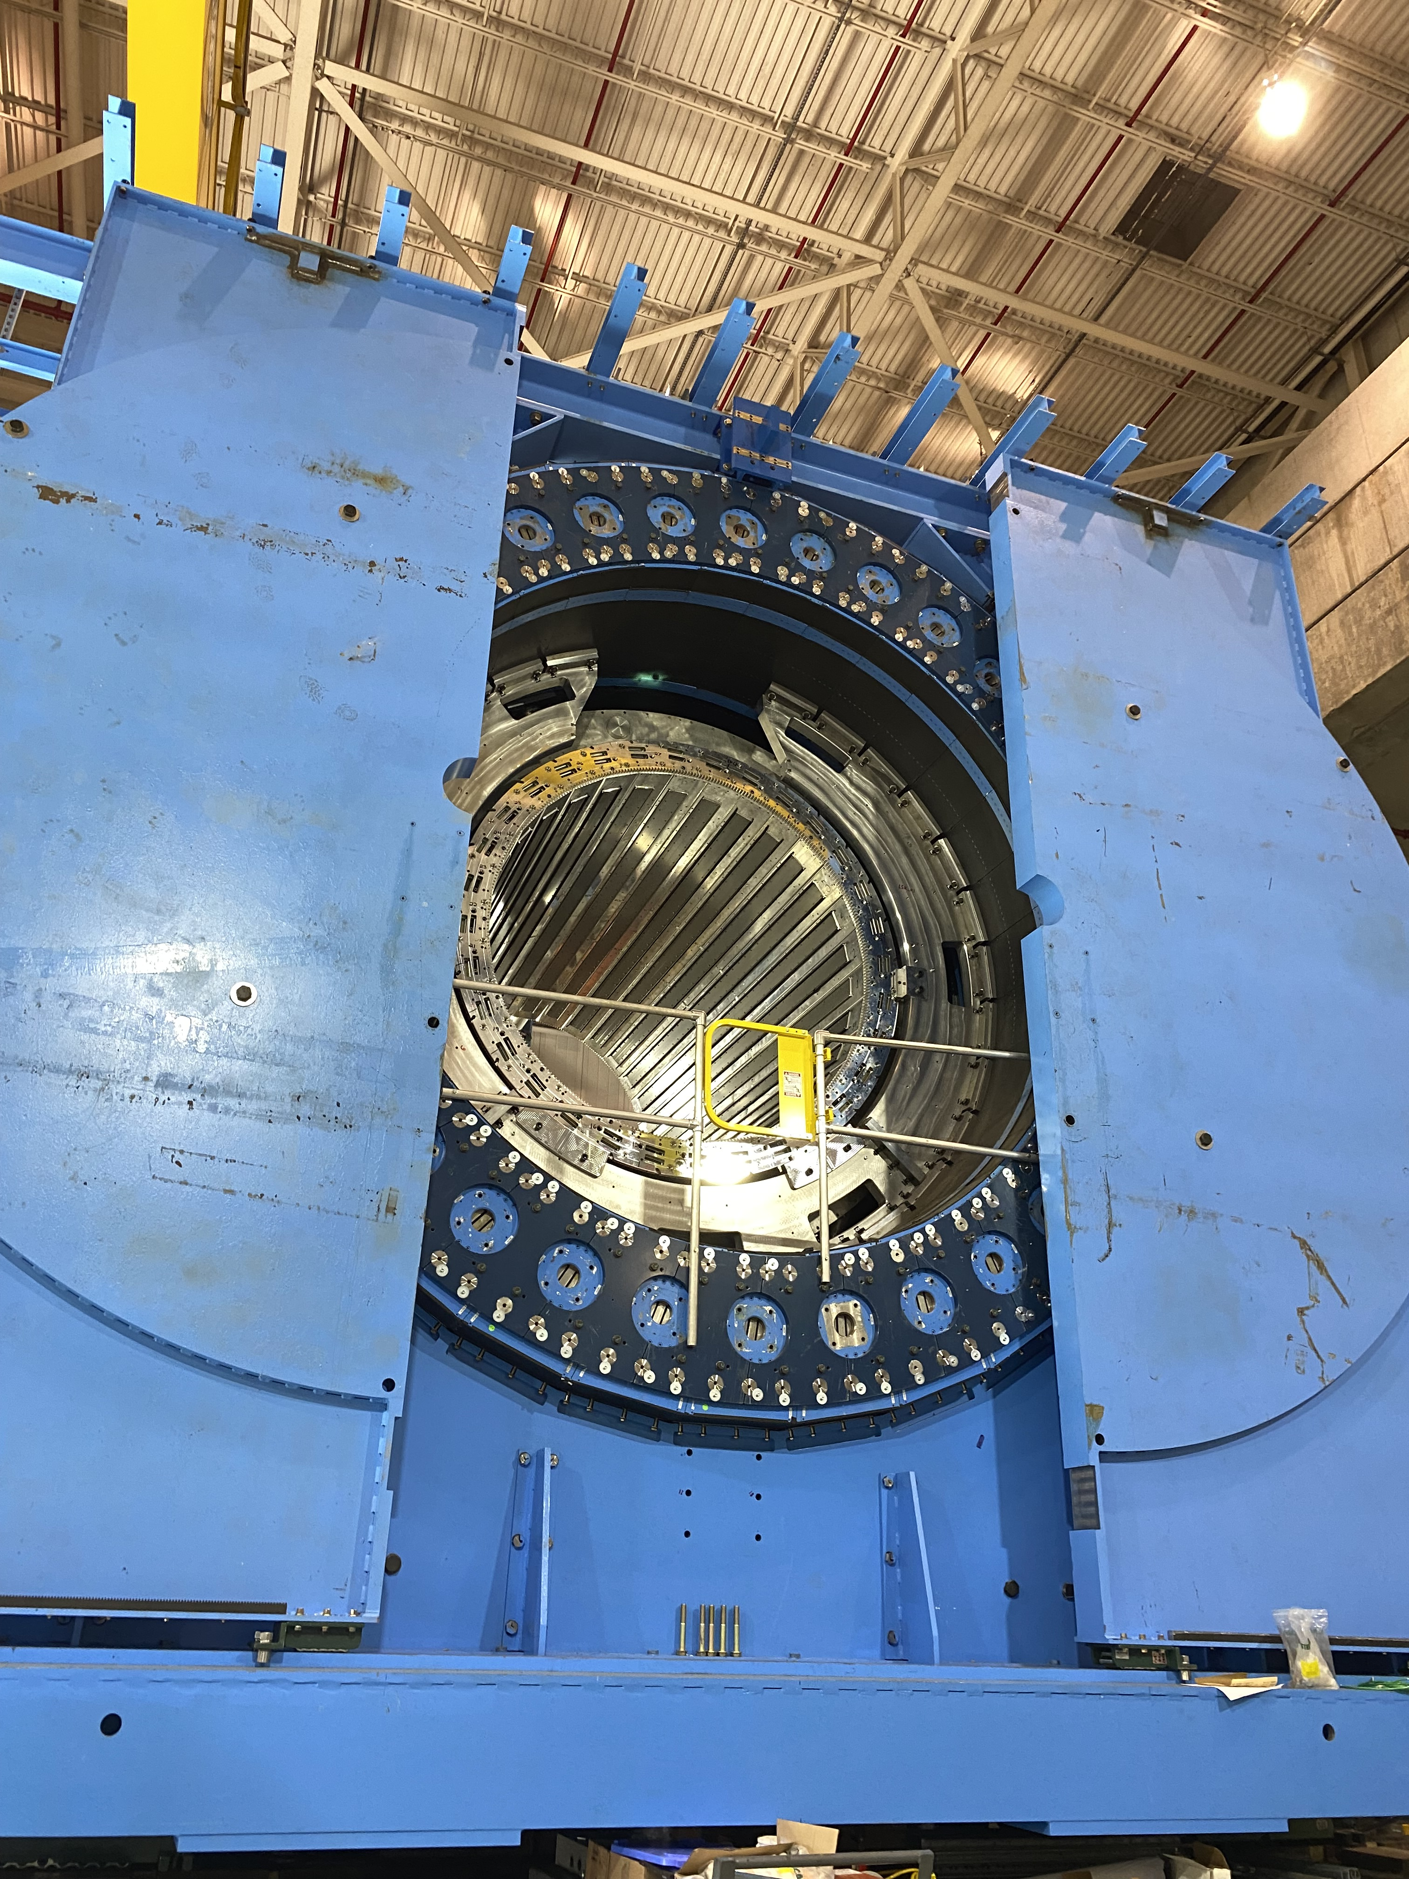
Relativistic Heavy Ion Collider at Brookhaven Natl Lab
Polarized Jet Target
(PHOBOS) Electron lenses
RHIC g EIC
(BRAHMS) Electron cooling
(s)PHENIX
RF
STAR
LINAC
NSRL
EBIS
Booster
New sPHENIX detector to be completed for operation 2023-2025
(uses former BaBar magnet)
Operation : 2000 – 2025 (planned)
Circumference : 3.8 km
Max dipole field : 3.5 T Energy : 255 GeV polarized p : 100 GeV/nucleon Au
Species : ph to U (incl. asymmetric) Experiments : BRAHMS, PHOBOS (complete) STAR, PHENIXgsPHENIX
BLIP
AGS
TPL
Tandems

Slide 14
Ion programs require high flexibility in
Species
Energy
also in LHC ion program
To date did not have same species combination in RHIC and LHC
(apart from p+p)
O+O likely also in LHC in the future
Nominal injection energy

Slide 15
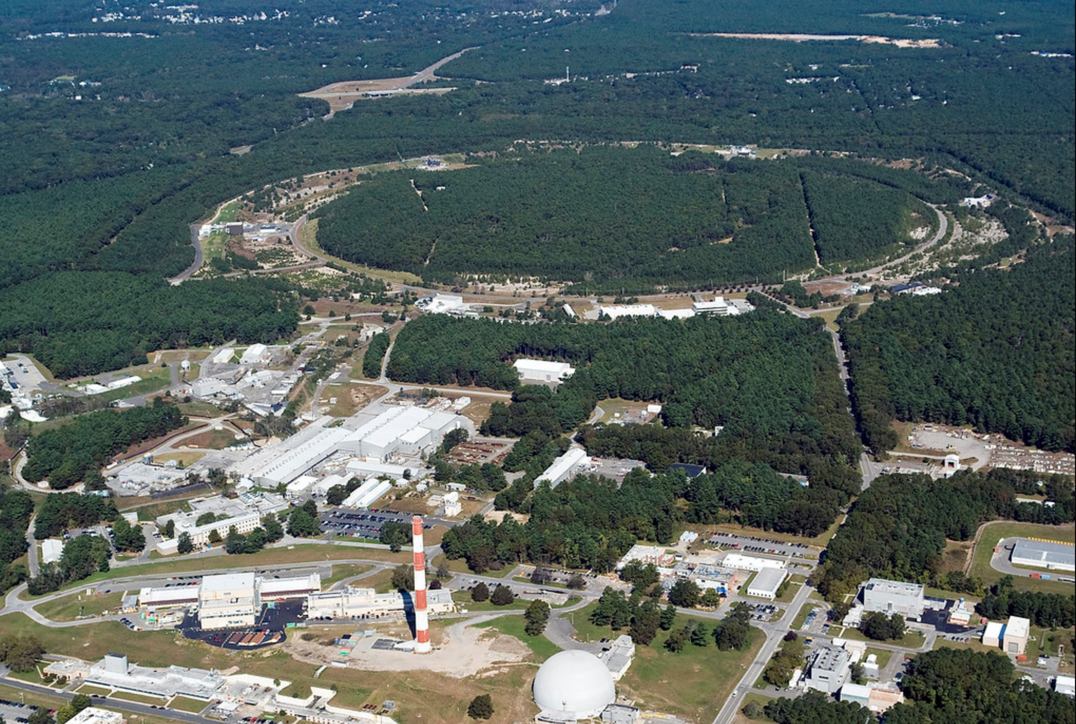
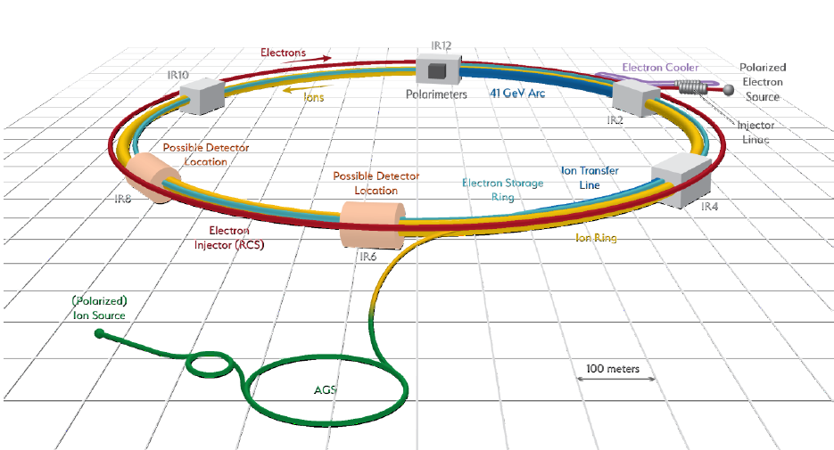
Electron-Ion Collider
Ferdinand Willeke et al.
BNL-JLab partnership with national and international contribution
sited at BNL - uses RHIC hadron complex CD-1 June 2021 (Conceptual Design complete, cost range), operation 2032 (planned)
Hadron storage Ring (RHIC Rings) 40-275 GeV (existing)
1160 bunches, 1A beam current (3x RHIC)
small vertical beam emittance 1.5 nm
strong cooling (coherent electron cooling)
Electron storage ring 2.5–18 GeV (new)
many bunches, large beam current, 2.5 A ➔ 9 MW S.R. power
SC RF cavities
Full energy injection of polarized bunches
Electron rapid cycling synchrotron 0.4–(new)
1-2 Hz
Spin transparent due to high periodicity
High luminosity interaction region(s) (new)
L = 10³⁴ cm⁻²s⁻¹
Superconducting magnets
25 mrad full crossing angle with crab cavities
Spin rotators (longitudinal spin)
Forward hadron instrumentation
RHIC
EIC

Slide 16
High-intensity machines
For secondary or tertiary particles

Slide 17
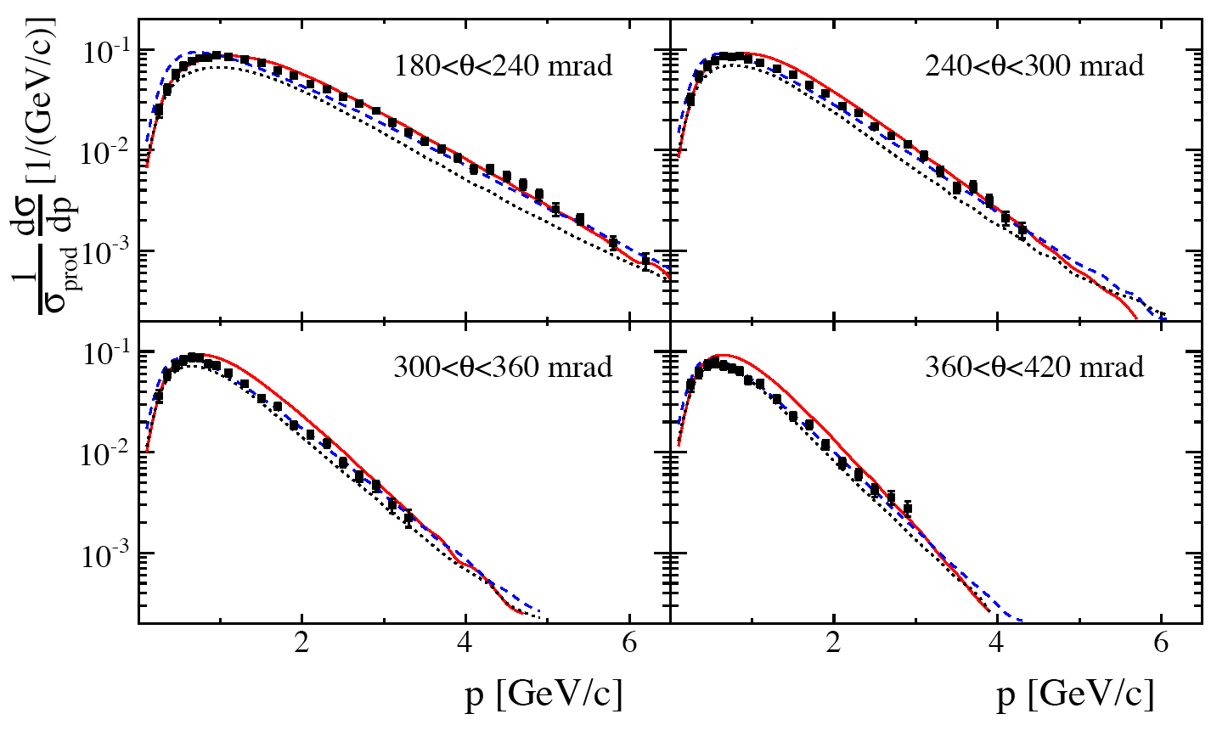
High-intensity accelerators – Important considerations
P_{beam} = (1/e) I_{beam} * E_{beam}
Power
Energy - used to increase power - used to maximize production cross section
Energy efficiency (grid-to-beam)
Beam loss / component activation
Targets
Limited by beam dynamics
Limited by funding
p+C to π–
[N. Abgrall et al., Phys. Rev. C 84, 034604 (2011)]

Slide 18
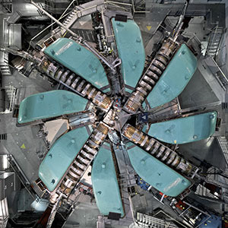
Cyclotrons, Linacs, Rings
PSI cylotron 1.4 MW
Cyclotrons
Limited to ~600 MeV (extension: Fixed Field Alternating (FFA) gradients machines)
Present power frontier: PSI cyclotron 1.4 MW
Best energy efficiency
Linacs
Space charge limit at source
Present power frontier: ORNL SNS 1.4 MW
Good energy efficiency with SRF and CW
Accelerator rings
Highest energy reach
Space charge limit at injection
Low power efficiency
ring
ring
Linac
Intensity upgrade of rings:
raise injection energy into ring eg CERN Linac4, FNAL PIP-II
reduce cycle time eg J-PARC Main Ring
replace ring by linac
Space charge limits (~1/γ²)
- At source
- In rings at injection

Slide 19
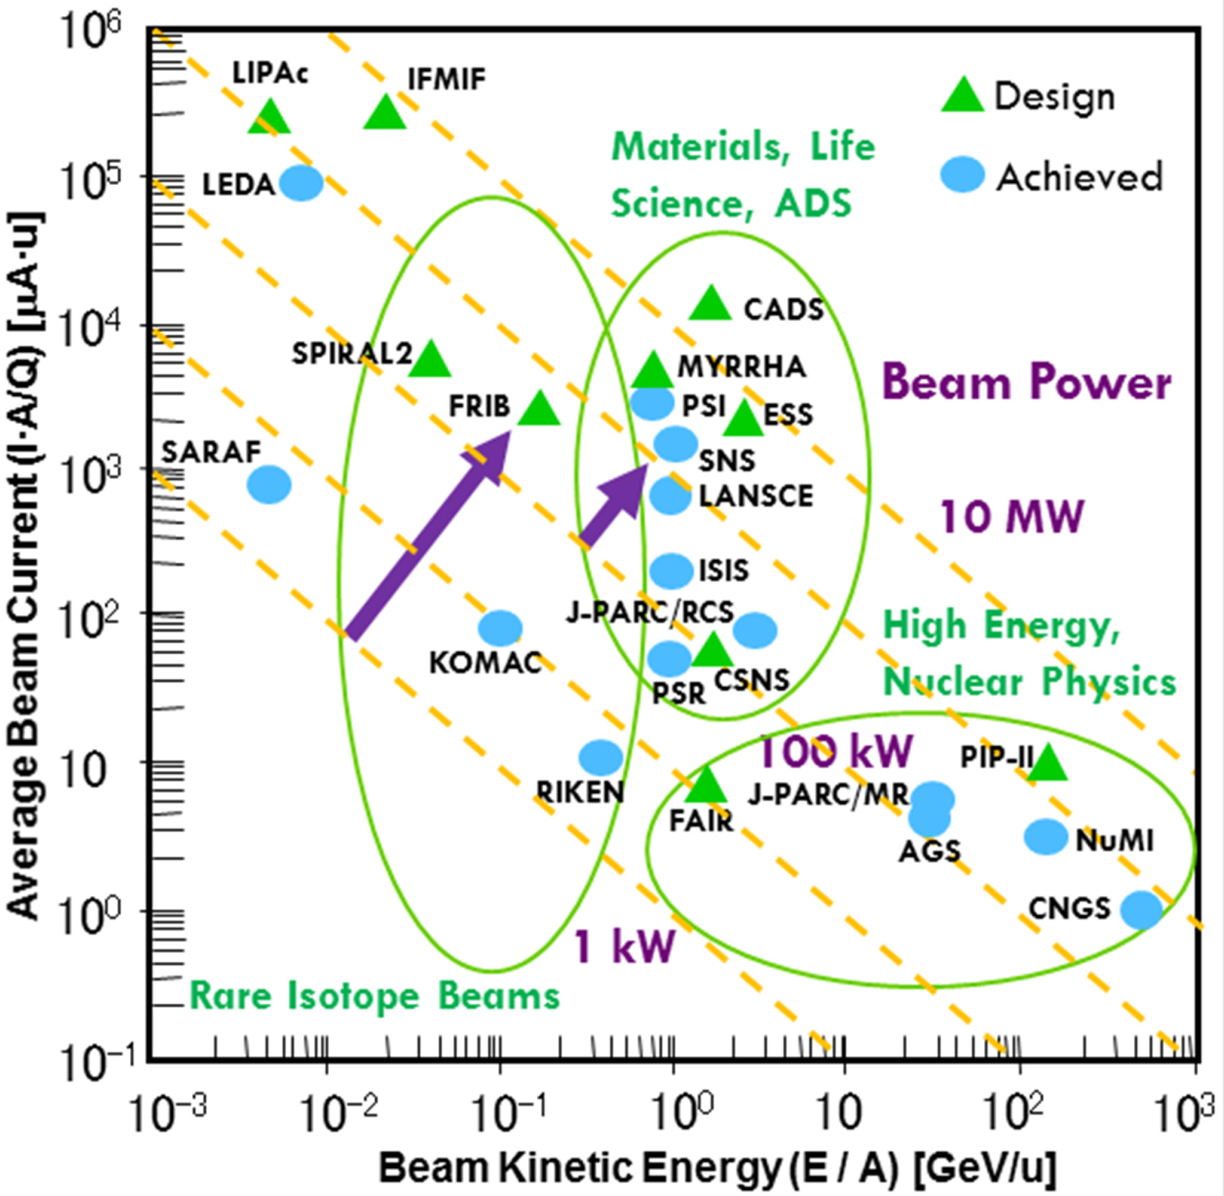
High-intensity
accelerators for HEP
[J. Wei, “Particle accelerator development: selected examples,” Modern Physics Letters A, vol. 31, no. 10, pp. 1630010-1-13, Mar. 2016.]

Slide 20
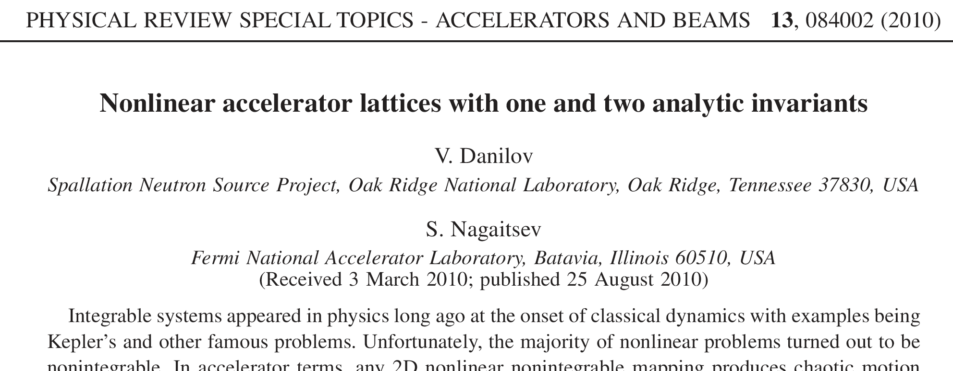
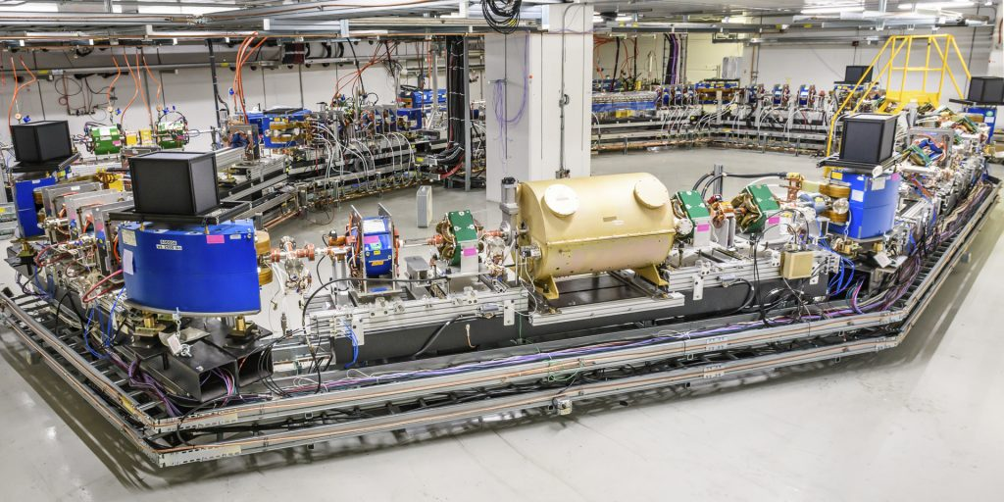
IOTA – test ring at Fermilab
S. Nagaitsev et al.
One research topic is nonlinear integrable optics
Guiding fields realized with magnets or electron lenses
Could increase the space charge limit in rings, as alternative to build higher energy linac
Notes:
Pic from: https://news.fnal.gov/2019/08/fermilabs-newest-accelerator-delivers-first-results/

Slide 21
High-intensity machines for HEP
Machine | Energy [GeV] | Beam power [MW] | Machine Type | Comment | Used for [examples]
PSI Cyclotron | 0.590 | 1.4 | Cyclotron, CW 51 MHz | 1974 start | mu3e
TRIUMF Cyclotron | 0.520 | 0.2 | Cyclotron, CW 23 MHz | 1974 start | PIENU
J-PARC MR | 30 | 0.8 | Ring, 2.48 sec, FX/SX | 2010 start | Neutrinos FX, HEF SX
… with fast ramping | 30 | 1.3 | Ring, 1.16 sec, FX/SX | 2028 (planned) | Neutrinos FX, HEFSX
FNAL Booster | 8 | 0.08 | Pulsed 15 Hz FX | 1970 start | NuMI, SpinQest, g-2, mu2e
FNAL MI | 120 | 0.7 | Pulsed FX/SX | 1998 start | Neutrinos
… with PIP-II | 120 | 1.2 | Pulsed FX/SX | 2028 (planned) | Neutrinos
CERN PS | 24 | 0.03 | Pulsed FX/SX | 1959 start | CLOUD
CERN SPS | 450 | 0.5 | Pulsed FX/SX | 1976 start | COMPASS, SHINE, NA62/63/64 AWAKE
FX = Fast eXtraction, SX = Slow eXtraction

Slide 22
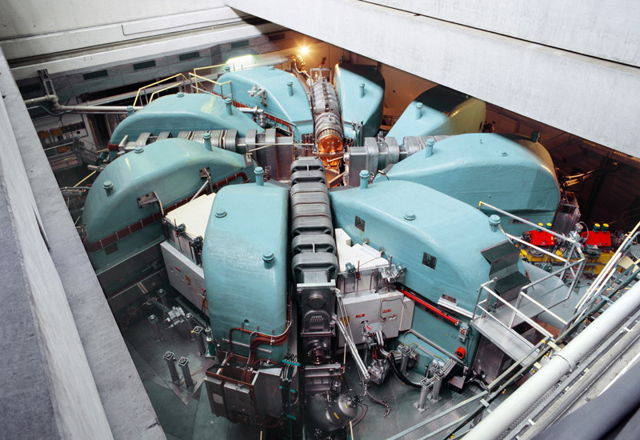
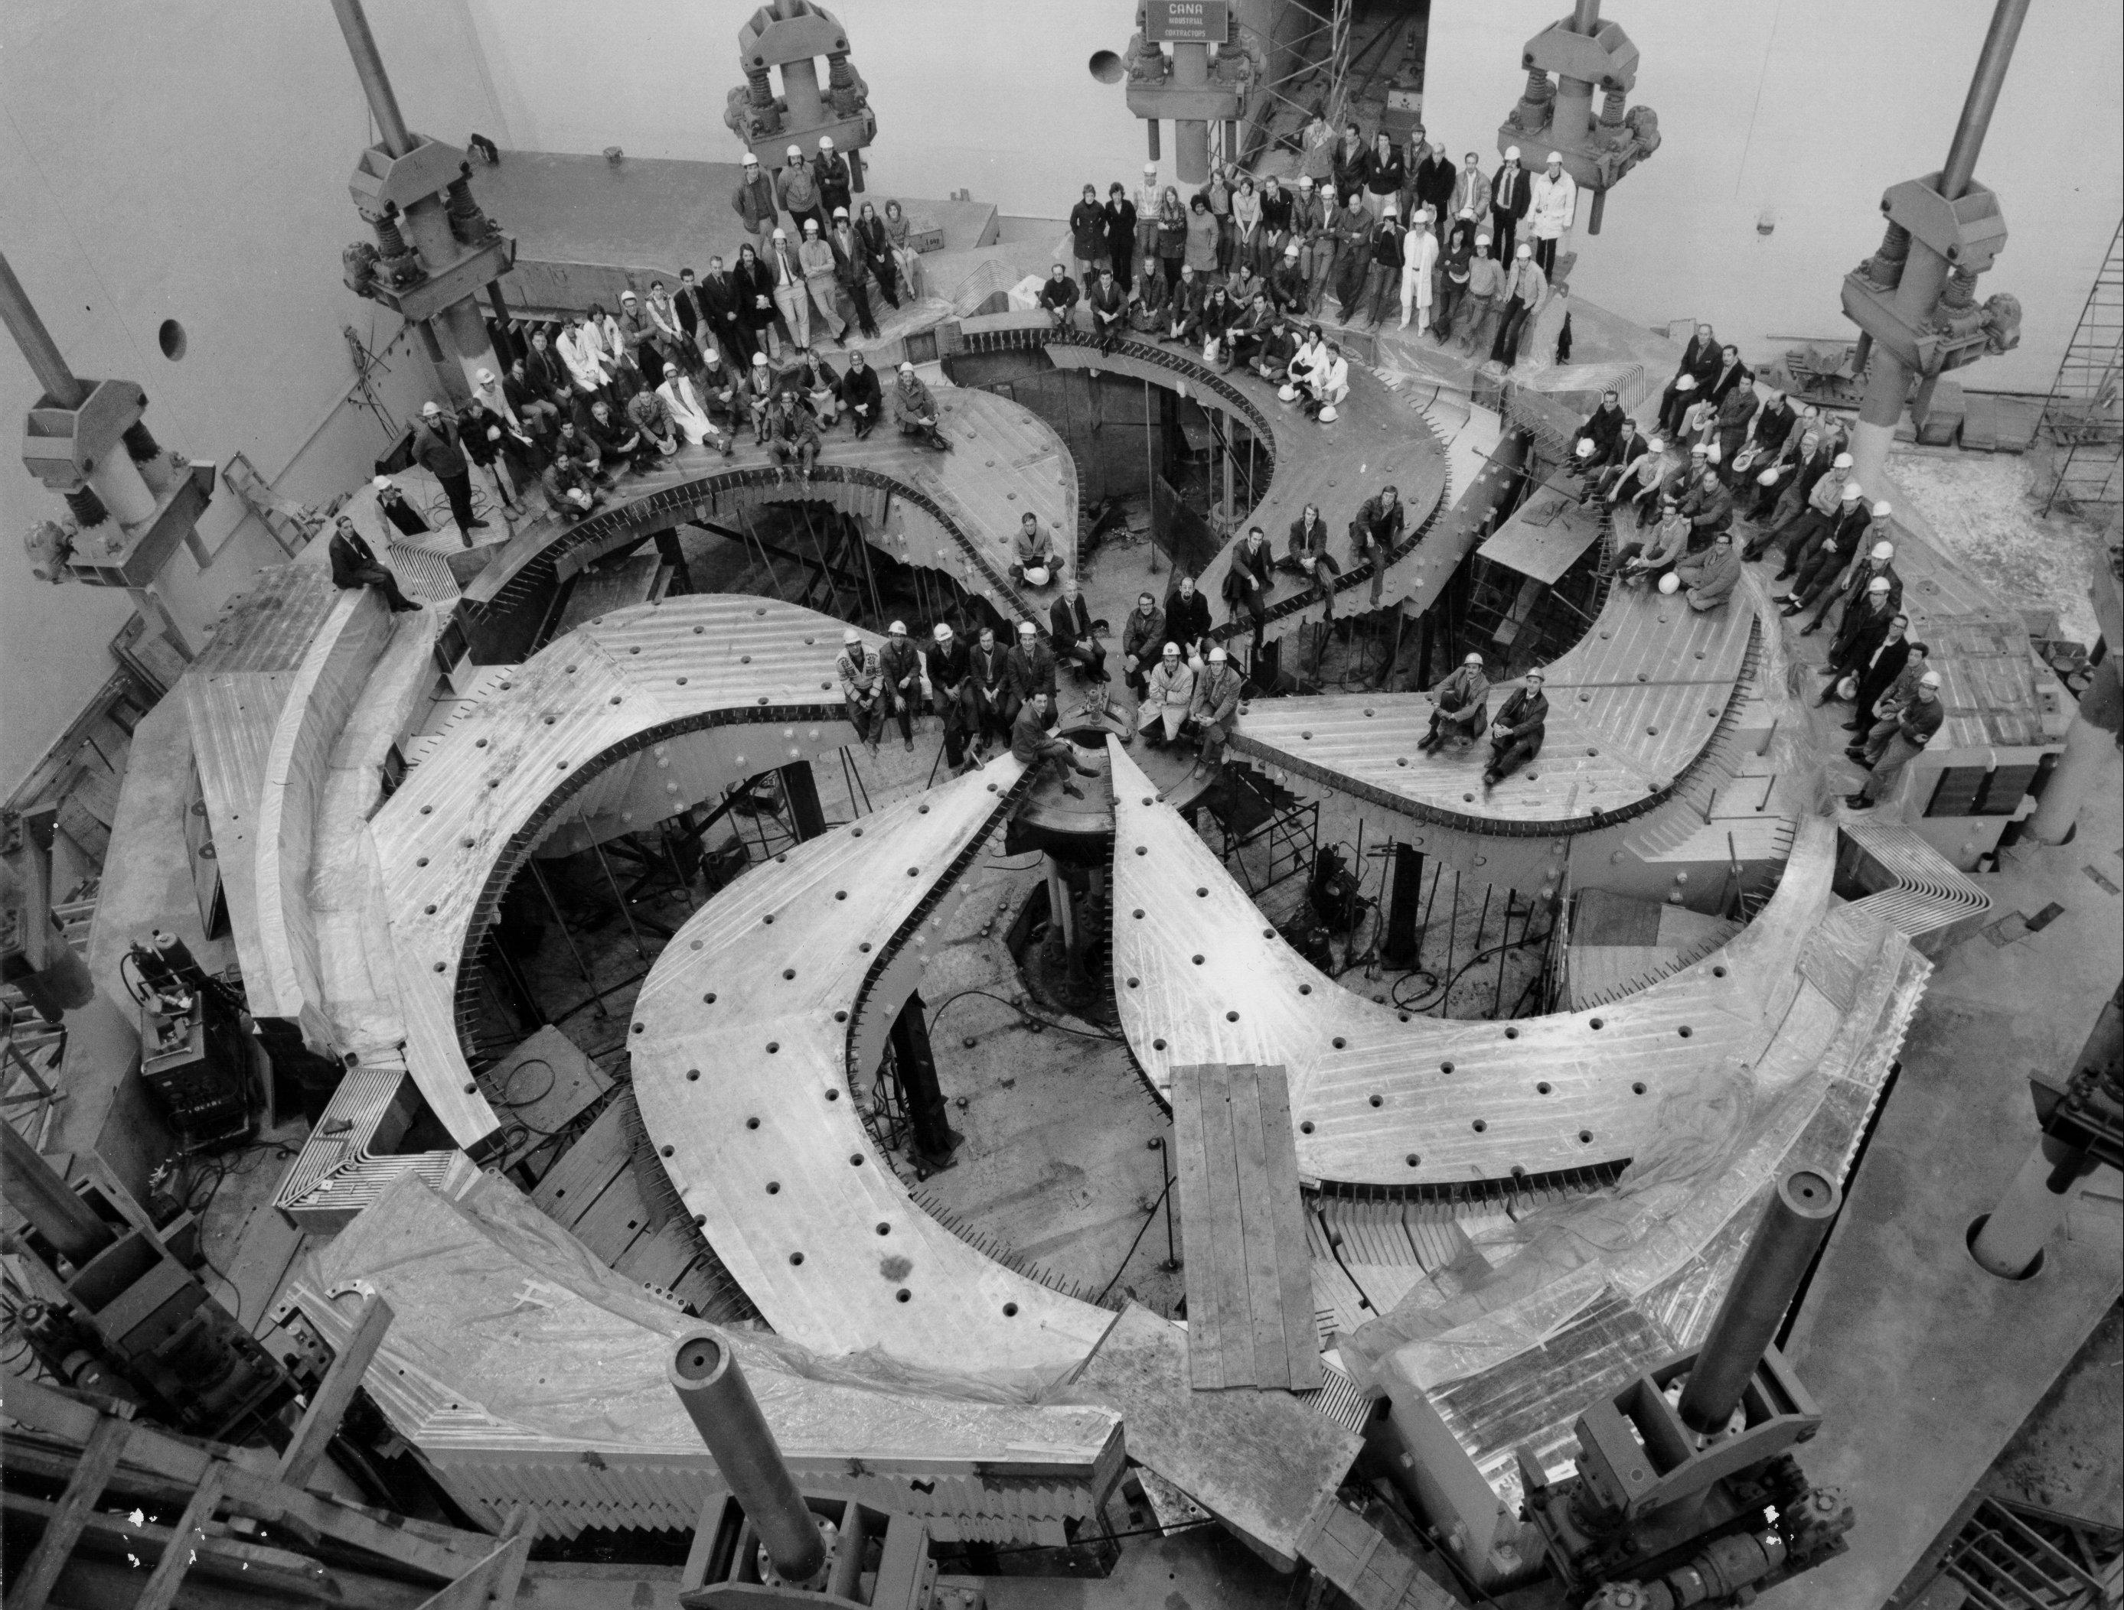
PSI and TRIUMF Cyclotrons
Paul Scherrer Institute (PSI), Cyclotron
Particle: p, most energy efficient machine today
E = 590 MeV, P = 1.4 MW
Experiments: e.g. mu3e 𝜇⁺→𝑒⁺𝑒⁺𝑒⁻
TRIUMF, Cyclotron
Particle: H–, multiple simultaneous extractions
E = 520 MeV, P = 0.2 MW
Experiments: e.g. PIENU π⁺ → e⁺ ν / π⁺ → μ⁺ ν

Slide 23
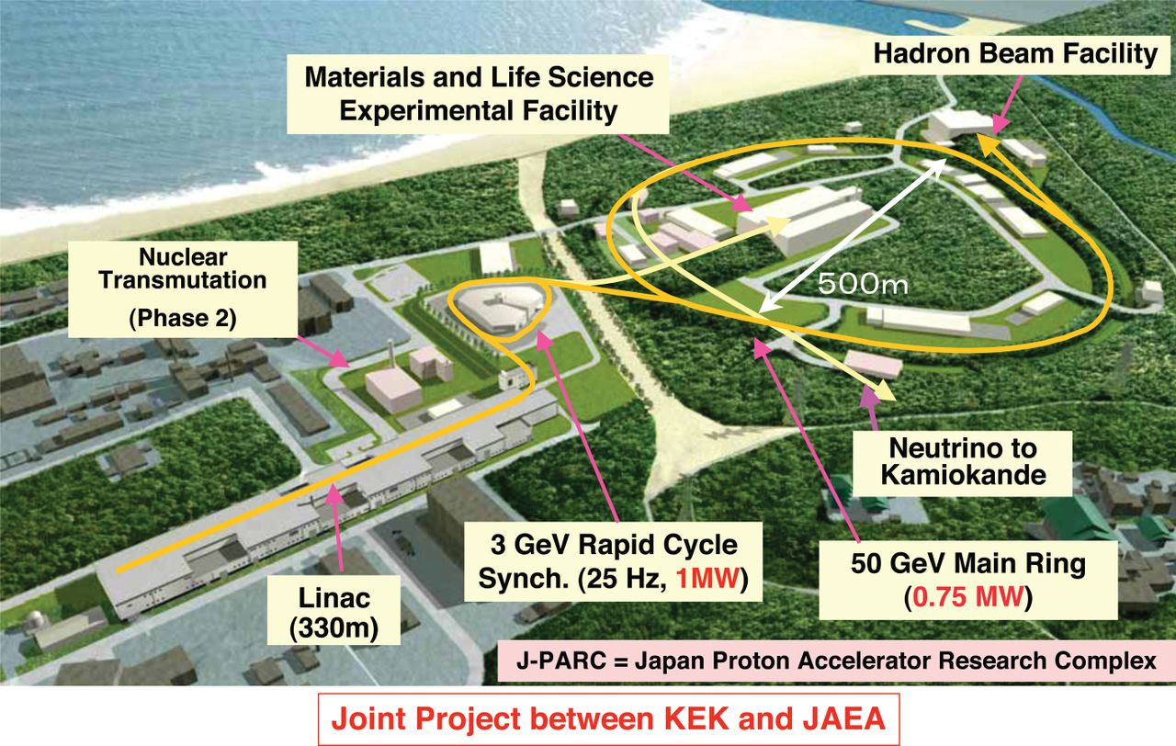
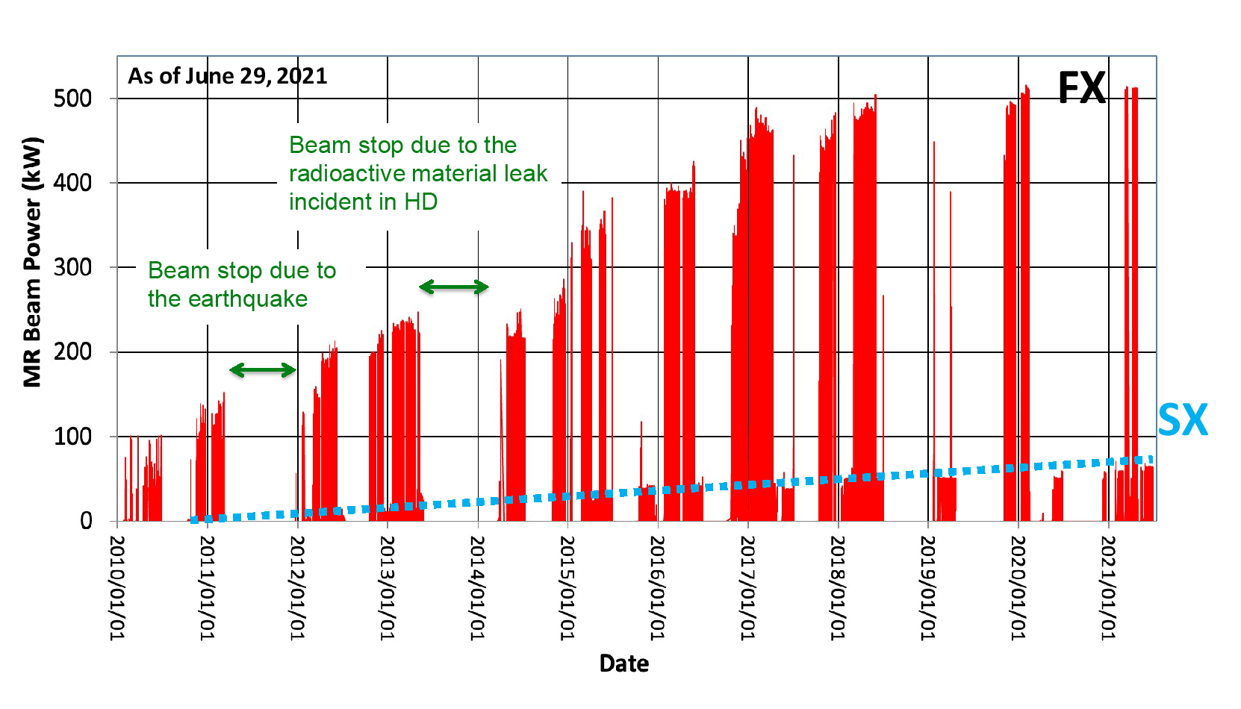
J-PARC Main Ring beam power history
Energy : 30 GeV
Intensity : 2.6x10¹⁴ ppp
Beam power : 510 kW
3 GeV Rapid Cycle Synch. (25 Hz, 700 kW)
30 GeV Main Ring (500 kW)
2010
2021
[Michikazu Kinshu, J-PARC ATAC 2022]
Notes:
Picture from Wikipedia

Slide 24
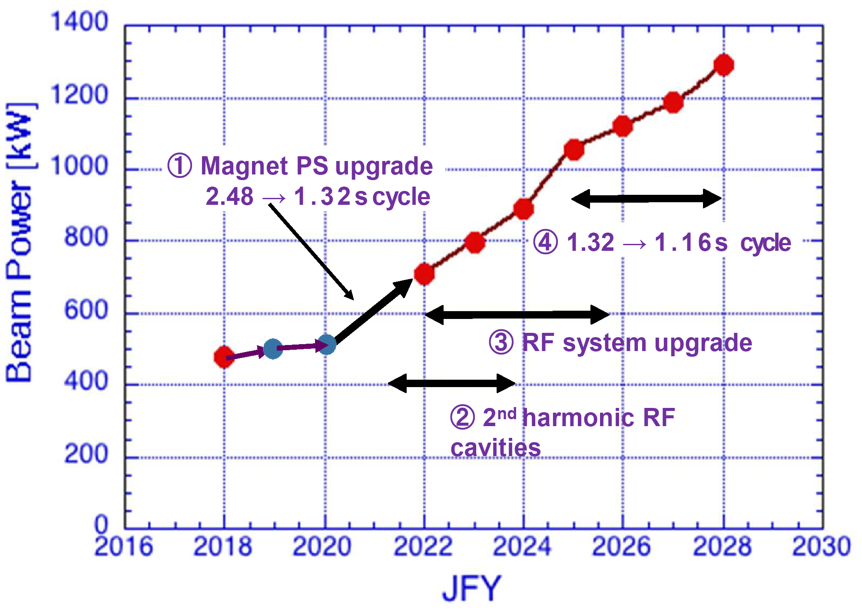
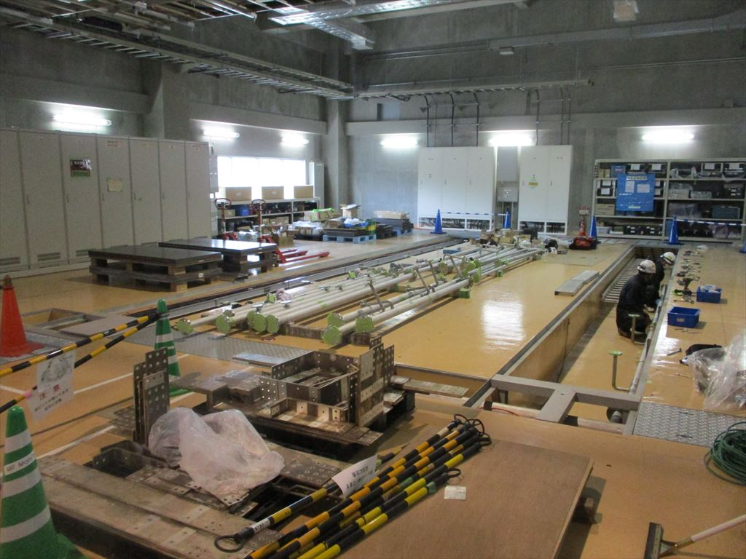
J-PARC Main Ring power upgrade to 1.3 MW
MR cycle reduction from 2.48 to 1.16 sec +30% intensity increase with new PS with capacitive energy storage, RF, extraction and collimation upgrade
Preparation for new PS (3x)
QFNPS site
QDNPS site
[Michikazu Kinshu and Yuichi Morita, J-PARC ATAC 2022]

Slide 25
Fermilab accelerator complex
Space charge limit here
Notes:
Jeff Eldred, HB 2021

Slide 26
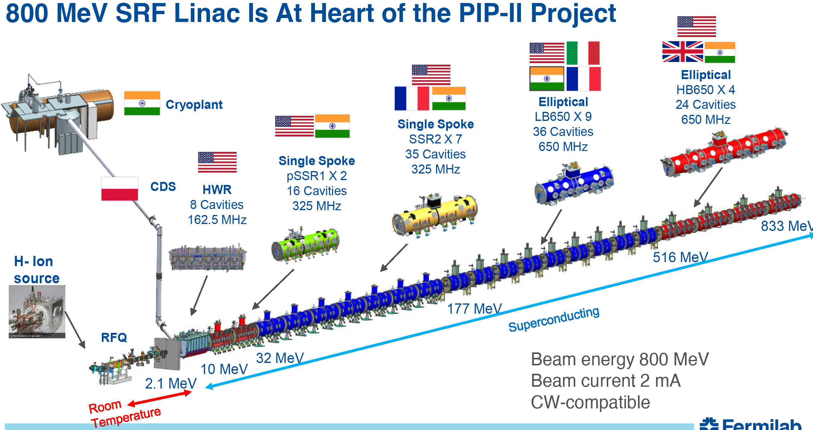
PIP-II = Proton Improvement Plan II (PIP-I doubled Booster repetition rate from 7.5 to 15 Hz)
Fermilab project in construction phase
Replaces existing 400 MeV normal-conducting linac with 800 MeV superconducting linac
Increase beam power out of Main Injector from 0.7 to 1.2 MW,
Large international contributions
Notes:
Jeff Eldred, HB 2021

Slide 27
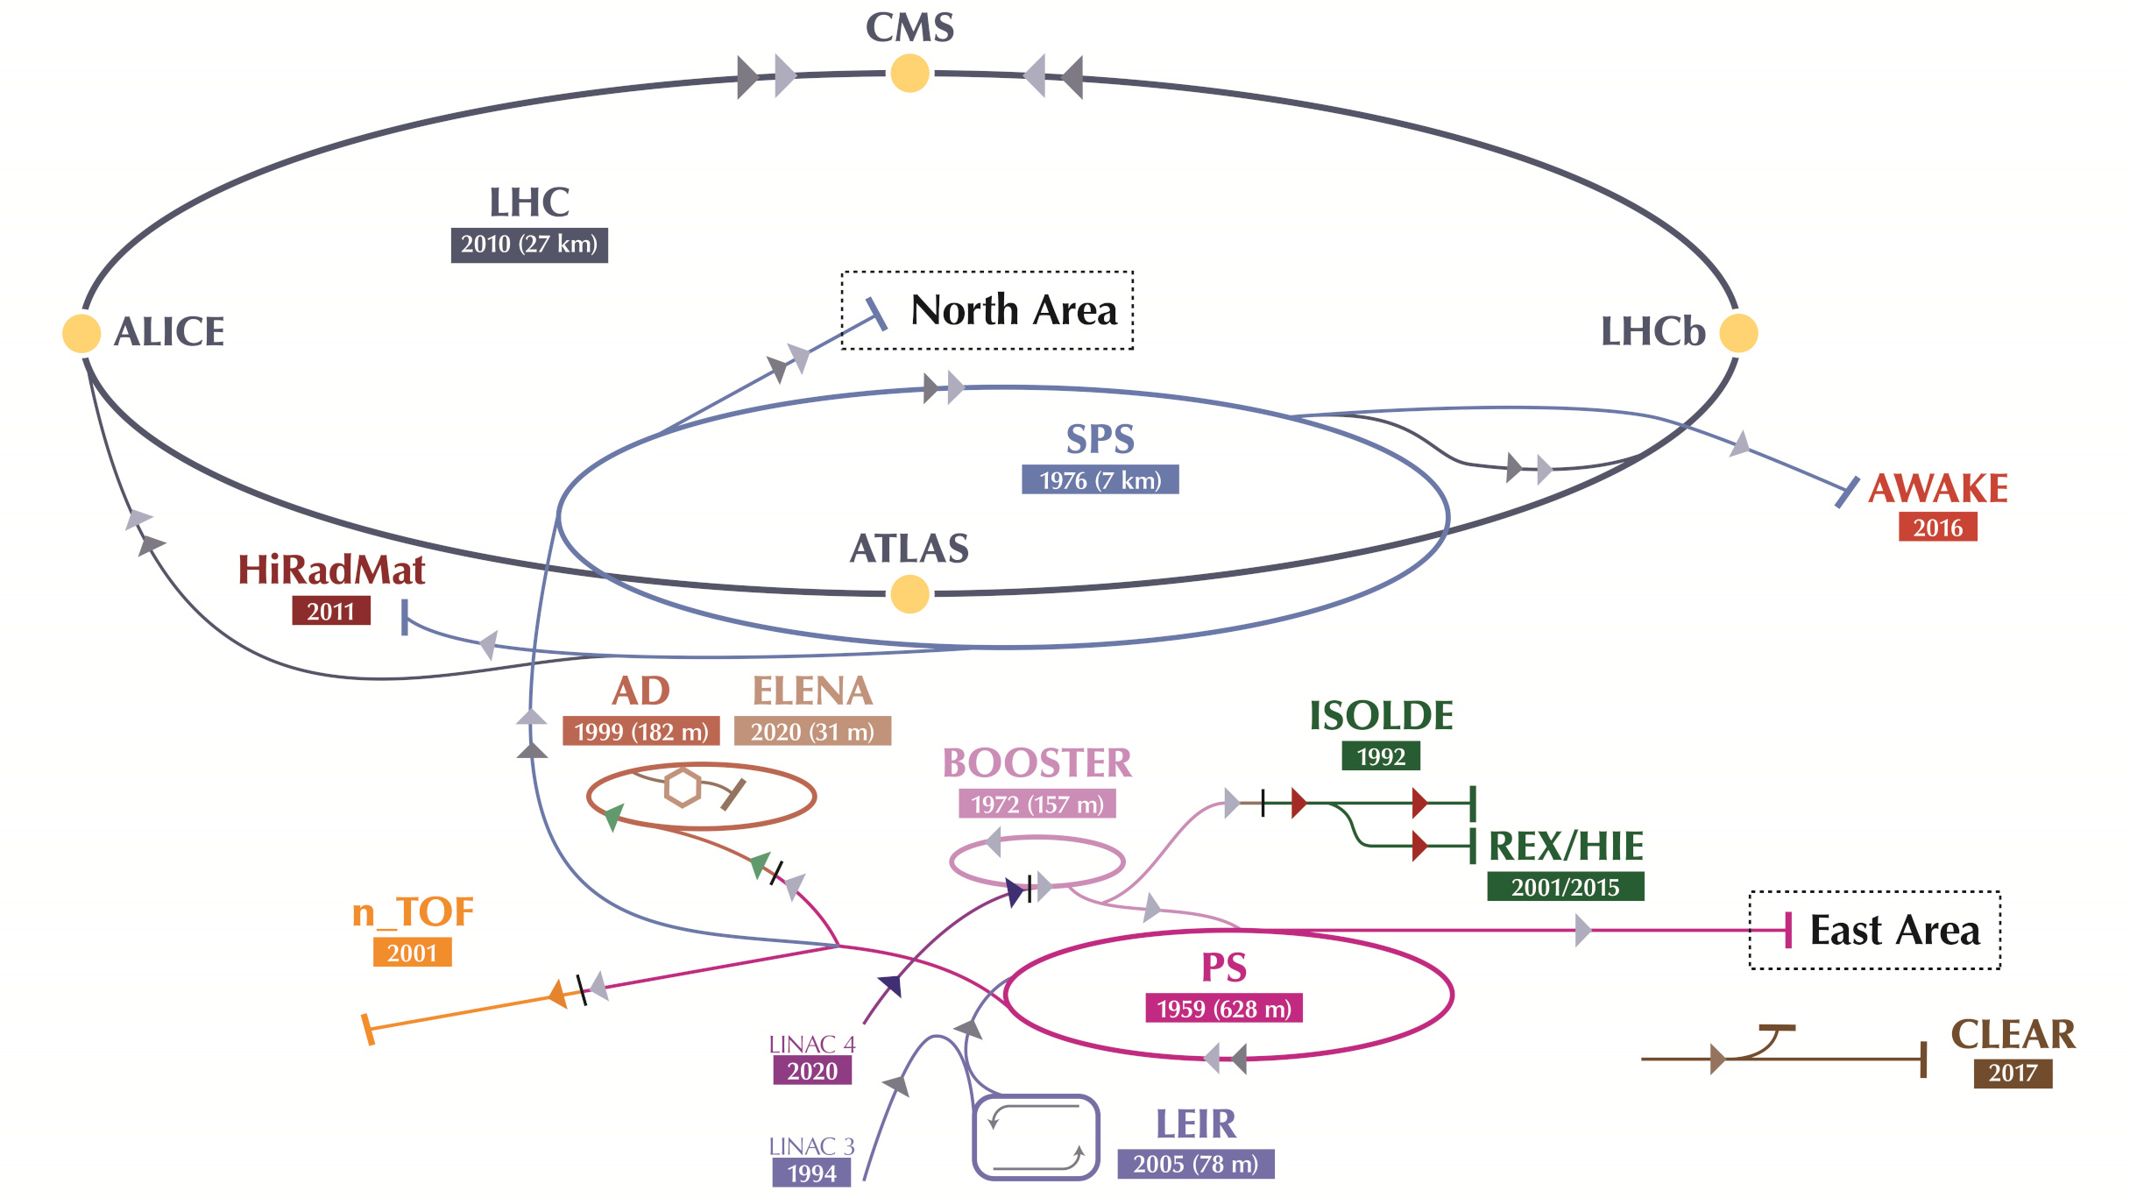
CERN PS and SPS
LHC Injector Upgrade (LIU) recently completed (increased Linac and Booster energy)
PS to East Area
CLOUD, IRRAD, CHARM
SPS to North Area
COMPASS, SHINE, NA62/63/64
AWAKE = Advanced Proton Driven Plasma Wakefield Acceleration Experiment
Plasma Wakefield acceleration with proton beam driver, bunch with 19 KJ
Rb vapor 10 m long plasma cell, accelerated 18 MeV electrons to ~800 MeV
HiRadMat = High-Radiation to Materials
Protons: 440 GeV, max 3.46x10¹³ p/pulse, max 2.4 MJ/pulse, 7.95 μs pulse
Lead : 173.5 GeV/nucleon, max 3.64x10⁹ ions/pulse, max 21 kJ/pulse, 5.2 μs pulse
[E. Adli et al., “Acceleration of electrons in the plasma wakefield of a proton bunch”, Nature 561, pages 363–367 (2018)]

Slide 28
Mike Seidel, PSI, at IPAC 2022

Slide 29
Mike Seidel, PSI, at IPAC 2022

Slide 30
Future HEP accelerators, concepts, ideas
PERLE
HE-LHC
CERC
FCC-ee
ILC
FCC-hh
μμ collider
LHeC
CLIC
Plasma acceleration
FCC-eh
CEPC
HE-LHC
Dielectric laser acceleration
γγ collider
Factories
C³
CPPC
Neutrino factories
ERLC
ReLiC

Slide 31
Summary – present accelerators (non-LHC) and approved facilities
BNL EIC project – working towards baseline
collisions 2032 (planned)
Present colliders: 5x e⁺e– and 2x hh
Low-energy colliders are technology test beds (beam-beam compensation, crab crossing, beam cooling, collimation, …)
SuperKEKB (very high L) prototype for future e⁺e– colliders, EIC
hh colliders – increasing flexibility (energy, species)
Present collider project:
BNL Electron-Ion Collider: ~100x HERA luminosity, polarized e,p,He-3 and heavy ions
Present high-intensity machines
MW beam power available, ν beams drive increases
Synergies with other applications: spallation neutron sources, nuclear physics, Accelerator Driven Systems (ADS)
Present high-intensity project:
FNAL PIP-II: SRF Linac into Booster, increases beam power out of Main Injector from 0.7 to 1.2 MW
EIC
FNAL PIP-II project – SRF linac under construction
beam 2028 (planned)

