Slide 1
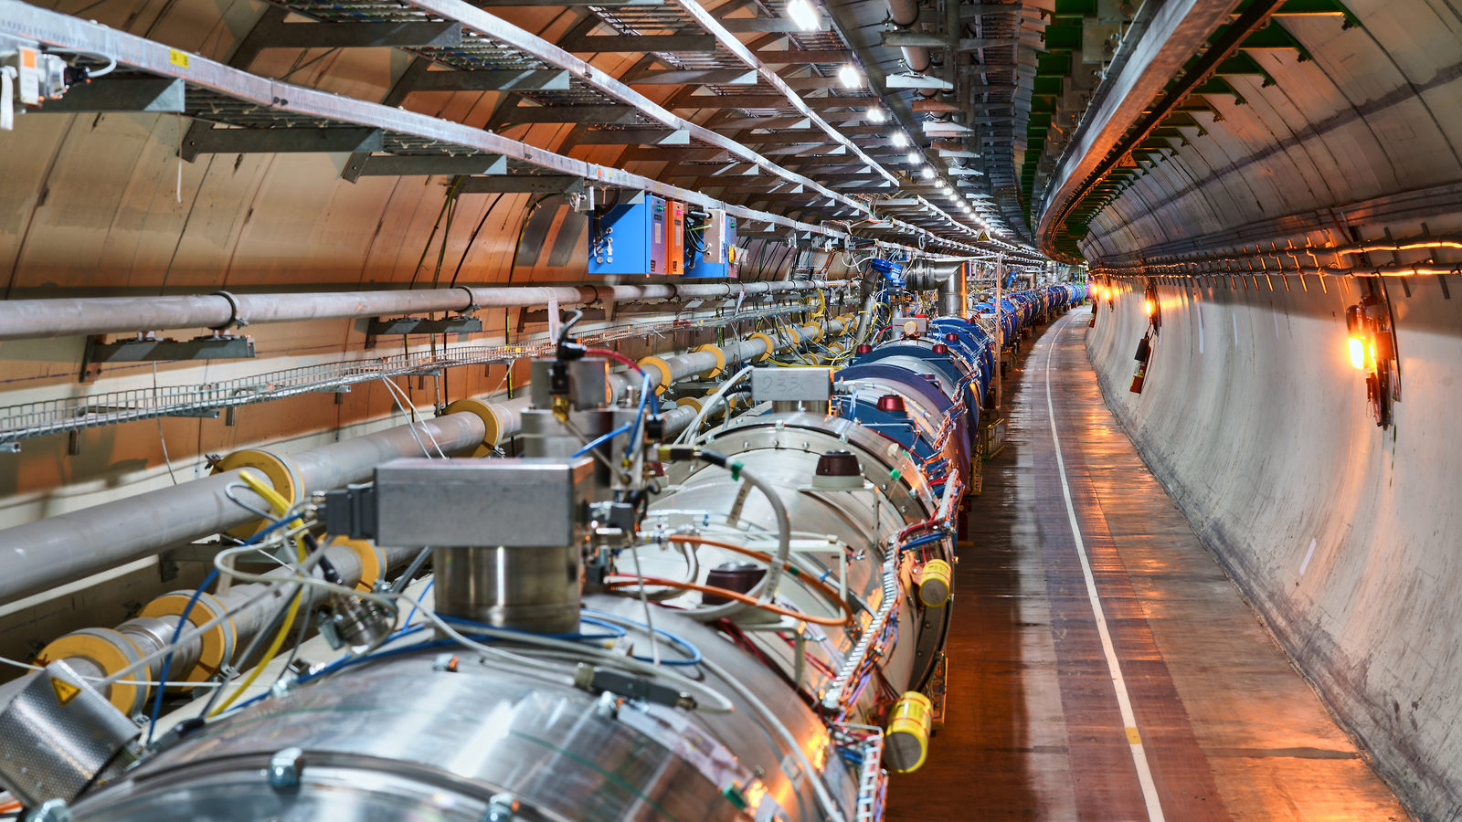
LHC: Status and Perspective

Slide 2
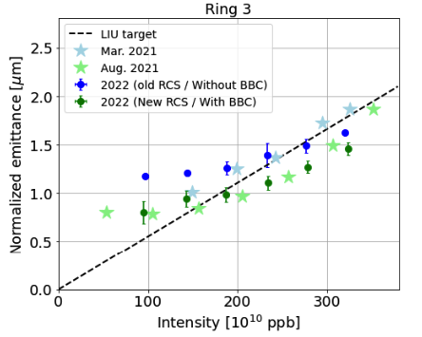
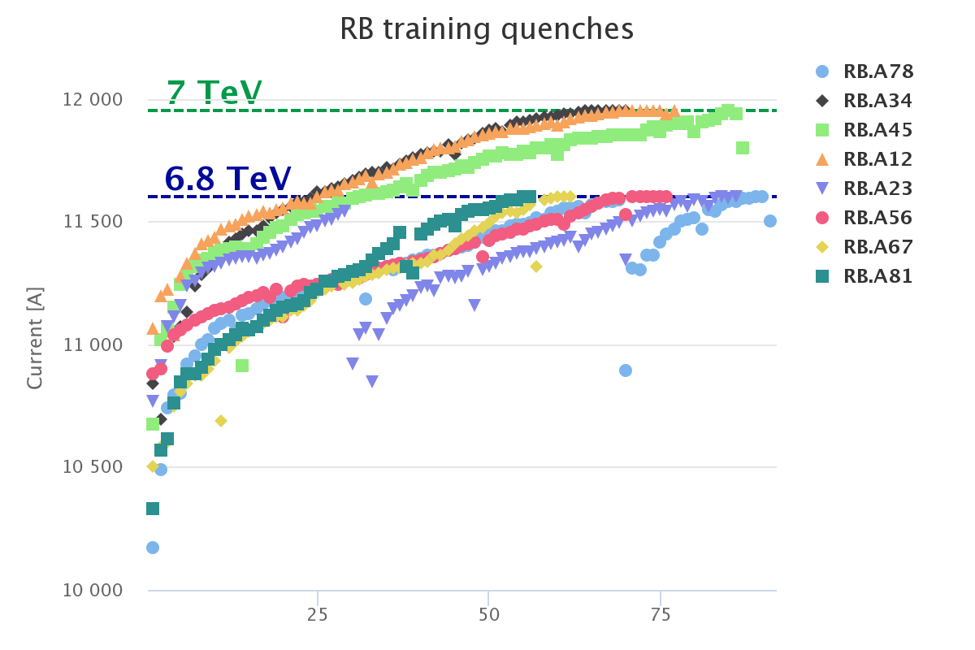
Recall
Injector complex started again in 2021 following deployment of the LHC Injectors Upgrade in LS2. Excellent progress since in achieving the HL-LHC beam characteristics.
LHC in 2021 - hardware commissioning and a long dipole magnet training campaign opening the way to operation at 6.8 TeV (via 3 sector WU-CDs).
Booster
“Beam Size”
Protons per bunch

Slide 3
2022 – Q2
Started Beam Commissioning Friday 22 April
Week’s stop for LHCb VELO side A installation mid-May
1st June
T₀
1st May
Re-commissioning with beam

Slide 4
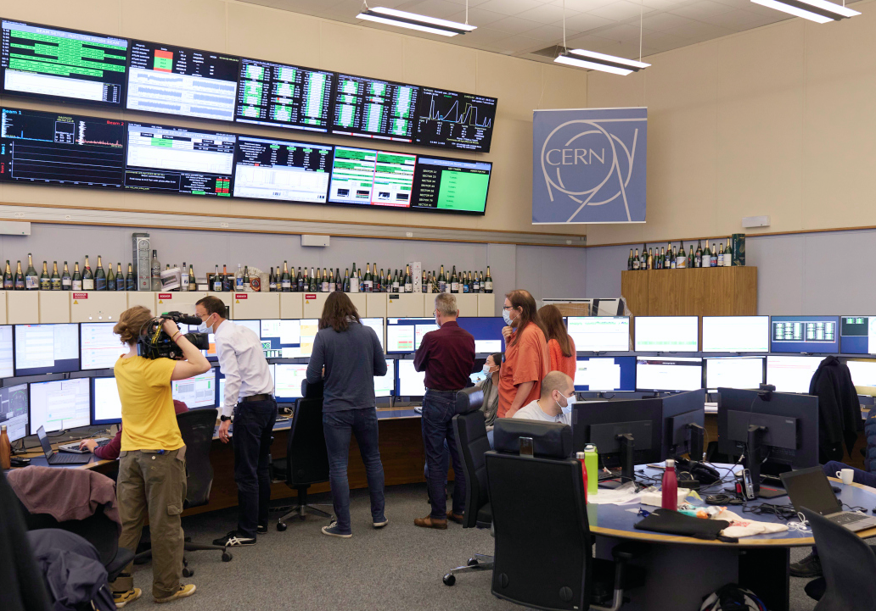
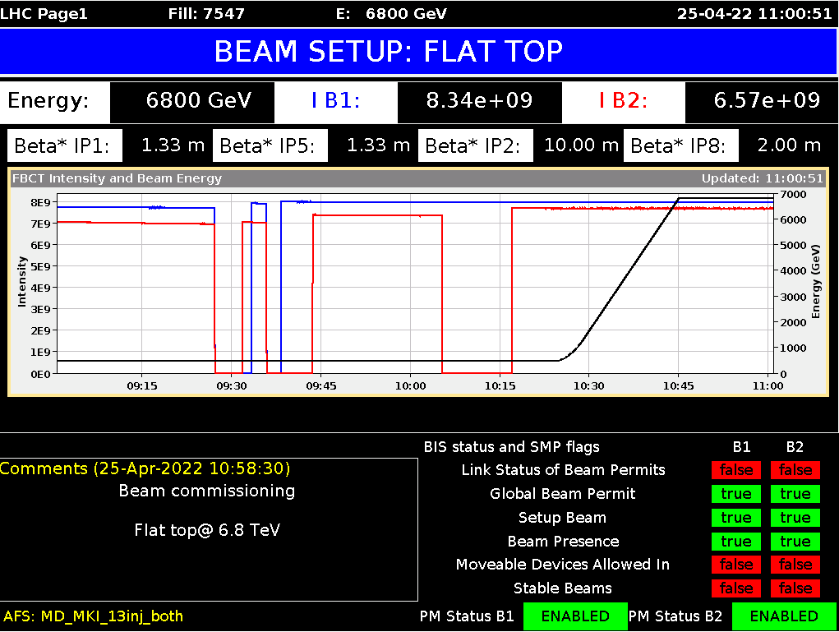
25th April - First beams at 6.8 TeV
T₀ + 3 days
No big deal on the day but on the back of a long training and powering test campaign

Slide 5
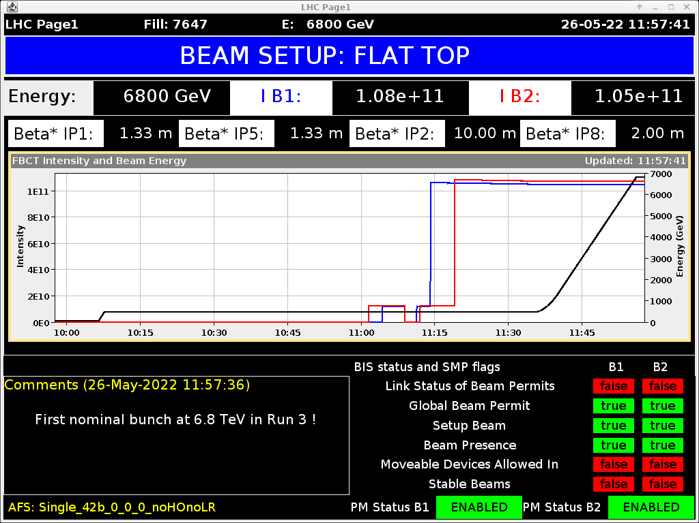
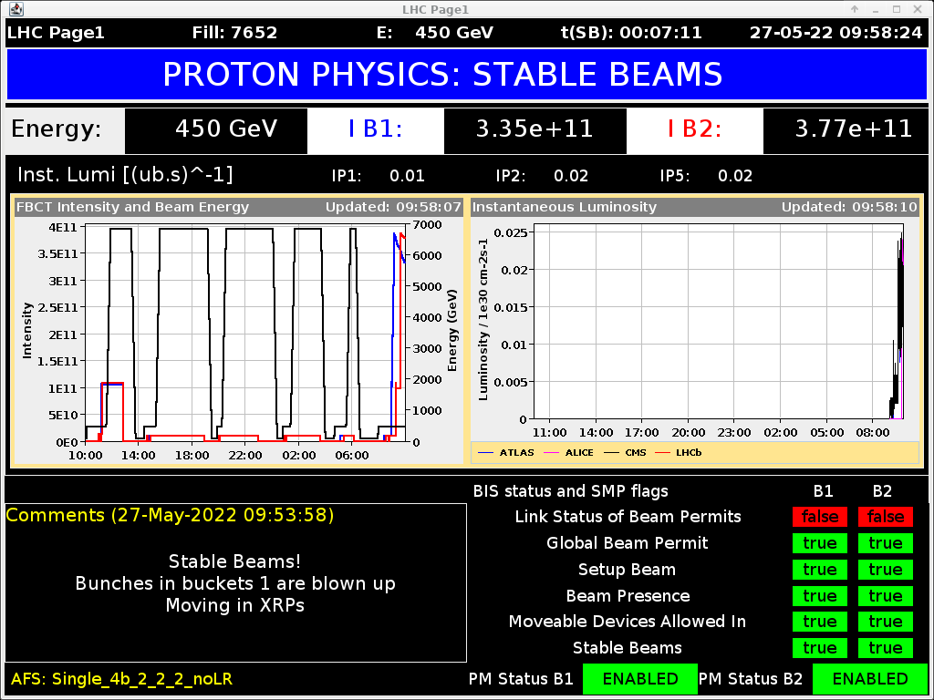
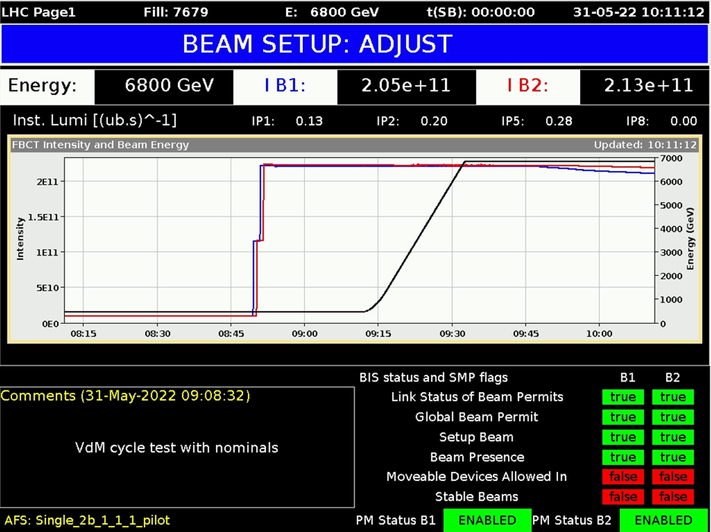
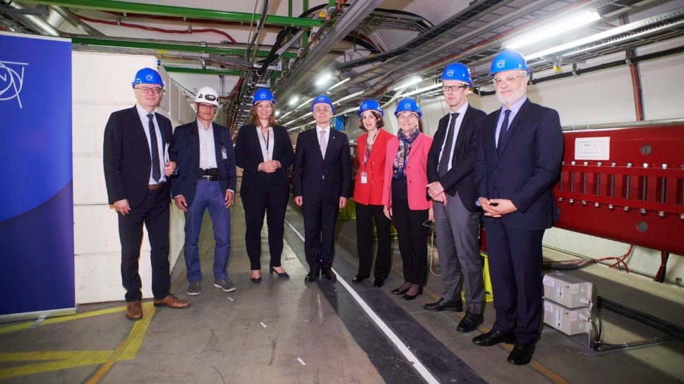
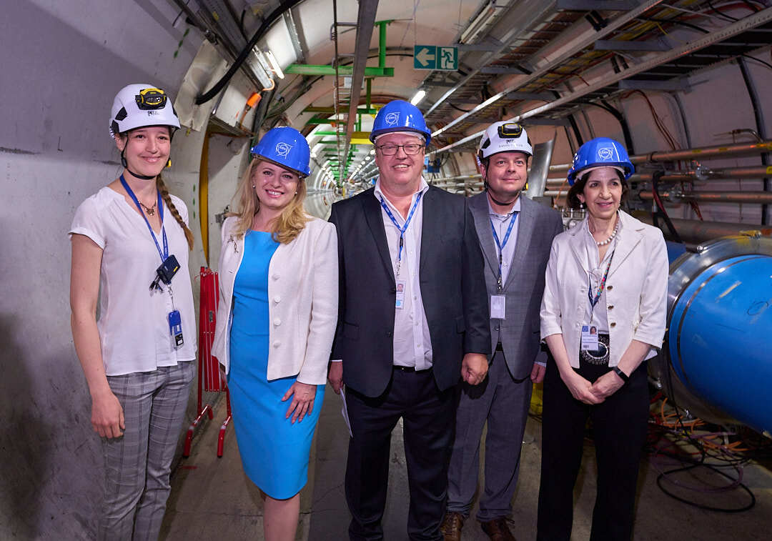
Commissioning progress
First nominal intensity bunches at 6.8 TeV
Stable beams at 900 GeV
T₀ + 35 days
T₀ + 36 days
President of the Swiss Confederation
President of Slovakia
First collisions at 6.8 TeV
T₀ + 40 days

Slide 6
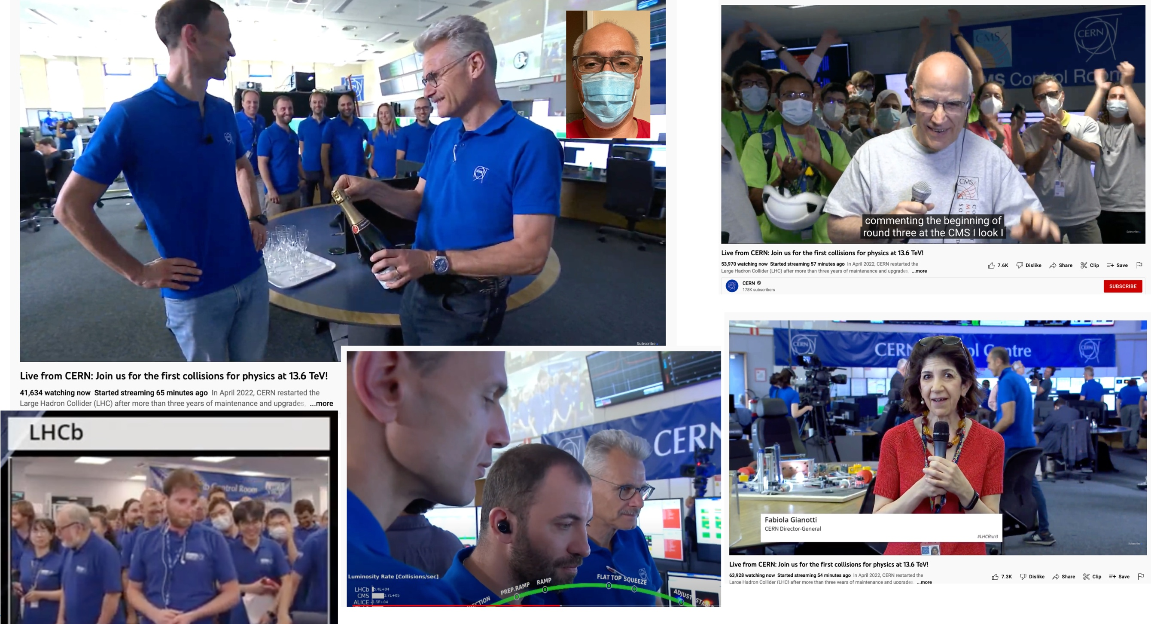
First Stable Beams at 13.6 TeV – 5th July

Slide 7
β* (and crossing-angle) levelling
Beam commissioning has made impressive progress, huge amount of experience, tools, instrumentation and accelerator systems in good shape
Typified by deployment of beta* levelling – reduction of beam size at interaction point via adjustments of optics across an interaction region – during Stable Beams…

Slide 8
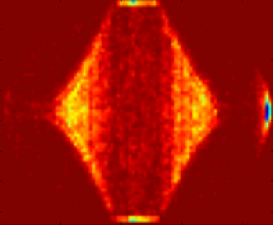
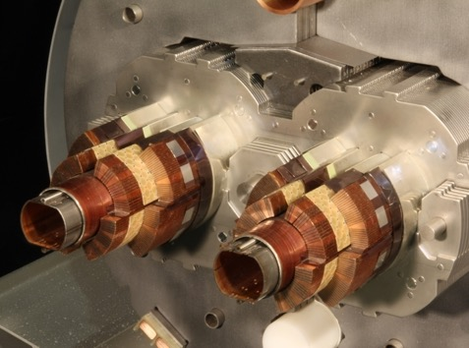
Electron Cloud
The LHC suffers from electron cloud
Degradation of beam quality
Power deposition on the arc beam screens
Heat load in the cryogenic magnets
Fill 4485 (Oct 2015)
25 ns, 1825b, 72b-trains, 1.15e11 p/bunch
Average per half cell
Beam screens

Slide 9
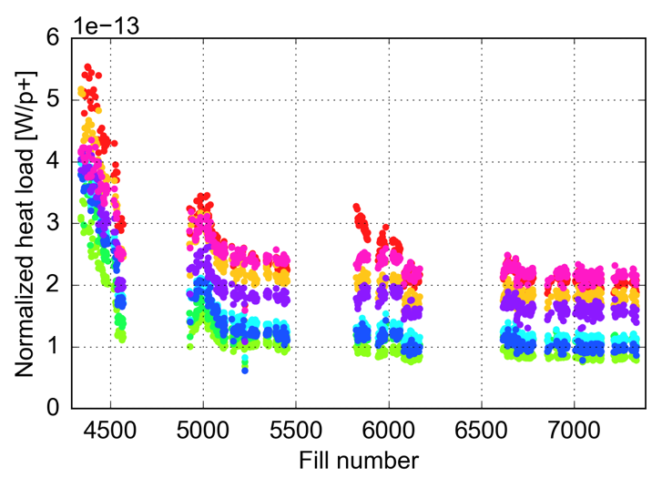
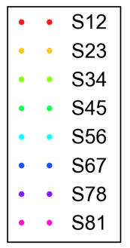
Conditioning through scrubbing
Beam-induced scrubbing is able to mitigate electron cloud to a large extent
A strong reduction of the arc heat loads was observed in 2015 and the first part of 2016
Allowed a satisfactory exploitation of 25 ns beams for physics
25 ns physics fills with >600b
2015
2016
2017
2018

Slide 10
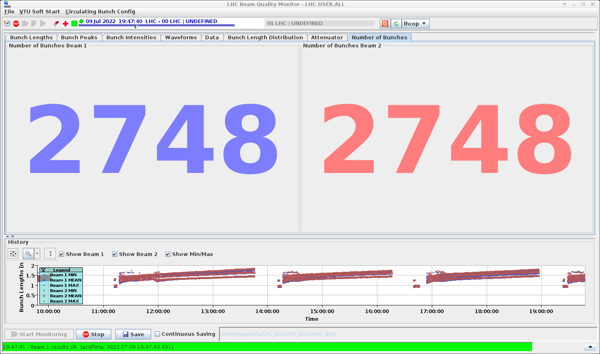
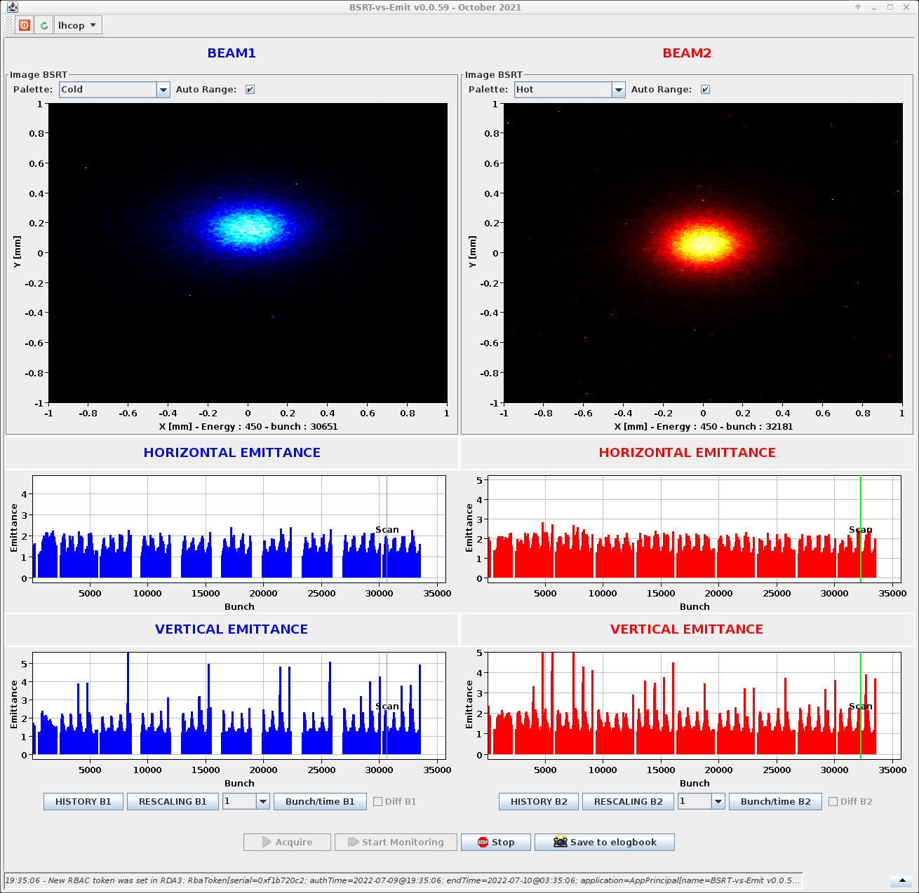
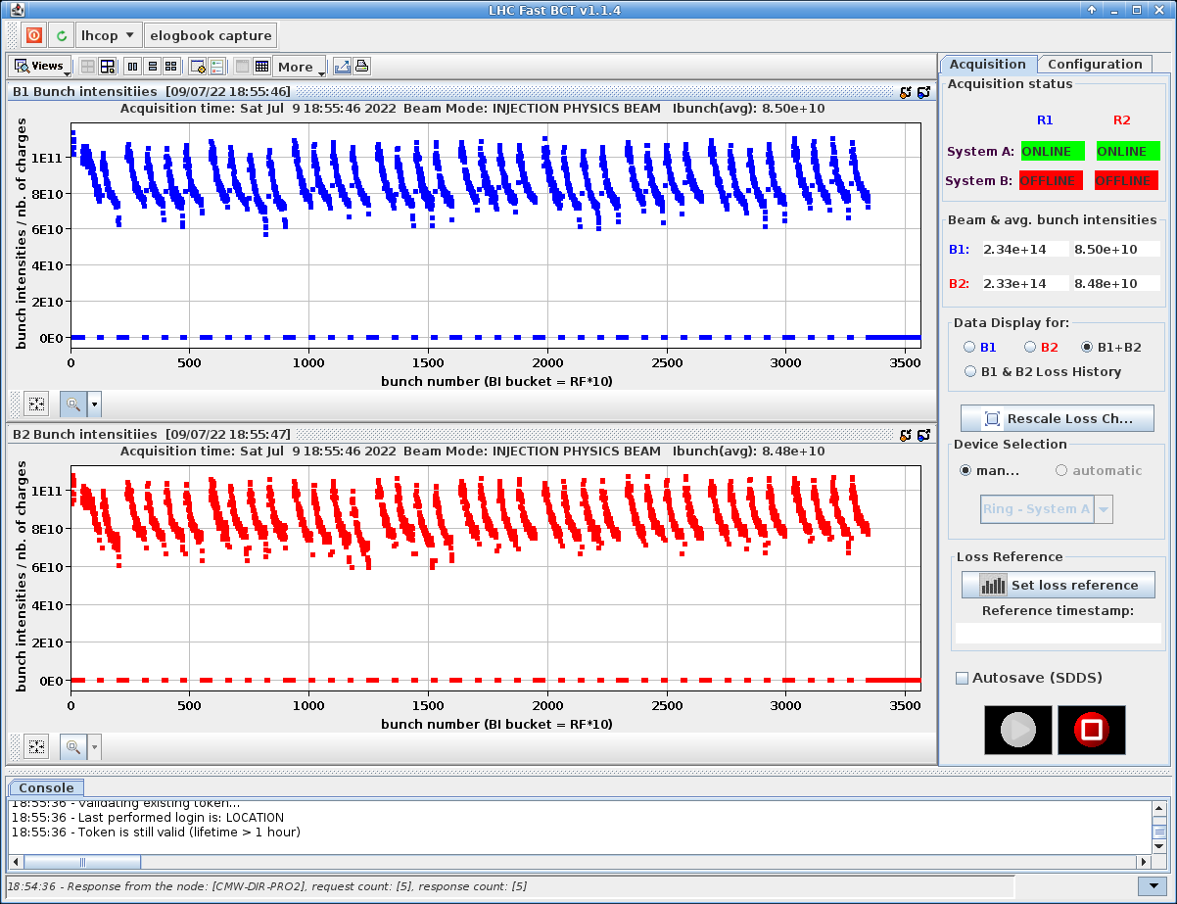
Scrubbing – KPIs
Last Saturday evening

Slide 11
Coming weeks/Q3 2022
Entering a mixed phase of operation (intensity ramp up), scrubbing (2-3 slots) and some left-over commissioning activities
On track to reach 1200 bunches by end of July, thereafter up to 2748 bunches in quanta of ~300 bunches - dictated by machine protection considerations
Today
75b
3-12b
300b

Slide 12
2022 – Q4
p-p
Pb-Pb
End 25 ns proton run: 08:00 3rd November
End of Run: 06:00 12th December

Slide 13
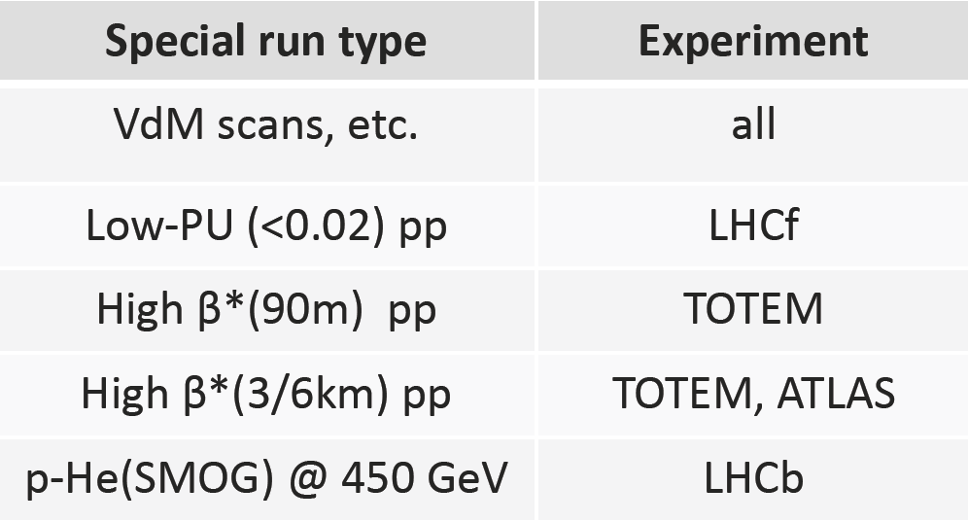
Run 3
Proton-proton
6.8 TeV
Levelled to a maximum luminosity 2.05 × 10³⁴ cm⁻²s⁻¹ in ATLAS and CMS
Levelled to a target of ~1.4 × 10³¹ cm⁻²s⁻¹ and 2 × 10³³ cm⁻²s⁻¹ in ALICE and LHCb respectively
~1.8×10¹¹ protons/bunch in 2023 – 2025 - long levelling times!
Mode | ATLAS/CMS | LHCb | ALICE
proton-proton | 250 - 270 fb⁻¹ | 25 – 30 fb⁻¹ | 200 pb⁻¹
lead-lead | 7 nb⁻¹ | 1 nb⁻¹ | 7 nb⁻¹
proton-lead | 0.5 pb⁻¹ | 0.1 pb⁻¹ | 0.25 pb⁻¹
oxygen-oxygen | 0.5 nb⁻¹ | 0.5 nb⁻¹ | 0.5 nb⁻¹
proton-oxygen | LHCf 1.5 nb⁻¹ | 2.0 nb⁻¹

Slide 15
HL-LHC - goals
Prepare machine for operation beyond 2025 and up to ~2040
Operation scenarios for:
Total integrated luminosity of 3000 fb⁻¹ in around 10-12 years
An integrated luminosity of ~250 fb⁻¹ per year
Nominal: levelled luminosity of 5 x 10³⁴ cm⁻²s⁻¹ (events/crossing ~130)
Ultimate: levelled luminosity of 7.5 x10³⁴ cm⁻²s⁻¹ (events/crossing ~200)

Slide 16
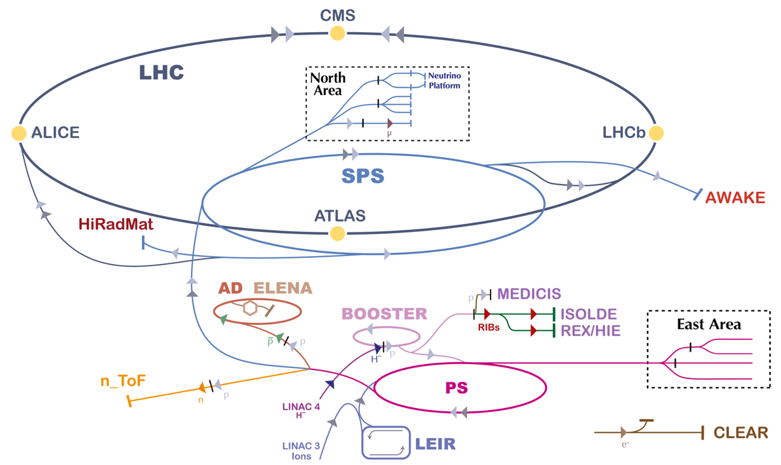
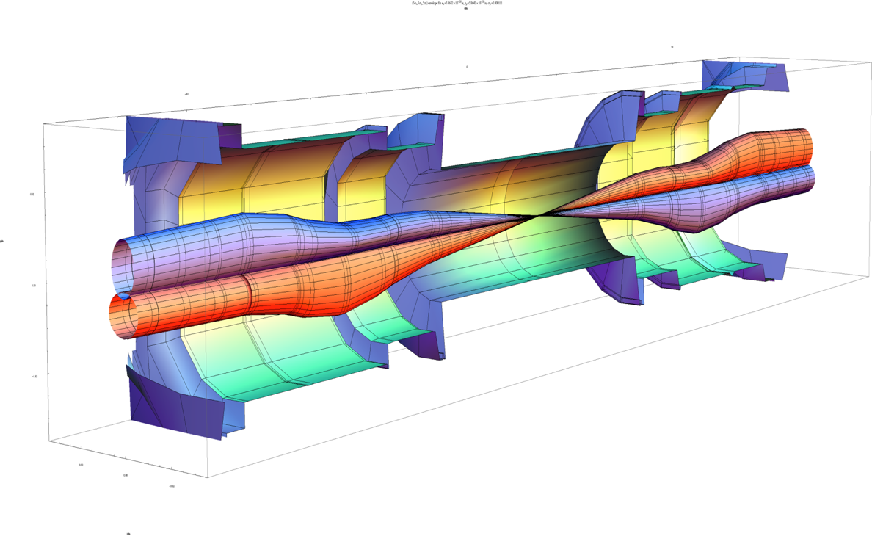
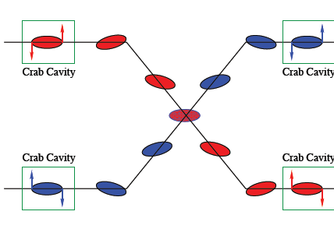
Interaction region upgrade (beta*)
Injector upgrade (bunch population, emittance)
Crossing angle compensation (crabs)
Operate in a high luminosity regime

Slide 17
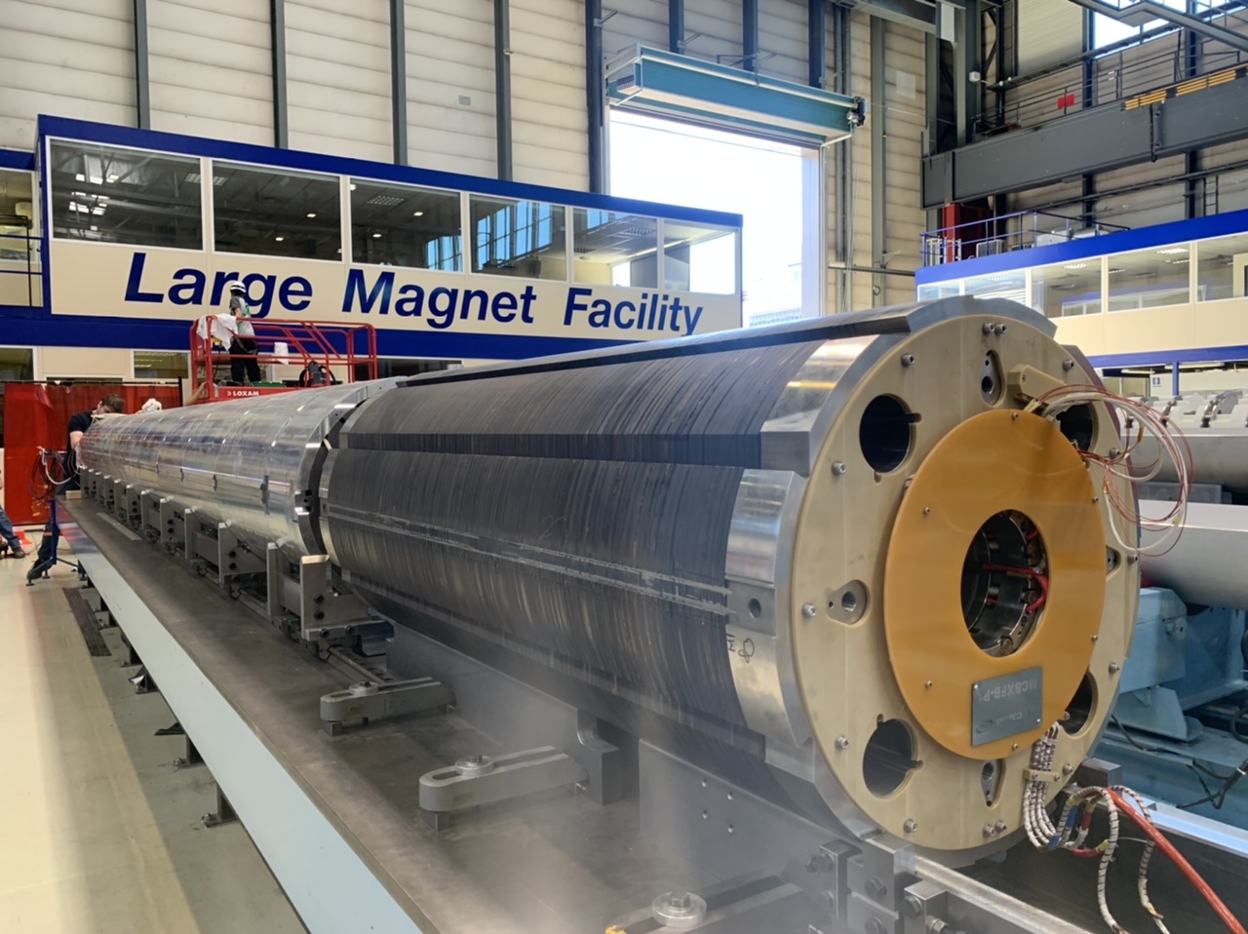
June 2022: MQXFBP2 (Q2) and corrector MCBXFBP1 on the alignment bench

Slide 18
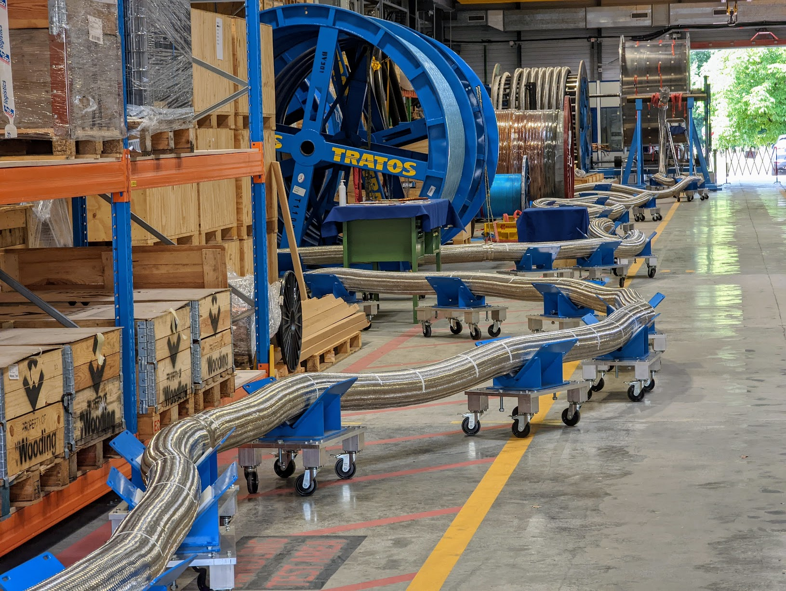

Slide 19
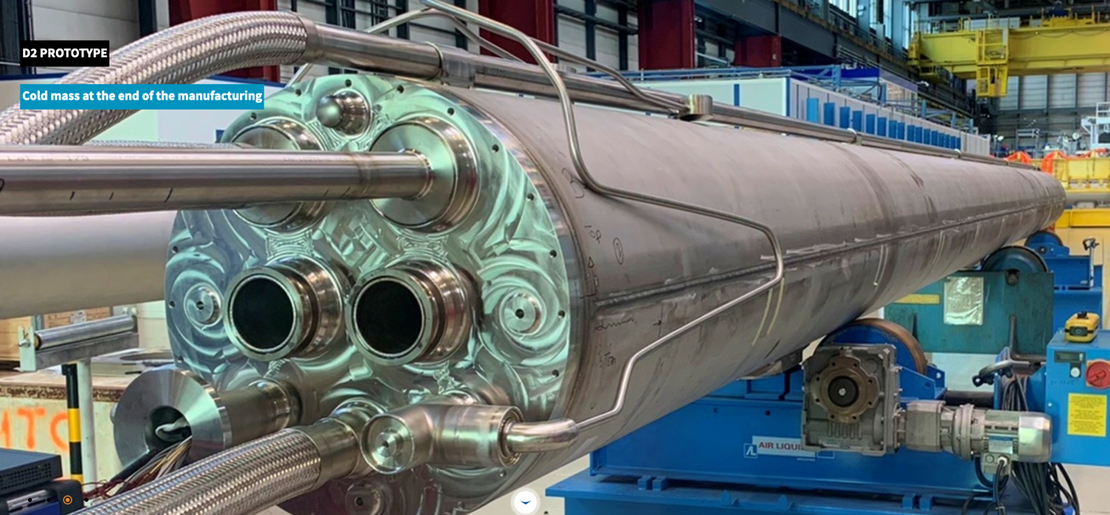
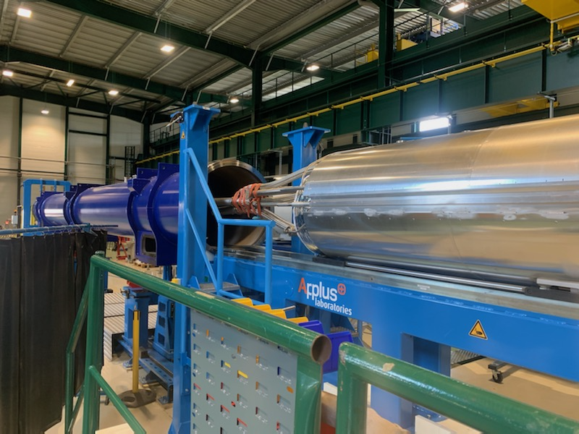
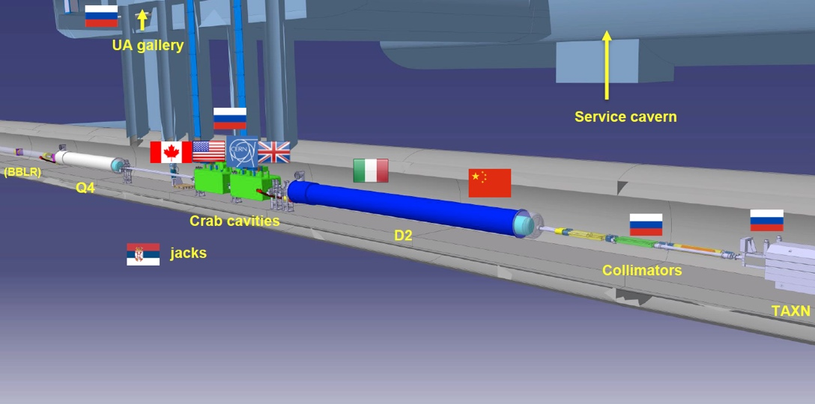
Separation/re-combination dipole (D2 - INFN) cold mass assembly – Large Magnet Facility

Slide 20
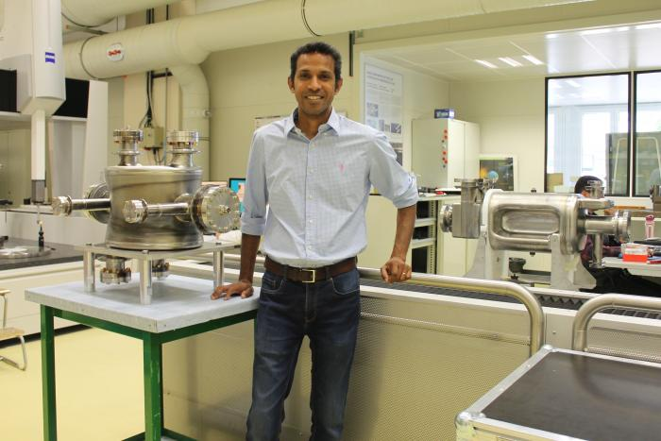

Slide 21
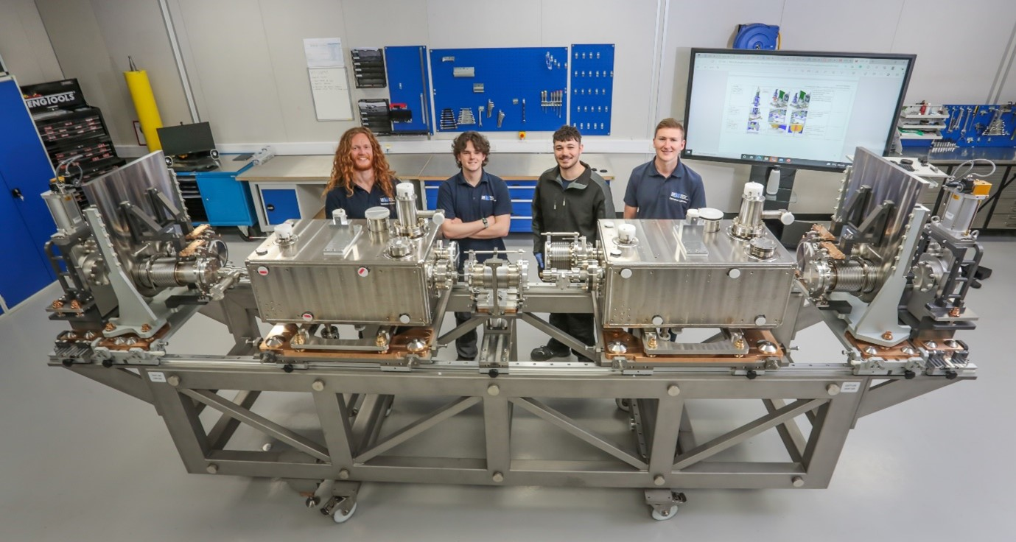
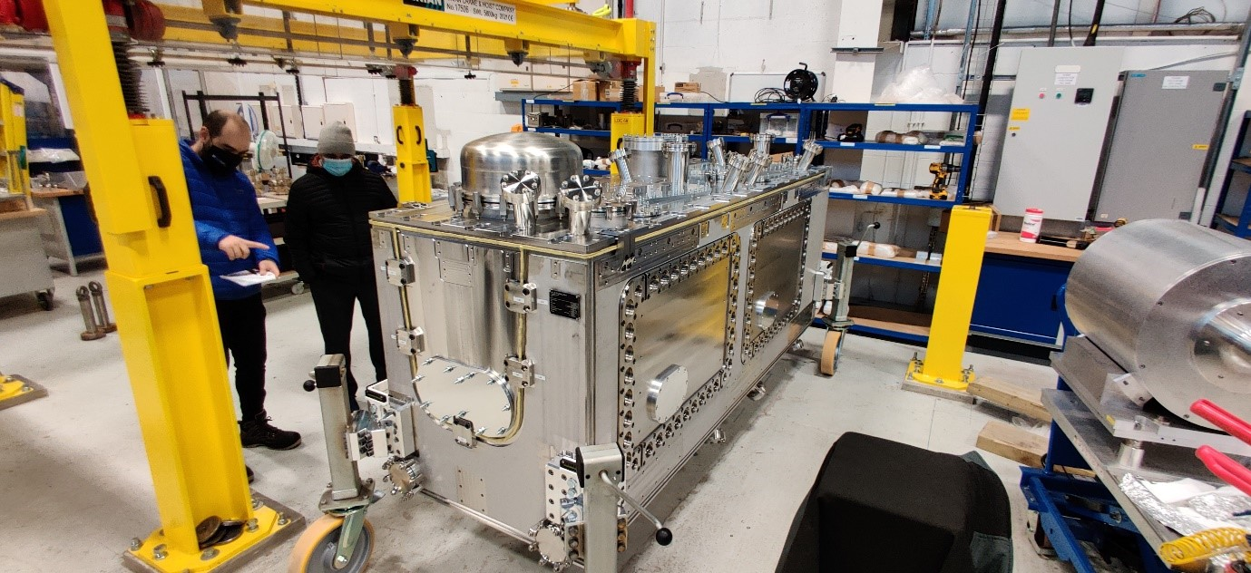
RFD Crab Cavities to UK, cryostating ongoing
Outer Vacuum Chamber for the Cryomodule adjacent to the bespoke Cavity String Lifting Device
STFC-DL technicians adjacent to the Cavity String prior to cleanroom assembly

Slide 22
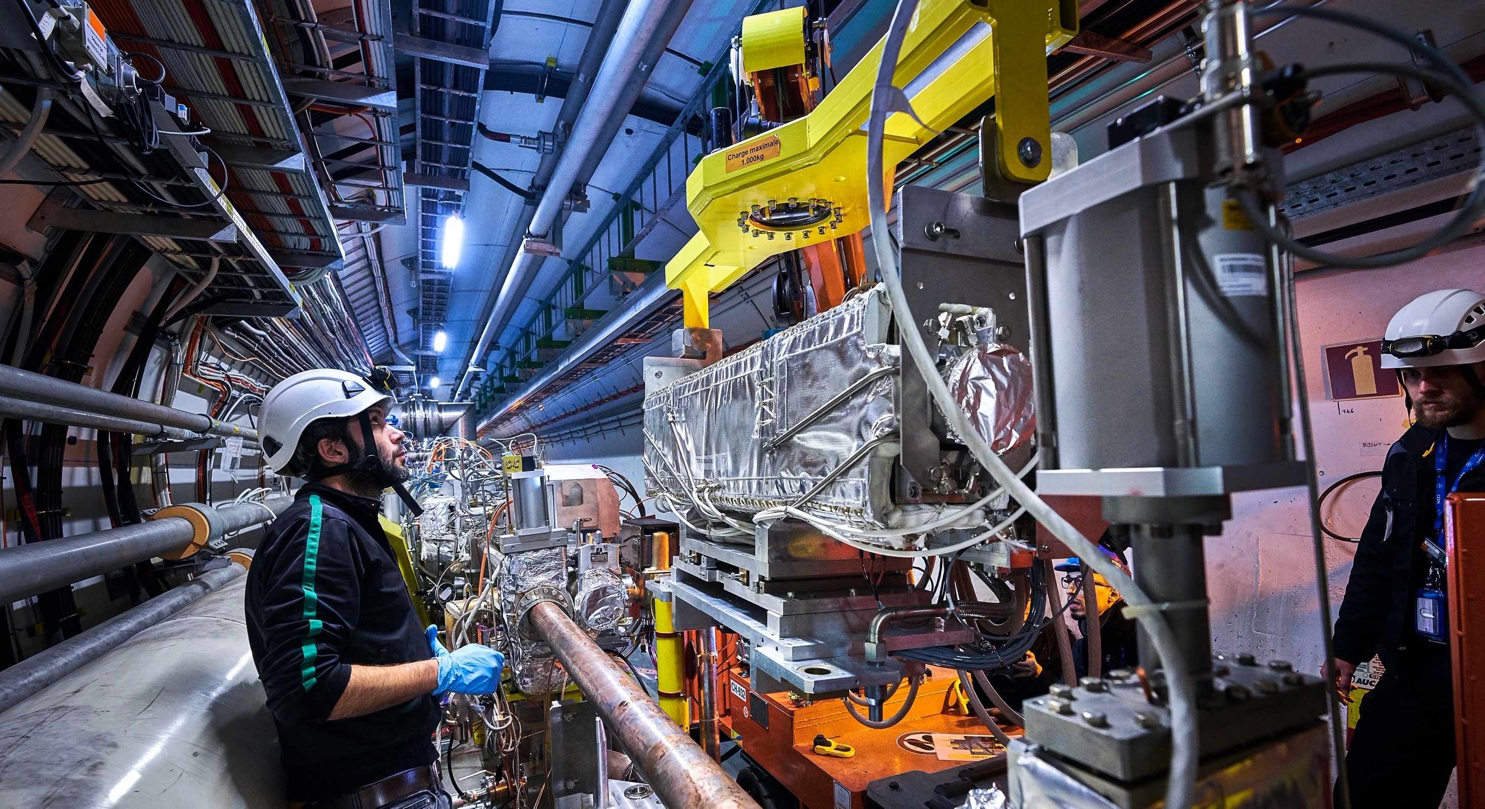

Slide 23
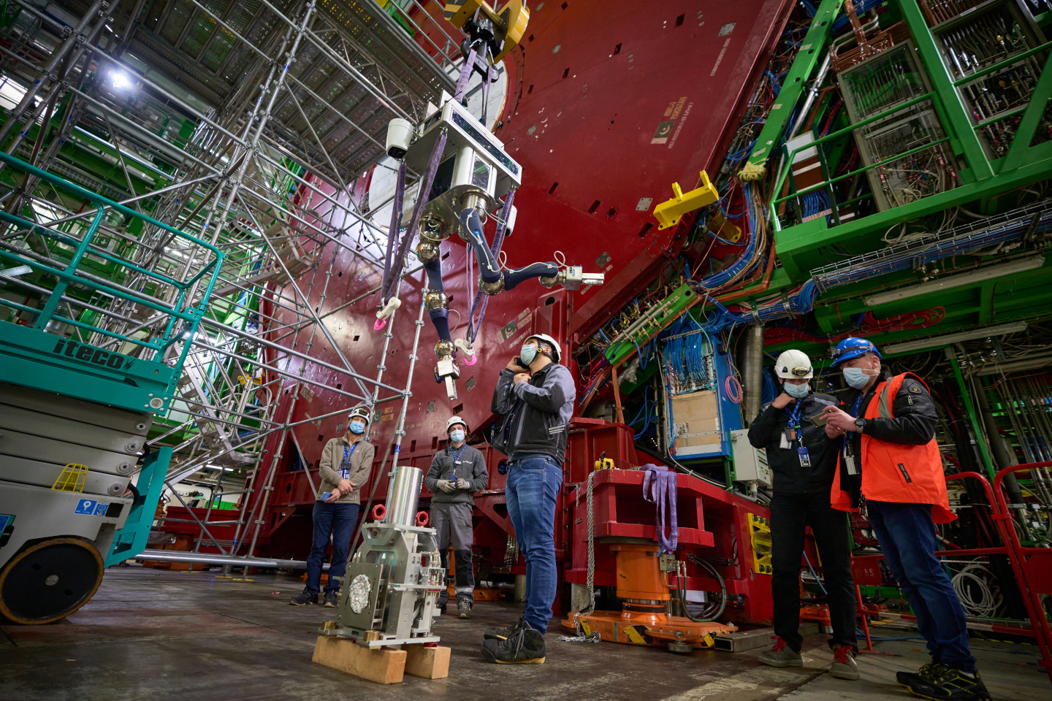
CRANEbot will handle a VAX module without the need for human intervention.

Slide 24
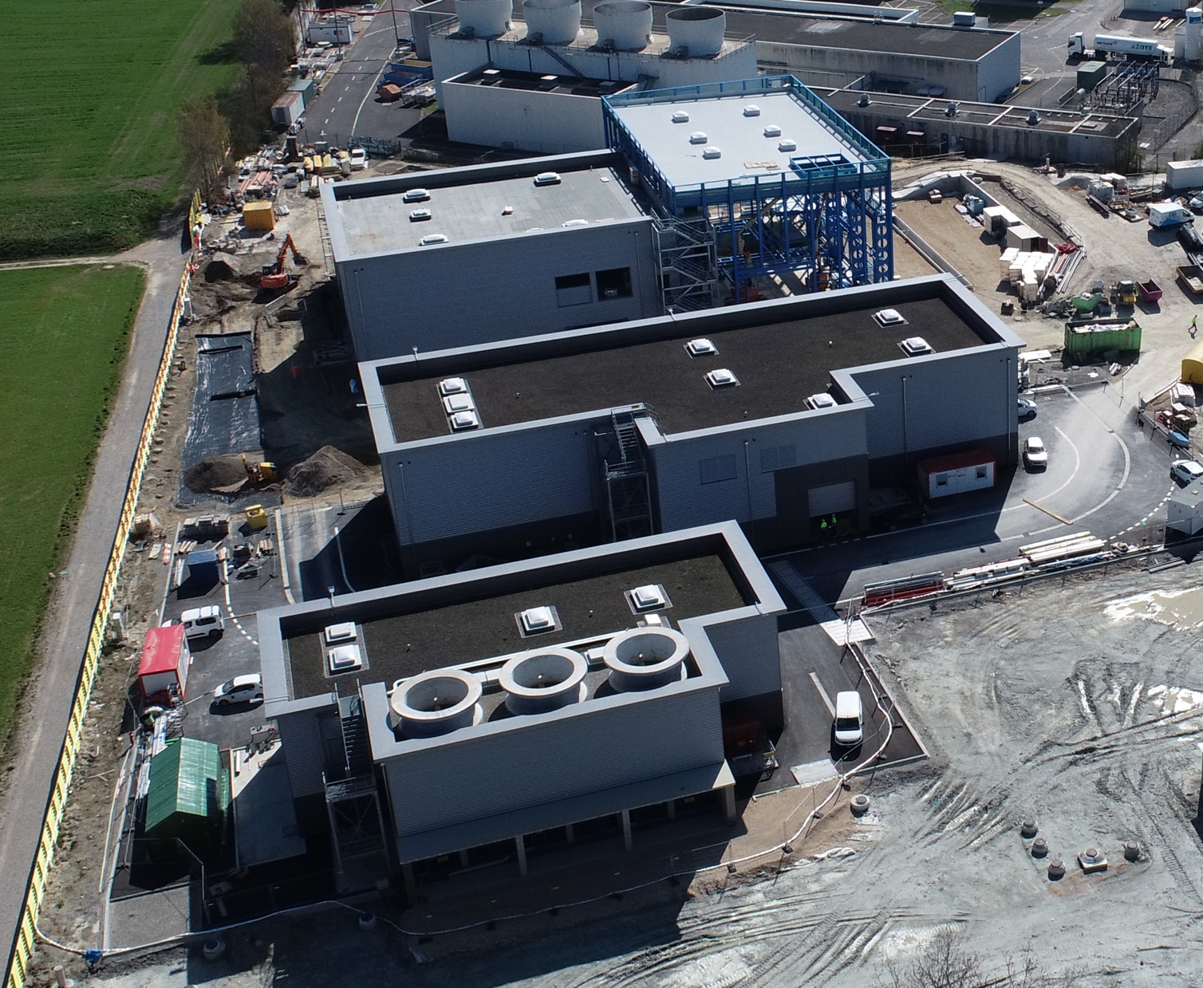
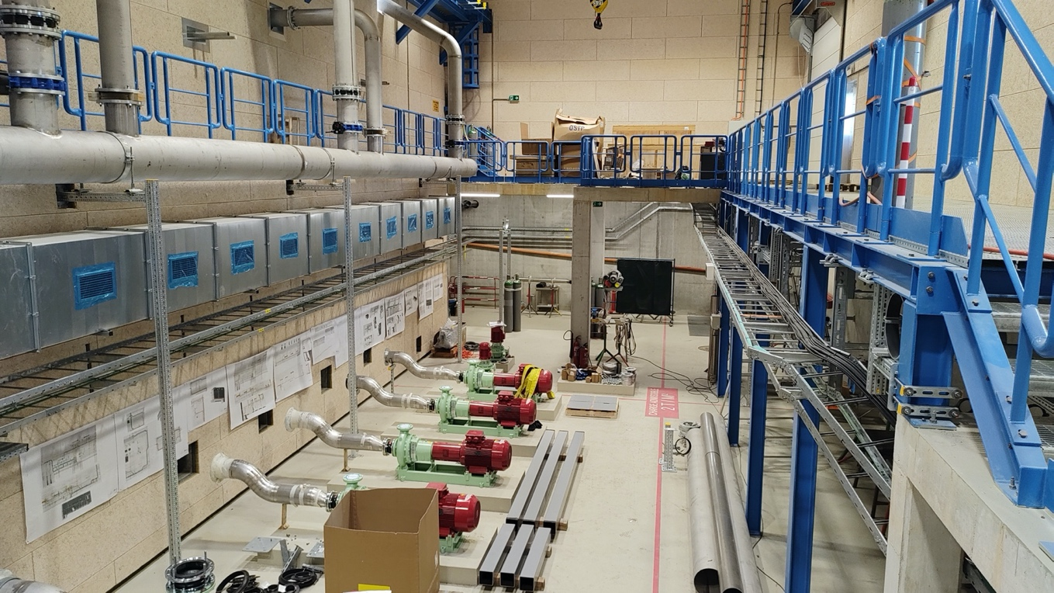
Point 1 surface buildings
SD17
SU17
SF17
SHM17
SF17

Slide 25
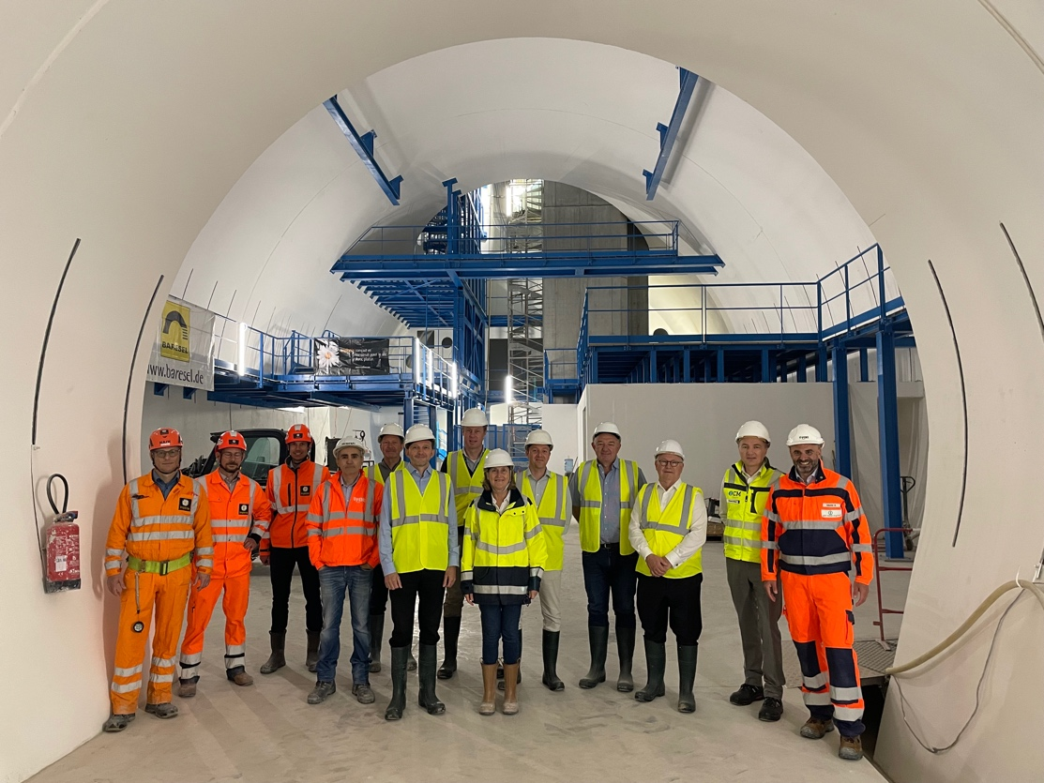
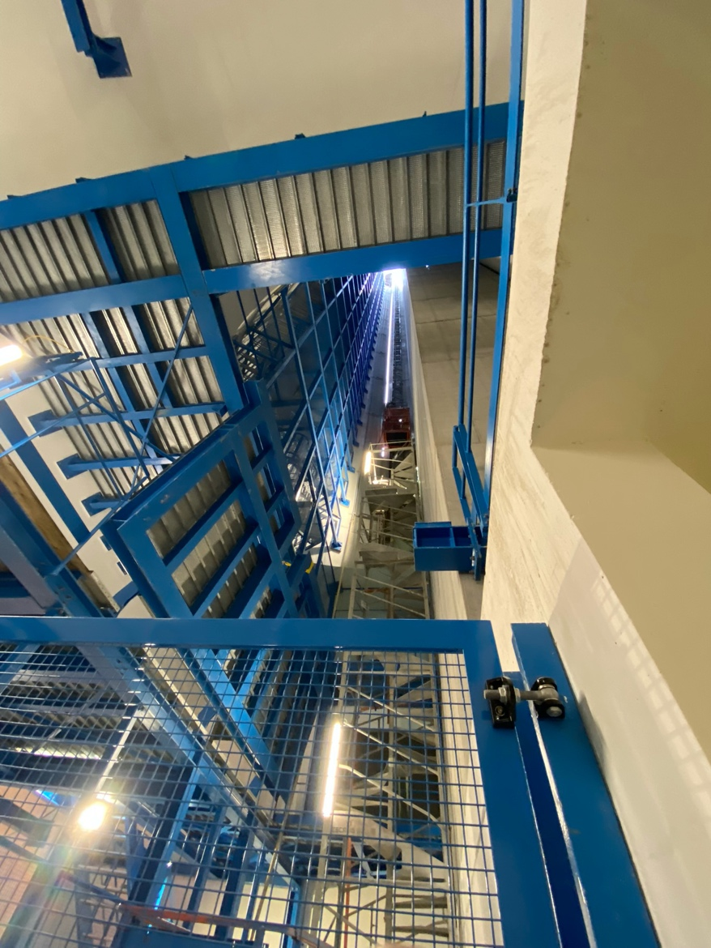
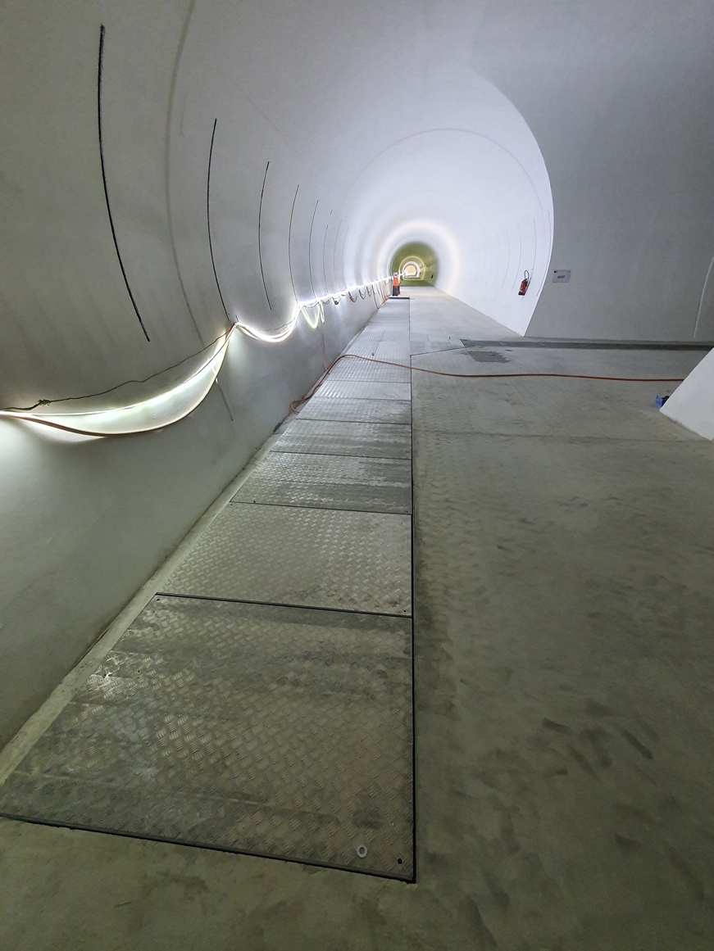
Underground works at P5
US57 cavern
UR55 gallery
PM57 shaft

Slide 26
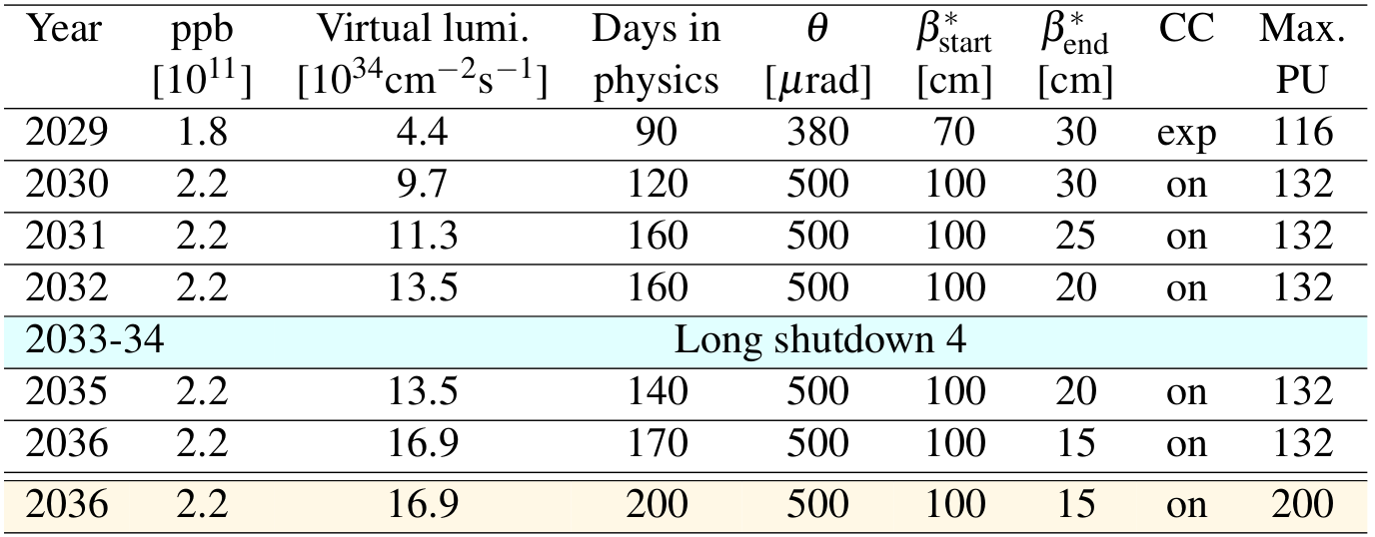
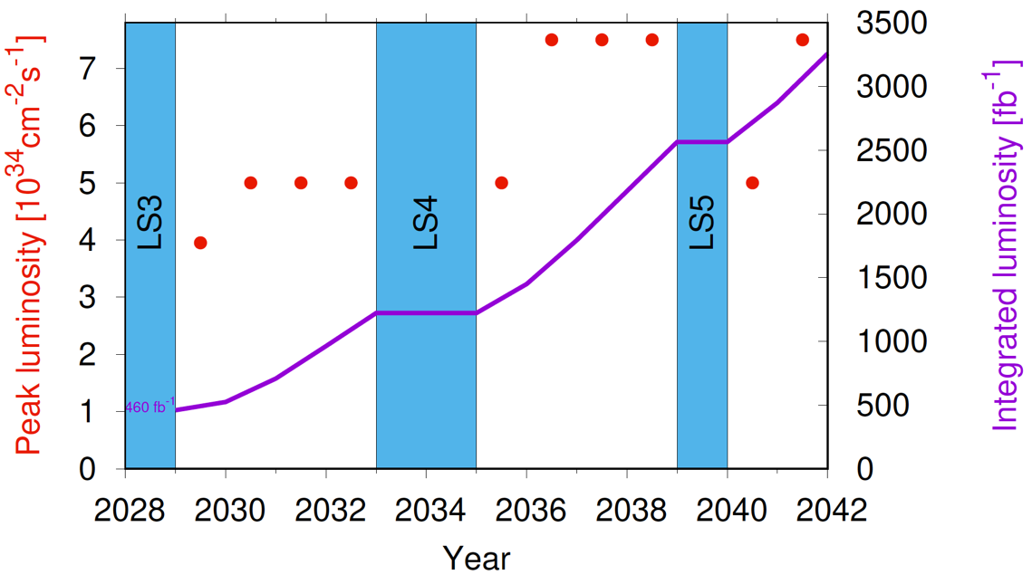
Then another miracle happens…

Slide 27
Conclusions
LHC Injectors Upgrade
Successful deployment in LS2, essential for what follows
Run 3
Commissioning has gone well, now into intensity ramp-up
Subsequent high intensity operations will not be without its challenges
Diverse programme incoming
HL-LHC
Paving the way from Run 3 to Ultimate performance
Completion of prototypes and start of series production for many components – interesting times!
Acknowledgements and huge thanks to everyone in the accelerator sector, our colleagues from across the organization, and our international collaborators.

Slide 28
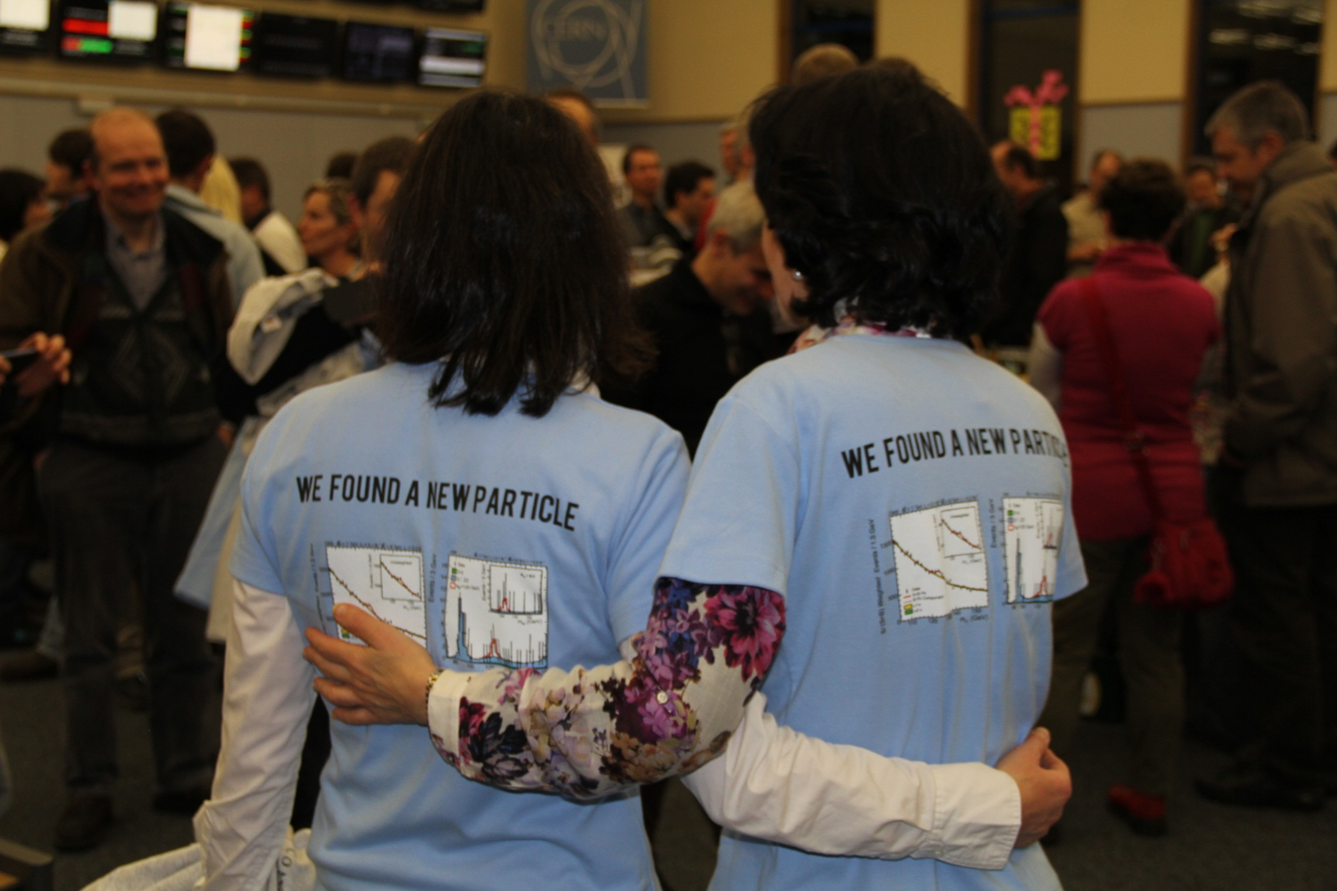

Slide 29
Backup

Slide 30
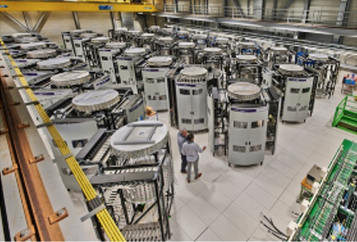
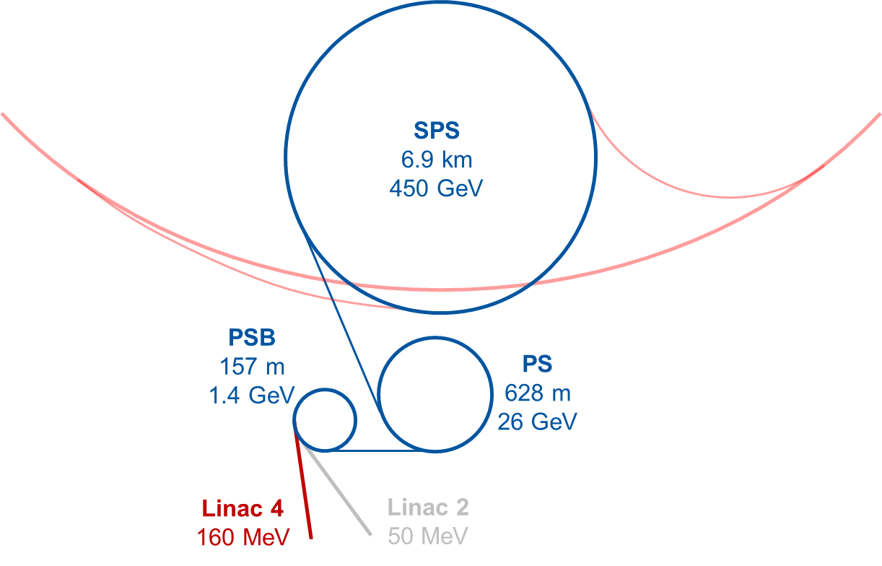
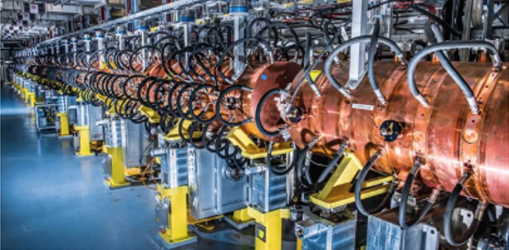
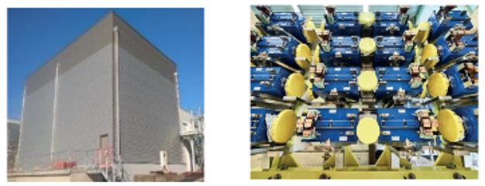
LHC Injectors Upgrade
SPS
RF system upgrade → solid state power amplifiers
Impedance mitigation
Robust beam dump and protection devices
Deployed in LS2 (2019-20)
Linac 4
H- ions at a higher energy of 160 MeV
PSB
charge exchange injection at 160 MeV, reduced space charge → improved brightness
Top energy: 1.4 GeV to 2 GeV
New main power supply
New RF systems

Slide 31
Unidentified Falling Objects (UFOs)

Slide 32
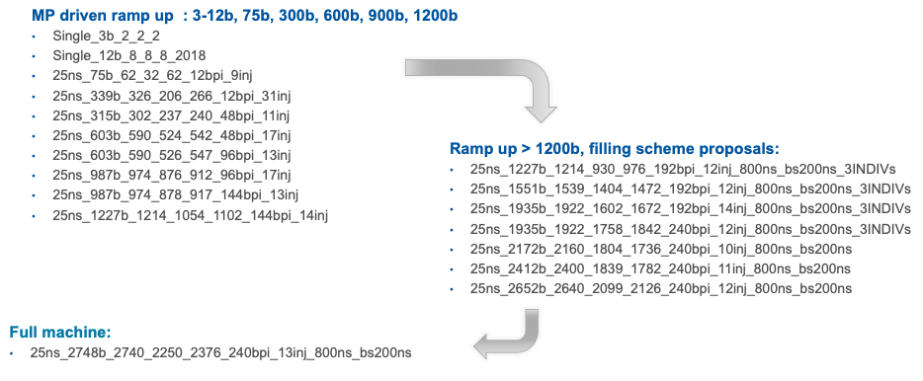
Intensity ramp up: filling schemes
plus a couple of low pile-up fills

Slide 33
HL-LHC: key nominal 25 ns parameters (GPDs)
Beam energy | 7 TeV
Protons per bunch | 2.2 x 10¹¹
Number of bunches | 2760
Normalized emittance | 2.5 $μ$m
Beta* | 15 cm
Crossing angle | 500 $μ$rad
Geometric reduction factor (F) | 0.342
“Virtual” luminosity (with crabs) | 1.7 x 10³⁵ cm⁻²s⁻¹
Levelled luminosity | 5 x 10³⁴ cm⁻²s⁻¹
Levelled <pile-up> | ~130

Slide 34
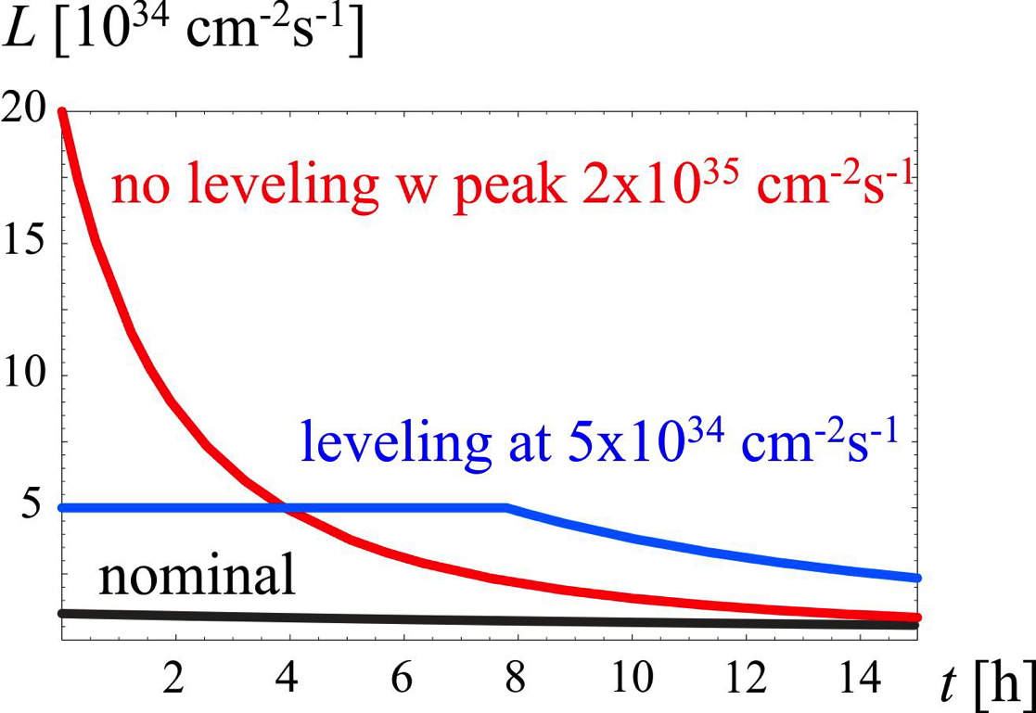
HL-LHC Operational scenario
No levelling - peak ~2 x 10³⁵ cm⁻²s⁻¹
Levelling at 5 x 10³⁴ cm⁻²s⁻¹
Nominal levelling time ~7 hours

