Slide 1
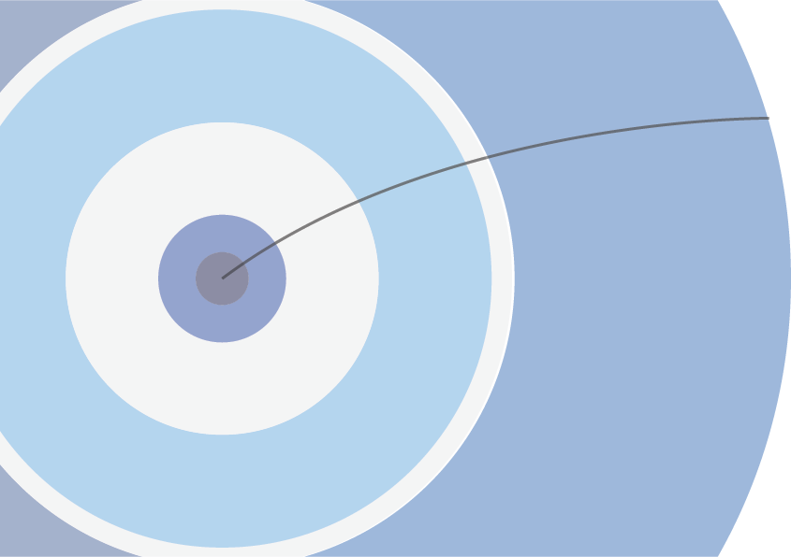
ATLAS Printables
Colouring Books, Activity Sheets, Fact Sheets, Cheat Sheets
ICHEP 2022, Bologna
8 July, 2022
Valerie Buxbaum (California State University)
on behalf of the ATLAS Collaboration

Slide 2
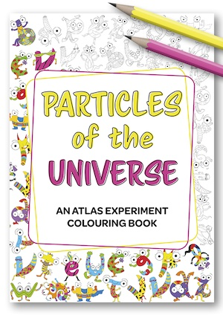
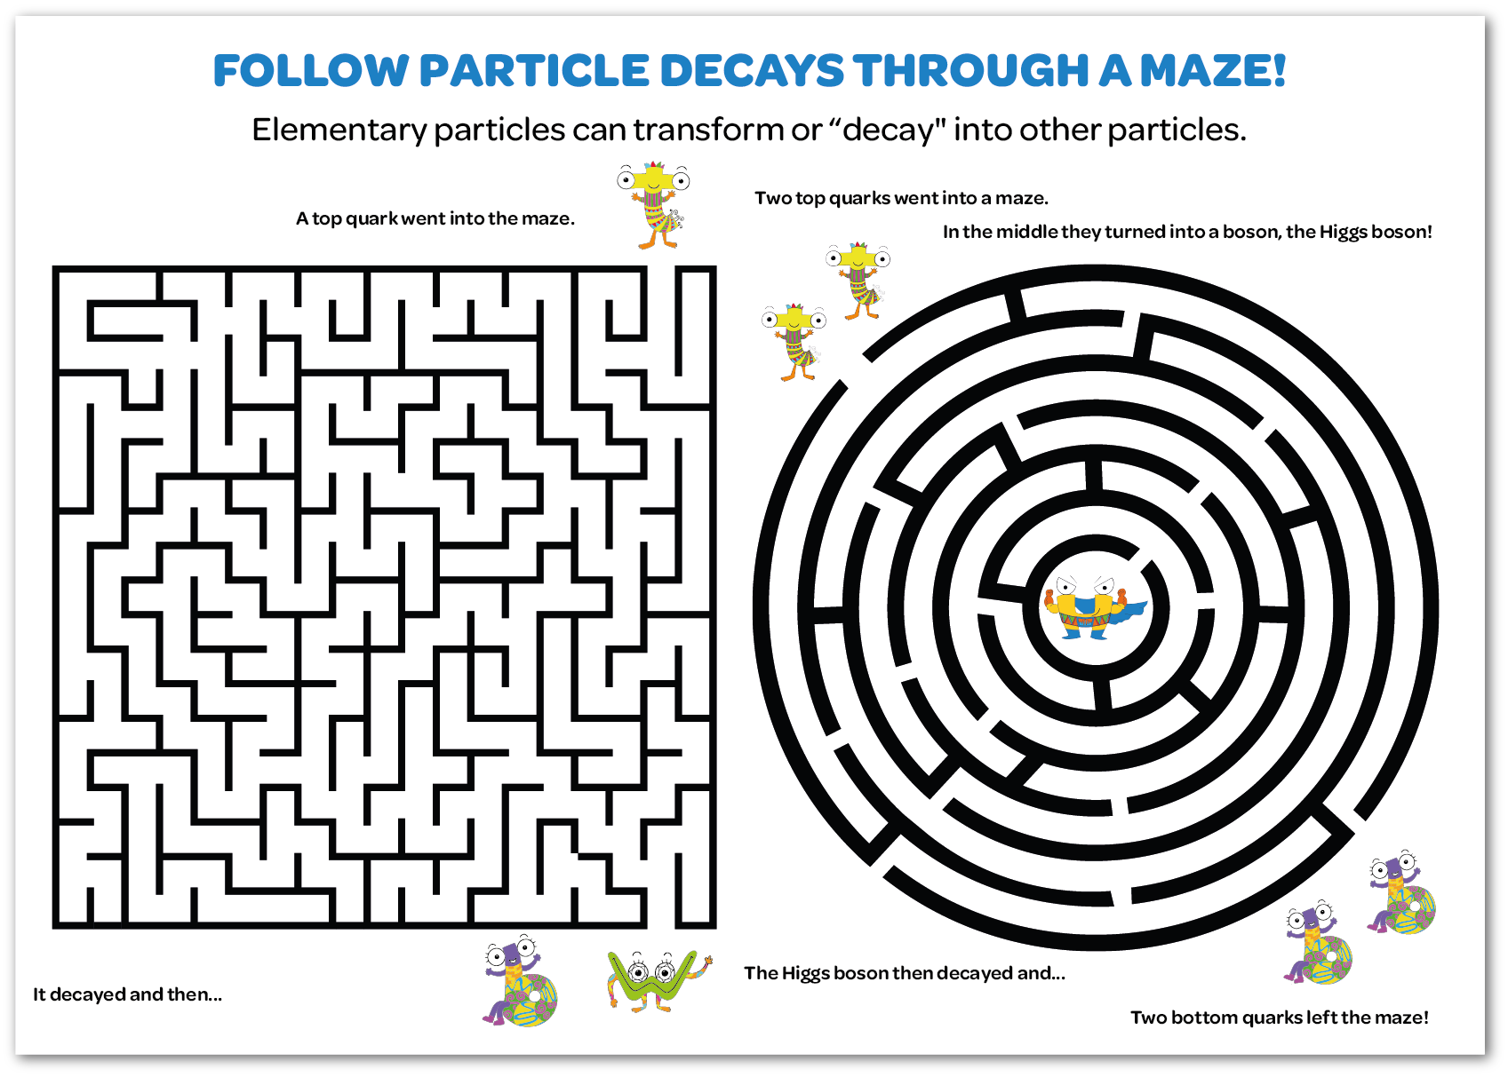
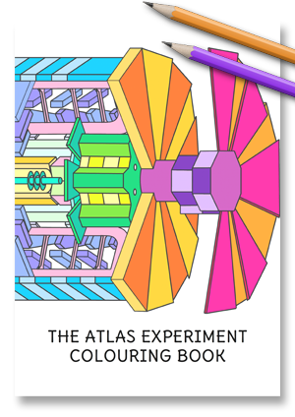
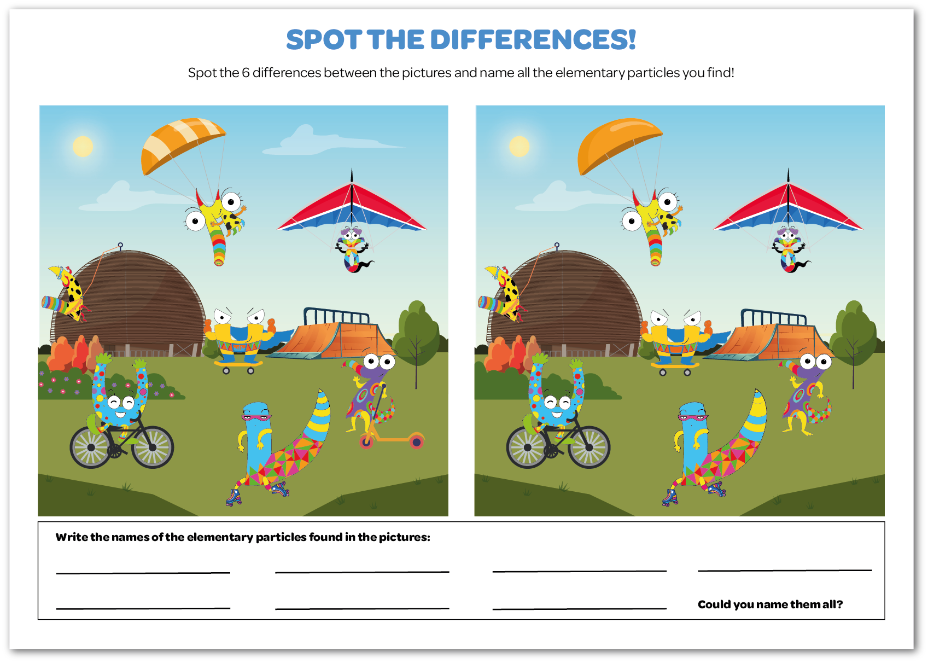
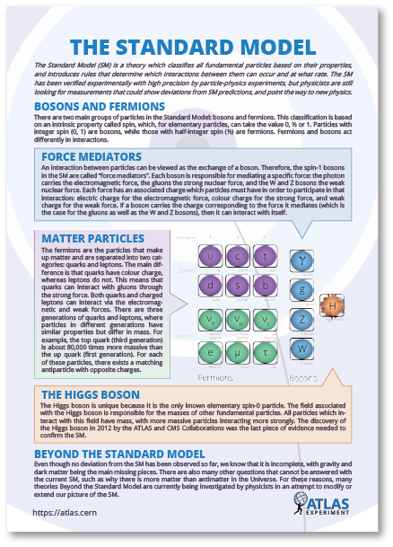
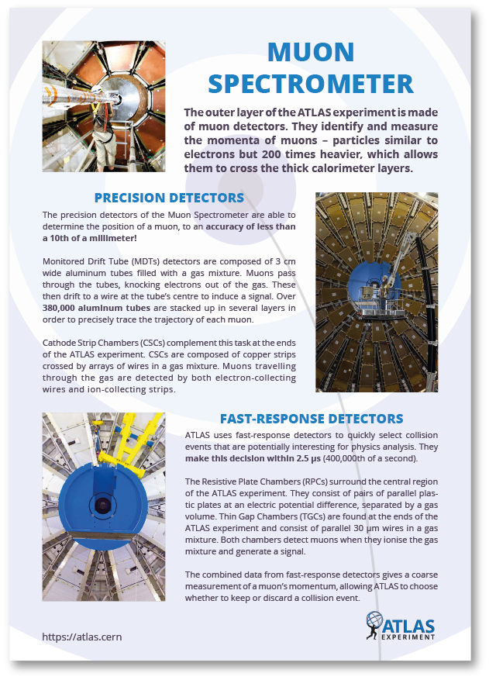
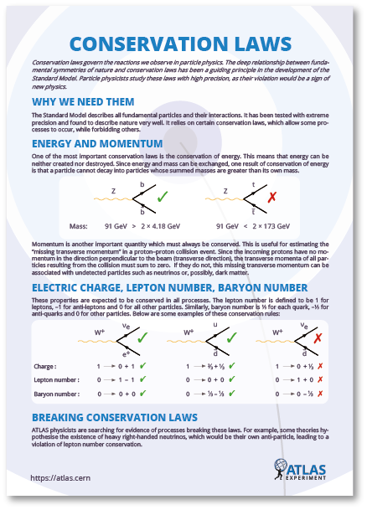
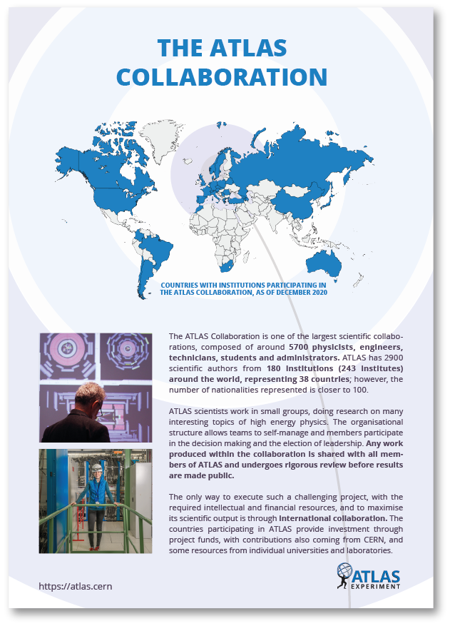
Educational Printables
ATLAS has developed a wide range of educational materials for all ages and levels of expertise.
Designed to be visually appealing and concise.
Publicly available on the ATLAS website and can be printed– especially useful for teachers and students in the classroom.
Many languages are already available, with more to come!
Work on these resources is ongoing and more topics will be released in the future.
basic level
Activity Sheets
more advanced
Fact Sheets
Cheat Sheets

Slide 3
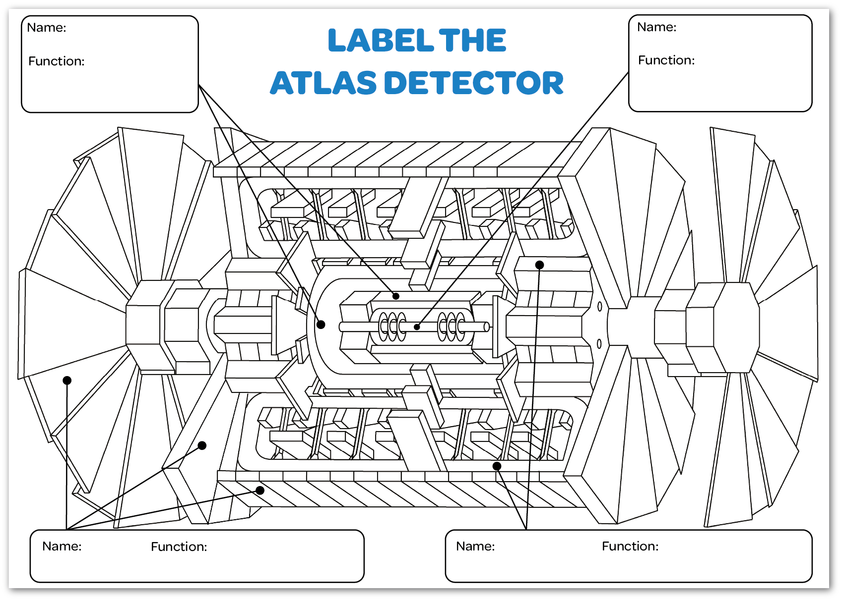
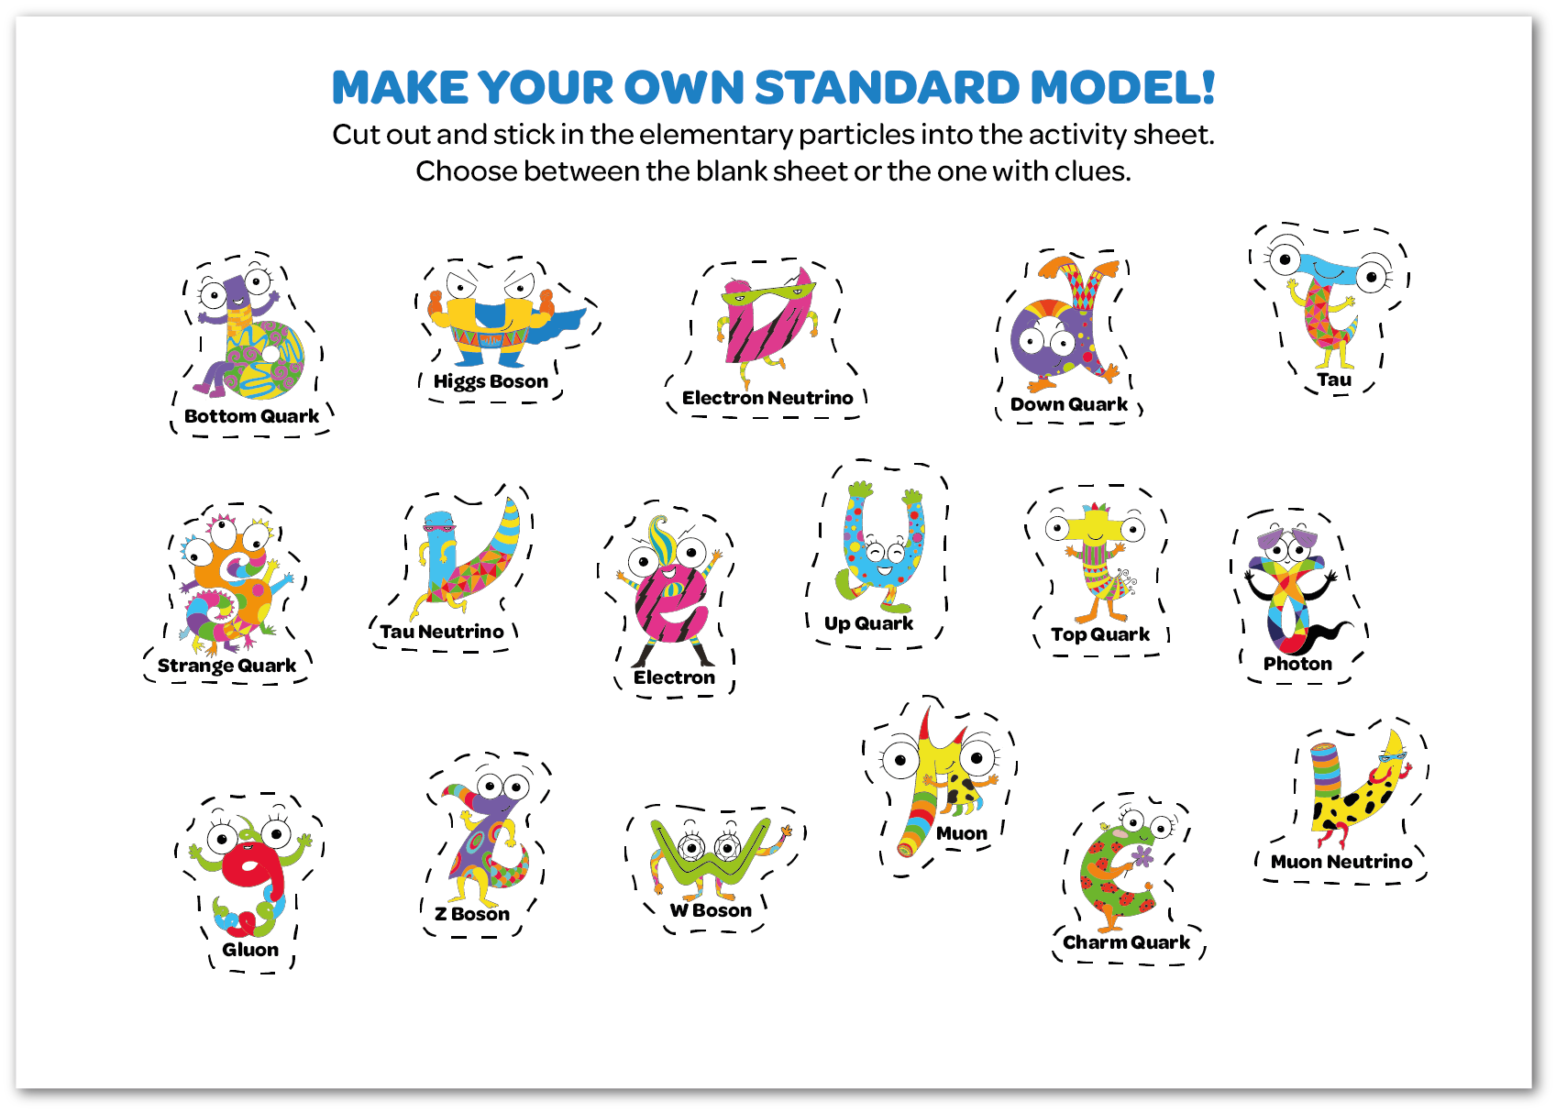
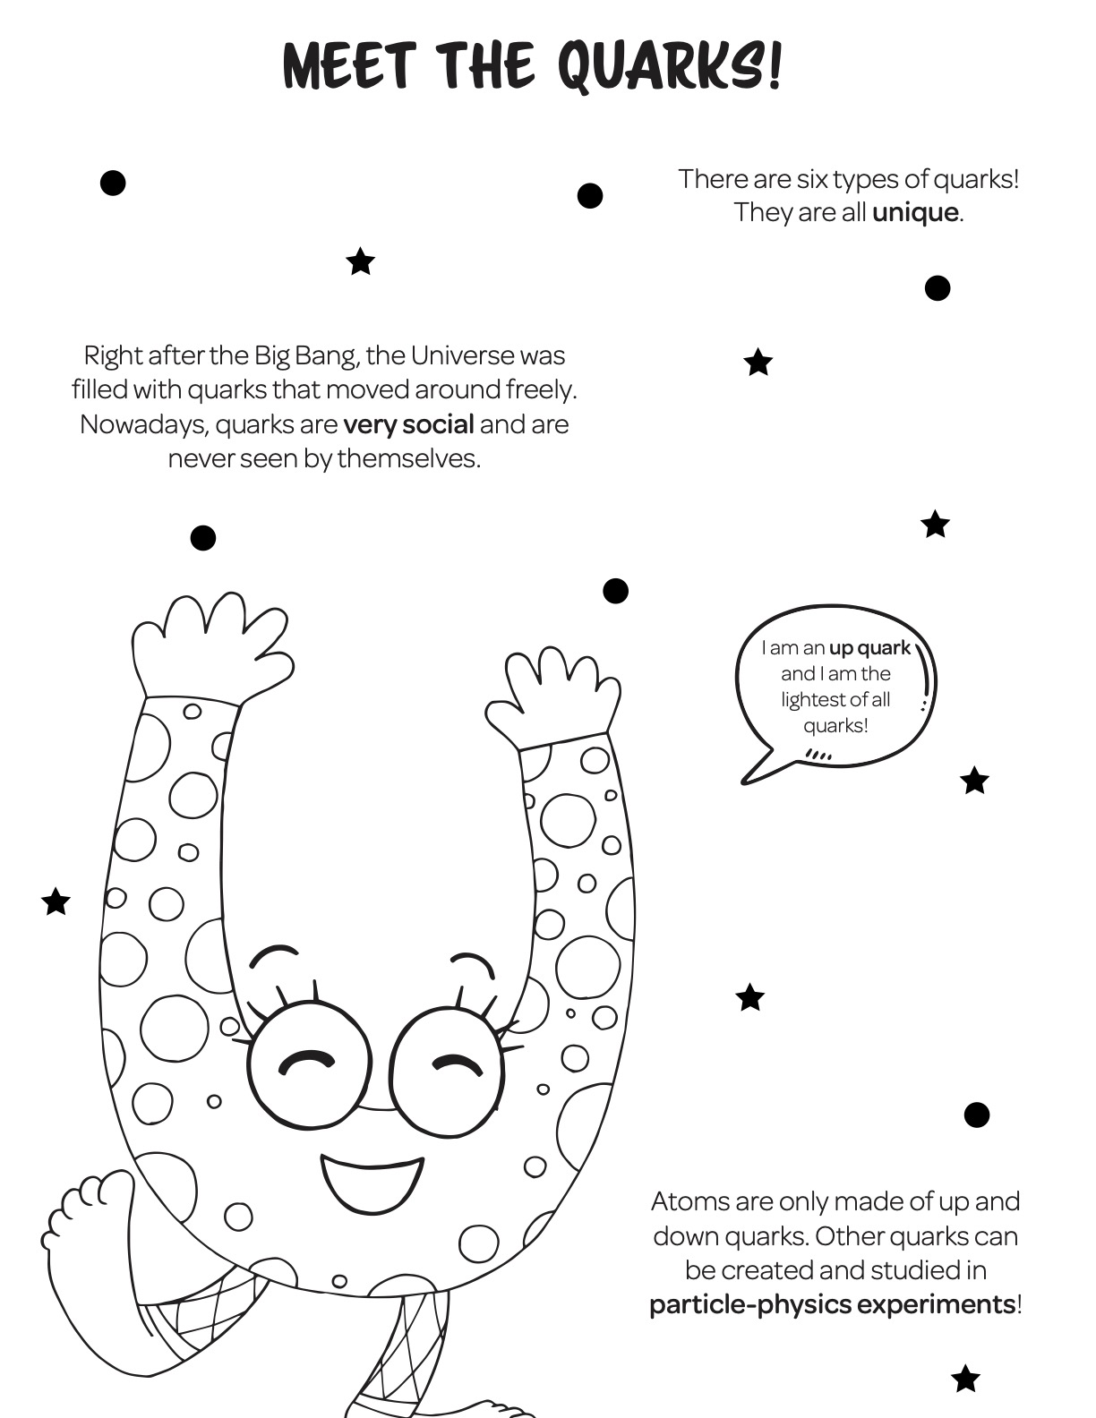
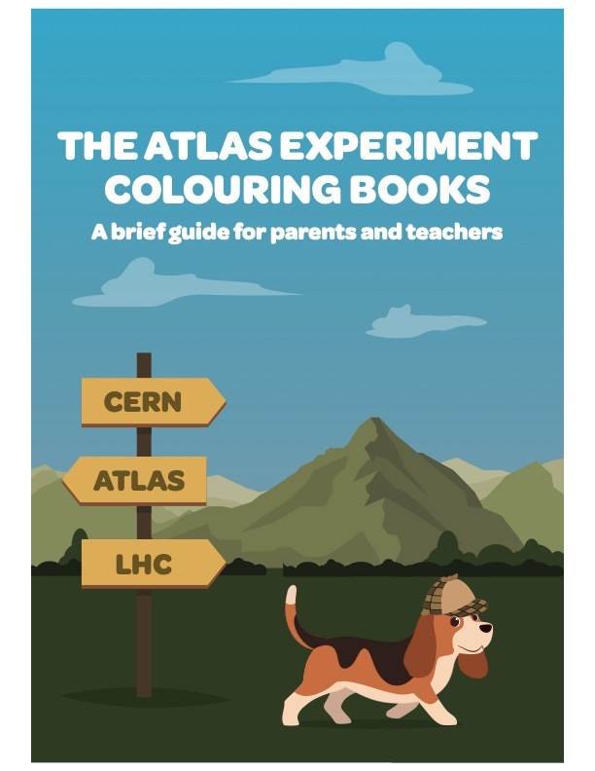
COLOURING BOOKS
Two fun-filled books about the ATLAS detector, the Collaboration, and the Standard Model! Published in 2016 and 2020, we introduce particles as lovable characters and examine elementary concepts.
ACTIVITY SHEETS
Five dynamic, interactive sheets complement the colouring books.
PARENT AND TEACHER GUIDE
A new, comprehensive guide helps parents and teachers with questions about material presented in the colouring books and activity sheets.
Introduces particles as fun characters!
link here

Slide 4
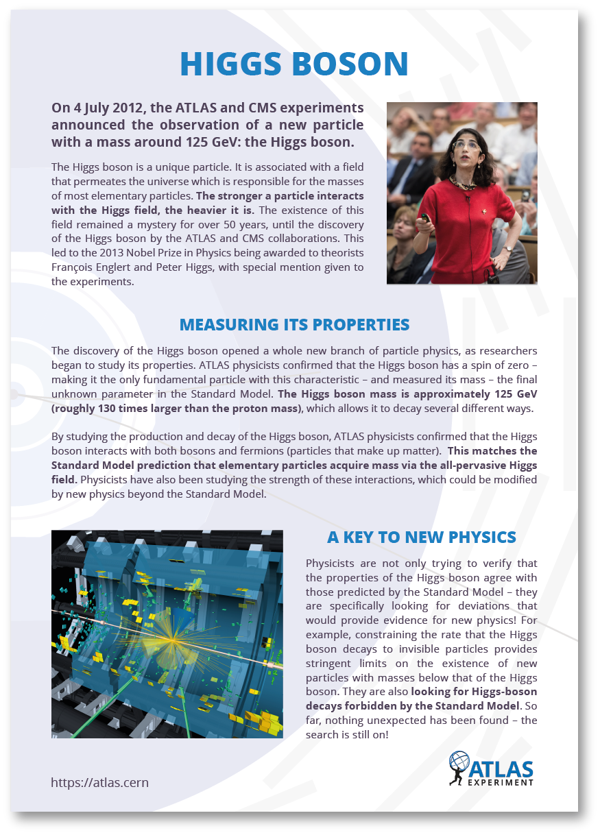
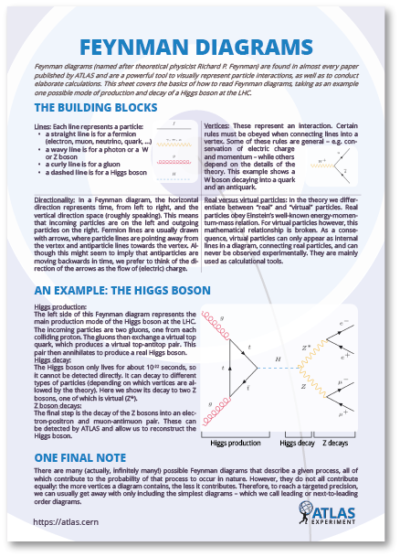
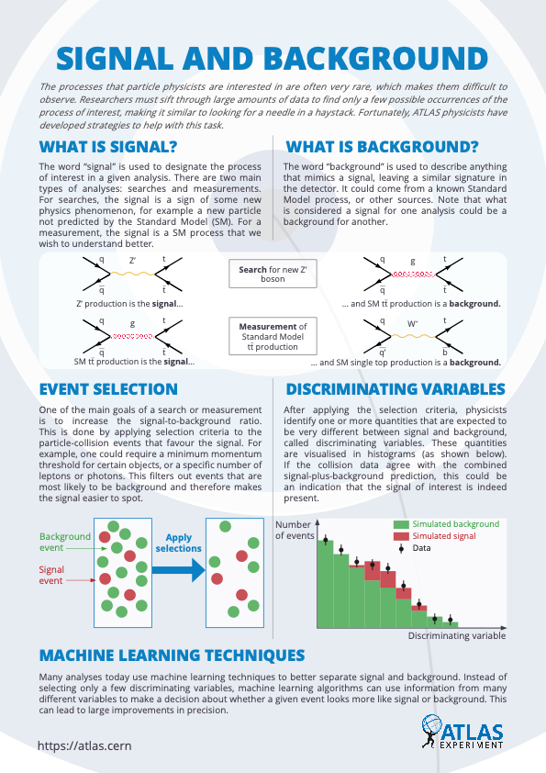
FACT SHEETS
Ten sheets to present facts about the ATLAS detector and its components, the Collaboration, and the ATLAS physics programme. Target a broad audience with minimal science education.
CHEAT SHEETS
Currently five Cheat Sheets and more in progress. One-concept sheets designed for a more scientifically literate audience, such as students of particle physics or even scientists in other fields.
TRANSLATIONS
ATLAS educational printables are accessible to many readers through translations reviewed by ATLAS physicists. The ATLAS Experiment Colouring Book is available in 22 languages, Particles of the Universe in 11 languages, Activity Sheets in 7 languages, and Fact Sheets in 4 languages, and Cheat Sheets in 3. Translations are ongoing.
Fact Sheets here
Cheat Sheets here

Slide 5

Future plans to add ”stars” to distinguish levels of difficulty.
Publicly available on the ATLAS website:
https://atlas.cern/resources
Translations are ongoing.
More topics will be released soon!
Contact
Colouring Books & Activity Sheets:
Mariana Velho mariana.velho@cern.ch
Katarina Anthony katarina.anthony@cern.ch
Fact Sheets:
Ana Maria Rodriguez Vera a.mariarv@cern.ch
Cheat Sheets:
Elise Le Boulicaut elise.maria.le.boulicaut@cern.ch
Valerie Buxbaum valerie.buxbaum@cern.ch

