Slide 1
Imprint of quark flavor violating SUSY
in h(125) decays at future lepton colliders
K. Hidaka
Tokyo Gakugei University
Collaboration with
H. Eberl, E. Ginina (HEPHY Vienna)
References:
Phys. Rev. D 91 (2015) 015007 [arXiv:1411.2840 [hep-ph] ]
JHEP 1606 (2016) 143 [arXiv:1604.02366 [hep-ph]]]
IJMP A34 (2019) 1950120 [arXiv:1812.08010 [hep-ph]]
PoS(EPS-HEP2021)594, 2021 [arXiv:2111.02713 [hep-ph]]
ILC White Paper for Snowmass 2021 [arXiv:2203.07622]
ICHEP2022, 7 July 2022, Bologna, Italy

Slide 2

1. Introduction
What is the SM-like Higgs boson discovered at LHC?
It can be the SM Higgs boson.
It can be a Higgs boson of New Physics.
This is one of the most important issues in the present particle physics field!
Here we study a possibility that it is the lightest Higgs boson of the
Minimal Supersymmetric Standard Model (MSSM), focusing on the decays h⁰(125) $→$c c̅ , b b̅ , b s̅ , γ γ, g g.

Slide 3
2. MSSM with QFV
Key parameters in this study are:
* QFV parameters: c̃_{L/R} – t̃_{L/R} & s̃_{L/R} – b̃_{L/R} mixing parameters
* QFC parameter: t̃_{L} – t̃_{R} & b̃_{L} – b̃_{R} mixing parameters
Μ ²_{Q23} = (c̃_{L} – t̃_{L} mixing parameter)
Μ ²_{U23} = (c̃_{R} – t̃_{R} mixing parameter)
Μ ²_{D23} = (s̃_{R} – b̃_{R} mixing parameter)
Τ_{U23} = (c̃_{R} – t̃_{L} mixing parameter)
Τ_{U32} = (c̃_{L} – t̃_{R} mixing parameter)
Τ_{U33} = (t̃_{L} – t̃_{R} mixing parameter)
Τ_{D23} = (s̃_{R} – b̃_{L} mixing parameter)
Τ_{D32} = (s̃_{L} – b̃_{R} mixing parameter)
Τ_{D33} = (b̃_{L} – b̃_{R} mixing parameter)

Slide 4
3. Constraints on the MSSM
We respect the following experimental and theoretical constraints:
(1) The LHC limits on the masses of squarks, sleptons, gluino, charginos and neutralinos.
(2) The constraint on (m_{A / H+ ,} tanβ ) from MSSM Higgs boson search at LHC.
The constraints on the QFV parameters from the B & K meson data.
etc.
(4) The constraints from the observed Higgs boson mass and couplings at LHC ; e.g.
121.6 GeV < m_h⁰ < 128.6 GeV (allowing for theoretical uncertainty) ,
0.71 < κ_{b} < 1.43 (ATLAS), 0.56 < κ_{b} < 1.70 (CMS)
(5) The experimental limit on SUSY contributions to the electroweak ρ parameter
Δ ρ (SUSY) < 0.0012.
(6) Theoretical constraints from the vacuum stability conditions for the
trilinear couplings T_{Uαβ} and T_{Dαβ} .
Notes:
Experimental constraint from B(b -> s l+ l-) ;
The low-s region (1 GeV^2 < s < 6 GeV^2) is dominated by the Wilson
coefficients C_9 and C_10, has sizable integrated branching ratio and is very
sensitive to the C_7 - C_9 interference. In the following, we utilize the latter
to put constraints on the Wilson coefficients C_7,8,9,10.
We calculate the integrated branching ratio in the low-s region following Ref. [52]:

Slide 5
* Constraints on the MSSM parameters from W boson mass data:
The recent m_{W} data from CDF II [1] is quite inconsistent with the other
experimental data. (-> See backup slides.)
[1] CDF Collaboration, Science 376, 170–176 (2022)
This issue of the m_{W} data is not yet settled.
Hence, we do not take into accont this m_{W} constraint on the MSSM
parameters in our analysis.
Notes:
Experimental constraint from B(b -> s l+ l-) ;
The low-s region (1 GeV^2 < s < 6 GeV^2) is dominated by the Wilson
coefficients C_9 and C_10, has sizable integrated branching ratio and is very
sensitive to the C_7 - C_9 interference. In the following, we utilize the latter
to put constraints on the Wilson coefficients C_7,8,9,10.
We calculate the integrated branching ratio in the low-s region following Ref. [52]:

Slide 6
4. Parameter scan
We compute the h⁰(125) decay widths in the MSSM with QFV.
- We take parameter scan ranges as follows:
10 < tanβ < 80
2500 < M₃ < 5000 GeV
100 < M₂ < 2500 GeV
100 < M₁ < 2500 GeV
100 < μ < 2500 GeV
1350 < m_{A}(pole) < 6000 GeV
etc. etc.
1 TeV < M_{SUSY} < 5 TeV
In the parameter scan, all of the relevant experimental and
theoretical constraints are imposed.
377180 parameter points are generated and 3208 points
survive the constraints.

Slide 7
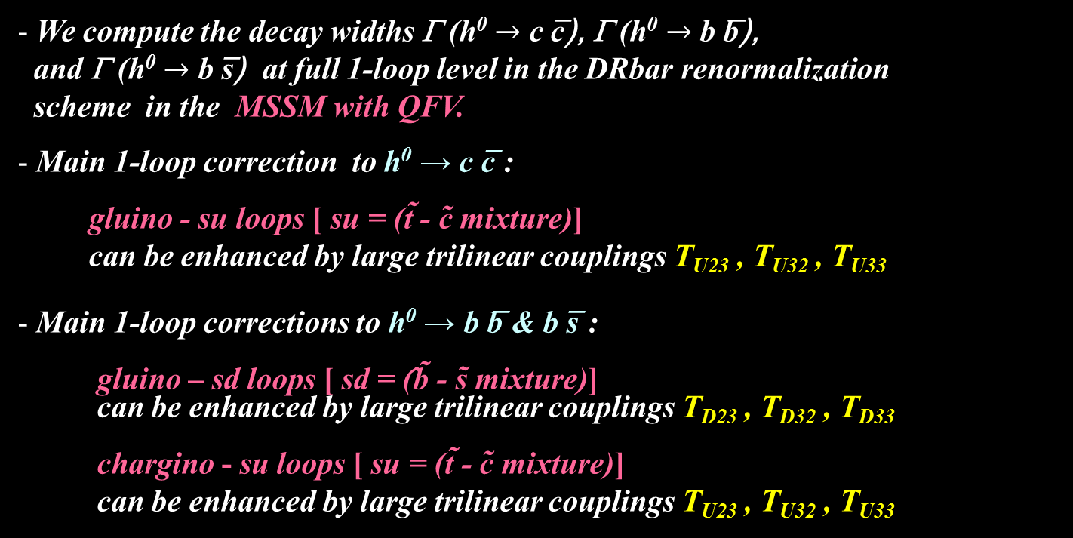
5. h⁰ → c c̅ , b b̅ , b s̅ in the MSSM
We compute the decay widths Γ (h⁰ $→$ c c̅), Γ (h⁰ $→$ b b̅),
and Γ (h⁰ $→$ b s̅) at full 1-loop level in the DRbar renormalization
scheme in the MSSM with QFV.
Main 1-loop correction to h⁰ → c c̅ :
gluino - su loops [ su = (t̃ - c̃ mixture)]
can be enhanced by large trilinear couplings T_{U23} , T_{U32} , T_{U33}
Main 1-loop corrections to h⁰ → b b̅ & b s̅ :
gluino – sd loops [ sd = (̂b̃ - s̃ mixture)]
can be enhanced by large trilinear couplings T_{D23} , T_{D32} , T_{D33}
chargino - su loops [ su = (t̃ - c̃ mixture)]
can be enhanced by large trilinear couplings T_{U23} , T_{U32} , T_{U33}

Slide 8
In large & mixing scenario;
h⁰ ̴ H₂⁰
g̃
In our scenario, “trilinear couplings“ ( , ,
couplings) = (T_{U23} T_{U32} , T_{U33} ) are large!
couplings are large!
Gluino loop contributions can be large!
Deviation of Γ (h⁰ → c c̅) from SM width can be large!

Slide 9
In large s̃_{R/L} - b̃_{R/L} & b̃_{L} - b̃_{R} mixing scenario;
b
h⁰ ̴ - sα H₁⁰ + cα H₂⁰
d̃_{1,2}
d̃_{1,2} ̴ s̃_{R/L} + b̃_{R/L}
h⁰
g̃
d̃_{1,2}
b̅ / s̅
In our scenario, “trilinear couplings“(T_{D23} T_{D32} , T_{D33} ) =
(s̃_{R} - b̃_{L} - H₁⁰ , s̃_{L} - b̃_{R} - H₁⁰ , b̃_{L} - b̃_{R} - H₁⁰ couplings) are large!
d̃_{1,2} - d̃_{1,2} - h⁰ couplings are large!
Gluino loop contributions can be large!
Deviation of Γ (h⁰ → b b̅/s̅ ) from SM width can be large!

Slide 10
In large c̃_{R/L} - t̃_{R/L} & t̃_{L} - t̃_{R} mixing scenario;
b
h⁰ ̴ H₂⁰
ũ_{1,2}
ũ_{1,2} ̴ c̃_{R/L} + t̃_{R/L}
h⁰
χ̃±
χ̃± ~ W̃± + H̃±
ũ_{1,2}
b̅ / s̅
In our scenario, “trilinear couplings“ ( , ,
couplings) = (T_{U23} T_{U32} , T_{U33} ) are large!
couplings are large!
Chargino loop contributions can be large!
Deviation of Γ (h⁰ → b b̅/s̅ ) from SM width can be large!

Slide 11
5.1 Deviation of the width from the SM prediction
- The deviation of the width from the SM prediction:
_ _ _
DEV(h⁰ -> X X) = Γ(h⁰ -> X X)_{MSSM} / Γ (h⁰ -> X X)_{SM} - 1
X = c, b

Slide 12
Scatter plot in DEV(h⁰ -> c c̅) - DEV(h⁰ -> b b̅) plane
MSSM
DEV(h⁰ -> b b̅)
DEV(h⁰ -> c c̅)
DEV(h⁰ -> c c̅) and DEV(h⁰ -> b b̅) can be very large simultaneously!:
DEV(h⁰ -> c c̅) can be as large as ~ ±60%.
DEV(h⁰ -> b b̅) can be as large as ~ ±20%.
ILC can observe such large deviations from SM at high significance (arXiv:1908.11299)!:
Δ DEV(h⁰ -> c c̅) = (3.60%, 2.40%, 1.58%) at (ILC250, ILC500, ILC1000)
Δ DEV(h⁰ -> b b̅) = (1.98%, 1.16%, 0.94%) at (ILC250, ILC500, ILC1000)

Slide 13
Scatter plot in DEV(h⁰ -> c c̅) - DEV(h⁰ -> b b̅) plane
DEV(h⁰ -> b b̅)
DEV(h⁰ -> c c̅)
Recent LHC data:
DEV(h⁰ -> b b̅) = 0.12 +0.92/-0.62 = [-0.50, 1.04] (ATLA S) (arXiv:1909.02845)
DEV(h⁰ -> b b̅) = 0.37 +1.52/-1.06 = [-0.69, 1.89] (CMS) (arXiv:1809.10733)
Both SM and MSSM are consistent with the recent ATLAS/CMS data!
The errors of the recent ATLAS/CMS data are too large!

Slide 14

5.2 BR(h⁰ → b s̅ / s b̅)
BR(h⁰ -> b s̅ / s b̅) $≅$ 0 (SM)
BR(h⁰ -> b s̅ / s b̅) can be as large as ~ 0.2% (MSSM with QFV)!
(See also Gomez-Heinemeyer-Rehman, PR D93 (2016) 095021 [arXiv:1511.04342]. )
ILC(250+500+1000) sensitivity could be ~ 0.1% (at 4 σ significance)!
Private communication with Junping Tian;
See also Barducci et al., JHEP 12 (2017) 105 [arXiv:1710.06657].

Slide 15
Scatter plot in T_{D23} - BR(h⁰ -> b s̅ / s b̅) plane
ILC(250+500+1000) sensitivity at 4 σ significance
← 0.1%
BR(h⁰ -> b s̅ / s b̅)
T_D23 (GeV)
s̃_{R} – b̃_{L} mixing parameter
There is a strong correlation between T_{D23} - BR(h⁰ -> b s̅ / s b̅)!
BR(h⁰ -> b s̅ / s b̅) can be as large as 0.2% for large T_{D23} !
ILC(250 + 500 + 1000) sensitivity could be ~ 0.1% at 4 sigma significance!
Private communication with Junping Tian;
See also Barducci et al., JHEP 12 (2017) 105 [arXiv:1710.06657].
- LHC & HL-LHC sensitivity should not be so good due to huge QCD BG!

Slide 16

6. h⁰ → γ γ, g g in the MSSM
As the h⁰ decays to photon photon and gluon gluon are loop-induced decays,
these decays are very sensitive to New Physics!
We compute the widths Γ (h⁰ $→$ γ γ) and Γ (h⁰ $→$ g g) at NLO QCD level
in the MSSM with QFV .
Main 1-loop contributions to h⁰ $→$ γ γ :
[W⁺/ top-quark / su] - loops [ su = (t̃ - c̃ mixture)]
The su-loops can be enhanced by large trilinear couplings T_{U23} , T_{U32} , T_{U33} ,
resulting in sizable deviation of Γ (h⁰ → γ γ) from the SM width!
Main 1-loop contributions to h⁰ → g g:
[top-quark / su] - loops [ su = (t̃ - c̃ mixture)]
The su-loops can be enhanced by large trilinear couplings T_{U23} , T_{U32} , T_{U33 ,}
resulting in sizable deviation of Γ (h⁰ → g g) from the SM width!

Slide 17


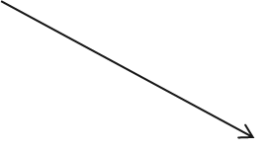

γ
X
X = W ⁺/ t / ũ_{1,2}
h⁰
X
γ
g
X
h⁰
X = t / ũ_{1,2}
X

Slide 18
We perform a MSSM parameter scan respecting all the relevant
theoretical and experimental constraints.
From the parameter scan, we find the followings:
(1) DEV(h⁰ → γ γ ) and DEV(h⁰ → g g) can be sizable simultaneously:
DEV(h⁰ → γ γ ) can be as large as ~ ±1%,
DEV(h⁰ → g g) can be as large as ~ ±4%.
(2) There is a very strong correlation between DEV(h⁰ → γ γ )
and DEV(h⁰ → g g). This correlation is due to the fact that the
stop-loop (stop-scharm mixture loop) contributions dominate the
two DEVs.
(3) The deviation of the width ratio Γ (h⁰ → γ γ ) / Γ (h⁰ → g g ) in the
MSSM from the SM value can be as large as ~ ±5%.

Slide 19
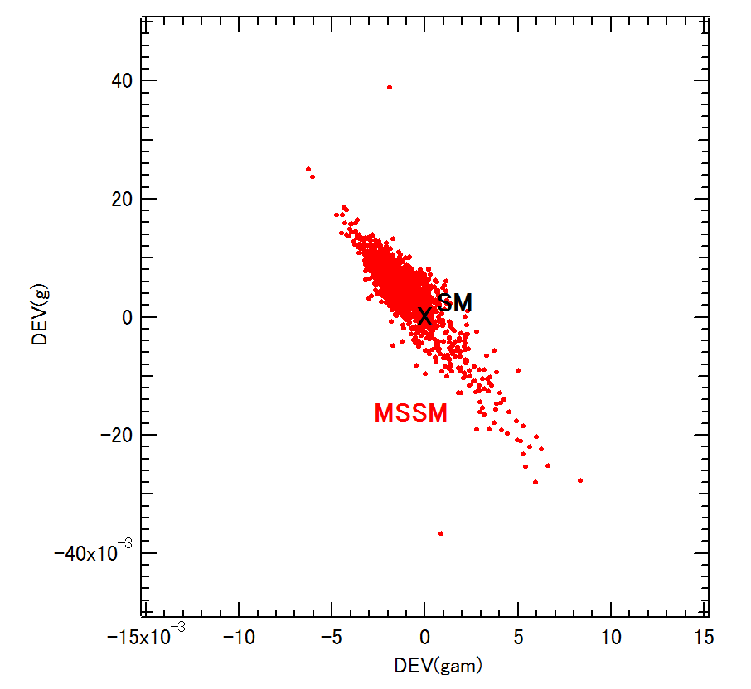
Scatter plot in DEV(h⁰ → γ γ ) - DEV(h⁰ → g g) plane
DEV(h⁰ → g g)
DEV(h⁰ → γ γ )
DEV(h⁰ → γ γ ) and DEV(h⁰ → g g) can be sizable simultaneously!
There is a strong correlation between DEV(h⁰ → γ γ ) and DEV(h⁰ → g g)!
- Future lepton colliders such as ILC can observe such sizable deviations from SM!
(See arXiv:1908.11299 and Backup slides))

Slide 20
7. Conclusion
- We have studied the decays
h⁰ (125GeV) → c c̅ , b b̅ , b s̅ , γ γ, g g in the MSSM with QFV.
Performing a systematic MSSM parameter scan respecting all of the relevant theoretical
and experimental constraints , we have found the followings:
* DEV(h⁰ -> c c̅) and DEV(h⁰ -> b b̅) can be very large simultaneously! :
DEV(h⁰ -> c c̅) can be as large as ~ ± 60%,
DEV(h⁰ -> b b̅) can be as large as ~ ± 20%.
* The deviation of the width ratio Γ (h⁰ -> b b̅) / Γ (h⁰ -> c c̅)
from the SM value can exceed ~ +100%.
* BR(h⁰ -> b s̅ / s b̅) can be as large as ~ 0.2%!
ILC(250 + 500 + 1000) sensitivity could be ~ 0.1% at 4 sigma signal significance!

Slide 21
* DEV(h⁰ -> γ γ ) and DEV(h⁰ -> g g) can be sizable simultaneously! :
DEV(h⁰ -> γ γ ) can be as large as ~ ±1%,
DEV(h⁰ -> g g) can be as large as ~ ±4%.
* The deviation of the width ratio Γ (h⁰ -> γ γ )/ Γ (h⁰ -> g g) from the SM value
can be as large as ~ ±5%.
* There is a very strong correlation between DEV(h⁰ -> γ γ )
and DEV(h⁰ -> g g). This correlation is due to the fact that the stop-loop
(stop-scharm mixture loop) contributions dominate the two DEVs.
- All of these large deviations in the h⁰ (125) decays are due to
large c̃ - t̃ mixing & large c̃ / t̃ involved trilinear couplings T_{U23}, T_{U32}, T_{U33} and
large s̃ - b̃ mixing & large s̃ / b̃ involved trilinear couplings T_{D23}, T_{D32}, T_{D33}.
Future lepton colliders such as ILC, CLIC, CEPC, FCC-ee can observe
such large deviations from SM at high significance!
In case the deviation pattern shown here is really observed at the future lepton colliders, then it would strongly suggest the discovery of QFV SUSY (MSSM with QFV)!
- See next slide also.

Slide 22
Our analysis suggests the following:
PETRA/TRISTAN e- e+ collider discovered virtual Z⁰ effect for the first time.
Later, CERN p p̄ collider discovered the Z⁰ boson.
Similarly, lepton colliders, such as ILC, could discover virtual Sparticle effects for the first time in h⁰(125) decays!
Later, FCC-hh p p collider could discover the Sparticles!

Slide 23
END
Thank you!

Slide 24

Backup Slides

Slide 25
2. MSSM with QFV
The basic parameters of the MSSM with QFV:
{tanβ, m_{A} , M₁ , M₂ , M₃ , μ , M²_{Q,αβ} , M²_{U,αβ} , M²_{D,αβ} , T_{Uαβ} , T_{Dαβ} }
(at Q = 1 TeV scale ) (α,β = 1,2,3 = u, c, t or d, s, b)
tanβ : ratio of VEV of the two Higgs doublets <H⁰ ₂>/<H⁰₁>
mA : CP odd Higgs boson mass (pole mass)
M_{1,} M₂ ,M₃ : U(1), SU(2),SU(3) gaugino masses
μ : higgsino mass parameter
M²_{Q,αβ} : left squark soft mass matrix
M²_{Uαβ} : right up-type squark soft mass matrix
M²_{Dαβ} : right down-type squark soft mass matrix
T_{Uαβ} : trilinear coupling matrix of up-type squark and Higgs boson
T_{Dαβ} : trilinear coupling matrix of down-type squark and Higgs boson

Slide 26
2. Key parameters of MSSM
Key parameters in this study are:
* QFV parameters: Μ ²_{Q23} , Μ ²_{U23} , Μ ²_{D23} , Τ_{U23} , Τ_{U32} , Τ_{D23} , Τ_{D32}
* QFC parameter: Τ_{U33,} Τ_{D33}
Μ ²_{Q23} = (c̃_{L} – t̃_{L} mixing parameter)
Μ ²_{U23} = (c̃_{R} – t̃_{R} mixing parameter)
Μ ²_{D23} = (s̃_{R} – b̃_{R} mixing parameter)
Τ_{U23} = (c̃_{R} – t̃_{L} mixing parameter)
Τ_{U32} = (c̃_{L} – t̃_{R} mixing parameter)
Τ_{U33} = (t̃_{L} – t̃_{R} mixing parameter)
Τ_{D23} = (s̃_{R} – b̃_{L} mixing parameter)
Τ_{D32} = (s̃_{L} – b̃_{R} mixing parameter)
Τ_{D33} = (b̃_{L} – b̃_{R} mixing parameter)

Slide 27
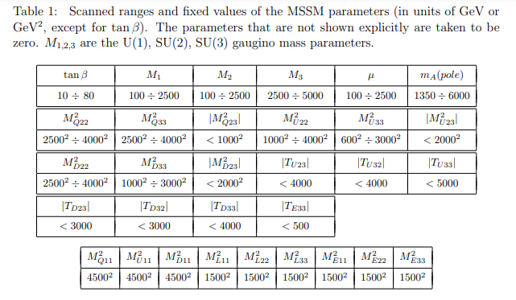
4. Parameter scan for h⁰ decay in the MSSM

Slide 28
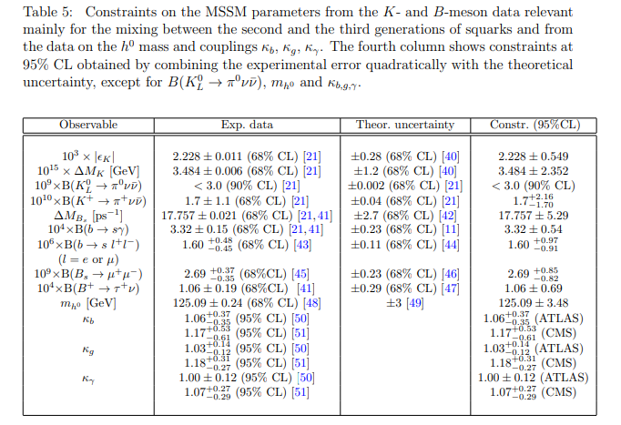
Constraints on the MSSM parameters from K & B meson and h⁰ data:

Slide 29
Constraints on the MSSM parameters from W boson mass data:
The recent m_{W} data from CDF II [1] is quite inconsistent with the other
experimental data. (-> See next slides.)
[1] CDF Collaboration, Science 376, 170–176 (2022)
This issue of the m_{W} data is not yet settled.
Hence, we do not take into accont this m_{W} constraint on the MSSM
parameters in our analysis.

Slide 30
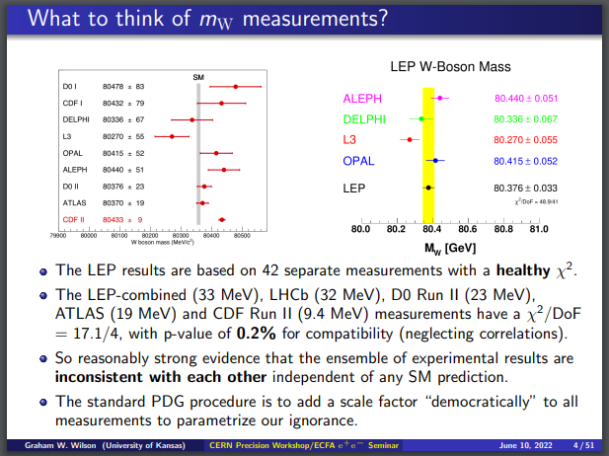
From G. Wilson’s talk at ECFA Higgs Factory seminars: Precision physics in the e+e- -> WW region, June 10 2022: https://indico.cern.ch/event/1163667/

Slide 31
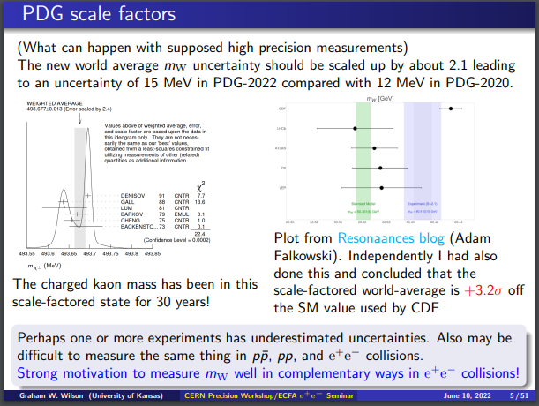

Slide 32
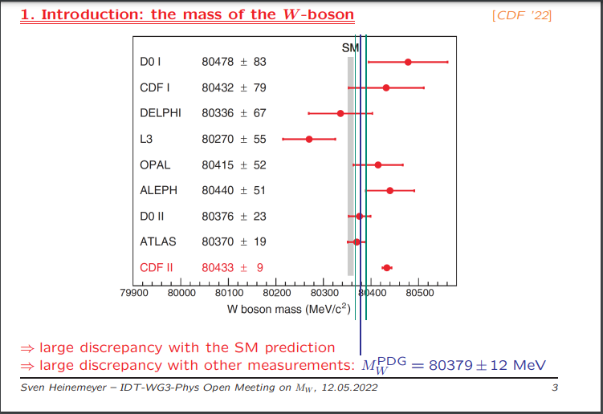
From S. Heinemeyer’s talk at IDT-WG3-Phys Open Meeting on mW , 12 May 2022: https://agenda.linearcollider.org/event/9357/

Slide 33
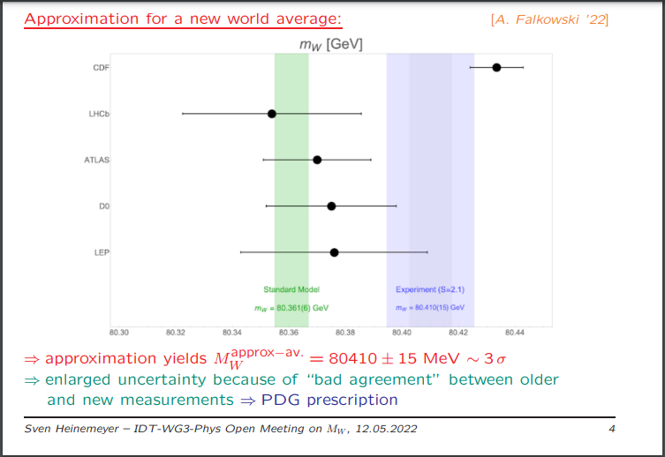

Slide 34
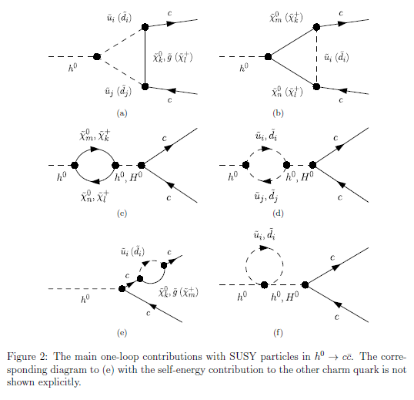
_
Main SUSY one-loop contributions to h⁰ -> c c

Slide 35
5.2 Deviation of width ratio from the SM prediction
- The deviation of the width ratio from the SM prediction:
DEV(b/c) = [Γ (b) / Γ (c)]_{MSSM} / [Γ (b) / Γ (c)]_{SM} - 1
_
Γ (X) = Γ (h⁰-> X X)

Slide 36
Scatter plot in T_{U32} – DEV(b/c) plane
DEV(b/c)
SM
T_U32 (GeV)
c̃_{L} – t̃_{R} mixing parameter
There is a strong correlation between T_{U32} – DEV(b/c)!
DEV(b/c) can exceed ~ +100% for large T_{U32} !

Slide 37
5.2 BR(h⁰ → b s̅ / s b̅)
BR(h⁰ -> b s̅ / s b̅) $≅$ 0 (SM)
BR(h⁰ -> b s̅ / s b̅) can be as large as ~ 0.2% (MSSM with QFV)!
(See also Gomez-Heinemeyer-Rehman, PR D93 (2016) 095021 [arXiv:1511.04342]. )
ILC(250+500+1000) sensitivity could be ~ 0.1% (at 4 σ significance)!
Private communication with Junping Tian;
See also Barducci et al., JHEP 12 (2017) 105 [arXiv:1710.06657]

Slide 38
Scatter plot in T_{D23} - BR(h⁰ -> b s̅ / s b̅) plane
ILC(250+500+1000) sensitivity at 4 σ significance
← 0.1%
BR(h⁰ -> b s̅ / s b̅)
T_D23 (GeV)
s̃_{R} – b̃_{L} mixing parameter
There is a strong correlation between T_{D23} - BR(h⁰ -> b s̅ / s b̅)!
BR(h⁰ -> b s̅ / s b̅) can be as large as 0.2% for large T_{D23} !
ILC(250 + 500 + 1000) sensitivity could be ~ 0.1% at 4 sigma significance!
Private communication with Junping Tian;
See also Barducci et al., JHEP 12 (2017) 105 [arXiv:1710.06657].
- LHC & HL-LHC sensitivity should not be so good due to huge QCD BG!

Slide 39
Scatter plot in T_{D32} - BR(h⁰ -> b s̅ / s b̅) plane
ILC(250+500+1000) sensitivity at 4 σ significance
← 0.1%
BR(h⁰ -> b s̅ / s b̅)
s̃_{L} – b̃_{R} mixing parameter
T_D32 (GeV)
There is also a strong correlation between T_{D32} - BR(h⁰ -> b s̅ / s b̅)!
BR(h⁰ -> b s̅ / s b̅) can be as large as 0.2% for large T_{D32} !

Slide 40
Scatter plot in BR(h⁰ → b s̅ / s b̅) - DEV(h⁰ → b b̅ ) plane
ILC(250+500+1000) sensitivity at 4 σ significance
← 0.1%
BR(h⁰ → b s̅ / s b̅)
SM
x
DEV(h⁰ → b b̅ )
- There is a strong correlation between DEV(h⁰ → b b̅ ) & BR(h⁰ → b s̅ / s b̅)!
- This is due to the fact that DEV(h⁰ → b b̅) & BR(h⁰ → b s̅ / s b̅) have
a common origin of enhancement effect, i.e. large trilinear couplings
T_{D23,32,33} & T_{U23,32,33} .

Slide 41
Scatter plot in BR(h⁰ → b s̅ / s b̅) - tanβ plane
ILC(250+500+1000) sensitivity at 4 σ significance
BR(h⁰ → b s̅ / s b̅)
← 0.1%
tanβ
- There is a strong correlation between BR(h⁰ → b s̅ / s b̅) & tanβ !
- BR(h⁰ -> b s̅ / s b̅) can be as large as 0.2% for tanβ ∼ 30 !

Slide 42
Caveat for very large DEV(h⁰ -> c c̅)
MSSM
SM
DEV(h⁰ → c c̅)
T_U32 (GeV)

Slide 43
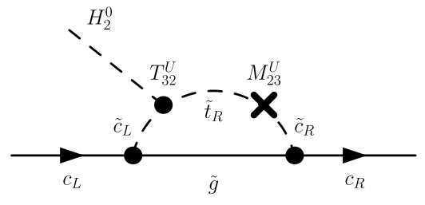

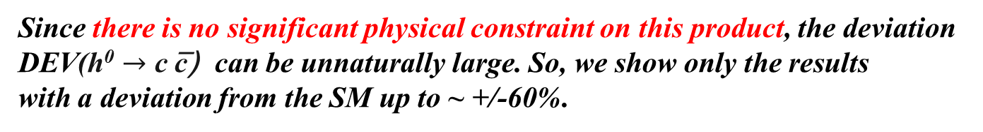
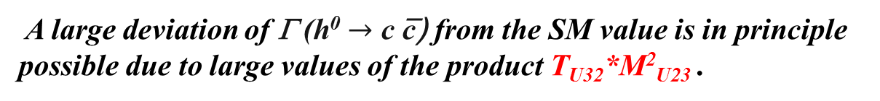
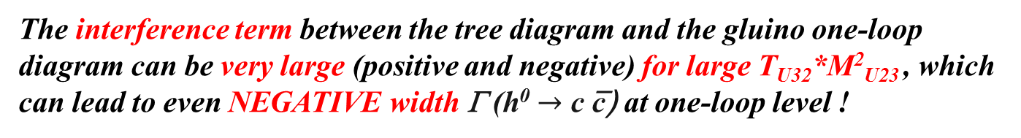
Caveat for very large DEV(h⁰ -> c c̅)
h⁰ ~
Gluino loop contribution to h⁰ $→$ c c̅ can be very
large (positive and negative) for large T_{U32}*M²_{U23}!
T_{U32}
M²_{U23}
The interference term between the tree diagram and the gluino one-loop
diagram can be very large (positive and negative) for large T_{U32}*M²_{U23} , which
can lead to even NEGATIVE width Γ (h⁰ $→$ c c̅) at one-loop level !
In this case perturbation theory breaks down!
A large deviation of Γ (h⁰ $→$ c c̅) from the SM value is in principle possible due to large values of the product T_{U32}*M²_{U23} .
Since there is no significant physical constraint on this product, the deviation DEV(h⁰ $→$ c c̅) can be unnaturally large. So, we show only the results
with a deviation from the SM up to ~ +/-60%.

Slide 44
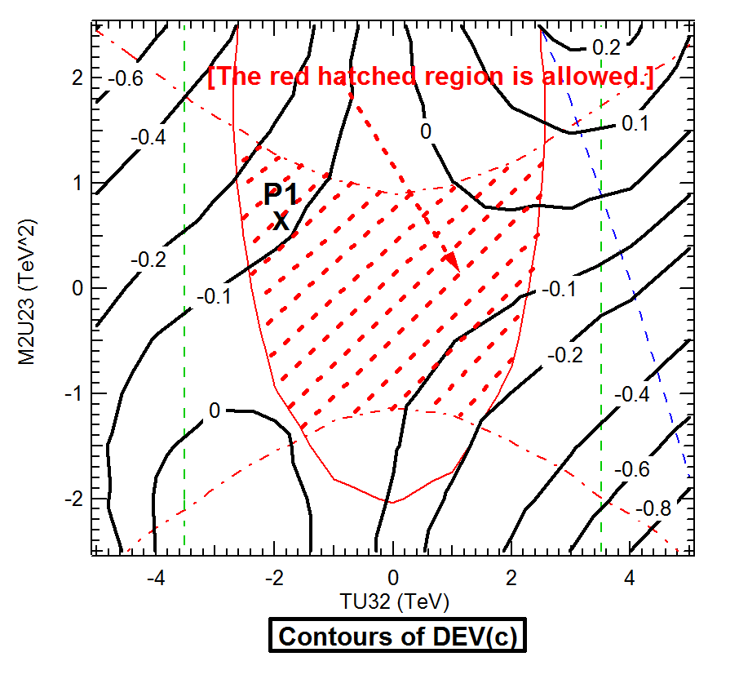
Contours of DEV(h⁰ -> c c̅) in T_{U32} - M²_{U23} plane

Slide 45
Correlations among DEV(h⁰ -> b b̅), BR(h⁰ -> b s̅ / s b̅), tanβ

Slide 46
Effect of Resummation of the bottom Yukawa coupling at large tanβ
As for Γ (h⁰ -> b b̅ ) & Γ (h⁰ -> b s̅ / s b̅), we have considered the large tanβ
enhancement and the resummation of the bottom Yukawa coupling [1].
It turns out, however, that in our case with large m_{A} close to the decoupling Higgs limit, the resummation effect (Δ_{b} effect) is very small (< 0.1%) [2].
[1] M. Carena et al., Nucl. Phys. B 577 (2000) 88 [hep-ph/9912516].
[2] H. Eberl, E. Ginina, A. Bartl, K. Hidaka and W. Majerotto, JHEP 06
(2016) 143 [arXiv:1604.02366 [hep-ph]];
E. Ginina, A. Bartl, H. Eberl, K. Hidaka and W. Majerotto,
PoS(EPS-HEP2015)146 [arXiv:1510.03714 [hepph]].

Slide 47
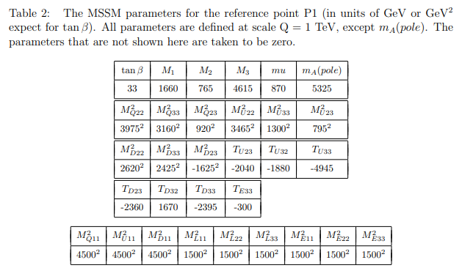
Benchmark scenario P1

Slide 48
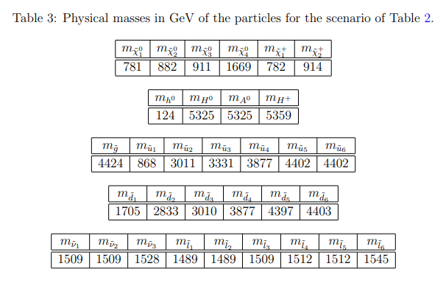
Physical masses for Benchmark scenario P1

Slide 49
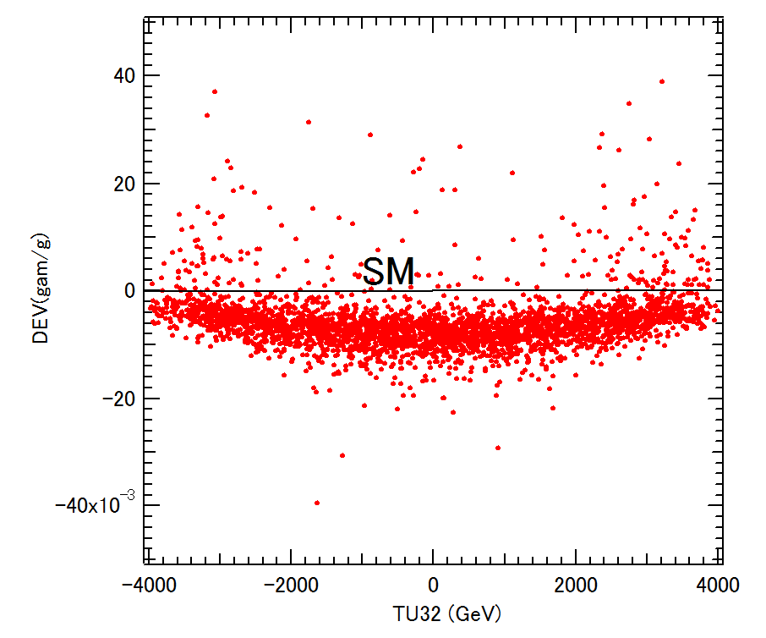
Scatter plot in T_{U32} – DEV(γ / g) plane
MSSM
DEV(γ / g)
T_U32 (GeV)
c̃_{L} – t̃_{R} mixing parameter
There is a strong correlation between T_{U32} – DEV(γ / g) !
DEV(γ / g) can be as large as ~ +4% for large T_{U32} !

Slide 50
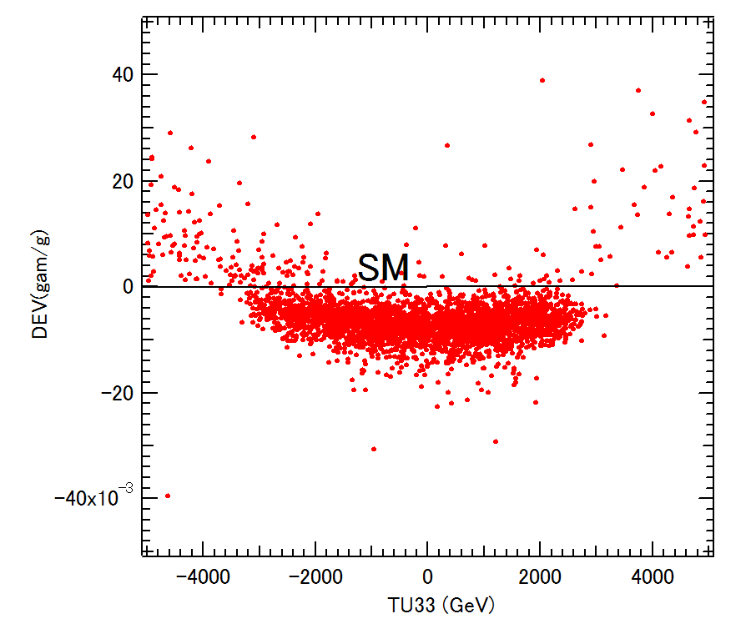
Scatter plot in T_{U33} – DEV(γ / g) plane
MSSM
DEV(γ / g)
T_U33 (GeV)
t̃_{L} – t̃_{R} mixing parameter
There is a strong correlation between T_{U33} – DEV(γ / g) !
DEV(γ / g) can be as large as ~ +4% for large T_{U33} !

Slide 51
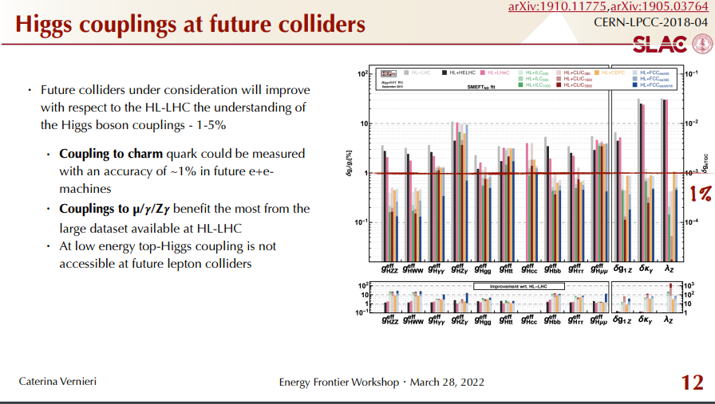
Higgs couplings at future colliders
Higgs coupling precision in % at future colliders

Slide 52
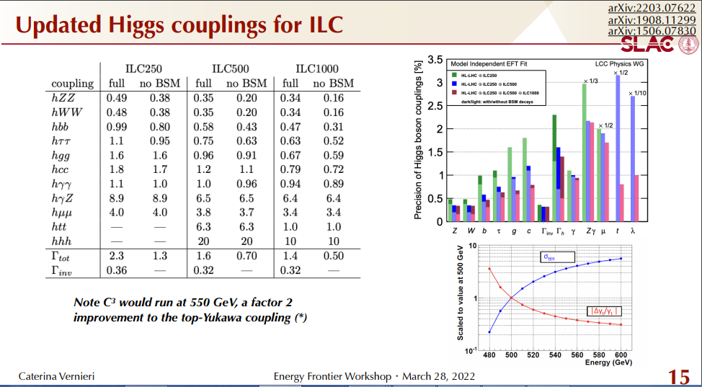
Higgs couplings at future colliders
Higgs coupling precision in % for ILC

Slide 53
DEV error - coupling error relation
Δ DEV(h → X X) = 2 δ g(hXX)
δ g(hXX) = [Expected relative error of coupling g(hXX)]
Δ DEV(h → X X) = [Expected absolute error of deviation
DEV(h → X X)]

