Slide 1
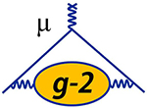
Tracking the magnetic field in the Fermilab
Muon g-2 experiment
René Reimann
for the Muon g-2 collaboration
ICHEP 2022, Bologna
Jun 7th , 2022

Slide 2
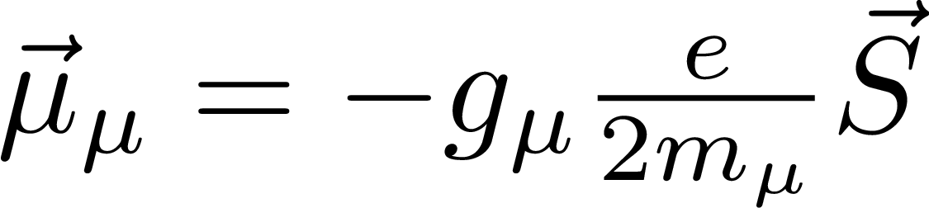
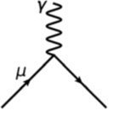
Muon g-2
magnetic moment
proportionality
constant
spin
Figure: Zoltan Fodor
$g= 2 \left( 1 + a_{μ}^{QED} + a_{μ}^{EW} + a_{μ}^{had} \right)$
Hadronic vacuum polarization dominates theoretical uncertainty.
Dispersive and lattice QCD approach deviate
Run 1 result consistent with BNL measurement

Slide 3
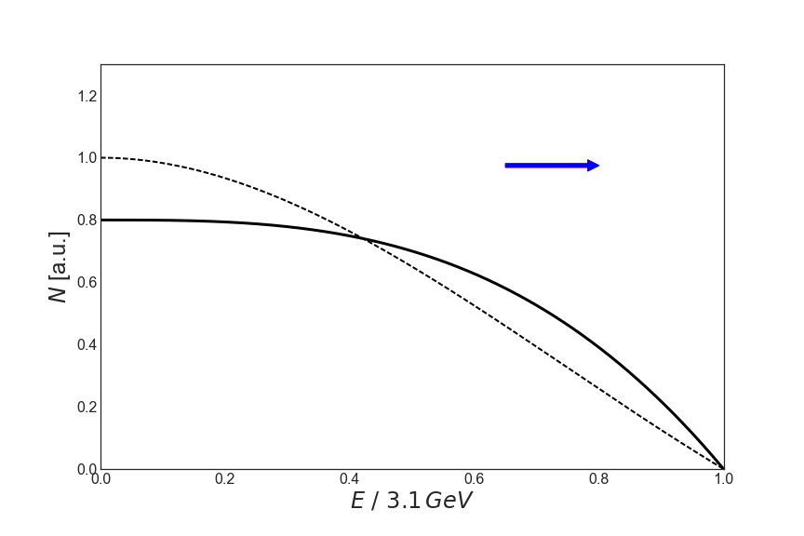
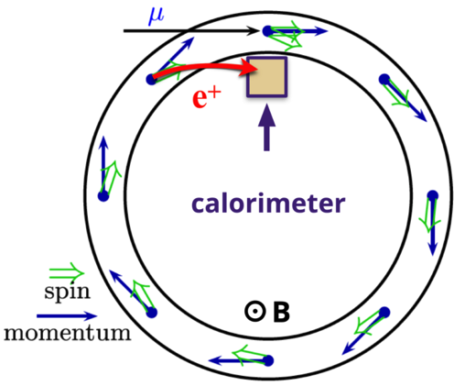
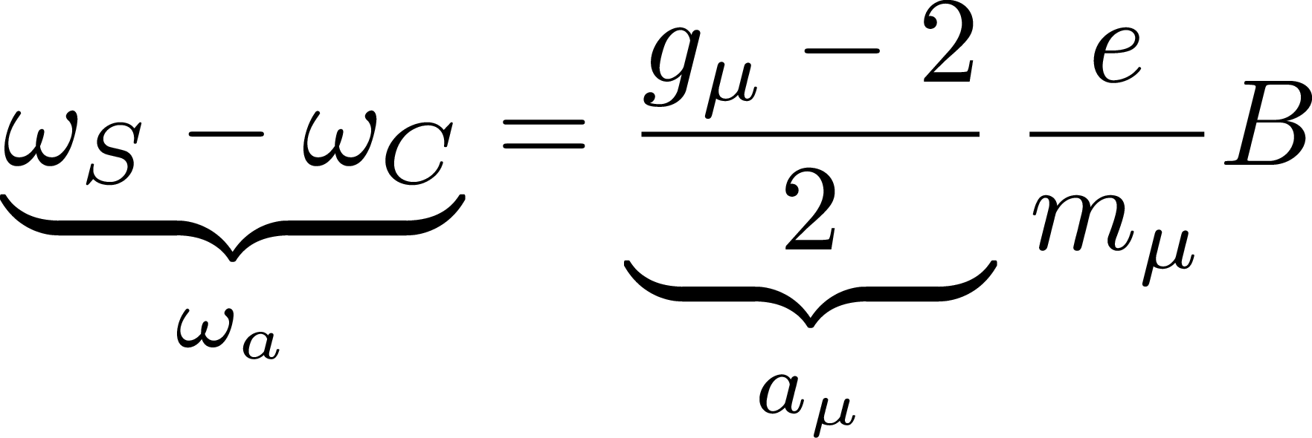
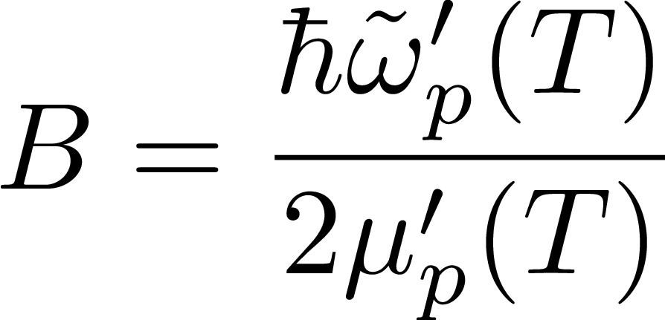
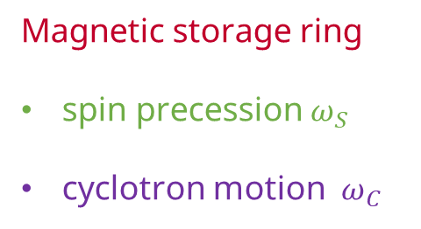
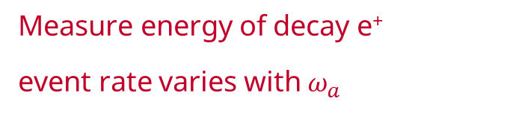
Measurement principle
spin polarized muons
Magnetic storage ring
spin precession $ω_{S}$
cyclotron motion $ω_{C}$
Measure energy of decay e⁺
event rate varies with $ω_{a}$
spin precession of protons
measured using nuclear
magnetic resonance (NMR)
Notes:
$$ \underbrace{\omega_S - \omega_C}_{\omega_a} = \underbrace{\frac{g_\mu - 2}{2}}_{a_\mu} \frac{e}{m_\mu} B $$

Slide 4
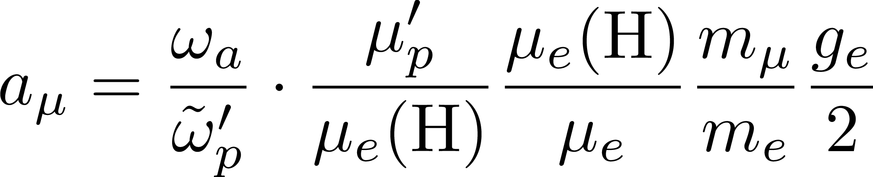
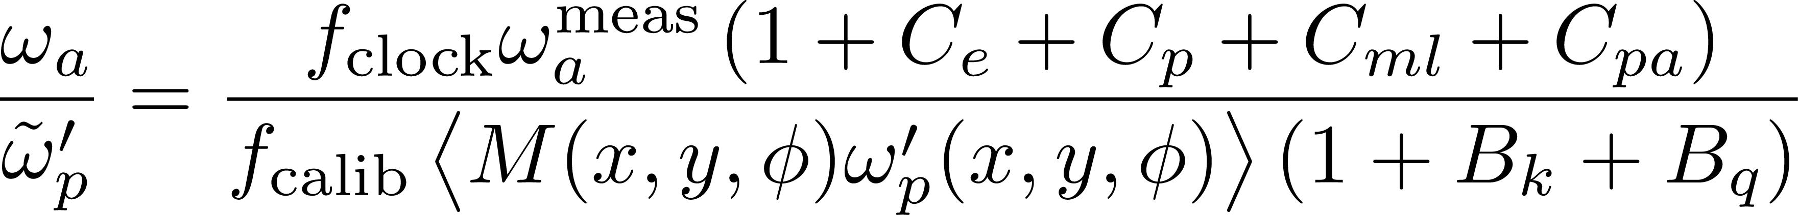
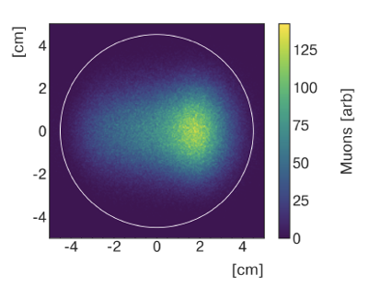
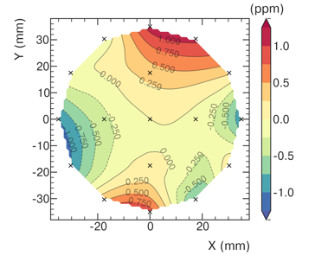
Extracting a_{µ}
external measurements known to 25ppb
Talk by L. Cotrozzi
Quarks & Lepton Flavor Physics
Jul 8, 11:32
Talk by A. Driutti
Accelerators, Jul 7, 9:30AM
Anomalous spin
precession frequency
Muon beam dynamics
corrections
Clock blinding
Spatial muon distribution
Spatial distribution of
magnetic field
Transient magnetic fields
Calibration

Slide 5

Superconducting storage ring magnet
µ⁺
$p_{μ}^{magic}=3.094\frac{GeV}{c}±0.5\%$
3 cryostats with 4 superconducting coils (5300 A)
1.45 T vertical magnetic field
90 mm muon storage region
180 mm gap for vacuum chambers

Slide 6
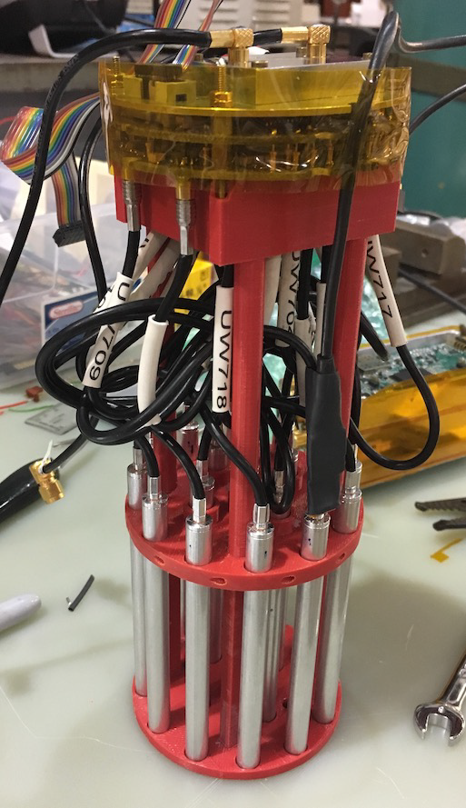
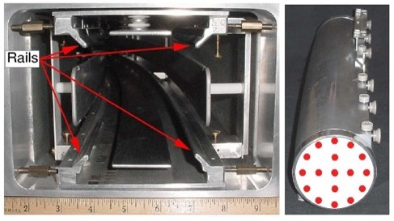
Trolley System
17 NMR probes
Measures spatial field distribution in storage region
Pulled through ring every ~3 days

Slide 7
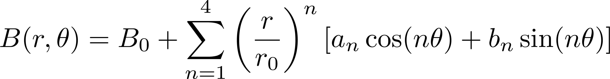
Spatial distribution of field
Phys. Rev. A 103, 042208 (2021)
quadrupole
sextupole
dipole
azimuthal slice
octupole

Slide 8
Trolley measurements
Phys. Rev. A 103, 042208 (2021)
>8000 azimuthal locations
Trolley measures spatial distribution, but can not measure while muon beam

Slide 9
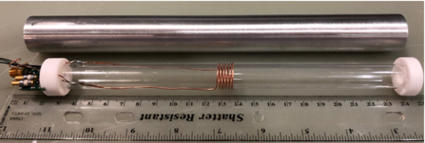
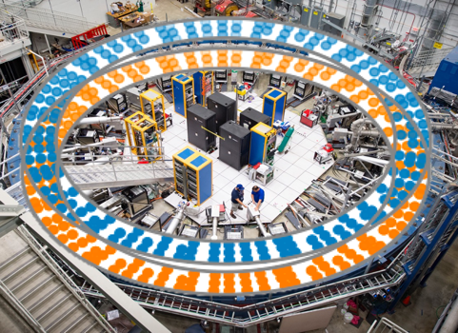
Fixed Probe System
aluminum
  72 azimuthal location (stations)
  allows to extract 4 to 5 multipole moments
  tracks field drift 24/7
  measures field differences

Slide 10
Trolley Footprint Removal
Phys. Rev. A 103, 042208 (2021)
trolley electronics disturbs field (footprint)
veto measurements
interpolate from neighboring probes

Slide 11
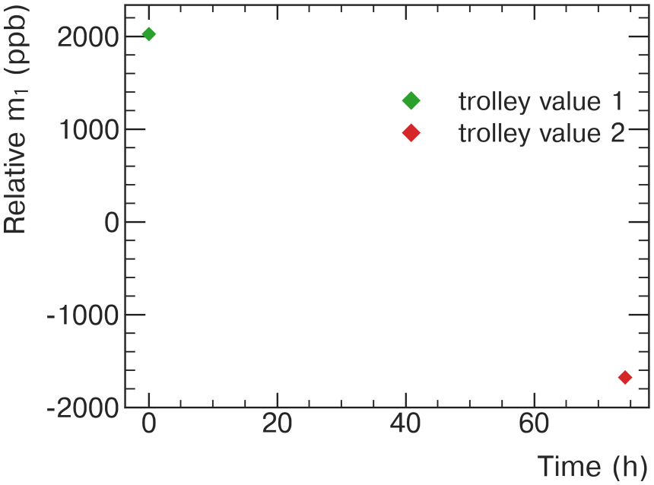
Time tracking
Phys. Rev. A 103, 042208 (2021)

Slide 12
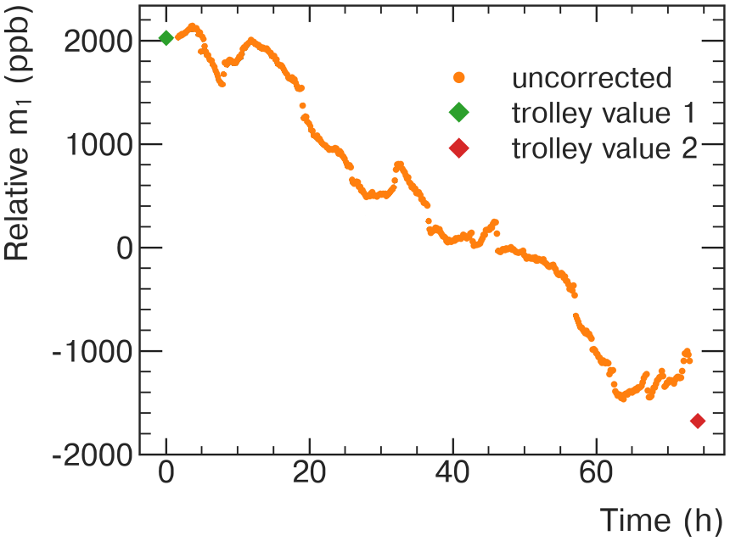
Time tracking
Phys. Rev. A 103, 042208 (2021)

Slide 13
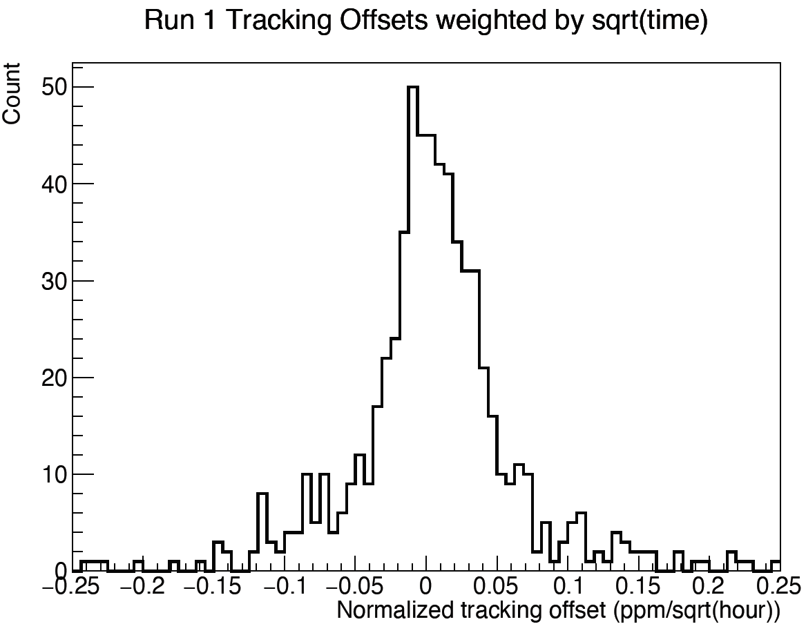
Time tracking
Phys. Rev. A 103, 042208 (2021)
M
drifts in higher order moments lead to tracking offset

Slide 14
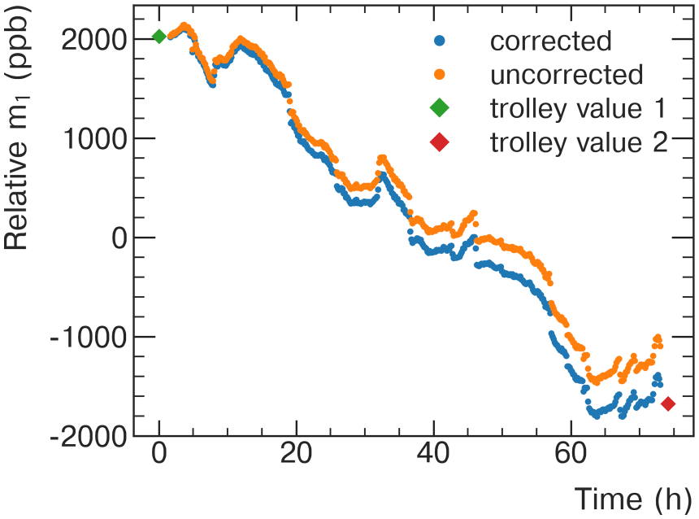
Time tracking
Phys. Rev. A 103, 042208 (2021)
M
drifts in higher order moments lead to tracking offset

Slide 15
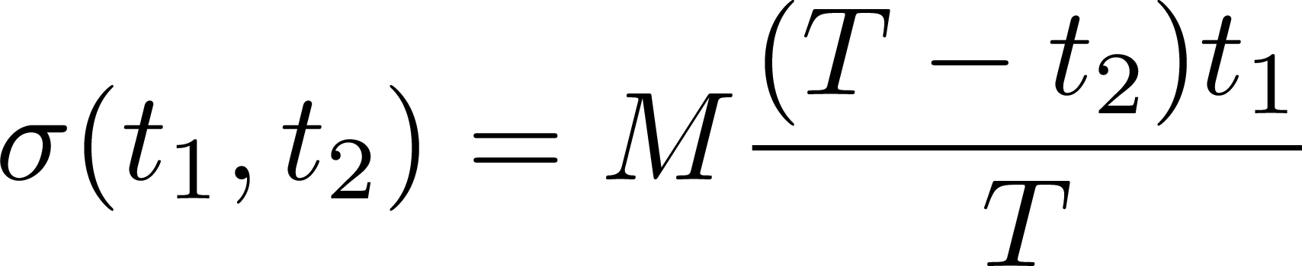
Tracking Uncertainty
Fixed Probe drift: Random walk
End point known: Brownian bridge model
Improvements
improved position determination
continues azimuthal treatment
(virtual trolley, Fourier method)
improved trolley footprint removal
more trolley runs
improved field stability
by temperature regulation
no second Trolley run
Uncertainty vs time

Slide 16
Trolley Probe Calibration
Absolute calibrated water probe
Cross-calibrated at Argonne National Lab test magnet
Probe can be placed in ring by 3D translation stage
Swap trolley and calibration probe to get calibration constant
Derive calibration constants for each trolley probe
Improvements
Study of temperature effects
Calibration twice a year with automated procedure
Consistent results

Slide 17
Kicker transient magnetic field
Kicker used to place beam on storage orbit
Kicker pulse induces 22mT field in radial direction
Measurement based on optical faraday rotation
Improvements
Reduced uncertainties due to vibration mitigation
Second independent magnetometer ready to go

Slide 18
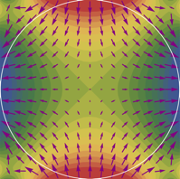
Beam related magnetic field transients
Pulsing electrostatic quadrupoles for beam confinement leads to magnetic field transient.
Only measured after run 2 → conservative estimates
Full mapping of ring between run 4 and run 5

Slide 19
Beam related magnetic field transients
Pulsing electrostatic quadrupoles for beam confinement leads to magnetic field transient.
µ present
Only measured after run 2 → conservative estimates
Full mapping of ring between run 4 and run 5
Improved
understanding

Slide 20
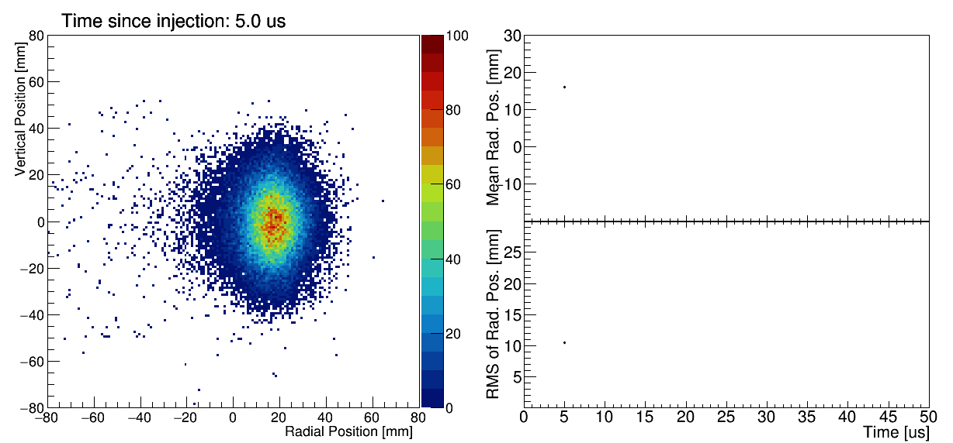
Muon weighted average magnetic field
Using tracker profiles and beam dynamics simulation
Improvements
Better placement of beam, due to replacing broken resistors
Better placement of beam, due to stronger kick
CBO reduction due to quad RF (run 5)

Slide 21
Summary
First time a three-way comparison of a_{µ}
is possible, very exciting
Run 2 / 3 analysis on-going
Magnetic field tracked by trolley system (spatial distribution) and fixed probe system (drift)
Probes are calibrated with absolute calibrated water probe twice a year
Detailed measurement campagnes to measure transient magnetic fields from kickers and quads
Improvements in running conditions (temperature stability), data processing (position reconstruction) and analysis
Exciting times ahead!
Thank you
Notes:
\documentclass{article}
\usepackage{amsmath}
\pagestyle{empty}
\begin{document}
\begin{tabular}{lrr}
\hline
\hline
Quantity & Correction Terms & Uncertainty \\
& (ppb) & (ppb) \\
\hline
$\omega_a^m$ (statistical) & - & 100 \\
$\omega_a^m$ (systematic) & - & - \\
\hline
Total systematic & - & 100 \\
Total fundamental factors & - & 25 \\
Totals & - & 140 \\
\hline
\hline
\end{tabular}
\end{document}

Slide 22
Backup

Slide 23
Magnetic Field Analysis Overview
calibration
quality cuts
field tracking
muon weighting
transients

Slide 24
Uncertainty budget
Run 1 uncertainties
Technical Design Report goal
  Total uncertainty 140 ppb
  Total systematic uncertainty 100 ppb
  Magnetic field uncertainty 70 ppb
Dominant magnetic field uncertainty due to transient fields from quadrupole and kicker operations
  Conservative estimate for run 1
  Detailed investigation ongoing
Reduce tracking uncertainty to achieve overall goal

Slide 25
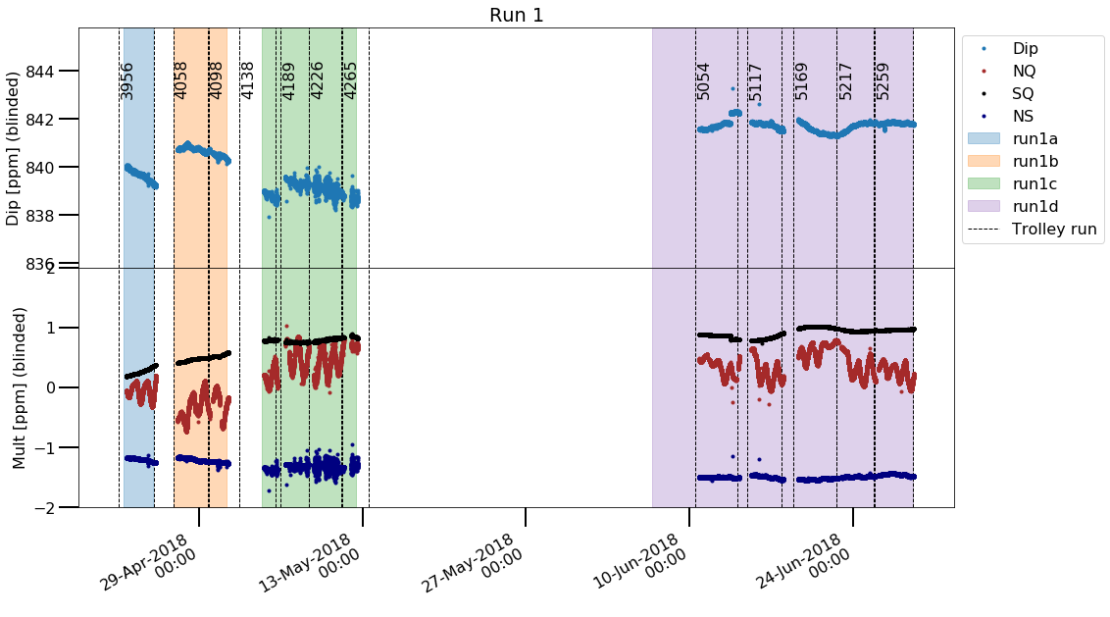
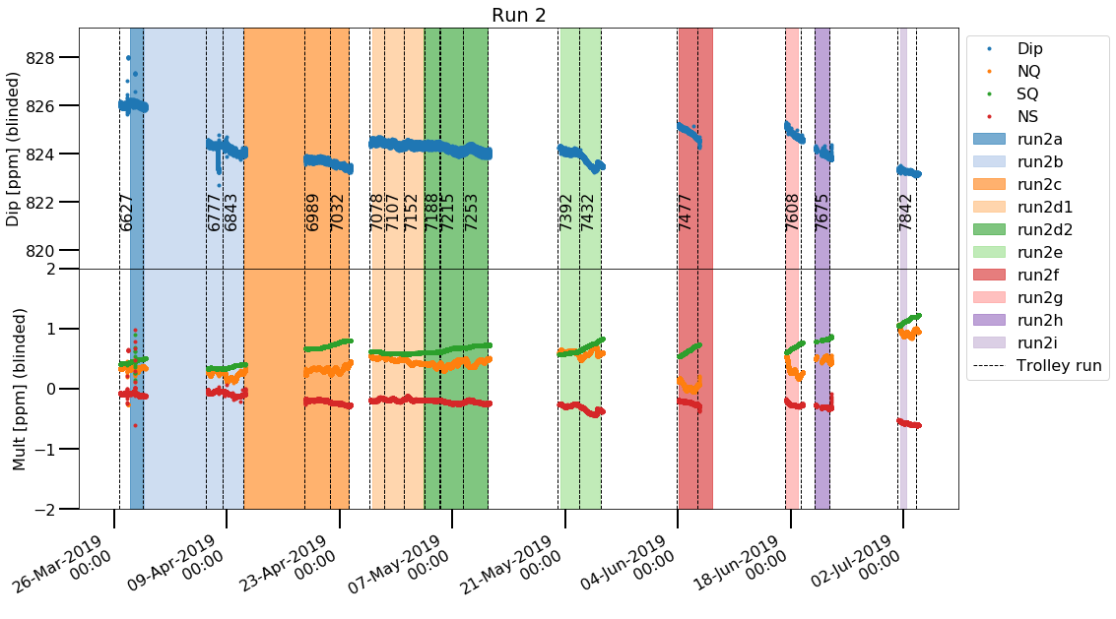
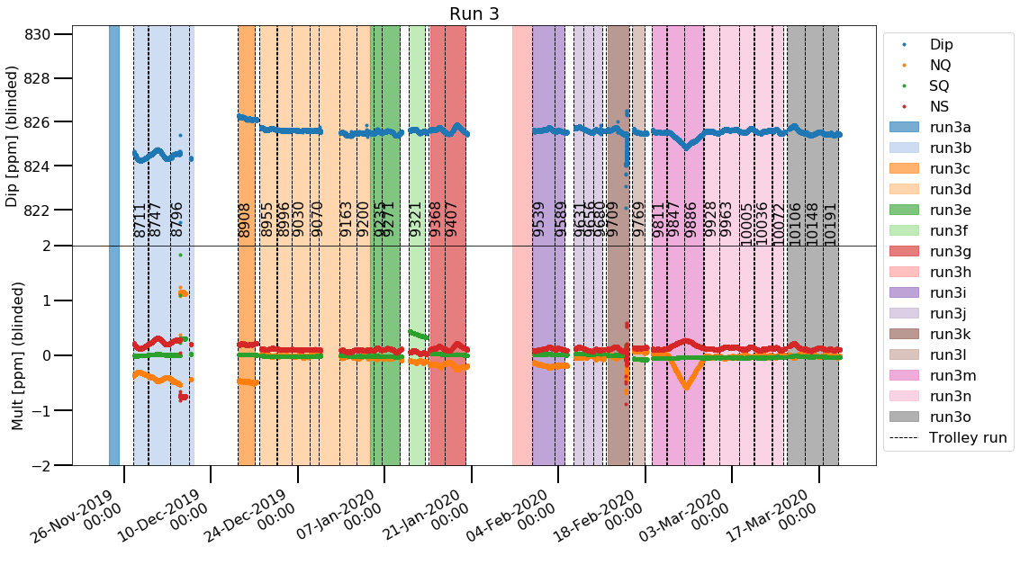
Magnetic field stability
Hall temperature changes
caused field changes
See diurnal field variation
Influences magnetic field systematic

Slide 26
Magnetic field stability
Magnet insulation
Hall temperature changes
caused field changes
See diurnal field variation
Influences magnetic field systematic
before
after

Slide 27
Magnetic field stability
Magnet insulation
Hall temperature changes
caused field changes
See diurnal field variation
Influences magnetic field systematic
before
after

Slide 28
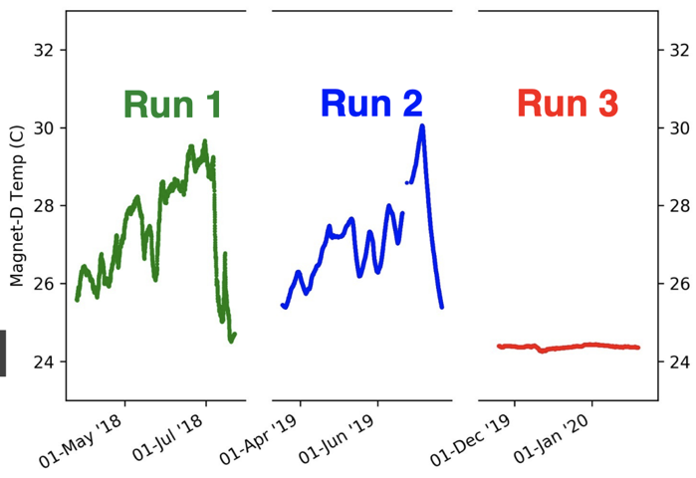
Magnetic field stability
Magnet insulation
Upgrade Air Conditioning System
Hall temperature changes
caused field changes
See diurnal field variation
Influences magnetic field systematic
before
after

Slide 29
Magnetic field stability
Improved
operating conditions
Magnet insulation
Upgrade Air Conditioning System
Hall temperature changes
caused field changes
See diurnal field variation
Influences magnetic field systematic
before
after

Slide 30
Run 1 Result
Muon g-2 collaboration published Run 1 result
B. Abi et al. (Muon g−2 Collaboration) Phys. Rev. Lett. 126, 141801, 2021
Uncertainty in theory calculation dominated by calculation of hadronic vacuum polarization
Dispersive approach, 4.2σ tension
T. Aoyama et al., Phys. Rept. 887 (2020) 1-166
Lattice QCD approach , 1.5σ tension
Borsányi et al., Nature 593, 51–55, 2021 and arXiv:2002.12347
Figure: Zoltan Fodor

Slide 31
Magnetic Storage Ring
In order to measure to the required precision:
Keep the field as uniform as possible
  passive & active shimming
Keep the field as stable as possible
  power supply feedback & temperature stabilization
Measure the field experienced by the muons
Track drifts during the times when muons are present
Calibrate the field measurements with a well-understood measurement standard
B = 1.45 T

