Slide 1
A new method with minimized systematic error sources to detect axion dark matter in storage rings using an rf Wien filter
On Kim¹ and Yannis K. Semertzidis^{1,2}
¹Institute for Basic Science, Center for Axion and Precision Physics Research
²Korea Advanced Institute of Science and Technology, Physics Department
2022 July 7th
41th International Conference on High Energy Physics

Slide 2
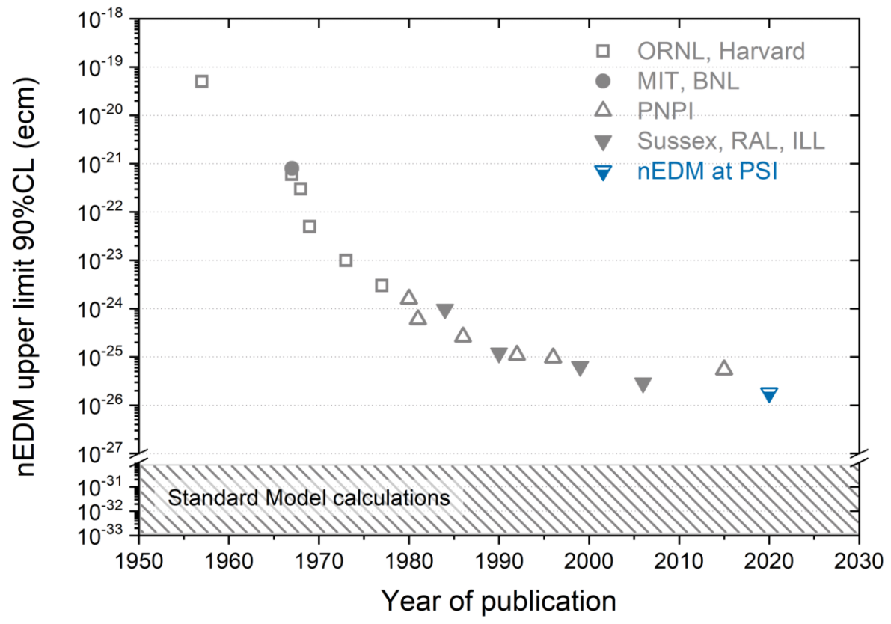
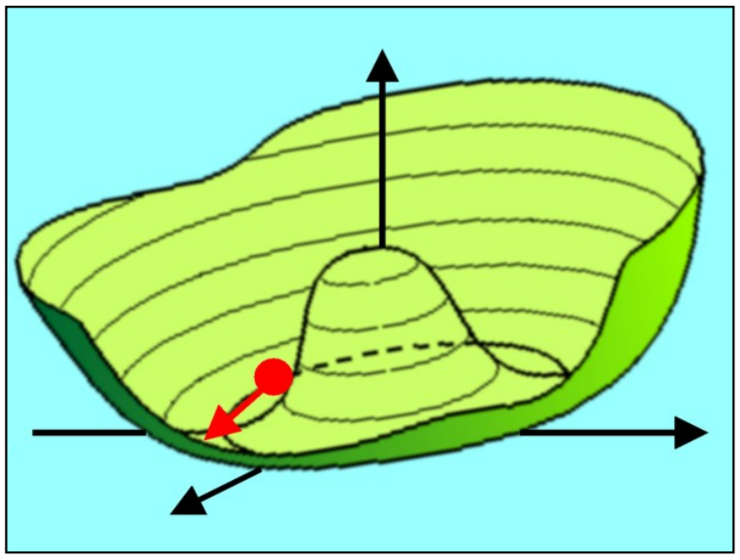
Axion Dark Matter
Strong $CP$ problem: why $θ_{CP}≪𝒪\left(1\right)$?
$$d_{n}\sim \overline{θ}×{10}^{−16} e⋅cm$$
$$\overline{θ}<5×{10}^{−11}$$
Peccei-Quinn theory
$U_{PQ}\left(1\right)$ spontaneous symmetry breaking induces a dynamical pseudoscalar field: Axion
Dark Matter (DM) candidate
Axions or Axion-Like Particles (ALPs) can constitute some or all DM $⇒$ Axion-like dark matter
Phys. Rev. Lett. 38, 1440 (1977)
Georg Raffelt
C. Abel et al. Phys. Rev. Lett. 124, 081803 (2020)

Slide 3
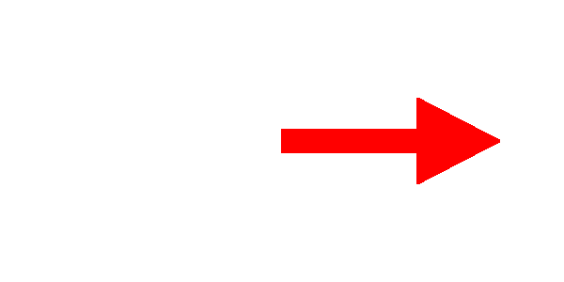
Storage ring probes of axion DM
Couplings with axion-like DM through nucleon EDM P. Graham and S. Rajendran, PRD 88, 035023 (2013)
ALP DM-EDM ($g_{aNγ}a{\hat{σ}}_{N}⋅E$) $⇒$ oscillating EDM at $m_{a}$. For the QCD axion: $d_{N}^{QCD}≈{10}^{−34}\cos\left(m_{a}t\right) e⋅cm$.
$$ω_{axion−EDM}∝\cos\left(m_{a}t\right)\hat{x}$$
Spin precesses around this oscillating axis.
$$p$$

Slide 4
Oscillating EDM
How should we detect it?
First, review the frozen spin method for the static $d$.
Frozen spin
Spin rotates vertically due to $ω_{EDM}$
$$ω_{EDM}$$
MDM ($g−2$ precession)
In-plane
EDM Out-of-plane
$$G≡\frac{g−2}{2}$$

Slide 5
Oscillating EDM
How should we detect it?
What if $d=d_{0}\cos\left(m_{a}t\right)$ oscillates? (used an extreme case for illustration)
Frozen spin
& Oscillating EDM
Spin does not rotate vertically on average
$$ω_{EDM}$$
MDM ($g−2$ precession)
In-plane
EDM Out-of-plane
$$G≡\frac{g−2}{2}$$

Slide 6
Oscillating EDM
How should we detect it?
Why don’t we make spin precess in the ring plane at the same frequency? (used an extreme case for illustration)
$g−2$ precession
& Oscillating EDM
Spin rotates vertically on average when
$$ω_{EDM}$$
$$ω_{MDM}=m_{a}$$
MDM ($g−2$ precession)
In-plane
EDM Out-of-plane
S. Chang et al.,
Phys. Rev. D 99, 083002 (2019)
$$G≡\frac{g−2}{2}$$

Slide 7
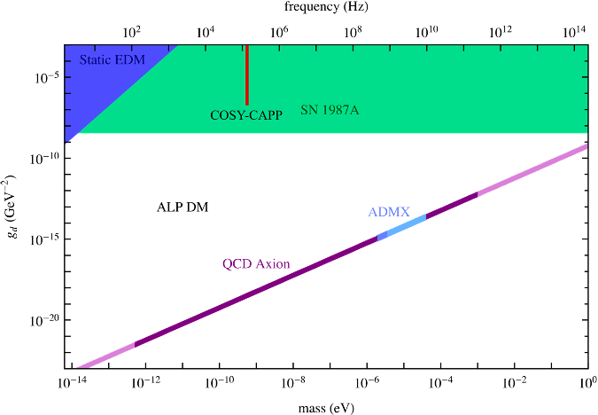
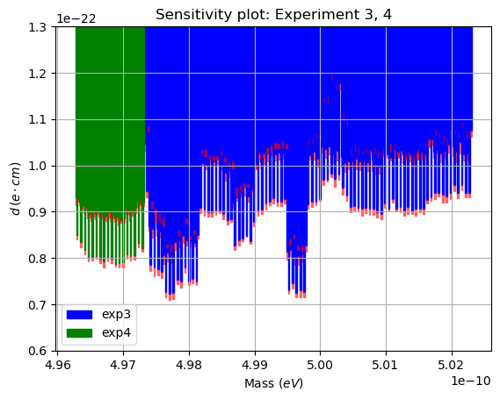
First axion DM search in a storage ring
IBS-CAPP and COSY collaborated to conduct a precursor experiment at COSY in 2019.
Total measurement time: ~4 days.
Total statistics: 2M hits.
Preliminary analysis (Seung Pyo Chang (IBS-CAPP)): $d≲{10}^{−22} e⋅cm$ at $m_{a}≈0.5 neV$.

Slide 8
A new method using an rf Wien filter
The resonance condition of the previous method is: $ω_{MDM}\left(≡ω_{g−2}\right)=m_{a}$.
Not very practical to “manipulate” $ω_{g−2}$ for scanning $m_{a}$, because one needs to change the momentum accordingly ($p=Br_{0}$ for a magnetic ring).
New idea is to add another knob to tune the resonance with an rf field inside the storage ring.
$$\left|ω_{g−2}±ω_{rf}\right|=m_{a}$$
Natural candidate is an rf Wien filter (WF) which exerts no Lorentz force on the beam by design.
$$\left|ω_{g−2}±ω_{WF}\right|=m_{a}$$
$$F_{WF}=q\left(E_{WF}+v×B_{WF}\right)=0$$

Slide 9
A new method using an rf Wien filter
Putting all possibilities together
Axion-induced EDM search in storage rings
PRL 93, 052001 (2004)
RSI 87, 115116 (2016)
PRAB 16, 114001 (2013)
PRAB 23, 024601 (2020)
PRD 99, 083002 (2019)
EPJC 80, 107 (2020)
PRD 104, 096006 (2021)
Frozen-spin
Highly constrained by systematic effect
Challenging to change $ω_{g−2}$
Practical way to scan $m_{a}$ by tuning $ω_{WF}$.
Avoid systematic effects by carefully tuning $ω_{WF}$.
No need to build a new storage ring.

Slide 10
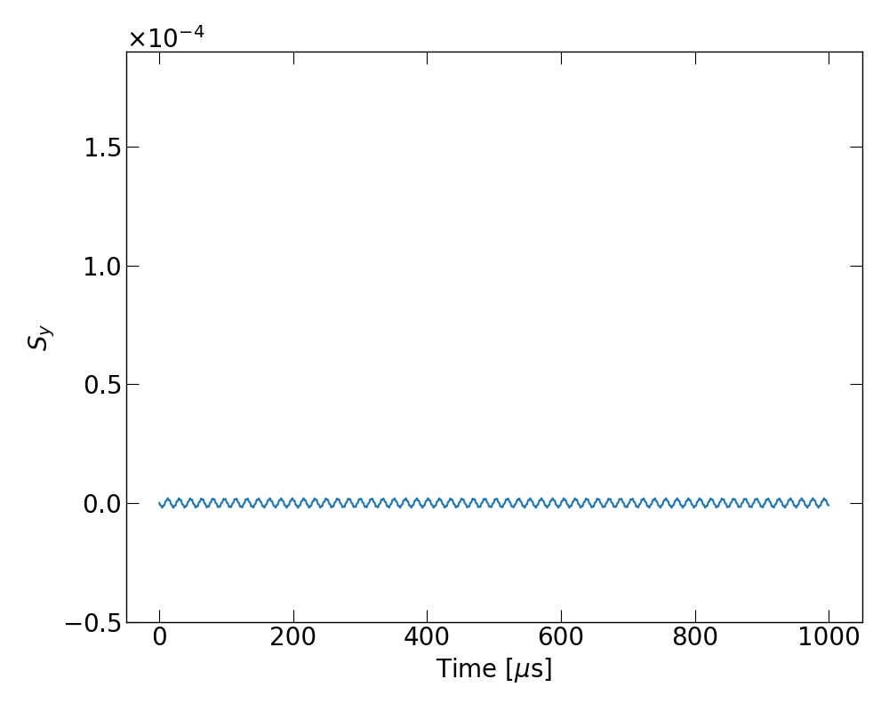
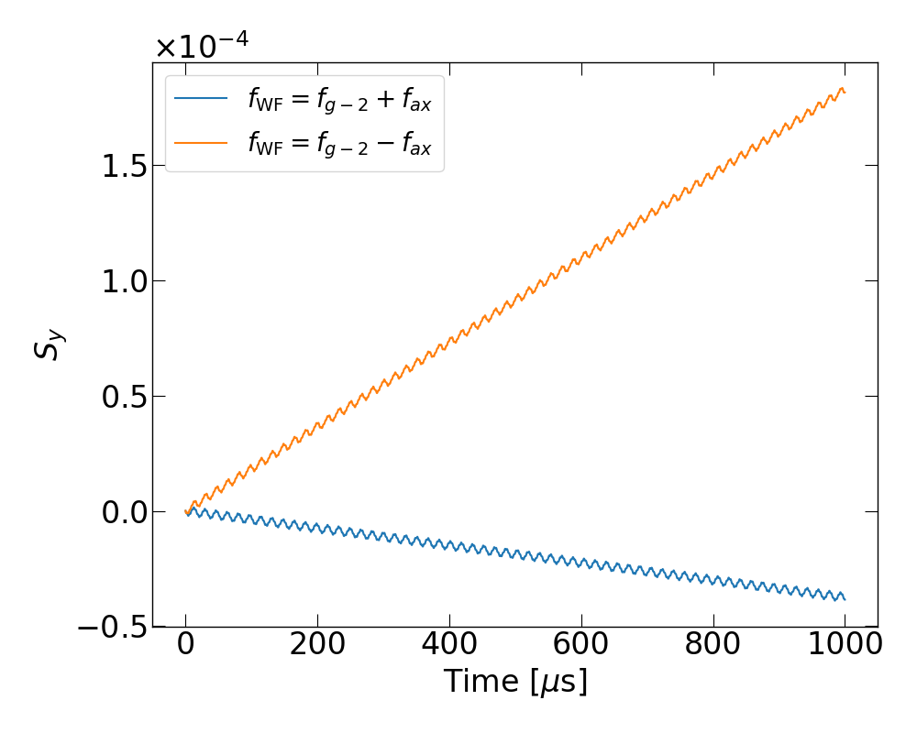
Numerical verification
High precision spin tracking simulation
No approximation in Lorentz force & T-BMT equations. Used $f_{g−2}≈120$ kHz and $f_{axion}=180$ kHz as an example.
Without WF
With WF

Slide 11
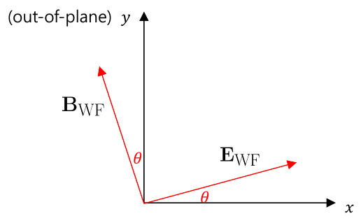
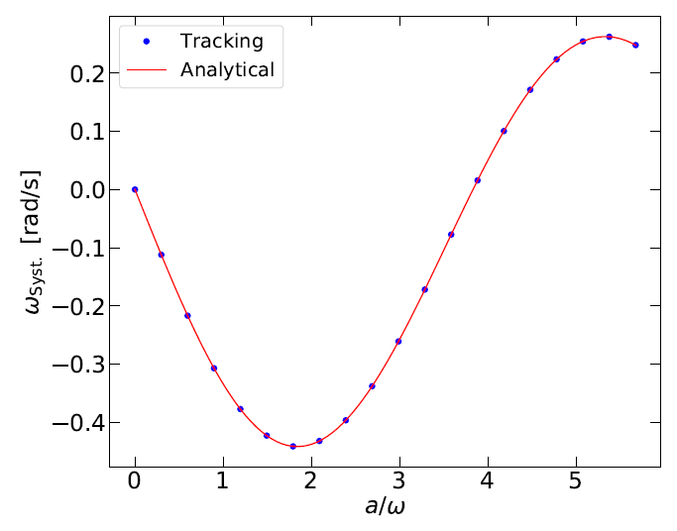
Systematic effects
“Frozen spin” suffers from field errors ($B_{r}, E_{v}$) $⇒$ And beautifully resolved by CW/CCW beam, hybrid & symmetric ring design
When we drop the frozen-spin and those dc field errors are not the problem. But an rf field errors can be critical, for instance from small misalignments of the WF.
The systematic “false EDM” signal is huge.
Z. Omarov et al., PRD 105, 032001 (2022)
$$θ_{m}=1 μrad$$
Analytical estimation
Typical EDM signal $\sim 𝒪\left(1 nrad/s\right)$
: WF performance parameter

Slide 12
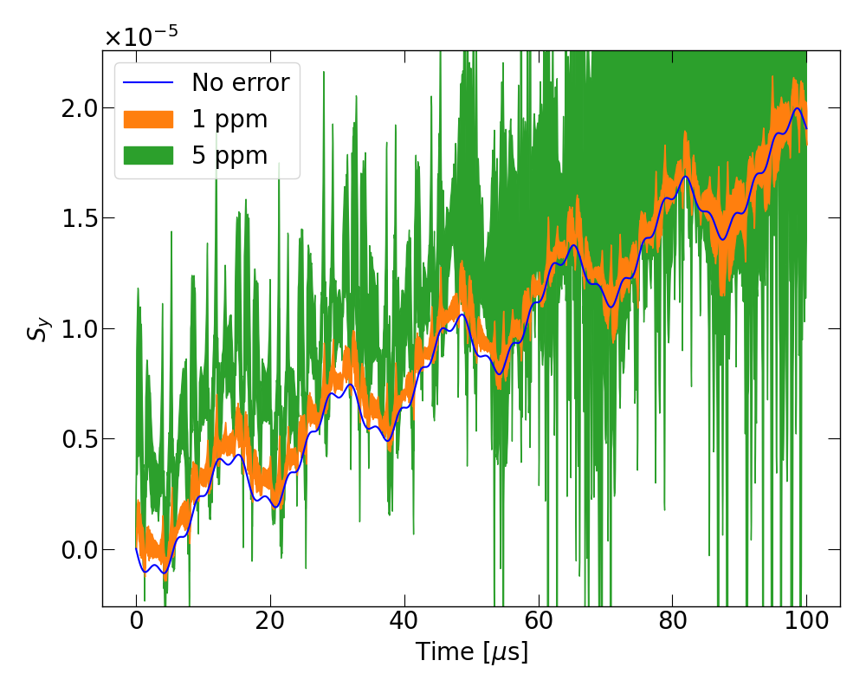
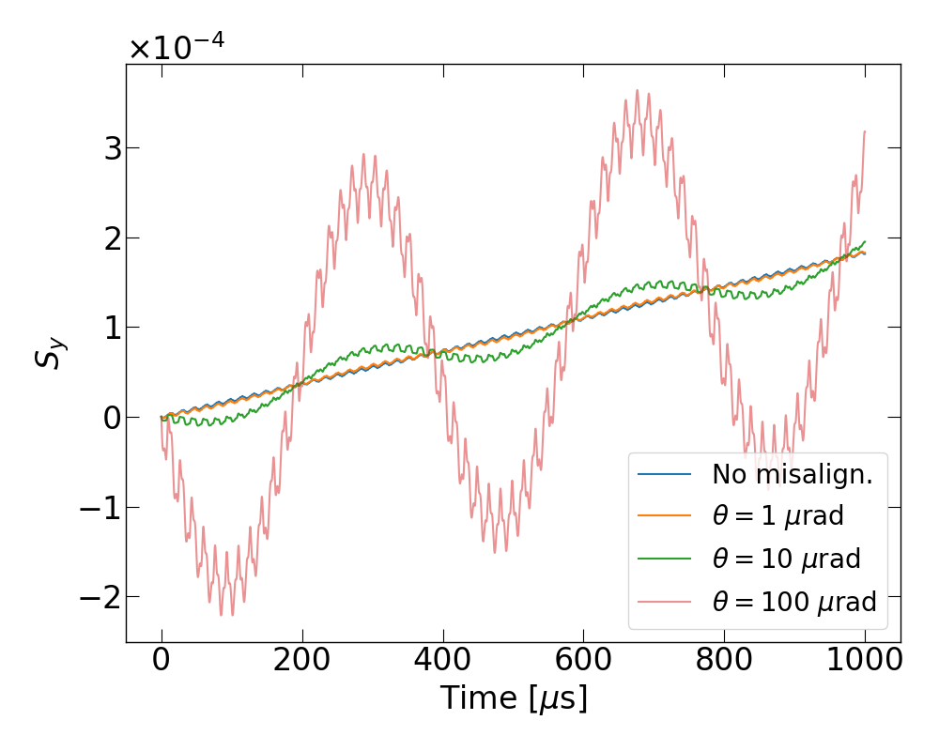
Systematic effects
New method using the WF vetoes the described systematic effect by using distinct resonant frequency.
Typical field errors of $𝒪\left(1 ppm\right)$ also turned out not significant.
In general, if there appears a signal, one can tell if it’s a true or false signal by readjusting $ω_{WF}$ & $ω_{g−2}$ targeting the same $m_{a}$.
$$ω_{g−2}=\left|ω_{WF}±m_{a}\right|$$

Slide 13
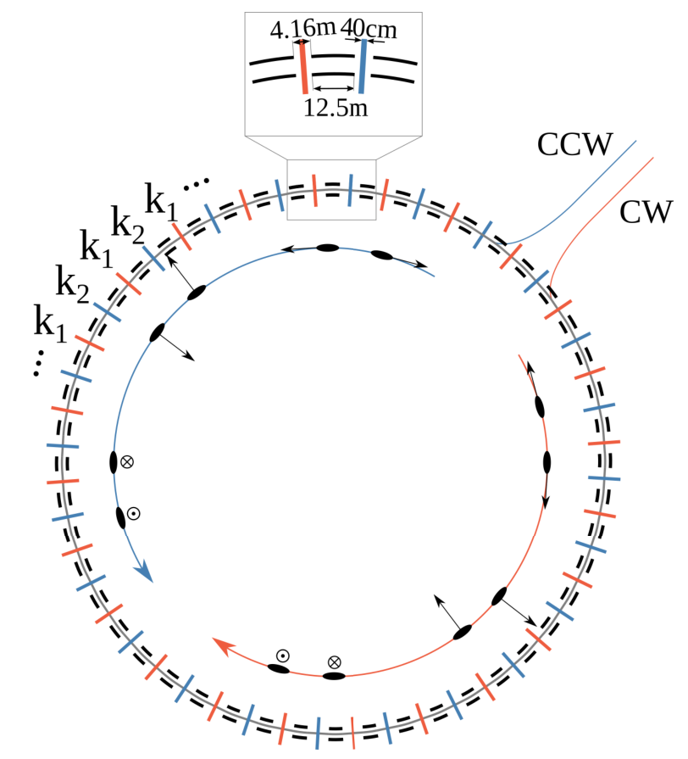
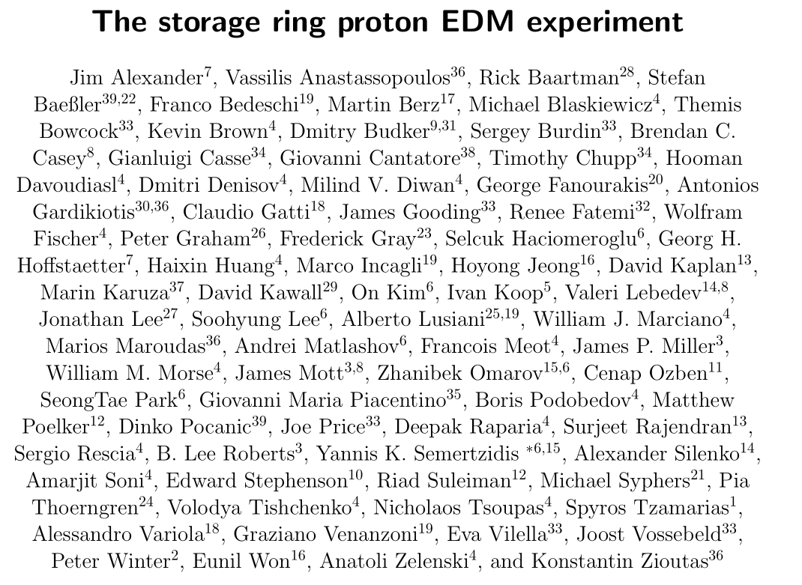
Snowmass proposal: pEDM experiment
Comprehensive studies are underway to realize the pEDM experiment.
Snowmass proposal arXiv:2205.00830
Symmetric-hybrid lattice design Z. Omarov et al., PRD 105, 032001 (2022)

Slide 14
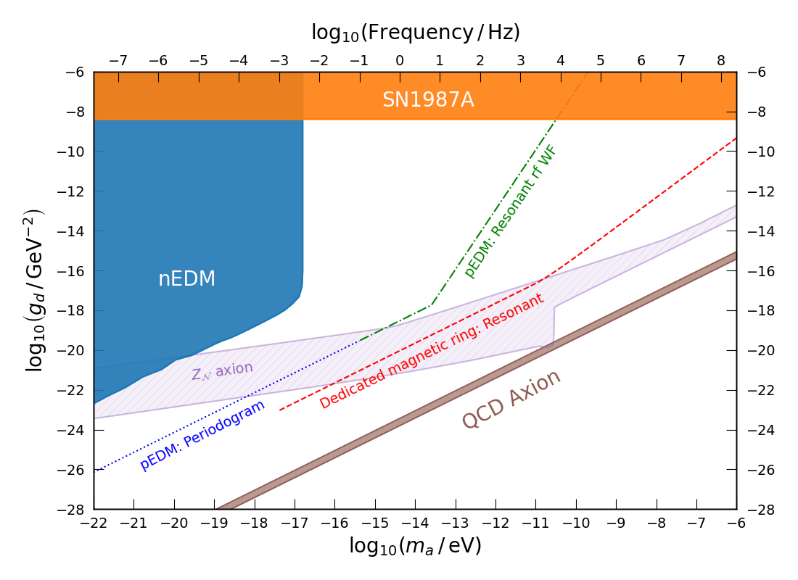
Sensitivity
Axion-EDM coupling $g_{d}$
Theoretically-motivated
QCD axion P. Graham and S. Rajendran, PRD 88, 035023 (2013)
$Z_{𝒩}$ axion L. Luzio et al., JCAP 2021, 001, JHEP 2021, 184
Excluded
(Direct) nEDM C. Abel et al., PRX 7, 041034 (2017)
(Indirect) SN1987A P. Graham and S. Rajendran, PRD 88, 035023 (2013)
Projected sensitivity (preliminary)
Parasitic to proposed pEDM experiment.
Periodogram: Oscillating EDM is effectively dc EDM.
Resonant rf WF: apply WF to make a resonance.
Dedicated magnetic ring (assuming $B≈1 T$).
Tune $ω_{g−2}$ or $ω_{WF}$.
Other experiments
CASPEr D. Budker et al., PRX 4, 021030 (2014)
nEDM beams I. Schulthess et al., arXiv:2204.01454

Slide 15
Summary
Storage ring EDM method is applicable to search for axion-like dark matter.
Spin precession as observables. Projected EDM sensitivity $\sim 𝒪\left({10}^{−29} e⋅cm\right)$.
Sensitive to relatively low mass regions ($m_{a}≲μeV$).
New method utilizing an rf Wien filter has been studied.
Wider scannable range by tuning the WF frequency.
Minimal systematic effects.
Applicable to existing storage rings.
Parasitically applicable to pEDM experiment.
Thank you for your attention!

Slide 16
Backups

Slide 17
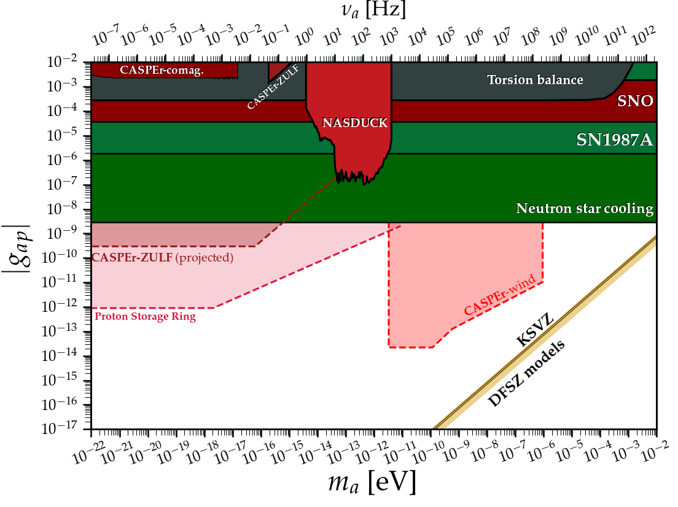
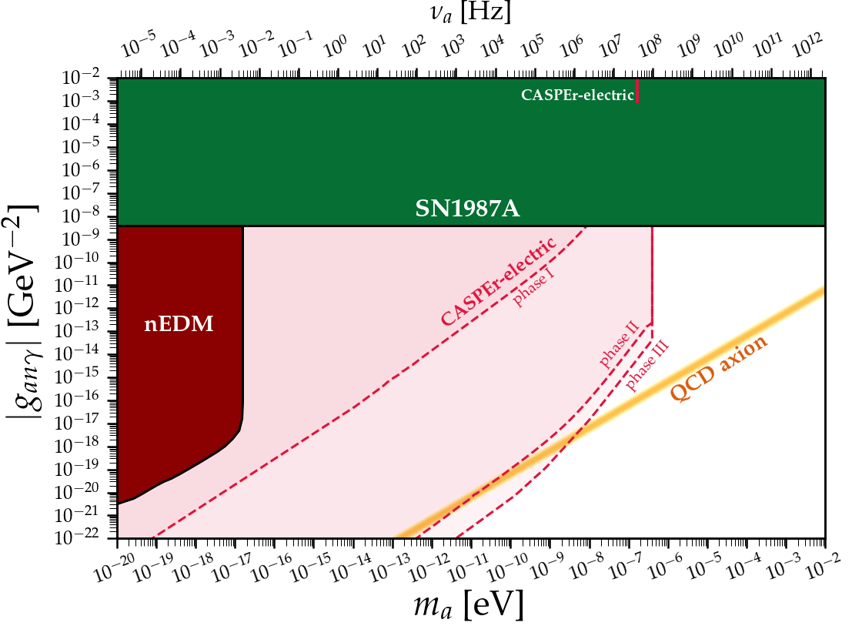
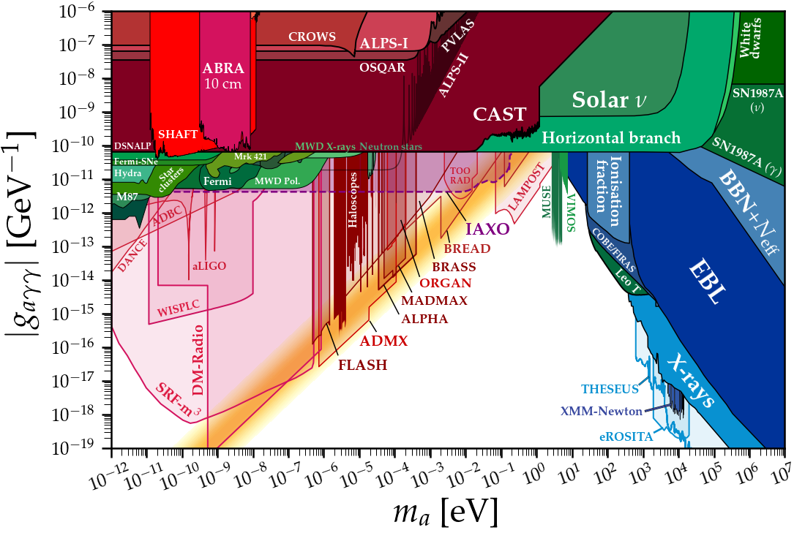
Axion coupling with SM particles
In general, there are three sorts of axion-SM couplings
$$g_{aγγ}aE⋅B$$
$$g_{aff}∇a⋅\hat{S}$$
$$g_{EDM}a\hat{S}⋅E$$
Haloscope
Helioscope
Light Shinning through Wall
…
ARIADNE
CASPEr
Storage ring
…
nEDM
CASPEr
Storage ring
…
Source: Ciaran O'Hare, https://cajohare.github.io/AxionLimits

Slide 18
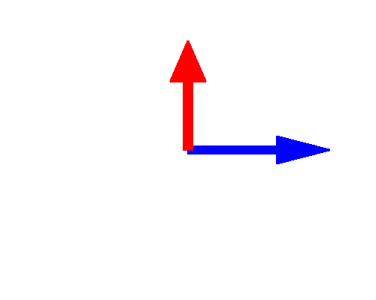
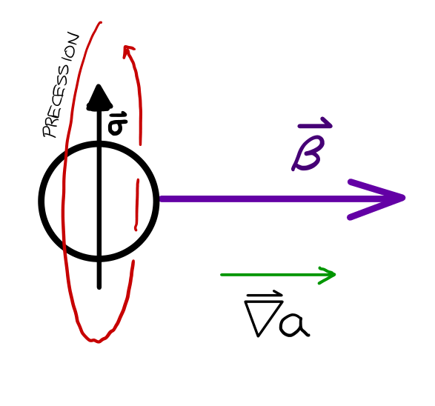
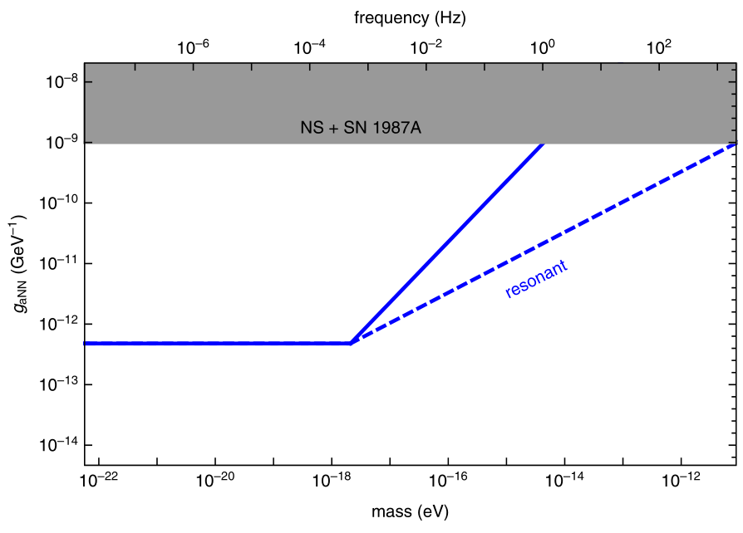
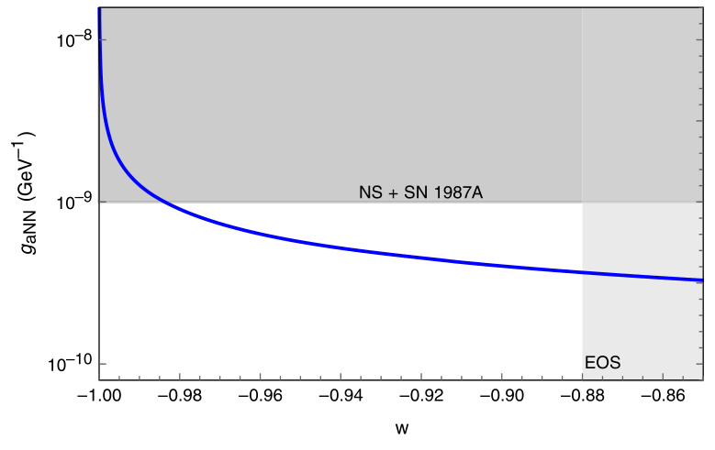
Storage ring probes of DM/DE
P. Graham and S. Rajendran, PRD 88, 035023 (2013)
P. Graham et al., PRD 103, 055010 (2021)
Couplings with dark matter (DM) and dark energy (DE)
ALP or vector DM wind ($g_{aNN}∇a⋅{\hat{σ}}_{N}$) $⇒$ anomalous longitudinal oscillating $B$ field.
DE wind $⇒$ anomalous longitudinal $B$ field.
Storage ring is an optimal probe for wind coupling since $β$ is large!
$$ω_{DM}∝\cos\left(m_{a}t\right)\hat{β}$$
$$ω_{DE}∝\hat{β}$$
$$p$$
DE wind
DM wind

Slide 19
Storage ring probes of DM/DE
P. Graham and S. Rajendran, PRD 88, 035023 (2013)
P. Graham et al., PRD 103, 055010 (2021)
Couplings with dark matter (DM) and dark energy (DE)
ALP or vector DM wind ($g_{aNN}∇a⋅{\hat{σ}}_{N}$) $⇒$ anomalous longitudinal oscillating $B$ field.
DE wind $⇒$ anomalous longitudinal $B$ field.
ALP DM-EDM ($g_{aNγ}a{\hat{σ}}_{N}⋅E$) $⇒$ oscillating EDM at $m_{a}$. For the QCD axion: $d_{N}^{QCD}≈{10}^{−34} e⋅cm$.
$$ω_{axion−EDM}∝\cos\left(m_{a}t\right)\hat{x}$$
$$p$$
Storage ring probes of axion-induced oscillating EDM: S. Chang et al., PRD 99, 083002 (2019).
Complementary method using an rf Wien filter: On Kim and Y. Semertzidis, PRD 104, 096006 (2021).
Allows parasitic measurement with pEDM experiment: (LF) periodogram + (HF) rf resonance.

Slide 20
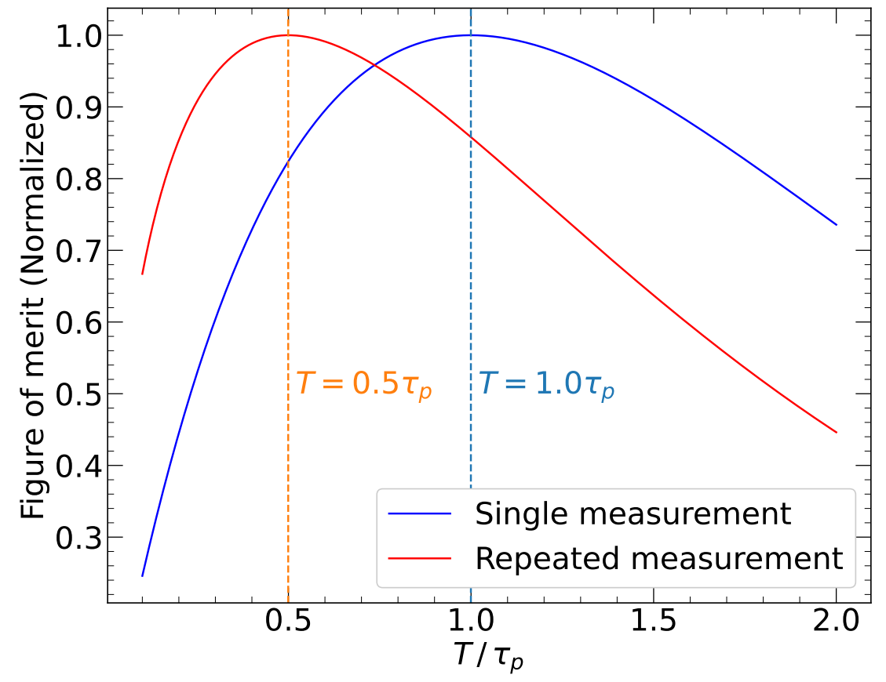
Statistical sensitivity
Weighting the data taking
Essentially we seek for non-zero asymmetry ($ε$) as a EDM signal:
Because $θ\left(t\right)$ grows with time, it’s better to have large statistics at later time than earlier.
As an extreme limit, consider taking ALL statistics at time $T$.
This enhances the sensitivity by ~50%.
Considering the repeated measurements, we have:
optimized when $T=0.5 τ_{p}$.

Slide 21
Statistical sensitivity
Statistical sensitivity has been modified accordingly in presence of the WF.
Putting ideal experimental conditions:
Initial polarization
Effective E field
Polarimeter efficiency
Total experiment time
$$E^{∗}≡E_{0}−vB_{0}$$
Spin
Analyzing power
WF coefficient
Number of particles per cycle
Spin coherence time
$$P=P_{0}e^{−t/τ_{p}}$$

