Slide 1
Juan Ramos Cabezas (Ariel University, Israel)
Title of the presentation:
A Large family of solvable lattice models (Interaction round to face) based on WZW models
The talk is partially based on the paper: “The crossing multipliers of solvable lattice models”, arxiv. 2110.09798. V. Belavin, D. Gepner, J. Ramos.
July 8, 2022
41st International Conference on High Energy Physics, Bologna, Italy.

Slide 2
Content:
Known models:
[Jimbo, Miwa and Okado, Nucl.Phys.B 300 (1988);
Commun. Math. Phys. 116(1988)]
Definition of the Interaction Round-to-Face 2D lattice models.
Solution of the Models.
Physical quantities we can define and find.
Generalization of known models.
A general method to solve them (Proposal). Application (connection with other fields of physics).
New models:
[Gepner, 1990, arxiv, 9211100]

Slide 3
Interaction Round-to-Face Lattice models (IRF)
Definition of the model: N
a
b
c
d

Slide 4
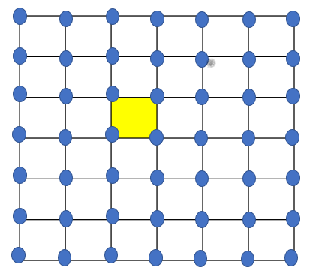
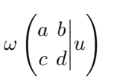
Interaction Round-to-Face Lattice models (IRF)
Affine Lie algebras:
Affine Lie algebras:
Definition of the model: N
a
b
Basis:
c
d
“Rules of the game ”:
How to find the Boltzmann weights of this model?
Yang-Baxter equation:

Slide 5
Interaction Round-to-Face Lattice models (IRF)
Affine Lie algebras:
Affine Lie algebras:
Definition of the model: N
a
b
Basis:
c
d
“Rules of the game ”:
How to find the Boltzmann weights of this model?
Yang-Baxter equation:
a
b
a
b
a
b
u+v
u
g
g
=
f
v
=
f
v
c
u
c
u
u+v
c
d
g
u
g
e
d
e
d

Slide 6
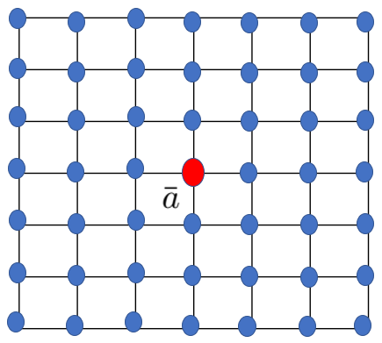
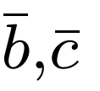
Solutions of Jimbo-Miwa-Okado models
What other physical quantities we can compute?
Crossing multipliers
Principal specialized character a representation
To compute it we use: the CTM method of Baxter; Some simplifications; Inversion relation of BW
Relation of LSP with the branching functions

Slide 7
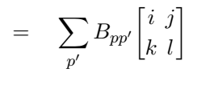
Generalization and Gepner method
Generalization of the admissible conditions (rules of the game)
a
b
Affine Lie algebras:
Affine Lie algebras:
Basis:
c
d
“Rules of the game ”:
Generalization of the rules:
Fusion rules of fluctuation variables:
Gepner’s method: With this method we can find Boltzmann weights of any IRF models based on any algebra once we have:
Braiding matrices of the CFT related to the IRF model in question
j
k
j
k
i
p’
p
l
i
l
j
k
j
k
p’
i
p
l
i
l

Slide 8
Conclusions
We expect that our conjecture about the LSP of other IRF models based on the other AL algebras holds.
We can check this proposal for some specific new models (algebras).
The method here discussed is a powerful method that can help us to solve new interesting IRF models. We plan to apply this method to solve new models.
[M.Gaberdiel, Gopakumar, An AdS_3​ Dual for Minimal Model CFTs] . Is the LSP related to some models which live in an AdS_3?

Slide 9
Thank you for your attention

