Slide 1
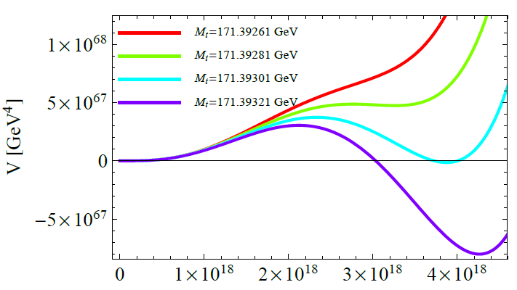
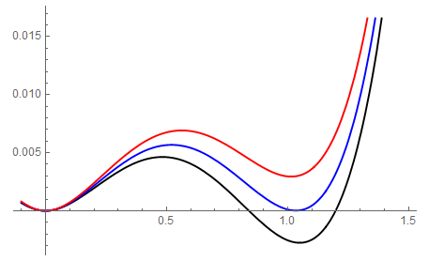
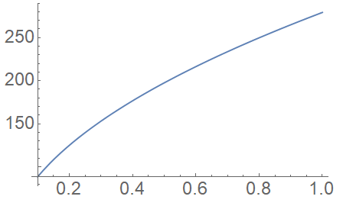
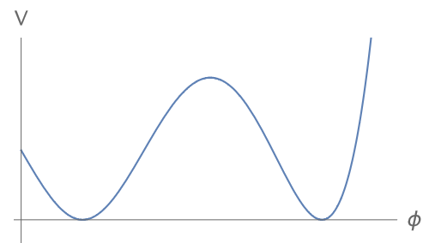
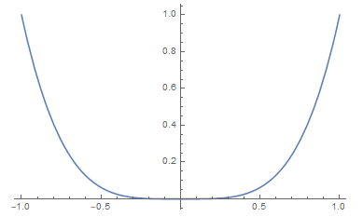
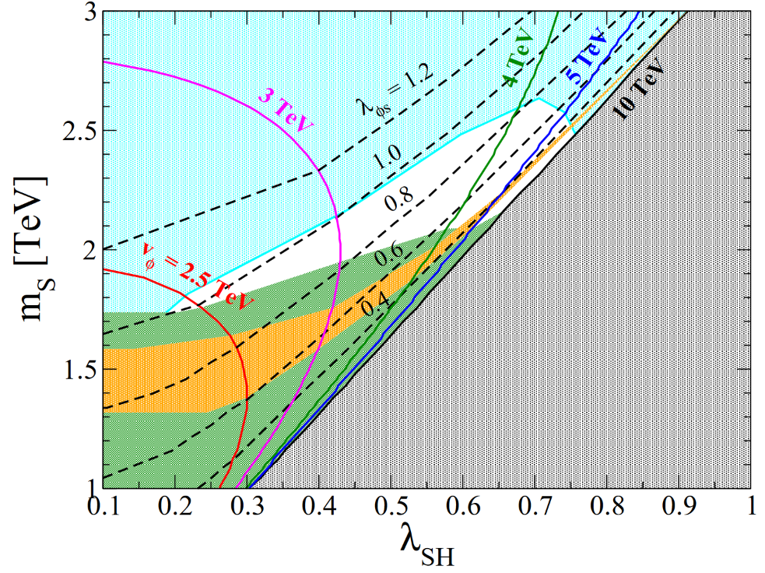
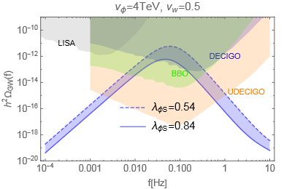
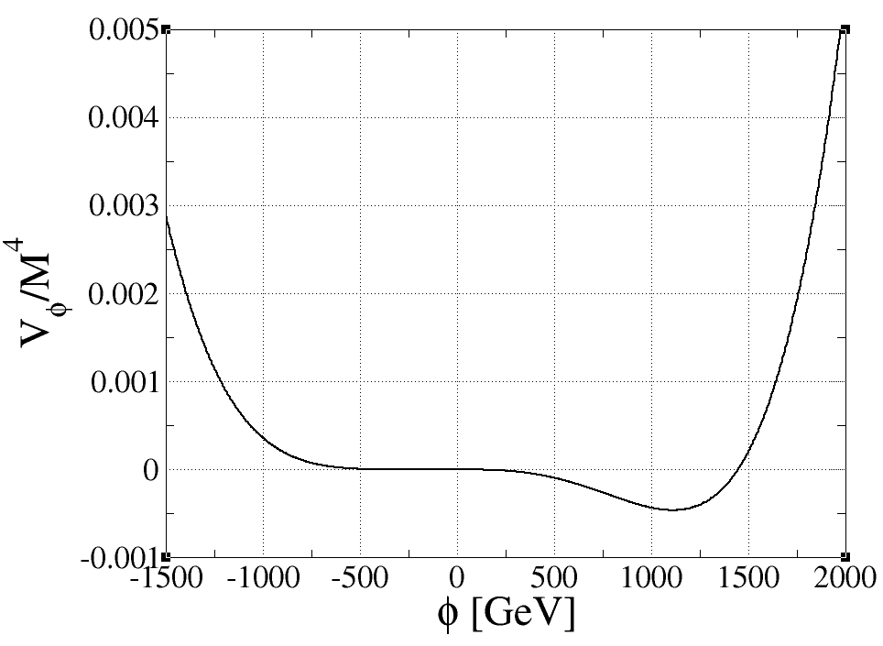
Multicritical Point Principle and Its Phenomenology
Eur. Phys. J. C 82, 5, 481 (2202.04221 [hep-ph])
JHEP 01, 087 (2008.08700 [hep-ph])
Yuta Hamada^{(a)}, Hikaru Kawai^{(b)}, Kiyoharu Kawana^{(c)}, Kin-ya Oda^{(d)}, Kei Yagyu^{(e)}
(a) KEK, (b) National Taiwan U., (c) Seoul National U., (d) Tokyo Woman’s Christian U., (e) Osaka U.
Multicritical point principle (MPP)?
Froggatt & Nielsen (1995)
Potential at finite temperature
m_{h} ~ 125 GeV and m_{t} ~ 171 GeV can indicate criticality.
Hamada, Kawai, Oda, Park (2015)
MPP: Parameters are tuned to one of the multicritical points of vacua.
T_{c} [GeV]
M = 1 TeV
Generalize
E.g., 1 parameter tuning
h [GeV]
λ_{ΦS}
Deg. vacua
V’ = V’’ =0
Critical temperature (T_{c}) is determined only by λ_{ΦS}.
We propose a minimal model for DM and dim. transmutation in the MPP.
1st order phase transition can be realized! → GWs?
Minimal model with MPP
S → -S
(to be DM)
Results
・SM + Φ & S (real scalars, singlet under SM) with a Z₂ sym.
・Model parameters: λ_{H}, λ_{ΦH}, λ_{ΦS}, λ_{SH}, M (λ_{S} : not relevant to pheno.)
→ m_{h}~125 GeV, v~246 GeV, m_{S} (DM mass), v_{Φ}, λ_{SH}
・Scalar potential with a maximal criticality:
Others
→ even
Trigger the EWSB when Φ develops a VEV
Landau pole below 10¹⁸ GeV
Gravitational wave spectrum
DM abundance
cannot be explained
Maximal (triple) criticality
λ_{ΦS} = 1, M = 1 TeV
*M is a scale where λ_{Φ} (coef. of Φ⁴) vanishes.
v_{Φ} ~ 1.1 M
Sound wave dominated
Φ = Φ_{S}
Excluded by XENON1T
Excluded by LHC
DM mass is well predicted to be ~ 2 TeV and GW signature can be
detected at DECIGO and/or BBO.
Dim. transmutation
ICHEP2022, Bologna (Italy), 8th July, 2022
Questions/Comments are welcome! → yagyu@het.phys.sci.osaka-u.ac.jp

