Slide 1
D&I Evolution at CERN since Higgs Boson ~ ICHEP 2022, Bologna ~
Louise Carvalho
Diversity & Inclusion Programme Leader, CERN
09 July 2022

Slide 2
CERN Value: Diversity
Diversity & Inclusion at
CERN is based on the three principles of :
appreciating differences, fostering equality,
promoting collaboration
CERN's Diversity value
CERN Code of Conduct

Slide 3
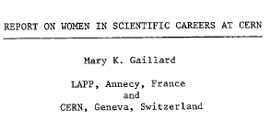
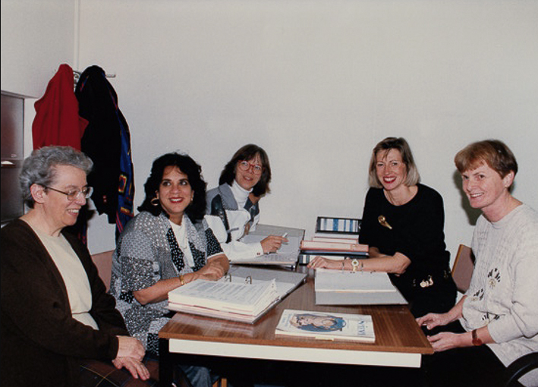
1983
1993
1996
Equal Opportunities Officer appointed
D&I-related
milestones @CERN
2010
Code of Conduct enters into force
Ombuds role established
Professionalization of Harassment resolution process
Diversity Programme established
2012
2019
“Diversity & Inclusion” Programme renamed
2021
First Gender Target approved by Management

Slide 4
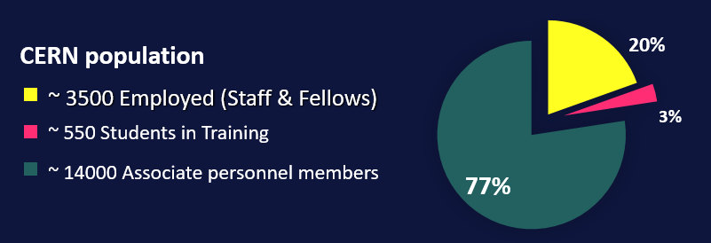
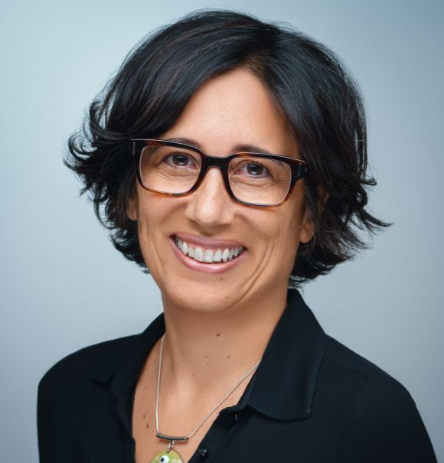
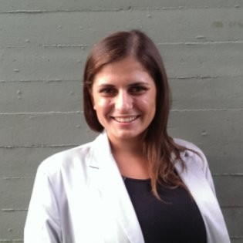
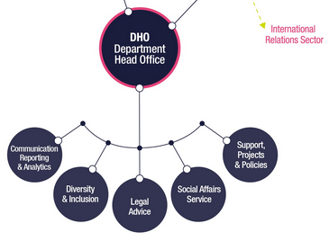
The Diversity & Inclusion (“D&I”) Programme
Louise Carvalho
D&I Programme Leader
(+ Legal Adviser, HR)
Melania Coletta
D&I Analyst

Slide 5
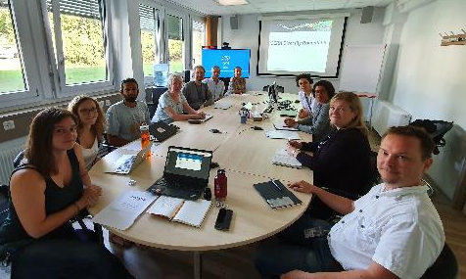
The Diversity & Inclusion Roundtable
Diversity Roundtable Recommendations “wholeheartedly” approved by the DG 2020
Making CERN’s Science Gateway accessible and inclusive.
Gender-inclusive language for Staff Rules and Regulations.
Extension of Fellow’s employment contract following maternity leave.
ATLAS, ALICE, CMS, LHCb
LGBTQ Network
Women in Technology Network
Disability Network
TH Diversity & gender representative
International Relations taskforce
Staff Association
Chaired by D&I Programme
Notes:
Barriers: D&I Reporting, bring the activists to the table

Slide 6
D&I-related sample actions at CERN
Gender Equality Plan; International Gender Champion; Contract extension post-maternity leave; Increase co-parent leave; Genera Network; Women-in-TECH network
Career Break Fellowship; Non-binary inclusion study group; Dual Career Network; DG Statement LGBTQ STEM;
Policies in gender inclusive language; Official D&I lanyard; D&I Roundtable; Nationality and Gender dashboards; Gender diverse selection boards; 577 email policy
D&I Awareness Workshops; Active Bystander training; D&I embedded in mandatory learnings;
Invisible dimensions poll; Harassment prevention seminars
STEM internship for students with disability; Central budget for office adaptations; Disability & Inclusion at work handbook
“Spouse & Partner equal rights”; Infant feeding room; Crèche en-site; Swiss working permit for spouse

Slide 7
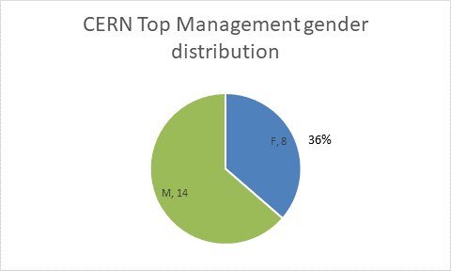
Leading from the Top
D&I Programme annual report to Tripartite Employment Forum (TREF) photograph featuring:
Madame President of CERN Council
Madame Chair or CERN Tripartite Employment Forum
Madame Director-General, CERN
Madame Legal Counsel, CERN
Madame President, CERN Staff Association (since 2020)
Aug 2021: Directors, Deputies, Dep’t Heads
Photo: Oct 2019; TREF, CERN

Slide 8
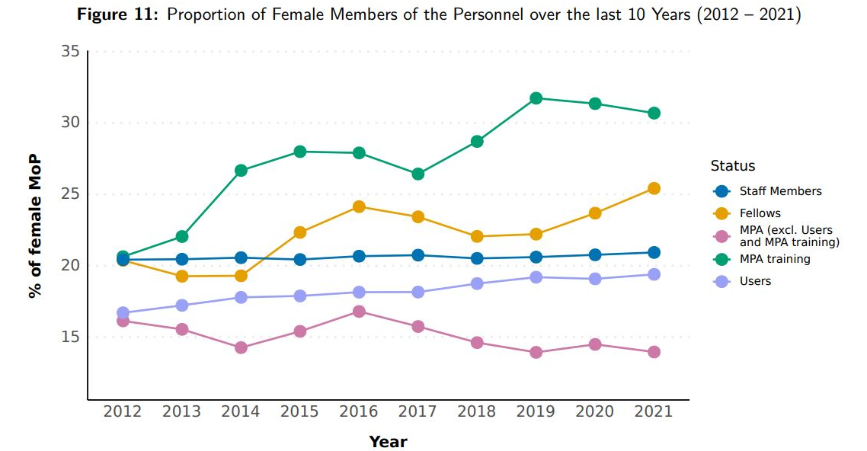
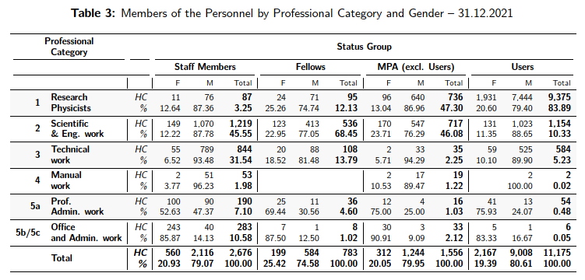
Proportion of Female Members of Personnel: Talent Pipeline
by Contract Type, 10 years’ evolution:
by professional category, @Dec 2021
- from post-secondary to post-doc
CERN Personnel Annual Statistics
Annual Personnel Stats, Dec 2021

Slide 9
“We commit to
placing the principles of
equality, diversity & inclusion
at the heart of all the
physics community’s
activities.”
- ESPP 2020 update
OUR VISION
scientific excellence through diversity and inclusion
OUR GOAL
to increase the nationality and gender diversity
of Staff & Fellows (MPE) population by 2025
The STRATEGY
GENDER target
NATIONALITY indicator
(aspirational)
Leadership-led
Leverage existing progress: gender balance increased in Senior Management
25% as an average across MPE population (not per Department)
Diversity & inclusion in recruitment (and talent pipelines), promotion, training, communications
Sustainable actions toward long-term gender parity
(not a cap, not a quota)
GOAL
With a particular focus on women in STEM:
GOAL
With a particular focus on under-represented MS and a more balanced return by 2025:
from 21%
in 2020
address nationality clusters
> 25%
25% in 2025
and increase our conscious efforts toward nationality diversity in recruitment & retention

Slide 10
Imperative: Top Management Endorsement
“The particle physics
community commits to
placing the principles of
equality, diversity & inclusion
at the heart of all the
physics community’s
activities.”
- ESPP 2020 update
Gender Equality Plans
in place by 2022
= New EC requirement
for all public research
organisations seeking funding
under Horizon Europe.
Companies with more diverse management teams have 19% higher revenues due to innovation.
- BCG 2018
As an International Organisation,
we need to reflect the diverse communities of our Member States

Slide 11
Maximise: Engagement, Collaboration, Accountability
Personnel
Management
D&I Programme
1. Strategy Paper to Director-General (2020).
2. Enlarged Directorate approves Strategy Proposal (2021)
5. Department Nat / Gen dashboard
3. Department Heads appoint Focal Points
6. Focal Points appoint Focus Groups (2021=
4. Kick-off meetings: Department Head + Focal Points
7. 1st D&I Review Exercise (2021-22)
8. Action Menu + Fitness Plans (2022)
= progress

Slide 12
D&I Periodic Review Exercise
using international standard benchmarks

Slide 13
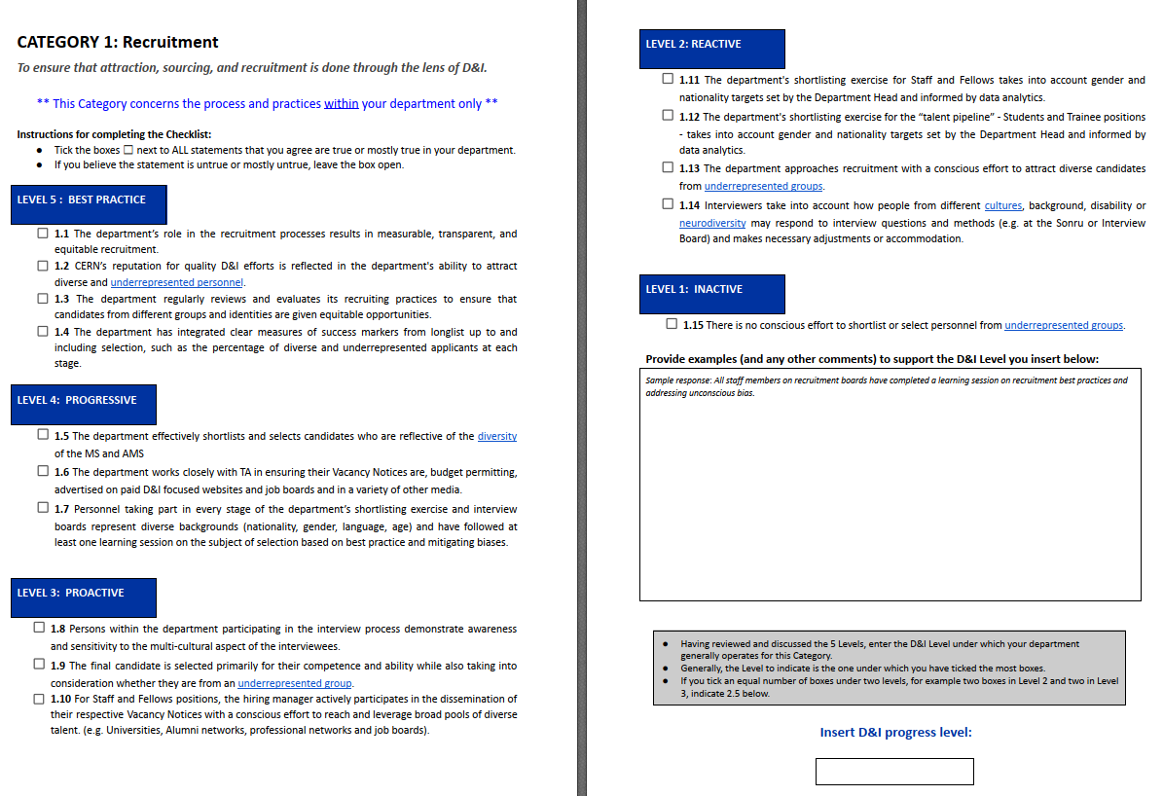
D&I Review Exercise sample page: recruitment

Slide 14
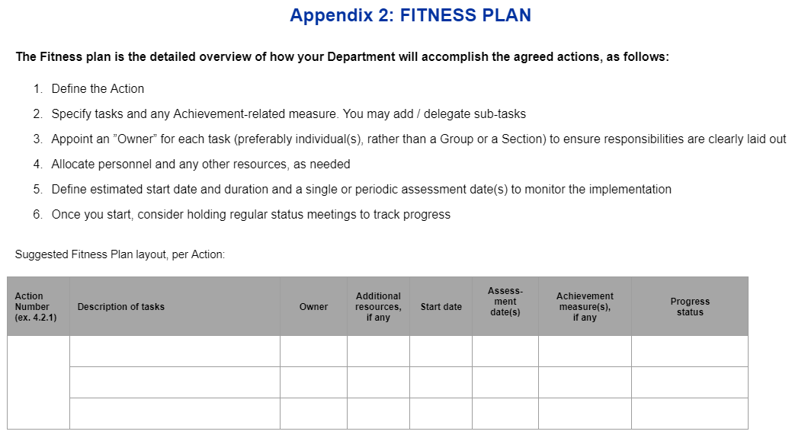
Departmental Action Menu + Fitness Plan
~ Evaluate not only a diverse candidate’s potential for excellence,
but the potential for excellence
of a diverse team ~

Slide 15
Measuring Progress

Slide 16
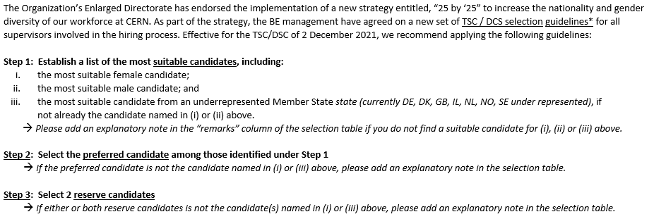
Department Head New Initiative Tech & Doct Student shortlist must include: female, male, + underrepresented nationality
effective 02 Dec ‘21

Slide 17
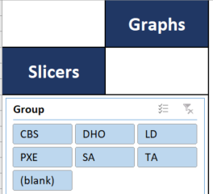
Nationality / Gender Dashboards, by Department
~ sample dashboard ~

Slide 18
Gender disaggregated statistics employed members of the personnel
2020
2021
beyond

Slide 19
Qualitative progress: the best part
conver-sations
gratitude
resistance
new policies
apologies
volunteers
external
invites
awareness
male allies
career change
reflection

Slide 20
Thank you!

Slide 21
extra slide

Slide 22
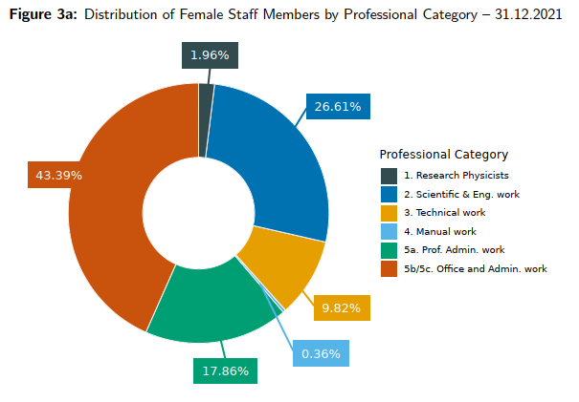
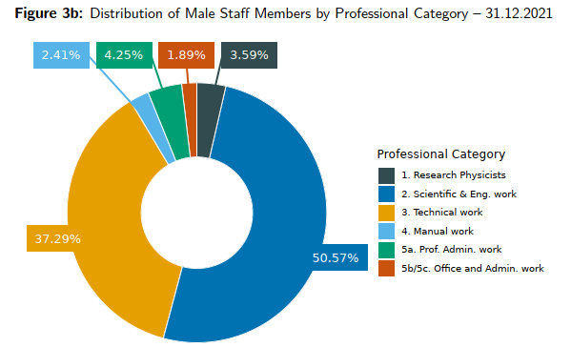
Distribution of Female & Male staff by Professional Category
Admin (F): 61.25%
STEM (F): 38.39%
Admin (M): 6.14%
STEM (M): 91.45%
Ref. CERN Annual Personnel Stats, Dec 2021

