Slide 1
real-time 3D dose imaging and source localization in brachytherapy
A. Giaz¹, N. Amplilogov¹, S. Cometti¹, W. Kam³, M. Martyn², R. Santoro¹, M. Caccia¹ and S. O’Keeffe³
¹Università degli Studi dell’Insubria, DiSAT, via Valleggio, 11, Como, Italy
²Department of Radiotherapy Physics, Galway Clinic, Galway, Ireland
³Optical Fibre Sensors Research Centre, University of Limerick, Limerick V94 T9PX, Ireland

Slide 2
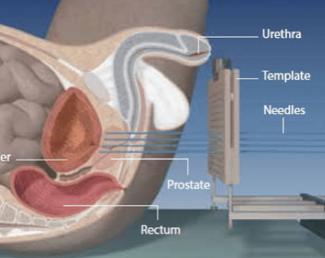
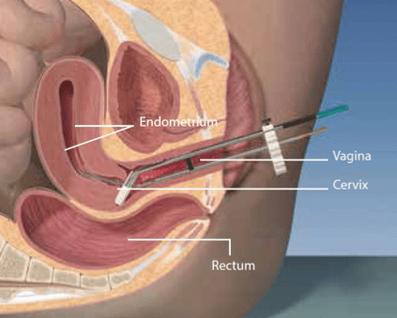
Oncological brachytherapy
prostate cancer
Radiotherapy is the use of ionizing radiation for treatment. It is delivered into external beam radiotherapy using accelerators, or internal, using sources, known as brachytherapy (BT).
Brachytherapy is a form of radiation therapy where a sealed radiation source is placed inside or next to the cancer area. The source placement is vital to ensure radiation to the tumor, while ensuring minimum exposure to nearby critical organs.
Brachytherapy is divided into Low Dose Rate (LDR) and High Dose Rate (HDR).
gynecological cancer
 | Source | Activity | Implantation | <Eγ> | Abs. Length
LDR | ¹²⁵I | 15 MBq | Permanent | 35 keV | 3 cm
HDR | ¹⁹²Ir | ∼100 GBq | Temporary | 380 keV | 10 cm

Slide 3
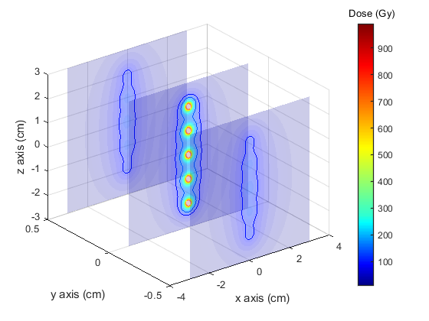









THE ORIGIN PROJECT
Optical Fibre Dose Imaging for Adaptive Brachytherapy
ORIGIN aims to deliver more effective, photonics-enabled, brachytherapy for cancer treatment through advanced real-time radiation dose imaging and source localisation. This will be achieved by the development of a new optical fibre-based sensor system to support diagnostics-driven therapy through enhanced adaptive brachytherapy.
ORIGIN CONSORTIUM
PI from Limerick University
The ORIGIN project is an initiative of the Photonics Public Private Partnership (www.photonics21.org), and has received funding from the European Union's Horizon 2020 Research and Innovation Programme under Grant Agreement n° 871324

Slide 4
THE ORIGIN PROJECT
Optical Fibre Dose Imaging for Adaptive Brachytherapy
ORIGIN aims to deliver more effective, photonics-enabled, brachytherapy for cancer treatment through advanced real-time radiation dose imaging and source localisation. This will be achieved by the development of a new optical fibre-based sensor system to support diagnostics-driven therapy through enhanced adaptive brachytherapy.
 | LDR - BT | HDR - BT
Sensitivity to Dose | up to 3 cm | up to 10 cm
Spatial Resolution | 3 mm @ 3 cm | 1 mm @ 5 cm
Dose Rate Range | 1 mGy/s up to 15 Gy/s
Statistical Precision | 5% in 0.5 s | 5% in 0.1 s
At least 16 dosimeters are need to localize the source.

Slide 5
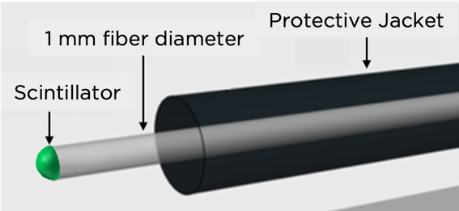
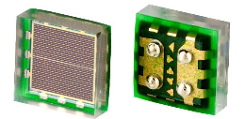
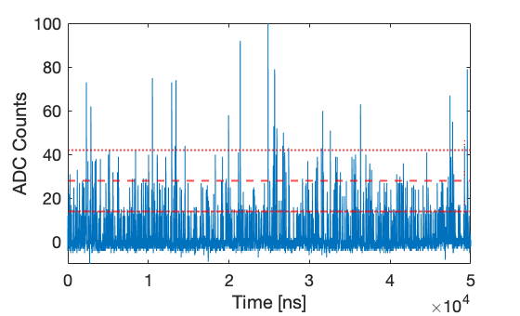
THE ORIGIN PROJECT: Dosimeter System
The project’s goal will be achieved by developing a 16 optical fiber-based system with scintillating light detected by SiPM to reconstruct the dose map.
The signal associated with an X-ray or 𝛾-ray interaction consists of a trail of single photons, and the dosimetry is based on photon counting.
Sensor: 1x1 mm² Ketek
Scintillator | Gadox (LDR) | YVO (HDR)
𝜏 [𝜇s] * | 500 | 500
𝜆_{max} [nm] | 545 | 600 - 650
LY [ph/MeV]* | 7.1 ∙ 10⁴ | 4.8 ∙ 10⁴
Transmittance* | 10.2 % | 4.2 %
3 p.e.
PDE @ 600 nm: 14 %
DCR @ 0.5 p.e.: 100 kHZ
OPT: 26%
Op. Voltage: V_{bd} + 7 V
2 p.e.
1 p.e.
*S. Cometti et al. “Characterization of scintillating materials in use for brachytherapy fiber based dosimeters”, accepted for publication to NIMA

Slide 6
Single Channel Measurements
From single channel measurement was possible to extract all the specification of the project.
The results prove that the single fibre dosimeter system complies with the specifications for both the HDR-BT and LDR-BT.
The data follow the Treatment Planning System (TPS)
Sensitivity to Dose: 3 cm
Spatial Resolution: 1.4 mm
Statistical Precision: 2.6 % in 0.5 s
LDR
HDR
Sensitivity to Dose: 10 cm
Spatial Resolution: 0.8 mm
Statistical Precision: 3 % in 0.1 s

Slide 7
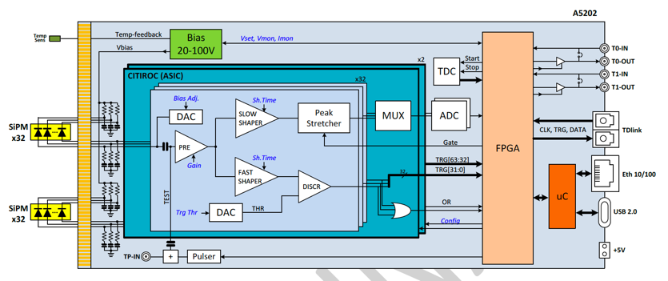
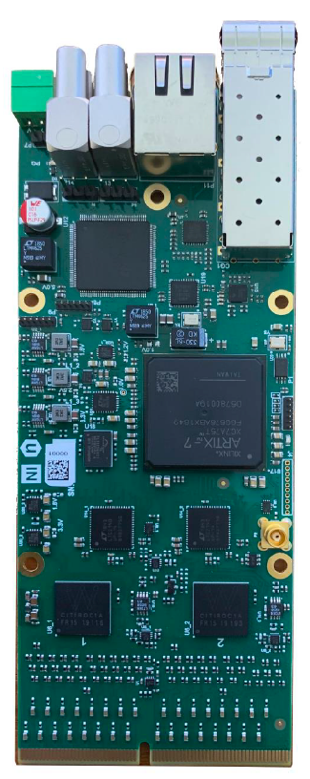
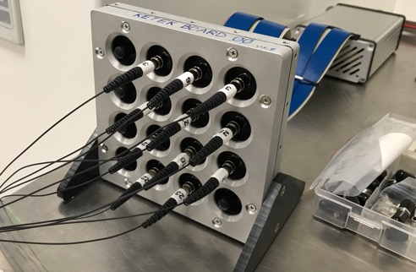
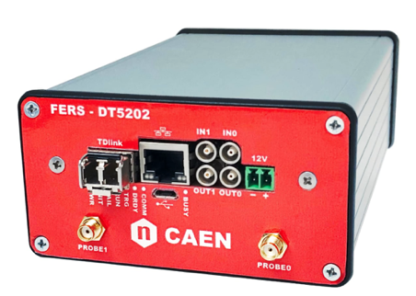
THE 16 Channel readout system
64-channel SiPM readout board (CAEN* FERS) equipped with 2 WEEROC CITIROC1A ASICs**
Single p.e. counting capability
Maximum counting rate: 20 MHz
1 HV power supply (20 – 100V) with temperature compensation
Ethernet, usb2 and optical link interface for readout (up to 6.25 Gbit/s)
Simplified Block-schema
60 mm
150 mm
*https://www.caen.it/products/a5202/
**https://www.weeroc.com/products/sipm-read-out/citiroc-1a

Slide 8
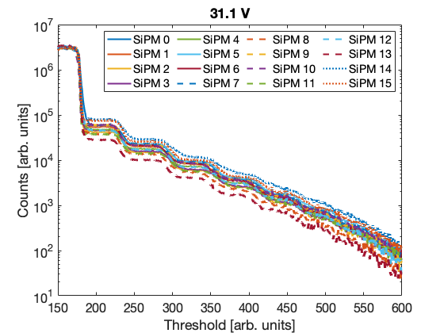
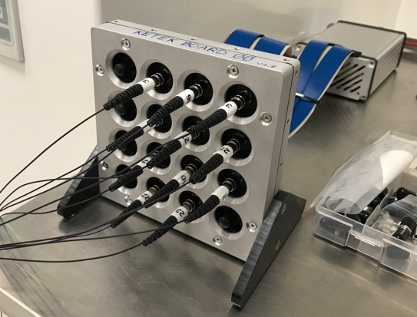
Laboratory-qualification
Baseline crossing
Typical Staircase
An automatic procedure is used to estimate the V_{BreakDown} (V_{BD}) for all SiPMs.
V _{BIAS} adjustment allows to equalize the 𝛥pp and to operate all SiPMs at the same PDE (V _{BIAS} = V_{BD} + 7 V).
Staircases acquired at V _{BIAS} to select 0.5 p.e. and 1.5 p.e. threshold.
0.5 p.e.
1.5 p.e.
Same Threshold on all channels

Slide 9
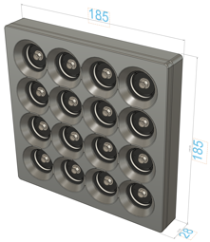

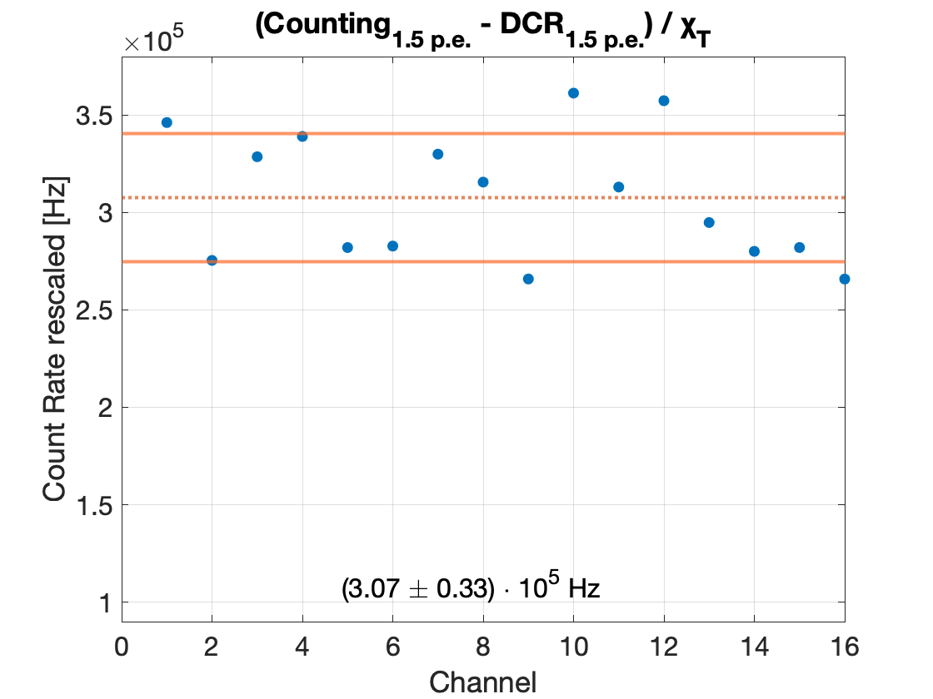
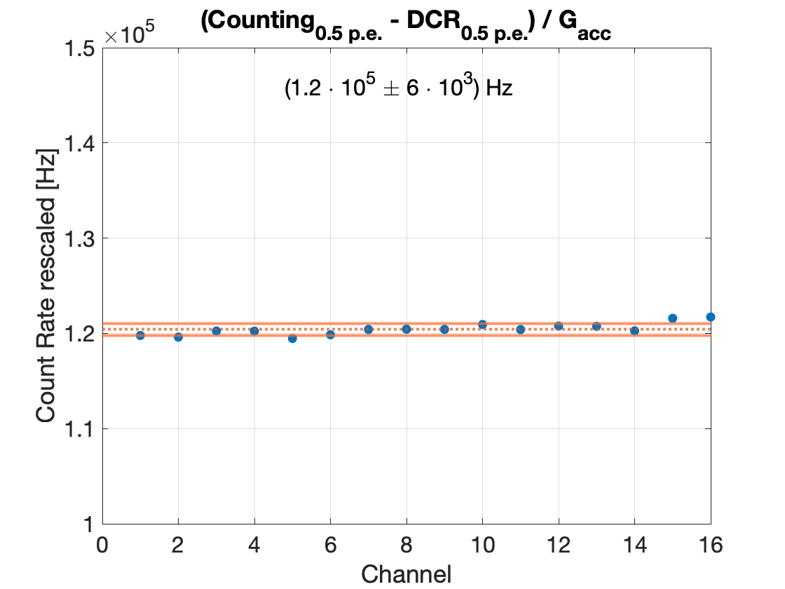
Laboratory-qualification
1 channel
16 fibers
Measurements with X-ray cabinet to evaluated the uncertainties:
Fiber positioning: 0.8%
Fiber connection: 0.1%
Geometrical acceptance: 10 %
16 channels
Fiber Non-Uniformity:
16 % (pre-production)
1.2 % (new production)
+
1 fiber
Normalization with a scaling factor including all the contributions
non-uniformity: < 1%
Raw Data
non-uniformity: 16%

Slide 10
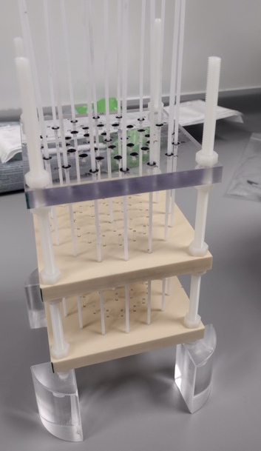
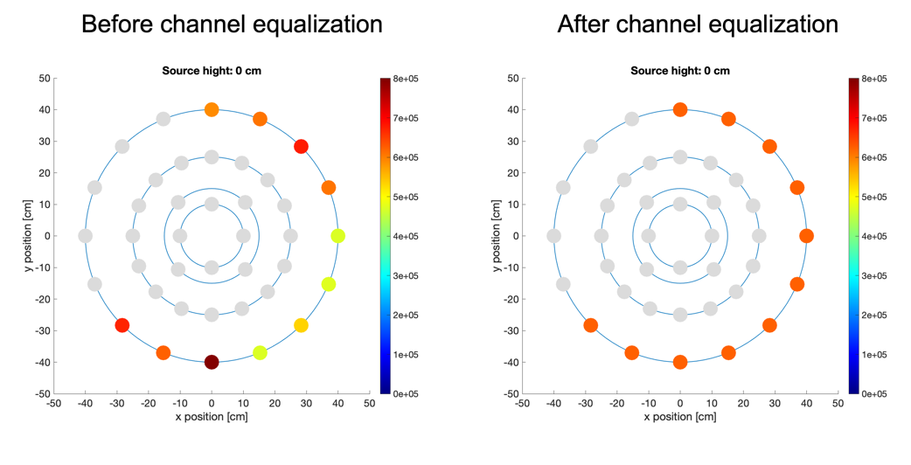
EQUALIZATION Measurement
Water-phantom with circular geometry
All fibres at the same distance from the source
Measured counting rate normalised at mean value
Run to check equalization procedure; systematics variation less than 1%
Non – Uniformity: 17 %
Non – Uniformity: < 1 %

Slide 11
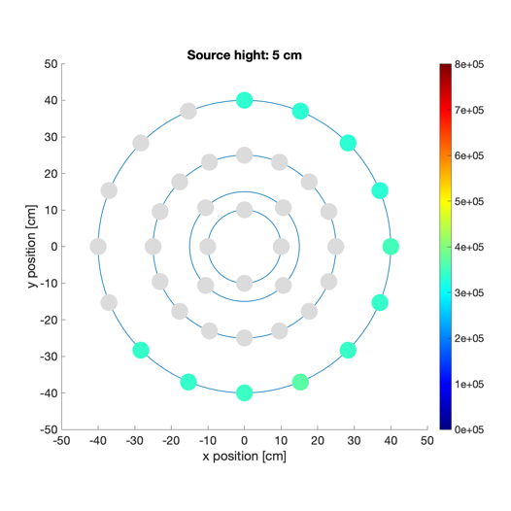
EQUALIZATION Measurement
Water-phantom with circular geometry
All fibres at the same distance from the source
Measured counting rate normalised at mean value
Run to check equalization procedure; systematics variation less than 1%
Non – Uniformity: < 1 %
The normalization scaling factor was check at different distances: 5 cm

Slide 12
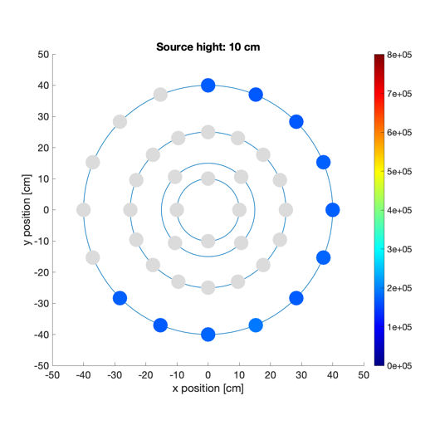
EQUALIZATION Measurement
Water-phantom with circular geometry
All fibres at the same distance from the source
Measured counting rate normalised at mean value
Run to check equalization procedure; systematics variation less than 1%
Non – Uniformity: < 1 %
The normalization scaling factor was check at different distances: 10 cm

Slide 13
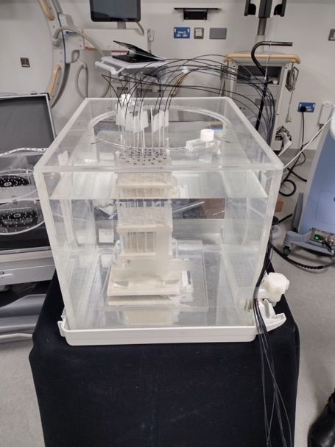
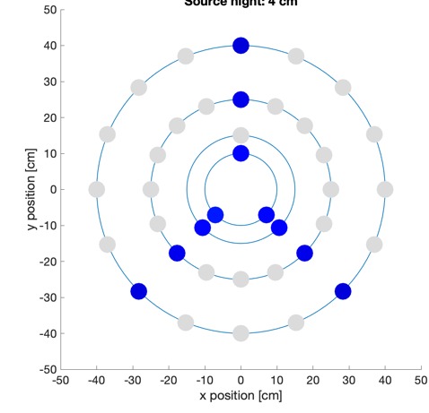
CLINICAL MEASUREMENTS
16-channel system, with dosimeters placed around a ¹⁹²Ir radioactive at the Queen’s University Hospital (Belfast, Ireland).
z = 10 cm
11 Fibres:
3 fibres at r = 4 cm,
3 fibres at r = 2.5 cm,
2 fibres at r =1.5 cm,
3 fibres at r = 1 cm.
z
y
Step: 1 cm
x
z = 3 cm
Step: 0.2 cm
z = 0 cm

Slide 14
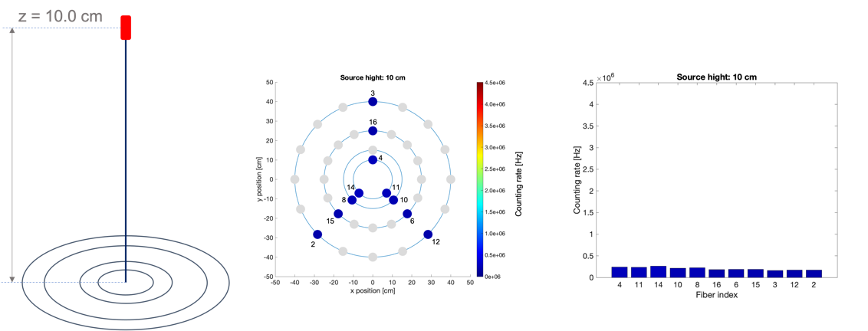
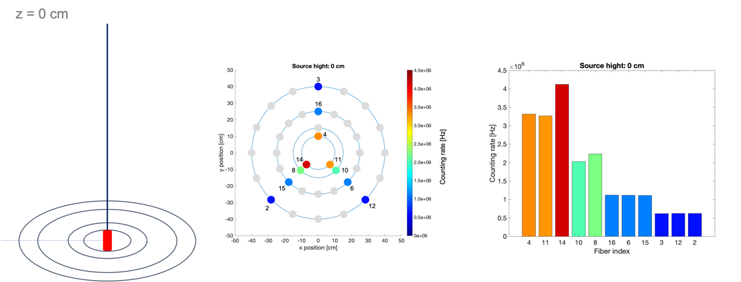
CLINICAL MEASUREMENT Results
The source is moved from a 10 cm distance on the z axis down to z = 0 cm and the corresponding counting rate as a function of distance was measured.

Slide 15
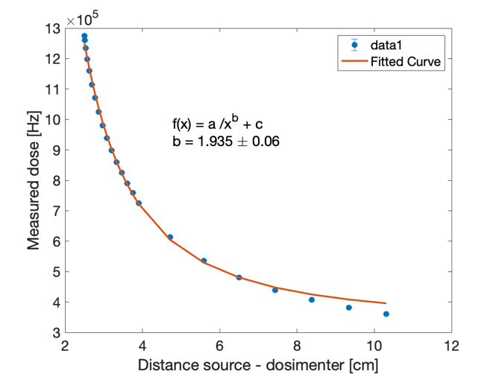
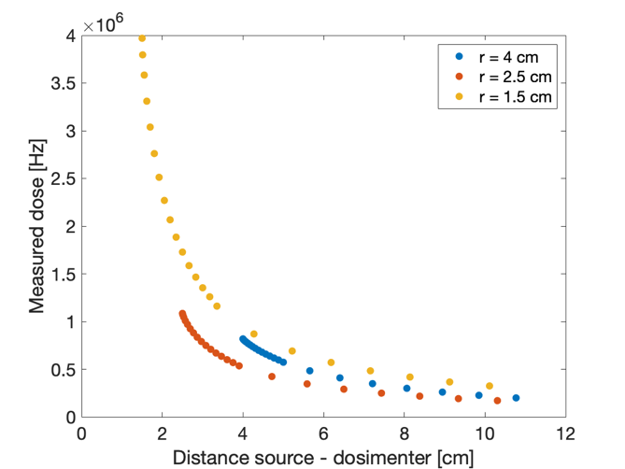
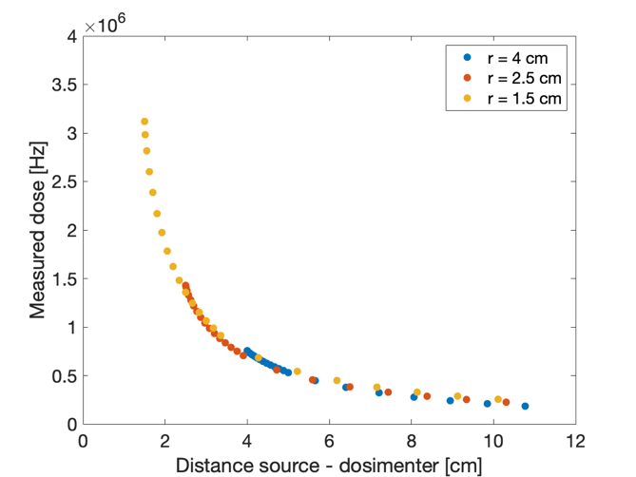
CLINICAL MEASUREMENT Results
Tree Fibres:
(r = 4 cm, r = 2.5 cm, r =1.5 cm):
pile-up corrected - DCR subtracted
Tree Fibres:
(r = 4 cm, r = 2.5 cm, r =1.5 cm):
pile-up corrected - DCR subtracted
After Equalization
One Fiber (r = 2.5 cm):
pile-up corrected
Trend ∝1/r²
Last 3 points excluded
𝜸 Att. Coeff. at 300 keV in water ∼ 6 cm
Preliminary
Preliminary
The sensors are capable of monitoring the radiation dose at distances compatible with brachytherapy.
Data has to be compared with TPS.

Slide 16
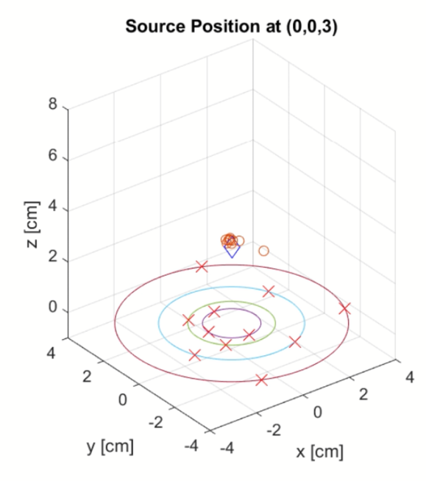
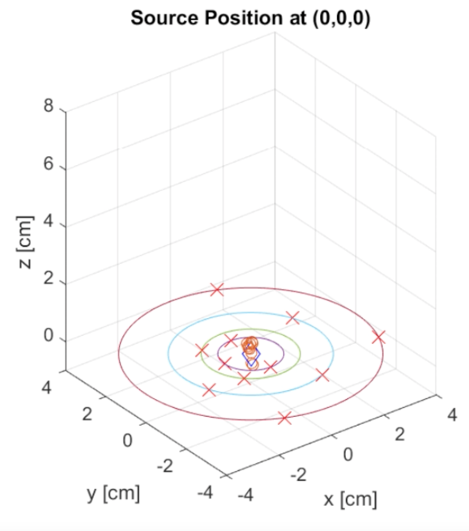
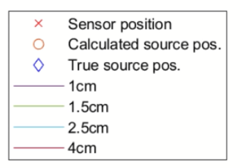
Source localization
Source localization has been implemented using triangulation algorithm. Initial results looks promising.
A quantitative assessment was not completed yet.
z = 3 cm
Preliminary
Preliminary
z = 0 cm

Slide 17
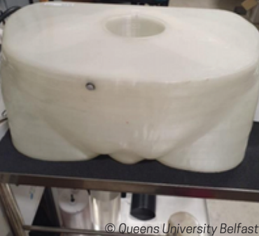
OUTLOOK
The laboratory characterization shows that the uncertainties of the system are less than 1%.
The clinical HDR characterization of the ORIGIN dosimeter shows the expected trends. The data has to be compared with TPS.
3D-printed semi-anatomical phantom prototypes were developed to provide be used in the evaluation of the dosimetry system.
will be integration of the ORIGIN dosimeter prototype in a clinical systems started.

Slide 18



Contact Us ORIGIN@ul.ie
@ORIGIN_2020
ORIGIN2020.eu

