Slide 1
Developments in software
performance and portability
for Madgraph5_aMC@NLO
ICHEP, Bologna, 8th July 2022
https://agenda.infn.it/event/28874/contributions/169193
Taylor Childers
Walter Hopkins
Nathan Nichols
Laurence Field
Stephan Hageboeck
Stefan Roiser
David Smith
Andrea Valassi
Olivier Mattelaer

Slide 2
Outline
Introduction
Results and outlook in three main areas of development (cudacpp, portability frameworks, Madevent)
Conclusions

Slide 3
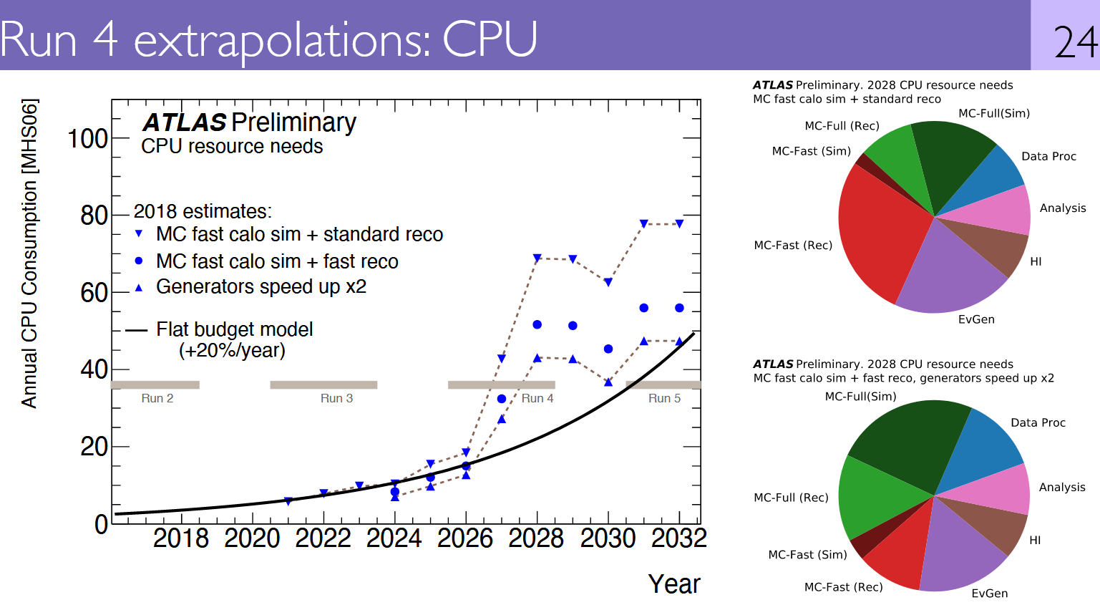
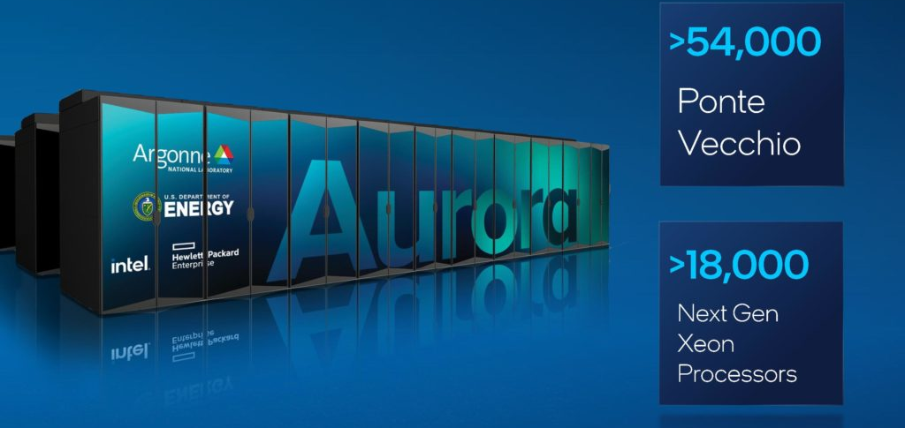
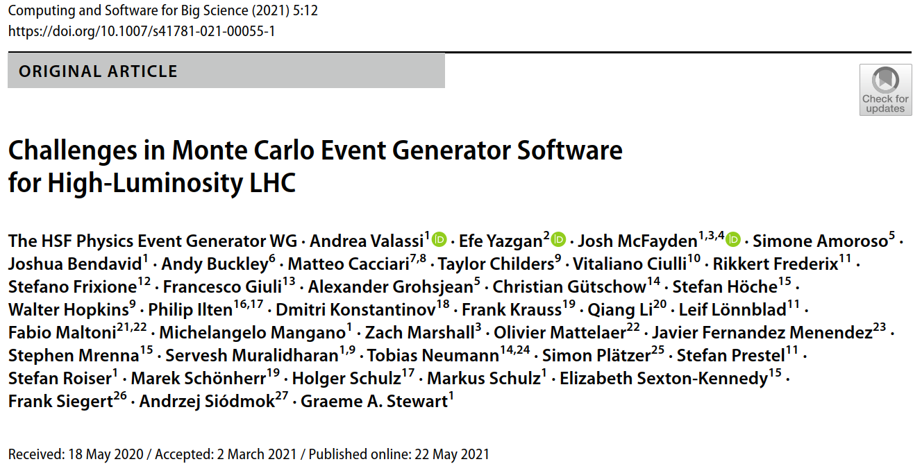
Motivation: Monte Carlo Event Generators in WLCG computing
LHC computing needs are predicted to outpace resource growth on HL-LHC timescales
Need R&D to improve software efficiency and port it to new resources, such as GPUs at HPC centers
MC generators, the essential 1st step in simulation, use 10-20% of ATLAS/CMS WLCG CPU budget
Many ways to speed them up – see the HEP Software Foundation (HSF) Generator WG review
MC generators are ideal candidates to exploit data parallelism in GPUs (SIMT) and in vector CPUs (SIMD)
https://doi.org/10.1007/s41781-021-00055-1
WLCG meeting with LHCC referees, Feb. 2020

Slide 4
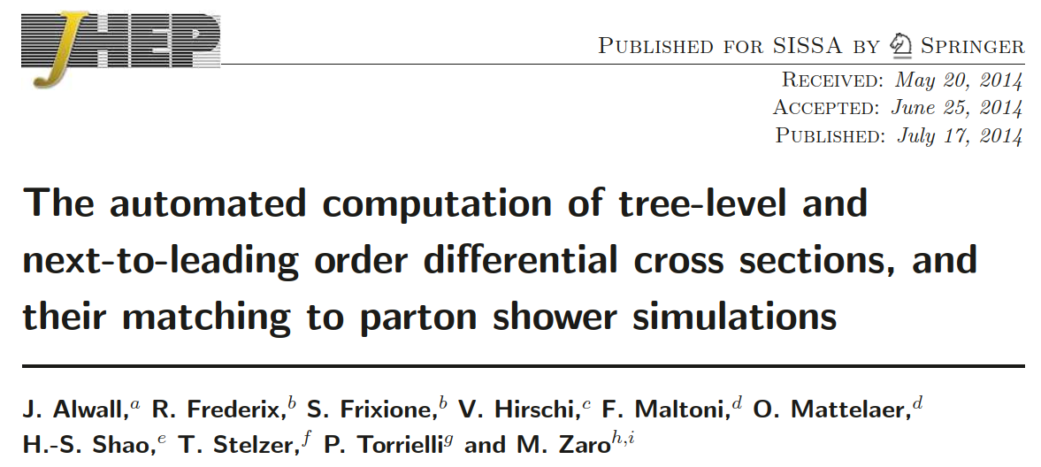
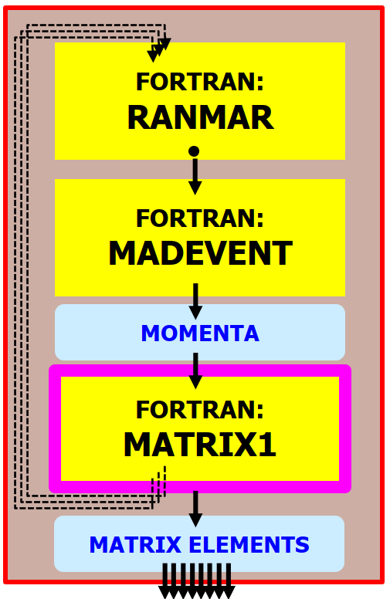
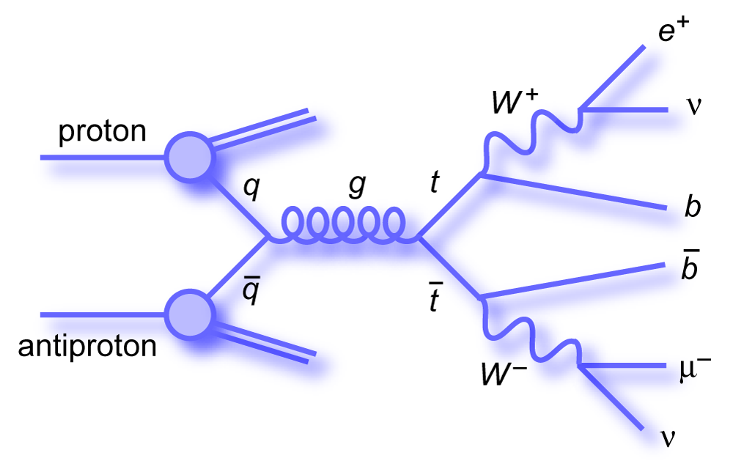
Madgraph5_aMC@NLO (MG5aMC)
One of the workhorses for event generation in ATLAS and CMS!
MG5aMC production version is in Fortran
Software outer shell: Madevent (random sampling, integration and event generation)
Software inner core: Matrix Element (ME) calculation code, automatically generated for each physics process
Matrix Element calculations take 95%+ of the CPU time for complex processes (e.g. $gg$→$t\overline{t}ggg$)
https://doi.org/10.1007/JHEP07(2014)079

Slide 5
MG5aMC and the madgraph4gpu project
madgraph4gpu: speed up Matrix Element calculation in MG5aMC on GPUs and vector CPUs
Collaboration of theoretical/experimental physicists with software engineers – born in the HSF generator WG
Previous results for ‘cudacpp’ (C++ vectorization on CPUs, CUDA on Nvidia GPUs) were shown at vCHEP2021
New progress since May 2021 has been mainly in three areas of development:
(1) Not only hardcoded $e^{+}e^{−}$→$^{+}^{−}$: full code generation in cudacpp, performance for more complex processes
(2) Not only cudacpp: add implementations in Alpaka, Kokkos, Sycl also for AMD/Intel GPUs
Goal: gain experience for the HEP software community on the usefulness of portability frameworks (PFs)
(3) Not only a standalone application: integrate CUDA/C++ MEs into Madevent (cross sections, event generation)
Goal: first release of MG5aMC for LO event generation in ATLAS/CMS (CPU SIMD speedups and GPU port)
https://doi.org/10.1051/epjconf/202125103045

Slide 6
MC event generators are a great fit for GPUs and vector CPUs!
Monte Carlo methods are based on drawing (pseudo-)random numbers: a dice throw
From a software workflow point of view, these are used in two rather different cases:
MC SAMPLING
Event generators* (before ME calculation):
MC integration (cross sections)
MC generation (event samples)
MC DECISIONS
Detector simulation (Geant4)
Particle/matter interaction (when? how?)
Particle decays (when?)
Event generators*
(after ME calculation):
MC unweighting (keep/reject) Parton showers (PS)
Fragmentation and decays
INPUT
INPUT
SAME CALCULATION
ON DIFFERENT DATA!
DECISION
DIFFERENT CALCULATIONS
ON DIFFERENT DATA!
OUTPUT
OUTPUT
Lockstep processing
Good for SIMT/SIMD
Stochastic branching
Bad for SIMT/SIMD
*NB: the CPU-intensive ME calculation comes before PS, fragmentation, detector simulation

Slide 7
Implementation ($gg$→ $t\overline{t}gg$) | MEs/second Double | MEs/second Float
1-core Standalone C++ scalar | 2.39E3 (=1.00) | 2.50E3 (x1.05)
1-core Standalone C++ 128-bit SSE4.2 (x2 doubles, x4 floats) | 4.59E3 (x1.9) | 9.42E3 (x3.6)
1-core Standalone C++ 256-bit AVX2 (x4 doubles, x8 floats) | 1.06E4 (x4.4) | 2.15E4 (x9.0)
1-core Standalone C++ “256-bit” AVX512 (x4 doubles, x8 floats) | 1.15E4 (x4.8) | 2.28E4 (x9.5)
1-core Standalone C++ 512-bit AVX512 (x8 doubles, x16 floats) | 1.96E4 (x8.2) | 4.03E4 (x16.9)
Matrix Element (ME) calculation in cudacpp: results
(1) First area of development: MEs in “cudacpp”
Single code base (#ifdef’s) for C++ on CPUs and CUDA on Nvidia GPUs
SIMD vectorization on CPUs through Compiler Vector Extensions in C++
(all numbers for one single CPU thread)
Main new results since vCHEP2021:
Backport to code generation (test more complex processes)
speedups seen for ee_mumu now also ~confirmed for gg_ttgg
but GPU speedups decrease a bit (higher "register pressure")
Achieve full theoretically possible SIMD speedup on CPUs
x8 double, x16 float from AVX512 on high-end Intel CPUs
New features added for MadEvent integration
(this slide shows numbers from the standalone test application;
see the final slides for performance numbers within madevent)
Intel Gold 6148 CPU (Juwels Cluster HPC)
Better AVX512/zmm results than on Intel Silver 4216 at CERN
(Gold 6148 has two FMA units, Silver 4216 has one FMA unit)
Implementation ($gg$→ $t\overline{t}gg$) | MEs/second Double | MEs/second Float
1-core Standalone C++ scalar | 1.84E3 (=1.00) | 1.80E3 (x0.98)
Standalone CUDA NVidia V100S-PCIE-32GB (TFlops*: 7.1 FP64, 14.1 FP32) | 4.89E5 (x270) | 9.27E5 (x500)
NVidia V100 GPU + Intel Silver 4216 CPU (CERN)

Slide 8
Portability Frameworks (PFs)
(2) Second area of development: MEs on PFs
PFs allow writing algorithms once and running on many architectures with some hardware-specific optimizations
CUDA only runs on NVidia GPUs, while Kokkos, Alpaka and Sycl[Intel] also run on AMD and Intel GPUs

Slide 9
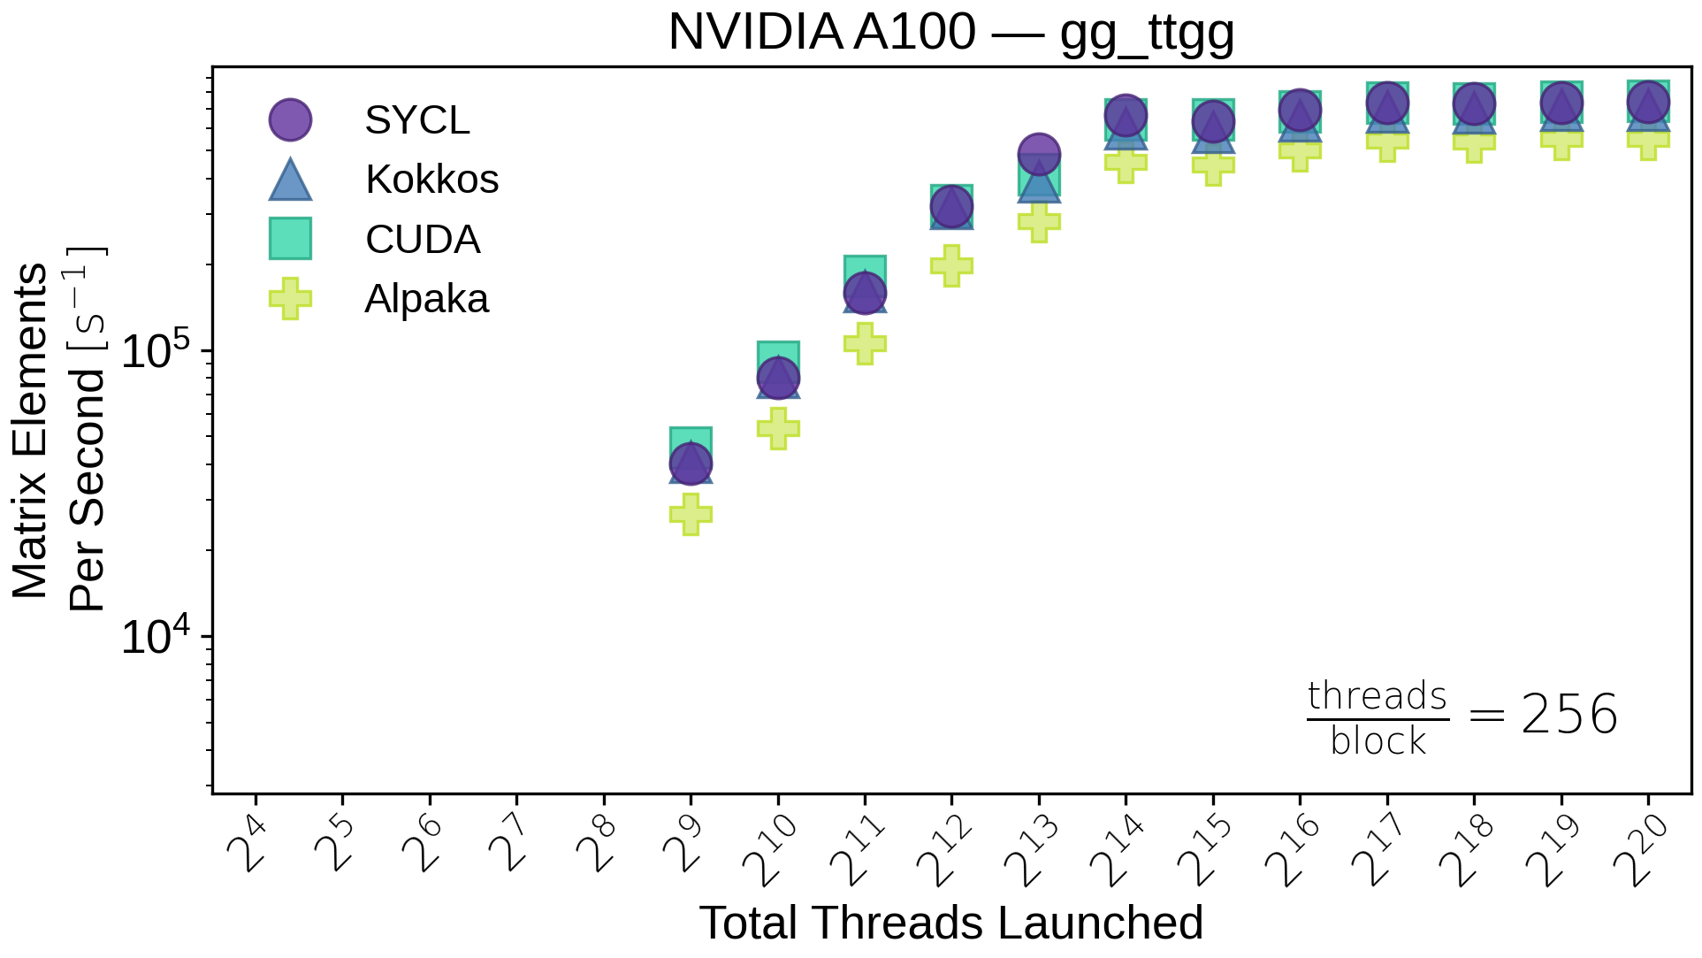
ME calculation in PFs: GPU results (Nvidia A100)
Throughput scaling (threads, blocks) for a complex $gg$→$t\overline{t}gg$ process
(note: this is an older version of the code with respect to the results shown earlier for cudacpp alone)
Good news 1: all four implementations look similar for Nvidia in gg_ttgg!
The benefit of direct CUDA over a PF is limited, if any at all
NB: focus on gg_ttgg which is computationally intensive!
In simpler processes like ee_mumu, performance is more affected by data
copies, memory access or kernel launching overheads (and the observed
SYCL implementation is faster than the CUDA one - to be understood)
En passant, keep in mind this for later: you need at least 16k “events per GPU grid” to fill up a V100 or A100 with gg_ttgg+
Simpler processes need even more, e.g. 500k for ee_mumu
(gg_ttgg) 16k

Slide 10
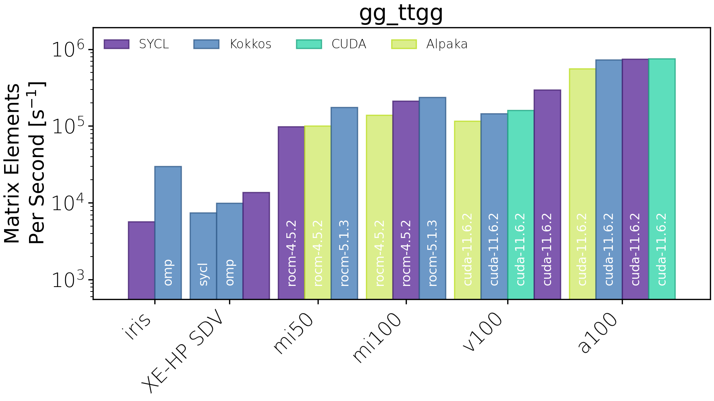
ME calculation in PFs: GPU results (Nvidia, Intel, AMD)
Maximum throughput (plateau of scaling plot on the previous slide) for a complex $gg$→$t\overline{t}gg$ process
(note: this is an older version of the code with respect to the results shown earlier for cudacpp alone)
Good news 1: all four implementations look similar on Nvidia in gg_ttgg!
The benefit of direct CUDA over a PF is limited, if any at all
Good news 2: PFs also work on AMD and Intel GPUs!
Out of the box, with a single implementation
(There is no Alpaka on Intel in the plots because we use Cupla: we should move to using native Alpaka)
PFs also run out of the box on CPUs (performance under investigation)
Xe-HP is a software development vehicle for functional testing only - currently used at Argonne and other customer sites to prepare their code for future Intel data centre GPUs
INTEL
AMD
NVIDIA

Slide 11
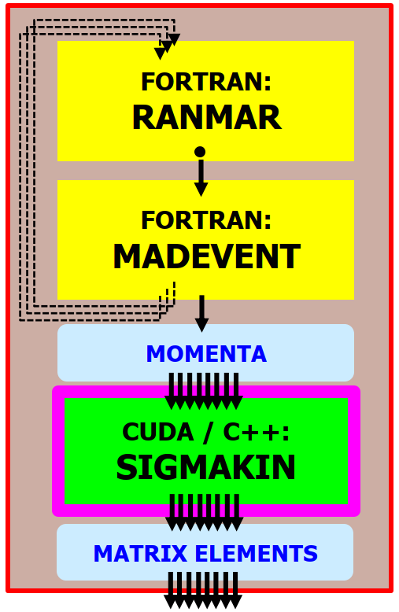
Matrix element integration in MadEvent: overview
(3) Third area of development: replace Fortran by cudacpp MEs in Madevent (keep the user interface!)
Linking Fortran and C++ has been easy. As expected, the two main issues have been, instead:
1. Moving Madevent from single-event to many-event (need 16k+ per GPU grid ⇒ huge arrays in CPU memory!)
2. Debugging the issues caused by hidden inputs and outputs, largely coming from Fortran common blocks
REENGINEER MADEVENT
ADAPT CUDACPP
SINGLE event
(momenta)
MANY events
(momenta)
COMMON
BLOCKS
(hidden inputs
and outputs?)
PURE FUNCTION (clear inputs and outputs)

Slide 12
Matrix element integration in MadEvent: results
Functional results (Madevent with Fortran MEs vs CUDA/C++ MEs, using the same random seeds)
Cross section calculation: done! (Same cross section within ~E-14 relative accuracy)
Unweighted event generation: almost done! (Same LHE output files, except for missing color/helicity)
Performance results ⇒ Total time = Madevent time (scalar, sequential) + ME time (vector, parallel)
The overall speedup is limited by the incompressible scalar component (we need to reduce that too!)
Amdahl’s law: if parallel fraction is initially p, maximum speedup is 1/(1-p)
Implementation ($gg$→ $t\overline{t}gg$) | Evts/second full workflow | MEs/second MEs only
1-core MadEvent Fortran scalar | 1.96E3 (=1.00) | 2.12E3 (=1.00)
1-core Standalone C++ scalar | 1.72E3 (x0.9) | 1.85E3 (x0.9)
1-core Standalone C++ 128-bit SSE4.2 (x2 doubles, x4 floats) | 3.56E3 (x1.8) | 4.08E3 (x1.9)
1-core Standalone C++ 256-bit AVX2 (x4 doubles, x8 floats) | 6.72E3 (x3.4) | 8.80E3 (x4.2)
1-core Standalone C++ “256-bit” AVX512 (x4 doubles, x8 floats) | 7.08E3 (x3.6) | 9.41E3 (x4.4)
1-core Standalone C++ 512-bit AVX512 (x8 doubles, x16 floats) | 9.92E3 (x5.1) | 1.52E4 (x7.2)
Implementation ($gg$→ $t\overline{t}ggg$) | Evts/second full workflow | MEs/second MEs only
1-core MadEvent Fortran scalar | 7.01E1 (=1.00) | 7.37E1 (=1.00)
Standalone CUDA NVidia V100S-PCIE-32GB | 1.17E3 (x16.7) | 7.39E3 (x100)
NVidia V100 GPU +
Intel Silver 4216 CPU
(CERN)
Intel Gold 6148 CPU (Juwels Cluster HPC)
Summary of performance within madevent so far:
- on CPU: ~x8 for MEs alone, ~x5 for madevent+MEs
- on GPU: ~x100-300 for MEs alone, ~x20 for madevent+MEs

Slide 13
Matrix element integration in MadEvent: detailed results (CPU)
(81952 MEs)
Intel Gold 6148 CPU (Juwels Cluster HPC)
TIME Total =
MadEvent (scalar) + MEs (parallel)
TIME
MEs (parallel)
THROUGHPUT MEs
(within madevent)
THROUGHPUT MadEvent + MEs
(within madevent)
THROUGHPUT MEs
(within standalone test application)
TIME
MadEvent (scalar)

Slide 14
Matrix element integration in MadEvent: detailed results (GPU)
NVidia V100 GPU + Intel Silver 4216 CPU (CERN)
8k events
per GPU grid
ggttgg GPU MEs speedup is lower than eemumu (higher register pressure)
3. SMALLER GPU KERNELS TO INCREASE SPEEDUP
16k events
per GPU grid
2. INCREASE GPU GRIDS (REDUCE CPU MEMORY) TO INCREASE SPEEDUP
TIME
MadEvent (scalar)
1. REDUCE THIS TO INCREASE SPEEDUP

Slide 15
Outlook and main plans
[madevent/functionality, Q3 2022] Alpha release for the experiments
Add event-by-event random choice of color and helicity (same LHE files), check pdf, user parameters…
[madevent/performance, end 2022?] Speed up GPU workflow (reduce madevent scalar overhead)
One possible option: heterogenous workflow (madevent on many CPU cores, MEs on GPU)?
[madevent/performance, end 2022?] Speed up GPU MEs in madevent (allow larger GPU grids)
This requires reducing the number of Fortran arrays in madevent (reduce CPU memory usage)
[MEs/functionality, 2023] Add support for NLO (loops and matching to parton showers)
[MEs/performance, 2023] Add “helicity recycling” (x2-3 extra speedup in CPU/GPU, now only in Fortran)
[MEs/performance, 2023] Numerical precision studies: float (x2 extra speedup in CPU/GPU), fast math
[MEs/performance, end 2022?] Try smaller GPU kernels, try Nvidia tensor cores for QCD color algebra
[portability/performance/GPU, 2023?] HIP in cudacpp, detailed comparisons with PFs with newer code
[portability/performance/CPU, 2023?] std::thread in cudacpp, detailed SIMD/MT comparisons with PFs

Slide 16
Conclusions
ALL Matrix Element Generators are perfect fits to exploit CPU vectorization/SIMD and GPUs
Lockstep parallelism in MEGs much easier to exploit than in detector simulation (Geant4, stochastic branching)
An alpha release of MG5aMC for LO with GPU ports and CPU speedups from SIMD is imminent
Cross section calculation is ready; a few details to fix for unweighted event generation (random color/helicity...)
For the ME calculation alone, speedups ~x8 for CPUs and ~x300 for V100 GPUs have been observed
Our performance on CPUs achieves the theoretical limit for SIMD vectorization: ~perfect lockstep processing
For the full MadEvent+MEs, performance is limited by scalar processing in MadEvent (Amdahl's law)
On CPUs, an overall speedup ~x5 compared to Fortran has been achieved so far
On GPUs, the overall speedup is limited to ~x20 so far for processes where MEs "only" take up 95% of the time
Speeding up the scalar processing in MadEvent is one of our next challenges (with large potential gains!)
There is potential for many additional speedups (single precision, helicity recycling, smaller kernels...)
Portability Frameworks work well for us - easier development with a single code for many GPU flavors
Similar performance to direct CUDA on Nvidia GPUs - and also run out of the box on AMD and Intel GPUs

Slide 17
Acknowledgements
We gratefully acknowledge the computing resources provided and operated by the Joint Laboratory for System Evaluation (JLSE) at Argonne National Laboratory. This research used resources of the Argonne Leadership Computing Facility, which is a DOE Office of Science User Facility supported under Contract DE-AC02-06CH11357.
We gratefully acknowledge the use (under PRACE proposal PRACE-DEV-2022D01-022) of the JUWELS supercomputer and other computing resources provided and operated by the Jülich Supercomputing Centre at Forschungszentrum Jülich.

Slide 18
BACKUP SLIDES

Slide 19
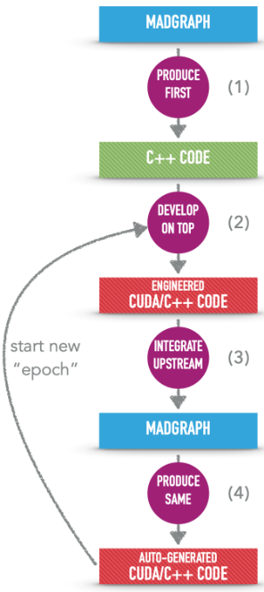
Code generation: from many “epochs” to a single evolving “epoch”
OLD MODEL
(2020- early 2021)
Now using upstream MG5AMC from https://github.com/mg5amcnlo !
NEW MODEL
(since end 2021)
Code generation infrastructure
- Python framework and “cudacpp” plugin
- Fortran, C++, CUDA templates
- Post-generation patches (temporary...)
(3) re-generate
Automatically generated code
- Fortran framework (Madevent)
- CUDA/C++ Matrix Elements
(1) develop on top of auto-generated code
(2) backport immediately to code generation infrastructure

Slide 20
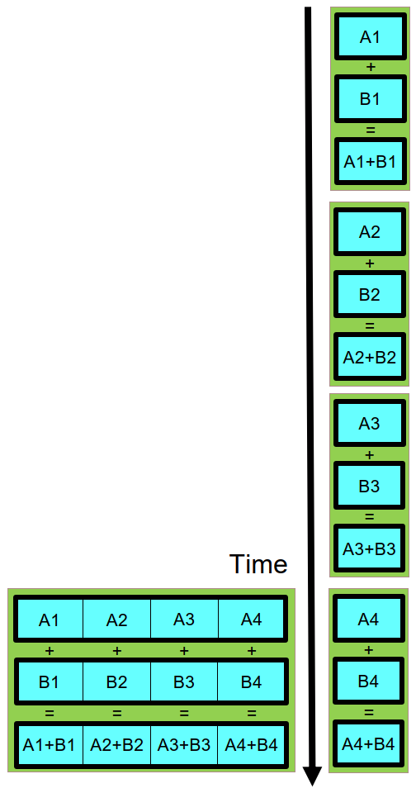
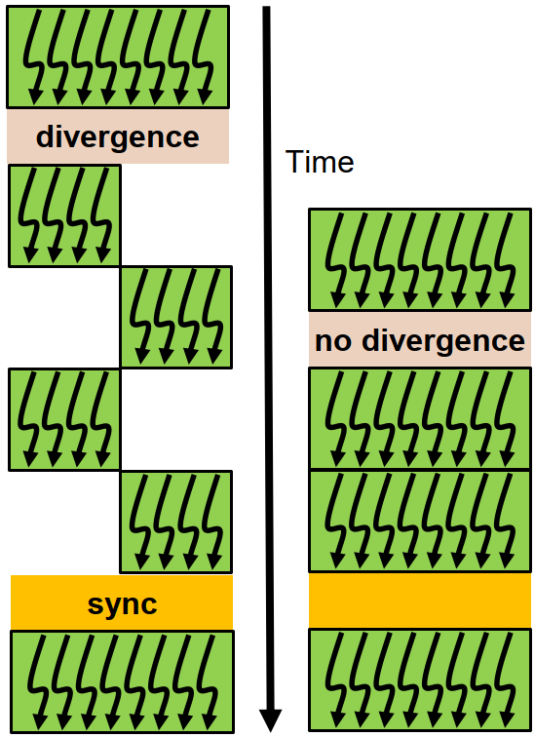
MG5aMC computational anatomy and data parallelism strategy
In MC generators, the same function is used to compute the Matrix Element for many different events
ANY matrix element generator is a good fit for lockstep processing on GPUs (SIMT) and vector CPUs (SIMD)
Data parallelism strategy in madgraph4gpu is event-level parallelism (many events = many phase space points)
PSEUDO RANDOM
NUMBERS
PHASE SPACE
SAMPLING
See the NVidia Volta whitepaper
MOMENTA
+ optional event cuts
(will need to repack data once)
GPU SIMT
MATRIX ELEMENT
CALCULATION
CPU SIMD
MATRIX ELEMENTS
GPU SIMT (Single Instruction Multiple Threads)
Lockstep: all threads in a warp follow the same branch
Minimum parallelism: 32 threads in a warp (NVidia)
CPU SIMD (Single Instruction Multiple Data)
Lockstep: same op for all data in a vector register
Minimum parallelism: 2 to 16 (SSE/AVX2/AVX512...)

Slide 21
Portability Frameworks (PFs)
(2) Second line of development: MEs on PFs
PFs allow writing algorithms once and running on many architectures with some hardware-specific optimizations
CUDA code can only run on NVidia GPUs, while Kokkos, Alpaka, and Sycl[Intel] codes can run on most hardware
In “cudacpp”, #ifdef directives separate code branches for GPU and CPU code during compilation (but these are very few: only kernel launching and memory access, not MEs)
With PFs, the algorithm is typically the same, but the compilation occurs once per architecture type
PFs often use templating to handle data types and hardware configuration and function lambdas or pointers for passing kernels (the cudacpp plugin has many of these, too)
PFs still require user to think about “host” vs “device”
“cudacpp” example of compiler directives
For GPU
For CPU
Kokkos example of Templating & lambda
Kokkos example of Memory Management

Slide 22
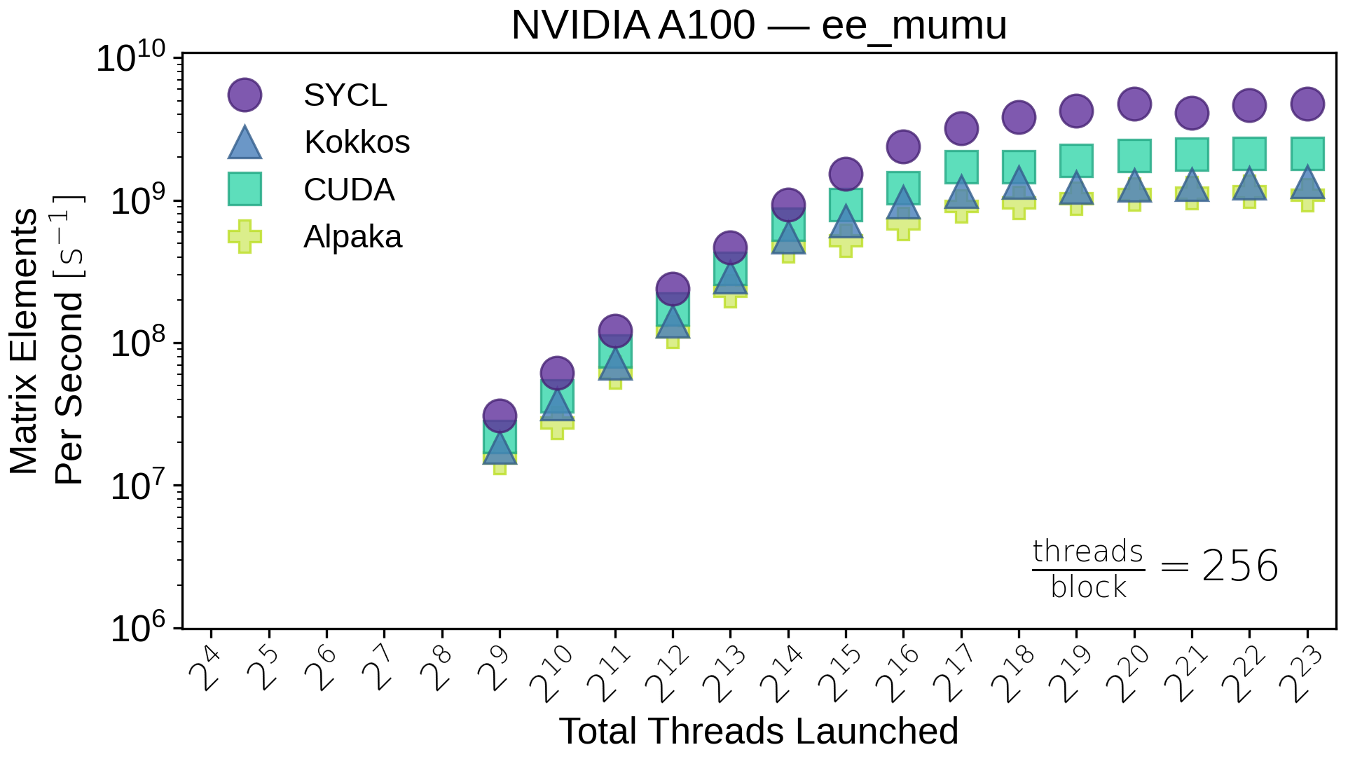
ME calculation in PFs: GPU results (Nvidia A100)
Throughput scaling (threads, blocks) for a complex $gg$→$t\overline{t}gg$ process
(note: this is an older version of the code with respect to the results shown earlier for cudacpp alone)
Good news 1: all four implementations look similar for Nvidia in gg_ttgg!
The benefit of direct CUDA over a PF is limited, if any at all
NB: focus on gg_ttgg which is computationally intensive!
In simpler processes like ee_mumu, performance is more affected by data
copies, memory access or kernel launching overheads (and the observed
SYCL implementation is faster than the CUDA one - to be understood)
En passant, keep in mind this for later: you need at least 16k “events per GPU grid” to fill up a V100 or A100 with gg_ttgg+
Simpler processes need even more, e.g. 500k for ee_mumu
(gg_ttgg) 16k
(eemumu) 500k

Slide 23
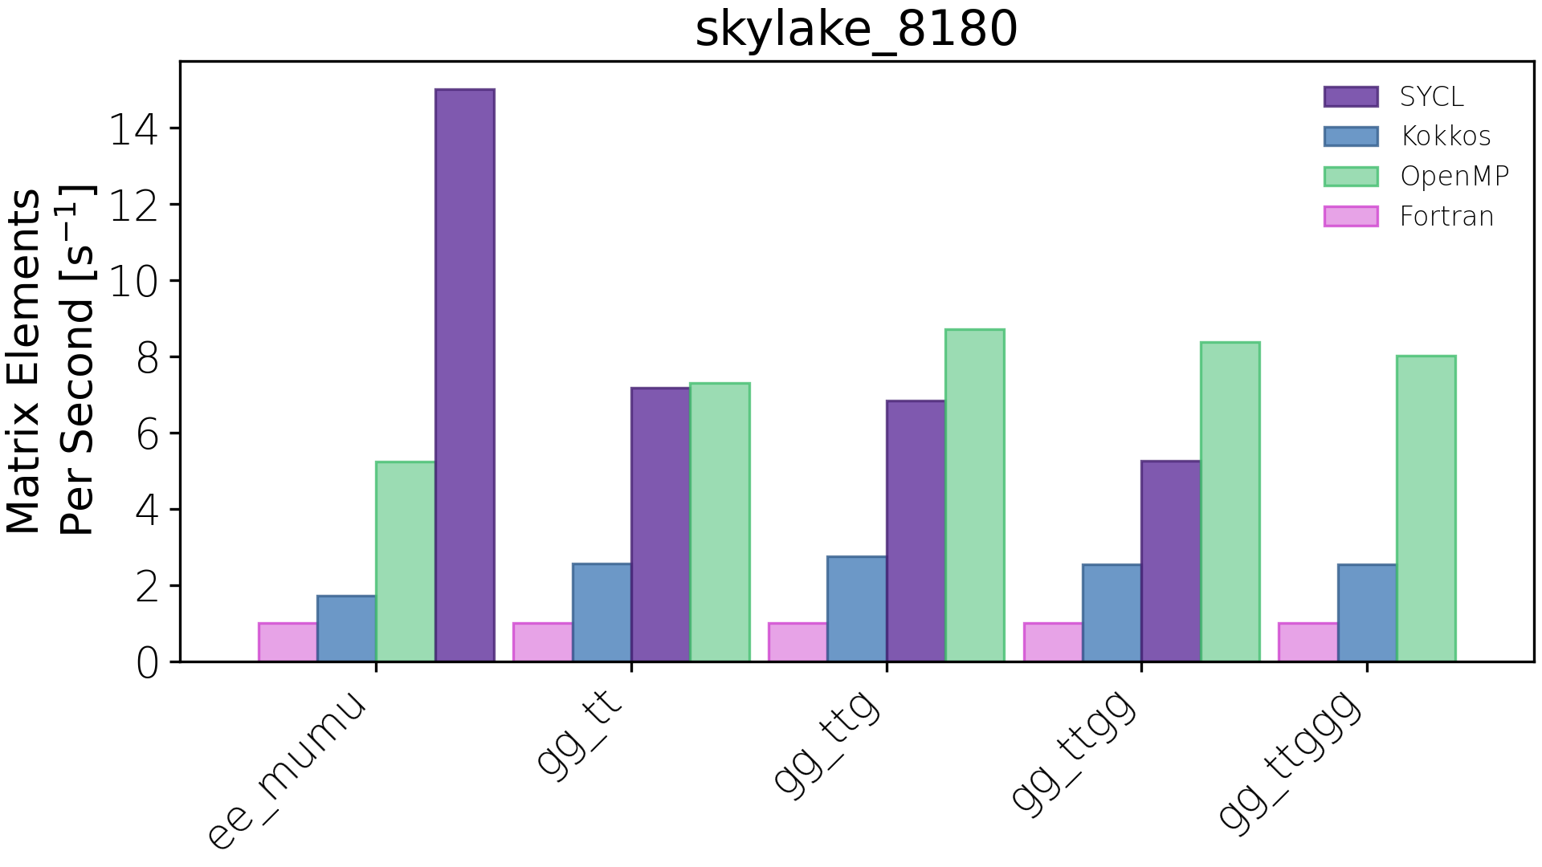
ME calculation in PFs: CPU results (preliminary! need systematic study)
Maximum throughput for five processes, from simple ($e^{+}e^{−}$→$^{+}^{−}$) to more complex ($gg$→$t\overline{t}ggg$)
(note: this is an older version of the code with respect to the results shown earlier for cudacpp alone)
CPUs have two very different parallelisms we can exploit:
Many floats/doubles per vector register: vectorization (SIMD)
Many physical/virtual cores: multi-threading (or many processes)
NB: this plot is not comparing exactly apples to apples!
Fortran: many copies of one process (MPI), no vectorization
Kokkos: internal multithreading? limited auto-vectorization?
SYCL: internal multithreading? limited auto-vectorization?
cudacpp: OpenMP multithreading, explicit vectorization (CVE)
NB: the OMP multithreading in the cudacpp plugin is known to be suboptimal and will be reengineered (probably with std::thread instead)
PFs code runs out of the box also on CPUs
The cudacpp implementation handles both vectorization and threading at a much lower level

Slide 27
EVEN MORE BACKUP SLIDES

Slide 28
Argonne’s Joint Laboratory for System Evaluation (JLSE)
We used JLSE systems to run all performance tests described for Alpaka/Kokkos/Sycl vs Cuda/OpenMP
NVidia A100 Nodes
AMD 7532 32c 2.4Ghz
DDR4-3200 256GB (8x32G DIMMs) RAM
1x Nvidia A100 40GB PCIe 4.0
Mellanox ConnectX-6 EDR
Iris Nodes
Intel Xeon E3-1585 v5 CPU w/ Intel Iris Pro Graphics P580
4x 16GB DDR4-2666 SODIMMs (operating at DDR4-2133)
1GbE Onboard
AMD MI100 Nodes
2x AMD EPYC 7543 32c (Milan)
4x AMD MI100 32GB GPUs
Infinity Fabric
512GB DDR4-3200
Arcticus Nodes
2x Intel development GPU card (Codename XeHP_SDV)
2x Intel(R) Xeon Gold 6336Y CPU (48 physical cores total) 2.4Ghz
256GB: 16x 16GB DDR4 @ 3200
Mellanox ConnectX-6: EDR InfiniBand (100 Gbps)
NVidia V100 Nodes
4x NVIDIA Tesla V100 SXM2 w/32GB HBM2
2x Intel Xeon Gold 6152 CPU 22c 2.10GHz
192GB RAM DDR4-2666
Mellanox ConnectX-5 EDR
AMD MI50 Nodes
Gigabyte G482-Z51
2x 7742 64c Rome
4x AMD MI50 32GB GPUs
Infinity Fabric
256GB DDR-3200 RAM
Skylake Nodes
Intel S2600WF,
2x Intel Xeon Platinum 8180M CPU @ 2.50GHz
768GB RAM

Slide 29
Build environment on JLSE (Sycl)
We used JLSE systems to run all performance tests described here for Alpaka/Kokkos/Sycl
NVidia A100 Nodes
Intel oneAPI DPC++ (commit b9cb1d1247e2)
CUDA 11.6.2
Iris Nodes
Intel oneAPI DPC++ (NDA)
AMD MI100 Nodes
Intel oneAPI DPC++ (commit b9cb1d1247e2)
ROCM 4.5.2
Arcticus Nodes
Intel oneAPI DPC++ (NDA)
NVidia V100 Nodes
Intel oneAPI DPC++ (commit b9cb1d1247e2)
CUDA 11.6.2
AMD MI50 Nodes
Intel oneAPI DPC++ (commit b9cb1d1247e2)
ROCM 4.5.2
Skylake Nodes
Intel oneAPI DPC++ (2021.4.0)

Slide 30
Build environment on JLSE (Kokkos)
We used JLSE systems to run all performance tests described for Alpaka/Kokkos/Sycl vs Cuda/OpenMP
NVidia A100 Nodes
Kokkos 3.5.00
CUDA 11.6.2
g++ 9.4.0
Iris Nodes
Intel oneAPI DPC++ (NDA)
Kokkos (NDA)
AMD MI100 Nodes
Kokkos 3.5.00
ROCM 4.5.2
Arcticus Nodes
Intel oneAPI DPC++ (NDA)
Kokkos (NDA)
NVidia V100 Nodes
Kokkos 3.5.00
CUDA 11.6.2
g++ 9.4.0
AMD MI50 Nodes
Kokkos 3.5.00
ROCM 4.5.2
Skylake Nodes
Intel oneAPI DPC++ (NDA)
Kokkos (NDA)

Slide 31
Build environment on JLSE (Alpaka)
We used JLSE systems to run all performance tests described for Alpaka/Kokkos/Sycl vs Cuda/OpenMP
NVidia A100 Nodes
Kokkos 3.5.00
CUDA 11.6.2
g++ 9.4.0
Iris Nodes
Intel oneAPI DPC++ (NDA)
Kokkos (NDA)
AMD MI100 Nodes
Kokkos 3.5.00
ROCM 4.5.2
Arcticus Nodes
Intel oneAPI DPC++ (NDA)
Kokkos (NDA)
NVidia V100 Nodes
Kokkos 3.5.00
CUDA 11.6.2
g++ 9.4.0
AMD MI50 Nodes
Kokkos 3.5.00
ROCM 4.5.2
Skylake Nodes
Intel oneAPI DPC++ (NDA)
Kokkos (NDA)

Slide 32
Build environment on JLSE (Cuda and OpenMP)
We used JLSE systems to run all performance tests described for Alpaka/Kokkos/Sycl vs Cuda/OpenMP
NVidia A100 Nodes
CUDA 11.6.2
g++ 9.4.0
NVidia V100 Nodes
CUDA 11.6.2
g++ 9.4.0
Skylake Nodes
g++ 11.3.0
OMP_NUM_THREADS=56

Slide 40
https://doi.org/10.5281/zenodo.4028834

Slide 41
https://doi.org/10.5281/zenodo.4028834

