Slide 1
Preparation of the charged kaon mass measurement through kaonic atoms with the HPGe detector at DAPHNE
Damir Bosnar
with I. Friščić, M.Makek and P. Žugec
Department of Physics, University of Zagreb, Zagreb, Croatia
C. Curceanu et al. Laboratori Nazionali di Frascati
J. Zmeskal et al. Stefan Meyer Institute, Vienna
and SIDDHARTA-2 members
Motivation and previous measurements of the charged kaon mass
Preparations for measurements at DAɸNE LNF during SIDDHARTA-2 run:
hardware and simulations
Croatian Science
Foundation Project 8570
Fundamental physics with exotic atoms and radiation detectors, Frascati , 25.-26.11.2021.

Slide 2
Motivation
The accuracy of the determination of the charged kaon mass (m_{K}=493.677±0.013 MeV, 26 p.p.m.) is much less than the accuracy of the charged pion mass (m_{π}=139. 57061±0.00023 MeV, 1.6 p.p.m.), PDG2020.
Serious disagreement between the two precise measurements
->Large scaling factor: S=2.4 (m_{K}=493.677±0.005 MeV)
Kaon mass has large influence on the K⁻N scattering lengths and through them on the kaon-nucleon sigma terms and eventually degree of chiral symmetry breaking.
Kaonic atoms, charmed mesons, searches beyond standard model

Slide 3
Measurements of kaon mass, history
Q value K⁻->π⁺+π⁻+π⁻
W.H. Barkas, Annu. Rev. Nuclear Sci. 15 (1965) 67 m_{K}=493.75+0.16 MeV
Range measurements in emulsions
(A. Barbaro-Galtieri et al., Revs. Mod. Phys. 42 (1970) 87, m_{K}=493.7+0.3 MeV;
L.M. Barkov et al. Nucl. Phys. B148 (1979) 53 (ɸ->K+K-) m_{K}=493.670+0.029 MeV
Energies of X-ray transitions in kaonic atoms, m_{K}=493.679 ± 0.013 MeV
all with energetic kaons (PDG2020)

Slide 4
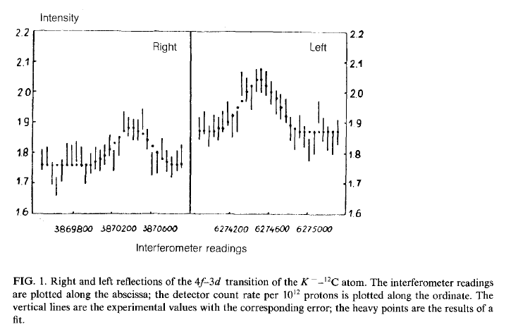
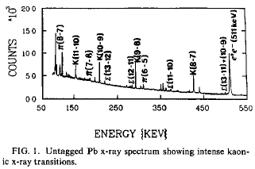
PDG 2020:
The main disagreement is between the two most recent and precise measurements (x-ray energies from kaonic atoms):
m_{K}=493.696±0.007 MeV
A.S. Denisov et al. JEPT Lett. 54 (1991)558
K⁻ ¹²C, crystal diffraction spectrometer
(6.3 eV at 22.1 keV), 4f-3d
m_{K}=493.636±0.011 MeV
K.P. Gall et al. Phys. Rev. Lett. 60 (1988)186
K⁻ Pb, K⁻ W; HPGe detector (1 keV), K⁻Pb (9 -> 8),
K⁻Pb (11 -> 10), K⁻W (9 -> 8), K⁻W (11 -> 10),
PDG2020
m_{K}=493.679 ± 0.013 MeV
Average m_{K}=493.679 ± 0.006 MeV S=2.4

Slide 5
Previous measurements, motivation
PDG2020:
PDG20 conclusion:
” While we suspect that the GALL 88 K− Pb (9 ->8) measurements could be the problem, we are unable to find clear grounds for rejecting it. Therefore, we retain their measurement in the average and accept the large scale factor until further information can be obtained from new measurements and/or from reanalysis of GALL 88 and CHENG 75 data”.
It is sufficient that the new measurement has the same precision (10 keV) as the 2 previously mentioned measurements, which differ by 60 keV (PLB535 (2002)52):
-if the new result agrees with Denisov (and results from Gall are disregarded) the precision would be 5 keV (10 p.p.m)
-it the new results agrees with Gall, the precision would be 7 keV (14 p.p.m.)
-> substantial improvement in the precision

Slide 6
Principles of measurements of kaon mass in kaonic atoms
Measure X-ray energies in kaonic atoms for transitions not influenced by strong interactions.
In order to determine the kaon mass, the experimental energies have to be compared with the calculated energies obtained with a certain K-mass value (corrections: vacuum polarization, electron screening, non-circular trasitions)
Measurements with HPGe detectors and with crystal diffraction spectrometer, TES, …

Slide 7
Kaonic atom formation
X-ray energies in kaonic atoms
Kaon cascade -> X-rays
Kaon absorption
K⁻
1) Kaon capture
Interesting X-rays from the
the transitions in the middle
of spectrum:
No influence from strong
interaction
avoid electron screening
of nuclei
^{e-}
X-ray
2) Kaon cascade
3) Kaon absorption

Slide 8
Principles of measurements of kaon mass in kaonic atoms
Measure X-ray energies in kaonic atoms for transitions not influenced by strong interactions.
In order to determine the kaon mass, the experimental energies have to be compared with the calculated energies obtained with a certain K-mass value (corrections: vacuum polarization, electron screening, non-circular trasitions)
Measurements with HPGe detectors and with crystal diffraction spectrometer, TES, …

Slide 9
Measurement at DAɸNE with HPGe
-> Our aim is to do measurements with HPGe detector(s) during SIDDHARTA-2 run at DAɸNE - using the available space at the SIDDHARTA-2 interaction region and with different solid targets (Pb, W, ..).
All previous measurements have used energetic kaons and a thick degrader to slow them down was necessary.
Advantage: DAɸNE is producing low momenta kaon pairs – no need for degrader. No secondary particles in the beam.
Disadvantage: High background from the beam close to the interaction point (unknown!).
In both cases: background originating from the kaons absorbed in nuclei.

Slide 10
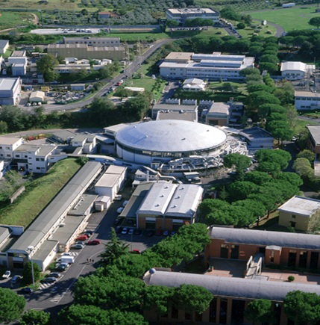
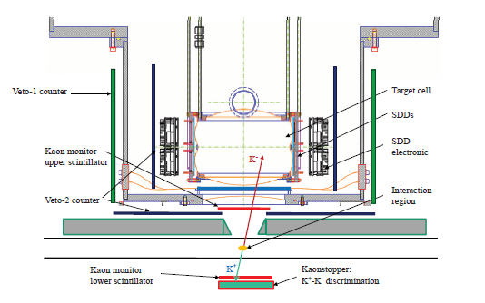
SIDDHARTA-2 at DAɸNE Silicon Drift Detector for Hadronic Atom Research by Timing Application
e+e-- -> ɸ -> K⁺K⁻, E_{K} ≈ 16 MeV
-> Our aim is to do measurements with HPGe detector(s) during SIDDHARTA-2 run at DAɸNE - using the available space at the SIDDHARTA-2 interaction region and with different solid targets.
2021 SIDDHARTA-2 run: X-ray transitions in gaseous targets: deuterium, helium, …
e+
e-
Advantage: DAɸNE is producing low momenta kaon pairs – no need for degrader. No secondary particles in the beam.
Disadvantage: High electromagnetic background from the beam close to the interaction point (unknown!).
Background originating from the kaons absorbed in nuclei.

Slide 11
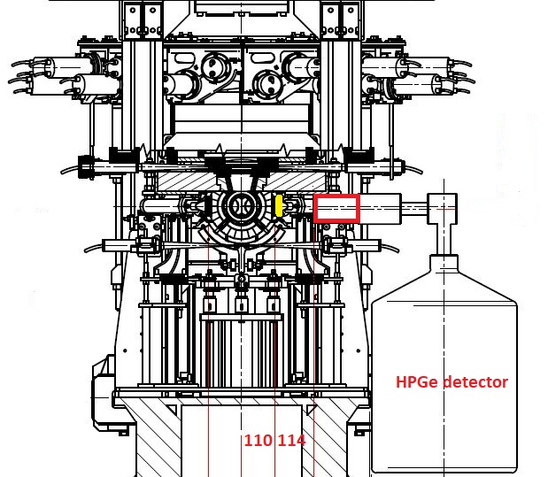
Measurement at DAɸNE with HPGe during SIDDHARTA-2 run
HPGe detector system is
independent of SIDDHARTA-2
Signal from the luminometer
(80x40x2 mm³) as a trigger
for HPGe detector.
Interaction point
Positions of the target
and the HPGe detector
is restricted by
SIDDHARTA-2 setup
-> Hardware preparations
-> Simulations (GEANT4)
Figure: Cesidio Capoccia

Slide 12
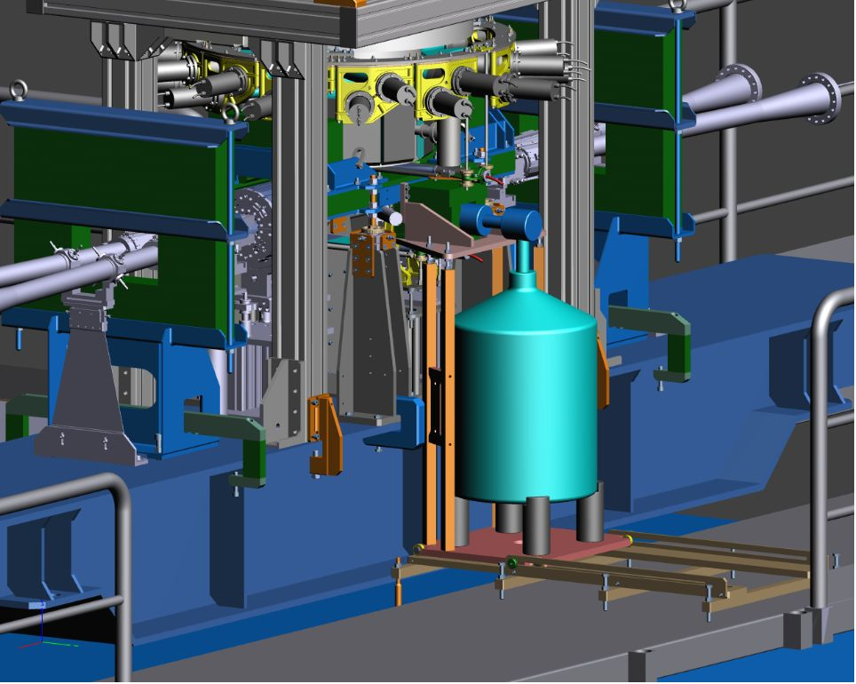
Holder and shielding have been prepared at LNF
-> Hardware preparations
-> Simulations (GEANT4)
First measurements were foreseen for March/April 2020, unfortunately postponed to 2021

Slide 13
Preparation of the measurement at DAɸNE with HPGe
Our aim is to do measurements with HPGe detector(s) during SIDDHARTA-2 run - using the available space at the SIDDHARTA-2 interaction region with different solid targets (Pb, W, …).
-> Hardware preparation
-> Simulations: to determine position and size of the target, degrader,
and position of the detector, estimate duration of measurement.

Slide 14
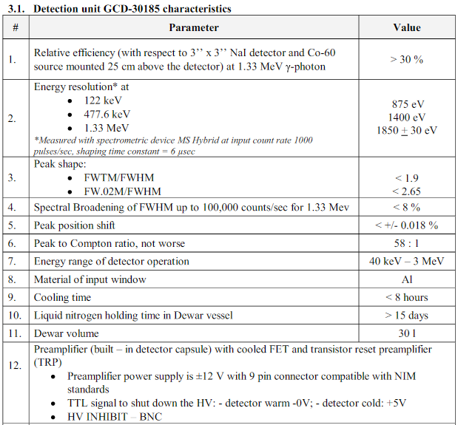
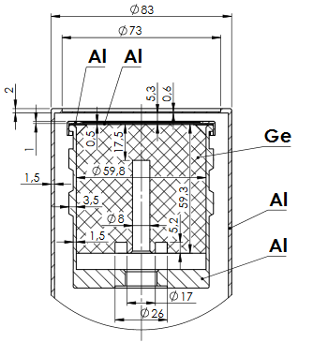
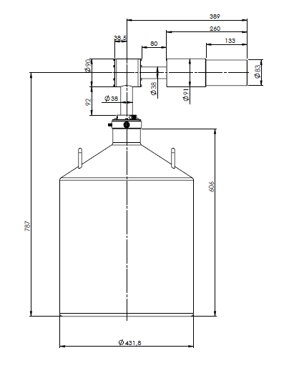
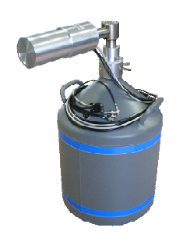
Measurement at DAɸNE with HPGe during SIDDHARTA-2
BSI HPGe detector with
transistor reset preamplifier (TRP).
HPGe active detector diameter ~60 mm, height ~60 mm.
Analog electronics and fast pulse digitizer.

Slide 15
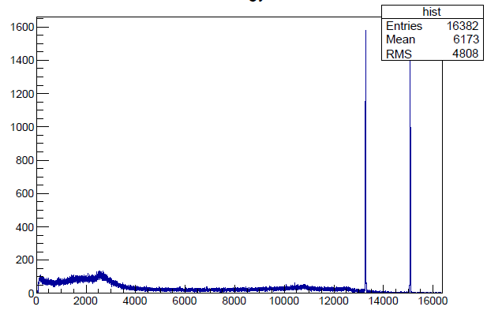
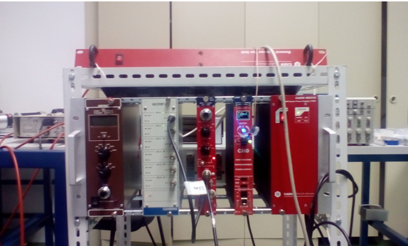
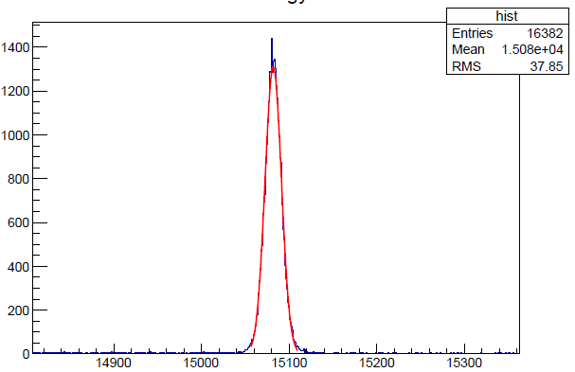
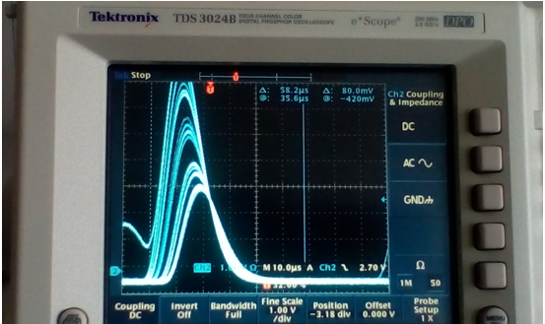
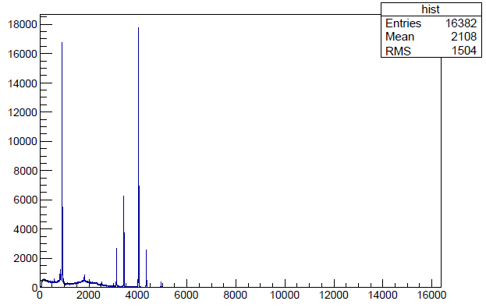
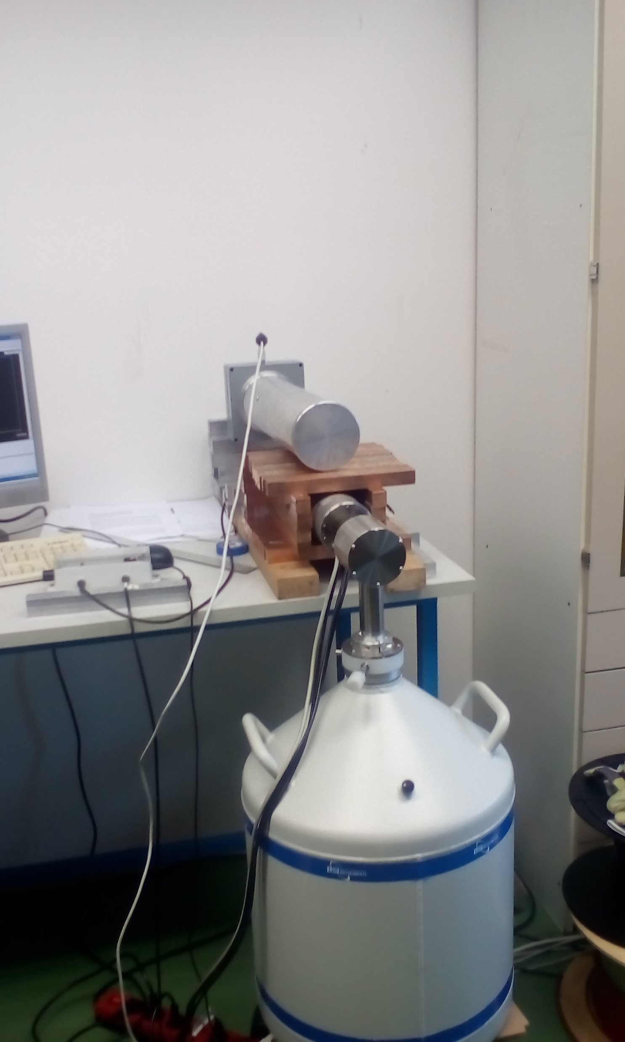
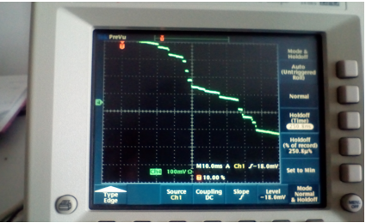
Laboratory tests of HPGe (BSI - TRP preamp) & analog electronics
Signal from spectroscopy amplifier
Signal from preamp of HPGe with TRP
Pb lines
Stability tests
⁶⁰Co, ¹³³Ba spectra,
resolutions: 0.870 keV at 81 keV
1.06 keV at 302.9 keV
1.11 keV at 356 keV
1.67 keV at 1330 keV
CAEN spectroscopy amplifier N968, Canberra
Multiport II, Canberra Genius DAQ + analysis

Slide 16
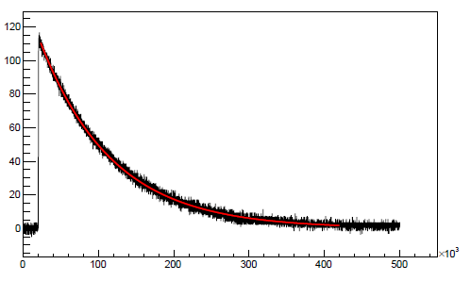
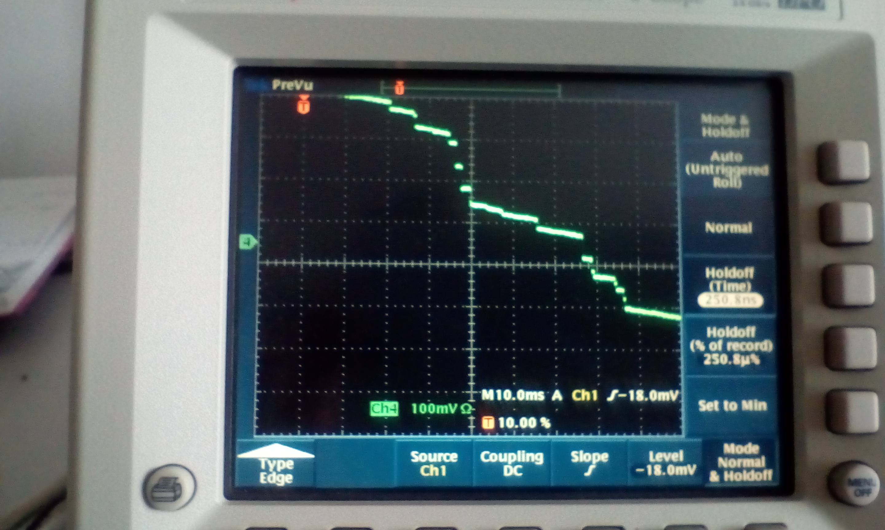
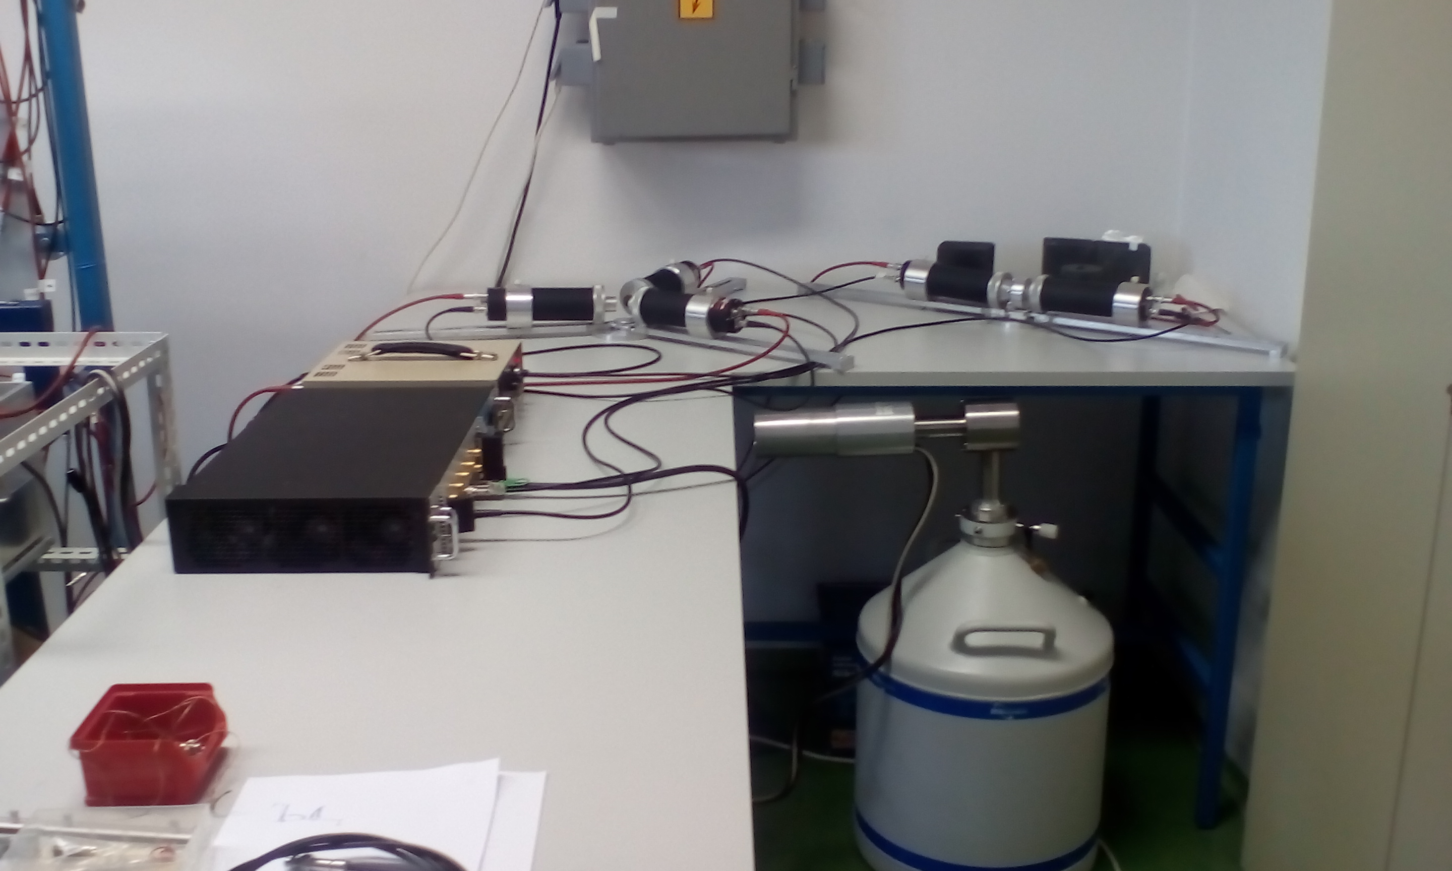
Laboratory tests of HPGe (BSI - TRP preamp) & fast pulse digitizer, CAEN DT5781 4 ch, 14 bit,
CAEN DT5781 4 ch, 14 bit, 10ns sampling time
Signal from spectroscopy amplifier ~20 μs (shaping time 6 μs),
restriction on the rate.
Digital Pulse Processing for Pulse Height Analysis firmware , based on
V.T. Jordanov et al. Nucl. Instr. Meth. A 353
(1994) 337
Signal from HPGe with RC preamp
Signal from preamp of HPGe with TRP
Possible rates up to 150 kHz, something worse resolution
Coincidences – HPGe + luminometer

Slide 17
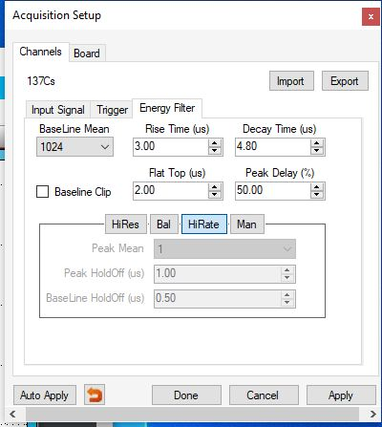
Adjustment of the parameters for energy reconstruction
V.T. Jordanov et al. Nucl. Instr. Meth. A 353 (1994) 337

Slide 18
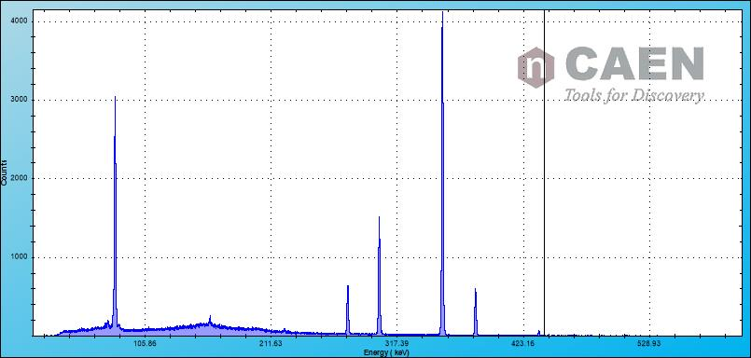
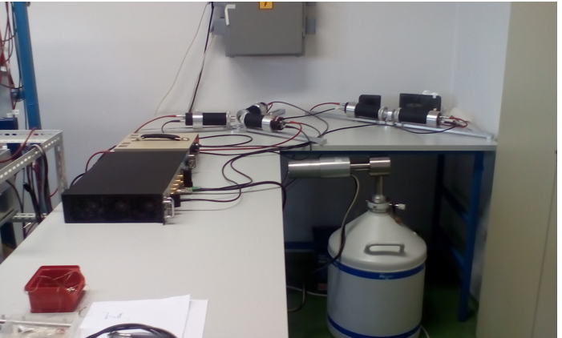
Laboratory tests (Zagreb) of HPGe (BSI - TRP preamp) & fast pulse digitizer, CAEN DT5781 4 ch, 14 bit,
CAEN DT5781 4 ch, 14 bit, 10ns sampling time
Tests: ¹³³Ba
Digital Pulse Processing for Pulse Height Analysis firmware , based on
V.T. Jordanov et al. Nucl. Instr. Meth. A 353
(1994) 337
Low rates – same resolution as with conventional electronics
High rates – 10-20% worse resolution

Slide 19
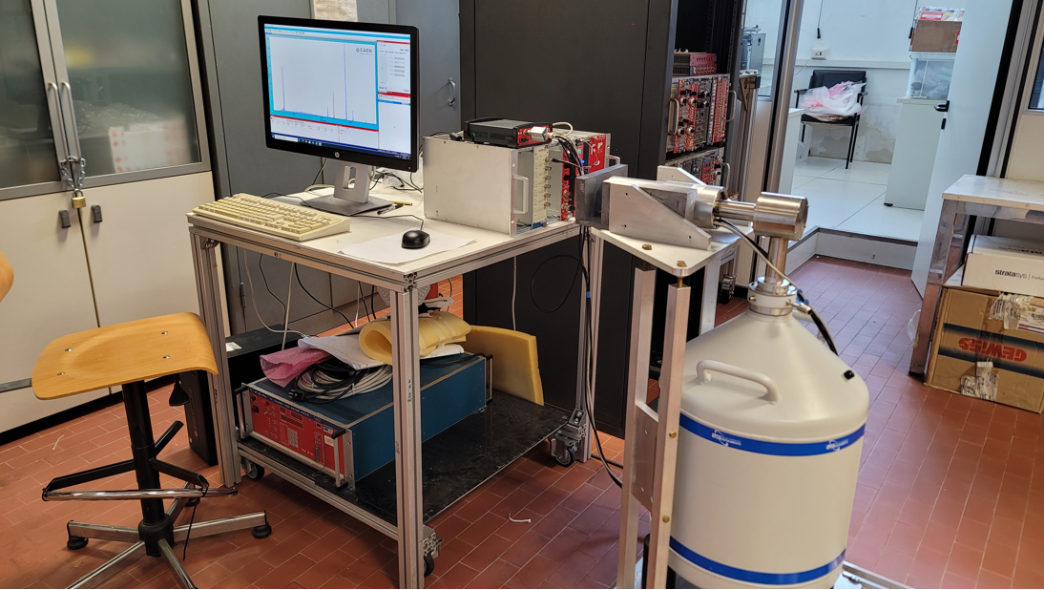
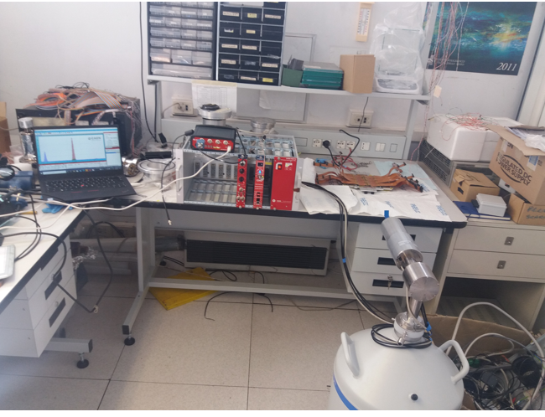
HPGe at the LNF, July 2021, holder + shielding, tests Oct., Nov. 2021

Slide 20
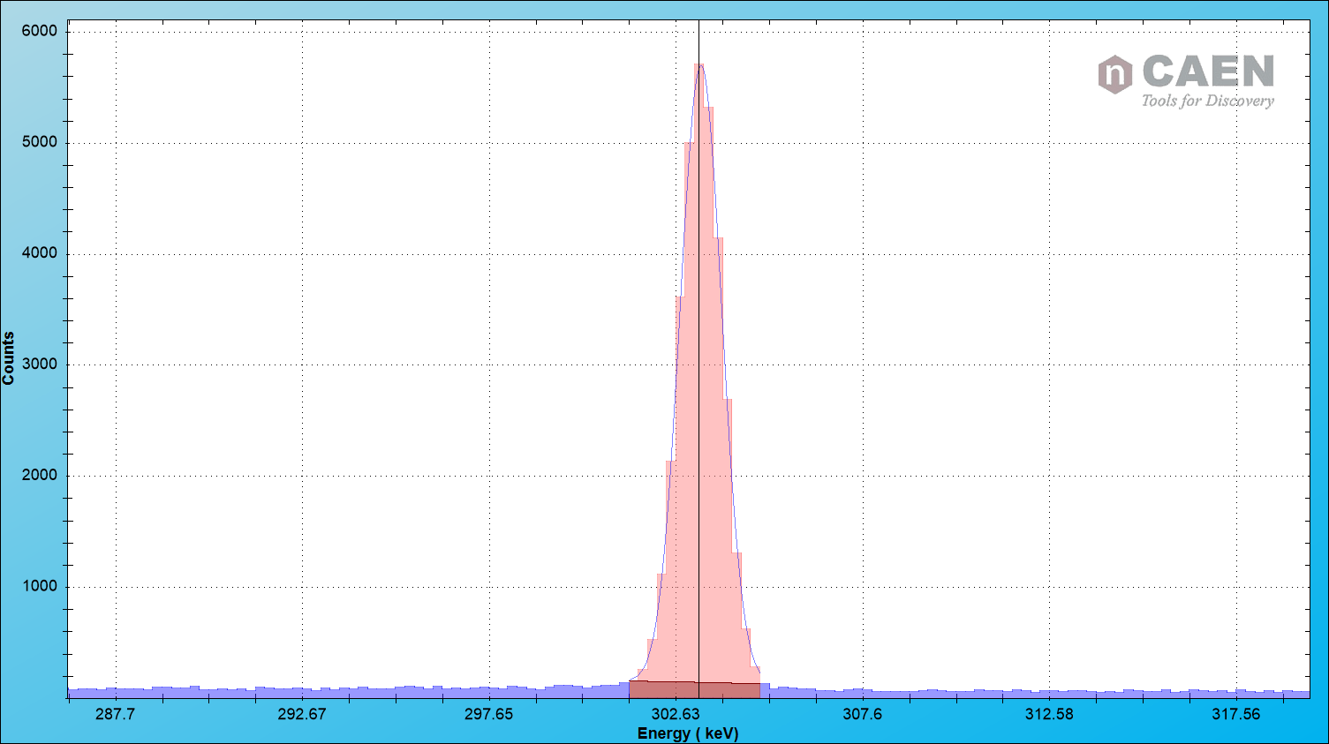
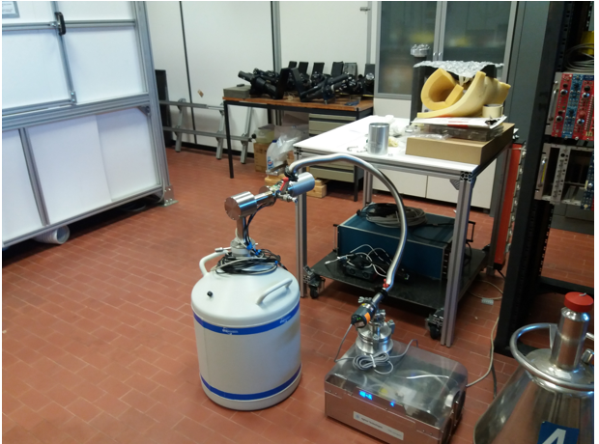
Tests Oct. and Nov. 2021, ¹³³Ba
Resolution, 302.9 keV: (with analog electronics: 1.06 kev,
Rise time: 3 us -> FWHM ~ 1.4 keV low rates)
Rise time: 5 us -> FWHM ~ 1.3 keV Not understood yet.
Rise time: 7 us -> FWHM ~ 1.2 keV
Evacuation of the HPGe:
(Old measurements resolution ~1.4 keV )
Resolution with analog electronics ~1 keV

Slide 21
HPGe holder in the hall, Nov. 2021:

Slide 22
Measurement at DAɸNE with HPGe during SIDDHARTA-2 run
Signal from the luminometer
(80x40x2 mm³) as a trigger
for HPGe detector.
The position of luminometer
110 mm from the interaction point (+30 mm) .
Targets (Pb, W) just behind
the luminometer,
80mm x 40mm x 0.6mm
no degrader
min. 100 mm from the HPGe
Positions of the detector and
the target (size)
are being determined by
GEANT4 simulations.
Efficinency
Background (kaon absorption)
Figure: Cesidio Capoccia

Slide 23
Simulations – GEANT4
To estimate the thickness and size of the target, setup configuration and HPGe efficiency
To estimate background – from the beam (?) and from the kaon absorption and to determine optimal position of the detector and target (+ target size) and shielding .
To estimate required time for the measurements.
Not all parameters are known: beam background !? – test measurements with the beam are required.

Slide 24
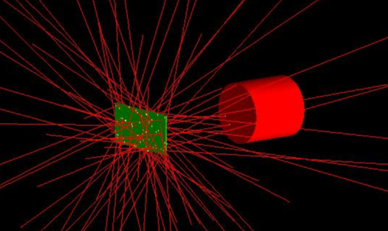
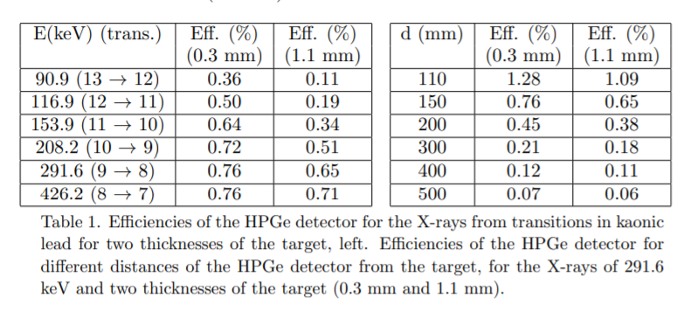
Simple GEANT4 Simulations – HPGe efficiency
X-rays are generated
in the lead plate
D. Bosnar et al. Acta Phys. Pol.B51 (2020) 115

Slide 25
Simple GEANT4 simulations – hadronic background after kaon absorption
Geometry:
Kaons are fired randomly from interaction point (IP) through luminometer on Pb target.
Kaon momenta = 141 MeV/c (boost side)
Luminometer (yellow) - 80mmx40mmx2mm, 100 mm from IP
Pb target (green) – 80mm x 40mm , thickness 1.2mm, 104mm from interaction point
HPGe detector (red) is d mm (d variable, d=110mm, d=150mm) from the Pb target
Generated 3.8*10^6 kaons on Pb target, corresponds to total luminosity of 100 pb^-1
and 1.5*10^7 kaons, approx 400 pb^-1

Slide 26
Estimation of the requested number of X-rays in the peak (Pb, 9->8 transition,291 keV)
precision(trans.)$=\frac{σ}{\sqrt{N}}$
FWHM(302.9 keV)=1.1 keV -1.3 keV (depending on the
rate)
N≈6.000-9.000 X-rays in the peak (291.6 kEV)
to reach the precision of previous
measurements (10 keV).
Estimation: A. Scordo

Slide 27
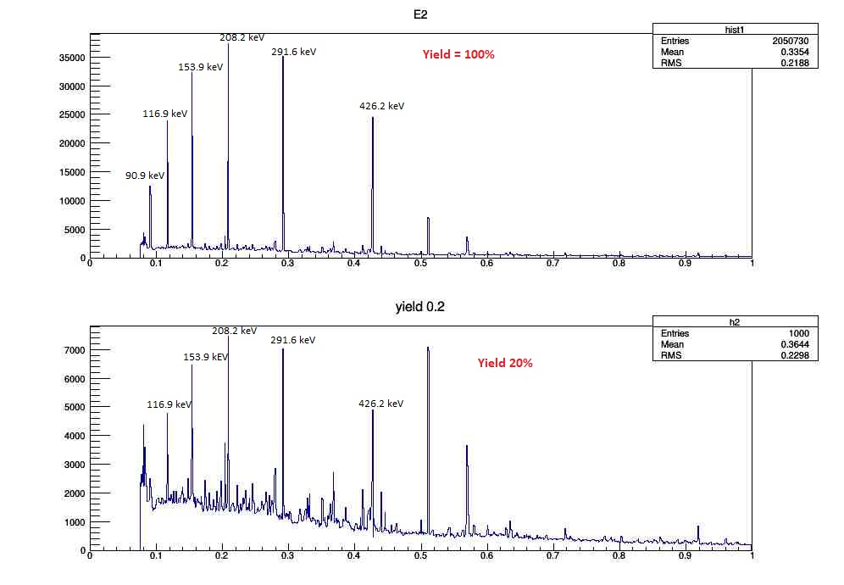
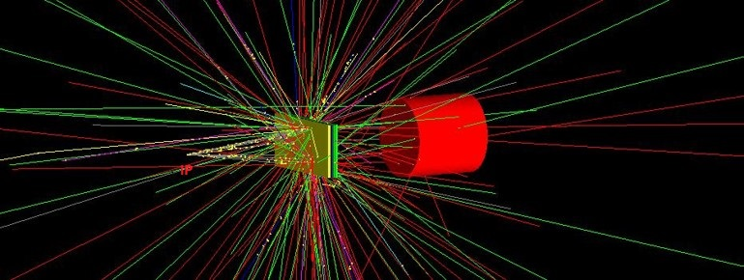
HPGe detector on d=110mm from the Pb target (closest position), 400 pb^-1
X-rays from Pb, in the peak at 291.6 keV there are approx 9.144 X-rays (yield 20%).
Approx. 9.000 X-rays in the 291.6 keV are needed for the required precisison
Only hadronic background, peaks are smeared with the detector resolution.

Slide 28
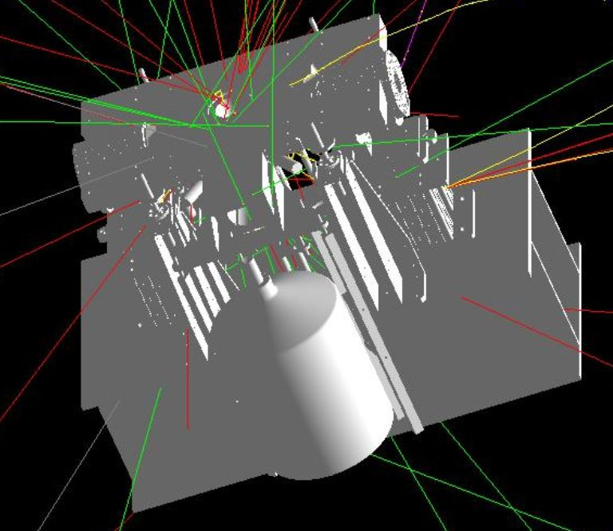
GEANT4 full simulation – work in progress
CAD drawing
GEANT4 simulation
CAD files for selected objects are converted in GEANT4 gdml files for geometry description,
different materials are taken into account

Slide 29
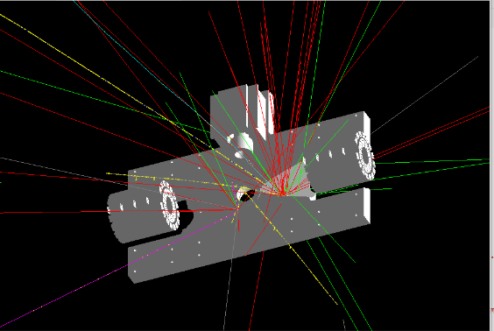
GEANT4 full simulations
Lead

Slide 30
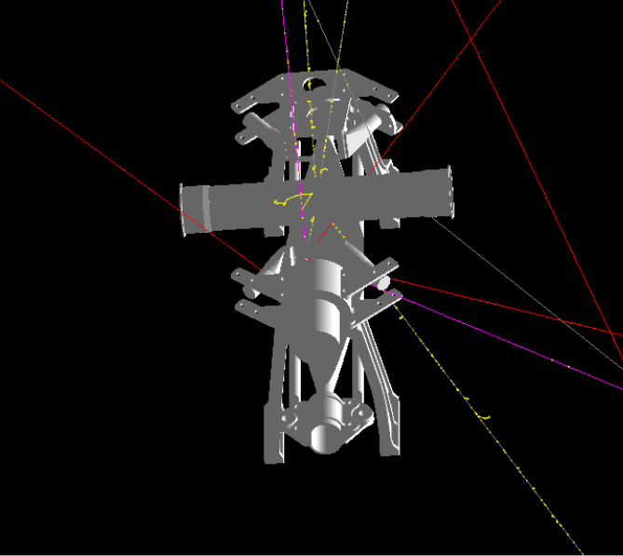
GEANT4 full simulations
Plastic

Slide 31
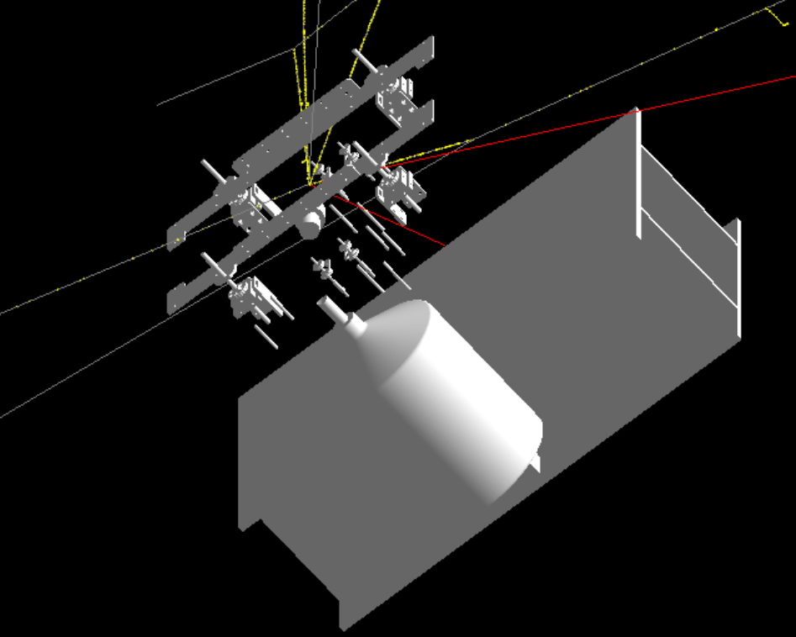
GEANT4 full simulations
Steel

Slide 32
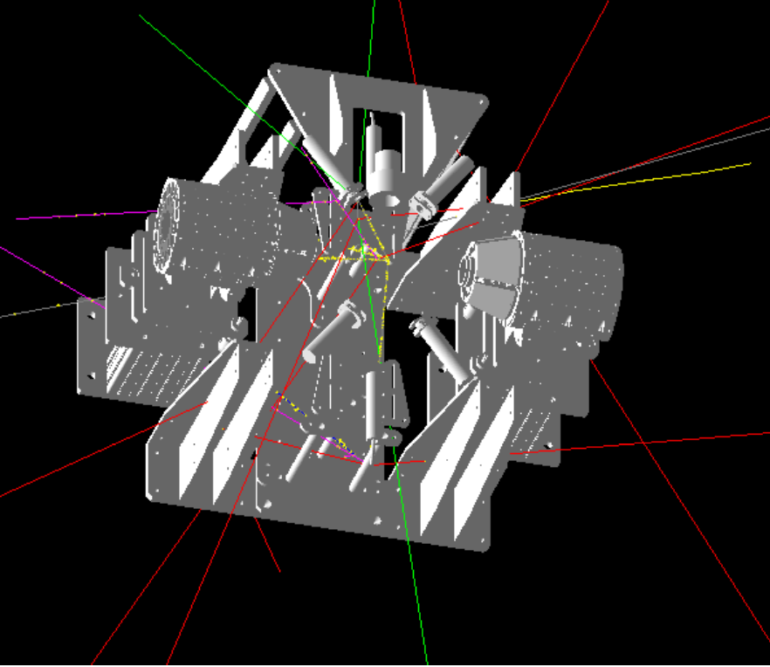
GEANT4 full simulations
Aluminum

Slide 33
GEANT4 full simulations
All material

Slide 34
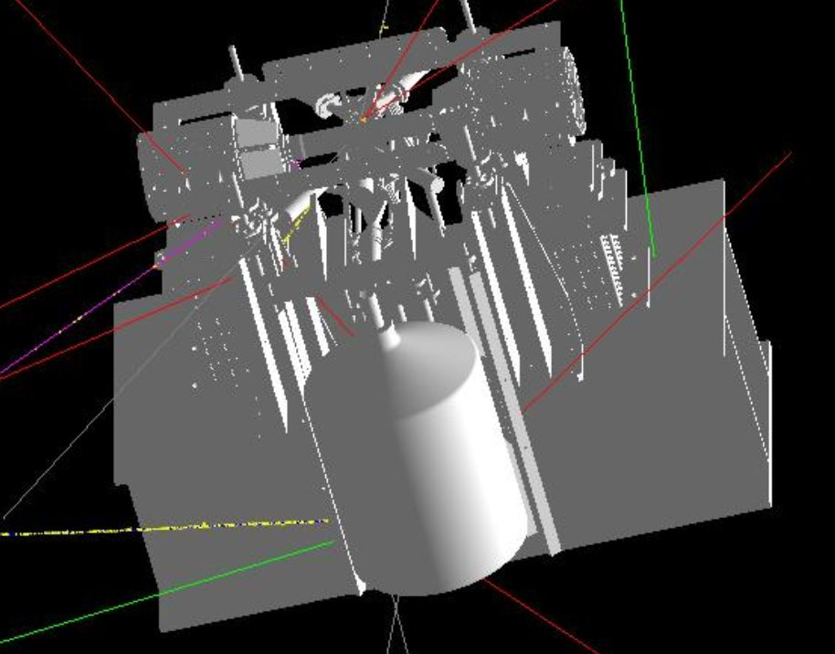
GEANT4 full simulation – work in progress
All materials
No lead

Slide 35
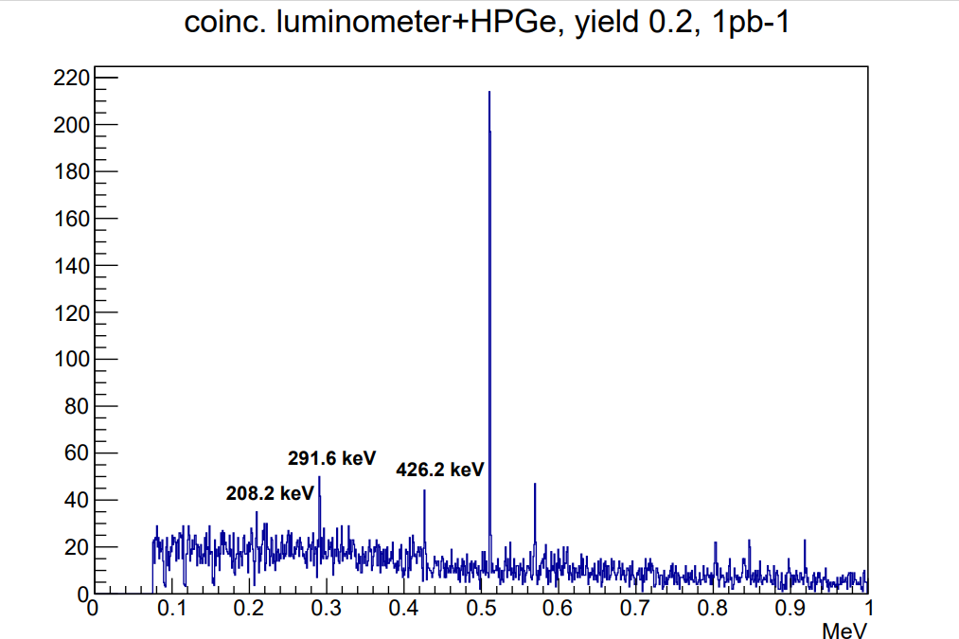
GEANT4 full simulation – work in progress
Kaons are generated uniformly in 4π
Only hadronic background., no background from e+e- beams
Front shielding of HPGe detector should be optimized
Preliminary
Approx. 50 events (291.6 keV) / pb⁻¹,
12 pb⁻¹ /day -> approx. 600 events/day.
~9.000 events -> 10 keV precision (15 days)
~25.000 events-> 5 keV precision (40 days)

Slide 36
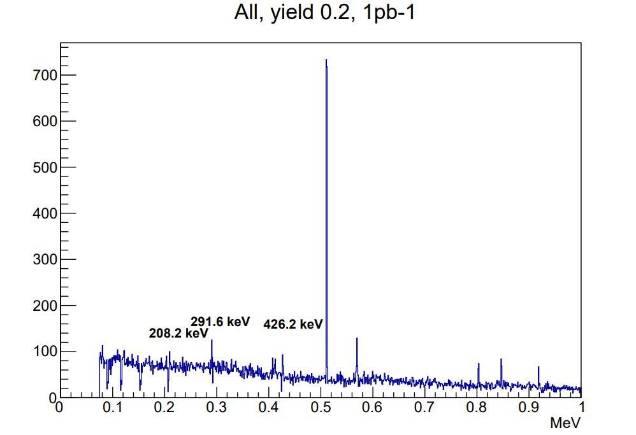
GEANT4 full simulation – work in progress
Electromagnetic background ? -> Measurements in the hall
Electromagnetic background will not have influence on this spectra
(coincidence luminometer + HPGe), but it can lead to too big pile-ups in the HPGe

Slide 37
Principles of measurements of kaon mass in kaonic atoms
Measure X-ray energies in kaonic atoms for transitions not influenced by strong interactions.
In order to determine the kaon mass, the experimental energies have to be compared with the calculated energies obtained with a certain K-mass value (corrections: vacuum polarization, electron screening, non-circular trasitions)
Measurements with HPGe detectors and with crystal diffraction spectrometer, TES, …

Slide 38
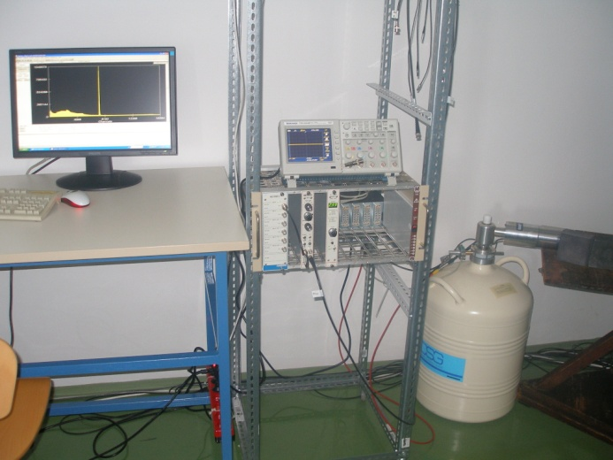
Second HPGe detector
Additional HPGe detector
with RC preamplifier (DSG)
Application for a new HPGe detector and electronics in 2022 ?

Slide 39
Thank you for your attention !

Slide 40
Backup slides

Slide 41
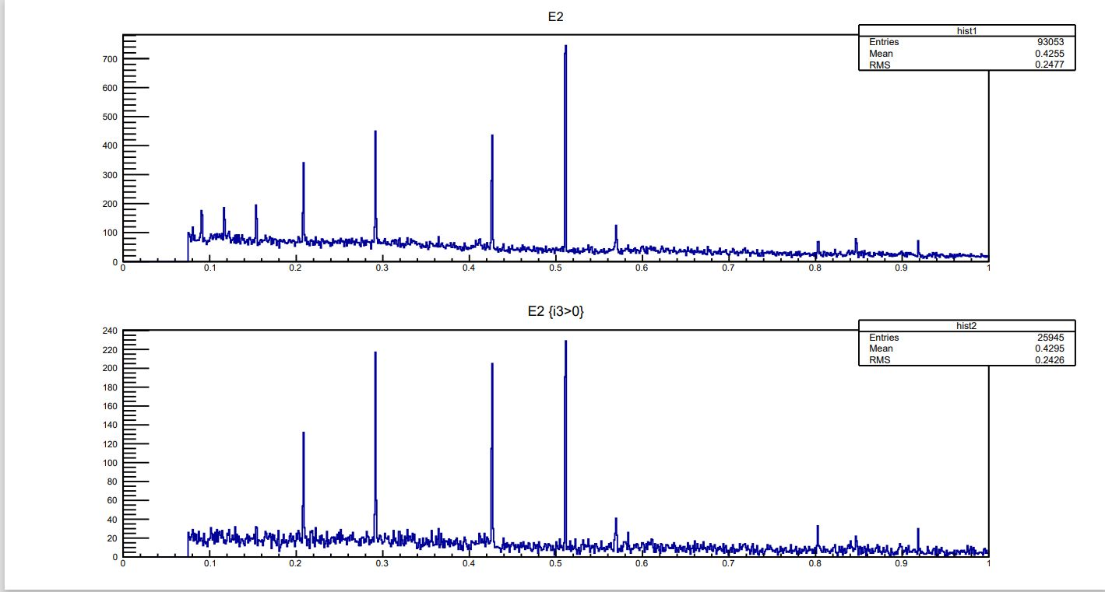
1pb-1 (~2h)
Yield = 1
All events in HPGe,
Total 93.053
Rate in HPGe ~ 13 Hz
Coincidence Luminometer + HPGe

