Slide 1

Radiation Sources from relativistic electron beams: Compton Back-scattering, Free Electron Lasers, THz radiators
Luca Serafini – INFN-Milan and University of Milan
luca.serafini@mi.infn.it
Research activities on radiation sources at LNF (EupraXia, SPARC-Lab, Sabina, Latino), Roma1 (TERA), Milan-LASA (BriXSinO, STAR, EXMP)
Presently no activity on Synchrotron Sources in the context of our PhD School
Emphasis on Electron Beams of Large Phase Space Density (i.e. brightness, peak and/or average)
Thanks to S. Lupi (LaSapienza), V. Petrillo (Univ. Milano), L. Giannessi (INFN-LNF) for providing PhD thesis subjects

Slide 2
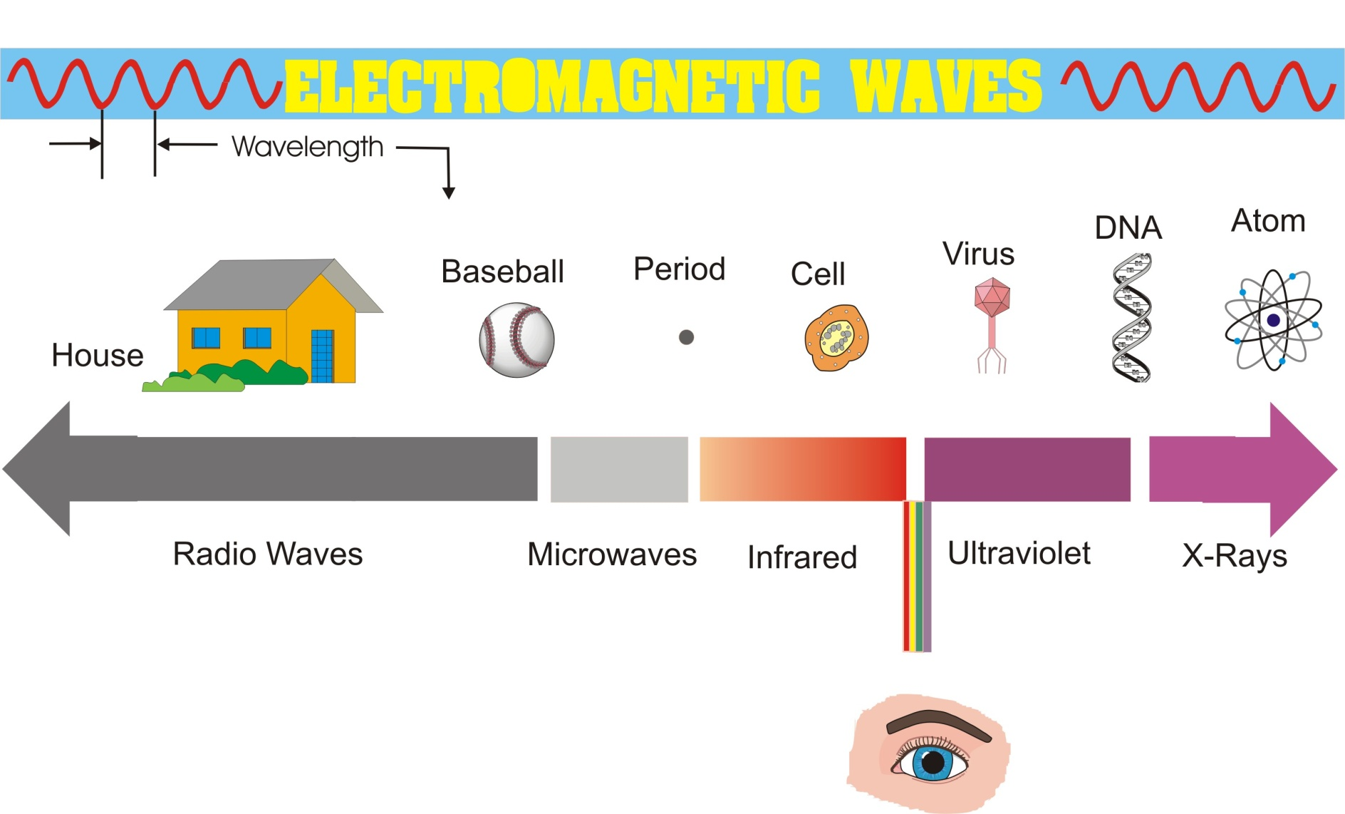
The electro-magnetic spectrum: a travel through electro-magnetic waves and photons (wave-particle duality of light)
Atomic
nucleus
Lasers
Syncr. Rad.
F.E.L.
Compton
Sources
THz
VUV to X-rays
γ-Rays
km m mm μm nm Angstrom fermi
visible
10³ 1 10⁻³ 10⁻⁶ 10⁻⁹ 10⁻¹⁰ 10⁻¹⁵
Classical Electro-Dynamics
with electro-magnetic waves
Quantum Electro-Dynamics
with photons (particle-like)

Slide 3
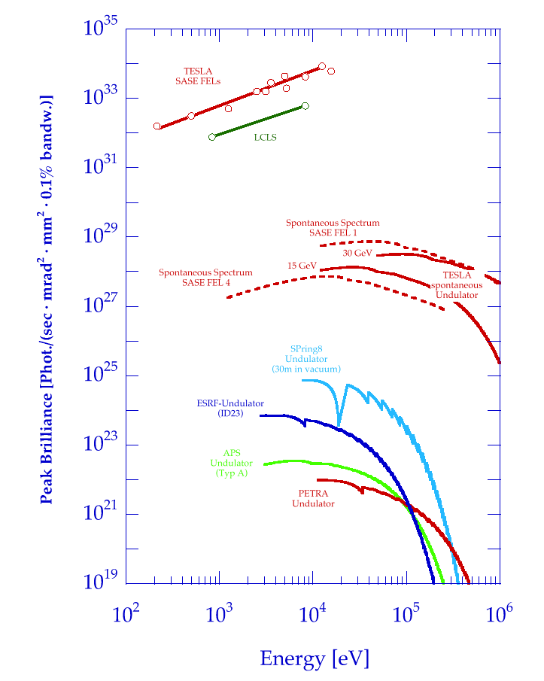
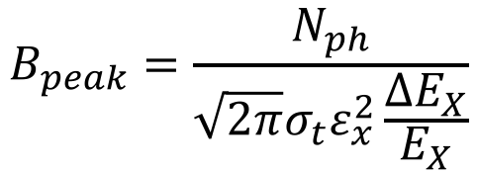
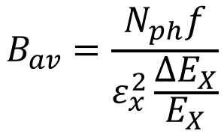
Brilliance of Lasers and X-ray sources
ELI
12.4
1.24
0.124
λ (nm)
BELLA
FLASH
$$B_{peak}=\frac{N_{ph}}{{\sqrt{2π}σ_{t}ε}_{x}^{2}\frac{ΔE_{X}}{E_{X}}}$$
Thomson/Compton Sources
$$B_{av}=\frac{N_{ph}f}{ε_{x}^{2}\frac{ΔE_{X}}{E_{X}}}$$

Slide 4
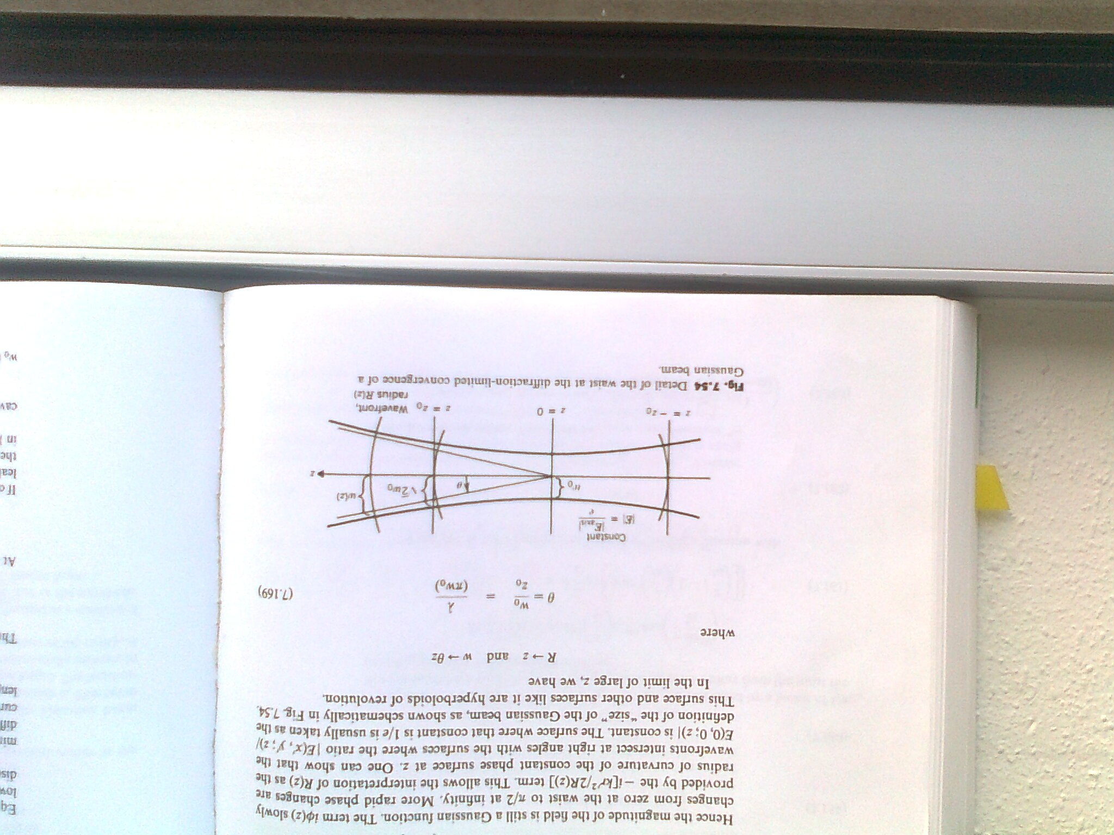
Matching Conditions for Electron and Photon beams in
Phase Space to maximize Coherence and/or Spectral Density
Example: TEM₀₀ Gaussian Laser mode (M²=1 diffraction limited)
w laser spot size
Z₀ Rayleigh range (diffraction length)

Slide 5
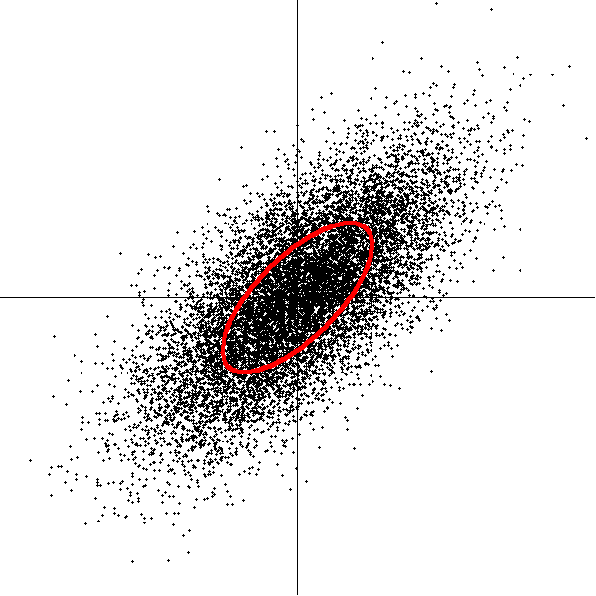
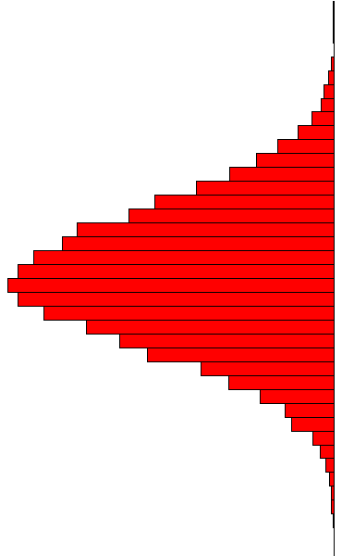
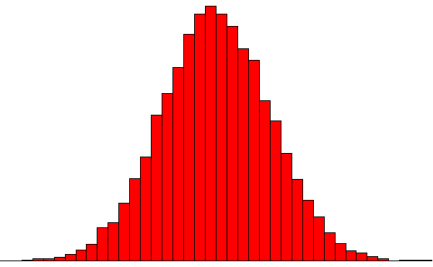
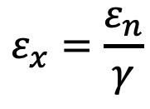
Particle Beam Emittance and beam sizes
The emittance is the area of the phase space occupied by the particles Knowing the emittance and the Twiss parameters in a point of the accelerator, the beam dimensions are obtained : σ_{x,y} e σ’_{x,y}
p_{x}
x
Ellipse area= πε_{x}
normalized emittance ε_{n} vs.
geometrical emittance ε_{x}
$$ε_{x}=\frac{ε_{n}}{γ}$$

Slide 6

LASER
PARTICLE BEAM
$$\frac{λ}{4π}$$
Emittance of a laser beam:
Phase Space matching =
DIFFRACTION LIMIT

Slide 7
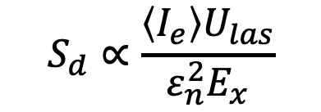

Matching Conditions for Electron and Photon beams in
Phase Space to maximize Coherence and/or Spectral Density
Synchrotrons: diffraction limit
ε < λ
(ESRF record emittance at 100 pm to be compared to
12 keV X-rays i.e. 10⁻¹⁰ m wavelength)
I.C.S. bandwidth scaling as γ²ε²/σ²
Petrillo-Serafini criterion
Pellegrini-Kim criterion on SASE FEL:
FELs and ICS share strong requests on peak/average electron beam brightness B
$$S_{d}∝\frac{\left\langle I_{e}\right\rangle U_{las}}{ε_{n}^{2}E_{x}}$$
$$B=\frac{I_{e}}{ε_{n}^{2}\frac{Δγ}{γ}}$$

Slide 8
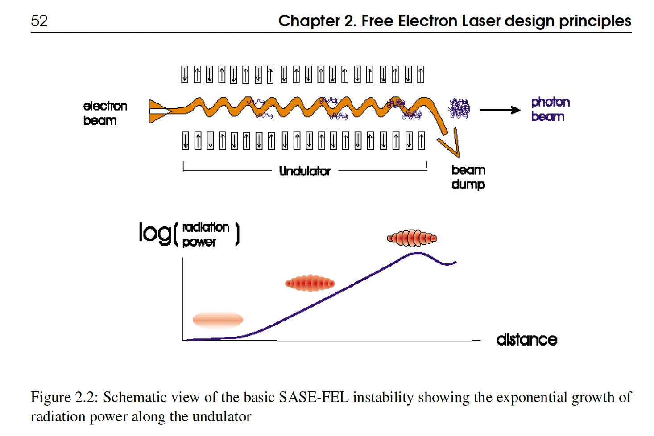
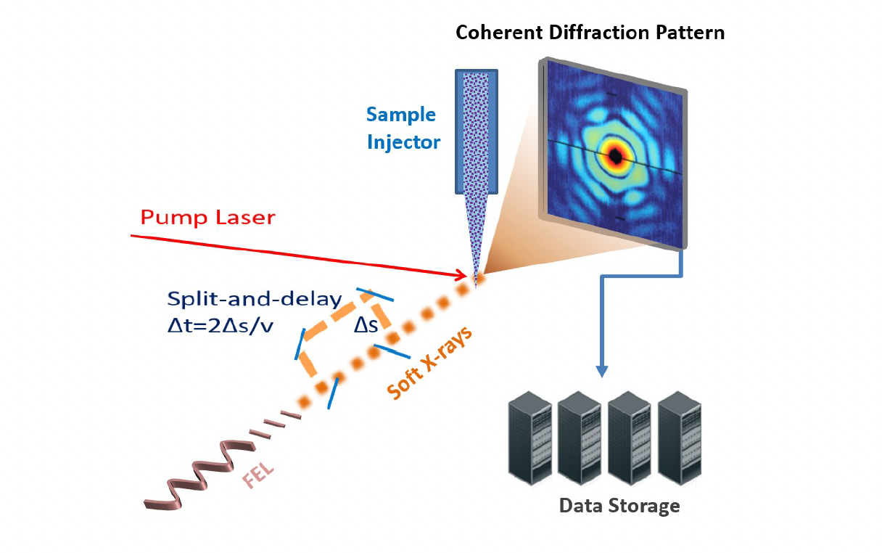
Free Electron laser at
EupraXia LNF

Slide 9
PhD Thesis Projects on FELs at EupraXia/LNF
1) Seeded free-electron laser for the generation of UV ultrashort coherent pulses from a plasma-wake accelerator
2) Design of a narrow bandwidth, seeded free-electron laser for the generation of VUV light
Luca Giannessi INFN/LNF
luca.giannessi@lnf.infn.it

Slide 10
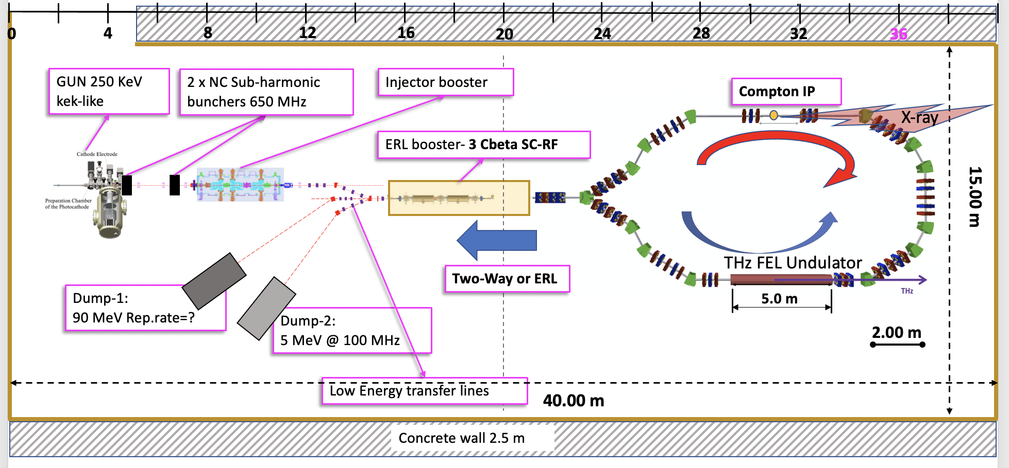
BriXSinO: Energy Recovery SC Linac
(45 MeV, 5 mA CW)

Slide 11
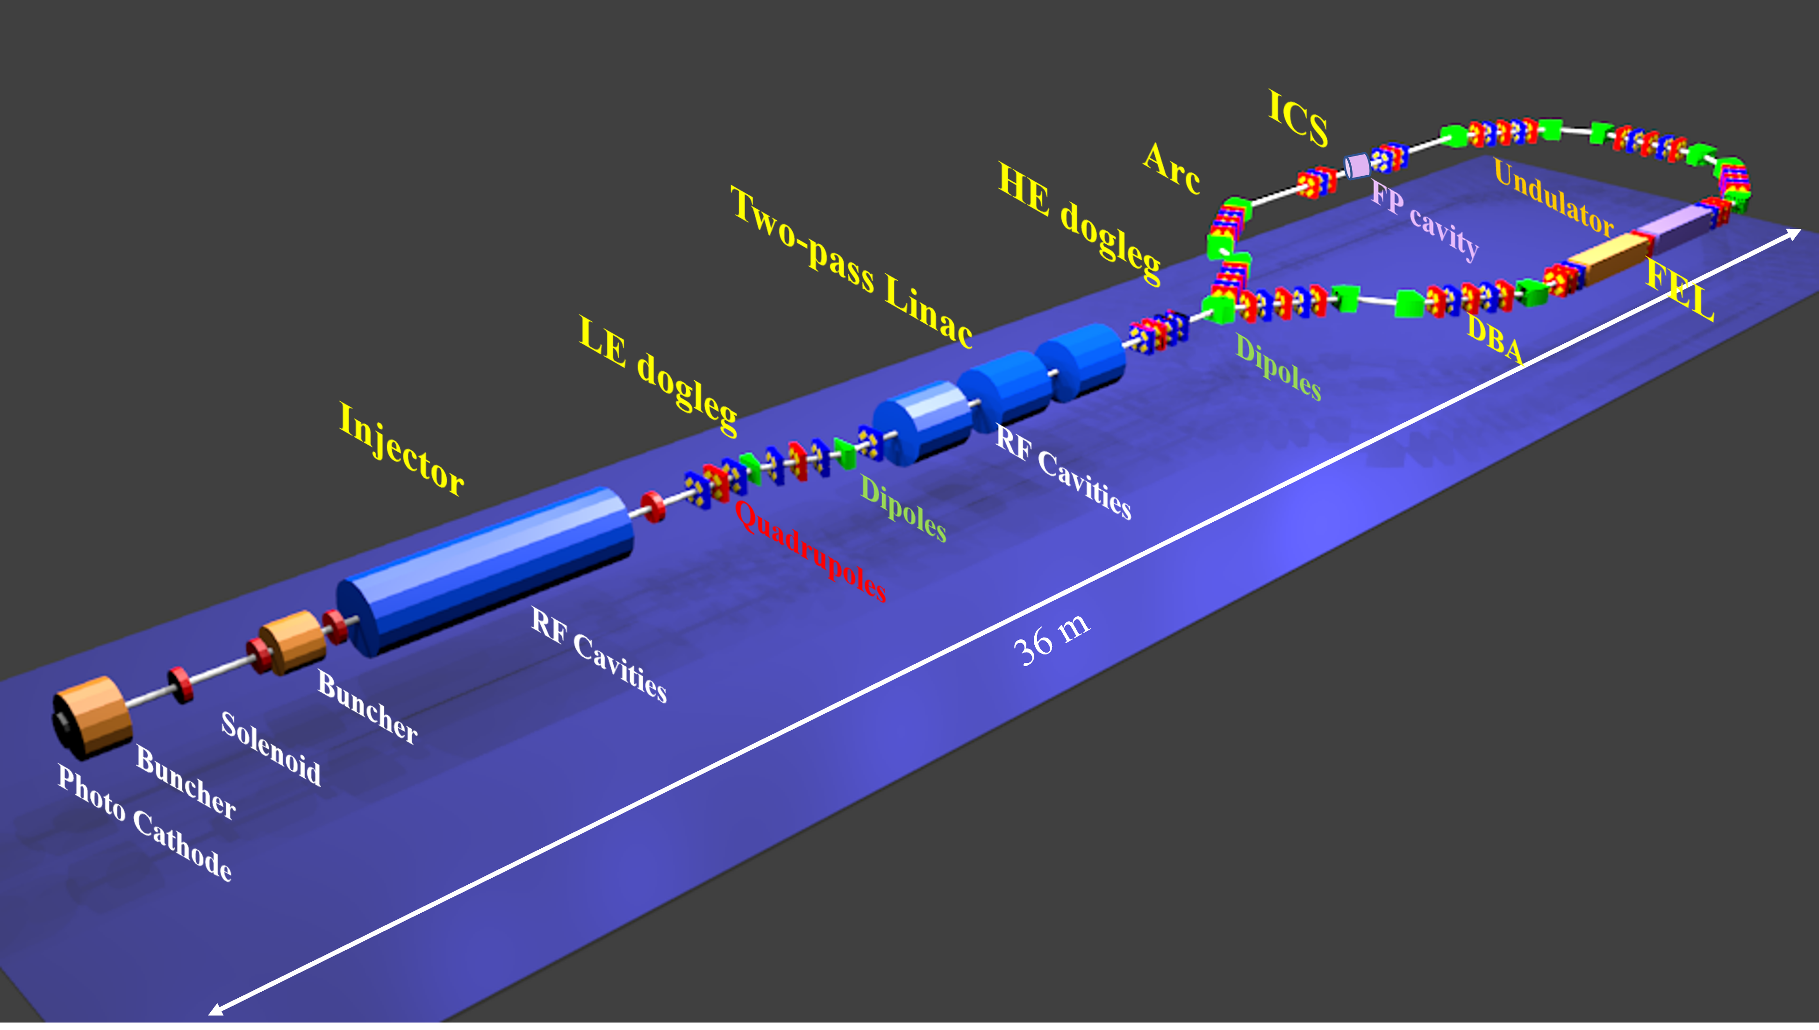
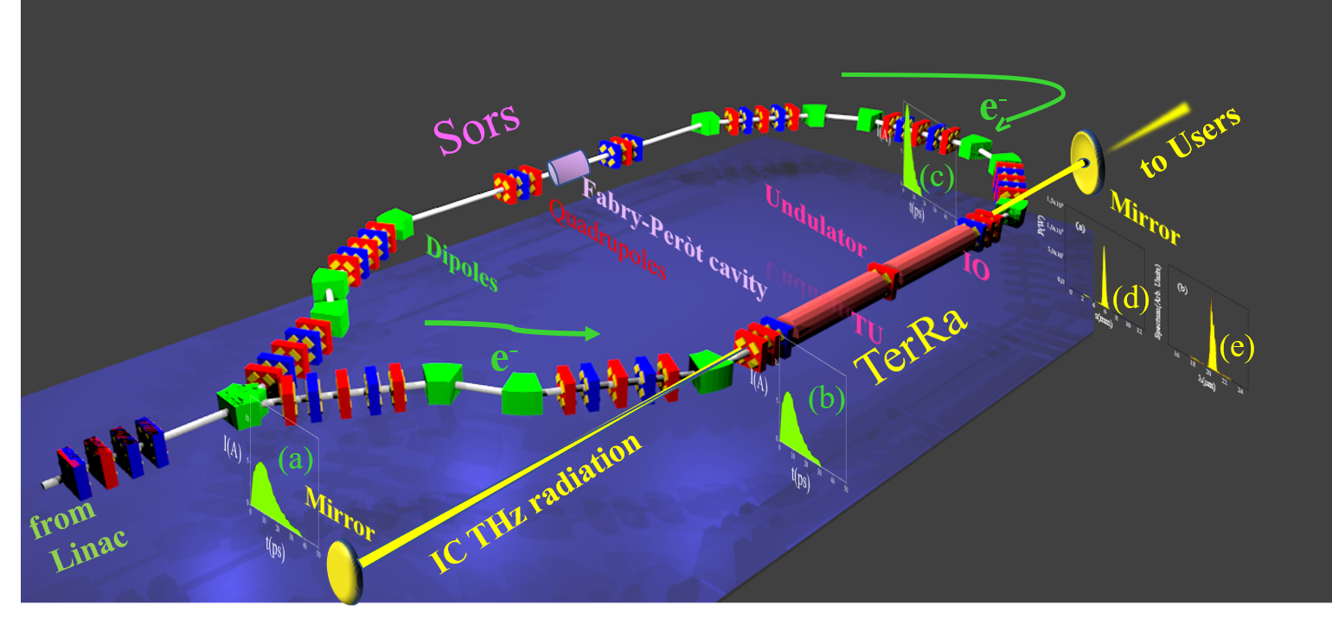
BriXSinO ERL general view
BriXSinO ERL radiation sources

Slide 12
Thesis on BriXSinO ERL radiation sources at
very high average flux/power/brilliance
Inverse Compton source:
Optimization of the working points of the ICS on BriXSinO
(with L. Serafini, I. Drebot, A. Bacci, M. Rossetti Conti)
kW-class FEL Oscillator source in the TeraHertz range:
A synchronized THz and Soft X-ray source based on a FEL
Oscillator
2) Superradiant regime in FEL Oscillators
(with V. Petrillo, M. Opromolla, I Drebot)
Luca Serafini and Vittoria Petrillo (vittoria.petrillo@mi.infn.it)

Slide 13
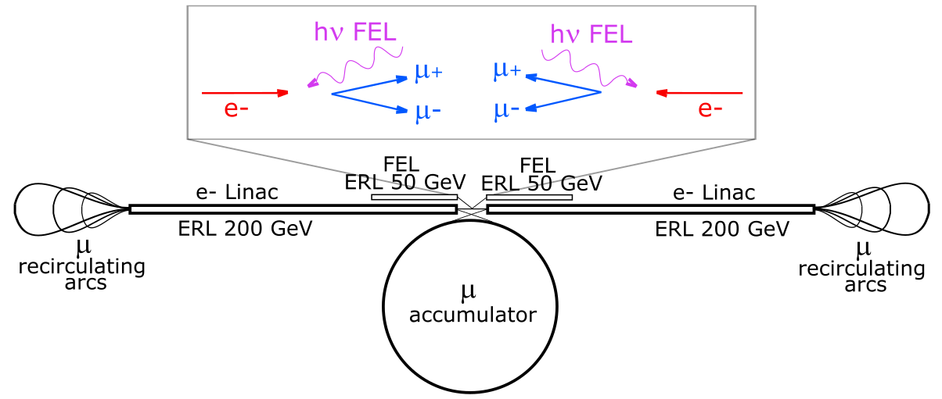
High Efficiency High Power X-ray FELs for EXMP
with nm-class focusing
Very recent idea (C. Curatolo and L. Serafini, arXiv:2106.03255v1 , 6 Jun 2021) on a new scheme of muon collider based on electron-photon collisions: EXMP (Electron and X-rays to Muon Pairs)
X-ray photons by FELs in the 60-150 keV with 1% efficiency
(FEL beam power / e- beam power) focused to 10 nm spot sizes
Luca Serafini (INFN-Milan/LASA)

Slide 14
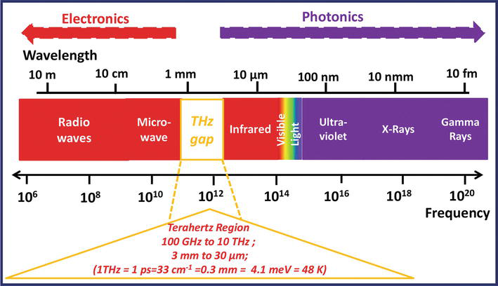
Terahertz (THz) Radiation Activity in Rome
Stefano Lupi and Massimo Petrarca, INFN and Sapienza University
Applications
Medical
Imaging
Detectors
Chemical
Recognition
High
Penetration
Innovative
Material
Investigation
Terahertz
Radiation
Space
Applications
High Electric Field vs. long wavelength
Phase and Polarization control
International Scenario
Particle
Acceleration
Farmaceutic
And Food
Security
Properties
Stefano.lupi@roma1.infn.it
Massimo.petrarca@uniroma1.it

Slide 15
Terahertz (THz) Radiation Projects
Stefano Lupi and Massimo Petrarca, INFN and Sapienza University
1) TERA (THz-ERA): THz Technology for Particle Acceleration
Why Terahertz
λ_{THz}=100 microns>>L_{e-beam}
Relaxed conditions with respect to NIR/VIS Laser
Same laser for e-beam and THz production:
Low jitter and good synchronization
Surface Resistence increases with ω^{1/2}
Breakdown effects at higher electric field
Multiple THz production mechanisms
Acceleration
Cavity
TM01
PhD Proposal :
Development of THz Technology for THz Acceleration
From Acceleration Cavities to Detectors

Slide 16
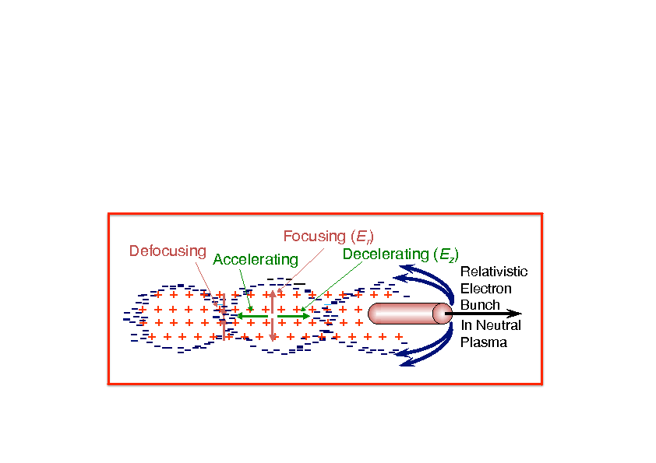

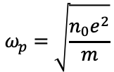
Terahertz (THz) Radiation Projects
Plasma-based accelerators – Plasma properties
Stefano Lupi and Massimo Petrarca, INFN and Sapienza University
2) Plasma by Terahertz: THz Diagnostic of Plasma
Plasma Frequency
$$ω_{p}=\sqrt{\frac{n_{0}e^{2}}{m}}$$
Plasma wavelength
Maximum accelerating gradient
Driver bunch
λp
Witness bunch
Plasma density affects all acceleration parameters:
Maximum accelerating gradient;
Plasma wavelength (It also determines the bunch properties, σ_{z} and σ_{x});
Plasma acceleration regime;
Beam Emittance;
PhD OBJECTIVES
I Objective: Study of the plasma at low density (≤ 10¹⁵ cm³), through THz reflectivity and transmittance;
II Objective: Study the of plasma/electron bunch interaction (density modulation) inside the capillary;

Slide 17
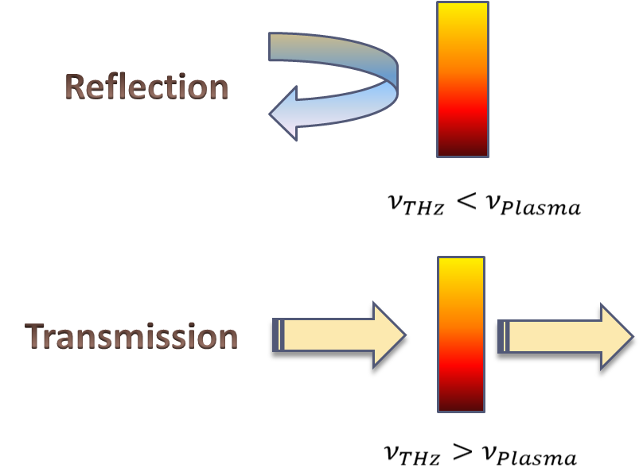
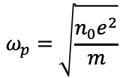
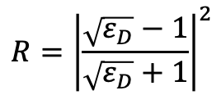
Electromagnetic Properties of a Plasma
A plasma at any density can be described through the Drude model
$$ω_{p}=\sqrt{\frac{n_{0}e^{2}}{m}}$$
The Drude model is defined by two parameters:
Plasma Frequency ω_{p}
Scattering rate γ=1/τ ◊ τ=time between two scattering processes
$$R={\left|\frac{\sqrt{ε_{D}}−1}{\sqrt{ε_{D}}+1}\right|}^{2}$$
Measuring Reflectance and Transmittance=1-Reflectance
one can determine both the average density and its
fluctuations of a plasma
Laser/Particles induced Plasma
ω<ω_{plasma}
ω>ω_{plasma}

Slide 18
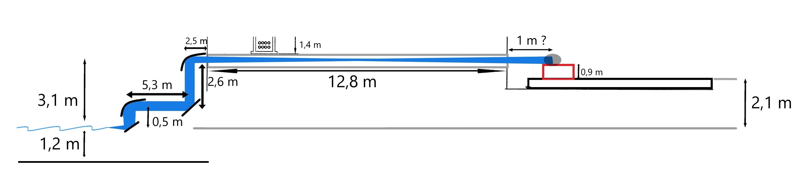
Terahertz (THz) Radiation Projects
Stefano Lupi and Massimo Petrarca, INFN and Sapienza University
3) SABINA@LNF-INFN: Development of a THz/IR Beamline
from SPARC Linac for Spectroscopy of Advanced Materials
APPLE-X Undulator
Extraction optics
Here the accelerated electrons generate the THz/IR radiation
An OTR screen acting as first mirror, separate the electron beam and the THz/IR radiation
Experimental hutch
Diagnostic
The radiation is directed to the laboratory
The radiation is focused on a diagnostic setup (alignment, beam characterization)
PhD Proposal
Development of Ondulator and Optics for SABINA

