Slide 1
CHANNELING in crystals:
INFN-Ferrara activities
L. Bandiera, V. Guidi, A. Mazzolari
12/11/2021

Slide 2







Crystals technology at INFN-Ferrara
Collimation & beam steering
Innovative radiation sources
Pair production studies
Innovative detectors
Involved in Channeling experiments since 2000
Beam steering
Innovative radiation sources
Innovative radiation and positron sources
Innovative detectors
Beam extraction
Innovative radiation sources
Beam steering
ERC-CoG CRYSBEAM (LHC beam extraction)
ERC-CoG SELDOM (Studies of MDM and EDM of charmed baryons)
MCA-IRSES CUTE (crystalline undulators)
MSCA-RISE PEARL (crystalline undulators)
MSCA-RISE N-LIGHT (crystalline radiation sources)
EIC-PATHFINDER TECHNO-CLS (crystalline radiation sources)

Slide 3

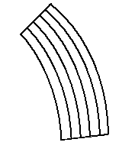
Channeling in a bent CRYSTAL
Channeling of a charged particle beam in a bent crystal results in steering of its trajectory
λ
Bent crystals can be used in particle accelerators as collimating or extraction element
E. Tsyganov, 1976

Slide 4
INFN Competencies
INFN has competencies related to
  Development of innovative ideas and research activities
  (connected to channeling and related effects)
  Simulations of coherent effects in crystals
  Design of setups for channeling experiments
  Crystals manufacturing and characterization
  Holders manufacturing and characterization
  Goniometry
  Trackers and detectors
  Data analysis
INFN is a scientific agency encompassing a full set of competencies related to studies of coherent effects between charged particle beams and crystals.

Slide 5
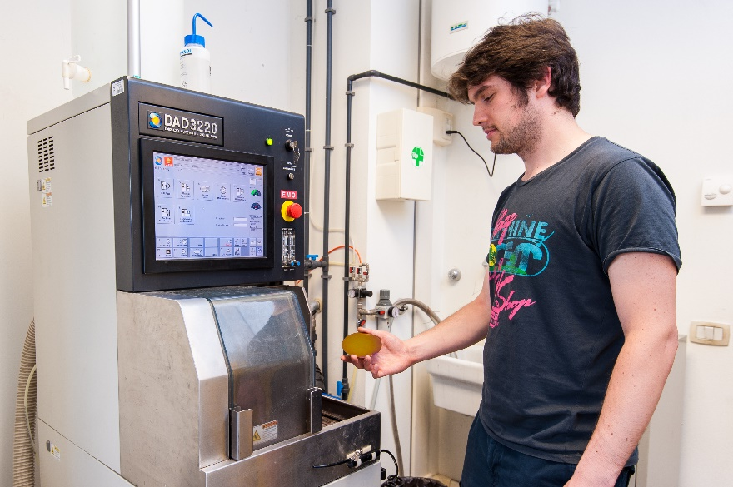
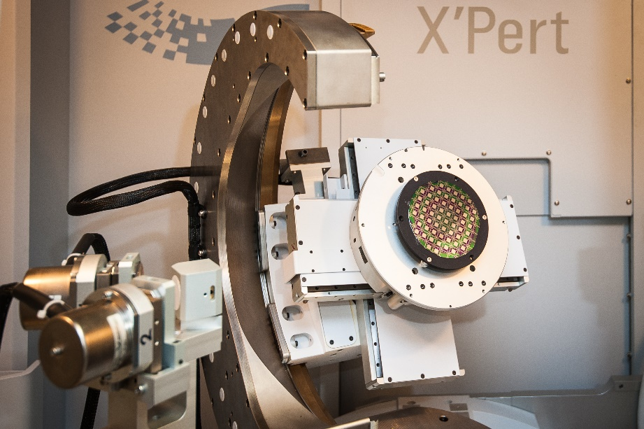
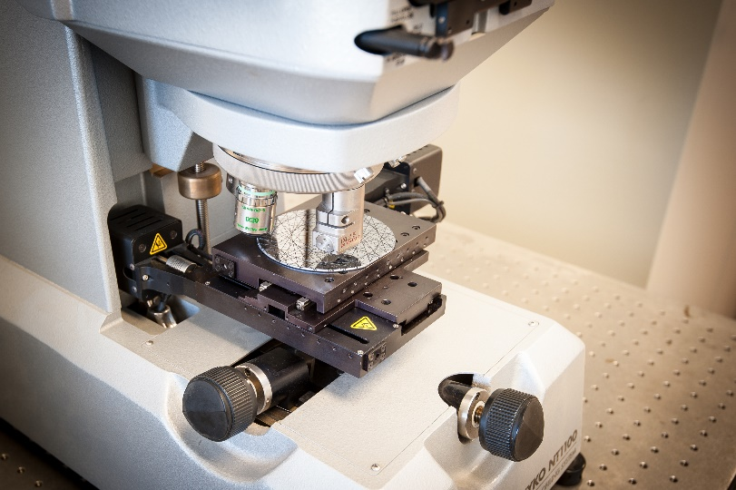
INFN-Ferrara infrastructure
Laboratory fully equipped for silicon micro and nanomachining
ISO4 certified clean room (130 m²)
High-resolution x-ray diffraction
Dicing and polishing equipment
White light and Fizeau inteferferometers

Slide 6
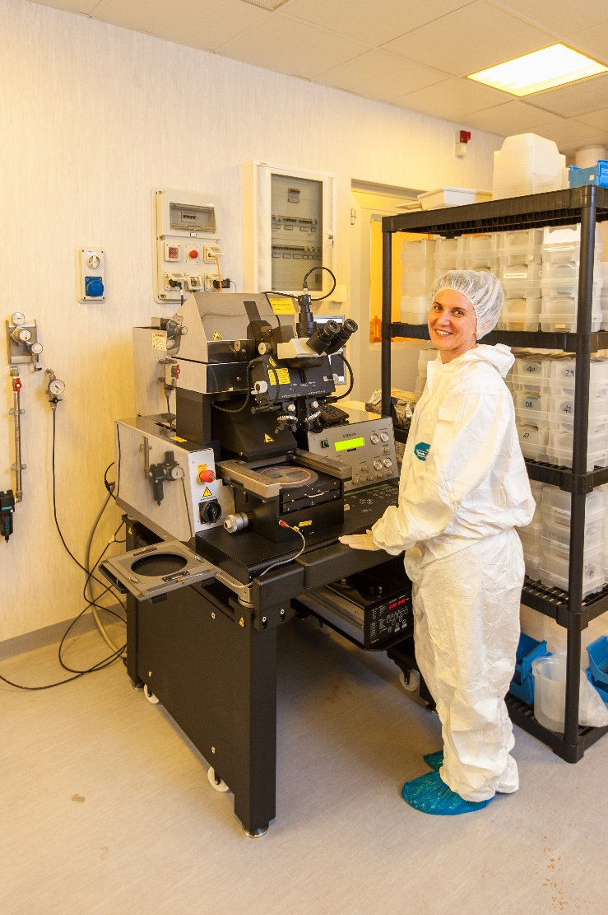
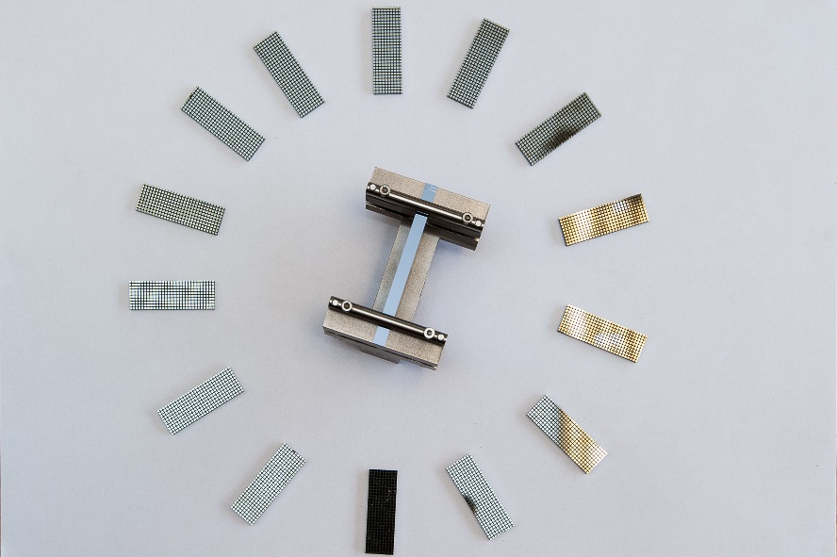

INFN-Ferrara infrastructure
Laboratory fully equipped for silicon micro and nanomachining
Fotolitography
Equipment for silicon chemical etching
Nanoimprint

Slide 7
LHC beam collimation
Particle beam collimation: classic approach
LHC circulating beam
Collimation is needed to prevent supermagnets quenching
Primary collimator (bulky «absorber»)
Spray of secondary unwanted particles
Secondary collimator
Tertiary collimator...

Slide 8
LHC beam collimation
Particle beam collimation: an innovative approach
LHC circulating beam
Bent crystal act as a primary collimator
Avoided spray of secondary particles
Secondary, tertiary... colimators no more needed
Contratto INFN-CERN
per fornitura cristalli
Bent
crystal

Slide 9
EUROPEAN PROJECT ERC CoG SELDOM
P.I. Nicola Neri

Slide 10
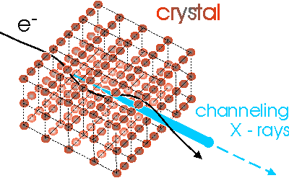
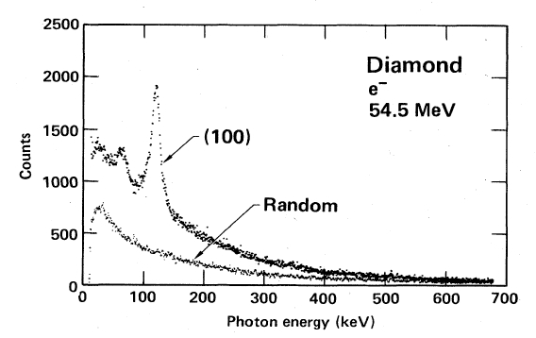
Enhancement of bremsstrahlung in aligned crystals
String of atoms
Single atom
e⁻
e⁻
Channeling Radiation (1976, Kumakhov)
HE
e⁻
Notes:
Crystal-assisted collimation: a curved crystal deviates the halo directly to the primary absorber.
10

Slide 11
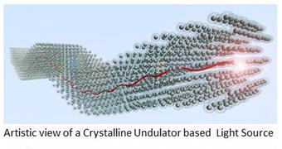
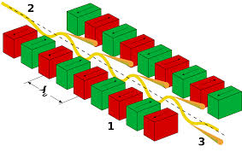
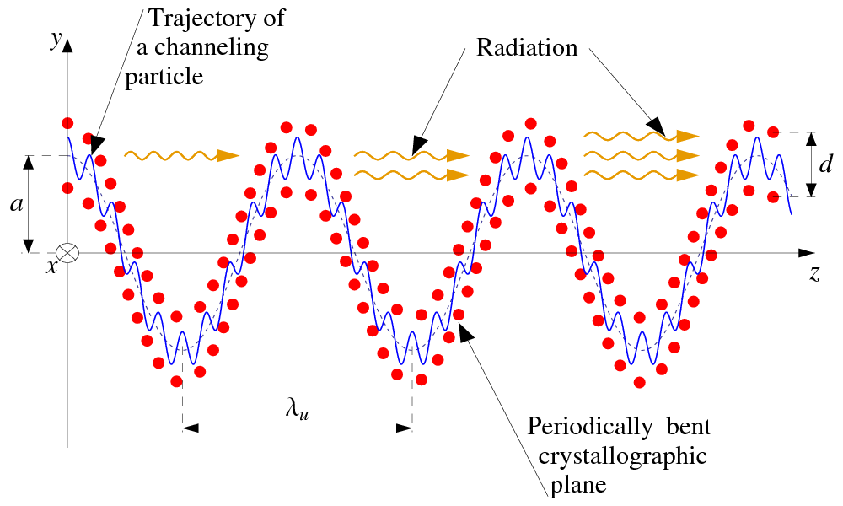
Crystalline undulator as intense X- and gamma-ray source
Classical scheme: magnetic undulator in a free electron laser
Soft X-rays
Innovative scheme:
Crystalline undulator->
Hard X-rays and gamma rays
Application in basic science, medical physics and industries.
EU projects MSCA RISE N-LIGHT (2020-2023)
EIC-PATHFINDER TECHO-CLS (2022-2026)

Slide 12
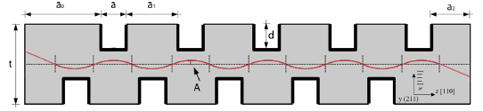
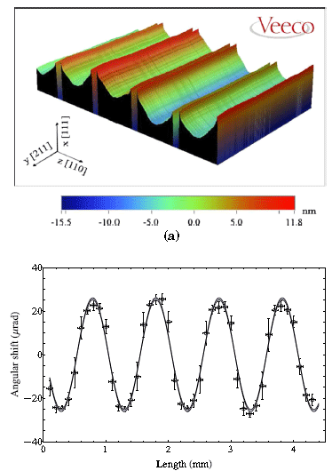

Crystalline undulator as intense X- and gamma-ray source
Classical scheme: magnetic undulator in a free electron laser
Soft X-rays
5 mm long crystalline undulator fabricated @INFN Ferrara
Innovative scheme:
Crystalline undulator->
Hard X-rays and gamma rays
Application in basic science, medical physics and industries.
EU projects MSCA RISE N-LIGHT (2020-2023)
EIC-PATHFINDER TECHO-CLS (2022-2026)

Slide 13

The hybrid positron source using channeling: a promising devices for future colliders
Idea of R. Chehab and A. Variola
Recent test at KEK NIMB 402 (2017) 58 with 7 GeV electrons interacting with a <111> W crystal
We are collaborating with I.Chaikovska and R.Chehab (LAL Orsay), responsible for FCC-ee positron source and already involved in the Muon Collider group, in Monte Carlo simulation and crystal tests on beam.
Notes:
1 mm W crystal; 1.75-18 mm amorphous granular target

Slide 14
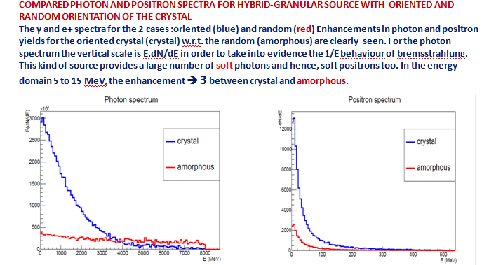
The hybrid positron source using channeling: a promising devices for future colliders
Enhancement of photon generation in crystals in channeling conditions ➔
radiation length shorter than in amorphous and decrease with increasing energy.
* High rate of soft photons ➔ creation of soft positrons easily captured in matching systems.
Courtesy of R. Chehab
and X. Artru

Slide 15
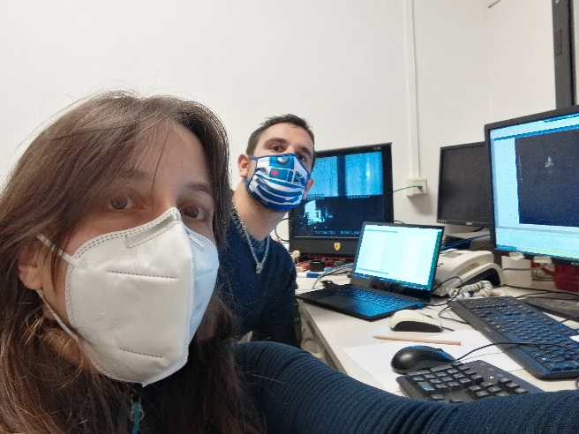
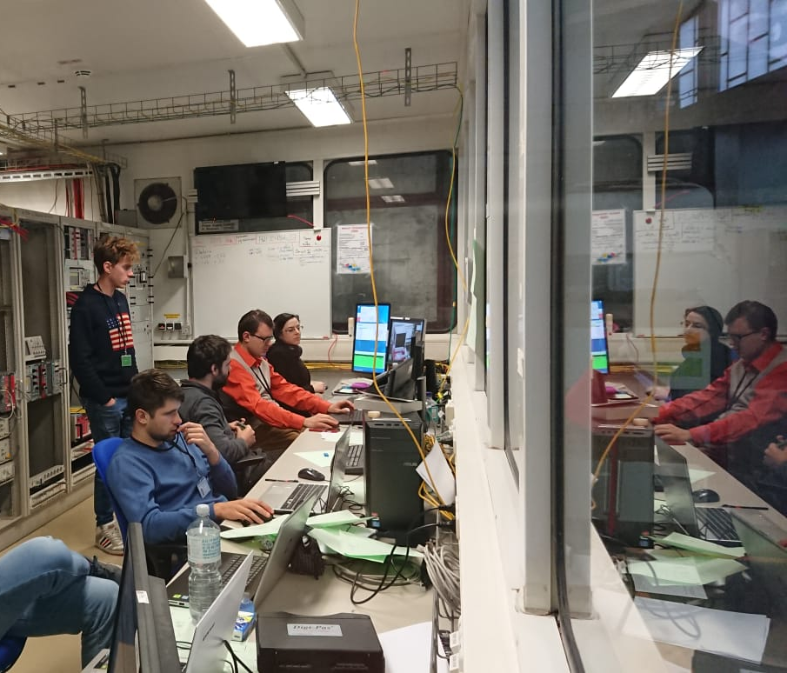
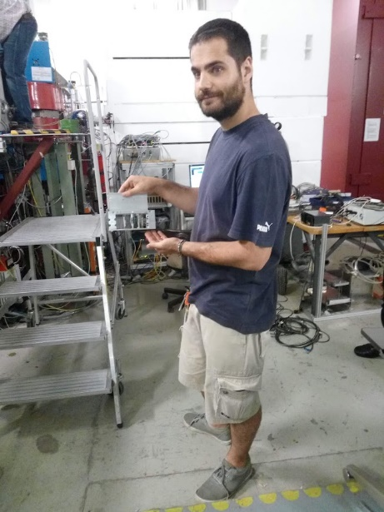
FERRARA TEAM
Laura Bandiera
Vincenzo Guidi
Andrea Mazzolari
Marco Romagnoni
Mattia Soldani
Alexei Sytov
Main italian collaborations
UniPD, UniRoma, UniInsubria, UniMilano
Legnaro labs, Frascati Labs
Main external collaborations
CERN, DESY, MAMI, MBN Center, INP Minsk, IJCLab

Slide 16
MAIN achievements
W. Scandale et al., | PRL 98, 154801 (2007)
W. Scandale et al., | PRL 101, 234801 (2008)
W. Scandale et al., | PRL 101, 164801 (2008)
W. Scandale et al., | Physics Letters B 681 (2009) 233–236
W. Scandale et al., | Physics Letters B 680 (2009) 129–132
W. Scandale et al., | Physics Letters B 680 (2009) 301–304
W. Scandale et al., | Physics Letters B 688 (2010) 284–288
W. Scandale et al., | Physics Letters B 692 (2010) 78–82
D. De Salvador et al., | APL 98, 234102 (2011)
W. Scandale et al., | Physics Letters B 703 (2011) 547–551
W. Scandale et al., | Physics Letters B 714 (2012) 231–236
E. Bagli et al., | PRL 110, 175502 (2013)
W. Scandale et al., | Physics Letters B 719 (2013) 70–73
E. Bagli et al., | Eur. Phys. J. C (2014) 74:2740
L. Bandiera et al., | PRL 111, 255502 (2013)
A. Mazzolari et al., | PRL 112, 135503 (2014)
U. Wienands et al., | PRL 114, 074801 (2015)
E. Bagli et al., | PRL 115, 015503 (2015)
L. Bandiera et al., | PRL 115, 025504 (2015)
W. Scandale et al., | Physics Letters B 748 (2015) 451–454
T. N. Wistisen | PRL 119, 024801 (2017)
E. Bagli et al., | Eur. Phys. J. C (2017) 77:71
L. Bandiera et al., | PRL 121, 021603 (2018)
A. Mazzolari et al., | Eur. Phys. J. C (2020) 80:63
A. Mazzolari et al., | PR Reserach 3 (2021) 013108
L. Bandiera et al., | Eur. Phys. J. C 81, 284 (2021)
L. Bandiera et al., | Eur. Phys. J. C 81, 238 (2021)
Observation of volume reflection and characterization of its features
First observation of steering through axial channeling
First observation of multi-volume reflection in a single crystal
First observation of steering of negatively charged particle beams
Crystal-assisted steering of sub-GeV particle beams
Installation of crystals in the SPS for extraction and collimation of the circulating beam
First installation of crystals in the LHC for beam collimation
First observation of radiation emission in bent crystals for sub-GeV particles
First obseravation of strong reduction of radiation lenght in a scintillating crystal
Contract INFN-CERN for the supply of crystals for collimation of the circulating beam

Slide 17
ConclusionS
INFN-Ferrara has unique infrastructures in the world for the production of crystals for the manipulation of particle beams.
Collaborations with laboratories and accelerators all over the world.
Crystals as innovative elements for the manipulation of particle beams, for the realization of intense radiation and particle sources and useful elements for fundamental physics research .
Contacts: bandiera@fe.infn.it
guidi@fe.infn.it
mazzolari@fe.infn.it

