Slide 1
Accelerator physics with crystals – UA9 (CERN) collaboration
Roma 1.
Matteo Bauce, Francesco Collamati, Paolo Valente, Alessandro Variola
alessandro.variola@roma1.infn.it – alessandro.variola@lnf.infn.it, matteo.bauce@roma1.infn.it,
paolo.valente@roma1.infn.it, francesco.Collamati@roma1.infn.it

Slide 2
Crystals are one of the most interesting technology to be study for the future accelerator technology
- They can provide extremely high magnetic fields for VHEP particle manipulations (proton and muon colliders)
- Curved crystals, special shapes are possible introducing also a focalizing component.
- In crystals, channeled particles minimize the multiple scattering contributions.
- Crystals provide coherent effects for light particles -> Radiation emission and possible application in medical physics (and others)
- At low energy possible application for slow spill extraction in medical machines…matching the patient breath
- Very compact elements
…………………………………………………………………..and many others

Slide 3
UA9 Scientific Activity from 2009 -2019 : Where ?
Particles Crystal interaction on North Area - H8 : (Channeling & Nuclear Interaction)
Beam Pipe
CMS strip detectors
CMS strip detectors
Beam Pipe
Gonio on AIR
Particles Crystal interaction in SPS : (Collimation, Extraction, Double Channeling)
Timepix or Tcherenkov
Beam Pipe
Gonio in Vacuum
Roman
Pot
Beam Pipe
PNPI
CERN-LNF
Particles Crystal interaction in LHC : (Collimation)
Beam Loss Monitor
Beam Pipe
Gonio in Vacuum
Beam Pipe
CERN

Slide 4
UA9 Summary 2009 - 2019
Collaboration :
CERN EN-Collimation-Extraction SPS, LHC, NA-H8, Analysis, Operations, Simulation
Italy INFN : LNF, NA, Roma1, FE Crystals, Analysis, Detectors (GEM, Timepix, Tcherencov, Trigger) ,
Mechanics, Optics, Simulation
Russia PNPI Crystals, Gonio, Crystal allignment
UK Imperial College Silicon strip telescope
FRANCE IN2P3 Cherencov diagnistics, Analysis
UA9 Results :
Crystal R&D and Characterization North Area H8 & SPS
Double Channeling SPS
Heavy Ions Collimation SPS & LHC
Proton Collimation SPS & LHC
Beam Extraction SPS
Septum shadowing SPS

Slide 5
Crystals Future 2021 - 2026
UA9 Collaboration :
CERN EN-STI, SPS, NA-H8 Analysis, Operations, Simulations
Italy INFN : LNF, NA, Roma1 Analysis, Detectors (Timepix Telescope, Ecal) , Mechanics,
Beam Optics, Simulation
Russia PNPI, IHEP, JINP Crystals, Crystal allignment, Simulations, Theory
UK Imperial College Silicon strip telescope
UA9 Future Scientific Activity :
Crystal characterization with muon beams (+/-) North Area H8
Muon energy losses and radiation emission North Area H8
Protons and Muon Coalescence and Merging North Area H8
Bending crystal angular PSF North Area H8
Crystal R&D and Characterization North Area H8
Possible Assistance to Crystal CERN Operation Activity :
Crystal Characterization Beam Instrumentation
LHC Collimation LHC
SPS extraction SPS
Double Channeling SPS (later on LHC?)

Slide 6
1) Crystal characterization with muons
CONTEXT : future muon accelerators beam merging and manipulation
Very important is the characterization
of both sign particles in VR regime. The result
should open the way for a recombination scheme
very efficent for both beams (+/-).

Slide 7
SET UP
Curved and planar crystal to be measured.
Goniometer
One magnetic dipole with Power supply
Une position measurement strip(Medipix?) for the integrated energy losses measurement
One Ecal to measure the radiative component
Si strip
Goniometer
& crystal
μ beam
μ beam
μ beam
Dipole
Ecal
Radiation
Radiation

Slide 8
Ecal – radiation measurements (G.Hall)
Reminder: ECAL readout architecture
• One Serenity for tracker and ECAL
• FE board uses existing MGPA preamps
• FPGA to be on external FC7
– modest firmware requirements
• APDs larger than original CMS devices
– Can run with same gain (adjustable by HV)
• ADC – 16-bit part selected
ECAL BW requirement estimate later
Single Serenity communicates with front-ends in the test run
-Expected event size : 1Kb (Tk)
-Output data split across 4 servers via 10 Gbps Ethernet (UDP)
-Empty frames from beam gaps forwarded in addiction to in spill data
-From switch to EOS/CTA with 20Gbps

Slide 9
3) Protons and muon merging

Slide 10


The merging importance….
L$=\frac{f N_{1}N_{2}}{4πσ_{x}^{∗}σ_{y}^{∗}}$
HEAD on Collisions
L$=\frac{f N^{2}}{4πσ^{2}}$
HEAD on Collisions and symmetrical - cylindrical beams
σ −> given by the bunches characteristics (SQRT(emittance)) and accelerator lattice (β function). This trigger the interest for the beam cooling in colliders
f =Number of bunches x Frep -> It is much more convenient to have 1 x 10exp10 particles bunch than 10x10exp9
N In a given emittance is mainly produced by the source characteristics. Then, in the past, we had two kind of colliders :
Synchrotron cooling effective (leptons). The machine has not the source memory
Synchrotron cooling not effective (Hadrons). The machine has the source memory
Muons? (like 1 at very high energy for human B fields…)
FOR THIS REASONS IT IS VERY IMPORTANT IF WE CAN MERGE TWO BUNCHES (transv or long)

Slide 11
Why it is so difficult ?
To mix to beams I have to apply a force to one beam and to to the other one!!!!!
This linear force does not exist for beams of the same charge
(the ones that we want to mix in the colliders….)
Beam 1
Beam 1
Beam 2
Beam 2
But in an ideal world we can have something that plays the angular filter
Role that we are looking for -> curved crystal!!

Slide 12
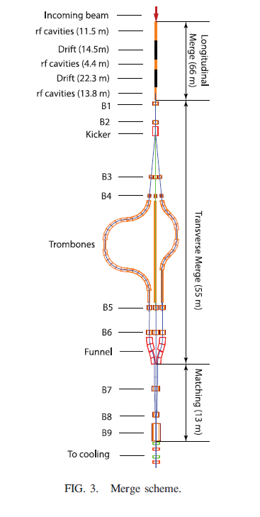
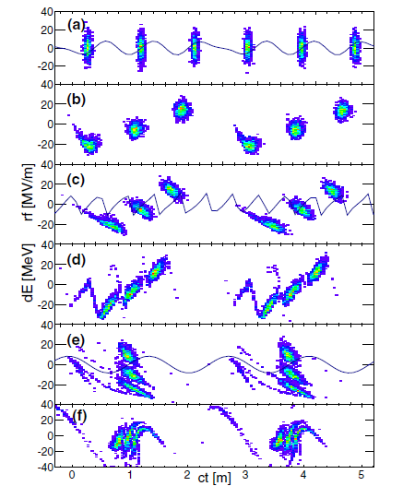
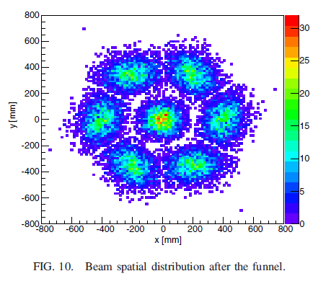
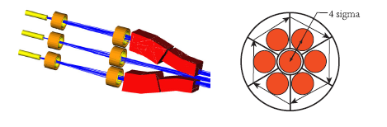
Example : Merging in MAP
134 m -> around half microsec!!!! ¼ of the rest lifetime!!!

Slide 13
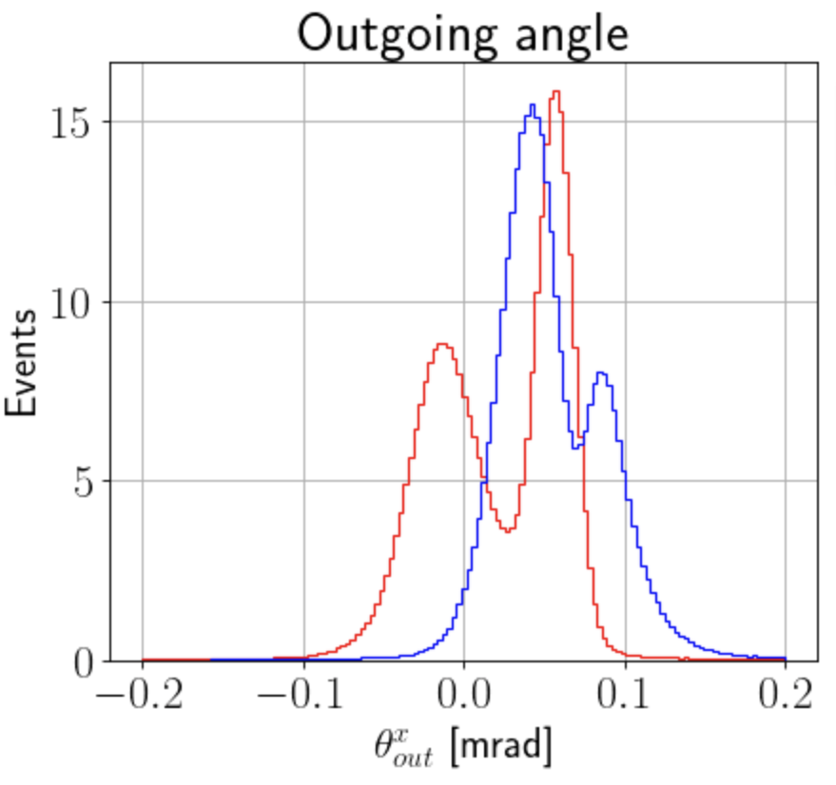
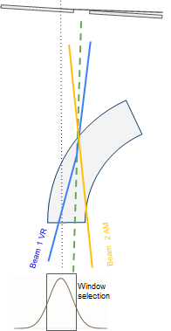
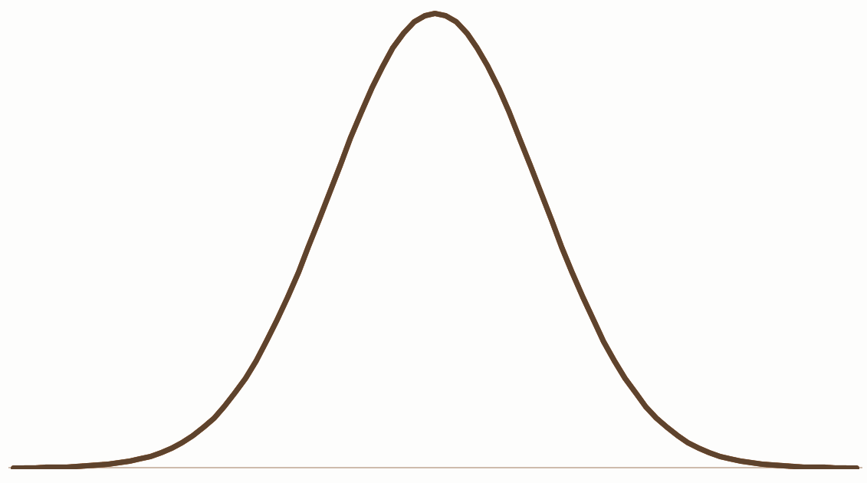
Proposed Principle of beam merge/coalescence in crystals:
The principle is to merge the two beams by taking advantage from the regime of channeling, VR and Amorphous for particle beams impinging on the crystal from different directions
No CH
No VR
Beam VR
Beam CH
Window selection

Slide 14
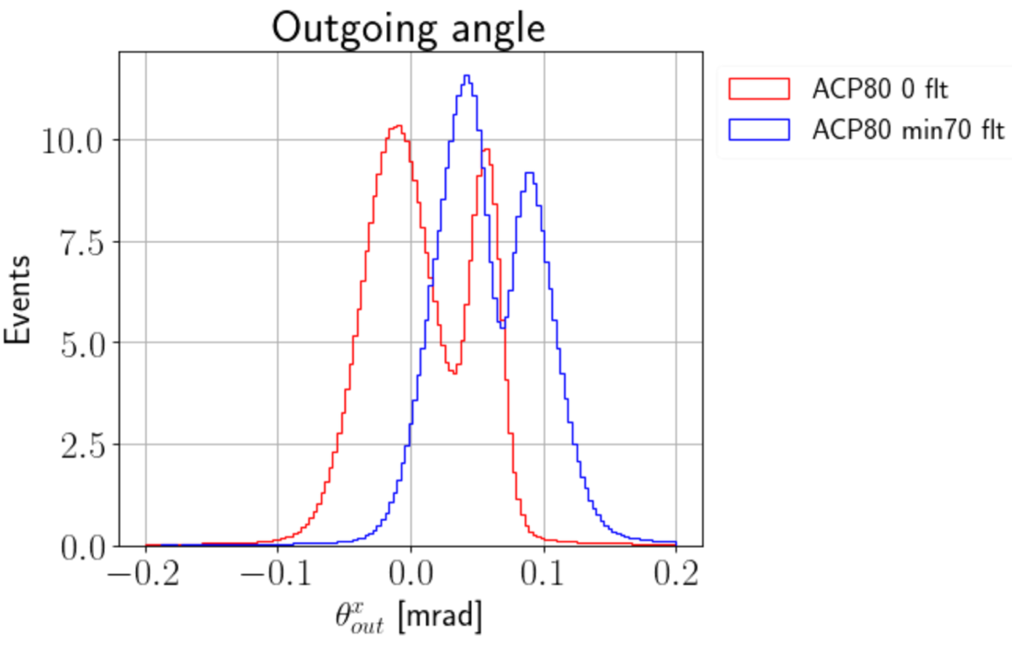
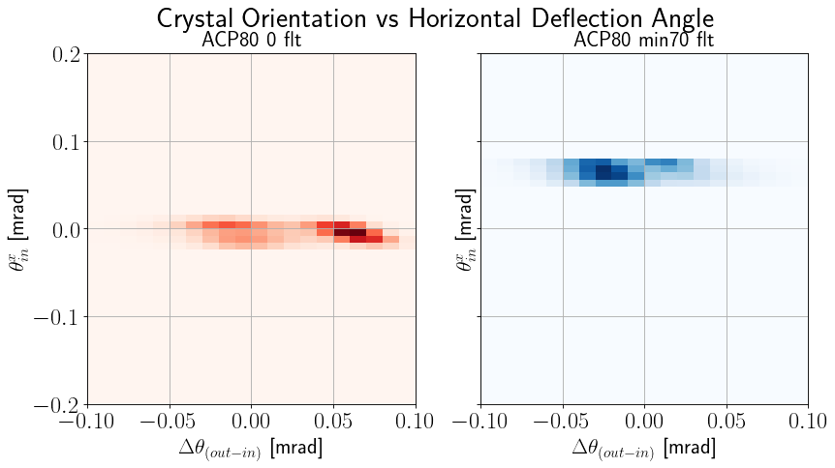
Two experiments classes:
Integrated : the two beams are simulated by the crystal rotation. The two resulting populations are subsequently overimposed
Simultaneous : With a first crystal we separate a fraction of the incoming beam and by means of another crystal we reinject it
so testing the synchro – merging on two phase space population

Slide 15
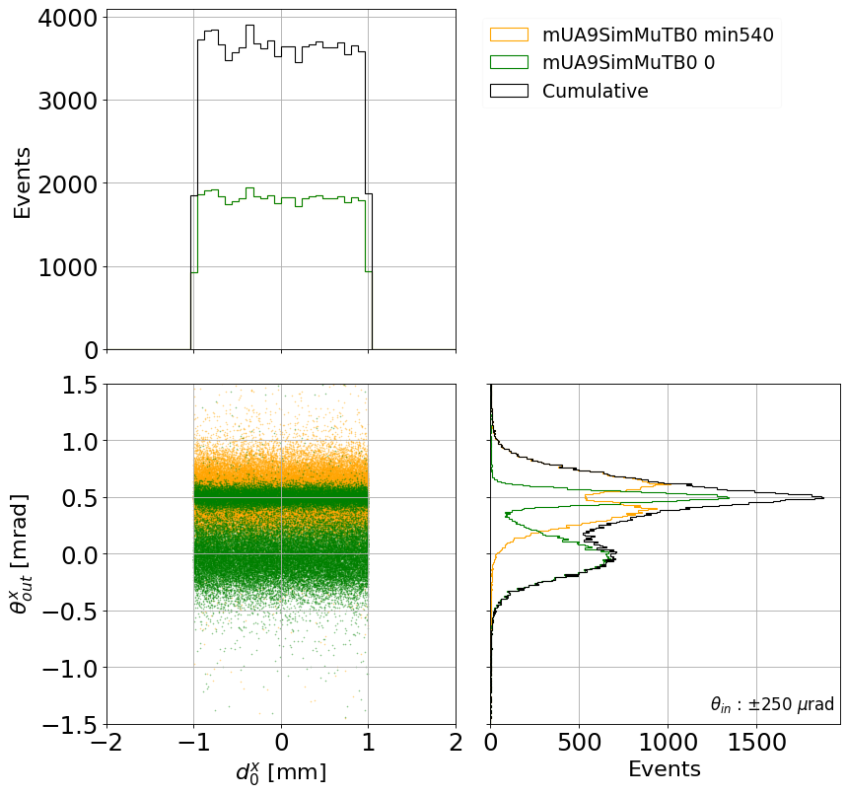
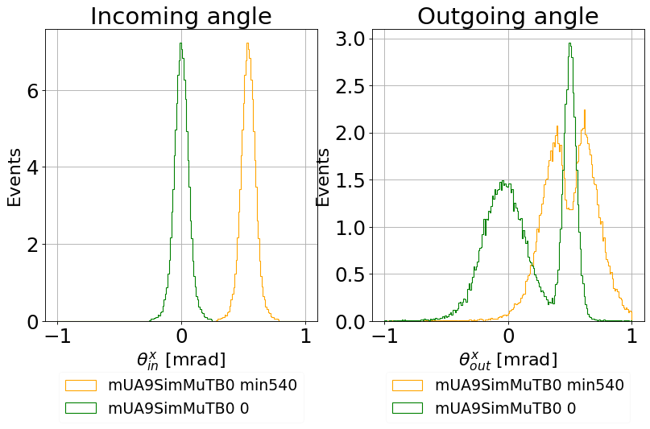
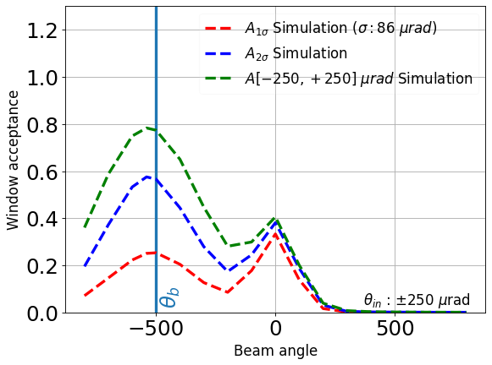
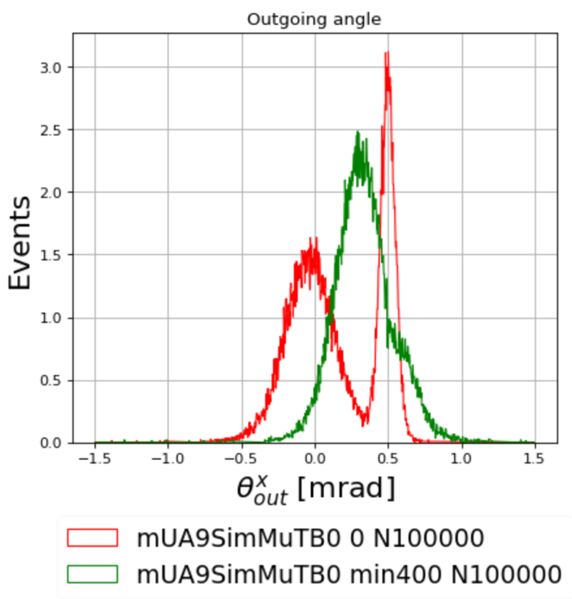
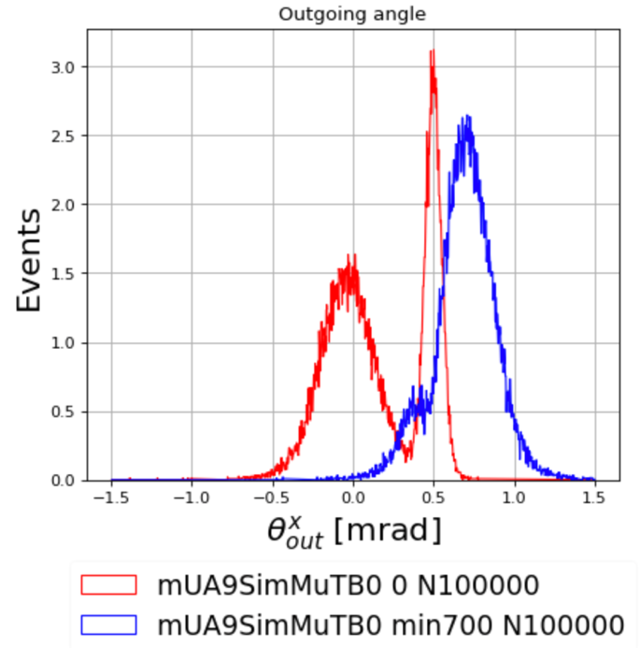
MUONS SIMULATIONS

Slide 16
Following different theories this experiment should represent
a FIRST partial violation of the Liouville theorem,
a fundamental theorem of statistical physics
that represent a true foudation stone
of particle accelerator physcis

Slide 17
4) Bending crystal angular PSF
This is a FUNDAMENTAL measurements in the crystal physics field.
Question : what is the distribution after the crystal in CH and VR regime for a ‘delta of dirac’ input?
This will set the limit of application for the recombinations schemes once the 4D emittance are considered
The measurement is extremely challenging due to the multiple scattering contribution in the Si strips that must be
negligible in respect to the critical angle.
Work to be performed in strict collaboration with the CERN accelerator phisicist to require a input beam with reduced
angular spread (fraction of θc)
A experimental procedure and set up reducing the number of strips should be implemented
R&D on thin detectors

Slide 18
A possible spin off (CSN5 Grant)
Crystal for medical physics.
Beam extraction, Crystal efficiency at low energy – long crystals (med physics, Grant CSN5 application) – CNAO
-The real trigger for the crystal application to medical physics
-No existing results
-Medical Applications : Medical machine extraction strategy. Tunability on the patient characteristics (breath, etc …). Possible application for local beam steering needs a careful evaluation of the efficiency results of this activity
-The best partners (CNAO and Medaustron)

Slide 19
TECHNOLOGICAL R&D
In kind contribution
For beam merging -> trade off between Channeling / VR efficiency and multiple scattering contribution
For beam merging -> Test of cuved focalizing crystals, to reduce the multiple scattering contribution
For beam merging -> Efficiency of VR in lateral injection
For crystal PSF -> Large critical angle crystals
For extraction, injection (also for medical physics) -> Long crystals efficiency

Slide 20
WE HAVE DIFFERENT TOPICS TO PROPOSE FOR A PHD THESIS!!!!!

