Slide 1


Accelerators for FLASH radiotherapy
Supervisor
Lucia Giuliano Luigi Palumbo
Co-supervisor
Luigi Faillace
XXXIV ciclo - PhD school in accelerator physics

Slide 2

Contents
The FLASH therapy
7 MeV S-band linac for Flash therapy: study, design and realization
Dosimetry and beam monitoring at Curie Institute (Orsay)
12 MeV C –band structures
Future perspectives: VHEE FLASH
Conclusion

Slide 3
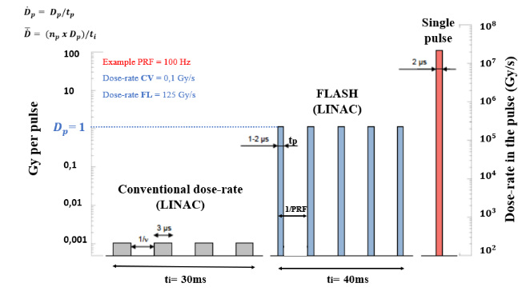
FLASH Radiotherapy
Temporal structure of energy deposition in the FLASH effect
Fig. Courtesy of Vincent Favaudon- Curie Institute
FLASH THERAPY is a new way to deliver the dose:
μs pulses of radiation,
beam-on time < 100-200ms
high dose per pulse (>1 Gy)
high dose rate (>40-100Gy/s).
FLASH EFFECT is the improvement of the healthy tissue tolerance to the delivered dose. It stems from a combination of high doses in a single, short session at ultrahigh dose-rate during the pulse .
For a given dose FLASH irradiation time is over 1000 times shorter than conventional treatments.

Slide 4
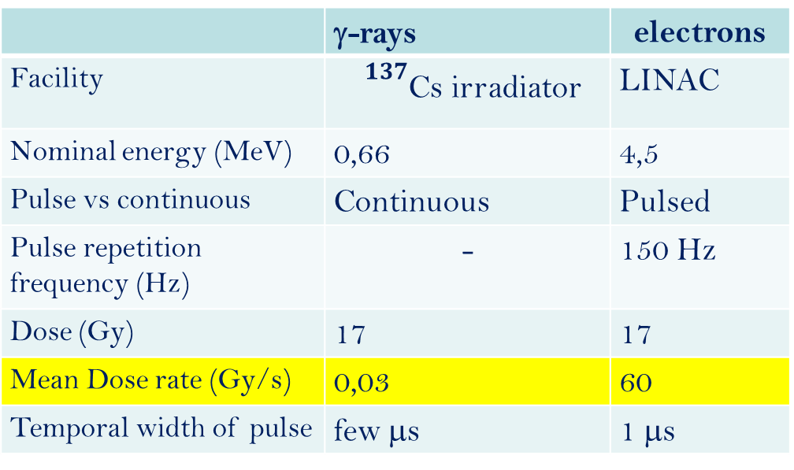
Flash therapy in mice:
first experiment
 | γ-rays | electrons
Facility | ${}^{137}$Cs irradiator | LINAC
Nominal energy (MeV) | 0,66 | 4,5
Pulse vs continuous | Continuous | Pulsed
Pulse repetition frequency (Hz) | - | 150 Hz
Dose (Gy) | 17 | 17
Mean Dose rate (Gy/s) | 0,03 | 60
Temporal width of pulse | few μs | 1 μs
FLASH irradiation protects lungs from radiation-induced fibrosis and is as efficient as CONV irradiation in the repression of tumor growth
Control 17Gy CONV 17Gy FLASH
Healthy Fibrosis Healthy
Favaudon et al., “Ultrahigh dose-rate FLASH irradiation increases the differential response between normal and tumour tissue in mice”, Science Translational Medicine 6, 2014

Slide 5
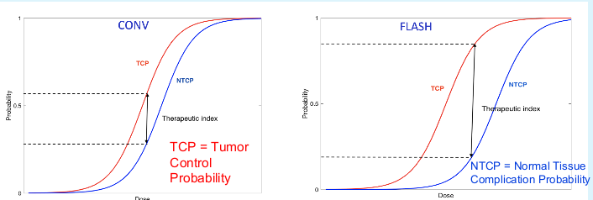
Therapy window
FLASH is as efficient as CONV irradiation to cure tumors.
Protection of normal tissue from complications by FLASH allows dose escalation to cure tumors growth

Slide 6
Accelerator to clarify the FLASH effect
Understanding the FLASH RT limits (min/max dose/time)
Clarifying bio mechanisms underlying FLASH effect
Defining conditions for clinical practice
First accelerator for clinical use
Curie Institute commisioned a new Linac dedicated for Flash therapy and radiobiology experiments.
We have developed the RF and beam dynamics design of the accelerator built by the company S.I.T. Sordina IORT Technologies S.p.A.

Slide 7
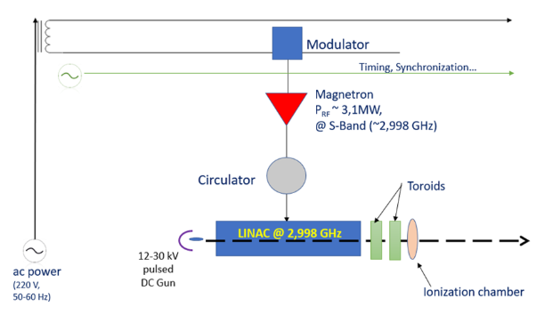
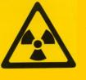
Scheme of a medical Linac

Slide 8
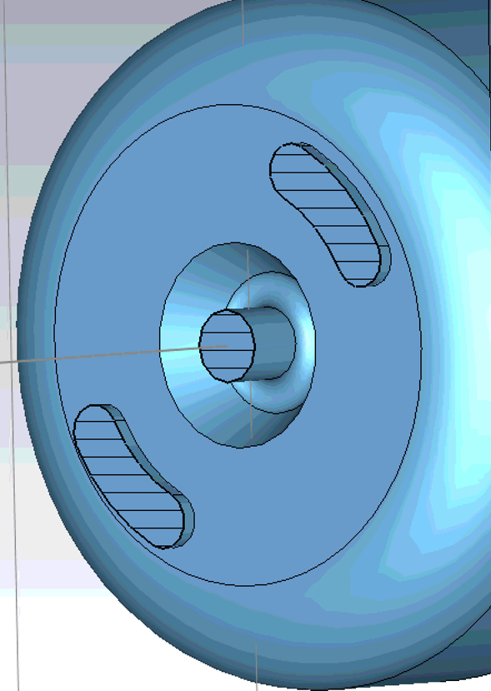
3D model of the FLASH LINAC
S-band linac (f=2,998 GHz)
Standing wave structure (SW)
π/2 mode
Bi-periodic geometry: accelerating and on-axis coupling cells
Magnetic coupling with hole off axis
Electric coupling on axis with irisis

Slide 9
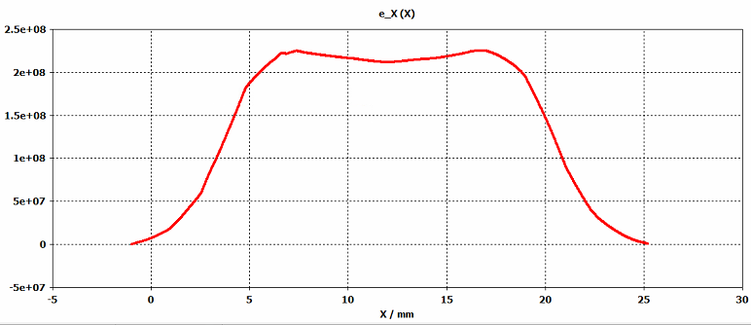
RF design of the linac
CST Studio SUITE simulation software in Eigenmode solver is used to:
design the cavity profile
look for resonant modes frequencies
simulate the main RF parameters for each cell (Shunt impedance per unit length, Quality factor, e.m. field, ecc)
Each unit of cell are tuned modifying the diameter (according with Slater theorem) to reach the resonance frequency desired
‘perfect E’
‘perfect H’
Nose-cone type geometry very high electric field in the middle of the accelerating cells very efficient acceleration of the beam

Slide 10

Bunching section
L= λβ/2 allows to synchronize the beam passage in each cell with the accelerating field, granting a continuous acceleration process.
Bunching section is designed to match the low energy charges continuously emitted by the gun (12kV) with the linac the particles lost at the entrance of the linac are dramatically reduced.
V/m

Slide 11
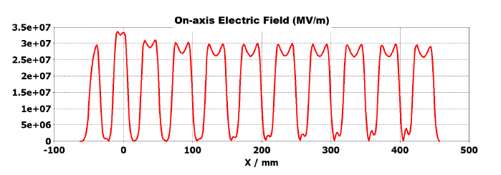
Sequential tuning for linac RF design
After the tuning of the single cells , the simulation of the whole structure was carried out using the sequential tuning
We progressively synchronize multiple cells modifying the radius of the last added cell to obtain:
- π/2 mode resonance frequency around 2,998 GHz
- field flatness

Slide 12
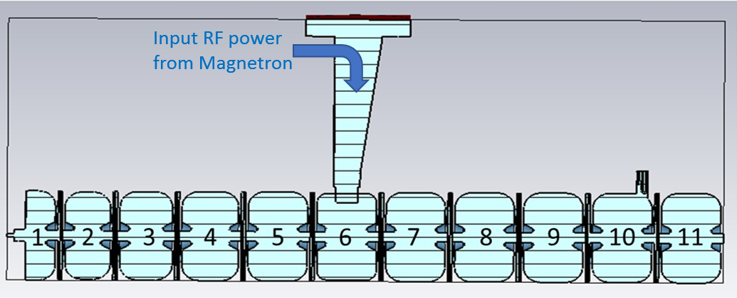
Power supplied waveguide
The RF waveguide is inserted in the middle cell allows to delete half of the linac resonant not excited modes
The linac resulted untuned: several iterations have been required to obtain a good field flatness using the frequency domain solver of CST

Slide 13
Coupling hole optimization
To design the coupler one has to follow an iterative procedure:
fix the slot dimension between the waveguide and the coupler cell,
simulate the structure retuning the coupler cell,
calculate the coupling coefficient,
if the coupling is not the desired one, start again from 1.
βc= 1,52

Slide 14
Beam dynamics simulation S-band
Energy Spectrum
The phase space plots show the longitudinal distribution (in degrees) of the electron beam, beam spot, the energy spread, the energy as a function of the length of the beam at the entrance of the linac (top) and at the exit (right).
Long. Distribution
(Microbunch)
ΔE (keV) vs Δϕ (deg)
Energy Spectrum

Slide 15
Long. Distribution
(Microbunch)
ΔE (keV) vs Δϕ (deg)
Energy Spectrum

Slide 16
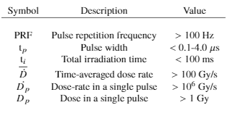
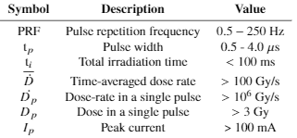
FLASH regime
The definition of FLASH regime requires the specification of different inter-dependent temporal parameters
FLASH parameters
EF4000 parameters

Slide 17
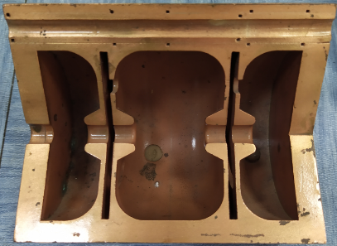
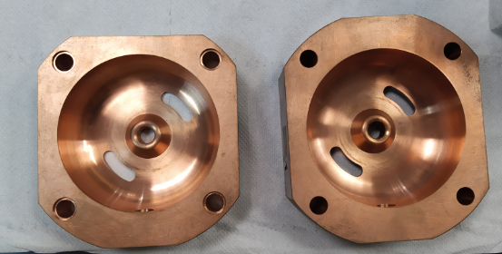
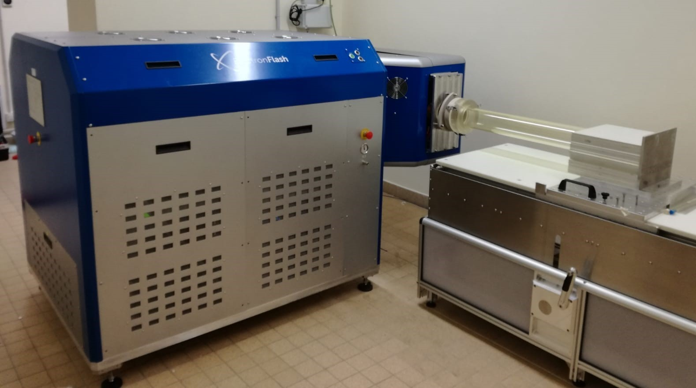

Realization of ElettronFlash4000
Accelerating cells and clamped linac before brazing
Linac installed at Curie Institute

Slide 18

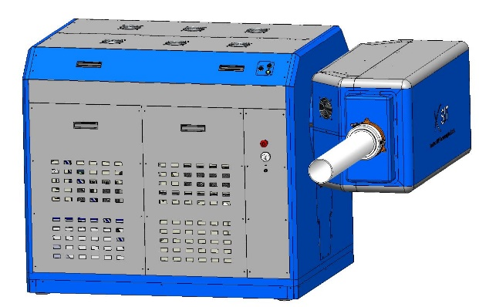
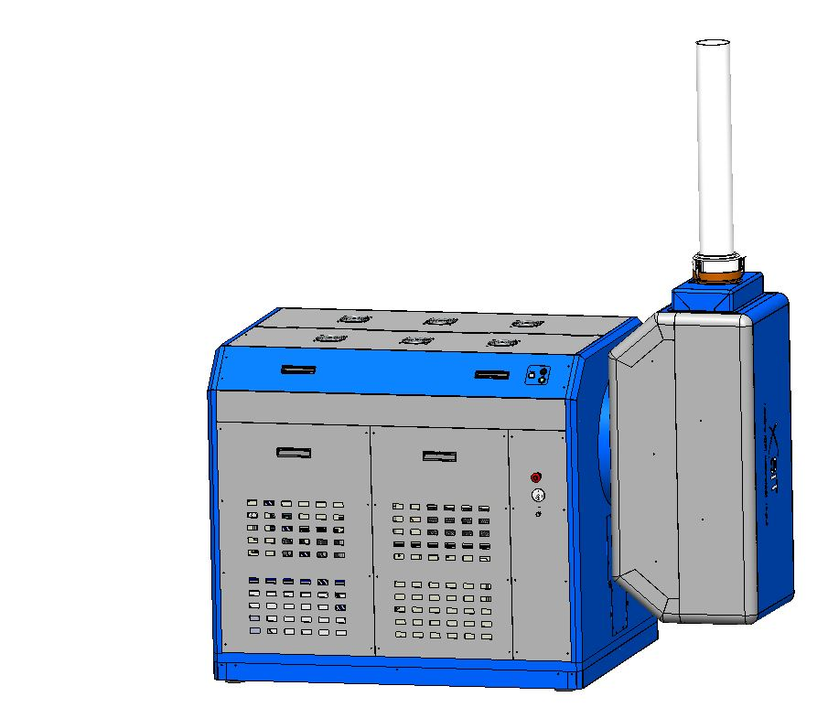
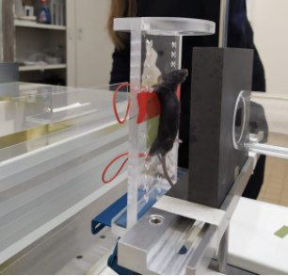
In vivo and vitro experimental set-up
In vivo
In vitro

Slide 19

Commissioning at Curie Institut

Slide 20

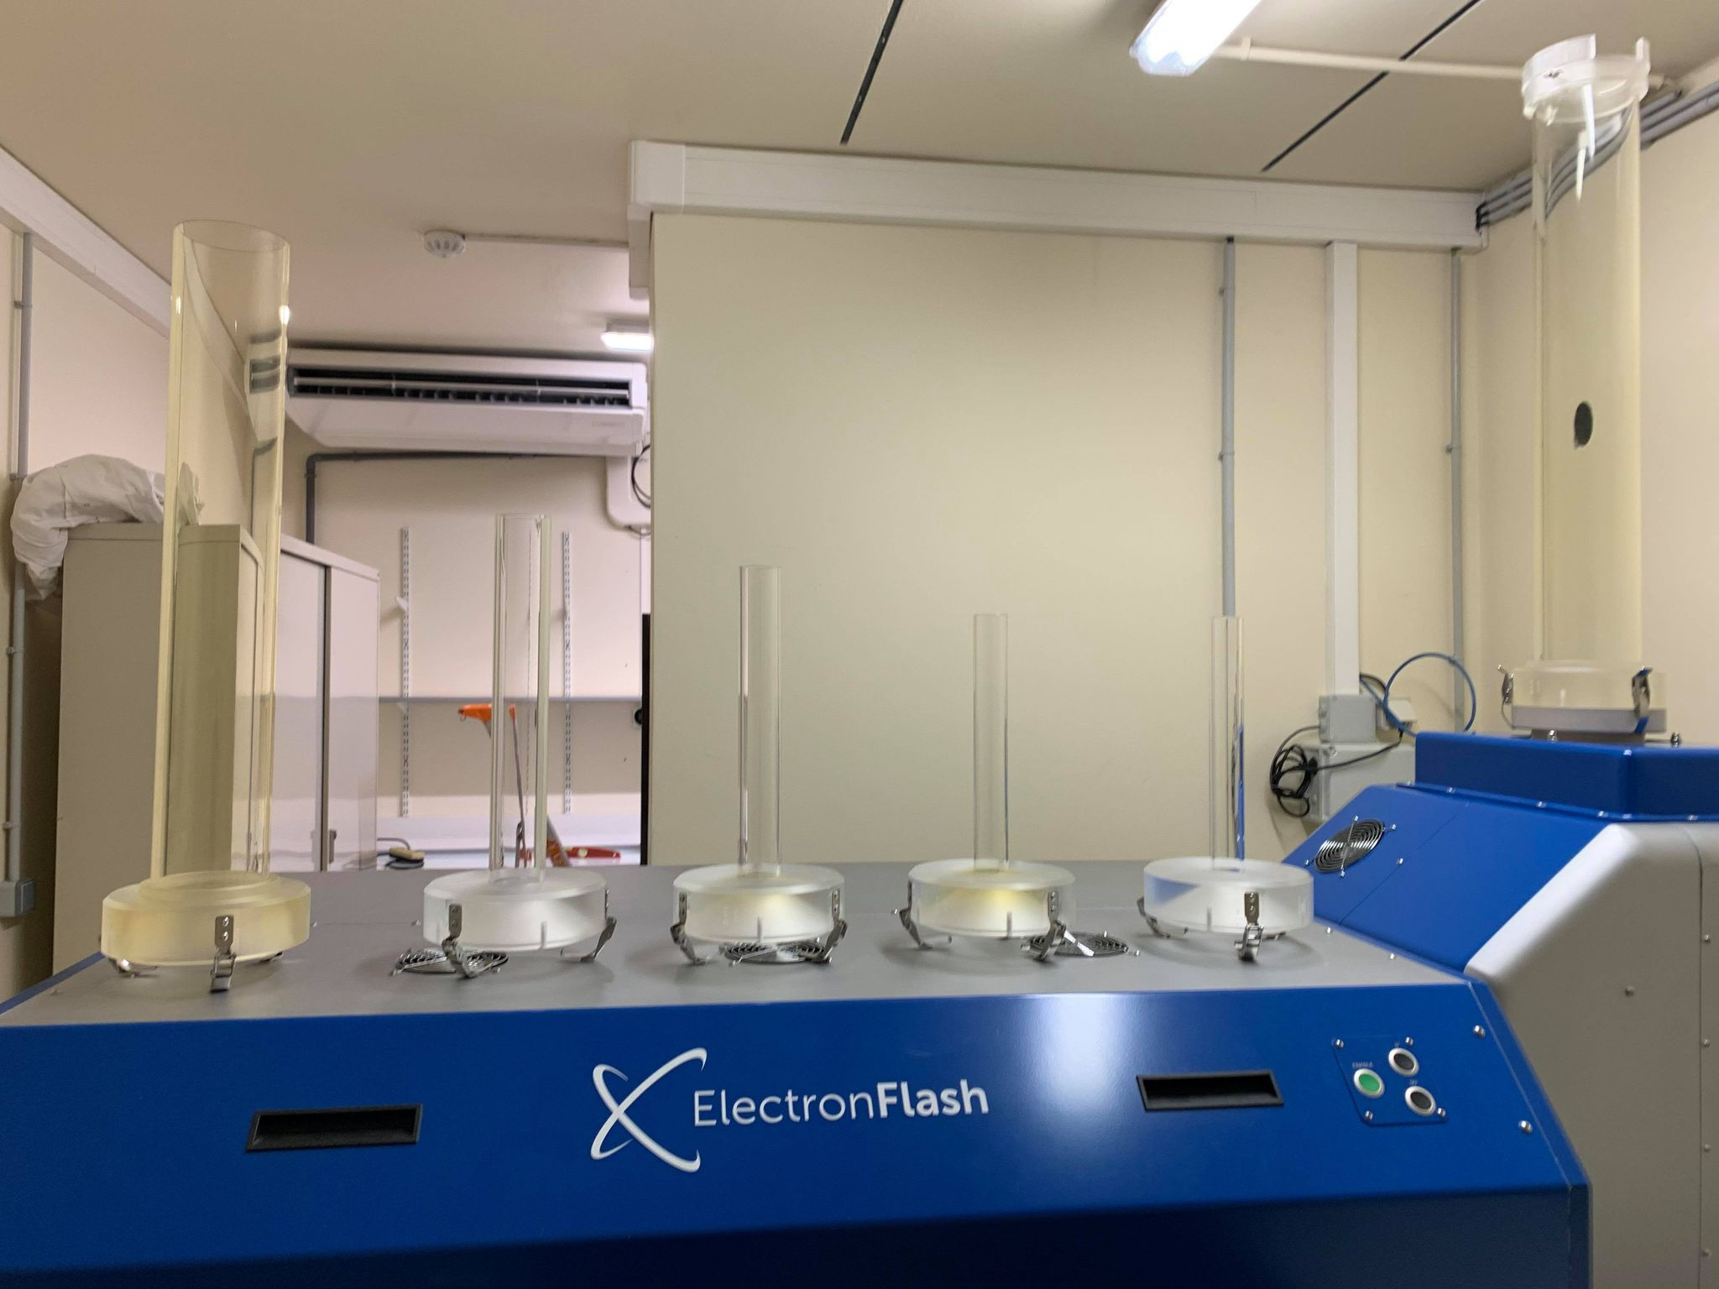
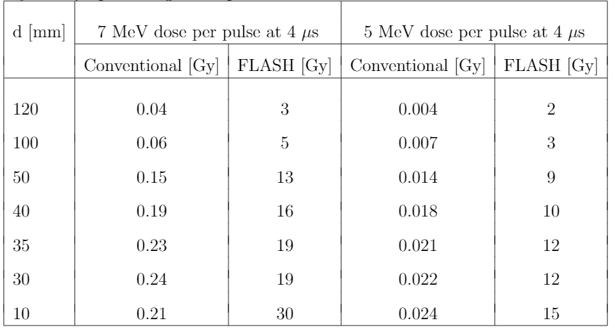
ElectronFlash4000
        PMMA applicators allow to irradiate different field.
        Varying the applicator the dose range can be changed.
        Maximum dose: 30 Gy per pulse in Ø10 mm.
        Mean dose-rate: 0.05 Gy/s (Conv) and up to 1000 Gy/s (FLASH).

Slide 21
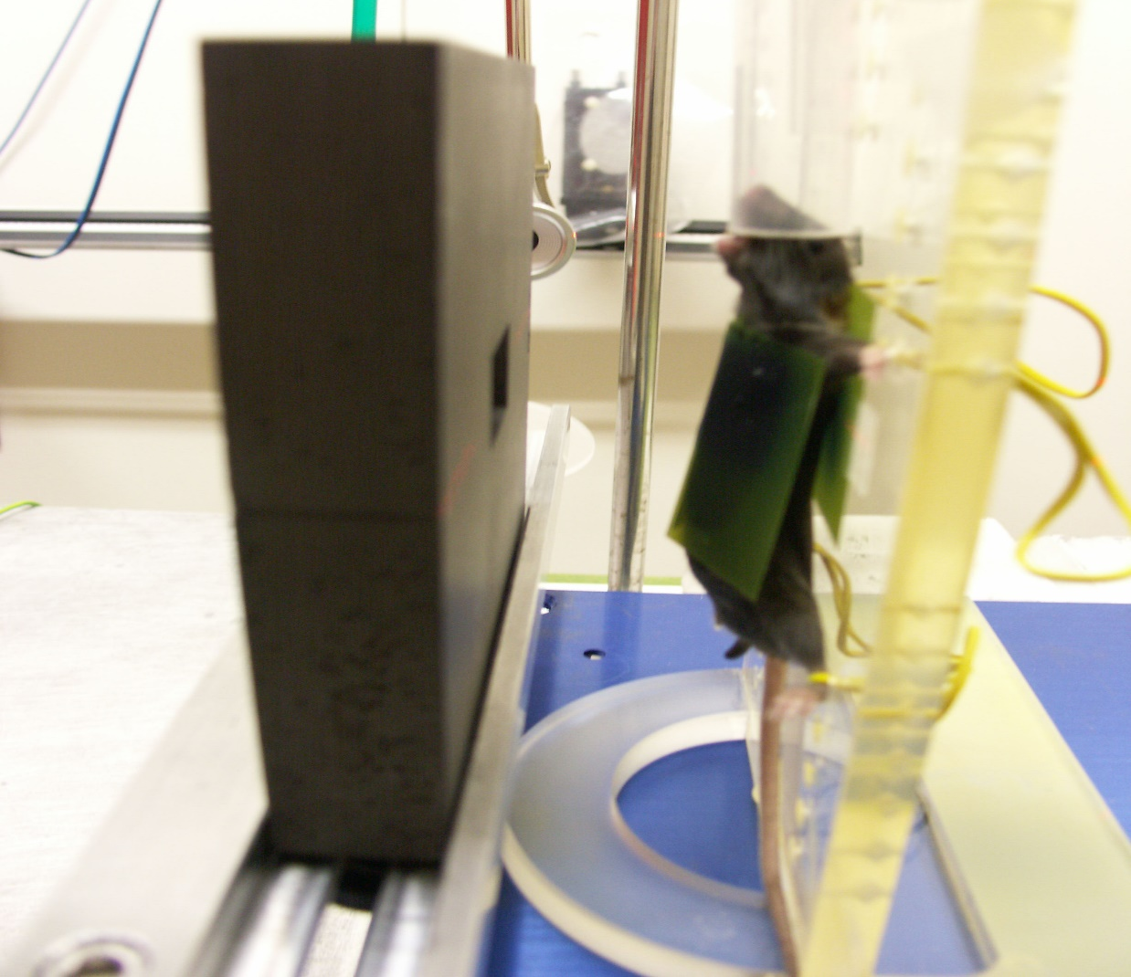
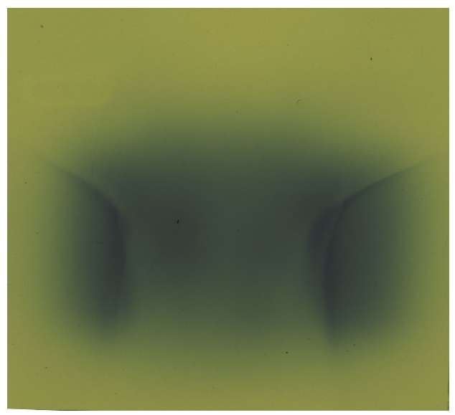
Dosimetry with Radiocromic films
      Conventional dosimeters are not suitable for FLASH irradiation
  They can read dose > 40 Gy
  No dependence on beam energy
  No dependence on dose rate
The films must be verified by a second dosimeter
Analysis require long time (24h to scanner film and several time to analyzed them)
Current precision on dose with film dosimetry > 5%

Slide 22
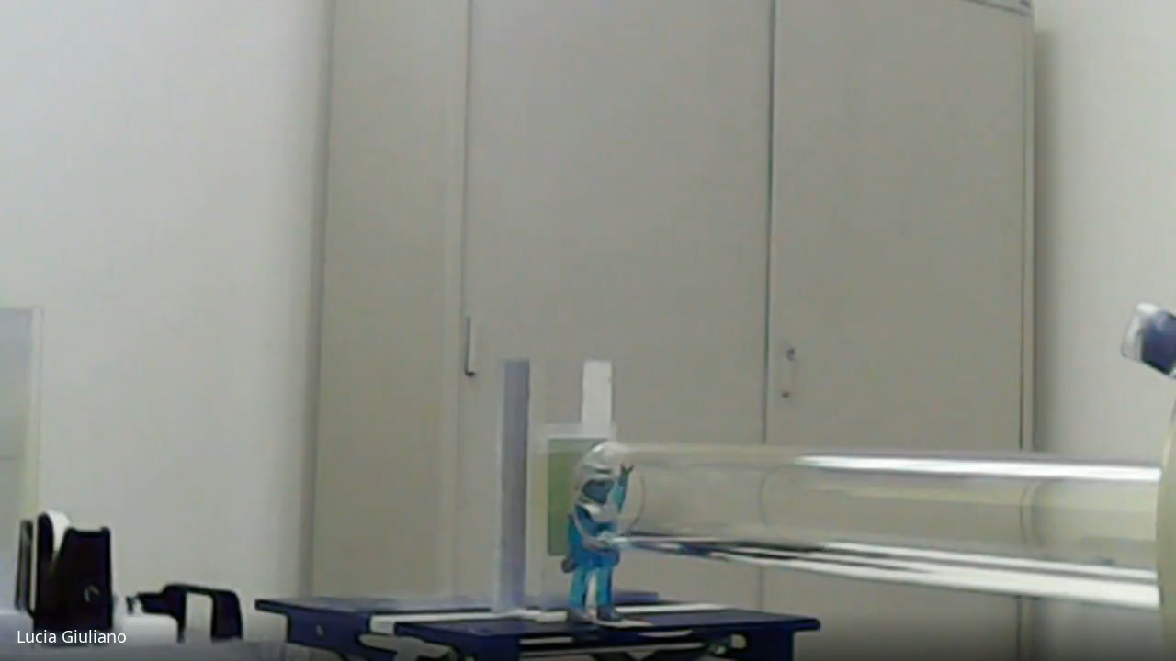
RADIOCROMIC FILM
IRRADIATED SAMPLE

Slide 23
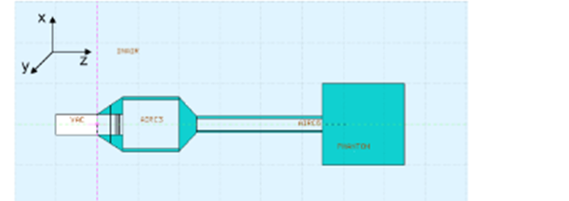

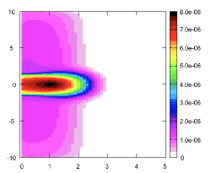

MonteCarlo simulations with FLUKA
We have evaluated the dosimetric quantities to be compared to experimental measurements by means of the FLUKA- Monte Carlo software.
2D visualization of the FLUKA simulation geometry used for the A-d120 (right) and A-d30 (left) simulation. The beam travels in the z direction
cm
cm
cm
cm
Two dimensional projection of the dose deposition inside the PMMA phantom for an electrons beam having 7 MeV nominal energy, obtained with the A-d30 (left) andA-d120(right). The z linear scale represents the dose released in GeV/g/primary units

Slide 24
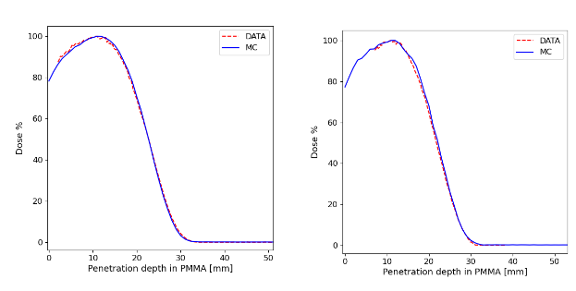
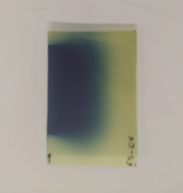
PDD with Radiocromic films
Percentage Depth Dose obtained for the 7 MeV electrons beam collimated with the A-d30 (left)
PDD on radiocromic film irradiated with 7MeV 1Pulse 4μs A-d30
Measured (dotted red line) and simulated (blue line) PDD in the PMMA phantom

Slide 25
PDD with Radiocromic films
Percentage Depth Dose obtained for the 7 MeV electrons beam collimated with the A-d30 (left)
R100
Dose
R80
0
mm
R50
PDD on radiocromic film irradiated with 7MeV 1Pulse 4μs A-d30
Measured (dotted red line) and simulated (blue line) PDD in the PMMA phantom

Slide 26
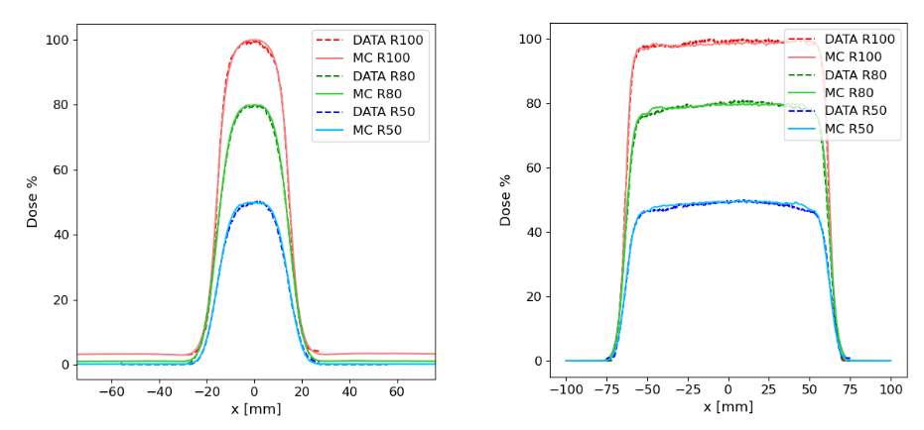

Dose profiles with Radiocromic films
R100
Radiocromic film irradiated with 7MeV 1Pulse 4μs A-d30
all the dose in one single pulse (>> 1Gy)
Max 19 Gy
R50 > 1Gy
$\dot{D}$p >10^6 Gy/s
Pulse width ~μs
30 mm
R80
R50
Dose profiles obtained at R100, R80 and R50 measured (dotted line) and simulated (continuous line) for the 7 MeV electrons beam collimated with the A-d30
with
R100 max dose deposition
R80 80% dose deposition
R50 50% dose deposition

Slide 27
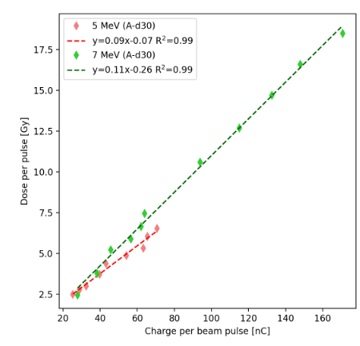
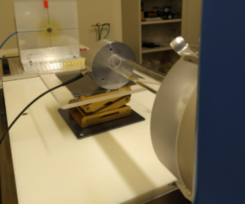
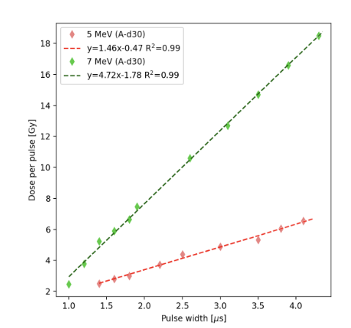
Measurement with Faraday Cup A-d30
FLASH regime
We are always in FLASH regime
Linear proportionality of the dose related to the pulse width
Linear proportionality of the nC with the dose per pulse
19 Gy per pulse corresponding 160nC at 7 MeV in Ø 30 mm
6 Gy per pulse corresponding 80nC at 5 MeV in Ø 30
FLASH regime

Slide 28
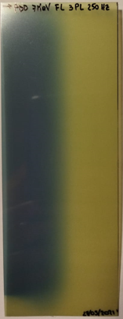
PDD with Radiocromic films
Percentage Depth Dose obtained for the 7 MeV electrons beam collimated with the A-d30 (left)
PDD on radiocromic film irradiated with 7MeV 3Pulse 4μs A-d120
Measured (dotted red line) and simulated (blue line) PDD in the PMMA phantom

Slide 29
PDD with Radiocromic films
Percentage Depth Dose obtained for the 7 MeV electrons beam collimated with the A-d30 (left)
Dose
R100
R80
0
R50
PDD on radiocromic film irradiated with 7MeV 3Pulse 4μs A-d120
Measured (dotted red line) and simulated (blue line) PDD in the PMMA phantom

Slide 30
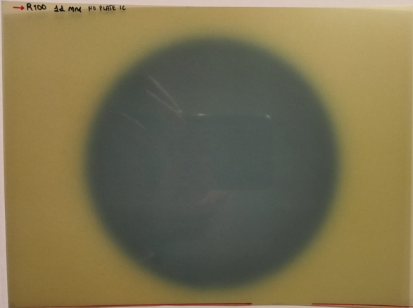
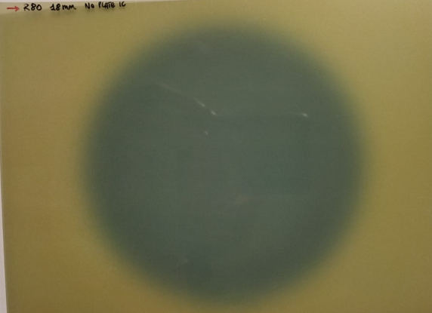
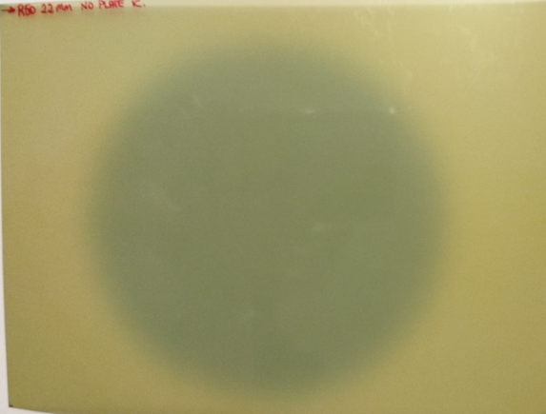
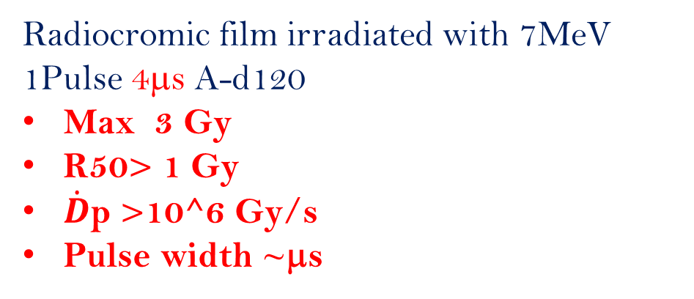
Dose profiles with Radiocromic films
R100
Radiocromic film irradiated with 7MeV 1Pulse 4μs A-d120
Max 3 Gy
R50> 1 Gy
$\dot{D}$p >10^6 Gy/s
Pulse width ~μs
120 mm
R80
R50
Dose profiles obtained at R100, R80 and R50 measured (dotted line) and simulated (continuous line) for the 7 MeV electrons beam collimated with the A-d120

Slide 31
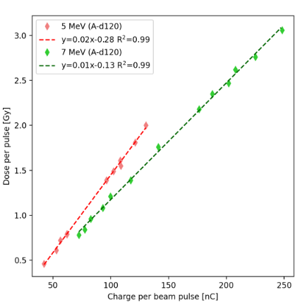
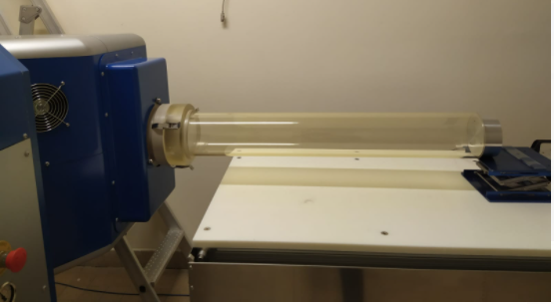
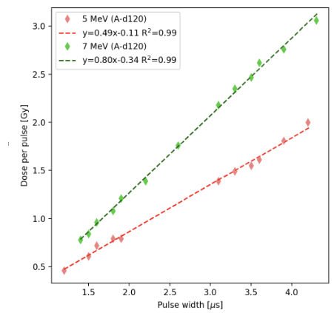

Measurement with Faraday Cup A-d120
FLASH regime
NO FLASH regime
Higher surface of irradiation less dose with same charges comparing with A-d30
FLASH regime
max 3 Gy per pulse corresponding 250 nC in Ø120 mm 7 MeV (>1Gy/pulse)
max 1,8 Gy per pulse corresponding 120 nC in Ø120 mm (5 MeV) (>1Gy/pulse)
NO FLASH regime

Slide 32
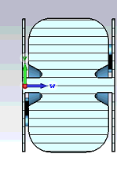
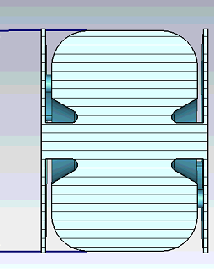
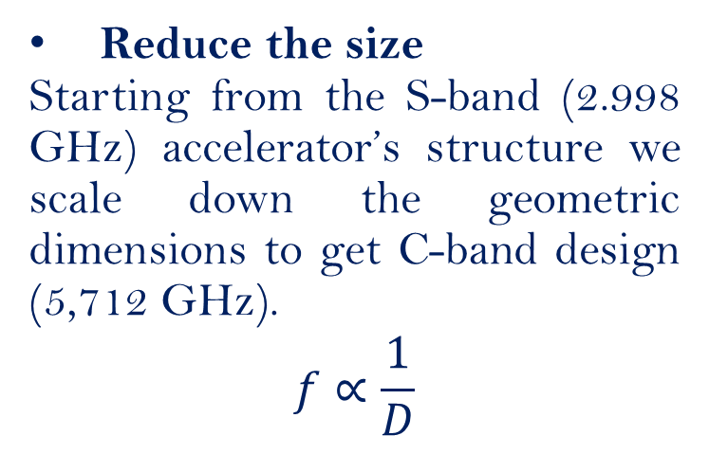
Compact electron linac for FLASH-RT
Reduce the size
Starting from the S-band (2.998 GHz) accelerator’s structure we scale down the geometric dimensions to get C-band design (5,712 GHz).
$$f∝\frac{1}{D}$$
D=36,54 mm
D=72.45 mm
Increase Energy gradient
Increase the energy gain per meter (energy gradient)
Example
3GHz → 6GHz
Ds-band = 7cm → DC-band =3,5 cm
GradientS-band 15 MV/m → GradientC-band 30MV/m

Slide 33
C-band linac 12 MeV for FLASH-RT
C-band linac (f=5,712 GHz)
Standing wave structure (SW)
π/2 mode
Bi-periodic geometry: accelerating and on-axis coupling cells
Bunching section

Slide 34
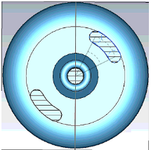
Slots cells optimization
Increasing the slot length there is a visible increment of coupling between cells.
There is a variation of the axial electric field profile in the linac that we use to maximize the beam capture

Slide 35
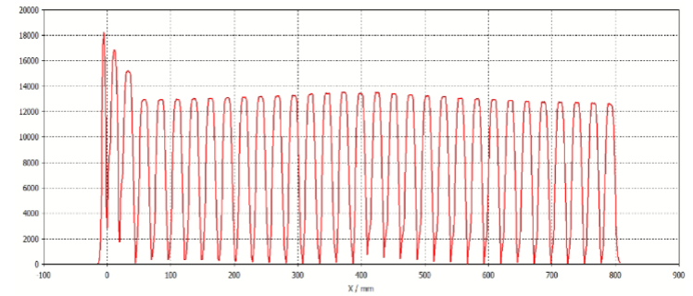
C-band linac 12 MeV for FLASH-RT

Slide 36
Beam dynamics simulation C-band
Energy Spectrum
The phase space plots show the longitudinal distribution (in degrees) of the electron beam, beam spot, the energy spread, the energy as a function of the length of the beam at the entrance of the linac (top) and at the exit (right).
Long. Distribution
(Microbunch)
ΔE (keV) vs Δϕ (deg)
Energy Spectrum

Slide 37
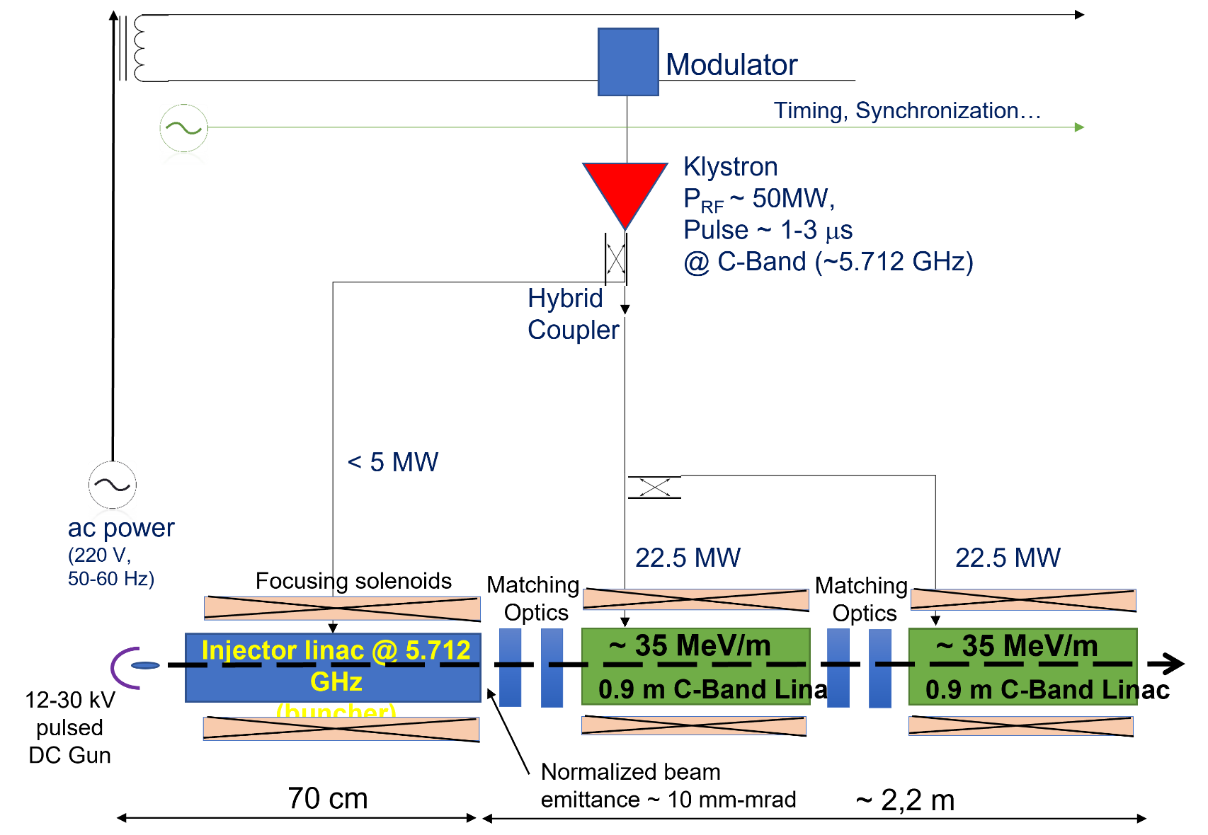
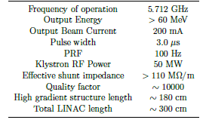
Future perspectives: VHEE
The implementation of the FLASH Therapy concept into actual clinical use, and the treatment of deep tumors require electrons in the range of > 60 MeV
12 MW beam loading

Slide 38
Conclusions
Flash therapy is an innovation in radiation therapy: it releases high Gy level dose in microsecond pulses.
The healthy tissues can support high dose and high dose rate without harmful effects of ionizing radiation.
We studied and developed a novel accelerator in S-band (SIT-Sapienza University cooperation) for Flash pre-clinical studies.
We did the upgrade to C-band technology (5.712 GHz) to reduce the size, the weight and increase the energy gradient.
I performed Dosimetry and beam monitoring of the EF4000 at Curie Institute (Orsay) to characterized the accelerator.
Design and development of C-band Very High Electron Energy linac is under study at Sapienza University, in collaboration with INFN

Slide 39
Articles
L. Faillace et al. Compact S-band linear accelerator system for ultrafast, ultrahigh dose-rate radiotherapy, Physical review acc. And beams 24, 050102,2021, doi:10.1103/PhysRevAccelBeams.24.050102.
2. Di Martino et al. Corrigendum: FLASH Radiotherapy With Electrons: Issues Related to the Production, Monitoring, and Dosimetric Characterization of the Beam FRONTIERS IN PHYSICS, 8, 2021, doi:10.3389/fphy.2020.630534.
3. L. Giuliano. Flash therapy: an innovation in radiation therapy IL NUOVO CIMENTO, 43 C,125, 2020 , doi:10.1393/ncc/i2020-20125-1.
4. L. Alunni Solestizi et al. Use of a CMOS Image Sensor for Beta-emitting radionuclides measurement , Journal of Instrumentation, Volume 13, 2018. doi:10.1088/1748-0221/13/07/P07003
5. L. Giuliano et al. Preliminary Studies of a VHEE Linear Accelerator System for FLASH Radio Therapy, doi:10.18429/JACoW-IPAC2021- MOPAB410, 2021.
6. F. Bosco et al. Modeling Short Range Wakefield Effects in a High Gradient Linac, doi:10.18429/jacow-ipac2021-wepab238, 2021.
7. M. Carillo et al. Three-Dimensional Space Charge Oscillations in a Hybrid Photoinjector, doi:10.18429/jacow-ipac2021-wepab256, 2021.
8. L. Faillace et al. Beam Dynamics for a High Field Cband Hybrid Photoinjector, doi:10.18429/JACoW-IPAC2021-wepab051, 2021.

Slide 40
Poster and oral presentations
Oral presentation at international and national meeting:
- International Conference on Medical Accelerators and Particle Therapy, 4-6 September 2019 CNA - Seville (Spain)
- 105°Congresso Nazionale della Società Italiana di Fisica
Gran Sasso Science Institute, 23-27 Settembre 2019 - L'Aquila (Italy)
(Award best communication )
Poster presentation
IPAC ’21 - Virtual edition (May 2021)
“Preliminary studies of a compact VHEE linear accelerator system for FLASH radiotherapy.”
FRPT ’21 – Vienna (December 2021)
“Evaluation of dose calibration techniques in ElectronFlash4000”
FRPT ’21 – Vienna (December 2021)
“S-BAND low energy linear accelerator for FLASH irradiation”

Slide 41

Thank you for your attention

