Slide 1
Direct 3D reconstruction of scintillating tracks
with Hadamard masks
Mihail Antoniu Iliescu,
DUNE-IT, November 2021

Slide 2
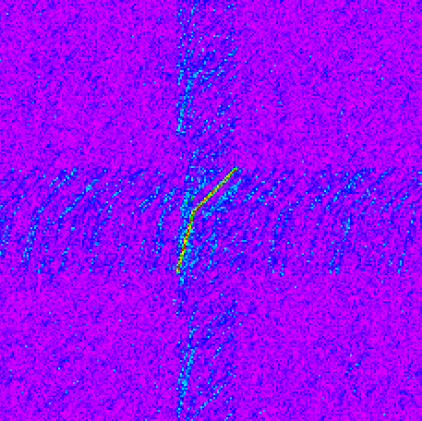
2D reconstruction
Based on an improved Fenimore et. al method, using autocorrelation
Ô = A*G + N*G
Implies relative index (mask-detector) -> image index (angle).
Valid for infinite distances, in astronomy and for very flat geometries (FLATCAM).
In the near field creates artifacts impossible to eliminate completely.
Reconstructs only short tracks, near to the detector.
Geometry optimization implies a "focusing distance",
the opposite of the mask idea, which should behave
as a generalized pinhole.
20 cm track 400000 ph/cm

Slide 3
3D reconstruction
Going "pre-Fenimore", to the original Hadamard idea:
The mechanic television was imagined as a system where light is sent back from the detector (position) -> redo the same, in volume.
No autocorrelation used.
No weighted voxel contribution (tried, but the result wasn't better).
No "near focusing" (pixel size = mask hole size).
High light sensitivity.
3D obtained with a single mask, depth included (more will be used).
Allows a direct product of different views (6 on a cube), no cushion effect implying complicate correlation.

Slide 4
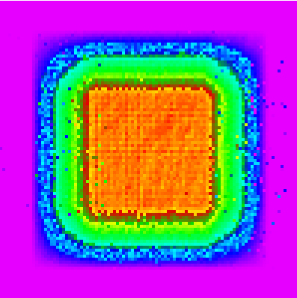
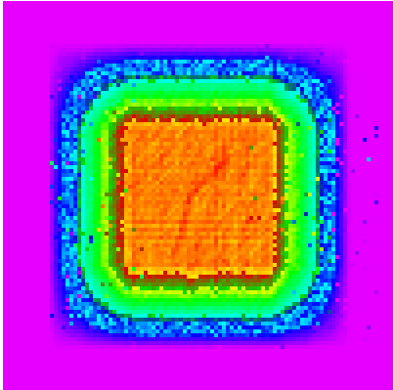
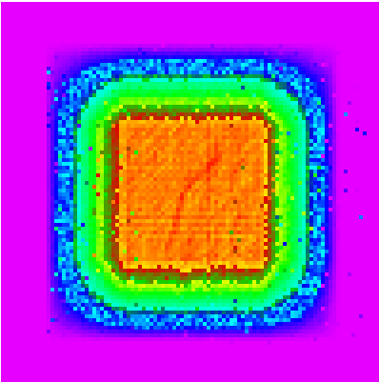
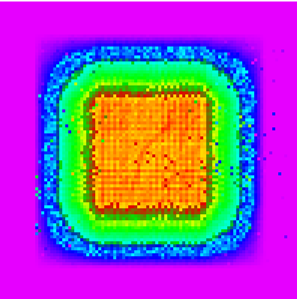
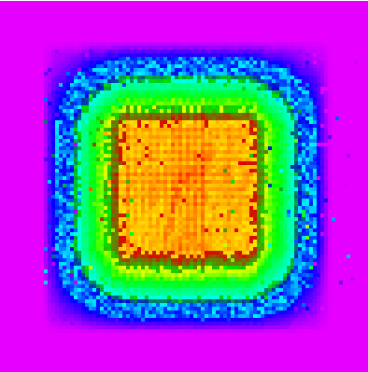
3D reconstruction
Huge detector size, but results indicate that can be reduced.
Mask(URA) & detector 137x139 ("Nipkov TV"). Volume: 1 m³
Pixel size 4 mm, voxel size 10 mm, distance mask-detector 200 mm
Timing, absorption, scattering not yet included.
A 31 cm track reconstructed at 50 cm, 2000 ph/mm with a single view
plane 49 plane 50 plane 51 plane 52 plane 53
(plane index in cm).

Slide 5
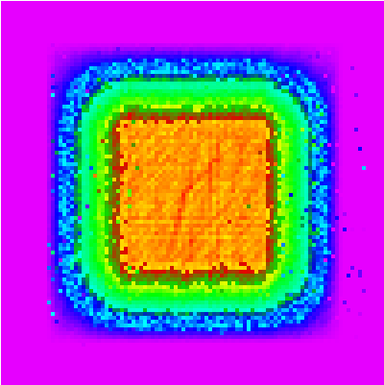
3D reconstruction
Reducing photon yield to 1300 ph/mm
(~QE=30%, no absorption)
Still very good reconstruction.
Run time (1 core) 20 s.
The code is just a proof of principle.
Part of it is multicore (image, illumination), tracking still single core.
There is a lot of room for further optimization.
With 6 views and timing the resolution will be higher and the detector size smaller.

Slide 6
3D reconstruction
Proposal for the name of the new detector (short and easy to adopt):
Tracker with Hadamard Optical Reconstruction (THOR)

