Slide 1
Giornata Nazionale EIC_NET 2021
Torino, December 20-21
ATHENA Vertex
R&D status and design
Giacomo Contin (INFN Trieste)
Domenico Elia (INFN Bari)

Slide 2
Outline
ATHENA vertex & tracking detector
requirements for physics @ EIC
design and selected technologies for the Proposal
basic performance from full simulation (more in Annalisa’s talk tomorrow)
Status and plans for EIC Si-tracker R&D
the EIC Silicon Consortium
path to 65 nm MAPS and synergies with CERN/ALICE ITS3
R&D needs and activities within eRD111 & 104 projects
costing overview and prospects for INFN contribution

Slide 3
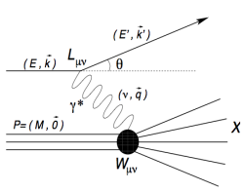
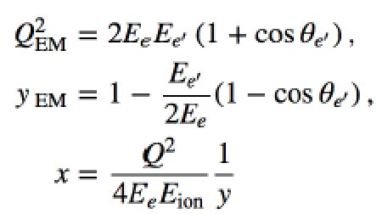
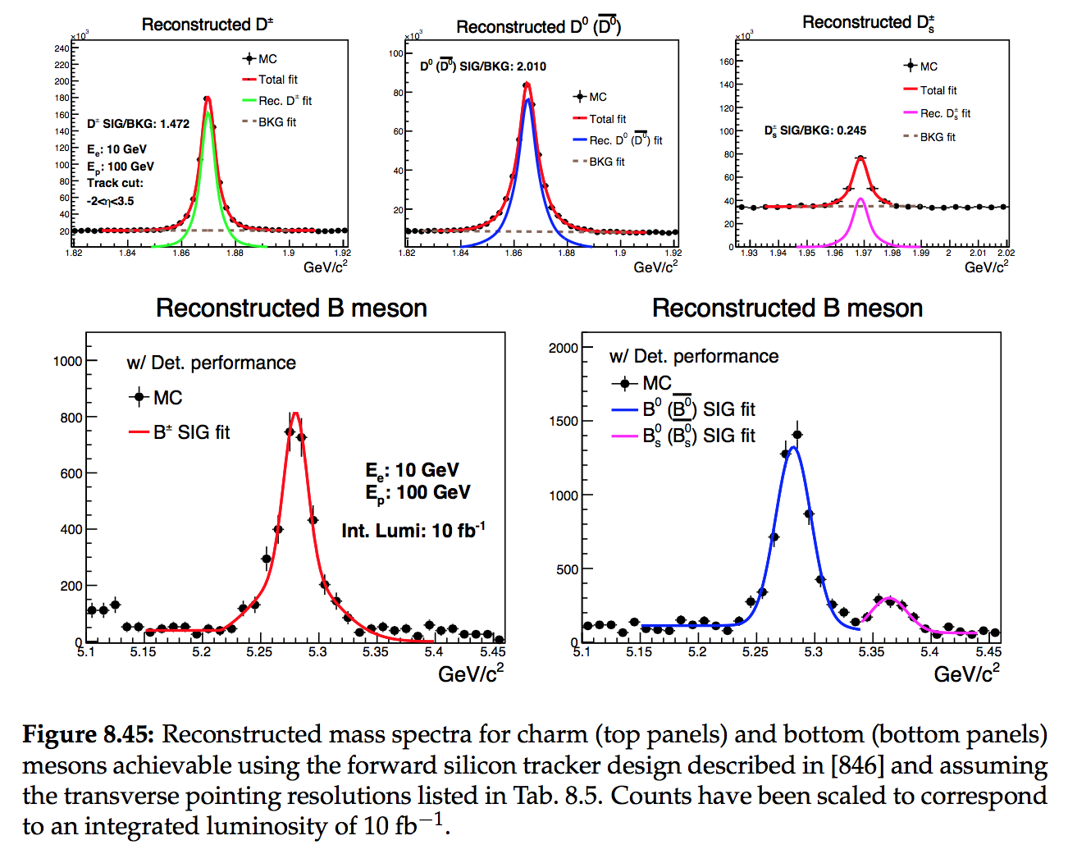
ATHENA vertex & tracking
Tracking requirements for physics @ EIC
Physics drivers for tracking:
inclusive DIS:
DIS kinematics reconstruction through precise electron measurement
mainly barrel and backward
low material budget to minimize Bremsstrahlung
SIDIS:
flavor tagging through identified hadron measurements
minimal momentum threshold (particle decay reco)
heavy quarks:
high resolution, low material budget
momentum/vertex determination (invariant mass reco)
precision jet measurement
improve PID, far-forward detection/tagging

Slide 4
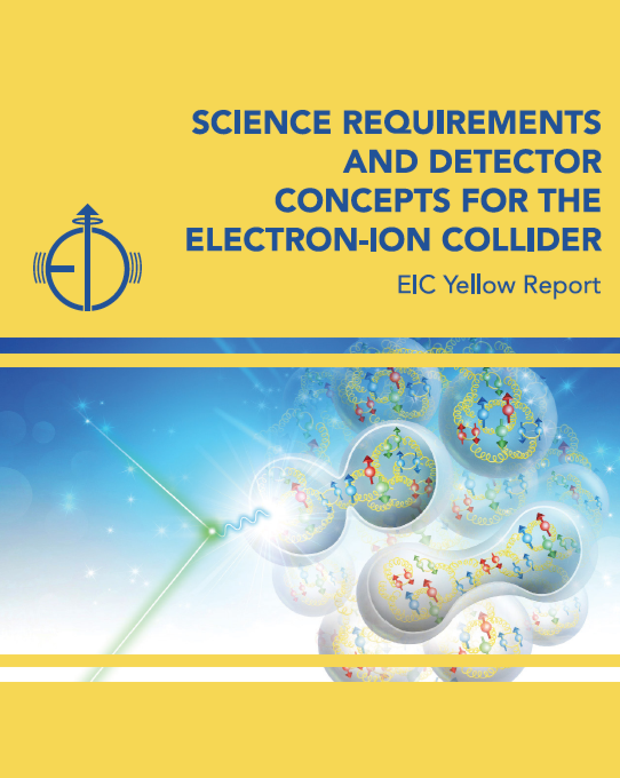
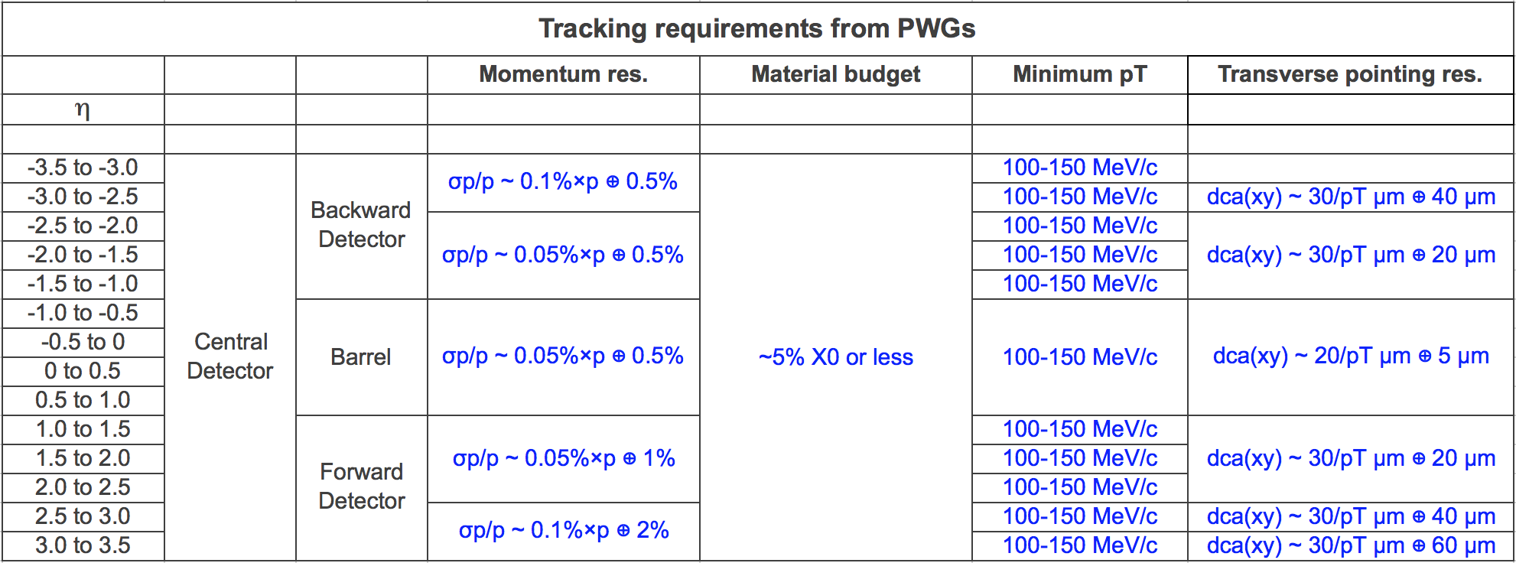
ATHENA vertex & tracking
Tracking requirements for physics @ EIC
PWG requirements in the YR:
https://arxiv.org/abs/2103.05419

Slide 5
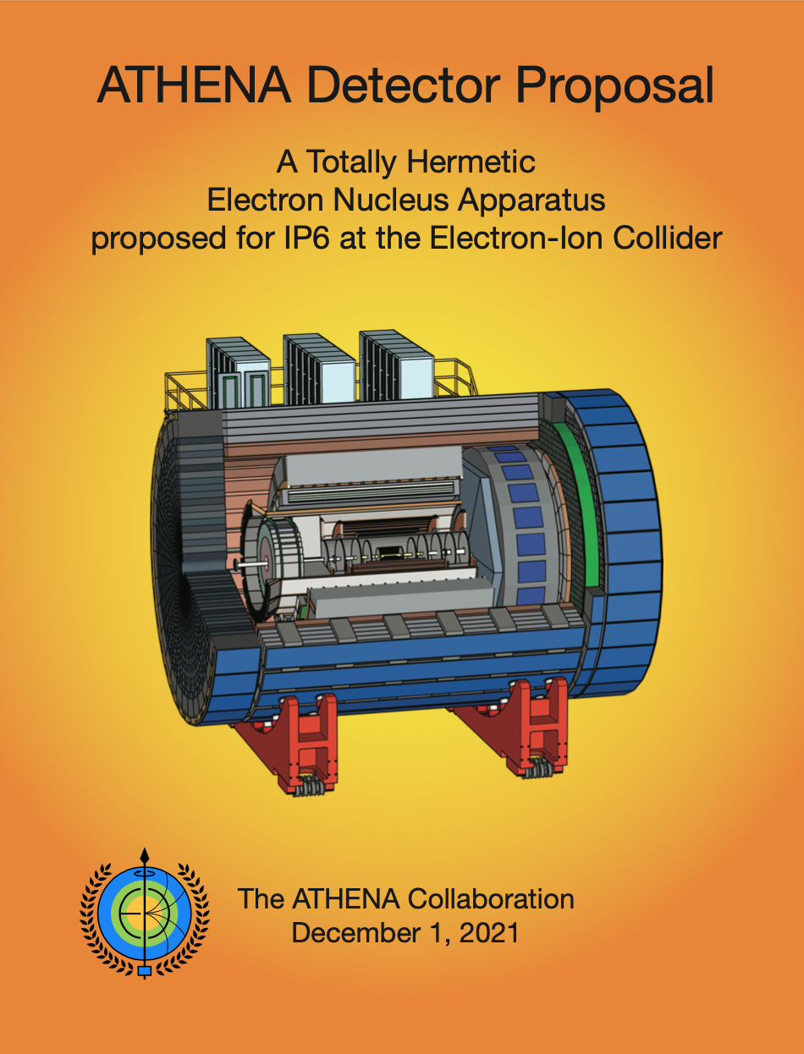
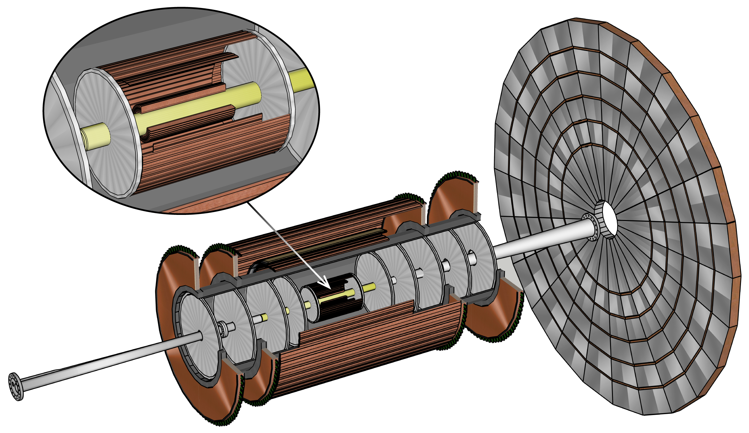
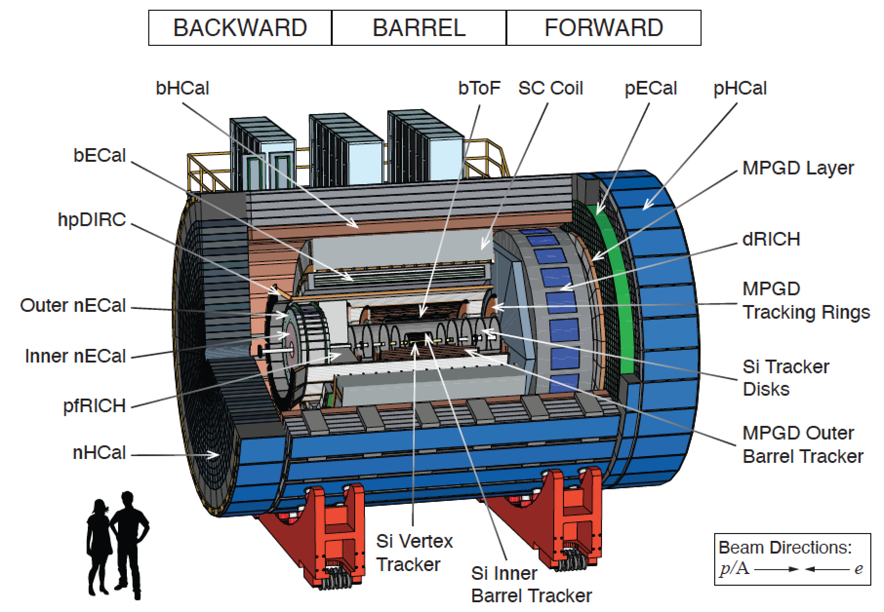
ATHENA vertex & tracking
Design and selected technologies
Tracking system in ATHENA:
Non-symmetric configuration
optimized for low material budget
in the backward direction

Slide 6
ATHENA vertex & tracking
Design and selected technologies
Tracking system in ATHENA:
Non-symmetric configuration
optimized for low material budget
in the backward direction
Hybrid configuration (technology mix)

Slide 7
ATHENA vertex & tracking
Design and selected technologies
Si Vertex Tracker: 3 layers
first layer @ R~33 mm
material 0.05% X₀ per layer
Si inner barrel Tracker: 2 layers
material 0.55% X₀ per layer
FW and BW Si Tracker disks: 5 (BW) + 6 (FW)
material 0.24% X₀ per disk
MPGD Tracker rings: GEM
complementing last 2 disks in each direction
MPGD Outer barrel Tracker: MicroMegas
cylindrical 2 x 2 layers
MPGD Forward Layer: μRWell
placed behind dRICH
Non-symmetric configuration
optimized for low material budget
in the backward direction
Hybrid configuration (technology mix)

Slide 8
ATHENA vertex & tracking
Design and selected technologies
Si Vertex Tracker: 3 layers
first layer @ R~33 mm
material 0.05% X₀ per layer
Si inner barrel Tracker: 2 layers
material 0.55% X₀ per layer
FW and BW Si Tracker disks: 5 (BW) + 6 (FW)
material 0.24% X₀ per disk
Experience from eRD16/eRD18/eRD25 → eRD111
65 nm MAPS technology (10 μm pitch, < 20 mW cm⁻²)
developed for ALICE ITS3
role of the EIC Silicon Consortium
next slides

Slide 9
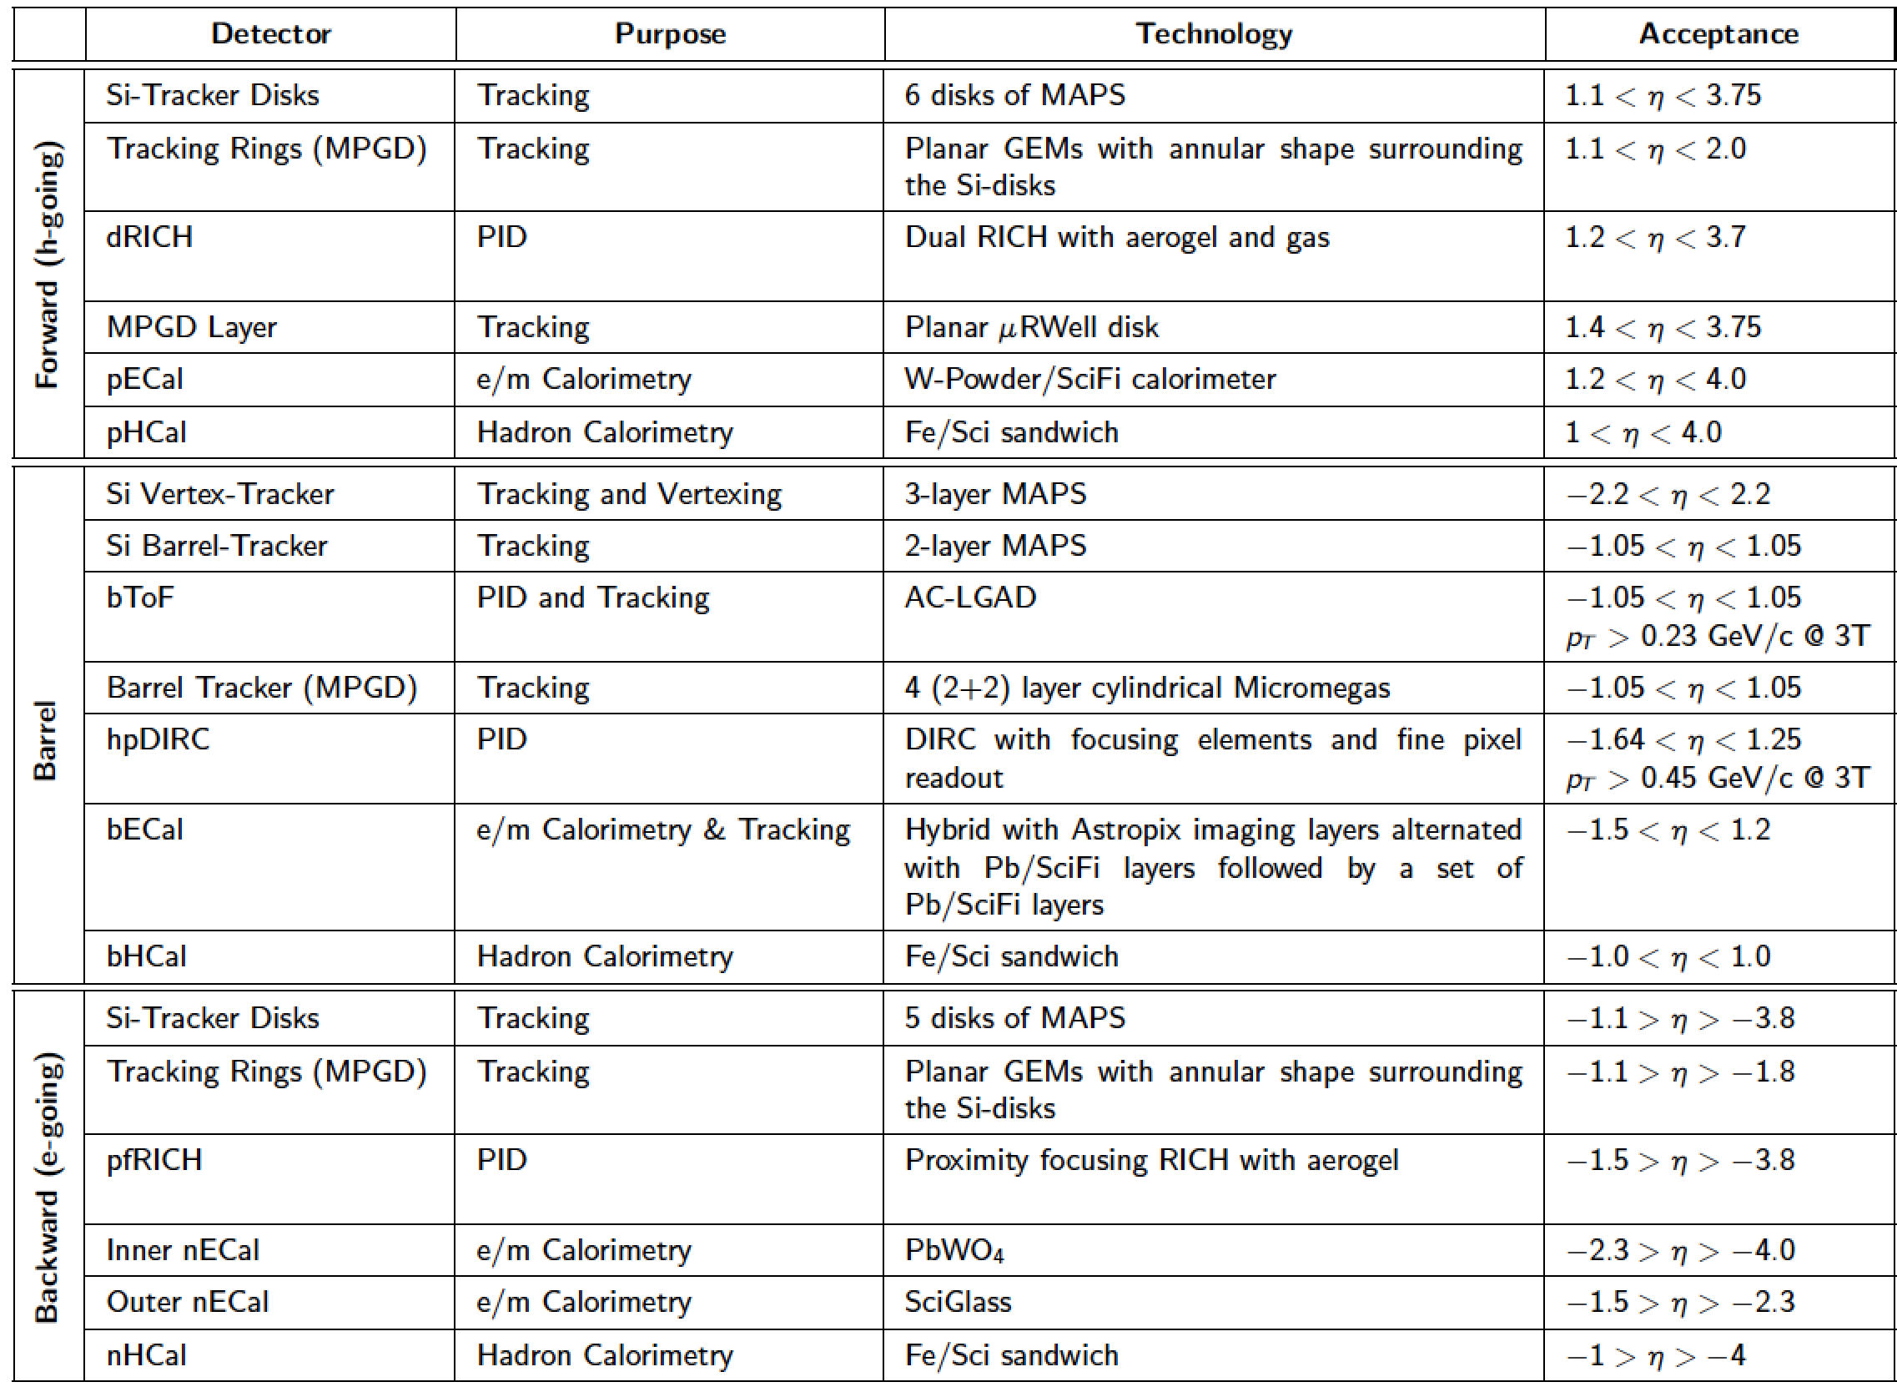
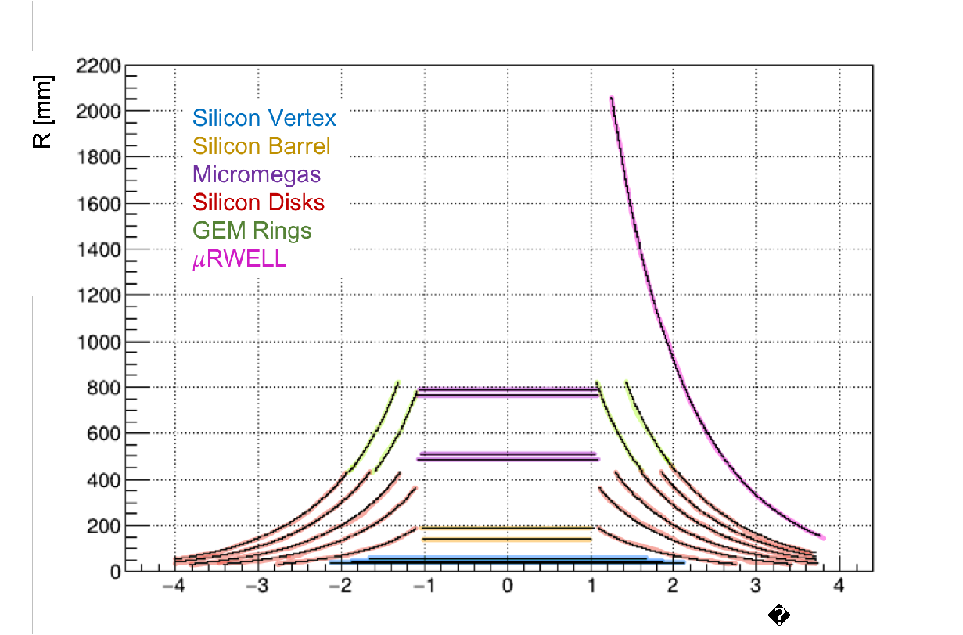
ATHENA vertex & tracking
Design and selected technologies
Pseudorapidity coverage:

Slide 10
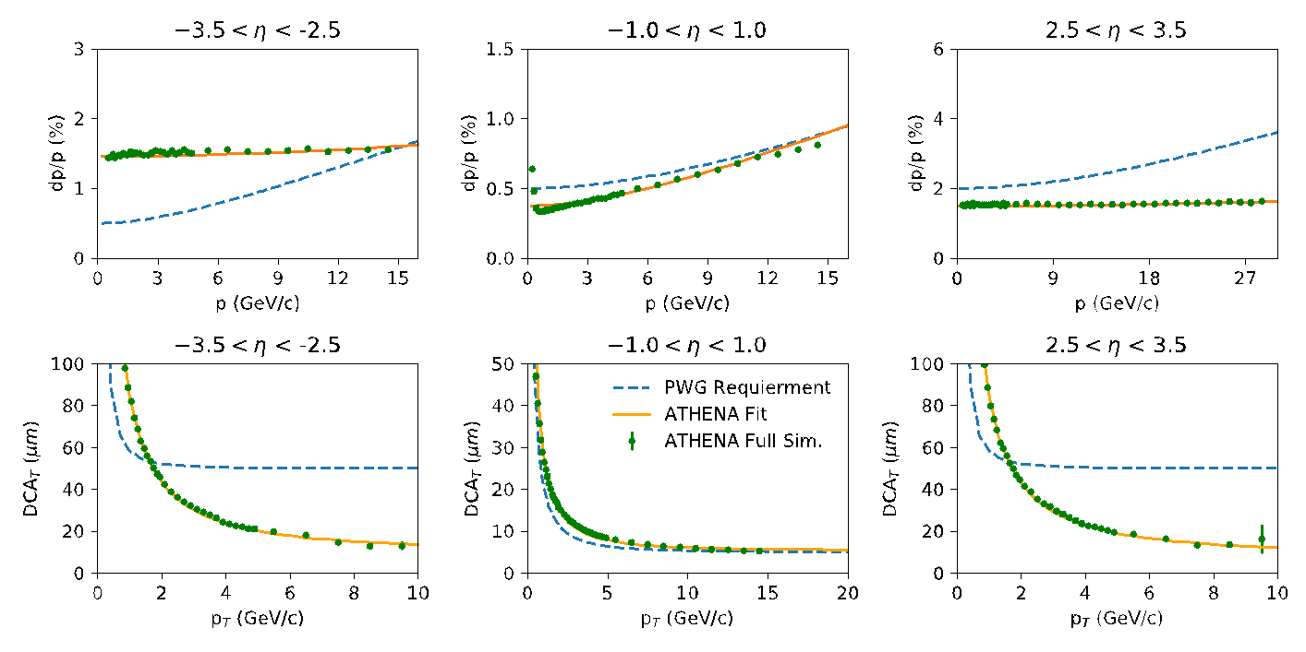
ATHENA vertex & tracking
Basic performance from full simulation
See talk by Annalisa M. tomorrow

Slide 11
Status and plans for Si-tracker R&D
The EIC Silicon Consortium
The development of the EIC vertex and tracking detector is carried out by the EIC Silicon Consortium and will be used as a baseline for the specific EIC detector implementation:
EOI: https://indico.bnl.gov/event/8552/contributions/43219/
Coordinated by a team from LBNL, Uni Birmingham, RAL, BNL, INFN
To join, subscribe the mailing list: https://lists.bnl.gov/mailman/listinfo/eic-rd-silicon-l
Indico page: https://indico.bnl.gov/category/354/
The EIC SC identified the sensor and detector concept under development for the ALICE ITS3 project as the optimal solution for EIC
The EIC SC is open to institutes from all the proto-collaborations interested in this solution:
Similar concept to the CERN RD groups (such as RD50, RD53)
Ensuring the successful delivery of the technology with the lowest cost to the project
Work organized in Work Packages: collaborations with ITS3 on sensor design, characterization, interconnections
Silicon strategy document, costing, milestones, timeline of development, drafted and shared with to the EIC project detector systems coordinators and with the ATHENA proposal committee

Slide 12
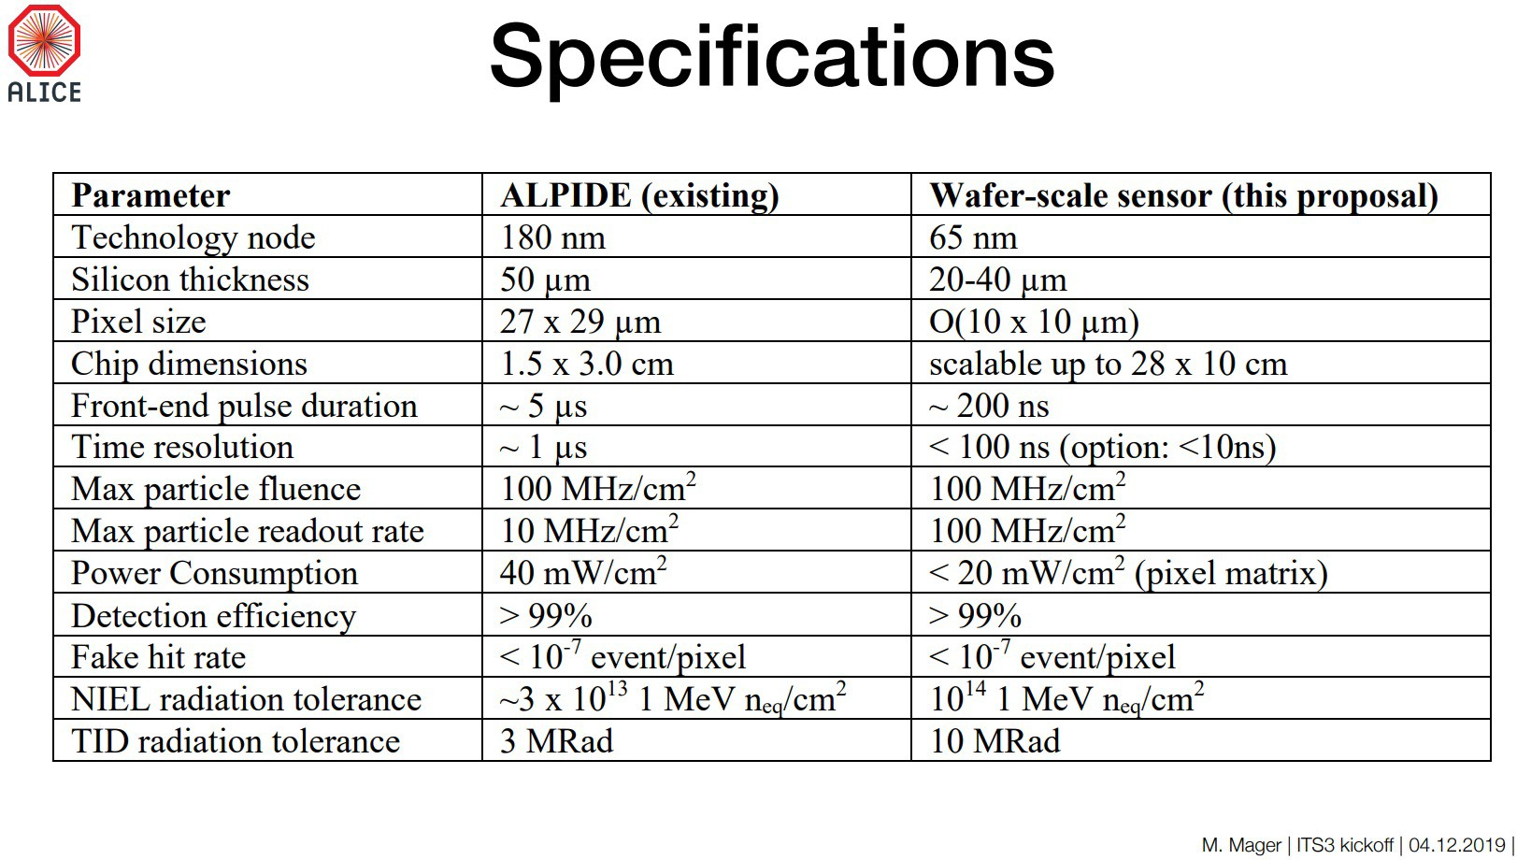
Status and plans for Si-tracker R&D
ALICE ITS3 as a solution for EIC
The ALICE ITS3 project aims at developing a new generation MAPS sensor at the 65 nm CMOS node with extremely low mass for the LHC Run 4 (HL-LHC)
ITS3 sensor (from the EIC point of view)
Specifications meet or even exceed the EIC requirements
Satisfactory granularity (now targeting 20μm pixel pitch) and power consumption (<20mW/cm²)
Also, integration time, fake hit rate and time resolution better than required at the EIC
Sensor design optimized for high yield, stitched sensor to reach wafer-scale size (up to 28 x 10 cm²)
Development schedule well aligned with EIC timeline
ITS3 Specifications

Slide 13
Status and plans for Si-tracker R&D
Path to 65 nm MAPS and synergies with ITS3
Despite the large overlap, the EIC and ITS3 detector have some significant differences:
The ITS3 is a 0.12 m², three layers, vertex detector
The proposed EIC concepts have vertex and tracking layers, disks in forward and backward direction, covering an area >10 m²
EIC sensor development needs to fork-off for different form factor / higher yield sensors:
Projected cost and yield of stitched wafer-scale sensors not compatible with use in the EIC detector outside the vertex layers
Tracking layers and disks will need a more conventional support structures (staves, disks) and sensor size
The path to an EIC detector based on 65 nm MAPS thus requires to develop:
ITS3-like vertexing layers
EIC variant for the staves and disks

Slide 14
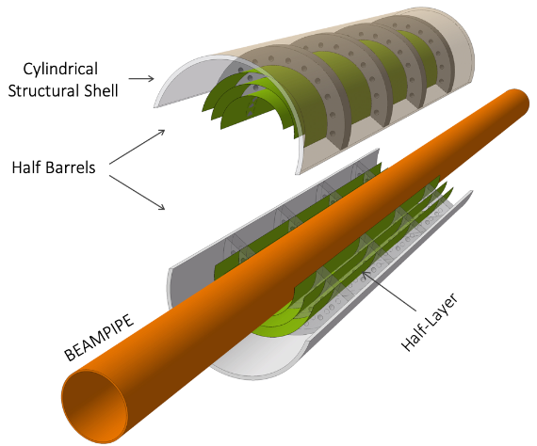
Status and plans for Si-tracker R&D
Overlap with ITS3: EIC inner vertexing layers
Modifications from the ITS3 base design to the EIC vertexing layers:
ITS3 length = 30 cm → set by the length of stitched sensors on a 12” wafer
EIC length (hybrid) = 42 cm
ITS3 radii = 18 mm, 24 mm, 30 mm → set by the integer width of rows of stitched sensors
EIC radii = 33 mm, 44.1 mm, 55.1 mm
EIC strawman design (modification of ITS3)
ITS3 base design
Reach larger radii by using 3 bent sections
Services exit from both sides of inner layers
Services exit from one end

Slide 15
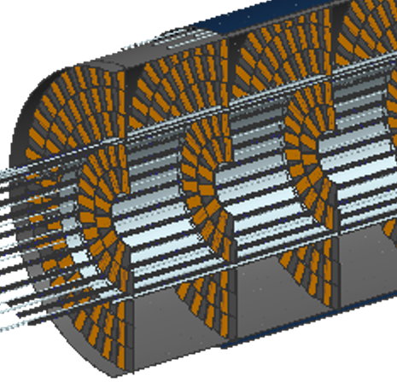
Status and plans for Si-tracker R&D
EIC tracking layers and disks
Forked-off EIC-specific sensor design based on the ITS3 sensor
Primary concern: yield for long rows of stitched sensors
Assess yield in the first ITS3 sensor Engineering Run
Adjust the EIC sensors to optimize yield for the number of stitched sensors in a row
Staves
Use shorter lengths of stitched sensors to form staves.
Power and signal will need to be propagated along the stave with flex PCBs over the stave length.
Discs
Several options being explored (radial/longitudinal)
Conforming the disk diameters or with sensors mounted to half-disc low-mass plates
Trying to balance coverage, material budget and fabrication/mechanical complexity
Double-sided radial option

Slide 16
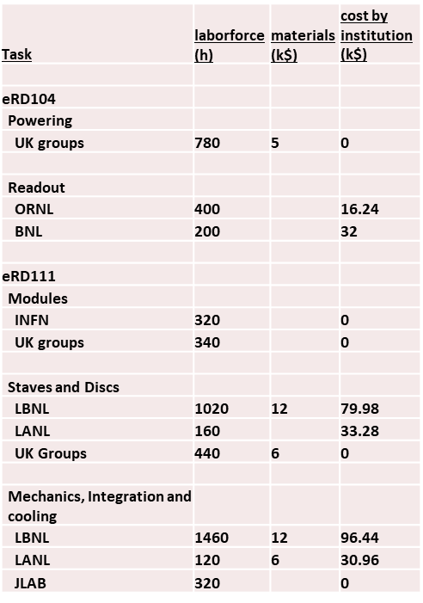
Status and plans for Si-tracker R&D
R&D activities within eRD111&104
The EIC SC participates in the EIC Detector R&D program with the following tasks for 2022:
eRD104 Silicon Services Reduction
Services Reduction
Powering system
Readout system
eRD111 Si-Vertex (excluding sensors)
Forming modules from stitched sensors (INFN)
Staves and Disks
Additional infrastructure including mechanics and cooling
INFN 2022 contribution: in-kind, not costed to project
80h Technicians/Engineers, 160h Staff, 80h Student

Slide 17
Status and plans for Si-tracker R&D
Mitigation strategy and fallback solutions
Fallback solutions in case the 65 nm technology or sensor development
encounter issues compromising the timeline and cost of the project:
New MAPS sensor in 180 nm developed by the ALICE ITS3 collaboration
No expected impact on physics performance
Still compatible with EIC timeline
Current 180 nm ITS2 sensor (ALPIDE)
Experiment-ready, plug-and-play solution
Not meeting the requirements, impact on physics performance to be evaluated
Would need to be replaced with an upgrade once the main development path
in 65 nm is ready to allow the EIC to meet its physics goals
Decision will be taken in 2022 after the results from the 65 nm stitched sensor

Slide 18
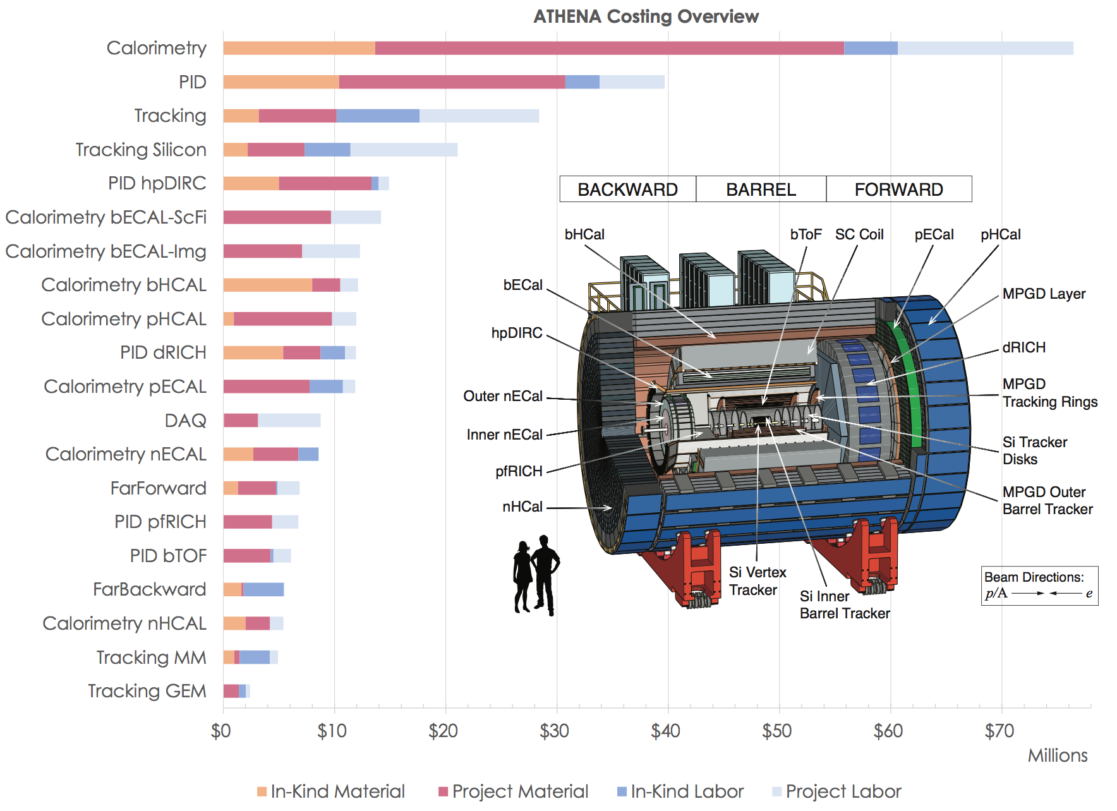
Status and plans for Si-tracker R&D
Participating institutes and Costing

Slide 19
Status and plans for Si-tracker R&D
Costing overview
Si-tracker costing compiled by EIC SC
Construction:
Sensors:
conservative estimate pending completion of R&D @CERN
Mechanics, readout, cooling and services:
actual costing for recently completed ALICE ITS2 with improvements of lower mass
In-kind contribution ~30%
UK planned contribution of ~7M$ for material & labor
INFN planned contribution: ~1M$ for material + ~1M$ for labor

Slide 20
Status and plans for Si-tracker R&D
Costing overview
Si-tracker costing compiled by EIC SC
Construction:
R&D:
From costing document: “R&D is carried out in common by all proto-collaborations within the EIC Silicon Consortium. A 50% in-kind contribution is anticipated to the labor costs for the sensor development. The UK has confirmed funding for R&D through the UKRI-STFC Infrastructure Fund and will contribute a fraction of the 50% in-kind silicon labor as well as 15% to silicon material, and some effort to modules, staves and disks. More contributions are to be confirmed by other EIC SC collaborators.”
INFN planned in-kind contribution ~0.2M$

Slide 21
Status and plans for Si-tracker R&D
Prospects for INFN contribution
INFN is very active within the Silicon Consortium
Two Coordination Board members (BA, TS)
INFN Institutes well connected to the ALICE ITS3 R&D activities
Current and planned activities for INFN in FY2022
Coordinating EIC contribution to ITS3 MLR1 testing campaign
Developing a path for forming modules from stitched sensors (eRD111 item)
Integrating stitched sensor reticles into building block units that:
are compatible with detector size requirements
are electrically and mechanically integrated units
can be joined together to propagate power and signal lines
are suitable for forming staves and disks out of them
Next step: increase FTEs on silicon by attracting colleagues and other Institutes

Slide 22
Summary
ATHENA tracker in the Proposal:
hybrid configuration design
performance match requirements for physics
optimal solution for the EIC sensor and detector concept has been identified:
65 nm CMOS sensor based on stiched design
vertexing layers based on curved ultra-thin wafer-size sensors
large area tracking layers based on staves and disks
synergy with ongoing R&D for ALICE ITS3:
matching project timelines until design fork-off for EIC
fallback options co-developed with ALICE
leveraging INFN member experience and involvement in the ITS3 R&D
INFN contribution:
in-kind, not costed to project for 2022
preliminary estimate included in ATHENA budgeting exercise
→ increase FTEs and enlarge community will be key!

