Slide 1



Quantum computing to witness nonclassicality
SMFT - Bari – December 2022
Giovanni Scala
With L. Catani, M. Leifer, D. Schmid, and R. W. Spekkens,
“What is Nonclassical about Uncertainty Relations?” Phys. Rev. Lett. 129, 240401, Dec 2022
“What aspects of the phenomenology of interference witness nonclassicality?” arXiv:2211.09850
This research was made possible by funding from QuantERA/2/2020, an ERA-Net cofund in Quantum Technologies, under the project eDICT.

Slide 2
What is missed in the quantum theory?
Classical explainability

Slide 3
We want a theory
Without no-go theorems
Notes:
If we do not have such a theory we cannot say what is it, we
can only say what is not.

Slide 4
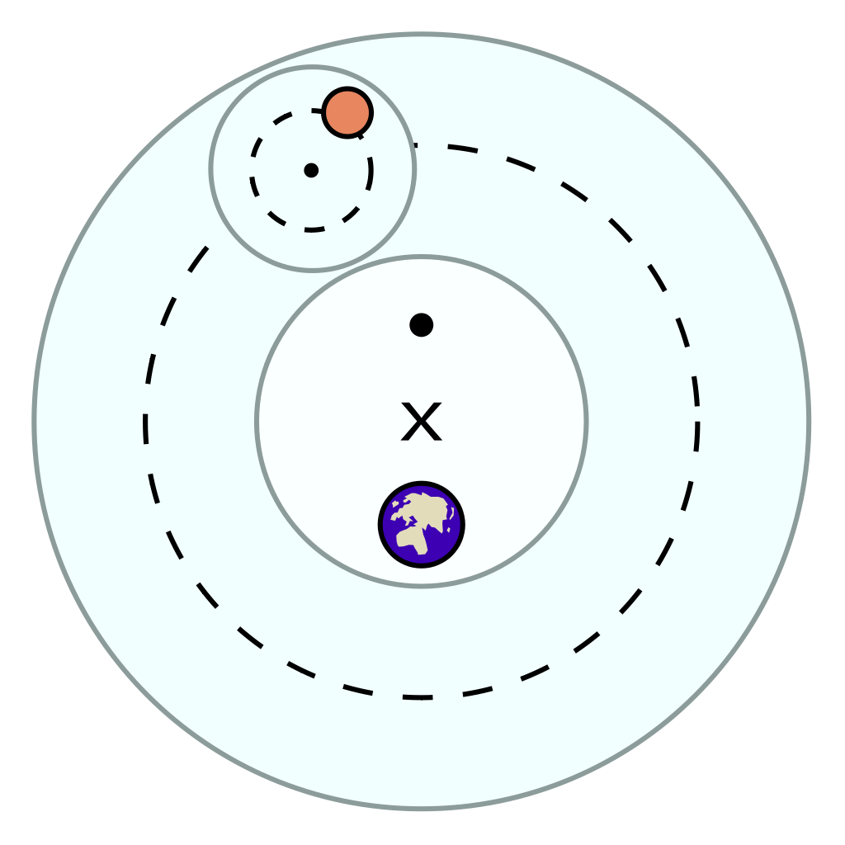
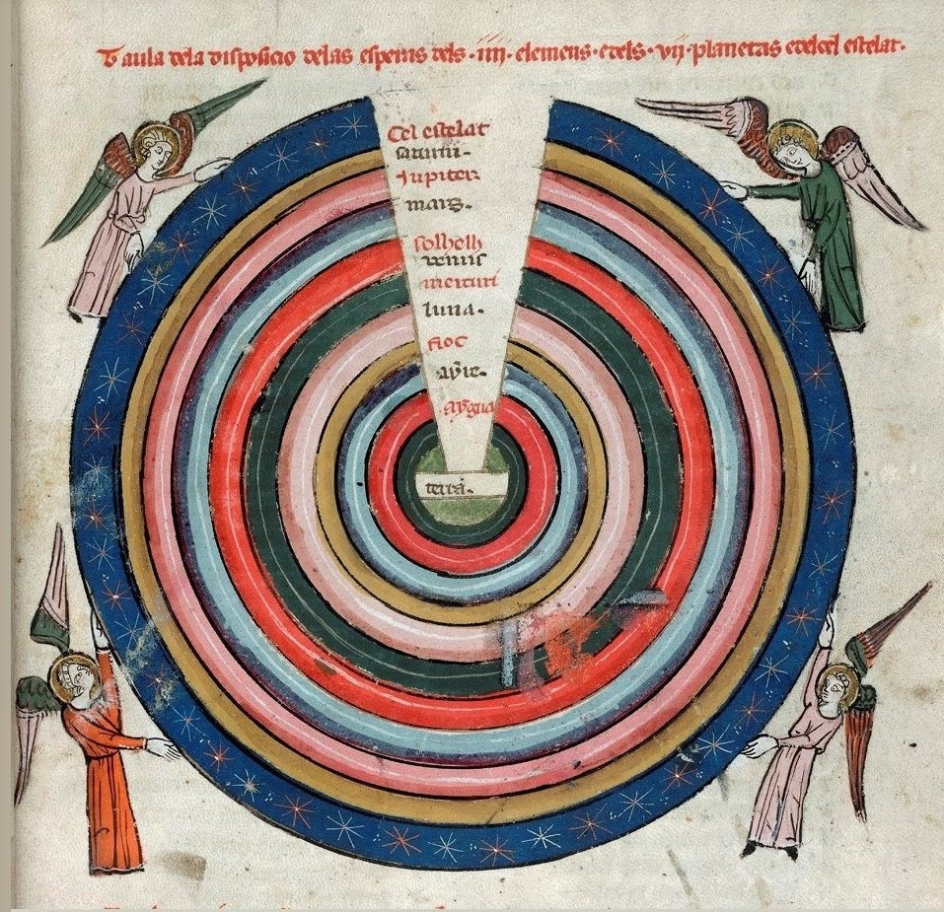
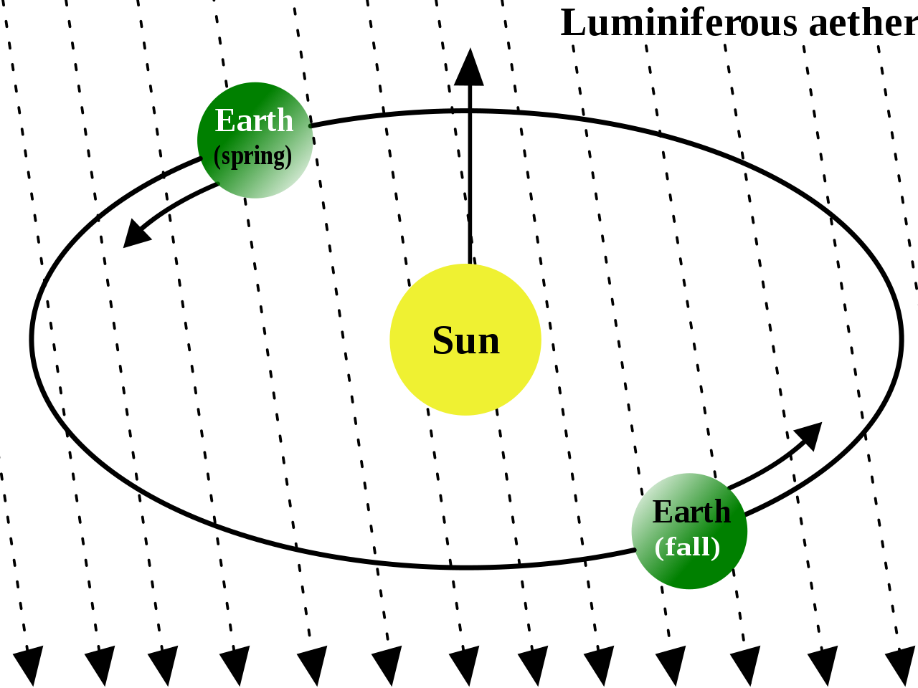
Without fine-tunings
Celestial spheres, epicicloids, etere
Notes:
the process in which parameters of a model must be adjusted very precisely in order to fit with certain observations

Slide 5

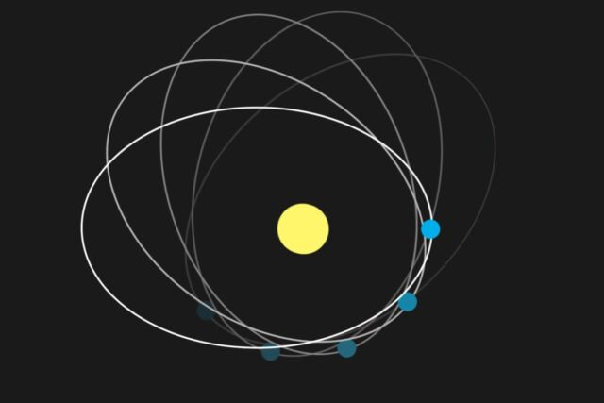
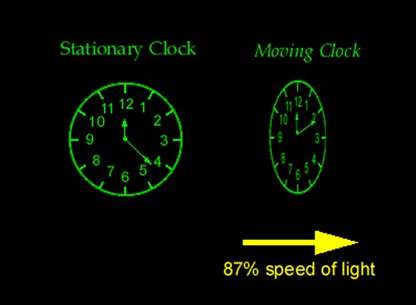
With naturalness
discovery of Neptune, Mercury’s precession, contraction of length and time dilation

Slide 6
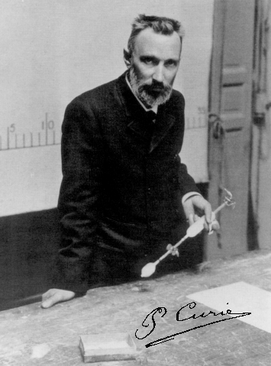
Curie’s principle
Any asymmetry in a physical effect must be found in its causes
Pierre Curie
(1859 – 1906)

Slide 7


Violation of Curie’s principle?

Slide 8
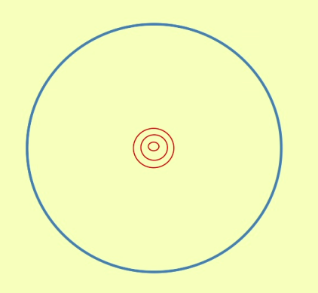
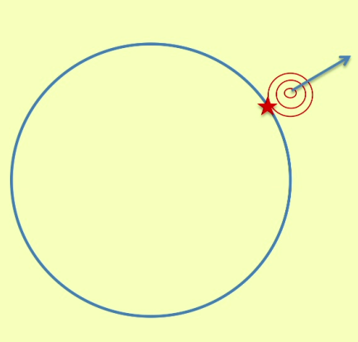
Violation of Curie’s principle?

Slide 9
Joint measurement of incompatible observables and the bell inequalities

Slide 10


Slide 11
Noncontextuality
Preparation Noncontextuality

Slide 12
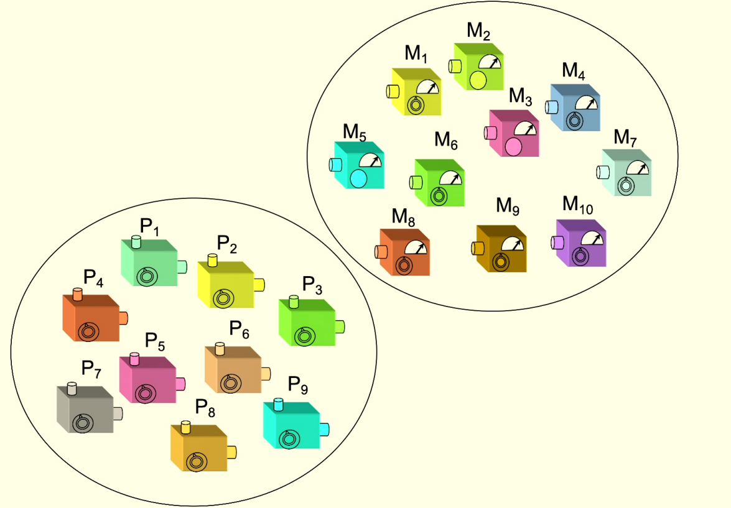





Operational equivalence classes of preparations

Slide 13
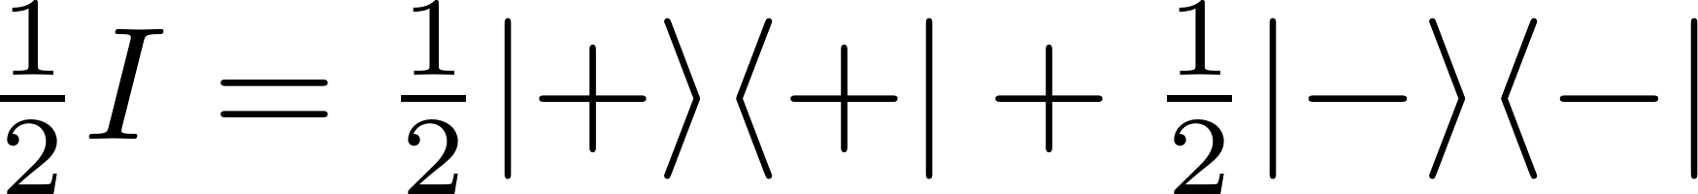
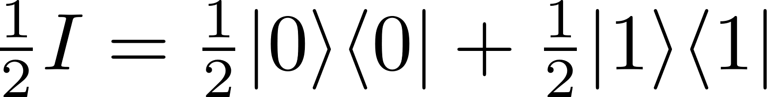

Example from quantum theory

Slide 14
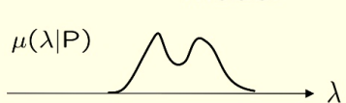

Preparation noncontextual model

Slide 15

Preparation contextual model

Slide 16
Preparation Noncontextuality

Slide 17

Preparation Noncontextuality

Slide 18
“Product” uncertainty relations in quantum theory
H.P. Robertson (1903-1961)
W. Heisenberg (1901-1976)
Notes:
1) Heisenberg-Robertson UR bounds the variances of two observables with the expectation value of their commutator (also Schrodinger improved this, but still has the same problem below).
About joint predictability of two measurements on a state. So like us, not like error-disturbance UR, about trade-off between info gain and disturbance.
2) However these are unsatisfactory in the finite dimensional case.
Both expectation value of variances are calculated on a state psi. So imagine that A and B are Pauli X and Z, and you choose as psi one of their eigenstate, e.g. of X, then this uncertainty relation is trivial. Even if the measurements are incompatible and have a tradeoff relation on their predictabilities for that state.
(Pair of measurements for which there is a nontrivial tradeoff in their predictabilities.
UR express limits on the extent to which the outcomes of distinct measurements on a single state can be made jointly predictable.)

Slide 19




“Sum” uncertainty relations in quantum theory
In the case of Pauli and measurements,
Notes:
A solution to the above is to consider sums instead of products. For this talk we consider Pauli X and Z measurements, that are complementary and are the discrete analogue of position and momentum. In general, our results will hold for any two binary-outcome measurements.
This tradeoff relation holds for any state in quantum theory, and so it is an uncertainty relation. Its validity comes from the fact that it is a description of the Bloch ball of qubit quantum states.
Other versions of these are the entropic UR. Connected to ours, but we do not deal with them. I can spend some words later on them.

Slide 20
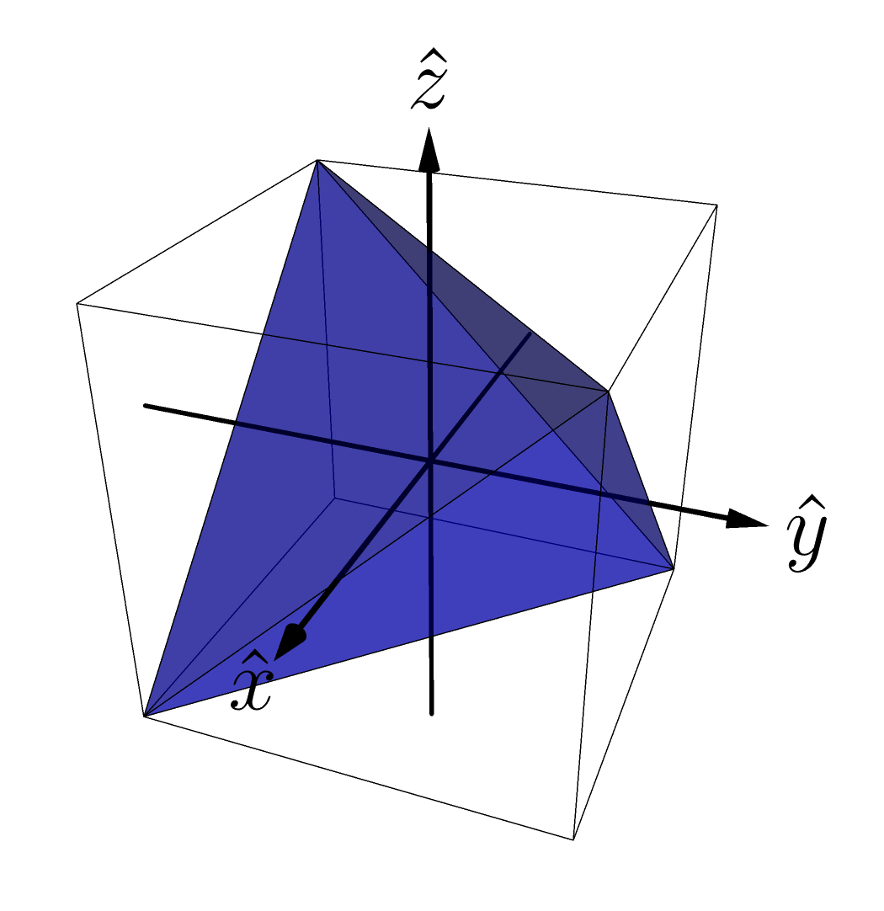
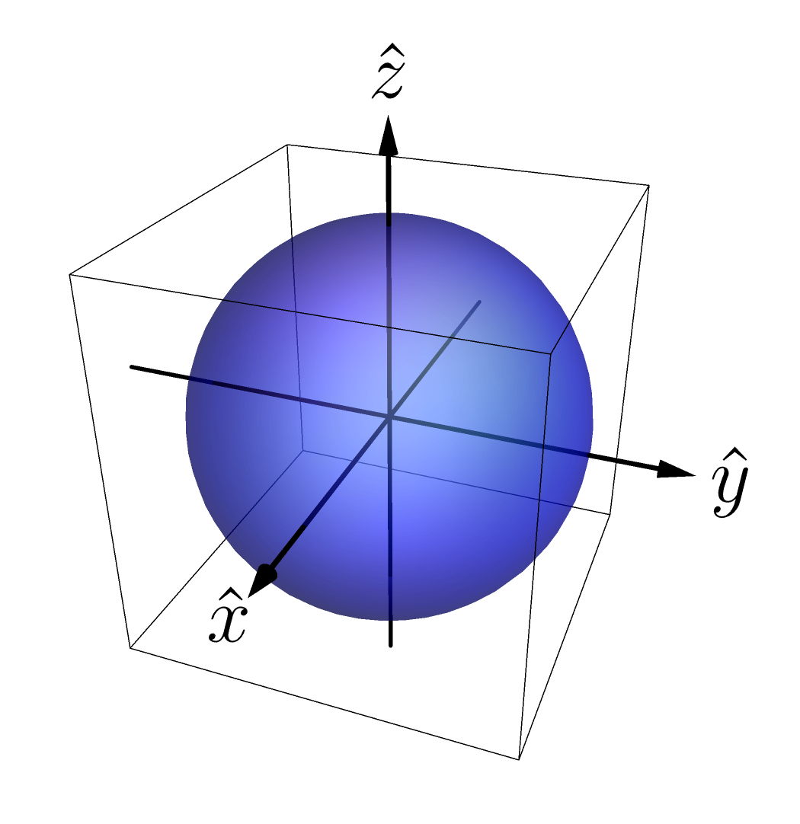
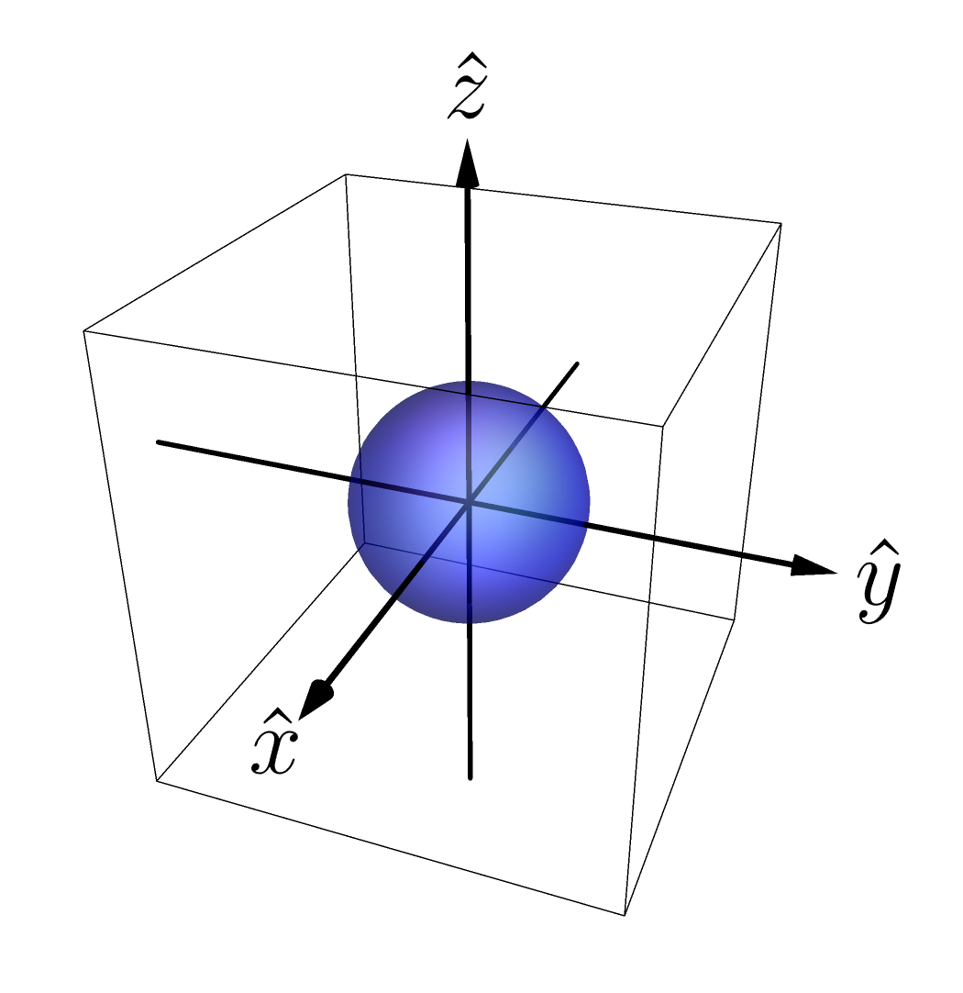
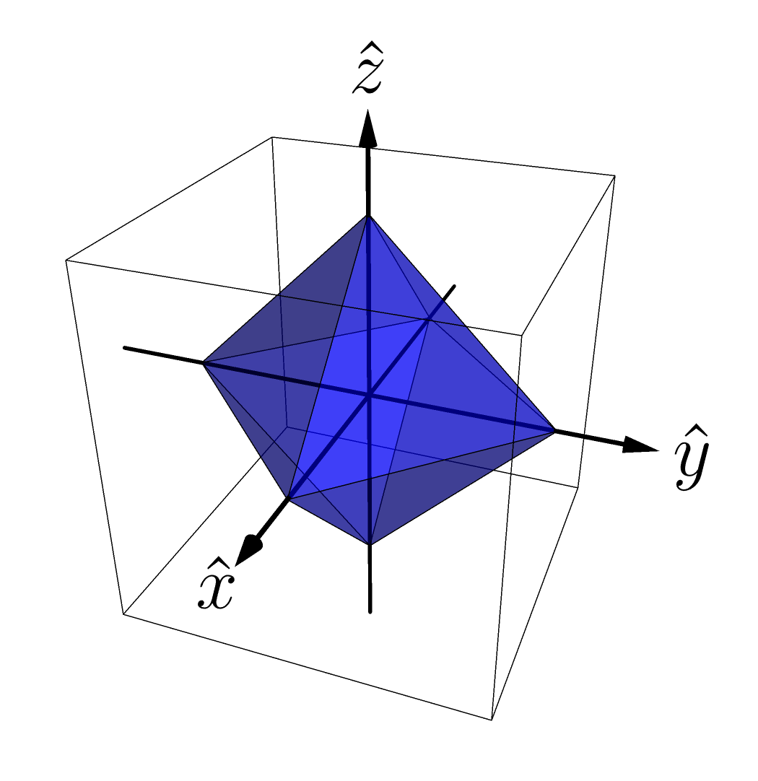
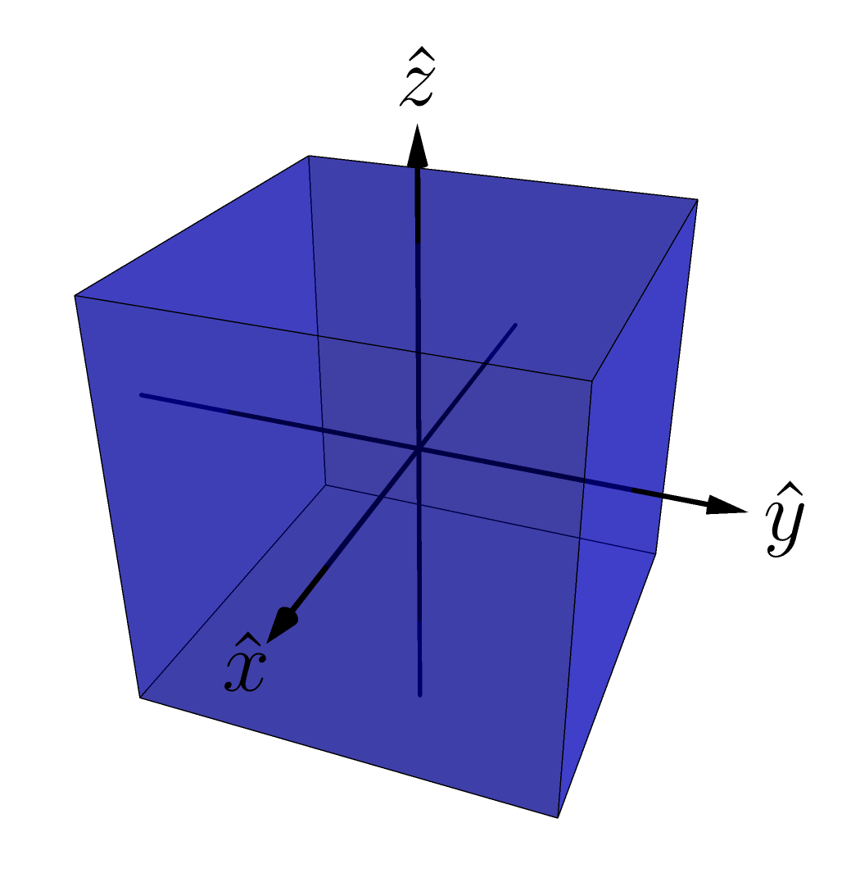
Operational theories – examples
Gbit theory
depolarized qubit theory
Stabilizer theory
Simplicial theory
Qubit theory
Notes:
In particular we consider simple examples. We start with the state-space representation of the qubit, which is the standard Bloch sphere. In R3 we represent a 4-dimensional space of Hermitian operators. Every qubit operator is represented as a linear combination of elements of a basis of the 4-dimensional space of Hermitian operators.
The expectation values of X and Z are linearly related to the probability of getting X and Z, and so with the projections of the state space on those axes.

Slide 21
Examples: comparison of uncertainty relations
Notes:
The ii is gonna be clear in a bit why it’s red. For now imagine that they’re all blue. Predictability of X and of Z plotted.
The expectation values of X and Z are linearly related to the probability of getting X and Z, and so with the projections of the state space on those axes.

Slide 22
How to link uncertainty relations and contextuality?
Problem:
Uncertainty relations single state.
Contextuality requires operational equivalences (at least 4 states).
Notes:
An UR expresses the predictability tradeoff between two measurements for any single state in the theory.
Contextuality requires at least 4 states (and two tomographically complete measurements like X and Z here).

Slide 23
How to link uncertainty relations and contextuality?
Solution:
Notes:
Consider operational theories with a pair of joint measurements, denoted X,Z, and a state that satisfies the condition of A12 orbit realizability.

Slide 24
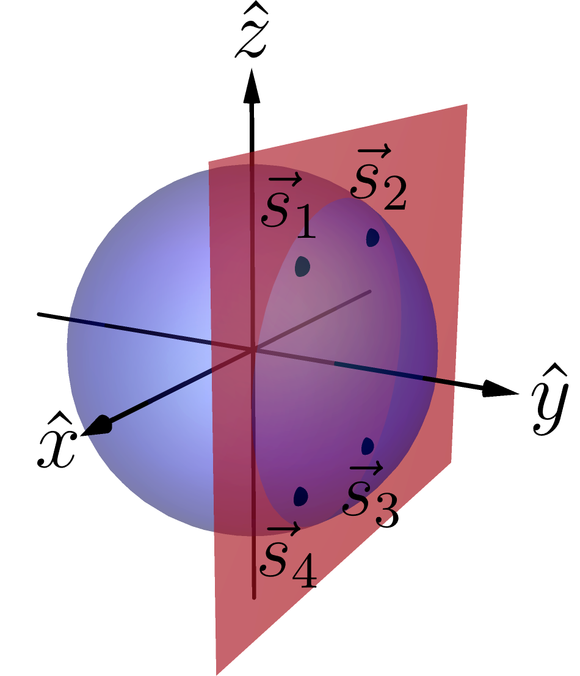
The state has equal predictability counterparts.
The state manifest operational equivalences with such counterparts.
Example in the qubit theory:
Notes:
i.e. there exists other states (at least other 3) that have the same predictabilities, in modulus, for X and Z. Other states manifest those predictabilities, so they also show the same uncertainty relation!
i.e. among these states there are at least 3 with which the state can have operational equivalence. Moreover, among these states there are operational equivalences.
So they lie in a rectangle in a plane parallel to the ZX plane. These vertices are the orbit of the original state under the action of the symmetry group of a rectangle under reflections, the Coxeter group A21. That’s why the name.
Basically it’s a rectangle condition.

Slide 25

Notes:
So noncontextuality imposes a nontrivial constraint on the X and Z predictabilities of a state.
Not doing the proof. It’s easily followable in the paper.
Noise robust. It can be tested experimentally.
So the UR it’s a NC inequality. It’s not about a single state as you could pick any in the A12 orbit realizability.
Despite our result shows contextuality of a theory whenever you have one state in your theory satisfying the symmetry and s.t. the bound is violated, our result has deeper significance for theories where all states satisfy the symmetry.

Slide 26


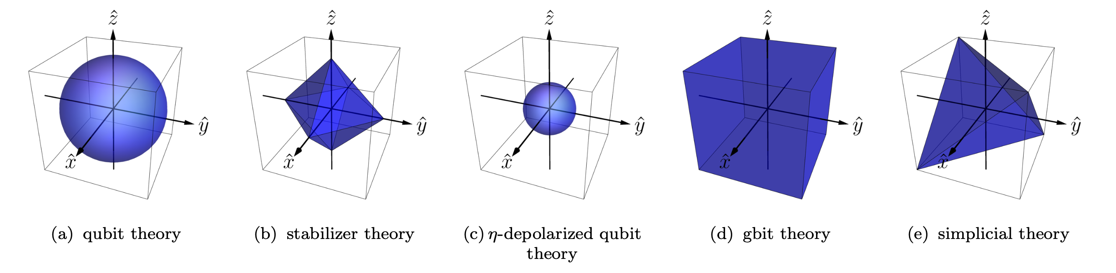
Theories with
If all states in an operational theory satisfy the condition of
we say that the theory has .
Examples:
Notes:
They all satisfy apart from simplicial. The set of states satisfying the A12 symmetry forms an octahedron inside the tetrahedron, whose vertices are at the midpoints of the edges, i.e. the stabilizer octahedron.
The vertices of the tetrahedron do not satisfy the symmetry, as they don’t manifest operational equivalences.
Notice, however, that our result applies to any theory with some state having A12 symmetry. Not only the theories that have all states satisfying it.
Thanks Giovanni for the very nice figures.

Slide 27
Noncontextuality and uncertainty relations
Notes:
So noncontextuality implies the functional form of the uncertainty relation to be below a linear curve.
Our bound is a universal constraint on the predictability tradeoff within such theories.

Slide 28
Comparison of uncertainty relations
Notes:
So noncontextuality implies the functional form of the uncertainty relation to be below a linear curve.
Notice that the NC bound intersects the quantum ZX UR only for X=1 and Z=0 or vice versa. This is what happens in the toy theory. Max predictability of X and zero of Z or vice versa. Otherwise the qubit can violate the bound and indeed shows contextuality.
Stabilizer UR as noncontextuality inequality.
Qubit maximum violation of the bound is sqrt{2} and gbit is 2. Geometrically easy to see.
Notice that in the case of the simplicial theory, our bound is not a universal constraint on the predictabilities of the theory. Only in the subset of states that satisfy the symmetry, and that indeed satisfy our bound, consistently with the fact that the simplicial theory admit of a noncontextual model.
The vertices, that allow to beat our bound and provide the UR for the simplicial theory, do not satisfy the symmetry and so are not subjected to our result.

Slide 29
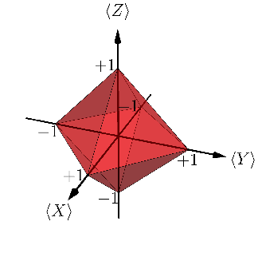
Generalization to three measurements
Notes:
Noise robust. It can be tested experimentally.
So the UR it’s a NC inequality. It’s not about a single state as you could pick any in the A12 orbit realizability.

Slide 30


What is non-classical about quantum interference?
Notes:
We want to understand quantum theory. In order to do so we think we need to single out the features that are inherently nonclassical of quantum theory. In this work we show that interference phenomena are not among those features, unlike usually claimed, by providing a classical statistical theory – the toy field theory -- that reproduces those phenomena within a classical worldview (explicitly refuting all the radical interpretational claims that are usually taken to be implied by quantum interference phenomena). With this work we also want to promote a more rigorous way of studying nonclassicality.

Slide 31
What is non-classical about quantum interference?
It is possible to provide a classical account of the TRAP phenomenology of quantum interference. However, reproducing the precise trade-off between visibility and distinguishability in quantum theory requires contextuality.
Notes:
We want to understand quantum theory. In order to do so we think we need to single out the features that are inherently nonclassical of quantum theory. In this work we show that interference phenomena are not among those features, unlike usually claimed, by providing a classical statistical theory – the toy field theory -- that reproduces those phenomena within a classical worldview (explicitly refuting all the radical interpretational claims that are usually taken to be implied by quantum interference phenomena). With this work we also want to promote a more rigorous way of studying nonclassicality.

Slide 32



Thank you
Merry Christmas
Notes:
We want to understand quantum theory. In order to do so we think we need to single out the features that are inherently nonclassical of quantum theory. In this work we show that interference phenomena are not among those features, unlike usually claimed, by providing a classical statistical theory – the toy field theory -- that reproduces those phenomena within a classical worldview (explicitly refuting all the radical interpretational claims that are usually taken to be implied by quantum interference phenomena). With this work we also want to promote a more rigorous way of studying nonclassicality.

Slide 33
Extra slides

Slide 34
Some references
This work :
Epistemically restricted theories :
What’s truly nonclassical about quantum theory :
L. Catani, M. S. Leifer, D. Schmid, R. W. Spekkens, arXiv: 2111.13727 (2021).
R. W. Spekkens Phys Rev A 75 (3): 032110 (2007).
S. Bartlett, T. Rudolph, R. W. Spekkens, Phys Rev A 86, 012103 (2012).
R. W. Spekkens, in Quantum Theory: Informational Foundations and Foils, pp 83-135, Springer Dordrecht (2016).
L. Catani, D. E. Browne, New J. Phys. 19, 073035 (2017).
L. Catani, M. S. Leifer, arXiv:2003.10050 (2020).
D. Schmid, J. Selby, R. W. Spekkens, arXiv:2009.03297 (2020).

Slide 35
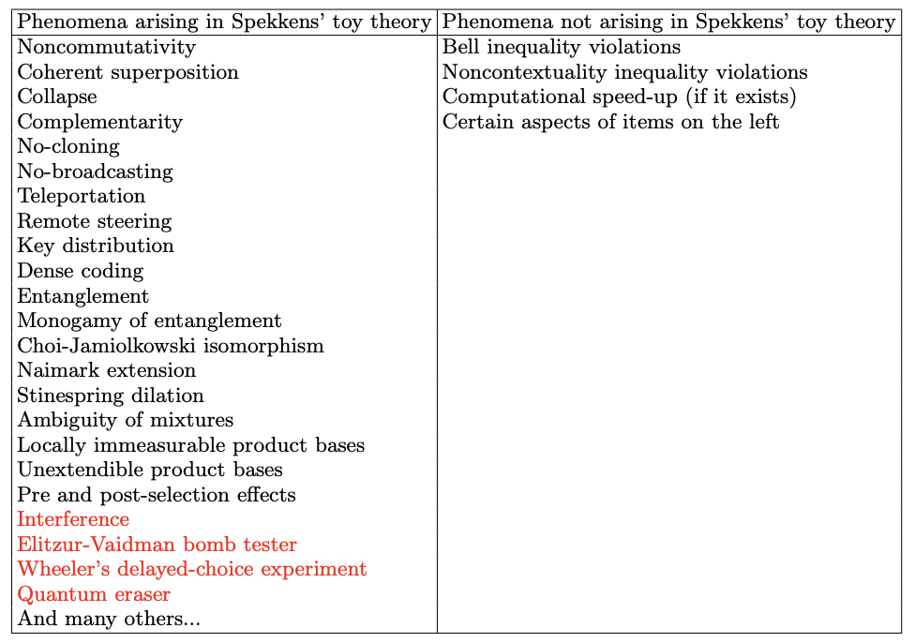
Motivation
Motivation
R. W. Spekkens, in Quantum Theory: Informational Foundations and Foils, pp 83-135, Springer Dordrecht (2016).
3/27
*L. Catani, M. Leifer, D. Schmid and R.W. Spekkens, arXiv:2111.13727 (2021).
Notes:
The red ones are novel with respect to the table in Spekkens’ paper.

Slide 36
Motivation
Motivation
There exist theories that manifest uncertainty relations but also admit of a noncontextual ontological model.
Which aspects of uncertainty relations witness contextuality?
5/27
Notes:
Which aspects of uncertainty relations, if any, witness nonclassicality, here in the form of contextuality?

Slide 37
Operational theories
Operational theory in a prepare and measure scenario:
Preparation
Measurement and outcome
Predicted statistics
8/27
Notes:
An operational theory in a prepare and measure stipulates the preparations the measurements and an algorithm for computing the predicted probabilities of an outcome given preparation and measurement for all possible preparations and measurements.
We can imagine that each preparation and measurement effect as a real-valued vectors, and the probability is given by their inner product.

Slide 38
Ontological models and Noncontextuality
Ontological model of an operational theory
Each system ontic state space describing possible ontic states .
Preparation
Measurement and outcome
Predicted statistics
15/27
Notes:
The theory predicts well because there’s actual system that is subjected to the experimental procedures. It has physical properties defined as ontic states.
Since we consider Lambda finite, we can represent the probability distributions as vectors.

Slide 39
Ontological models and Noncontextuality
Preparation noncontextuality
Two preparations are operationally equivalent, , if
In a preparation noncontextual ontological model,
In particular,
R.W. Spekkens, Phys. Rev. A 71, 052108 (2005)
16/27
Notes:
Where the w_i are probability distributions.
I presented the notion for preparations but it extends also to transformations and measurements and it is known as generalized contextuality.
Of the examples before, qubit QT, gbit theory and eta-depolarizing qubit theory when eta less than 2/3 do not admit of NC ontological model. Simplicial and stabilizer yes.

Slide 40
Ontological models and Noncontextuality
Why is it a good notion of classicality?
Instance of Leibnizian methodological principle / no-fine tuning.
Connected to locality and Kochen-Specker noncontextuality.
Connected to positivity of quasiprobability representations.
Connected to simplex embeddability in GPTs.
Emerges in the presence of sufficient noise.
It is empirically testable.
Its violation is connected to quantum computational advantages.
*watch David Schmid’s lectures at Solstice of Foundations or see references in our article.
17/27
Notes:
Applies to a broad class of physical scenarios. For ex a single system unlike locality.
Simplex embeddability is the notion of classical explainability in GPTs.

Slide 41
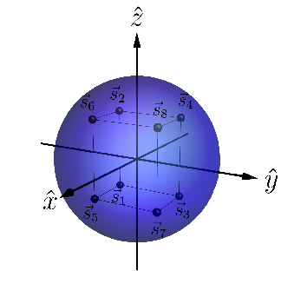
Generalization to three measurements
In any operational theory, if one can find a triple of measurements, and a state that satisfies the condition of , then noncontextuality implies that
Example of
in qubit theory:
25/27
Notes:
Noise robust. It can be tested experimentally.
So the UR it’s a NC inequality. It’s not about a single state as you could pick any in the A12 orbit realizability.

