Slide 1
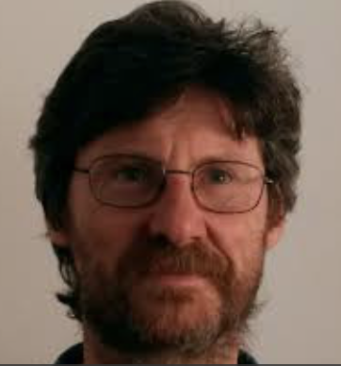
ordering kinetics with long-range interactions
Work with:
Paolo Politi (Institute for Complex Systems, Florence - CNR)
Eugenio Lippiello (Vanvitelli University, Naples)
Manoj Kumar, Alessandro Iannone
Summary:
Overview nearest neighbours
New results beyond n.n.
Both WLR and SLR
Didascalia
Didascalia

Slide 2
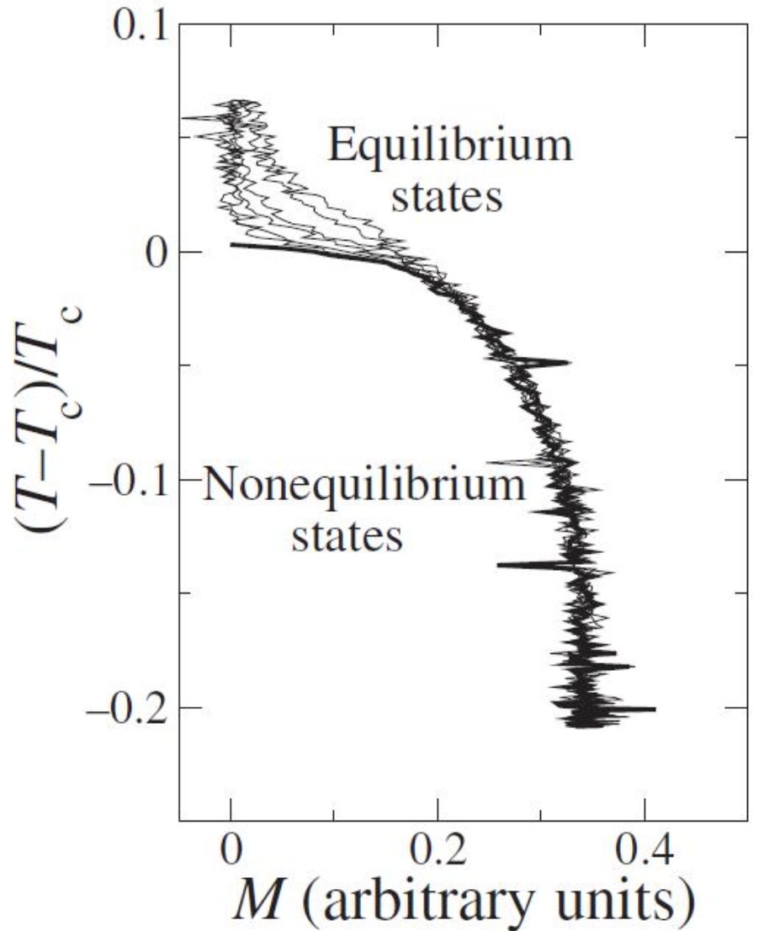
Equilibrium
T
$$T_{c}$$
m
Didascalia

Slide 3
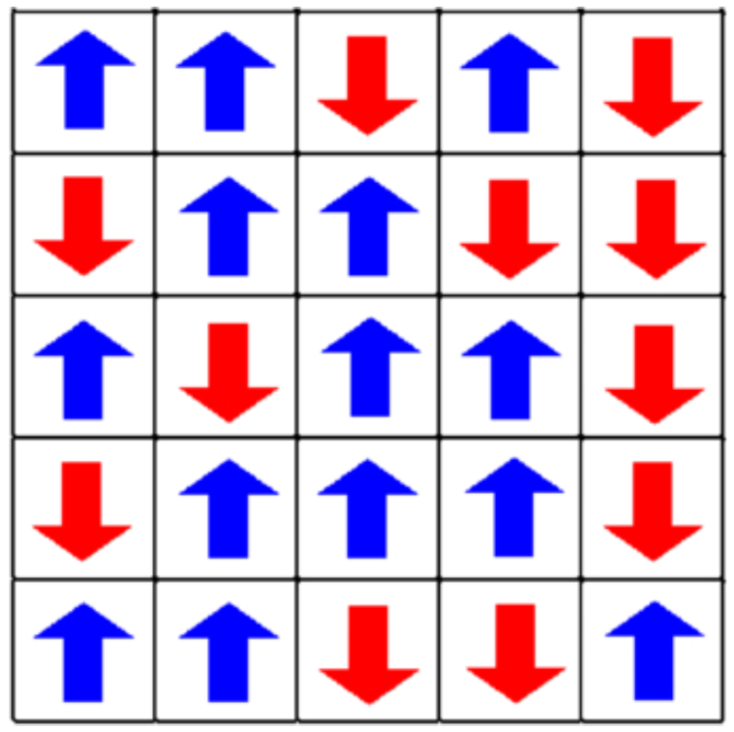
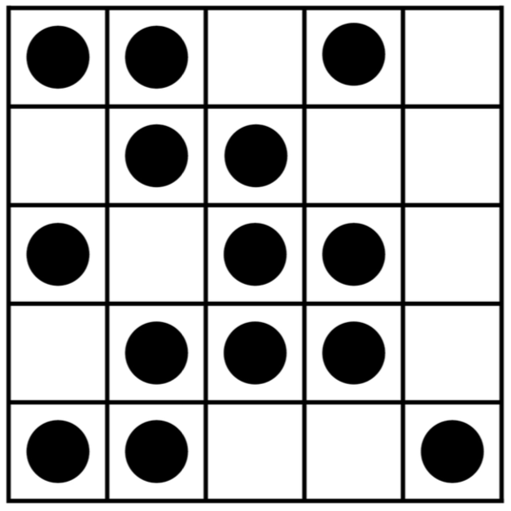
Magnets, gas-lattices and binary systems
Didascalia
Didascalia

Slide 4
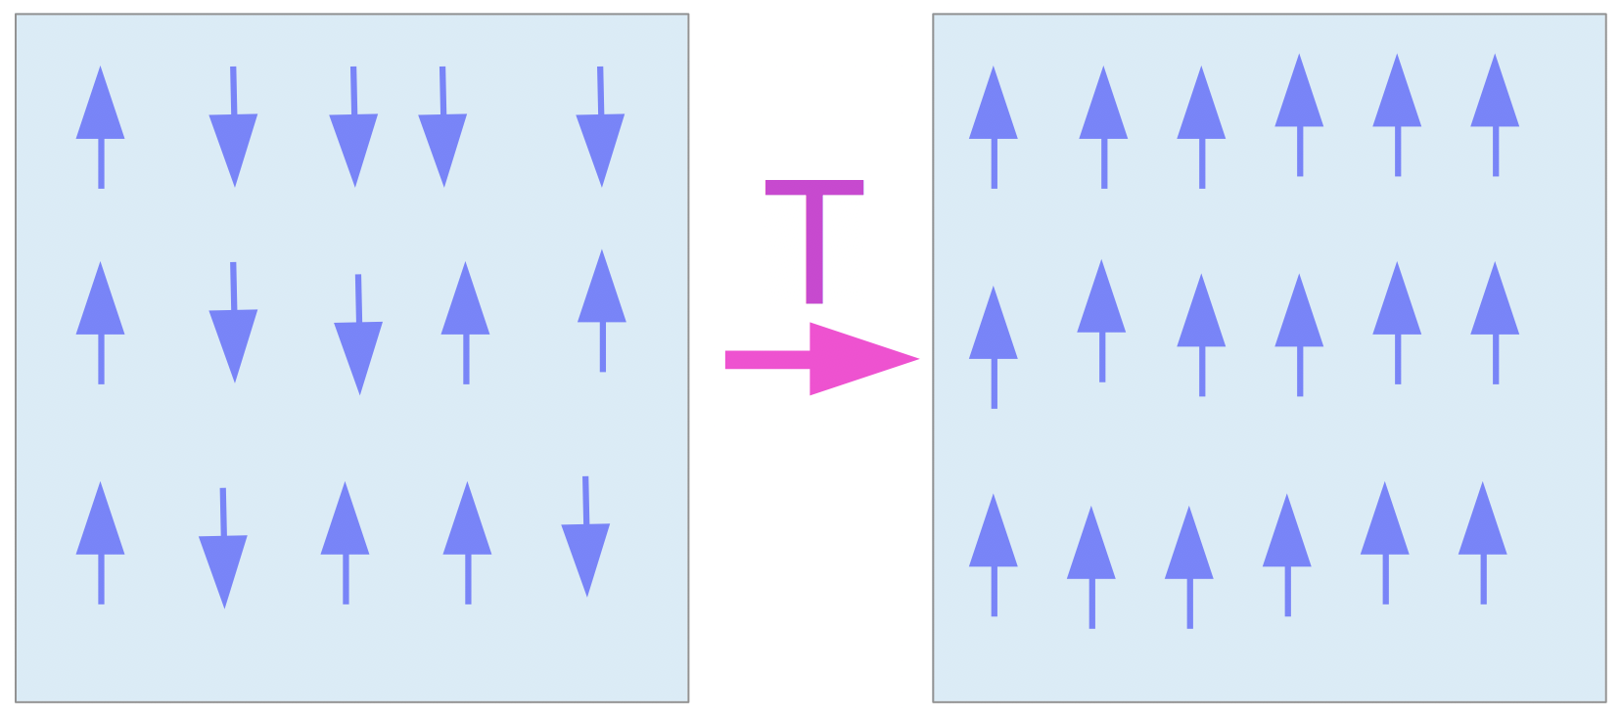
non-equilibrium Dynamics (quench)
T
$$T_{c}$$
m

Slide 5
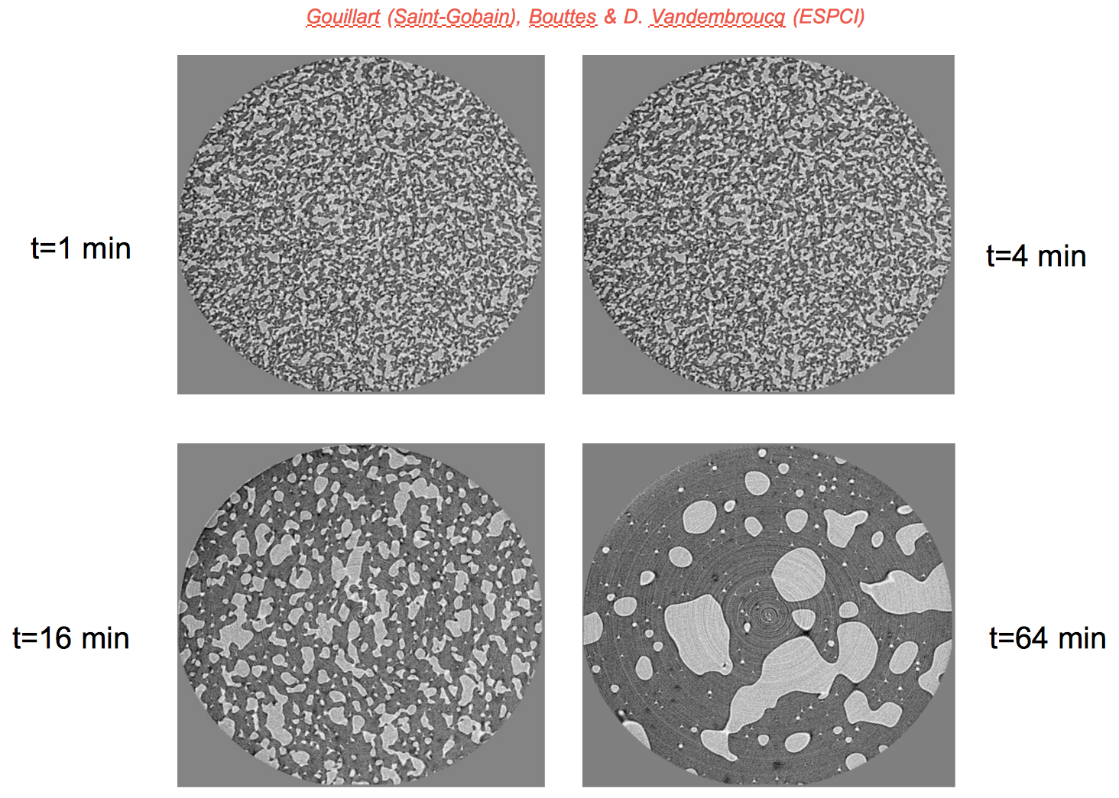
non-equilibrium Dynamics: coarsening after a Quench
Didascalia

Slide 6
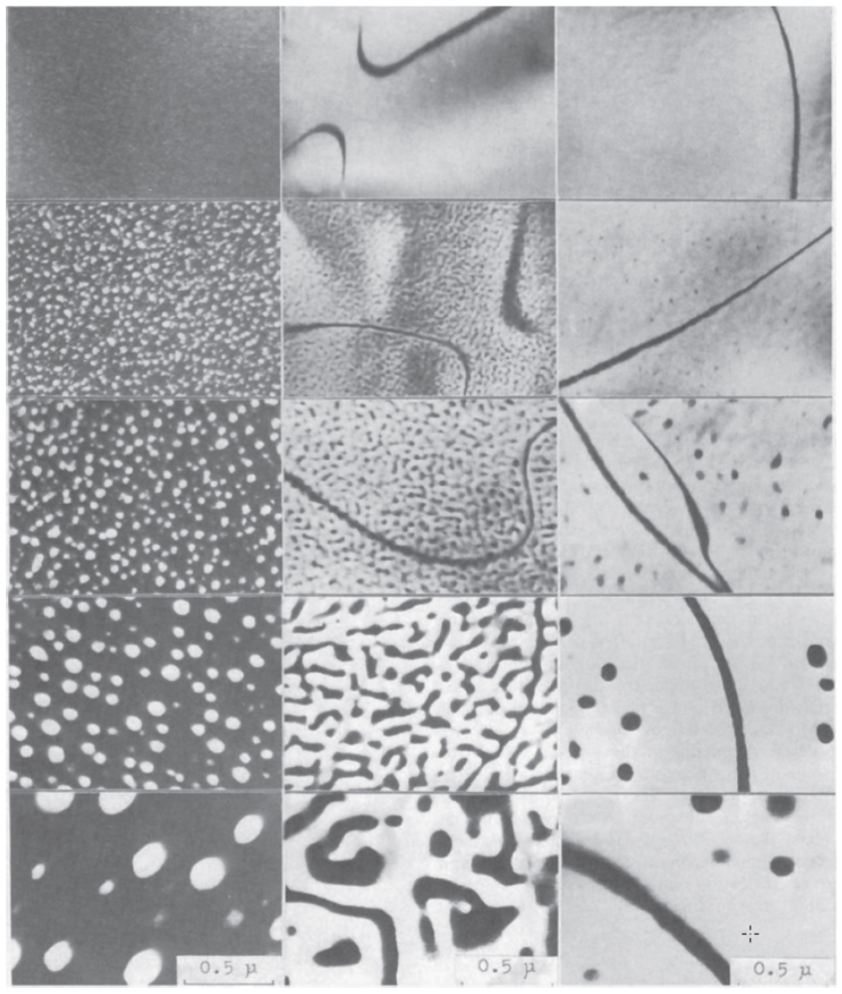
Non-equilibrium dynamics: Quench
Didascalia

Slide 7
Practical and fundamental interests
Mesoscopic structure affects properties of phase-ordering or phase-separating materials (e.g. Opto-mechanical properties in glasses).
Cooling rates effects on the density of topological defects in condensed matter and cosmology.
Simple instance of dynamics across a phase transition.
Many other.

Slide 8
Goals
Understanding dynamical scaling.
Role played by initial condition, cooling rate, range of interactions, short time dynamics.
Full geometric characterization of the growing structure.
Build a theory.
Others.

Slide 9
Discrete models
$$-H(\{s_{i}\})=\underset{i}{∑}\underset{\overset{⃗}{r}}{∑}J(r)s_{i}s_{i+\overset{⃗}{r}}$$
$$ω_{↑↓}$$
$$\frac{ω_{↑↓}}{ω_{↓↑}}=e^{-βΔE}$$
NCOP

Slide 10
continuum models
$$H[ϕ]=∫d\overset{⃗}{x}\left[(∇ϕ)^{2}+V(ϕ)\right]+∫d\overset{⃗}{x}∫d\overset{⃗}{r}J(r){\left[ϕ(\overset{⃗}{x}+\overset{⃗}{r})-ϕ(\overset{⃗}{x})\right]}^{2}$$
$$\frac{∂ϕ}{∂t}=-Γ\frac{∂H}{∂ϕ}+η$$
NCOP
$$\frac{∂ϕ}{∂t}=-∇J=-∇Γ\left[-∇\frac{∂H}{∂ϕ}\right]+η=Γ∇^{2}\frac{∂H}{∂ϕ}+η$$
COP

Slide 11
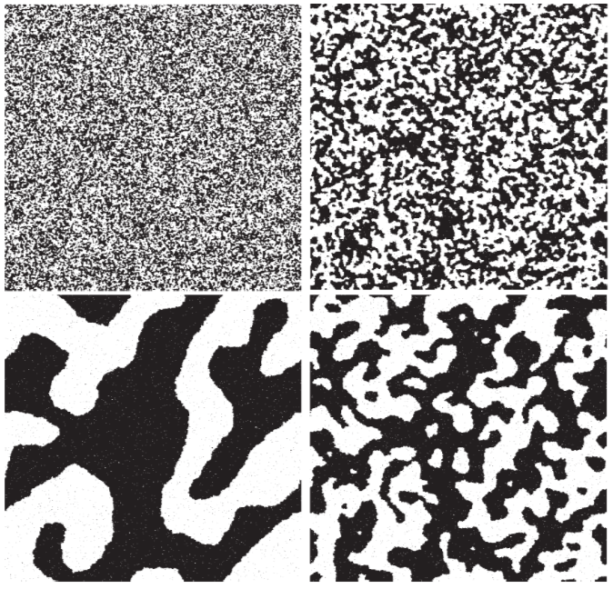
next nearest neighbour
$$(J(r)=Jδ_{r,1})$$
$$L(t)∼t^{1/2}$$

Slide 12
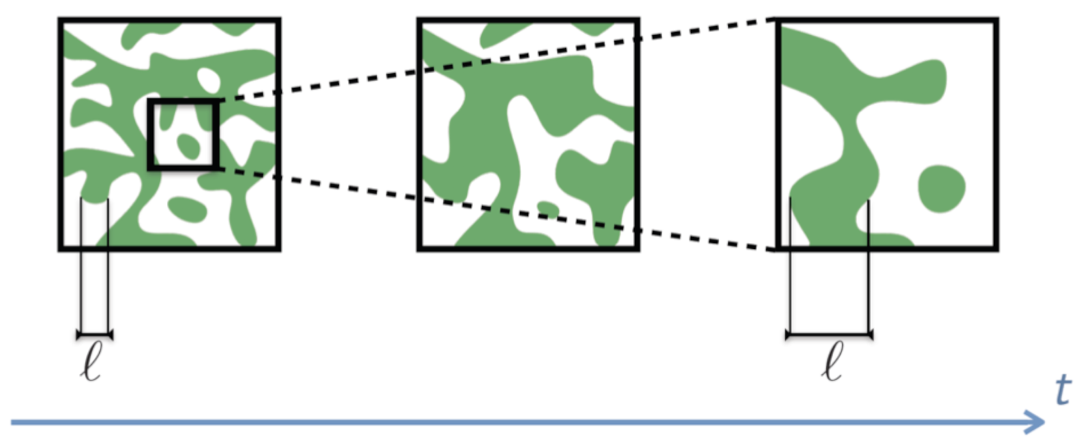
Dynamical scaling
L(t)
L(t)
Didascalia
At late times there is a single relevant length-scale L(t) the typical size of domains and the domain structure is independent (in statistical sense) of time when lengths are measured in units of L(t).

Slide 13
Meaning of dynamical scaling
At late times there is a single relevant length-scale L(t) the typical size of domains and the domain structure is independent (in statistical sense) of time when lengths are measured in units of L(t).
$$G(r,t)=⟨s_{i}(t)s_{i+\overset{⃗}{r}}(t)⟩≃m^{2}g\left(\frac{r}{L(t)}\right)$$
G(r,t)
t₁
t₂>t₁
$$G(r,T)=r^{d-2+η}g\left(\frac{r}{ξ(T)}\right)$$
r/L(t)
r

Slide 14
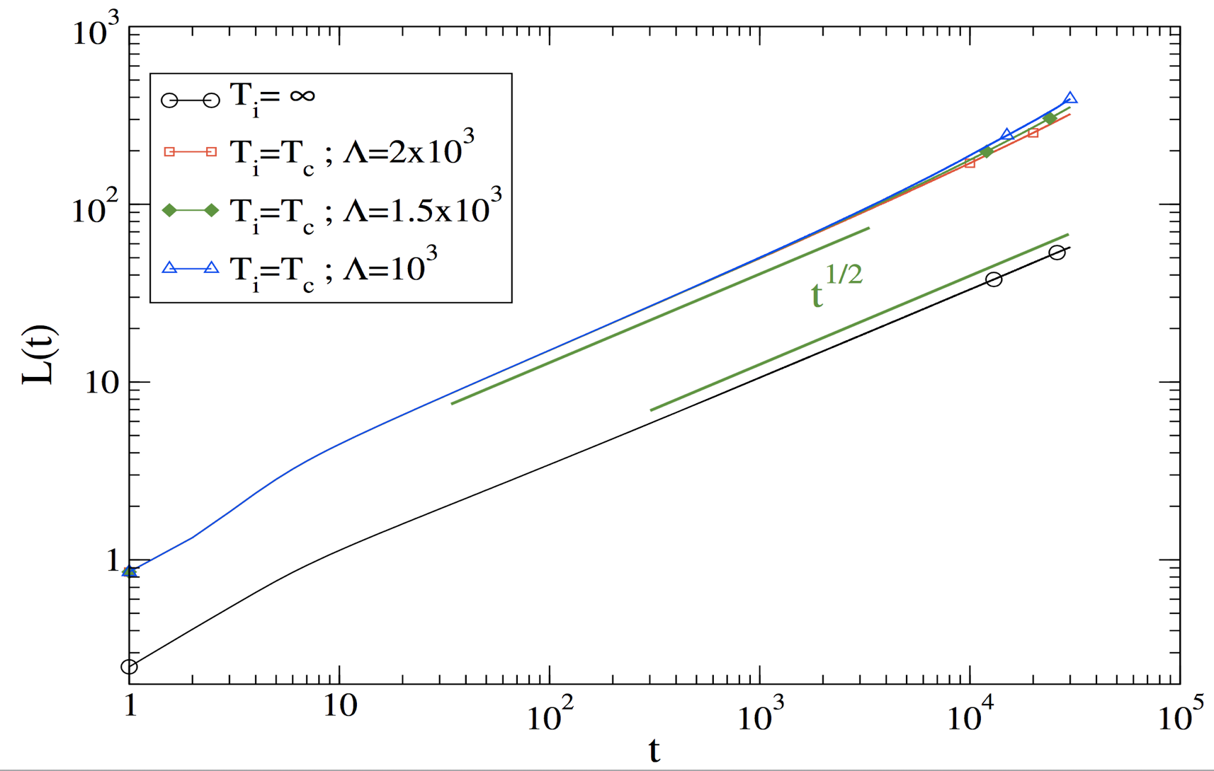
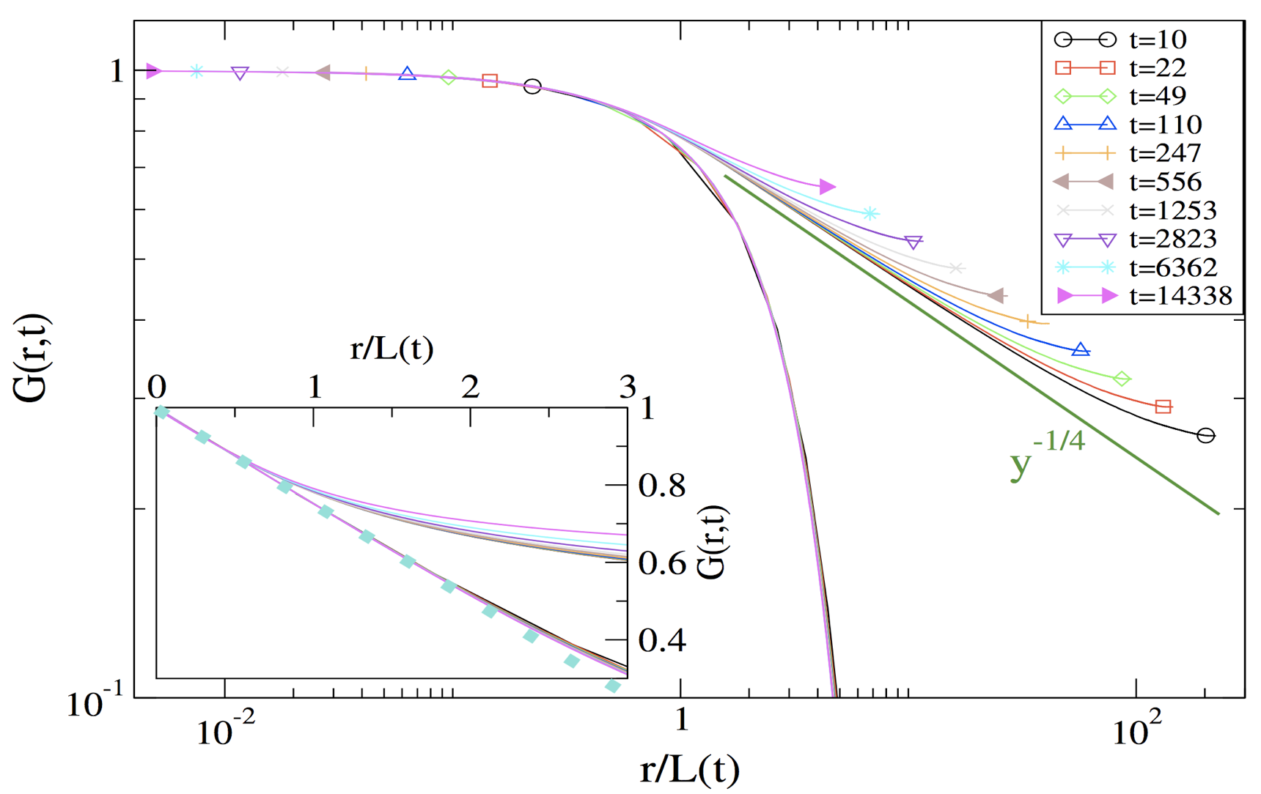
Dynamical scaling: numerics
Didascalia
Didascalia
Didascalia

Slide 15
Ncop: curvature driven (d>1)
$$v∝-K∝\frac{1}{r}$$
$$v∝\frac{dr}{dt}$$
$$t(L)∝L^{2}⇒L(t)∝t^{1/2}$$
r
Lifschitz - Cahn - Allen

Slide 16
COP: Evaporation-condensation (d>1)
r2
$$ρ_{2}∼ρ_{0}+\frac{k}{r_{2}}$$
$$ρ_{2}-ρ_{1}∝\frac{1}{L}$$
Using scaling
J
Gibbs-Thomson
or
Gibbs-Kelvin
$$J=∇ρ∝\frac{ρ_{2}-ρ_{1}}{L}$$
Using scaling
again
$$⇒J∝\frac{1}{L^{2}}$$
$$ρ_{1}∼ρ_{0}+\frac{k}{r_{1}}$$
$$\frac{dV}{dt}=-JΣ$$
Compact domains
r1
$$t(L)∝L^{3}⇒L(t)∝t^{1/3}$$
Lifshitz-Slyozov

Slide 17
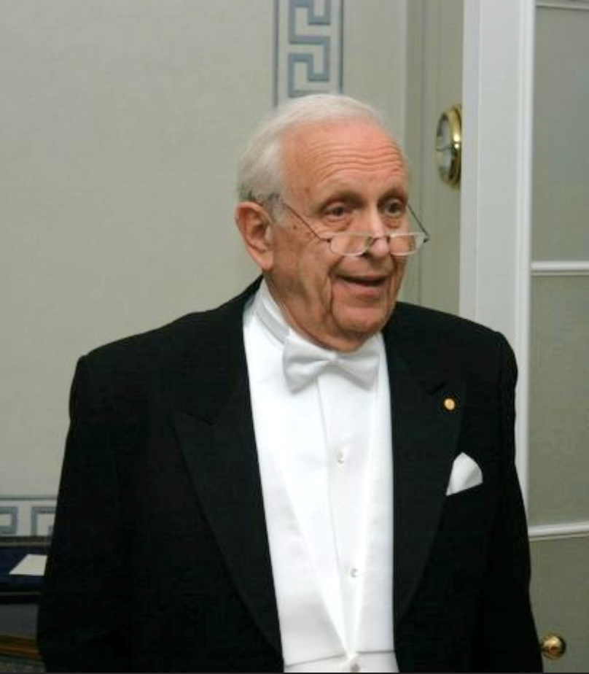
d=1, exact solution (n.N.)
$$ω_{↑↓}=\frac{1}{2}\left[1-tanh\left\{\frac{β}{2}ΔE\right\}\right]$$
Roy J. Glauber
but not for d>1, nor for J(r)

Slide 18
NCOP d=1(N.N.) Physical mechanism at low T
$$⇒L(t)∝t^{1/2}$$
t

Slide 19
COP d=1(N.N.)Physical mechanism at low T
L
p=1-1/L
p=1/L
$$⇒D(L)∝1/L$$
$$⇒L^{2}=2D(L)t⇒L(t)∝t^{1/3}$$
t

Slide 20
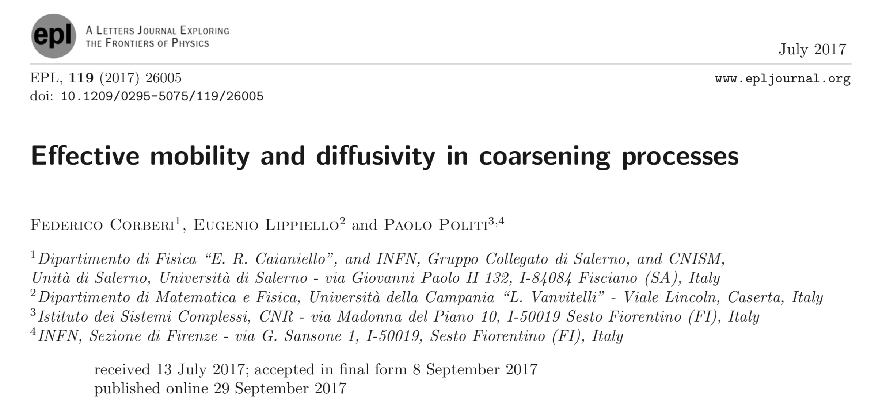
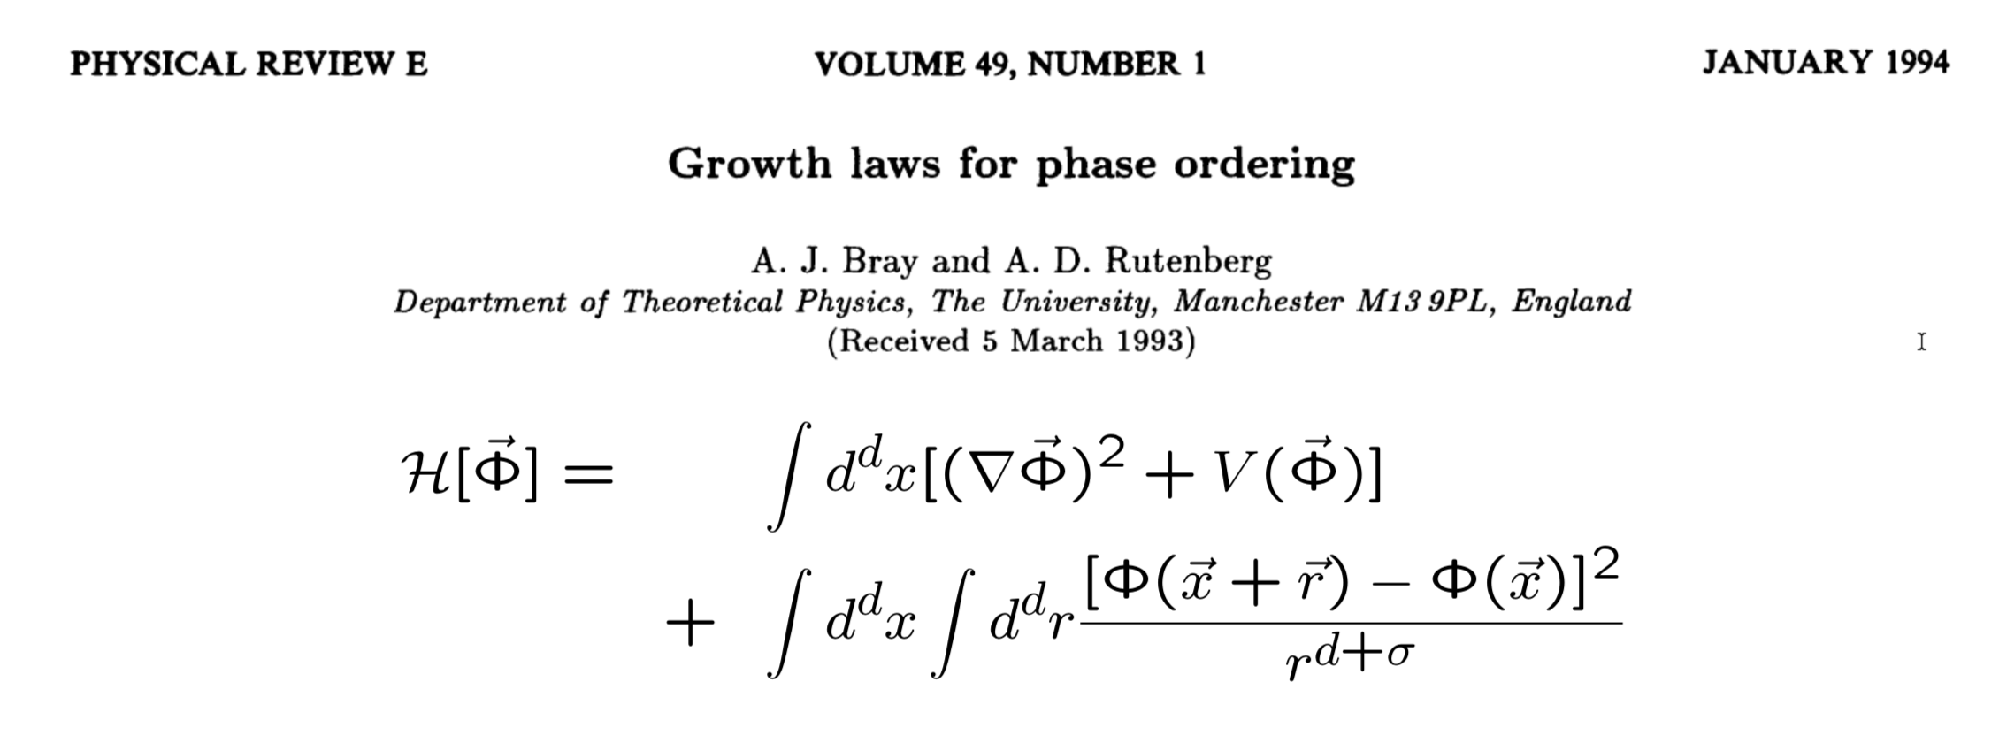
Beyond nearest neighbours (second part: new results, 1D)
{
$$J_{0}e^{-r/R}$$
$$H(\{s_{i}\})=\underset{i}{∑}\underset{\overset{⃗}{r}}{∑}J(r)s_{i}s_{i+\overset{⃗}{r}}$$
$$J(r)=$$
$$\frac{1}{r^{d+σ}},σ>0$$
Only (well organised) results we to our knowledge
Didascalia
Didascalia

Slide 21
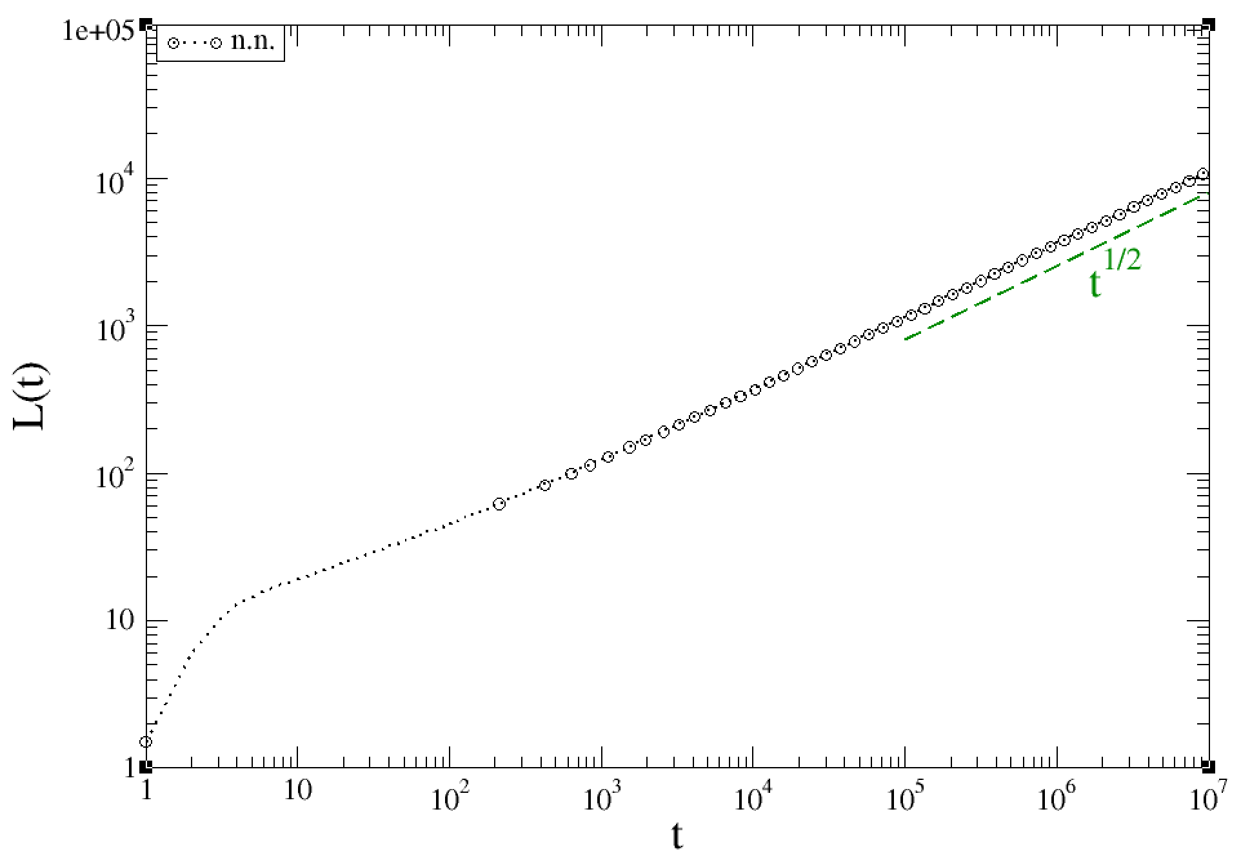
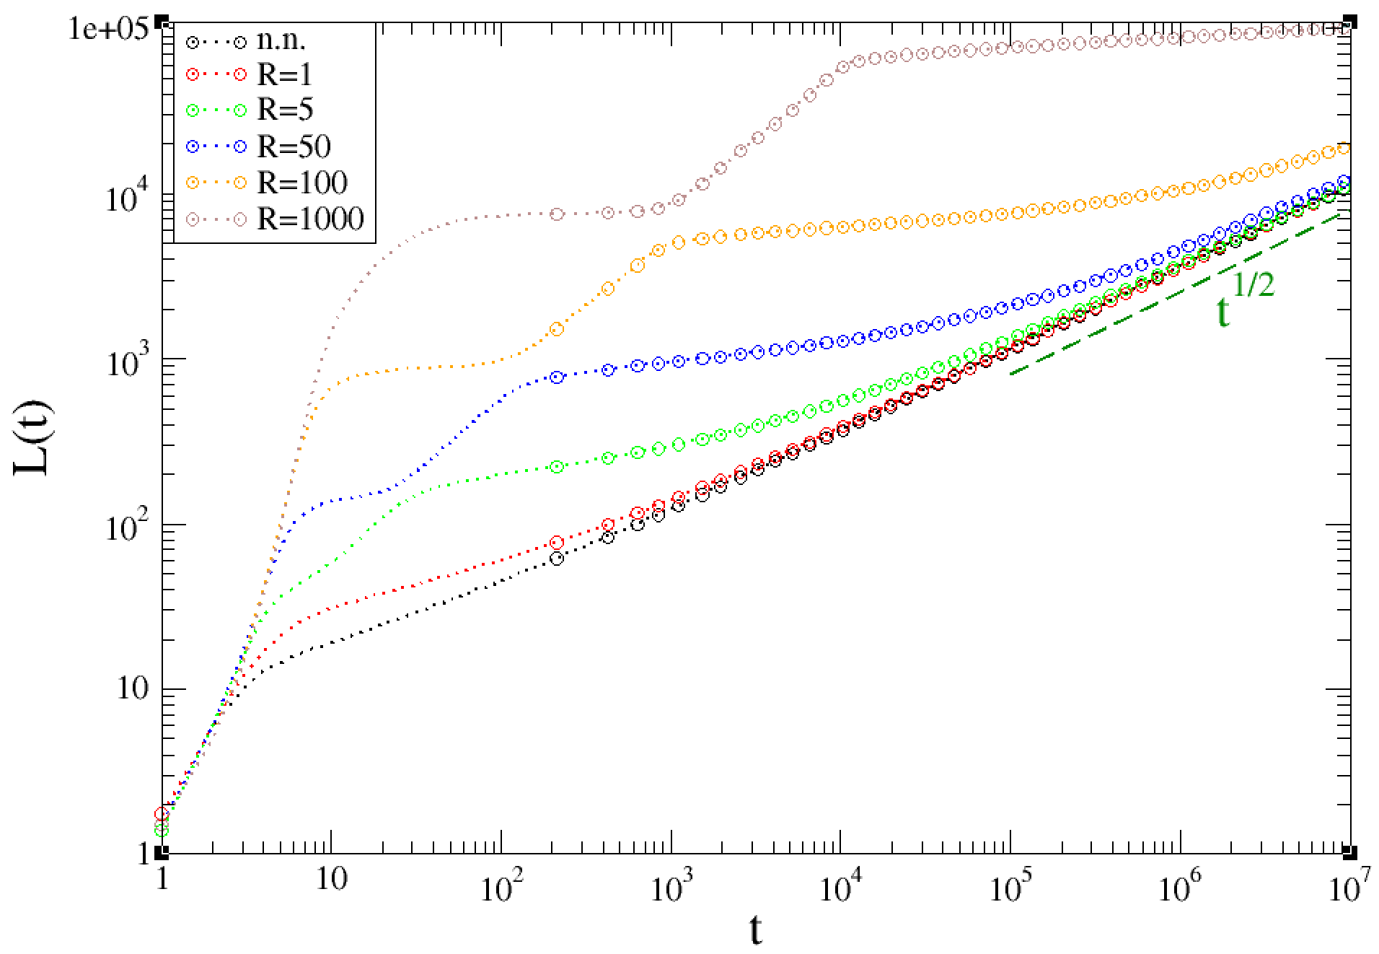
short range beyond n.n. (NCOP)
$$J(r)=J_{0}e^{-r/R}$$
Late
Early
NCOP
Didascalia
Didascalia

Slide 22
early Mean field regime (L<<R)
$$H(\{s_{i}\})=\underset{i}{∑}\underset{\overset{⃗}{r}}{∑}J(r)s_{i}s_{i+\overset{⃗}{r}}→-J_{0}m\underset{i}{∑}s_{i}$$
$$\frac{dm}{dt}=W\left[-m+tanh\left(βJ_{0}m\right)\right]$$
$$m_{eq}=tanh\left(βJ_{0}m\right)$$
$$|m(t)-m_{eq}|∝e^{-t/τ}$$
$$τ=W(tanhm_{eq})^{-2}$$
Didascalia
$$L(t)=\frac{2}{(1+m)(1-m)}$$

Slide 23
Late stages: Analytic strategy
L
Closure time t(L)
Invoking scaling get L(t) by reversing t(L)

Slide 24
Analytic calculation (L>R)
J(r)
drift
L
$$⇒t(L)=\frac{L}{v}tanh\left(\frac{vL}{2D}\right)$$
Convection-diffusion eq.
$$v=v_{0}tanh\left(\frac{βΔE(L)}{2}\right)$$
diff. coeff.
$$ΔE(L)=4∫_{L}^{∞}J(r)dr$$
get L(t) by reversing t(L)

Slide 25
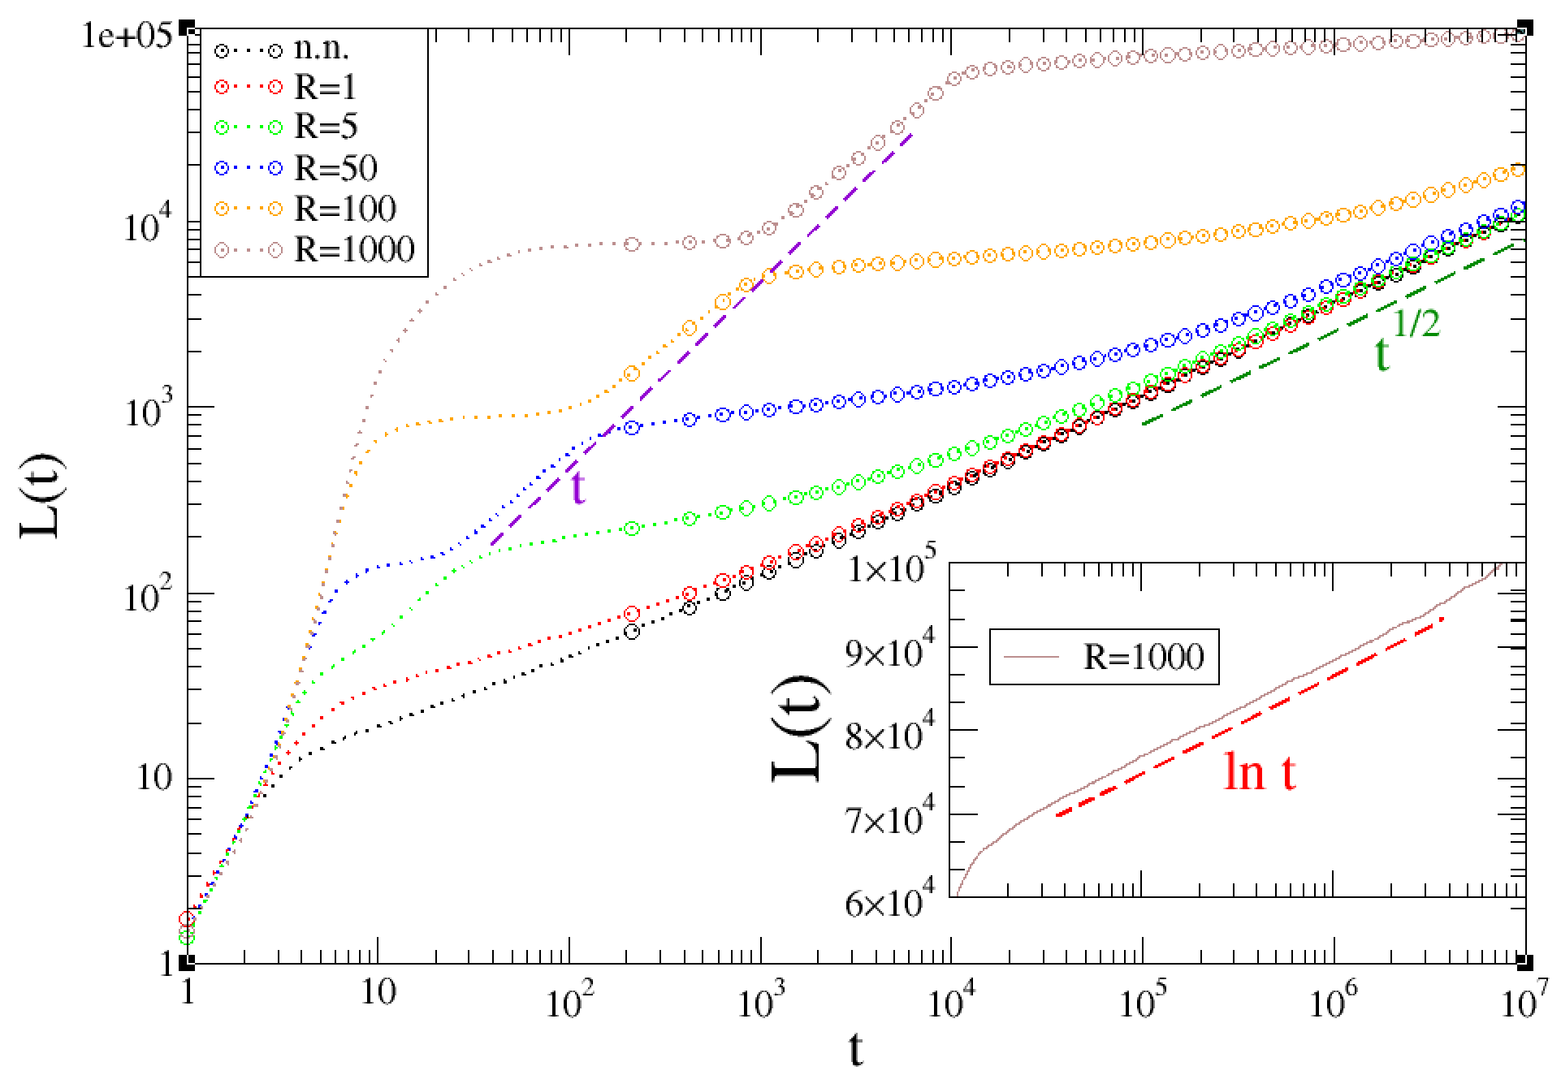
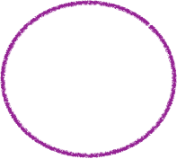
dynamical regimes
(after Mean field)
Name
When
Growth-law
Ballistic
$$2D/v_{0}≪L(t)≪Rln(2βJ_{0}R)$$
$$L(t)≃v_{0}t$$
Logarithmic
$$Rln(2βJ_{0}R)≪L(t)≪Rln[βJ_{0}v_{0}D^{-1}R^{2}ln(2βJ_{0}R)]$$
$$L(t)≃R(a+lnt)$$
Diffusive
$$L(t)≫Rln[βJ_{0}v_{0}D^{-1}R^{2}ln(2βJ_{0}R)]$$
$$L(t)=\sqrt{2Dt}$$
Didascalia

Slide 26
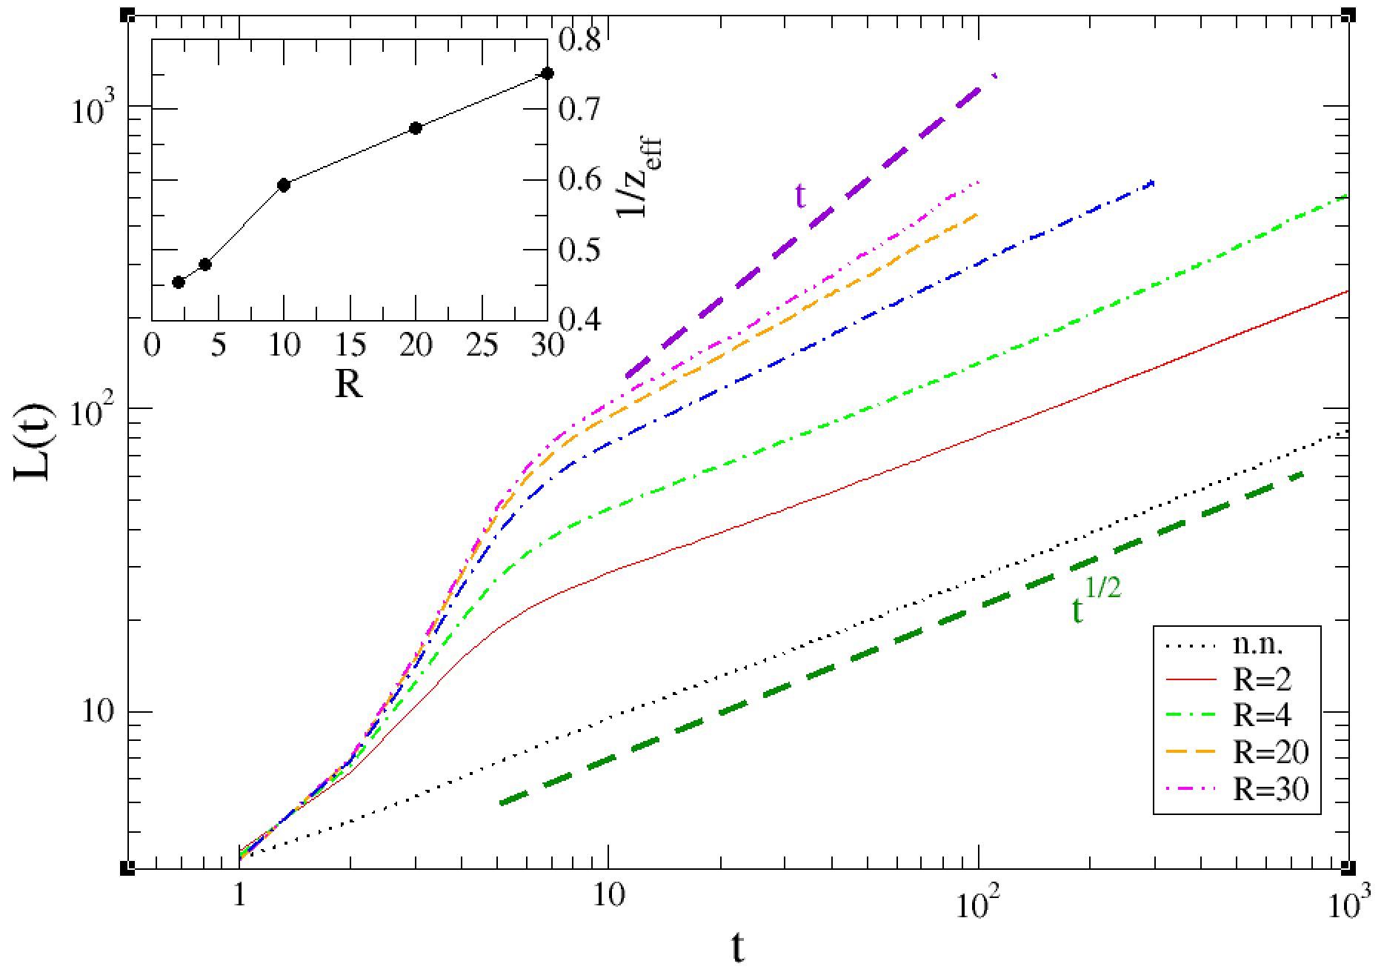
Dimension d>1
Didascalia

Slide 27
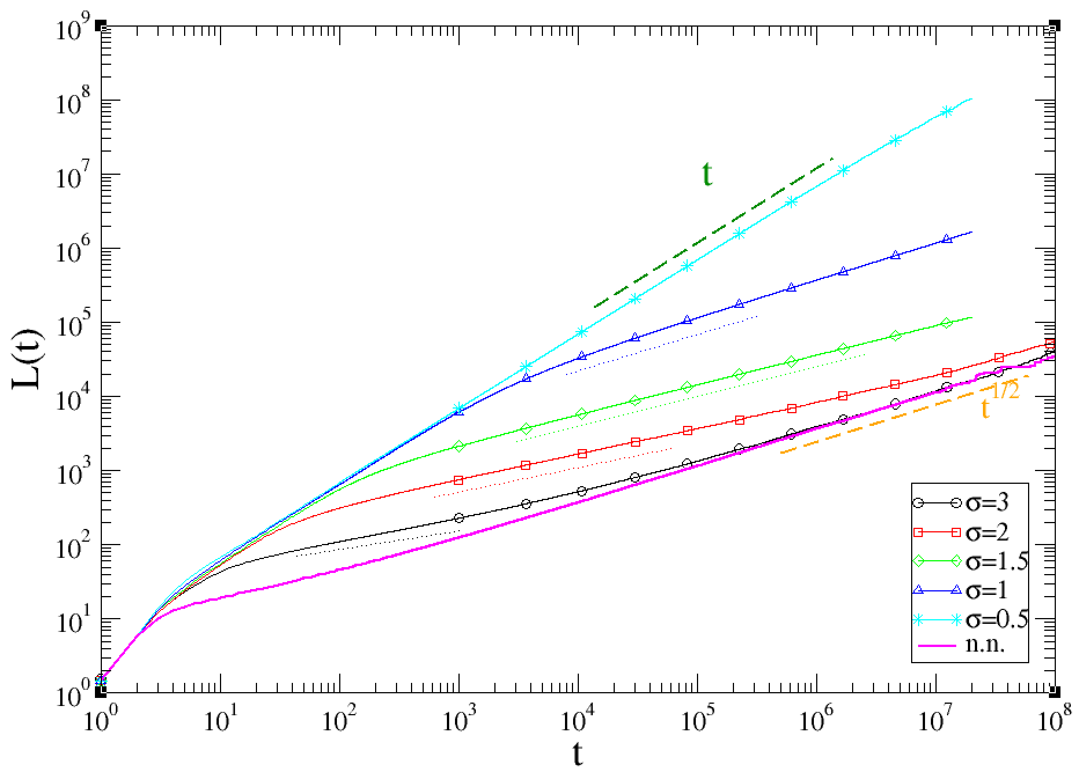
weak Long-range interactions
$$J(r)=r^{-α}=r^{-(1+σ)},α>d$$
(WLR)
$$t^{*}≃β^{1/σ}$$
$$t^{*}≃β^{1/(σ-1)}$$
Ballistic
Power
Diffusive
$$(σ>1)$$
t
$$L(t)∼t^{\frac{1}{1+σ}}$$
$$∞$$
$$T_{c}$$
$$ifσ≤1$$
Equilibrium
$$1$$
$$σ$$
Didascalia

Slide 28
strong Long-range interactions
$$J(r)=r^{-α}=r^{-(1+σ)},α≤d$$
Mean Field
$$α=0$$
m
Spins align with global magnetisation m(t)
Feedback on magnetisation
1
t
Exponential convergence of m(t) to equilibrium value
No formation of domains

Slide 29
strong Long-range interactions
$$J(r)=r^{-α}=r^{-(1+σ)},α≤d$$
$$0<α≤1$$
Two kind of configurations
Mean-field like
(no domains)
Coarsening
(with domains)
Relative abundance regulated by $α$

Slide 30
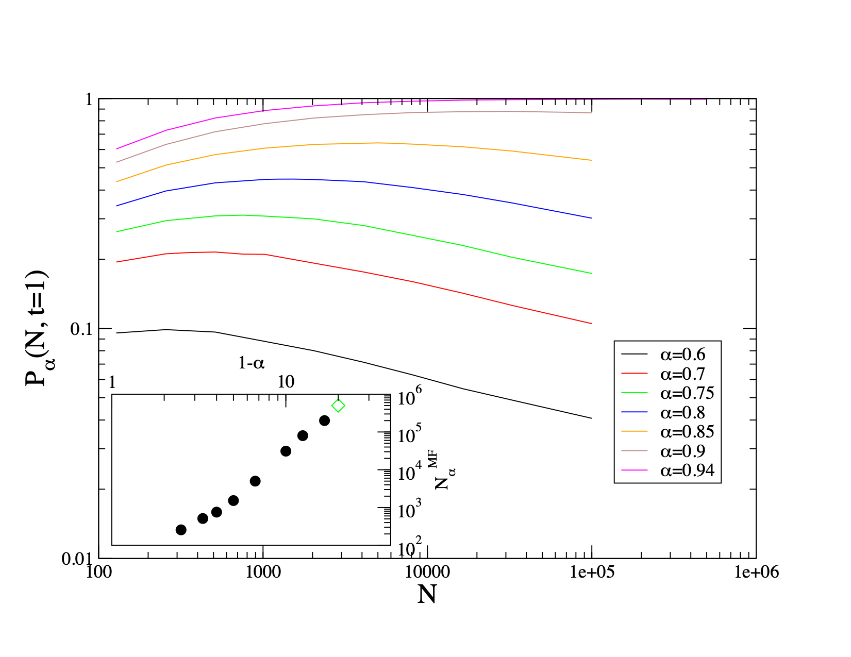
Meaning of
statistical
averages ?
$$\lim_{α→1}\lim_{N→∞}P_{α}(N)≠\lim_{N→∞}\lim_{α→1}P_{α}(N)$$

Slide 31
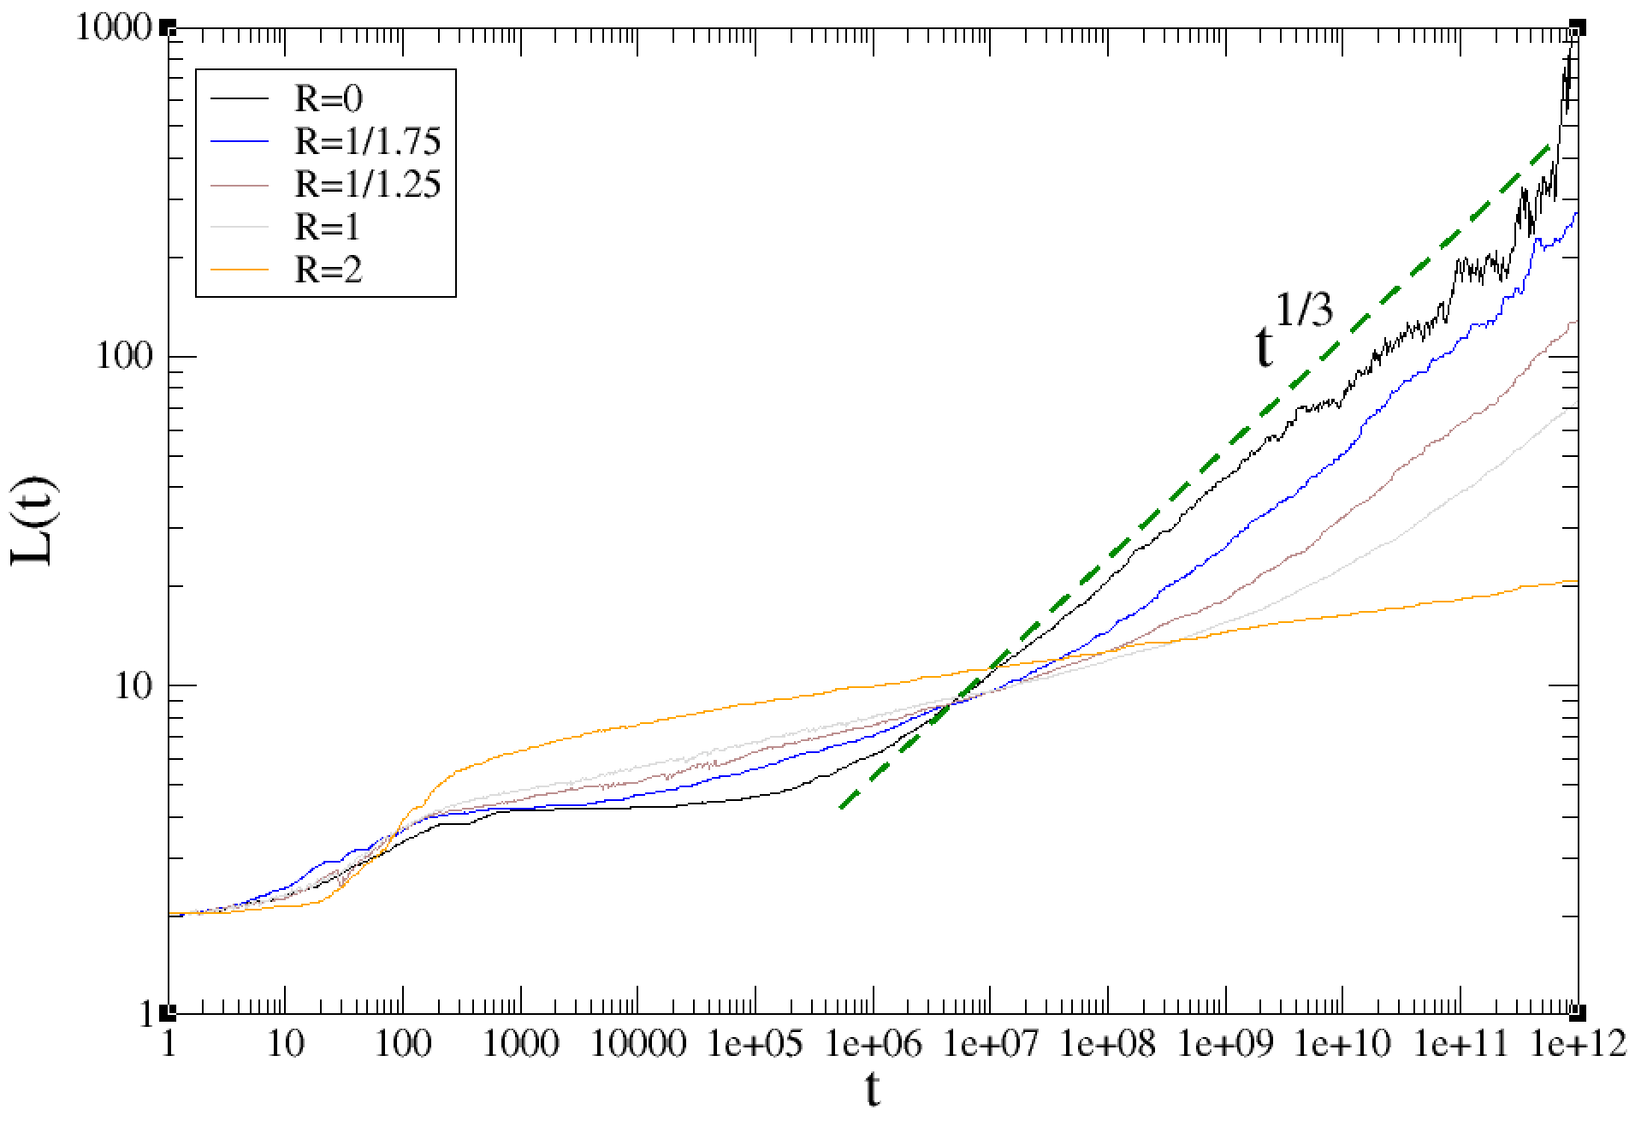
cop: short range beyond N.N.
early Mean field regime (L<<R)
$$J(r)=J_{0}e^{-r/R}$$
$$H(\{s_{i}\})=\underset{i}{∑}\underset{\overset{⃗}{r}}{∑}J(r)s_{i}s_{i+\overset{⃗}{r}}→-J_{0}m\underset{i}{∑}s_{i}$$
$$\underset{i}{∑}s_{i}=const.$$
$$⇒L(t)=\text{const.}$$
Didascalia

Slide 32
late stage regime (l>R)
Backdrift -v
L
x
$$p=1-2D(L)$$
$$p=2D(L)$$
$$p(x,L)=\frac{e^{\frac{vx}{D}}-1}{e^{\frac{vL}{D}}-1}$$
$$⇒2D(L)=p(1,L/2)$$
$$v=v_{0}tanh\left(\frac{βΔE(x,L)}{2}\right)$$
$$⇒v=v_{0}\frac{2}{L}∫_{0}^{L/2}tanh\left(\frac{βΔE(x,L)}{2}\right)dx$$

Slide 33
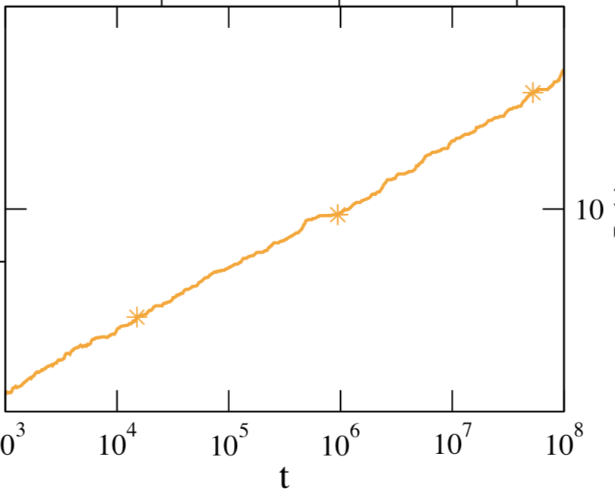
dynamical regimes
(after Mean field)
Name
When
Growth-law
Ballistic
Never
$$L(t)≃v_{0}t$$
Logarithmic
$$L(t)≃blnt$$
Diffusive
$$L(t)=ct^{1/3}$$
Didascalia
Didascalia

Slide 34
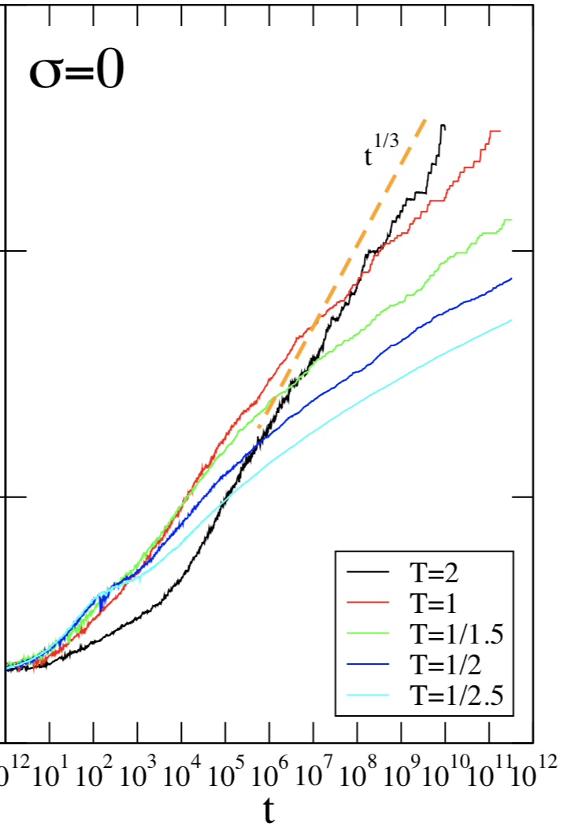
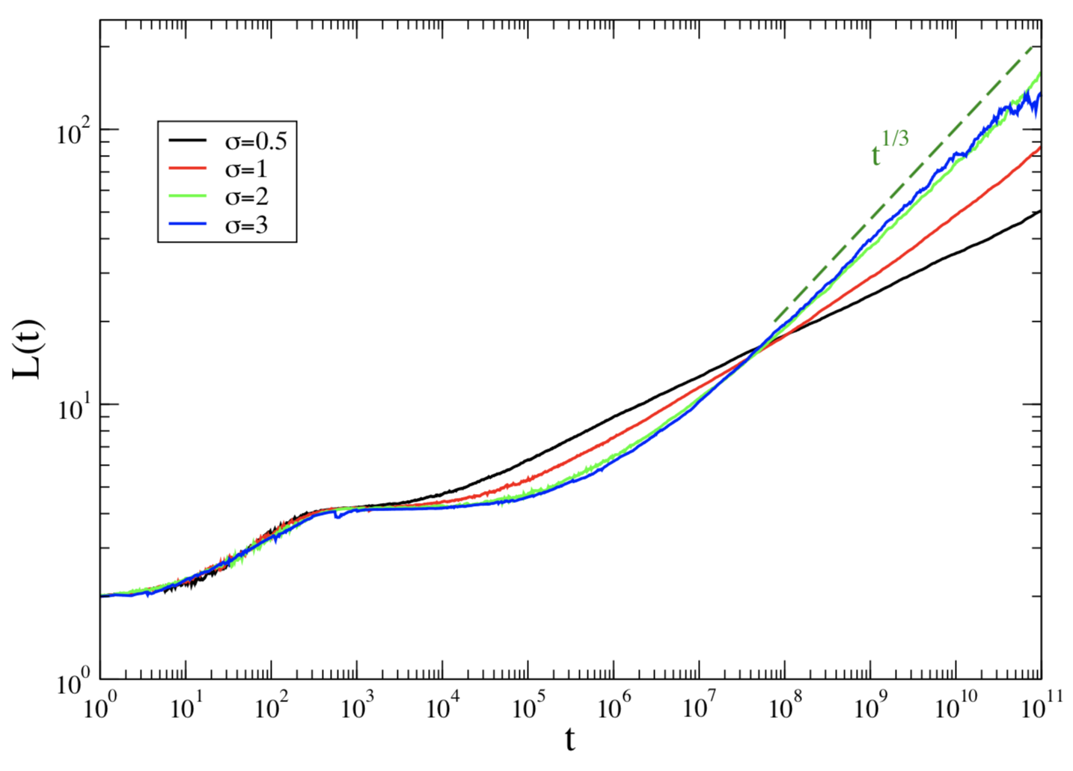
long-range interactions cop
$$J(r)=r^{-(1+σ)}$$
Name
When
Growth-law
Ballistic
$$L(t)≃v_{0}t$$
Never
Logarithmic
$$L(t)≃R(a+lnt)$$
Never
$$t=c\frac{L^{3+\frac{βv_{0}JJ_{0}}{2D}}}{lnL}$$
$$σ=0$$
Diffusive
$$L(t)=bt^{1/3}$$
Didascalia
Didascalia

Slide 35
conclusions
Integrable long-range interactions modify the process only at a quantitative level (exponents)
Non-integrable ones profoundly change the physics already at a qualitative level - two kids of behaviours coexist in the statistical ensemble: mean-field like and coarsening.
In the latter case, quite a bit remains to be understood.
Thank you

