Slide 1

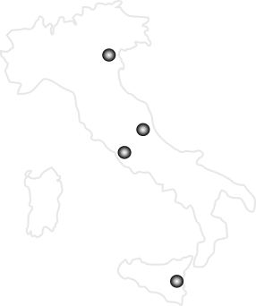

Nuclear Physics Mid Term Plan in Italy
LNL – Session
Legnaro, April 11th-12th 2022
Nucleosynthesis up to the Iron peak
Antonio Caciolli
University and INFN of Padova, Italy

Slide 2


Nucleosynthesis up to the iron peak
Antonio Caciolli
outlook
Big Bang Nucleosynthesis
p(d,γ)³He
d(d,p)³H
d(d,n)³He
⁷Be(d,α)⁵Li
¹²C production and Hoyle state
¹⁴N(d,α)¹²C
⁴He(¹²C,¹²C*)⁴He
⁹Be(α,n)¹²C
⁴He(nn,γ)⁶He
Deuterium abundance
Lithium-7 problem
Stellar Burning
¹⁴N(p,γ)¹⁵O Solar Composition Problem
¹³N(p,γ)¹⁴O HOT CNO in Nova explosions
²⁰Ne(α,α’)²⁰Ne for the ¹²C+¹²C burning
¹⁶O+¹⁶O
Radioactive nuclei
observed in the Galaxy: the ²⁶Al case
²⁶Al^{m}(n,p)²⁶Mg and ²⁶Al^{m}(n,p)²⁶Mg
²⁶Al^{m}(p,γ)²⁷Si

Slide 3
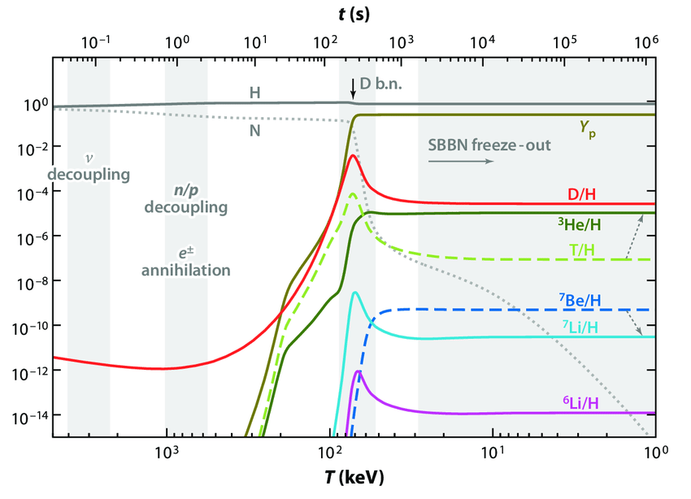
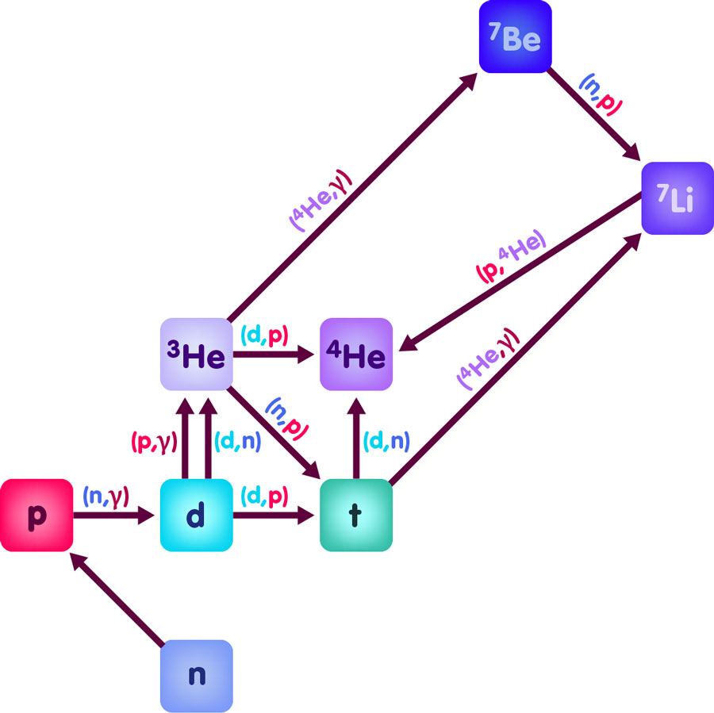

Nucleosynthesis up to the iron peak
Antonio Caciolli
Text
Big Bang Nucleosynthesis
BBN occurs 3 minutes after Big Bang
After BBN we have mainly H and ⁴He plus small amounts of D, ³He, ⁶Li and ⁷Li
Notes:
Soon after the Big Bang in our Universe we have mainly neutrons and protons, as a consequence of the expansion the temperature of the Universe decreases and roughly 3 min after BB the nucleosynthesis can start and proceed through this network of reactions whose bottleneck is deuterium since it has a very low binding energy; the result of primordial nucleosynthesis is mainly the production of H and 4He plus small amounts

Slide 4
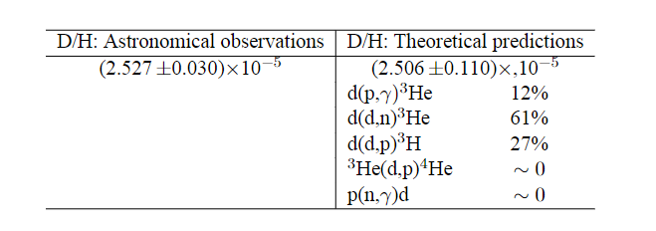
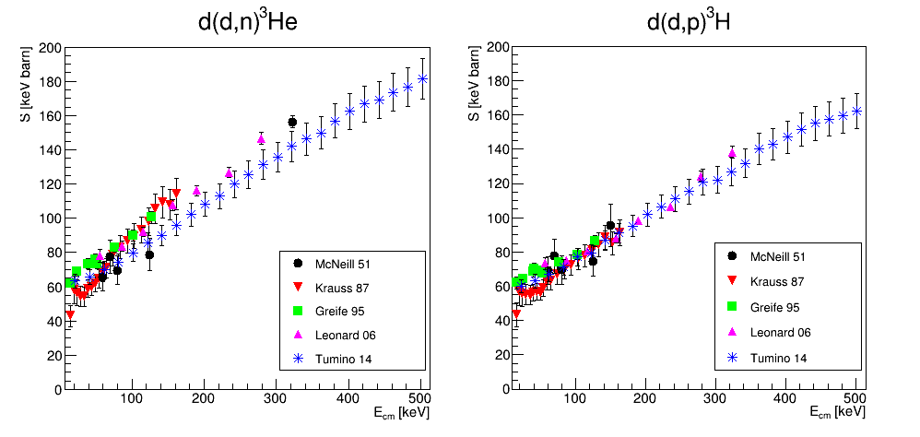
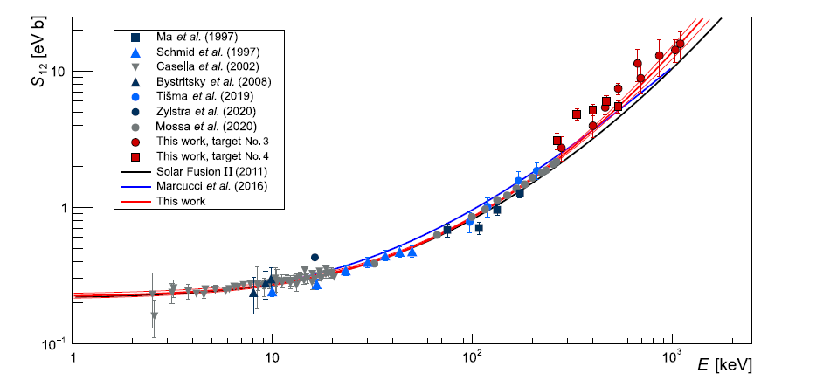
Nucleosynthesis up to the iron peak
Antonio Caciolli
Text
Big Bang Nucleosynthesis: the d abundance
The uncertainty on [D/H]_{BBN} is related to the knowledge of the reactions involved in the deuterium production and distruction
The uncertainty on [D/H]_{BBN} is dominated by the uncertainty on the d(d,n)³He and d(d,p)³H S-factors
Yeh, Olive and Fields, JCAP03 046 (2021)
d(p,γ)³He
PHASE B/C
Link to the activity of LNS (see Rapisarda slide)

Slide 5
Nucleosynthesis up to the iron peak
Antonio Caciolli
Text
Big Bang Nucleosynthesis: the d abundance
The uncertainty on [D/H]_{BBN} is related to the knowledge of the reactions involved in the deuterium production and distruction
The uncertainty on [D/H]_{BBN} is dominated by the uncertainty on the d(d,n)³He and d(d,p)³H S-factors
Yeh, Olive and Fields, JCAP03 046 (2021)
These reactions are of interest not only for astrophysics, but also for nuclear fusion
energy production, because they could be very suitable processes used to fuel magnetic- and inertial-confinement
fusion reactors. In particular, the accurate knowledge of the d+d reaction rates would clarify whether the neutron-
producing channel branching ratio is reduced in favor of the proton channel (H. Paetz gen. Schieck, EPJA 2010)
Microscopic ab-initio calculations (Marcucci et al. Front. Phys. 2020) are ongoing on those systems and experimental data on cross section and angular distribution are crucial to compare to theroretical predictions.
Those calculations are also moving to higher mass number, exploring A = 6 in this years and A = 7 in the future
Link to the nuclear structure working group

Slide 6
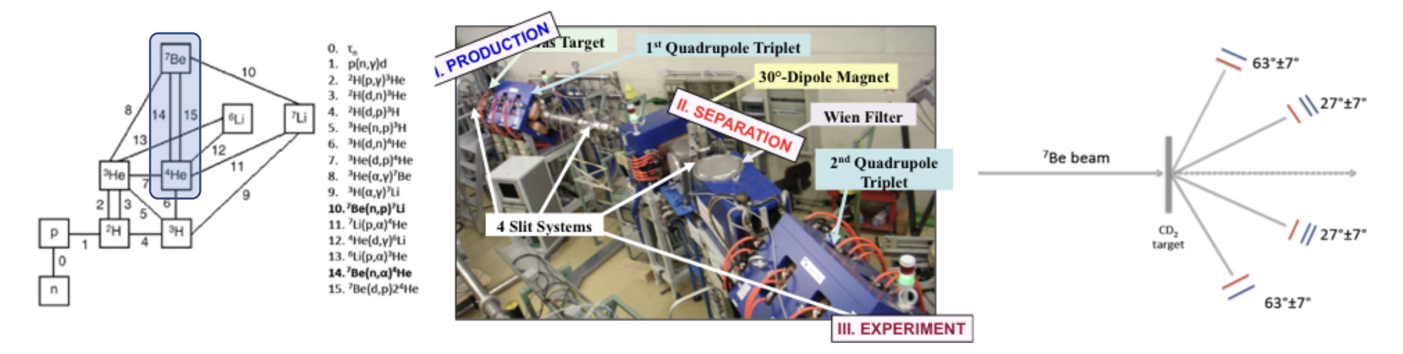
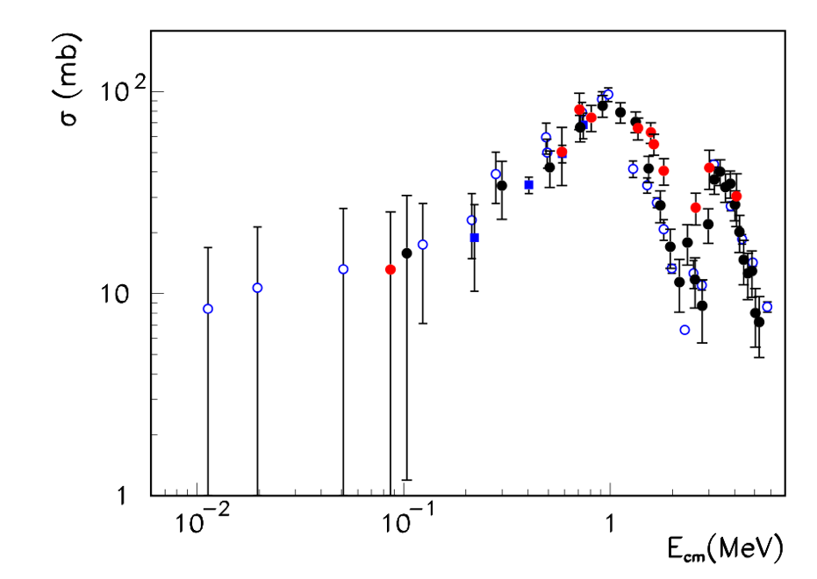
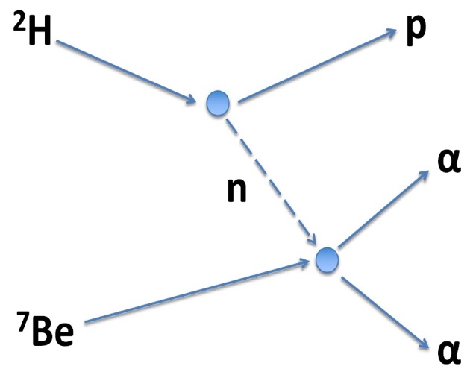
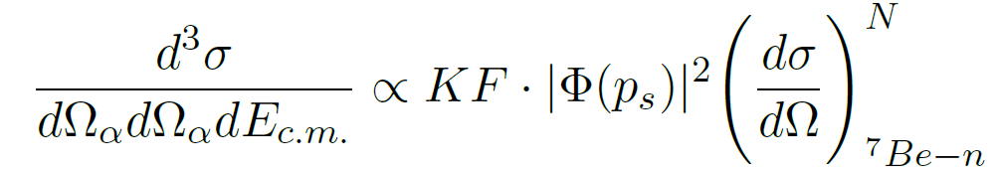
Nucleosynthesis up to the iron peak
Antonio Caciolli
Text
Big Bang Nucleosynthesis: the ⁷Li problem
Lamia et al. ApJ2017

Slide 7
Nucleosynthesis up to the iron peak
Antonio Caciolli
Text
Big Bang Nucleosynthesis: the ⁷Li problem
⁷Be(d,α)⁵Li reaction study via the Trojan Horse Method
⁶Li
α
Rijal et al. PRL 2019
d
α
Direct data partially cover BBN energies: influence of subthreshold state!
⁷Be
⁵Li
1) ⁷Be beam specifics:
10-15 MeV, 5*10^5 pps, 99% purity
2) ⁶LiF target:
200-400 ug/cm^2
3) Possible study of the ⁷Be(d,p)⁸Be reaction from the same data set
THM energies
Link to the activity of LNS (see Rapisarda and Pidatella slide)
PHASE B/C

Slide 8
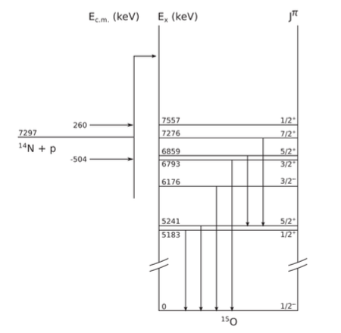
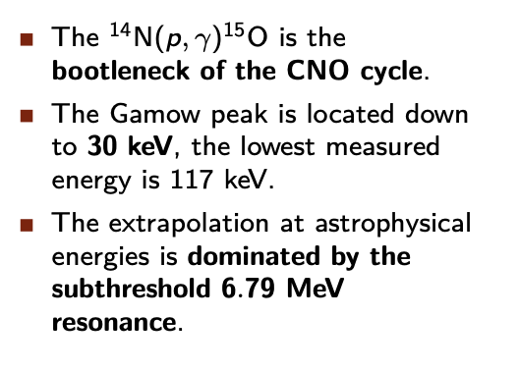
Nucleosynthesis up to the iron peak
Antonio Caciolli
Hydrogen Burning in the CNO: ¹⁴N(p,γ)¹⁵O
Text
Solar neutrinos play a significant role in constraining physical conditions in the interior of the Sun and are a unique tool to investigate its core composition.
Expected elemental abundances in the Sun based on 3D models for Solar atmosphere lead to a predicated sound speed profile that is at odds with helioseismology
CNO neutrino fluxes are controlled by the rate of the ¹⁴N(p,γ)¹⁵O reaction and Solar models require an S-factor with 5% precision

Slide 9
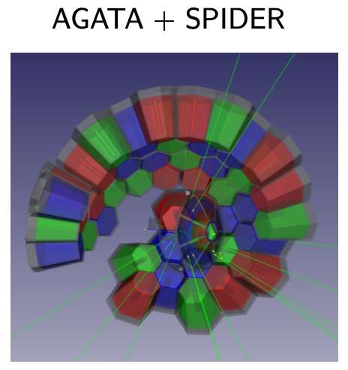
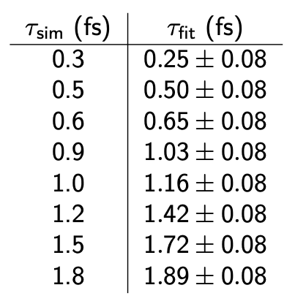
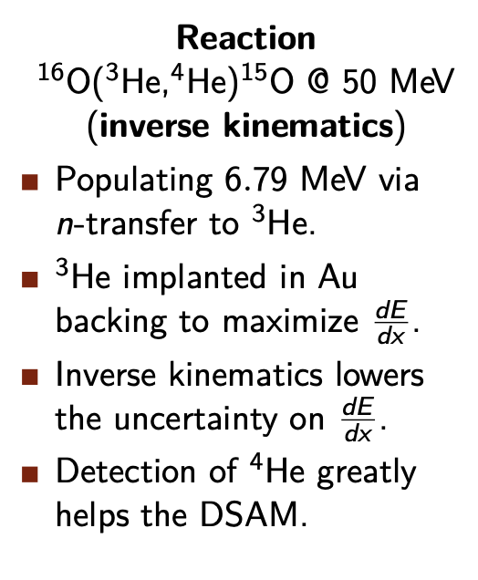
Nucleosynthesis up to the iron peak
Antonio Caciolli
Hydrogen Burning in the CNO: ¹⁴N(p,γ)¹⁵O
Text
PHASE A

Slide 10
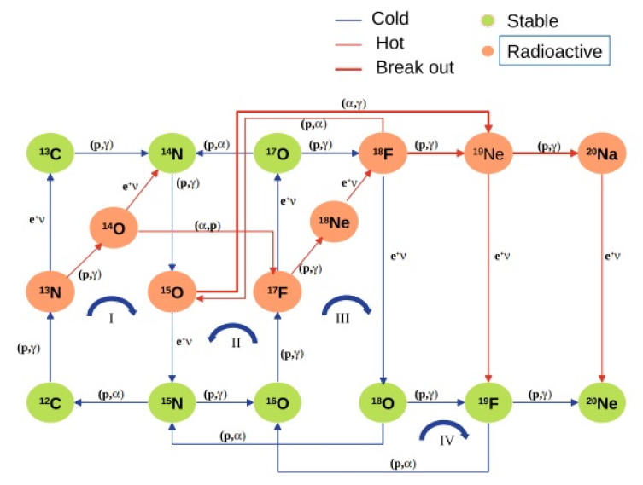
Nucleosynthesis up to the iron peak
Antonio Caciolli
Hydrogen burning in the HOT CNO: ¹³N(p,γ)¹⁴O
Text
Hot and Cold CNO Cycles
Novae scenario occurs in the range 0.1 < T₉ < 0.3 (T₉ in GK).
@Lower temperatures: cold CNO cycle operates. Energy generation rate is dominated by the lowest p-capture reaction ¹⁴N(p,γ)¹⁵°
@Increasing temperature: rate of p-capture reactions in CNO cycle exponentially increases and the reaction rate for the ¹³N(p,γ)¹⁴O exceeds the rate of ¹³N β decay.

Slide 11
Nucleosynthesis up to the iron peak
Antonio Caciolli
Hydrogen burning in the HOT CNO: ¹³N(p,γ)¹⁴O
Text
Hot and Cold CNO Cycles
Astrophysical S factors extracted by means of the Asymptotic Normalization Coefficient indirect method applied to peripheral proton transfer reactions.
First step: check ¹³N production via EXOTIC facility
Then: aim to ANC measurement via the reaction ¹³N(d,n)¹⁴O in inverse kinematics with errors not larger than 10% at a ¹³N beam energy of ∼50 MeV
PHASE B/C
Link to the activity of LNS (see Pidatella slide)

Slide 12
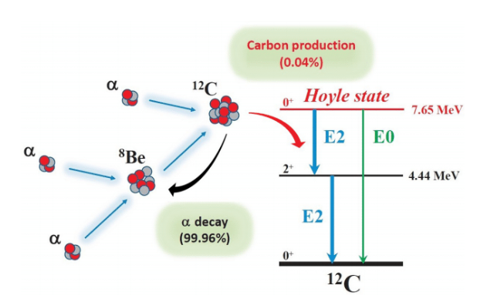
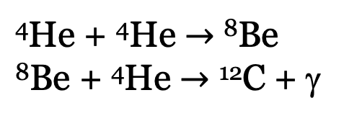
Nucleosynthesis up to the iron peak
Antonio Caciolli
Text
THE HOYLE STATE
Three-alpha process:
⁴He + ⁴He $→$ ⁸Be
⁸Be + ⁴He $→$ ¹²C + γ
Carbon → cannot be synthetized in its observed abundances in the early universe → we trace its abundance in the universe to the nucleosynthesis of elements in stars → Helium burning (three-alpha process).
Link to the activity of LNS (see Pidatella slide)

Slide 13


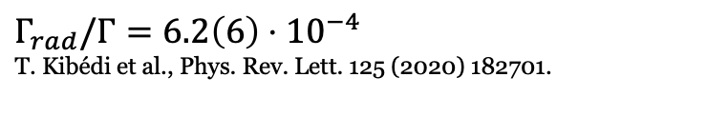


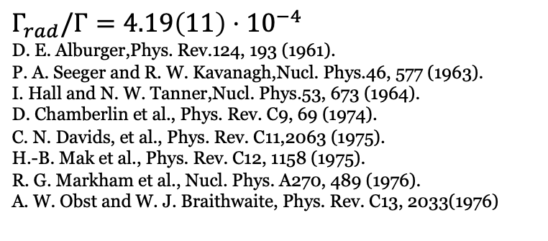
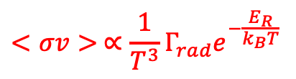
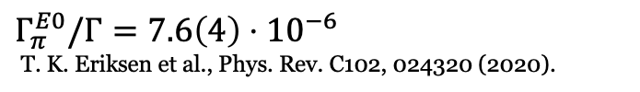



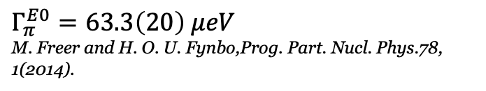


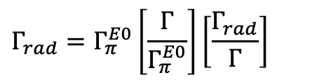
Reaction rate of the three-alpha process in stars
→ spectroscopic properties of the Hoyle state in ¹²C:
state-of-the-art
$$Γ_{rad}/Γ=4.19\left(11\right)⋅{10}^{−4}$$
D. E. Alburger,Phys. Rev.124, 193 (1961).
P. A. Seeger and R. W. Kavanagh,Nucl. Phys.46, 577 (1963).
I. Hall and N. W. Tanner,Nucl. Phys.53, 673 (1964).
D. Chamberlin et al., Phys. Rev. C9, 69 (1974).
C. N. Davids, et al., Phys. Rev. C11,2063 (1975).
H.-B. Mak et al., Phys. Rev. C12, 1158 (1975).
R. G. Markham et al., Nucl. Phys. A270, 489 (1976).
A. W. Obst and W. J. Braithwaite, Phys. Rev. C13, 2033(1976)
$$<σv> ∝\frac{1}{T^{3}}Γ_{rad}e^{−\frac{E_{R}}{k_{B}T}}$$
$$Γ_{rad}=Γ_{π}^{E0}\left[\frac{Γ}{Γ_{π}^{E0}}\right]\left[\frac{Γ_{rad}}{Γ}\right]$$
$$Γ_{π}^{E0}=63.3\left(20\right) μeV$$
M. Freer and H. O. U. Fynbo,Prog. Part. Nucl. Phys.78, 1(2014).
$$0^{+}$$
Hoyle state
$$7.65$$
$$Γ_{π}^{E0}/Γ=7.6\left(4\right)⋅{10}^{−6}$$
T. K. Eriksen et al., Phys. Rev. C102, 024320 (2020).
$$Γ_{γ}^{E2}$$
$$Γ_{π}^{E2}$$
$$Γ_{π}^{E0}$$
$$2^{+}$$
$$4.44$$
recent improved gamma-ray spectroscopy experiment
Tremendous impact on the three-alpha process in stars → about 34%!!!
$$0^{+}$$
$$0.0$$
¹²C
$$Γ_{rad}/Γ=6.2\left(6\right)⋅{10}^{−4}$$
T. Kibédi et al., Phys. Rev. Lett. 125 (2020) 182701.

Slide 14
Nucleosynthesis up to the iron peak
Antonio Caciolli
Text
The moralis proposal
¹²C detector
(anti-coincidence telescope)
Use the ¹⁴N(d,α)¹²C reaction to populate ¹²C in its Hoyle state and then measure the fraction of its radiative decays by deducing the ¹²C-α coincidence rate.
Beam: d @ 2.7 MeV (CN accelerator)
Target: C₃H₆N₆ + C backing
Detectors: Anti-coincidence telescope (90°) + Anti-coincidence telescope (64.8°).
¹²C kinematic cone
¹²C*
C₃H₆N₆ target (tilted by 65°)
α
alpha-detector
(anti-coincidence telescope)
accelerated deuteron beam
PHASE A

Slide 15
Nucleosynthesis up to the iron peak
Antonio Caciolli
Text
SUGAR: The Supersonic Gas Jet Target
SUGAR (SUpersonic GAs jet taRget) is a device developed at IFUNAM, Mexico City, commissioned in 2015.
Such system has the capability to produce a gas jet target at supersonic velocities.
The gas is continuously going in and going out of a reaction chamber, thank to a robust pumping system.
A differential vacuum system allow the enough conditions to maintain the reaction chamber (jet chamber) in windowless mode.

Slide 16
Nucleosynthesis up to the iron peak
Antonio Caciolli
Text
SUGAR: The Supersonic Gas Jet Target
  A extremely thin pure target (if gas is a molecular element, example N₂).
  Thickness around 10¹⁸ atoms/cm².
    The jet target is well defined, enclosed in a small area.
    Better than “gas target” and/or “cryogenic target”.
  The DVS allow a windowless system, i.e.:
    No other nuclei interacts with the beam, just the gas injected in the chamber.
    Better than “gas target” and/or “cryogenic target”.
  The thin target allows to perform experiments at very low energies, ensuring forward scattering (ideal for nuclear astrophysics experiments but also for low energy accelerators).
  While the gas lasts, jet target will be there, it doesn’t break.
  Most of the components are standard ones (commercial, in case of all pumps) assembled one each other. This feature allow easy changes (in case) and try with new sizes and/or new pieces.

Slide 17
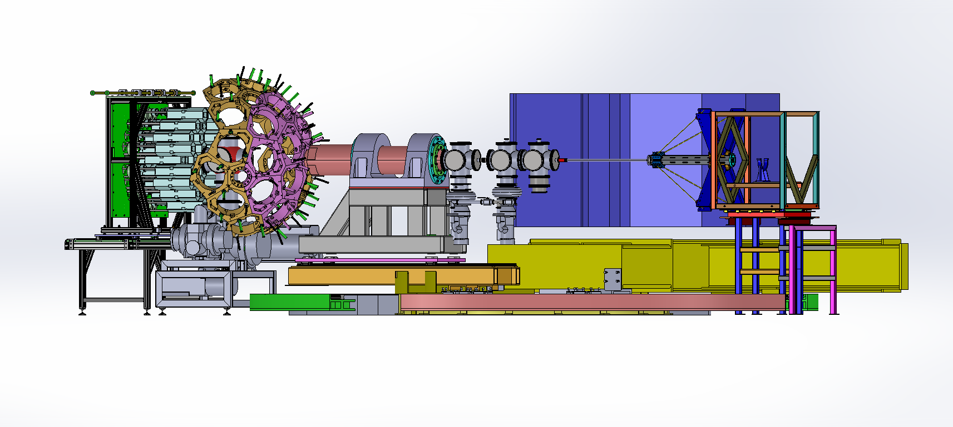
Nucleosynthesis up to the iron peak
Antonio Caciolli
Text
SUGAR at LNL
In the framework of the March’19 meeting at Legnaro, called “AGATA@LNL”, we presented a Letter of Intent searching the use of SUGAR as part of the scientific program of AGATA. Coupling NEDA and a silicon array. This would be a unique opportunity to measure charge particles, gamma and neutrons simultaneously, using a thin pure target.

Slide 18
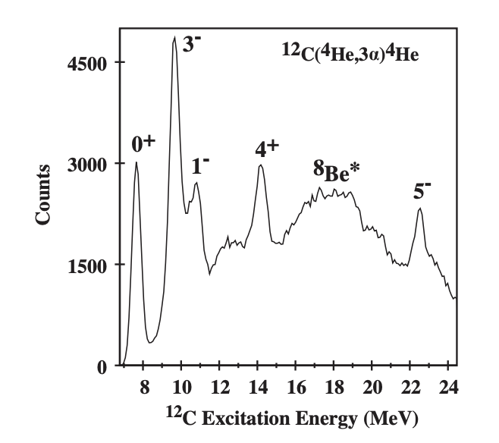
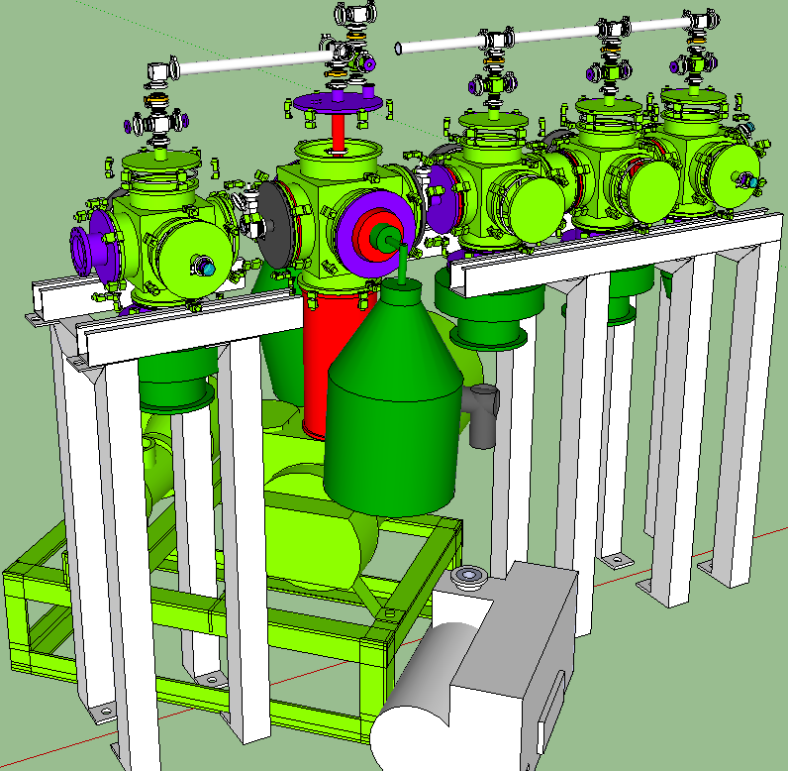
Nucleosynthesis up to the iron peak
Antonio Caciolli
Text
Two possible application for the study of ¹²C
⁴He(¹²C,¹²C*)⁴He at AGATA
¹²C beam on α jet target with SUGAR
Detection System: silicon telescopes (~1500 um thick) + positive sensitive plastic “phoswiches”
AGATA Gamma rays in coincidence would confirm the existence of the predicted rotational bands, find the missing states and confirm the spin and parity assignments
PHASE B

Slide 19
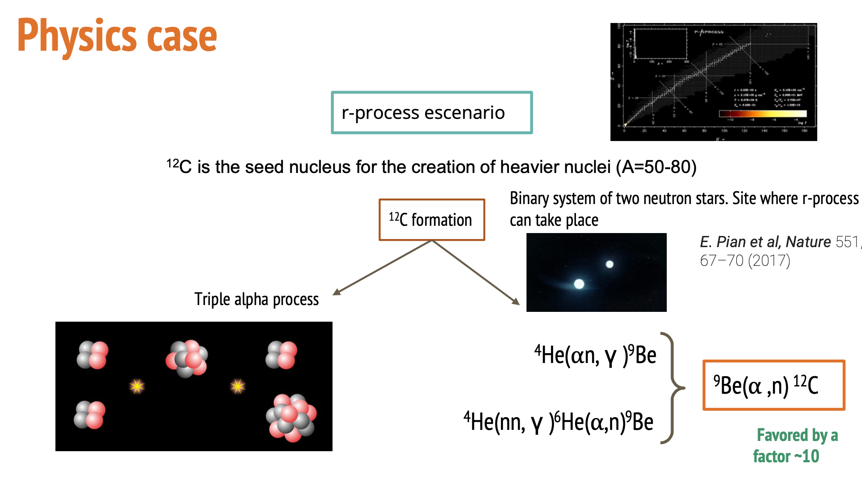
Nucleosynthesis up to the iron peak
Antonio Caciolli
Text
¹²C production in explosive scenarios
PHASE C
See next talk by T. Kurtukian Nieto

Slide 20
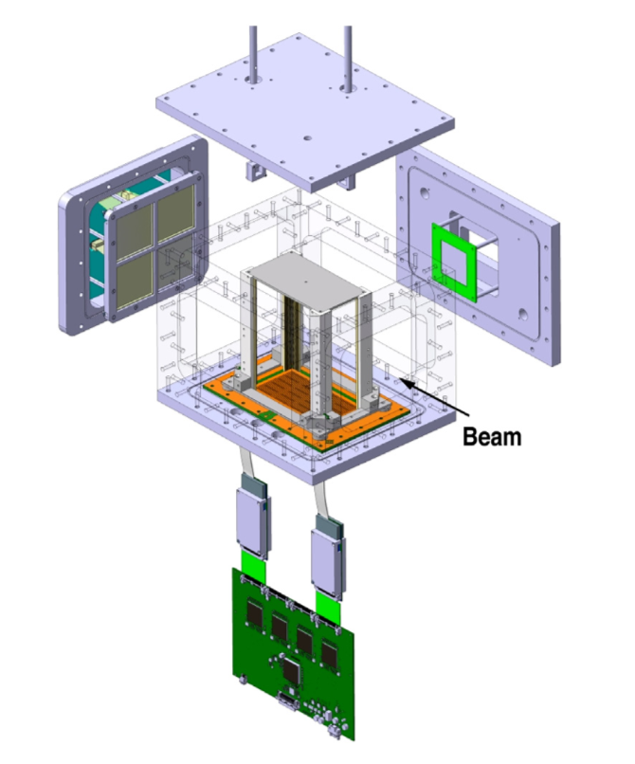
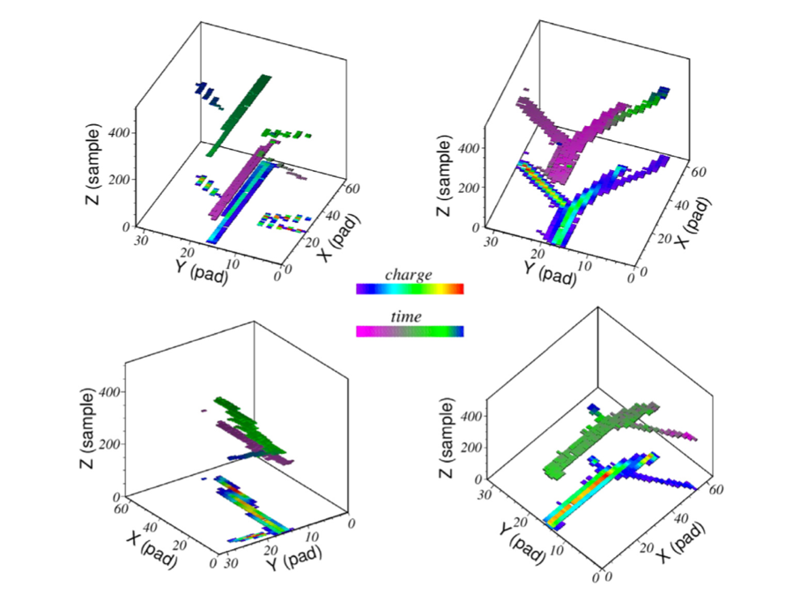
Nucleosynthesis up to the iron peak
Antonio Caciolli
Text
ADVANCED BURNING STAGES: ¹²C+¹²C VIA THE ²⁰Ne(α,α’)²⁰Ne RESONANCE SCATTERING
The ACTAR demonstrator is able to separate elastic or inelastic events thanks to vertex reconstruction
A pad of Si detectors at forward angles will increase the sensitivity in the tracking by using their signals as trigger
E_{20Ne} = 60 MeV
He gas pressure ~ 700 bar (CO₂ as quencher)
Maximum beam intensity: 3 * 10⁴ pps
Two weeks of beam needed to perfom the experiment
10 days for statistics
4 days to calibrate the setup
PHASE A
²⁴Mg states at 14-17 MeV excitation energies investigated with ²⁰Ne+α resonant

Slide 21
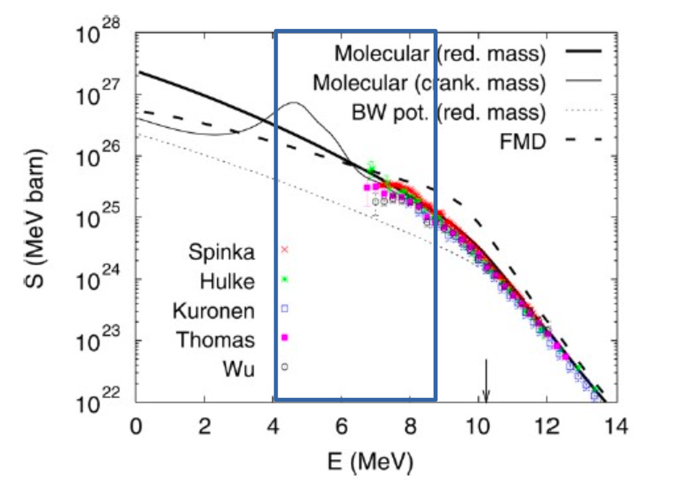
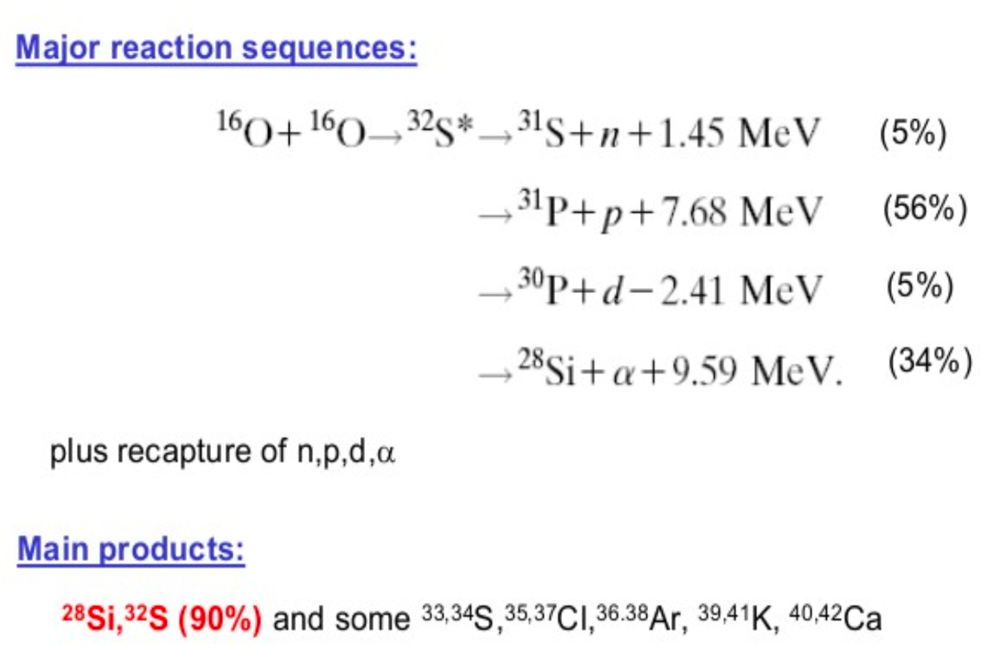
Nucleosynthesis up to the iron peak
Antonio Caciolli
Text
ADVANCED BURNING STAGES: ¹⁶O+¹⁶O WITH SUGAR JET TARGET
The ¹⁶O⁺¹⁶O fusion reaction is a key reaction for the later oxygen burning phase of massive stars (M > 8 Ms), influencing also the carbon burning phase.
The nucleosynthesis during carbon and oxygen burning depends not only on the 16O+16O reaction rate but also on the branching between proton, neutron, or alpha decay channels of the fused compound nucleus
The combination of most sophisticated devices worldwide at LNL (AGATA, GRIT, NEDA, SUGAR) simultaneously for a period, makes the experimental study of the proposed reaction ¹⁶O⁺¹⁶O , worth to be explored regarding the beam production in the TANDEM
PHASE C

Slide 22
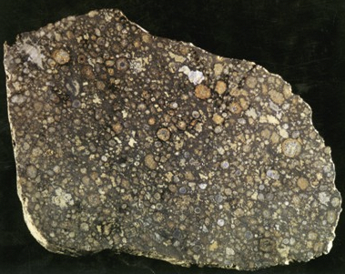
Nucleosynthesis up to the iron peak
Antonio Caciolli
Text
Study of the ²⁶Al destruction
Observation of 1808.65 keV γ-rays from the decay of ²⁶Al to ²⁶Mg in the interstellar medium demonstrated that ²⁶Al nucleosynthesis does occur in the present Galaxy. The present-day equilibrium mass of ²⁶Al was found to be 2.8±0.8 M_{sun}.
The irregular distribution of ²⁶Al emission seen along the plane of the Galaxy provided the main argument for the idea that massive stars dominate the production of ²⁶Al. (Diehl et al 2006)
Keane and Kramer (2008).
Diehl et al. (2006).
Baker et al. (2005).
In CAIs (the oldest solid of the Solar System):
the inferred 6.5 x 10⁻⁵ < (²⁶Al/²⁷Al)₀ <2 x 10⁻⁶.
→²⁶Al was injected into the ²⁶Al-poor protosolar nebula, possibly by a wind from a neighboring massive star. Crucial role in planets formation?
Presolar grains:
Corundum, hibonite and carbonaceous chondrites formed before the birth of the solar system show excesses in ²⁶Mg. The highest ratios are found in grains originated in supernova ejecta, but the largest number of grains with ²⁶Al/²⁷Al >3 x 10⁻³ (at least 100 times larger than the solar value) are of the type that come from low mass stars.

Slide 23
Nucleosynthesis up to the iron peak
Antonio Caciolli
Text
Study of the ²⁶Al destruction
Observation of 1808.65 keV γ-rays from the decay of ²⁶Al to ²⁶Mg in the interstellar medium demonstrated that ²⁶Al nucleosynthesis does occur in the present Galaxy. The present-day equilibrium mass of ²⁶Al was found to be 2.8±0.8 M_{sun}.
The irregular distribution of ²⁶Al emission seen along the plane of the Galaxy provided the main argument for the idea that massive stars dominate the production of ²⁶Al. (Diehl et al 2006)
Neutron stars counting: NS birth rate has been estimated to be 10.8^{+7.0}/_{-5.0} NSs/century, while the CCSN rate is estimated to be 1.9+/-1.1 SNe/century from measurements of gamma-ray from ²⁶Al. Additional sources necessary?
Keane and Kramer (2008).
Diehl et al. (2006).
Baker et al. (2005).
In CAIs (the oldest solid of the Solar System):
the inferred 6.5 x 10⁻⁵ < (²⁶Al/²⁷Al)₀ <2 x 10⁻⁶.
→²⁶Al was injected into the ²⁶Al-poor protosolar nebula, possibly by a wind from a neighboring massive star. Crucial role in planets formation?
Presolar grains:
Corundum, hibonite and carbonaceous chondrites formed before the birth of the solar system show excesses in ²⁶Mg. The highest ratios are found in grains originated in supernova ejecta, but the largest number of grains with ²⁶Al/²⁷Al >3 x 10⁻³ (at least 100 times larger than the solar value) are of the type that come from low mass stars.

Slide 24
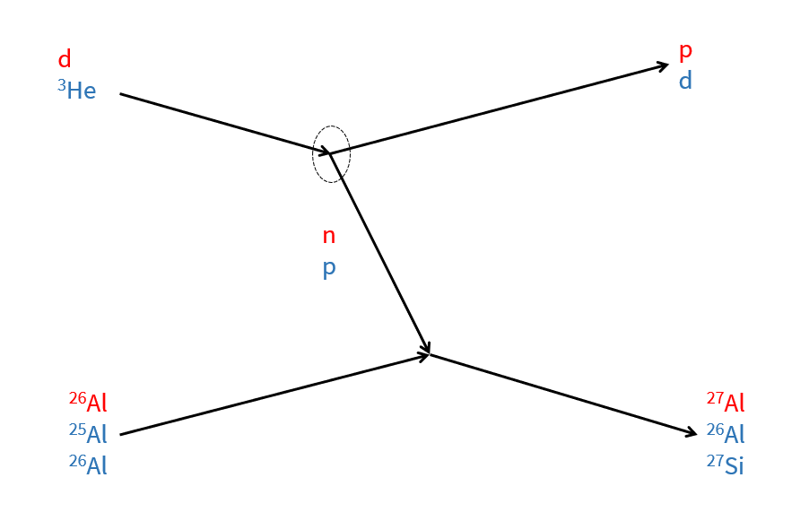
Nucleosynthesis up to the iron peak
Antonio Caciolli
Text
Study of the 26Al destruction: two different experimental proposals
Study of the ²⁶Al^{m}(p,γ)²⁷Si reaction using the ANC indirect method
²⁶Al + n via the Trojan Horse Method
²H
³He
d
p
n
p
⁴He/p
²⁶Al
²³Na/²⁶Mg
²⁶Al^{m}
²⁷Si
Close connection with the activities of LNS laboratory where reactions on ²⁶Al^{gs} will be studied

Slide 25
Nucleosynthesis up to the iron peak
Antonio Caciolli
Text
THM: theoretical approach
When narrow resonances dominate the S-factor the reaction rate can be calculated by means of the resonance strengths and resonance energies only. Both can be deduced from the THM cross section. Let’s focus on resonance strengths
²H
p
Where:
Ĵ=2J+1
Γ_{(AB)} is the partial width for the A+B channel
Γ_{i} is the total with of the i-th resonance
E_{Ri} is the resonance energy
n
⁴He/p
What is its physical meaning?
Area of the Breit-Wigner describing the resonance
Advantage:
no need to know the resonance shape (moderate resolution necessary)
²⁶Al
²³Na/²⁶Mg
Trojan Horse Method: THM
Where:
ω_{I} = Ĵ_{i} / Ĵ_{p} Ĵ_{27Al} statistical factor
N_{i} = THM resonance strength
However:
QF condition must be enforced
Normalization necessary!!!!
In the THM approach:
Advantages:
possibility to measure down to zero energy
No need of expensive neutron beam facilities
No spectroscopic factors in the Γ_{(p27Al)} /𝞂 ratio
For narrow resonances:
La Cognata et al. (2010)

Slide 26
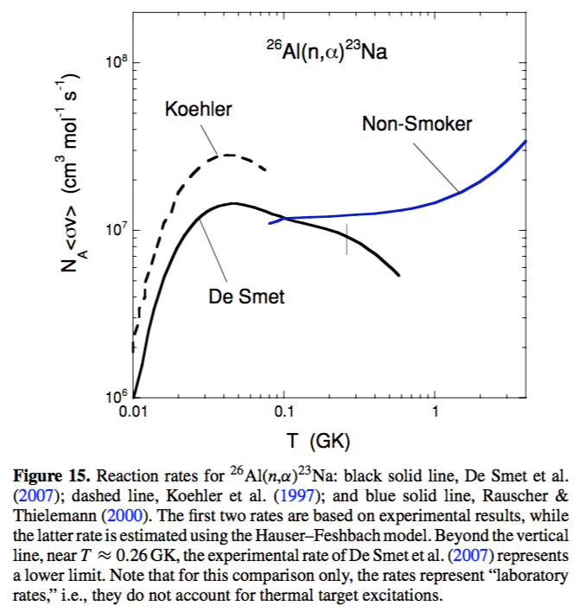


Nucleosynthesis up to the iron peak
Antonio Caciolli
State of the ART: ²⁶Al(n,p)²⁶Mg
Temperatures of interest → No experimental data available
1.1 GK (convective shell C/Ne burning)
2.3 GK (explosive Ne/C burning)
0.05 – 0.5 GK (AGB stars)
Large discrepancy between available data sets

Slide 27
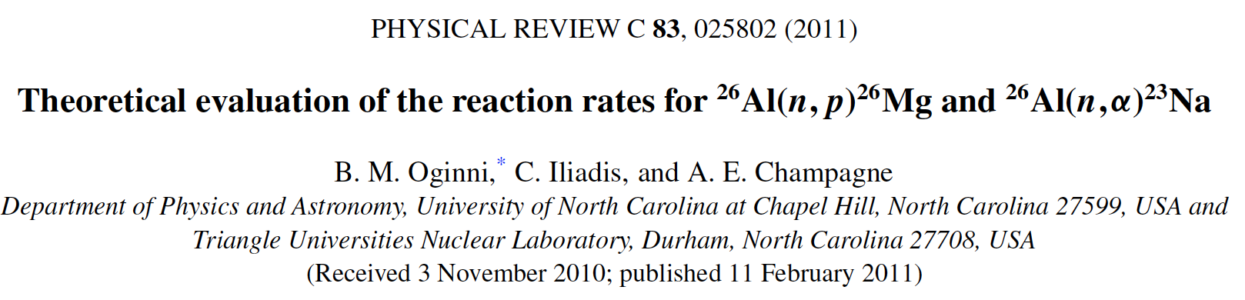
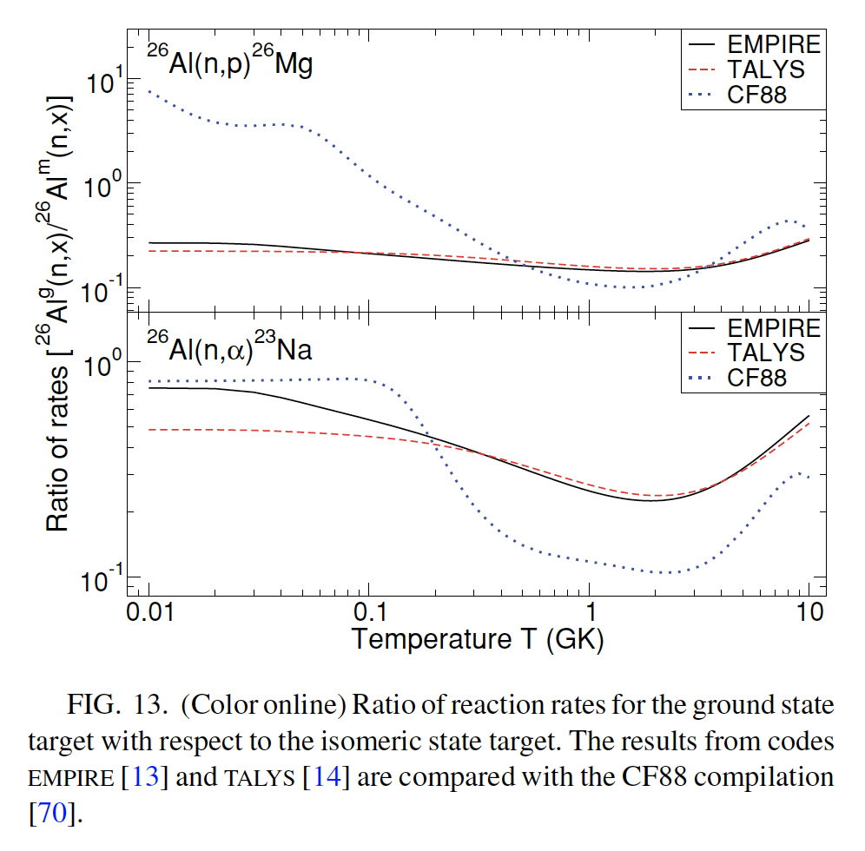
Nucleosynthesis up to the iron peak
Antonio Caciolli
Text
State of the ART: ²⁶Al(n,α)²³Na
Temperatures of interest → No experimental data available
1.1 GK (convective shell C/Ne burning)
2.3 GK (explosive Ne/C burning)
0.05 – 0.5 GK (AGB stars)
Large discrepancy between available data sets

Slide 28
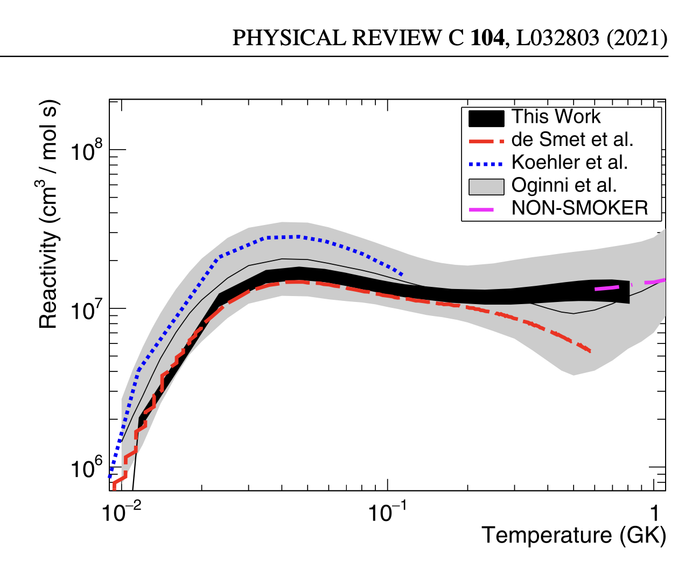
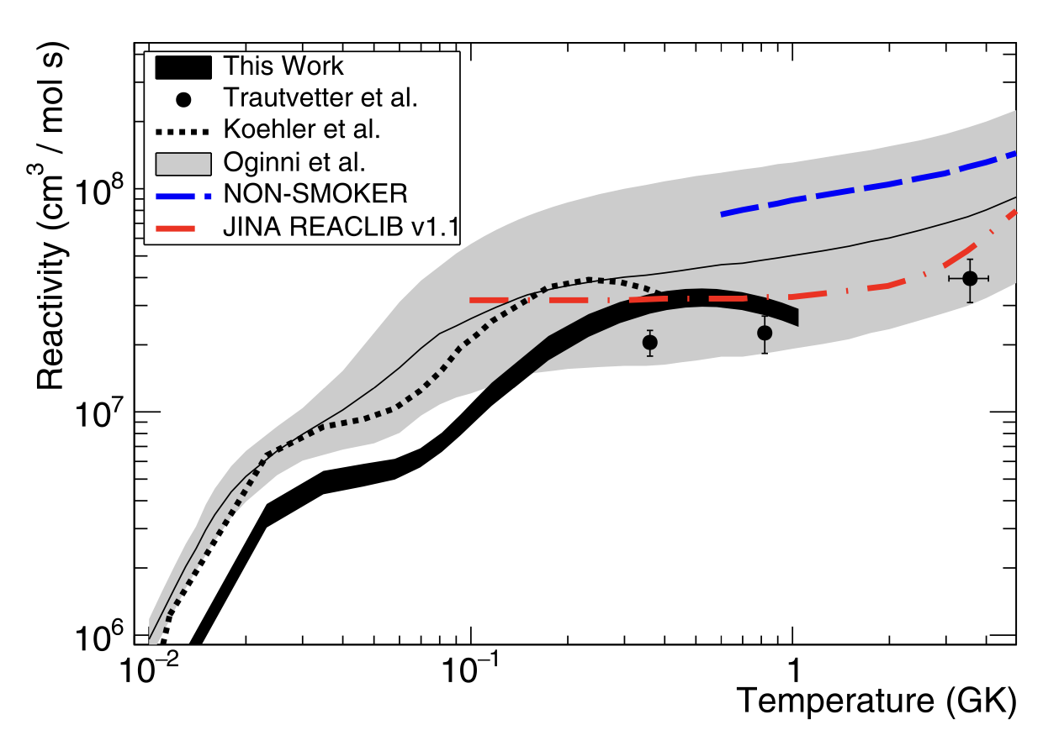
Nucleosynthesis up to the iron peak
Antonio Caciolli
Text
Recent results from n_TOF
Temperatures of interest → No experimental data available
1.1 GK (convective shell C/Ne burning)
2.3 GK (explosive Ne/C burning)
0.05 – 0.5 GK (AGB stars)
Large discrepancy between available data sets

Slide 29
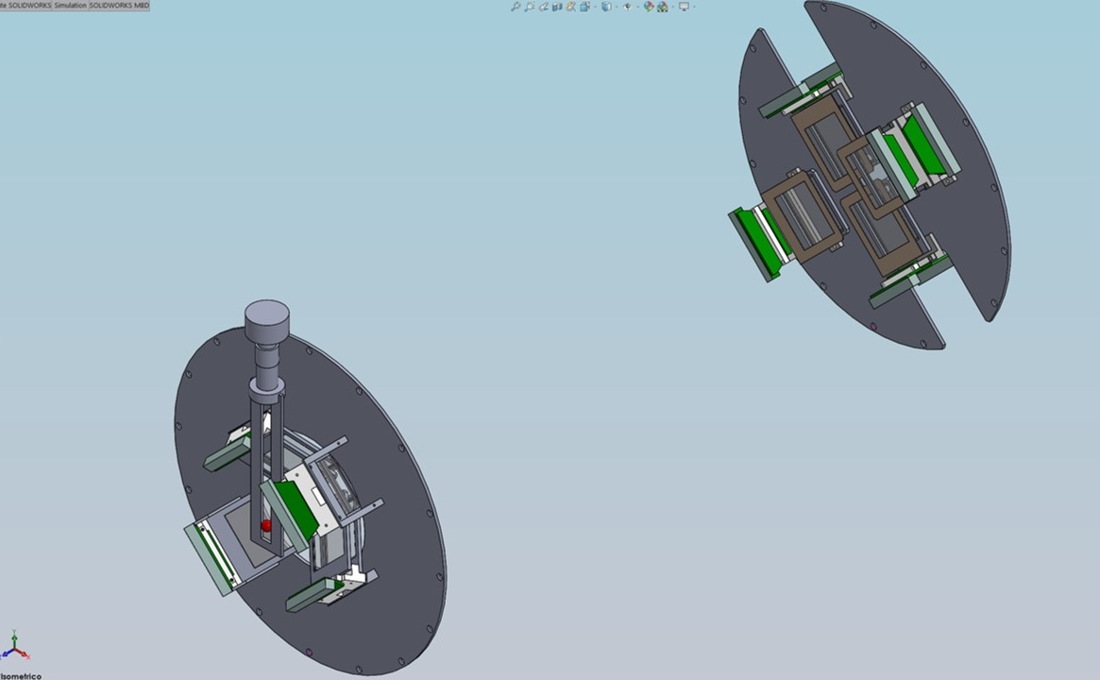
Nucleosynthesis up to the iron peak
Antonio Caciolli
Text
Experimental setup
Introducing NEFASTA (NEar FAr Silicon Telescope Array)
B1 detectors will cover the 2°-6.1° angular range, while B2 telescopes will cover the 2.9°-7.1° interval
8 telescopes arranged into two groups:
- group A 60 mm away from the target, made up of two couples of telescopes, set in the vertical (A1) and in the horizontal (A2) planes. Each telescope will be composed of one DSSSD 1000 μm thick (16x16 strips, 51.2x51.2 mm²) and one pad detector 1500 μm thick
BEAM DIRECTION
A1 group will cover the angular ranges 9.4°-55.6°, while those in A2 will cover 32.9°-79.1°
- The second group of detectors (named B) will be placed at about 700 mm from the target position. Two couples of telescopes, set in the vertical (B1) and in the horizontal (B2) planes, each composed of a 20 μm SSSSD and a 1000 μm DSSSD
PHASE B
Mechanical drawings by Dr. M. Costa

Slide 30
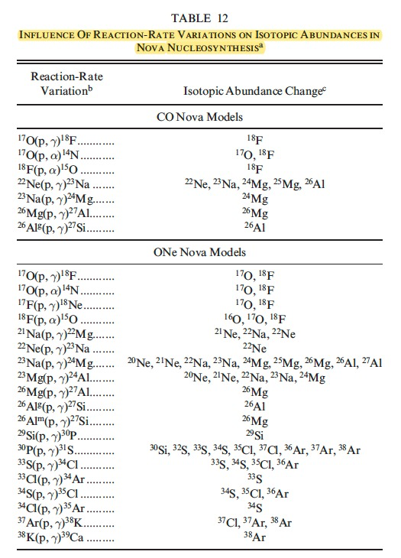
Nucleosynthesis up to the iron peak
Antonio Caciolli
Text
²⁶Al^{m} (p,γ)²⁷Si at SPES via ANC method
Astrophysical Motivation
In AGB stars, CN and CCSN the destruction of ²⁶Al is governed by radiative proton capture reactions on ²⁶Al^{g} and ²⁶Al^{m}
Sensitivity studies have highlighted that uncertainties in this reaction have an high impact to understand the ²⁶Al production in massive stars and the isotopic abundances of ²⁶Mg synthesized in novae environments
C. Iliadis et al.. The Astrophysical Journal Supplement Series, 142:105–137, 2002 September

Slide 31
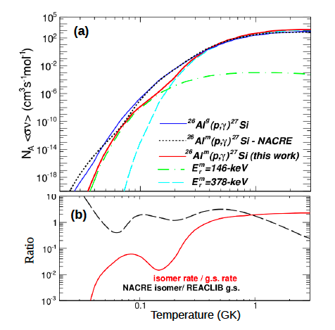
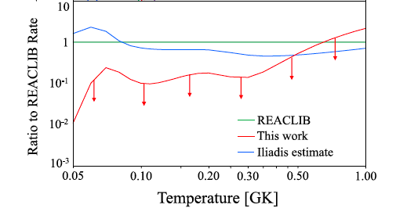
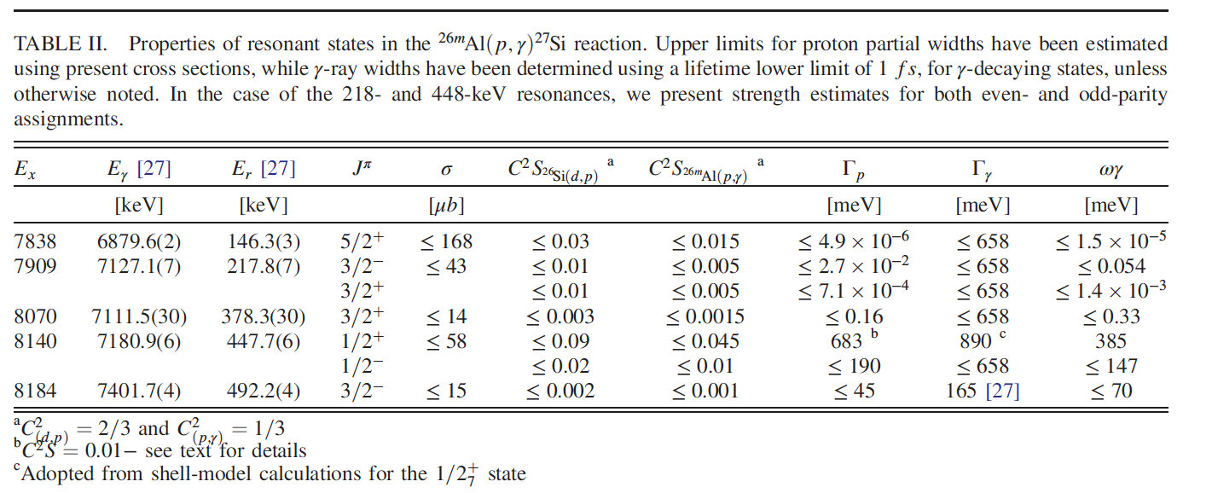
Nucleosynthesis up to the iron peak
Antonio Caciolli
Text
S. Hallam et al. PRL 126, 042701 (2021)
S. Almaraz-Calderon PRL 119, 072701 (2017)
Reaction rate obtained from the upper-limit contributions of individual resonances
G. Lotay et al. PRL 128, 042701 (2022)
First direct measurement of the strength of the 447-keV resonance
Further constraints on the rate of the ²⁶Al^{m}(p; γ) reaction at temperatures relevant for classical novae would now require in particular for the E_{r} = 218 keV resonance strength

Slide 32
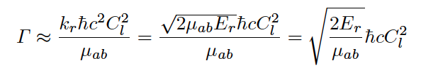
Nucleosynthesis up to the iron peak
Antonio Caciolli
Text
²⁶Al^{m} (p,γ)²⁷Si at SPES via ANC method
to gain information on the direct capture contribution to the ²⁶Al^{m}(p,γ)²⁷Si reaction cross section
to get information on the ²⁷Si resonate states above the threshold
the ANC values is related to the corresponding Γ of the considered
resonant level
A. M. Mukhamedzhanov and R. E. Tribble, PRC, vol. 59, pp. 3418–3424, Jun 1999.
Transfer reaction to be measured ³He(²⁶Al^{m} ,d)²⁷Si
²⁶Al^{m} beam from SPES (should be one of the first SPES beam delivered)
@3-5 AMeV (feasible with ALPI post-acceleration)
Experimental setup
Gas Target
Array of silicon detectors placed at forward (and backwards), in order to perform angular distribution measurements in particular at small c.m. angles.
³He
d
p
²⁶Al^{m}
²⁷Si
PHASE B
Possible further ANC study ²⁶Al(n,γ)²⁷Al

Slide 33
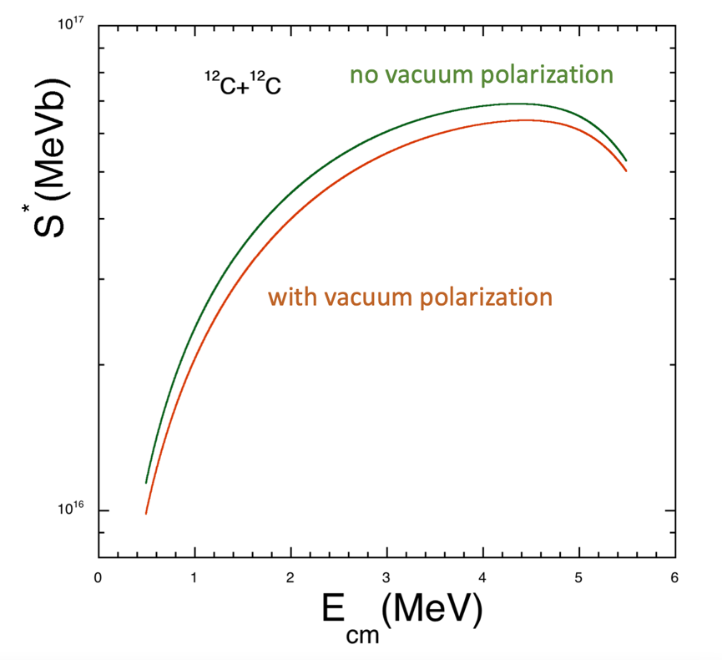
Nucleosynthesis up to the iron peak
Antonio Caciolli
Text
Dynamical production of e⁺ e⁻ in sub-barrier reactions of light ions
The two nuclei approach each other under Coulomb plus the nuclear (Bass) potential.
Classically → stop and bounce back.
Quantum mechanically → finite probability of tunneling
Probability and cross section found by integrating imaginary action between turning points.
Vacuum polarization decreases fusion cross section by as much as 15% for energies ~ MeV.
Solve Dirac equation along Coulomb trajectory.
Production occurs when a virtual electron “tunnels”
experimental coincidence correlation
PHASE C
See Manuel Caamaño talk tomorrow

Slide 34
Nucleosynthesis up to the iron peak
Antonio Caciolli
Text
SUMMARY
Nucleosynthesis during BBN and in different stellar burning exploits several approaches
The National Laboratories of Legnaro has several facilities (in terms of accelerators and detection systems) to perform those studies
Nuclear Astrophysics community is mature in Italy and Europe and in this session we are showing combined experiments to investigate specific scenarios (BBN, ¹²C formation, ²⁶Al production) in different ways
New experimental facilities or different technological upgrades are already planned to face those issues
In all phases of the mid term plan there are interesting cases to be studied and where the community can work together
An effort of the laboratory is required to improve the existing facilities in order to fulfil the proposed goals (beam intensities, stabilities, beam energy calibration procedures, etc )
The prosed experimental selections will for sure grown the interest of the community in working in the LNL and will attract new proposals in Nuclear Astrophysics
Close connections and synergic activities with the proposed experiments at the LNS
Thank you for you attention!

