Slide 1
Results of Hadron Spectroscopy at LHCb
NSTAR2022
Elisabetta Spadaro Norella
University & INFN Milano
on behalf of the LHCb experiment
Oct 20th, 2022

Slide 2
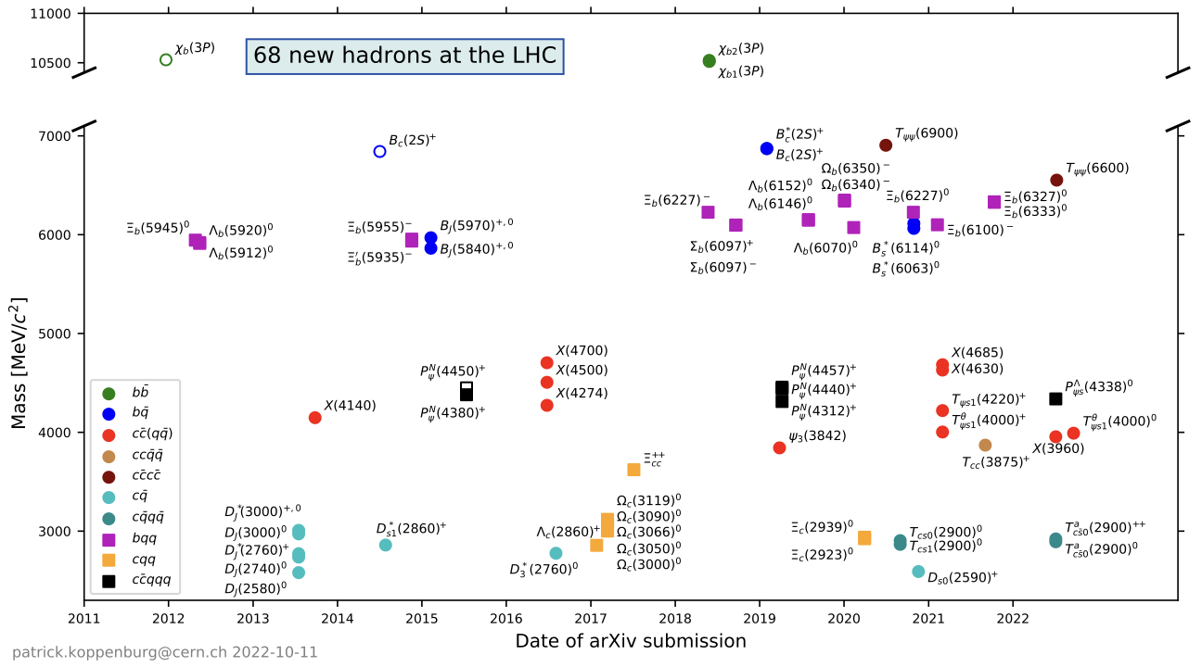
Spectroscopy at LHC
Over the past 10 years more than 60 new hadrons
More than 15 states are exotics:
⇒ New naming scheme used here
arxiv2206.15233
Link
Notes:
To test the validity of the Heavy quark effective theory (HQET) assumptions / Lattice QCD calculations

Slide 3
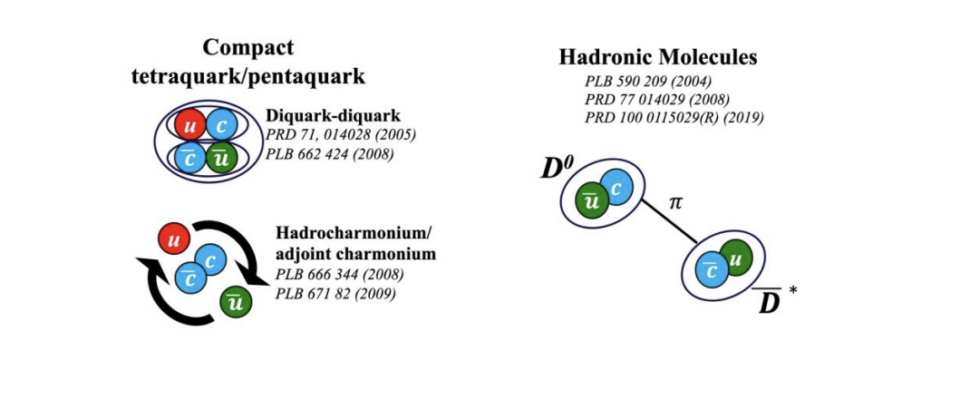
QCD and spectroscopy
Standard Model
Nature
Exotic spectroscopy
Many states predicted with minimal quark content different from qq and qqq
Lots of theoretical models
Quarks & gluons
Color-singlet mesons and baryons
strong interaction (long-distance effects)
Conventional spectroscopy
HQET predicts the masses of the heavy hadrons:
expansion in Λ_{QCD}/m_{Q} ~ 0
Need for precise measurements of the excited hadron properties to test the validity of HQET
Study of exotics in production and decays to discriminate among models
Both can be used to test Lattice QCD calculations at low energies
Notes:
We are still investigating the binding mechanism of quarks and gluons inside hadrons because long-distance effects are the least understood aspects of QCD.
HQET comes into play which is a theory that predicts masses of heavy hadrons → but we need measurement of properties.
On the other hand, in recent years the field of exotic spectroscopy is attracting interest. Infact it can help understand the binding. In order to discriminate among theorectical models further observations and studies in production and decays of exotic states are needed.

Slide 4
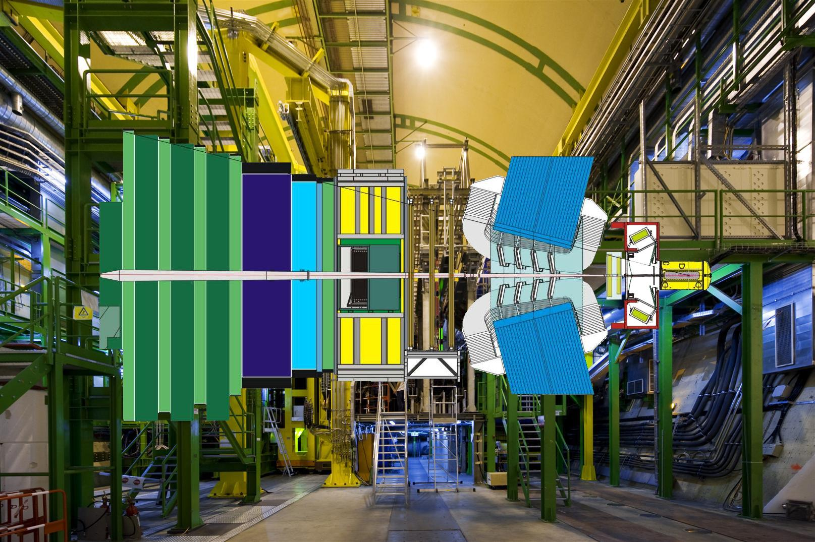
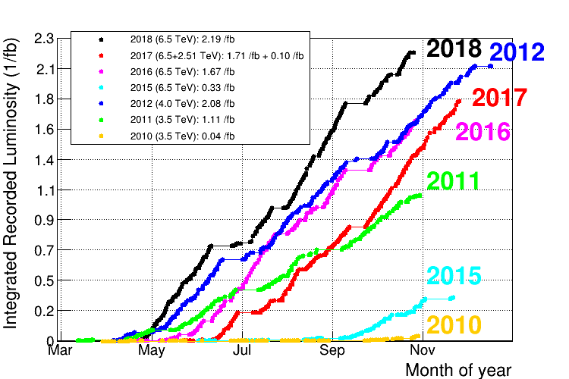
LHCb detector
JINST 3 (2008) S08005
IJMP A 30, 1530022 (2015)
The major player in spectroscopy
thanks to its unique dedicated design
high vertex resolution
high invariant mass resolution
RICH detectors for PID
highly performant trigger
VELO: vertex detector
IP resolution: ~25 μm
Tracking: momentum resolution of σ_{p} / p ~ 0,5 - 1%
Luminosity:
Run 1 and Run 2: 9 fb⁻¹
Muon chambers, hardware trigger with ~90% efficiency
RICH detectors for particle ID. pid(K-π)~95%
Calorimeters, hadron trigger with ~50% efficiency
Notes:
LHCb experiment at CERN is a forward spectrometer which is dedicated to the b physics.
Thanks to the high IP reso is capable to distinguish btw PV and SV.
With the full tracking system reaches a p reso <1%
It is also capable to distinguish btw charged hadrons thanks to 2 Ch detectors
The muons chambers are part of the hardware trigger and have a very high eff
LHCb is undergoing a major update installed this year, where it will reach a readout frequency at the pp collision freq. with an expected lumi 5times the actual one and an integrated lumi of 5fb-1

Slide 5
Outline
Conventional spectroscopy
Observation of excited Ξ_{b}⁰, Ξ_{c}⁰ and Ξ_{cc}⁺⁺ baryons
Search for Ξ_{cc}⁺, Ξ_{bc}⁰, Ξ_{bc}⁺ , Ω_{bc}⁰
Exotic spectroscopy
χ_{c1}(3872) state: dipion mass spectrum
Tetraquarks:
doubly charmed tetraquark T_{cc}
charm-strange tetraquarks T_{cs0}(2600)^{0/++}
Pentaquark with strangeness
see also talk by Roberta Cardinale

Slide 6
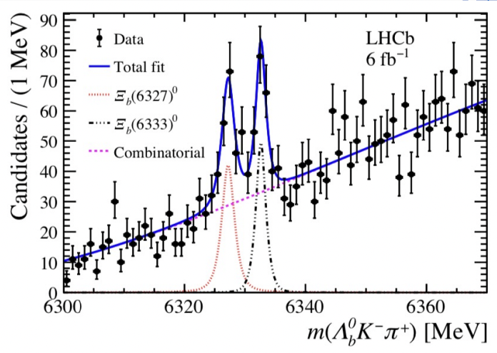
Spectroscopy study techniques
Invariant-mass fit
To extract mass peaks parameters, M and Γ
⇒ used for conventional resonances
Amplitude analysis
Phase space:
masses and angles
Helicity/ Tensor formalism +
lineshape
DATA
MODEL
FIT
Maximum L fit
to extract parameters
Moment analysis
Legendre poly expansion
⇒ Model independent check
PRL 126 (2021) 252003
To measure J^{P}, mass and width
& account for reflections
⇒ more important for exotic hadron studies

Slide 7
Conventional spectroscopy

Slide 8
Excited Ξ_{c} states
NEW
LHCb-PAPER-2022-028, in preparation
interesting for conventional & exotics
High-purity sample with N=1365 ± 42
No significant hint of exotics in
on the contrary of Belle result in [1]
[1] Phys.Rev.Lett.101:172001,2008

Slide 9
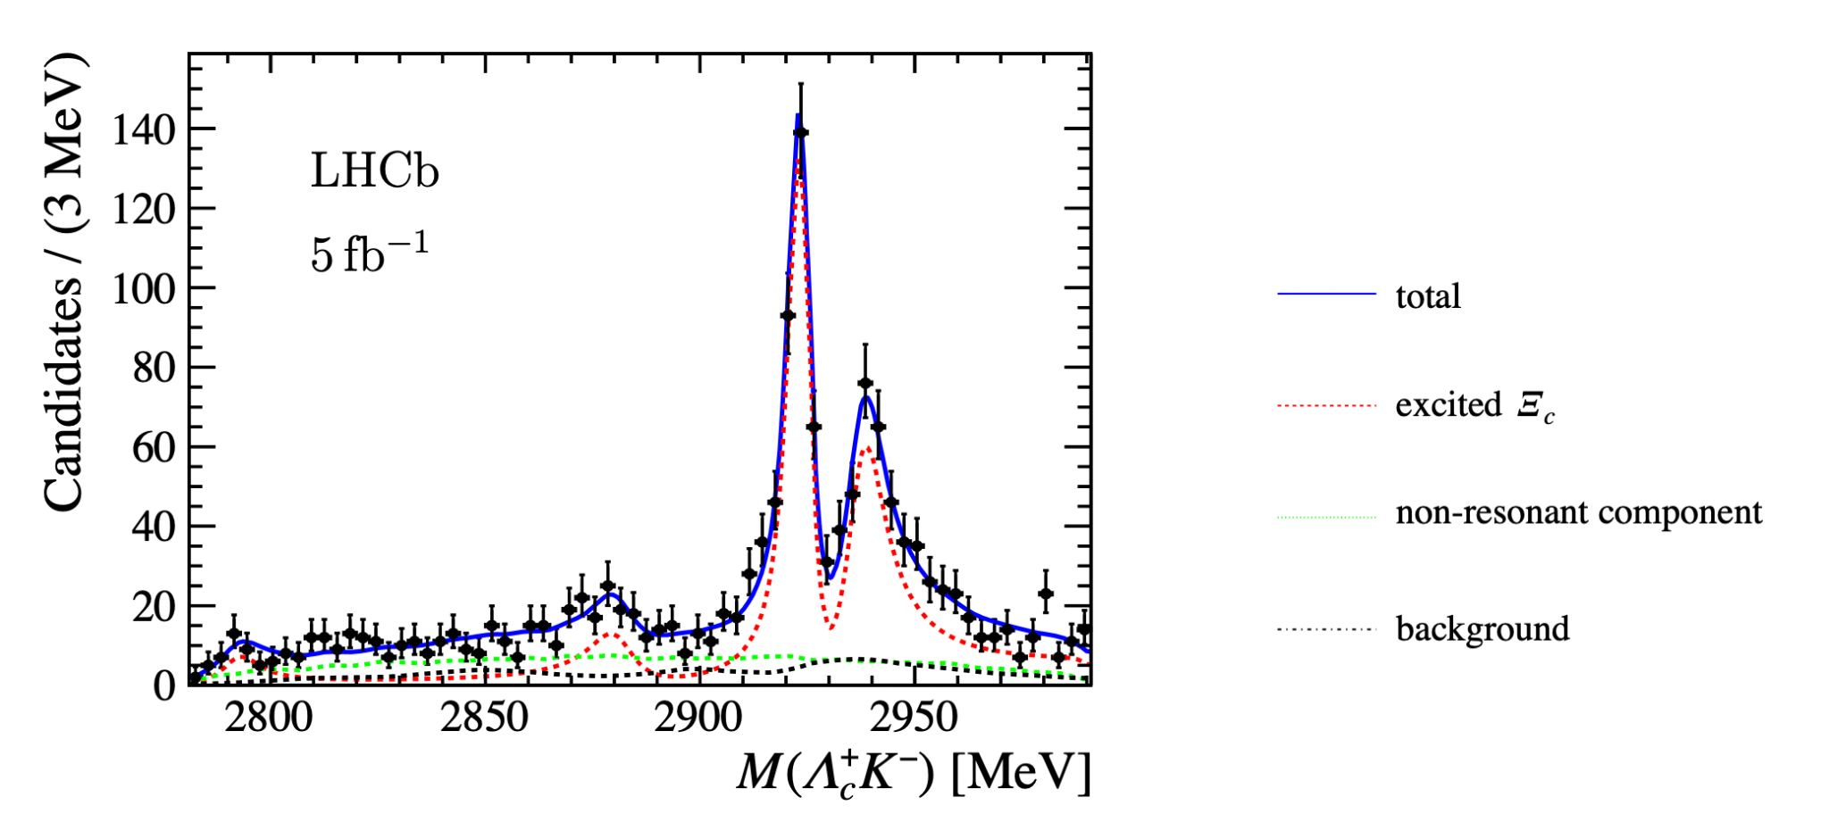
Excited Ξ_{c} states (1)
NEW
LHCb-PAPER-2022-028, in preparation
Search for excited Ξ_{c} states in decays, decaying to
Ξ_{c}(2930)⁰ state observed by Belle^{[1]} is resolved into 2 peaks:
Ξ_{c}(2923)⁰ with Γ~5 MeV
Ξ_{c}(2939)⁰ with Γ~11 MeV
Evidence at ~ 3.7σ of:
new state Ξ_{c}(2880)⁰
new decay mode of Ξ_{c}(2790)⁰
preliminary

Slide 10
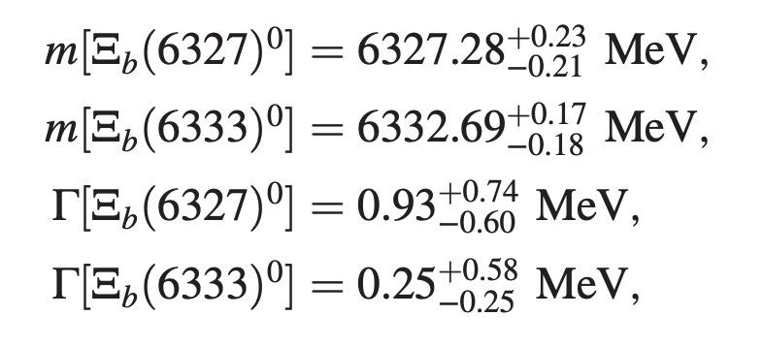
Observation of new excited Ξ_{b}
PRL 128, 162001 (2022)
Few excited Ξ_{b} states observed so far:
Ξ_{b}(6227)⁰/Ξ_{b}(6227)^{ー} by LHCb [1,2]
Ξ_{b}(6100)^{ー} by CMS [3]
New searches in Λ⁰_{b}K⁻π⁺ final state
⇒ 2 states observed: Ξ_{b}(6327)⁰, Ξ_{b}(6333)⁰
Widths consistent with mass reso
1D doublet, J^{P}= 3/2⁺ and J^{P} = 5/2⁺
(RBW)
[1] Phys. Rev. Lett. 121, 072002 (2018).
[2] Phys. Rev. D 103, 012004 (2021).
[3] Phys. Rev. Lett. 126, 252003 (2021).
Notes:
BOth CMS and LHCb recently observed Csib resonances. CMS observed a narrow state decaying to …. with significance . The width is so narrow that un UL is places <1.9 MeV. This state is consistent.
LHCb measured two neutral states, which widths are consistent with mass reso and belong to the 1D doublet

Slide 11
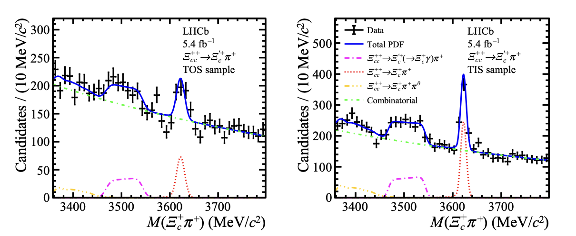
Observation of Ξ_{cc}⁺⁺ → Ξ_{c}^{'+}π⁺
JHEP 2205 (2022) 038
Partially reconstructed decay of Ξ_{c}'⁺ → Ξ_{c}γ
& exploiting decay of Ξ_{c}→ pKπ
With different trigger requirements
triggered by at least one of the Ξ_{c}⁺ decay products
Ξ_{c}⁺⁺ → Ξ_{c}'⁺π⁺: shifted and distorted
exclusively triggered
Ξ_{c}⁺⁺ → Ξ_{c}⁺π⁺
⇒ Observed at 9.6σ
Ratio of BRs

Slide 12
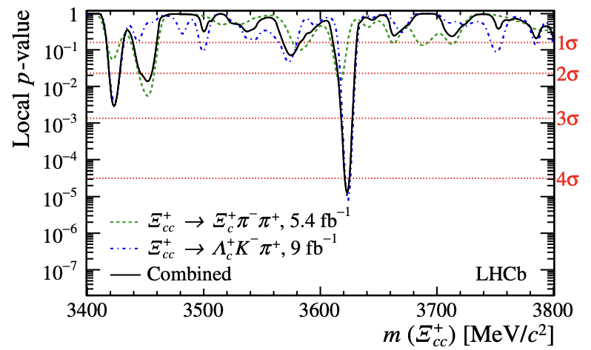
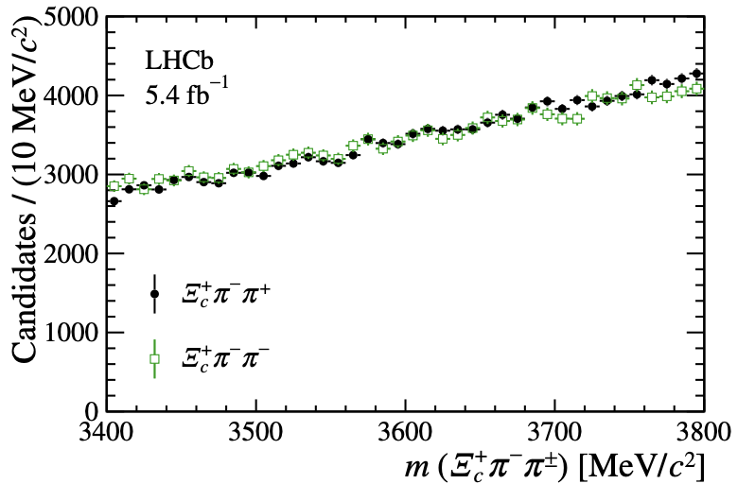
Search for Ξ_{cc}⁺ states
JHEP 2112 (2021) 107
Search in Ξ_{c}⁺π⁻ π⁺ final state
→ No peaks are seen and UL are set on R
R: production cross-section multiplied by BR and normalised to Ξ_{c}⁺⁺ → Ξ_{c}⁺ π⁺
Results combined with Λ_{c}⁺K⁻ π⁺ results [1]
Local significance of ~4σ at 3620 MeV
[1] Sci. China Phys. Mech. Astron. 63 (2020) 221062

Slide 13
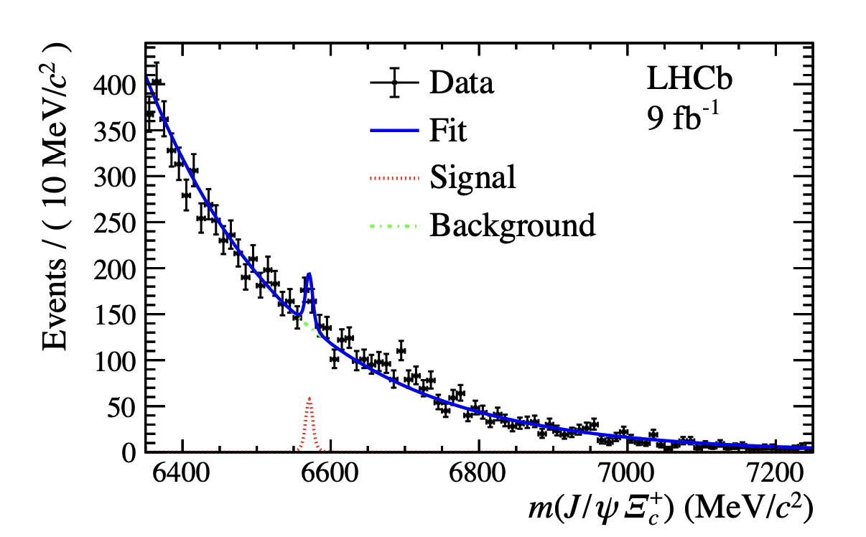
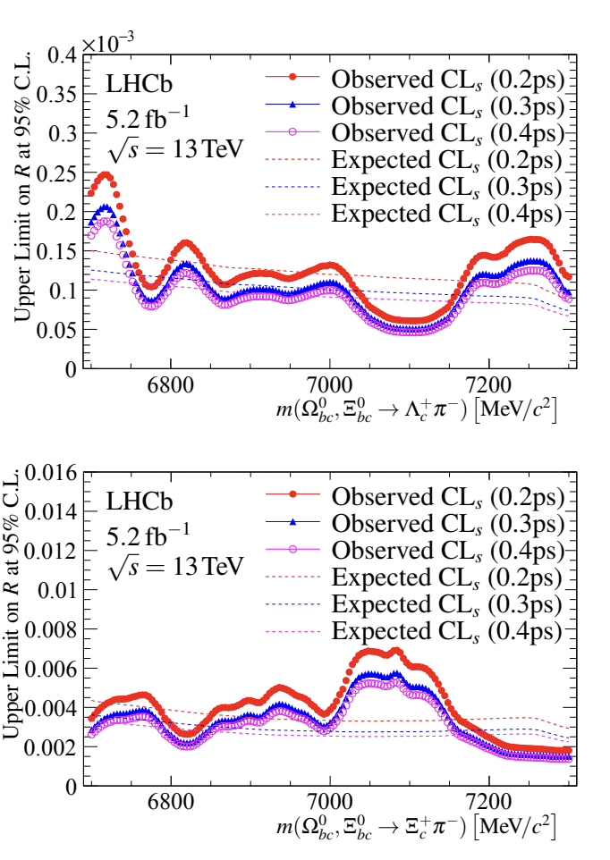
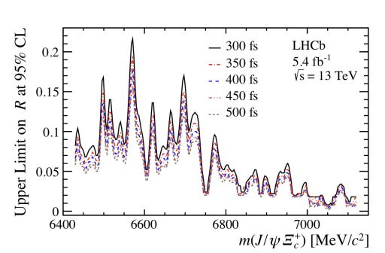
Search for Ξ_{bc}⁰, Ω_{bc}⁰,Ξ_{bc}⁺
Chin. Phys. C 45 093002, arXiv:2204.09541v1
Search for peaks in the Λ_{c}⁺π⁻ / Ξ_{c}⁺π⁻ and J/ψ Ξ_{c}⁺ final states
No obvious peaks
UL are set at 95% CL
R: production cross-section multiplied by BR and normalised with Λ_{b}⁰/Ξ⁰_{b} (decays to Λ_{c}⁺π⁻/Ξ⁺_{c}π⁻) and B_{c}⁺→J/ψ D_{s}⁺
Ξ_{bc}⁺ → J/ψ Ξ_{c}⁺
4.3(2.8)σ local (global)significance
Ξ_{bc}⁰/Ω_{bc}⁰ →Λ_{c}⁺π⁻
Ξ_{bc}⁰/Ω_{bc}⁰ →Ξ_{c}⁺π⁻
Notes:
LHCB has also conducted a search for baryons in the bc sector. But no obviuos peak is observed, therefore UL are places on the Ratio R of production multiplied by BR

Slide 14
Exotic spectroscopy

Slide 15
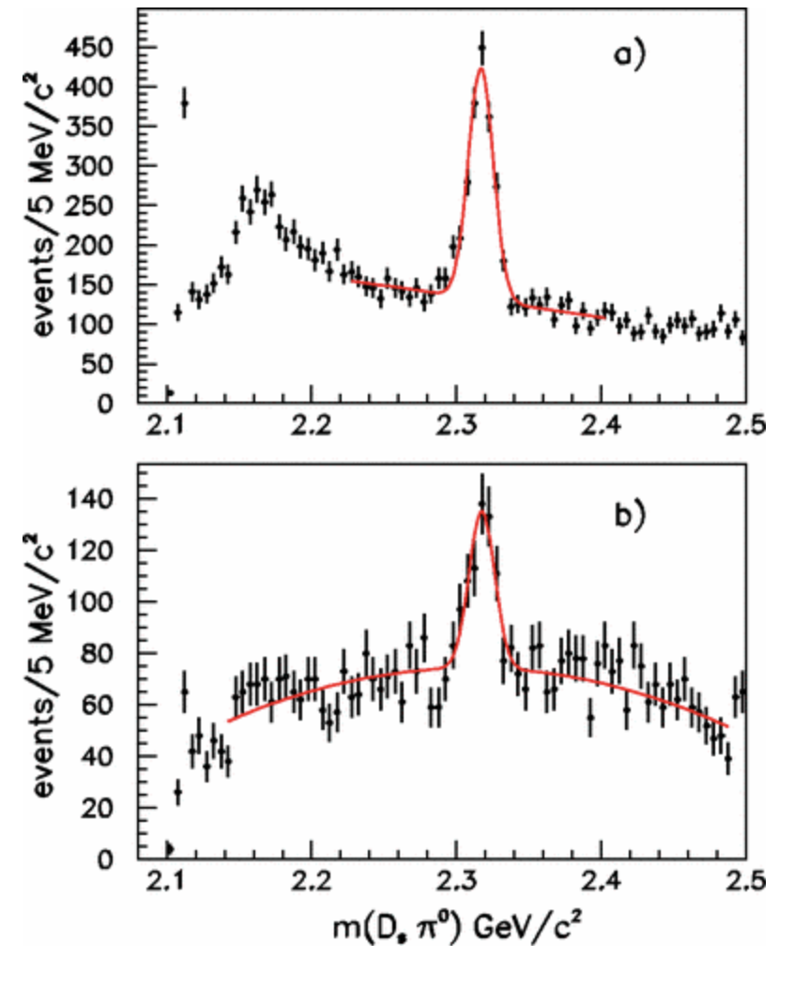
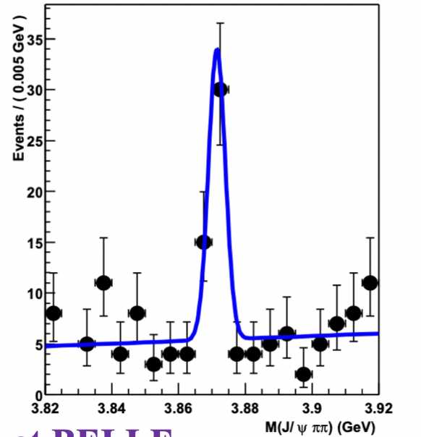
First exotic candidates
by Belle in 2003 in B±→K±π⁺π⁻J/ψ decays
χ_{c1}(3872)
𝐷*_{s0}(2317)
by BABAR in 2003
in the isospin violating 𝐷⁺_{s}𝜋⁰ decay
PRL 90, 242001 (2003)
?
PRL 91, 262001 (2003)
cs ?
⇒ J^{PC}=1⁺⁺ by LHCb
PRL. 110 (2013) 222001
Notes:
The first states with exotic properties have been observed in 2003, the first one is the chi_c1(3872), seen by Belle in B decays. As soon after LHC started taking data its JP have been measured to be 1++, the second candidate is the D*0_s senne in the Ds pi0 decay observed by Babar. These 2 states have exotic properties but their exotic nature is still under debate.

Slide 16
Nature of χ_{c1}(3872) state
Many experiments contribute to it:
Spin assignment: J^{PC} = 1^{++ [1]}
Mass is consistent with m(D⁰) + m(D^{*0})
Width is surprisingly narrow
Its nature is still under debate!
Study of decay processes can help understand its nature, ie. decay to π⁺π⁻J/ψ
⇒ ρ⁰(770) contamination seemed to describe the phsp [2]
JHEP 08 (2020) 123
[1] PRL. 110 (2013) 222001,
PRD 92 (2015) 011102(R)
[2] JHEP 01(2017)117
Notes:
DA RIFARE: SLIDE TROPPO PIENA, se metto risulatati di chi_c1 solo un cenno come introduzione per dire che la natura di questo stato è ancora dibattuta:
Studio dei processi di decadimento / produzione → servono per chiarire la natura, quindi evidenziare questo!

Slide 17
Is it all χ_{c1}→ρ⁰J/ψ?
LHCb-PAPER-2021-045, arXiv:2204.12597v1
2D fits in m(π⁺π⁻J/ψ ) and m(π⁺π⁻) intervals
Previous χ_{c1}(3872) → 𝜌𝐽/𝜓 simulations do not simulate the effects of phase space on resonance masses in a decay sequence
⇒ p(𝐽/𝜓) suppression factor missing in the simulations!
ω contribution is small (~2%) but is enhanced by ω-ρ interference (~19%)
Ratio of isospin violating to isospin conserving χ_{c1}(3872) couplings: much larger than expected for a charmonium state
⇒ hint of exotic nature!
Notes:
However, recently LHCB analyse the full statistics data and performed a 2d fit. An omega contr even if its small on its own it contributes 20% through the interference with the rho. This result has iomportant consequences on the isospin violating term vs isospinn conserving. which is larger than expected for a charmonium state

Slide 18
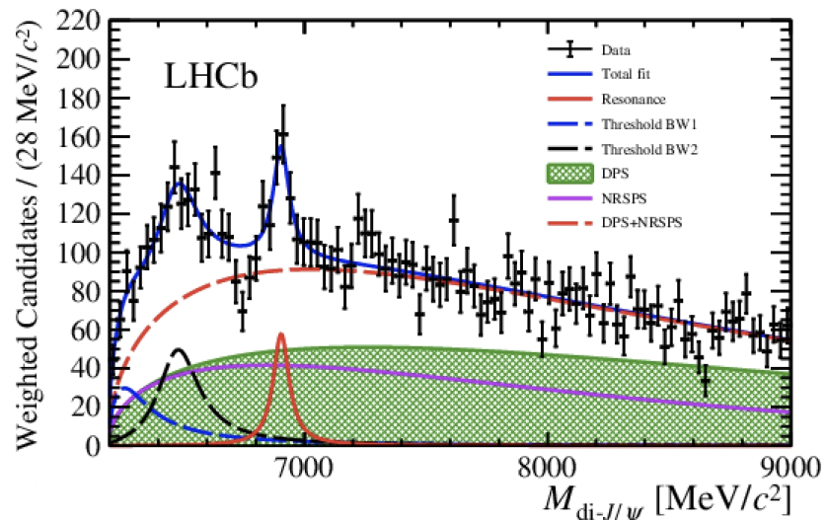
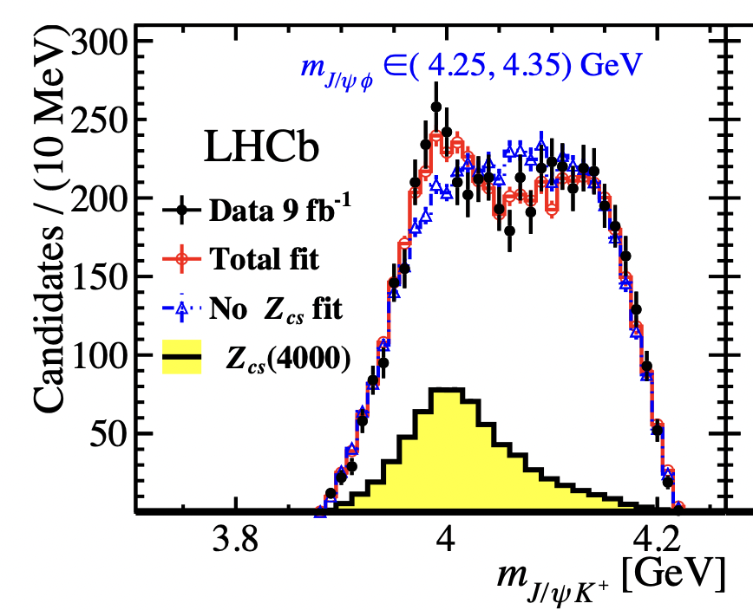
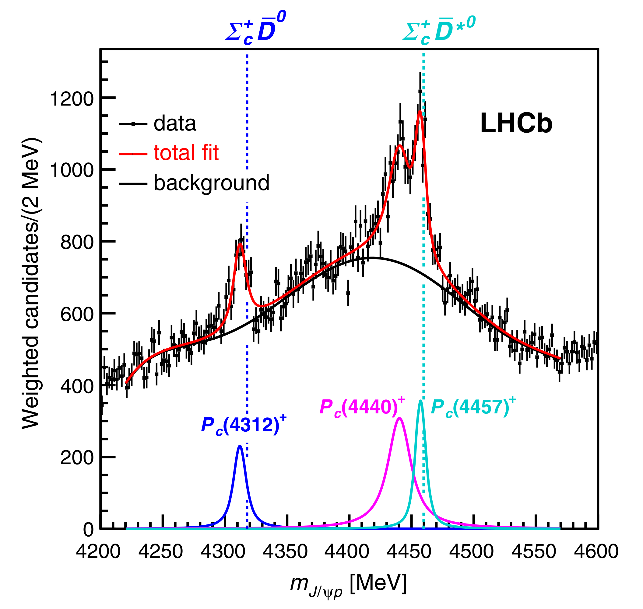
Manifestly exotic
T_{ψψ}(6900): di-ψ resonance ^{[4]}
Pentaquarks
by LHCb in 2015 in Λ_{b}➞J/ψpK ^{[1]}
Tetraquarks
9 fb⁻¹
^{N}
Z_{cs}(4000)⁺ (→ T^{θ}_{ψs1}) ^{[3]}
P_{ψ}(4312)⁺ + 2 peaks at 4450 MeV ^{[2]}
9 fb⁻¹
Doubly-charm tetraquark T_{cc}(3875)^{+ [5,6]}
[1] PRL 115, 072001 (2015)
[2] PRL 122, 222001 (2019)
[3] PRL 127, 082001 (2021)
[4] Sc. Bull. 2020 65(23)1983-1993
[5] Nature Physics (2022),
[6] Nature Comm., 13, 3351 (2022)
Notes:
On the contrary, many states which are manifestly exotics have been observed by LHCb, and among them we annoverate the pentaquarks which have been observed by LHCb in the Lambda_b as states of Jpsip performing an amplitude analysis with Run1 data. Two states have been seen, a narrower one at mass 4450 and a broader at mass 4380
The meas has been extended with full data set with a 1D fit, a new state have been observed at mass 4312 and it was possible to resolve the old peak at mass 4450.
Other states fall in the tetraquark category and are tetraquark with s, 4 charm state and the doubly charm tetraquark

Slide 19
Other pentaquark evidences
^{Λ}
^{N}
Evidence for P_{ψs}(4459)
in 𝛯_{b}⁻→ 𝑱/𝝍Λ𝑲 at 3.1σ
Evidence for P_{ψ}(4337)
in B_{s}→𝑱/𝝍𝑝p̄ at 3.1σ
⇒ pentaquark with strangeness
at 𝛯_{c}⁰D^{*0} threshold
^{N}
⇒ P_{ψ} in B meson decay
J^{P} = ½⁺ for P_{ψ}⁺ preferred (?)
^{N}
Sci.Bull. 66 (2021) 1278-1287
PLB 772 (2017) 265-273
PRL 122, 191804 (2019)
PRL 128, 062001 (2022)
Notes:
After the pentaquark discovery in 2015, we reach evidences for two pentaquark states.
I want to mention 2 analysis where we got an evidence for such states. The first is the evidence for a pentaquark with strangeness in the Csi decays decaying to JpsiLambda and the second one is the evidence of a pentaquark in Bs meson decay which decays in Jpsip and Jpsipbar.

Slide 20
New Tetraquarks

Slide 21
Observation of doubly charm tetraquark
Nature Physics (2022); Nature Communications 13, 3351 (2022)
First observation of same-sign
double charmed tetraquark, T_{cc}⁺(3875)
⇒ exotic quark content ccūd
Mass close to D^{*+}D⁰ threshold and very narrow
Consistent with isoscalar J^{P}=1⁺
Notes:
LHCb has recently observed a new tetraquark, doubly charmed state, with exotic quark content. Its a very narrow state with mass at the DD th. Consistent with an isoscalar

Slide 22
Tetraquark candidates in B→DDh
LHCb-PAPER-2022-026
LHCb-PAPER-2022-018

Slide 23
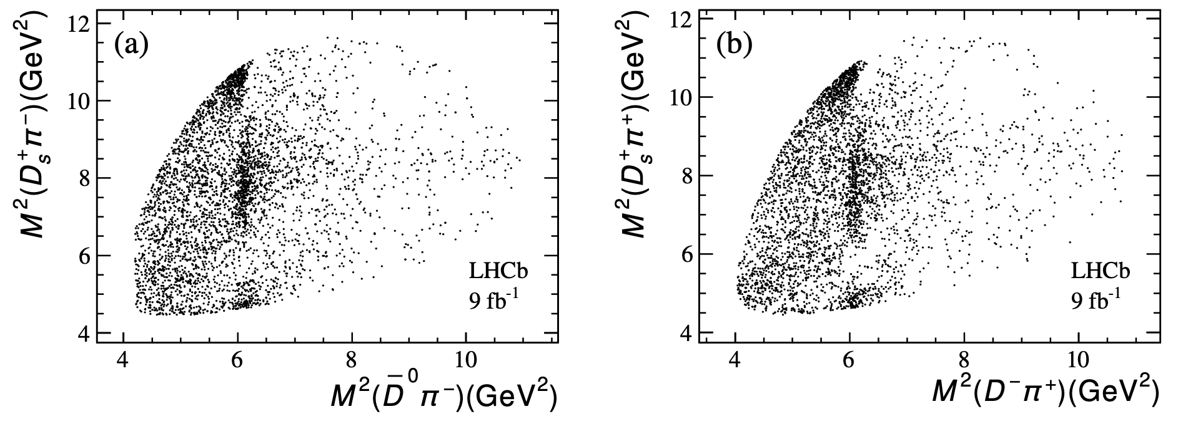
Dalitz plot of B^{0/+}→D^{0/-}D_{s}⁺π^{-/+} decays
LHCb-PAPER-2022-026
Signal yields: ~4000 with 90% signal purity 3750 with 95% signal purity
preliminary
preliminary
Clear vertical band at M²(Dπ)~6 GeV²: D₂*(2460)
Horizontal band at M²(D_{s}π)~8.5 GeV²
⇒ tetraquark candidates?

Slide 24
→ D_{s}⁺π^{-/+} states
LHCb-PAPER-2022-026
Not well described, even adding new D**
preliminary
preliminary
preliminary
Inclusion of a single resonance in D_{s}π
with significance > 9σ
J^{P}= 0⁺ preferred at 7.5 σ
preliminary
preliminary
(RBW)
Consistent masses → Isospin partners

Slide 25
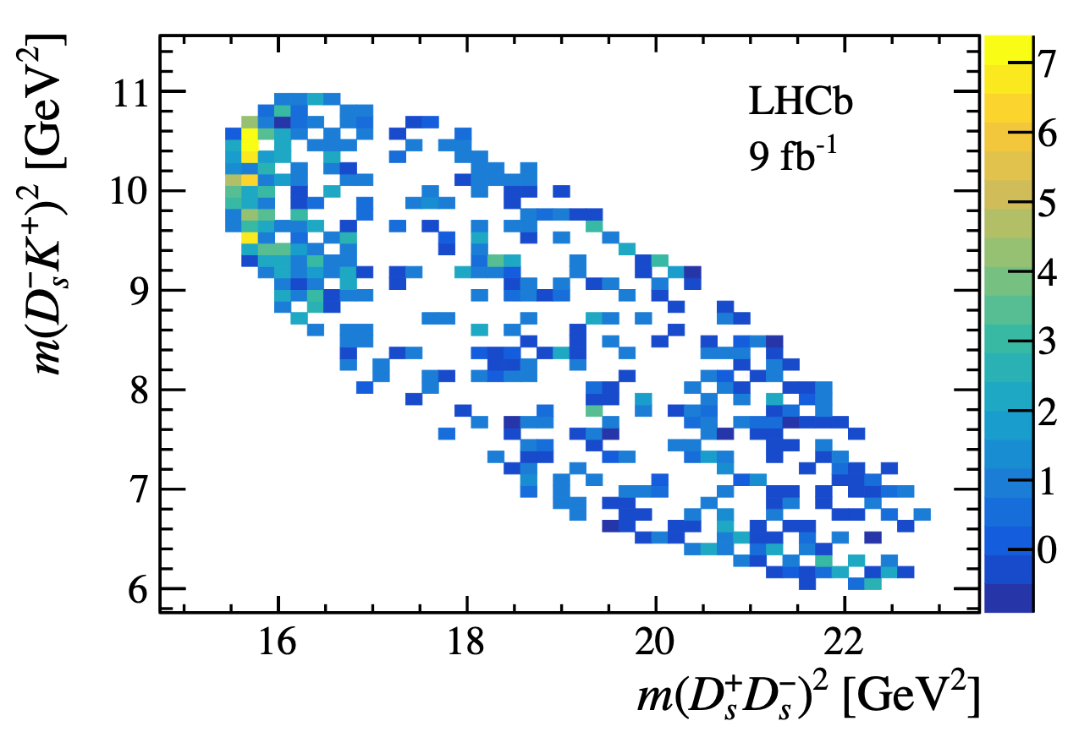
New X(3960) → D_{s}⁺D_{s}⁻
LHCb-PAPER-2022-018
Signal yield: 360 events with 9 fb⁻¹
Near threshold enhancement in D_{s}⁺D_{s}–
Baseline model:
0⁺⁺: X₀(4140), NR, + new X(3960)
1⁻ ⁻: ψ(4260), ψ(4660)
X(3960) describes the near-threshold enhancement
X₀(4140) to describe the dip at ~4.14 GeV via interference
preliminary
preliminary
preliminary

Slide 26
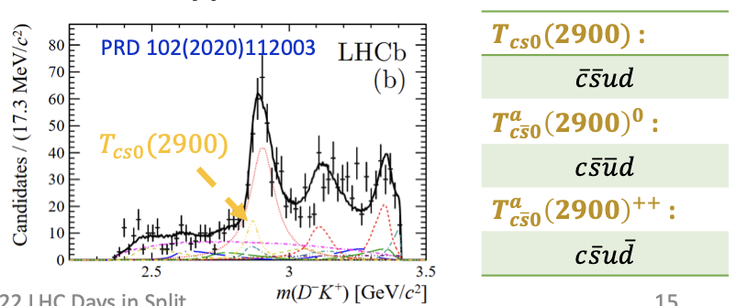
Summary of new tetraquark states
First tetraquark candidates
composed of and
first doubly charged tetraquark
isospin triplets
flavour partners of T_{cs0}(2900) observed in B⁺ → D⁺D– K⁺ [1]?
Same state as χ_{c0}(3930)?
Exotic or conventional state?
not compatible with predicted mass
conventional charmonium predominantly decay to D^{(*)}D^{(*)},
while:
⇒ more precise measurements are needed
[1] Phys. Rev. D, 2005, 72: 054026, PRD, 2009, 79: 094004
[2] JHEP 06 (2021) 035, Sci. Bull., 2021, 66: 1413

Slide 27
Pentaquarks

Slide 28
B⁻ → J/ψΛp decays
LHCb-PAPER-2022-031, arxiv:2210.10346
Search for pentaquark candidates in J/ψΛ and J/ψp̄
Full LHCb dataset: 9 fb⁻¹
⇒ 4600 candidates in 2.5σ around peak with 93% of purity
Narrow structure in J/ψΛ
Activity in J/ψp̄
Possible reflections from K*_{2,3,4} ?
⇒ need for a full amplitude analysis
preliminary
Notes:
We analyses the full dataset corresponding to 9 inv fb and obtained 4 th 600 hundred candidated in the 2.5 sigma window around the peak with 93% of purity as can be seen from the inv mass fit on the right.
Looking at the phsp distribution,

Slide 29
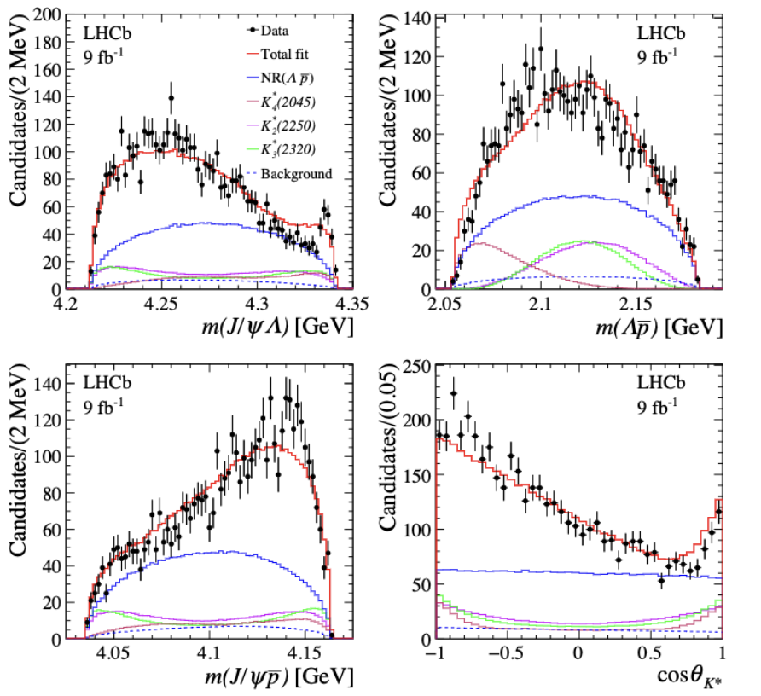
Model with only K*
LHCb-PAPER-2022-031, arxiv:2210.10346
Amplitude contributions:
NR(p̄Λ)
K^{*+}_{2,3,4}
preliminary
preliminary
→ peaks out of phsp, no obvious contribution in p̄Λ distribution
PDG 2020
preliminary
preliminary
Model with K* cannot describe data
Goodness-of-fit test
Notes:
This model cannot describe data as seen from the GoF → in particlular as can be seen from the m(JpsiL) inv mass.

Slide 30
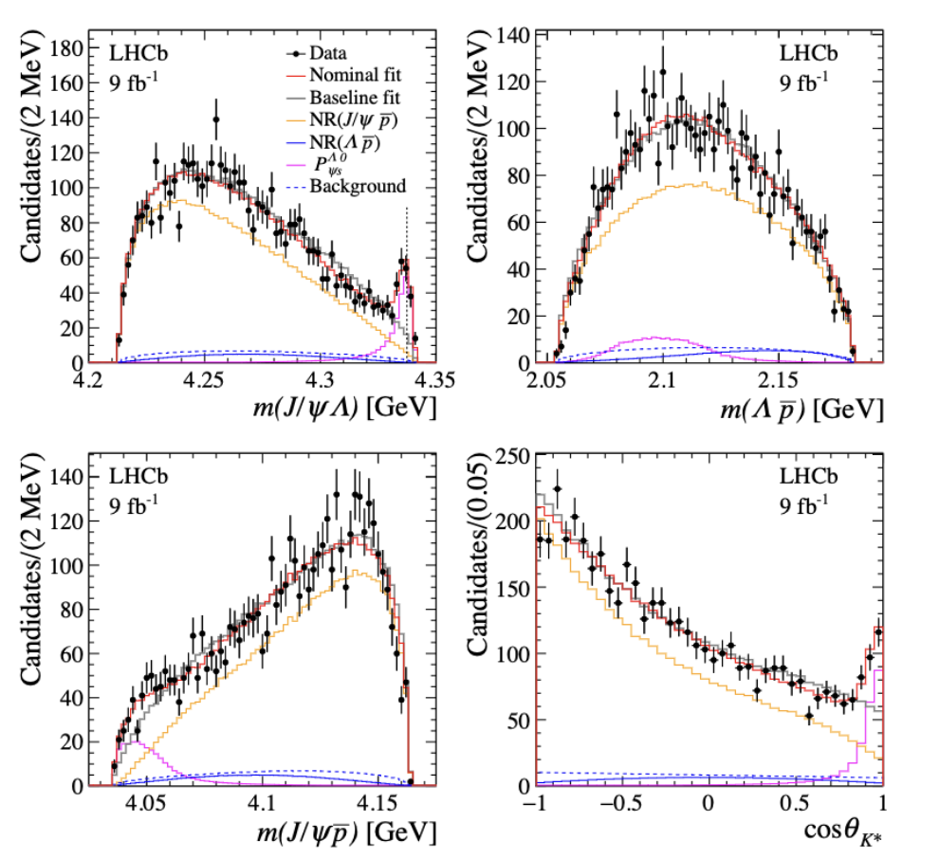
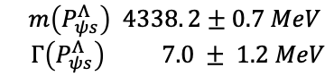
Pentaquark with strangeness in J/ψΛ
LHCb-PAPER-2022-031, arxiv:2210.10346
Amplitude contributions:
NR(p̄Λ), NR(p̄J/ψ), P_{ψs}(J/ψΛ)
^{Λ}
Mass and width (RBW) measured:
with significance >10σ
⇒ Spin-parity:
J = ½ determined
P = -1 favored, ½⁺ rejected @90% CL
Notes:
This fit results in a new state with mass equal to 4338 and a very narrow width of 7 MeV, and a fit fraction of 12%.
We assessed the spin of this state to be ½ and negative parity is preferred. Indeed positive parity can be discarded at 90% of CL.
From the WIlk’s theorem we extracted a significance above 10 sigma.

Slide 31
Discussion on the new J/ψΛ state
LHCb-PAPER-2022-031, arxiv:2210.10346
For theoretical interpretation
narrow and close to 𝛯_{c}⁺D⁻ threshold
not compatible with state outside the phsp
pentaquark with strangeness due to SU(3) symmetry
^{Λ}
First pentaquark candidate P_{ψs}(4338)
with strange quark content ,
⇒ first pentaquark with spin-parity
determined at 90%CL → J^{P}=½⁻
𝛯_{c}⁺D⁻

Slide 32
Conclusion & Prospects
Exotic contributions
New tetraquark: T_{cc}⁺, T_{cs0} (2900)^{0,++}
First pentaquark with strangeness
Spectroscopy of heavy hadrons
excited b and c hadrons
bc searches already started
We are looking for collaborators for LHCb Upgrade 2
→ pleased to have you onboard!
2022-2025
2029-2032
2035-...
Upcoming Run 3 data:
higher integrated luminosity
new detector with fully software-based trigger
⇒ Boosting data to a new level!
x2 by Run3, x7 by Run4
(+ improvements of analysis skills)
Notes:
With run3 we are boosting to a new level.

Slide 33
Conclusion & Prospects
More investigation of the observed states:
Confirm P_{c} and P_{cs} states
Measure quantum numbers
Many new states to explore:
Observation of Ξ_{cc}⁺, Ω_{cc}⁺?
Access to bc tetraquarks and pentaquarks and bb spectroscopy
Search for exotic flavour multiplets
Thank you for listening!

Slide 34
Backup slides

Slide 35
New naming scheme
LHCb-PUB-2022-013, arxiv2206.15233
Impact on existing states
No PDG rule for
exotic mesons with s, c, b quantum numbers
no extension for pentaquark states
Idea of the proposal
T for tetra, P for penta
Superscript: based on existing symbols, to indicate isospin, parity and G-parity
Subscript: heavy quark content

Slide 36
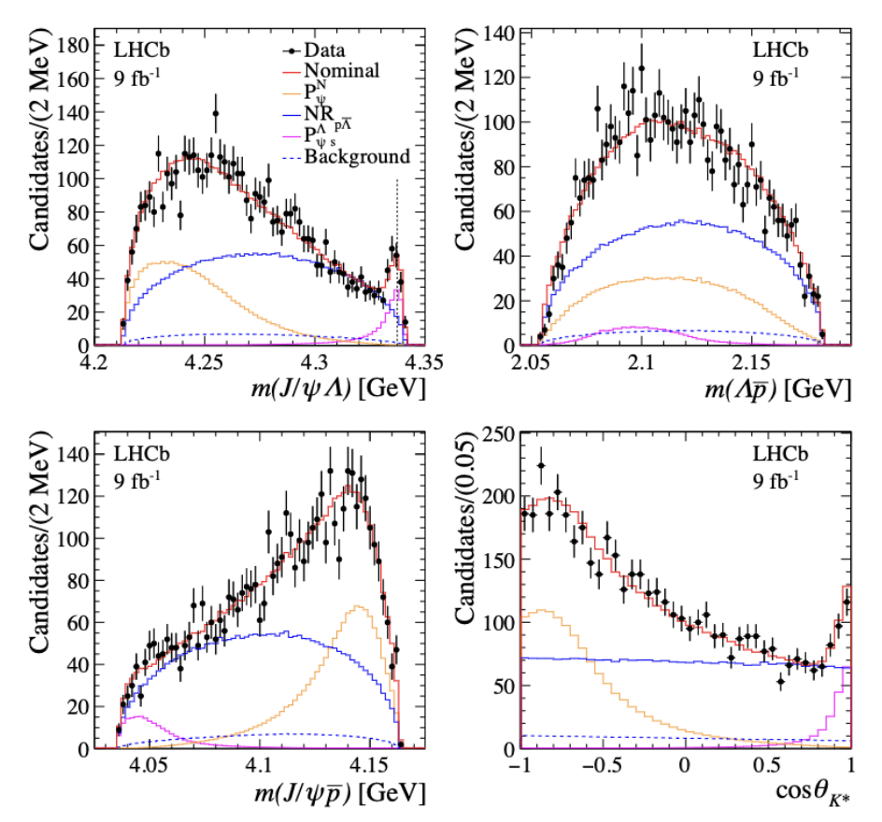
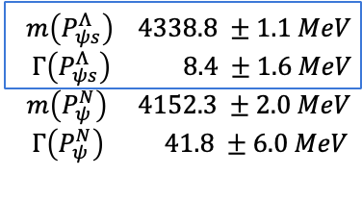
P_{ψ} contributions in pJ/ψ?
^{N}
Amplitude contributions:
NR(p̄Λ)
NR(p̄J/ψ)
P_{ψs}(J/ψΛ)
preliminary
preliminary
BW(P_{ψ}) J^{P}=½⁻
^{Λ}
^{Λ}
Compatible P_{ψs} results
preliminary
preliminary
-logL decreases by 80 wrt nominal model
Model with NR polynomial is preferred,
not very sensitive to p̄J/ψ structures with current statistics
Notes:
We BW

Slide 37
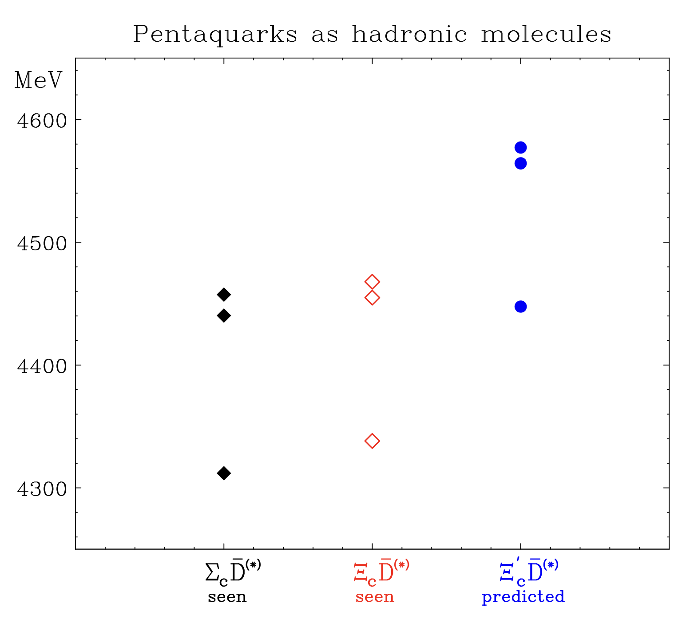
Molecular interpretations for P_{cs}
Phys. Rev. D 106, 036024
Vicinity to the relevant baryon-meson threshold: 0.8 MeV above 𝛯_{c}⁺D⁻ threshold
Spin-parity: states in S-wave as the hadronic molecules
Narrow width: 7 MeV is unnaturally small given the Q-value of the decay (~126 MeV).
Decay requires the charm and anti-charm quarks getting close, but the distance between is 𝛯_{c}⁺ and D⁻ >> 1fm ⇒ suppression mechanism
Prediction of states at 𝛯_{c}’D thresholds

Slide 38
New pentaquark: P_{c}(4337)
PRL 128, 062001 (2022)
In B⁰_{(s)}➞𝑱/𝝍pp̄ decays: ~800 events
4D amplitude analysis
in Φ=(m_{pp}, cosθ_{l}, cosθ_{v}, φ)
Evidence for a structure in 𝑱/𝝍p and 𝑱/𝝍p̄
No evidence
for P_{c}(4312)
nor for f_{J}(2220) glueball^{[1]}
Peculiar that:
P_{c}(4312) only in Λ_{b} decays
P_{c}(4337) only in B_{s} decays
^{[1]}Eur. Phys. J. C75 (2015), no. 3 101
Notes:
LHCb is a factory of exotic state! This is a result of a

Slide 39
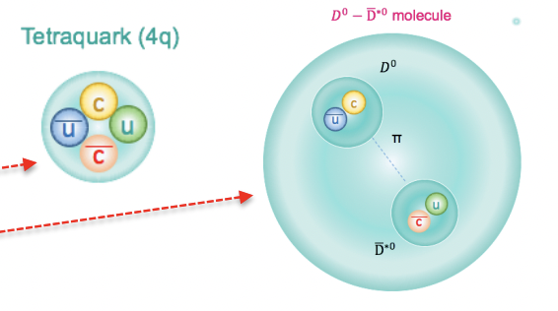
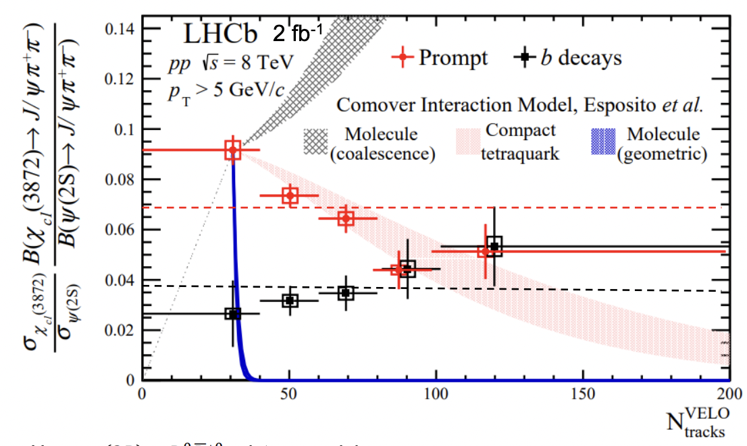
χ_{c1} production in pp @ LHCb
PRL 126 (2021) 092001, JHEP 01 (2022) 131
Differential cross section ratio of χ_{c1}(3872) relative to ψ(2S)
Both in prompt pp collisions and from b-hadron decays
Measured as a function of track multiplicity, p_{T} and y
Separate a compact tetraquark (r<1 fm) from a large-sized molecular state (r~10 fm)
Prompt ratio is suppressed as multiplicity increases (5σ)
→ compact tetraquark model favored
→ Dominated by comover breakup^{[1]}:
small radius = decrease of xsection ratio
^{[1]}PRD 103 (2021) 7, EPJC 81 (2021) 669
Notes:
LHCb has measured diff xsection. Prompt ratio is suppressed as multiplicity increases and this favors the compact model scenario since it is dominated by the comover breakup. Indeed the breaskup xsection increases with the radius of the state.

Slide 40
What happens in HI collisions?
LHCb-CONF-2022-001
Production of χ_{c1}(3872) in pPb collisions to help understand the dynamics
Formation of QGP could enhance the χ_{c1}(3872) production through the quark coalescence mechanism
ψ(2S) is suppressed in pPb and Pbp
χ_{c1}(3872) production may also be enhanced as in PbPb collisions
Increasing trend:
at high density quark coalescence can become the dominant mechanism affecting χ_{c1} production
But still large uncertainties
Molecule, tetraquark or a mixture?
Notes:
Production in pPb can shed light on the interplay between low and high multiplicity systems. LHCb analyses pPb collisions, and measure a suppression of psi and an increase of chi_c1. At high density quark coalescence mechanism can become dominant. But still the large uncertainties do not allow to draw conclusions. The nature of chic1 is not clear?

