Slide 1
Belle II Perspectives for Baryon Physics
John Yelton
U. of Florida
yelton@ufl.edu
1. Recent results from Belle II on charmed baryon lifetimes
2. Some selected examples of future Belle II analyses
NSTAR Conference, October 2022, Santa Margherita Ligure

Slide 2
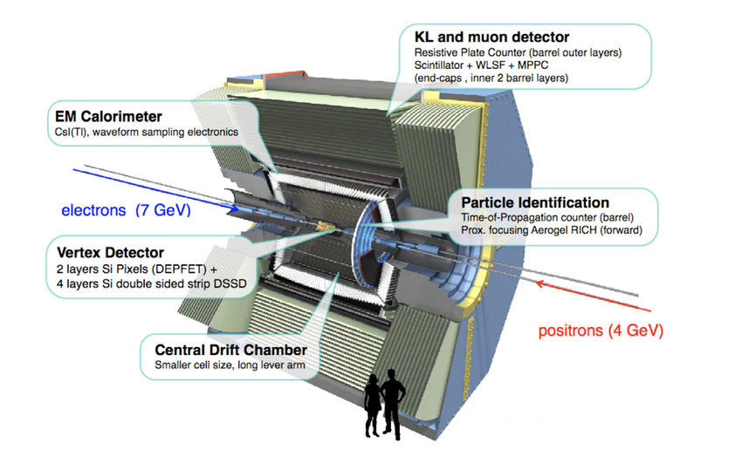
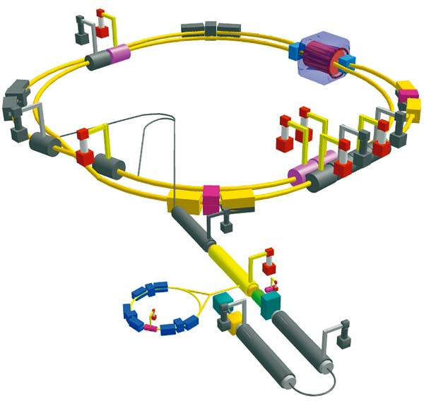

Slide 3
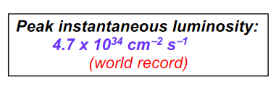
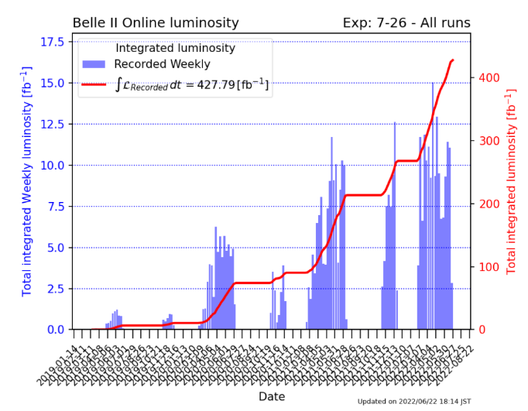
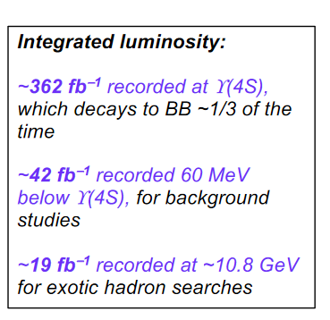
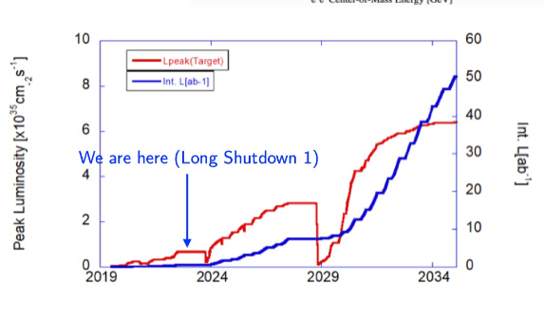
BELLE II Luminosity
2022
Previous record instantaneous luminosity 2.1 x 10³⁴ cm⁻²s⁻¹
Belle integrated luminosity 1000 fb⁻¹
BaBar integrated luminosity 500 fb⁻¹

Slide 4
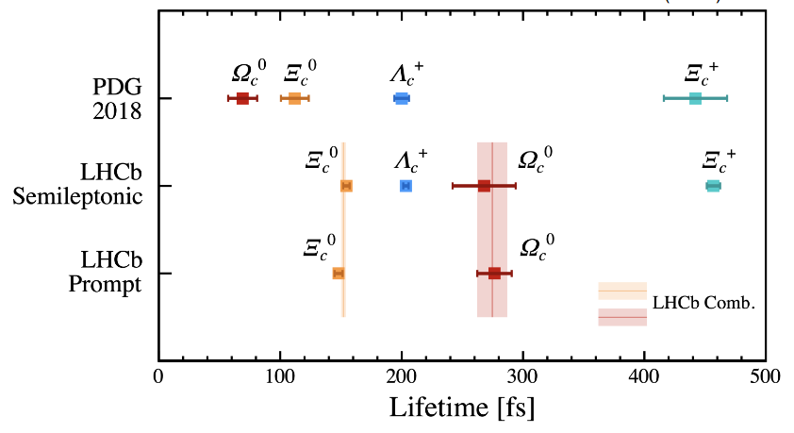
Lifetime measurements of weakly-decaying charmed baryons
Charmed baryon lifetimes are difficult to describe because of the interplay of different decay diagrams including external W-decay spectator diagrams and W-exchange diagrams.
css csd cud cus
Recent LHCb results have turned around the lifetime hierarchy which had been unchallenged for many years

Slide 5
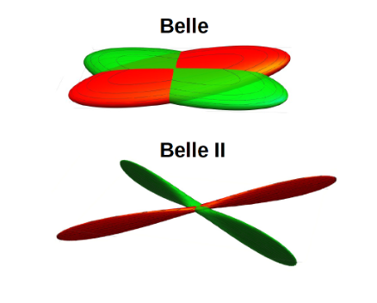
Belle II Lifetime Measurement
New Drift Chamber with longer lever arm than Belle .
60,0000 parameters used for the alignment of the 14336 wires
Not fully instrumented in the current dataset
(Will be after present shutdown)
Beamspot effectively point-like in x,y and small in z
Resolution in pathlength 40 μm (around 87 ps)

Slide 6
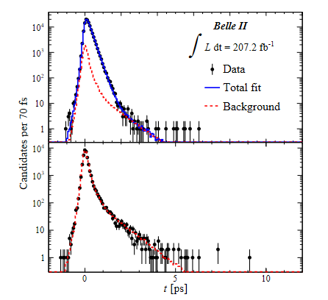
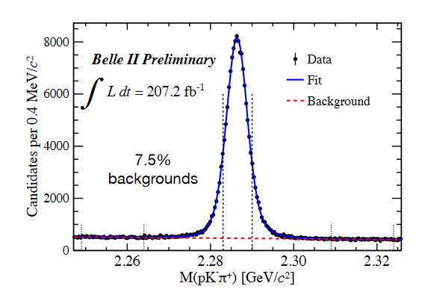
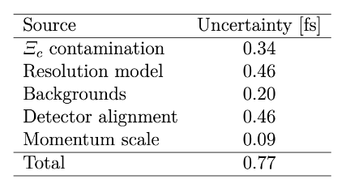
Λ_{c}⁺ Lifetime Measurement at Belle II
Use Λ_{c}⁺ → pK⁻π⁺ decays at high momentum (not from B decays)
Measured Lifetime: 203.20 ± 0.89 ± 0.77 ps
Decays of Ξ_{c}⁰ → Λ_{c}⁺π⁻ (discovered by Belle, measured by LHCb and by Belle)
and Ξ_{c}⁺ → Λ_{c}⁺π⁰ (theoretically estimated and experimentally limited by looking at the distributions in the data)

Slide 7
Belle II result accepted for publication by PRL
arxiv.org/abs/2206.15227

Slide 8
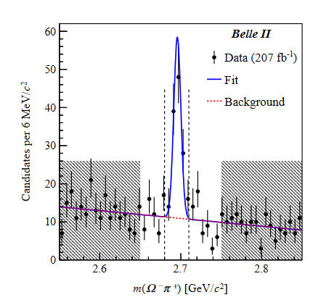
Ω_{c}⁰ Lifetime Measurement
Previous measurements: WA89
s, 86 events, modes: Ω⁻π⁺ π⁻ π⁺, Ξ⁻ K⁻ π⁺ π⁺
Wrong mass!
Decay mode not seen by any other experiment!
${55}_{−25}^{+22}×{10}^{−15}$
E687
FOCUS
LHCb
$${86}_{−30}^{+39}×{10}^{−15}$$
s, 25 events, mode: Σ⁺K⁻ K⁻ π⁺
72$±16×{10}^{−15}$
s, 64 events, modes: Ω⁻π⁺, Ξ⁻ K⁻ π⁺ π⁺
268$±26×{10}^{−15}$
276.5±13.7 $×{10}^{−15}$
s, pK⁻K⁻ π⁺ (in semi-leptonic decays)
s, modes: inclusive pK⁻K⁻ π⁺
For Belle II we knew already that Ω⁻π⁺ was decay mode with the best statistics and signal:noise ratio.
All cut were defined before looking at any lifetime distribution.
132 candidates with a signal purity 66.5%

Slide 9
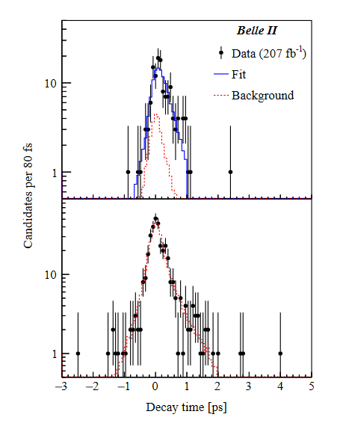
τ(Ω_{c}⁰) = 243 ± 48 (stat) ± 11 (syst) fs
(scaled)
•
BELLE II

Slide 10
Prospect for future BARYON analyses in BELLE II
Look at what has been done recently in Belle, and we can extrapolate
Charmed baryon spectroscopy
Other baryon spectroscopy (e.g. excited strange baryons)
Charmed baryon decay modes
CP Violation in charmed baryons
Clearly too much to say – we can just demonstrate some examples of each

Slide 11
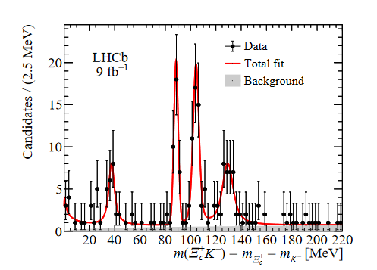
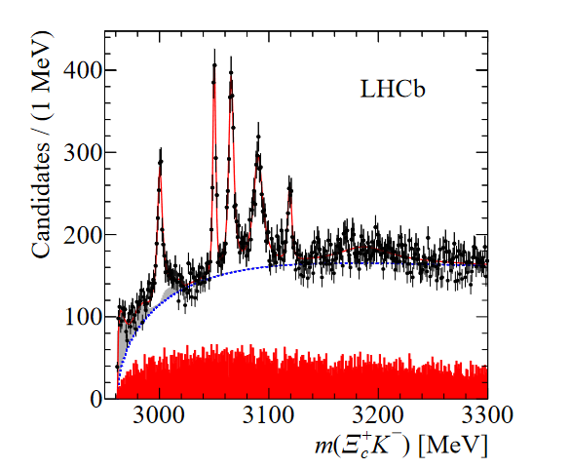
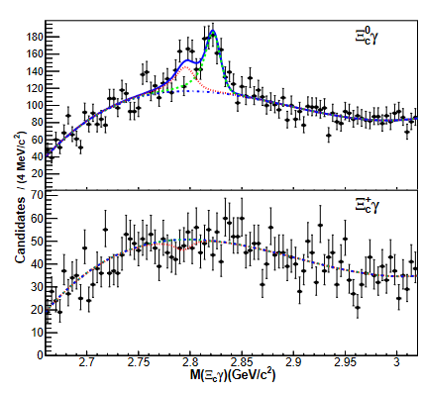
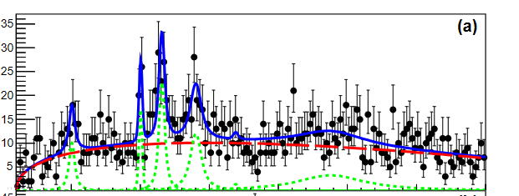
Excited Ω_{c} Spectroscopy
LHCb inclusive
LHCb in Ω_{b} decays
We may not be able to compete with LHCb for the inclusive cross-section of excited states, but:
We have a specific production mechanism that is understood
We will, with enough luminosity, be able to make similar plots with Ξ_{c}/
We can also look for electromagnetic decays as we have for Ξ_{c}γ
BELLE

Slide 12
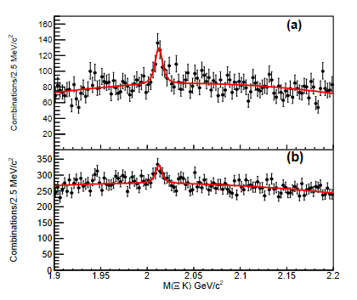
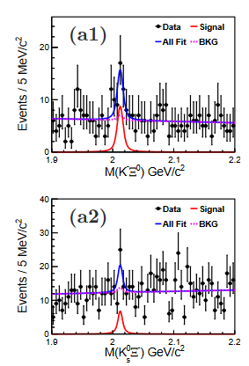
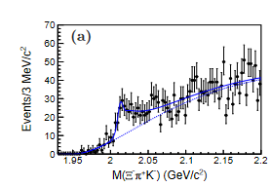
Spectroscopy of (non-charmed) baryons
Many excited singly/doubly/triply strange baryons can be found, particularly in charmed baryons decays
Example: Ω⁻(2012)
Found in narrow resonance data
Confirmed in Ω_{c} decays
Confirmed in 3-body decay (through tail of Ξ(1520))
Strong indication that it is an orbital excitation
J^{P} = (3/2)⁻ state, or a molecular state.
It would be expected to have a (1/2)⁻ partner;
Belle II can look for these and other states.
Other example: Investigation of excited Ξ baryons in Ξ_{c}
decays. Belle II uniquely positioned for this kind of physics.
Preliminary
PRL 121 (2018) 5, 052003
e-Print 2207.03090
Phys. Rev. D 104 (2021), 5, 052005

Slide 13
Charmed Baryon Decays: Branching Fractions
Λ_{c}⁺ has two measurements of the absolute branching fraction: BES III (pK⁻π⁺) 5.84 ± 0.27 ± 0.23%
Belle (pK⁻π⁺) 6.84 ± 0.24^{+0.21}_{-0.27}%
This “tension” needs to be resolved. If absolute branching fraction is 6.4% or so, all major decay modes have been discovered and only “rare” decays searches remaining.
Ξ_{c}⁺ has one measurement of the absolute branching fraction: Belle (Ξ⁻π⁺π⁺) 2.86 ± 1.21 ± 0.38%
Statistically limited!
Many decay modes remain unmeasured or poorly measured. Not close to getting the overall picture of decays.
Ξ_{c}⁰ has one measurement of the absolute branching fraction: Belle (Ξ⁻π⁺) 1.80 ± 0.50 ± 0.14%
Belle (ΛK⁻π⁺) 1.07 ± 0.37 ± 0.09%
Statistically limited!
Many decay modes remain unmeasured or poorly measured. Not close to getting the overall picture of decays.
Ω_{c}⁰ has NO measurement of the absolute branching fractions.
Clearly the lifetime saga shows us that Ω_{c}⁰ decays have not been understood.
BELLE II/BES III will both contribute
BELLE II best placed to contribute
BELLE II best placed to contribute
BELLE II best placed to contribute
For instance B(Ω_{c} →Ω⁻π⁺π⁻π⁺)/ B(Ω_{c} →Ω⁻π⁺ ) = 0.31 ± 0.05
whereas B(Λ_{c}⁺ →Λπ⁺π⁻π⁺)/ B(Λ_{c}⁺ →Λπ⁺ ) = 2.80 ± 0.27

Slide 14
CP violation searches using charmed baryons
CP violation in baryons very important to understand (baryon asymmetry in the universe……)
CPV in baryons has to be direct as there is no mixing between particle and anti-particle
Some clear experimental advantages over searches in B-baryons:
e⁺e⁻ machines can get good signals for many charmed baryon modes
comparatively low multiplicity makes for final states that are easier to analyze
Looking for CPV in charmed baryon decays is a several step process:
Choose a suitable decay mode and measure the branching fraction
(Nothing measurable expected in Cabibbo-favored decays)
2. Measure the asymmetry parameter, α
For a decay such as Λ_{c}⁺ → BP (baryon + pseudoscalar meson), the α parameter is defined to be: $\frac{2Re(s.p)}{\begin{aligned}{\left|s\right|}^{2}+|{p|}^{2} \\ \\ \end{aligned}}$
α =
(where s and p are the parity-violating s-wave and the parity-conserving p-wave amplitudes in the decay)
3. Measure the difference in the asymmetry parameters for particles/antiparticles
(Note that Belle II has excellent hyperon detection efficiency and purity)

Slide 15
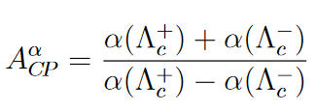
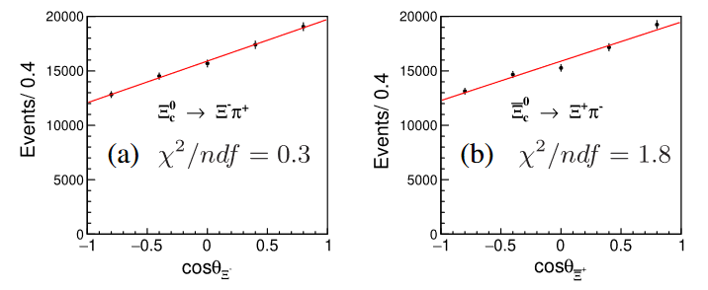
Example Search for CP Violation in Charmed Baryons - BELLE data
Asymmetry measurement of the (Cabibbo-allowed) decay Ξ_{c}⁰→Ξ⁻ π⁺
α Is the slope of the line of dN/dcos(θ)
For Ξ_{c}⁰
No Evidence of CP Violation
Y.B. Li et al, PRL 127, 121803 (2021)
Baryons Anti-Baryons
Ξ
Ξ
Ξ
Ξ
For each 1 ab⁻¹ data expected $A_{CP}^{}$ precision for the Cabibbo-suppressed modes
Λ_{c}⁺ → Λ K⁺ and Σ⁰ K⁺ are ∼0.1 and ∼0.3
Not very precise, but who knows?

Slide 16
CONCLUSIONS
I presented two Belle II Measurements of charmed baryons
Λ_{c}⁺ 203.20 ± 0.89 ± 0.77 fs (world’s most precise measurement)
Ω_{c}⁰ 243 ± 48 ± 11 fs (consistent with LHCb measurement)
I have reviewed some (of the many) lines of research in baryons for which Belle II is uniquely placed
Charmed Baryon Spectroscopy (particularly involving γ decays)
Strange Baryon Spectroscopy (particularly using hyperons in charmed baryon decays)
Charmed Baryon Decay Modes
CP Violation searches
For all of these, Belle II has the working experiment, it is well calibrated and understood, and now all we need is the luminosity

Slide 17
BACKUP

Slide 18
CP violation searches using charmed baryons continued
What sort of modes should we look for?
Λ_{c}⁺ → Λ K⁺ and Σ⁰ K⁺ are the theoretically simplest decay modes to look at
Branching Fractions: (6.1 ± 1.2) x 10⁻⁴ and (5.2 ± 0.8) x 10⁻⁴
(dominated by statistical uncertainty)
At e⁺e⁻ machines:
efficiency and purity are good
Σ⁰→ Λγ efficiency and purity OK
For 1 ab⁻¹ (Belle integrated luminosity, but small fraction of what Belle II WILL take)
Λ K⁺ will have around 10,000 events and statistical uncertainty ∼ 3%
Σ⁰ K⁺ will have around 3,000 events and statistical uncertainty ∼ 6%

Slide 19
CP violation searches using charmed baryons continued
For a decay such as Λ_{c}⁺ → BP (baryon + pseudoscalar meson), the α parameter is defined to be: $\frac{2Re(s.p)}{\begin{aligned}{\left|s\right|}^{2}+|{p|}^{2} \\ \\ \end{aligned}}$
α =
(where s and p are the parity-violating s-wave and the parity-conserving p-wave amplitudes in the decay)
Operationally, for a decay such as Λ_{c}⁺ → Λ K⁺ we define an angle θ_{Λ} , which is the angle between the proton momentum in the Λ frame and the Λ in the Λ_{c}⁺ frame. We divide the data into bins of cos(θ_{Λ} ) and then use the equation:
dN/dcosθ_{Λ} ∝ 1 + α(Λ_{c}⁺ → Λ K⁺) α(Λ → pπ⁻)cosθ_{Λ}
In other words, split the data into bins of cosθ_{Λ} , fit the peak in each one, make a plot, find the slope and extract the product of the α parameters
(α for a Λ is well known)
Luckily for these analyses, the efficiency tends to be rather flat over varying cosθ_{Λ}

