Slide 1
Baryon spectroscopy with the CBELSA/TAPS experiment
Recent results and future plans
R. Beck
University of Bonn
NSTAR2022 , Santa Margherita Ligure, October 17th 2022
Introduction
Some highlights of the CBELSA/TAPS experiment
Impact of the new polarization data
Future plans of the CBELSA/TAPS experiment
Summary

Slide 2
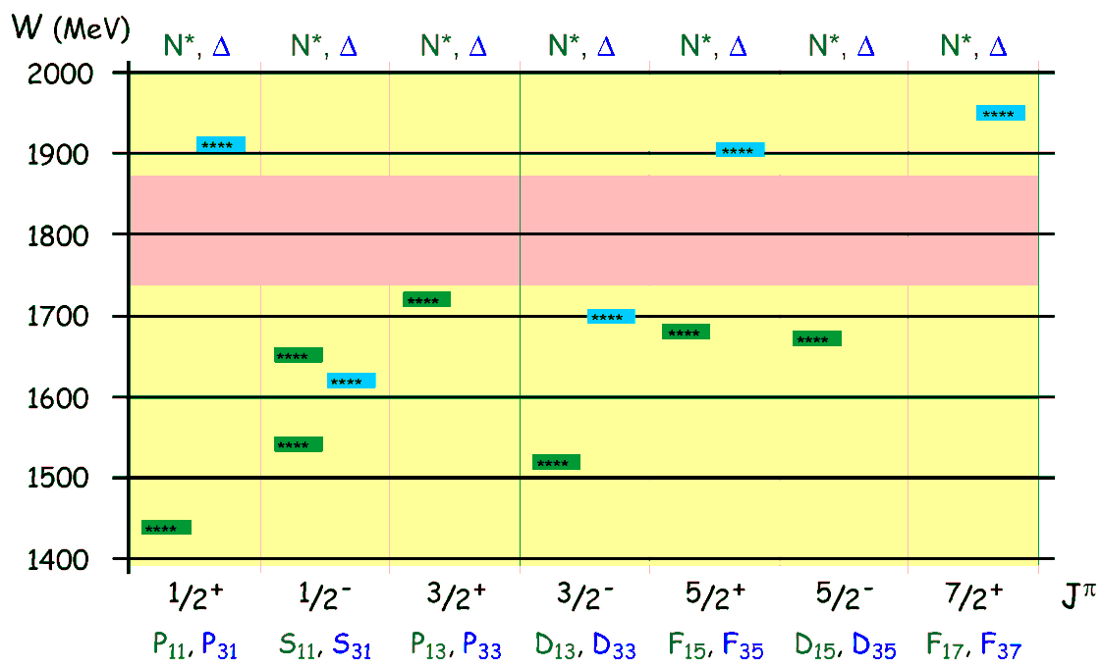
Introduction
Experiments at ELSA: focus on baryon spectroscopy, meson photoproduction
Excitation spectra: information about interaction and dynamics between constituents
Nucleon Excitation Spectrum
mesons
mesons
π
N*,△*
N
baryon
photon
mesons
γ
N*,△*
N
baryon
only 7 N* and 5 Δ* well established in the mass region 1400 MeV < W < 2000 MeV
Energy pattern for the dominant states
Various nucleon models predict many more states
- Constituent Quark Models
- weak coupling to πN final state
Talk: U. Thoma
- Dynamic Models , Lattice QCD
- incomplete data base
Talk: D. Rönchen

Slide 3
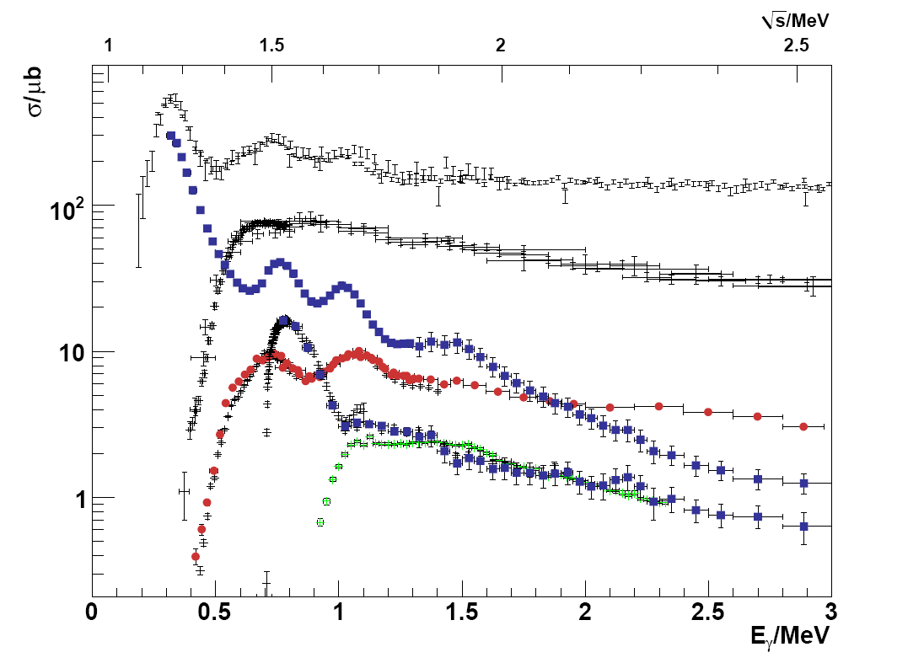
Experimental program for N*
Common effort at ELSA (Bonn), JLab (USA) and MAMI (Mainz)
Talk: D. Carman
Precision data for different final states (pπ⁰, nπ⁺, pη , K⁺Λ, pπ⁰π⁰....)
Talk: P. Pedroni
Polarization experiments (beam, target and recoil)
“complete data base”
To constrain PWA −> unique PWA solution
γ + p −> p + π⁻ + π⁺
γ + p −> p + π⁰ + π⁰
γ + p −> p + π⁰
γ + p −> K⁺ + Λ
γ + p −> p + η

Slide 4
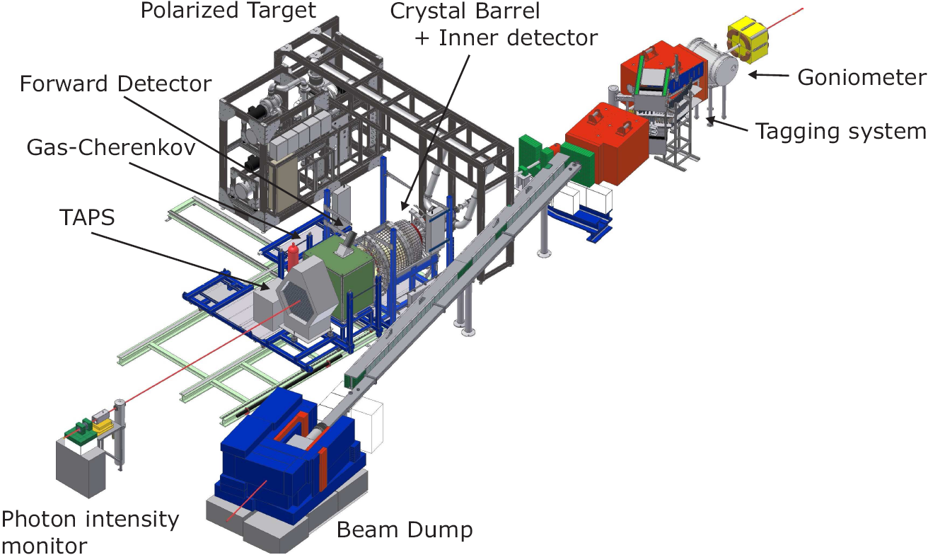
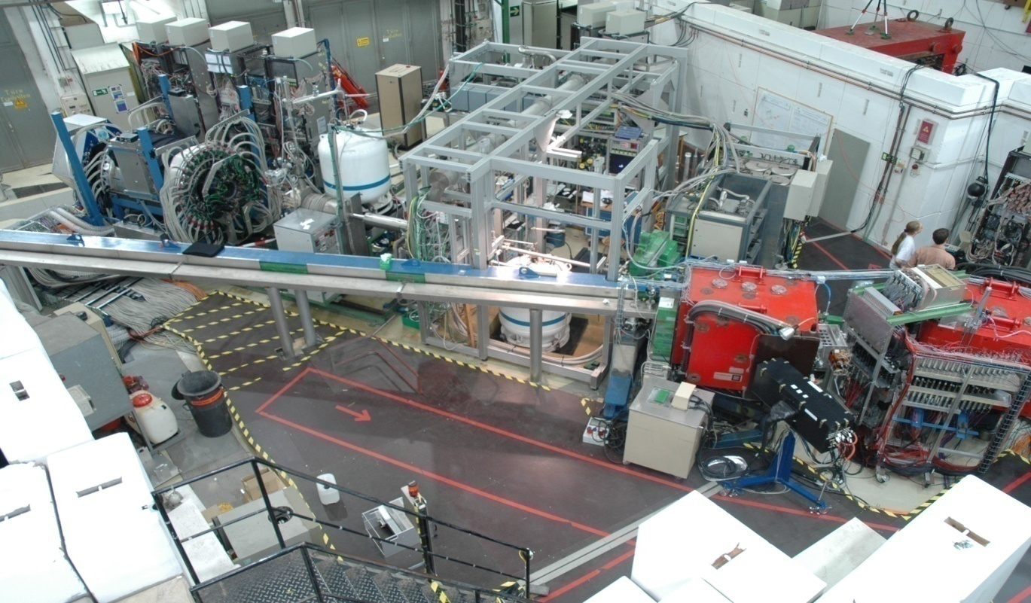
CBELSA/TAPS Experiment
Important:
Polarized beam from ELSA
Polarized targets
4π detector setup

Slide 5
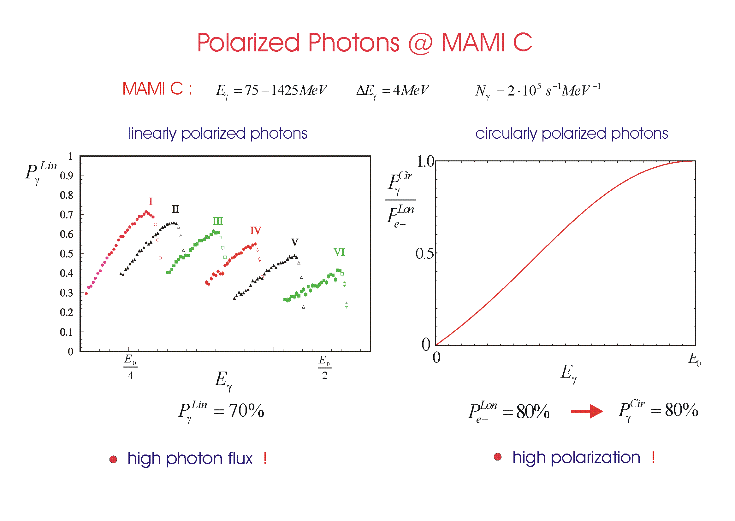
Polarized Photons at ELSA
Linearly polarized photons:
- coherent bremsstrahlung
- diamond radiator
Circularly polarized photons:
- longitudinally polarized electrons
- helicity transfer to photon
Linearly polarized photons
Circularly polarized photons
high polarization at low photon energies
high polarization at high photon energies

Slide 6
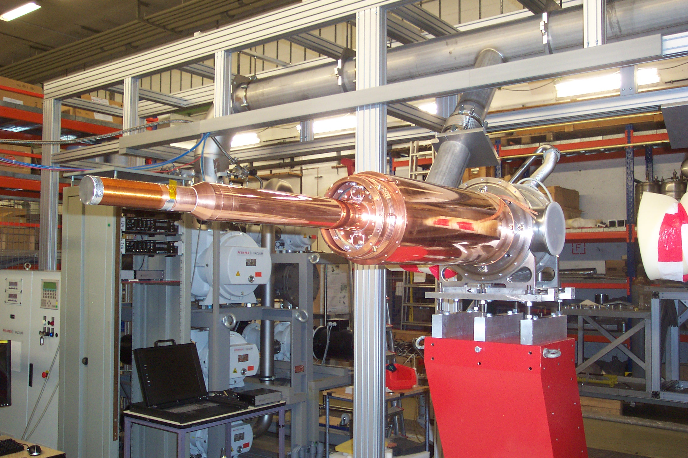
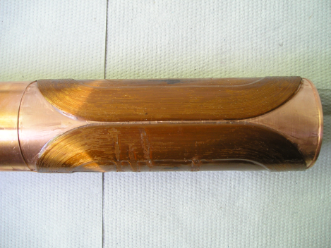
Mainz- Dubna Polarized Target at ELSA
Mainz-Dubna polarized target :
³He⁴He Dilution refrigerator (Mainz, JINR Dubna)
based on Bonn Frozen spin target design
Frozen spin target (25 mK at 0.6 T)
Transverse holding coil (saddle coil at 1.2 K)
Since 2010 in operation with the Crystal Ball
at MAMI, since 2017
Operated and maintained by Bonn, Bochum, Dubna and Mainz polarized target group (H. Dutz, G. Reichertz, Y. Usov and A. Thomas)
Common effort of the Bonn, Bochum, Dubna and Mainz polarized target groups
New second ³He⁴He Dilution refrigerator at Bonn finished and under tests
Corona and the Ukrainian war delayed the final tests

Slide 7
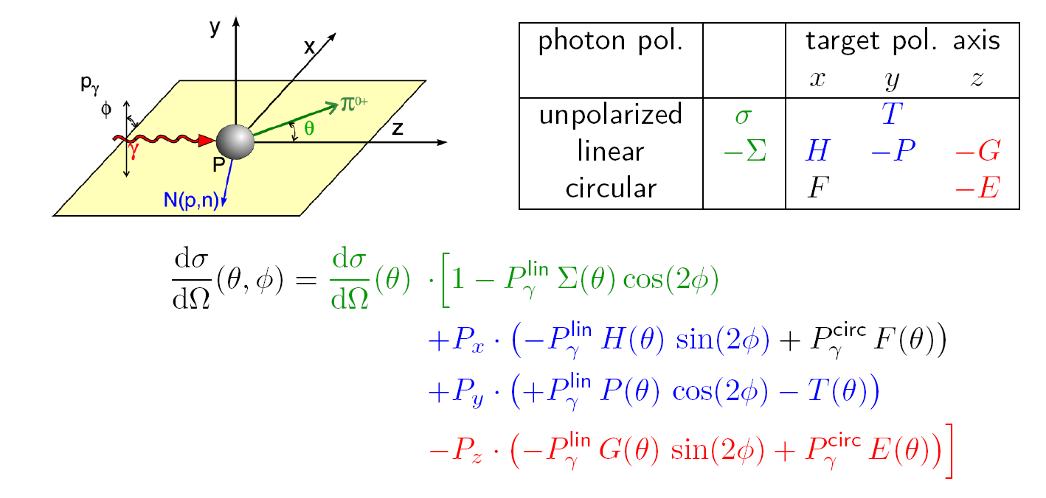
Beam-Target Polarization Observables
photoproduction of pseudoscalar mesons with polarized beam and target :
all three single polarization observables Σ, P , T and cross section σ
4 double polarization observables G , E , F and H
can be measured
ELSA- Experiments:
Data on all three single pol. observables Σ, P , T and diff. cross section σ
and on four double polarization observables G , E and H and (F)
for and

Slide 8
Problem with a Unique PWA Solution
8 well chosen observables have to be measured to determine the production amplitudes (F₁,F₂,F₃ and F₄)
π- threshold until Δ⁺(1232)- region
additional constraints:
(a) s- and p- wave approximation truncated PWA
(b) Fermi- Watson theorem
same I, J in the final state
same scattering phase δ_{IJ}
two observables sufficient for “complete data base”
differential cross section : dσ/dΩ
beam asymmetry : Σ
above ππ- threshold
- Fermi- Watson theorem not valid any more
- More observable needed to get a unique partial wave solution
- Different final states are important -> coupled PWA are essential

Slide 9
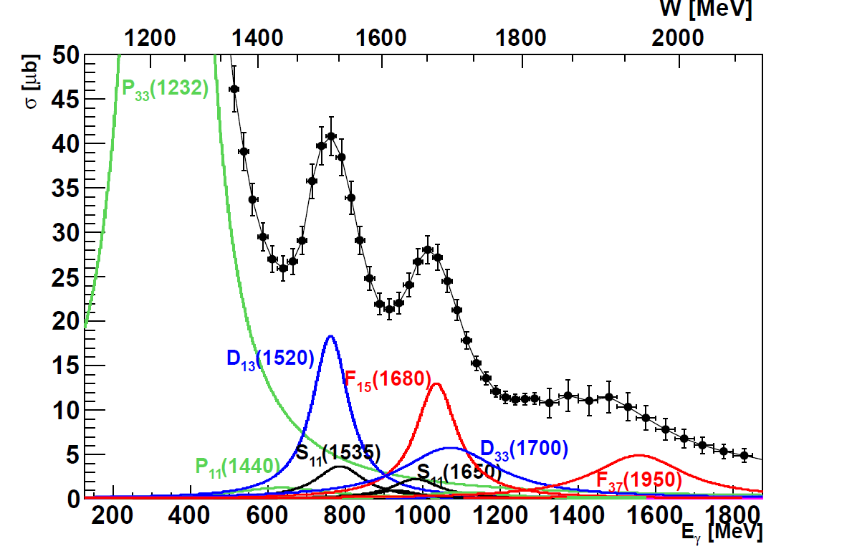
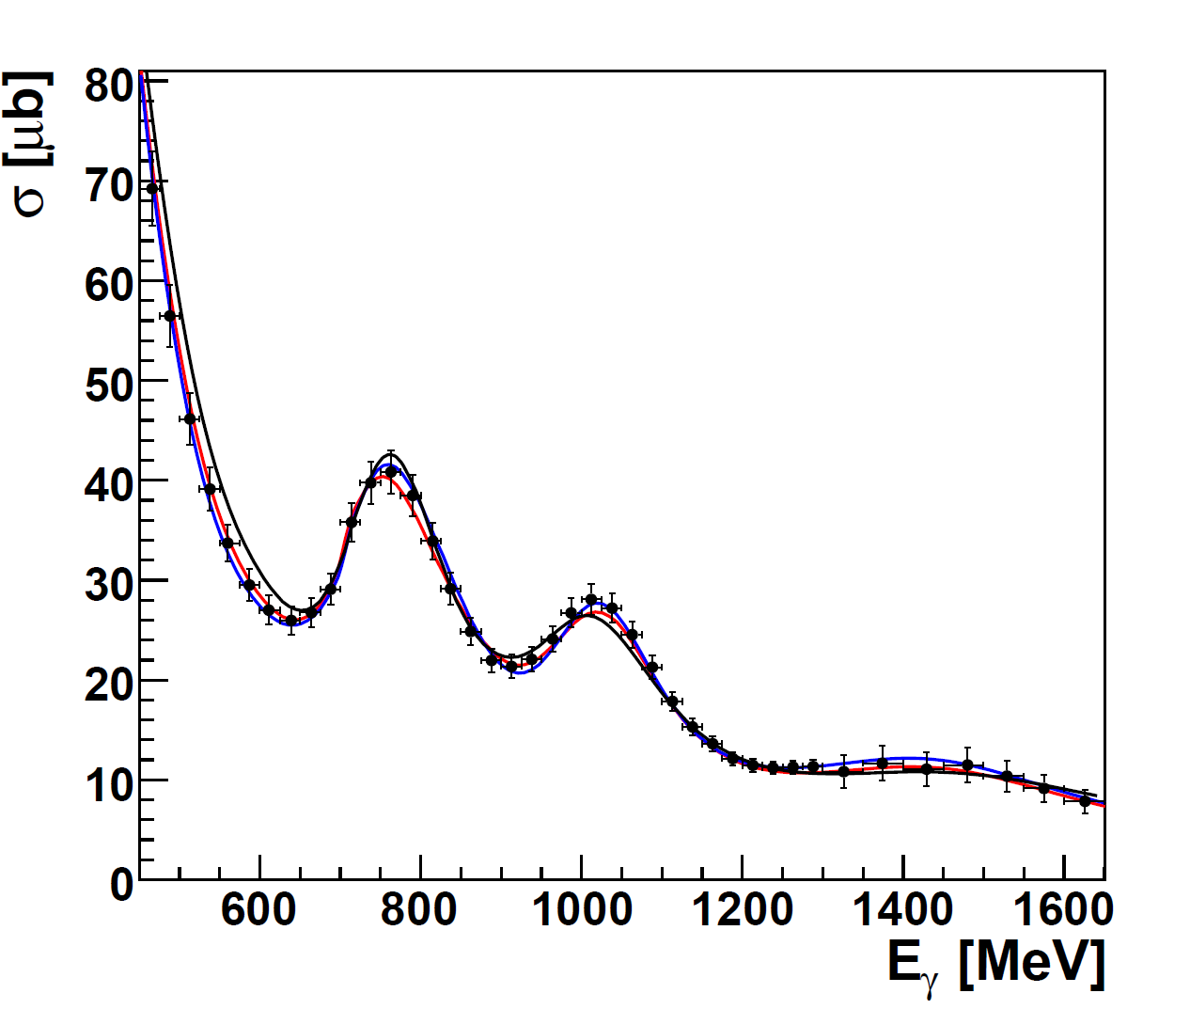
Problem with a Unique PWA Solution
2. resonance region
3. resonance region
Total cross section:
Partial wave analysis:
__ BnGa Bonn-Gatchina group
__ SAID Washington group
__ MAID Mainz group
Total cross section:
σ_{tot} ~ |A(P₃₃)|² + |A(D₁₃)|² + |A(F₁₅)|² + …..
no interferences between resonances

Slide 10
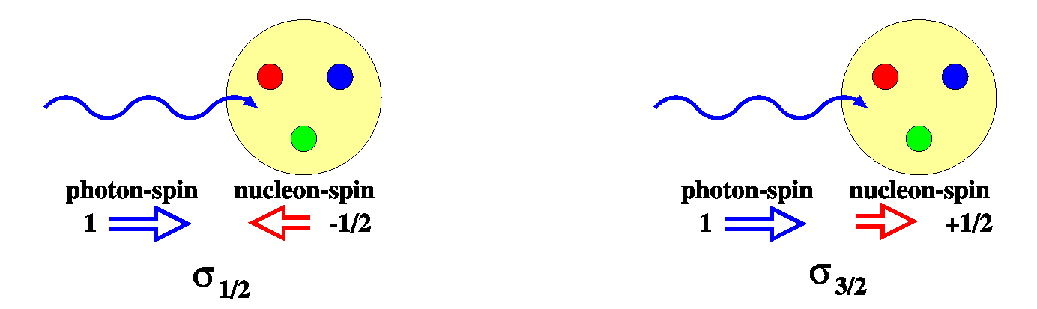
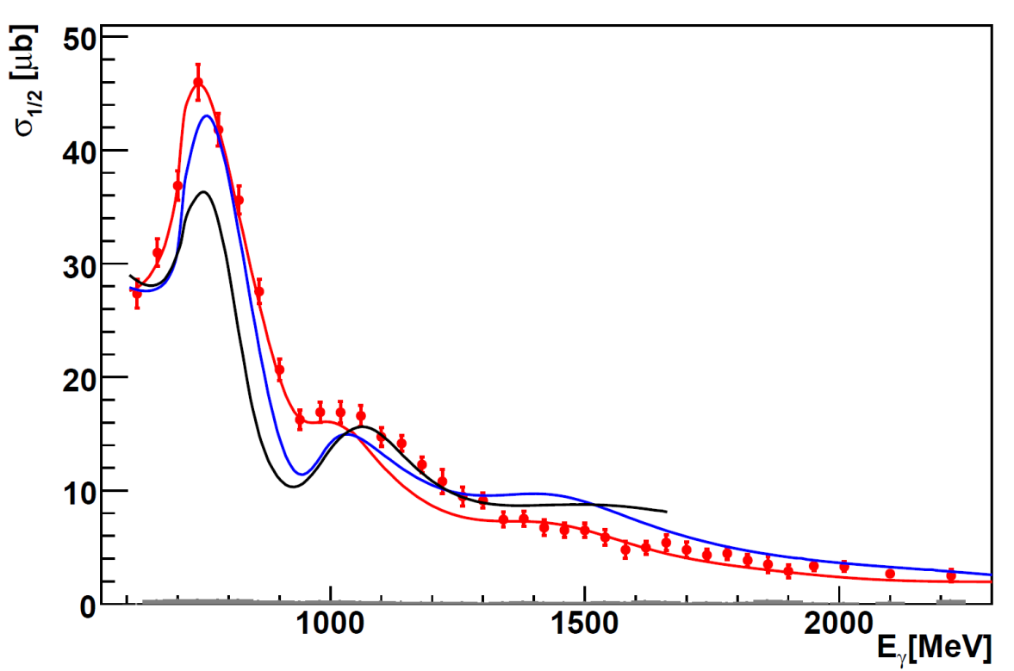
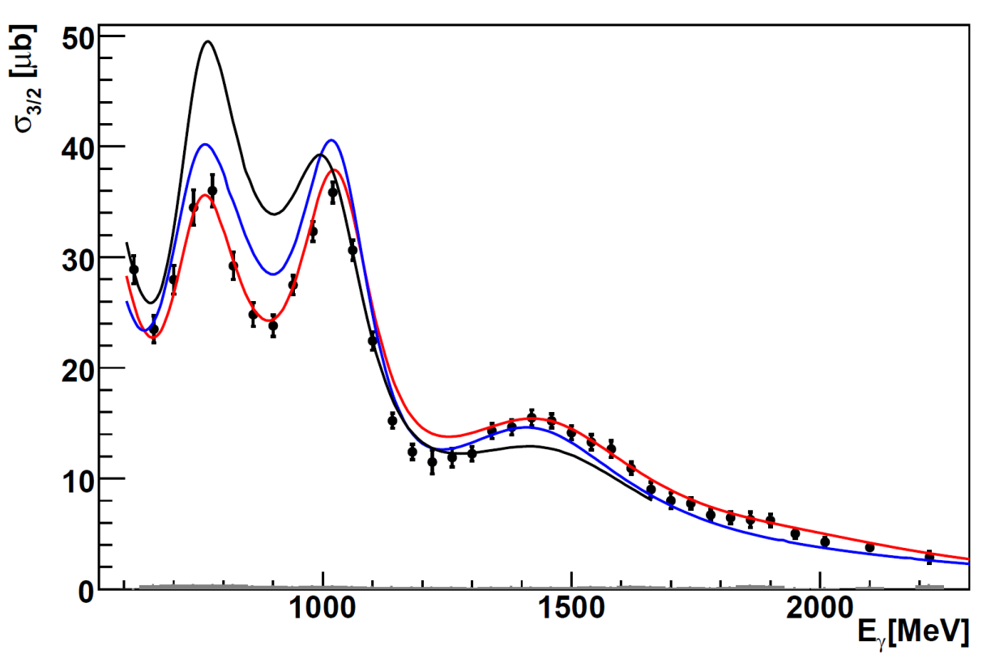
Helicity Dependent Cross Section for pπ⁰
reaction:
circularly polarized photons
longitudinally polarized proton
CBELSA/TAPS , M. Gottschall, PRL 112 (2014), 012003
σ_{1/2}
2. resonance region
σ_{3/2}
2. resonance region
3. resonance region
3. resonance region
4. resonance region
Helicity dependent cross section
σ_{1/2} ~ |A(P₃₃)|² + |A(D₁₃)|² + |A(F₁₅)|² + …..
+ Interference terms with same Lπ
like E₁₊ M₁₊ for P₃₃ or E₂₋ M₂₋ for D₁₃
4. resonance region
Partial wave analysis predictions :
__ BnGa
__ SAID
__ MAID

Slide 11
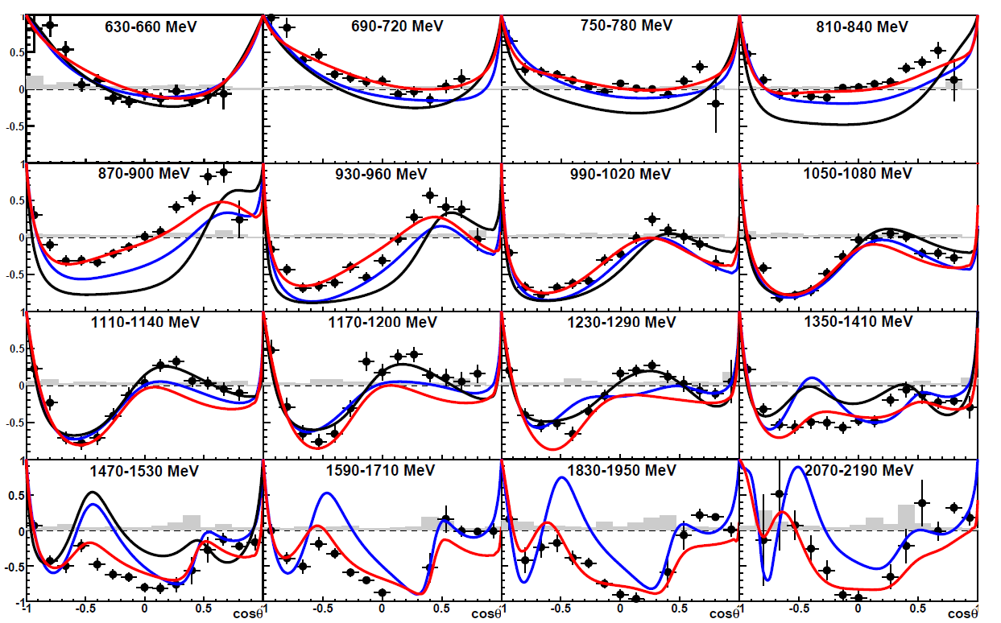
CBELSA/TAPS: Helicity Asymmetry E for pπ⁰
reaction:
CBELSA/TAPS, M. Gottschall, PRL 112 (2014), 012003
σ_{1/2} - σ_{3/2}
E =
σ_{1/2} + σ_{3/2}
Angular distributions
Sensitive to interference terms with different Lπ
Highest sensitivity to small resonance contributions
Partial wave analysis
prediction:
__ BnGa
__ SAID
__ MAID

Slide 12
Impact of the new polarization data
2. resonance region
3. resonance region
Which L_{max} is seen in the new polarization data ? −> Truncated partial wave analysis possible
L_{max} = 0 , S-wave , resonances in S-wave: S₁₁(1535) , S₁₁(1650) , S₃₁(1620)
L_{max} = 1 , P-wave , resonances in P-wave: P₁₁(1440) , P₁₃(1710) , P₃₃(1232) , P₃₁(?) ,
L_{max} = 2 , D-wave , resonances in D-wave: D₁₃(1520), D₁₅(1680), D₃₃(1700) , D₃₅(?),
L_{max} = 3 , F-wave , resonances in F-wave: F₁₅(1680) , F₁₇(?) , F₃₅(?) , F₃₇(1950)
L_{max} = 4 , G-wave , resonances in G-wave: G₁₇(?) , G₁₉(?) , G₃₇(?) , G₃₉(?)

Slide 13
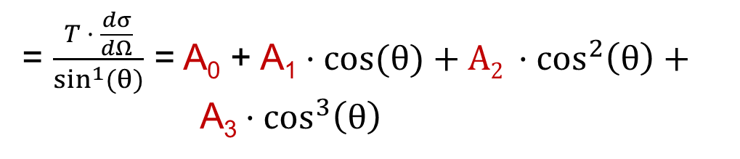
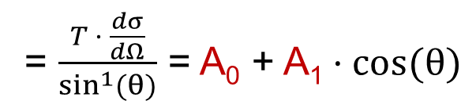
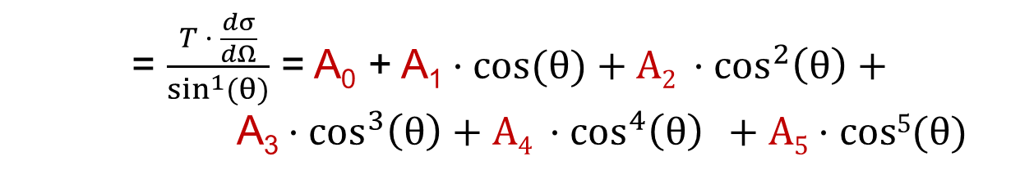
L_{max} Interpretation of T- Asymmetry
for L ≤ 1 : only S- and P- waves
= $\frac{T · \frac{dσ}{dΩ}}{\sin^{1}{(θ)}}$ = A₀ + A₁$·cos{(θ)}$
for L ≤ 2 : only S-, P- and D- waves
= $\frac{T · \frac{dσ}{dΩ}}{\sin^{1}{(θ)}}$ = A₀ + A₁$·cos{(θ)}+A2{ ·cos}^{2}\left(θ\right)+$
A₃${ ·cos}^{3}\left(θ\right)$
for L ≤ 3 : only S-, P-, D- and F- waves
= $\frac{T · \frac{dσ}{dΩ}}{\sin^{1}{(θ)}}$ = A₀ + A₁$·cos{(θ)}+A2{ ·cos}^{2}\left(θ\right)+$
A₃${ ·cos}^{3}\left(θ\right)+\text{A}\text{4}{ ·cos}^{4}\left(θ\right)$ $+ A5·cos5{(θ)}$

Slide 14
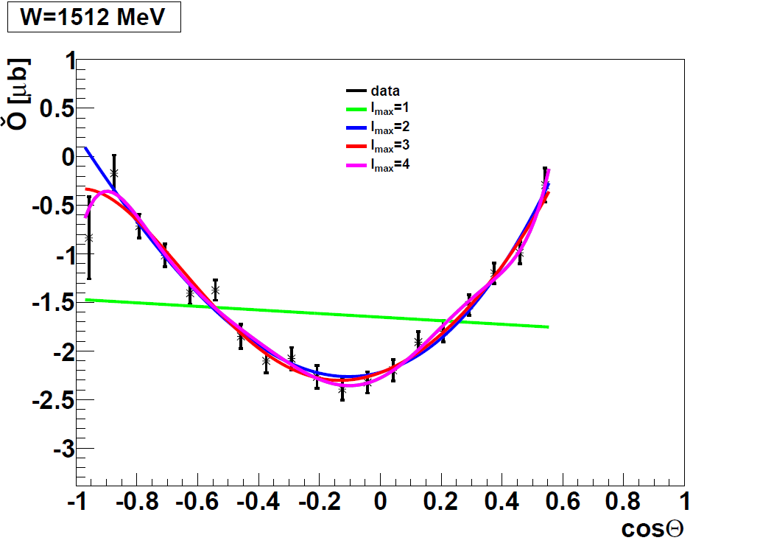
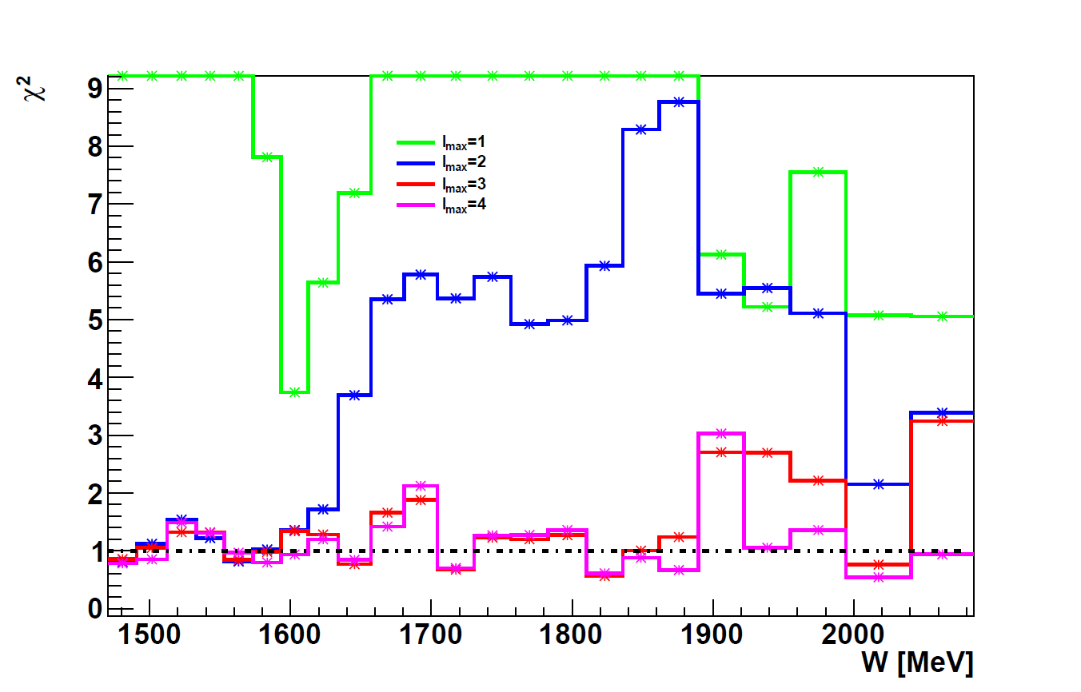
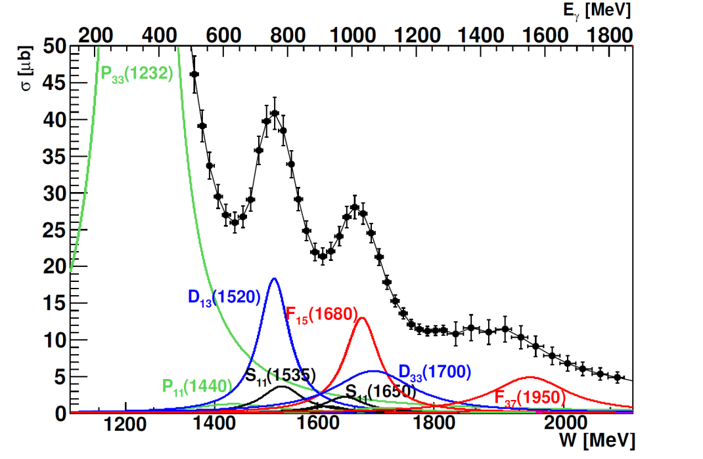
L_{max} Interpretation of T- Asymmetry
CBELSA/TAPS
Significant L = 3 signal seen
above W = 1500 MeV
Below L ≤ 2 seems to be sufficient
Some indication for L = 4 signal
above W = 1850 MeV
___ L_{max} = 1
___ L_{max} = 2
___ L_{max} = 3
___ L_{max} = 4

Slide 15
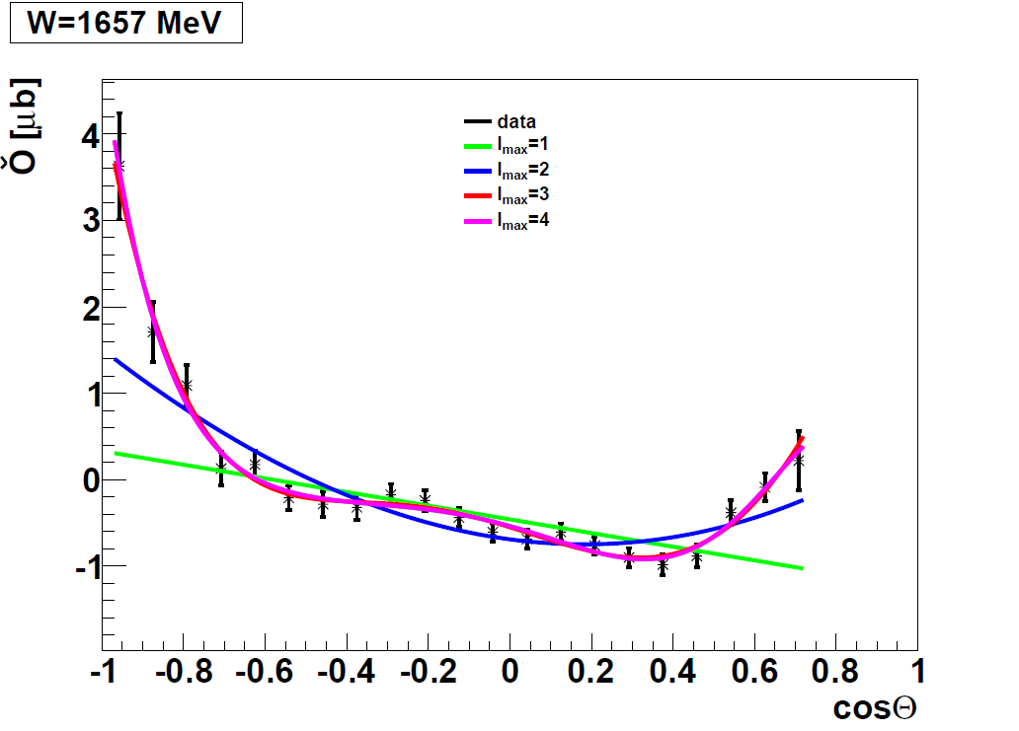
L_{max} Interpretation of T- Asymmetry
CBELSA/TAPS
Significant L = 3 signal seen
above W = 1500 MeV
Below L ≤ 3 seems to be sufficient
Some indication for L = 4 signal
above W = 1850 MeV
___ L_{max} = 1
___ L_{max} = 2
___ L_{max} = 3
___ L_{max} = 4

Slide 16
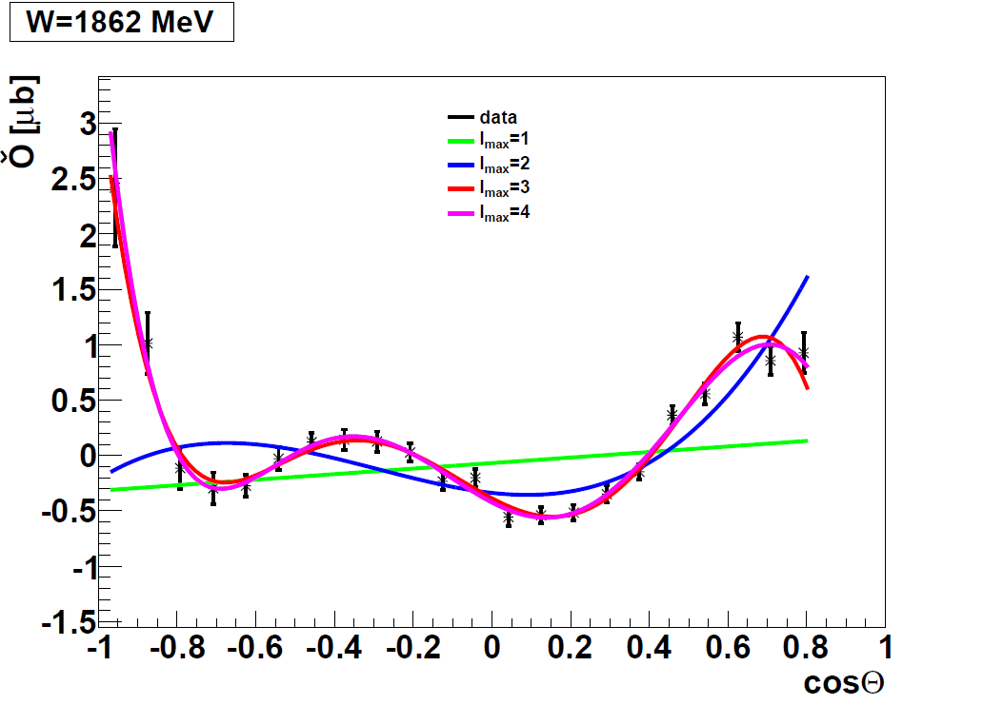
L_{max} Interpretation of T- Asymmetry
CBELSA/TAPS
Significant L = 3 signal seen
above W = 1500 MeV
Below L ≤ 3 seems to be sufficient
Some indication for L = 4 signal
above W = 1850 MeV
___ L_{max} = 1
___ L_{max} = 2
___ L_{max} = 3
___ L_{max} = 4

Slide 17
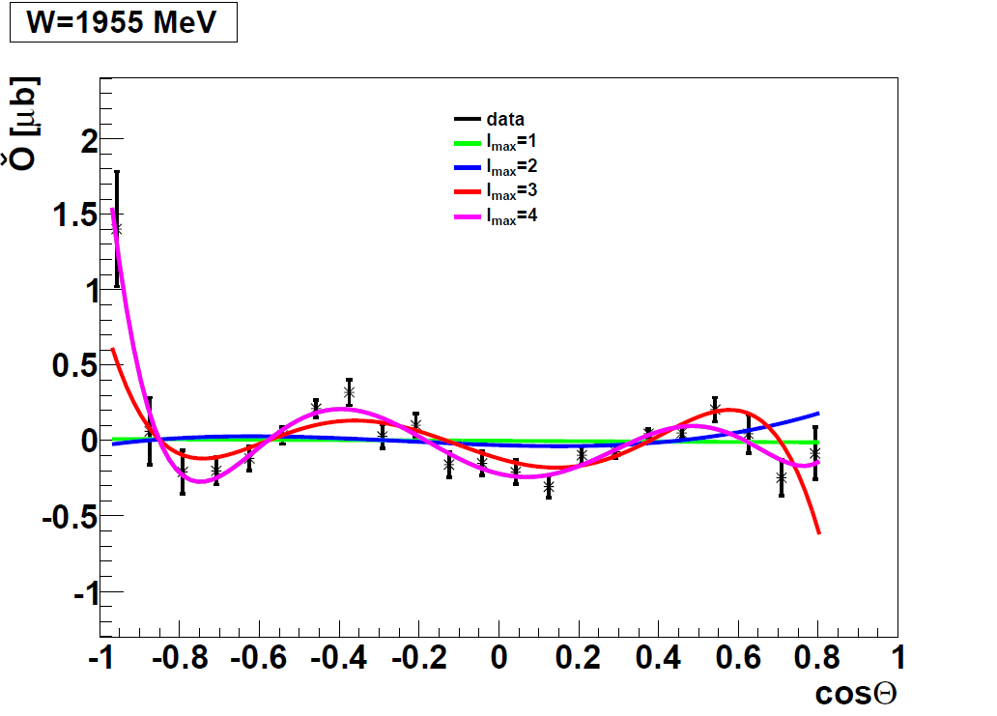
L_{max} Interpretation of T- Asymmetry
CBELSA/TAPS
Significant L = 3 signal seen
above W = 1500 MeV
Below L ≤ 3 seems to be sufficient
Some indication for L = 4 signal
above W = 1850 MeV
___ L_{max} = 1
___ L_{max} = 2
___ L_{max} = 3
___ L_{max} = 4

Slide 18
L_{max} Interpretation of T- Asymmetry
CBELSA/TAPS, J. Hartmann, PRL 113 (2014), 062001
CBELSA data
Precision data are necessary
- to be sensitive to large L contributions
- data sets with full angular coverage
- good angular resolution
___ L_{max} = 1
___ L_{max} = 2
___ L_{max} = 3
___ L_{max} = 4

Slide 19
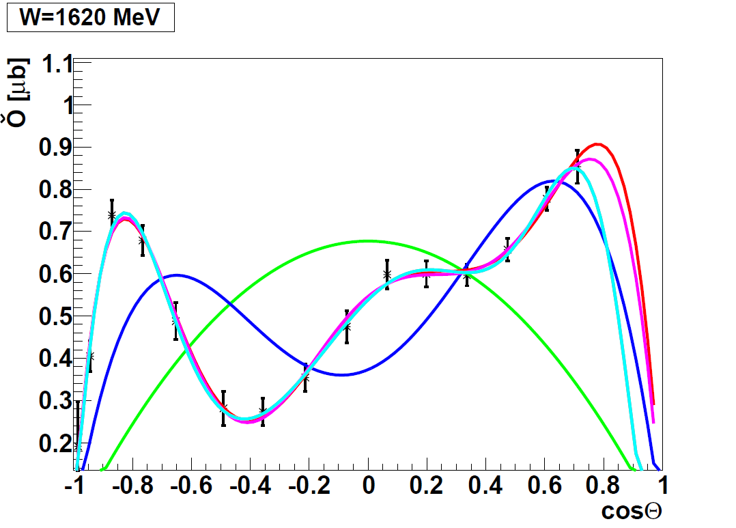
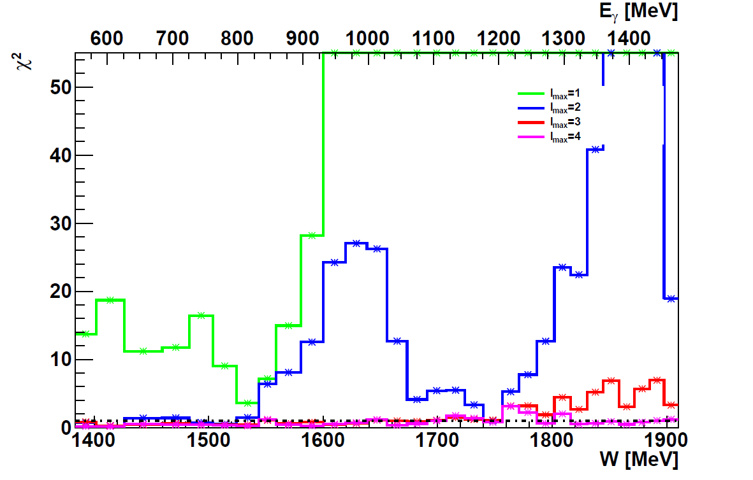
L_{max} Interpretation of Σ- Asymmetry
___ L_{max} = 1
Significant L = 3 signal seen
above W = 1500 MeV
Below L ≤ 2 seems to be sufficient
L = 4 signal above W = 1750 MeV
GRAAL data
___ L_{max} = 2
___ L_{max} = 3
___ L_{max} = 4

Slide 20
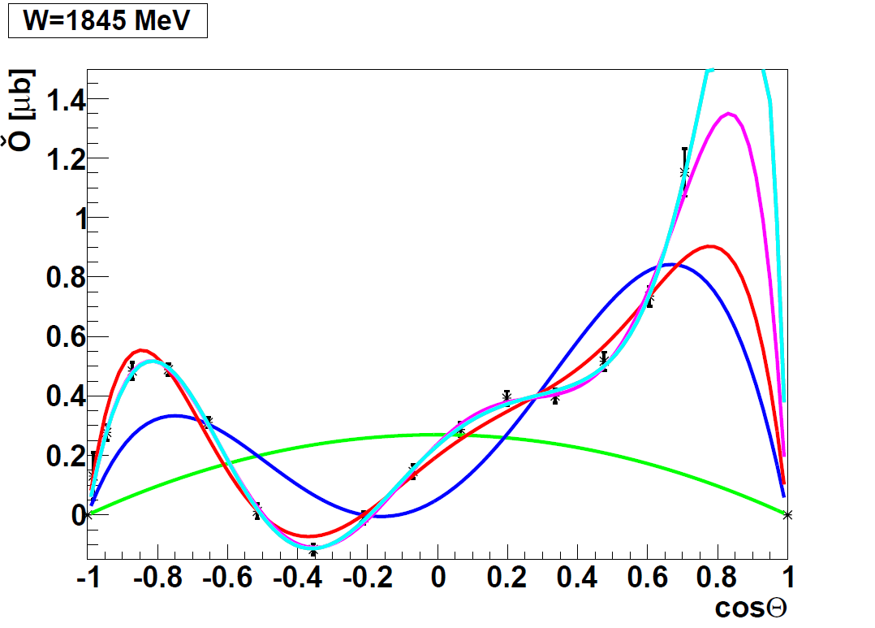
L_{max} Interpretation of Σ- Asymmetry
Significant L = 3 signal seen
above W = 1500 MeV
Below L ≤ 2 seems to be sufficient
L = 4 signal above W = 1750 MeV
GRAAL data
___ L_{max} = 1
___ L_{max} = 2
___ L_{max} = 3
___ L_{max} = 4

Slide 21
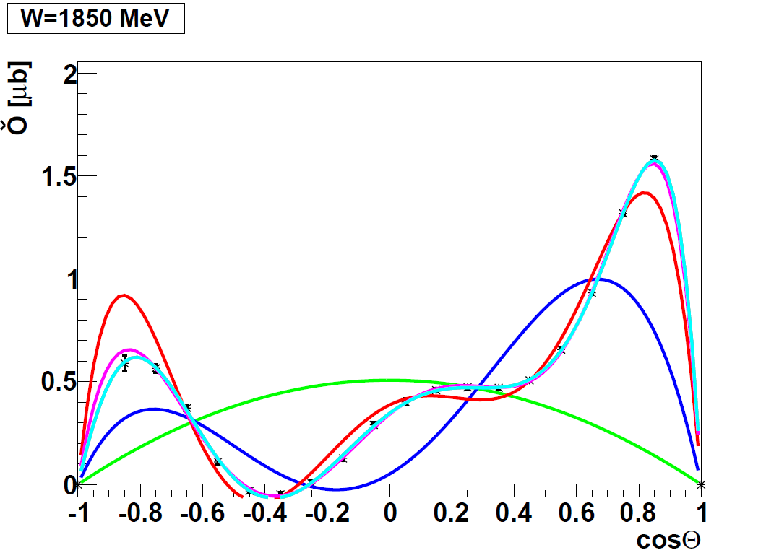
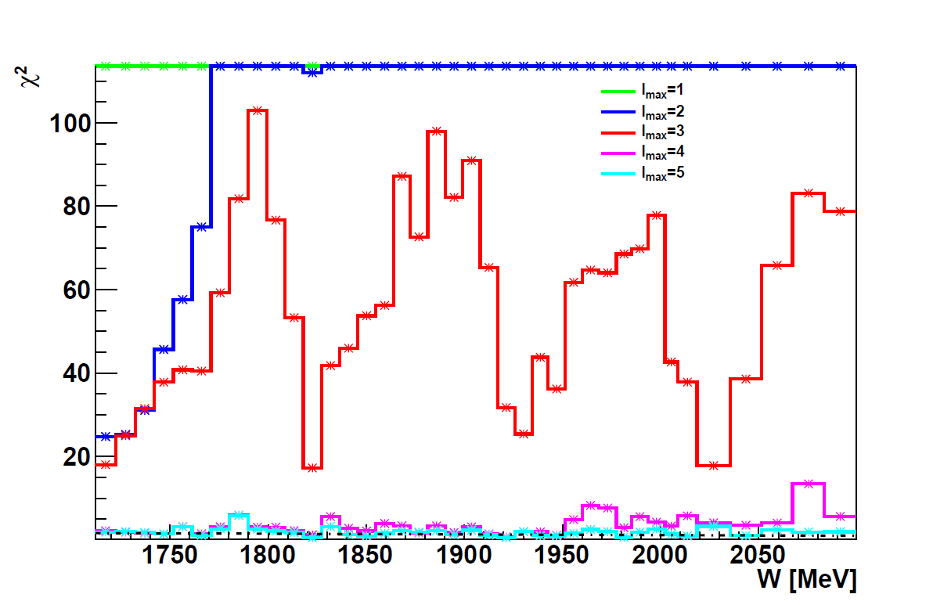
L_{max} Interpretation of Σ- Asymmetry
CBELSA/TAPS
CLAS
Significant L = 3 signal seen
above W = 1500 MeV
Below L ≤ 2 seems to be sufficient
L = 4 signal above W = 1700 MeV
___ L_{max} = 1
___ L_{max} = 2
___ L_{max} = 3
___ L_{max} = 4
High precision data for Σ from
CBELSA/TAPS
CLAS

Slide 22
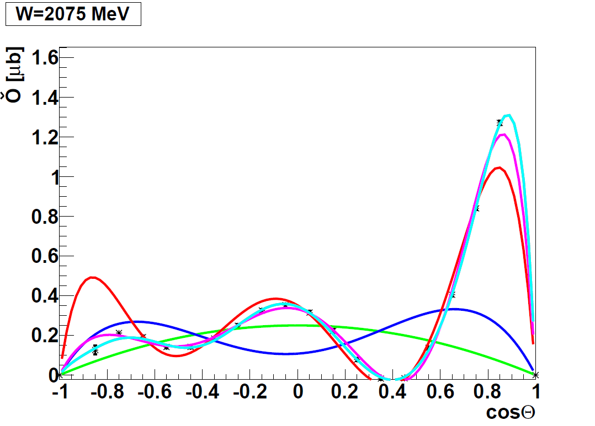
L_{max} Interpretation of Σ- Asymmetry
CBELSA/TAPS
CLAS
Significant L = 3 signal seen
above W = 1500 MeV
Below W =1500 MeV
L ≤ 2 seems to be sufficient
L = 4 signal above W = 1700 MeV
___ L_{max} = 1
___ L_{max} = 2
___ L_{max} = 3
___ L_{max} = 4
High precision data for Σ from
CBELSA/TAPS
CLAS

Slide 23
L_{max} Interpretation of Σ- Asymmetry
CBELSA/TAPS
CLAS
___ L_{max} = 1
Precision data are required
- for large L contributions
- full angular coverage and good angular resolution
- small systematic error in angular dependence
___ L_{max} = 2
___ L_{max} = 3
___ L_{max} = 4
___ L_{max} = 5

Slide 24
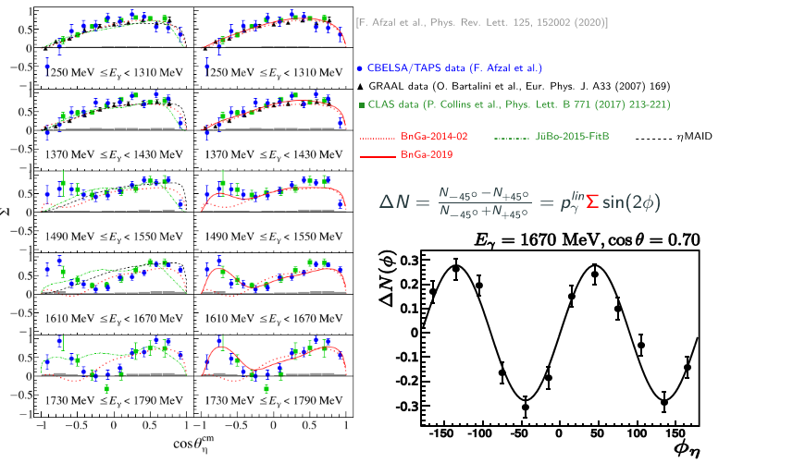
L_{max} Interpretation of Σ- Asymmetry

Slide 25
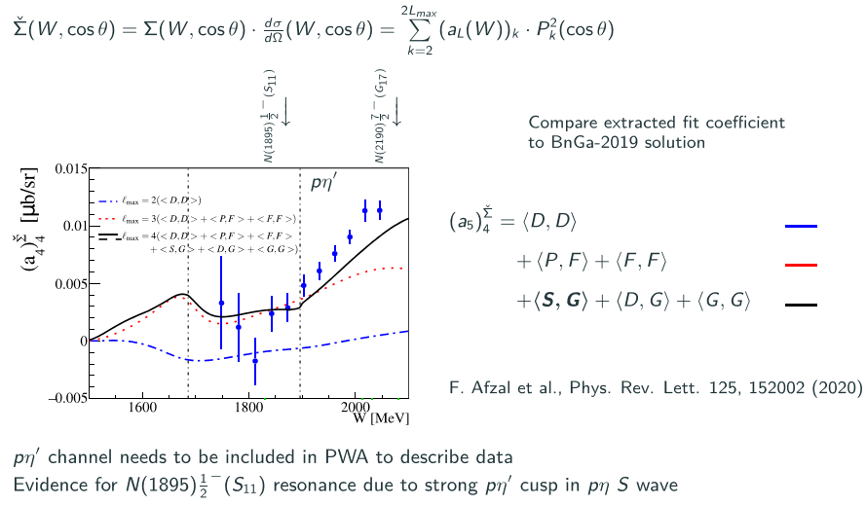
L_{max} Interpretation of Σ- Asymmetry

Slide 26
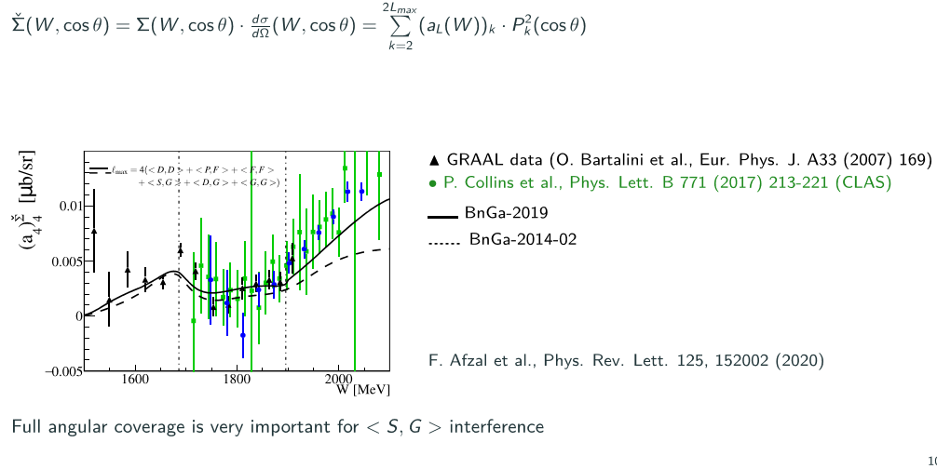
L_{max} Interpretation of Σ- Asymmetry

Slide 27
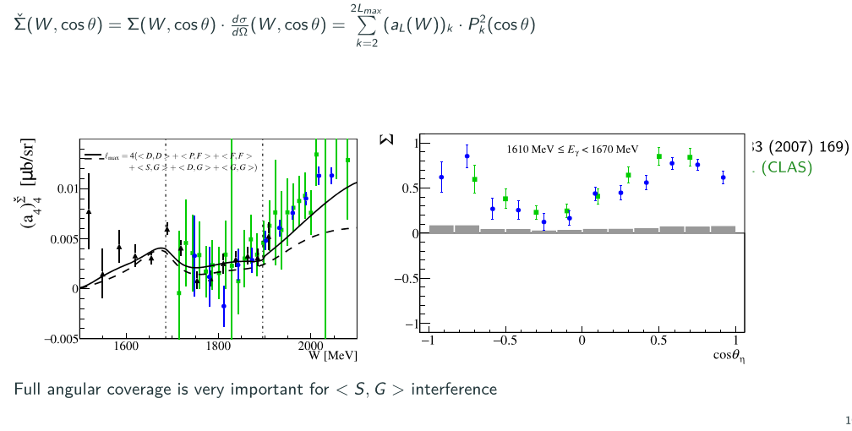
L_{max} Interpretation of Σ- Asymmetry

Slide 28
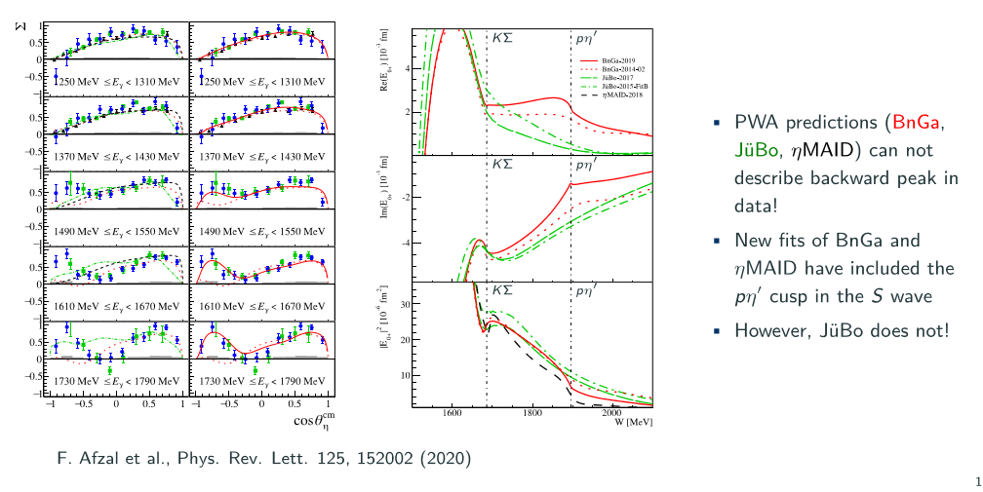
L_{max} Interpretation of Σ- Asymmetry

Slide 29
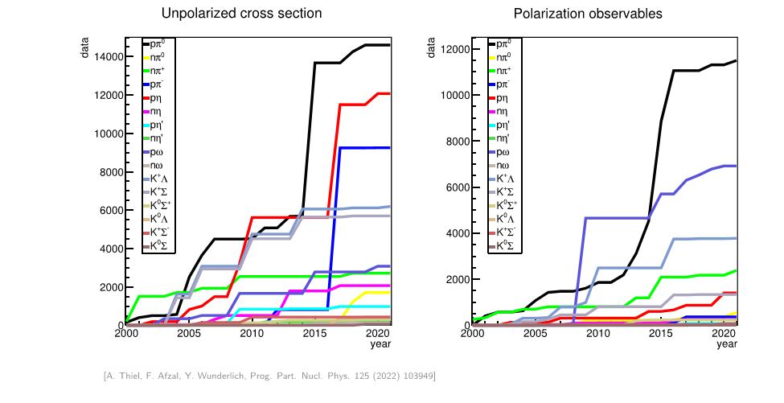
Impact of the polarization data

Slide 30
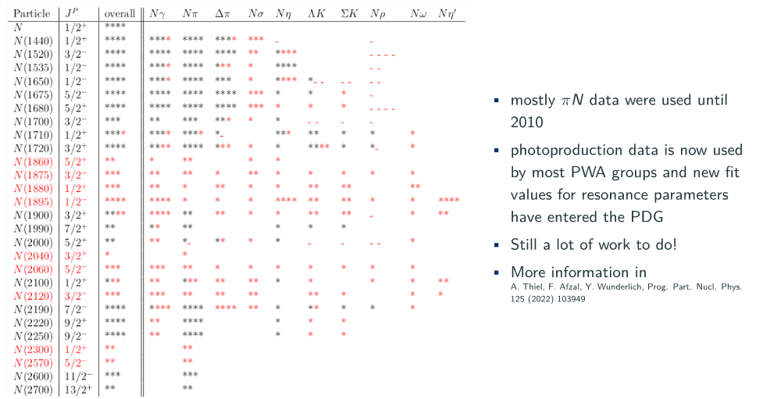
Impact of the polarization data

Slide 31
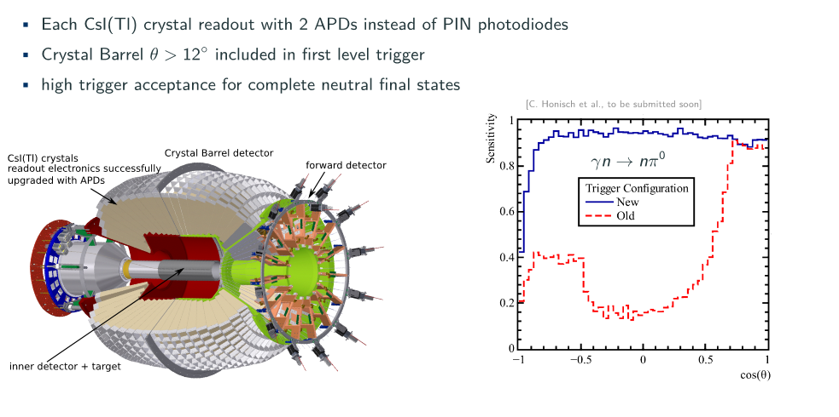
Status and Future Plan for CBELSA/TAPS
Since NSTAR 2019 in Bonn:
New data on T, P, H off the proton
New data on T, P, H off the neutron

Slide 32
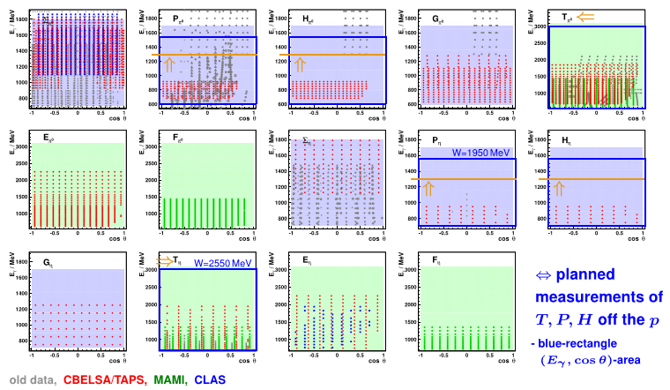
New T, P, H data off the proton

Slide 33
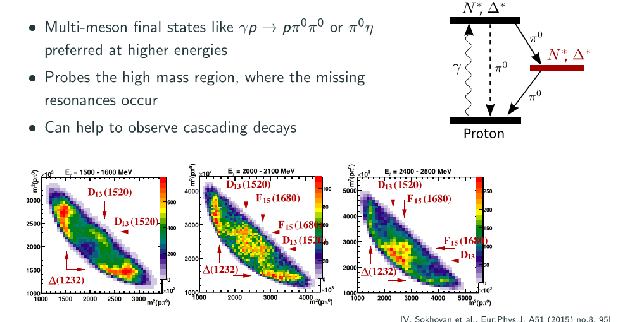
Observables in Multi-Meson Final States
Talk: N. Stausberg

Slide 34
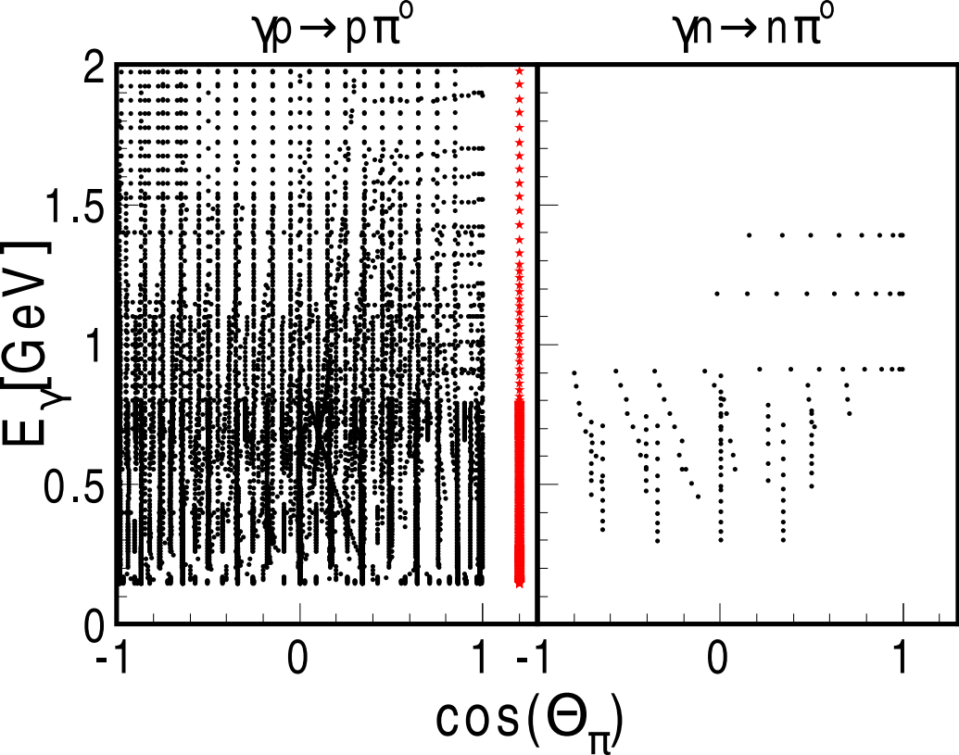
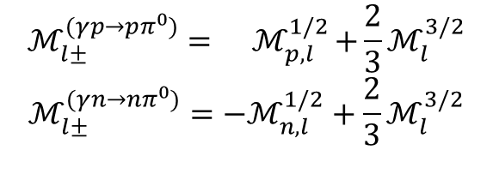
Spectroscopy off the Neutron
Nucleon resonances (Isospin I =1/2) couple differently to Neutron and Proton
$$ℳ_{l±}^{(γp→pπ^{0})}={ ℳ}_{p,l}^{1/2}+\frac{2}{3}ℳ_{l}^{3/2}$$
$$ℳ_{l±}^{(γn→nπ^{0})}=−ℳ_{n,l}^{1/2}+\frac{2}{3}ℳ_{l}^{3/2}$$
CBELSA/TAPS, I. Jaegle, PRL 100 (2008), 252002
CBELSA/TAPS experiment has been upgrade for measurements on the neutron

Slide 35

Honor to Bernd Krusche
Nucleon resonances (Isospin I =1/2) couple differently to Neutron and Proton
June 1. 2022, at the age of 66.
CBELSA/TAPS, I. Jaegle, PRL 100 (2008), 252002
Thursday talk: V. Metag

Slide 36
Summary
Precise polarization data from ELSA, Jlab and MAMI
- polarization data are essential to get unique PWA- solution
- full angular coverage and precision is important to find high spin states
- different final states are important, coupled channel analysis
Impact of the new polarization data
- the new polarization data constrain the possible multipole solutions
- new states have been found
Baryon Spectroscopy Future at ELSA
In the high W-mass region the final states
p η , p η‘ and K⁺ Λ , K⁺ Σ⁰ will be important
- the necessary precision in the data is still missing
Polarization data on the Neutron are necessary
- CBELSA/TAPS experiment has been upgraded and neutron measurements have started

Slide 37
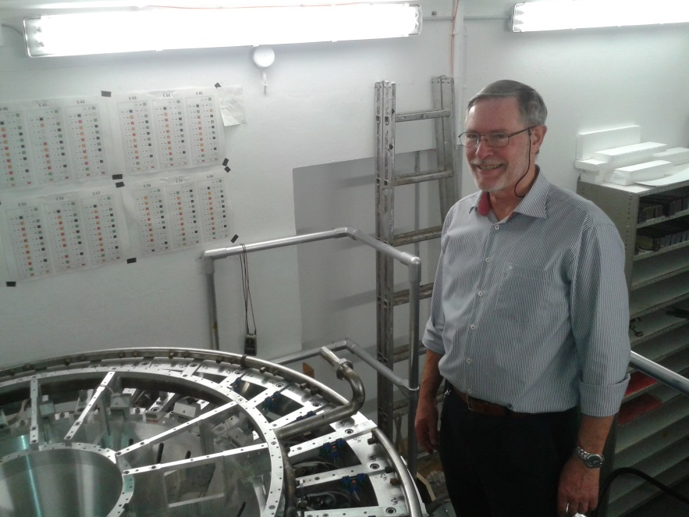
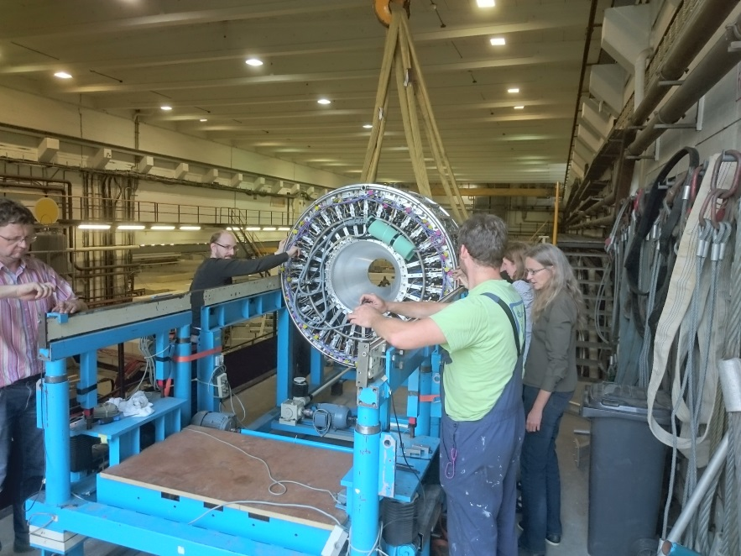
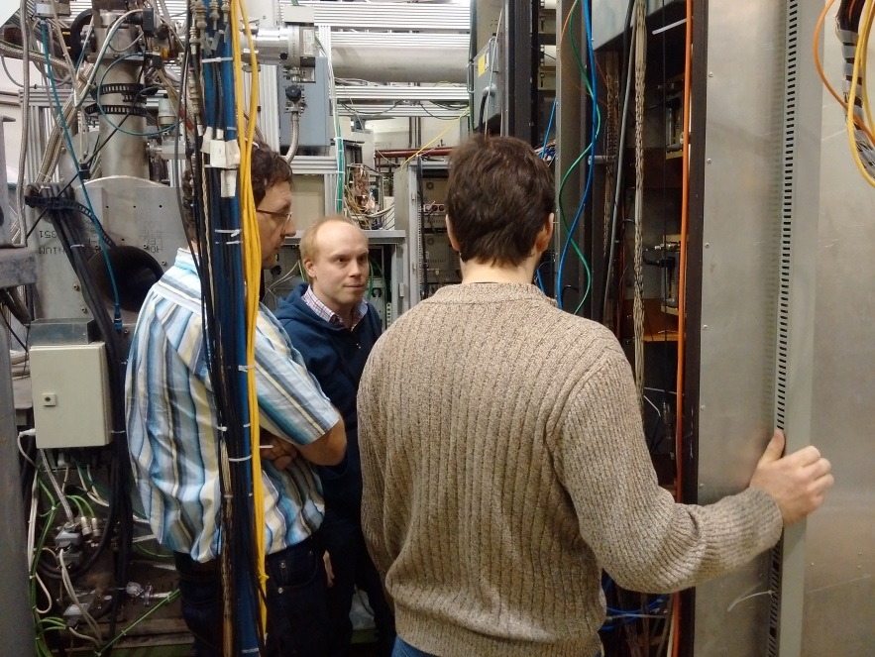
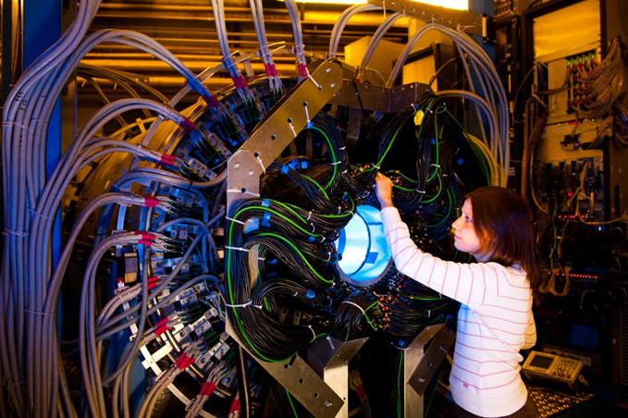
Thank you for your attention

Slide 38
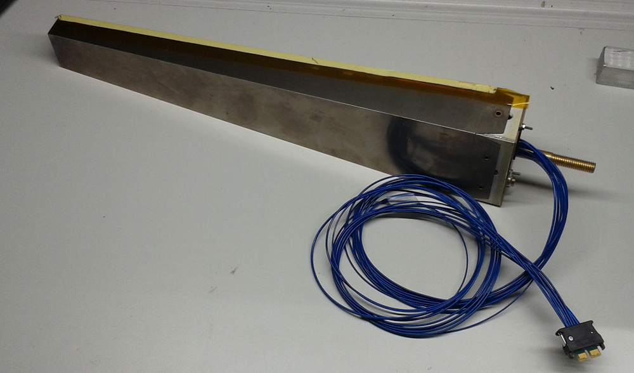
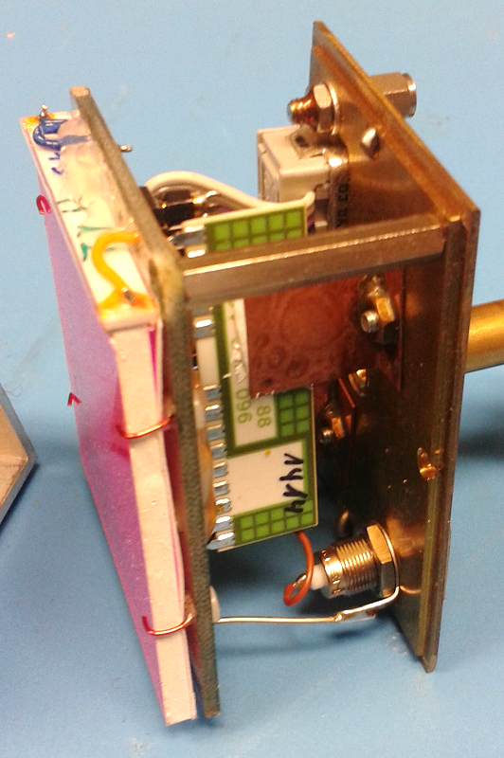
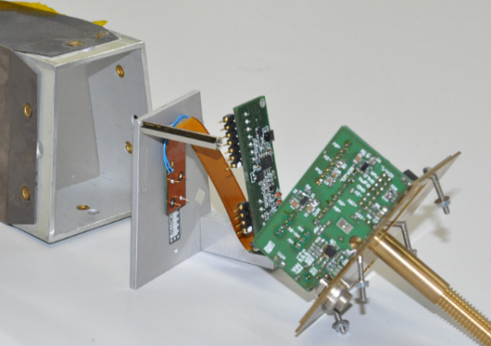
CBELSA/TAPS Experiment Upgrade
All 1320 single CsI crystals upgraded with 2 Avalanche Photodiode (APD)
Old Frontend:
New Frontend:

Slide 39
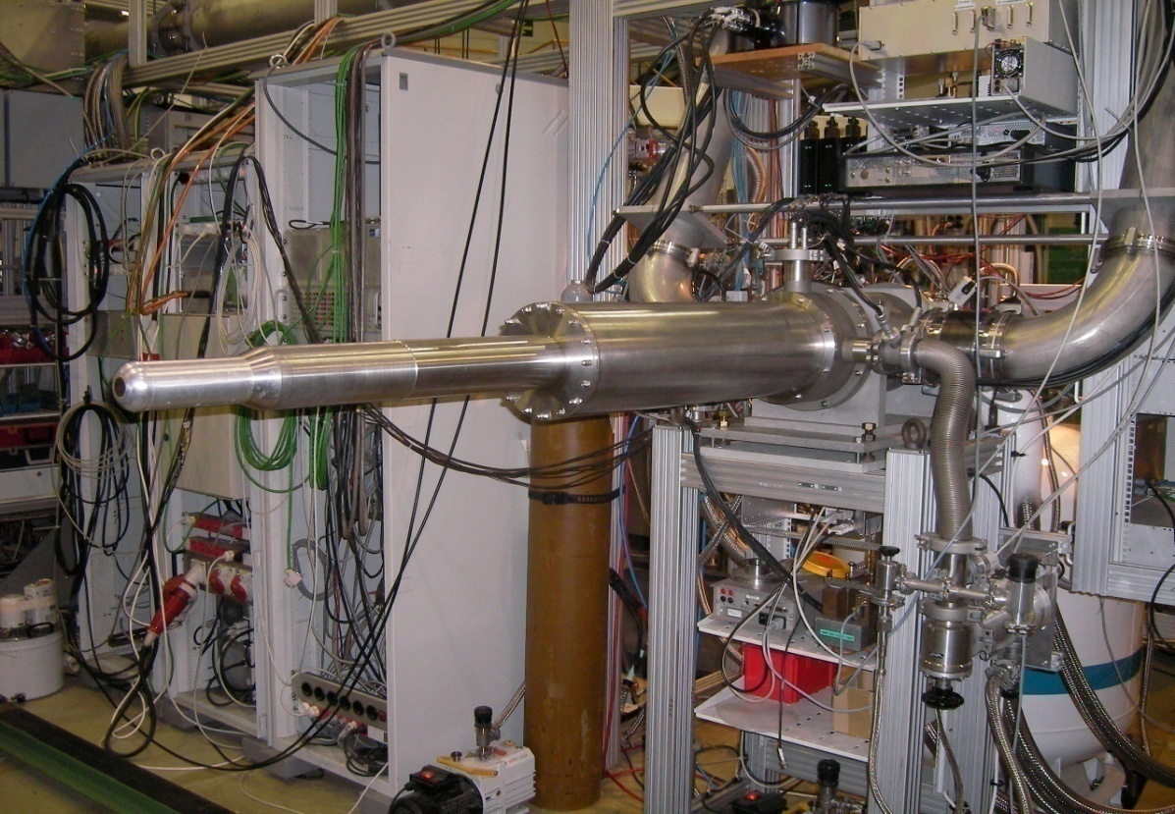
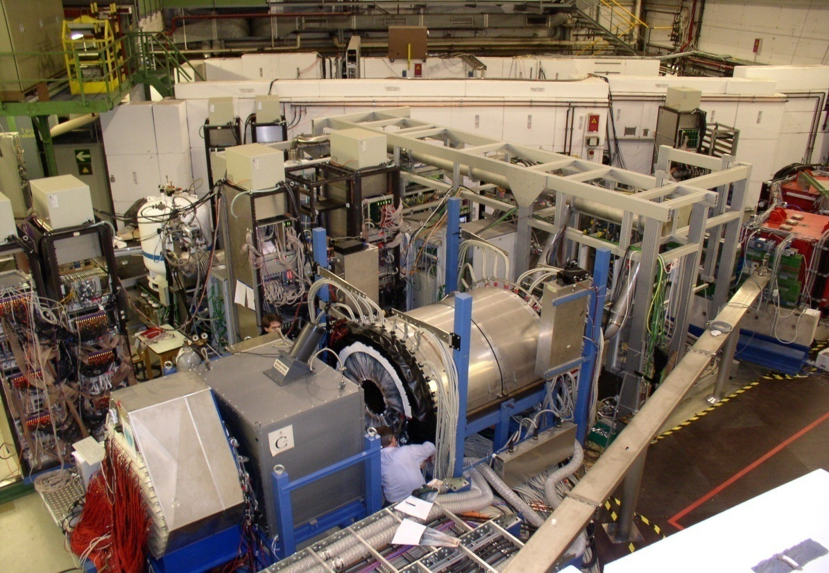
Polarized Target at ELSA
Bonn Frozen Spin Target (since 1998)
Horizontal cryostat with integrated
solenoid to freeze up the spin
Target: Butanol (C₄H₉OH)
Polarization: DNP at high B-field (2.5 T)
„freeze“ up the spin (0.4 T)
Talk: S. Goertz
horizontal cryostat
in experimental area
data taking
Bonn: H. Dutz, S. Goertz, S. Runkel, …
Bochum: W. Meyer, G. Reichertz, …

Slide 40
Baryon spectroscopy with the CBELSA/TAPS experiment
Recent results and future plans
R. Beck
University of Bonn
NSTAR2022 , Santa Margherita Ligure, October 17th 2022
Introduction
Some highlights of the CBELSA/TAPS experiment
Impact of the new polarization data
Future plans of the CBELSA/TAPS experiment
Summary

Slide 41

Introduction
Talk: U. Thoma
Talk: D. Rönchen

Slide 42

In Honoar of Bernd Krusche

