Slide 1
Studying laws of Nature with polarisation observables
Mikhail Bashkanov

Slide 2
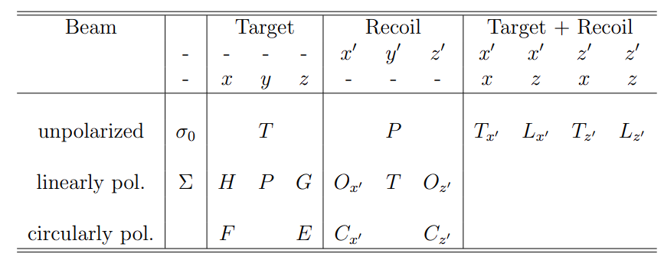
Baryon spectroscopy
Number of 3- and 4-star Resonances
Baryon | 2004 | 2020
$$N^{∗}$$ | 15 | 21
$$Δ$$ | 10 | 12
$$Λ$$ | 14 | 14
$$Σ$$ | 10 | 9*
$$Ξ$$ | 6 | 6
$$Ω$$ | 2 | 2
*$Σ\left(2250\right)$ was downgraded
MAMI, ELSA, JLAB
2

Slide 3
The full experiment
$$\vec{γ}\vec{p}→N^{∗}→\vec{B}M$$
3

Slide 4
Cx observable
Analysing power
Polarisation
$$γ_{\begin{aligned}⊙ \\ \end{aligned}}p→π^{+}\vec{n}$$
$$γ$$
$$π^{+}$$
$$n$$
$$Θ,φ,E$$
p
Target
$$Θ^{′},φ′$$
Polarimeter
4

Slide 5
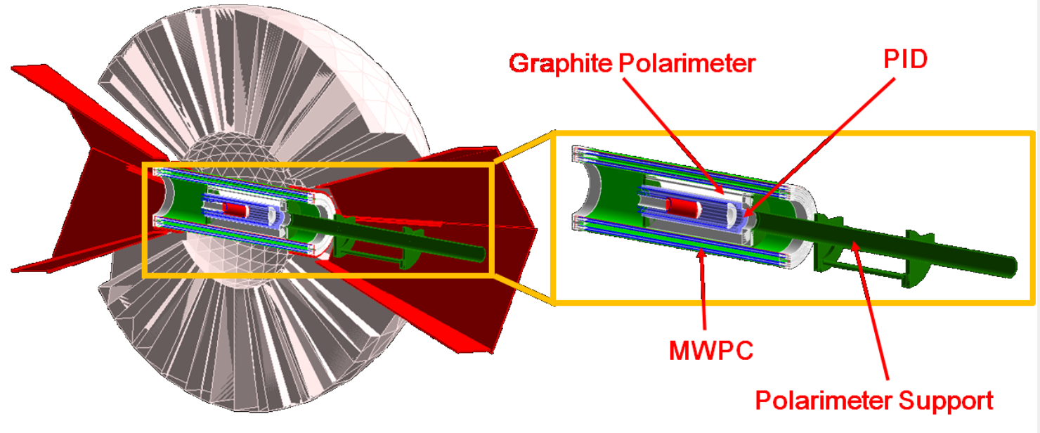
Setup
5

Slide 6
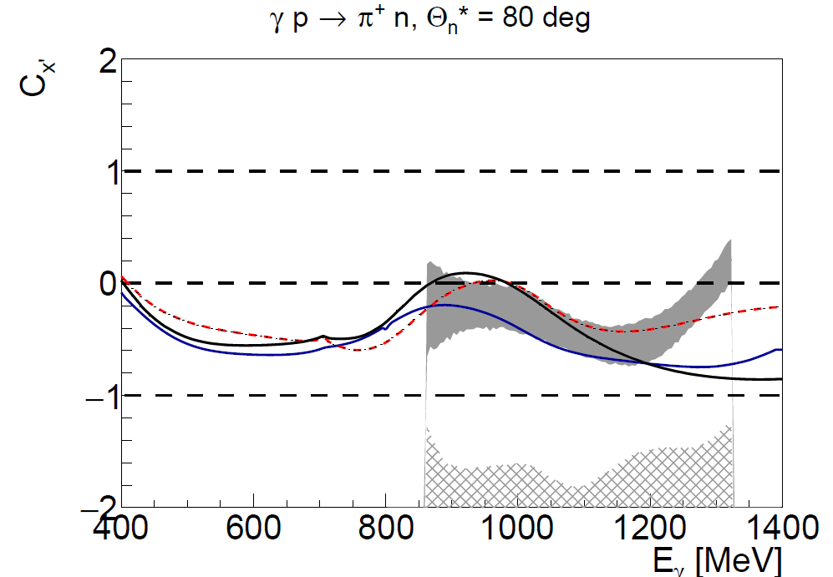
$γp→nπ^{+}$ $C_{x′}$
SAID14, SAID19, BnGa
6

Slide 7
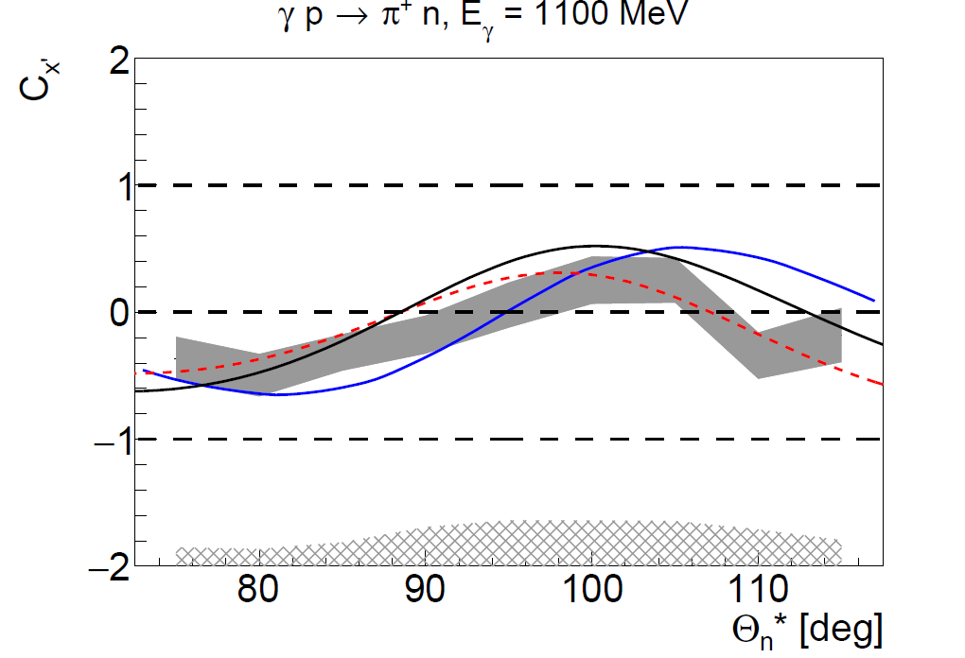
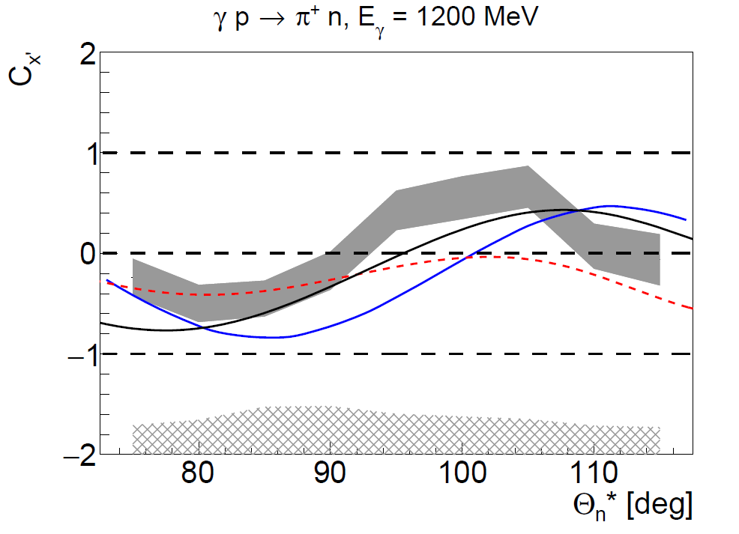
$γp→nπ^{+}$ $C_{x′}$
SAID14, SAID19, BnGa
7

Slide 8
$d^{∗}\left(2380\right)$Hexxaquark

Slide 9
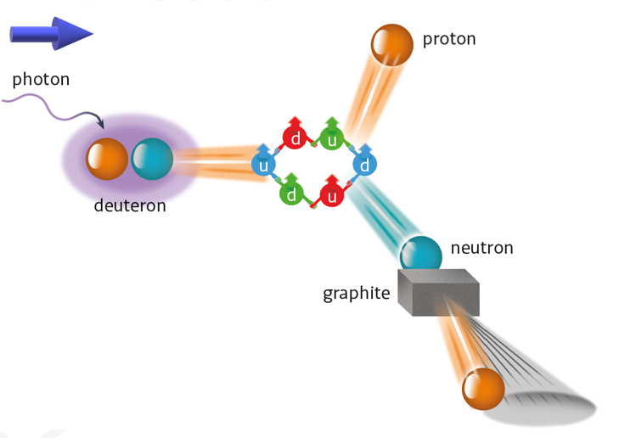
Experimentum crucis
$$\vec{γ}d→d^{∗}→p\vec{n}$$
9

Slide 10
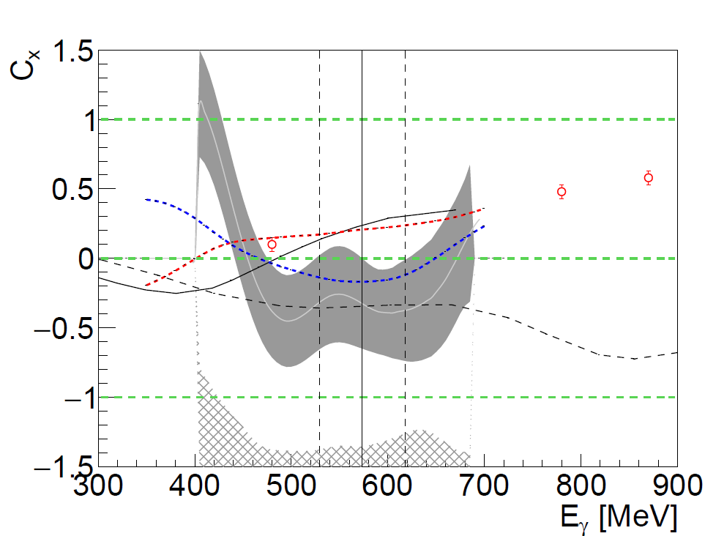
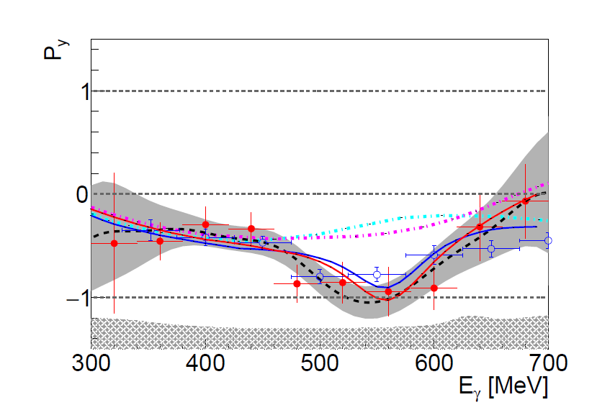
Results
$C_{x}$ at 90 degree
$P_{y}$ at 90 degree
proton
neutron
Arenhoevel
Kang
Fix
$$γd→d^{∗}→p\vec{n}$$
p
$$γd→d^{∗}→\vec{p}n$$
n
PRL. 124 (2020) 13, 132001
arxiv:2206.12299
10

Slide 11
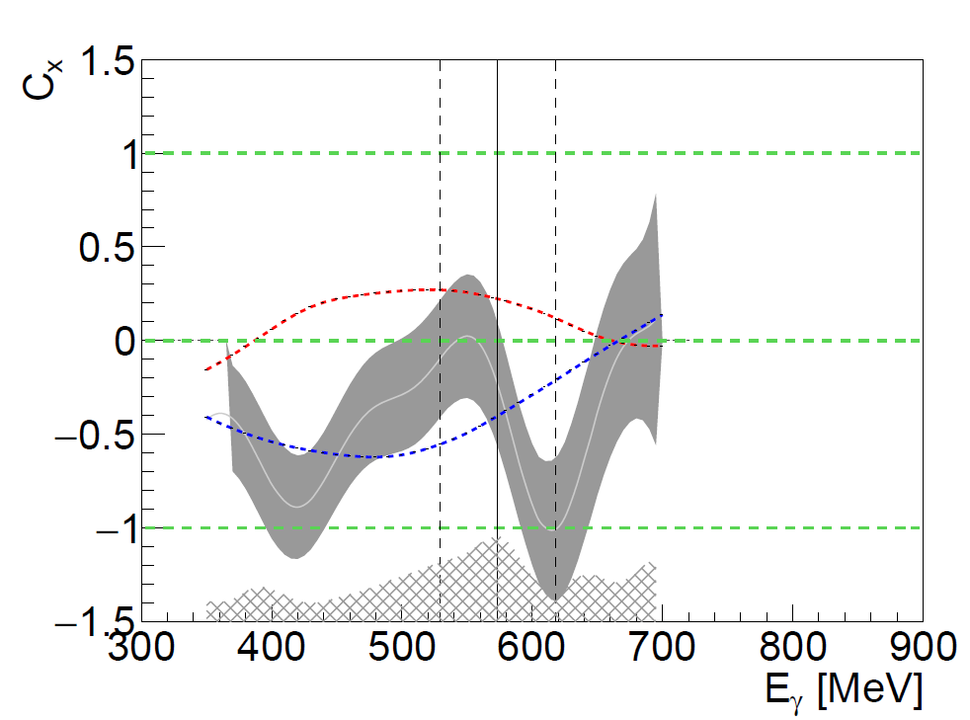
Results $C_{x′}$
$C_{x}$ at 90 degree
$C_{x}$ at 60 degree
Arenhoevel
Kang
Fix
p
n
arxiv:2206.12299
11

Slide 12
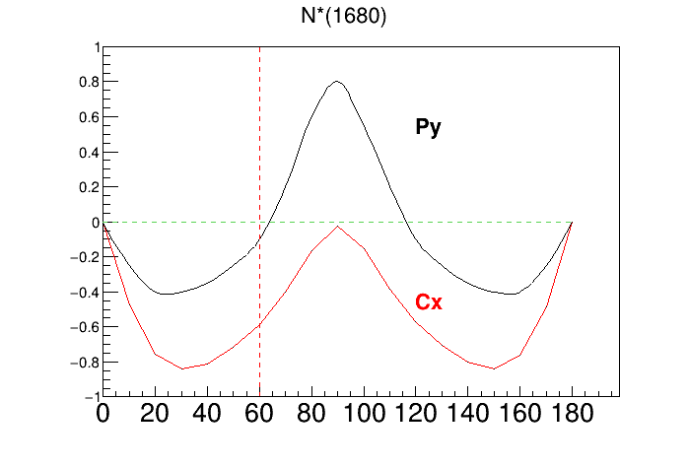
Cross-check $d^{∗}$ $C_{x′}$ expectations with $N^{∗}(1680)$ predictions
Mainz MAID
12

Slide 13
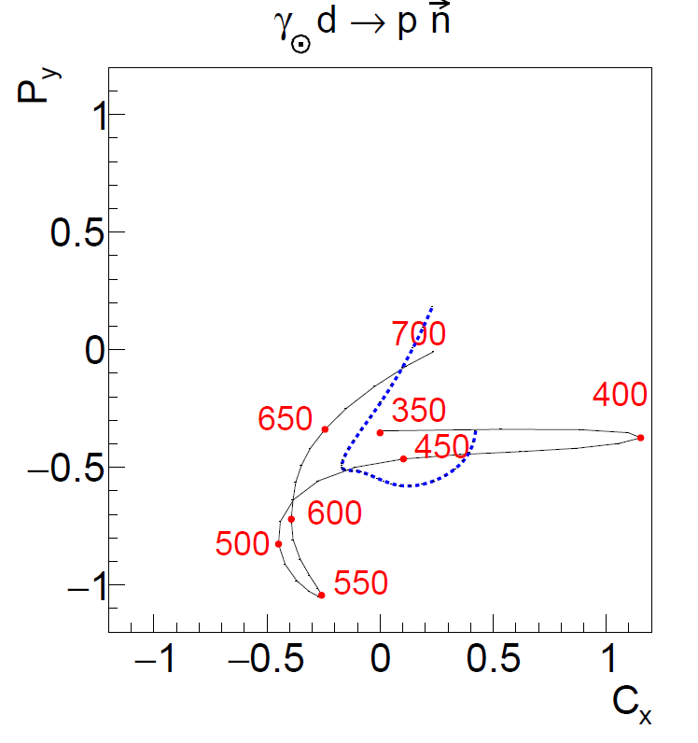
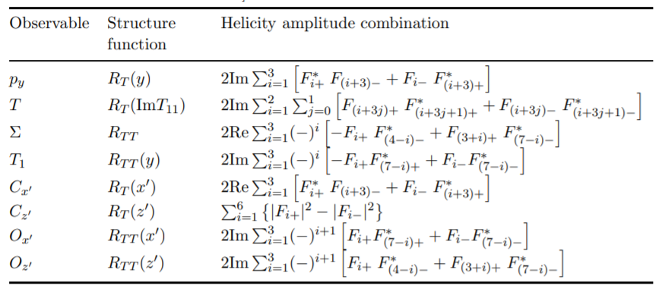
Argand type plots Re vs Im
$C_{x}$&$P_{y}$ at 90 degree
arxiv:2206.12299
13

Slide 14
Photon beam spin asymmetry
$$φ$$
p
$$γ$$
d
$\frac{Σ\left(Θ\right)σ\left(Θ\right)}{σ_{0}}$ $\sim \sum_{J=2}{a_{J}P_{J}^{2}(cosΘ)}$
n
$d^{∗}$ E2 transition likely to be small
$d^{∗}$ M3 transition seems to be preferable
M. Bashkanov et al., Phys. Lett B789, (2019), 7-12
14

Slide 15
Nuclear matter at high density
d*
n
p
15

Slide 16
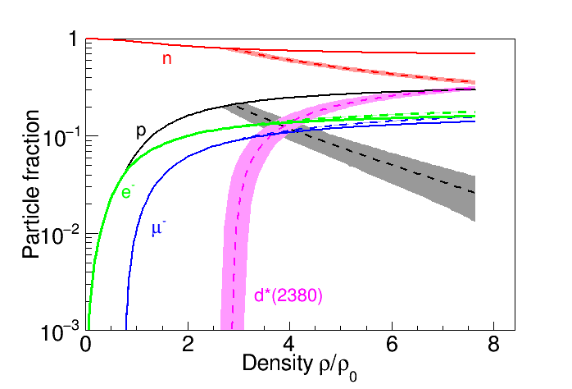
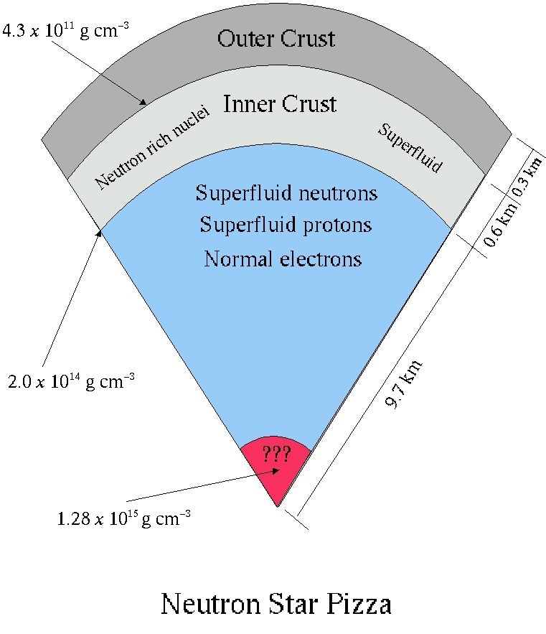
Hidden interior
I. Vidaña, M. Bashkanov, D.P. Watts, A. Pastore
Phys.Lett. B781 (2018) 112-116
$$d^{∗}(2380)$$
16

Slide 17
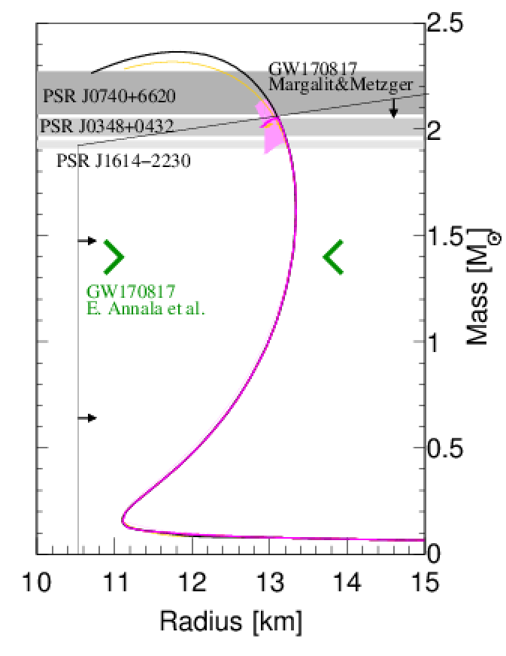
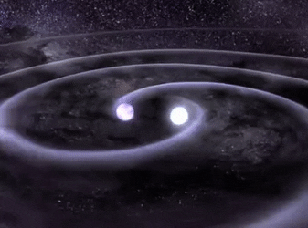
Hexaquarks in Neutron Stars
Nuclear Matter
Hexaquark Matter
I. Vidaña, M. Bashkanov, D.P. Watts, A. Pastore
Phys.Lett. B781 (2018) 112-116
Submitted to arXiv: 28.06.2017
17
See also Astron.Astrophys. 638 (2020) A40

Slide 18
Conclusion
Double-polarisation measurements is a powerful tool
Systematics
Baryon spectroscopy
Di-baryon spectroscopy
18

Slide 19
Thank you
ΔΩ

