Slide 1



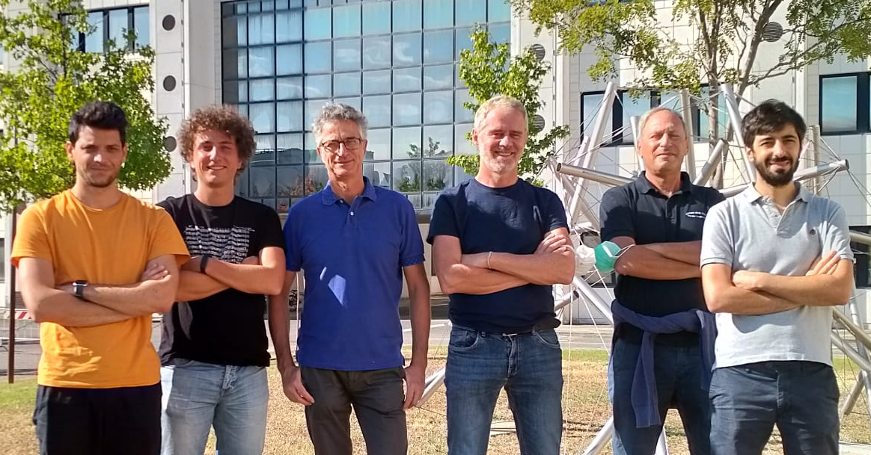


Exploring the supersolid phase of matter with dipolar quantum gases
Giovanni Modugno
    Dipartimento di Fisica e Astronomia and LENS, Università di Firenze, and CNR-INO, Pisa
QFS, Pisa, October 28, 2022
Theory: R. Bisset, L. Santos (Hannover);
S. Roccuzzo, A. Gallemì, A. Recati, S. Stringari (Trento); A. Alana, M. Modugno (Bilbao);
B. Donelli, L. Pezzè, A. Smerzi (Firenze).
Giulio Biagioni
Carlo Gabbanini
Nicolò Antolini
Luca Tanzi
Former members: J. Maloberti, F. Famà, E. Lucioni, J. Catani
Andrea Fioretti
http://quantumgases.lens.unifi.it/exp/dy

Slide 2
Bosonic quantum phases at T=0
ρ = ψ ²
ρ
φ₁
φ₂
φ₃
φ₄
φ
x
x
Crystals: localized particles, stiffness and plasticity
Superfluids: fully delocalized particles, supercurrents
ρ
φ
E. P. Gross, Unified theory of interacting bosons, Phys. Rev. 106, 161 (1957).
Supersolids???
x

Slide 3
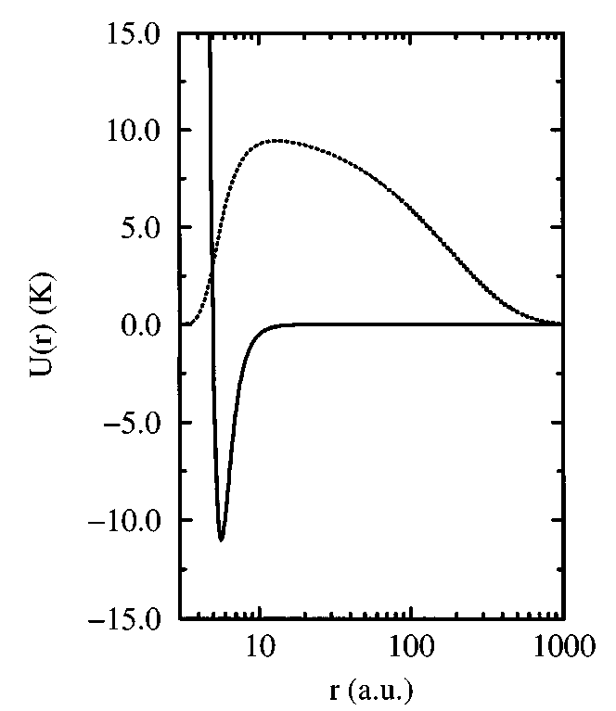
The quest for supersolids: solid helium
Seminal theory:
A.F. Andreev and L. M. Lifshitz, Quantum theory of defects in crystals, Sov. Phys. JETP 29, 1107–1113 (1969).
G.V. Chester, Speculations on Bose-Einstein condensation and quantum crystals, Phys. Rev. 2, 161 (1970).
A.J. Leggett, Can a solid be “superfluid”?, Phys. Rev. Lett. 25, 1543 (1970).
Pair wavefunction
Bose-Einsten condensate of “defectons”.
Two-body potential
Reviews: Balibar, Nature 464, 176 (2010); Chan, Hallock, Reatto, J. Low. Temp. Phys. 172, 317 (2013).

Slide 4





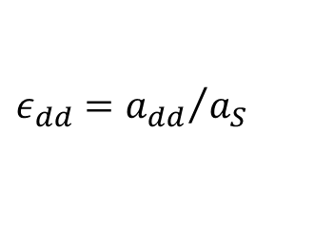
Dipolar (cluster) supersolids
Superfluid
Cluster supersolid
Crystal of self-bound droplets
B
$${d\sim ℓ}_{z}$$
$$ℓ_{z}$$
$${{ε_{dd}=a}_{dd}}/{a_{S}}$$
Dipolar interaction
Contact interaction
Quantum fluctuations (zero-point energy)
$Eint≈ρ\frac{4πℏ^{2 }a_{S}}{m} \left[1−\frac{a_{dd}}{a_{S}}\left(3\cos^{2}θ−1\right)\right]+\frac{32gρ}{3} \sqrt{\frac{a_{S}^{3} ρ}{π}} (1+\frac{3}{2}$ $\frac{a_{dd}^{2}}{a_{s}^{2}})$

Slide 5
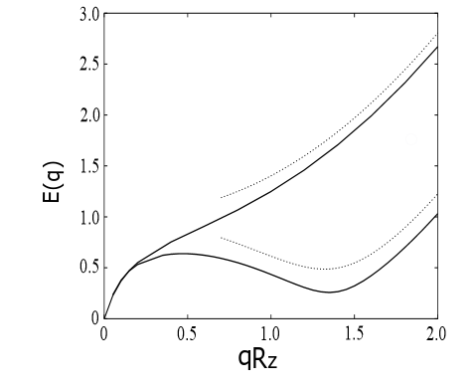


A long journey …
108
94
$$E(k)$$
88
$${kl}_{z}$$
L. Santos, G. V. Shlyapnikov, and M. Lewenstein, Phys. Rev. Lett. 90, 250403 (2003).
L. Tanzi et, Observation of a dipolar quantum gas with metastable supersolid properties, Phys. Rev. Lett. 122, 130405 (2019), theory by R. Bissett and L. Santos
Related theory by Roccuzzo and Ancilotto; related experiments and theory in Innsbruck and Stuttgart.

Slide 6
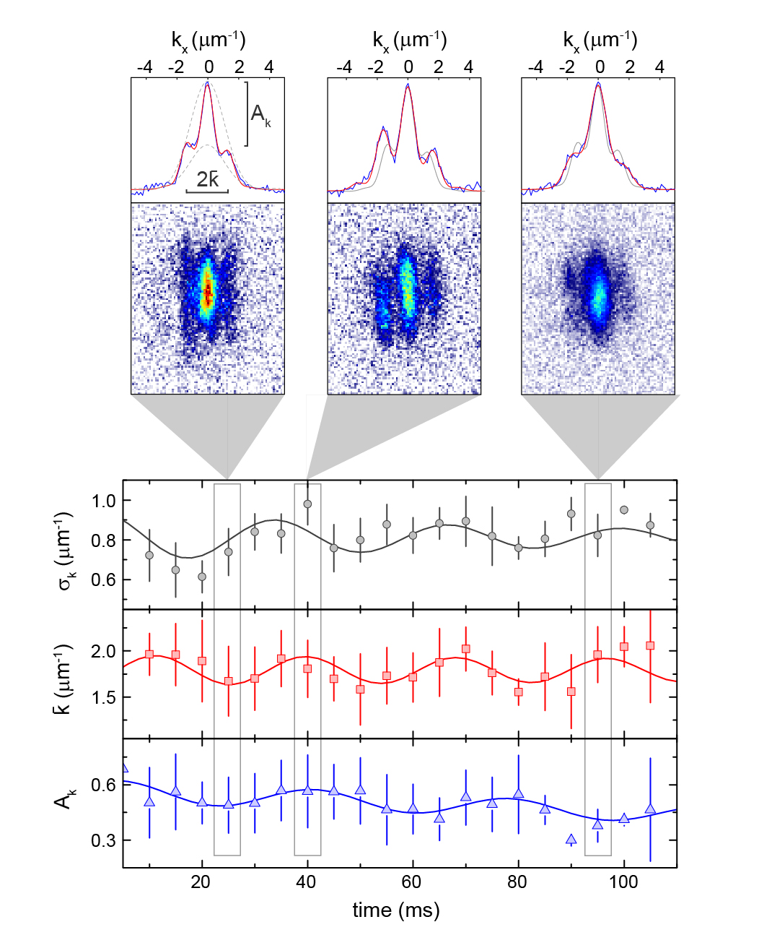
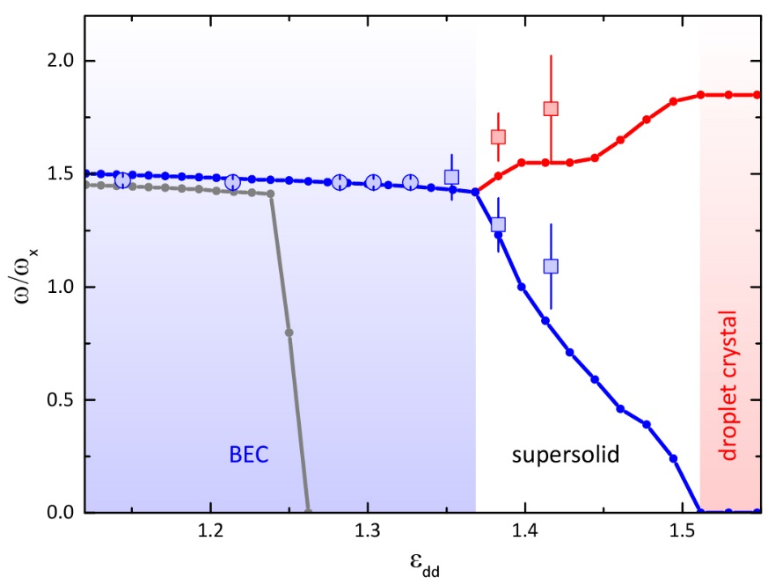

Double symmetry breaking
L. Tanzi, S. Roccuzzo et al., Supersolid symmetry breaking from compressional oscillations in a dipolar quantum gas, Nature 574, 382 (2019).
no quantum fluctuations
lattice mode
amplitude mode
$$ε_{dd}=a_{dd}/a_{s}$$
Collaboration with A. Recati and S. Stringari, Trento

Slide 7
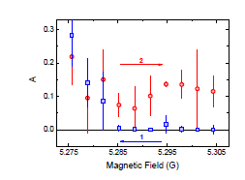
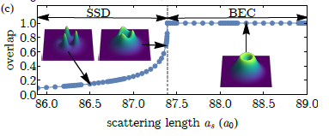
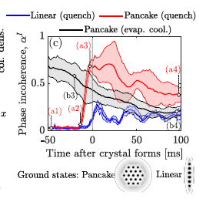
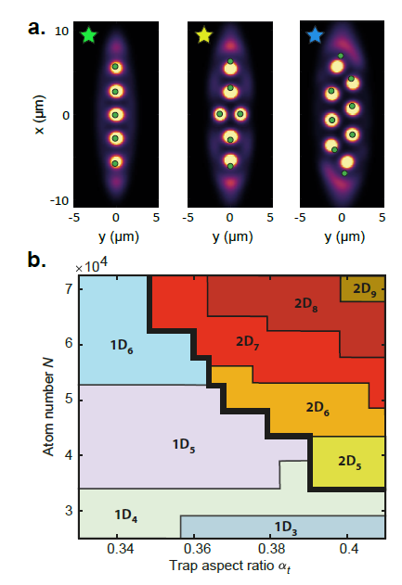
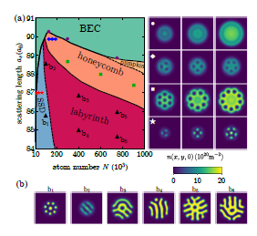
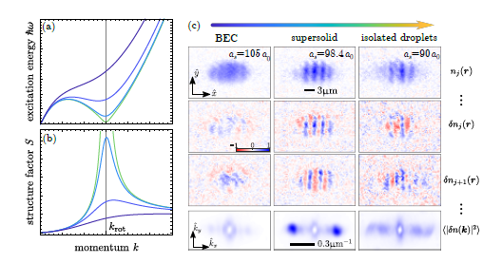
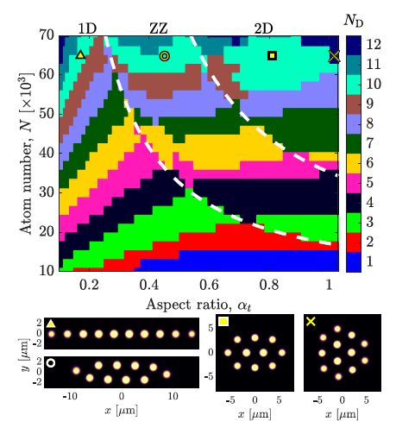
Superfluid – supersolid quantum phase transition
J. Hektorn et al. arXiv:2103.09752
L. Tanzi et al. Phys. Rev. Lett. 122, 130405 (2019), arXiv:1811.02613v1
T. Bland et al. arXiv:2107.06680
J. Hektorn et al. Phys. Rev. Research 3, 033125 (2021)
J. Hektorn et al. Phys. Rev. X 11, 011037 (2021)
M. A. Norcia et al. Nature 596, 357(2021)
E. Poli et al. arXiv:2108.02682
Theory: Y.-C. Zhang, F. Maucher, and T. Pohl, Phys. Rev. Lett. 123, 015301 (2019).
P. B. Blakie, D. Baillie, L. Chomaz, F. Ferlaino, Phys. Rev. Research 2, 043318 (2020)

Slide 8
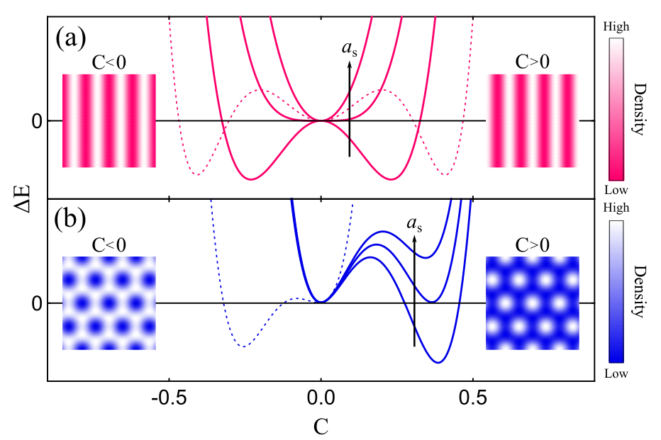
Landau model
$$∆E=a C+b C^{2}+c C^{3}+dC^{4}+..$$
1D lattice: even free-energy
Second-order (continuous) phase transition
2D lattice: odd free-energy
First-order (discontinuous) phase transition
HONEYCOMB
TRIANGULAR
Collaboration with M. Modugno and A. Alana from Bilbao University
Biagioni G. et al., Dimensional crossover in the superfluid-supersolid quantum phase transition, Phys. Rev. X 12, 021019 (2022)

Slide 9
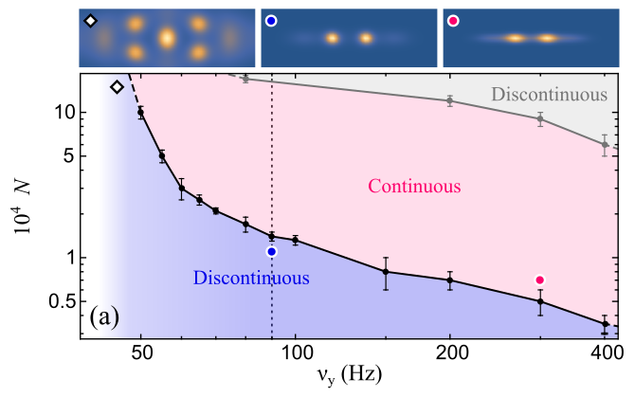

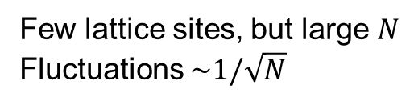



Numerical phase diagram
$$ω_{x }=2 π × 20 Hz$$
${ ω}_{z} =$ $2 π × 80 Hz$
Few lattice sites, but large $N$
Fluctuations $\sim 1/\sqrt{N}$
$$y$$
$$x$$

Slide 10
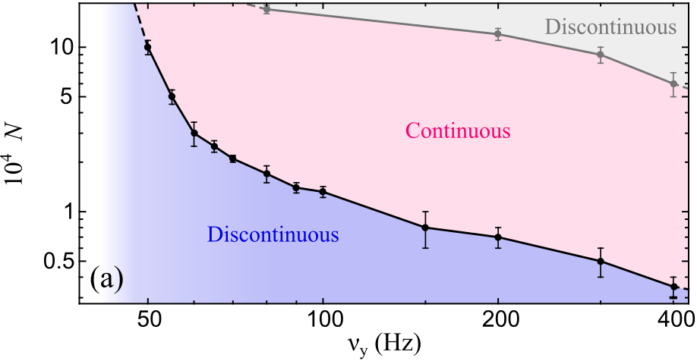
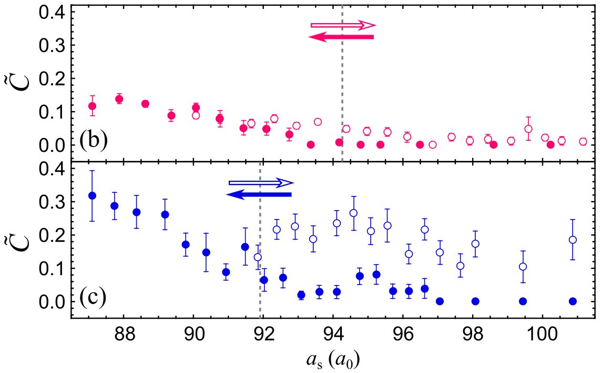
Experimental evidence
Trap C
Trap C
Trap D
Trap D
Different character in the two traps:
Strong excitations after the out-going ramp only in trap D
Strong fluctuations at the transition only in trap D

Slide 11
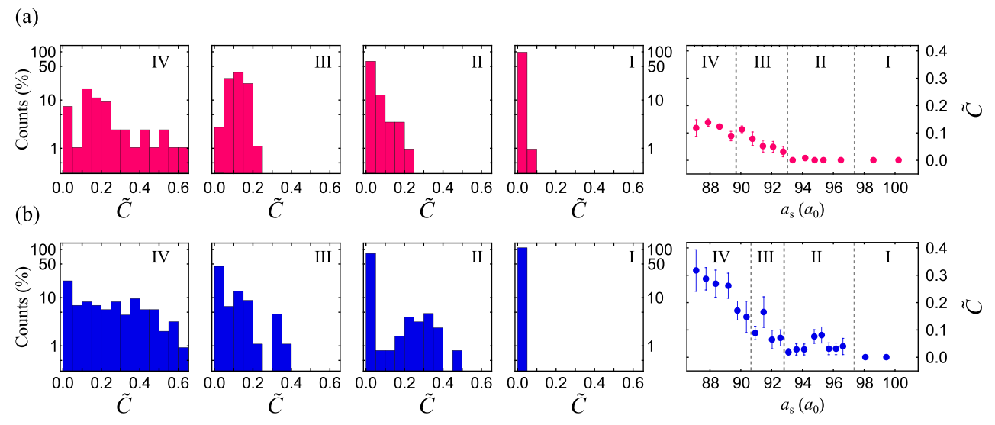
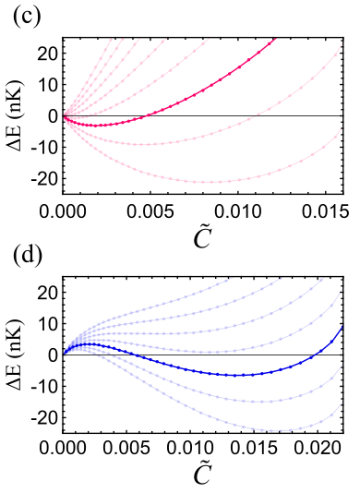
Free-energy scenario from fluctuations spectra
After the transition
Before the transition
Single energy minimum
Two energy minima
Free energy from density ansatz + experimental parameters

Slide 12


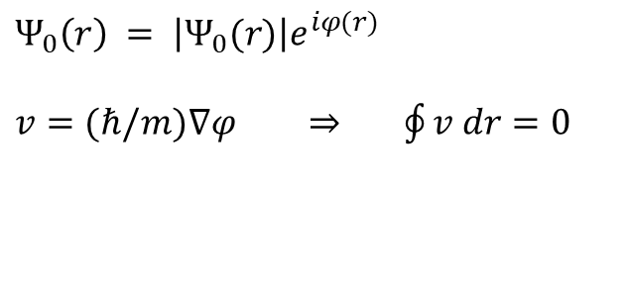



Superfluidity from rotations
A.J. Leggett, Can a solid be “superfluid”?, Phys. Rev. Lett. 25, 1543 (1970)
Cylindrical geometry, low $ω$
$$Ψ_{0}\left(r\right) = \left|Ψ_{0}(r)\right|e^{iφ(r)}$$
$v=(ℏ/m)∇φ$ ⇒ $\oint{v dr}=0$
$$y$$
$$x$$
$L=Iω=0$and $I=0$
$$ω$$
Dalibard 2000
Hess and Fairbank 1967

Slide 13
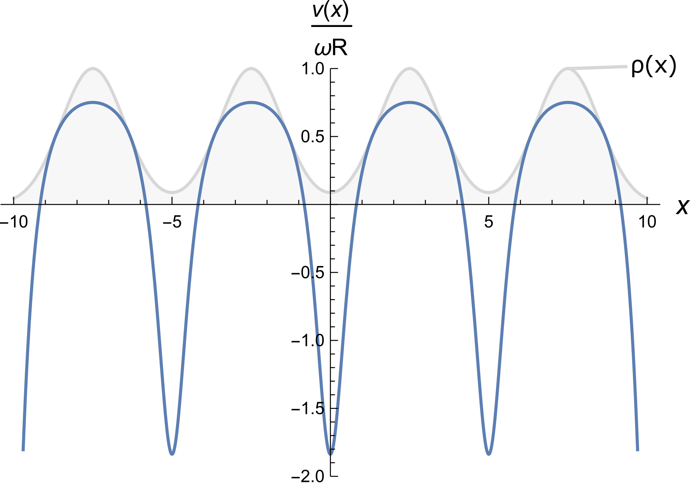


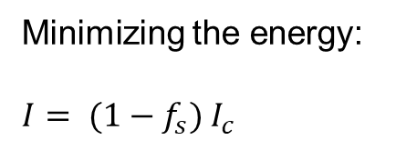

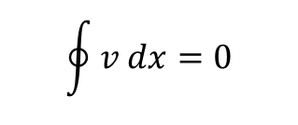
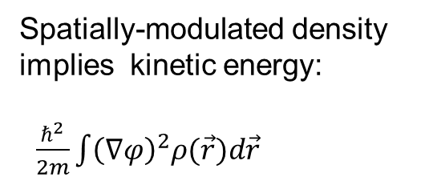

Superfluidity of supersolids
A.J. Leggett, Can a solid be “superfluid”?, Phys. Rev. Lett. 25, 1543 (1970)
Annular geometry, no radial effects (1D)
$$φ\left(x\right)=\int_{0}^{x}{\left.dx′/ \overline{ρ}(x′\right)}$$
Spatially-modulated density implies kinetic energy:
$\frac{ℏ^{2}}{2m}\int{{\left(∇φ\right)}^{2}ρ(\vec{r}})d\vec{r}$
$$x$$
$$ω$$
Minimizing the energy:
$$I= (1−f_{s}){ I}_{c}$$
Superfluid fraction: $f_{s}={\left(\int_{0}^{λ}{dx/ρ(x)}\right)}^{−1}$
$$\oint{v dx}=0$$
Biagioni G., Rotation of a dipolar supersolid, Il nuovo Cimento 44 C 107 (2021)

Slide 14
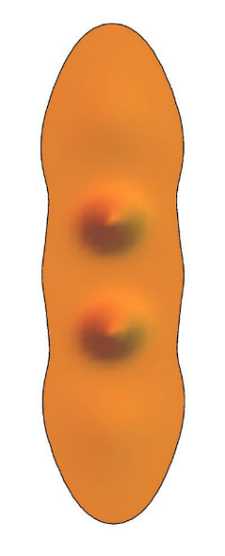
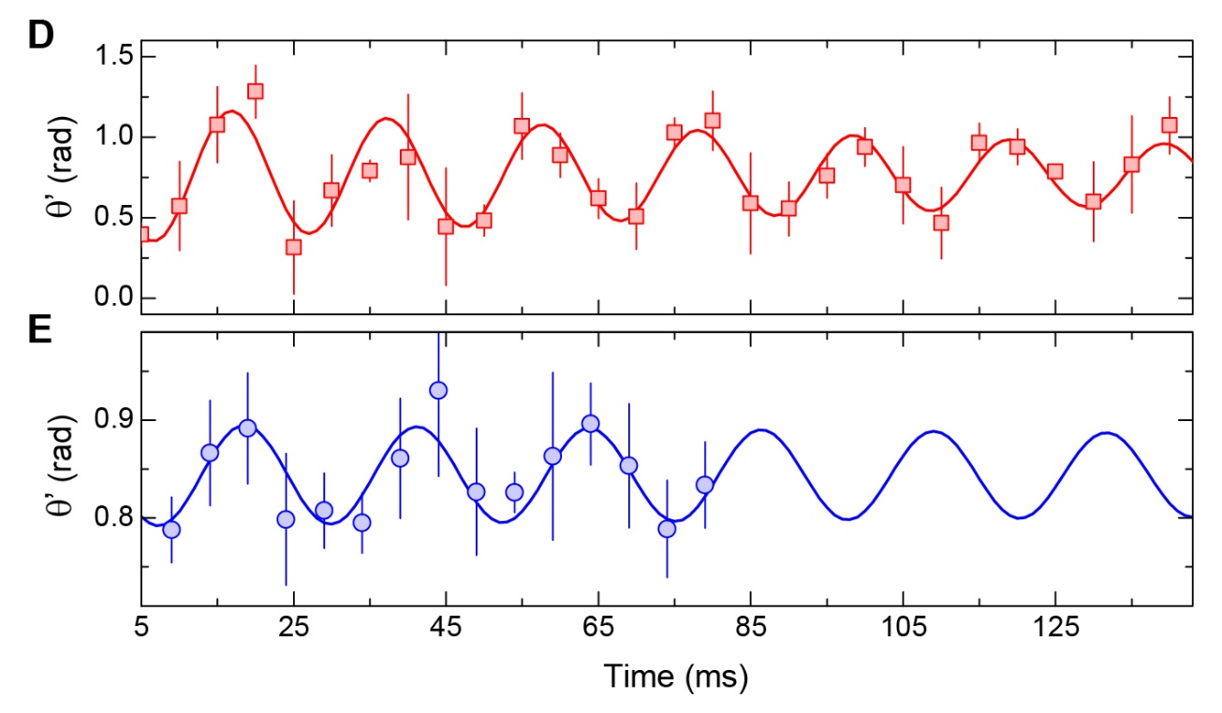


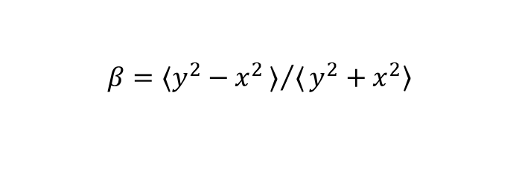
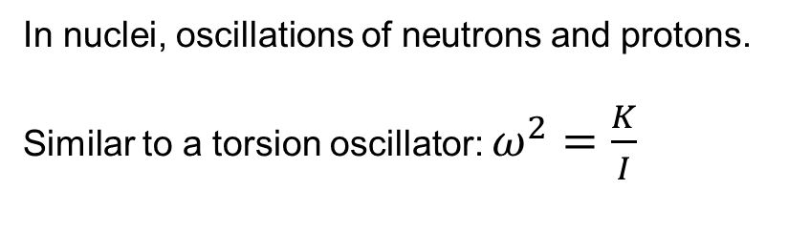
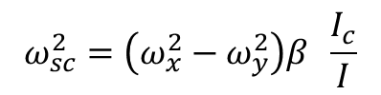
Scissors mode
$$θ$$
BEC
In nuclei, oscillations of neutrons and protons.
Similar to a torsion oscillator: $ω^{2}=\frac{K}{I}$
supersolid
supersolid
Standard BECs:
Theory: Guéry-Odelin and Stringari, Phys. Rev. Lett. 83, 4452 (1999)
Experiment: Maragò et al., Phys. Rev. Lett. 84, 2056, (2000)
Single-mode approximation:
$$ω_{sc}^{2}=\left(ω_{x}^{2}−ω_{y}^{2}\right)β \frac{I_{c}}{I}$$
$$β=〈y^{2}−x^{2}〉/〈y^{2}+x^{2}〉$$
Analogous to torsion oscillator experiments with helium
S. M. Roccuzzo, A. Gallemì, A. Recati, S. Stringari, Phys. Rev. Lett. 124, 045702 (2020)

Slide 15
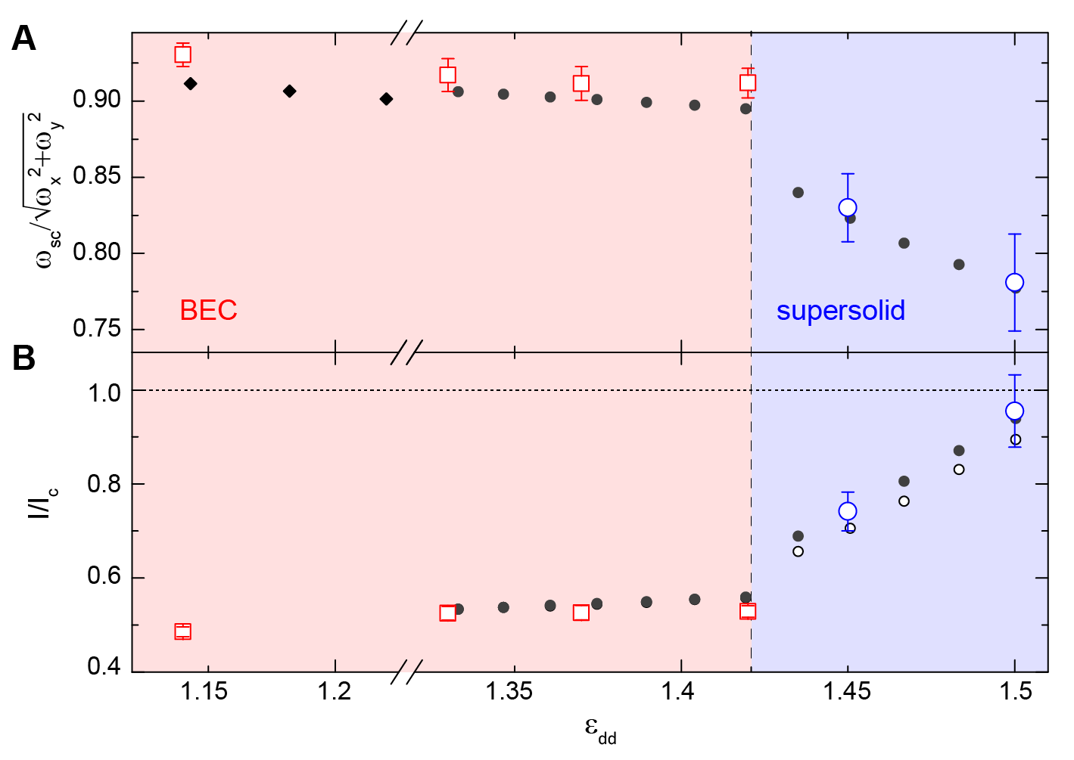


Scissors frequency and moment of inertia
experiment
simulations
Operative definition of superfluid fraction:
$$I={\left(1−f_{s}\right)I_{c }{+ f}_{s}β}^{2}I_{c}$$
recovers the two known limits
$β$²
In collaboration with Trento: S. Roccuzzo et al, Rotating a supersolid dipolar gas, Phys. Rev. Lett. 124, 045702 (2020).

Slide 16
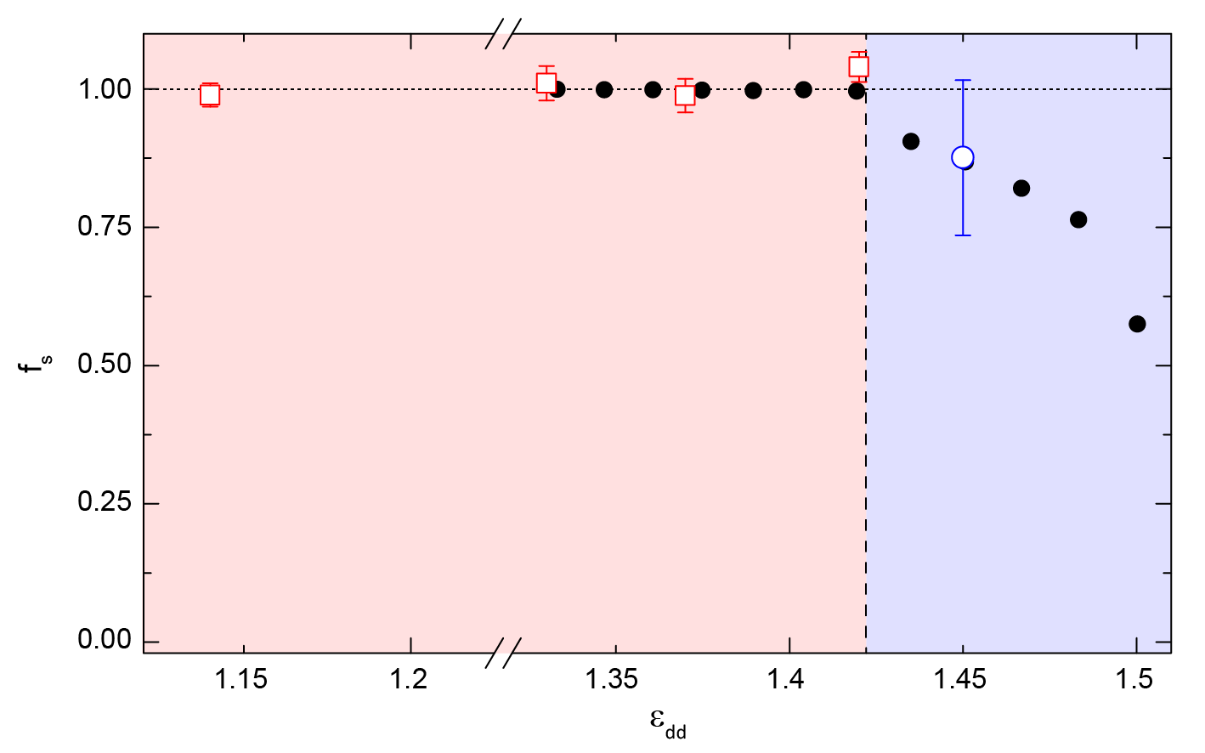
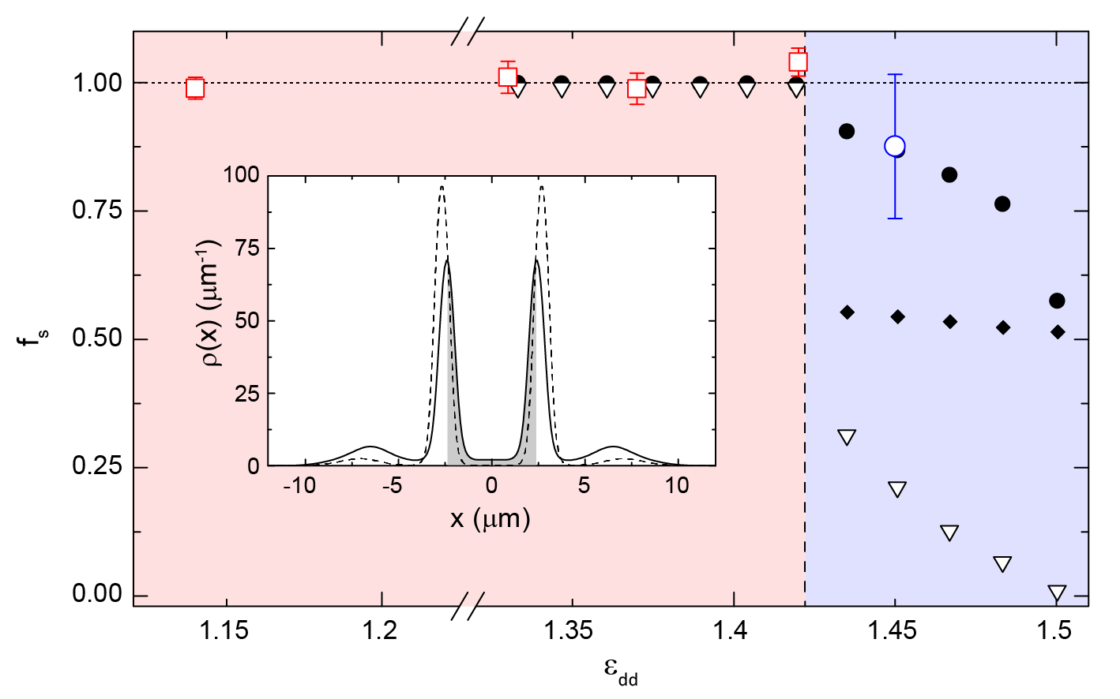
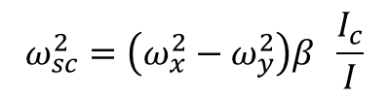

Superfluid fraction
simulations
$$I={\left(1−f_{s}\right)I_{c }{+ f}_{s}β}^{2}I_{c}$$
$$ω_{sc}^{2}=\left(ω_{x}^{2}−ω_{y}^{2}\right)β \frac{I_{c}}{I}$$
BEC
supersolid
L. Tanzi et al. Evidence of superfluidity in a dipolar supersolid from non-classical rotational inertia, Science 371, 1162 (2021).

Slide 17
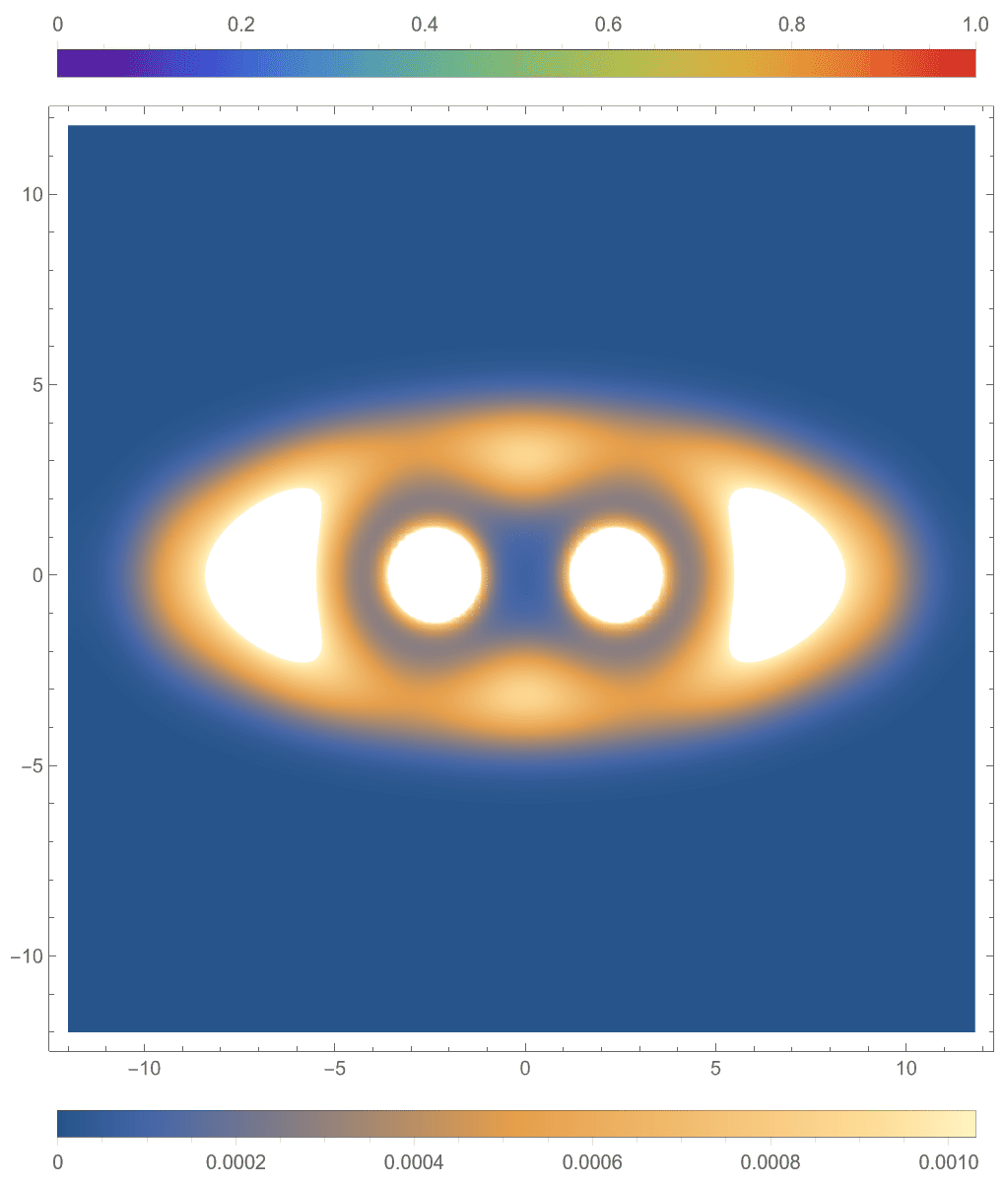
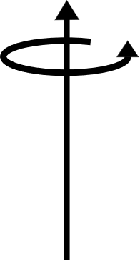



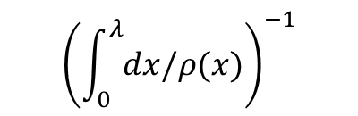
Superfluid fraction
Rotation of superfluid doplets
$$y$$
$$\frac{1}{1+β}$$
Leggett mechanism
$${\left(\int_{0}^{λ}{dx/ρ(x)}\right)}^{−1}$$
$$x$$
L. Tanzi et al. Evidence of superfluidity in a dipolar supersolid from non-classical rotational inertia, Science 371, 1162 (2021).

Slide 18
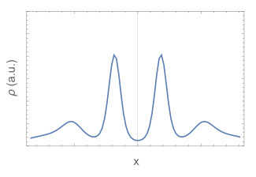
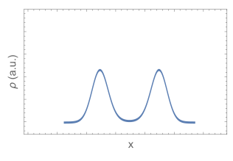
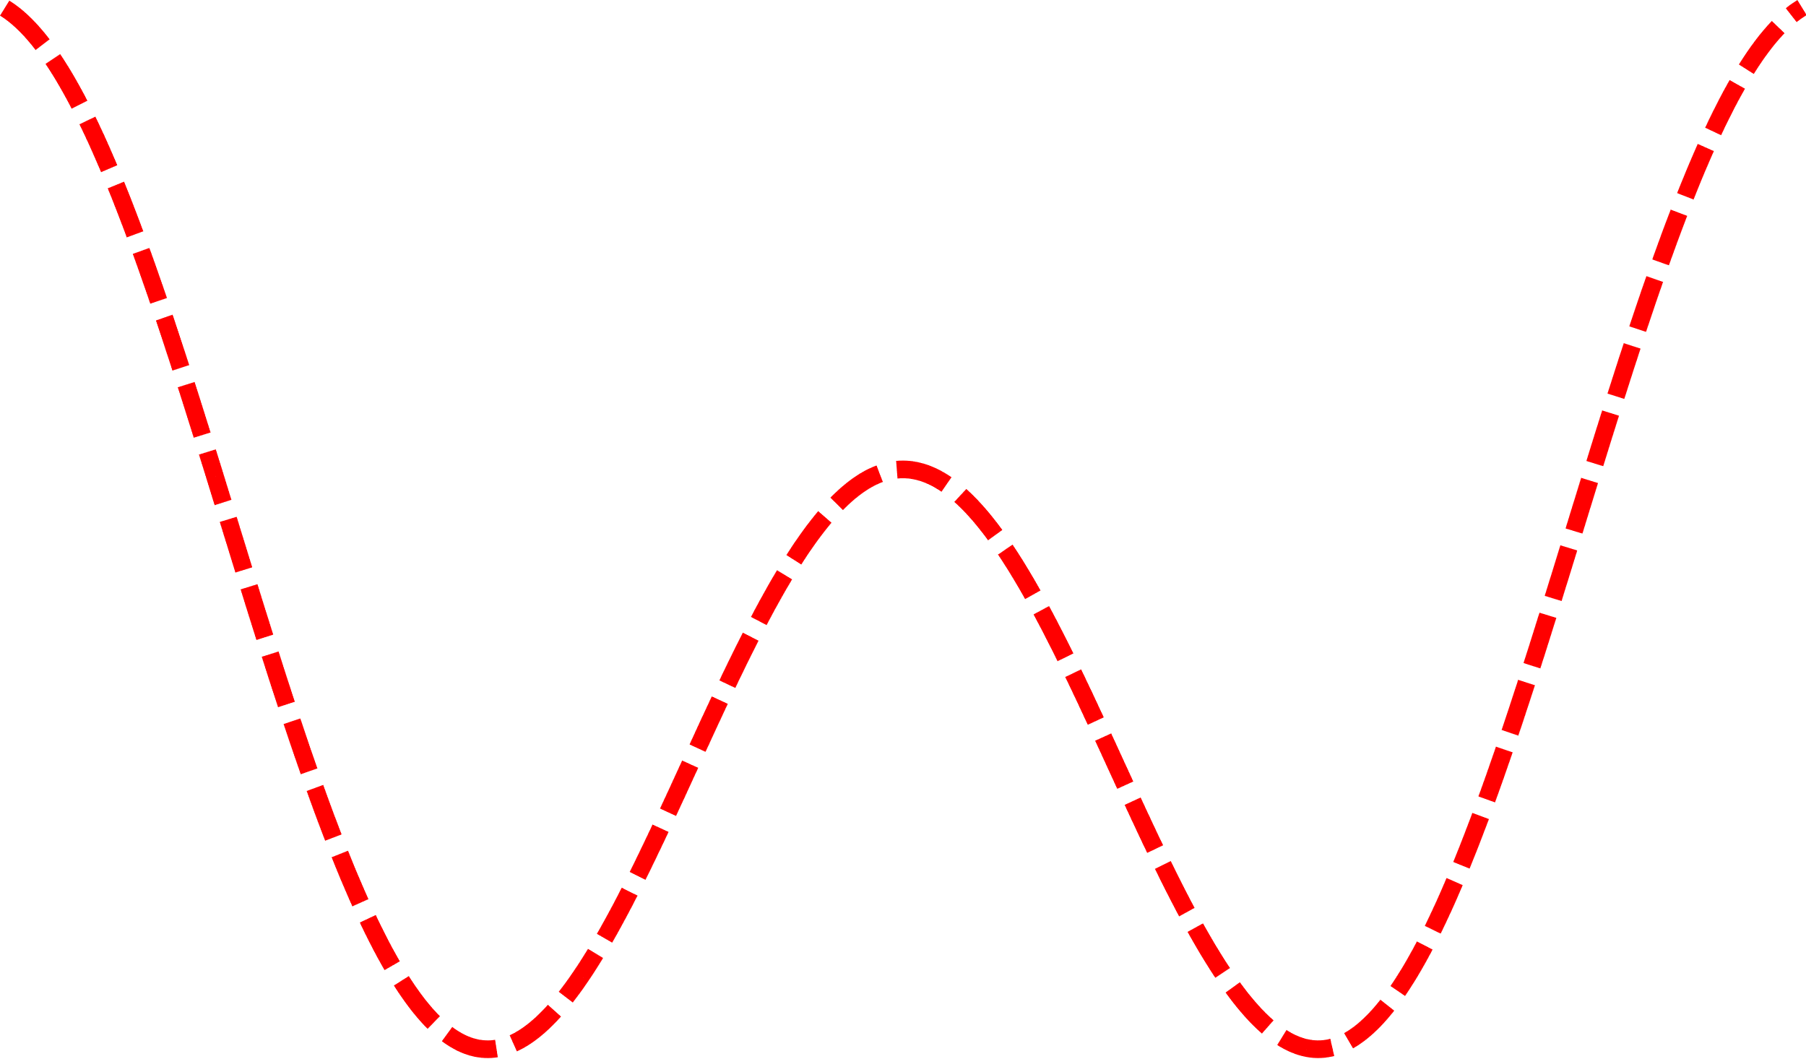
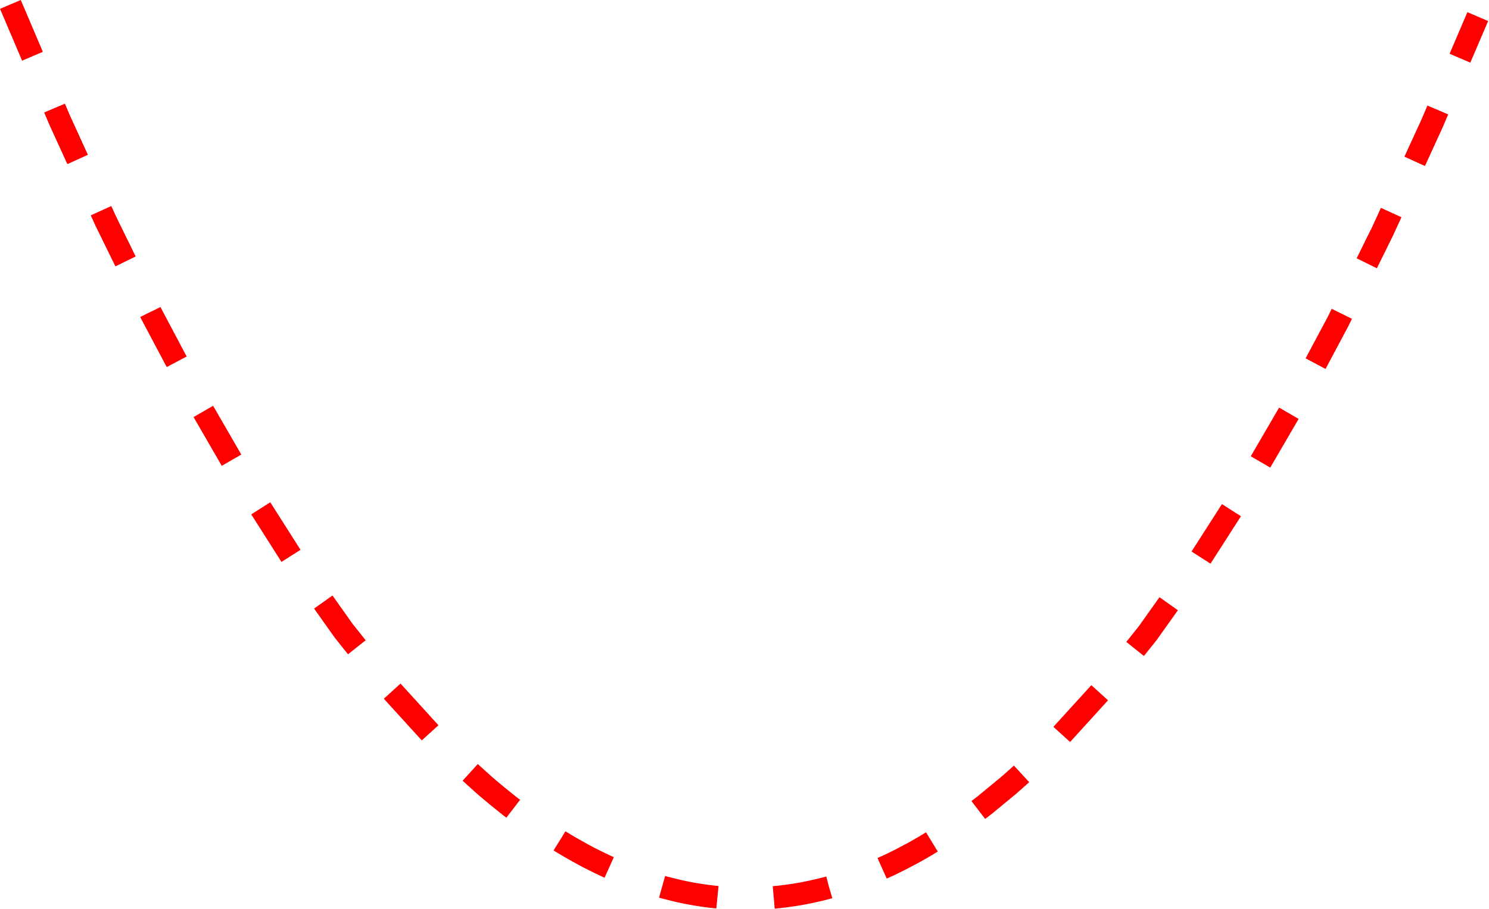

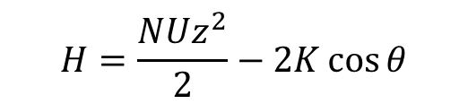






Self-induced Josephson effect?
Small dipolar supersolid
BEC in a double-well potential
$$φ$$
$$N_{2}$$
$$N_{1}$$
external potential
$$U$$
interaction
$$z={(N}_{2}−N_{1})/N$$
Fully open problem!
$$K$$
tunneling
$$H=\frac{NUz^{2}}{2}−2K\cos{θ}$$
$$ω=2K\sqrt{1+NU/2K}$$
Collaboration with B. Donelli, L. Pezzè and A. Smerzi, Firenze.
A. Smerzi, S. Fantoni, S. Giovannazzi, and S.R. Shenoy, Phys. Rev. Lett. 79, 4950 (1997)

Slide 19
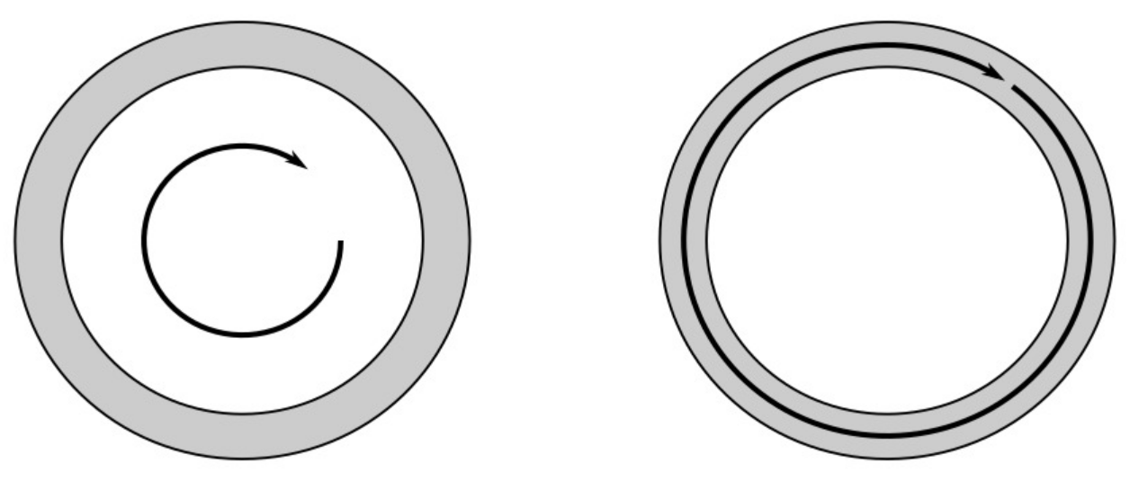
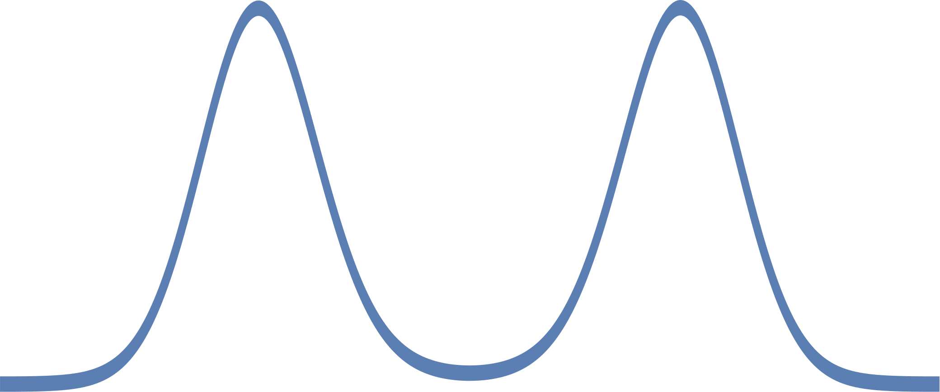




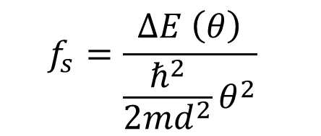
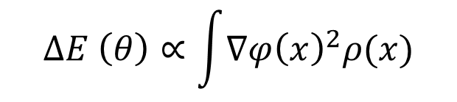

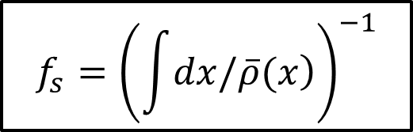
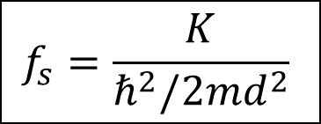
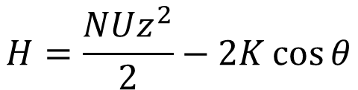

Superfluid fraction
General definition:
$$θ$$
phase twist:
$$f_{s}=\frac{∆E \left(θ\right)}{\frac{ℏ^{2}}{2md^{2}}θ^{2}}$$
system
‘Leggett’ approach
$$θ$$
$$d$$
$$ω$$
‘Josephson’ approach
Co-rotating frame
$$H=\frac{NUz^{2}}{2}−2K\cos{θ}$$
$$∆E \left(θ\right)∝\int{∇φ{\left(x\right)}^{2}ρ(x)}$$
$$K$$
$$∆E \left(θ\right) \sim Kθ^{2}$$
$$f_{s}={\left(\int{\left.dx/\overline{ρ}(x\right)}\right)}^{−1}$$
$$f_{s}=\frac{K}{ℏ^{2}/2md^{2}}$$

Slide 20
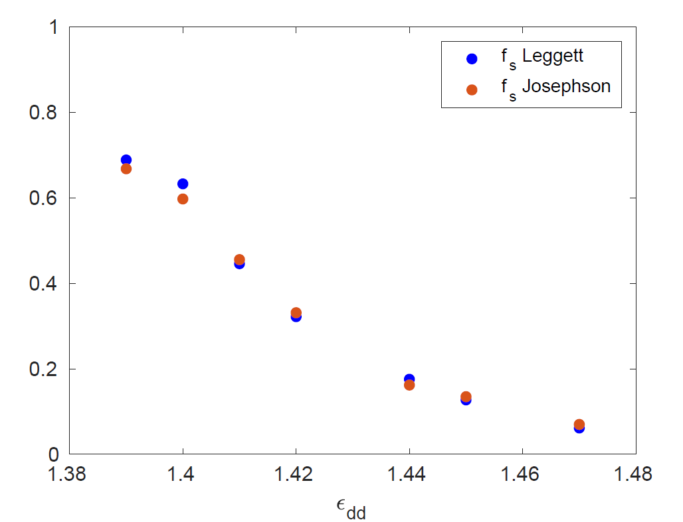
Superfluid fraction – numerical results
eGPE simulations
Josephson model

Slide 21

Self-induced barrier: Goldstone mode
Small dipolar supersolid
experiment
center of mass
individual peaks
The «barrier» can move!
M. Guo et al., The low-energy Goldstone mode in a trapped dipolar supersolid, Nature, 574, 386–389 (2019)

Slide 22





Adiabatic preparation in an optical lattice
Slow ($ω≪ω_{x}$) and fast oscillations ($ω \sim ω_{x}$)
Z $φ$

Slide 23





Phase imprinting with an optical lattice
Dominant fast oscillation ($ω \sim ω_{x}$)
Z $φ$

Slide 24




Experimental methods
interference: φ
switch on the optical lattice for 50-100 μs
in-situ density: $z$
$$3μm$$

Slide 25


Josephson oscillations!
Phase
Imbalance

Slide 26


Josephson frequencies: experiment
eGPE numerical simulations

Slide 27



Josephson frequencies: model
$$f_{s}=\frac{K}{ℏ^{2}/2md^{2}}$$
$$ω=2K\sqrt{1+NU/2K}$$
Paper in preparation

Slide 28
Conclusions and outlook
Fundamental properties of supersolids accessible in few-cluster systems:
Two oscillation modes (solid nature)
Phase transition similar to crystallization
Non-classical rotational inertia (superfluid nature)
Josephson effect (solid and superfluid nature)
More and more open questions: solid nature of supersolids (shear forces, lattice slips, …), entanglement properties (Josephson fluctuations, …)
Also strongly correlated supersolids accessible with dipolar gases

Slide 29




Supersolid-like low energy phases
Helium-4 on graphite: Nyeky et al. Nature Phys. 13, 455 (2017)
Helium-3 under confinement: Levitin et al. Phys. Rev. Lett. 122, 085301 (2019); Shook et al. Phys. Rev. Lett. 124, 015301 (2020)
Cuprates: Edkins et al., Science 364, 976 (2019). TMD: Liu et al. Science 372, 1447 (2021).
FFLO…
Optical cavities: J. Léonard et al., Science 358, 1415 (2017). Spin-Orbit coupling: J. R. Li et al., Nature 543 (2017); theory: Y. Li et al. Phys. Rev. Lett. 110, 235302 (2013) .
Many theoretical proposals for quantum gases: e. g. dipoles in lattices or in 2D:
S. Wessel, M. Troyer, Phys. Rev. Lett. 95 127205 (2005); Z.-K. Lu et al. Phys. Rev. Lett. 115, 075303 (2015); …

Slide 30
Team
    Dipartimento di Fisica e Astronomia and LENS, Università di Firenze, and CNR-INO, Pisa
Theory: R. Bisset, L. Santos (Hannover);
S. Roccuzzo, A. Gallemì, A. Recati, S. Stringari (Trento); A. Alana, M. Modugno (Bilbao);
B. Donelli, L. Pezzè, A. Smerzi (Firenze), M. Chiofalo (Pisa).
Giulio Biagioni
Carlo Gabbanini
Nicolò Antolini
Luca Tanzi
Andrea Fioretti
Former members: J. Maloberti, F. Famà, E. Lucioni, J. Catani
http://quantumgases.lens.unifi.it/exp/dy
Master students, Phd students and post-doc applications are welcome!

Slide 31


Experiments on solid helium
Supersolids have a reduced moment of inertia:
$$I= (1−f_{s}){ I}_{c}$$
Superfluid fraction
E. Kim and M. H. W. Chan, Probable observation of a supersolid helium phase, Nature 427, 225 (2004).
J. Day and J. Beamish, Low-temperature shear modulus changes in solid ⁴He and connection to supersolidity, Nature 450, 853 (2007).
D. Y. Kim and M. H. W. Chan, Absence of supersolidity in solid helium in porous Vycor glass, Phys. Rev. Lett. 109, 155301 (2012).
﻿More refined experiments do not exclude supersolidity of bulk helium, with $f_{s}\sim {10}^{−4}$
A. Eyal, …, J. D. Reppy et al., Search for supersolidity in solid ⁴He using multiple-mode torsional oscillators, PNAS 113, E3203 (2016).

Slide 32


Double symmetry breaking
In trapped systems, phonons map to collective oscillations.
Superfluid: gauge symmetry (phase invariance)
Supersolid: gauge and translational symmetries
Solid: translational symmetry
axial breathing mode
$${ω_{BEC}=\sqrt{5/2} ω}_{x}$$
S. Stringari, Collective excitations of a trapped Bose-condensed gas, Phys. Rev. Lett. 77, 2360 (1997).
S. Saccani et al., Phys. Rev. Lett. 108, 175301 (2012).

Slide 33









Dimensional crossover
1
Continuous – 1D structure
Discontinuous – 2D structure
The crossover is peculiar to the cluster solid
3
Few lattice sites, but large $N$
Fluctuations $\sim 1/\sqrt{N}$
2
Fourier transformation
1
2
3
Cut along $k_{x}$

Slide 34


Fluctuations in the self-induced Josephson junction
What is the role of the Goldstone mode in the fluctuations?
Squeezing in the population imbalance
Even higher cost in interaction energy
Relatively lower cost in interaction energy, stronger number fluctuations
Minimizes interaction energy
Cost in interaction energy
Phase squeezing?

Slide 35






Fluctuations in the self-induced Josephson junction – T > 0
$$Δφ^{2}=\frac{T}{2NK}$$
$$T=2NKΔφ^{2}\sim 120 nK$$
From thermal component measurements
$$T<30 nK$$
A lower energy scale sets the amplitude of the oscillations
$$T=2NKΔφ^{2}∝ ω_{J}Δφ^{2}$$
$$ω_{G}Δφ^{2}\sim 30 nK$$

