Slide 1



Nuclear Physics Mid Term Plan in Italy
LNS – Session
Catania, April 4th-5th 2022
WG4 – Applications
Medical Applications
G. Petringa, INFN-LNS
LASER-driven Applications
GAP Cirrone and G. Milluzzo, INFN-LNS
PLASMA TRAPS Applications
D. Mascali, INFN-LNS
Salvatore Tudisco
Laboratori Nazionali del Sud, INFN, Catania, Italy

Slide 2
Nuclear Physics Mid Term Plan in Italy
LNS – Session
Catania, April 4th-5th 2022
Medical Applications
Giada Petringa
Laboratori Nazionali del Sud
Istituto Nazionale di Fisica Nucleare
Catania, Italy

Slide 3


Giada Petringa
Outline
Text
1. Target and Projectile fragmentation and nuclear reaction for medical and space applications
1.1 Proton beams
1.2 Multiple-ion
1.2.1 Flash radiotherapy
1.3 Boron Neutron Capture Therapy
1.4 Radioprotection in space applications
2. Radioactive beams in particle therapy: in beam PET
3. Cross-section study for exotic radioisotopes production with high-intensity beams at LNS

Slide 4



Target fragmentation in protontherapy
Contributions
Vincenzo Patera, Giacomo Traini
Università di Roma Sapienza, Istituto Nazionale di Fisica Nucleare – Sezione Roma 1
Michela Marafini
Centro Ricerche Enrico Fermi

Slide 5
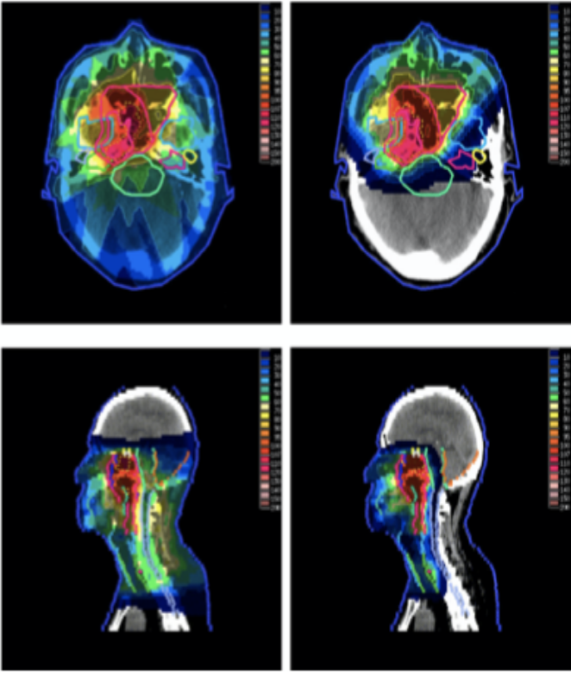

Giada Petringa
Text
FOOT (FragmentatiOn Of Target)
Goal: measurement of target and projectile fragmentation cross section relevant for particle therapy and for radioprotection in space applications
Projectile fragmentation of ⁴He, ¹²C, ¹⁶O ion beams in the energy range 100-500 MeV/u, interaction with main constituent of human body (H,C,O)
¹²C and ¹⁶O target fragmentation induced by proton beams of 70-250 MeV
Same ions used in particle therapy plus ions up to ⁵⁶Fe interacting with hydrogen rich targets, of interest for shielding , at energy 100-800 MeV/u
Radiotherapy
Particle therapy
Notes:
Charged particles therapy exploits protons or 12C beams to treat deep tumor. However the beam nuclear interaction with the patient tissue induces fragmentation both projectile and target nuclei and needs to be carefuly take in into accoun.
In proton treatments, target fragmentation produces low energy, short range fragments along all the beam range, which deposit a non negligible dose in the entry channel.
In 12C treatments the main concern is represented by long range fragments due to beam fragmentation that release their dose in the healthy tissues beyond the tumor.
The FOOT experiment (FragmentatiOn Of Target) of INFN is designed to study these processes, in order to improve the nuclear fragmentation descriptionin next generation Treatment Planning Systems and the treatment plans quality.
Target (16O and12C nuclei) fragmentation induced by —proton beams at therapeutic energies will be studied via an inverse kinematic approach, where 16O and12C therapeutic beams impinge on graphite and hydrocarbon targets to provide the nuclear fragmentation cross section on hydrogen. Projectile fragmentation of 16O and 12C beams will be explored as well.

Slide 6
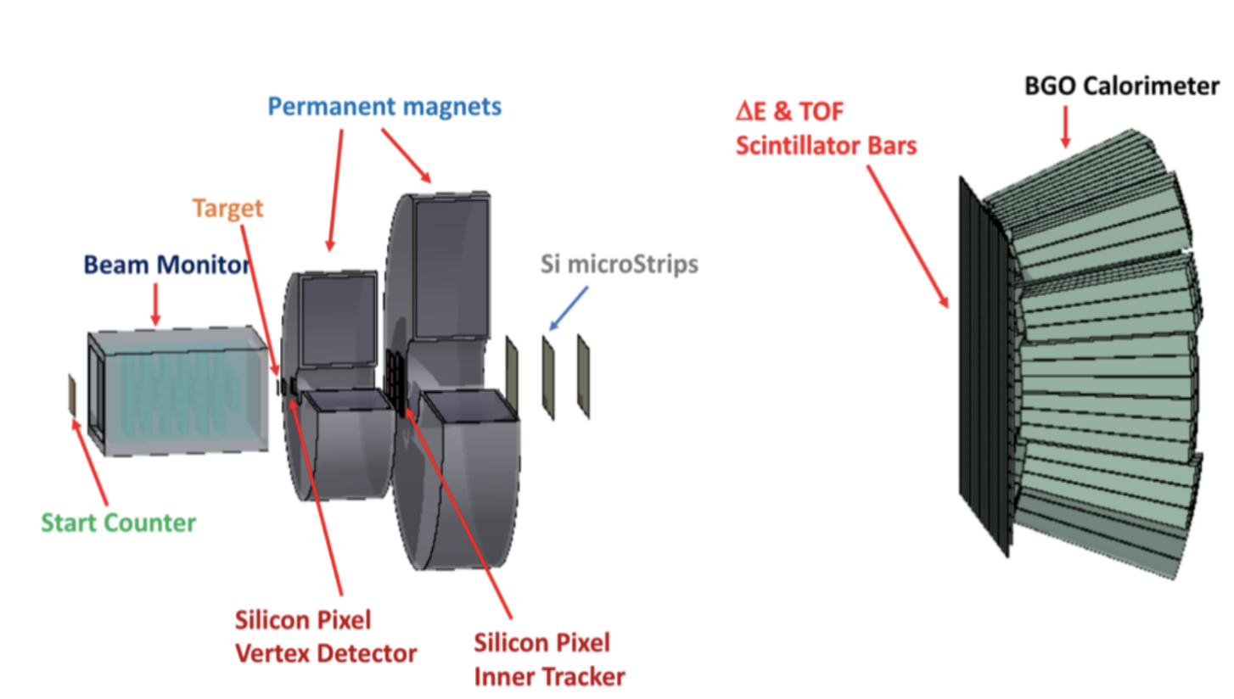
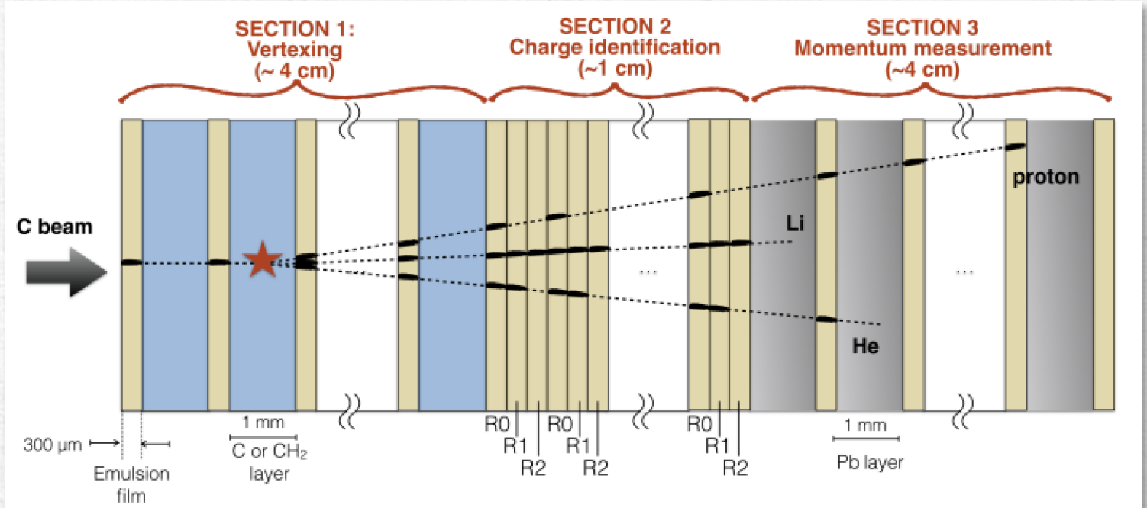
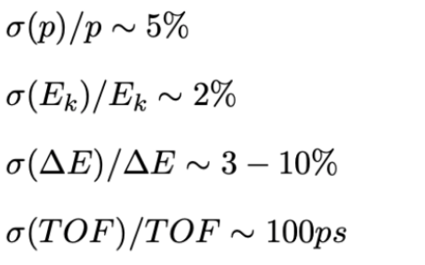
The FOOT apparatus
Giada Petringa
The FOOT detector is a movable set-up to fit the experimental rooms dimensions of different PT treatment centers experimental facility (CNAO, HIT, GSI) with ions beams
Fixed target experiment with magnetic spectrometer, optimized to detect Z>=3 fragments
Dedicated, independent setup for detection of Z<3 fragments based on emulsions
Full-apparatus completed in 2022
Required performance
for cross-section
accuracy < 10%
Notes:
Hence, the FOOT apparatus has been designed with two different setups: an electronic experimental setup,aiming to study heavy fragments, and an emulsion chamber,able to measure light fragments at larger angles.
The electronic setup has been optimized to study heavy (Z > 3) target fragment production, aiming to provide:
• different fragments production cross sections
• charge Z and mass A fragments identification
• fragment energy spectra
The measurement of the target fragmentation induced by protons is a challenging task due to the low energy and shortrange (∼tens of m) of the produced fragments. For this reason, an inverse kinematic approach will be implemented: the fragmentation of tissue-like ion beams (mainly C and O, which are the main constituents of human body) impingingon a Hydrogen enriched target will be studied.
Three different regions can be identified in the project ofthe electronic setup :
• Pre-target region. A thin plastic scintillator counter willgive trigger information and the TOF start time, while adrift chamber will monitor the beam direction and posi-tion. The target is placed immediately downstream thedrift chamber.
• Magnetic spectrometer region. Beyond the target, a tele-scope of Silicon pixel trackers will reconstruct the vertexposition and provide the initial tracking. Then two cylin-drical permanent magnets in the Halbach configurationwill provide the magnetic field (maximum value ∼0.8 T).Two other layers of Silicon pixel trackers and a tele-scope of Silicon microstrips will be placed between and at the end of the magnets respectively. All these track-ing elements will allow the measurement of fragmentsmomentum.
• Calorimeter region. A detector made of two orthogonalplanes consisting of plastic scintillator bars will measureE and TOF. Finally, the measurement of kinetic energyis provided by a calorimeter made of BGO crystals.
An emulsion cloud chamber will provide complementarylight fragments (Z ≤ 3) measurements. It will iprovide measurements of fragments emit-ted up to 70◦(mainly protons, deuterons, tritons, Heliumand Lithium ions).

Slide 7
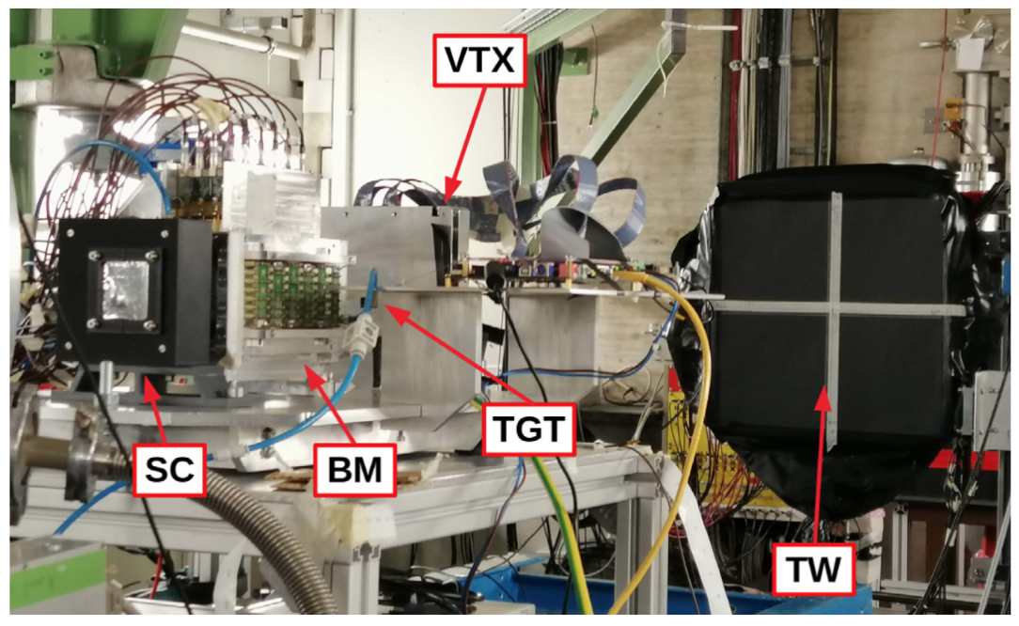
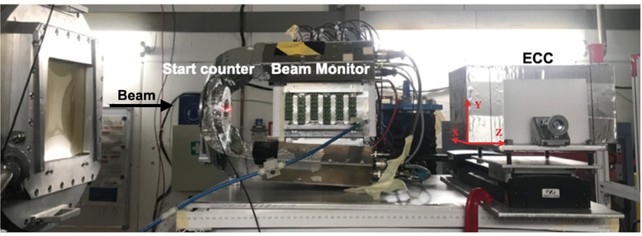
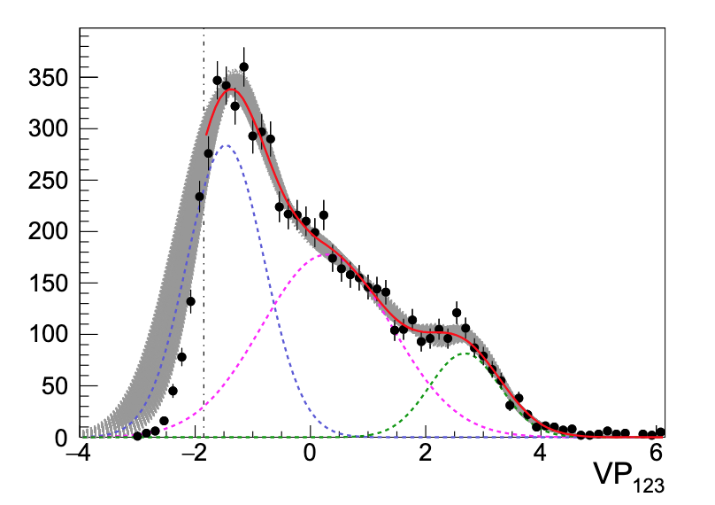
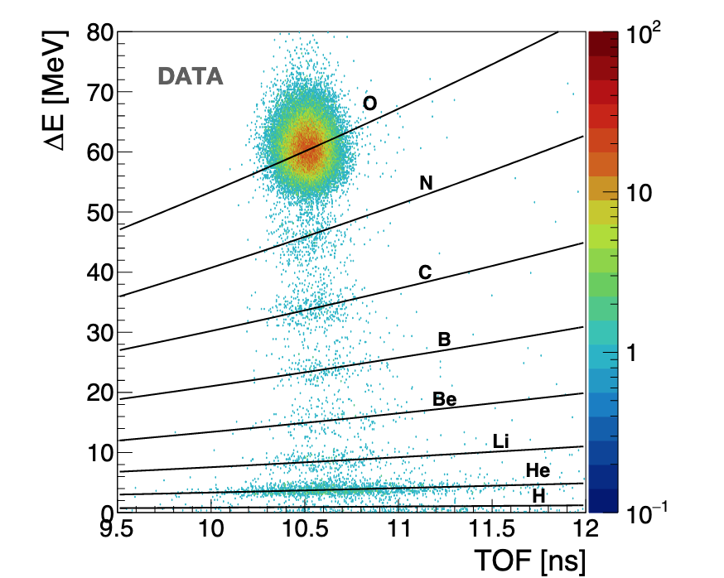
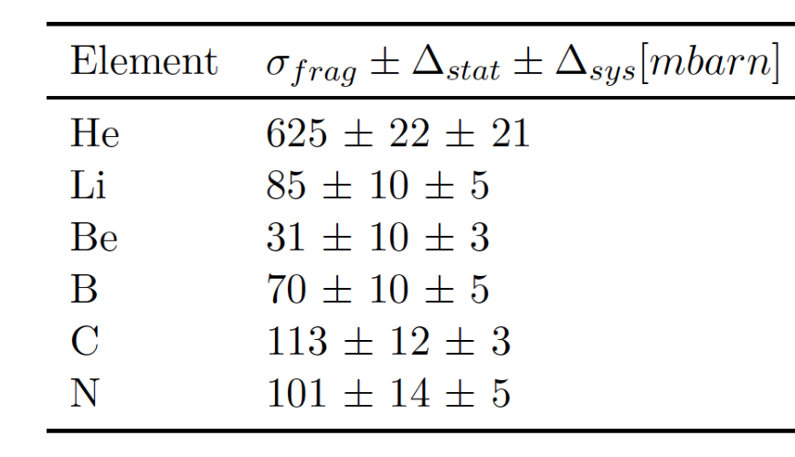
The FOOT data-taking campaigns
Calibration/data taking campaign with partial apparatus @
  GSI (¹⁶O @ 200-400 MeV/u)
  CNAO(¹²C @ 200 MeV/u)
¹⁶O beam @ 200 MeV/u
¹⁶O beam @ 200 MeV/u
Fragment identification with ToF system
Z=2
Fragment identification with emulsions
Z=3
Submit to Frontiers in Physics
preliminary
Z=4
Submitted to Frontiers in Physics

Slide 8
Possible activity @ LNS
The FOOT apparatus could be used to measure fragmentation cross section @ LNS with H,C and O beams.
Multi-ion radiotherapy (MIRT) theoretically provides an high dose optimised LET. In such scenario, helium offers a decreased lateral scatter effect versus proton with less fragmentation tail dose versus carbon. The energy available @ LNS (80MeV) is compliant for possible particle therapy application.
Moreover, the knowledge of fragmenation cross section of C and O ion beams at such energy allow to investigate the fragmentation reactions in the entrance channel, where fragmentation play a fundamental role.

Slide 9

Nuclear Secondaries Measurements of interest for single and multi-ion treatments in particle therapy
Contributions
Andrea Mairani (spokesperson for the contribution)
Biophysics in Particle Therapy Group (BioPT)
Heidelberg Ion-beam Therapy Center (HIT)
University Hospital Heidelberg (UKHD)
German Cancer Research Center (DKFZ)
National Center for Tumor Diseases (NCT)
Benedik Koop, Stewart Mein, Thomas Tessonnier
Heidelberg Ion-beam Therapy Center (HIT)
LNS Collaboration
Pablo Cirrone, Giacomo Cuttone, Giada Petringa, Roberto Catalano

Slide 10
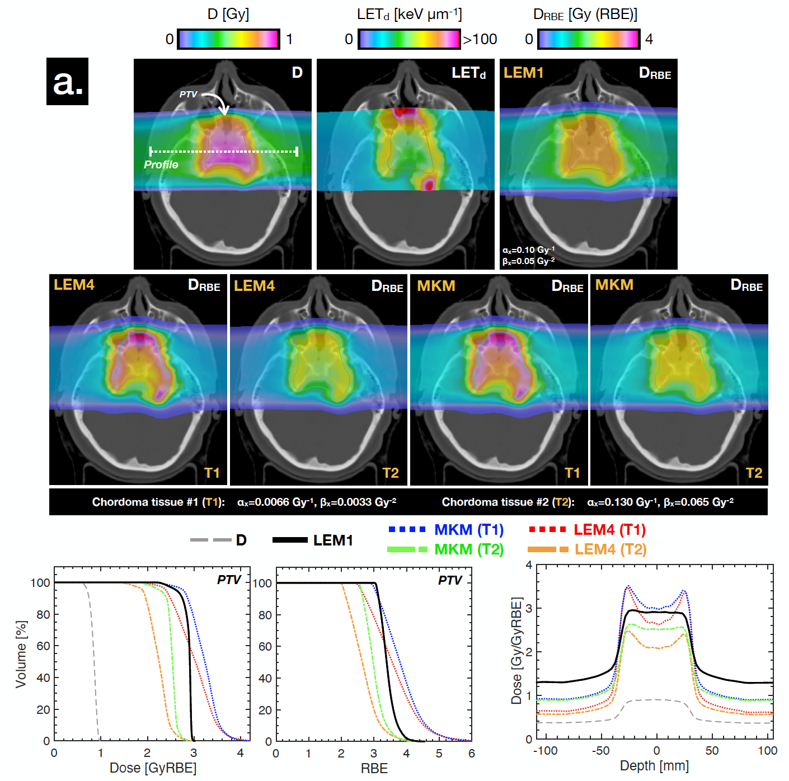
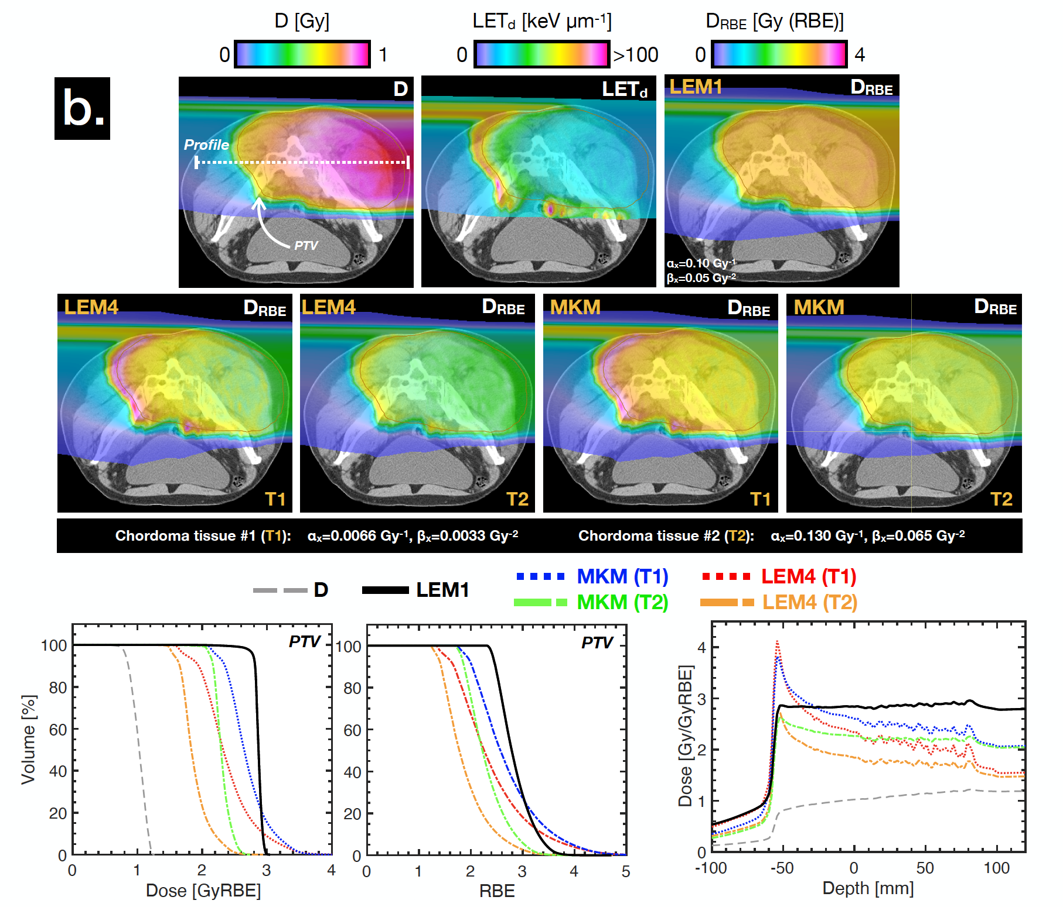
State of the art: carbon ion therapy
α/β = 2Gy
2F
1F
Can novel single and multi-ion therapy techniques improve stability of phys/bio distributions?
Notes:
Treatment design and delivery techniques for particle radiotherapy are becoming more sophisticated, from passive scattering (broad beam) to active scanning (spot/raster-scanning). Until now, only a single ion species (proton [p], helium [He], carbon [C], oxygen [O] or neon [Ne] ions) is used in the treatment of a patient. Conversely, one emerging topic known as multi-ion therapy (MIT) is a potential treatment concept that involves mixing ion species into a single treatment fraction.
While the carbon-ion beam has demonstrated unique and promising suitability in clinical trials toward the hypofractionated treatment of hypoxic and/or radioresistant cancer, substantial developmental potential remains. Perhaps most notable is the ability to paint LET in a tumor, theoretically better focusing damage delivery within the most resistant areas.
However, the technique may be limited in practice by the physical properties of the beams themselves.
A heavy-ion synchrotron may provide irradiation with multiple heavy ions: carbon, helium, and oxygen are prime candidates.
Each ion varies in LET distribution, and so a methodology combining the use of multiple ions into a uniform LET distribution within a tumor may allow for even greater treatment potential in radioresistant cancer.

Slide 11
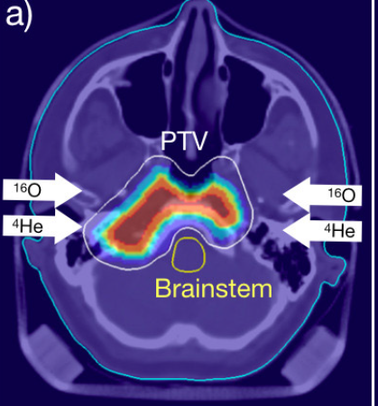
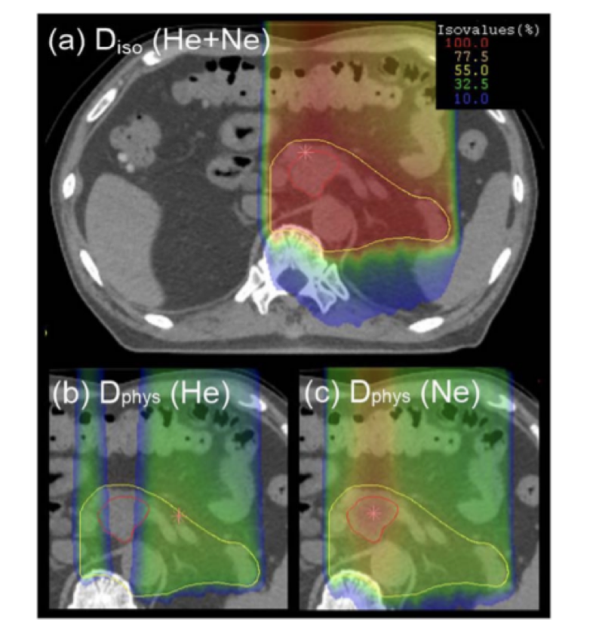
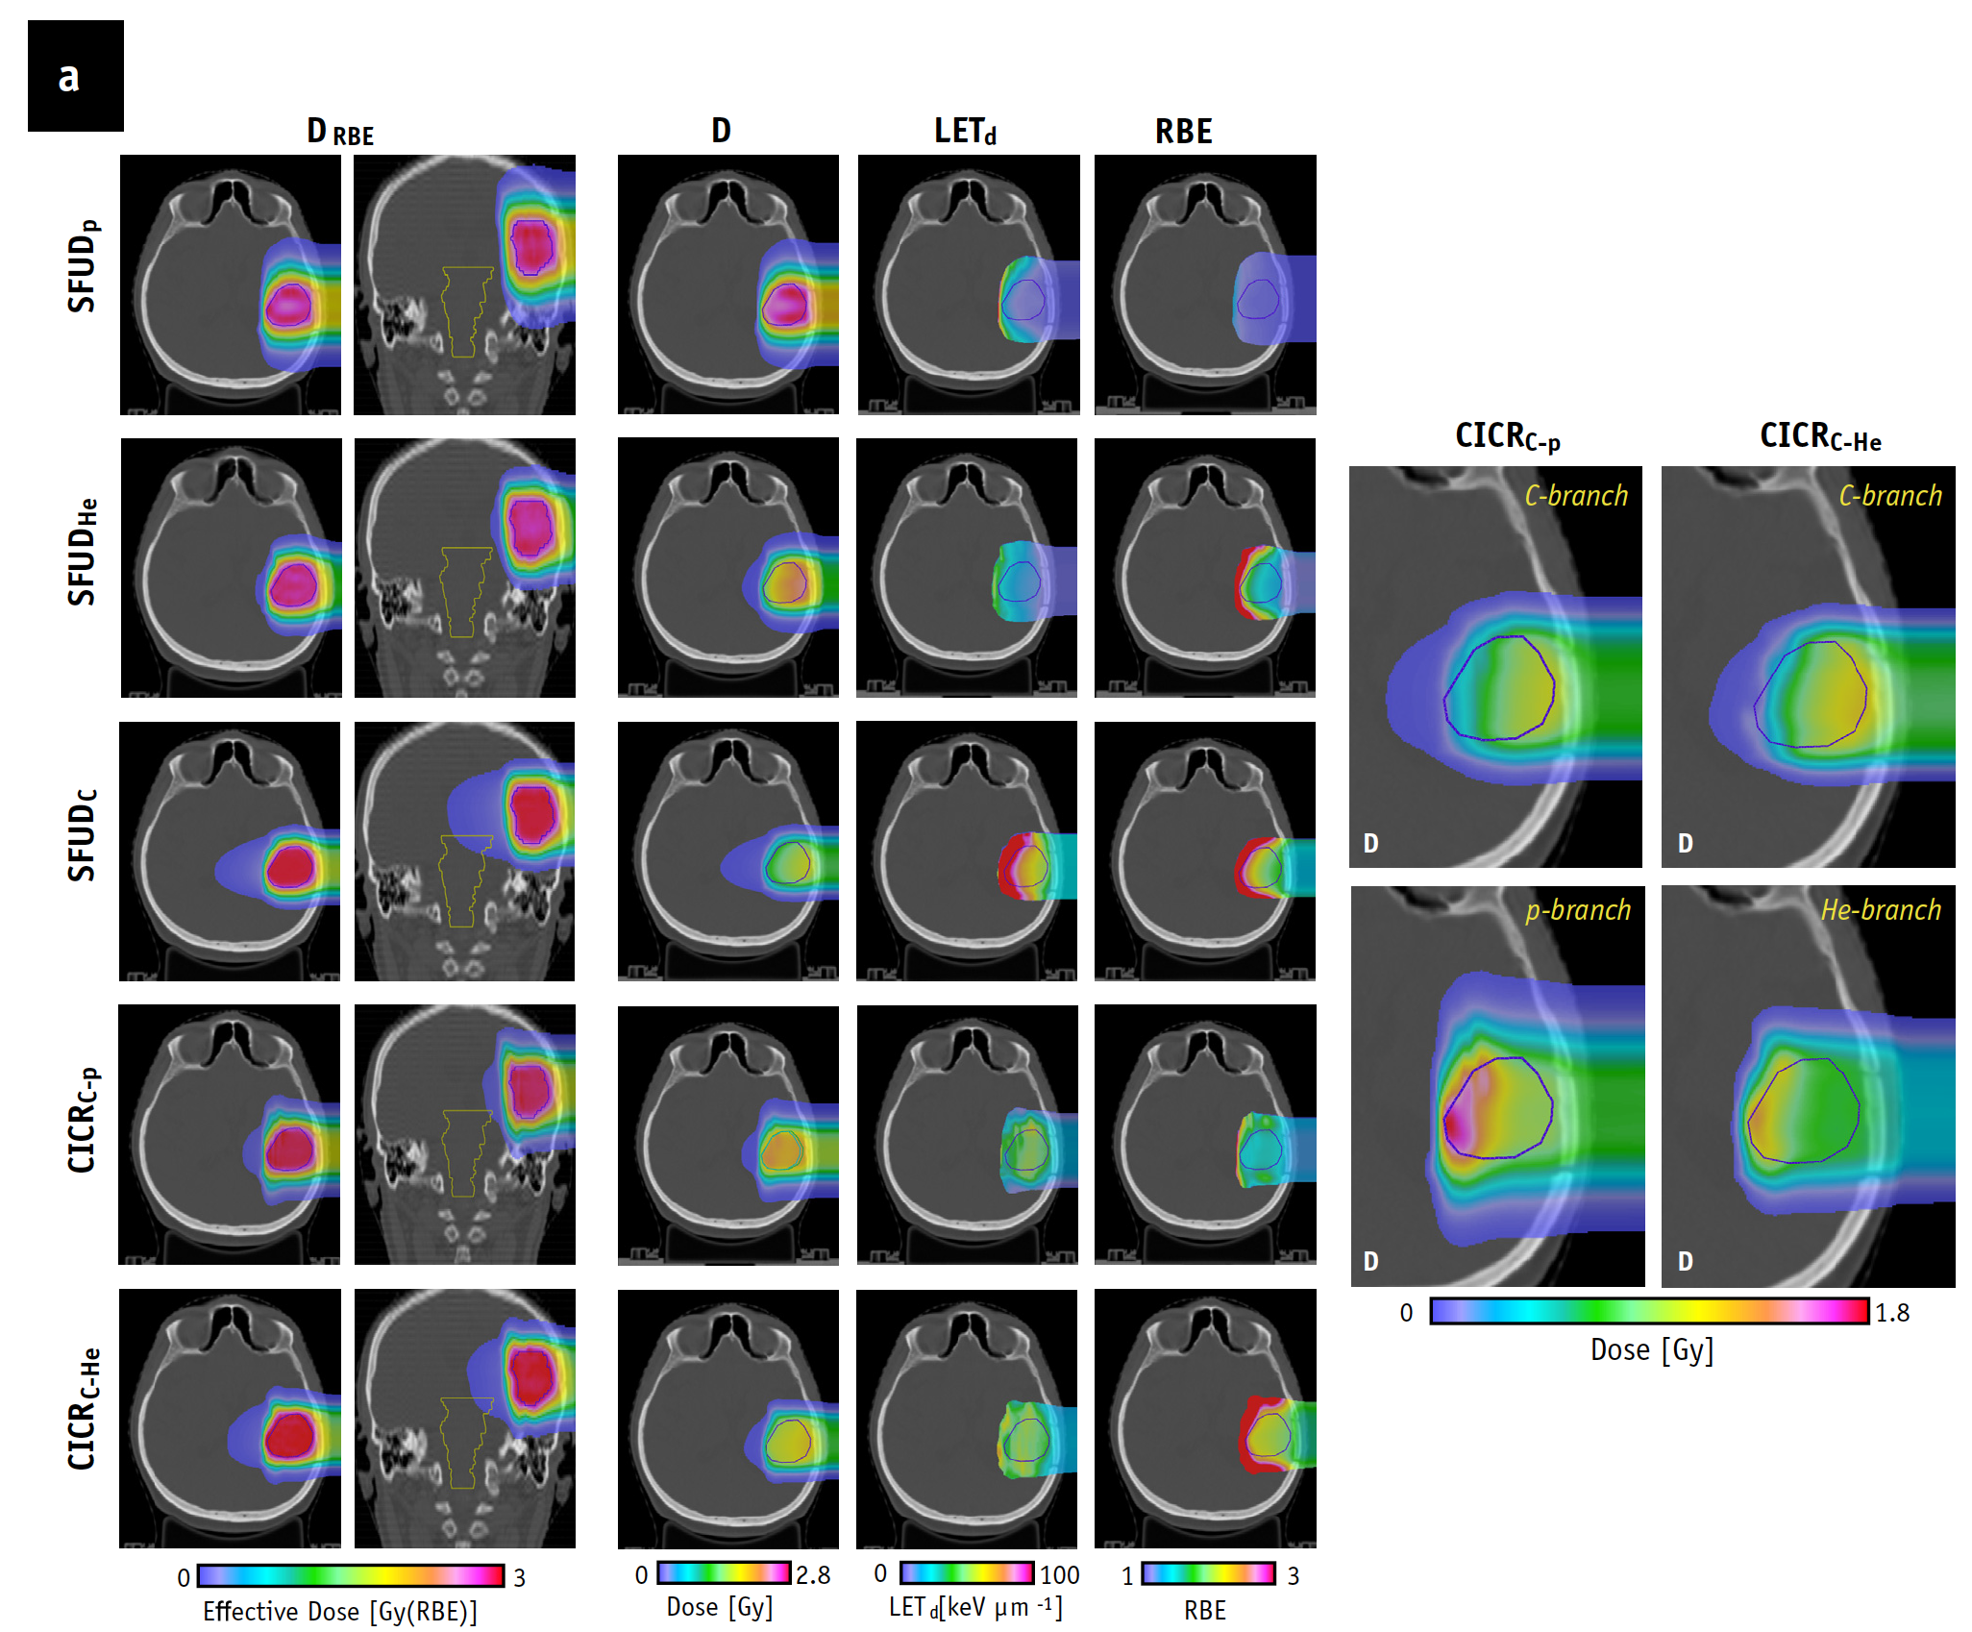
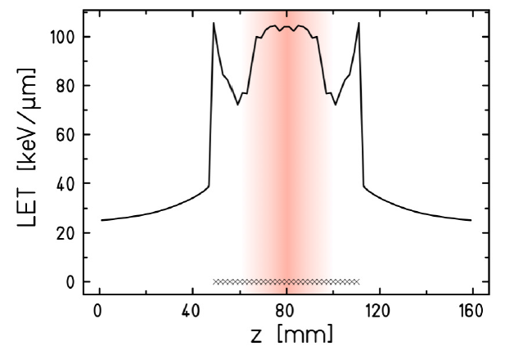
Multi-ion Therapy (MIT): Recent Results
HIT (Germany)
NIRS (Japan)
GSI (Germany)
Combined ion-beam constant RBE (CICR)
Intensity modulated composite particle therapy (IMPACT)
Multi-ion kill painting
Aim: overcome hypoxia-related tumor radio resistance
Aim: robust biological optimization and Organ At Risk sparing. Harmonize clinical practice via inter-/intra-patient RBE/LET/D_{phys}
Aim: expand therapeutic window via optimization of D_{phys} /LET. Combat hypoxia
FWD
wedge
INV
wedge
Inaniwa et al. Phys. Med. Biol.
2017, 2018, 2020, 2021
O Sokol et al 2019 Phys. Med. Biol.
Tinganelli et al 2015 Sci. Rep.
Notes:
By mixing low (p, He) and high (C, O, Ne) LET particles, MIT offers additional degrees of freedom in treatment design, planning and optimization otherwise not attainable with the use of a single radiation quality.
MIT Dedicated treatment planning and optimization systems must handle the mixed radiation field of multiple primary particle beams to accurately predict effective dose.
==> CICR treatment plans for the 3 patients presented highly uniform physical dose while reducing high dose-averaged linear energy transfer gradients compared with carbon ions alone. When considering uncertainty in tissue parameter (α/β)x assignment and RBE modeling, the CICRC-p treatment exhibited enhanced biophysical stability within the target volume, similar to protons alone. CICR treatments reduced dose to normal tissue surrounding the target, exhibiting similar or improved dosimetric features compared with SFUDH

Slide 12
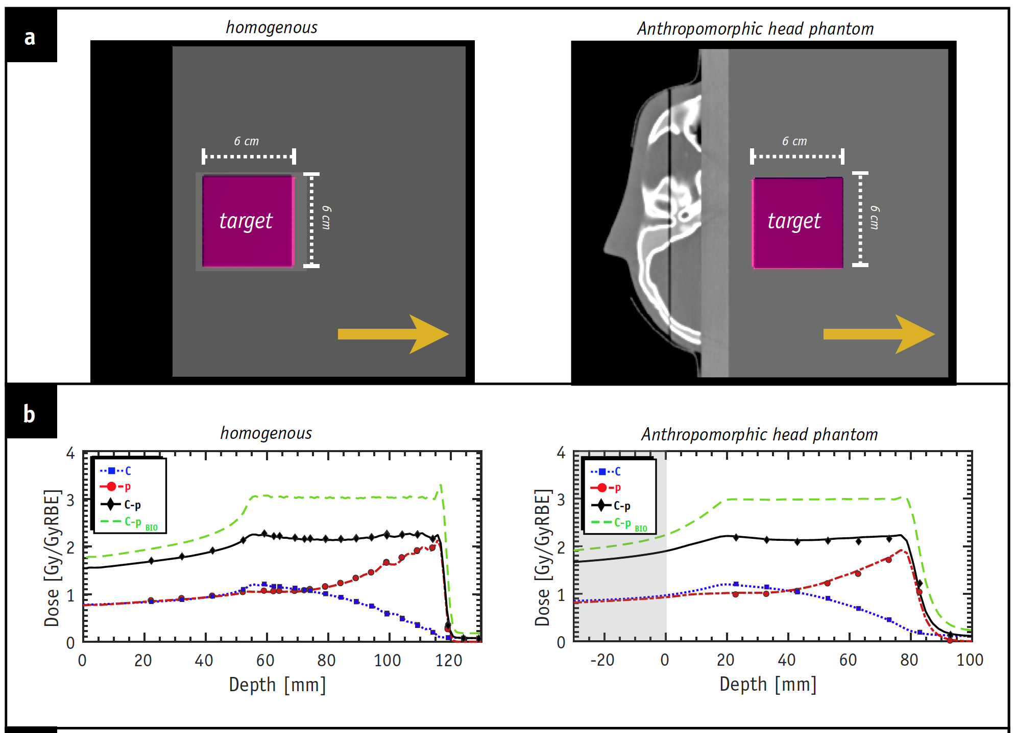
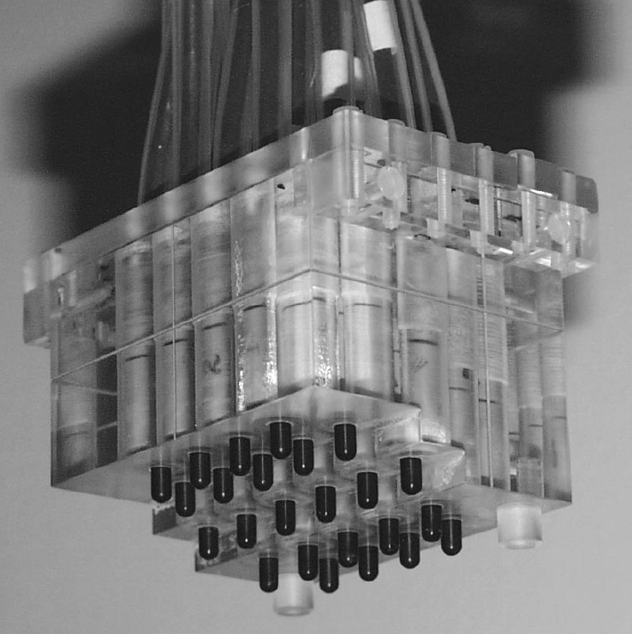
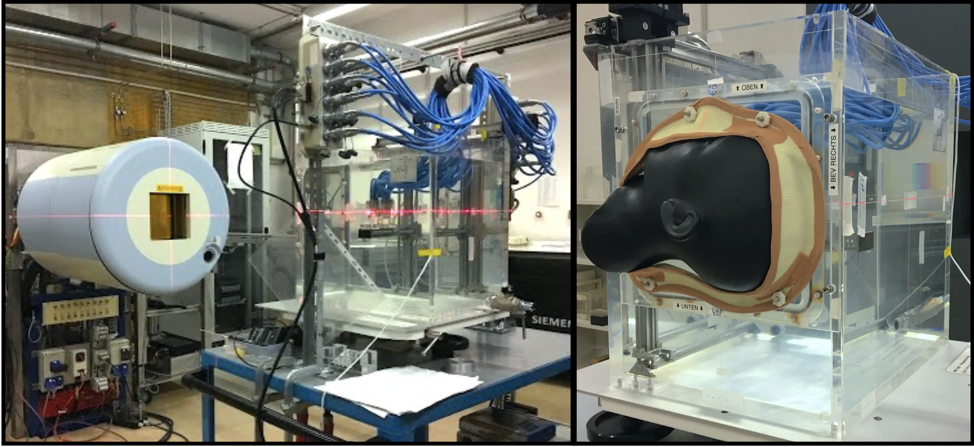
@Laboratori Nazionali del Sud
CICRC-p
+
Measurement, characterization and modeling nuclear secondaries for low and high LET particles

Slide 13
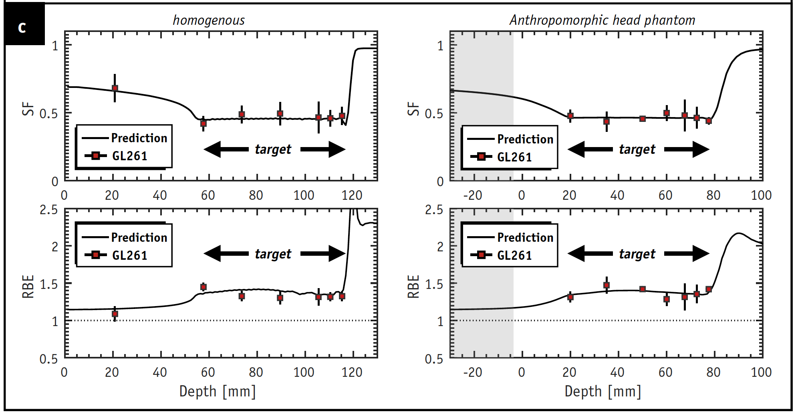
@Laboratori Nazionali del Sud
1st multi-ion bio-effect verification
in vitro
clonogenic assay:
glioma cell line (GL261)
CICRC-p
+
Measurement of biological effect for low and high LET particle mixtures

Slide 14
Flash radiotherapy with multi-ion in particle therapy
Contributions
Andrea Mairani (spokesperson for the contribution)
Biophysics in Particle Therapy Group (BioPT)
Heidelberg Ion-beam Therapy Center (HIT)
University Hospital Heidelberg (UKHD)
German Cancer Research Center (DKFZ)
National Center for Tumor Diseases (NCT)
Benedik Koop, Stewart Mein, Thomas Tessonnier
Heidelberg Ion-beam Therapy Center (HIT)
LNS Collaboration
Pablo Cirrone, Giacomo Cuttone, Giada Petringa, Roberto Catalano

Slide 15
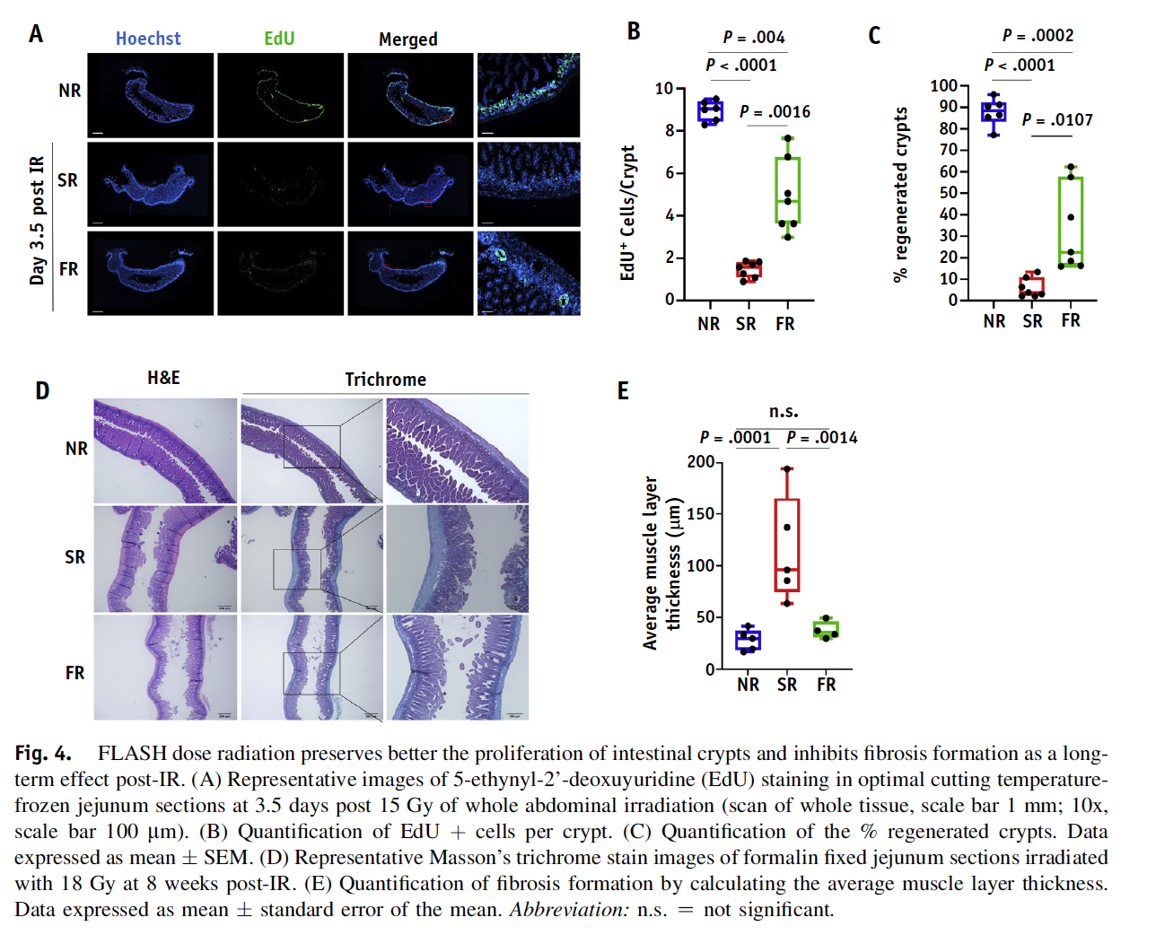
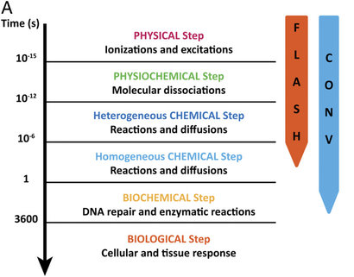
State of the art: FLASH particle therapy
Ultra-high dose rate (uHDR) shows promise to improve efficiency and efficacy:
78 Gy/s
Vs
0.9 Gy/s
Using a mouse model of combined syngeneic
heterotopic pancreatic tumors and upper intestinal
track injury, we show that FLASH PRT elicits significantly reduced intestinal fibrosis compared with standard PRT.
Montay-Gruel et al, 2020;
Diffenderfer et al, 2019;
Notes:
Recently reported studies have emphasized the benefits of ultra-high-dose-rate FLASH radiation therapy (FLASH-RT) when examining normal tissue toxicities. Preclinical and clinical studies by us and others showed the absence of severe toxicities in several FLASH-irradiated normal tissues (3–6), along with a maintained anti-tumor effect (7). This observation has been coined as the FLASH effect.
Using a mouse model of combined syngeneic
heterotopic pancreatic tumors and upper intestinal
track injury, we show that FLASH PRT elicits significantly
reduced intestinal fibrosis compared with standard PRT.

Slide 16
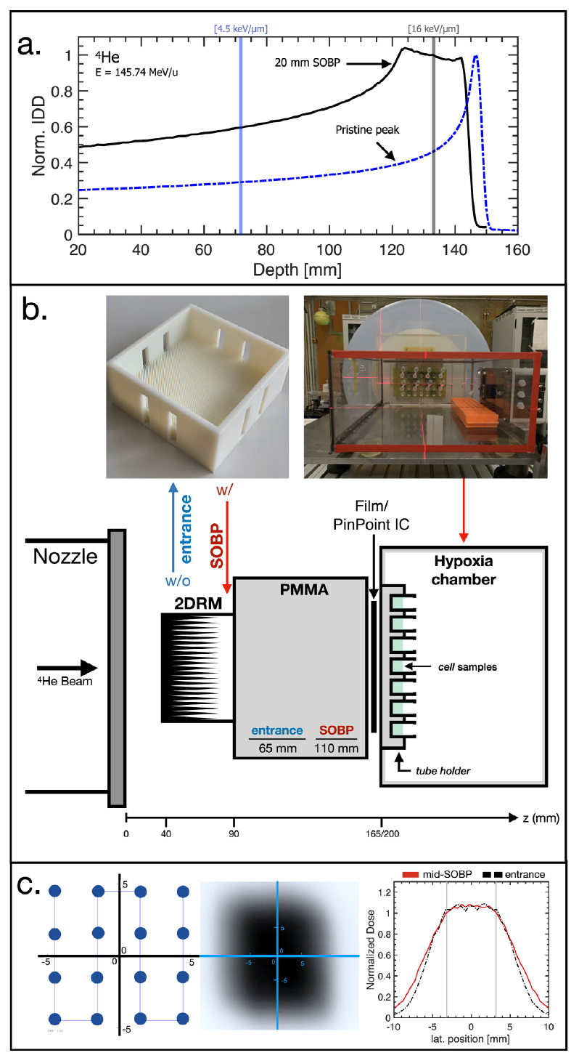
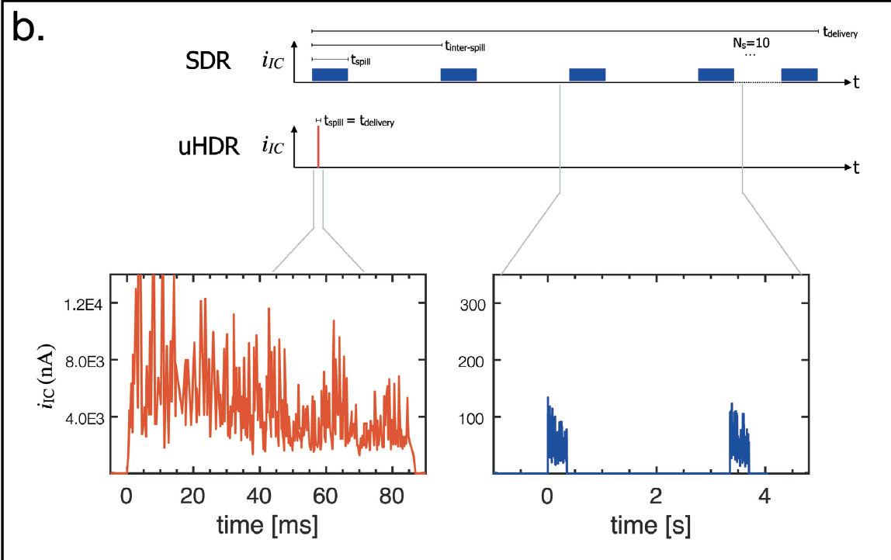
State of the art: Recent results @HIT
Average dose-rates achieved were 185 Gy/s and 0.12 Gy/s for uHDR and SDR, respectively.​
Tessonnier et al, IJROBP 2021
Experimental conditions dictated by physics limitations of clinical synchrotron facility
i.e., max fluence and current (dose-rate) settings yield: field size = 1cm³, <10 Gy @ ~100Gy/s
Notes:
Average dose-rates achieved were 185 Gy/s and 0.12 Gy/s for uHDR and SDR, respectively.
No differences in cellular response to SDR vs. uHDR were observed for all tested doses at 21% O2,
as well as at 2 and 4 Gy at 1% O2. In contrast, at 1% O2 and dose threshold of ≳8Gy cell survival
was higher and correlated with reduced nuclear γH2AX RIF signal indicating FLASH sparing effect
in the investigated cell lines irradiated with uHDR as compared to SDR .
Conclusion: The first uHDR delivery of raster-scanned particle beams was achieved using helium
ions, reaching FLASH-level dose-rates of >100 Gy/s. Baseline oxygen levels and delivered dose (≳ 8
Gy) play a pivotal role, irrespective of the studied cell lines, for observation of a sparing effect for
helium ions.

Slide 17
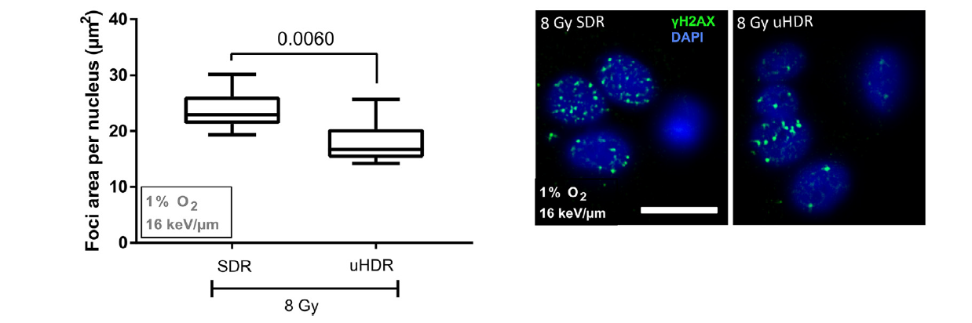
@Laboratori Nazionali del Sud
Investigate high dose levels in both low and high LET regions for various particle species (p, He, C… )
comprehensive radio-biological investigations will be made possible via delivery using the high intensity cyclotron present at the facility.
Tessonnier et al, IJROBP 2021

Slide 18

Boron Neutron Capture Therapy
Contributions
Silva Bortolussi, Valerio Vercesi, Ian Postuma
Università di Pavia, Dipartimento di Fisica
Istituto Nazionale di Fisica Nucleare – Sezione di Pavia

Slide 19
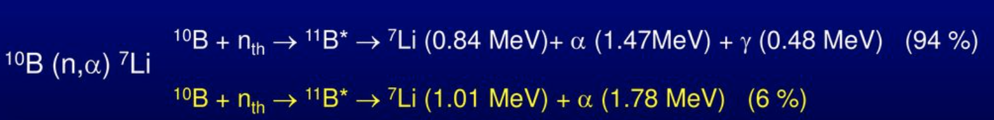
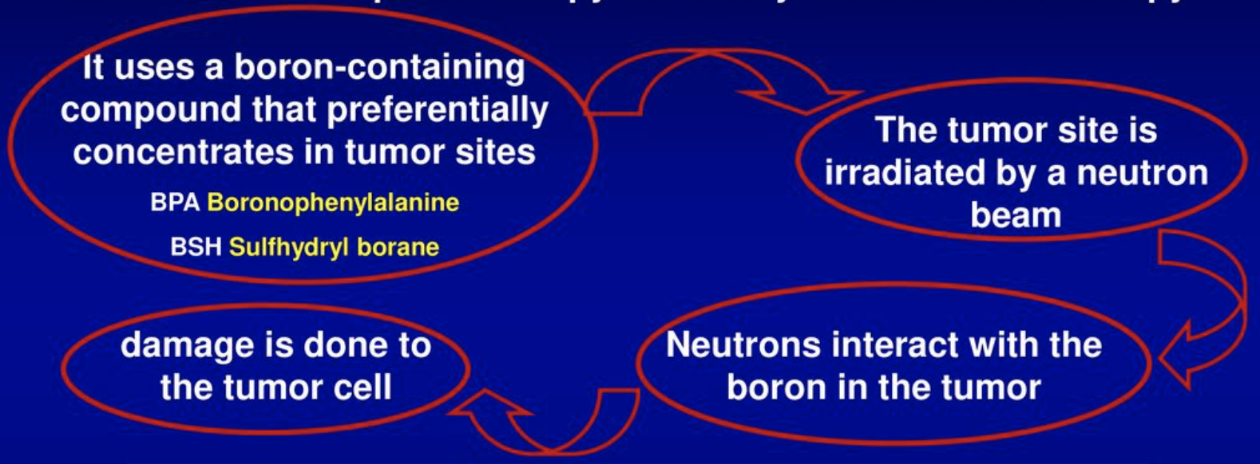
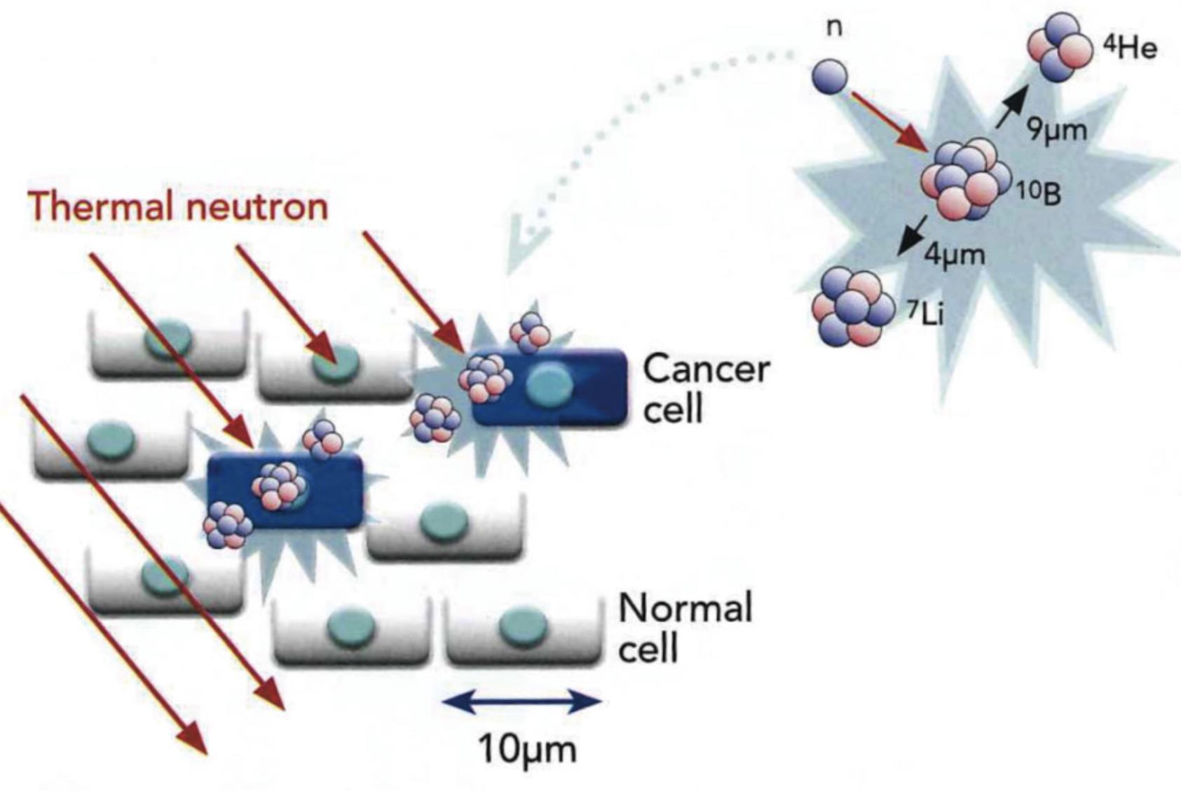
State of the art: BNCT
Boron Neutron Capture Therapy is a binary form of cancer therapy
Novel neutron sources for BNCT
Disadvantages of nuclear reactors:
Reactors are large, expansive and subject tor strict regulations making them unsuitable for in-hospital treatment.
SEARCH for in-hospital neutron sources:
- Charged particle accelerators;
- Compact neutron generators;
- LINAC accelerators for radiotherapy

Slide 20
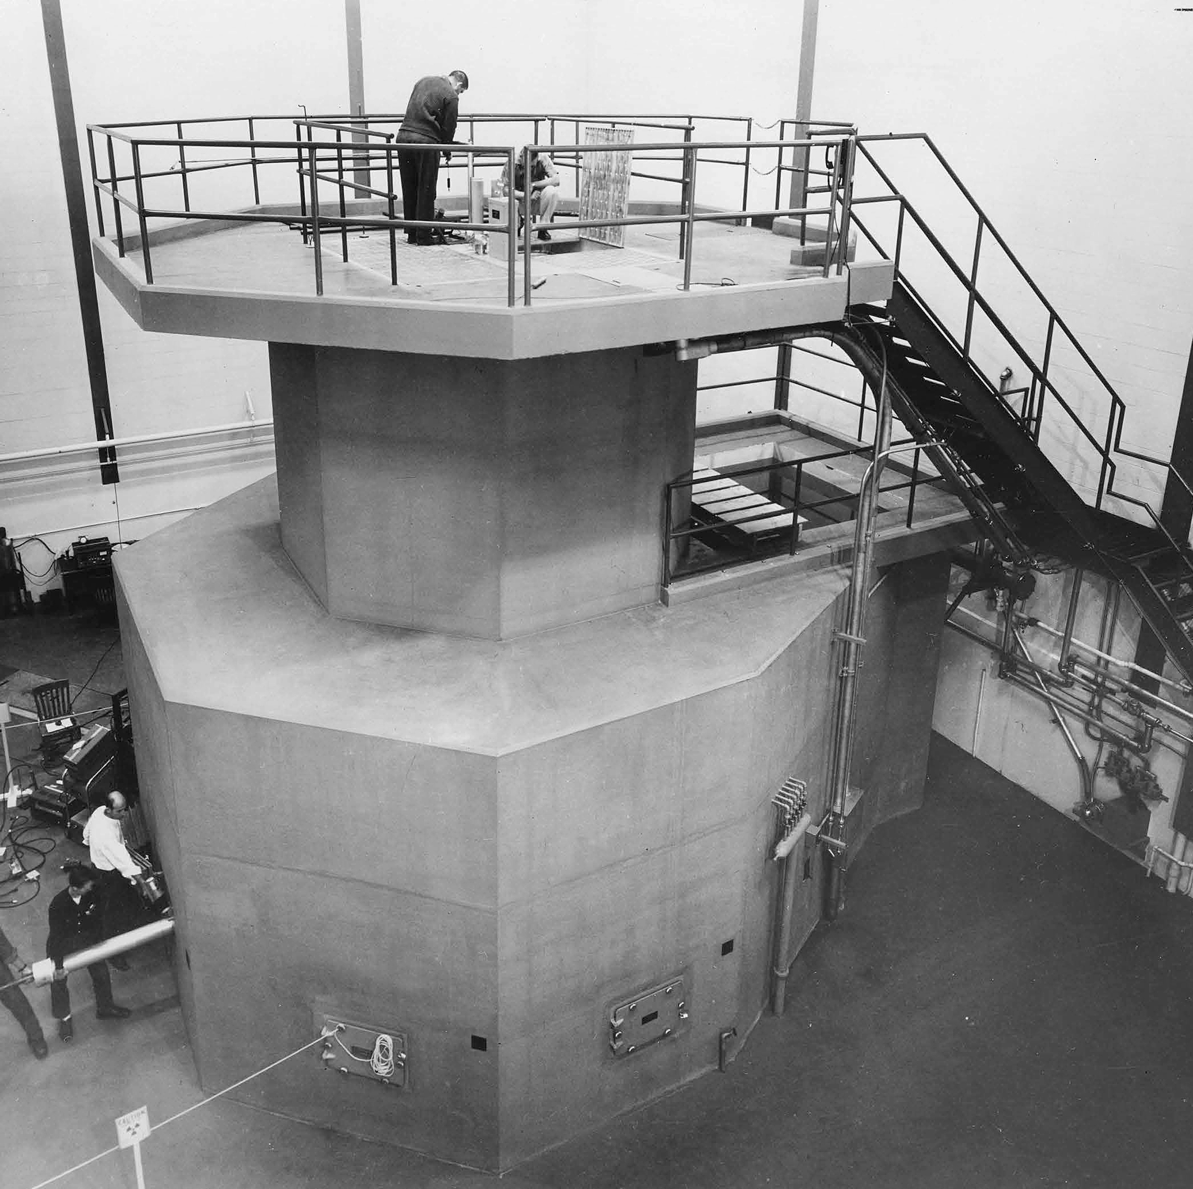
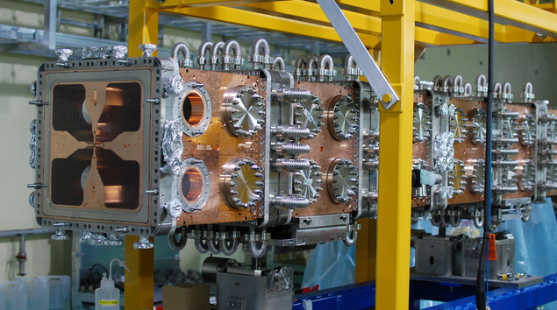
Neutron source: current status and next future
Given the recent advances in the production of suitable neutron beams for boron neutron capture therapy (BNCT), the interest in this kind of experiments is growing.
Presently, neutron facilities for dosimetry and radiobiology are being built by interaction of protons with Be or Li targets. The possibility to count on thermal neutron fields obtained with other technologies is very appealing.
up to ≈ 10¹⁰ s^{-1 .} cm⁻²
25 meV neutrons
Graphite chamber
30x40x60 cm³
cell samples
small animals
detectors/dosimeters
Triga Mark II research reactor at the University of Pavia.
up to ≈ 10⁹ s⁻¹ cm⁻²
10 keV neutrons
Clinical BNCT facility neutron beam of 14 cm diameter

Slide 21
@Laboratori Nazionali del Sud
Studies for beam characterization
collimated epithermal neutrons
Also low n flux -Low gamma, thermal and fast n contaminations
Detectors/n spectrometry/ beam quality systems/dosimetry
Radiobiology
thermal neutrons field for cell culture
> 0.5 ∙ 10⁸ s⁻¹ ∙ cm⁻²
Low gamma and fast n contaminations
Studies towards CLINICAL or experimental neutron beams
collimated epithermal neutrons
> 10⁹ s⁻¹ ∙ cm⁻²
Low gamma, thermal and fast n contaminations
Other applications:
Thermal neutrons, collimated beam, Low gamma contamination
Neutron imaging for cultural heritage or industrial studies/neutron activation analysis
see Laser-Matter Interaction talk – G.A.P. Cirrone, G. Milluzzo
Notes:
The spectrum necessary for cell culture irradiation is completely thermalized. For this reason, apart from the neutron source it is necessary to build a thermalization assembly to create the irradiation chamber, with dimensions adequate to histone or two cell culture flasks at minimum. Inside this chamber, a uniform thermal neutron field is required with sufficient neutron flux in order to ensure an irradiation time compatible with the cell life outside the incubator
If the source intensity is high enough, it is possible to build an assembly which creates a beam instead of a field, with a certain degree of collimation and freedom in tuning the spectrum by interposing different types of materials between the source and the irradiation position. The final designed is achieved by Monte Carlo simulation. This possibility would allow more applications of the neutron facility such as dosimetry, test of detector and radiation hardness tests.

Slide 22

Heavy ion cross section measurements at intermediate energies for therapy and space applications
Contributions
Marco Durante (Spokesperson for the contribution)
GSI Helmholtzzentrum fur Schwerionenforschung GmbH, Germany
Daria Boscolo, Felix Horst, Christoph Schuy, Uli Weber, Claire-Anne Reidel
GSI Helmholtzzentrum fur Schwerionenforschung GmbH, Germany

Slide 23
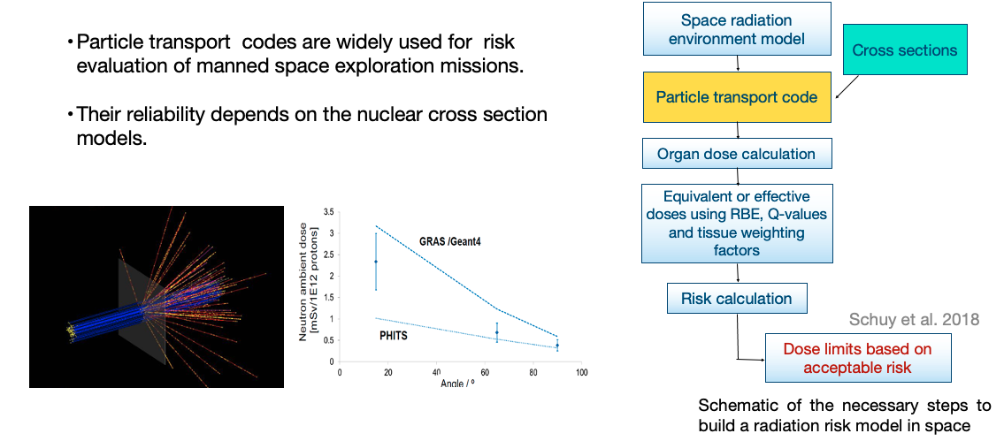
Needs of for space applications
SPE – Solar Particle Events
GCR – Galactic Cosmic Radiation

Slide 24
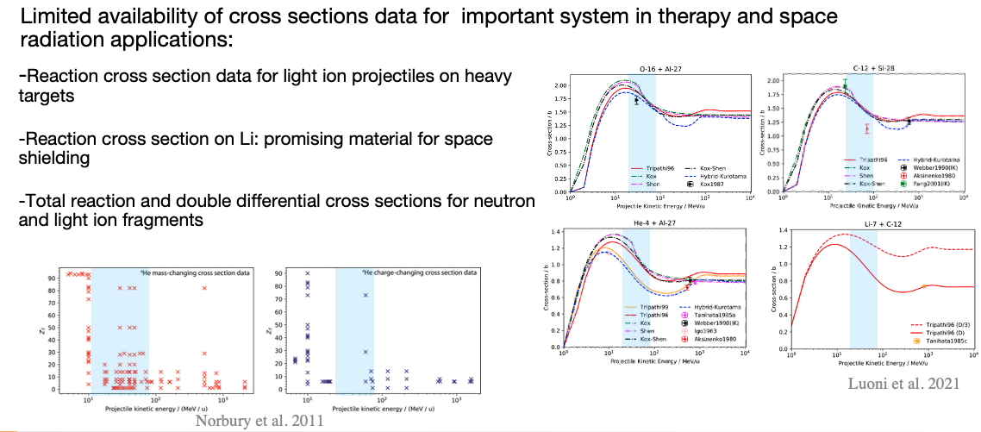
Current achievements

Slide 25
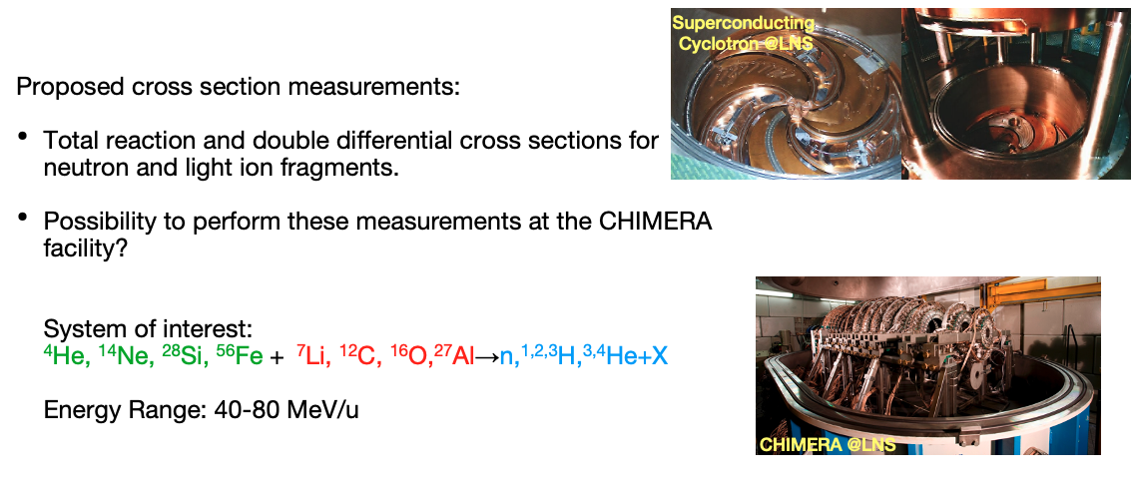
Possible measurements at the Laboratori Nazionali del Sud cyclotron facility
Thanks to the collaboration with CHIMERA's group

Slide 26

Advanced imaging techniques: in beam PET
Contributions
Katia Parodi (Spokesperson for the contribution)
Ludwig-Maximilians-Universität München (LMU Munich)
Department of Medical Physics, Munich, Germany
Peter Thirolf
Ludwig-Maximilians-Universität München (LMU Munich)
Department of Medical Physics, Munich, Germany

Slide 27
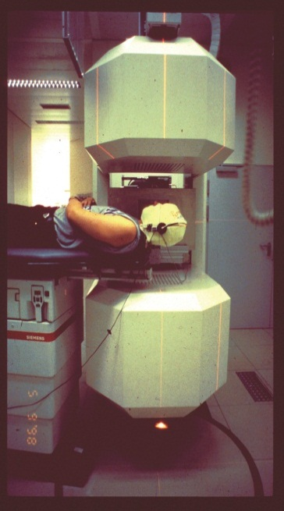
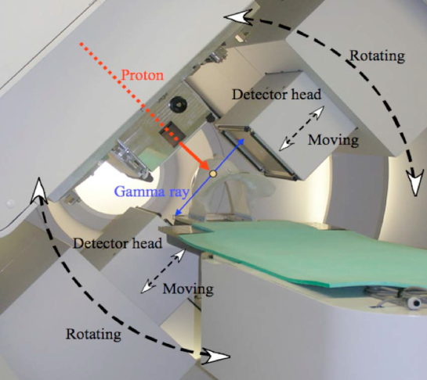
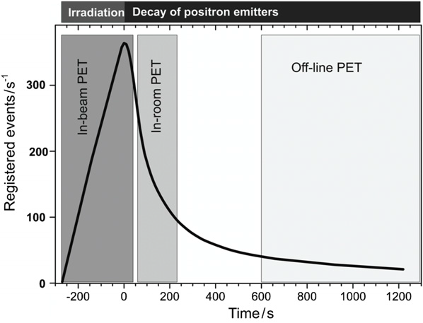
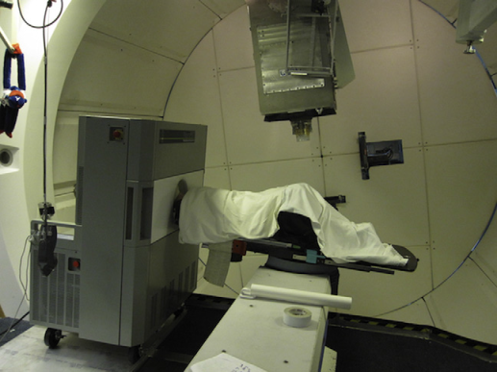
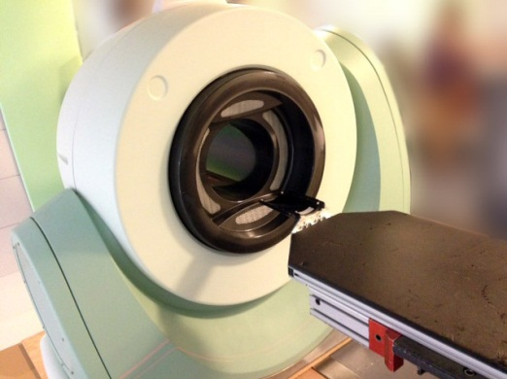
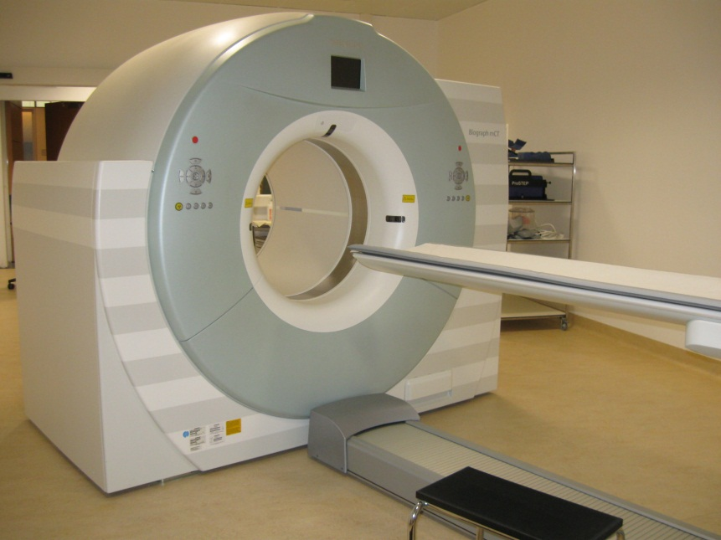
PET: Adopted Techniques
NCC
In-beam/On-board:
NCC (Japan): p, passive, cycl., planar
camera (0s after irradiation)
GSI (Germany): ¹²C, scanned, synchr.
(pauses of irradiation)
Miyatake et al, MedPhys 2010
GSI
MGH
MGH
Enghardt et al, NIMA 2004
~ 30 min
~ 3-5 min
In room:
MGH (USA): p, passive, cycl.,
(~ 2 min after irradiation)
Shakirin et al, PMB 56, 2011
Min et al, IJROBP 2013
MGH website 2014
HIT Heidelberg
Offline:
MGH (USA): p, passive, cycl. (~10-20 min after)
NCC (Japan): p, passive, cyc. (~7 min after)
HIT (Germany): p, ¹²C, scanned, synchr. (~5-15 min after)
Siemens Biograph mCT
Notes:
The application of positron emission tomography (PET) for non-invasive monitoring of
radiation therapy was
In summary, there are three concepts for monitoring of radiation therapy by means
of PET: in-beam (measurement during the irradiation by an integrated PET scanner), inroom
(measurement immediately after irradiation by a nearby PET scanner), and off-line
(measurement after irradiation by a standard PET/CT scanner located outside, but preferably
close to the treatment bunker).

Slide 28
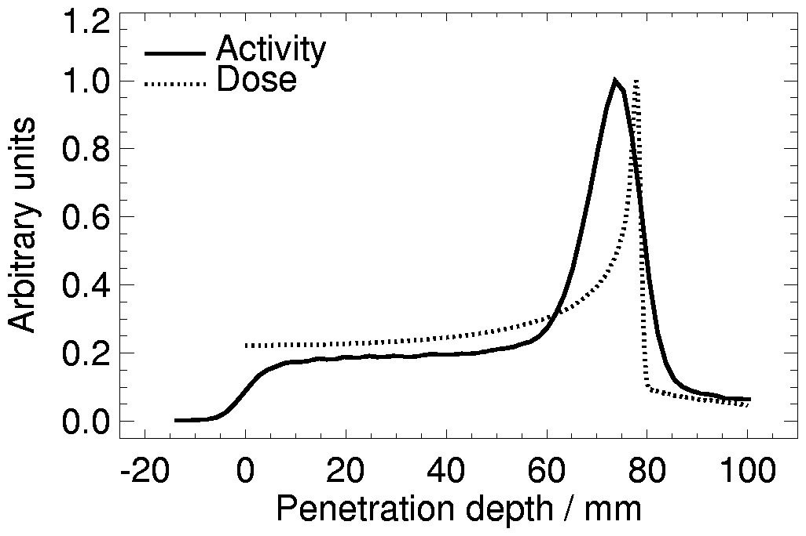
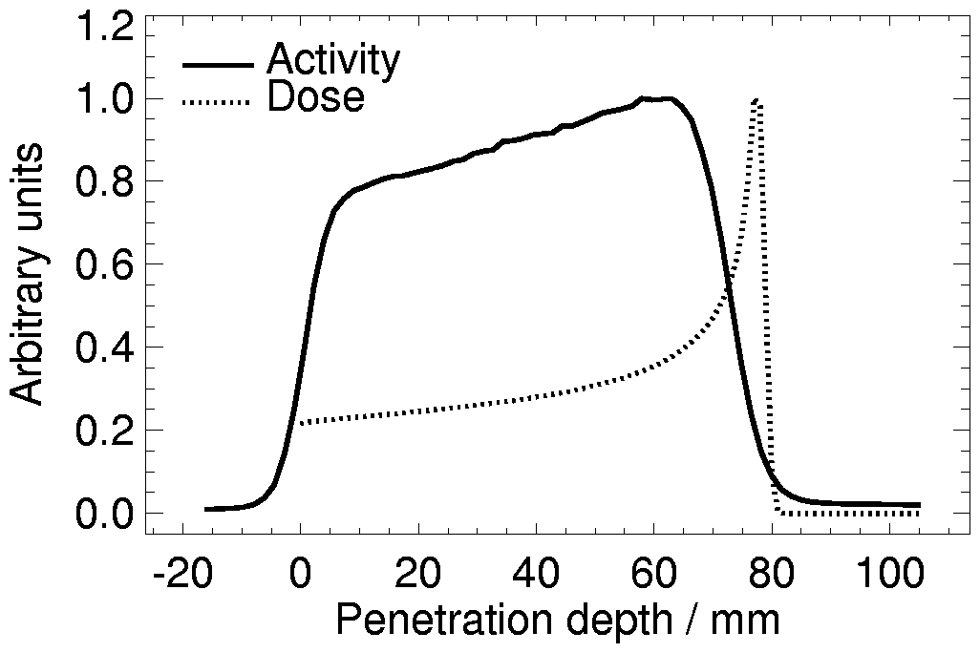
PET for range verification of ion beam therapy
Z > 5
Projectile fragments
Target fragments
Z < 5
Target fragments
¹²C: E = 212 AMeV
Target: PMMA
¹¹C,
¹⁰C
Arbitrary units
¹H: E = 110 MeV
Target: PMMA
¹⁵O, ¹¹C, ¹³N ...
¹⁵O, ¹¹C, ¹³N ...
Therapy beam | ¹H | ³He | ⁷Li | ¹²C | ¹⁶O | Nuclear medicine
Activity density / Bq cm⁻³ Gy⁻¹ | 6600 | 5300 | 3060 | 1600 | 1030 | 10⁴ – 10⁵ Bq cm⁻³
K. Parodi et al.: IEEE T. Nucl. Sci. 52 (2005) 778; M. Priegnitz et al.: Phys. Med. Biol. 53 (2008) 4443

Slide 29
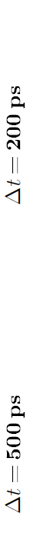
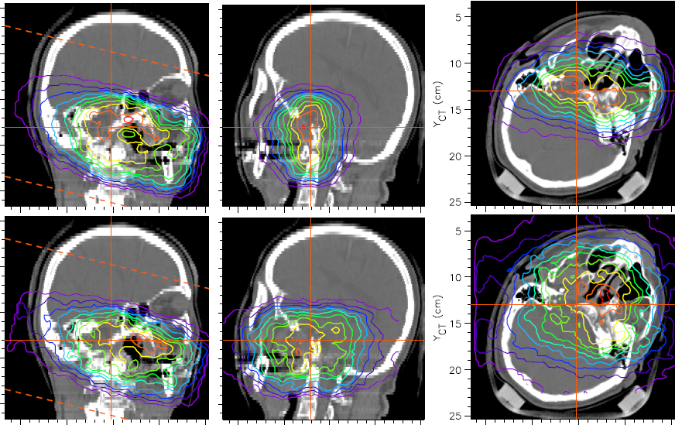
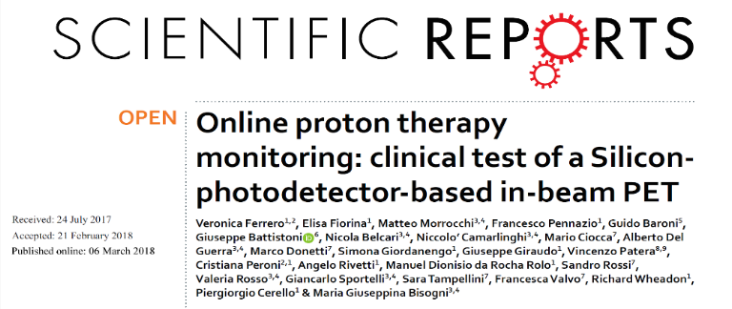
Next generation detectors and further future developments
Calculated in-beam TOF-PET images
→ Reduced limited angle artifacts for dual-head designs
Ultrafast time of flight in beam PET
Dual-head solution @CNAO:
Clinical evaluation for p and 12C ions started
Notes:
The INSIDE (Innovative Solutions for In-beam DosimEtry in hadrontherapy) in-beam PET scanner features
two planar heads of 10 x 25 cm2 active area, each one made of 2 x 5 detection modules with 16 x16 Lutetium Fine
Silicate (LFS) crystals coupled 1:1 to Hamamatsu MPPCs, resulting in 25602 lines of response. The PET heads are
positioned above and below the patient, at a relative distance of 60 cm; therefore the Field Of View (FOV) covers
25 cm along the beam direction, 10 and 22 cm along the transverse and vertical directions, respectively. The detector
resolution on the photon interaction point in the crystal is in the order of the mm, thans to the 1-to-1 coupling
between the crystals (3.2 mm pitch) and the SiPM.

Slide 30
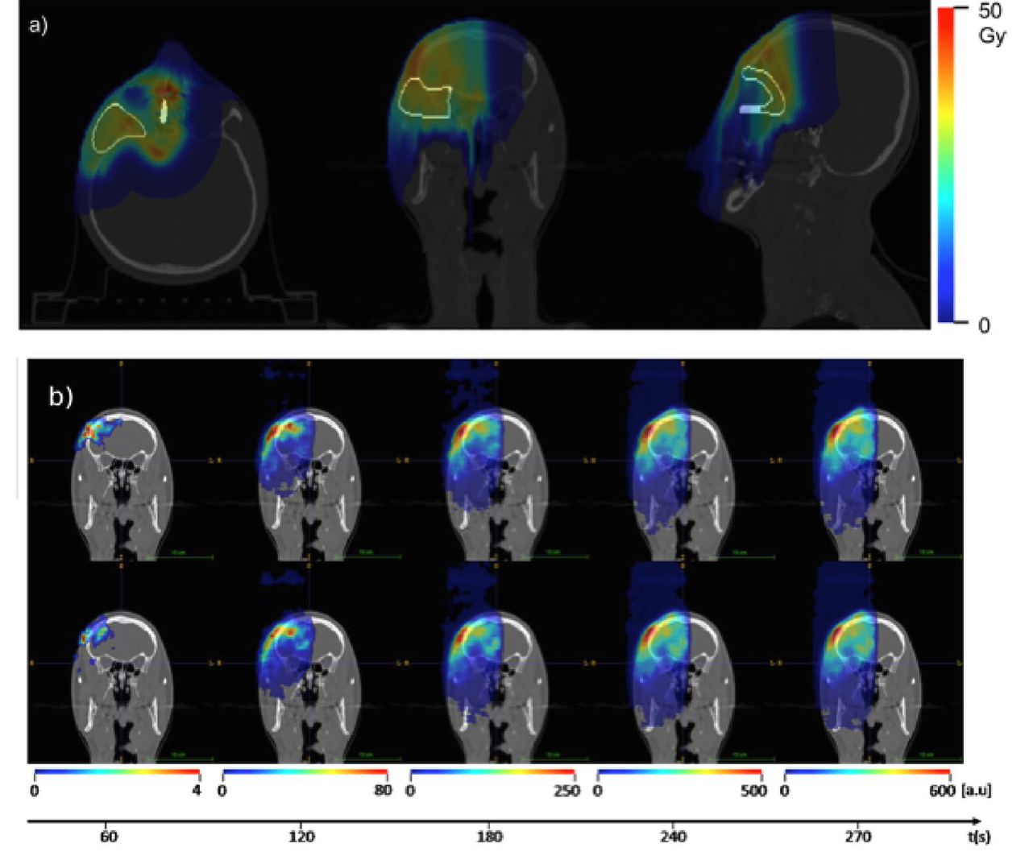
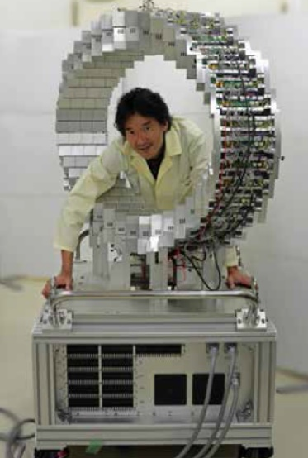
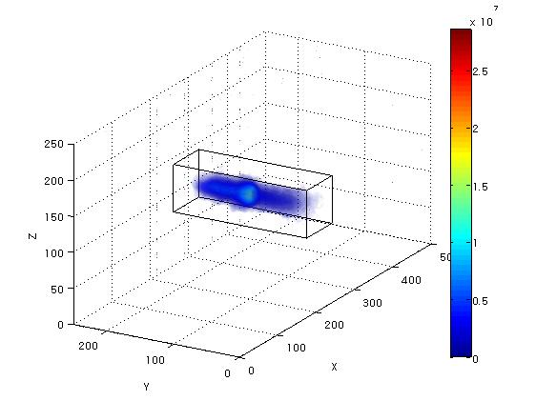
Next generation detectors
Proton treatment plan
Measured activity over time, fr. 1
Single ring OpenPET
Measured activity over time, fr. 2
PET (meas.)
Dual-head solution @CNAO:
Full-ring openPET @NIRS: planned clinical integration
Clinical evaluation for p and ¹²C ions started

Slide 31
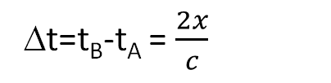
Further future developments: ultrafast time of flight in beam PET
For state-of-the-art detectors (t = 200 ps) a resolution of 3 cm is achieved
For emission at x from the LOR mid point
Calculated in-beam TOF-PET images
Δt=t_{B}-t_{A} = $\frac{2x}{c}$
Dual-head in-beam solutions
A
L
GSI
B
→ Reduced limited angle artifacts
for dual-head designs
→ Toward real-time direct reconstruction
with ultrafast (~10 -30 ps) TOF
Crespo et al, PMB 2007

Slide 32
Further future developments: quasi prompt PET

Slide 33
Research at high current low/mid energy accelerators: possible studies @LNS
Refinement of cross section data at energies close to reaction threshold
Test benches for new detector developments
ultrafast TOF in-beam PET
suppression or exploitation (eg gamma-PET)
of radiation background during beam-on
radiation hardness tests
...
Horst et al, PMB 2019
Acquisition of experimental benchmark data
validation of computational models for different ion species
…

Slide 34
Research at high current low/mid energy accelerators: possible studies @LNS
Pre-clinical research in small animals (e.g., mice)
Studies on biological washout and possible radiation-induced changes for different ion species
Toramatsu…Yamaya, Phys Med Biol 65 (2020) 105011;
Boscolo, …Parodi, Durante Front Oncol 2021
In-situ imaging of relevant biomarkers in connection with new treatment schemes (eg FLASH, …)

Slide 35

xs studies for innovative radioisotopes production for Nuclear Medicine as well as applied physics
Contributions
Juan Esposito (Spokesperson for the contribution)
LARAMED project leader
Isitituto Nazionale di Fisica Nucleare, Laboratori Nazionali di Legnaro (LNL)
Liliana Mou, Gaia Pupillo
Isitituto Nazionale di Fisica Nucleare, Laboratori Nazionali di Legnaro (LNL)
Simone Manetti, Flavia Groppi
Isitituto Nazionale di Fisica Nucleare, Sezione di Milano
Università degli Studi di Milano

Slide 36
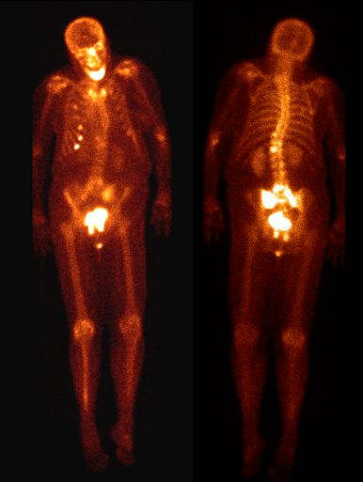
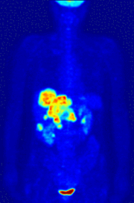
Need of reliable nuclear data aimed at emerging radionuclides (RNs) production in Nuclear Medicine (NM)
The new frontier of NM is the “theranostic approach”, i.e. RNs combining properties specific for imaging and those for radiotherapy (e.g. local tumors treatment) by using a single radiopharmaceutical product.
The most important theranostic RNs known nowadays, i.e. having a nuclear decay pattern suitable for both applications are
⁶⁷Cu,⁶⁴Cu, ⁴⁷Sc, ⁶⁷Ga...others...still to be found
IMAGING
THERAPY
THERAPY (+ DIAGNOSTIC) = THERANOSTIC
The theranostic approach may be also obtained with “theranostic pair” i.e. Isotopic RNs, one specific for imaging, while the other one for therapy. The most known pairs belonging to this group are ^{61/64}Cu/⁶⁷Cu, ^{43/44}Sc/⁴⁷Sc, ⁶⁸Ga/⁶⁷Ga, ^{149/152}Tb/^{155/161}Tb and others ...still to be found

Slide 37
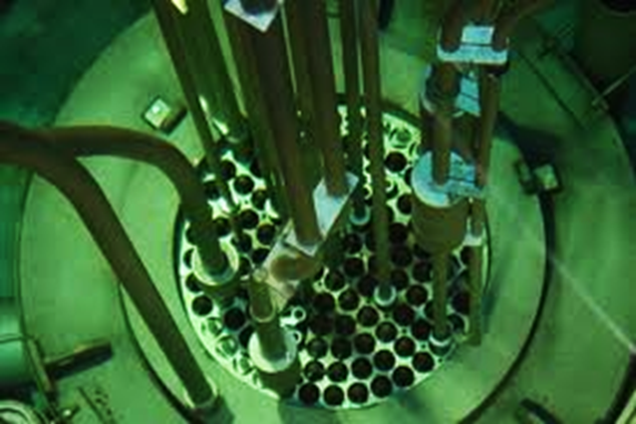




Some key points about established/emerging RNs production for NM
Most of RNs nowadays used in NM are massively produced by using nuclear reactors (e.g., Mo99/Tc99m generators, the most used radionuclide worldwide).
Particles accelerators (p,d,alpha …..), e.g.cyclotrons/linacs (or e-linacs producing a γ-source) are becoming the alternative supplying route of choice (in some cases, the only way). NOT only for already established RNs, but also for the new emerging RNs.
Typical target (plate): high density LEU-Al alloy
To select the optimal RNs’ production pathway, it is mandatory to probe all the possible nuclear reaction routes (xs measurements) and determine the full map of isotopic contaminants.
For most of them optimal production routes still needs to be cleared/investigated.
Exploring reaction routes by using heavier (Z>2) hitting particles may be of interest.

Slide 38




Production of established/ emerging RNs in NM (some examples)
Most accelerator-based radionuclides are nowadays, produced by public/private facilities using:
large network of low-energy medical cyclotrons ( Ep<20 MeV)
→ e.g. ACSI TR19/300 Sacro Cuore Don Calabria Hospital (Negrar, VR)
some mid-energy p,d,α cyclotrons (i.e. Ep 20-35 MeV)
→ e.g IBA Cyclone -30, Kolkata Research Center, India
a few high-energy p,d,α cyclotrons (i.e. Ep>35 MeV)
→ e.g. ARRONAX (France), ZEVACOR (Us), LARAMED (Italy)
The power-efficient Cyclone-30 (15-30 MeV, 350µA max) isotope-producing cyclotron, Kolkata-based VECC India
Radiopharmacy and cyclotron unit Sacro Cuore Hospital, Negrar (VR)
The quality of the final product strongly depends on the chosen target/projectile/energy parameters set
(e.g., ⁶⁷Cu, ⁴⁷Sc, ¹⁰³Pd, ¹⁸⁶Re, ⁹⁷Ru and ²¹¹At……… )
The BEST BCSI 70p (35-70 MeV, 750µA max) cyclotron, SPES/LARAMED facility, Italy
The IBA Cyclone-70 (15-30 MeV, 350µA max) isotope-producing cyclotron, ARRONAX facility, France
G.Pupillo, S. Manenti, F.Groppi, J.Esposito, F.Haddad,
Nuclear data for light charged particle induced production of emerging medical radionuclides, Radiochimica Acta (under review)

Slide 39




The proposal: possible xs studies @LNS of RNs for NMM
With the planned upgrade, currently underway, for both the
K800 Superconducting Cyclotron -> improvement in beam intensities which will be available for low-mid Z ion species with respect to the past;
MP Tandem accelerator -> installation of an ion source of noble gases
a dedicated (and very-well characterized) beamline for high quality nuclear xs measurements may be envisaged.
new p,d,α, (heavier-ions) driven nuclear reaction routes may be explored to produce specific/emerging RNs (for imaging/therapy/theranostic applications).
Such beamline could be also usefully employed for any specific interest, to measure xs values, for any nuclear reaction route of interest.
Alternatively, to produce low amounts of the radionuclide concerned to study its nuclear decay properties) for fundamental as well as applied physics studies. Moreover, to play the role of servicing industry in case of needs.
Possible research activities which may be carried out shall be coordinated between LNS and LNL labs, where the LARAMED facility is under construction, in order to avoid superpositions.
The LARAMED facility will have a dedicated beamline for xs measurements but based upon the SPES cyclotron that will accelerate (at least in the initial years) only protons.

Slide 40



Possible studies @LNS: some examples of RNs produced by different (p,d, X) routes and corresponding (alpha, X) beams
Table taken from:
S. Qaim et al., Uses of alpha Particles, especially in Nuclear Reaction studies and Medical Radionuclide Production, Radiochim. Acta 2016; 104(9): 601–624

Slide 41

Possible studies @LNS: some examples of RNs produced by different (p,d, X) routes and corresponding (alpha, X) beams
Table taken from:
S. Qaim et al., Uses of alpha Particles, especially in Nuclear Reaction studies and Medical Radionuclide Production, Radiochim. Acta 2016; 104(9): 601–624
The examples here reported are just a little part of different nuclear reaction studies which may be carried out, exploiting the different hitting beams (p,d,α…) at energies which could be available at LNS

Slide 42
















Thanks for your attention

