Slide 1

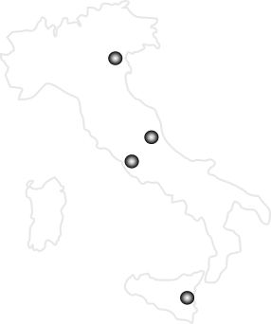

Nuclear Physics Mid Term Plan in Italy
LNS – Session
Catania, April 4th-5th 2022
WG Nuclear Astrophysics
Rosario Gianluca Pizzone
INFN LNS

Slide 2



R.G. Pizzone
WG1 (Pidatella): Nuclear and Atomic input for quiescent burning
Stable Beams (a):
Important physical cases can be studied with pre-upgrade accelerator conditions (e.g. Tandem):
ANC + THM measurements: physical cases NeNaAl cycles, Hoyle state* or C-burning (e.g. ¹²C+¹⁶O reaction);
some measurements may be studied in laser induced plasma.
Noble gas sources (b):
Potentially groundbreaking results may be achieved with Noble Gas Tandem Source, e.g. ¹⁶O +¹⁶O fusion *
via THM after ²⁰Ne breakup with similar methodology of successful ¹²C+¹²C *studies. NeNa cycles.
Pandora (c):
Measurement of decay time of ⁷Be which is crucial for lithium abundance determination
Strong interactions with the other LNS workgroup
*LNL-LNS synergy
Text
Mantle
H shell
He shell
C/O shell
Ne/O shell
O shell
Si shell
Fe/Cr

Slide 3
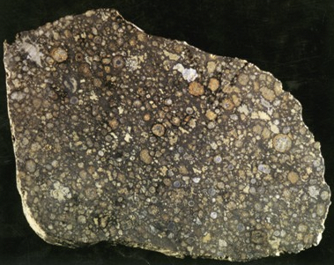
R.G. Pizzone
WG2 (Rapisarda): Explosive nucleosynthesis
Long-lived isotopes induced reactions at Tandem (a)
Potential breakthrough: Long-lived isotopes induced reactions at Tandem via THM and ANC: e.g. ²⁶Al_{GS}(n,α), (n,p) (p,γ) while metastable state to be investigated at LNL – SPES*, ¹⁰Be and ⁴⁴Ti induced reactions
BBN nucleosynthesis studied via Noble gas Tandem Source (b);
BBN nucleosynthesis studied via Laser (c )
BBN * via Indirect methods and laser induced plasma: stable and noble gas beams. Sinergic effort in studying reactions in laser-induced plasma (e.g. d+d reactions). Electron screening.
Novae nucleosynthesis studied via FRAISE beams (c)
Novae and XRB nucleosynthesis studied with FRAISE
Strong interactions with the other LNS workgroup
*LNL-LNS synergy

Slide 4
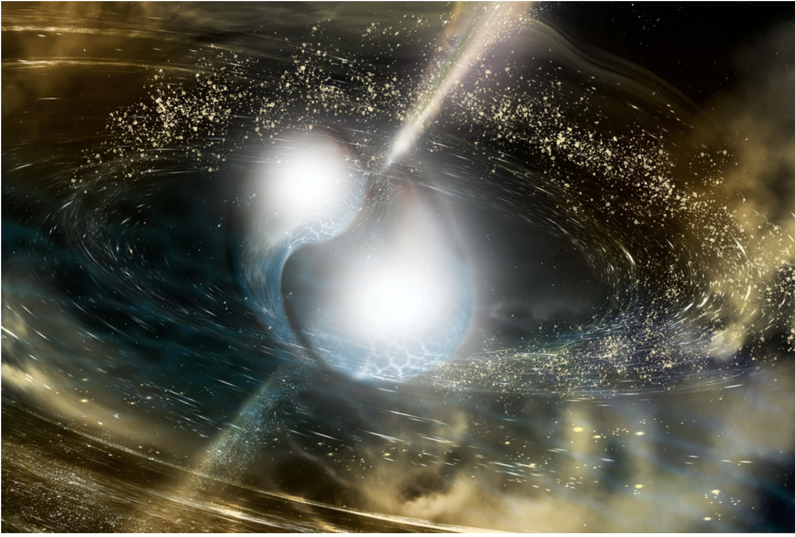
R.G. Pizzone
WG3 (Sergi): s and r process
EOS investigations and application to n-mergers (a);
EOS and n-merger: theoretical studies;
S-process reactions studied at Tandem (a,b), n poison/production;
Study of s-process relevant branching points with decay
measurements in Pandora (a,b);
KiloNovae opacities investigated at Pandora (b);
R-process nucleosynthesis investigation with Polyfemo detector (c ).

Slide 5
Phase A
Phase B
Phase C
He & C-burning reactions (TANDEM/Nestor)
Li-Be-B reactions with THM or Laser ³He+^{7,6}Li, ³He+⁹Be, ³He+^{10,11}B (NESTOR/i LUCE)
⁷Be case: studying decay of trapped Be (PANDORA) + CB&RFQ line
WG1
Quiescent burning
AGB quiescent burning with indirect methods: (TANDEM/Nestor)
O-burning reactions (NESTOR)
CCSN:
²⁶Al^{gs}(n,p), ²⁶Al^{gs}(n,α),
²⁶Al^{gs}(p,γ)
(long-living RIB @ TANDEM, THM + ANC)
BBN:
(TANDEM, Nestor & I Luce) decay of trapped Be (PANDORA)
WG2
Explosive nucleosynthesis
X-Ray Bursts:
¹⁴O(𝝰,p)¹⁷F and ¹⁸Ne(𝝰,p)²¹Na
(RIBs @ FRAISE + Multipurpose chamber, THM)
Novae:
³¹P(p,𝝰)²⁸Si and ³⁵Cl(p,𝝰)³²S (TANDEM/)
neutron poison reaction:
(TANDEM & NESTOR)
neutron source reaction: (TANDEM+ NESTOR + MAGNEX)
WG3
s and r process
plasma opacity measurement: Se, Sr, Nb elements
(PANDORA)
measurements of half-life and branchings in stellar plasma
(PANDORA)
R-process with POLYFEMO
(FRAISE)
Phase A: research activties/experiments almost ready to be performed
Phase B: other research still requiring some test and feasibility study
Phase C: research activities requiring R&D and/or development of devoted apparata/facilities of on-construction infrastructures

Slide 7
Summary of research perspectives on WG1
Phase A
Phase B
Phase C
He & C-burning reactions (TANDEM/Nestor)
Li-Be-B reactions with THM or Laser ³He+^{7,6}Li, ³He+⁹Be, ³He+^{10,11}B (NESTOR/i LUCE)
⁷Be case: studying decay of trapped Be (PANDORA) + CB&RFQ line
AGB quiescent burning with indirect methods: ²³Na(p,α)²⁰Ne (TANDEM/Nestor)
AGB quiescent burning with indirect methods: ²³Na(p,g)²⁰Ne (TANDEM/Nestor)
O-burning reactions (NESTOR)

Slide 8
Conlcusione: Mid Term Plan – WG: Nuclear Astrophysics
Giuseppe Gabriele Rapisarda
Summary of research perspectives on The «explosive» universe: BBN and explosive nucleosynthesis
Phase A
Phase B
Phase C
CCSN:
¹⁰Be(α,n)¹³C
(long-living RIB @ TANDEM, THM)
BBN:⁷Be case: studying decay of trapped Be (PANDORA) + CB&RFQ line
BBN:
⁷Li(d,n) ⁸Be ⁷Li(p,𝝰)⁴He
(NESTOR+TANDEM, THM )
BBN:
³H(d,n)⁴He (TANDEM, THM )
Alpha scattering on low mass neutron-rich isotopes
(RIBs @ FRAISE + Multipurpose chamber)
Novae:
³¹P(p,𝝰)²⁸Si and ³⁵Cl(p,𝝰)³²S (TANDEM, THM)
BBN:
d(d,n)³He, d(d,p)t, ³He(d,p) ⁴He, t(d,n)α
(I-LUCE Coulomb explosion)
CCSN:
⁴⁴Ti(𝝰,p)⁴⁷V
(long-living RIB @ TANDEM, THM)
time
CCSN:
²⁶Al^{gs}(n,p), ²⁶Al^{gs}(n,α),
²⁶Al^{gs}(p,γ)
(long-living RIB @ TANDEM, THM + ANC)
X-Ray Bursts:
¹⁴O(𝝰,p)¹⁷F and ¹⁸Ne(𝝰,p)²¹Na
(RIBs @ FRAISE + Multipurpose chamber, THM)
Phase A: research activties/experiments almost ready to be performed
Phase B: other research still requiring some test and feasibility study
Phase C: research activities requiring R&D and/or development of devoted apparata/facilities of on-construction infrastructures

Slide 9
Conlcusione: Mid Term Plan – WG: Nuclear Astrophysics
Maria Letizia Sergi
Summary of research perspectives on r and s processes
Phase A
Phase B
Phase C
measurements of the ^{134,135}Cs half-life in stellar plasma
(PANDORA)
neutron source reaction: ²²Ne(𝛼,n)²⁵Mg (THM) (TANDEM+ NESTOR)
neutron poison reaction:
¹⁶O(n,𝛾)¹⁷O (ANC) (TANDEM)
Measurements of decay rates of ⁸⁶Rb and ⁸⁵Kr (both gs and ms) in plasma conditions (PANDORA)
neutron source reaction: ²²Ne(𝛼,n)²⁵Mg (transfer) (TANDEM+ NESTOR+MAGNEX)
neutron poison reaction: ¹⁷O(𝛼,n)²⁰Ne (THM) (TANDEM+ NESTOR)
⁶³Co(𝛼,n)⁶⁶Cu inverse elastic scattering experiment
(FRAISE)
Continuous and pulsed neutron sources driven by Laser and Ion beams
(I-LUCE +FRAISE)
neutron poison reaction: ¹⁸O(𝛼,n)²¹Ne (transfer)
(TANDEM+ MAGNEX)
time
plasma opacity measurement: Se, Sr, Nb elements
(PANDORA)
measurement of beta decay rate of the isomeric state of ¹⁷⁶Lu
(PANDORA)
neutron poison reaction: ²¹Ne(p,p’)²¹Ne (TANDEM+ NESTOR)
POLYFEMO
(FRAISE)
Phase A: research activties/experiments almost ready to be performed
Phase B: other research still requiring some test and feasibility study
Phase C: research activities requiring R&D and/or development of devoted apparata/facilities of on-construction infrastructures

