Slide 1

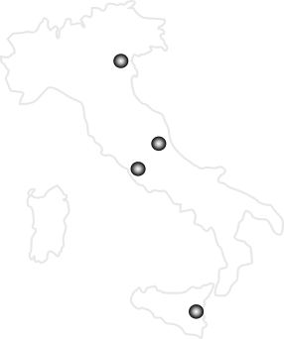

Nuclear Physics Mid Term Plan in Italy
LNS – Session
Catania, April 4th-5th 2022
Future beams at LNS
Luigi Celona
INFN-LNS, Catania, Italy
Paolo Russotto
INFN-LNS, Catania, Italy

Slide 2
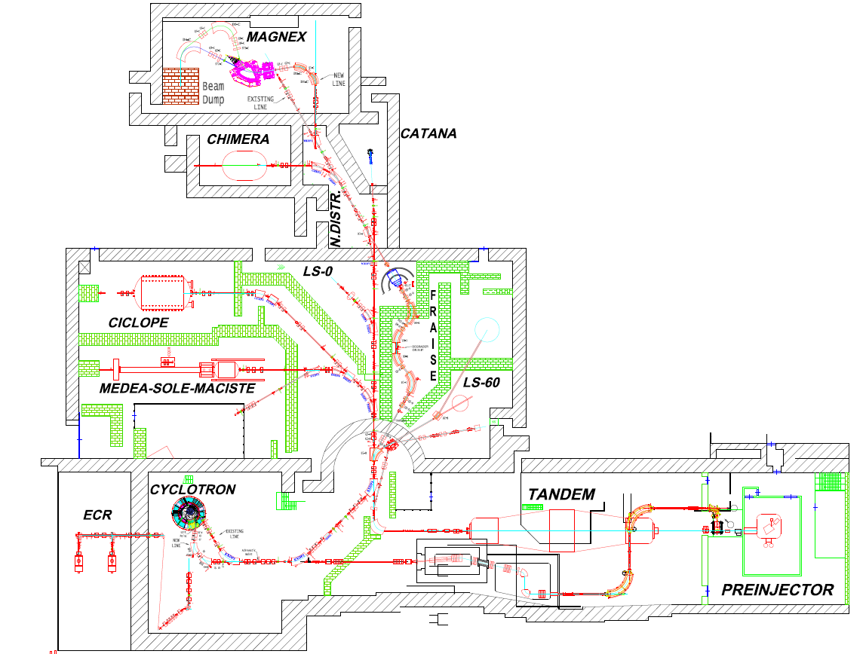

LNS LAYOUT AFTER THE UPGRADING
Luigi Celona

Slide 3
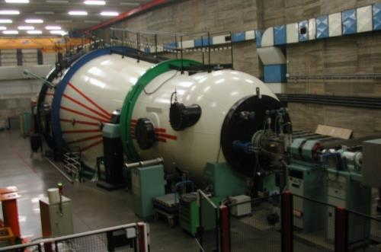
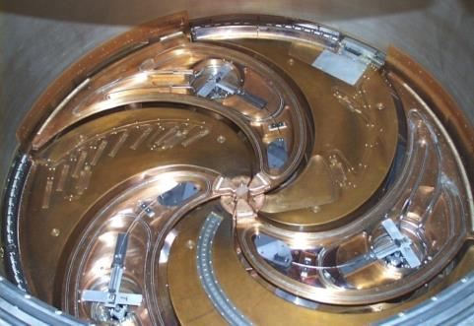
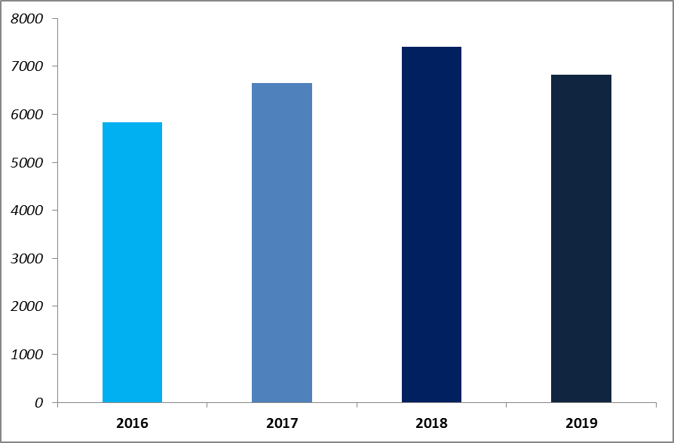
Tandem & Cyclotron Beam Time
Luigi Celona
Tandem + Cyclotron beam time
35 - 40 experiments per year, including the proton therapy sessions
Beam time lost for failures:
Tandem: < 2%
Cyclotron: < 4%
About 430 BTU per year delivered by each accelerator
(excluding beam time preparation)

Slide 4
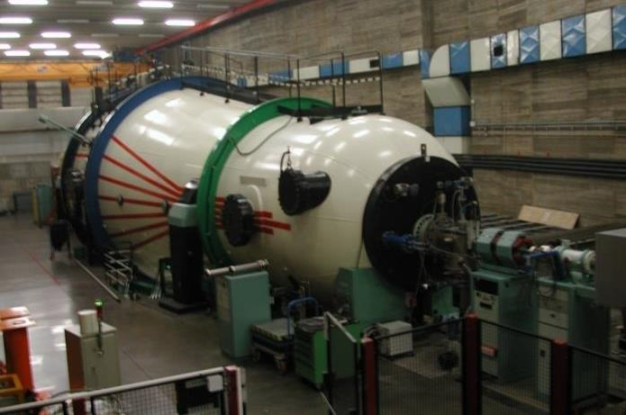
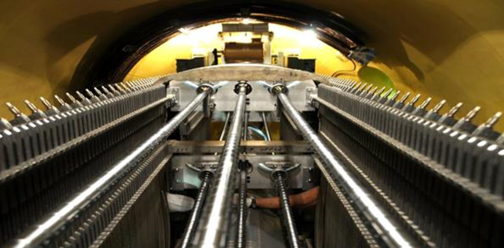
Tandem Beams
Luigi Celona
Tandem Beam Menu
Maximum High Voltage ≈ 13.5MV
Pelletron charging system
HV stability ≈ 10⁻⁴
¹H, ²H
⁶Li, ⁷Li
⁹Be, ¹⁰Be
¹⁰B, ¹¹B
¹²C, ¹³C
¹⁴N
¹⁶O, ¹⁷O, ¹⁸O
¹⁹F
²³Na
²⁴Mg, ²⁵Mg
²⁷Al
²⁸Si, ²⁹Si
³²S, ³⁴S
³⁵Cl, ³⁷Cl
⁴⁰Ca
⁵⁸Ni, ⁶⁰Ni
⁶³Cu, ⁶⁵Cu
⁷⁰Ge
⁷⁹Br
⁹³Nb
¹¹⁶Sn, ¹²⁰Sn
¹²⁷I
¹⁹⁷Au
Noble gases beam development in progress
Actions: Replacement of obsolete parts (electronics, power, automation) mandatory to permit future safe and reliable operations

Slide 5
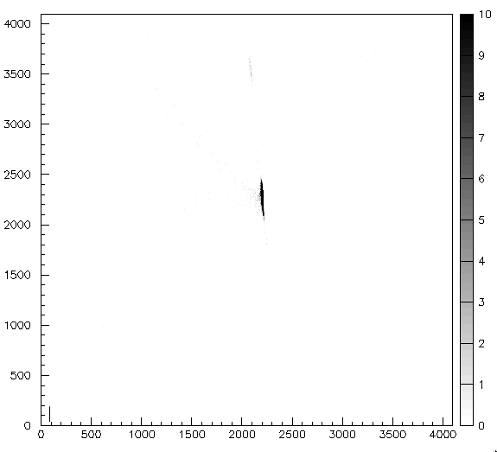

Batch mode operation with Tandem
Luigi Celona
Long half-life isotopes in batch-mode
¹⁰Be (T_{1/2} = 1.39×10⁶ y) Tandem beam has been produced in batch-mode, in collaboration with PSI (Zurich)
ΔE(ch)
¹⁰B≈0.1%
@ 47 MeV
I≈10 nA for a few days
Contamination of ¹⁰B≈ 0.1%
¹⁰Be
Batch-mode beam development is foreseen for the next years.
Next possible beam: ²⁶Al (T_{1/2}=7.17×10⁵ y)
E (ch)

Slide 6
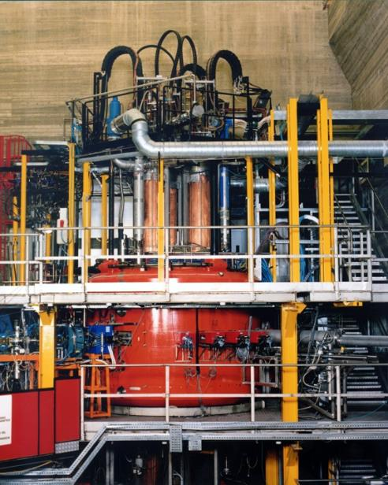
LNS K800 Superconducting Cyclotron
Luigi Celona
Superconducting Cyclotron
Operating 1994 - 2020
E_{MAX} ~ 80 AMeV for lighter ions
E_{MAX} ~ 25 AMeV for heavier ions (i.e. Au³⁶⁺)
K_{bend} =800 - K_{foc}=200
Pole radius: 90 cm – Mag. field: 2.2 - 4.8 T
RF range: 15-48 MHz
Since 1999
Two ECR ion sources: CAESAR and SERSE
June 2020 last experiment, disassembly for the upgrading started in November.

Slide 7
Extraction by stripping
Luigi Celona
Cyclotron Upgrade
Beam extraction by stripping
Efficiency >99%
Instantaneous change of the magnetic rigidity, when the charge state of the ion is suddenly increased crossing a thin carbon foil.
New Extraction line
Matching Point at Achromatic Waist

Slide 8
Cyclotron beams
Luigi Celona
Cyclotron Beams Menu
^{A}X E (AMeV)
H₂⁺ 62,80
H₃⁺ 30,35,45
²D⁺ 35,62,80
⁴He 25,62,80
He-H 10, 21
⁹Be 45
¹¹B 55
¹²C 23,62,80
¹³C 45,55
¹⁴N 62,80
¹⁶O 21,25,55,62,80
¹⁸O 15,55
¹⁹F 35,40,50
²⁰Ne 20,40,45,62
²⁴Mg 50
²⁷Al 40
³⁶Ar 16,38
⁴⁰Ar 15,20,40
^{A}X E (AMeV)
⁴⁰Ca 10,25,40,45
^{42,48}Ca 10,45
⁵⁸Ni 16,23,25,30,35,40,45
^{62,64}Ni 25,35
^{68,70}Zn 40
⁷⁴Ge 40
^{78,86}Kr 10
⁸⁴Kr 10,15,20,25
⁹³Nb 15,17,23,30,38
¹⁰⁷Ag 40
¹¹²Sn 15.5,35,43.5
¹¹⁶Sn 23,30,38
¹²⁴Sn 15,25,30,35
¹²⁹Xe 20,21,23,35
¹⁹⁷Au 10,15,20,21,23
²⁰⁸Pb 10

Slide 9
High intensity beams with cyclotron through extraction by stripping
Luigi Celona
Cyclotron Upgrade: expected currents by stripping
Ion | Energy | Isource | Iextr | Iextr | Pextr
 | MeV/u | eμA | eμA | pps | watt
¹²C | 30 | 200 | 45 | 4.7•10¹³ | 2700
¹²C | 45 | 400 | 90 | 9.4•10¹³ | 8100
¹²C | 60 | 400 | 90 | 9.4•10¹³ | 10800
¹⁸O | 20 | 400 | 80 | 6.2•10¹³ | 3600
¹⁸O | 29 | 400 | 80 | 6.2•10¹³ | 5220
¹⁸O | 45 | 400 | 80 | 6.2•10¹³ | 8100
¹⁸O | 60 | 400 | 80 | 6.2•10¹³ | 10800
¹⁸O | 70 | 200 | 34 | 2.7•10¹³ | 5400
²⁰Ne | 28 | 400 | 85 | 5.3•10¹³ | 4800
²⁰Ne | 70 | 400 | 85 | 5.3•10¹³ | 10280
⁴⁰Ar | 60 | 400 | 77 | 2.7•10¹³ | 10280
Beam extraction by stripping: Efficiency >99%

Slide 10
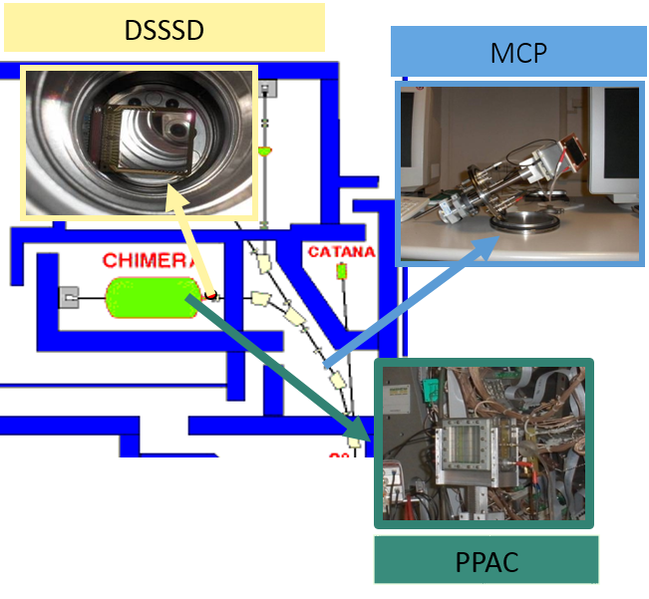


Our experience: FRIBs
Paolo Russotto
Text
At INFN-LNS RIBs were produced, since 2001, using the FRIBs (in Flight Radioactive Ion Beams at LNS) facility through the In-Flight fragmentation method (primary beam accelerated by CS + ⁹Be target), employing a maximum beam power of 100 W
RIBs produced: from ⁶He to ⁶⁸Ni with max intensity of ≈ 10⁵ pps
Tagging system in the CHIMERA beam line
Two 45° dipoles of the beam line for the fragments selection
production target
Lombardo I. et al., Nucl. Phys. B, 215 (2011) 272

Slide 11
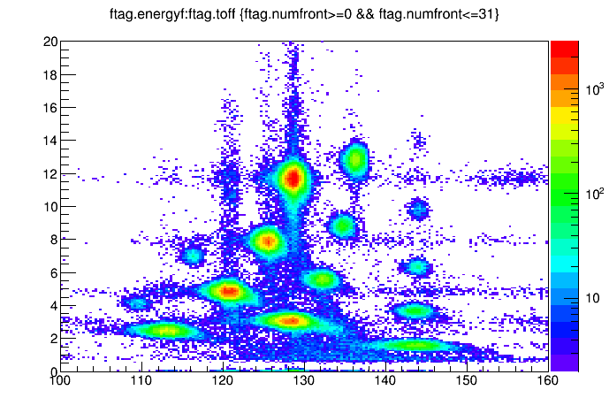
Our experience: FRIBS
¹⁸O(55 AMeV) + ⁹Be(1500 um)
Bρ=2.78Tm
Paolo Russotto
Text
Di-proton decay from ¹⁸Ne excited states
A/Z=2.66
A/Z=3
ΔE (MeV)
¹⁸C
¹⁶C
¹⁵B
¹²Be
G. Raciti et al., PRL 100 192503 (2008)
⁹Li
⁸Li
⁶He
ToF (ns)
Exotic nuclei cluster structure: ¹⁰Be->⁶He+⁴He
Isoscalar excitation of Pygmy resonance in ⁶⁸Ni
⁶⁸Ni coinc.
background
After background subtraction
D. dell’Aquila et al., PRC 93, 024601 (2015)
N.S. Martorana et al, PLB 2018 in press

Slide 12
Our experience: FRIBs
Paolo Russotto
Text
In specific cases, an aluminum degrader, placed between the two 45° dipoles of the fragment separator, was used to obtain fragmentation beams with high purity of a particular isotope
DSSSD 16x 16 strips
+ plastic scintillators
¹³C (50 enA) + ⁹Be @ 55 AMeV
RIBs with a ¹¹Be purity of 95 %
Two 45° dipoles of the beam line for the fragments selection
production target
Al (1000 µm) degrader

Slide 13
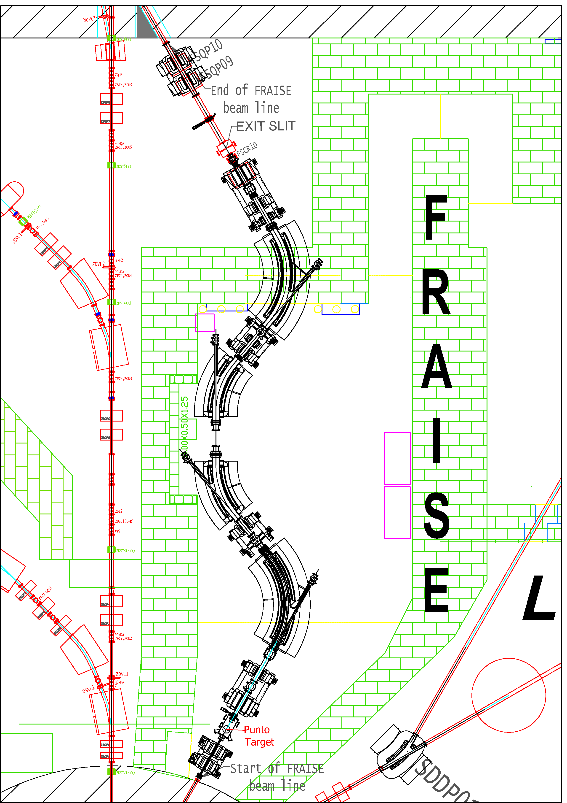
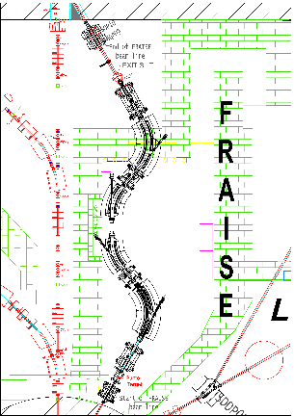
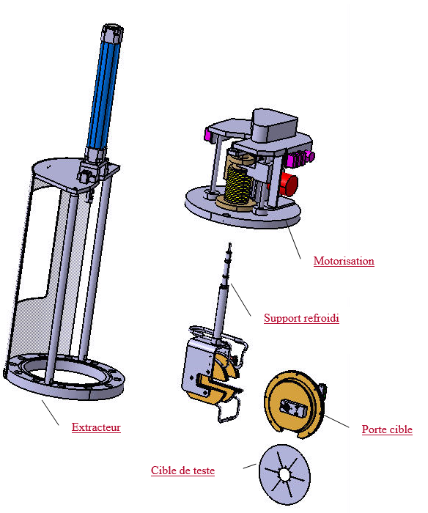
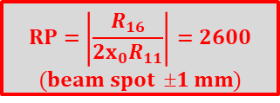
Our future: FraISe
Paolo Russotto
Text
Main features:
4 dipoles, 6 quadrupoles and 2 sextupoles, arranged in two symmetric branches, to ensure optimal achromatic condition
maximum magnetic rigidity 3.2 Tm
momentum acceptance ±1.2%
solid angle acceptance ±2.5 msr
5 m dispersion at symmetry plane, energy resolving power
thanks to high energy dispersion value at the symmetry plane, it will allow to deliver stable beams with an energy spread of 0.1 %
$$RP=\left|\frac{R_{16}}{2x_{0}R_{11}}\right|=2600$$
$$(beam spot 1 mm)$$
Degrader and/or selection slits
Rotating Target
CLIM (GANIL)

Slide 14
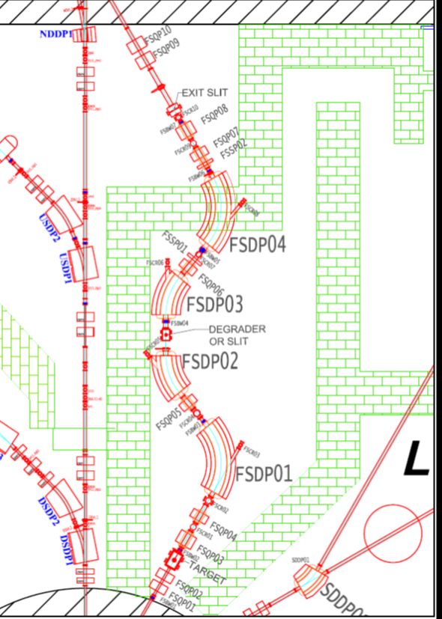
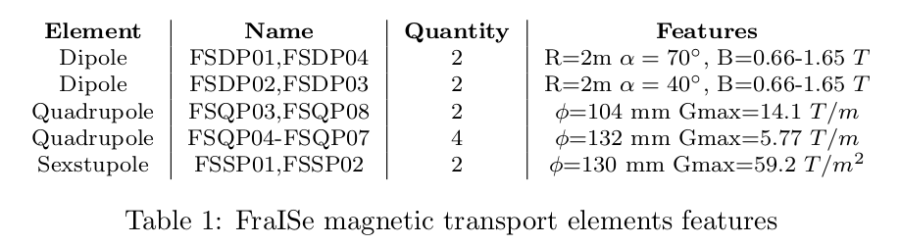
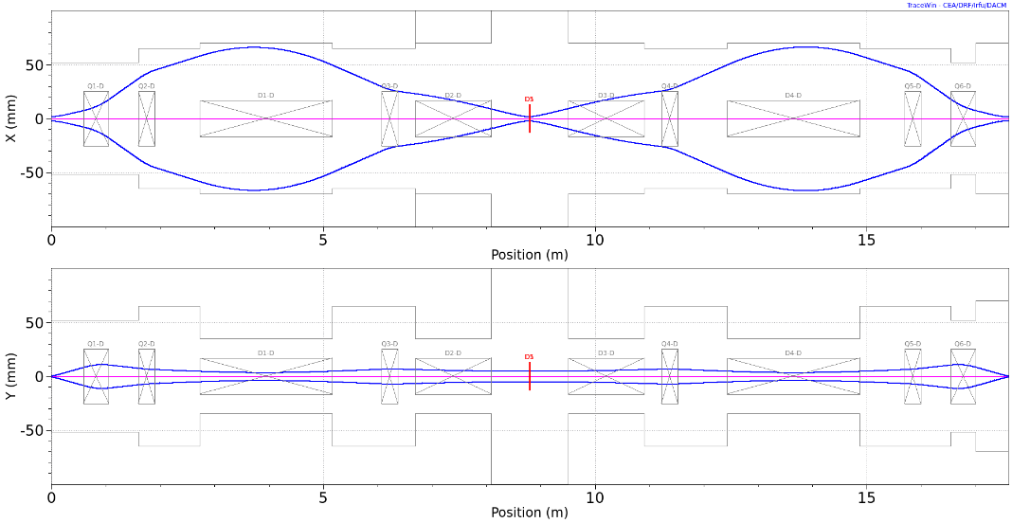
Our future: FraISe
Paolo Russotto
First order envelope calculated in case of x-x' maximum acceptance
contact A.D. Russo for further info

Slide 15
Our future: FraISe
Paolo Russotto
Text
Also, a revision and improvement of the diagnostics and tagging systems are needed to measure features of the RIBs → the systems will be versatile and useful for FRAISE and other facilities
Inside a Fragment Separator:
Need of a point-to-point measurement of cocktail intensity, relative composition, energy distribution, 2D profile, angular distribution during optimization
Monitoring of beam properties, start time for event-by-event ToF/energy measurement during data taking
In the final set-up point:
Need of event-by-event tagging of cocktail beam and trajectory measurement
SiC is the new emerging technology for the future (low consumption, radiation-hard) sensing and electronic devices fabrication
In the last years R&D on these materials and technologies was carried out @ INFN Tudisco S. et al., Sensors 2018, 18, 2289
A feasibility study, in synergy with Research Division, has already started, performing simulations and preliminary tests in order to evaluate the possibility of using SiC detectors
What we want to develop:
Side View
5 mm
array of detectors based on SiC technology, where the single detection unity pad will be 5 × 5 mm² and 100 µm thick fully depleted SiC rad-hard multi-pad sensors: up to 10⁷ pps over ≈ 72 channels with Δt ≈ 200 ps (≈0.1% precision on energy for 20 m base-of-flight) with 200 µm inter-pad dead zone, 10% dead area
30 mm
60 mm
14

Slide 16
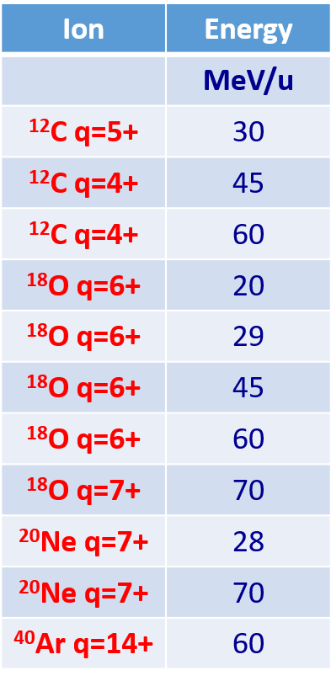
Our future: FraISe
Paolo Russotto
Some refs:
P. Russotto et al., J. Physics: Conf. Ser., 1014 (2018) 012016;
N.S. Martorana, Nuovo Cimento 44 C (2021) 1 and LNS report 2019-2020;
F. Risitano, Master thesis Univ. Of Messina 2020 and LNS report 2020;
A.D. Russo et al., Nucl. Instrum. Methods B, 463 (2020) 418.
F. Risitano, in press on Nuovo Cimento C
N.S. Martorana, Proceedings of IWM-EC 2021, to be published in Nuovo Cimento C
web: https://potlns.lns.infn.it/it/motivazioni-scientifiche/fraise.html
Studied cases
Text
In the following:
-Al 100 μm homogenous degrader on symmetry plane
-100 μm SiC tagging detector at the exit

Slide 17
Our future: FraISe
Paolo Russotto
Text
¹²C⁶⁺ @ 60 AMeV 2 kW on ≈2500 um ⁹Be target
 |  |  |  | ¹⁷Ne | ¹⁸Ne | ¹⁹Ne | ²⁰Ne | ²¹Ne | ²²Ne | ²³Ne | ²⁴Ne | ²⁵Ne | ²⁶Ne | ²⁷Ne | ²⁸Ne
 |  |  |  |  | ¹⁷F | ¹⁸F | ¹⁹F | ²⁰F | ²¹F | ²²F | ²³F | ²⁴F | ²⁵F | ²⁶F | ²⁷F
 |  | ¹³O | ¹⁴O | ¹⁵O | ¹⁶O | ¹⁷O | ¹⁸O | ¹⁹O | ²⁰O | ²¹O | ²²O | ²³O | ²⁴O
 |  | ¹²N | ¹³N | ¹⁴N | ¹⁵N | ¹⁶N | ¹⁷N | ¹⁸N | ¹⁹N | ²⁰N | ²¹N | ²²N | ²³N
⁹C 4.0E5 45 | ¹⁰C 1.2E7 43 | ¹¹C 2.2E8 44 | ¹²C | ¹³C | ¹⁴C | ¹⁵C | ¹⁶C | ¹⁷C | ¹⁸C | ¹⁹C | ²⁰C |  | ²²C
⁸B 3.1E6 42 |  | ¹⁰B | ¹¹B | ¹²B | ¹³B | ¹⁴B | ¹⁵B |  | ¹⁷B |  | ¹⁹B
⁷Be 1.5E7 43 |  | ⁹Be | ¹⁰Be 1.6E7 50 | ¹¹Be | ¹²Be |  | ¹⁴Be
⁶Li | ⁷Li | ⁸Li 4.2E6 50 | ⁹Li 8.9E5 51 |  | ¹¹Li
 | ⁶He 2.1E6 51 |  | ⁸He 1.8E4 51
Expected yield (pps)
Energy after the exit slit (AMeV)

Slide 18
Our future: FraISe
Paolo Russotto
Text
¹²C⁶⁺ @ 60 AMeV – ¹⁸O⁸⁺ @ 70 AMeV 2 kW on ≈ 2500-1500 um ⁹Be target
 |  |  |  | ¹⁷Ne | ¹⁸Ne | ¹⁹Ne | ²⁰Ne | ²¹Ne | ²²Ne | ²³Ne | ²⁴Ne | ²⁵Ne | ²⁶Ne | ²⁷Ne | ²⁸Ne
 |  |  |  |  | ¹⁷F | ¹⁸F | ¹⁹F | ²⁰F | ²¹F | ²²F | ²³F | ²⁴F | ²⁵F | ²⁶F | ²⁷F
 |  | ¹³O 7.2E4 54 | ¹⁴O 1.4E6 40 | ¹⁵O 2.8E7 54 | ¹⁶O | ¹⁷O | ¹⁸O | ¹⁹O 4.4E6 50 | ²⁰O | ²¹O | ²²O | ²³O | ²⁴O
 |  | ¹²N 1.2E6 49 | ¹³N 2.3E7 50 | ¹⁴N | ¹⁵N | ¹⁶N 6.9E8 53 | ¹⁷N 3.2E8 57 | ¹⁸N | ¹⁹N | ²⁰N | ²¹N | ²²N | ²³N
⁹C 4.0E5 45 | ¹⁰C 1.1E7 43 | ¹¹C 2.2E8 44 | ¹²C | ¹³C | ¹⁴C 1.1E8 59 | ¹⁵C 4.0E7 59 | ¹⁶C 1.4E7 60 | ¹⁷C 1.2E5 58 | ¹⁸C 4.8E2 55 | ¹⁹C | ²⁰C |  | ²²C
⁸B 3.1E6 42 |  | ¹⁰B | ¹¹B | ¹²B 2.6E7 57 | ¹³B 7.5E6 58 | ¹⁴B 1.4E6 60 | ¹⁵B 2.6E5 51 |  | ¹⁷B |  | ¹⁹B
⁷Be 1.5E7 43 |  | ⁹Be | ¹⁰Be 1.6E7 50 | ¹¹Be 1.5E6 58 | ¹²Be 2.8E5 60 |  | ¹⁴Be 3.0E3 63
⁶Li | ⁷Li | ⁸Li 4.2E6 50 | ⁹Li 8.9E5 51 |  | ¹¹Li 3.3E3 60
 | ⁶He 2.1E6 51 |  | ⁸He 1.8E4 51
Notes:
¹³C will allow: ¹²B 1.2E8 pps
¹⁶O will allow: ¹⁵O 2.7E8 pps, ¹⁴O 1.3E7 pps, ¹³O 4.2E5 pps
Primary beams at lower energy (≈30 AMeV) and thinner target will give about yield lower by ≈ 1 order of magnitude and final energies of 15-25 AMeV
Expected yield (pps)
Energy after the exit slit (AMeV)

Slide 19
Our future: FraISe
Paolo Russotto
¹²C⁶⁺ @ 60 AMeV - ¹⁸O⁸⁺ @ 70 AMeV - ²⁰Ne¹⁰⁺ 2 kW @ 70 AMeV on 2500-1500-1250 um ⁹Be target
Text
 |  |  |  | ¹⁷Ne 8.7E5 53 | ¹⁸Ne 3.1E7 51 | ¹⁹Ne 6.0E8 52 | ²⁰Ne | ²¹Ne | ²²Ne | ²³Ne | ²⁴Ne | ²⁵Ne | ²⁶Ne | ²⁷Ne | ²⁸Ne
 |  |  |  |  | ¹⁷F 1.7E8 50 | ¹⁸F | ¹⁹F | ²⁰F 9.5E6 55 | ²¹F | ²²F | ²³F | ²⁴F | ²⁵F | ²⁶F | ²⁷F
 |  | ¹³O 7.2E4 54 | ¹⁴O 1.4E6 40 | ¹⁵O 2.8E7 54 | ¹⁶O | ¹⁷O | ¹⁸O | ¹⁹O 2.3E6 39 | ²⁰O | ²¹O | ²²O | ²³O | ²⁴O
 |  | ¹²N 1.2E6 49 | ¹³N 2.3E7 50 | ¹⁴N | ¹⁵N | ¹⁶N 6.9E8 53 | ¹⁷N 3.2E8 57 | ¹⁸N 3.7E6 57 | ¹⁹N | ²⁰N | ²¹N | ²²N | ²³N
⁹C 4.0E5 45 | ¹⁰C 1.1E7 43 | ¹¹C 2.2E8 44 | ¹²C | ¹³C | ¹⁴C 1.1E8 59 | ¹⁵C 4.0E7 59 | ¹⁶C 1.4E7 60 | ¹⁷C 1.2E5 58 | ¹⁸C 4.8E2 55 | ¹⁹C | ²⁰C |  | ²²C
⁸B 3.1E6 42 |  | ¹⁰B | ¹¹B | ¹²B 2.6E7 57 | ¹³B 7.5E6 58 | ¹⁴B 1.4E6 60 | ¹⁵B 2.6E5 51 |  | ¹⁷B |  | ¹⁹B
⁷Be 1.5E7 43 |  | ⁹Be | ¹⁰Be 1.6E7 50 | ¹¹Be 1.5E6 58 | ¹²Be 2.8E5 60 |  | ¹⁴Be 3.0E3 63
⁶Li | ⁷Li | ⁸Li 4.2E6 50 | ⁹Li 8.9E5 51 |  | ¹¹Li 3.3E3 60
 | ⁶He 2.1E6 51 |  | ⁸He 1.8E4 51
Expected yield (pps)
Energy after the exit slit (AMeV)

Slide 20
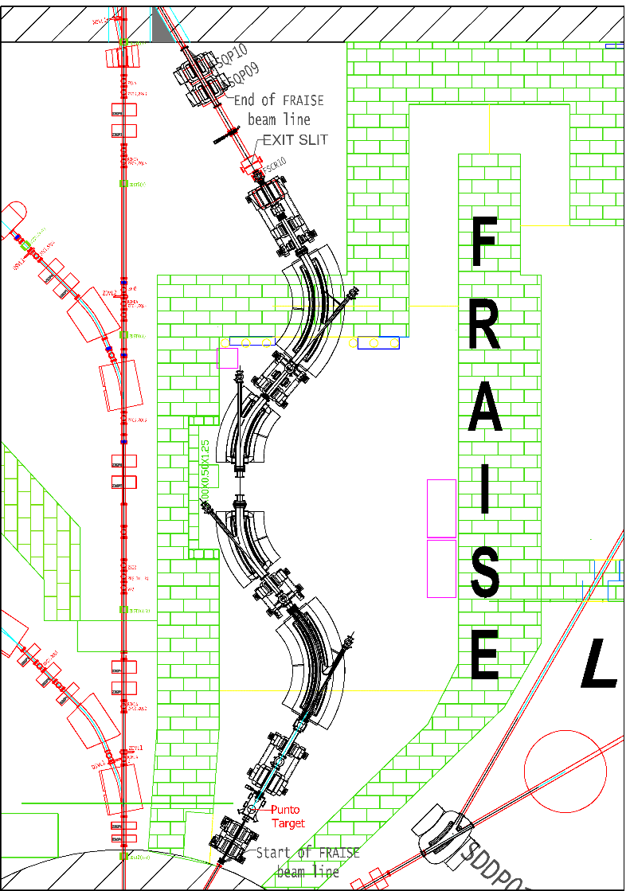
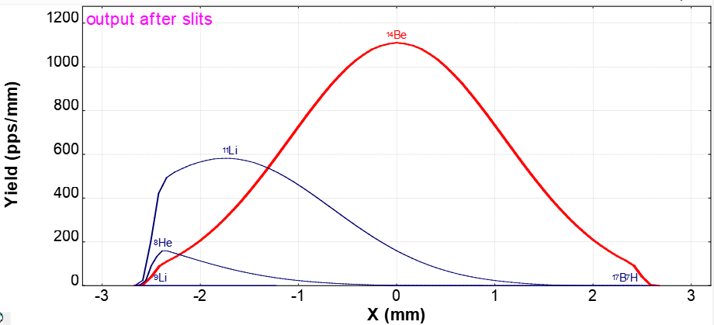
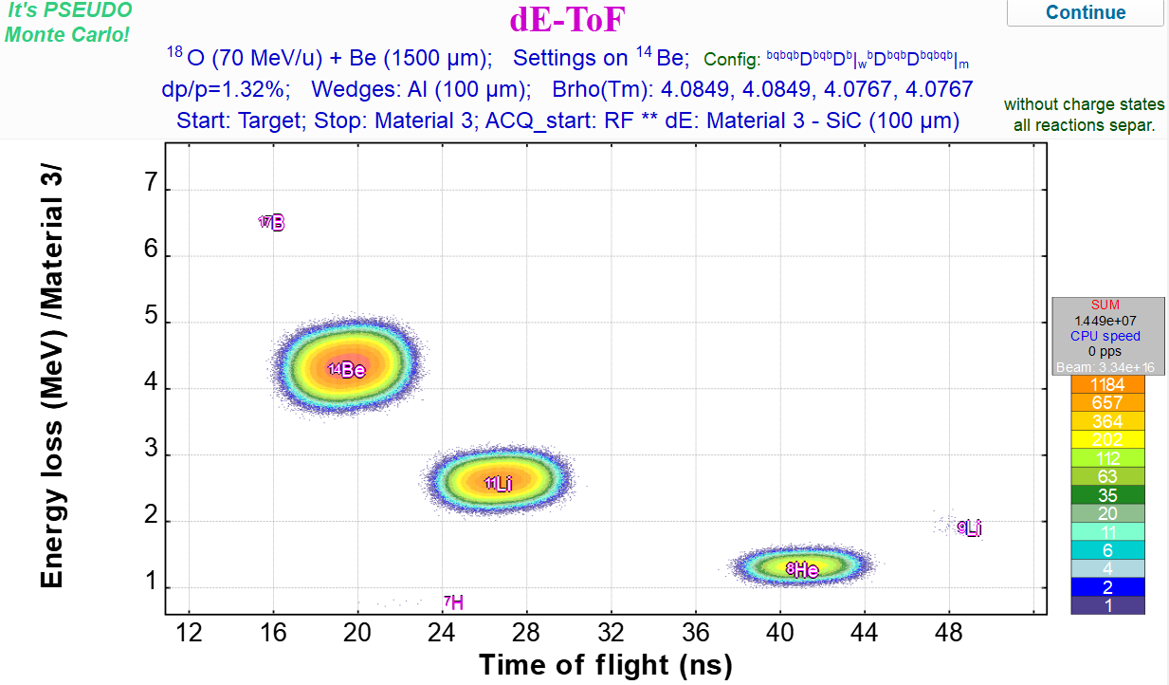
Our future: FraISe
Some physics cases
Paolo Russotto
LISE++ simulations→ ¹⁸O primary beam at 70 MeV/nucleon, 2 kW on a ⁹Be target (1500 µm)
Simulation of spatial distribution of beam components, using a SiC detector placed after the exit slit
100 µm SiC tagging detector at the exit
¹⁴Be: 69 %
3.0 10³ pps
¹¹Li
Al 100 µm homogenous wedge on the symmetry plane
⁸He
¹⁴Be
¹¹Li
⁸He

Slide 21
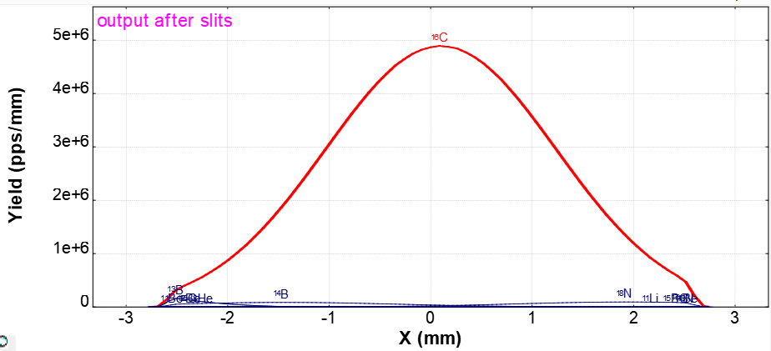
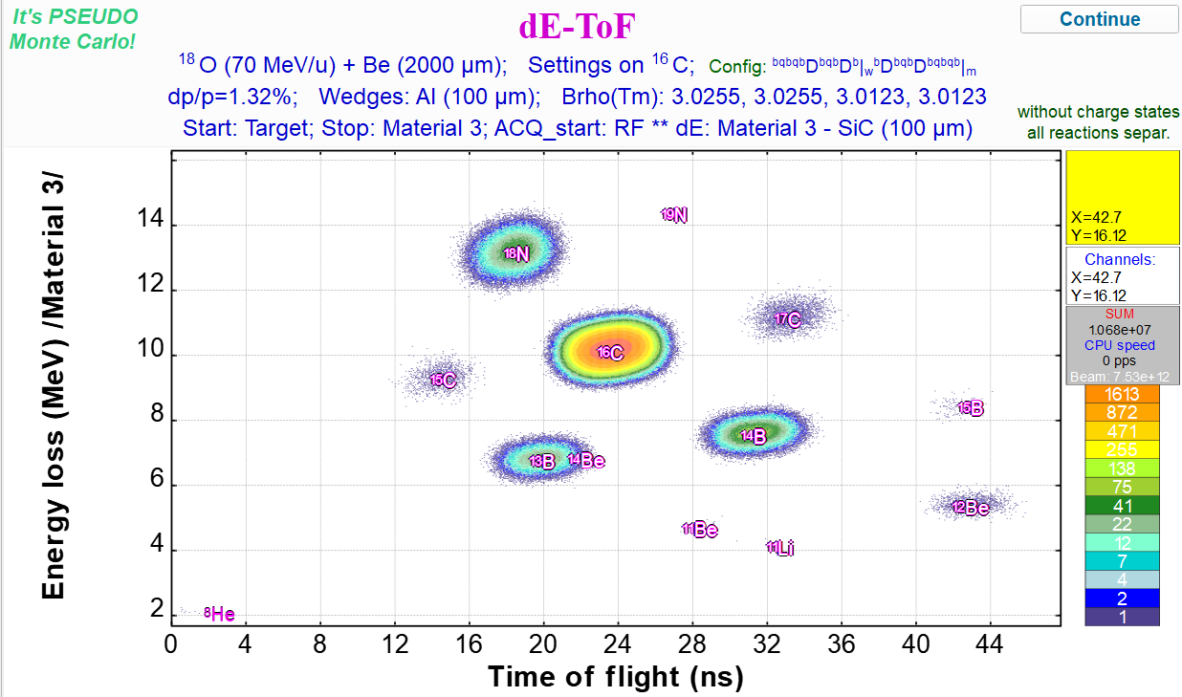
Our future: FraISe
Some physics cases
Paolo Russotto
LISE++ simulations→ ¹⁸O primary beam at 70 MeV/nucleon, 2 kW on a ⁹Be target (2000 µm)
Simulation of spatial distribution of beam components, using a SiC detector placed after the exit slit
100 µm SiC tagging detector at the exit
¹⁶C: 97 %
1.4 10⁷ pps
Al 100 µm homogenous wedge on the symmetry plane
¹¹Be
¹³B
¹⁴B
¹⁸N
¹⁸N
¹⁶C
¹⁴B
¹³B

Slide 22
Our future: FraISe
Paolo Russotto

Slide 23
Our future: FraISe
Paolo Russotto
⁴⁰Ar¹⁸⁺ @ 70 AMeV 2 kW on 500 um ⁹Be target
Text
 |  |  |  | ³⁵K | ³⁶K 6.6E3 48 | ³⁷K 8.2E4 48 | ³⁸K 6.3E5 49 | ³⁹K | ⁴⁰K | ⁴¹K | ⁴²K 8.2E5 32 | ⁴³K 1.7E3 33 | ⁴⁴K
 | ³¹Ar | ³²Ar | ³³Ar | ³⁴Ar | ³⁵Ar 8.9E5 45 | ³⁶Ar | ³⁷Ar 5.2E7 39 | ³⁸Ar | ³⁹Ar 7.0E8 39 | ⁴⁰Ar | ⁴¹Ar 7.9E6 34 | ⁴²Ar 1.5E4 34 | ⁴³Ar
 |  | ³¹Cl | ³²Cl 2.7E4 38 | ³³Cl 7.1E5 33 | ³⁴Cl 8.1E6 34 | ³⁵Cl | ³⁶Cl | ³⁷Cl | ³⁸Cl 4.5E8 35 | ³⁹Cl 2.0E8 35 | ⁴⁰Cl 3.6E6 30 | ⁴¹Cl 3.2E3 34 | ⁴²Cl
²⁸S | ²⁹S | ³⁰S 4.2E4 48 | ³¹S 1E6 49 | ³²S | ³³S | ³⁴S | ³⁵S 1.1E8 35 | ³⁶S | ³⁷S 3.9E7 36 | ³⁸S 1.2E7 40 | ³⁹S 1.1E5 40 | ⁴⁰S 3.2E2 39 | ⁴¹S
²⁷P | ²⁸P 5.8E4 42 | ²⁹P 1.4E6 43 | ³⁰P 1.1E7 43 | ³¹P | ³²P 5.2E7 40 | ³³P 6.7E7 48 | ³⁴P 3.9E7 44 | ³⁵P 1.5E7 46 | ³⁶P | ³⁷P 8.2E5 50 | ³⁸P 7.9E3 48 | ³⁹P | ⁴⁰P
²⁶Si | ²⁷Si 9.7E5 43 | ²⁸Si | ²⁹Si | ³⁰S | ³¹Si 3.5E7 45 | ³²Si 1.3E7 48 | ³³Si 3.5E6 52 | ³⁴Si 1.0E6 52 | ³⁵Si 1.9E5 49 | ³⁶Si 2.5E4 49 | ³⁷Si | ³⁸Si | ³⁹Si
²⁵Al 9.2E5 44 | ²⁶Al 5.4E6 44 | ²⁷Al | ²⁸Al 2.0E7 45 | ²⁹Al 1.2E7 45 | ³⁰Al 4.4E6 45 | ³¹Al 1.1E6 52 | ³²Al 1.6E5 41 | ³³Al 2.5E4 41 | ³⁴Al 2.9E3 41 | ³⁵Al 3.5E2 41 | ³⁶Al | ³⁷Al | ³⁸Al

Slide 24
Our future: FraISe
Paolo Russotto
E/A (MeV)
FAIR-GSI
BIGRIPS-RIKEN
200
150
100
90
80
70
60
50
40
30
20
10
0
FRIB-MSU
Complementarity!
RIPS-RIKEN
LISE-GANIL
In-flight: also shorter lifetimes
FRAISE
ISOL: only longer lifetimes, better beam quality
FraISe with TANDEM beams after developing a cryogenic gas targets (p,d,³He…)
SPIRAL2-GANIL
SPES-LNL
ISOLDE
10 20 30 40 50 60 70 80 90 100 150 200
A

Slide 25
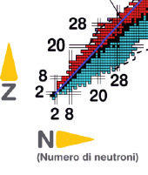
Our future: FraISe
Paolo Russotto
Text
(some) other cases of relevant interest:
⁷⁰Zn ->A≈68 region
^{58,64}Ni ->A≈60 region
¹⁶O->light n-poor isotopes
³⁶Ar ->A≈34 n-poor isotopes
²⁴Mg, ²⁷Al ->Al, Mg, Na, Ne, F isotopes
³²S ->S, P, Si, Al isotopes
¹³C->light n-rich isotopes

Slide 26
Conclusions & Perspectives
Luigi Celona & Paolo Russotto
Conclusion & Perspectives
Several infrastructures (CS, Tandem, Sources) which represented the core of the LNS nuclear research activities are suffering from ageing. Important maintenance and development activities are needed to ensure their use for the next decades.
The Tandem beam menu will be enriched with the possibility to accelerate noble gas beams and with the production of long half life isotopes. The Cyclotron beam menu will include high intensity ion beams through the extraction by stripping.
The upgrading of the entire infrastructure and the offer of new beams will open new perspectives and to attract new users (at least we hope !).
The cyclotron upgrading works are proceeding with some delays due to the global pandemic situation. Detailed plans of commissioning of the major subsystems and of the Cyclotron are in preparation.
We plan to efficiently produce neutron-poor and neutron-rich light RIBs of A<=20 and around A=36 at Fermi energies
Production of RIBs of A≈20-34 and, expecially, A≈40-70 needs to be deeply studied and tested.

Slide 28
Our future: FraISe
Paolo Russotto
²²Ne (50 AMeV) @ 2 kW on ⁹Be target
 |  |  |  | ²²Al | ²³Al | ²⁴Al | ²⁵Al | ²⁶Al | ²⁷Al | ²⁸Al | ²⁹Al | ³⁰Al | ³¹Al | ³²Al | ³³Al
 |  |  | ²⁰Mg | ²¹Mg | ²²Mg | ²³Mg | ²⁴Mg | ²⁵Mg | ²⁶Mg | ²⁷Mg | ²⁸Mg | ²⁹Mg | ³⁰Mg
 |  |  |  | ²⁰Na | ²¹Na | ²²Na | ²³Na | ²⁴Na | ²⁵Na | ²⁶Na | ²⁷Na | ²⁸Na | ²⁹Na
 |  | ¹⁷Ne | ¹⁸Ne | ¹⁹Ne | ²⁰Ne | ²¹Ne | ²²Ne | ²³Ne | ²⁴Ne | ²⁵Ne | ²⁶Ne | ²⁷Ne | ²⁸Ne
 |  |  | ¹⁷F | ¹⁸F 9.8E7 36 | ¹⁹F | ²⁰F 4.2E8 37 | ²¹F 1.6E8 42 | ²²F | ²³F | ²⁴F | ²⁵F | ²⁶F | ²⁷F
¹³O | ¹⁴O | ¹⁵O | ¹⁶O | ¹⁷O | ¹⁸O | ¹⁹O 3.2E7 40 | ²⁰O 9.2E6 43 | ²¹O 8.9E4 40 | ²²O 3.0E2 43 | ²³O | ²⁴O
¹²N | ¹³N | ¹⁴N | ¹⁵ N | ¹⁶N | ¹⁷N | ¹⁸N 1.5E6 40 | ¹⁹N 3.2E5 43 | ²⁰N 2.7E3 42 | ²¹N | ²²N | ²³N
¹¹C | ¹²C | ¹³C | ¹⁴C | ¹⁵C | ¹⁶C | ¹⁷C | ¹⁸C | ¹⁹C | ²⁰C |  | ²²C

Slide 29
Our future: FraISe
Paolo Russotto
²⁴Mg (50 AMeV) @ 2 kW on ⁹Be target
 |  |  |  | ²²Al | ²³Al | ²⁴Al | ²⁵Al | ²⁶Al | ²⁷Al | ²⁸Al | ²⁹Al | ³⁰Al | ³¹Al | ³²Al | ³³Al
 |  |  | ²⁰Mg 8.6E6 37 | ²¹Mg 3.5E5 37 | ²²Mg 1.2E7 38 | ²³Mg 3.0E8 35 | ²⁴Mg | ²⁵Mg | ²⁶Mg | ²⁷Mg | ²⁸Mg | ²⁹Mg | ³⁰Mg
 |  |  |  | ²⁰Na 3.8E6 35 | ²¹Na 7.6E7 35 | ²²Na 3.2E8 36 | ²³Na | ²⁴Na | ²⁵Na | ²⁶Na | ²⁷Na | ²⁸Na | ²⁹Na
 |  | ¹⁷Ne | ¹⁸Ne | ¹⁹Ne | ²⁰Ne | ²¹Ne | ²²Ne | ²³Ne | ²⁴Ne | ²⁵Ne | ²⁶Ne | ²⁷Ne | ²⁸Ne
 |  |  | ¹⁷F | ¹⁸F | ¹⁹F | ²⁰F | ²¹F | ²²F | ²³F | ²⁴F | ²⁵F | ²⁶F | ²⁷F
¹³O | ¹⁴O | ¹⁵O | ¹⁶O | ¹⁷O | ¹⁸O | ¹⁹O | ²⁰O | ²¹O | ²²O | ²³O | ²⁴O
¹²N | ¹³N | ¹⁴N | ¹⁵ N | ¹⁶N | ¹⁷N | ¹⁸N | ¹⁹N | ²⁰N | ²¹N | ²²N | ²³N
¹¹C | ¹²C | ¹³C | ¹⁴C | ¹⁵C | ¹⁶C | ¹⁷C | ¹⁸C | ¹⁹C | ²⁰C |  | ²²C

Slide 30
Our future: FraISe
Paolo Russotto
²⁷Al (40 AMeV) @ 2 kW on ⁹Be target
 |  |  |  | ²²Al | ²³Al 9.5E4 37 | ²⁴Al 2.8E6 41 | ²⁵Al 5.6E7 41 | ²⁶Al 5.1E8 34 | ²⁷Al | ²⁸Al | ²⁹Al | ³⁰Al | ³¹Al | ³²Al | ³³Al
 |  |  | ²⁰Mg | ²¹Mg | ²²Mg | ²³Mg | ²⁴Mg | ²⁵Mg | ²⁶Mg | ²⁷Mg 4.9E6 40 | ²⁸Mg | ²⁹Mg | ³⁰Mg
 |  |  |  | ²⁰Na | ²¹Na | ²²Na | ²³Na | ²⁴Na 8.1E7 39 | ²⁵Na 2.5E7 39 | ²⁶Na | ²⁷Na | ²⁸Na | ²⁹Na
 |  | ¹⁷Ne | ¹⁸Ne | ¹⁹Ne | ²⁰Ne | ²¹Ne | ²²Ne | ²³Ne 7.9E6 43 | ²⁴Ne 1.9E6 40 | ²⁵Ne | ²⁶Ne | ²⁷Ne | ²⁸Ne
 |  |  | ¹⁷F | ¹⁸F | ¹⁹F | ²⁰F | ²¹F | ²²F 5.7E5 40 | ²³F 5.9E4 43 | ²⁴F | ²⁵F | ²⁶F | ²⁷F
¹³O | ¹⁴O | ¹⁵O | ¹⁶O | ¹⁷O | ¹⁸O | ¹⁹O | ²⁰O | ²¹O | ²²O | ²³O | ²⁴O
¹²N | ¹³N | ¹⁴N | ¹⁵ N | ¹⁶N | ¹⁷N | ¹⁸N | ¹⁹N | ²⁰N | ²¹N | ²²N | ²³N
¹¹C | ¹²C | ¹³C | ¹⁴C | ¹⁵C | ¹⁶C | ¹⁷C | ¹⁸C | ¹⁹C | ²⁰C |  | ²²C

Slide 31
Our future: FraISe
Paolo Russotto
³²S (50 AMeV)@ 2 kW on ⁹Be target
 |  |  |  |  |  | ²⁸S | ²⁹S | ³⁰S 9.6E6 39 | ³¹S 2.7E8 39 | ³²S | ³³S | ³⁴S | ³⁵S | ³⁶S
 |  |  |  |  |  | ²⁷P 7.9E4 34 | ²⁸P 2.9E6 33 | ²⁹P 7.0E7 35 | ³⁰P 3.7E8 35 | ³¹P | ³²P 7.2E6 40 | ³³P 6.8E3 39 | ³⁴P | ³⁵P
 |  |  | ²³Si | ²⁴Si | ²⁵Si | ²⁶Si 1.1E6 39 | ²⁷Si 2.0E7 39 | ²⁸Si | ²⁹Si | ³⁰Si | ³¹Si 6.1E5 40 | ³²Si 2.2E3 40 | ³³Si | ³⁴Si
 |  |  | ²²Al | ²³Al | ²⁴Al | ²⁵Al | ²⁶Al | ²⁷Al | ²⁸Al 4.0E7 41 | ²⁹Al 1.0E7 41 | ³⁰Al 8.8E4 40 | ³¹Al | ³²Al | ³³Al
 |  | ²⁰Mg | ²¹Mg | ²²Mg | ²³Mg | ²⁴Mg | ²⁵Mg | ²⁶Mg | ²⁷Mg 5.6E6 41 | ²⁸Mg 6.6E5 41 | ²⁹Mg 6.4E3 40 | ³⁰Mg
 |  |  | ²⁰Na | ²¹Na | ²²Na | ²³Na | ²⁴Na | ²⁵Na 2.6E6 41 | ²⁶Na 3.6E5 41 | ²⁷Na 2.8E4 41 | ²⁸Na | ²⁹Na
 | ¹⁷Ne | ¹⁸Ne | ¹⁹Ne | ²⁰Ne | ²¹Ne | ²²Ne | ²³Ne | ²⁴Ne | ²⁵Ne 1.2E4 41 | ²⁶Ne 8.7E2 42 | ²⁷Ne | ²⁸Ne
 |  | ¹⁷F | ¹⁸F | ¹⁹F | ²⁰F | ²¹F | ²²F | ²³F | ²⁴F | ²⁵F | ²⁶F | ²⁷F

Slide 32
Our future: FraISe
Paolo Russotto
³⁶Ar (40 AMeV) 2 kW on ⁹Be target
ù |  |  |  | ³⁵K 6.1E4 36 | ³⁶K 4.2E6 37 | ³⁷K 3.8E6 37 | ³⁸K 6.3E5 37 | ³⁹K | ⁴⁰K | ⁴¹K | ⁴²K | ⁴³K | ⁴⁴K
 | ³¹Ar | ³²Ar | ³³Ar 1.9E5 37 | ³⁴Ar 8.2E6 37 | ³⁵Ar 2.7E8 38 | ³⁶Ar | ³⁷Ar 2.9E6 38 | ³⁸Ar | ³⁹Ar | ⁴⁰Ar | ⁴¹Ar | ⁴²Ar | ⁴³Ar
 |  | ³¹Cl 5.6E4 37 | ³²Cl 2.3E6 38 | ³³Cl 5.9E7 38 | ³⁴Cl 3.2E8 38 | ³⁵Cl | ³⁶Cl | ³⁷Cl | ³⁸Cl | ³⁹Cl | ⁴⁰Cl | ⁴¹Cl | ⁴²Cl
²⁸S | ²⁹S | ³⁰S | ³¹S | ³²S | ³³S | ³⁴S | ³⁵S | ³⁶S | ³⁷S | ³⁸S | ³⁹S | ⁴⁰S | ⁴¹S
²⁷P | ²⁸P | ²⁹P | ³⁰P | ³¹P | ³²P | ³³P | ³⁴P | ³⁵P | ³⁶P | ³⁷P | ³⁸P | ³⁹P | ⁴⁰P
²⁶Si | ²⁷Si | ²⁸Si | ²⁹Si | ³⁰Si | ³¹Si | ³²Si | ³³Si | ³⁴Si | ³⁵Si | ³⁶Si | ³⁷Si | ³⁸Si | ³⁹Si
²⁵Al | ²⁶Al | ²⁷Al | ²⁸Al | ²⁹Al | ³⁰Al | ³¹Al | ³²Al | ³³Al | ³⁴Al | ³⁵Al | ³⁶Al | ³⁷Al | ³⁸Al

Slide 33
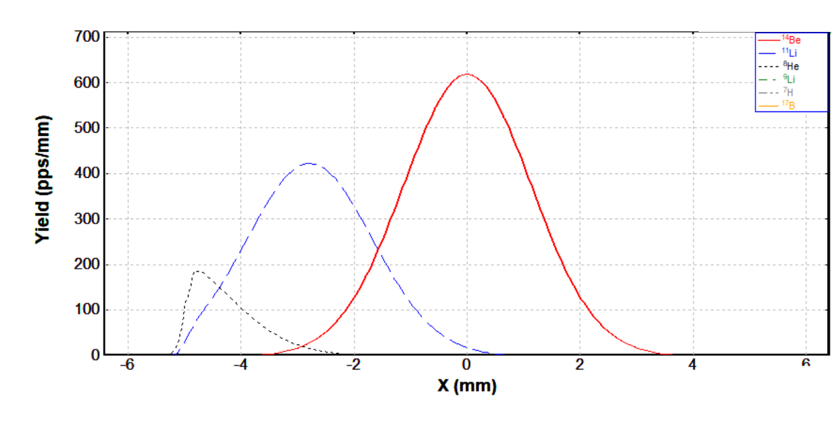
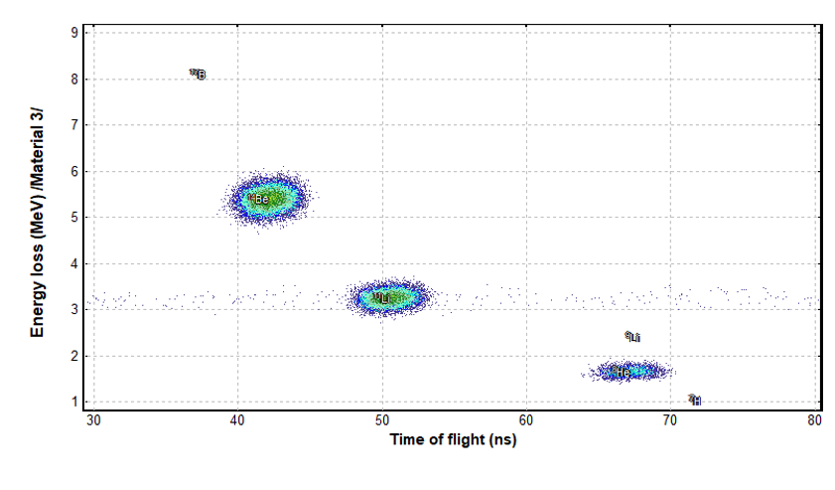
Our future: FraISe
Some physics cases
Paolo Russotto
Text
LISE++ simulations→ ¹⁸O primary beam at 70 MeV/nucleon, 2 kW on a ⁹Be target (1250 µm)
Simulation of spatial distribution of beam components, using a SiC detector placed after the exit slit
100 µm SiC tagging detector at the exit
¹⁴Be: 63 %
¹¹Li
3E3 pps
⁸He
Al 100 µm homogenous wedge on the symmetry plane
∆E-ToF plot
¹⁴Be
¹¹Li
⁸He
32

Slide 34
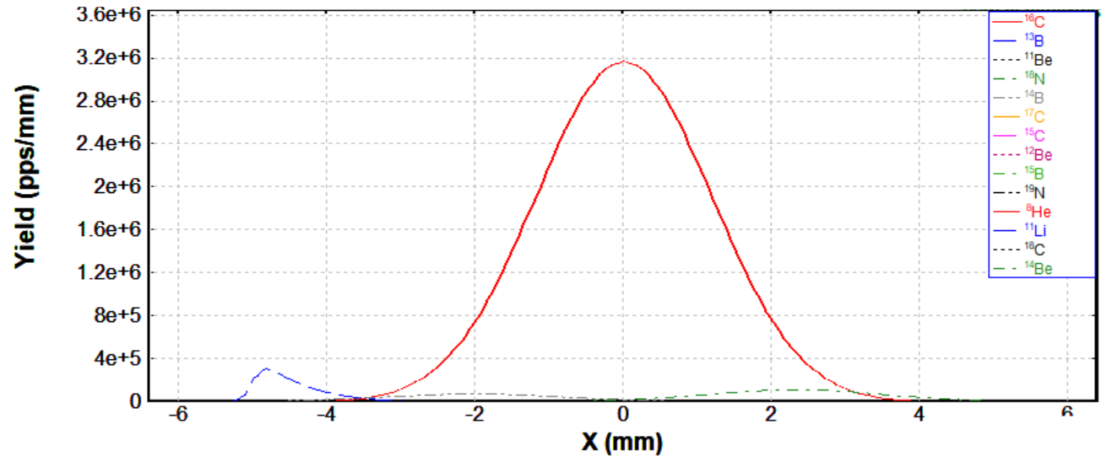
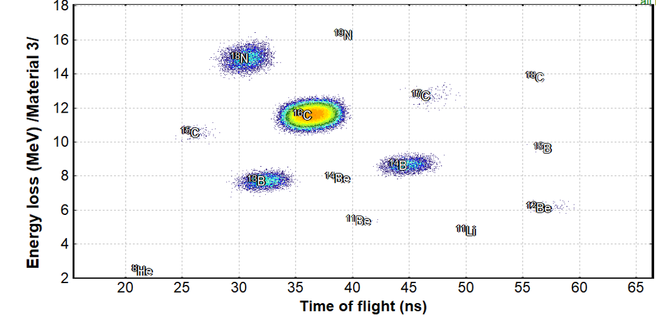
Our future: FraISe
Paolo Russotto
Some physics cases
Text
N.S. Martorana - martorana@lns.infn.it
4/1/2022
LISE++ simulations→ ¹⁸O primary beam at 70 MeV/nucleon, 2 kW on a ⁹Be target (1250 µm)
Simulation of spatial distribution of beam components, using a SiC detector placed after the exit slit
100 µm SiC tagging detector at the exit
¹⁶C: 85%
1.4E7 pps
Al 100 µm homogenous wedge on the symmetry plane
∆E-ToF plot
33
33

Slide 35
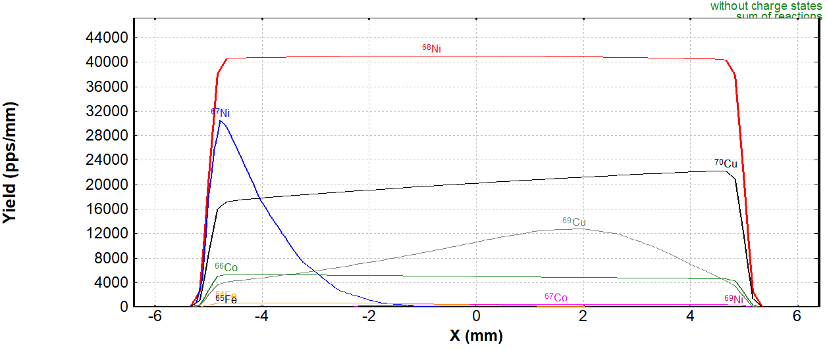
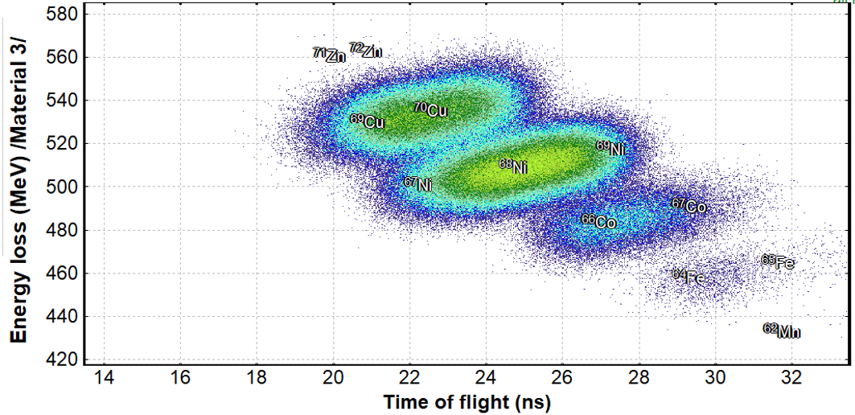
Our future: FraISe
Paolo Russotto
Some physics cases
LISE++ simulations→ ⁷⁰Zn primary beam at 40 MeV/nucleon, 1 kW on a ⁹Be target (500 µm)
Simulation of spatial distribution of beam components, using a SiC detector placed after the exit slit
100 µm SiC tagging detector at the exit
⁶⁸Ni: 52%
7.5E5 pps
Al 100 µm homogenous wedge on the symmetry plane
∆E-ToF plot
34

Slide 36
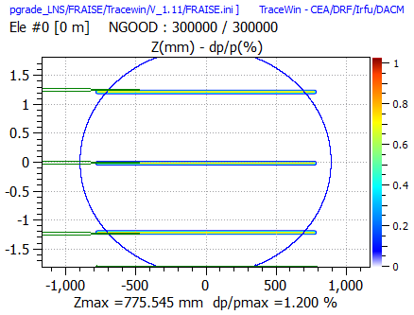
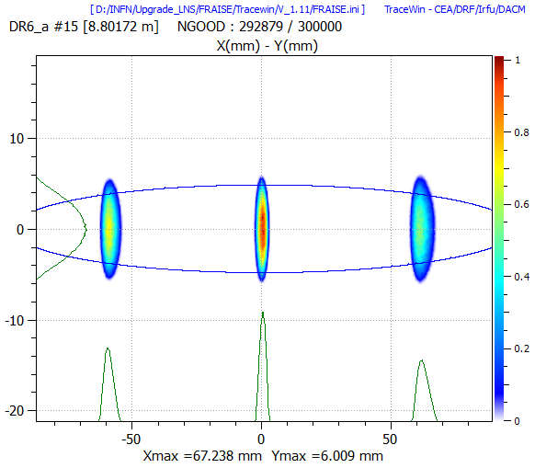
Our future: FraISe
Paolo Russotto
Momentum separation at FRAISE symmetry plane
First order envelope calculate in case of x-x' maximum acceptance

Slide 37
¹²C⁶⁺ @ 60 AMeV 2 kW on 2500 um ⁹Be
 |  |  |  |  |  |  | ²⁰Ne | ²¹Ne | ²²Ne
 |  |  |  |  |  |  | ¹⁹F
 |  |  |  |  | ¹⁶O | ¹⁷O | ¹⁸O
 |  | ¹²N 2.6E6 43 | ¹³N 6.6E5 41 | ¹⁴N | ¹⁵ N
⁹C 3.8E5 40 | ¹⁰C 1.1E7 42 | ¹¹C 2.2E8 44 | ¹²C | ¹³C | ¹⁴C 1.5E3 40
⁸B 3E6 42 |  | ¹⁰B | ¹¹B | ¹²B 3.7E6 48 | ¹³B 2.5E3 42
⁷Be 1.5E7 45 |  | ⁹Be | ¹⁰Be 1.6E7 48 | ¹¹Be 1.4E5 45
⁶Li | ⁷Li | ⁸Li 4.2E6 50 | ⁹Li 8.9E5 51
 | ⁶He 2.2E6 49 |  | ⁸He 2E4 50
Expected yield (pps)
Energy after the tagging detector (AMeV)

Slide 38
¹⁸O⁸⁺ @ 70 AMeV 2 kW on 1500 um ⁹Be
 |  |  |  | ¹⁷Ne | ¹⁸Ne | ¹⁹Ne | ²⁰Ne | ²¹Ne | ²²Ne | ²³Ne | ²⁴Ne | ²⁵Ne | ²⁶Ne | ²⁷Ne | ²⁸Ne
 |  |  |  |  | ¹⁷F | ¹⁸F | ¹⁹F | ²⁰F | ²¹F | ²²F | ²³F | ²⁴F | ²⁵F | ²⁶F | ²⁷F
 |  | ¹³O 6.3E4 56 | ¹⁴O 1.3E6 56 | ¹⁵O 2.4E7 57 | ¹⁶O | ¹⁷O | ¹⁸O | ¹⁹O 3.2E6 57 | ²⁰O 5.8E3 53 | ²¹O | ²²O | ²³O | ²⁴O
 |  | ¹²N 9.5E5 57 | ¹³N 1.7E7 59 | ¹⁴N | ¹⁵ N | ¹⁶N 5.4E8 60 | ¹⁷N 2.7E8 60 | ¹⁸N 4.2E6 61 | ¹⁹N 4.2E3 55 | ²⁰N | ²¹N | ²²N | ²³N
⁹C | ¹⁰C | ¹¹C | ¹²C | ¹³C | ¹⁴C 8.9E7 60 | ¹⁵C 3.7E7 61 | ¹⁶C 1.3E7 61 | ¹⁷C 1.2E5 58 | ¹⁸C 4.4E2 55 | ¹⁹C | ²⁰C |  | ²²C
⁸B |  | ¹⁰B | ¹¹B | ¹²B 2.0E7 61 | ¹³B 7.2E6 61 | ¹⁴B 1.5E6 61 | ¹⁵B 2.9E5 62 |  | ¹⁷B 4 56 |  | ¹⁹B
⁷Be |  | ⁹Be | ¹⁰Be 4.4E6 61 | ¹¹Be 1.4E6 61 | ¹²Be 2.4E5 62 |  | ¹⁴Be 3E3 62
⁶Li | ⁷Li | ⁸Li 8.2E5 63 | ⁹Li 2.3E5 62 |  | ¹¹Li 3E3 62
 | ⁶He 2.7E5 66 |  | ⁸He 5.2E3 64

Slide 39
¹⁸O⁸⁺ @ 29 AMeV 2 kW on 500 um ⁹Be
 |  |  |  | ¹⁷Ne | ¹⁸Ne | ¹⁹Ne | ²⁰Ne | ²¹Ne | ²²Ne | ²³Ne | ²⁴Ne | ²⁵Ne | ²⁶Ne | ²⁷Ne | ²⁸Ne
 |  |  |  |  | ¹⁷F | ¹⁸F | ¹⁹F | ²⁰F | ²¹F | ²²F | ²³F | ²⁴F | ²⁵F | ²⁶F | ²⁷F
 |  | ¹³O 3.3E3 15 | ¹⁴O 7.9E4 16 | ¹⁵O 1.9E6 16 | ¹⁶O | ¹⁷O | ¹⁸O | ¹⁹O 4.6E5 19 | ²⁰O 8.7E2 20 | ²¹O | ²²O | ²³O | ²⁴O
 |  | ¹²N 7.5E4 17 | ¹³N 1.5E6 17 | ¹⁴N | ¹⁵ N | ¹⁶N 7E7 20 | ¹⁷N 3.6E7 20 | ¹⁸N 7.4E6 17 | ¹⁹N 6E2 21 | ²⁰N | ²¹N | ²²N | ²³N
⁹C | ¹⁰C | ¹¹C | ¹²C | ¹³C | ¹⁴C 1.2E7 20 | ¹⁵C 4.8E6 21 | ¹⁶C 1.7E6 21 | ¹⁷C 1.6E4 21 | ¹⁸C 7.7E1 21 | ¹⁹C | ²⁰C |  | ²²C
⁸B |  | ¹⁰B | ¹¹B | ¹²B 2.7E6 21 | ¹³B 8.3E5 21 | ¹⁴B 1.9E5 22 | ¹⁵B 3.4E4 22 |  | ¹⁷B |  | ¹⁹B
⁷Be |  | ⁹Be | ¹⁰Be 6E5 22 | ¹¹Be 1.6E5 22 | ¹²Be 3.3E4 22 |  | ¹⁴Be 3.6E2 23
⁶Li | ⁷Li | ⁸Li 1.2E5 25 | ⁹Li 3E4 25 |  | ¹¹Li 4E2 23
 | ⁶He 4.3E4 27 |  | ⁸He 7.3E2 25

Slide 40
²⁰Ne¹⁰⁺ @ 70 AMeV 2 kW on 1250 um ⁹Be
 |  |  |  | ¹⁷Ne 8.E5 56 | ¹⁸Ne 2.6E7 56 | ¹⁹Ne 4.9E8 57 | ²⁰Ne | ²¹Ne | ²²Ne | ²³Ne | ²⁴Ne | ²⁵Ne | ²⁶Ne | ²⁷Ne | ²⁸Ne
 |  |  |  |  | ¹⁷F 1.3E8 57 | ¹⁸F | ¹⁹F | ²⁰F 8.5E6 59 | ²¹F 8.6E3 53 | ²²F | ²³F | ²⁴F | ²⁵F | ²⁶F | ²⁷F
 |  | ¹³O 1.2E5 57 | ¹⁴O 3.3E6 57 | ¹⁵O 1.4E8 58 | ¹⁶O | ¹⁷O | ¹⁸O | ¹⁹O 6.8E5 56 | ²⁰O 2.4E3 54 | ²¹O | ²²O | ²³O | ²⁴O
 |  | ¹²N 1.3E6 57 | ¹³N 1.8E7 58 | ¹⁴N | ¹⁵ N | ¹⁶N | ¹⁷N | ¹⁸N | ¹⁹N | ²⁰N | ²¹N | ²²N | ²³N
⁹C | ¹⁰C | ¹¹C | ¹²C | ¹³C | ¹⁴C | ¹⁵C | ¹⁶C | ¹⁷C | ¹⁸C | ¹⁹C | ²⁰C |  | ²²C
⁸B |  | ¹⁰B | ¹¹B | ¹²B | ¹³B | ¹⁴B | ¹⁵B |  | ¹⁷B |  | ¹⁹B
⁷Be |  | ⁹Be | ¹⁰Be | ¹¹Be | ¹²Be |  | ¹⁴Be
⁶Li | ⁷Li | ⁸Li | ⁹Li |  | ¹¹Li
 | ⁶He |  | ⁸He

Slide 41
⁴⁰Ar¹⁸⁺ @ 60 AMeV 2 kW on 500 um ⁹Be
 |  |  |  | ³⁵K 1.7E2 44 | ³⁶K 6.6E3 45 | ³⁷K 8.2E4 45 | ³⁸K 6.3E5 45 | ³⁹K | ⁴⁰K | ⁴¹K | ⁴²K 9.1E5 46 | ⁴³K 1.8E3 45 | ⁴⁴K
 | ³¹Ar | ³²Ar 7E1 45 | ³³Ar 1.5E3 46 | ³⁴Ar 3.2E4 46 | ³⁵Ar 7.5E5 47 | ³⁶Ar | ³⁷Ar 6.8E7 47 | ³⁸Ar | ³⁹Ar 8.2E8 48 | ⁴⁰Ar | ⁴¹Ar 7.6E6 47 | ⁴²Ar 1.5e4 47 | ⁴³Ar
 |  | ³¹Cl 1.7E3 46 | ³²Cl 3.9E4 47 | ³³Cl 1E6 49 | ³⁴Cl 1.1E7 49 | ³⁵Cl | ³⁶Cl | ³⁷Cl | ³⁸Cl | ³⁹Cl 2.2E8 49 | ⁴⁰Cl 3.5E6 49 | ⁴¹Cl 4E3 49 | ⁴²Cl
²⁸S | ²⁹S 1.8E3 47 | ³⁰S 4.2E4 48 | ³¹S 1E6 49 | ³²S | ³³S | ³⁴S | ³⁵S 1.3E8 49 | ³⁶S | ³⁷S 5E7 49 | ³⁸S 1.5E7 49 | ³⁹S 1.5E5 49 | ⁴⁰S 4.1E2 48 | ⁴¹S
²⁷P 1.8E3 47 | ²⁸P 4.2E4 47 | ²⁹P 9.5E5 48 | ³⁰P 7.8E6 48 | ³¹P | ³²P 6.6E7 49 | ³³P 5.5E7 49 | ³⁴P 3.5E7 49 | ³⁵P 1.3E7 49 | ³⁶P 3.9E6 49 | ³⁷P 8E5 50 | ³⁸P 7.8E3 49 | ³⁹P 1.5E1 48 | ⁴⁰P
²⁶Si 4E4 48 | ²⁷Si 7.1E5 50 | ²⁸Si | ²⁹Si | ³⁰S | ³¹Si 2.8E7 49 | ³²Si 1.1E7 50 | ³³Si 3.5E6 50 | ³⁴Si 1E6 50 | ³⁵Si 1.7E5 50 | ³⁶Si 2.5E4 50 | ³⁷Si 2.5E2 50 | ³⁸Si | ³⁹Si
²⁵Al 6.7E5 51 | ²⁶Al 3E6 51 | ²⁷Al | ²⁸Al 1.6E7 50 | ²⁹Al 1.1E7 50 | ³⁰Al 5.9E6 50 | ³¹Al 1.1E6 50 | ³²Al 2.2E5 50 | ³³Al 3.1E4 50 | ³⁴Al 4.3E3 50 | ³⁵Al 5.5E2 50 | ³⁶Al 5 50 | ³⁷Al | ³⁸Al

Slide 42
Our future: FraISe
Summer 2019
Start Construction Site
Summer 2022
Closing of Construction Site
Jan.–Mar. 2023
Tandem beam
Fall 2023
CS preparation/operation
Paolo Russotto
Text
Studied cases
In the following:
-Al 100 um homogenous degrader on symmetry plane
-100 um SiC tagging detector at the exit
Some refs:
P. Russotto et al., J. Physics: Conf. Ser., 1014 (2018) 012016;
N.S. Martorana, Nuovo Cimento 44 C (2021) 1 and LNS report 2019-2020;
F. Risitano, Master thesis Univ. Of Messina 2020 and LNS report 2020;
A.D. Russo et al., Nucl. Instrum. Methods B, 463 (2020) 418.
F. Risitano, in press on Nuovo Cimento C
N.S. Martorana, Proceedings of IWM-EC 2021, to be published in Nuovo Cimento C

