Slide 1

Summary of the results of a new measurement of natural erbium Xs(n,γ) between 1-100 eV
N_TOF Italian national meeting, Pavia 30/11/2021
X.X. Li et alt., New experimental measurements of natural erbium Xs(n,γ) between 1-100 eV, 2021

Slide 2
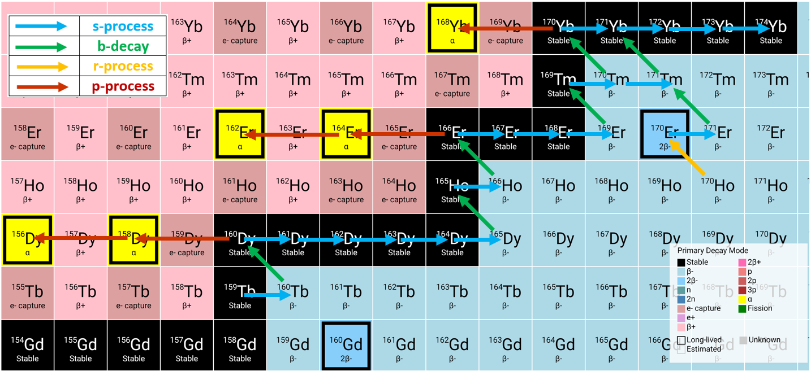
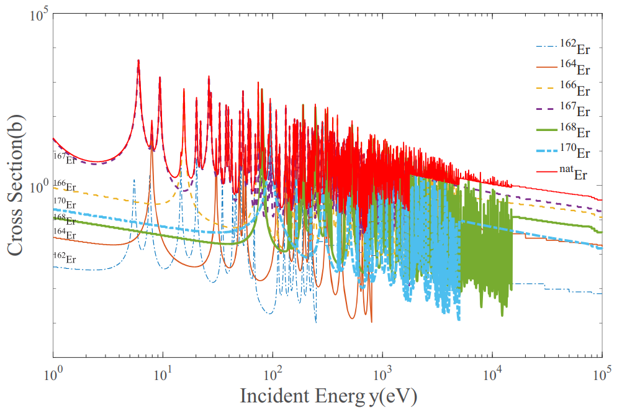
Erbium – astrophysics importance
Natural Erbium has six stable isotopes:
Er-166, Er-167, Er-168, s process;
Er-170, r process;
Er-162, Er-164, p-process (p-nuclei).
Er-166, Er-167, Er-168, Er-170 Xs(n,γ) are of great significance for understanding the pathways taken during the s process;
Er-162, Er-164 Xs(n,g) measurements can help to better understand the results of relevant photonuclear reaction experiments.
Isotopes | Er-162 | Er-164 | Er-166 | Er-167 | Er-168 | Er-170
%at | 0.139 | 1.606 | 33.503 | 22.869 | 26.940 | 14.910

Slide 3
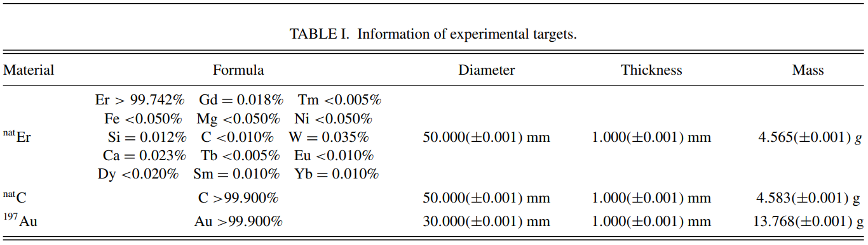
Erbium – experimental setup
Experimental facility: China spallation neutron source (CSNS), mainly used for exp. study of neutron scattering;
Detection system: four C₆D₆ scintillator installed 76 m away from the spallation target;
Neutron flux: measured using a silicon monitor based on the ⁶Li(n,α)³H reaction, energy range 0.5 eV÷200 MeV;
Experimental time: a total of 105 h, natural erbium target @ 72h in beam power 50.5-51.5 kW;
Experimental targets: ^{nat}Er, ^{nat}C, ¹⁹⁷Au.

Slide 4
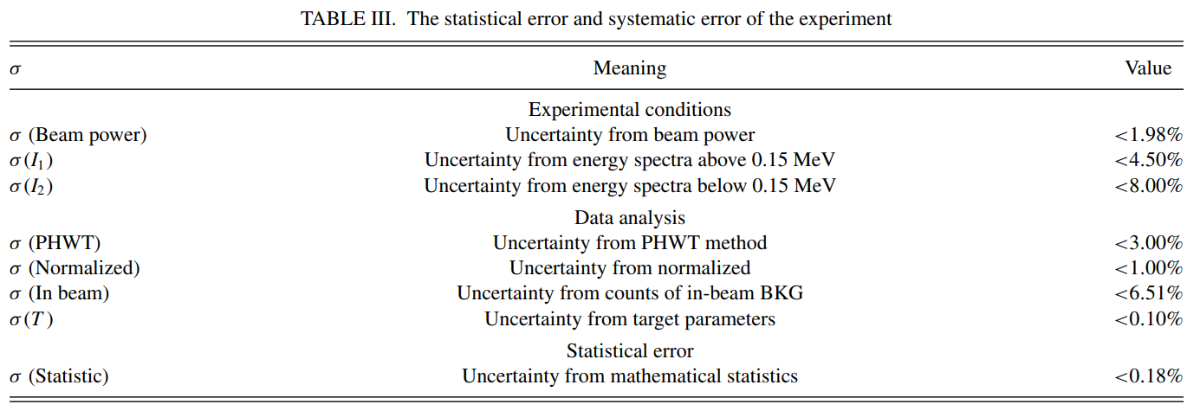
Erbium – experimental error
Experimental error: exp. conditions uncertainty, data analysis method uncertainty, exp. statistical error;

Slide 5
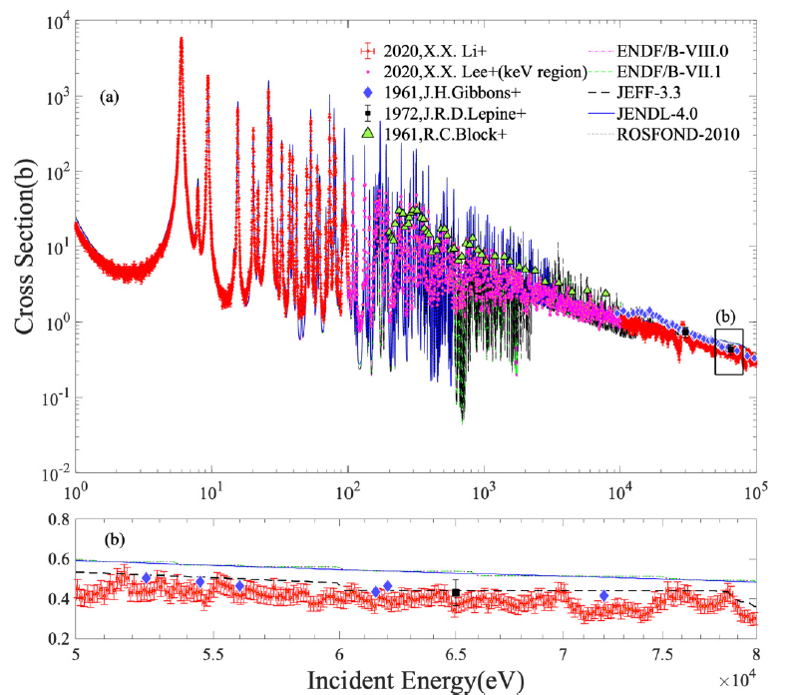
Erbium – results (10-100 keV) @ 2021
The results were compared with those existing experimental data in 10-100 keV region:
10 ÷ 100 keV:
  New data shows good agreement with some evaluated and experimental data;
  The experimental data results could be greatly improved with a more accurate response function of the beam-line.
  50 ÷ 80 keV:
    Three set of experimental data are basically the same and all lower the evaluation database, good agreement with JEFF-3.3.

Slide 6
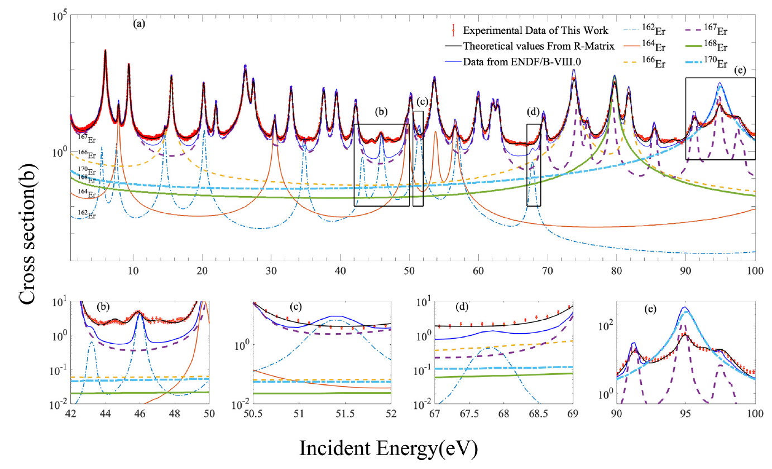
Erbium – results (1-100 eV) @ 2021
The only experimental data (EXFOR) for erbium natural element in the 1-100 eV energy region are:
Haddan et al. (0.1-1.2 eV), TOF, liquid scintillator, 1963;
X.X. Li (1-100 eV), TOF, C₆D₆ scintillator, 2021.
42 ÷ 50 eV: R matrix program fitting shows that the two nearby faint bumbs to 45.846 eV (due to Er-162) are not real resonance;
50.5 ÷ 69 eV: Er-162 should have weak resonance peaks at 51.4 eV and 67.8 eV (ENDF/B-VII.0), no obvious resonance structure found in experimental data.
90 ÷ 100 eV: three narrow resonance of Er-167 and a wide resonance of Er-170. Surprisingly the Er-170 contribute seemed to widely off
Recommend a separate further measurement of the Xs(n,g) of Er-170

Slide 7
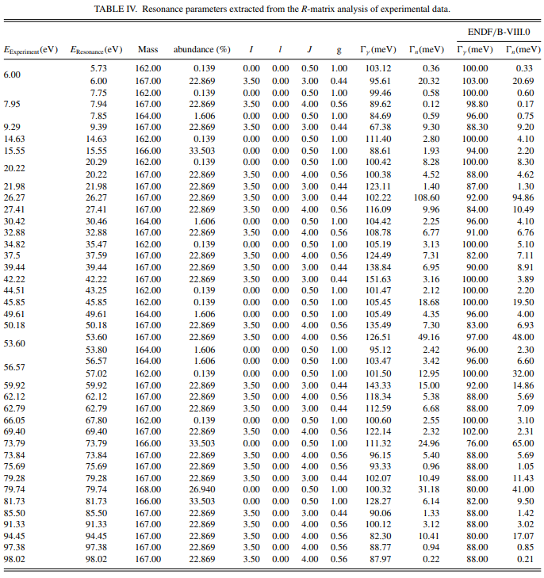
Erbium – considerations (1-100 eV) @ 2021
The resonance peak of natural erbium in the energy region of 1-100 eV is mostly contributed by Er-167 and Er-162, although their abundance is not the largest;
Most of the discrepancies in the experiments that did not match expectations were related to Er-162;
Er-162 is the p nuclei in astrophysics. Its resonance structure is significant for astrophysics, it would be necessary to use the high-purity isotope Er-162 for fine measurements analysis.

Slide 8
Conclusions
This work has supplemented and perfected the vacancy in the measurement data of neutron capture cross sections of the natural erbium in the 1-100 eV energy region;
The results shows that Er-162, Er-164 and Er-167 isotopes have a greater influence on the resonance peak of natural erbium in the 1-100 eV energy region;
Some experimental measurements of the resonance peak parameters and the ENDF evaluation database are different;
In particular, there are some possible weak resonance peak difference between the Er-162 isotopes experimental measurements and evaluation database;
We recommended taking further experimental studies for the neutron capture cross sections of isotopes of erbium, particularly Er-162 isotopes;
More accurate neutron source energy spectrum and detailed background measurements can significantly improve the neutron capture cross sections and nuclear astrophysics neutron capture rate research.

