Slide 1
Study of the transfer and matching line for a PWFA-driven FEL
CANDIDATE: Pasqualina Iovine iovine.1842739@studenti.uniroma1.it
SUPERVISOR: Enrica Chiadroni enrica.chiadroni@uniroma1.it
November 2, 2021

Slide 2
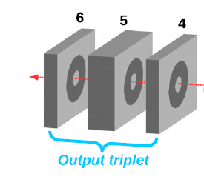
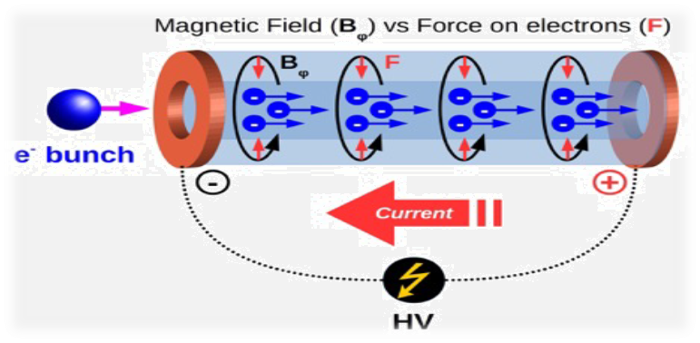
Working points
Low energy working point
Witness beam energy ≈ 93 MeV
Transfer and matching line downstream from the plasma accelerating module and down to the FEL undulator of the SPARC_LAB test facility using quadrupole magnets
High energy working point
Witness beam energy ≈ 1 GeV
Preliminary Studies for a compact and tunable system, based on active plasma lenses and collimators, for witness extraction and driver removal for the EuPRAXIA@SPARC_LAB Project

Slide 3
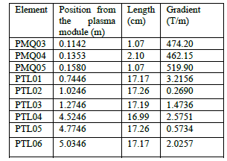
Low energy working point
First proof-of-principle demonstration of FEL lasing with a beam-driven PWFA module
First lasing of a free-electron laser with a compact beam-driven plasma accelerator. R. Pompili, D. Alesini, M.P. Anania,S. Arjmand, M. Behtouei, M. Bellaveglia, A. Biagioni, B. Buonomo, Submitted to Nature 2021.
Transfer and matching line downstream from the plasma accelerating module and down to the FEL undulator at SPARC_LAB was reproduced
Due to the deterioration of the magnets, their magnetic field gradient was varied from the nominal one (520T/m) to reproduce the experimental results
Simulations have been perfomed by means of GPT for beam dynamics
Notes:
PMQs downstream the plasma module that gradually catches the beam and matches it into the focusing-defocusing lattice consisting of six conventional electromagnetic quadrupoles (PTL01-PTL06) located upstream of the FEL beamline

Slide 4
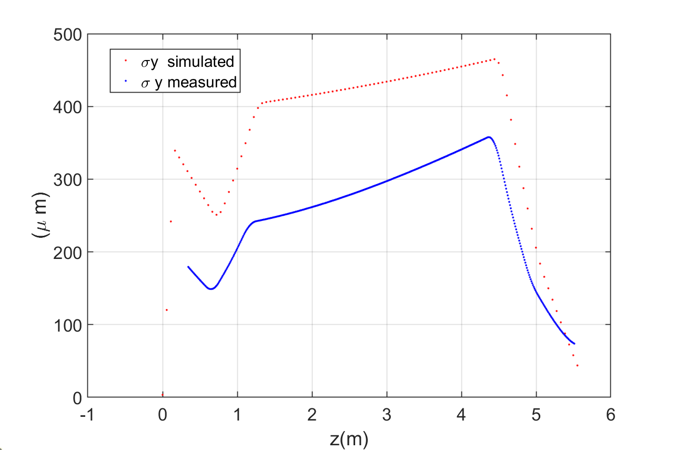
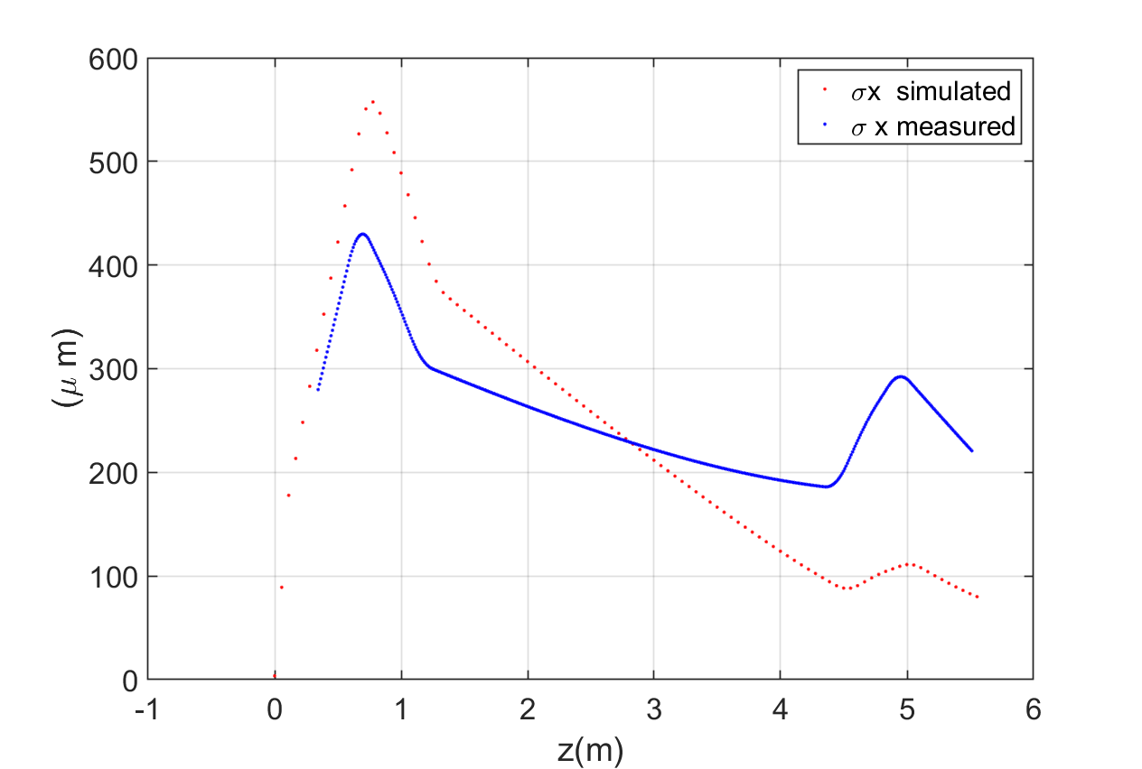
Simulated and extrapolated sigma of witness bunch along tranfer line
Simulations have well reproduced the trend of the experimental results
Simulated values are in red
Values extrapolated from the Twiss parameters are in blue, as obtained from the quadrupole scan emittance measurement of the plasma-accelerated witness beam

Slide 5
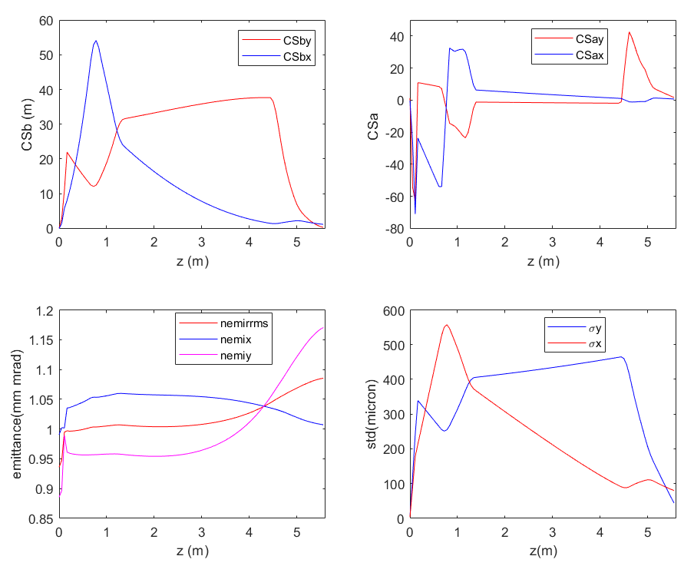
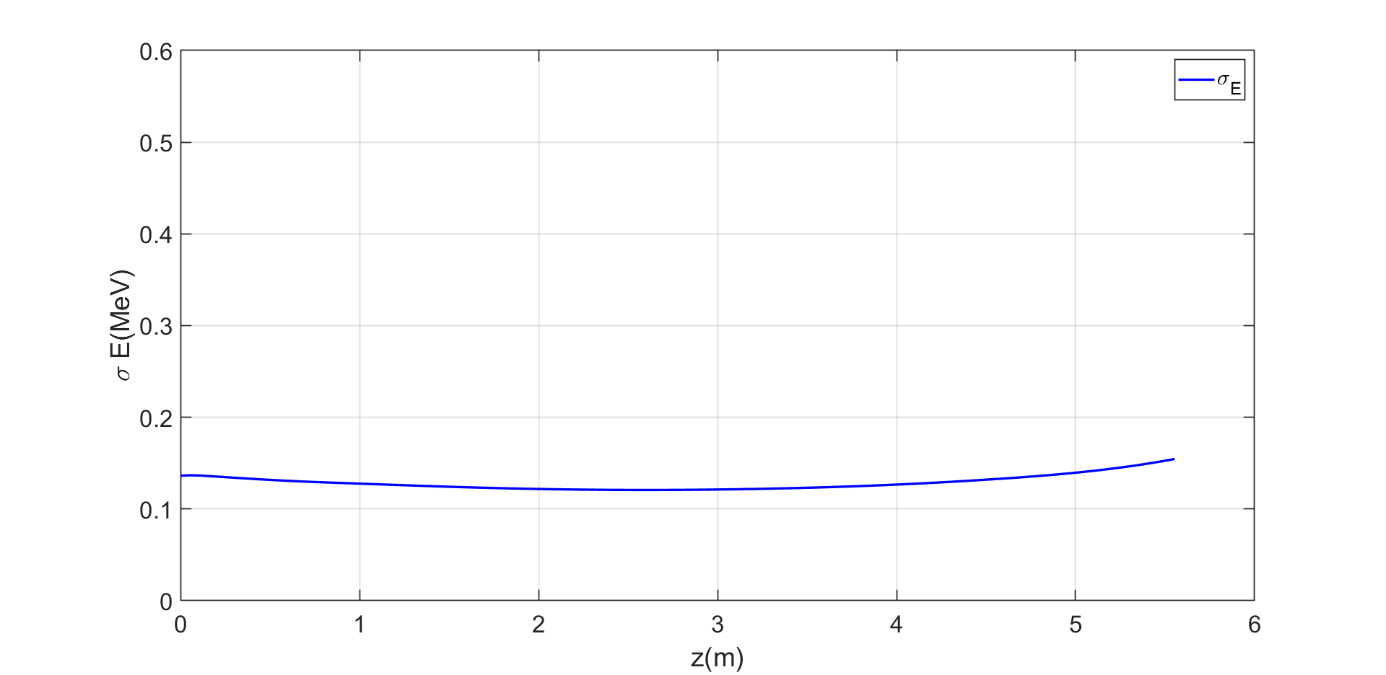
Simulated witness parameters along transport line
Witness parameters | Z start (0 cm) | Z end (5.5m)
Charge (pC) | 30 | 30
ε_{nrrms,} ε_{nx}, ε_{ny} (mm mrad) | 0.93, 0.99, 0.88 | 1.08,1.0, 1.16
σ_{x}, σ_{y} (μm) | 3.5,3.5 | 80 , 44
σ_{z} (μm) | 8.86 | 8.97
Energy (MeV) | 93.74 | 93.75
σ_{Ε} (MeV) | 0.137 | 0.154
By changing the gradient of the permanent quadrupoles, transverse beam size trends similar to those obtained from emittance measurements were obtained.
The final values of the Twiss functions after the transfer line, thus obtained, can be injected into the FEL simulation code.
Energy spread and bunch charge remain about constant.
witness | Z start (0 cm) | Z end (5,5 m)
αx | -0.3 | 0.7
αy | 1.2 | 1.6
βx (m) | 0.002 | 1.45
βy (m) | 0.003 | 0.74

Slide 6
High energy working point
Preliminary Studies for a compact and tunable system based on active plasma lenses for witness extraction and driver removal
In the frame of EuPRAXIA@SPARC_LAB, the goals are
to separate the bunches (1 GeV witness and ~500 MeV driver);
to eliminate the driver along the transport line;
to preserve the quality of the witness.
Starting point is the result from simulation presented in Pompili et al., … considering the PWFA working point reported in the CDR
A preliminary study for two alternative beamlines will be presented, always considering the old PWFA working point
Simulations have been perfomed by means of GPT for beam dynamics and a Matlab-based code for the plasma lens

Slide 7
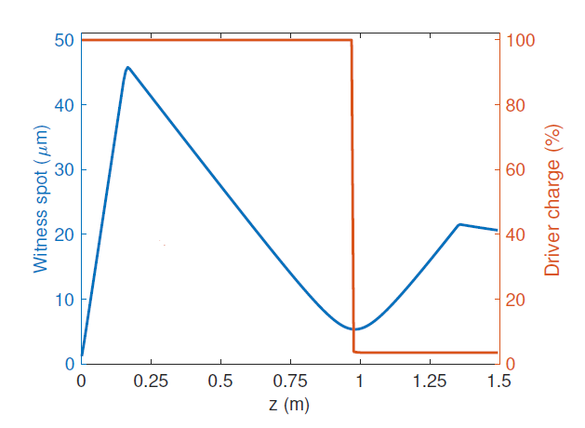
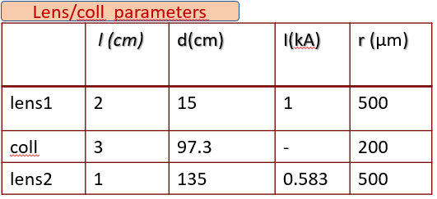
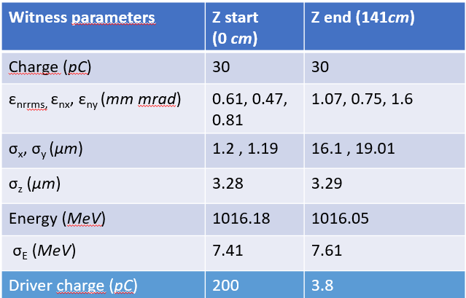
Old transfer line
To develop a compact system that catches and transports the witness bunch toward the final element of beam line it was designed a system with two active plasma lenses and one collimators. Such a system allows to extract and transport the accelerated and highly divergent witness bunch and, at the same time, remove the driver.
This transfer line allowed to preserve the qualities of the witness, to lose the driver (remains the 1.9 % of driver charge) reaching, however, emittance values greater than those of entry.
POMPILI, R., et al. Plasma lens-based beam extraction and removal system for plasma wakefield acceleration experiments. Physical Review Accelerators and Beams, 2019, 22.12: 121302.

Slide 8
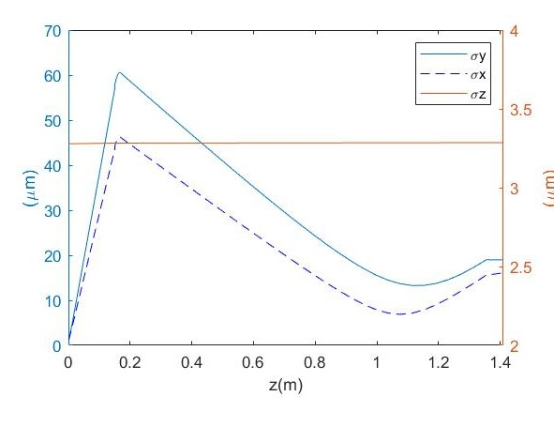
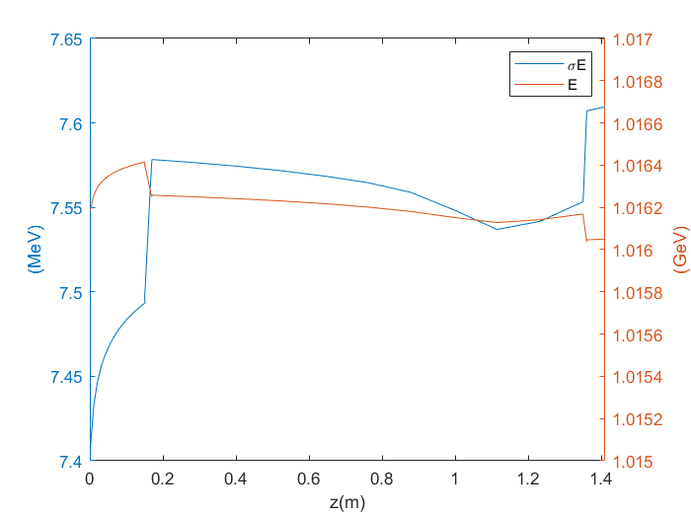
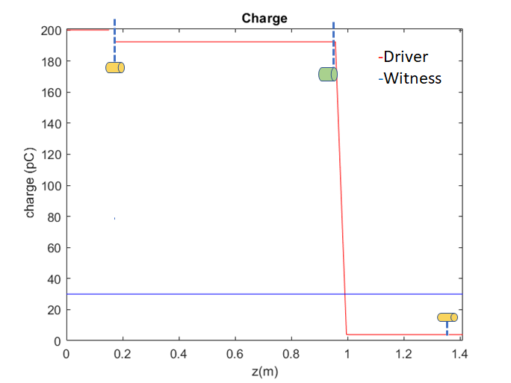
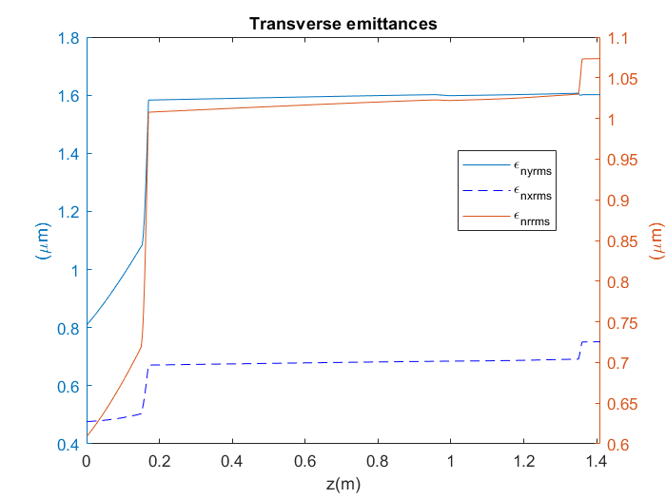
Old transfer line
Witness beam parameter
Driver and witness charge evolution
Lens
Collimator

Slide 9
New transport line prototypes
To cut more driver particles
radius and length of collimator were changed--> at the exit of the collimator, bunches have the same size.
Lens radius of 500 μm
To reduce emittance growth
the length of the lenses has been changed
Lens radius of 1mm
convergent bunch at the entrance of the lens !
two different systems for witness extraction and driver removal
One lens and one collimator
Two lenses and one collimator
SIMULATION CODES
Lens
Collimator
GPT

Slide 10
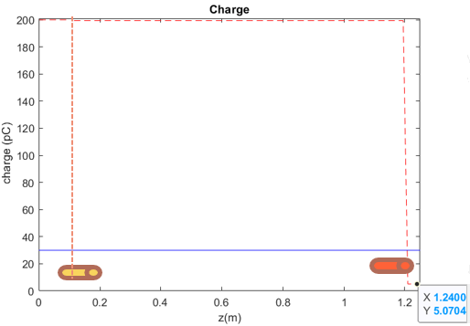
First configuration : lens-collimator
Lens
Collimator
This transfer line allowed to preserve the qualities of the witness and to lose the driver (remains the 2.5 % of driver charge).
Lens/coll parameters
 | l (cm) | d(cm) | I(kA) | r (μm)
lens1 | 1.5 | 10 | 1.8 | 500
coll | 2 | 119.5 | - | 300

Slide 11
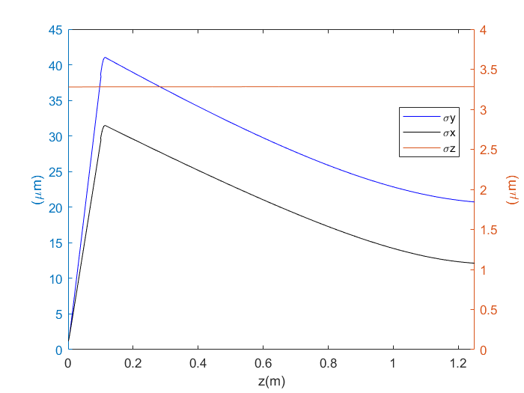
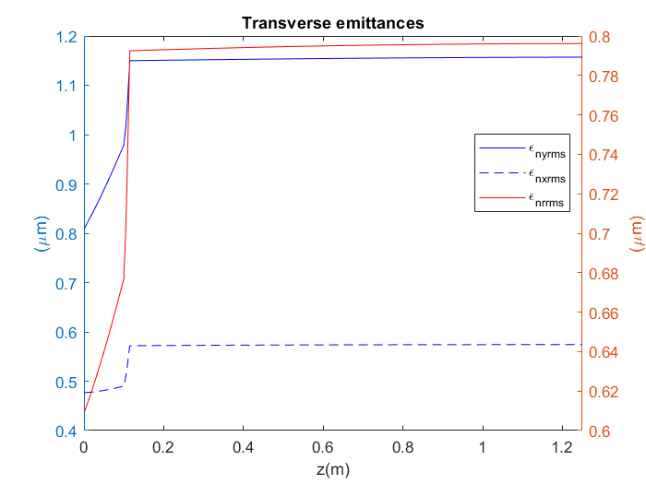
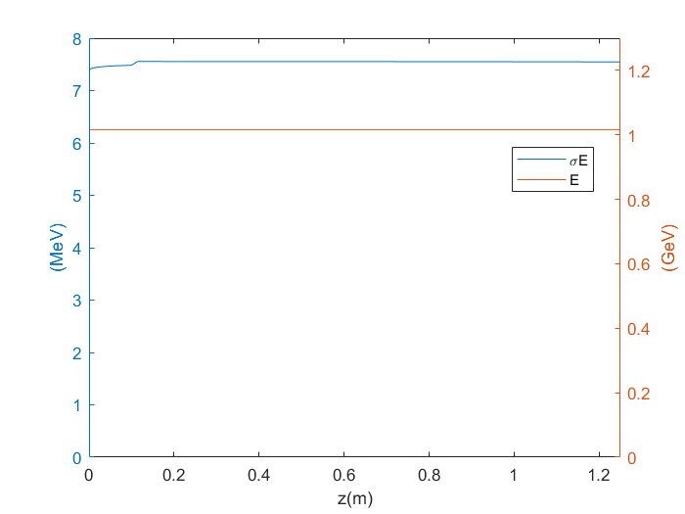
Witness parameters and driver charge along transport line
Lens
Collimator
Witness parameters | Z start (0 cm) | Z end (125cm)
Charge (pC) | 30 | 30
ε_{nrrms,} ε_{nx}, ε_{ny} (mm mrad) | 0.61, 0.47, 0.81 | 0.79, 0.57, 1.16
σ_{x}, σ_{y} (μm) | 1.20 , 1.19 | 12 , 21
σ_{z} (μm) | 3.28 | 3.28
Energy (MeV) | 1016.18 | 1016.20
σ_{Ε} (MeV) | 7.4 | 7.5
Driver charge (pC) | 200 | 5.1
transfer line of 121.5 cm
30 % increase in rms emittance
No change in bunch charge
Energy spread remains about constant
witness | Z start (0 cm) | Z end (125 cm)
αx | -1.02 | 0.13
αy | -0.46 | 0.14
βx (m) | 0.006 | 0.51
βy (m) | 0.003 | 0.74

Slide 12
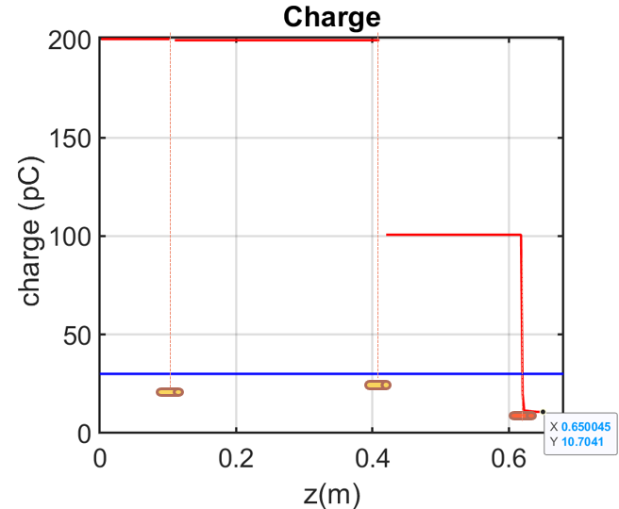
Second configuration: lens-lens-collimator
This configuration, of 2 active plasma lens and 1 collimator, allows to transport the witness along transfer line and, at the same time, over-focus the driver and cut its charge.
Lens/coll parameters
 | l (cm) | d(cm) | I(kA) | r (μm)
lens1 | 1 | 10 | 3 | 500
lens2 | 1 | 42 | 0.1 | 500
coll | 2 | 62 | - | 200
Lens
Collimator

Slide 13
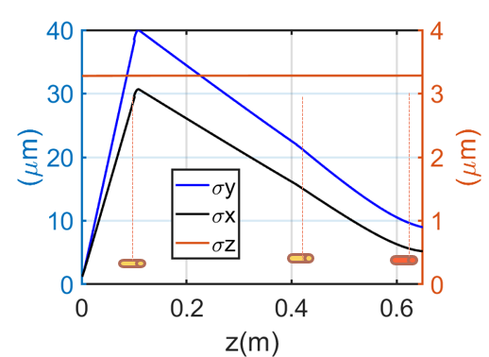
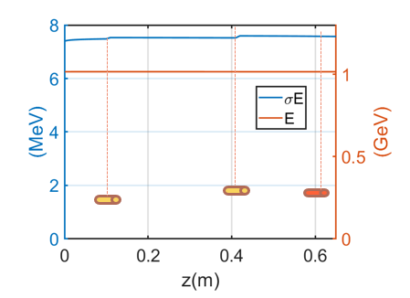
Witness parameters and driver charge along transport line
Witness parameters | Z start (0 cm) | Z end (62cm)
Charge (pC) | 30 | 30
ε_{nrrms,} ε_{nx}, ε_{ny} (mm mrad) | 0.61, 0.47, 0.81 | 0.85, 0.60, 1.27
σ_{x}, σ_{y} (μm) | 1.20 , 1.19 | 6.0 , 10
σ_{z} (μm) | 3.28 | 3.28
Energy (MeV) | 1016.18 | 1016.20
σ_{Ε} (MeV) | 7.4 | 7.5
Driver charge (pC) | 200 | 10.7
witness | Z start (0 cm) | Z end (64 cm)
αx | -1.02 | 0.14
αy | -0.46 | 0.26
βx (m) | 0.006 | 0.09
βy (m) | 0.003 | 0.12
transfer line of 64 cm
40 % increase in rms emittance
No change in bunch charge
Energy spread remains about constant

Slide 14
Comparison between the three lines
These configurations are tunable changing the current of the lenses
In all configurations witness particles are preserved
At zend (136 cm)
1.9% driver
emittance value from 0.61 mm mrad to 1.07 mm mrad
At zend (121.5 cm)
2.7% driver
emittance value from 0.61 mm mrad to 0.79 mm mrad
At zend (64 cm)
5% driver
emittance value from 0.61 mm mrad to 0.85 mm mrad

Slide 15
Conclusion
Low energy working point
Simulations have well reproduced the trend of the experimental result but
for the difficulties due to the emittance measurements of the accelerated witness bunch
also the extrapolated curve could move away from the real one.
High energy working point
In all configurations witness particles are preserved and the driver is cut almost in its entirety.
These configurations are tunable changing the current of the lenses.
.
Future simulation studies will be done with other codes (Elegant and Trace 3-D) to improve these simulations.
Future studies will be conducted for the design of a very compact and tunable system (tens of centimetres scale) adaptable to different beam configurations (from hundreds MeV up to several GeV energies).
Parametric studies with different beam configurations
Alternative solution: Dogleg or chicane
Notes:
The results confirmed that such a solution can be implemented in a future facility based on plasma acceleration where the compactness represents the mail goal.

Slide 16
Backup slides

Slide 17
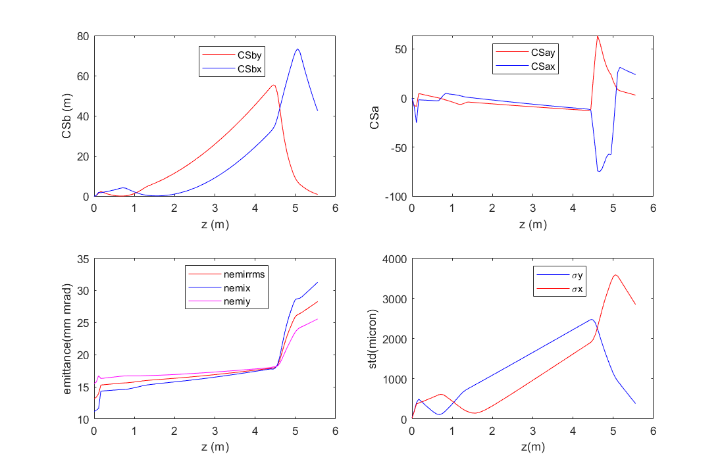
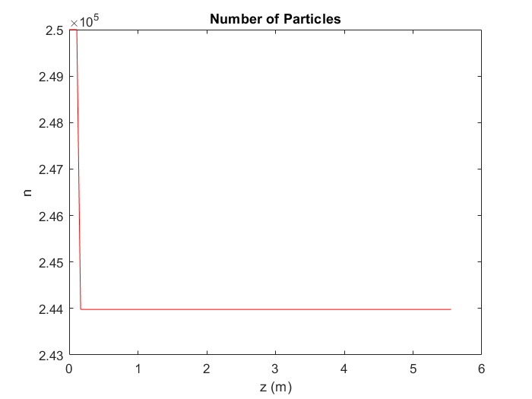
DRIVER (LOW Energy WP)

Slide 18
z | βx | αx | γx | βy | αy | γy
0 | 7,646 | -13,125 | 22,66 | 2,162 | 1,446 | 1,43
5,5 | 4,1 | 2,5 | 1,8 | 0,3 | 0,2 | 2,9

