Slide 1



BEAM DYNAMICS STUDIES FOR HIGH BRIGHTNESS ELECTRON LINEAR ACCELERATORS
XXXVth PhD School in Accelerator Physics – Thesis status report: 02/11/2021
PhD Candidate: F. Bosco^{1,2*}
Supervisors: M. Migliorati^{1,2} , L. Palumbo^{1,2}
¹La Sapienza University of Rome, 00161 Rome, Italy
²INFN-Sez. Roma1, 00161 Rome, Italy
Acknowledgements: M. Behtouei, O. Camacho,
M. Carillo, L. Faillace, L. Ficcadenti, A. Giribono,
L. Giuliano, A. Mostacci, J. Rosenzweig,
B. Spataro, C. Vaccarezza
* fabio.bosco@uniroma1.it
Notes:
Good morning everyone, my name is Fabio Bosco and for my PhD activities I have joined a group from the department of basic and applied science for engineering at La Sapienza
With their support, I am working on a thesis entitled “beam dynamics studies for high brightness electron linear accelerators”

Slide 2







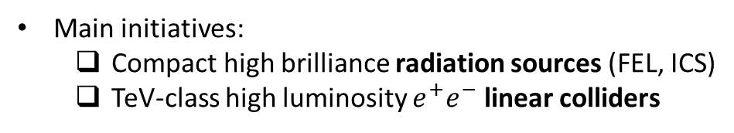
The Projects of the Collaboration
The “Cryo-rf” collaboration joins universities, laboratories and research institutes in the fields of accelerators and beam physics
Realization of high brightness electron linac based facilities exploiting advanced accelerator concepts
Main initiatives:
  Compact high brilliance radiation sources (FEL, ICS)
  TeV-class high luminosity $e^{+}e^{−}$ linear colliders
Our group, from department SBAI*, mainly contributes to beam dynamics studies with special dedication to collective effects
(*SBAI = Department of basic and applied science for engineering)
The group is especially involved in two projects: Stingray, an ICS source and an ultra compact X-rays FEL (UC-XFEL)
Notes:
This work takes place in the framework of an international collaboration guided by UCLA
The partners involved share the interest in exploiting advanced accelerator and beam physics concepts in order to realize facilities based on high brightness electron linear accelerators
The main initiatives are addressed to particle-driven radiation sources such as FEL and ICS machines but there is also interest for TeV-class electron positron colliders
The primary activities of our group in the context of the collaboration is the contribution to the studies of beam dynamics with special dedication to the so called collective effects
We are especially involved in the project “Stingray” for an ICS source and UC-Xrays FEL

Slide 3
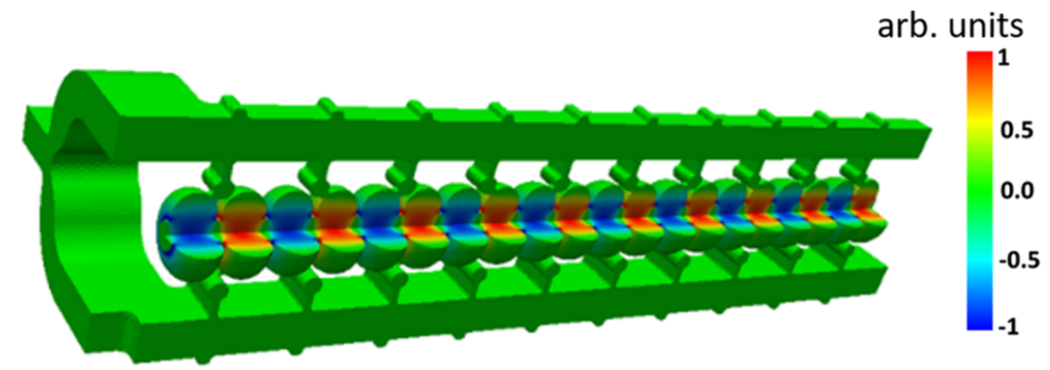
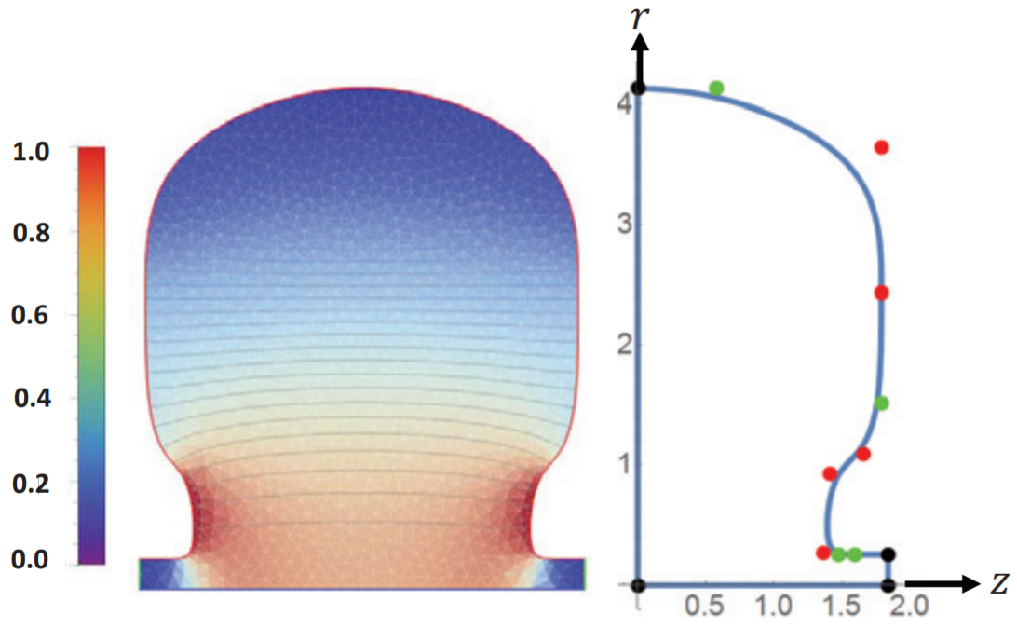
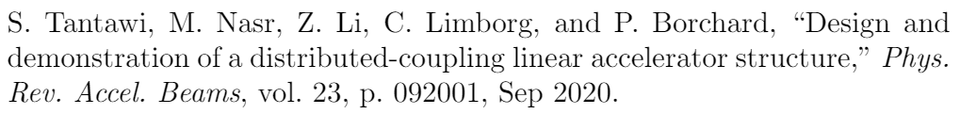
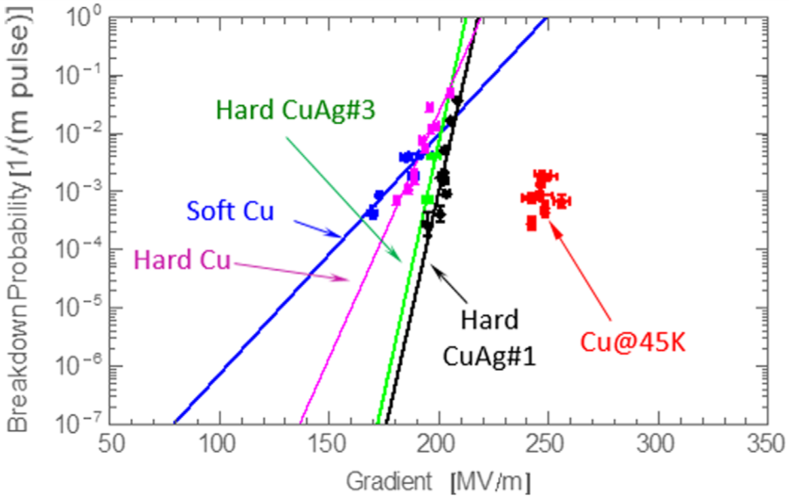
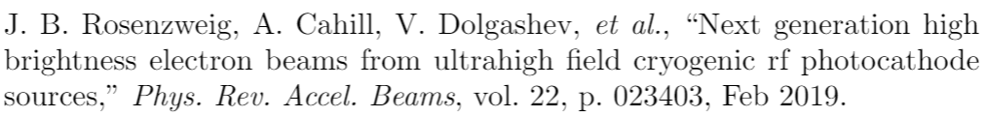
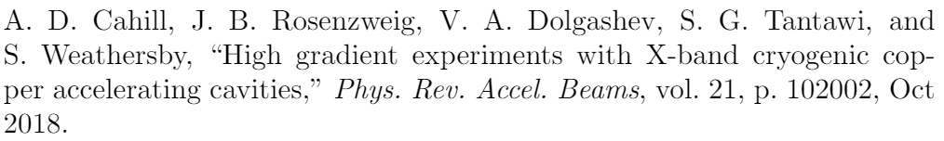
The Projects of the Collaboration (2)
Common innovation in rf-concepts:
(a)
(b)
Distributed coupling scheme: cells receive the rf power individually from a guiding manifold structure (a)
Optimized cavity topology (b) enhances the efficiency in acceleration of charged particles (cell irises not subjected to coupling constraints)
Cryogenic operation: copper structures in the 45-77 K range support higher electromagnetic fields for a given breakdown rate (c)
(c)
Techniques enabling also next-generation rf photoinjectors
Notes:
Before moving on, let me just mention some of the main rf-technology innovations characterizing the activities of the collaboration
The first example is the distributed coupling technique that consists in feeding the rf power individually in each cell of a periodic accelerating cavity by means of a manifold guiding structure
What this means is that the iris dimensions are no longer constrained to coupling requirements and can be reduced in order to optimize the acceleration process
In addition for some cases operation with cryo-cooled resonant cavities is foreseen
Cryogenic but still not superconductive temperatures mitigates the rf breakdown limits meaning that it is possible to operate with higher accelerating fields for a given breakdown rate
Also, the former techniques are

Slide 4


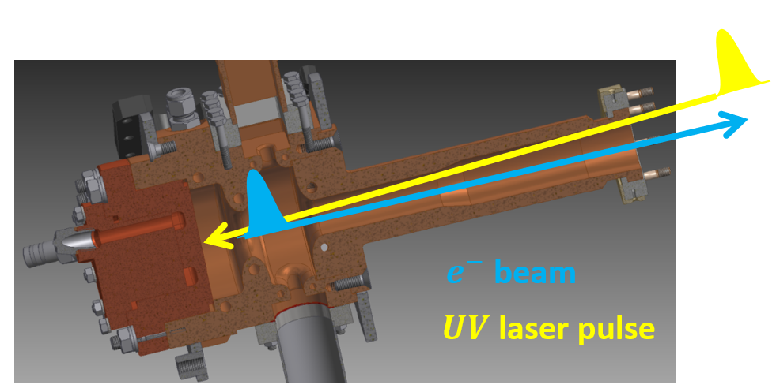
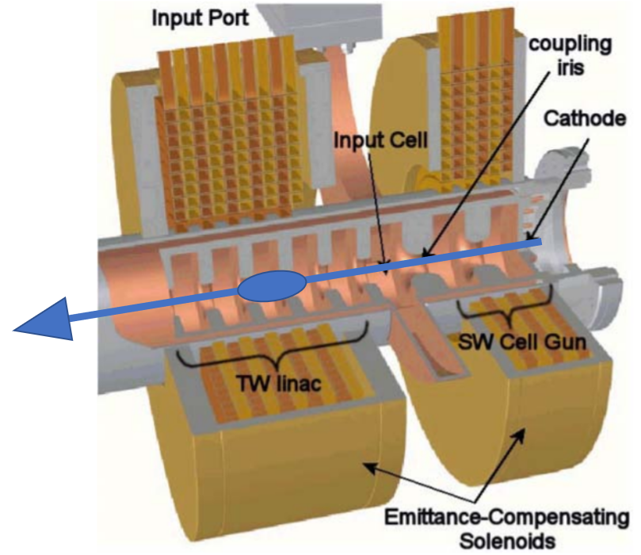
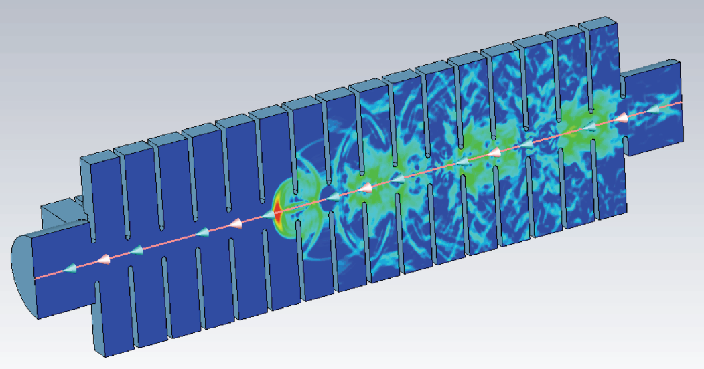
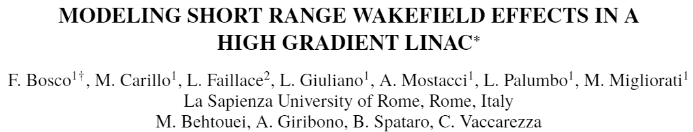
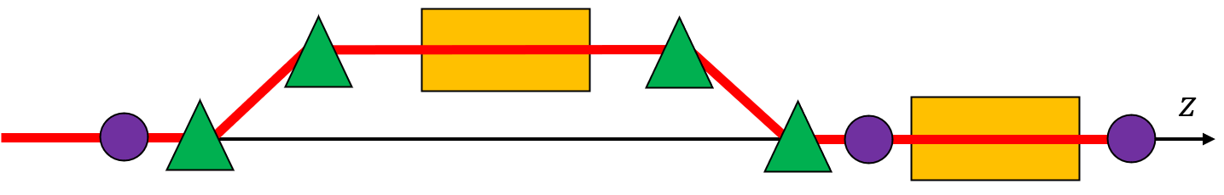
Contents
High brightness beams from rf photoinjectors
Wakefield interaction in high gradient linac structures
The code MILES: particle tracking in electron linacs with self-induced fields
Applications: misaligned linac structures and possible correction schemes
Notes:
In the following we will introduce the concept of HB beams and the typical accelerator layout employed to produce them
Then I will discuss the difficulties arising from the strong wakefield interaction in high gradient linacs as well as the custom tracking code I developed to investigate such effects
Last, I will show some applications with my tracking code aimed to study alignment errors of linac sections and their correction

Slide 5
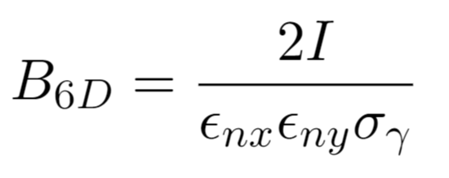
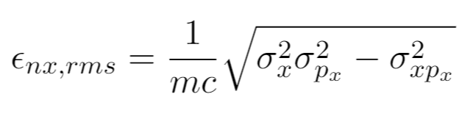
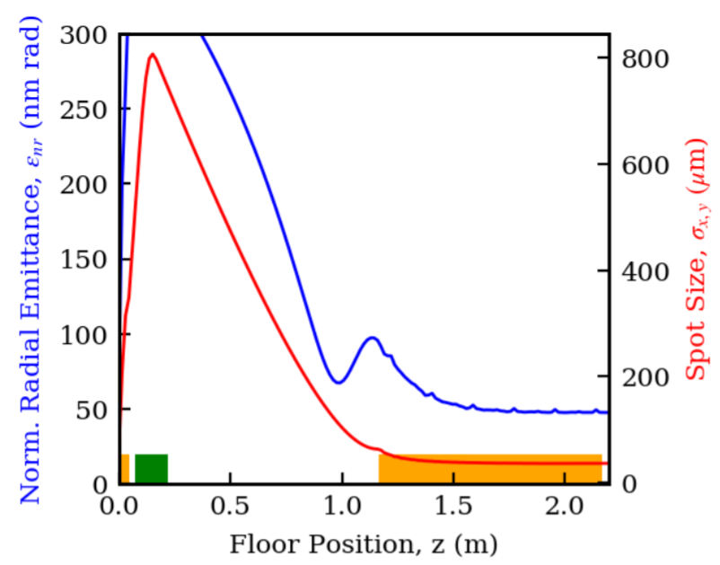
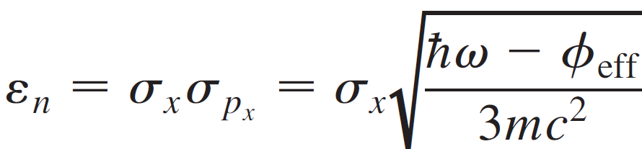
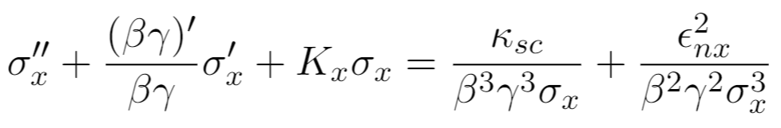
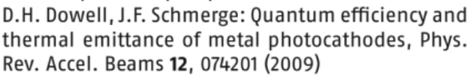
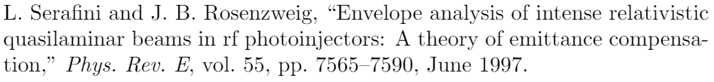
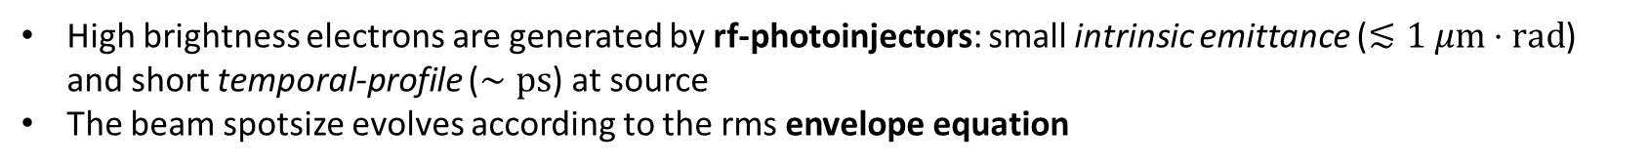

High Brightness $e^{−}$ Beams
The performance of particle-driven radiation sources relies on the high beam brightness: high current, low transverse emittances and narrow energy spectrum
M. Reiser, Theory and Design of Charged Particle Beams,
John Wiley & Sons, New York, 1994
High brightness electrons are generated by rf-photoinjectors: small intrinsic emittance ($≲1 μm⋅rad$) and short temporal-profile ($∼ps$) at source
The beam spotsize evolves according to the rms envelope equation
Courtesy of O. Camacho
Matching to an equilibrium-like solution ($σ_{x}∝γ^{−1/2}$) in the booster linac: the “invariant envelope” and the emittance compensation process
Notes:
The quality of the radiation from electron-driven photon sources relies on some key parameters of the particle beam
In particular, the peak current accounts for the intensity of the beam while
The transverse rms emittance is a measure of the phase space area and its distortion
The two quantities, combined with the energy spread, define the six-dimensional brightness that is proportional to the number of charges per unit of 6D PS volume
Electron beam of high brightness are typically produced by rf photoinjectors which consist of metallic photocathode embedded in a high field standing wave cavity
compared to other electron sources, the photoemission process ensures a small intrinsic emittance and ultra-short temporal length
Typically such sources are properly combined with a focusing lens and a booster linac downstream, so that the beam propagates according to an equilibrium solution of the envelope equation and experiences emittance compensation

Slide 6
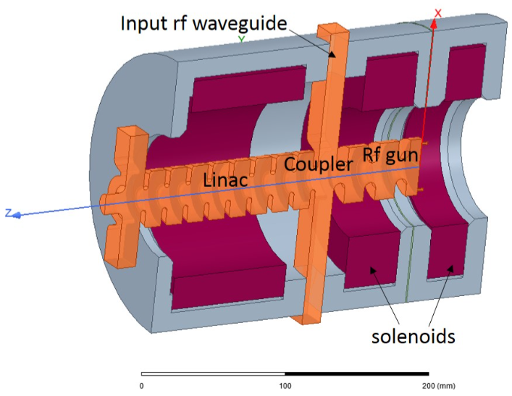
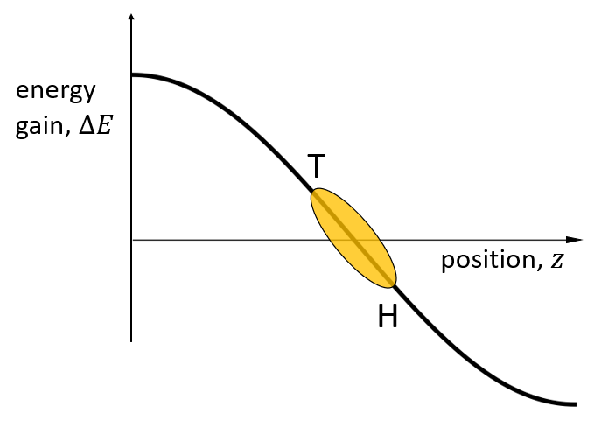
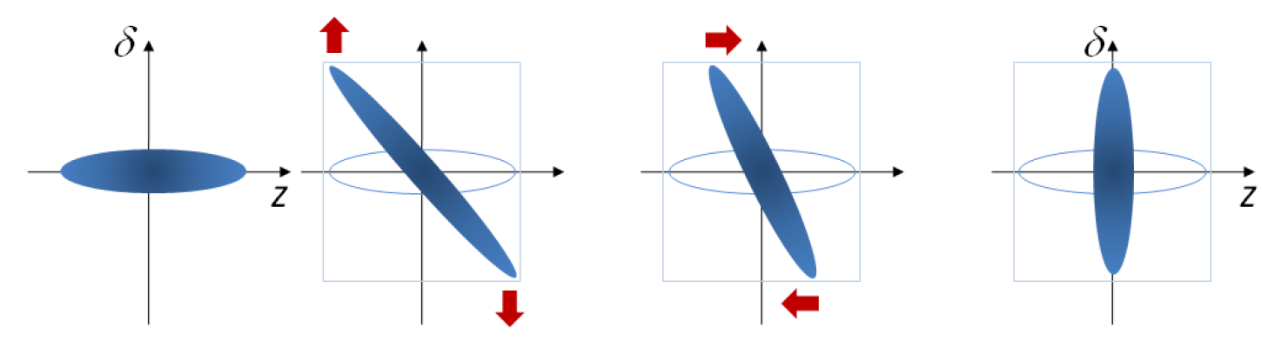
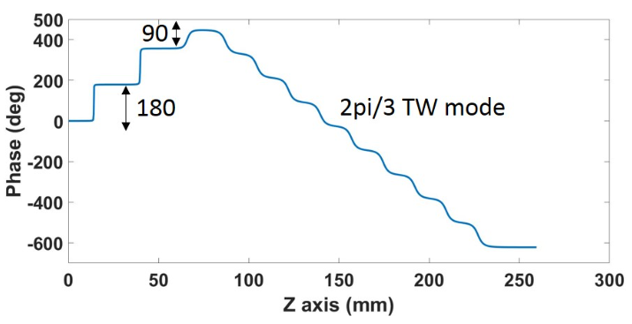
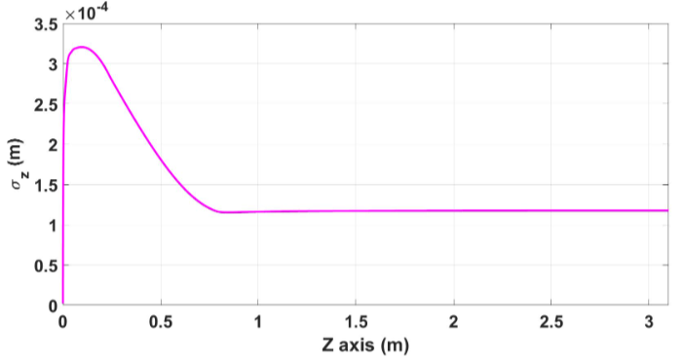
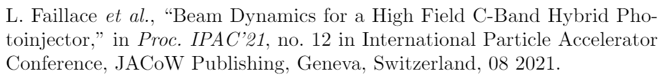


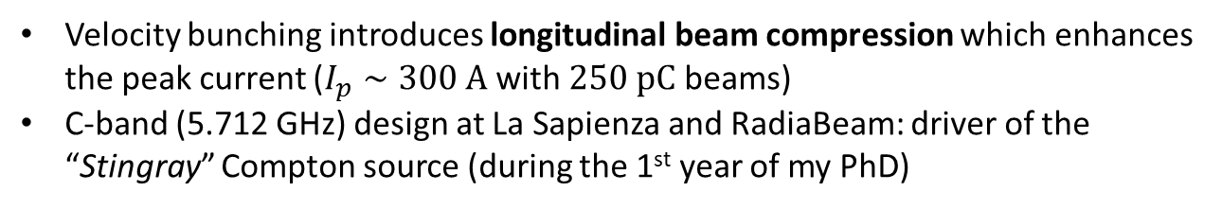
High Brightness $e^{−}$ Beams (2)
Rf hybrid photo-injectors combine a SW and a TW section joint by a coupling cell
  The SW section provides energy gain (typically up to 4-6 MeV)
  The TW chirps the longitudinal phase-space and allows for velocity bunching
TW
SW
Velocity bunching introduces longitudinal beam compression which enhances the peak current ($I_{p}∼300 A$ with $250 pC$ beams)
C-band (5.712 GHz) design at La Sapienza and RadiaBeam: driver of the “Stingray” Compton source (during the 1st year of my PhD)
Rms beam length
Courtesy of L. Faillace
120 $μm$, 400 $fs$
Notes:
Photoinjectors also exist in the so-called hybrid mode which combines a SW and a TW section through a coupling cell
Due to the particular EM coupling properties the field in the two section exhibits a 90 degrees phase shift which introduces an energy-time correlation
Such chirp compresses the beam longitudinally enhancing the peak current with a positive impact on the brightness. In fact, hybrid photoinjectors can achieve hundreds of amps peak currents which is one order of magnitude above the traditional rf gun
As a reference, the examples shown here refer to the hybrid gun driving the Compton source for which my group has provided the rf design and the beam dynamics studies during the first year of my PhD

Slide 7
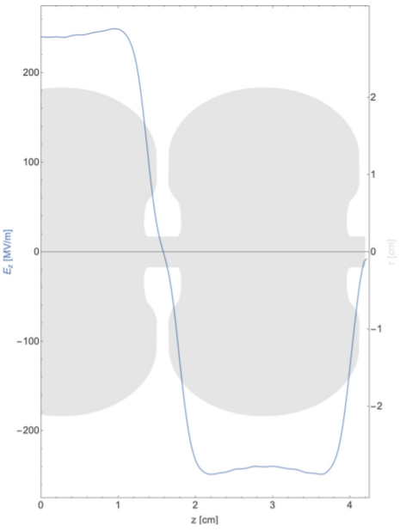
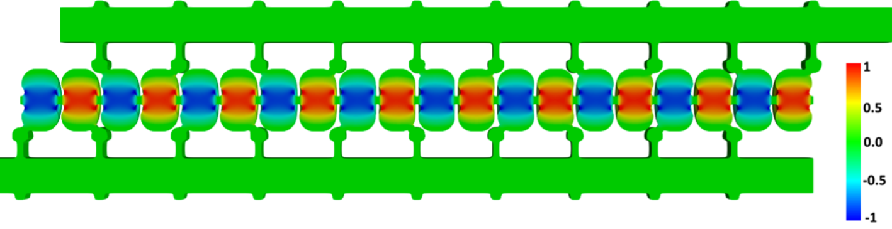
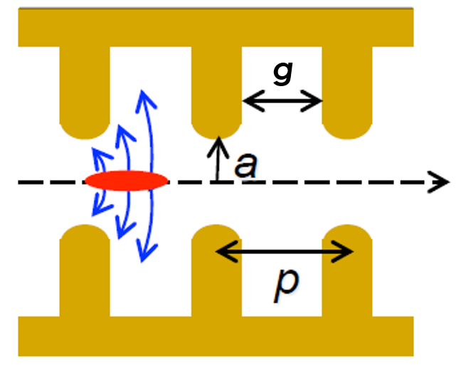
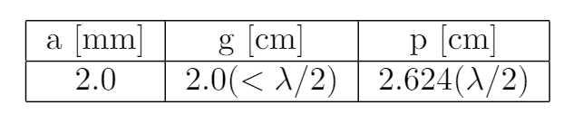
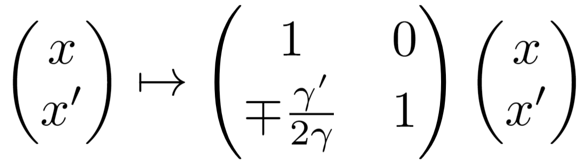
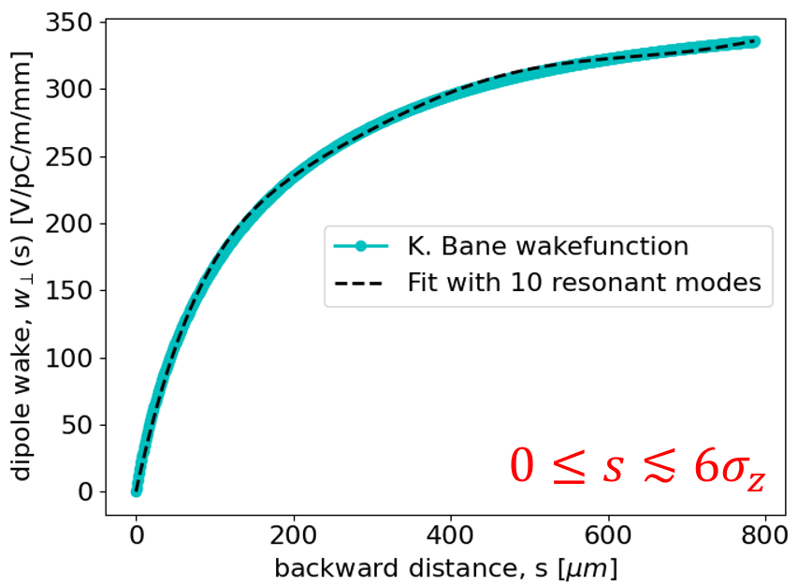
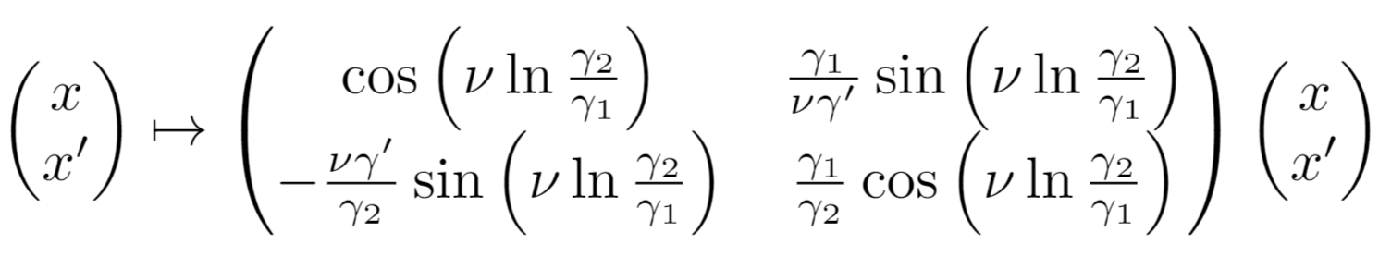
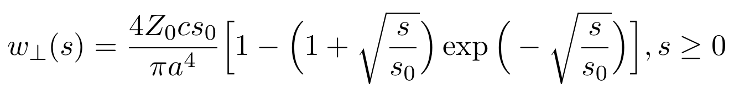
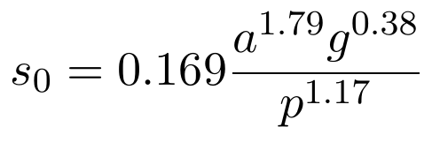
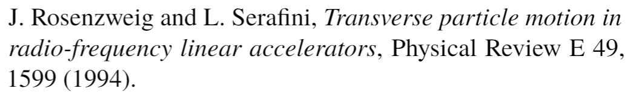
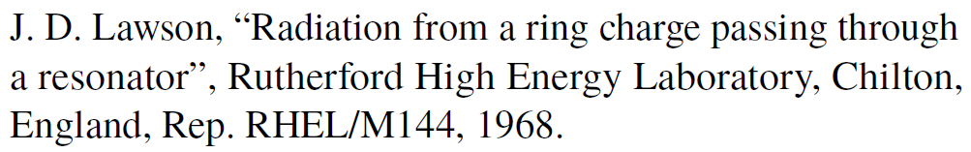
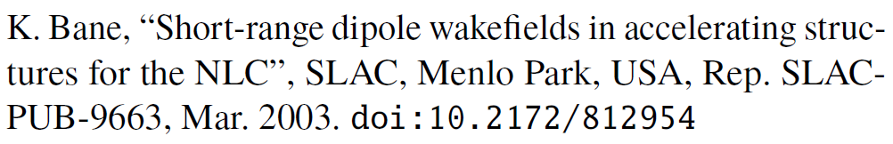
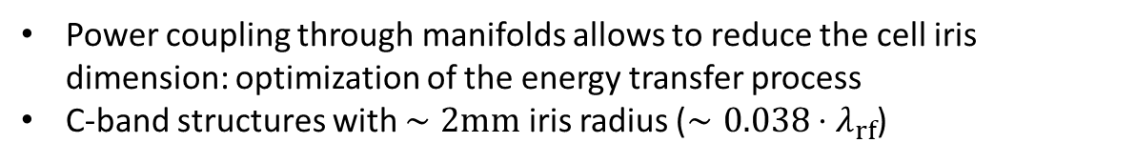
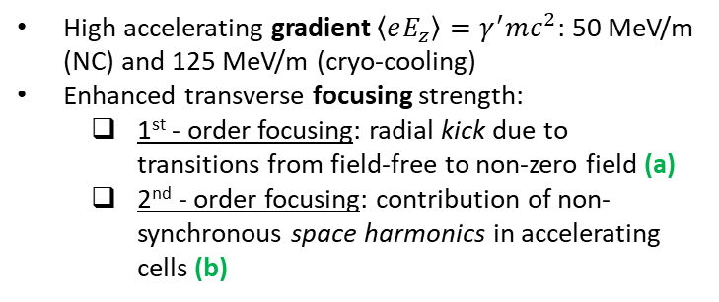
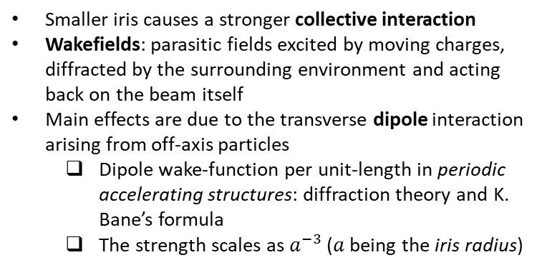
High Gradient Linac Sections
Power coupling through manifolds allows to reduce the cell iris dimension: optimization of the energy transfer process
C-band structures with $∼2mm$ iris radius ($∼0.038⋅λ_{rf}$)
Advantages
Disadvantages
(Tantawi’s structure)
High accelerating gradient $\left\langle eE_{z}\right\rangle =γ^{′}mc^{2}$: 50 MeV/m (NC) and 125 MeV/m (cryo-cooling)
Enhanced transverse focusing strength:
  1st - order focusing: radial kick due to transitions from field-free to non-zero field (a)
  2nd - order focusing: contribution of non-synchronous space harmonics in accelerating cells (b)
Smaller iris causes a stronger collective interaction
Wakefields: parasitic fields excited by moving charges, diffracted by the surrounding environment and acting back on the beam itself
Main effects are due to the transverse dipole interaction arising from off-axis particles
  Dipole wake-function per unit-length in periodic accelerating structures: diffraction theory and K. Bane’s formula
  The strength scales as $a^{−3}$ ($a$ being the iris radius)
(a)
(b)
Notes:
Booster linac sections with small irises present advantages and difficulties: on one hand
They allow to achieve high accelerating gradients, which promotes the compactness of the overall machine,
And they enhance the transverse focusing due to radial fields related mechanisms
Conversely, acceleration in small iris structures is accompanied by stronger collective effects
In particular, parasitic fields, or wakefields, excited by moving charges, act back on the tail of the beam perturbing its motion
In linacs, the major effect arises from the transverse dipole component which is excited by particles traveling off axis
The corresponding binary interaction in periodic accelerating structures is described by the well-known K. Bane’s wake-function whose strength scales approximately as the inverse third power of the iris radius

Slide 8


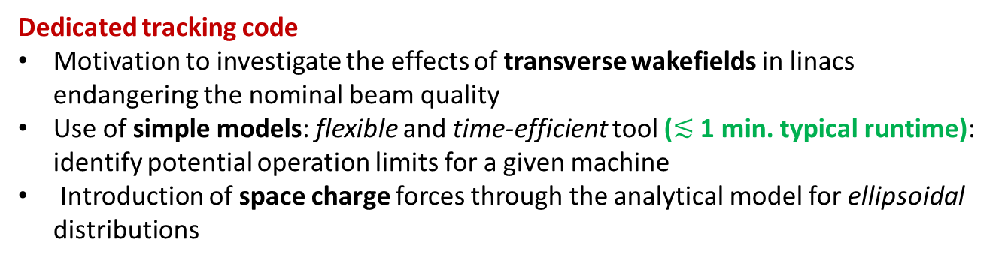
The Code MILES
Dedicated tracking code
Motivation to investigate the effects of transverse wakefields in linacs endangering the nominal beam quality
Use of simple models: flexible and time-efficient tool ($≲$ 1 min. typical runtime): identify potential operation limits for a given machine
Introduction of space charge forces through the analytical model for ellipsoidal distributions
Miles Davis (May 26, 1926 – September 28, 1991)
MILES = Modeling Instabilities in Linacs with Ellipsoidal Space charge
Speed vs accuracy compromise
Simplified models for the beam dynamics may reduce the accuracy
Acceptable results as long as the main aspects of the dynamics are included
Continuous benchmark process: each mechanism included has to be validated (comparison with pre-existent codes and theory)
More information about MILES
From UC-XFEL workshop: Talk, Slides
From IPAC 2021: Paper
Main applications: estimation of short-range dipole wakefield effects induced by misaligned linac sections and their compensation.
Notes:
This challenging framework has motivated us to investigate the effects of transverse wakefields endangering the phase-space quality in the accelerating sections of interest
To do so, I started to develop a dedicated tracking code studying these effects. Such code is designed to work with simple analytical models that yield a flexible and time-efficient tool.
Since the code accounts also for space charge forces through the analytical model for ellipsoidal distributions it is called MILES which stands for “Modeling Instabilities in Linacs with Ellipsoidal Space charge” and it is also a tribute to the jazz musician Miles Davis.
In general, the approximations introduced by simplified models for the beam dynamics will reduce the accuracy nevertheless, the results are still acceptable as long as the main aspects of the dynamics are identified and included
The primary applications conceived for MILES are the investigation of tolerances to misaligned linac sections and the design of correction schemes based on steering magnets mitigating the imperfections
--------
The tool we use is the code MILES that we have developed for studying the effects of transverse wakefield in linacs
In case anybody is hearing about this for the 1st time, here is the essential information you need to know about it
MILES is a tracking code including both space charge and dipole wakefield effects by means of simple analytical models (short run times)
It is primarily conceived for investigate tolerances to alignment errors and the design of correction schemes based on steering magnets

Slide 9
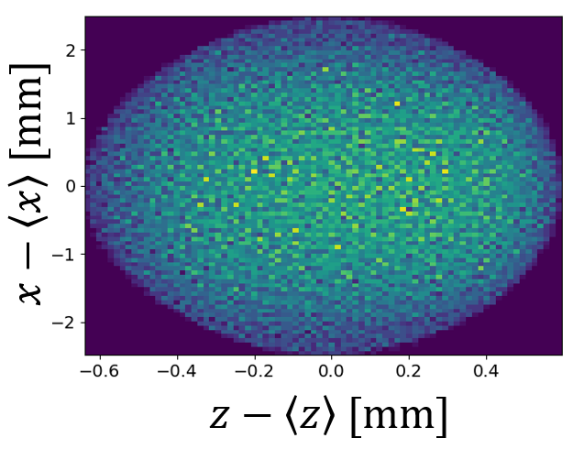
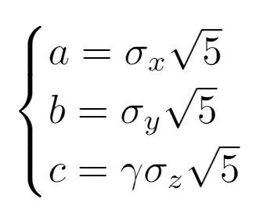
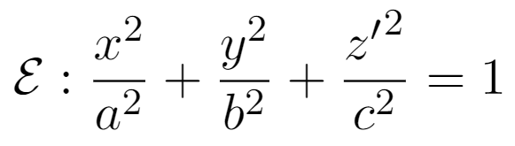
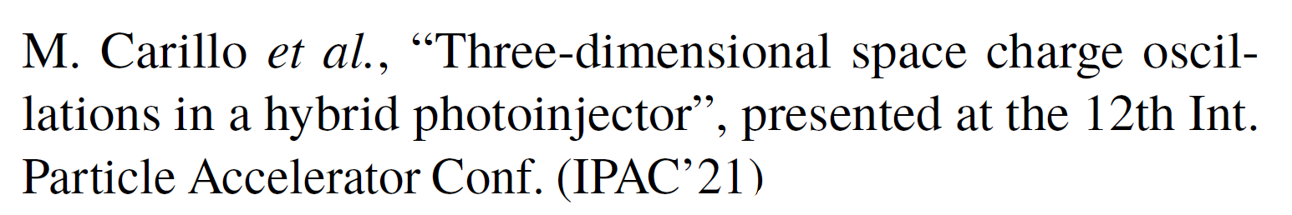
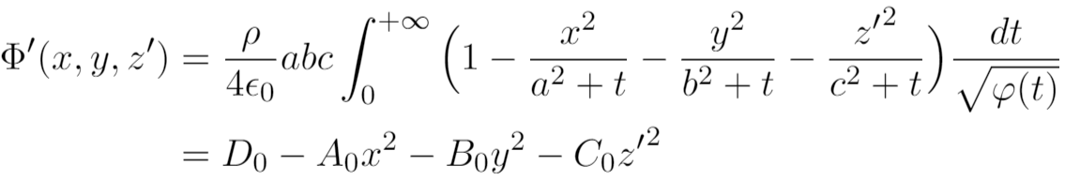
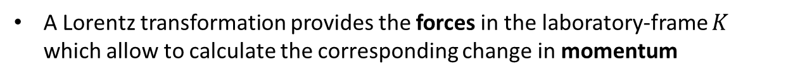
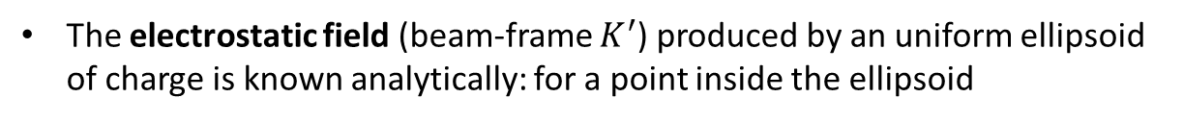
Ellipsoidal Space Charge
Hybrid gun exit
After the hybrid gun, the beam exhibits a nearly-ellipsoidal shape which is almost uniformly filled
Courtesy of M. Carillo
The electrostatic field (beam-frame $K^{′}$) produced by an uniform ellipsoid of charge is known analytically: for a point inside the ellipsoid
A Lorentz transformation provides the forces in the laboratory-frame $K$ which allow to calculate the corresponding change in momentum
Notes:
Writing a new tracking code requires a careful validation process and, accordingly, MILES has been continuously submitted to benchmark tests in comparison with pre-existent codes and models from theory
As a demonstration, here I want to show the benchmark test for the space charge forces
As I mentioned, we apply the model for uniform ellipsoidal charge distributions for which the electrostatic field is known in the literature
Specifically, this equations hold for the beam reference frame, where particles are almost at rest, but can be extended to the laboratory frame by applying a Lorentz transformation

Slide 10







Ellipsoidal Space Charge (2)
$250 pC e$lectron beam from the C-band hybrid photoinjector
Evolution in a field-free (drift) region with GPT (*) (solid lines) and with the ellipsoidal model (dashed lines)
$250 pC e$lectron beam from the C-band hybrid photoinjector
Evolution in a $∼2m$ linac with $\left\langle eE_{z}\right\rangle ≈50 MeV/m$ : GPT (solid lines) and tracking (dashed lines)
(*)
Transverse plane: $σ_{x}$
Rms beam envelope $σ_{x}$ vs position $z$
Longitudinal plane: $σ_{z}$, $σ_{E}$
Note: Examples from “Stingray” ICS linac
Notes:
Let us look at an example: we consider the beam produced by the hybrid photo-injector and let it propagate in a long drift where it is exclusively subjected to space charge forces
The rms beam moments calculated using the software GPT are shown with solid lines for both the transverse and longitudinal plane. The corresponding quantities calculated with our ellipsoidal model are represented by dashed lines showing a very good agreement
A similar analysis is shown for the transverse beam envelope in a 2m long linac
The analysis shows that for the low energy regime nearby the injection it is crucial to include the effects of space charge forces: if they are not included the focusing is too strong and there is a significant deviation from the expected behavior

Slide 11







Random Misalignments
Emittance growth factor
Alignment errors
Transverse offset $Δx_{i}$ (a)
Tilt angle $δ_{i}$ (b)
(a)
(b)
Procedure
Assume a gaussian distribution of errors and fix a standard deviation $σ_{Δx}$ (i.e. a characteristic error)
Perform a large number (e.g. 50) of simulations each time using a new set of random misalignments
Calculate the average normalized emittance to mitigate statistical fluctuations
!
Warning: up to $∼$40% growth with a few tens of micron or micro-rad errors
Note: Examples from “Stingray” ICS linac
Notes:
When real machines are installed they are typically subjected to alignment errors of random nature
Such errors will cause and enhance the excitation of dipole wakefields which can lead to a significant loss of phase space quality
Here we investigate both the cases of linac sections affected by random transverse offsets or tilt angles assuming that the errors follow a gaussian distribution for which we can vary the standard deviation
The plot shows the normalized emittance growth along the linac with respect to the injection value
The analysis identifies the existence of potential problems: errors of a few tens of microns can result in emittance growths up to a 40%. Therefore, the need arises for correction schemes to mitigate the imperfections.

Slide 12






Trajectory Steering
Steering magnets: dipole fields of moderate strength providing correction of the trajectories
Transverse kick from a corrector of integrated field $K$
Beam position monitors (BPMs) measure the transverse position of the beam
Beam based alignment (BBA): adjust the strength of the kickers as a function of the BPM readings
Courtesy of A. Mostacci
Notes:
A possible solution to correct off-axis trajectories is the introduction of steering dipole magnets combined with a set of beam position monitors
BPMs measure the transverse displacement of the beam at various locations and such information can be exploited to adjust the strength of the dipole kickers upstream which modify the centero-of-mass trajectory
This process of steering the trajectories from bpm readings is known as beam based alignments

Slide 13












One-to-one Steering Algorithm
Find the corrector strengths which ensure zero bpm readings:
$$K_{i} so that x_{i}=0, i=1,2$$
Reference case
Two section linac ($∼2 m$)
Section 1 is 100 $μm$ off-axis
Correctors $K_{1}$ and $K_{2}$ aim to compensate errors
Bpm readings
Corrector strength
Reminder term
$〈x〉$ vs $z$
$〈x^{′}〉$ vs $z$
$ε_{nx,rms}$ vs $z$
$$\left({x_{1} \atop x_{2}}\right)=\left(\begin{matrix}R_{12}^{1→1} & 0 \\ R_{12}^{1→2} & R_{12}^{2→2}\end{matrix}\right)\left({K_{1} \atop K_{2}}\right)+\left({m_{1} \atop m_{2}}\right)$$
$$\left({K_{1} \atop K_{2}}\right)=−{\left(\begin{matrix}R_{12}^{1→1} & 0 \\ R_{12}^{1→2} & R_{12}^{2→2}\end{matrix}\right)}^{−1}\left({m_{1} \atop m_{2}}\right)$$
(forcing $x_{i}=0$)
Integrated field $\left[μT⋅m\right]$:
$K_{1}=15.5$
$K_{2}=−6.14$
Note: Example from “UC-XFEL” linac
Notes:
The first kind of correction scheme investigated is the one-to-one steering algorithm which I have applied to a reference case with a two section linac where the first one is 100 micron off-axis
One-to-one algorithms aim to find the corrector strengths that ensure zero-offset at bpms’ locations.
The algorithm consists in writing an explicit relation connecting the bpm readings and the kicker strengths which can be solved forcing zero offset
If we do not apply the corrections the center of mass trajectory has a significant deviation from the nominal axis and the emittance grows up to 50% as shown by the red triangles
Conversely, if we apply the corrections calculated by the algorithm the new trajectory crosses the axis at bpm’s locations and the emittance growth is reduced even if it is not negligible.
Notice, in fact, that the algorithm fixes the trajectory imperfections with moderate integrated field strength however it is not optimized for emittance minimization

Slide 14





“Wake-free” Trajectories
Find trajectories with minimum wakefield excitation: force the beam to travel on-axis in each section
Two correctors (i.e. two degrees of freedom) per module adjust both the offset and the angle at injection
$〈x〉$ vs $z$
$〈x^{′}〉$ vs $z$
$ε_{nx,rms}$ vs $z$
Moderate corrector strength (order of $∼10μT⋅m$)
Note: Example from “UC-XFEL” linac
Notes:
An alternative approach I have recently investigated is to find a trajectory for which the excitation of dipole wakefield is minimized so that we can expect minimum emittance growth
If two dipole correctors per linac module are employed instead of a single one, we have two degrees of freedom which allow to adjust the offset and the angle independently at each section’s input
This procedure forces the beam to travel always on the axis of a given linac section so that dipole wakes are not excited and the emittance growth is limited
The solution is very simple and it works with moderate strength of the dipole correctors

Slide 15
Conclusions
XXXVth PhD School in Accelerator Physics – Thesis status report: 02/11/2021
Main achievements of the past two years
Contribution to the rf design and beam dynamics studies for a C-band hybrid photoinjector (1st year activities)
Development and benchmark of the code MILES: electron beam dynamics in linacs accounting for dipole wakefields and space charge forces
Investigation on alignment errors showing a potential loss in terms of phase-space quality
Design of beam-based alignment (BBA) correction schemes using steering dipole magnets to recover the original beam quality
Expected activities for the incoming year
Optimization of correction algorithms for minimal emittance growth
Multi-bunch operation: mutual long-range interaction among different bunches
Experimental activities at UCLA: rf measurements of C-band cavities and commissioning of the rf photoinjector
Thank you for your attention
(Questions are welcome)
fabio.bosco@uniroma1.it
Notes:
In conclusion, allow me to summarize the main achievements of the past two years
Contribution to the rf design and beam dynamics characterization of the Cband hybrid photoinjector
Development and benchmark of the code miles describing electron beams propagating in linacs in presence of self-induced fields
Investigation of misalignment effects and possible compensation techniques
In particular, the optimization of correction scheme aimed to preserve the original beam quality are still under investigation and will be part of the activities for the incoming year as well as
extending the investigation of wakefield effects to the mutual long-range interaction among different beams in multi-bunch operation
In addition, since I was invited at UCLA as a visiting student, I will also take part to the experimental activity concerning measurements of C-band accelerating structures photoinjectors
----------------
Today I have shown some examples of applications with MILES: the tracking code we developed for electron linacs in presence of self-induced fields

Slide 16
Back-up slides
Additional material for a more detailed discussion

Slide 17
Introduction and Motivation (2)
Common approaches for collective effects
Space charge forces – PIC Methods
3D mesh of the space
Solve 3D Poisson equation in the beam frame
Lorentz transformation of the fields in the laboratory frame
Integration of the equations of motion
Wakefield interaction – Convolution integral
Requires knowledge of both the wake-function and the current distribution
Requires to calculate at each step the wake-potential (interaction of a charge with the rest of the distribution)
Large number of operations $⇒$ More cpu/time resources
Analytical model for ellipsoidal distributions
Wakefield matrix formalism

Slide 18













Wakefield Matrix Formalism
Fit the (arbitrary) wake-function with a set of superposed effective resonant modes ($ω_{0i},R_{⊥i},Q_{i}$ with $α_{i}=ω_{0i}/2Q_{i}$)
Modes are represented by lumped RLC circuits: the voltage is proportional to the wake-function
Evolution of the voltage obeys a second-order linear differential equation
i-th mode
(dropping the index)
($q_{0}$,$x_{0}$ being charge and off-set of the source)
Dipole interaction
The wakefield matrix accounts for the interaction between two particles traveling with separation $s=cτ$
Particles behind the source experience a transverse kick
Notes:
Voltage = integrated force per unit charge

Slide 19








Floquet periodic field in $π$-mode cavities
Floquet expansion of the longitudinal field on axis
The fundamental harmonic ($a_{1}$) is resonant with the beam and provides acceleration
The non-synchronous harmonics ($a_{n}, n>1$) provide transverse focusing
Averaged radial force and focusing strength parameter
The averaged force in the transverse plane depends on the squared field: second order focusing effects
Typically $η≈1$ for SW structures and $η≈0$ for TW structures (no backward propagating wave)

Slide 20











Single Particle Dynamics
Linac layout
Sequence of accelerating structures separated by field-free regions
Smoothed energy gradient $γ^{′}=\left\langle eE_{z}\right\rangle /mc^{2}$
$$x$$
$$L_{d}$$
$e^{−}$ beam
$$z$$
Single particle transverse optics
First-order focusing: radial kick from field-free to non-zero field regions and vice versa (a)
Second-order focusing: transfer map for an accelerating cell, i.e. $γ_{1}↦γ_{2}$ (b)
$N$ linac sections
(a)
(b)
(*)
(*)

Slide 21



Single Particle Dynamics (2)
Single particle longitudinal optics
Deviation from the rf-crest $Δφ$ affects the energy gain
Energy spread is responsible for a slippage $Δζ$ relative to the centroid
$$x$$
$$L_{d}$$
$e^{−}$ beam
$$z$$
$N$ linac sections
Main consequences
Correlation with the transverse plane
Chromatic effects (energy dependent optics)
Synchrotron oscillations

Slide 22





Transverse Optics Benchmark
Tracking inside a two section linac
No space charge forces
First and second order RF-foscusing
$$η=\sum_{n=1}^{+∞}{a_{n−1}^{2}+a_{n+1}^{2}+2a_{n−1}a_{n+1}\cos{2Δφ}}=1.12−0.5\cos{2Δφ}$$

Slide 23



Space Charge Benchmark
Evolution in a field-free (drift) region
Electron beam ($Q=250 pC$) from the C-band hybrid photoinjector
Here $z=0$ is right after the exit of the TW section: particles’ coordinates are exported from GPT and used as initial state for tracking with MILES
Transverse Plane
Longitudinal Plane

Slide 24



Two Section Linac (with space charge)
Main settings
Beam charge: $Q=−250 pC$
Average injection energy: $\left\langle γ_{i}\right\rangle mc^{2}=4.42 MeV$
Focalization: $η\left(Δφ\right)=1.12 −0.5\cos\left(2Δφ\right)$
On-crest avg accelerating field: $eE_{acc}∼51 MV/m$
Injection-phase:
  $${Δφ}_{1}≈{23.5}^{∘}$$
  $${Δφ}_{2}≈−{1.5}^{∘}$$
Output avg energy: $\left\langle γ_{fin}\right\rangle mc^{2}≈102 MeV$

Slide 25



Short Range Wakefields - Benchmark
Example of tracking with wakefields
A reference case for BBU:
A. Chao’s asymptotic formula(**)
Linear increase of dipole wake strength from head to tail
Head is injected off-axis with $x_{0}$ offset
(**)

Slide 26








Misaligned Sections
Misaligned sections can be described by a local reference system $\left(x_{i},z_{i}\right)$
Coordinate transformations to the nominal machine axis
An example of tracking with a misaligned section
${Δx}_{2}=50 μm$
$δ_{2}=50 μrad$
$Δx_{i}, δ_{i}=0$, $i≠2$
The test focuses on the optics: wakefields are excluded
Average displacement $\left\langle x\right\rangle$ vs position $z$
Linac sections with arbitrary offset/tilt sequences can be easily investigated

