Slide 1
Silicon Trackers RD_FCC annual meeting 15 December 2021
Attilio Andreazza, Bianca Raciti, Fabrizio Sabatini - Università di Milano and INFN
Filippo Bosi, Fabrizio Palla – INFN Pisa

Slide 2
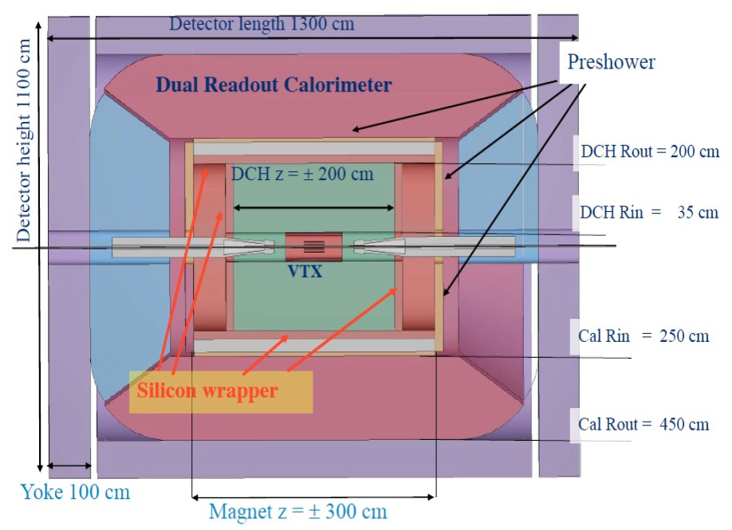
The IDEA concept
Central tracking device:
light Drift CHamber
Silicon detectors for precision measurements
vertex detector (see Manuel's presentation)
silicon internal tracker
silicon wrapper
Thin solenoid with 2T field (according to MDI limits)
Dual readout calorimeter
supplemented by a pre-shower detector
Muon chambers in the solenoid return yoke

Slide 3
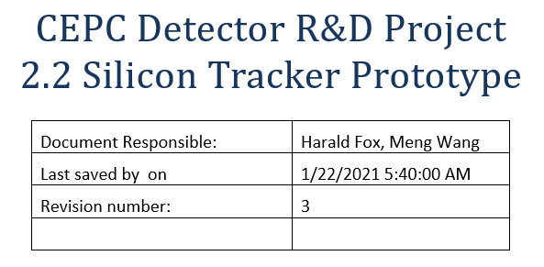
Silicon Tracker
Strategy is to workout solutions that can fit in in different detector layouts:
Suitable for FCCee as well as CEPC main detector layouts
ATLASPIX3 Depleted Monolithic Active Pixel Sensor
Development of multi-chip modules
Mechanical structure for long stave layouts
Designing integration of a full-size system
International collaborations:
CEPC:
R&D projects for the Silicon Tracker (see Harald's presentation)
AIDAInnova:
WP5: Depleted Monolithic Active Pixel Sensors
WP10: Advanced Mechanics for Tracking and Vertex detectors
China, Germany, INFN, UK

Slide 4
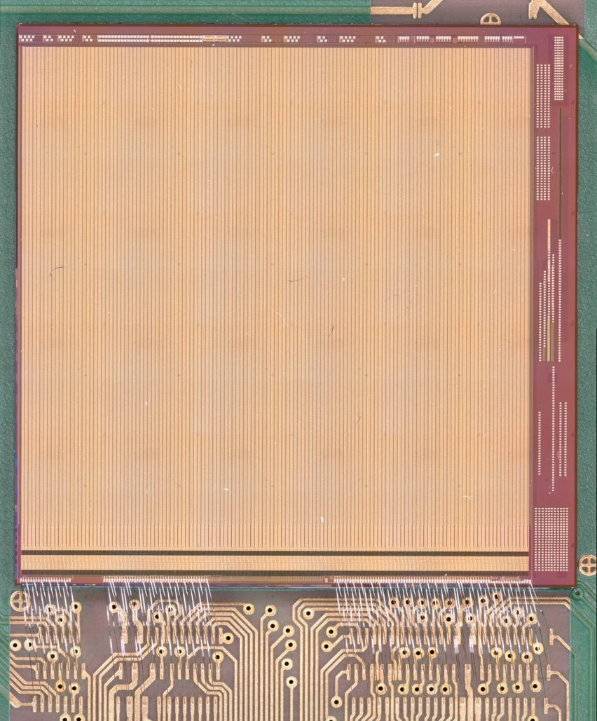
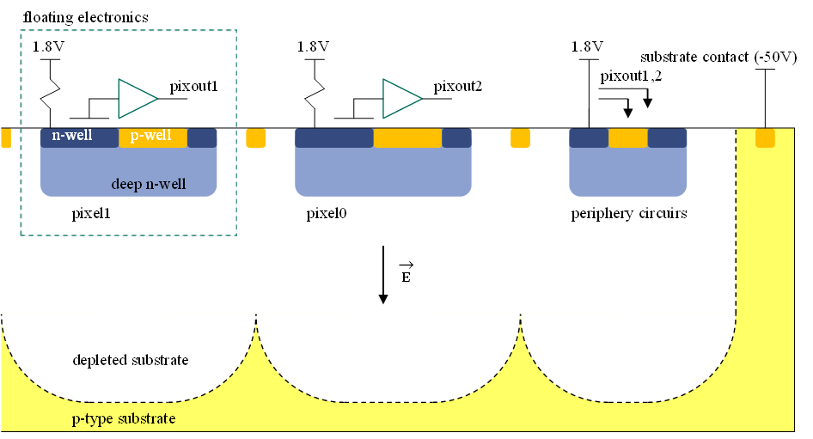
ATLASPIX3
Monolithic CMOS
widespread process allows to produce large areas, fast and cheap
no hybridization (bump-bonding) needed
single detection layer, can be thinned keeping high signal efficiency and low noise rate
ATLASPIX3 features
pixel size 50×150 μm² (25×165 μm² feasible)
up to 1.28 Gbps downlink
reticle size 20×21 mm²
TSI 180 nm process on 200 Ωcm substrate
132 columns of 372 pixels
digital part of the matrix located on periphery
both triggerless and triggered readout possible:
two End of Column buffers
372 hit buffers for triggerless readout
80 trigger buffers for triggered readout

Slide 5
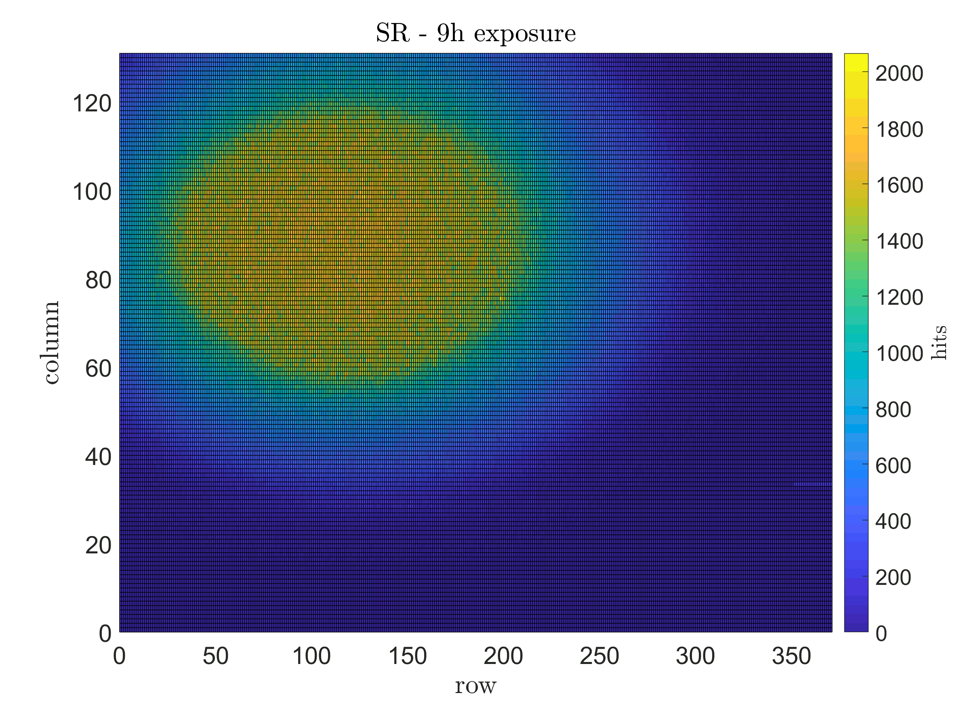
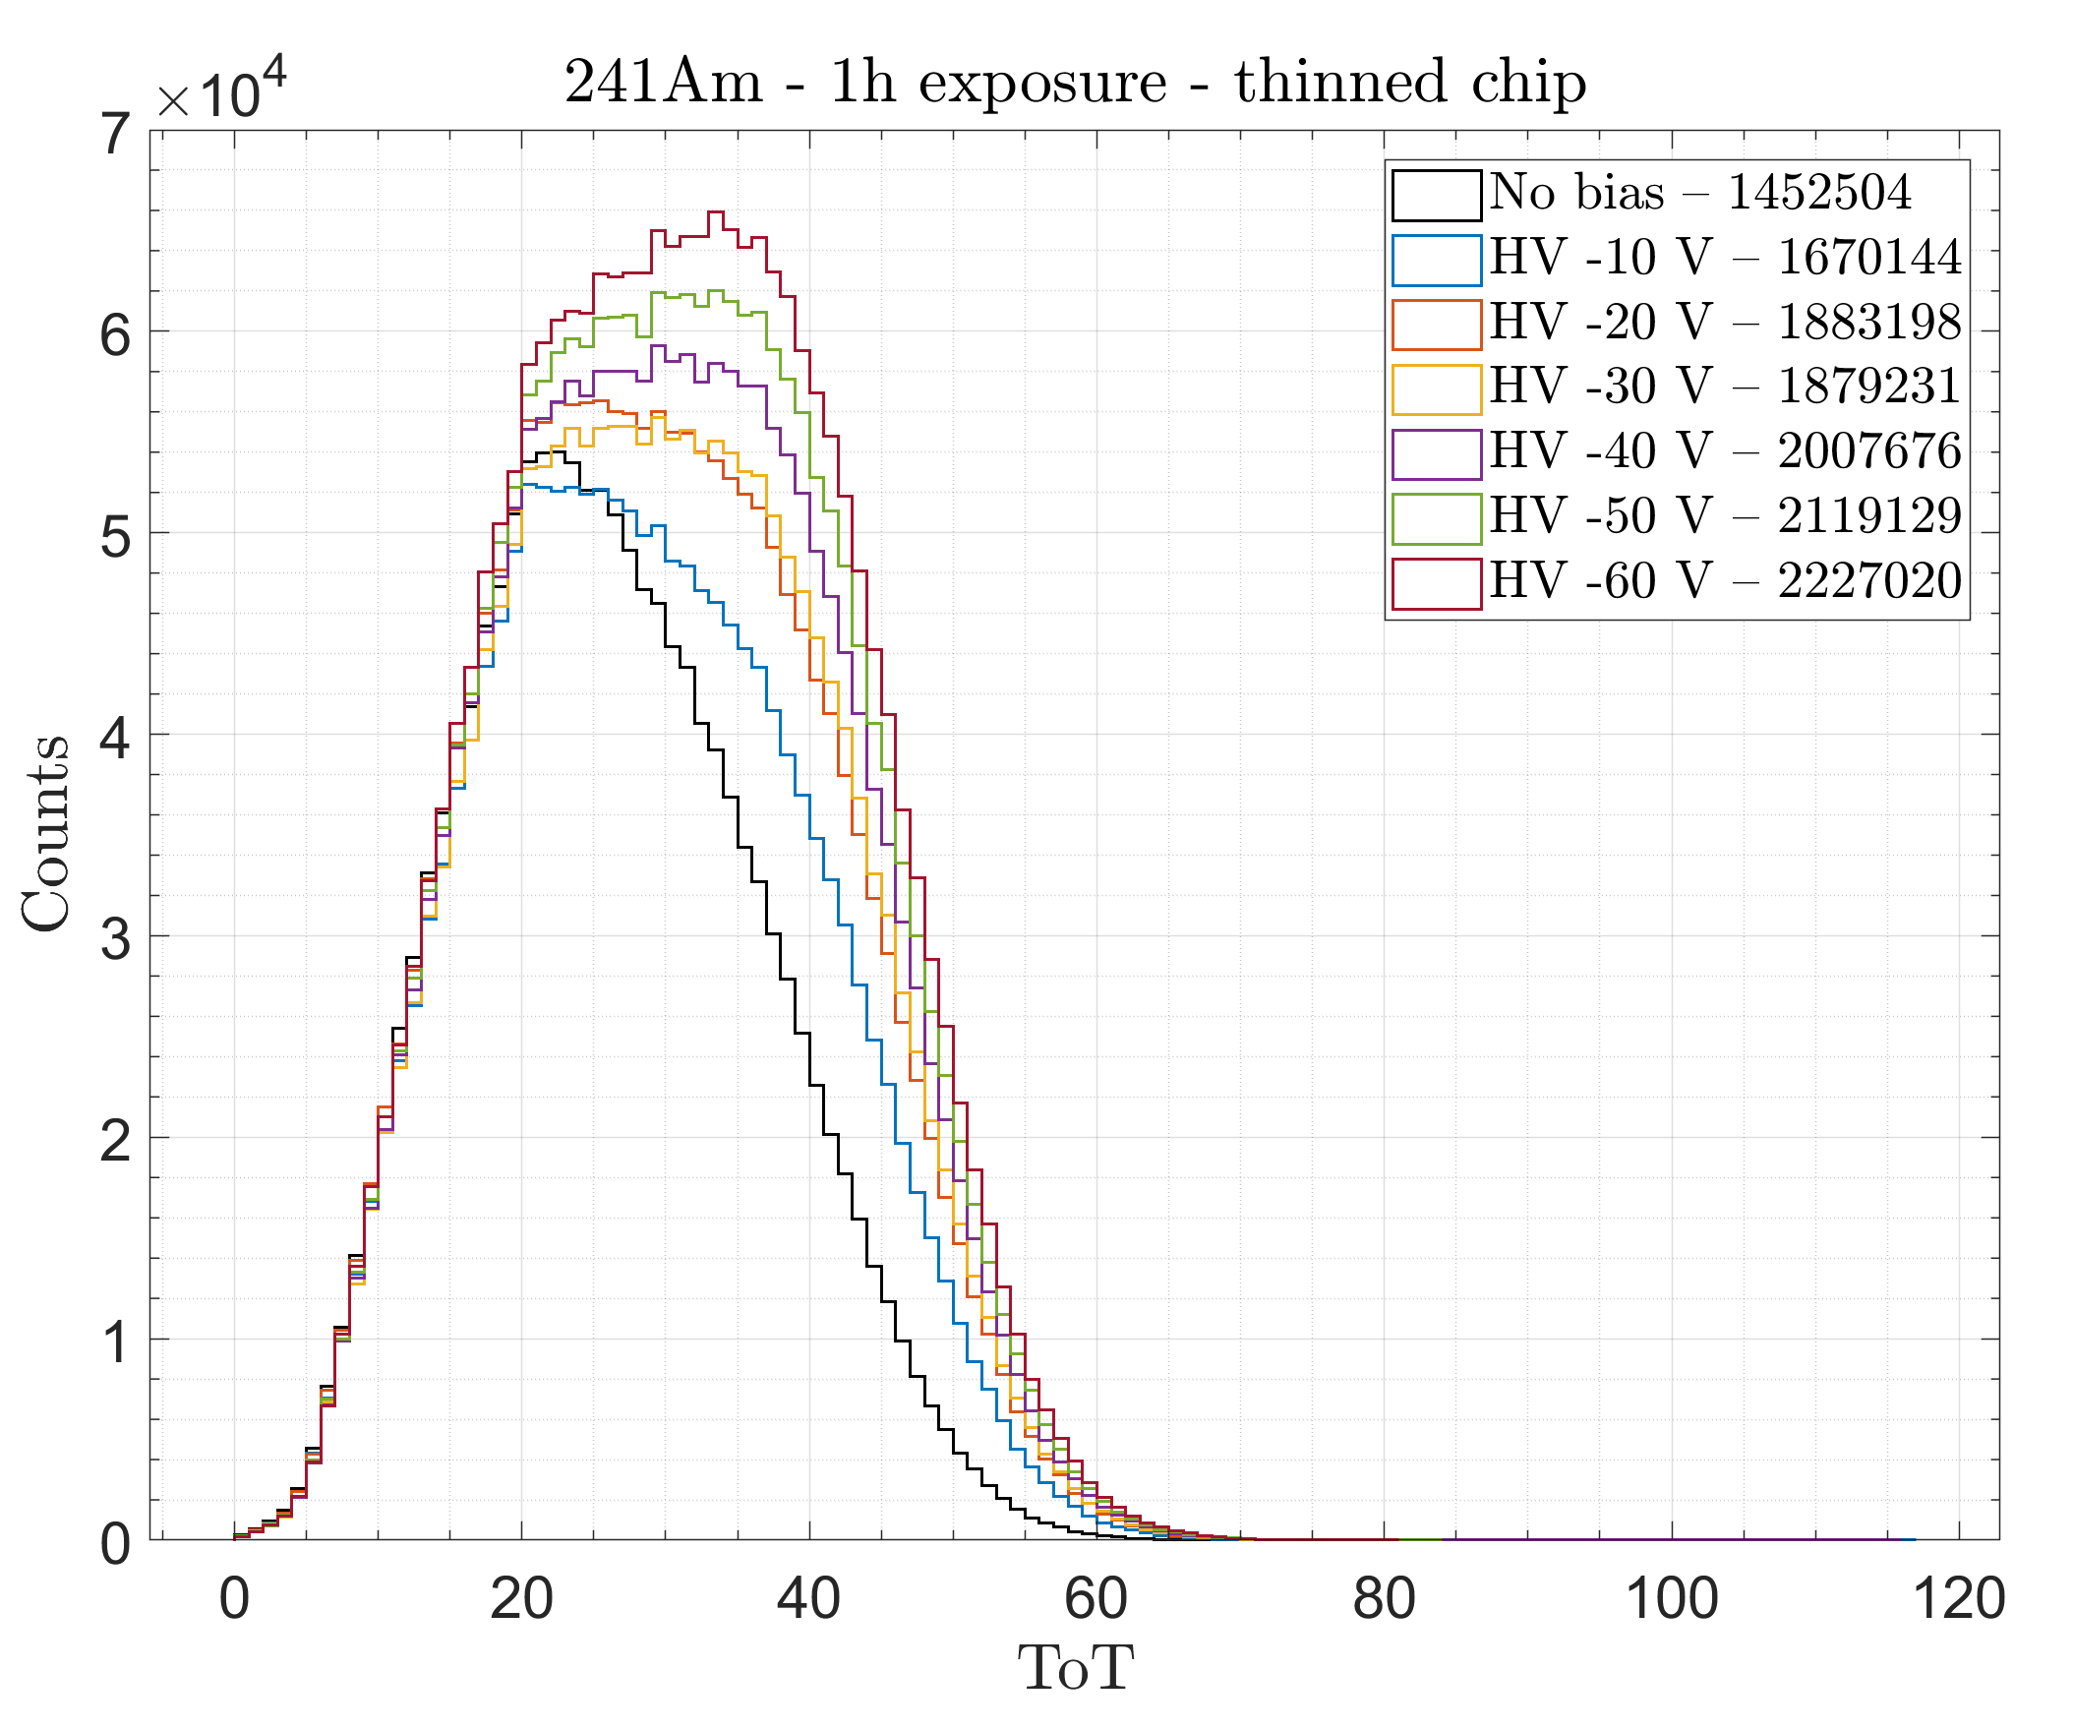
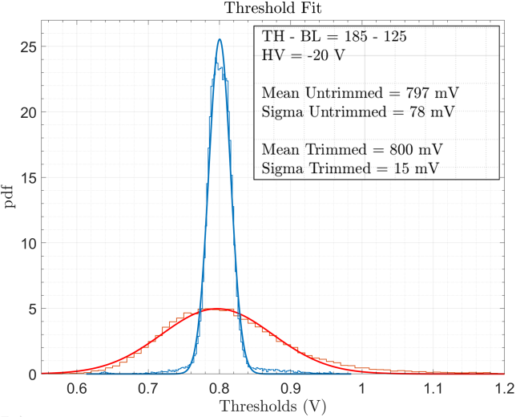
ATLASPIX3
Threshold and noise distributions
Estimated via s-curves fitting
Threshold uniformity after tuning
Test measurements with ²⁴¹Am
Increase of the depletion volume with HV bias
Amplitude measurements with ⁹⁰Sr
Solid shift of the average ToT

Slide 6
CEPC Baseline layout

Slide 7
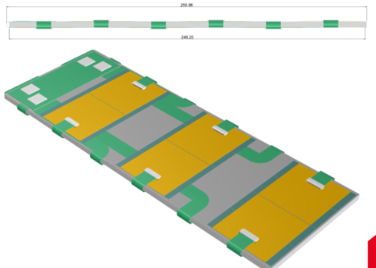
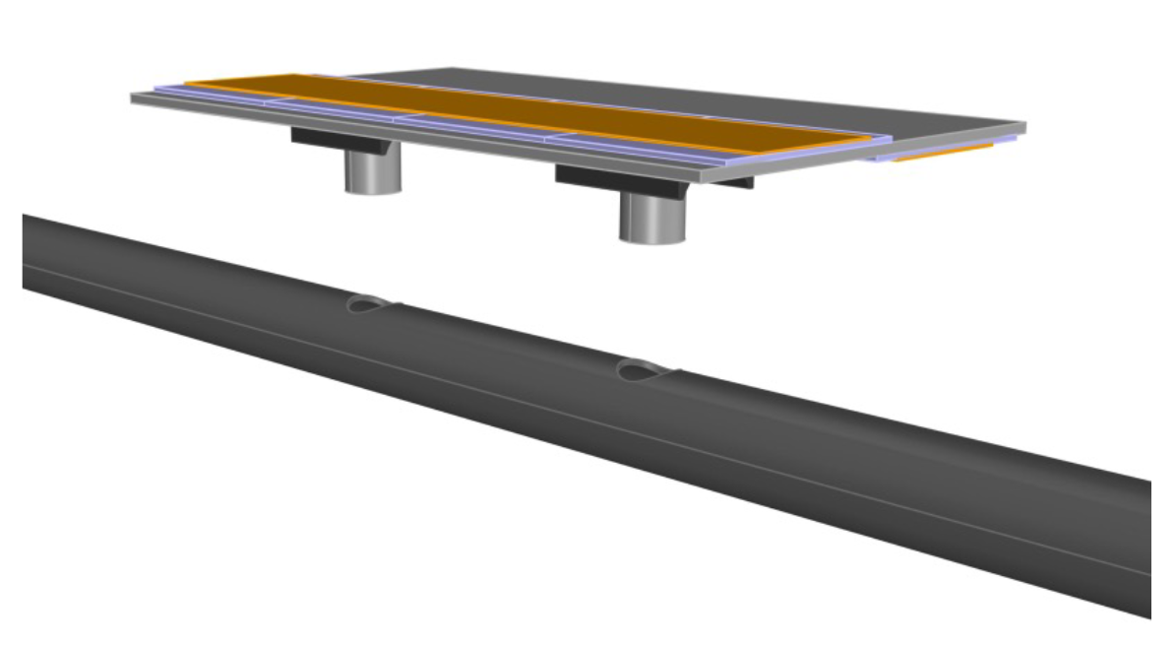
CEPC Baseline layout
INFN Focus

Slide 8
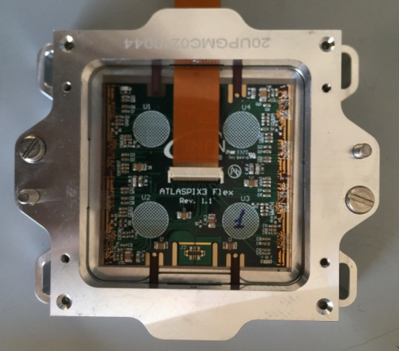
Multi Chip modules

Slide 9
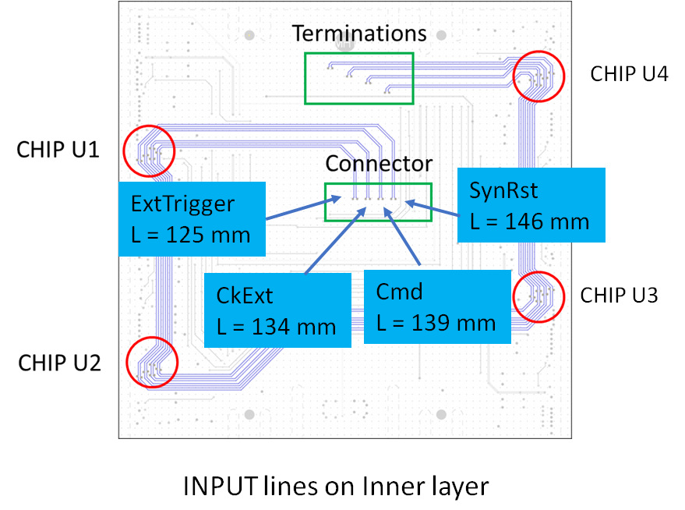
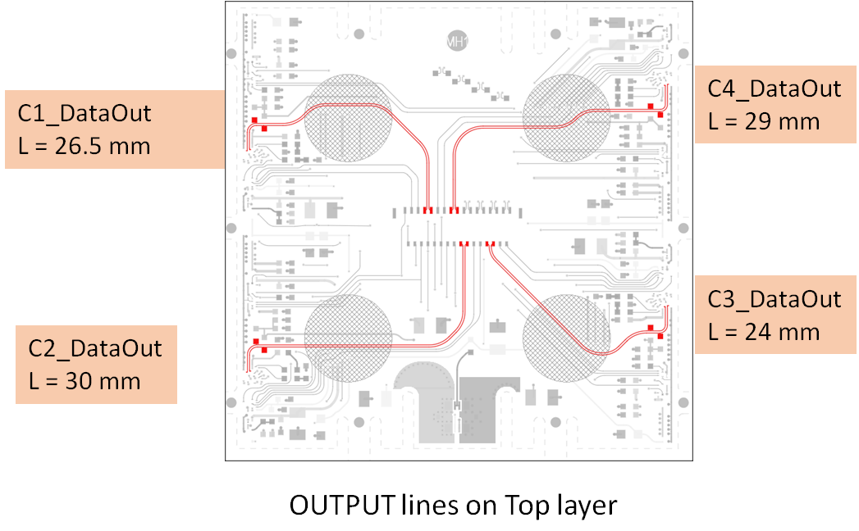
Connections: LVDS routing
Mechanical compatibility with ATLAS quad modules (Molex 5025983393)
Differential control signals distribution for SyncRst, Cmd, CkRef, ExtTrigger
Individual differential output for each chip
CMOS level configurations added to data connector

Slide 10
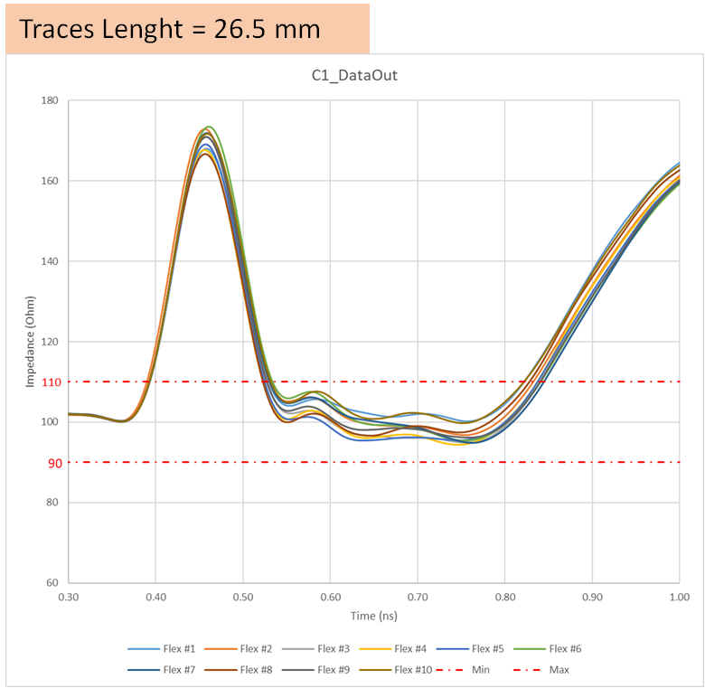
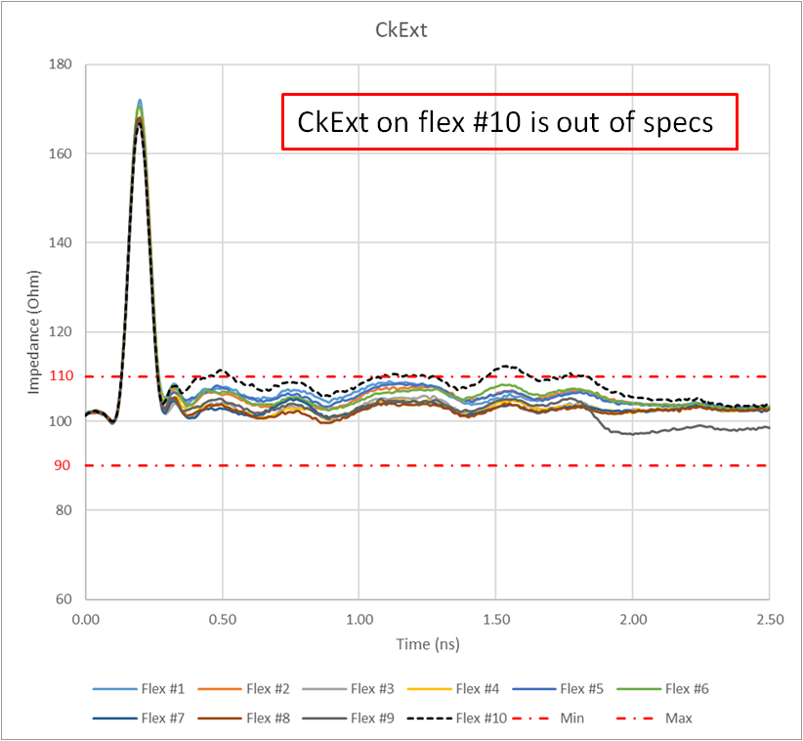
TDR measurements
Cumulative measure for chip DataOut: impedance
Traces Length = 26.5 mm
Traces Length = 134 mm

Slide 11
Eye diagram: clock and DataOut
Eye-Diagram 400 mV:
The evaluation of eye-diagram for CkExt is made including Molex cable
For DataOut only the flex is evaluated
DataOut @ 100 Mbit/s
CkExt @ 100 Mbit/s
160 mV
380 mV
160 mV
450 mV
DataOut @ 500 Mbit/s
CkExt @ 500 Mbit/s
180 mV
350 mV
130 mV
190 mV
380 mV

Slide 12
Assembly procedure
Shown with glass squares: same procedure also used for real module assembly
Gap between chip of 100 um ± 50 um has been achieved

Slide 13
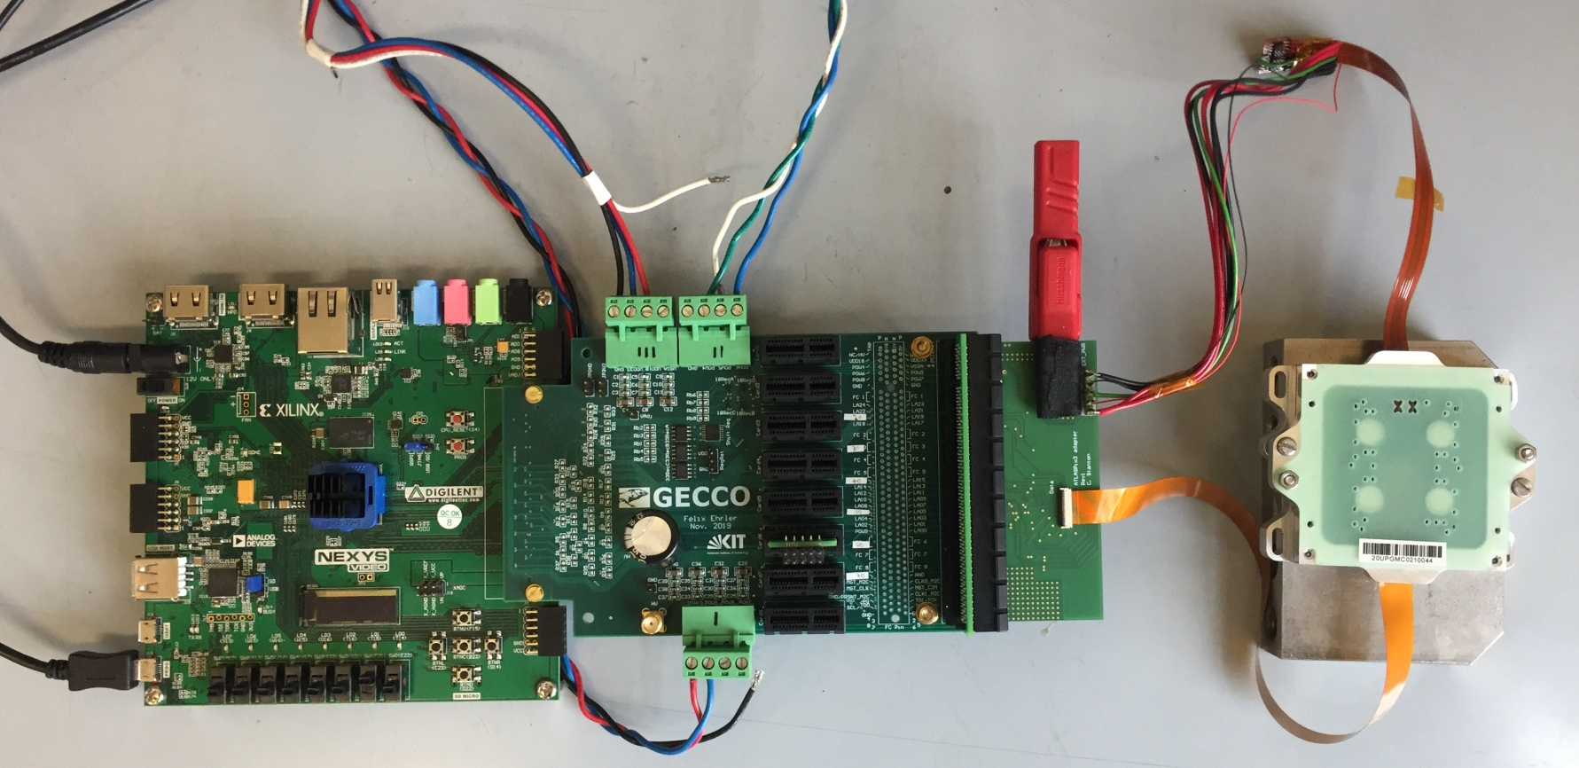
Testing setup
Adapter card designed at the Univesity of Edinburgh
Custom cable for the power connection
Nexys Video FPGA
GECCO readout system developped by KIT
Standard Molex data cable

Slide 14
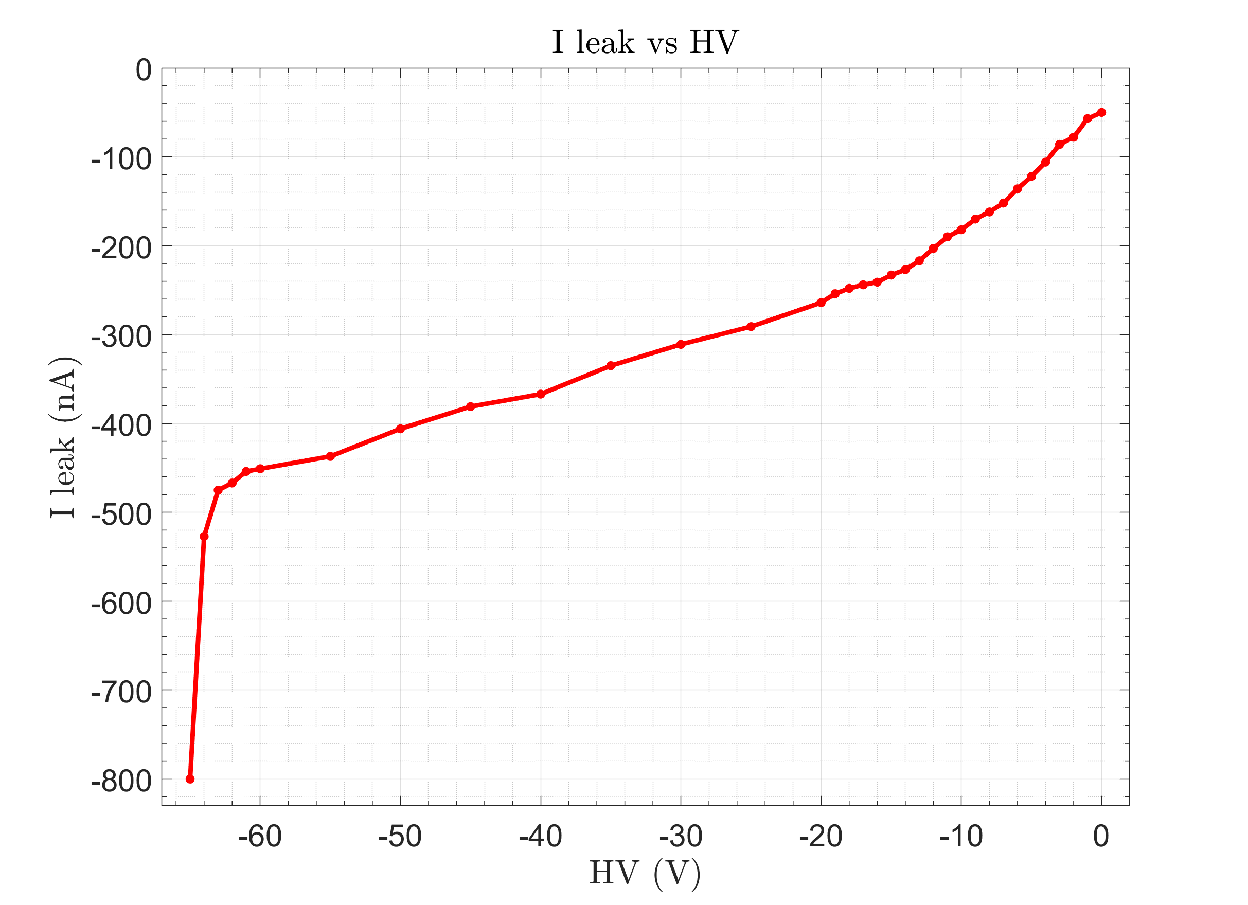
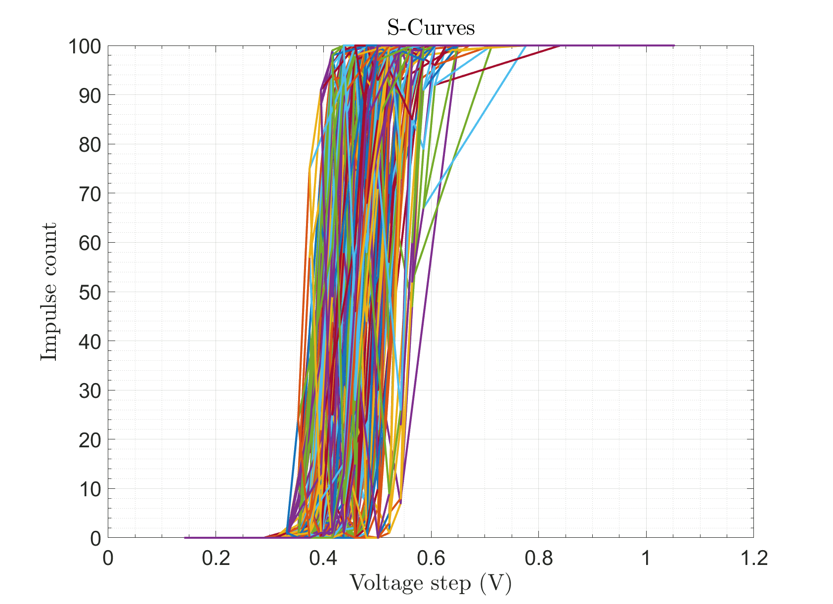
Module characterization
|I leak| < 400 nA for HV > -60 V. Breakdown voltage = -65 V
Current consumption power-up / configured = 1.65 A / 1.33 A for VDD = 1.9 V
Successful fitting of pixel thresholds
Occasional loss of configuration during long scans
Chip 3 can be configured but readout is not working (no wafer probing)

Slide 15
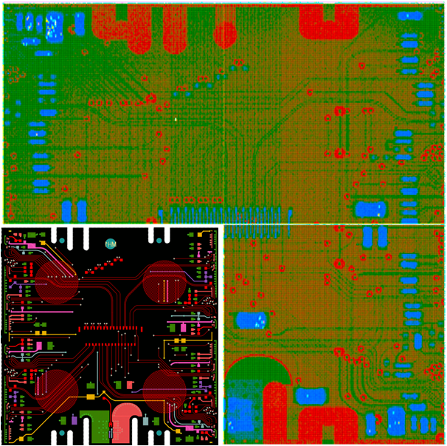
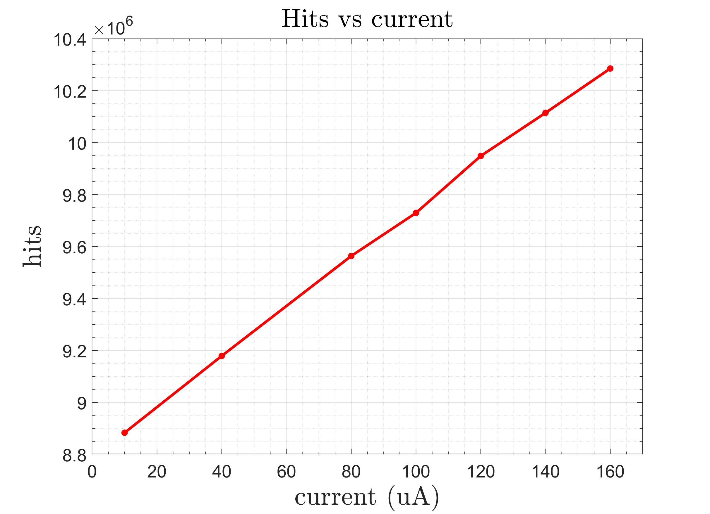
Lab tests with X-ray tube
Amptek Mini-X2 with silver anode, max energy 50 kV
Linear readout rate from 10 uA – 160 uA at 25 kV without low-energy filters
5 minutes source runs without biasing voltage
Missing threshold tuning, set average DAC value
Rate range: ~1.5 x 10⁴ hits/s to ~ 3.4 x 10⁴ hits/s
Components on the PCB can be easily identified

Slide 16
ATLASPIX3 Modules: planning
First 2 multi-chip modules with ATLASPix3 has been operated successfully
Other 7 are being assembled (wire bonding in progress)
Set of ATLASPIX3.1 wafers procured:
fixes on the main VDDA/VDDD regulators
on-chip command-clock-recovery
received 3× 48 chips after dicing and thinning at OPTIM (F)
Designing of a 2nd generation flex hybrid exploiting ATLASPIX3.1 fixes:
Only one LV supply (currently 3 are needed), exploiting the internal regulator fixes
Input lines for command and clock (dropping trigger and reset signals)
Drop of SPI and configuration lines used for debugging module behaviour
A/C coupling on LVDS lines for compatibility with serial powering
Use some free space for temperature sensors
Target is building few mini-staves of an outer tracker for FCCee/CepC/ILC

Slide 17
Long stave mechanics

Slide 18
Layout overview
Design of the support structure for long stave of Layer 2 SIT
Possible to implement also for Layer 1 SIT
Inspired to ALICE project, but different specifications
Easier process (instead of winding process) implemented by WaterJet cut process on carbon fiber laminated (50 µm precision)
Gluing mask for realization of the 3D truss structure
Goal of the mechanical structure: max radiation length 0.3% X₀
1330 mm

Slide 19
Profile of the single plane truss structures
Maximum dimensions of the cutting surface under the Waterjet machine:
580x465 mm²
Laminated plate Carbon Fiber: M46J
N.4 unidirectional layer 0-90-90-0
^{Thickness: 0.5 mm}

Slide 20
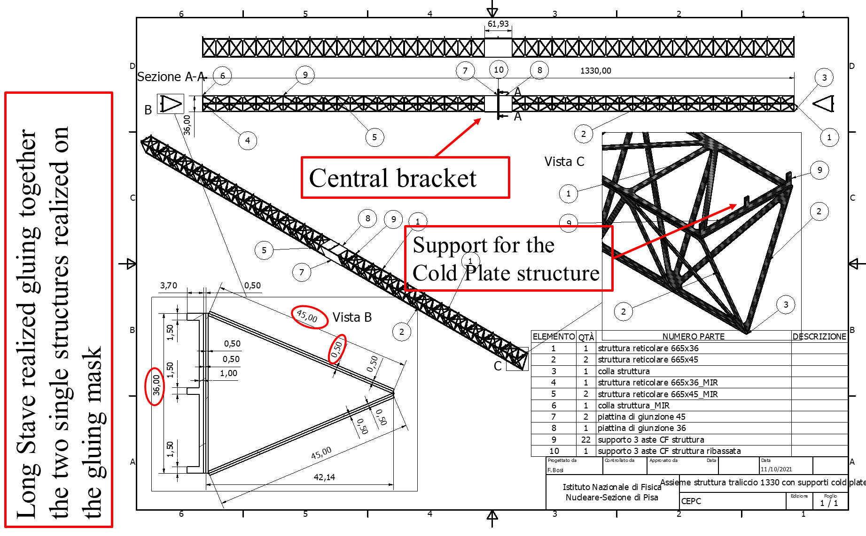
Long stave layout

Slide 21
Gluing truss mask for half stave
Precision Pin
Upper Positioning Brake
Truss Structure
Lateral Mask
Lateral Precision Support
665
Lateral Positioning Brake
Precision Pin
Upper Mask

Slide 22
Gluing truss mask for long stave
Upper Mask
Upper middle support
Upper positioner CF stiffness plate
Precision Pin
Lateral positioner CF stiffness plate
Lateral Mask
Upper middle support
Lateral middle support
Lateral Precision Support
1330
Long Truss Structure
Stiffness CF Plate
Lateral positioner CF stiffness plate
Lateral Mask
Lateral middle support

Slide 23
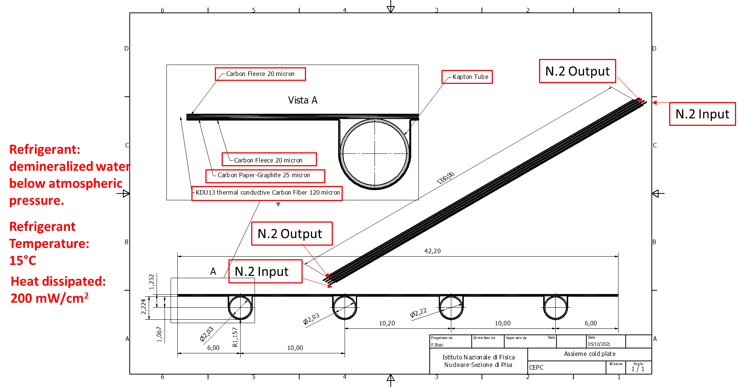
Cold plate

Slide 24
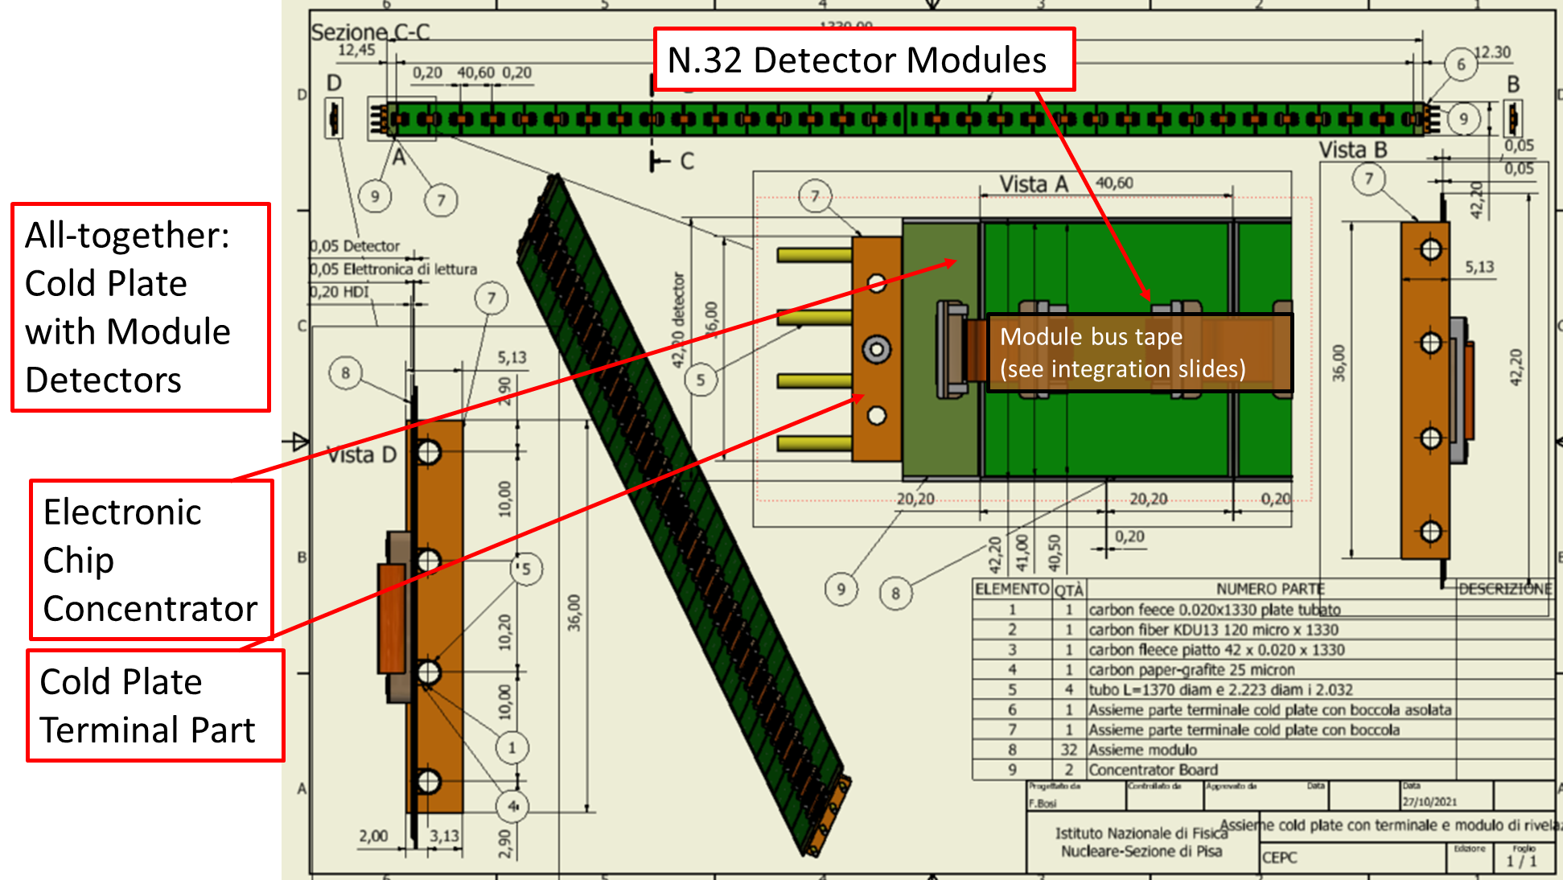
Populated cold plate

Slide 25
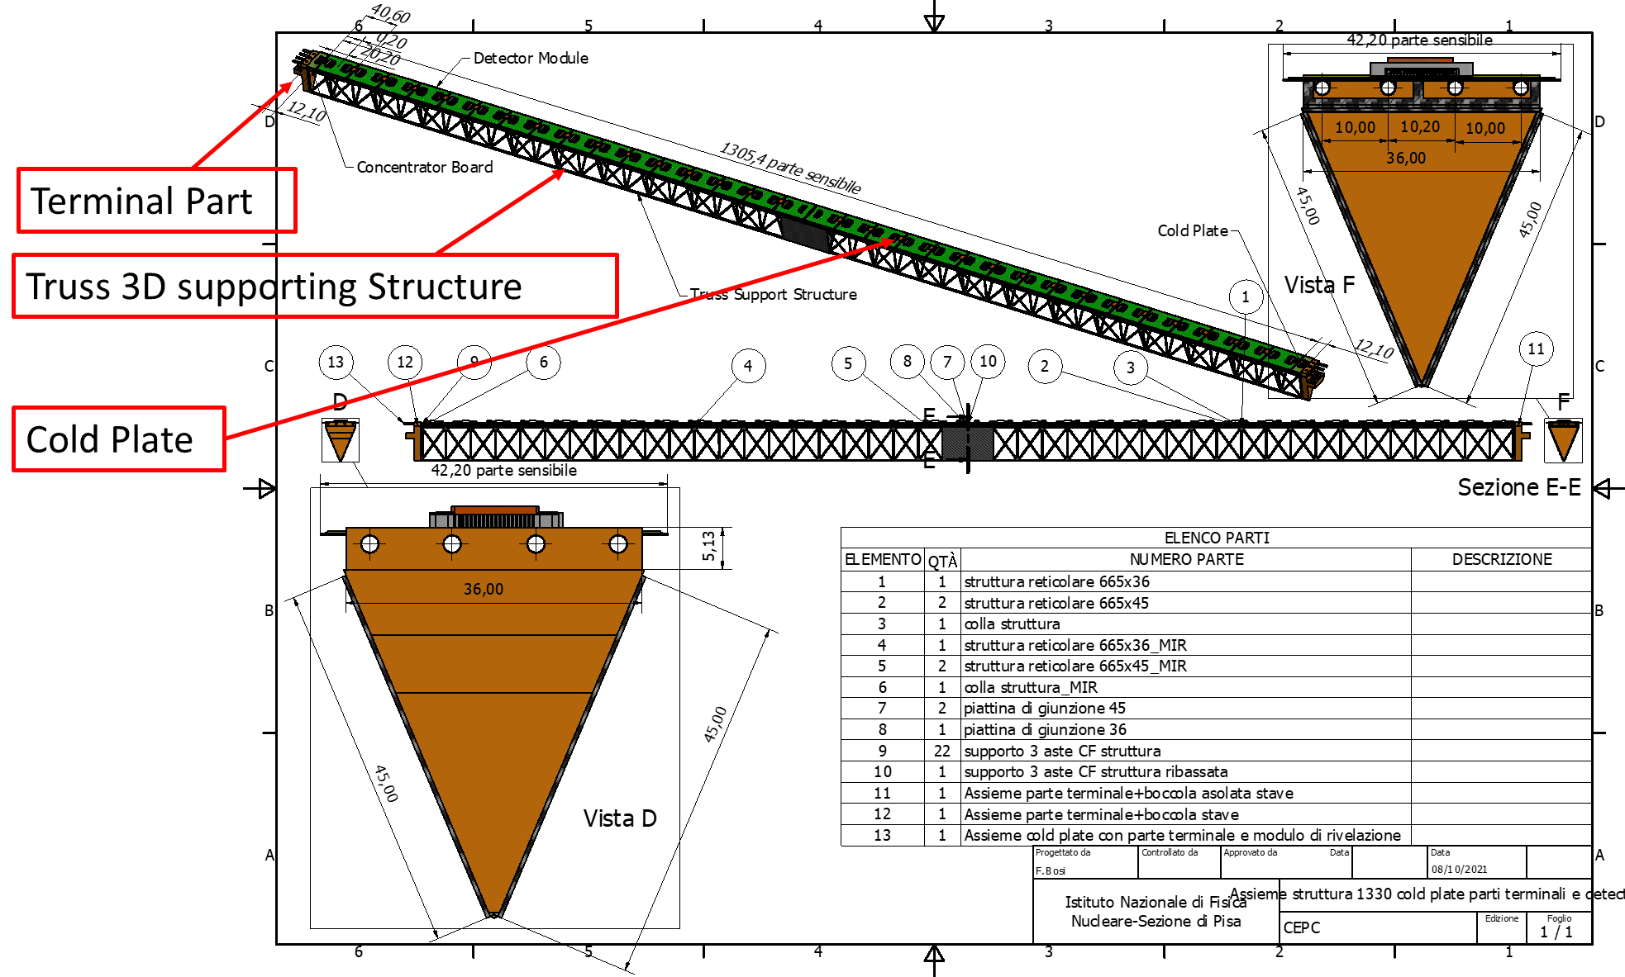
Complete long stave

Slide 26
Stave Mechanics: planning
Done in 2021:
Designed the long stave parts
Finished to design the long stave gluing mask
Ordered the carbon fiber material
Next steps in 2022:
Manufacturing of the Gluing Mask and the end part of the 3D truss and cold plate in peek material
Order WaterJet cutting operation
Assembly the Long Stave structure
Assembly of the cold plate
Measure the sagitta of the long stave and thermo-mechanical properties of the cold plate in Pisa lab

Slide 27
services integration

Slide 28
Si tracker: system considerations
Complete system consists of 900'000 cm² area / 4 cm² chip = 225k chips (56k quad-modules)
aggregation of several modules for data and services distribution is essential
inner tracker will be 5--10% of this
Data rate constrained by the inner tracker
average rate 10⁻⁴ - 10⁻³ particles cm⁻² event⁻¹ at Z peak
assuming 2 hits/particle, 96 bits/hit for ATLASPIX3
640 Mbps link/module (assuming local module aggregation) provides ample operational margin
16 modules can be arranged into 10 Gbps fast links: 3.5k links
can also assume 100 Gbps links will be available: 350 links
DAQ architecture
triggerless readout will fit the data transmission budget but requires off-chip re-ordering of data
triggered readout will be simpler and would also reduce the bandwidth occupancy
Power consumption
ATLASPIX3 power consumption 150 mW/cm²
600 mW/chip → 2.4 W/module → total FE power 130 kW
additional power for on detector aggregation and de-randomizations ~2W/link

Slide 29
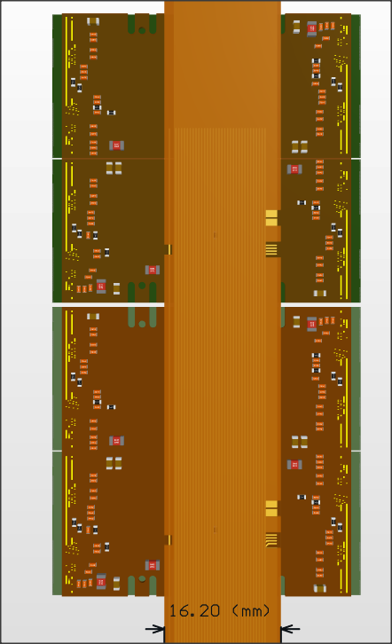
Stave Electrical Bus
Distribute power and data signals along the stave
Assume minimal I/O connection on chip:
All biases generated internally by shunt-LDO regulators
chip-to-chip data transmissions: local data aggregation on module
clock data recovery
Requirements:
LVDS command input
LVDS data output at 640 Mbps on ~700 mm (half)stave length
Serial powering assuming 0.5 A/chip, 2 A/module
HV distributed in parallel to all modules
Integrated signal and power bus:
Power distribution and return layers
Signal lines on top and bottom layers
Interconnection by soldering or wire bonding
Alternative under study:
separate power cables + twinax for signal (the LHC way)
Power IN/OUT
HV
Data IN/OUT

Slide 30
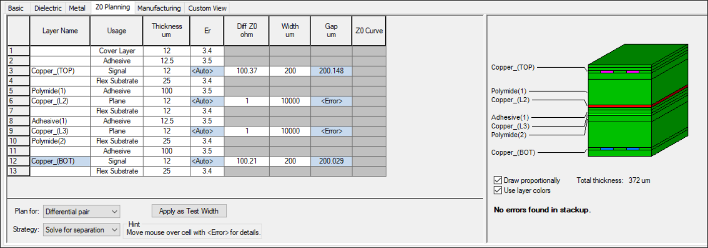
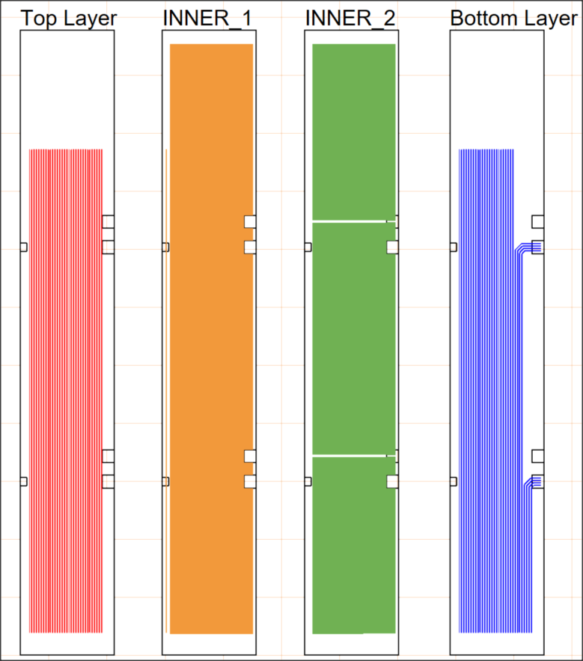
}
}
Modules 8-F
Modules 0-7
Total thickness 372 µm
Total copper 36 µm
Serial power bus
Signals:
LVDS trace width = 200 µm
resistance for a length of 70 cm ̴ 5 Ω
Stack-up minimizes cable thickness, but bottom signal lines face module hybrid circuit
Power:
Plane width = 14 mm
resistance for 70 cm ̴ 0.08 Ω
current I ̴2 A (@ 20 + 3 ºC)

Slide 31
Conclusions
INFN work on RD_FCC SiTracker progressing well within the CEPC Framework
sharing of parts and ATLASPIX3 testing
parallel development of structures for the different layers of the tracker
First multi-chip module(s) assembled
Build a 2nd generation based on ATLASPIX3.1 in 2022
Developed the full design of a long stave for the outermost layers of the SiTracker
Realization of prototypes and thermo-mechanical characterization in 2022

Slide 32
backup

Slide 33
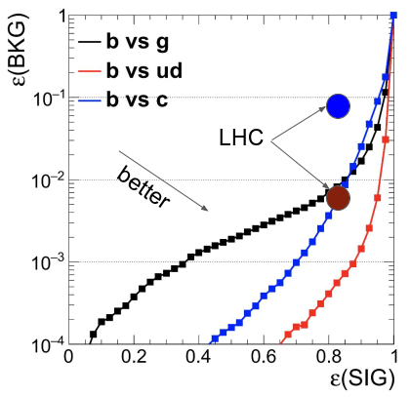
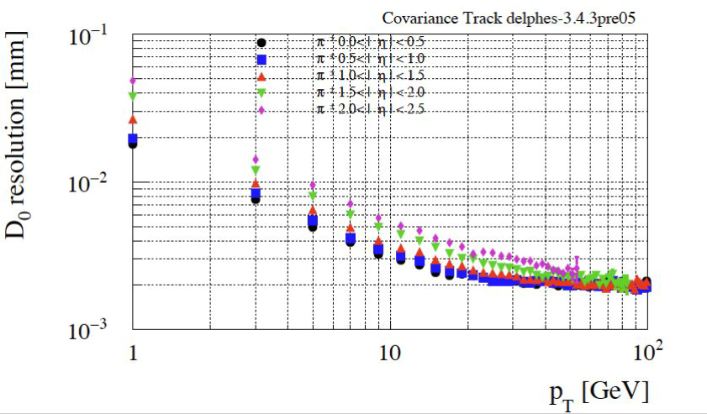
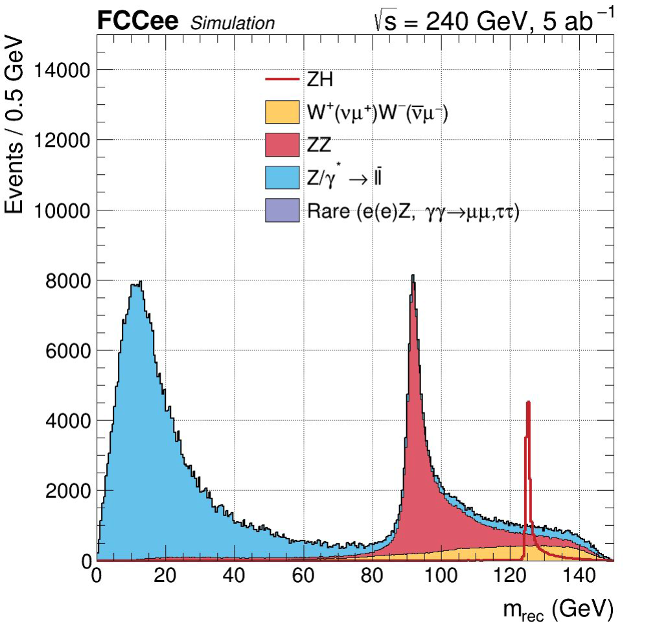
Physics requirements
b/c/g/τ tagging
Flavour physics
Recoil mass determination
M. Selvaggi on Tuesday
Impact parameter resolution
$$σ_{d}=a ⨁\frac{b}{p\sin^{\frac{3}{2}}{θ}} \\ a\sim 5 μm, b\sim 15 μm∙GeV$$
Particle identification capability (p/K/π)
Momentum resolution $\frac{σ_{p}}{p}=p∙a+\frac{b}{\sin{θ}}$ $a<2∙{10}^{−5}{GeV}^{−1}$
J. Eysermans on Tuesday
Example: $H→\begin{matrix}b\overline{b} \\ c\overline{c} \\ gg\end{matrix}$

Slide 34
IDEA: the vertex region
High precision impact parameter reconstruction with low mass vertex detector
at least 20 μm granularity
thickness < 0.3% of radiation length
low power <20 mW/cm² to minimize services
Supplemented by coarser/faster silicon detectors in front of the drift chamber
Depleted Monolithic Active Pixels sensors
not necessarily the same technologies for both: different requirements
present technologies are very promising
R&D on different approaches (ARCADIA, ATLASPIX3)

Slide 35
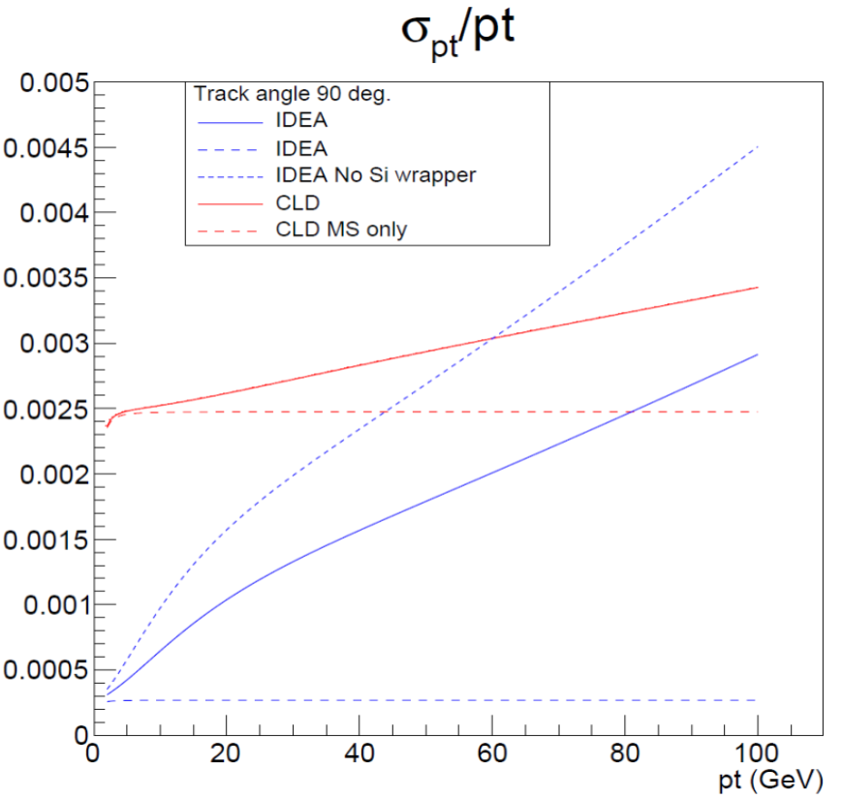
Si Wrapper
Precision silicon layer around the central tracker
Functionalities:
momentum resolution
extend tracking coverage in the forward/backward region by providing an additional point to particle with few measurements in the drift chamber
precise and stable ruler for acceptance definition
Covered area ~90 m²
Suitable technologies:
microstrips (2 layers)
double sided microstrip
DMAPS → single layer, high resolution on both coordinates, maybe simpler integration
Solenoid
Si Wrapper
DCH

Slide 36
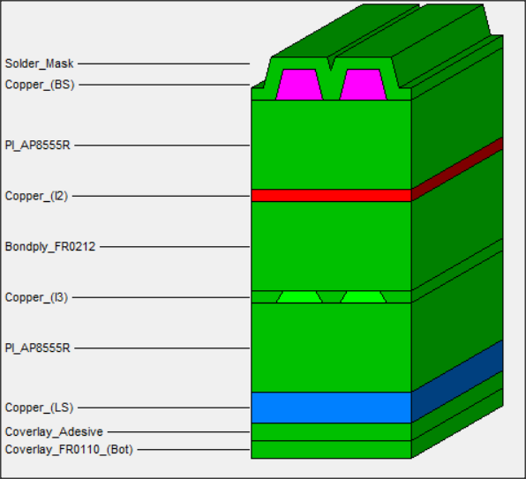
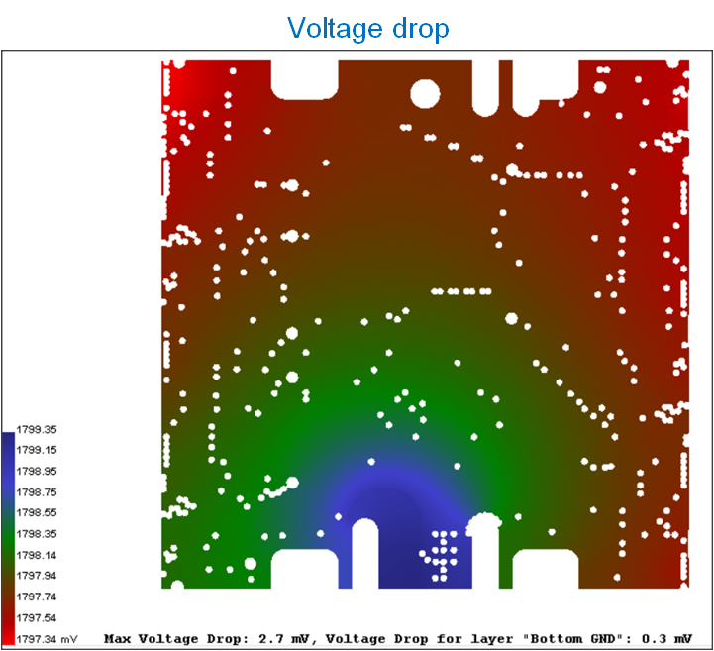
Flex Stackup and power integrity
In this initial version emphasis is on signal integrity, rather than minimizing material:
4 layers
External layers copper: 43 um
Inner layers copper: 18 um
Total thickness: 565 um
Via diameter: 300 um
Via hole size: 150 um
100 ohm impedance match on differential lines on top and inner layers
Power connector BM25: VDD, GND, HV, VGATE, VLVDS
Power Integrity simulation parameters:
Voltage source: 1.8 V
Current sink: 500 mA per chip
Max voltage drop: 3 mV
Max current density: 15 A/mm²
Simulation results for VDD (ref. GND)
Max Voltage Drop: 2.7 mV
Max Current Density: 13.9 A/mm²
Max Via Current: 137.0 mA

