Slide 1
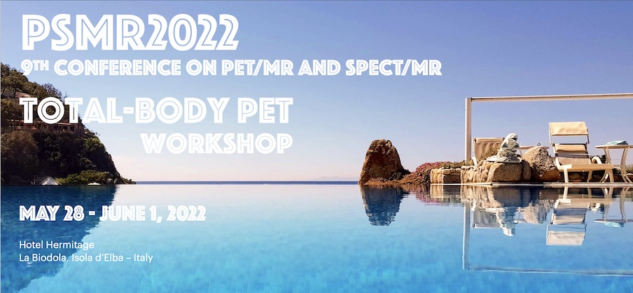
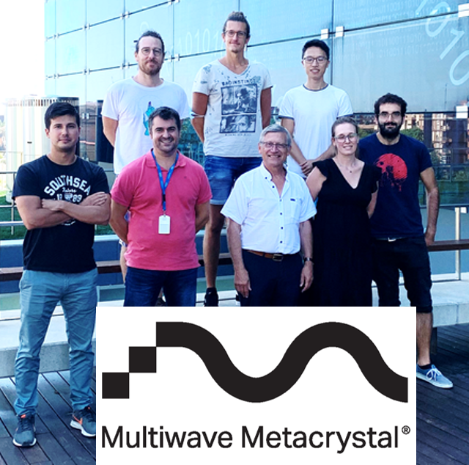
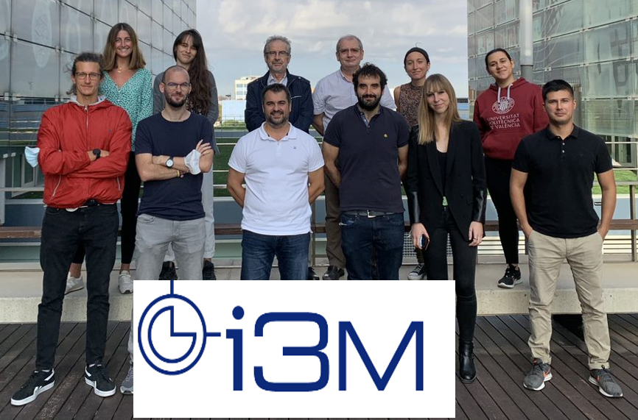
Exploiting Cherenkov radiation and cross luminescence emission with BGO/BaF2 metascintillators
Riccardo Latella
Ph.D. Student & Engineer
Metacrystal & I3M
1
Notes:
Welcome everybody. My name is Riccardo Latella, I’m doing my Ph.D. at Polytechnic of Valencia, precisely at the laboratory of i3M, while covering the role of Engineer in Metacrystal company based in Geneva. Today, I’m going to present some of the results we have obtain so far, regarding “Exploiting Cherenkov radiation and cross-luminescence emission with BGO/BaF2 metascintillators”

Slide 2
Index
Introduction
Testbench setup
Analysis
Results: BGO & BaF2 - VUV – CTR
Discussion & Future Plans
2
Notes:
Briefly, I’ll introduce all the sections in which my presentation is divided, starting from the introduction about metascintillators and the possible synergy between Cherenkov and Cross-luminescence emission. Then, I’ll explain in details the testbench setup used in our daily testing, focusing on the electronics, SiPMs, coupling material, pixel/metapixels, and the relative filtering approaches. Moving to the third section, I’ll go through the analysis on the two metapixels based on BGO used in this work. Leading to the results about BGO/BaF2 metapixel using VUV sensors and concluding with the discussion and future plans.

Slide 3
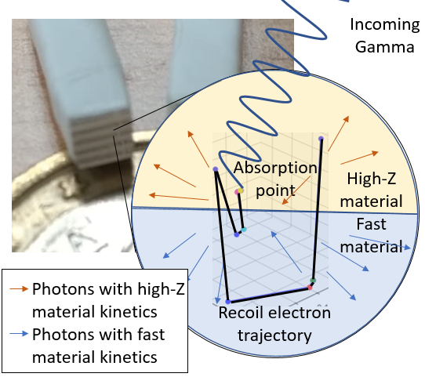
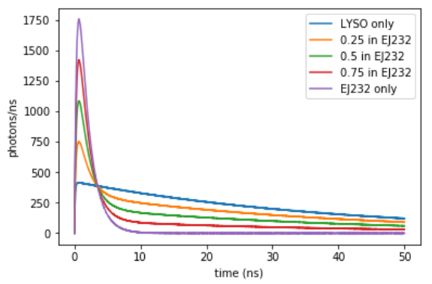
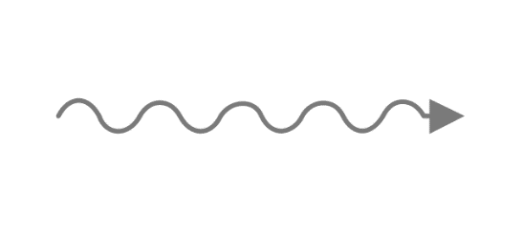
Introduction:
Metascintillators
$$f_{metascint}\left(t\right)=\frac{E_{f}×{LY}_{f}}{τ_{fd}−τ_{fr}}\left(e^{−\frac{t}{τ_{fd}}}−e^{−\frac{t}{τ_{fr}}} \right)+\frac{\left({E_{total}−E}_{f}\right)×{LY}_{s}}{τ_{sd}{−τ}_{sr}}\left(e^{−\frac{t}{τ_{sd}}}−e^{−\frac{t}{τ_{sr}}} \right)$$
Metascintillator heterostructures
Thin slices of a dense host material (e.g. LYSO, BGO) and a fast emitter (e.g. EJ232, BaF2)
Share scintillation
Good timing resolution & high stopping power.
WHY METASCINTILLATORS?
Enhance effective sensitivity
Reduce TB-PET costs
G. Konstantinou 2020
Recoil electron
Which materials give the strongest combination?
Gamma energy
Energy-sharing
3
Notes:
So, starting with the introduction, the first generation of metascintillator are composed of thin slices of a dense host material, like BGO or LYSO, and a fast emitter, like plastic or BaF2. The shared scintillation of these heterostructures could break the trade-off between high stopping power and good timing resolution. Indeed, the gamma energy is shared between the two materials thanks to the recoil electron trajectory. This phenomena enhances the total effective sensitivity of the system and, by using cheaper materials than commercial ones, can reduce the costs of large PET scanners like TB-PETs. But, which is the best combination in terms of synergy for metascintillators. This is actually the study we are conduction right now.

Slide 4
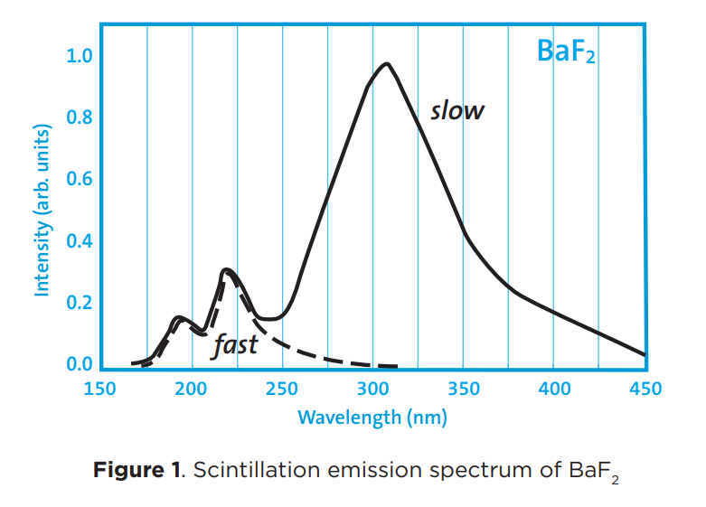
Introduction:
Cherenkov & Cross-luminescence emissions
Cherenkov emissions
∝
$${1/\text{λ}}^{2}$$
Fast scintillators
as
light-guiding materials
Prove of concept:
EJ232
BaF2
VS
BGO light absorption
< 300 nm
N. Kratochwil 2021
Synergy with VUV SiPM!
Combination of: - Cherenkov from BGO and BaF2
- Cross-luminescence from BaF2.
BGO/BaF2 metascintillators
4
Notes:
One of the possible scenario is combining Cherenkov and cross-luminescence emissions. But how? Well, I’m not going in the physical details but Cherenkov emissions are produced inside BGO crystal which is also a very dense and well known material. The Cherenkov light produced is inversive proportional to the wavelength squared, while BGO starts to absorb light below 300 nm, which means that the majority of strongest Cherenkov emissions are absorbed inside the crystal itself. To face this problem, fast scintillator can be used as light-guiding materials. To prove this concept, we are combining BGO plates with plastic and in particular with BaF2, that has its fast emission in the deep UV region. A synergy between these two materials can found by using BGO/BaF2 metascintillators coupled with VUV SiPMs. In this way, we can combine Cherenkov from BGO and BaF2 and Cross-luminescence from BaF2.

Slide 5
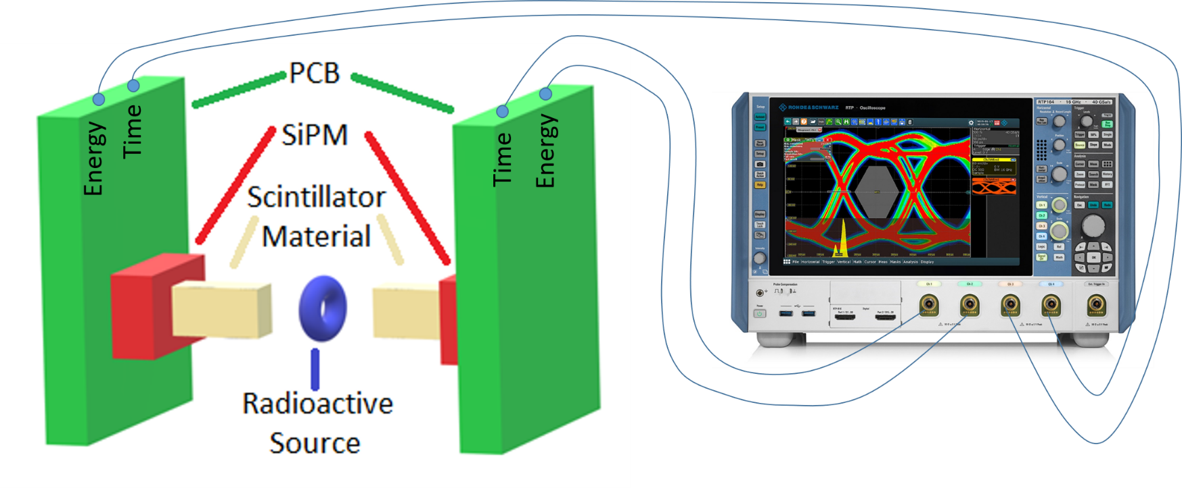
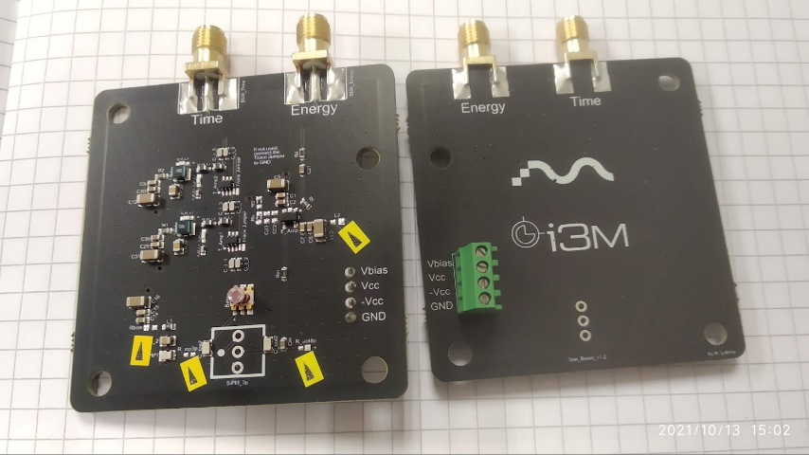
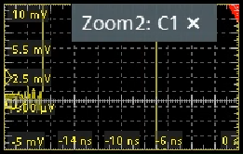
Testbench setup
Electronics
Oscilloscope
Boards
Timing amplification stage modified
Rhode & Schwarz RTP084, high-performance 8GHz bandwidth oscilloscope.
Inspired by Cates and Gundaker’s design
Energy
channel
CTR measurements
Two detectors:
Board
SiPM
Scintillator
Double-channel readout circuit
Low Noise
Baseline
Na-22 source (7 μCi)
Timing
channel
Balun transformer
5
Notes:
Let’s have a look on which parts our testbench setup is compose of, starting from the electronics. Our boards are inspired by a previous design with some improvements in terms of power consumption and noise level. Each board constitutes a double-channel readout circuit having a dedicated energy and timing channel, based on a balun transformer. These boards are connected to a high-performance 8GHz bandwidth oscilloscope, namely an Rhode & Schwarz RTP084. Our Coincidence Time Resolution measurements are performed initially on the oscilloscope by placing two detectors in front of each other and a sodium 22 source in between.

Slide 6
Testbench setup
SiPMs and Coupling materials
Coupling materials used:
Two optical greases:
SS-988 from Silicon Solution
Bluesil Paste 7 from Elkem
Glycerine bi-distilled
Fondazione Bruno Kessler
NO protective layer
Low temperature
Very fragile!
Good deep UV transmittance
Risk of damaging the SiPM
Epoxy resin
on
Bonding wires
Improve robustness
6

Slide 7
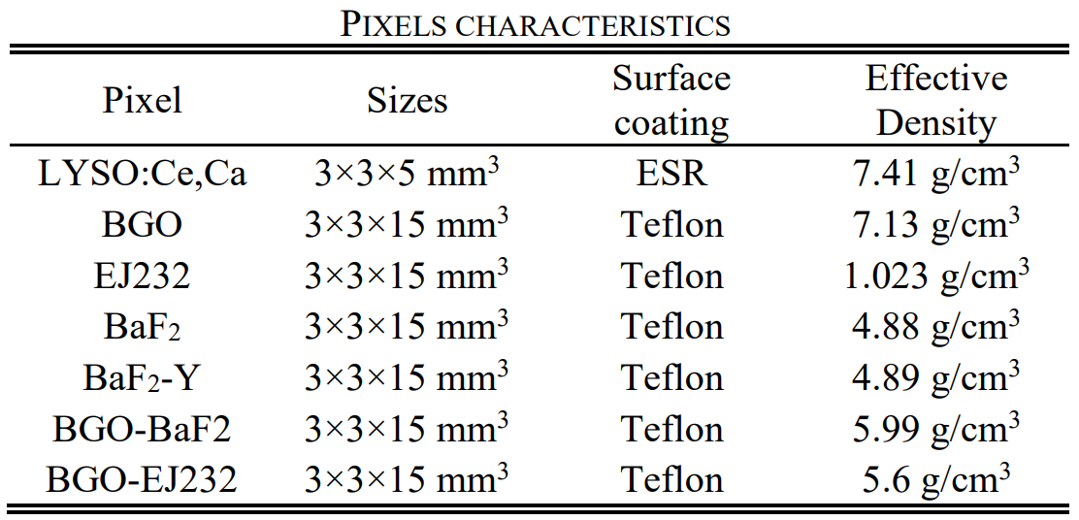
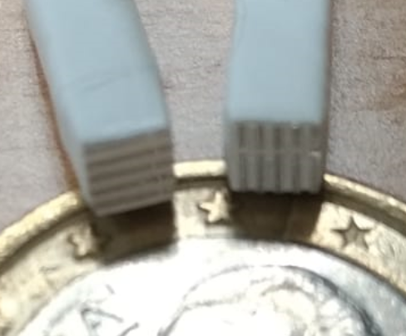
Testbench setup
Pixels and Metapixels
Reference detector:
3x3x5 mm3 LYSO:Ce,Ca
Bluesil Paste 7
NUV-HD sensor
DTR = 64.7 ps
Metascintillators in pixel configurations
Metapixels
Metapixels with variable plate materials and dimensions.
7

Slide 8
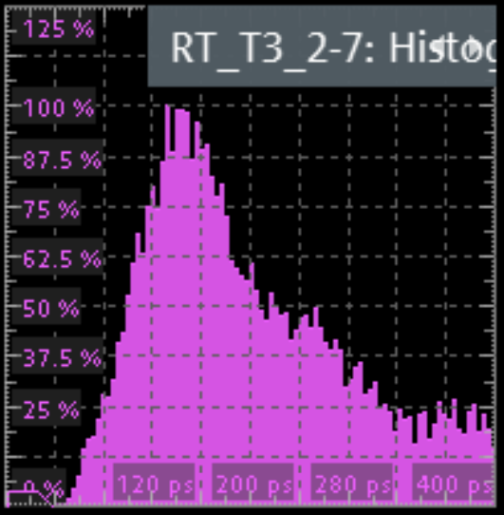
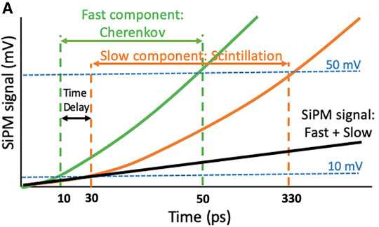
Filtering methods
Testbench setup
Rise Time (RT): Indicator of initial photon-time density
RTD 2-7mV
Maximum Peak (maxP): Standard energy photopeak filtering
Rising Time Distribution (RTD)
Fixing two voltage thresholds, close to the noise level
Signal maximum values distribution
~
surrogate
Integrated charge
distribution
(Pulse energy content)
Metapixels’ spectrums are more complex
5 mV rise time surrogate for energy-sharing
Choose only the fastest events
Maximum values
Integrated charge
Photoelectric events can be produced and shared in both materials
N. Kratochwil 2020
8

Slide 9
BGO & Plastic (EJ232) - RTD
Analysis
Test condition:
25ºC
SS-988
Vbias = 39.5 V
VuV less PDE than NUV for λ > 300 nm
BGO, EJ232 & meta with NUV
BGO & meta: NUV vs VUV
Plastic
Meta
BGO
Meta BGO/EJ232 is faster than BGO bulk
Increased population using VUV, even if pulses are weaker
The growth of the faster event population can only be attributed to the detection of Cherenkov photons.
9

Slide 10
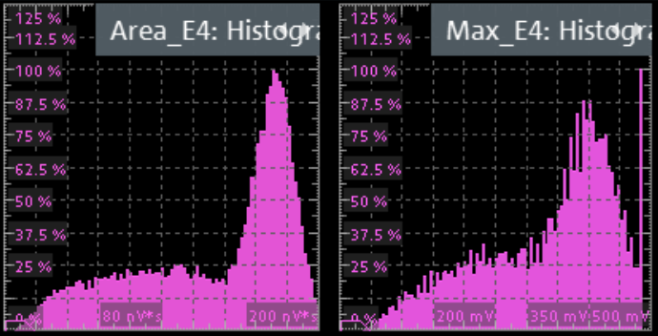
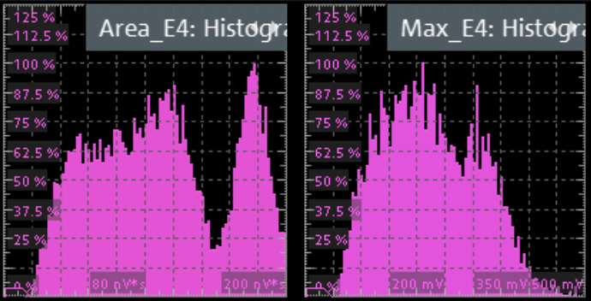
BGO & BaF2 - VUV
Analysis
Test condition:
15ºC
Glycerine
Vbias = 39.5 V
Glycerine:
liquid, low viscosity
hard to handle.
maxP usable for metascintillators energy filtering
Energy Spectrum
Integrated charge
Maximum values
Sensitive to energy sharing
BGO
Alignment of the energy spectrums
Integrated charge
Maximum values
BaF₂
integration window
wavelength-sensitive transfer function
RTD different between materials:
Energy sharing surrogate
Separate fastest events
Cross-luminescence in BaF₂
Cherenkov photons in BGO
10

Slide 11
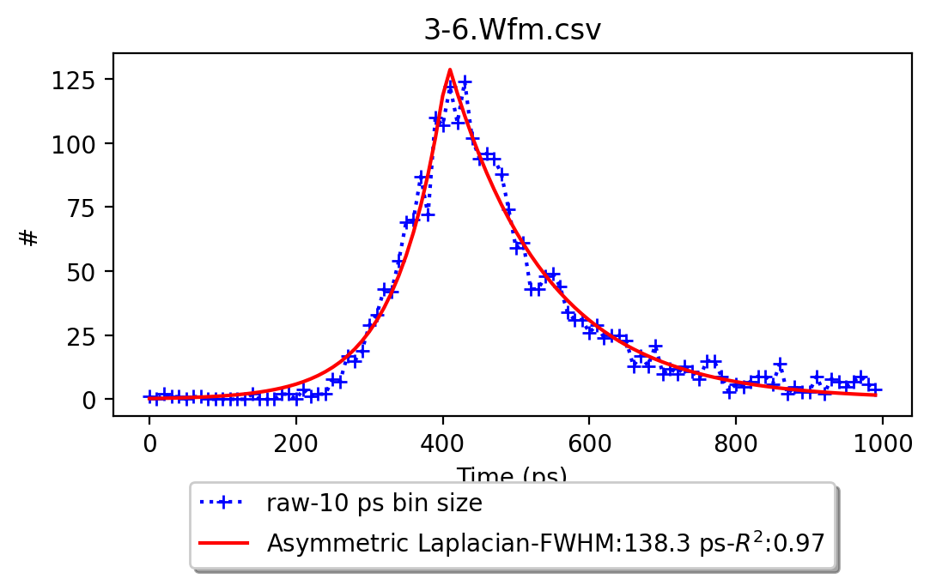
BGO & BaF2 – VUV - CTR
Results
Rough results
Reference
Pixel
Metapixel
Time-walk correction: 30% improvement
Most of the BaF2 events are already below 100 ps (62.4 %)
Combine
CTRs improvements around 25-30%
 | ER = 20/21% | ER = 24/25% | ER = 16/18%
CTR | BGO [ps] | BGO/BaF2 [ps] | BaF2 [ps]
maxP | 223.1 (0.98) | 186.1 (0.98) | 123.4 (1.00)
RT100ps | 159.9 (0.96) | 138.3 (0.97) | 154.5 (0.99)
maxP
RT100
11

Slide 12
Discussion & Future Plans
Improvement of the CTR of radiation detectors using BGO and fast emission material (CTR = 138.3 ps), especially BaF2 creating a synergy between Cherenkov and cross-luminescence emissions.
COST REDUCTION: these materials have less than half of the LYSO cost, making them a good alternative, especially for larger PET scanners, like TB-PET.
Future improvements are possible by combining maxP and RT filtering approaches and developing/combining new ones, like ToT or neural networks, to have a precise measurement of both energy of interaction and energy sharing.
Further analysis will be conducted on the combination between slabs of various thicknesses, exploiting both materials' characteristics.
Thank you for your attention
REFERENCES:
G. Konstantinou et al., "A novel metascintillator approach for ultra-fast timing in Positron Emission Tomography," 2020 IEEE Nuclear Science Symposium and Medical Imaging Conference (NSS/MIC), 2020, pp. 1-4, doi: 10.1109/NSS/MIC42677.2020.9508015.
P. Lecoq (2017). Pushing the Limits in Time-of-Flight PET Imaging. IEEE Transactions on Radiation and Plasma Medical Sciences.
R. Latella, A.J. Gonzalez, J. Barrio, J.M. Benlloch, P. Lecoq, G. Konstantinou (2021). Test Setup and Data Selection Protocols for the Measurement of Metascintillator CTR. IEEE proceeding, 2021 Tokyo.
A. Gonzalez-Montoro, S. Pourashraf, J. W. Cates, S. Merzi, A. Gola, G. Borghi, C. S. Levin (2021). Physical considerations for Cherenkov radiation-based coincidence time resolution measurements in BGO. IEEE proceeding, 2021 Tokyo.
N. Kratochwil, E. Auffray, S. Gundacker (2020). Exploring Cherenkov emission of BGO for TOF-PET. IEEE Transactions on Radiation and Plasma Medical Sciences.
J. W. Cates, S. Gundacker, E. Auffray, P. Lecoq, C. S. Levin. Improved single photon time resolution for analog SiPMs with front end readout that reduces influence of electronic noise. Physics in Medicine & Biology (63 185022).
12

