Slide 1
MRI-guided PET Reconstruction with Adaptive Prior Strength
Jorge Cabello¹, Udunna Anazodo²
¹Siemens Medical Solutions USA, Inc.
²Lawson Health Research Institute, London, Ontario, Canada and Research Centre for Studies in Aging, McGill University, Montreal, Quebec, Canada

Slide 2
Siemens Medical Solutions, Knoxville
Jorge Cabello, PhD

Slide 3
Introduction
PET suffers from limited spatial resolution and noise, partly due (but not limited) to crystal size, injected dose and scan time, while anatomical MRI has high spatial resolution and soft tissue contrast.
The combination of MRI in the PET reconstruction is a method to regularize the PET reconstruction inverse problem, under the general assumption that similar voxels in MRI are similar in the PET image.
PET and MRI data are combined in the objective function, where the influence of the MRI is controlled by a hyper-parameter (β), which is usually fixed for every voxel and iteration, and tweaked for each dataset (patient).
This work presents a method that adaptively calculates β, and out-performs regular OSEM for a wide range of statistics and different radiotracers, applied to brain PET.
$$\hat{u}=\arg{max\left\{\log{p\left(y | u\right)−βR\left(u\right)}\right\}}$$

Slide 4
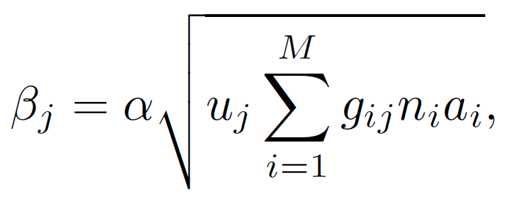
Methods
Distance weight
Similarity weight
Potential function
The prior model, written of the form
was based on the Bowsher model, where only voxels similar in the MRI are considered in the calculation of the prior.
The similarity weight was based on the Burg joint entropy¹:
The hyper-parameter β² is calculated for each voxel j, at each iterations, as
where α is a scanner-dependent constant, and u_{j} is the intensity in voxel j, making β dependent on the statistical noise in that voxel.
PET
MRI
System model, norm and attenuation
¹A. Mehranian et al., PMB (2017) 62 (15) 5975-6007.
²A. Salomon et al., arxiv Physics (2019).

Slide 5
Materials
The method was evaluated with simulated and experimental data.
Simulated data:
Experimental data:
Regional analysis was performed using Statistical Parametric Mapping².
Data were generated using a normal case from the BrainWeb brain database¹ and GATE (v8.1).
The phantom for emission data, attenuation map and T1-weighted were calculated.
22.6 MBq activity of a 5- and 1-minute scans were simulated, resulting in 152x10⁶ and 30x10⁶ trues, respectively.
PET and T1-weighted MRI were acquired on a Biograph mMR.
30 min [¹⁸F]-FDG brain scan of 1 patient with suspected epilepsy (200 MBq, 40min p.i)
20 min [¹⁸F]-florbetapir brain scan of 2 patients with suspected Alzheimer's disease (~370MBq, 50 min p.i)
All scans were re-framed to 5- and 1-minute scans.
¹https://brainweb.bic.mni.mcgill.ca/
²https://www.fil.ion.ucl.ac.uk/spm/software/spm12/

Slide 6
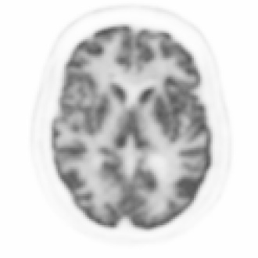
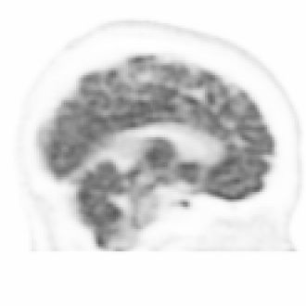
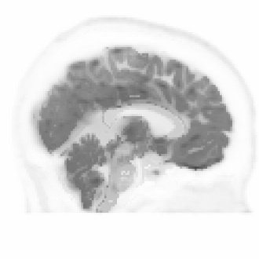
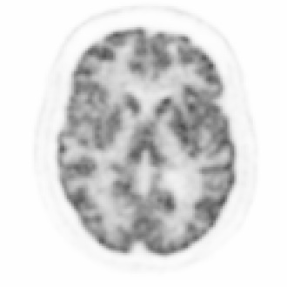
Results – simulated data
OSEM
MRI-guided β=10²
MRI-guided adaptive β
57.0
5-min scan
152x10⁶ trues
[kBq/mL]
1-min scan
30x10⁶ trues
0.0

Slide 7
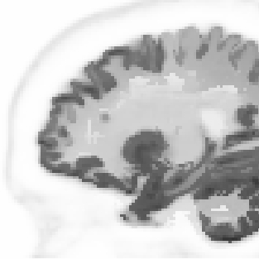
Results – simulated data
Lesions only present in the PET data but absent in the MRI data
MRI-guided adaptive β
Lesions in T1w
MRI-guided β=10²
MRI-guided adaptive β
Lesions NOT in T1w
50.0
5-min scan
[kBq/mL]
1-min scan
0.0

Slide 8
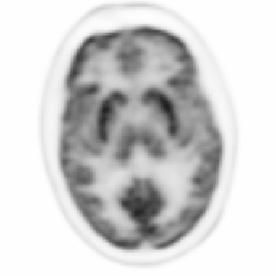
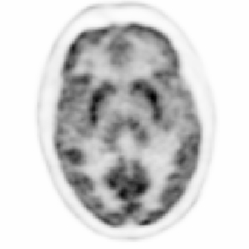
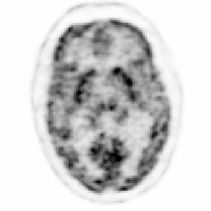
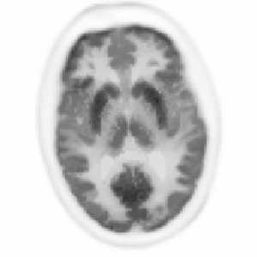
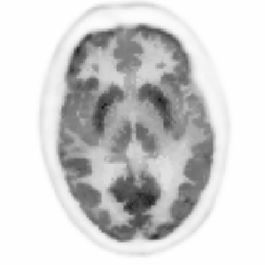
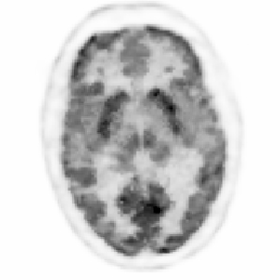
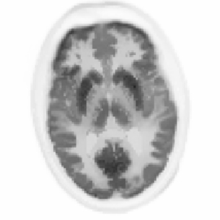
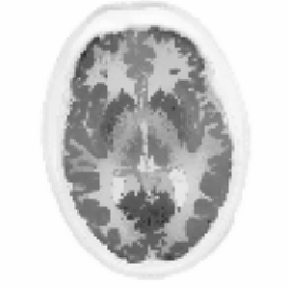
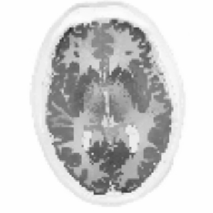
Results – [¹⁸F]-FDG Epilepsy case
30 min
5.4 10⁸ trues
10 min
9.6 10⁷ trues
1 min
1.9 10⁷ trues
PSF
3 iterations
21 subsets
OSEM
30.0
MRI-guided
Adaptive β
[kBq/mL]
[kBq/mL]
[kBq/mL]
[kBq/mL]
MRI-guided
Fixed β (10²)
0.0
Data from Lawson Health Research Institute, London, Ontario, Canada

Slide 9
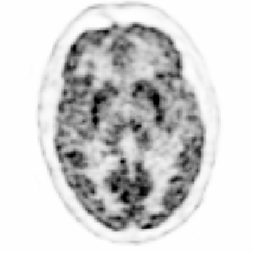
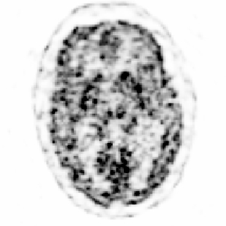
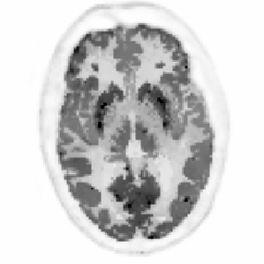
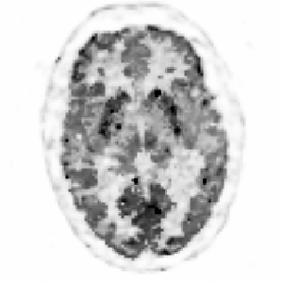
Results – [¹⁸F]-FDG Epilepsy case
30 min
5.4 10⁸ trues
10 min
9.6 10⁷ trues
1 min
1.9 10⁷ trues
PSF
10 iterations
21 subsets
OSEM
30.0
MRI-guided
Adaptive β
[kBq/mL]
[kBq/mL]
[kBq/mL]
[kBq/mL]
0.0
Data from Lawson Health Research Institute, London, Ontario, Canada

Slide 10
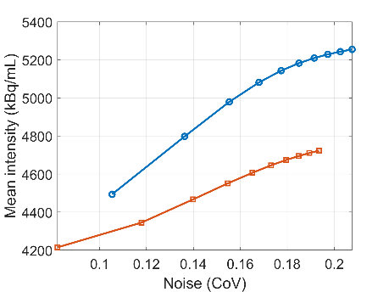
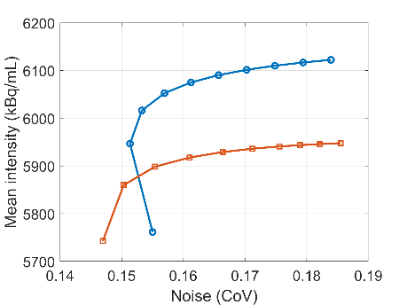
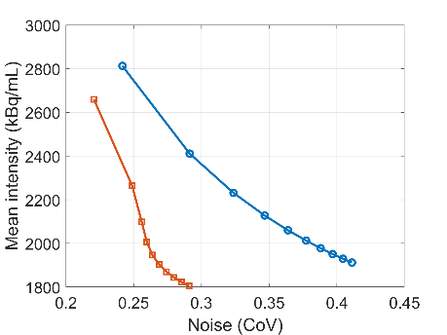
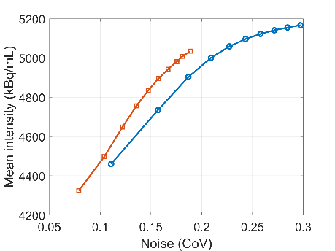
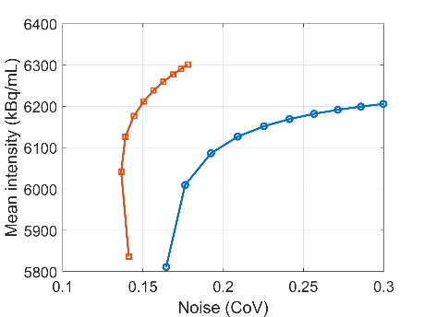
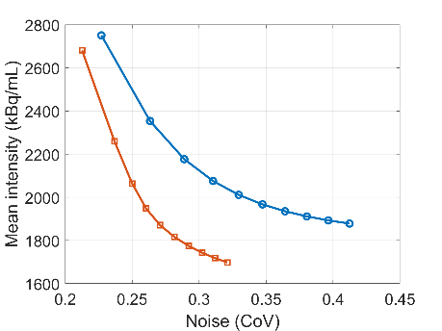
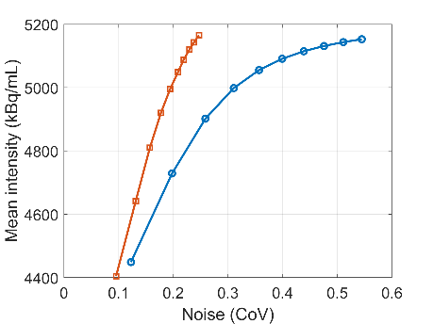
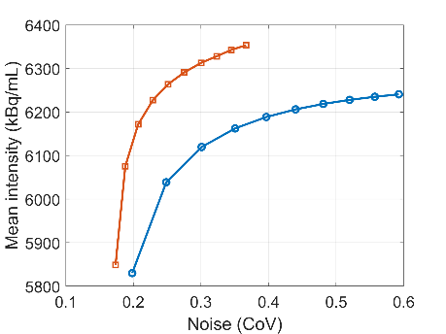
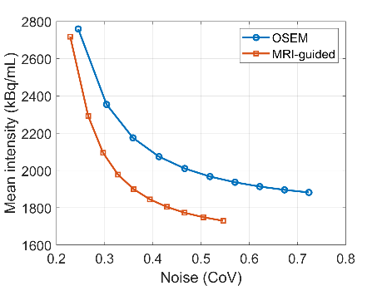
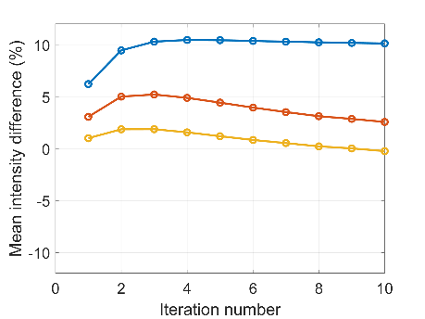
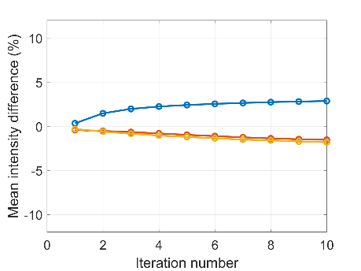
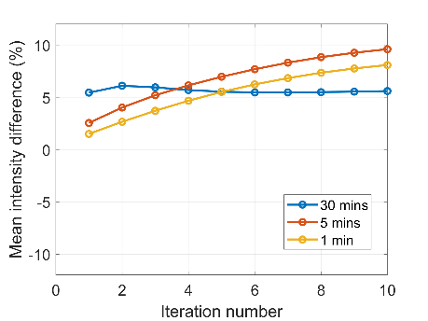
ROI analysis
Hippocampus
Cerebellum
Ventricles
30-min scan
Mean intensity vs noise
5-min scan
1-min scan
Relative difference between OSEM and MRI-guided for the 30-, 5- and 1-min scans.
Data from Lawson Health Research Institute, London, Ontario, Canada

Slide 11
β-amyloid imaging - [¹⁸F]-florbetapir
Patients injected ~375 MBq, scanned for 20 min, 50 min p.i.
Positive amyloid scan
Negative amyloid scan
Data courtesy of Hongyu An from the Mallinckrodt Institute of Radiology, Washington University School of Medicine (St Louis, MO,USA)

Slide 12
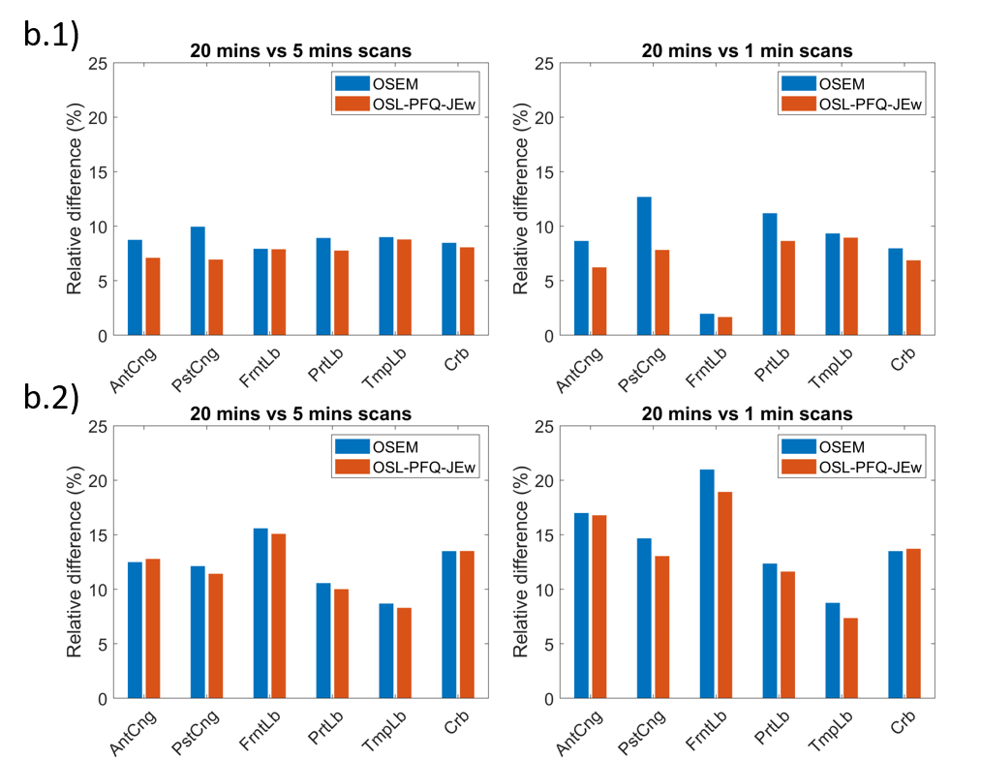
β-amyloid imaging - [¹⁸F]-florbetapir VOI analysis
Regions subject to show β-amyloid deposition.
Taking the 20 min scan as reference, relative difference for the 5- and 1-min scans.
Amyloid⁺ scan
Amyloid⁻ scan
Data courtesy of Hongyu An from the Mallinckrodt Institute of Radiology, Washington University School of Medicine (St Louis, MO,USA)

Slide 13
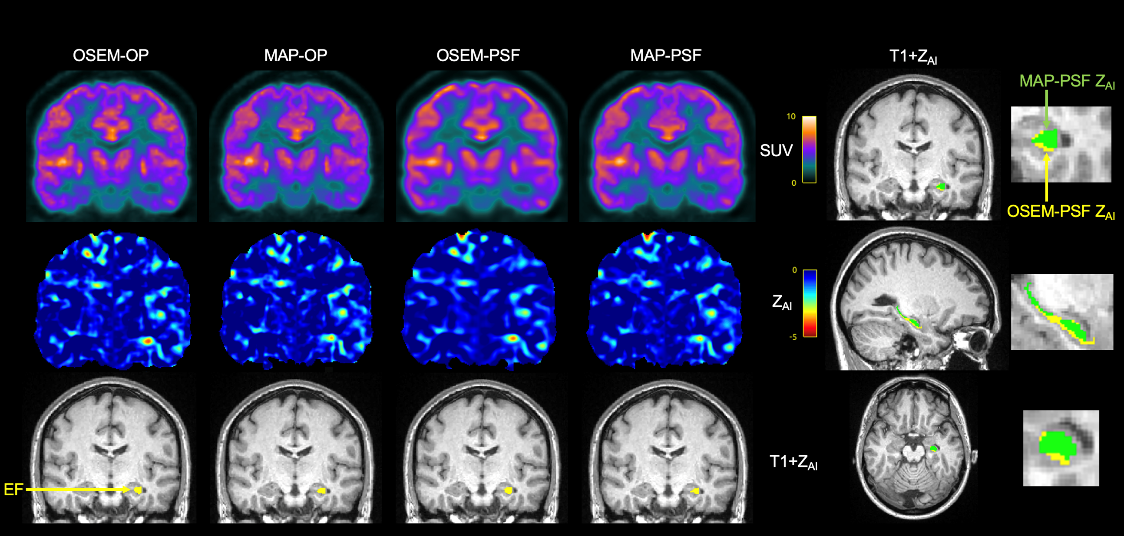
PET Quantification - Epilepsy
Poirier et al EJHI 2020; Poirier et al Epilepsy Research 2021

Slide 14
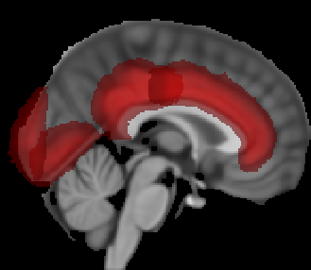
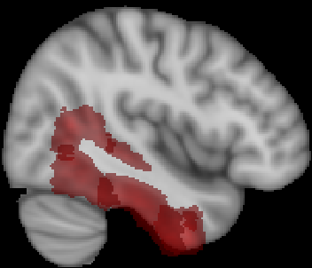
PET Quantification - Epilepsy
20 Epilepsy Patients
Poirier et al EJHI 2020; Poirier et al Epilepsy Research 2021; Raymond et al Brain & Brain PET 2022

Slide 15
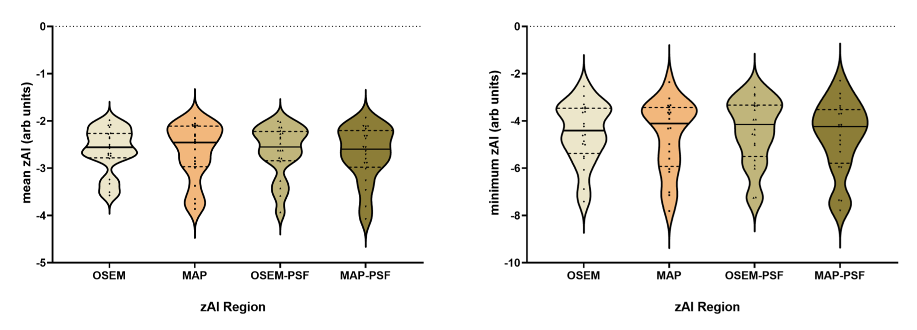
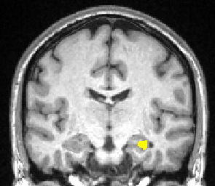
PET Quantification - Epilepsy
20 Epilepsy Patients
T1+Z_{AI}
Poirier et al EJHI 2020; Poirier et al Epilepsy Research 2021; Raymond et al Brain & Brain PET 2022

Slide 16
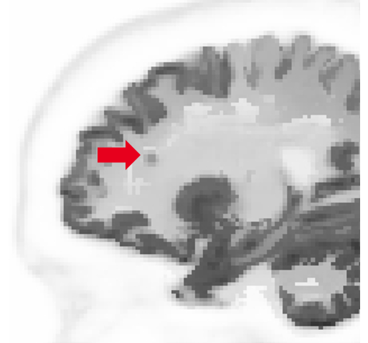
Conclusions
Fixed β showed how the MRI was overly enforced on the PET data for the different levels of statistics, producing in some cases artefacts, noise and loss of PET-only features. The adaptive β did not show this problem at the cost of the MRI not being so enforced.
The clinical cases showed how the usual acquisition time of 20/30 min could be reduced to 5 min without any visible loss of image quality (which could be translated into dose reduction).
The method not only showed to work for more than FDG, but also for activity distributions where the PET does not just follow one type of tissue according to the MRI.
Clinical data showed that differences between OSEM and MRI-guided are <10%. Same comparison with simulated data, comparing to ground truth, is on the way.
Notes:
3rd point. PET shows uniform distribution across white and gray matter in the amyloid case, even though MRI shows a clear division.

