Slide 1

Imaging Gas-Exchange Lung Function using Density-Weighted MRSI and Hyperpolarised ¹²⁹Xe Gas
Rolf F. Schulte¹, Guilhem J. Collier², James Ball², Graham Norquay², Madhwesha Rao², Jim M. Wild²
¹GE Healthcare, Munich, Germany
²POLARIS, University of Sheffield, Sheffield, United Kingdom

Slide 2
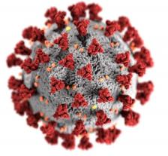
Motivation
Hyperpolarised ¹²⁹Xe: only method to detect lung function spatially resolved
Applications: chronic obstructive pulmonary disease (COPD), asthma and idiopathic pulmonary fibrosis
Long COVID-19: ~10-20% of infected people (pre-omicron) exhibit longer-term damages of lungs, kidneys, heart and brain
Polarean finished Phase 3 clinical trial (lung resection)

Slide 3
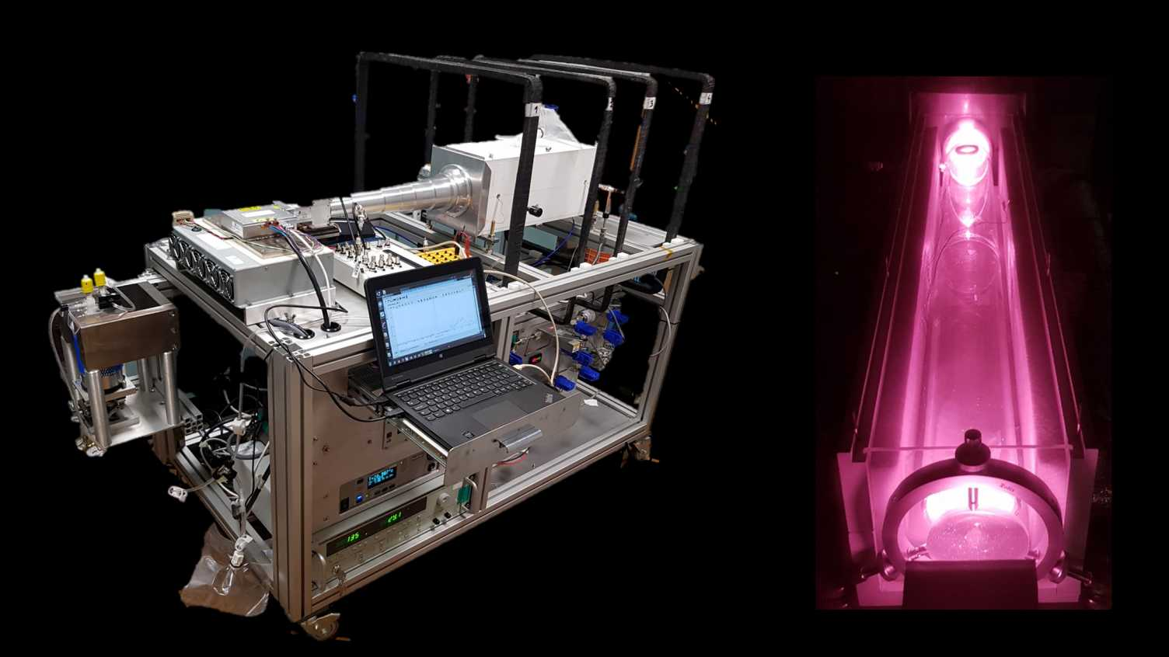

Introduction
Xenon-129: spin-½,
natural abundance=26.4%,
$f_{129Xe}≈1/4∙f_{1H}$ =-35.3MHz @3T
Hyperpolarisation of ¹²⁹Xe gas via Spin-Exchange Optical Pumping (SEOP)
Transport/temporary storage in Tedlar bags (T₁=minutes-hours)

Slide 4
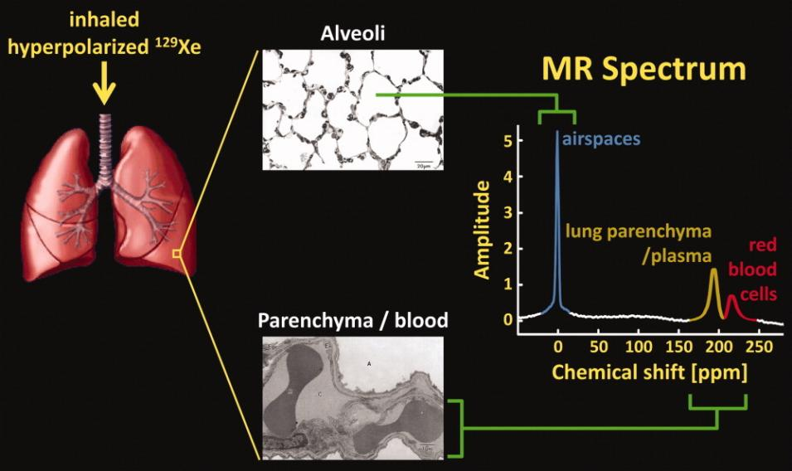
Introduction
Source: Muggler, Altes; review, JMRI 2013; https://doi.org/10.1002/jmri.23844

Slide 5
Introduction
Boundary conditions
T2*≈1ms (3T) or 2ms (1.5T) in red blood cells
Breath-hold < 15s
1-2% signal level of gas phase
Fast uptake (ms)
Chemical shifts: lung gas=1ppm, RBC=218ppm, tissue=198ppm
Published approaches of mapping gas uptake
3D radial 1-point Dixon
2D spiral CSI
3D radial spectroscopic imaging
Goal
Explore 3D density-weighted MRSI
Compare to 3D radial SI
Kaushik SS, Robertson SH, Freeman MS, He M, Kelly KT, Roos JE, Rackley CR, Foster WM, McAdams HP, Driehuys B. Single-breath clinical imaging of hyperpolarized (129)Xe in the airspaces, barrier, and red blood cells using an interleaved 3D radial 1-point Dixon acquisition. Magn Reson Med 2016;75(4):1434-1443.
Doganay O, Chen M, Matin T, Rigolli M, Phillips JA, McIntyre A, Gleeson FV. Magnetic resonance imaging of the time course of hyperpolarized (129)Xe gas exchange in the human lungs and heart. Eur Radiol 2019;29(5):2283-2292.
Collier GJ, Eaden JA, Hughes PJC, Bianchi SM, Stewart NJ, Weatherley ND, Norquay G, Schulte RF, Wild JM. Dissolved (129) Xe lung MRI with four-echo 3D radial spectroscopic imaging: Quantification of regional gas transfer in idiopathic pulmonary fibrosis. Magn Reson Med 2021;85(5):2622-2633.

Slide 6
Methods: Frequency-Tailored Excitation
Excite gas phase with 1% of dissolved phase
Partially self-refocused for reduced TE
Direct linear-LSQ design
For 3T (0.6ms) and 1.5T (1.2ms)

Slide 7
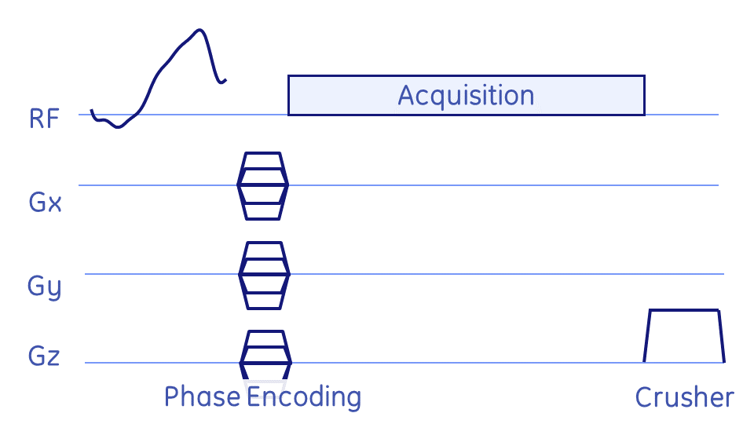
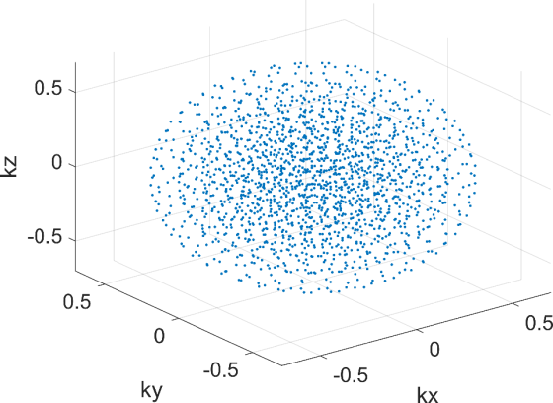
Methods: Density-Weighted MRSI
Impose apodisation during acquisition
Improved PSF & SNR
Peak integration → metabolite maps

Slide 8
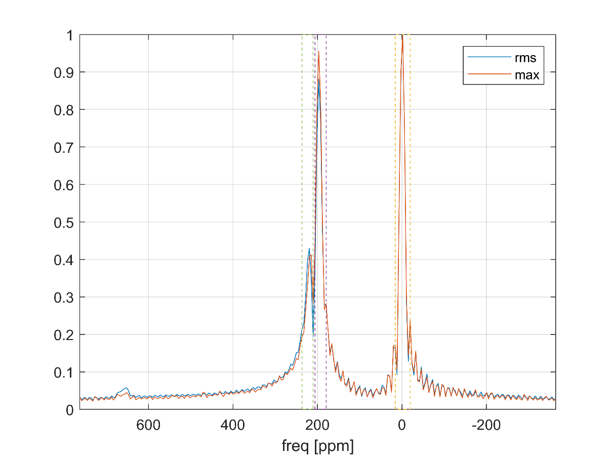
Methods: Reconstruction & Quantification
Density-weighted MRSI
Spectral apodisation
Zero-filling
Slow FT or gridding & FFT
Spectral FFT
Peak integration
Corrections for flip angles, T2*
Mask calculation (threshold)
Maps + (masked) ratio maps

Slide 9
Experimental
Home-built SEOP polariser
MR450w (1.5T) and PET-MR (3T) with MNS
129Xe vest coil (CMRS, MKE)
2 healthy volunteers
Comparison: 2 breath-holds; TR=8ms, flip angle=10° & 0.1°
  3D DW-MRSI: 14×14×7, FOV=30×30×15cm³, voxel size=(2.1cm)³, 1799 phase encodes, 88 spectral points, BW=20kHz, TR=8ms → acq. Time = 14.4s
  3D radial EPSI: voxel size=(2cm)³, FOV=(40cm)³, BW=31.25kHz, 1728 radial projections, 4TEs per projection with ΔTE=0.704ms
Fidall PSD, Matlab reconstruction
1L of enriched 129Xe gas polarised to ~30%

Slide 10
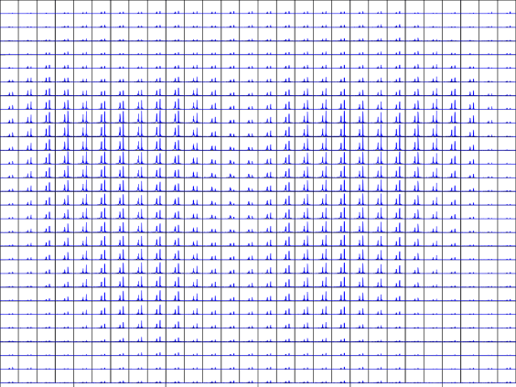
Results

Slide 11
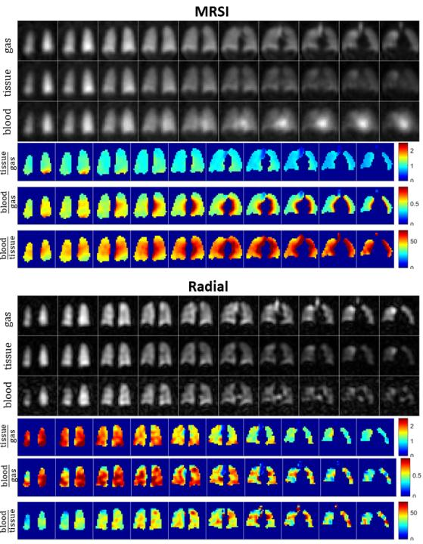
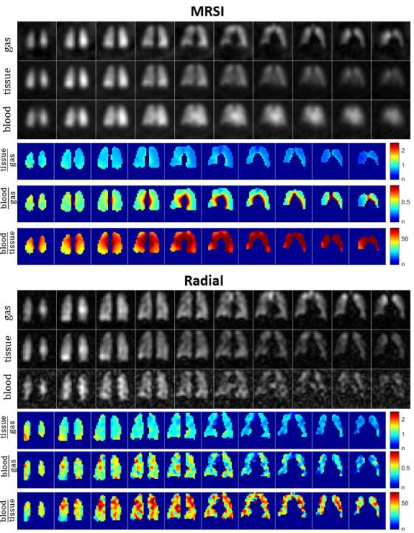

Slide 12
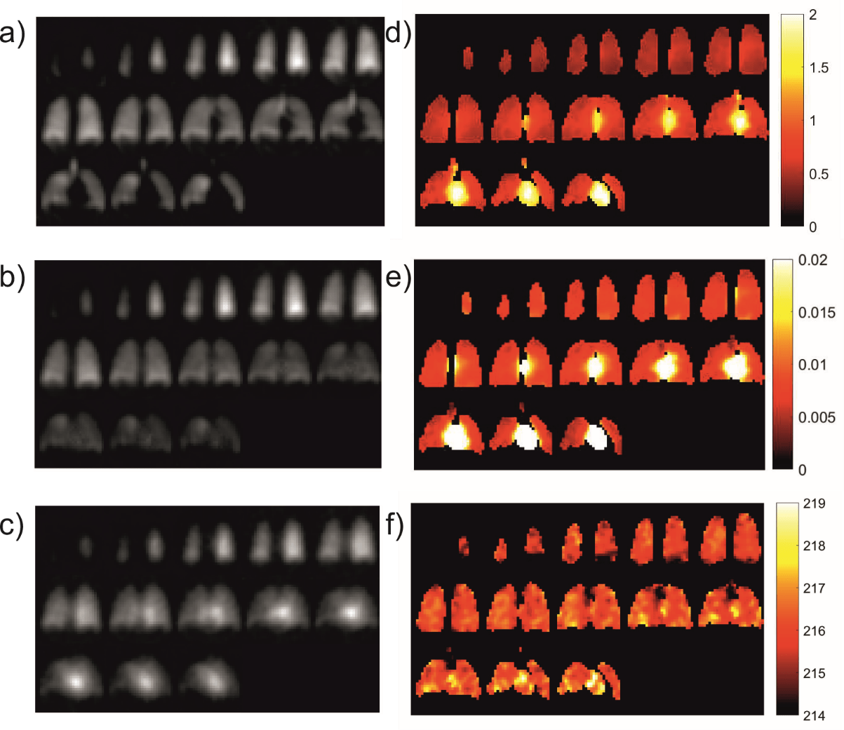
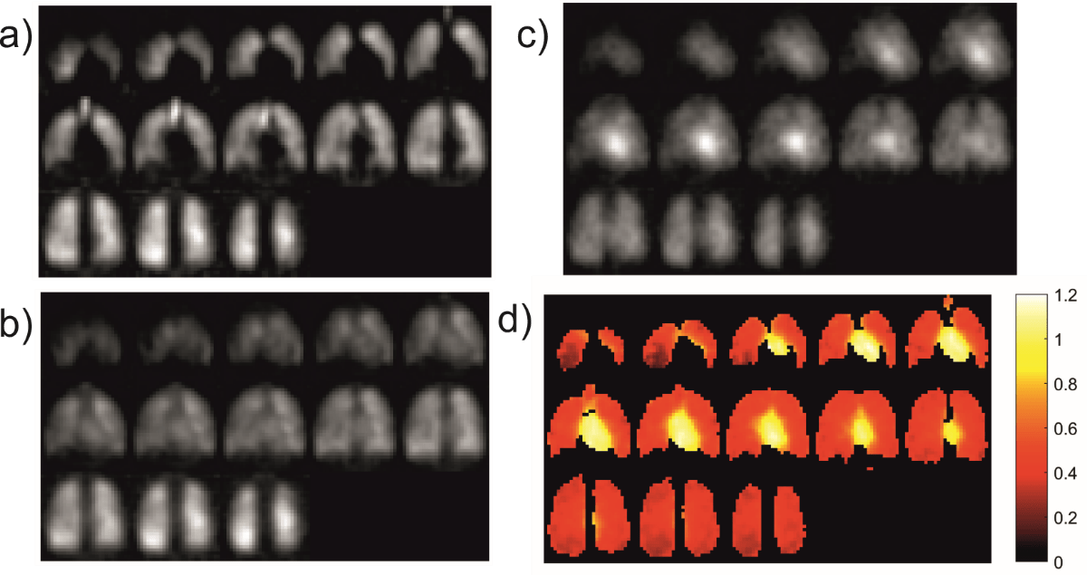
Results
1.5T
3T
gas
blood/tissue
gas
blood
tissue
blood/tissue
tissue
blood/gas
blood
blood-gas shift

Slide 13
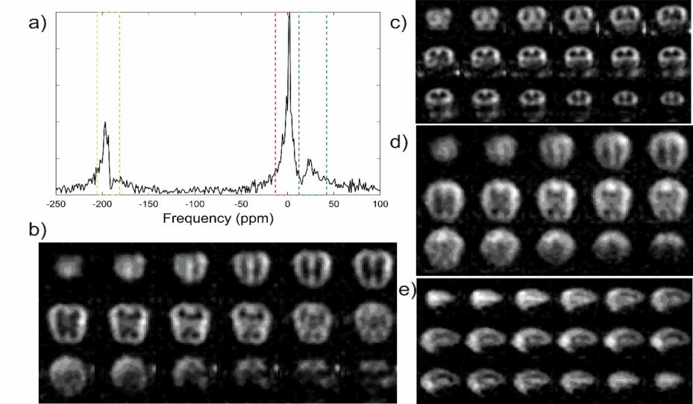
Outlook: 129Xe Brain Perfusion

Slide 14
Discussion and Conclusion
High SNR
Similar values as in literature
Full spectral information → robustness + confidence
RF pulse robust against mis-setting f₀ by 200Hz
Possibly use non-enriched xenon gas (cheaper)
Reconstruction on scanner → exporting dicom’s

