Slide 1
Evaluation of population-based input functions for kinetic modelling of 18F-FDG datasets from a long axial FOV PET scanner
Hasan Sari, Lars Eriksson, Clemens Mingels, Michael E. Casey, Paul Cumming, Ian Alberts, Kuangyu Shi, Maurizio Conti, Axel Rominger
PSMR-TBP 2022
Elba, 2022

Slide 2
I am a full time employee of Siemens Healthcare AG, Switzerland
Disclosure

Slide 3
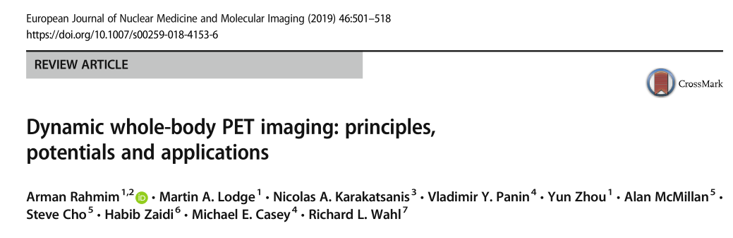
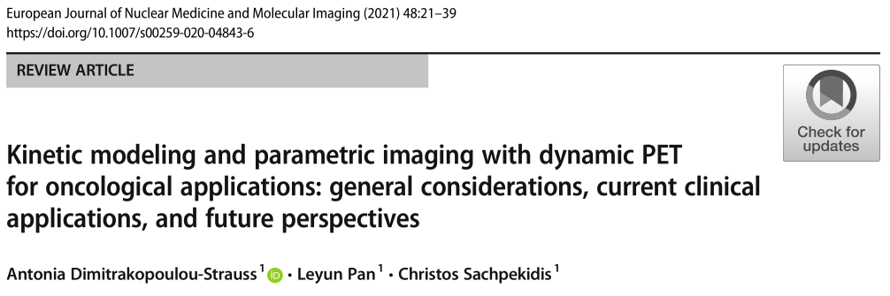
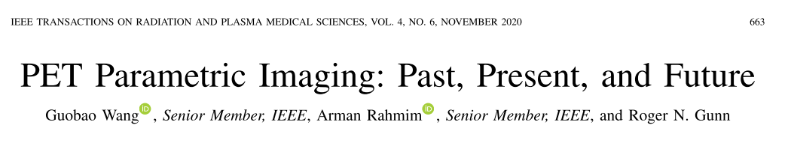
Parametric Imaging
Parametric imaging with dynamic ¹⁸F-FDG PET has shown potential for improved tumour detection, assessing tumour grading or response to treatment
Research on parametric imaging show that kinetic parameters can complement and add value to semi quantitative SUV measurements
Challenge is to understand how best to leverage the recent technological advances to recognise the importance of fully quantitative PET imaging

Slide 4
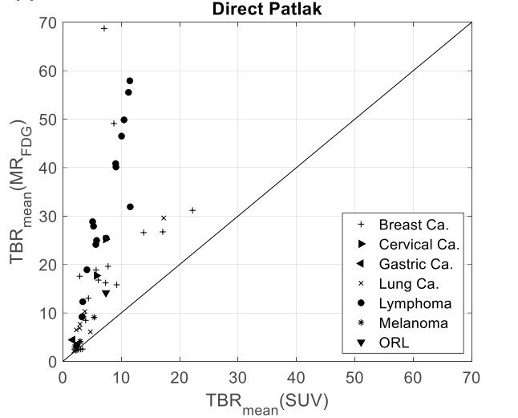
Parametric Images
SUV
MRFDG – Direct Patlak
Sari H. et al., EJNMMI 2022

Slide 5
Abbreviated Dynamic Imaging Protocols for ¹⁸F-FDG
65-minute long dynamic ¹⁸F-FDG acquisitions can be logistically challenging in a busy clinical setting
This limits the number of dynamic scans to 1 or 2 per day (i.e. the first patient of the day)
It is desirable to shorten acquisition duration of dynamic scans to make it more practical in clinic
    Abbreviated scan protocols to capture ¹⁸F-FDG kinetics
    Population-based input functions (PBIFs)

Slide 6
Population-based Input Function (PBIFs)
Can population based input functions, coupled with high sensitvity of LAFOV systems be used to shorten dynamic imaging protocols?
LAFOV PET system can be used to capture the tail of the IDIF curve in abbreviated imaging protocols with potentially less noise to those from SAFOV PET systems
In this work, we evaluate different scan durations
  For scaling of the PBIF
  For time t* : beginning of the range used in Patlak fitting with sPBIF to evaluate the potential of abbreviated Patlak protocols
Bias and precision (standard deviation of bias) of the estimated Patlak Ki values were computed using value estimated with IDIF as reference.

Slide 7

Materials and Methods
15 s
PET
CT
t=0
65 min
24 oncological patients underwent 65 minute ¹⁸F-FDG acquisition using Biograph Vision Quadra (Siemens Healthineers) PET/CT scanner
  4 lung ca., 4 breast ca., 9 lymphoma, 1 fallopian tube ca., 1 gastric ca., 1 cervical ca., 1 ORL
  Mean activity: 231 ± 51 MBq, 3 MBq/kg
¹⁸F-FDG was administered from left or right arm 15 seconds after start of the scan
62 frames: 2 × 10 s, 30 × 2 s, 4 × 10 s, 8 × 30 s, 4 × 60 s, 5 × 120 s, and 9 × 300 s.
Dynamic dataset from 24 subjects were split into 16 training sets and 8 testing sets
  No statistically significant differences were present between the age, weight and injected doses of the two sets (unpaired t-test, p>0.05).

Slide 8

Method
Image derived input functions (IDIFs) were derived from the descending aorta
  The descending aorta VOIs were extracted using a semi-automatic method
The IDIFs were fitted using the Feng’s input function model
Time activity curves were extracted from cerebral grey matter and tumour lesions for evaluation purposes
Cerebral grey matter VOIs were extracted utilizing a standard space ¹⁸F-FDG healthy brain template
A qualified nuclear medicine physician manually delineated 34 tumour lesions from the 8 testing sets using an isocontour tool

Slide 9
Population-based Input Function (PBIFs)
IDIFs are normalized to their AUCs
The normalized IDIFs are corrected for their delays (adjusted to mean delay ~43 sec)
Adjustion for
time delay

Slide 10
Population-based Input Function (PBIFs)
Delay corrected normalized IFs are averaged to generate a PBIF
The generated PBIF is fitted with Feng model
  τ=0.72, A₁=15.9, A₂=0.02, A₃=0.02, λ₁=17.8, λ₂=0.18, λ₃=0.01,
The PBIF is scaled with AUC of image derived blood curve tail with various periods to generate 5 scaled PBIFs for each subject:
  sPBIF_{35-65,} sPBIF_{40-65,} sPBIF_{45-65,} sPBIF_{50-65,} sPBIF₅₅₋₆₅

Slide 11
Population-based Input Function (PBIFs)
Over 8 validation datasets, there were no statistically significant differences between the AUCs of sPBIFs compared to the AUC of the IDIF

Slide 12
PBIF – Effect of PBIF scaling on Tumour K_{i}
We evaluated effects of scaling points on performance of sPBIFs on Patlak Flux parameters
The best performing time window for PBIF scaling was 55-65 minutes (bias 1.5%, SD, 6.8% in tumour lesions).
Notes:
All of the five sPBIFs were able to estimate the tumour lesion Ki with less than 4% bias and good precision (standard deviation of bias < 10%)

Slide 13
PBIF – Effect of scan duration on Tumour K_{i}
We also evaluated use of different values for t* : beginning of the range used in Patlak fitting using sPBIF_{55-65.} Estimates with IDIF and t*=35 min were used as reference.
Results show that 20 minute scan (i.e. 45 – 65 min post injection) is needed to achieve < 15% SD of bias and a 25 minute scan is needed (i.e. 40-65 min p.i.) for <10% SD of bias in tumour lesions.
Notes:
For brain grey matter, 15 minutes of PET data (50 to 65 minutes post injection) was adequate to achieve less than 5% bias and precision error.

Slide 14
Parametric Images
sPBIF₅₅₋₆₅ | RC (%) | Absolute RC (%) | SSIM | PSNR (dB)
t*=35 min | 0.3 ± 0.3 | 0.5 ± 0.3 | 0.998 ± 0.001 | 64.0 ± 3.6
t*=45 min | 0.1 ± 0.0 | 1.0 ± 0.2 | 0.996 ± 0.002 | 55.1 ± 3.5

Slide 15
Conclusion
Results of this study show that abbreviated protocols with a PBIF can serve for accurate Patlak modelling of FDG datasets from a LAFOV scanner.
We demonstrate that with a sPBIF, 20 minutes of ¹⁸F-FDG PET data (45-65 min p.i.) was adequate for accurate kinetic modelling of tumour lesions.
15 minutes (50-65 min p.i.) of ¹⁸F-FDG PET data yielded K_{i} values in brain grey matter with low bias and good precision
These abbreviated protocols exploiting PBIFs can enable wider implementation of quantitative parametric imaging protocols in a busy clinical setting.

Slide 16


Thank you!
Inselspital, Bern, Switzerland
Dr. Clemens Mingels
Dr. Ian Alberts
Robin Schepers
Patrik Caluori
Prof. Ali Afshar-Omorieh
Dr. Paul Cumming
Prof. Kuangyu Shi
Prof. Axel Rominger
Siemens Medical Solutions USA Inc.
Dr. Jicun Hu
Dr. Vladimir Panin
Dr. Vijay Shah
Dr. Maurizio Conti
Dr. Lars Eriksson
Dr. Sven Zuehlsdorff

Slide 17
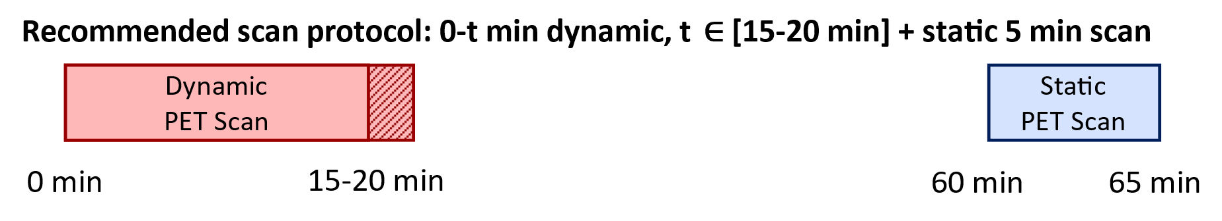
Abbreviated Dynamic Imaging Protocols for ¹⁸F-FDG
One of the major down sides of such a protocol is the requirement for two imaging sessions, including two CTs, and the necessity to register data across the two sets of scans. CT-less solutions might be desirable
Viswanath et al., EJNMMI 2022

