Slide 1



Integrating an annulus-shaped transmission imaging source into the body coil of a PET/MRI system: influence on MR imaging
Woutjan Branderhorst, Jan G.M. Kok, Martino Borgo, Marc Verheyen, Christoph R.L. Lorenz, Marc Tilman, Astrid L.H.M.W. van Lier, Casper Beijst, Volkmar Schulz, Dennis W.J. Klomp, Hugo W.A.M. de Jong
29 May 2022

Slide 2
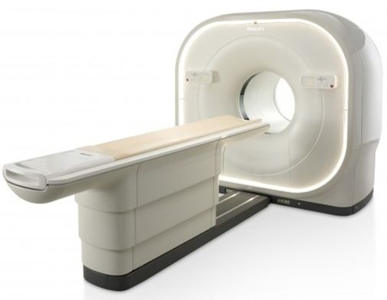
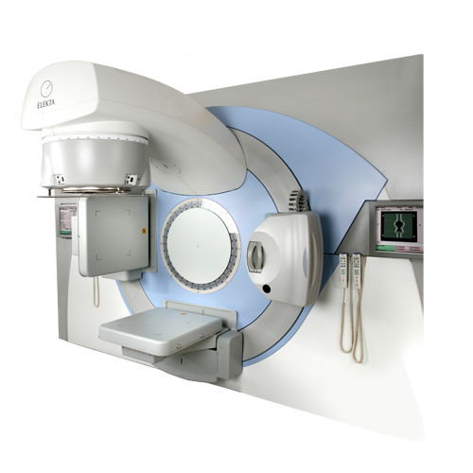
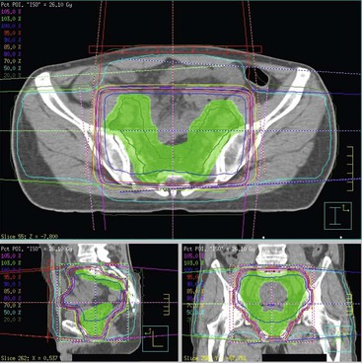
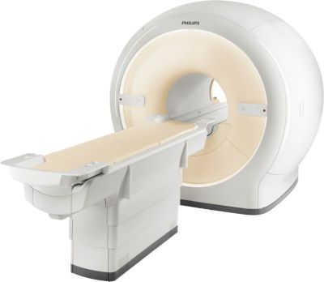
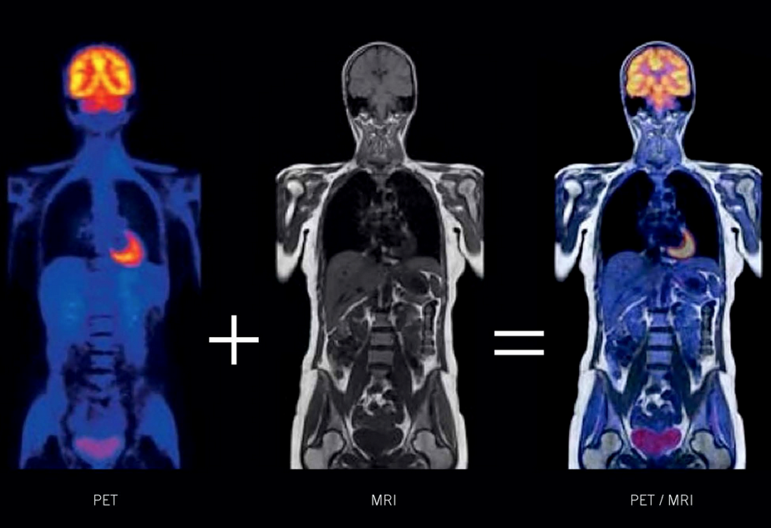
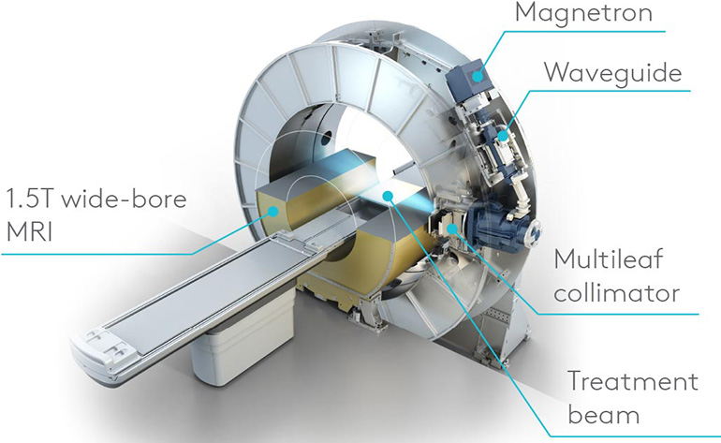
The PET/MRI system developed in the UMCU
(PET/)CT
Dose planning
Conebeam CT
Radiation therapy
Current
practice
MRI
Envisioned workflow
PET/MRI
Dose planning
MRI and radiation therapy
MR-to-pseudoCT
Position verification

Slide 3
Attenuation maps in PET/MRI
Current state-of-the-art iterative PET image reconstruction requires attenuation maps (µ-maps) for attenuation and scatter correction
Possible ways to obtain µ-maps:
  In PET: transmission (TX) scan
  In PET/CT: derive from CT scan (bi-linear scaling)
  In PET/MRI:
    Estimate from emission data
    Derive pseudo-CT from MR image (segmentation / atlas / deep learning)

Slide 4
Pseudo-CT from MRI: current status in clinic
Methods are typically made specific for a certain body part
Robustness varies
  Brain: good
  Pelvis, head/neck: quite good, still some exclusions
  Other (e.g. lung): poor (or no method available)
Current methods are inflexible and require much attention
  Patient positioning must match the training set very closely
  Automatic and manual checks needed to detect errors
  Exclusions for implants, pathologies, anatomical deviations
Currently no flexible and robust method for the entire body

Slide 5
Challenges in deriving pseudo-CT from MRI
Subject-specific anatomical deviations / pathologies
Tissue segmentation / classification errors
Workflow delay (additional MRI sequence takes time)
Long scan times required for visualizing bone in MRI
Truncation due to limited MRI field of view
Susceptibility artifacts due to (metallic) implants
MRI-invisible hardware components with unknown location
Many problems were solved, but could also potentially be avoided; they are not an issue with a transmission scan

Slide 6
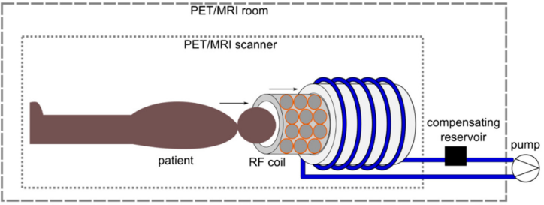
Transmission scan insert systems for PET/MRI
Fixed annulus
hose with F-18
(Mollet 2014)
Single torus with
bed movement
(Bowen 2016)
Rotating point source
(head coil)
(Navarro de Lara 2019)
DOI 10.2967/jnumed.113.125989 DOI 10.1088/0031-9155/61/15/5547 DOI 10.3390/s19153297

Slide 7
Why investigate integration of transmission scan systems into the UMCU PET/MRI scanner?
To facilitate the main goal of MRI-Linac treatment planning, the following characteristics are desirable:
Total-body, to localize tumors/metastases in any body part
Flexible, ideally: allowing any kind of positioning needed for MR-Linac treatment
Robust, the goal is an MR-only workflow, no extra CT scans
Fast, preferably no extra scan time
Wide-bore, no exclusions due to a reduction in bore size
Not possible with current pseudo-CT systems or TX inserts

Slide 8
Extra benefits and considerations
The attenuation maps can also be used for radiotherapy dose planning, making the workflow more robust and flexible
Increase in radiation dose is negligible compared to therapeutic dose
The system can be used to generate training data for further development of pseudo-CT methods

Slide 9
Goals of this study
To test the feasibility of integrating a transmission source into the UMCU PET/MRI system while maintaining bore size
To study the impact of adding this source on MRI performance, more specifically on these characteristics:
  Potential of generating fold-in artifacts
  B0 homogeneity
  B1 homogeneity
  Signal-to-noise ratio

Slide 10
Choice of transmission source type
Not designed / optimized for simultaneous emission and transmission scanning
Only demonstrated for brain
Requires complicated system for tracking location of transmission source
Approach Mollet (2014) chosen

Slide 11
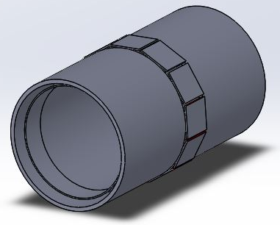
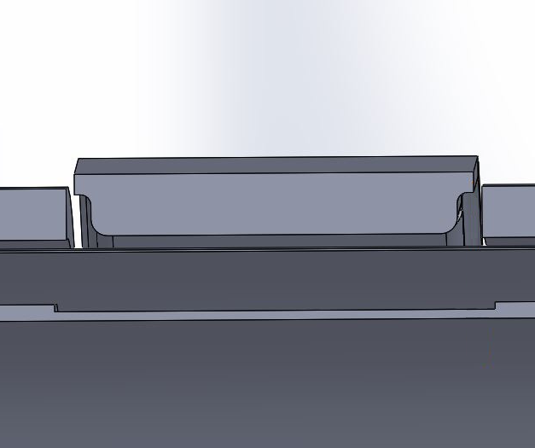
Integrating the hose into the UMCU system
PET module housing
Gradient coil
RF shield
15 mm
Body coil carrier
Hose dimensions:
Inner Ø 6 mm
Outer Ø 8 mm
Total liquid volume
in annulus: 2.6 dm³
150 mm
Transmission source
Bore diameter maintained! But very close to body coil rungs…

Slide 12
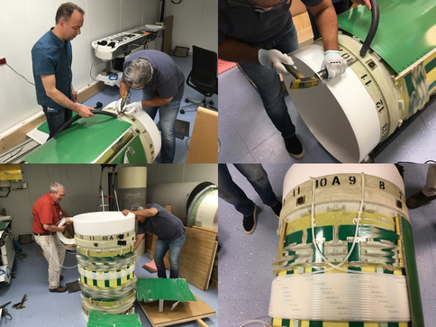
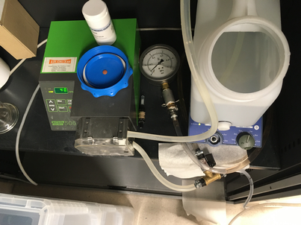
Creating the demonstrator
We adapted a separate body coil dedicated to the project
Annulus created by adding hose at the proposed location
Implemented system with peristaltic pump to fill hose with demineralized water (FDG in the future)
Filling took 7:30 minutes

Slide 13
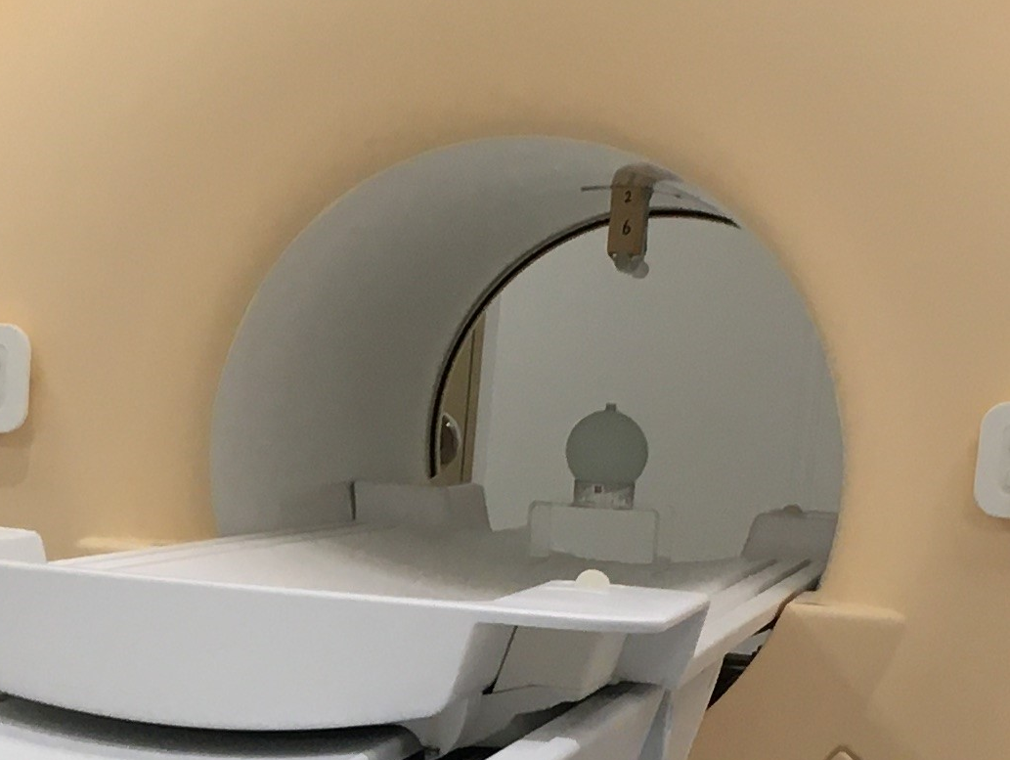
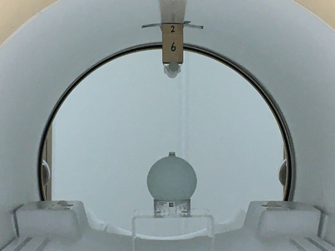
Methods - investigating potential fold-in artifacts
Syringe (tap water)
Distance to body coil carrier was varied
Phantom
(copper sulphate)
3-D MRI sequence performed:
TE=1.44 ms
TR=20 ms
FOV 120x120x70 mm
Fold-in suppression switched off
Non-selective RF pulse

Slide 14
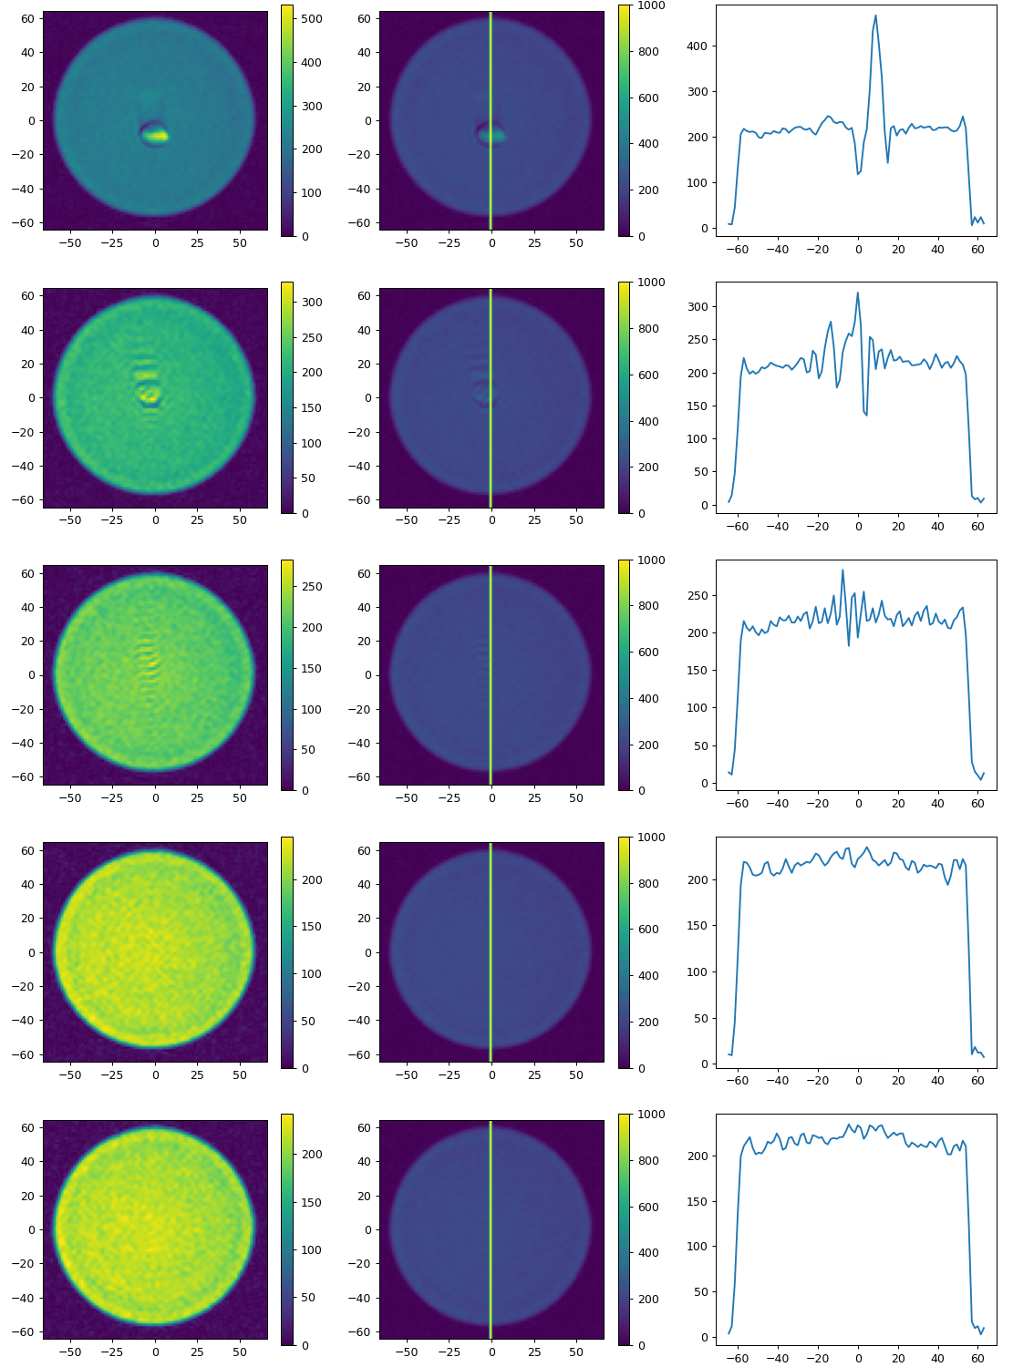
Results with syringe at varying distances
Fold-in artifact disappears when syringe is close to body coil carrier (BCC)
Increased B0 inhomogeneity
Offset of Larmor frequency beyond RF pulse bandwidth
8 cm from top BCC
6 cm from top BCC
4 cm from top BCC
2 cm from top BCC
0 cm from top BCC
Good place to integrate the annulus!
Profile location
Distance to isocentre [mm]

Slide 15
Methods - Influence of annulus on MRI
Both with an empty hose (air), and after filling it with demineralized water, we performed
The same 3-D short TE sequence as described before
Standard B0 map sequence
Standard B1 map sequence (actual flip angle method)
Signal-to-noise measurement:
  10 repetitions of standard performance test (SPT)
  Average S/N (B) value in (B10:MS,SE,30)
  (transversal quadrature body coil image quality test)
All tests performed on standard 1.5T body phantom

Slide 16
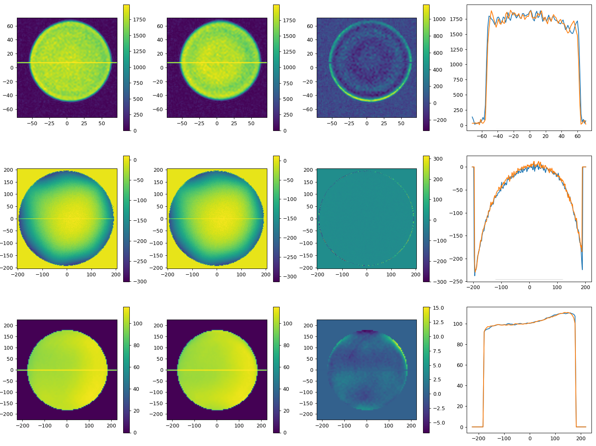

Results with / without water in annulus
with water
without water
difference
Short TE
sequence
Arbitrary units
B0 map
Deviation from resonance frequency [Hz]
Almost no difference
B1 map
% of reference B1
142.43 ±2.1
143.89
±2.4
Distance to isocentre [mm]
SNR

Slide 17
Conclusion
It is possible to integrate an annulus-shaped transmission source into the body coil of a wide-bore PET/MRI system
  without affecting MRI performance
  without sacrificing bore size
Important step towards enabling a flexible and robust one-stop pipeline for PET/MRI-guided radiotherapy

Slide 18
Special thanks!
Jan Kok
Martino Borgo
Dennis Klomp
This collaboration project is co-funded by the PPP Allowance made available by Health~Holland, Top Sector Life Sciences & Health, to stimulate public-private partnerships.
Powered by Health~Holland,
Top Sector Life Sciences & Health.

