Slide 1
Design of the BrainPET 7T Project’s UHF MRI-Compatible PET Modules based on the Hyperion III Platform
Florian Mueller¹, David Schug^{1,2}, Bjoern Weissler^{1,2}, Harald Radermacher¹, Karl Krueger¹, Laiyin Yin¹, Vanessa Nadig¹, Adalbert Mazur³, Axel Honné³, Jürgen Collienne⁴, Manfred Lennartz⁴, Dirk Grunwald⁴, Chang-Hoon Choi⁵, Jörg Felder⁶, Jürgen Scheins⁵, Debora Niekaemper⁵, Christoph Lerche⁵, N. Jon. Shah⁵, and Volkmar Schulz^{1,2,7,8}
1 Department of Physics of Molecular Imaging Systems, Institute for Experimental Molecular Imaging, RWTH Aachen University, Aachen, Germany
2 Hyperion Hybrid Imaging Systems GmbH, Aachen, Germany
3 Scientific Workshop University Hospital RWTH Aachen, RWTH Aachen University, Aachen, Germany
4 Central Institute of Engineering, Electronics and Analytics 1, Forschungszentrum Jülich, Germany
5 Institute of Neuroscience and Medicine 4, Forschungszentrum Jülich
6 Affinity Imaging, Jülich, Germany
7 Physics Institute III B, RWTH Aachen University, Aachen, Germany
8 Fraunhofer Institute for Digital Medicine MEVIS, Aachen, Germany

Slide 2
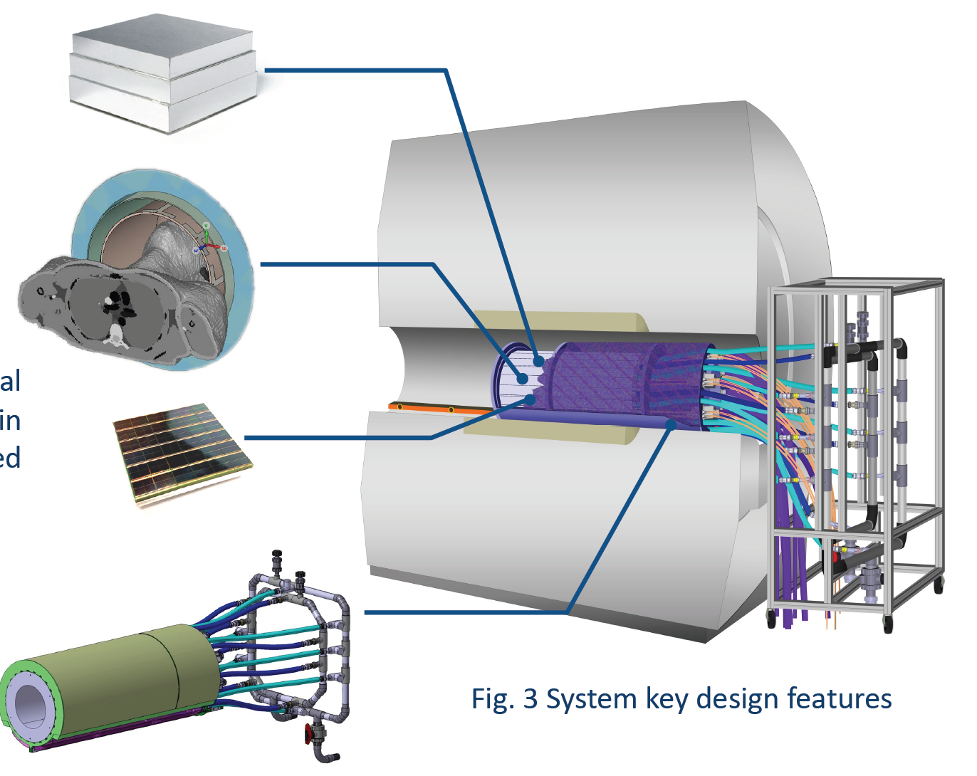
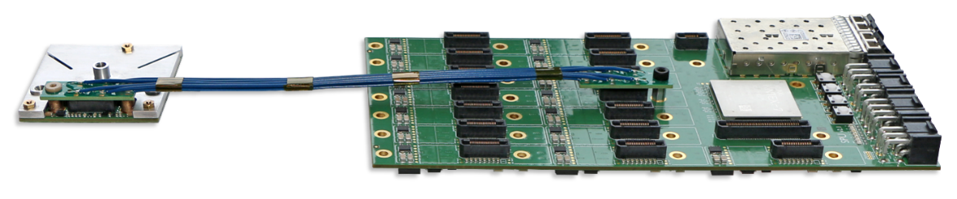
Overview BrainPET 7T Scanner
3-layer LSO detector with 2 mm crystal-pitch, total thickness 24 mm, 1634 crystals
511 keV Gamma transparent, 8 channel TX/RX head coil
Hyperion III PET platform
Gantry with integrated cooling, rear opening for visual stimulation
Figure adapted from Lerche et al., DGN 2020

Slide 3
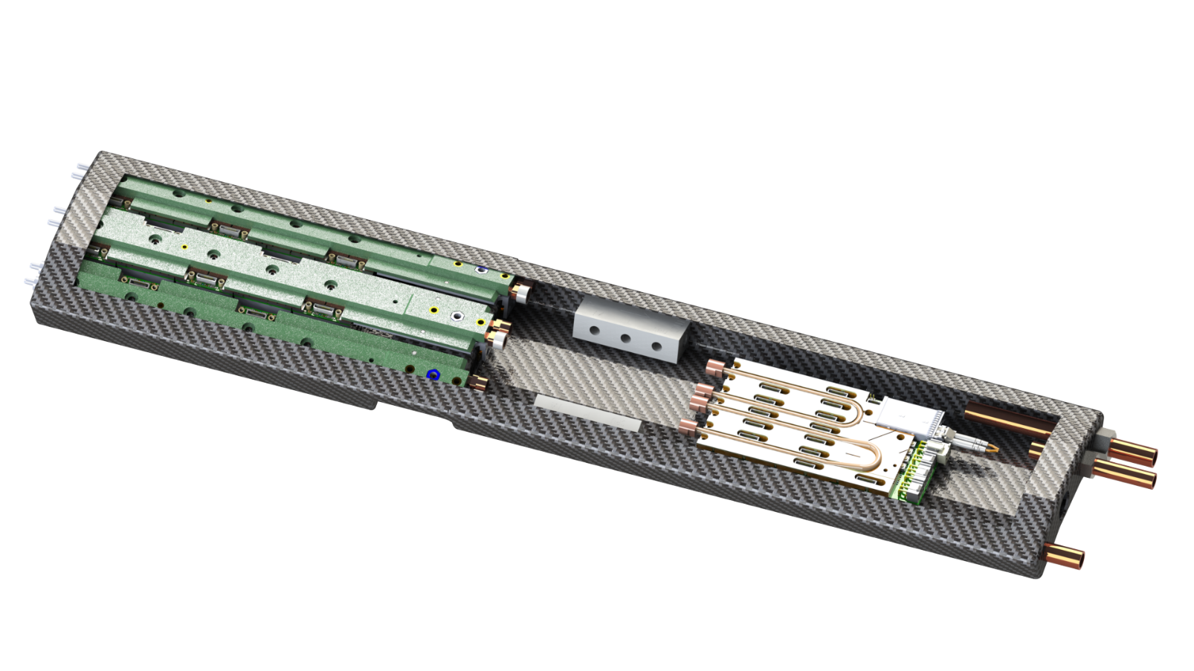
Design Overview of BrainPET 7T Insert
RWTH contribution to the HVF-Project:
Modules and its main components
  RF shielding
  Cooling infrastructure
  Entire module PET electronics
Advice/support for the system design, development of the other components and system integration
8 x

Slide 4
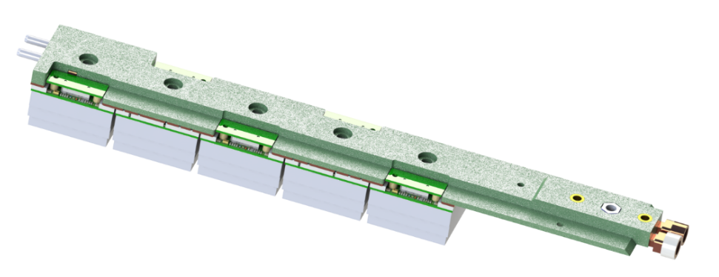

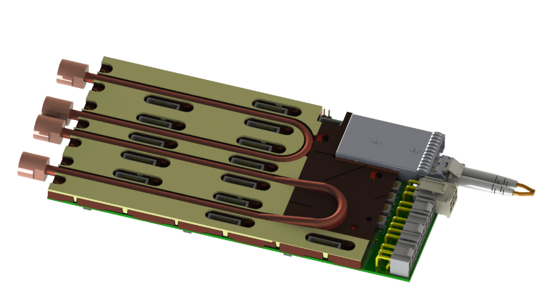
The PET Module
populated M&C structure
Carbon fiber module housing to shield RF
Module divided into
a) detector area and b) infrastructure area
Highly-integrated mounting & cooling (M&C) structure; liquid cooling
3×5 PET detectors connected to
a mainboard
Complete module follows a mechanically floating design for mechanical connections (kinematic mountings)
⇒ no thermal stress, fully constrained
mainboard incl. cooler
1 2 3 4 5
1 2 3
detector stack area
infrastructure area

Slide 5

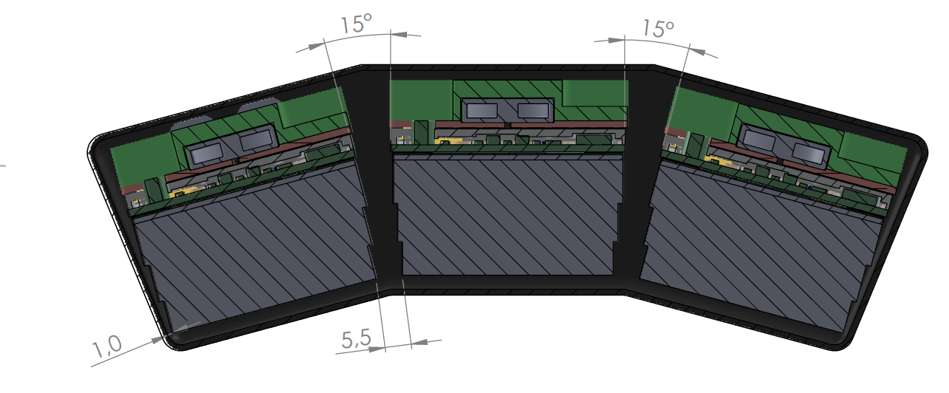
Carbon Fiber RF Shielding
section view
Expected shielding effectiveness of 30-40 dB @ 300 MHz (there is additional shielding around head coil)
All detectors are placed equidistantly in radial direction due to symmetry for reconstruction
  Very tight mechanical tolerances
Different thickness of carbon fibers for detector and infrastructure area
⇒ Establishing of a manufacturing process
with an inner and outer mold

Slide 6
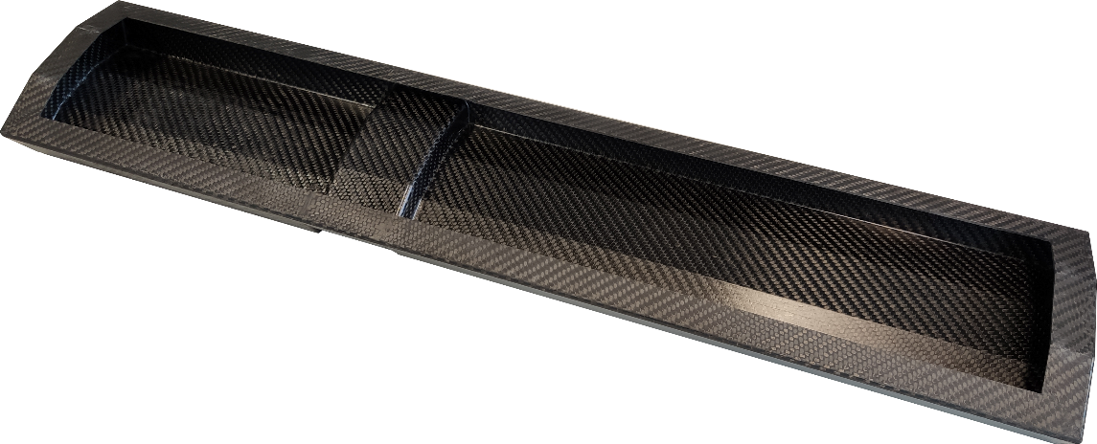
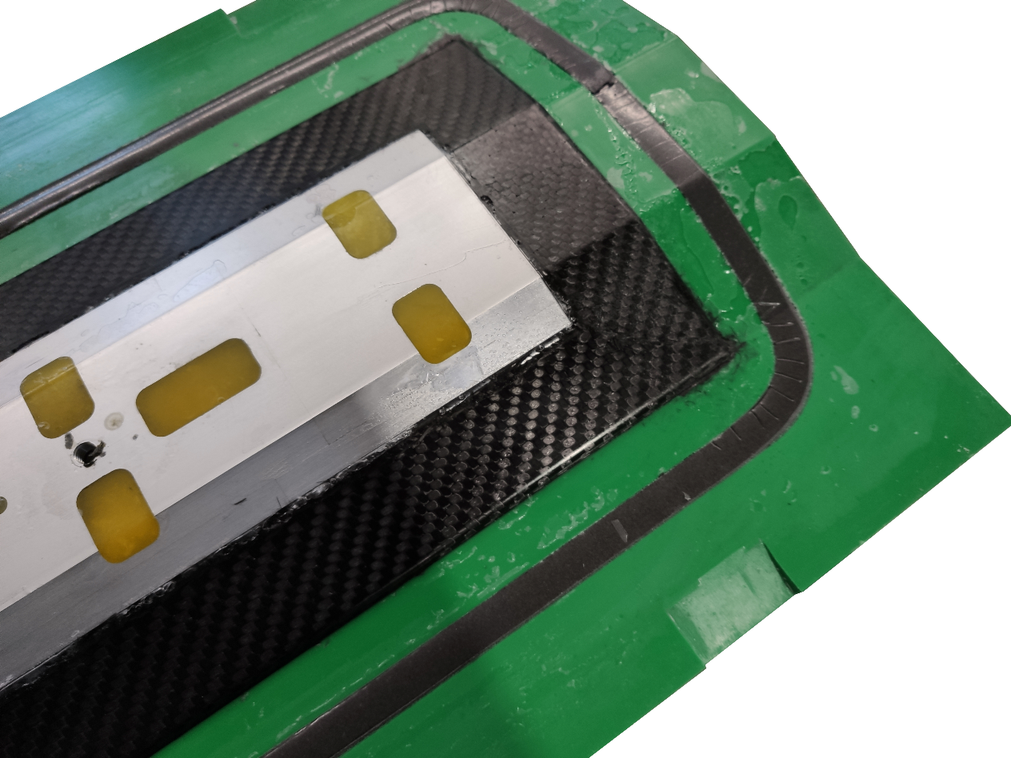
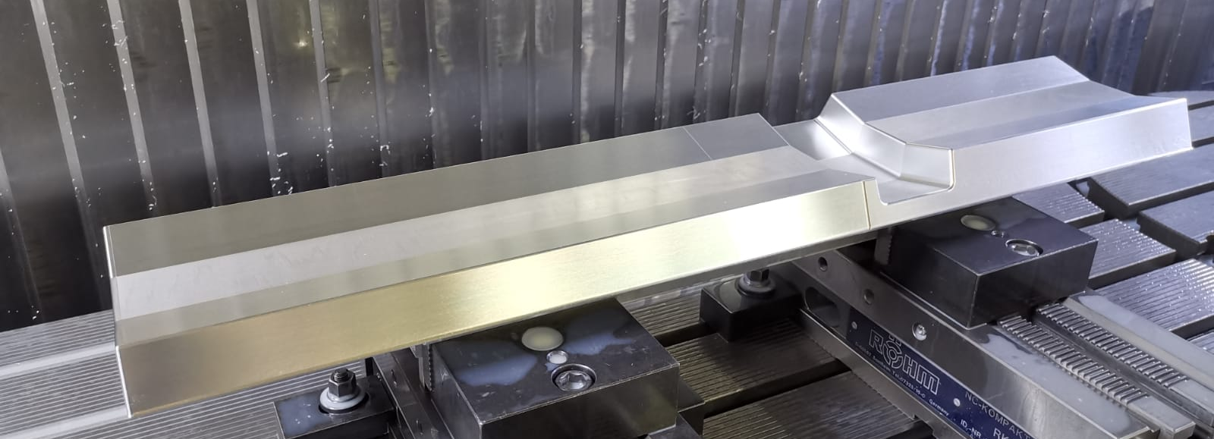
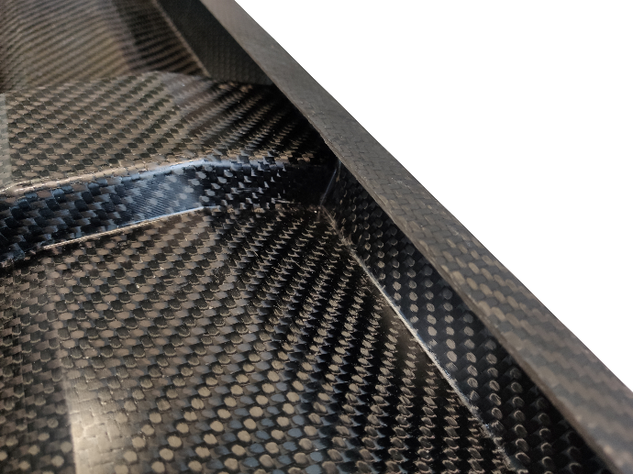
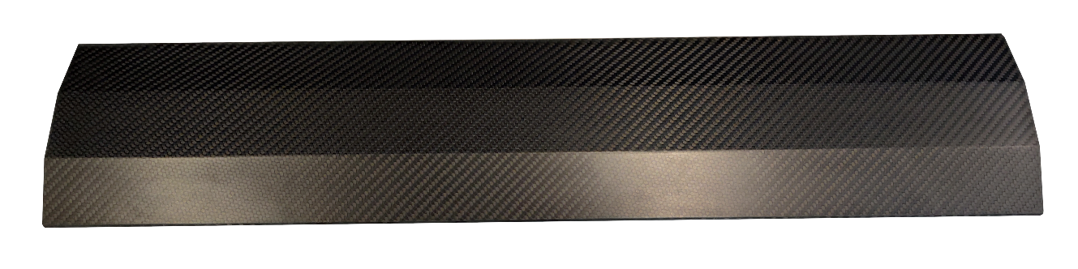
Manufacturing of Carbon Fiber Housing
Inner aluminium mold consists of separable parts
Two piece outer mold
Production
  Layup of carbon fiber and closing of the outer mould
  Filling with resin and curing agent
  Demould in multiple steps
  Inserting holes, grinding, …
Lid to close module

Slide 7
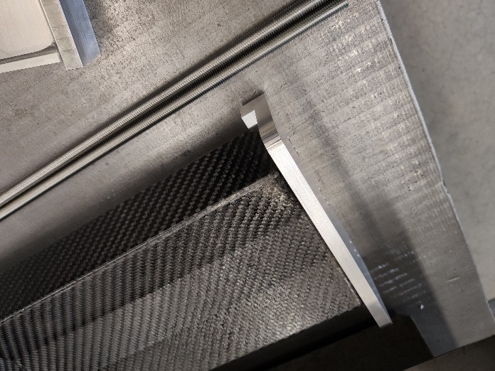
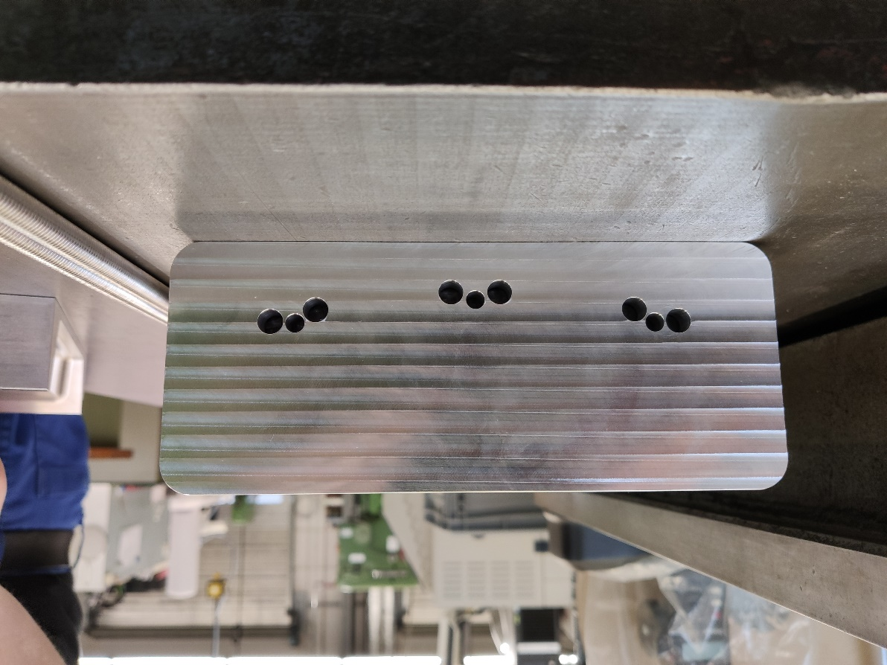
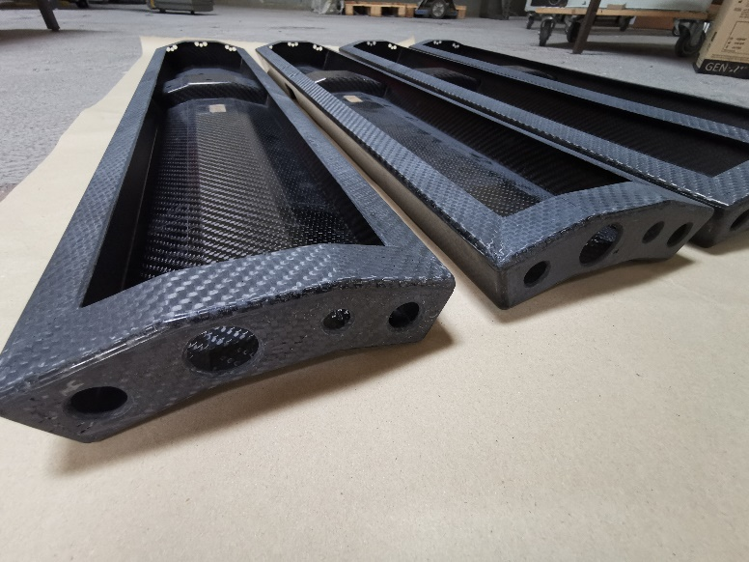
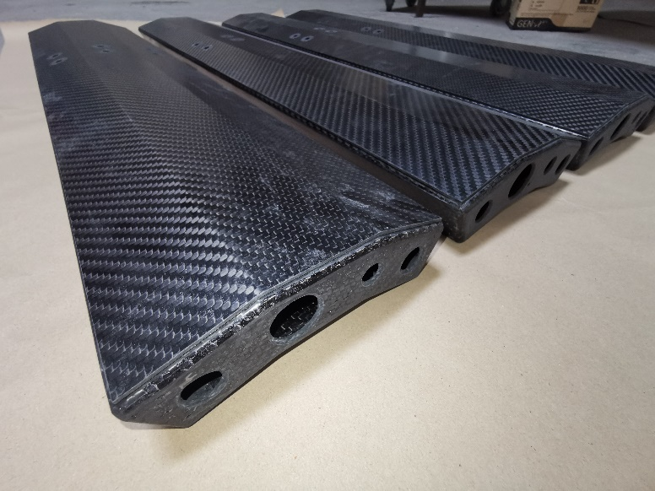
Carbon Fiber Housings – Series Production
Series of 12 housings and covers
Dedicated drilling templates
Grinded surfaces for better contact of gaskets to carbon fiber

Slide 8
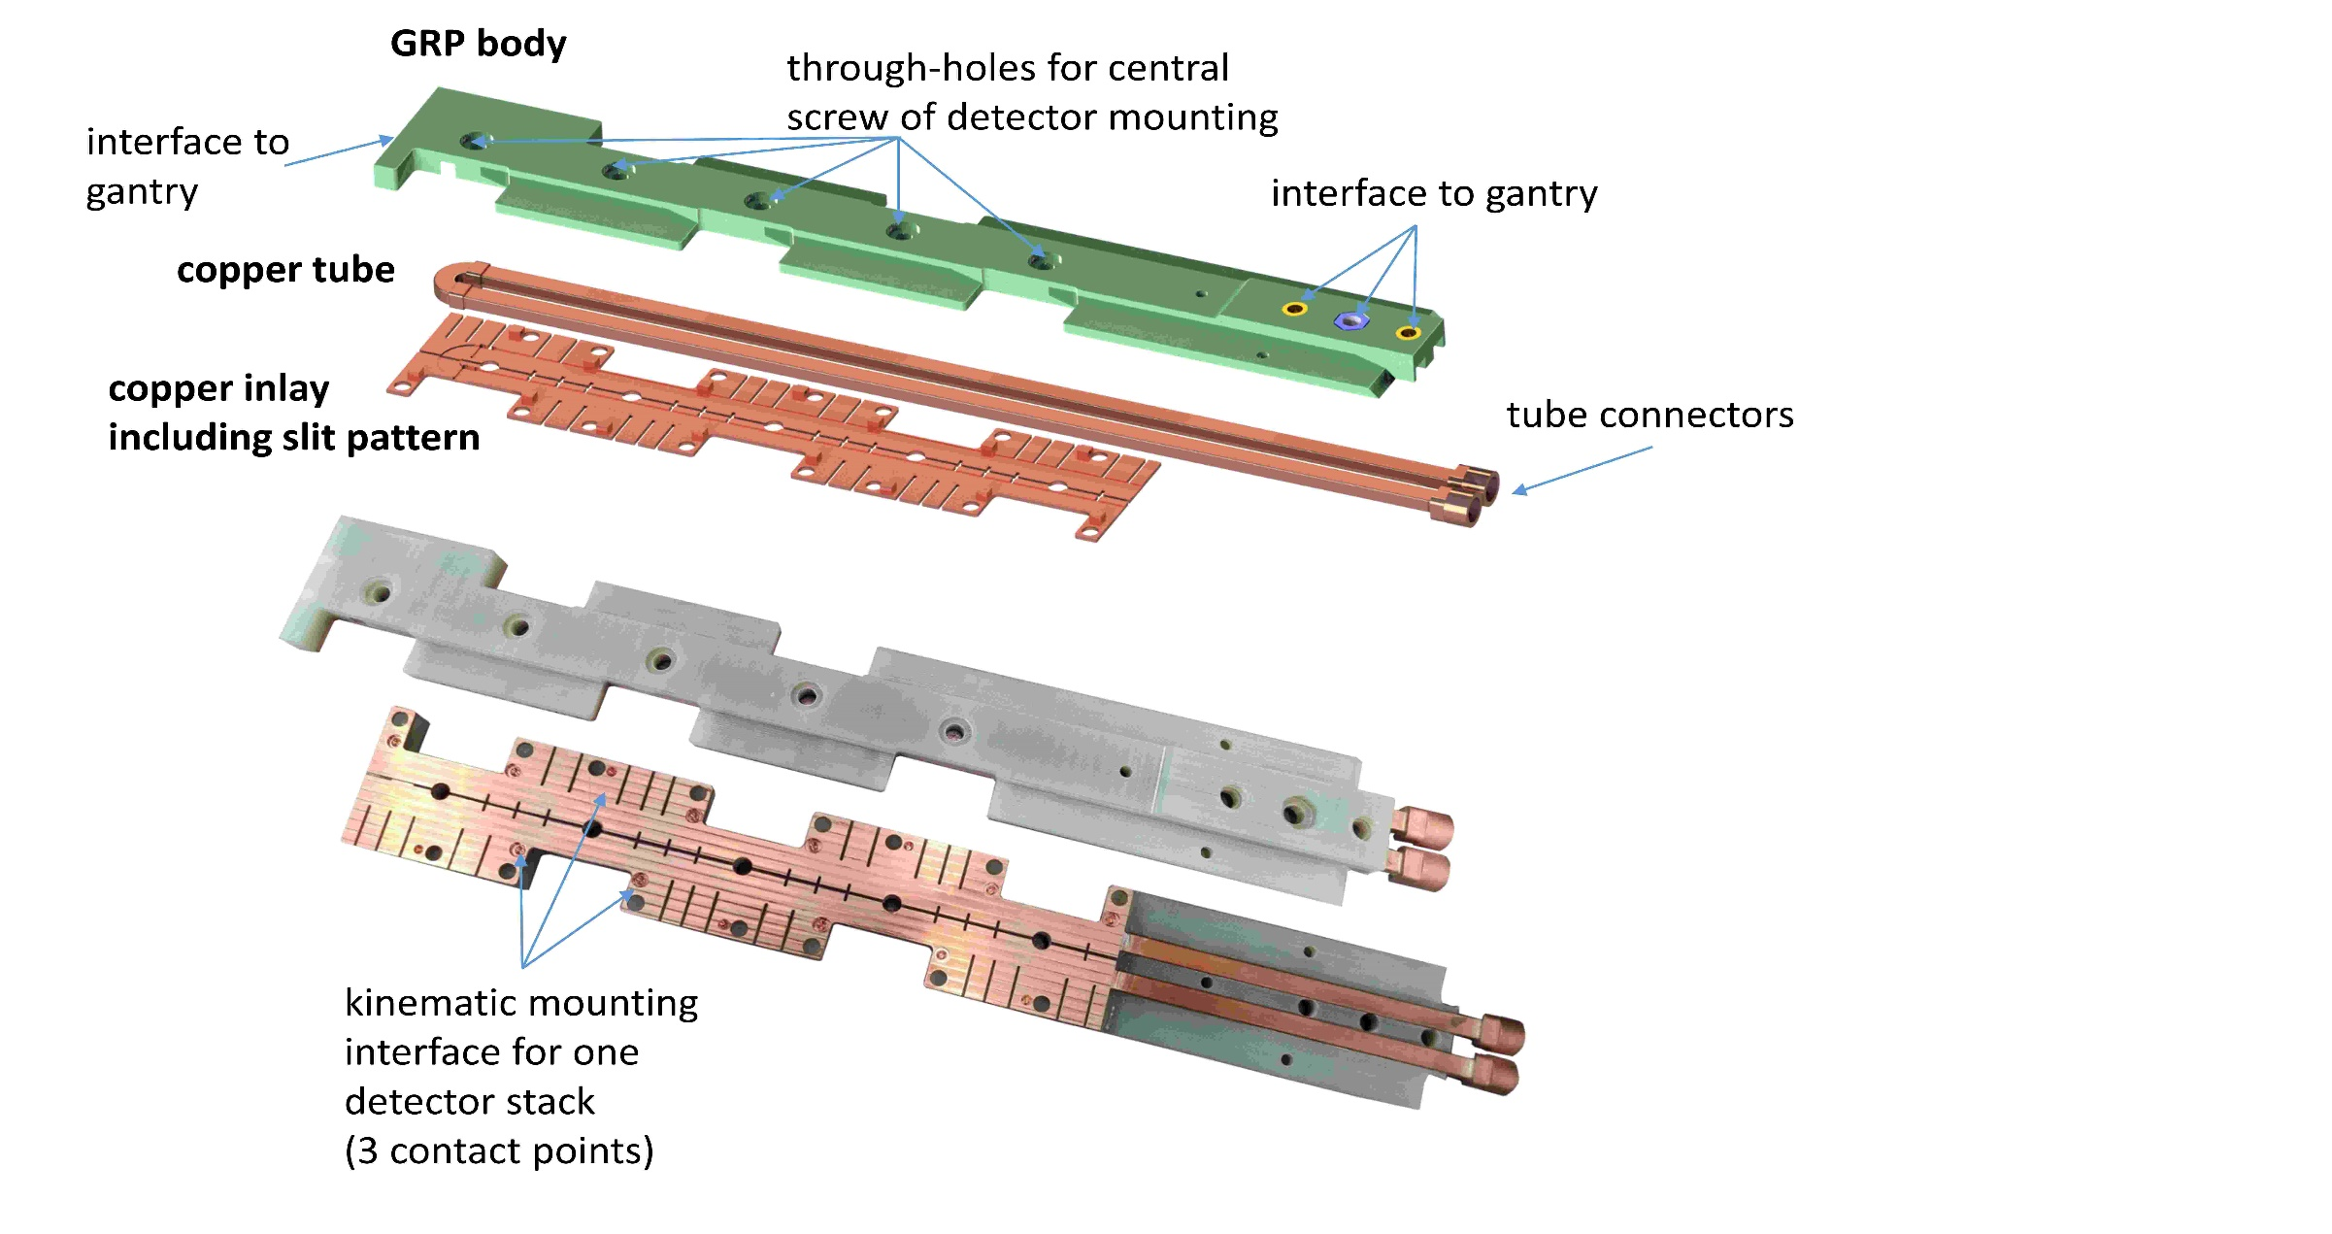
Mounting & Cooling (M&C) Infrastructure
Glass fiber (GRP) body provides stability
Cooling by copper inlay
Composite design allows highly structured surface of copper inlay → reduction of Eddy currents
Connection to the gantry

Slide 9
Manufacturing and Performance
Manufacturing:
Multiple machining steps
Inserts for mounting of structure to gantry
Slits for reduction of Eddy currents
Performance:
Temperature homogeneity better than 1 K over whole M&C structure
Repeatable precision of a few microns for detector mounting by kinematic mounting

Slide 10

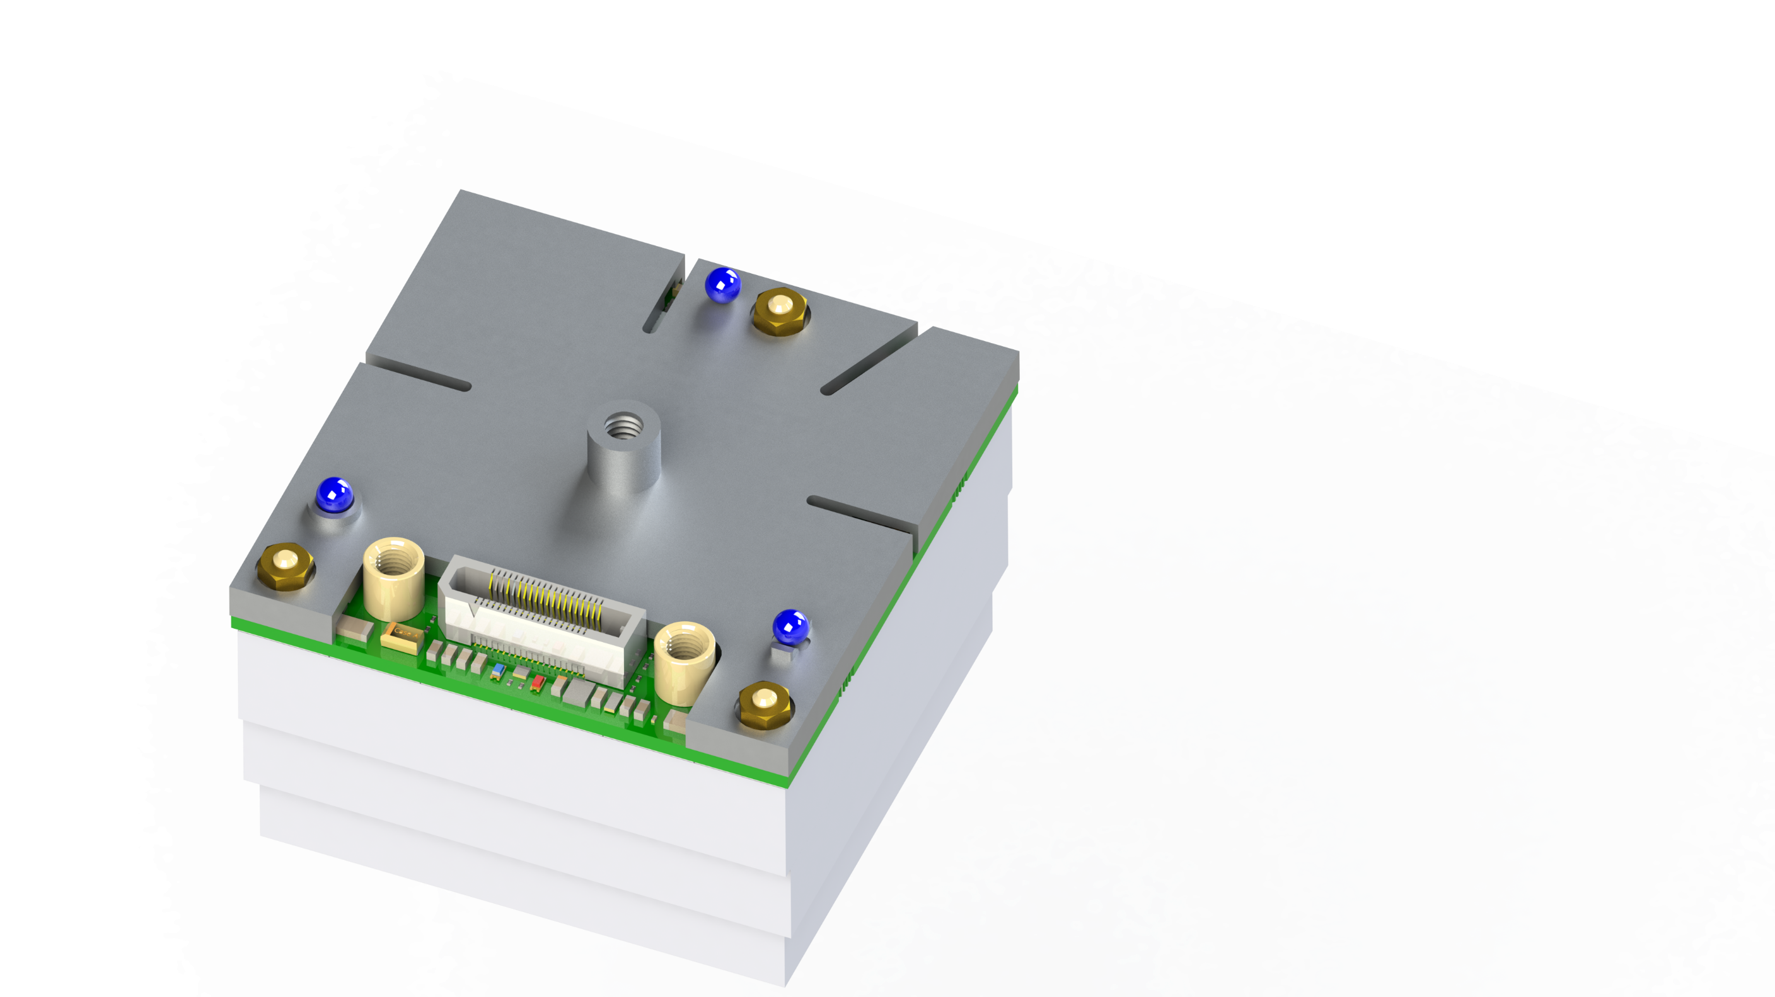

Detector Alignment by Kinematic Couplings
Requirements of detector mounting:
Precise and repeatable
Easy maintenance
Resistant against thermal stress
Kinematic mounting using 3 ball contacts and a central screw
All 6 degrees of freedom are exactly constrained
Only one screw to mount and dismount the detector

Slide 11
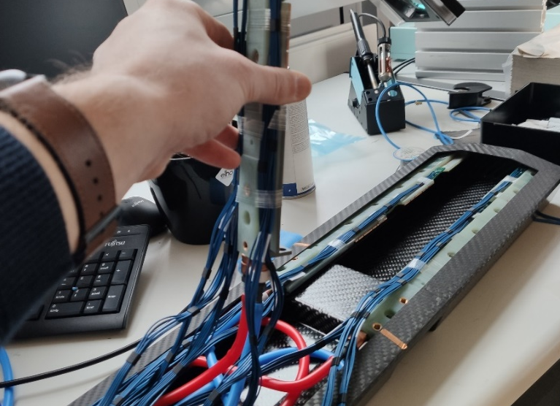
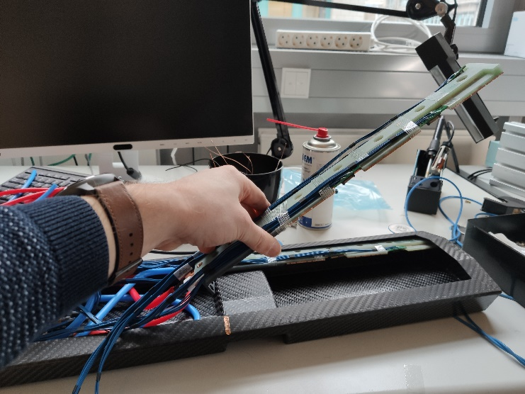
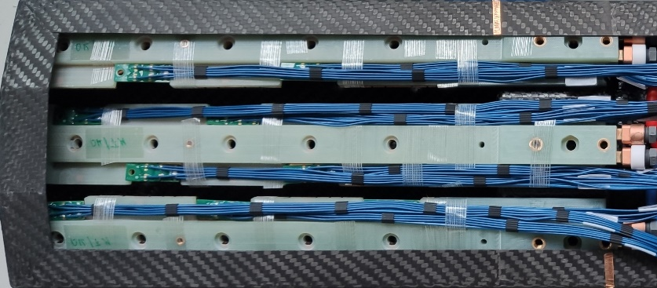
Detector Integration

Slide 12
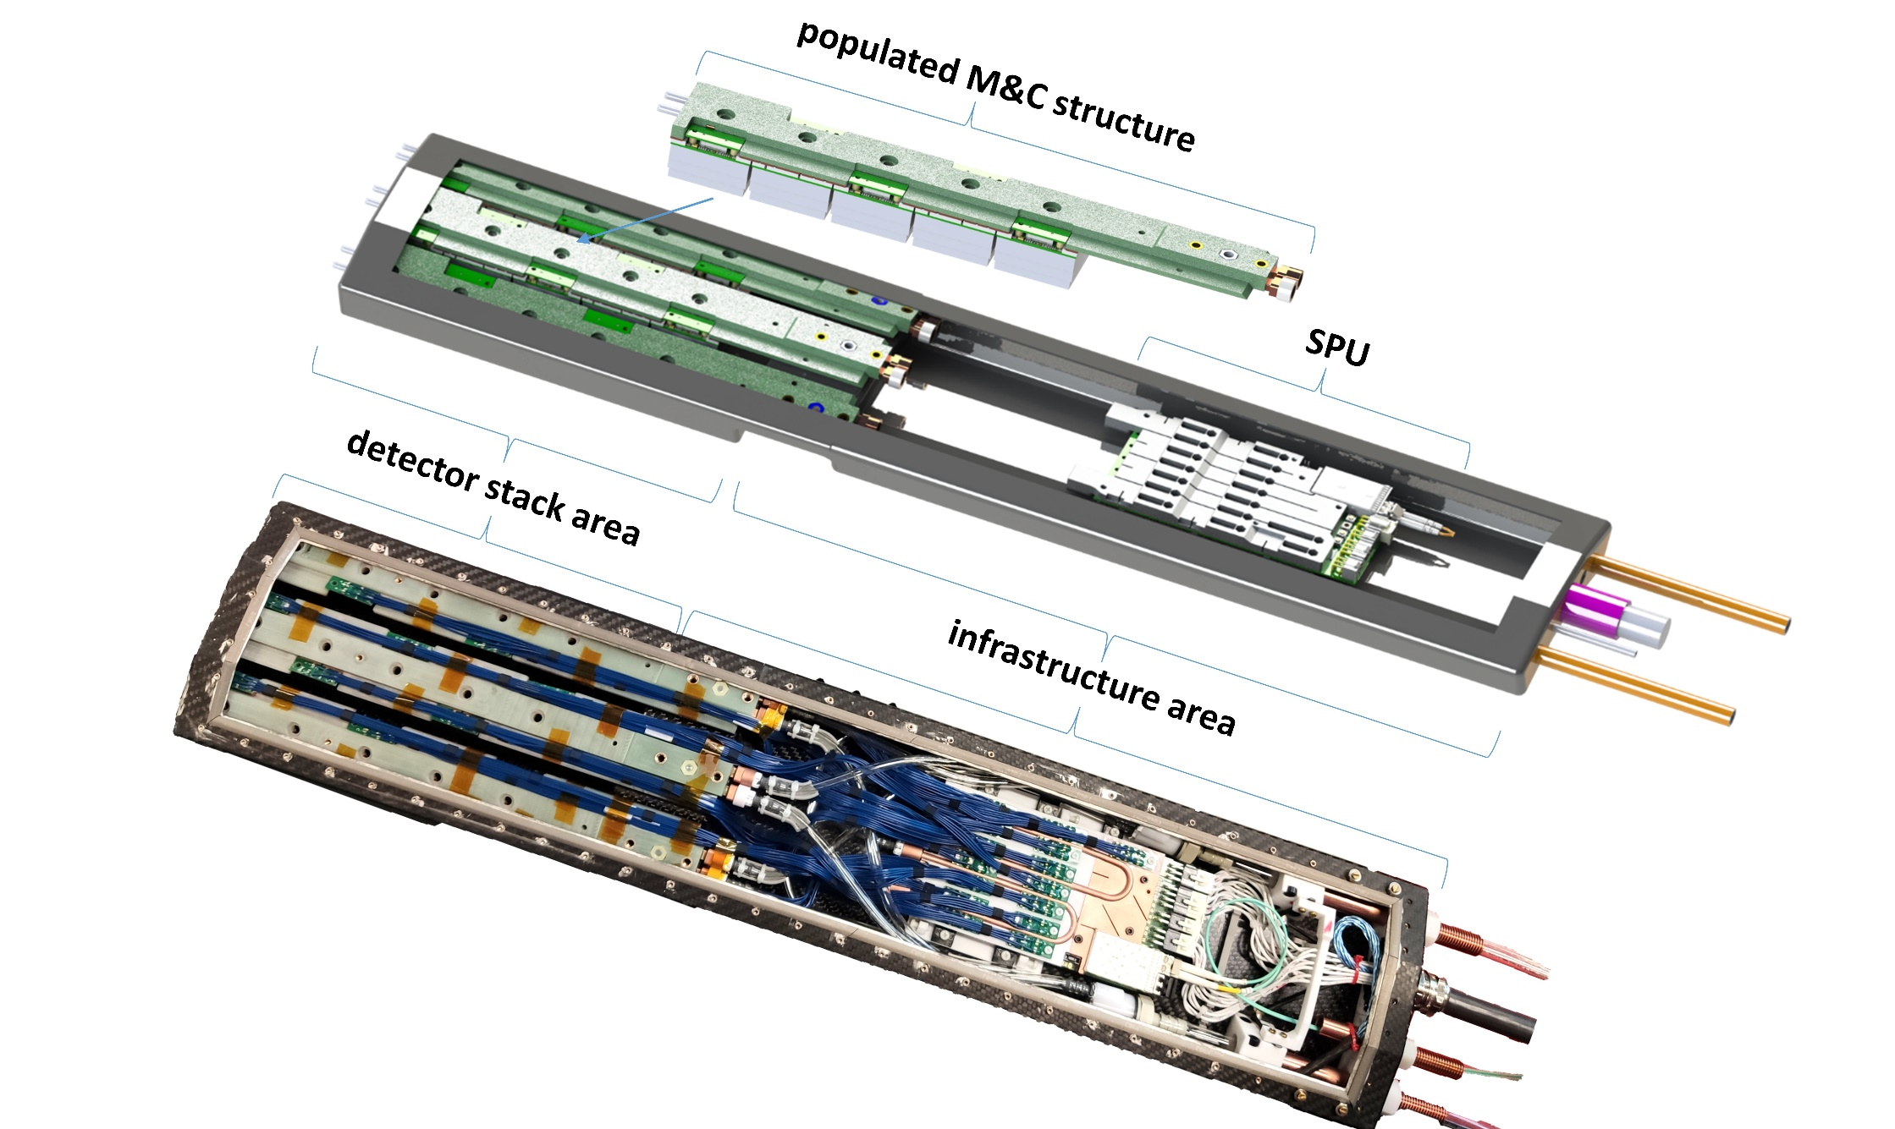
The Real World
mainboard

Slide 13
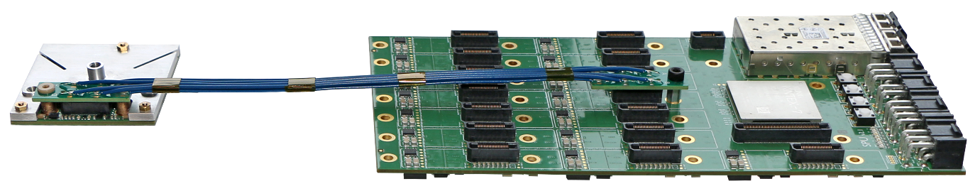
PET Electronics: Hyperion III platform
Sensor tile
  48 x 48 mm²
  Kinematic mounting interface
Mainboard
  Supports 15 sensor tiles
  Optical 10 Gb link (20 Gb possible)
Tile cable
Sensor tile
Mainboard
More details on the Hyperion III platform on Tuesday by Bjoern Weissler

Slide 14
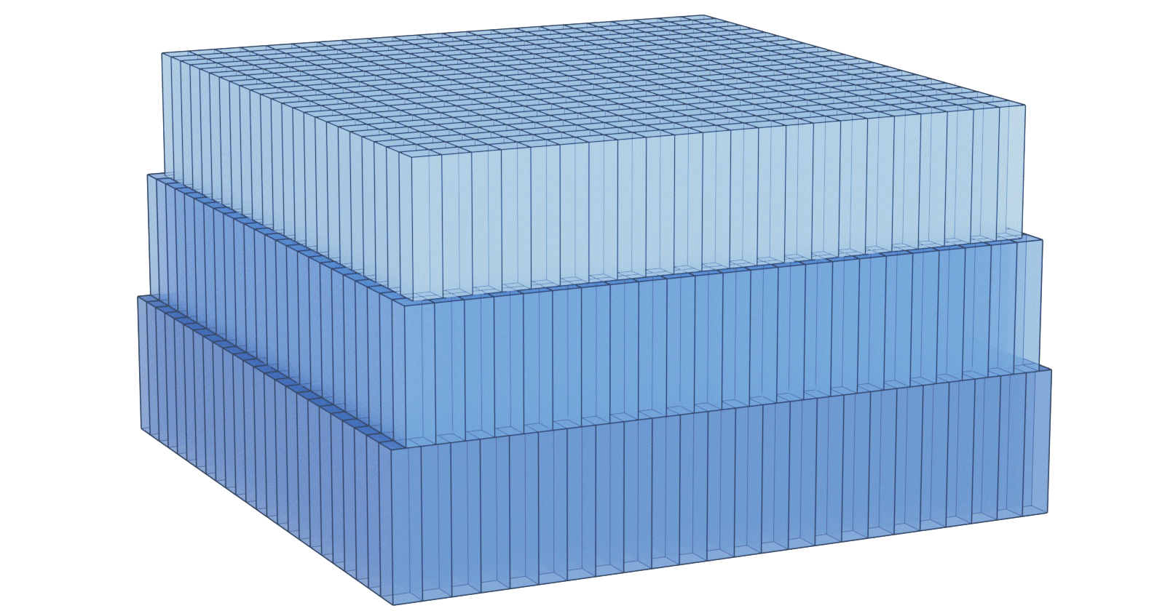
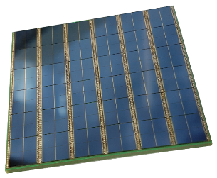
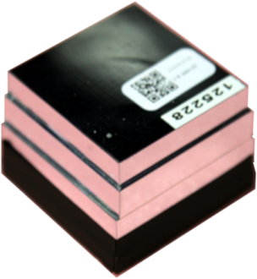
Detector Stack
Sensortile
  6 × 6 DPC-3200 dies
  (Philips PDPC)
  12 × 12 4-mm dSiPMs
  144 Channels, 36 TDCs
Scintillator
  LSO scintillator
  Size: 48x48x24 mm
  2 mm pixel pitch
  Wrapped in reflector
49 mm
49 mm
M. Ito, et al. "Four-layer DOI detector with a relative offset in animal PET system." 2007 IEEE Nuclear Science Symposium Conference Record. Vol. 6. IEEE, 2007.

Slide 15
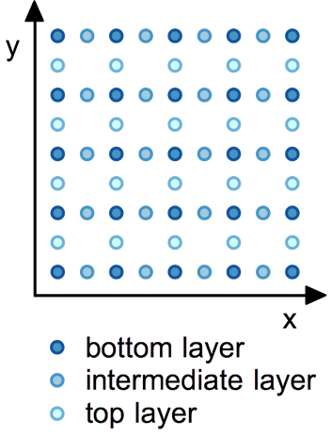
Scintillation Detector Design
Top Layer
Middle Layer
Bottom Layer
preliminary floodmap
at low overvoltage
M. Ito, et al. "Four-layer DOI detector with a relative offset in animal PET system." 2007 IEEE Nuclear Science Symposium Conference Record. Vol. 6. IEEE, 2007.

Slide 16
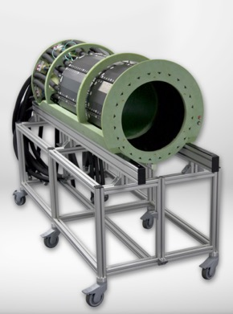
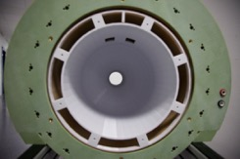
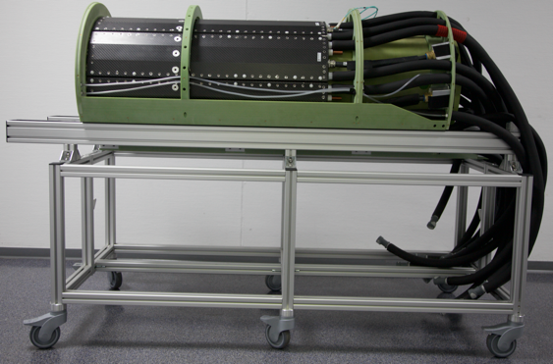
Further First Results
24 Heads with 5 scintillation detector blocks each
RF Seal
Gantry
Liquid cooling
8 RF shielded PET modules
Gantry with RF Coil
GFRP Gantry
Openings for EEG cables
Openings for mirrors
RF screen
RF coil array

Slide 17
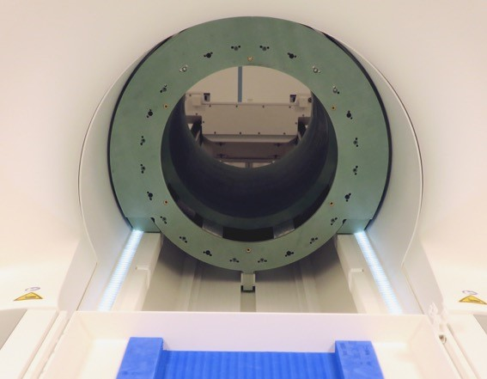
Conclusion & Outlook
Hyperion III platform allows high integration and easy maintenance of components due to its flexibility
Full assembly and delivery of 8 PET modules
  25 cm axial FOV
  Jülich is able to resolve all crystals of the
  3 layered, 24 mm thick LYSO detector (2 mm pitch)
We are looking forward to the first PET/MR measurements done in Jülich and more details on the PET performance

Slide 18





Collaborators
Prof. N. Jon Shah
Prof. S. van Waasen
Prof. G. Natour
Prof. V. Schulz
Prof. G. Egan
Dr. C.H. Choi
Dr. J. Felder
D. Arutinov
Dr. D. Schug
Dr. B. Weissler
Dr. J. Scheins
Dr. Z. Chen
Dr. E. Rota-Kops
Dr. J. Mauler
Dr. A. Mahr
Dr. M. Streun
Dr. P. Gebhardt
R. Heil
B. Scherrer
Y. Kitten
Dr. M. Lenz
D. Niekämper
F. Müller
H. Radermacher
K. Krüger
L. Yin
V. Nadig
A. Mazur
A. Honné
W. Bi
J. Colliene
D. Grunwald
M. Lennartz
L. Tellmann
S. Frensch
S. Schaden
M. Clemens
N. Engelbrecht
S. Schwan
A. Issa

