Slide 1
R&D Tracciatore @ Pisa
F. Bosi, F. Palla

Slide 2
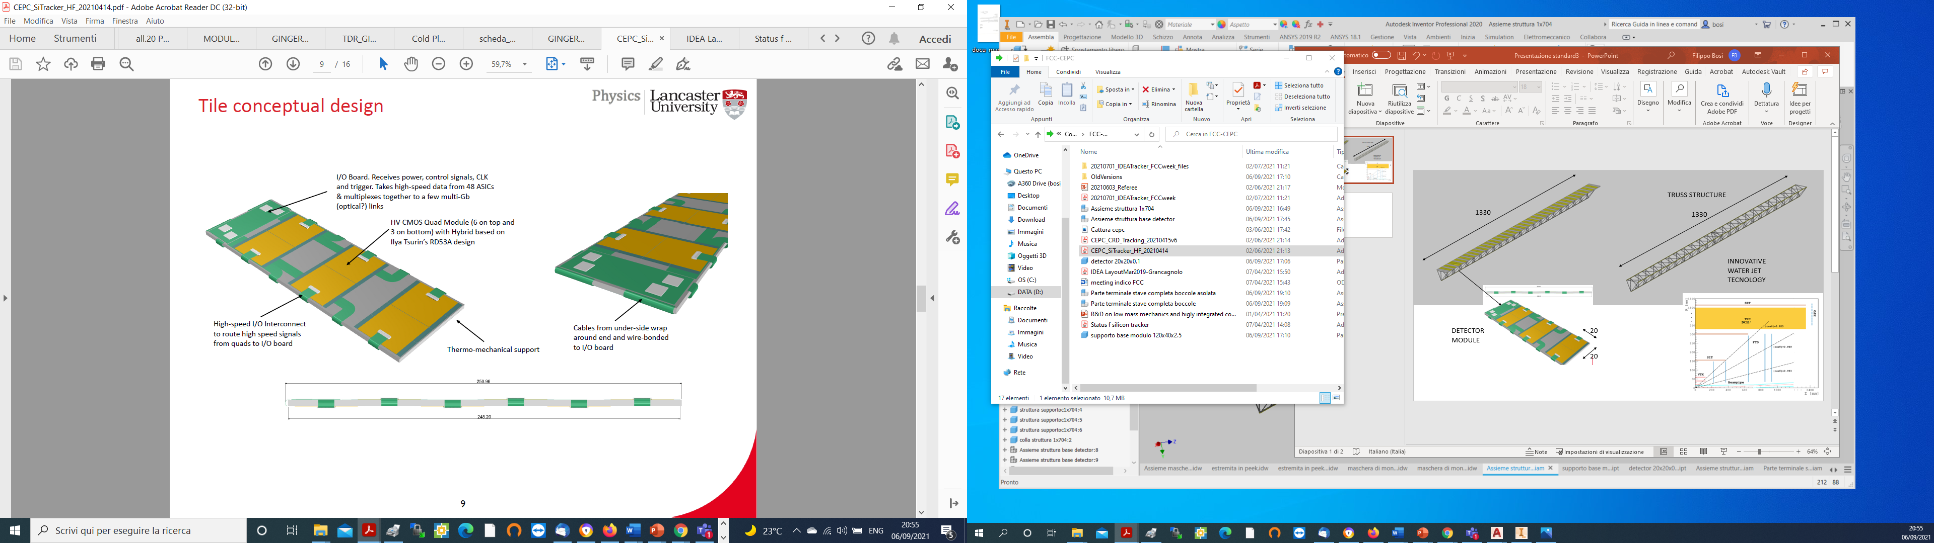

Slide 3
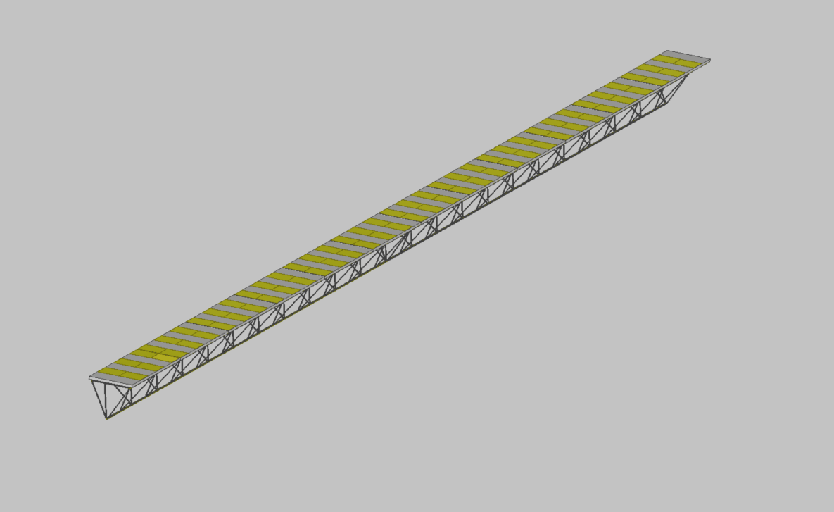
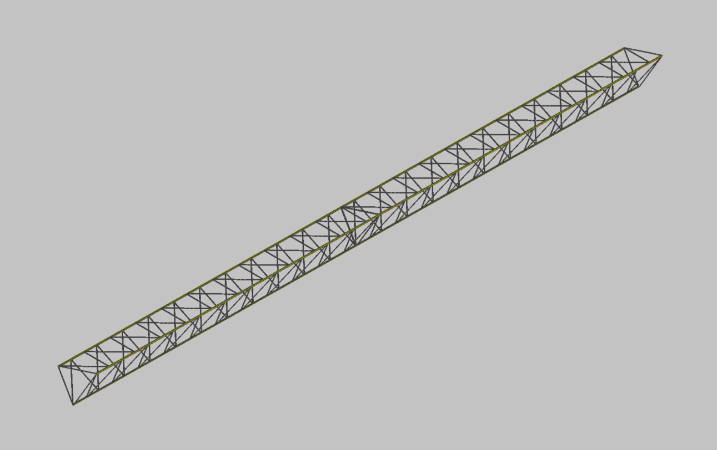
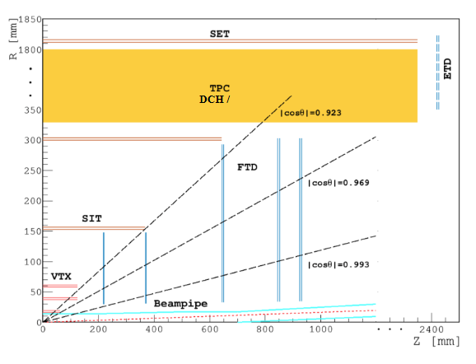
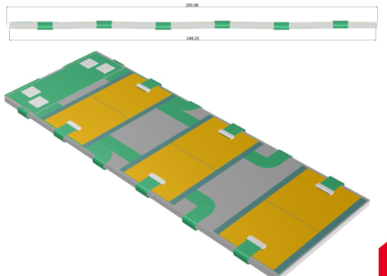
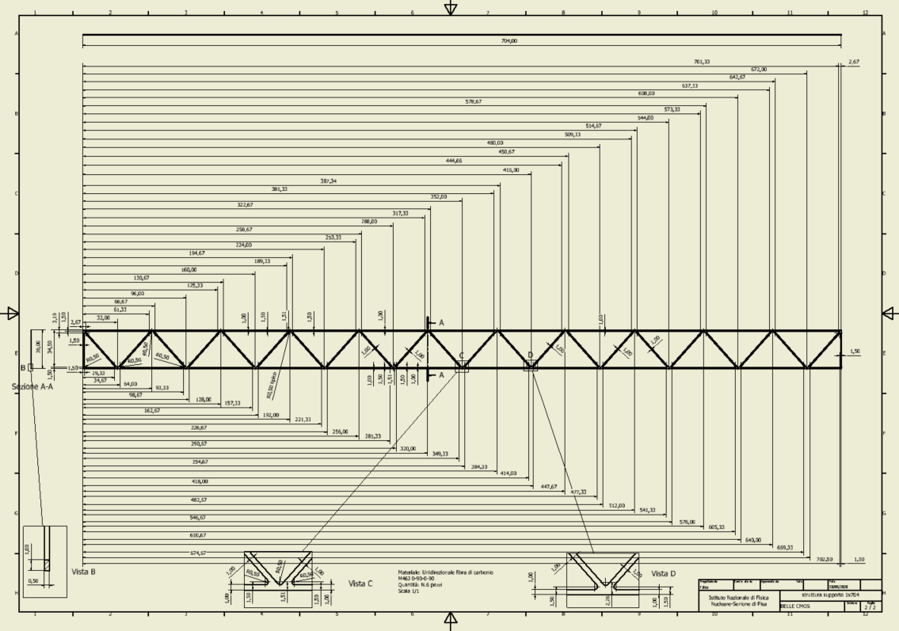
TRUSS STRUCTURE
1330
1330
Design of the long stave ladder structure
INNOVATIVE WATER JET TECNOLOGY
Water Jet cutting of laminated plane of carbon fiber.
Precision cut 50 micron
20
DETECTOR MODULE
10
10

