Slide 1
RF Power sources for the EuPRAXIA@SPARC_Lab project
A. Gallo, on behalf of the EuPRAXIA@SPARC_Lab RF team
EuPRAXIA@SPARC_LAB TDR Review Committee Meeting, Oct. 26-27 2021

Slide 2
A. Gallo et al. : RF power sources for the EuPRAXIA@SPARC_Lab project
X-band klystron selection: a hot topic
As reported in the project CDR, X band has been adopted as the technology of the EuPRAXIA@SPARC_Lab main linac to provide operational accelerating gradients in the ≥ 60 MV/m range;
At the CDR time, according to a survey on the existing test facilities, it seemed like the only existing option for the X-band power source was the CPI VKX-8311A tube (50 MW, EU-12 GHz, 100 Hz rep. rate);
This component immediately appeared as a critical one, for various reasons: cost (expected higher wrt to lower freq. tubes), reliability (few units produced and delivered), delivery times. On top of that, a strategy based on a unique supplier for a critical component is always a weakness point in a project.
CERN strongly suggested (and supported) us to promote the development of a high-efficiency version of the VKX-8311A tube. This would result in energy saving, smaller modulators (Scandinova K300 instead of K400), longer tube lifetime, (a bit) larger RF power headroom.
Accordingly, in spring 2021 we asked CPI budgetary quotations for both standard and upgraded (HE) tubes, as a replacement of the one we have on loan from CERN for our TEX test facility presently under commissioning.
2
EuPRAXIA@SPARC_LAB TDR Review Committee Meeting, Oct. 26-27 2021

Slide 3
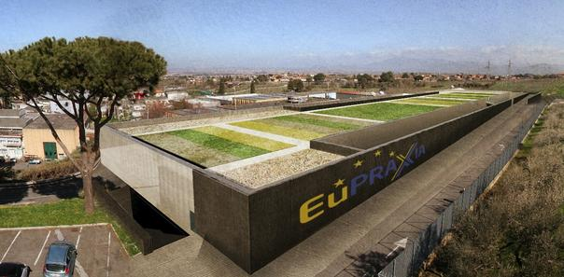
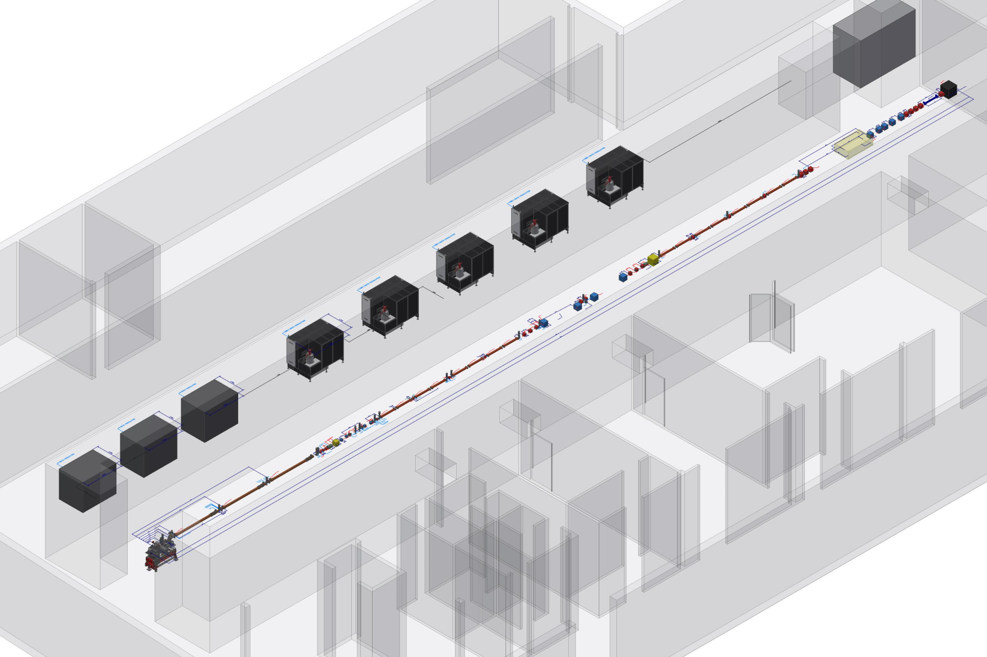
A. Gallo et al. : RF power sources for the EuPRAXIA@SPARC_Lab project
EuPRAXIA@SPARC_Lab project
FEL user facility based on HG RF + plasma acceleration;
National project funded by Italian government (108 M€);
One of the two pillars of the European project EuPRAXIA, recently inserted in the ESFRI roadmap;
TDR in preparation (to be delivered in 2024);
1 GeV beam produced by a high brightness injector + HG linac (X-band);
Present linac baseline:
4 X-band modules including 4 x TW structures and 1 x 50 MW power station each.
X band power stations
TL to plasma, beam dumps and undulators
chicane
X band modules
3
EuPRAXIA@SPARC_LAB TDR Review Committee Meeting, Oct. 26-27 2021

Slide 4
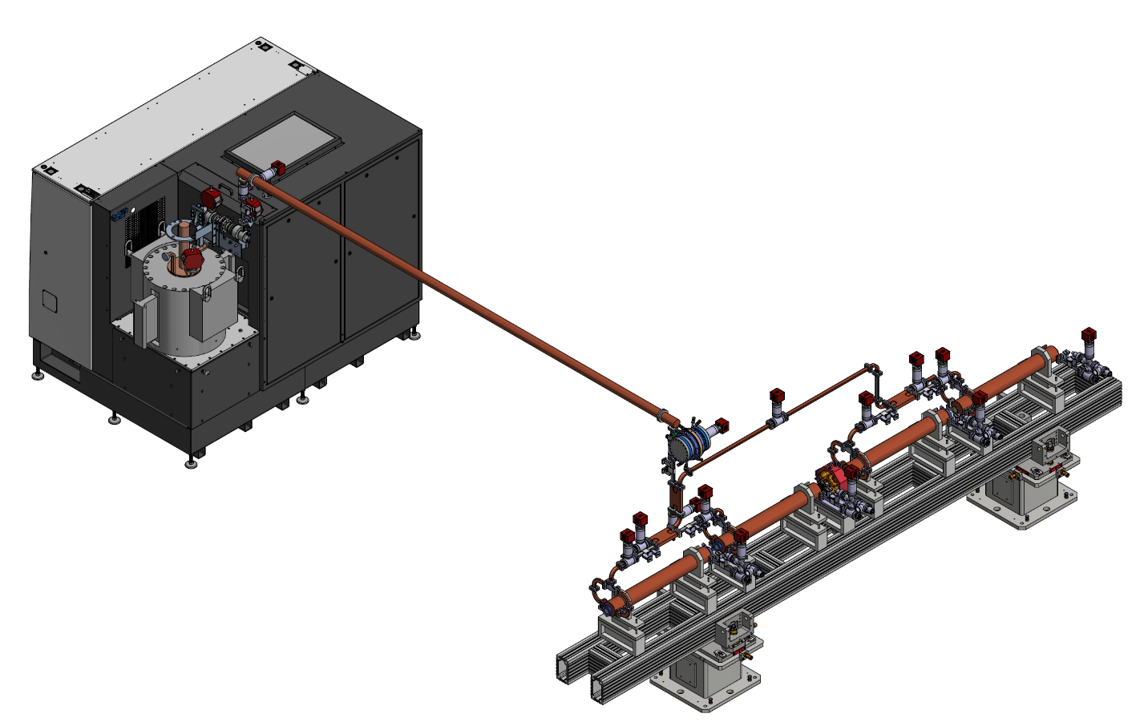
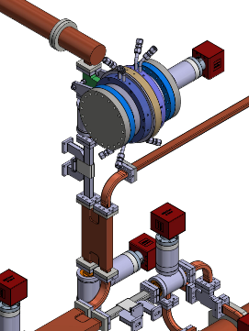
A. Gallo et al. : RF power sources for the EuPRAXIA@SPARC_Lab project
The X band LINAC: rf module layout
Klystron and modulator
Baseline Layout: one klystron, one PS (BOC-type), 4 TW structures (0.9 m, 60 MV/m, 100 Hz)
Waveguide components (DC, T pumping, hybrids,…) CERN design but there are some components for which we have to fix the design (circular-rectangular waveguide mode converter, pumping unit on circular waveguide)
Pulse compressor: BOC (PSI) or INFN Design
two version of the module: Low and High Energy
flexible and “adjustable” layout
We have investigated both a symmetric and an asymmetric waveguide distribution system
Diagnostic chamber+ vacuum valve
Low attenuation circular waveguide (4,7 m)
Circular-rectangular mode converter
hybrid
X band structures
DC
Stripline integrated into the quadrupole.
DC
BOC (PSI)
Pumps with T pumping units
hybrid
4
EuPRAXIA@SPARC_LAB TDR Review Committee Meeting, Oct. 26-27 2021

Slide 5
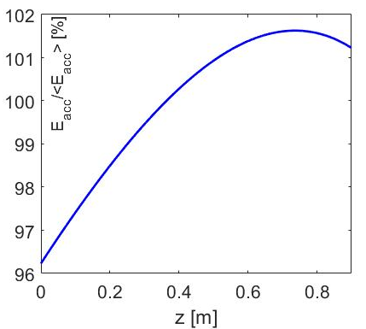
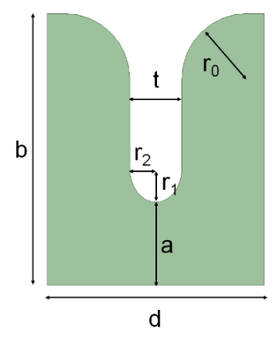
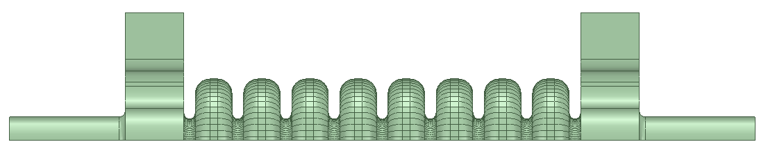
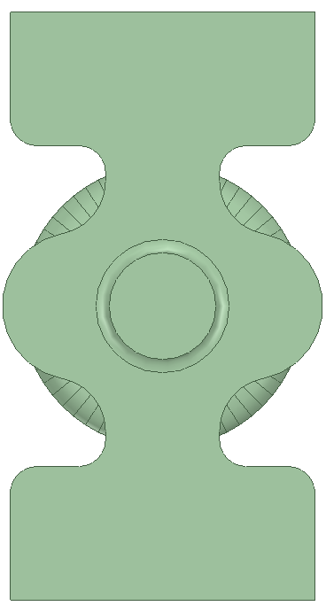
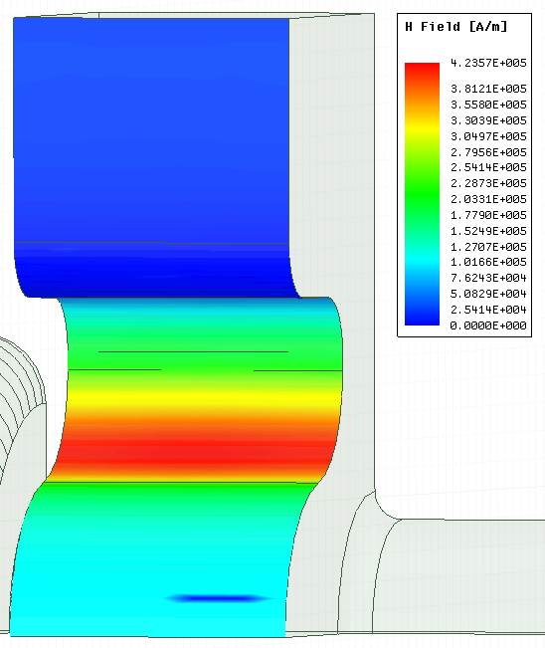
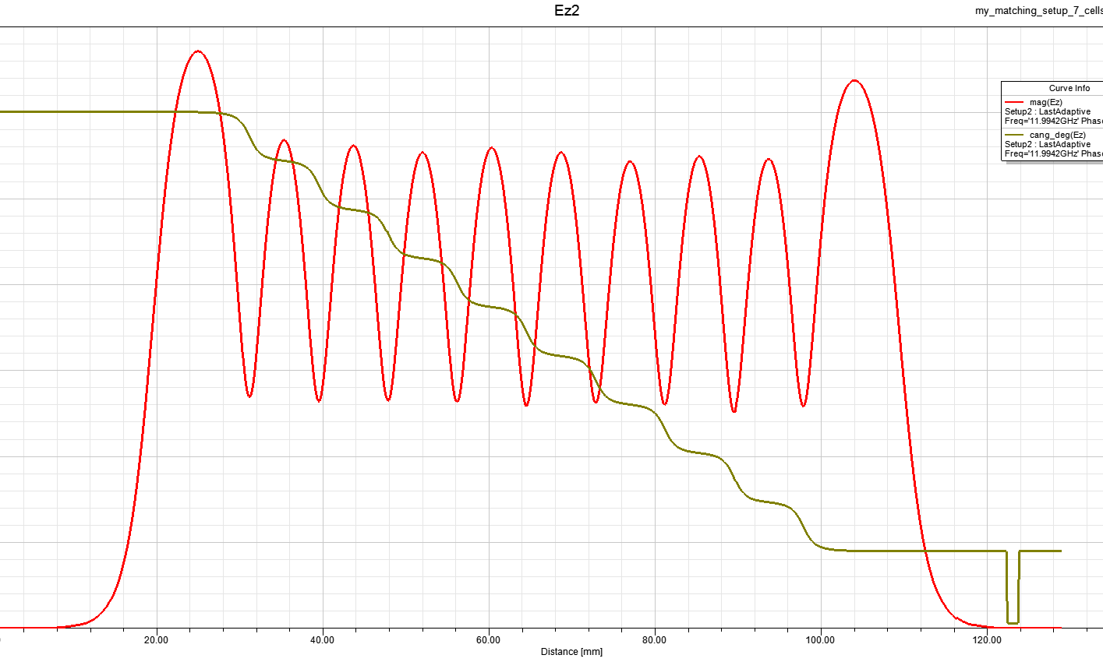
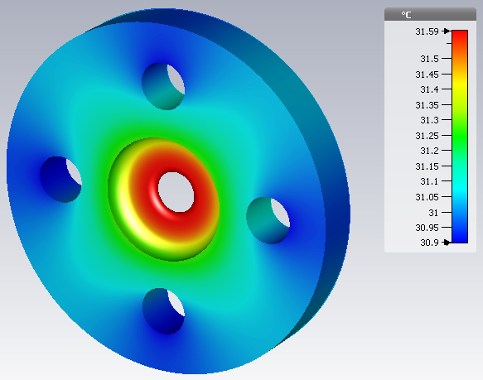
A. Gallo et al. : RF power sources for the EuPRAXIA@SPARC_Lab project
X BAND STRUCTURES: PARAMETERS
Parameter | Value
Frequency [GHz] | 11.9942
Average acc. gradient [MV/m] | 60
Structures per module | 4
Iris radius a (linear tapering) [mm] <a>=3.5 | 3.8-3.2
Tapering angle [deg] | 0.04
Structure length L_{s} [m] | 0.9
No. of cells | 109
Shunt impedance R [MΩ/m] | 94-107
Peak input power per structure [MW] | 65
Input power averaged over the pulse [MW] | 45
Average dissipated power [kW] | 1
Filling time [ns] | 126
Effective shunt Imp. R_{s} [MΩ/m] | 350
Peak Modified Poynting Vector [W/μm²] | 3.5
Unloaded SLED/BOC Q-factor Q₀ | 150000
External SLED/BOC Q-factor Q_{E} | 21000
Required Kly power per module [MW] | 37
RF pulse [µs] | 1.5
Klystron power (available) [MW] | 50 (45)
Rep. Rate [Hz] | 100
e.m. design: linear tapering of the irises, race track coupler to cancel the quadrupole field components (PhD M. Diomede in collaboration with A. Grudiev (CERN) and V. Dolgashev (SLAC));
0.9 m long structures, 3.5 mm average iris radius
Preliminary thermo-mechanical analysis done but to be checked according to the final mechanical drawing (prototyping activity in progress)
Profile of the accelerating field along the structure
G=average accelerating gradient
L=structure length
P_{kly}=klystron power (pre-sled pulse)
5
EuPRAXIA@SPARC_LAB TDR Review Committee Meeting, Oct. 26-27 2021

Slide 6
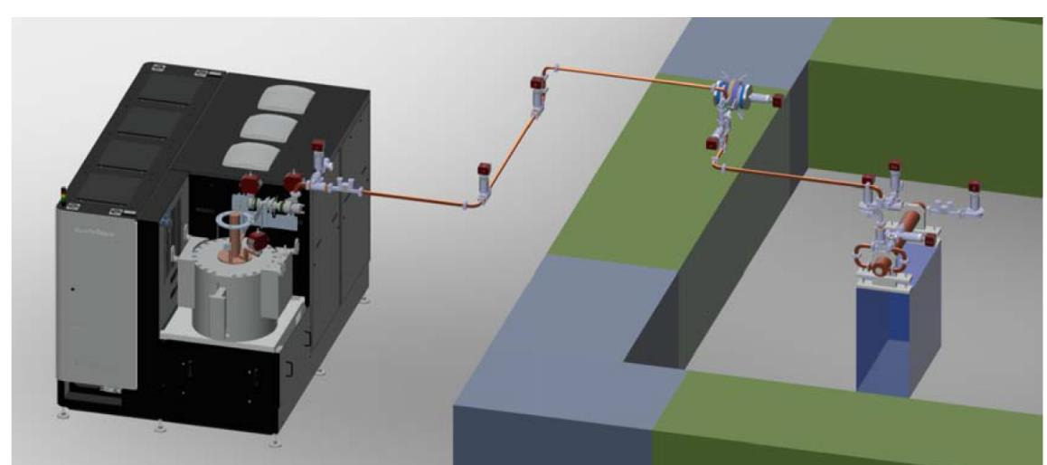
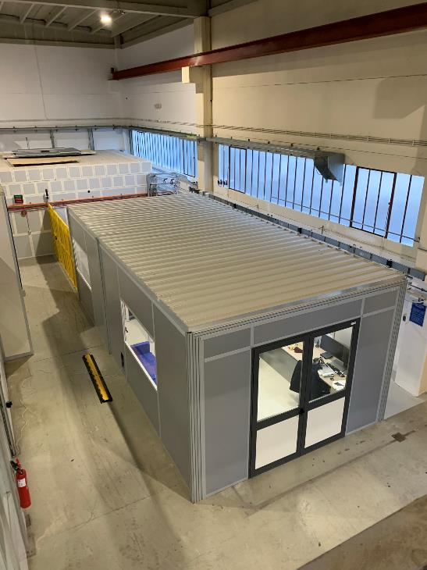
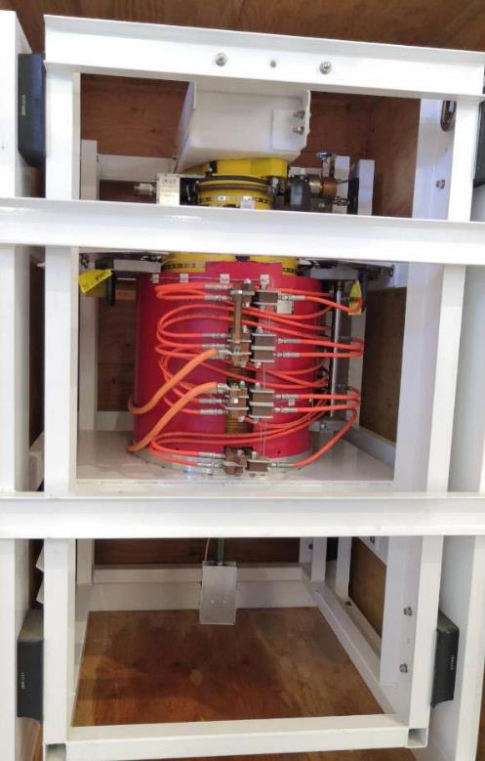
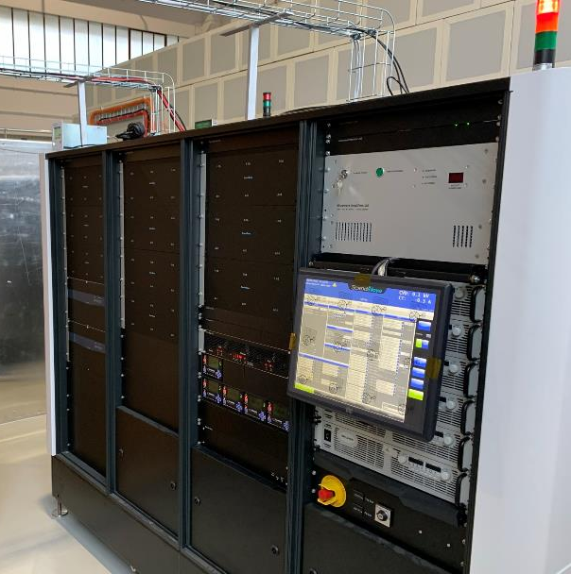
A. Gallo et al. : RF power sources for the EuPRAXIA@SPARC_Lab project
INFN-LNF X BAND TEXT FACILITY TEX
The TEX test stand (currently under implementation at LNF) has been conceived to test all the RF components and structures necessary for EuPRAXIA (including LLRF system, Vacuum, Control System,…).
TEX: it is fundamental to test all RF components at the nominal power and X band prototypes, there is a necessity to acquire asap a CPI klystron with the nominal parameters in term of power and rep. rate;
It has been co-funded by the Regione Lazio in the framework of the LATINO project
The setup of the test stand has been done in collaboration with CERN that provided the first CPI klystron and some waveguide component and will be also used to test CLIC structures.
klystron
Bunker
Courtesy
S. Pioli, F. Cardelli, E. Di Pasquale
Modulator
TEX Control Room
6
EuPRAXIA@SPARC_LAB TDR Review Committee Meeting, Oct. 26-27 2021

Slide 7
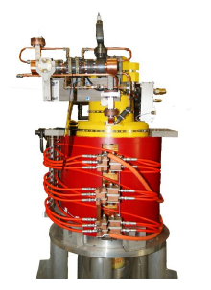
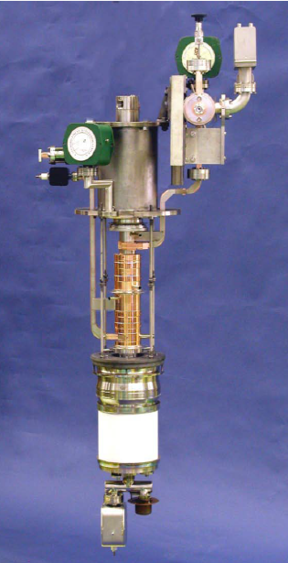
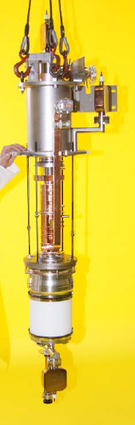
A. Gallo et al. : RF power sources for the EuPRAXIA@SPARC_Lab project
50 MW X-band tubes historical evolution
SLAC XL 4
11,452 MHz
SLAC XL 5
11,994 MHz
CPI – VKX-8311A industrial version
of XL-5
XL-5
Tubes for PSI, Trieste & CERN
XL4 variation to higher freq
11.992 –11.994 GHz
1.0 –1.5us
100 -50Hz
50MW
50MHz 3dB BW
410 -450kV
7
EuPRAXIA@SPARC_LAB TDR Review Committee Meeting, Oct. 26-27 2021

Slide 8
A. Gallo et al. : RF power sources for the EuPRAXIA@SPARC_Lab project
50 MW X-band tubes required
1 x TEX spare ASAP (24 months?)
4 x EuPRAXIA RF modules
1 x EuPRAXIA deflectors by 2026 ÷ 2027
2 x EuPRAXIA spares
1 (optimistic) ÷ 2 (pessimistic) / year from ≈2028
8
EuPRAXIA@SPARC_LAB TDR Review Committee Meeting, Oct. 26-27 2021

Slide 9

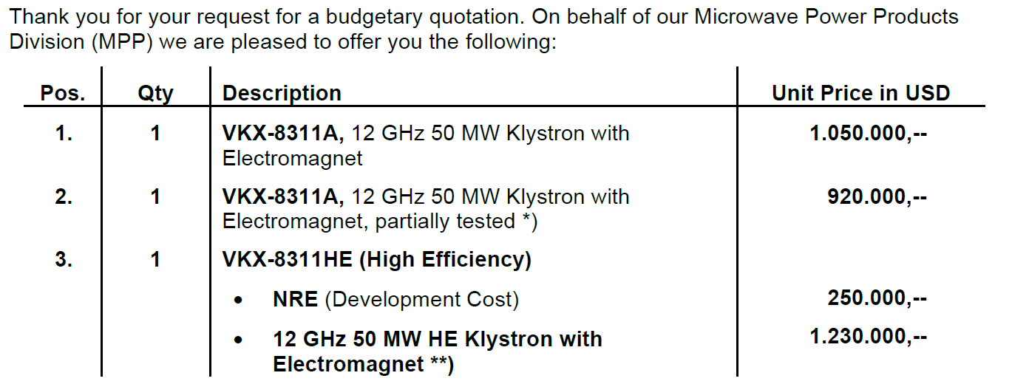
A. Gallo et al. : RF power sources for the EuPRAXIA@SPARC_Lab project
CPI Budgetary Quotation
≈ 900 k€ = 18 k€/MW (+ VAT)
≈ 1050 k€+ VAT= 21 k€/MW (+ VAT)
9
EuPRAXIA@SPARC_LAB TDR Review Committee Meeting, Oct. 26-27 2021

Slide 10
A. Gallo et al. : RF power sources for the EuPRAXIA@SPARC_Lab project
INFN reaction to Quotation
Prices higher than expected (≈30%), although we were aware than X-band is an expensive technology;
Delivery time of 15 months also worrying! Is it compatible with the presented procurement profile ?
ACTIONS:
Market survey to compare alternative X-band solutions (if any)
Consider HG C-band as extreme remedy
STATUS:
CANON declared the availability of a new product, the E37119 klystron, capable to deliver up to 25 MW peak at 400 Hz rep. rate (same RF freq. same pulse duration), apparently at a lower cost/peak_power wrt CPI. However, the project baseline would require some reconfiguration, with a larger number of modulators also impacting on the cost. On the other hand, higher rep rate is certainly an interesting option to be explored.
Preliminary calculations show that the gradient baseline of 60 MV/m could be reached, requiring a larger number of shorter RF modules. C-band tubes of 50 MW, 100 Hz are available, at a cost/peak_power reduced by a factor 3÷4! We will further study this as an extreme option, since it would limit our program toward larger gradients, and it would weaken our collaboration with the X-band international community (that is one of the added value of the EuPRAXIA program).
10
EuPRAXIA@SPARC_LAB TDR Review Committee Meeting, Oct. 26-27 2021

Slide 11
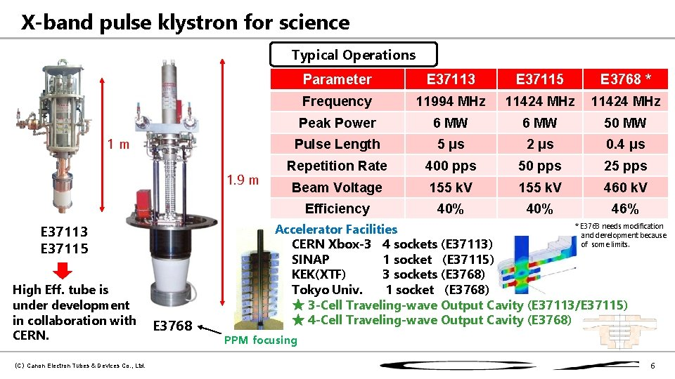
A. Gallo et al. : RF power sources for the EuPRAXIA@SPARC_Lab project
INFN reaction to Quotation
CERN X-box #3
11
EuPRAXIA@SPARC_LAB TDR Review Committee Meeting, Oct. 26-27 2021

Slide 12
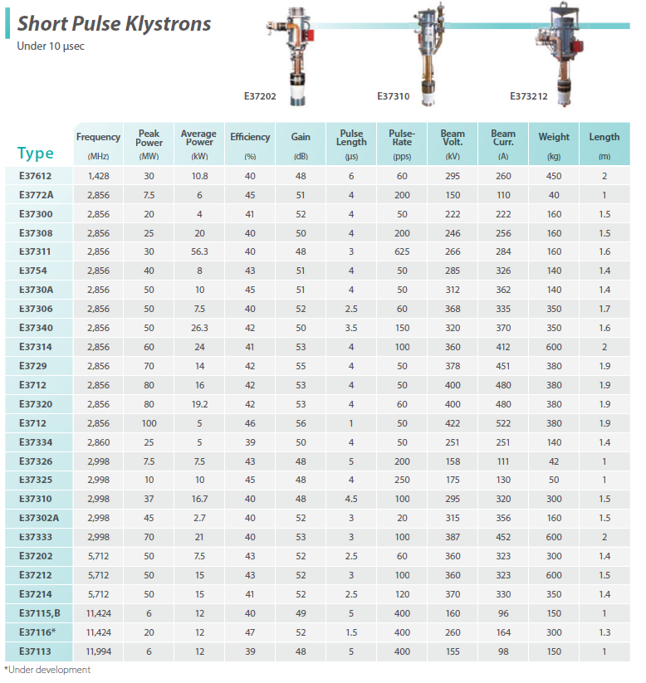
A. Gallo et al. : RF power sources for the EuPRAXIA@SPARC_Lab project
CANON X-band klystron catalogue
Already available
(≈10 months)
E37118 | 11,994 | 20 | 12 | 40 | 47 | 1,5 | 400 | 270 | 182
can be developed
(≈22months)
E37119 | 11,994 | 25 | 15 | 40 | 48 | 1,5 | 400 | 335 | 225
12
EuPRAXIA@SPARC_LAB TDR Review Committee Meeting, Oct. 26-27 2021

Slide 13
A. Gallo et al. : RF power sources for the EuPRAXIA@SPARC_Lab project
Recent and near future events
August 13th: meeting with CERN
September 14th: INFN-CERN-CPI meeting
October 7th: Meeting with Canon
October 22nd: Canon tube E37119 specifications received (preparatory to a more accurate budgetary offer)
October 26th: New budgetary quotation from CPI expected
November 2nd: INFN-CERN-CPI meeting (new offer discussion)
13
EuPRAXIA@SPARC_LAB TDR Review Committee Meeting, Oct. 26-27 2021

Slide 14
A. Gallo et al. : RF power sources for the EuPRAXIA@SPARC_Lab project
SUMMARY of the available information
 |  |  | CANON E37118 |  | CANON E37119 |  | CPI VKX-8311A |  | CPI VKX-8311HE
 |  |  | single piece | series | single piece | series | single piece | series | single piece | series
 | Peak RF Output Power | MW | 20 |  | 25 |  | 50 |  | 50
 | Average RF Ouput Power | kW | 12 |  | 15 |  | 7,5 |  | 7,5
 | Peak beam Voltage Vk | kV | 270 |  | 335 |  | 420 |  | 420
 | Peak beam Current Ik | A | 182 |  | 225 |  | 320 |  | 204
 | Peak Drive power | W | 400 |  | 400 |  | 900 |  | 400 (?)
 | Gain | dB | 47 |  | 48 |  | 48 |  | 51 (?)
 | Rep rate | Hz | 400 |  | 400 |  | 100 |  | 100
 | Efficiency | % | 40 |  | 40 |  | 40 |  | 60
 | Cost (with solenoid, no VAT) | k€ | 250 | 212,50 | 320 | 272 | 900 | 765 | 1050 | 892,5
 | Cost/Peak_power | k€/MW | 12,5 | 10,63 | 12,8 | 10,88 | 18 | 15,3 | 18 | 17,85
 | Cost/Ave_power | k€/kW | 20.8 | 17,71 | 21,33 | 18,13 | 120 | 102 | 140 | 119
 | Delivery time | months | 10 ? |  | 22 (first), 10 mass prod. |  | 15 |  | 26 (first), 15 mass prod.
 | Reference Modulator | Model | K200 |  | K300 |  | K400 |  | K300
 | Modulator price | k€ | 375 | 315 | 485 | 395 | 560 | 475 | 485 | 395
 | SS Driver Power | kW | 0,5 |  | 0,5 |  | 1 |  | 0,5
 | SS Driver cost | k€ | 50 |  | 50 |  | 100 |  | 50
 | LLRF cost | k€ | 120 |  | 120 |  | 160 |  | 160
 | Station cost | k€ | 795 | 697,50 | 975 | 837,0 | 1720 | 1500 | 1745 | 1497,5
 | Station cost/ Peak_power | k€/MW | 39,75 | 34,875 | 39 | 33,5 | 34,4 | 30 | 34,9 | 29,95
 | Station cost/ Ave_power | k€/kW | 66,25 | 58,13 | 65,0 | 55,8 | 229,3 | 200,00 | 232,67 | 199,67
Notes: | For series production Scandinova discounts K200 and K400 by about 15%, K300 about 18%
 | A guessed 15% discount is considered also for the tubes, without confirmation from the producers
 | Waveguides components have not been included since the network configuration is expeted to be independent on the station configuration
14
EuPRAXIA@SPARC_LAB TDR Review Committee Meeting, Oct. 26-27 2021

Slide 15
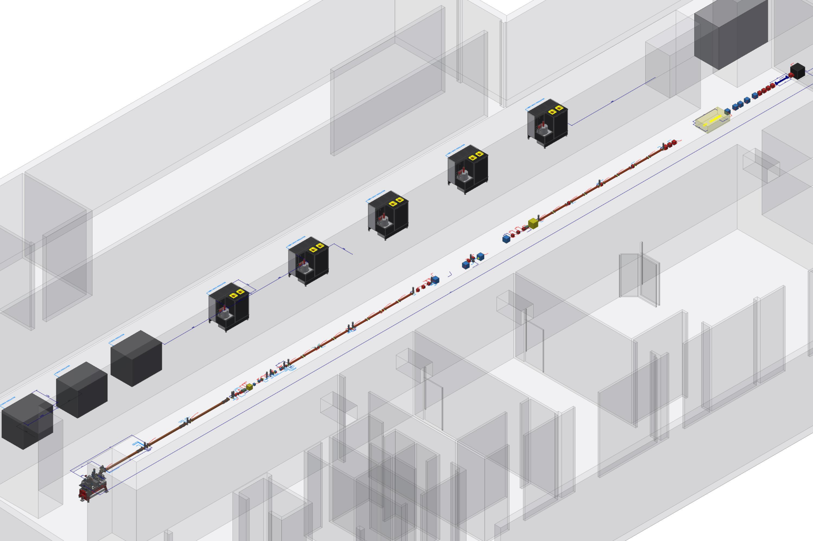
A. Gallo et al. : RF power sources for the EuPRAXIA@SPARC_Lab project
Gallery layout 1
50 MW HE tubes (CPI) equipped with K300 modulators
The use of high efficiency CPI VKX 8311HE would result in a number of benefits including:
Smaller/cheaper modulators;
More comfortable klystron gallery logistics;
Less power consumption (≈90 kW/station @ 100 Hz);
Longer tube lifetime
≈ 90 kW
15
EuPRAXIA@SPARC_LAB TDR Review Committee Meeting, Oct. 26-27 2021

Slide 16
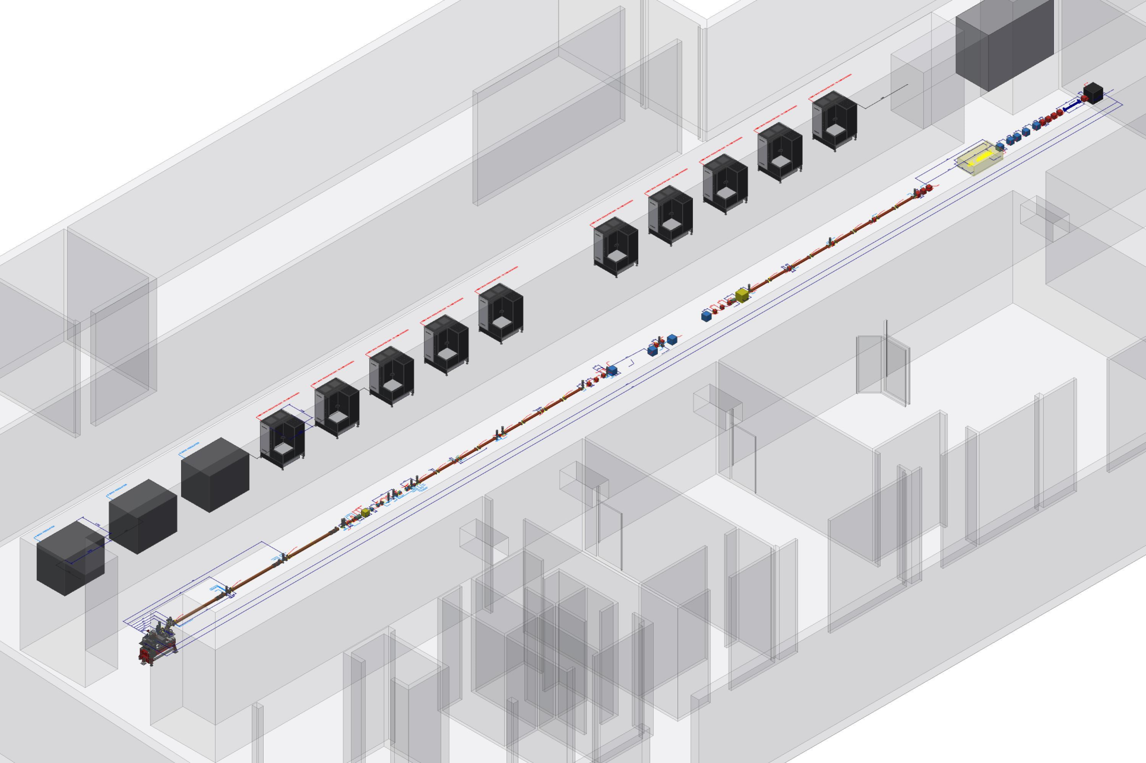
A. Gallo et al. : RF power sources for the EuPRAXIA@SPARC_Lab project
Gallery layout 2
25 MW tubes (CANON) equipped with reduced K300 modulators
The use of CANON E73119 tubes is in principle a viable alternative opening the possibility of increasing the operational rep rate (up to 400 Hz).
The required number of modulators is doubled wrt the CDR baseline. Scandinova is available to develop a modulator with the K300 model features
in a module having the same
footprint as the K200 model.
≈ 150 kW
However, various points need to be addressed especially in view of > 100 Hz operation:
Klystron gallery logistics;
Larger power consumption (≈150 kW/station @ 400 Hz, number of stations doubled);
Design of a different working point for high rep. rate (gradient reduced);
Development of an upgraded injector;
Upgrade of the plasma rep. rate;
…
16
EuPRAXIA@SPARC_LAB TDR Review Committee Meeting, Oct. 26-27 2021

Slide 17
A. Gallo et al. : RF power sources for the EuPRAXIA@SPARC_Lab project
Status of the activity
The appearance of a second vendor as a possible commercial competitor has been certainly effective, and it has increased the companies “responsivity”;
The two technical proposals can in principle fit the requirements of the project with some pros (CPI compactness, CANON rep. rate) and cons (CPI cost, CANON power consumption).
CPI normalized cost (k€/MW_{peak}) still not completely understood. However, once the normalized costs of the full stations are considered, the two solutions are closely comparable.
The 400 Hz provided by CANON is potentially a breakthrough feature. However many new aspects would need to be addressed, namely:
  The definition of a high rep rate (HRR) WP, requiring a reduced gradient in the X-band structures;
  New injector design for HRR operation. Many technical problems need to be solved (HRR Gun, C-band klystrons, …).
  New specifications for the gallery services (AC power, cooling) compatible with the HRR requirements. Cooling should manage much different heat-loads (standard vs. HRR operation).
  If plasma boost is included, then HRR related technical issues of the plasma-cell operation need to be considered.
17
EuPRAXIA@SPARC_LAB TDR Review Committee Meeting, Oct. 26-27 2021

Slide 18
A. Gallo et al. : RF power sources for the EuPRAXIA@SPARC_Lab project
Fund request for the R&D phase
Working Area | Item | Expected cost (k€) | Comment
WA.4 Integration | Klystron spare for TEX (CPI-HE) | 1300 | Includes NRE for HE development
 | X-Band Solid state amplifier | 100 | Critical, can stop the TEX operation
 | Warranty extension | 35 | Already procured
 | TEX Setup | 195 | Already procured
 | Klystron CANON E37119 + modulator | 750 | Strategic, to keep alive the CANON option and test HRR
Total = 2380
18
EuPRAXIA@SPARC_LAB TDR Review Committee Meeting, Oct. 26-27 2021

Slide 19
A. Gallo et al. : RF power sources for the EuPRAXIA@SPARC_Lab project
Perspectives
Continuing discussion with both producers for technical and commercial aspects;
Define (soon) a procurement strategy for the evaluation phase. At the moment we believe we have to continue stimulating both vendors by placing orders for the 2 most interesting models: CPI VKX 8311HE and CANON E73119 provided with a dedicated modulator. Development times are similar, both in the 2 years range.
Define a roadmap for the project baseline choice. This point remain crucial. It is clear from the presentation that probably the X-band klystron, i.e. the core of the EuPRAXIA@SPARC_Lab linac RF system, does not exist yet.
19
EuPRAXIA@SPARC_LAB TDR Review Committee Meeting, Oct. 26-27 2021

