Slide 1
EuPRAXIA@SPARC_LAB Review Committee, 26 Oct 2021
The X-band Linac and related R&D Program
D. Alesini
With the contribution of all WP involved:
WP1, WA1, WP 7, WP8, WP 10, WP12, WP13, WP13, WP 14, WP15, WP 17, WP 19

Slide 2
OUTLINE
1) X band linac design:
-module layout (CPI/CANON Klystrons configuration)
-waveguide system design and components studies
-X band structures: dark current studies, vacuum calculation progress, thermo- mechanical analysis
2) R&D and prototype activity:
-mechanical/rf X band prototype status
-strategy for waveguide component test at TEX
-TEX status
3) Financial requests justification
4) Discussion/progress on last RC report

Slide 3
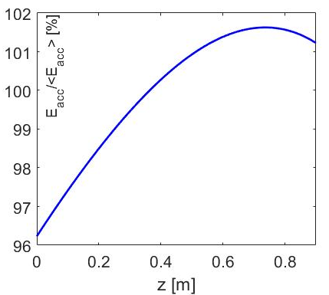
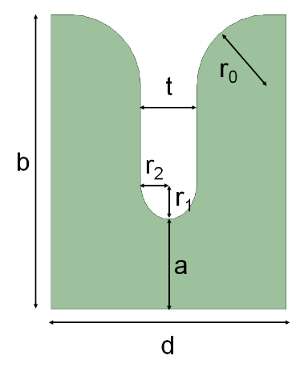
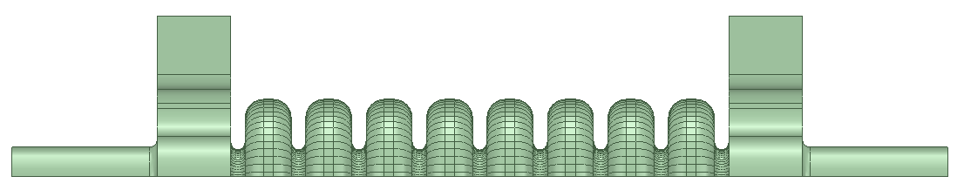
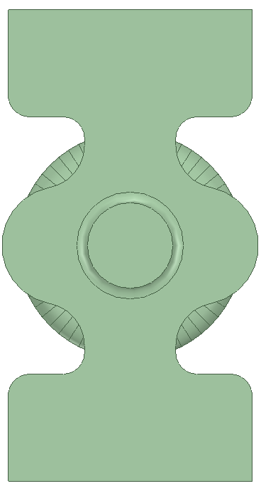
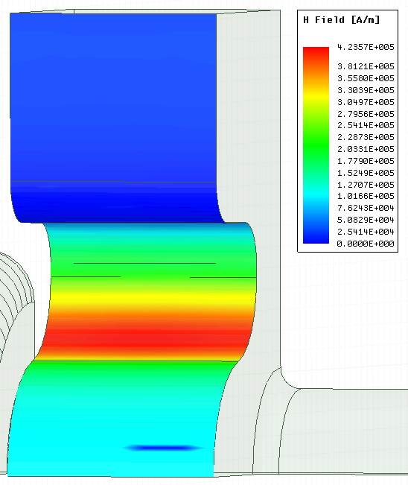
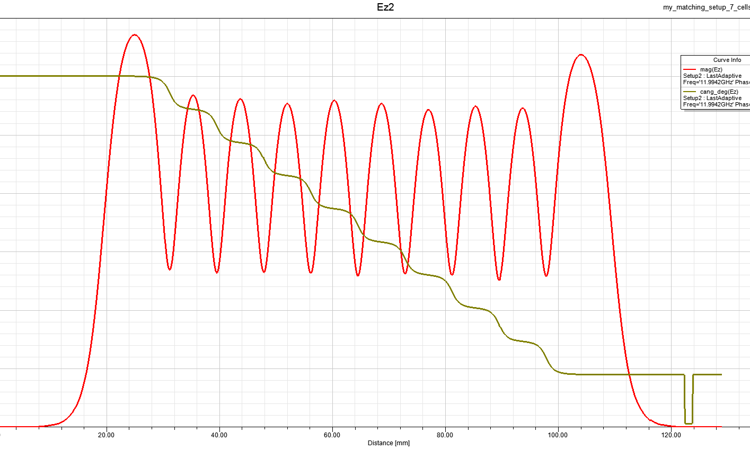
X BAND STRUCTURES: PARAMETERS
e.m. design: linear tapering of the irises, race track coupler to cancel the quadrupole field components (PhD M. Diomede);
0.9 m long structures with 3.5 mm average iris radius
60 MV/m average accelerating field
Parameter | Value
Frequency [GHz] | 11.9942
Average acc. gradient [MV/m] | 60
Structures per module | 4
Iris radius a (linear tapering) [mm] <a>=3.5 | 3.8-3.2
Tapering angle [deg] | 0.04
Structure length L_{s} [m] | 0.9
No. of cells | 109
Shunt impedance R [MΩ/m] | 94-107
Peak input power per structure [MW] | 65
Input power averaged over the pulse [MW] | 45
Average dissipated power [kW] | 1
Filling time [ns] | 126
Effective shunt Imp. R_{s} [MΩ/m] | 350
Peak Modified Poynting Vector [W/μm²] | 3.5
Unloaded SLED/BOC Q-factor Q₀ | 150000
External SLED/BOC Q-factor Q_{E} | 21000
Required Kly power per module [MW] | 37/19
RF pulse [µs] | 1.5
Klystron power (available) [MW] | 50/25
Rep. Rate [Hz] | 100
Profile of the accelerating field along the structure
G=average accelerating gradient
L=structure length
P_{kly}=klystron power (pre-sled pulse)
Courtesy M. Diomede

Slide 4
RF MODULE SCHEMATIC LAYOUTS: CPI/CANON KLYSTRONS
CPI VKX8311HE
CANON E37118+
50 (45) MW
25 (22.5) MW
Klystron gallery
Linac hall
Low attenuation waveguide
BOC₁
BOC₂
BOC₁
3dB hybrid
QUAD+ stripline
4755 mm (LE) 4810 mm (HE)
2240 mm
X band structures

Slide 5
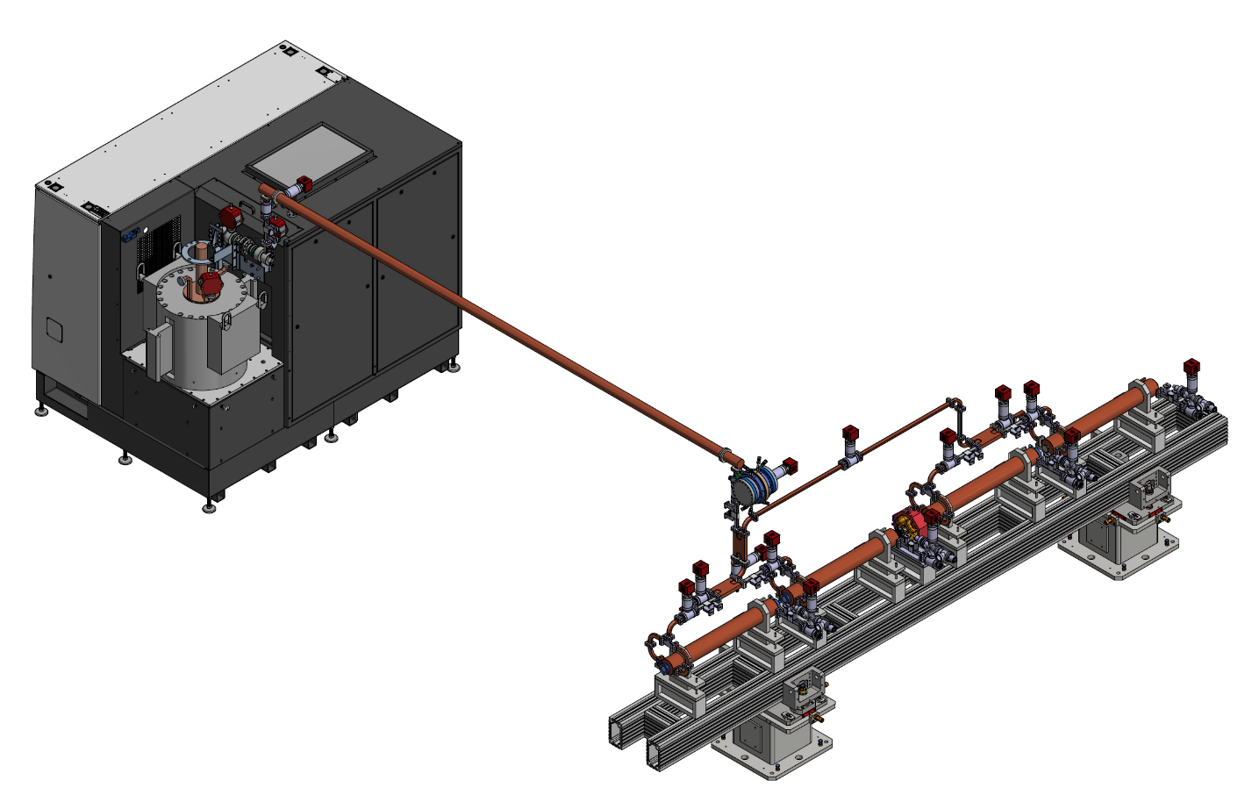
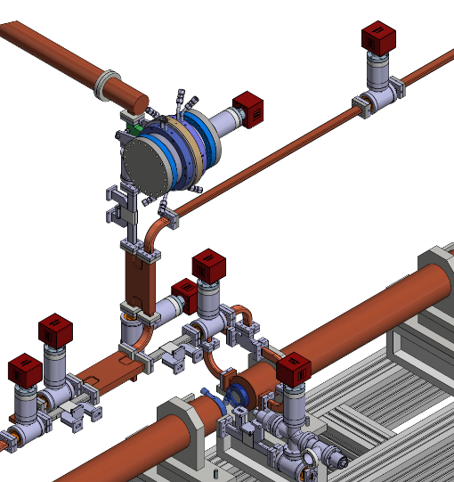
rf module layout
CPI VKX8311HE
CANON E37118+
25 (22.5) MW
50 (45) MW
Pumps with T pumping units
DC
Courtesy G. Di Raddo,
E. Di Pasquale, F. Cardelli
BOC (PSI)
Waveguide components (DC, T pumping, hybrids,…) CERN design but there are some components for which we have to fix the design (circular-rectangular waveguide mode converter, pumping unit on circular waveguide)
Pulse compressor: BOC (PSI) or INFN Design
Asymmetric waveguide distribution system to take into account the RF propagation time
hybrid
X band structures

Slide 6
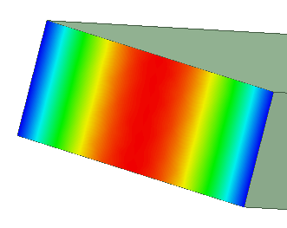
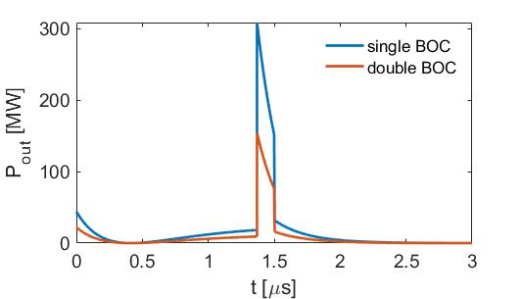
TWO BOCS FOR CPI (50 MW) CONFIGURATION
To reduce the peak power after the PC the possibility to have two pulse compressors is being considered
2.5 m
Klystron hall
1 m
Linac hall
Waveguide peak field
Shielding wall
5 m
2 m
∼50 MV/m
4.7 m
2.5 m
1.2 m
∼35 MV/m

Slide 7
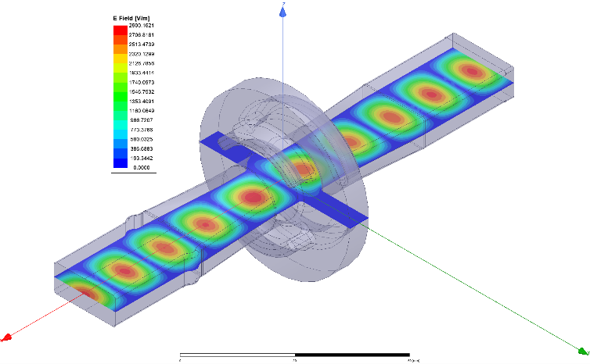
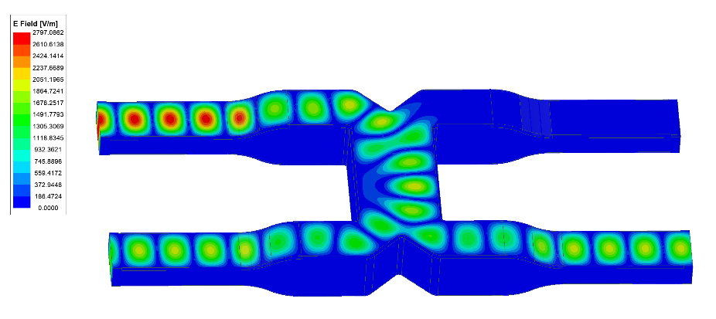
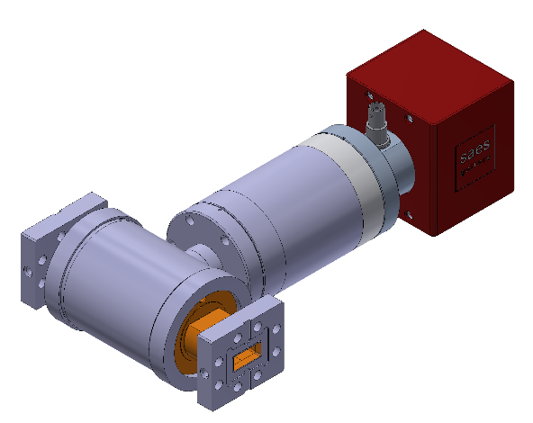
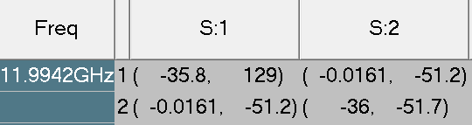
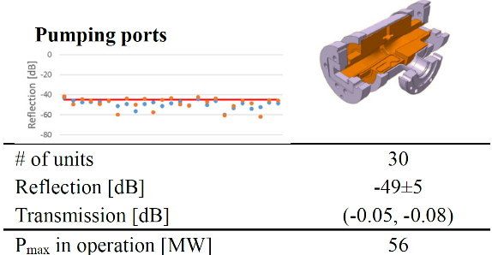
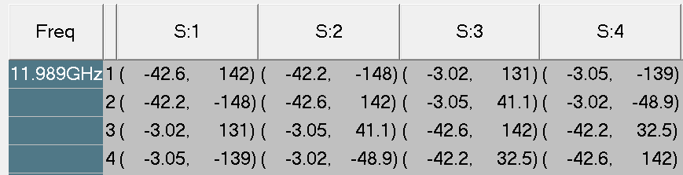
SIMULATIONS OF WAVEGUIDE COMPONENTS
T-Pumping Unit
3dB hybrid
F. Cardelli

Slide 8
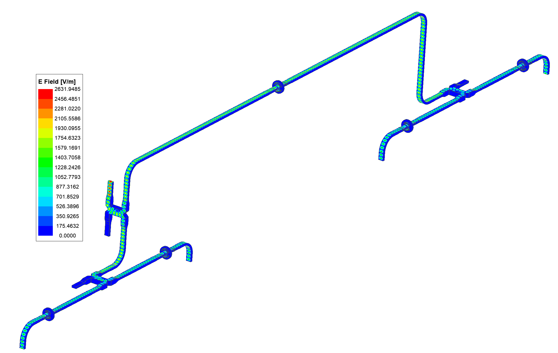
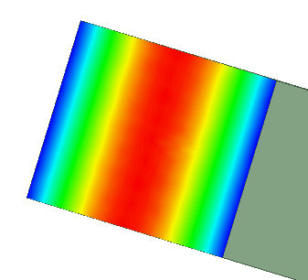
SIMULATIONS OF WAVEGUIDE DISTRIBUTION
Unfortunately, the attenuation of the X-band WR90 waveguide is strong (0.1 dB per meter) and the careful calculation of the total rf losses is important (10-15% power attenuation).
In order to mitigate and reduce losses:
  Redesign and standardize some components in order to reduce the total number of flanges in the module network.
  We are considering also the possibility to use double high WR90 waveguides.
Courtesy F. Cardelli
FROM KLY
D
C
Vacuum conductance
Hall the waveguide components will be tested at TEX at nominal power
20.32 mm
WAVEGUIDE | C * L [cm l/s]
WR90 | ≈57
Double high | ≈166
B
10.16 mm
22.86 mm
22.86 mm
Low Energy Asymmetric Module
WAVEGUIDE | Attenuation Structure A, B | Attenuation Structure C, D
WR90 | 10,05 | 14,34
Double high | 8,66 | 11,44
A
Low Energy Asymmetric Module
Structure A, B |  | Structure C, D
WR-90 total length [mm] | 1479,38 | WR-90 total length [mm] | 3473,38
WC-50 total length [mm] | 4678,00 | WC-50 total length [mm] | 4678,00
BOC loss [dB] | -0,10 | BOC loss [dB] | -0,10
Component loss [dB] | -0,16 | Component loss [dB] | -0,17
WR-90 loss [dB] | -0,14 | WR-90 loss [dB] | -0,34
WC-50 loss [dB] | -0,06 | WC-50 loss [dB] | -0,06
total loss [dB] | -0,46 | total loss [dB] | -0,67
total loss [%] | 10,05 | total loss [%] | 14,34
 | Loss dB/m
WR90 | -0,098
WC50 | -0,0124
∼35 MV/m
∼50 MV/m

Slide 9
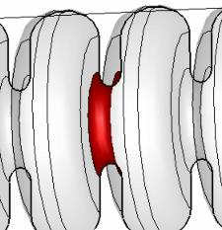
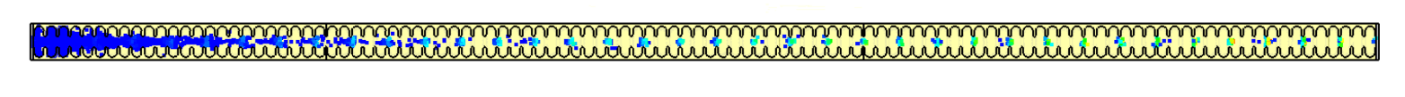
DARK CURRENT SIMULATIONS: SETUP
  The work has been done by F. Cardelli and is based on the work done at CERN by T. Lucas, D. B. Caballero and colleagues ([1],[2]).
  Dark current: field emitted electrons captured by the RF fields and transported up to the end of the structure. Its evaluation is necessary for radiation protection calculations for both EUPRAXIA@SPARC_LAB and TEX bunkers.
  General comment: the dark current strongly scales with accelerating field because to two effects:
      -decrease of the emitted current due to the lower surface field (emission effect);
      -decrease of the capture efficiency (capture process)
      Simulations have been done with CST studio (Eigenmode solver, PIC solver)
constants function of the metal work function
surface electric field
β = 30 (field enhancement factor)
Φ = 4.5 eV (work function)
CLIC style structure 24 cells
E_{acc} = 100 MV/m
EUPRAXIA@SPARC_LAB style structure 109 cells
E_{acc} = 60 MV/m
[1] T. G. Lucas, High Field Phenomenology in Linear Accelerators for the Compact Linear Collider, PhD Thesis, University of Melbourne, 2018
[2] D. B. Caballero et al., Dark current analysis at CERN, WEPRB059, Proceedings of IPAC2019, 2019

Slide 10
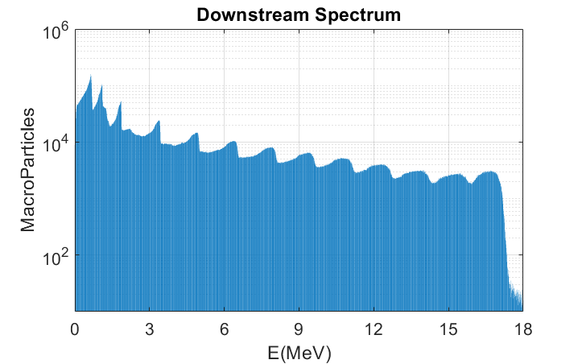
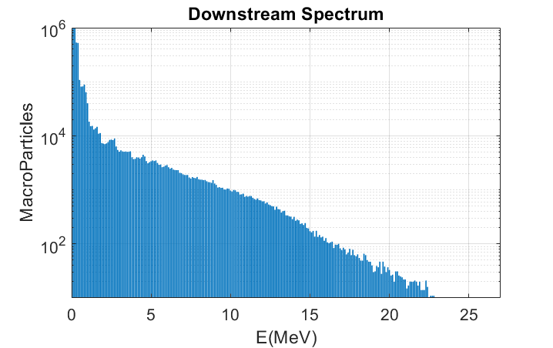

DARK CURRENT SIMULATIONS: RESULTS
CLIC Structure: 100MV/m, 24 cells (0.2m)
EUPRAXIA Structure: 60MV/m: 108 cells (0.9m)
      The CLIC case simulations have been replicated in order to found a scaling factor between CLIC and EUPRAXIA@SPARC_LAB structures thus evaluating the expected current directly scaling the current measured at the X-box test stands at CERN.
      We have considered in particular the downstream current.
Courtesy F. Cardelli
$F=\frac{I_{avg}(EUPRAXIA)}{I_{avg}(CLIC)}≈1.3e^{−5}$
$$I_{meas}^{CLIC}≈1mA→I^{EUPRAXIA}≈10nA$$
The scaling factor found has been used to scale the CLIC measured dark current to the EUPRAXIA case
D. B. Caballero et al., IPAC2019, 2019

Slide 11
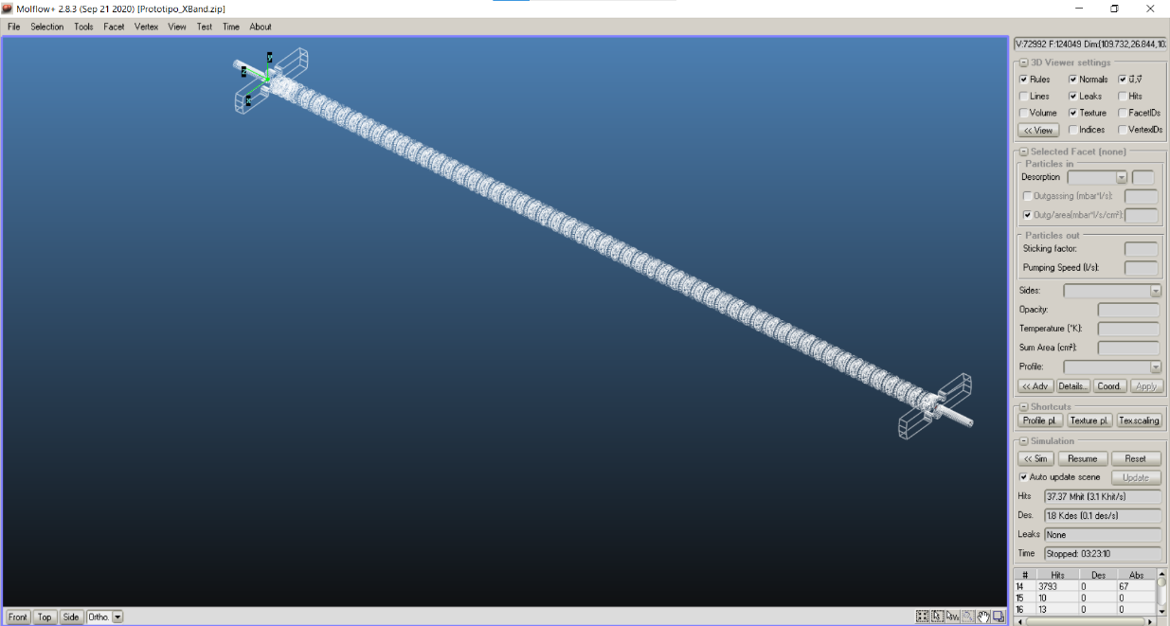

VACUUM PRESSURE CALCULATIONS
Vacuum pressure simulations have been done using Molflow (CERN).
To have a better control of the vacuum in the center of the structure, a dedicated chamber for vacuum treatment of accelerating structures after their construction/brazing is probably necessary to reduce the outgassing rate at levels below 10⁻¹² mbar l/s/cm²
Courtesy A. Liedl, S. Bini
$$\left[\frac{mbar∙l}{s∙ {cm}^{2}}\right]$$

Slide 12
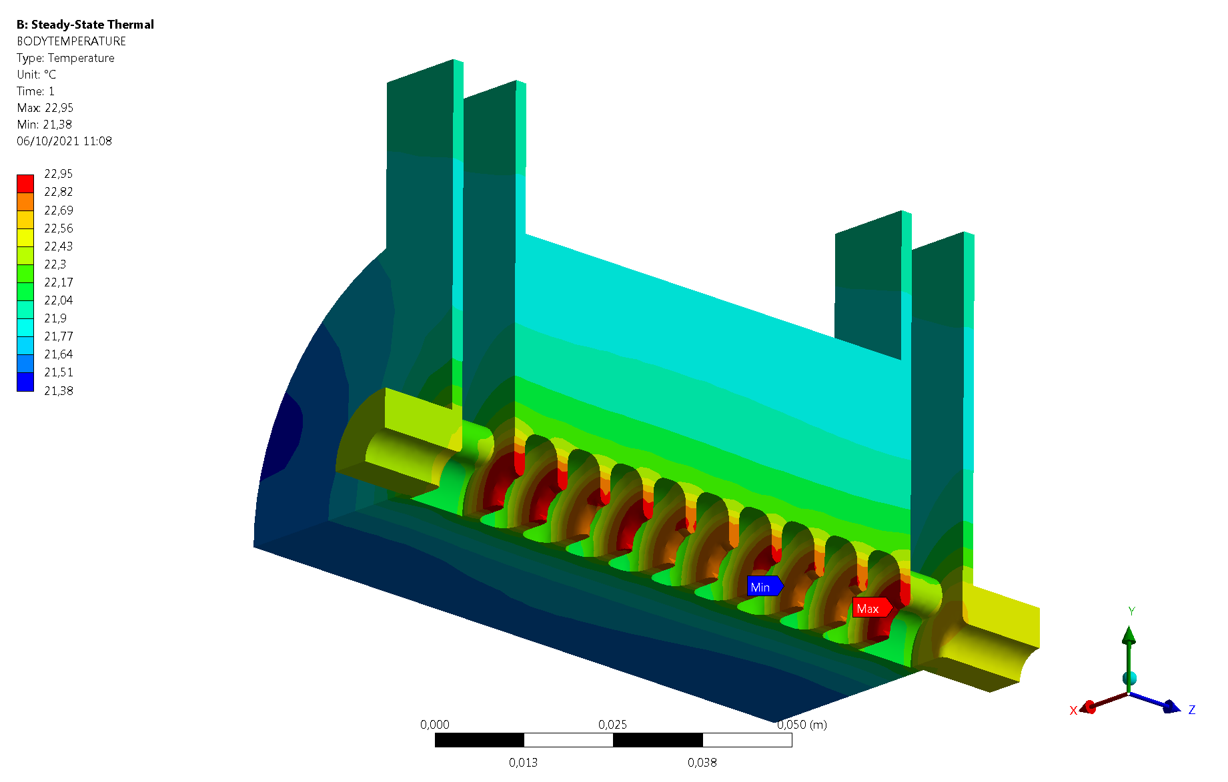
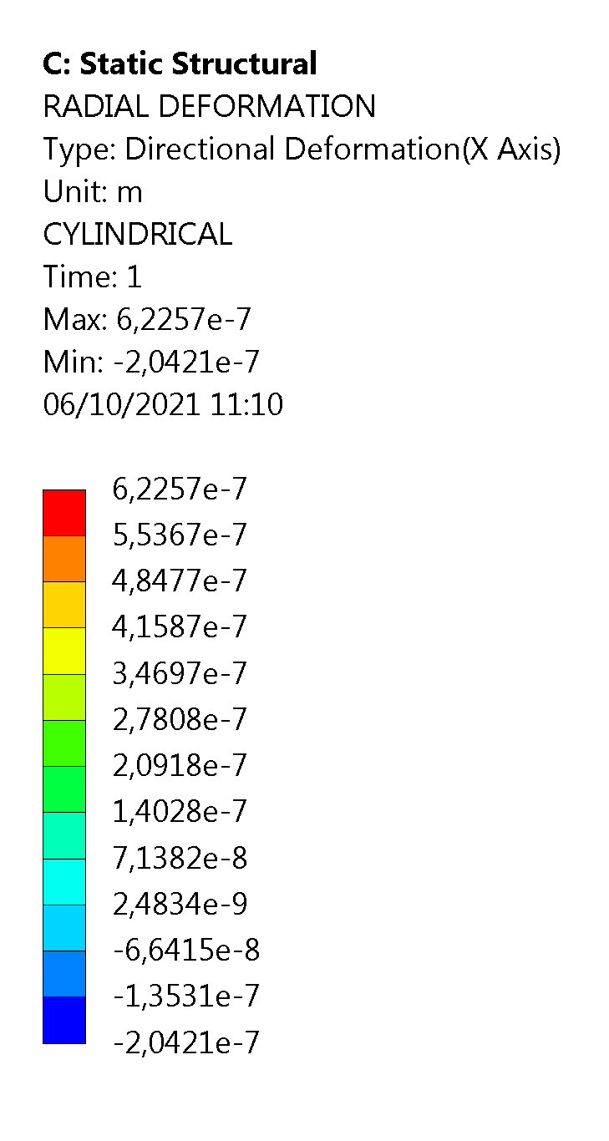

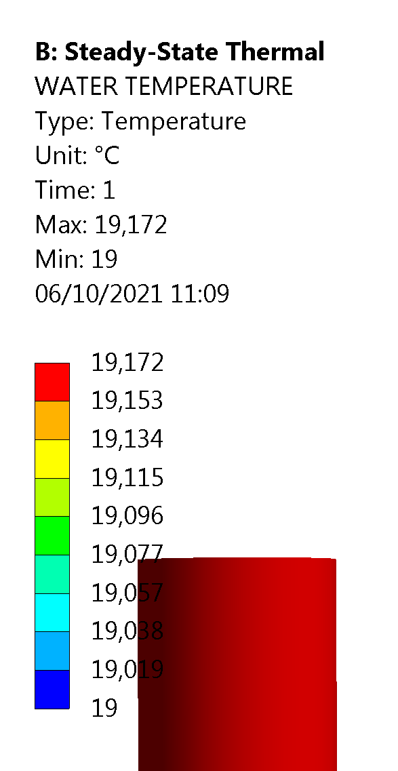

THERMO-MECHANICAL ANALYSIS
At regime, in the structure, we dissipate 1 kW
4 cooling pipes φ=8 mm are foreseen in the structure
Thermo-mechanical analysis (ANSYS workbench) have been done on the 10 cell prototype
They clearly show that the detuning of the structure at 100 Hz can be kept under control
109 cell thermo-mechanical analysis are still in progress
400 Hz operation will be also investigated
Cooling pipe water temperature
Work done in collaboration with S. Lauciani and L. Pellegrino

Slide 13
X-band Structure Prototyping Activities
The mechanical drawing of the final X band structure is under constant review and is strongly related to the result of the prototyping activity: brazing test, cell to cell alignment, tuning-precision, etc.
We will perform at least three steps of prototyping:
  Full scale mechanical prototype: to test the brazing process of the full structure and the cell-to-cell alignment we are able to achieve (ready for March/April 2022);
  Few cells-rf prototype for high power text: 10 cell prototype with input/output coupler to be tested at low and high power (ready for March/April 2022).
  Final full scale structure prototype (ready for March 2023).
Synergies with Int. projects: in the context of the I.FAST European project there is a Work Task on XLS-Compact light structure realization coordinated by G. D’Auria, to be fabricated in 2 years from May 2021. It is a structure very similar to the EuPRAXIA@SPARC_LAB one.
±30 μm
Accelerating cells
Courtesy G. Di Raddo, V. Lollo

Slide 14
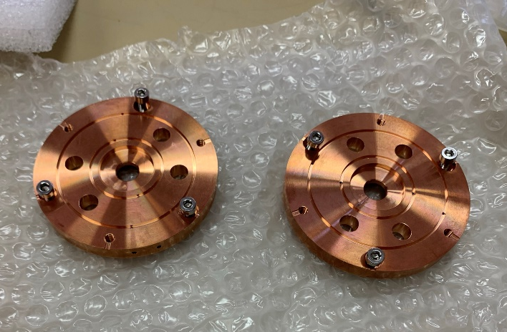
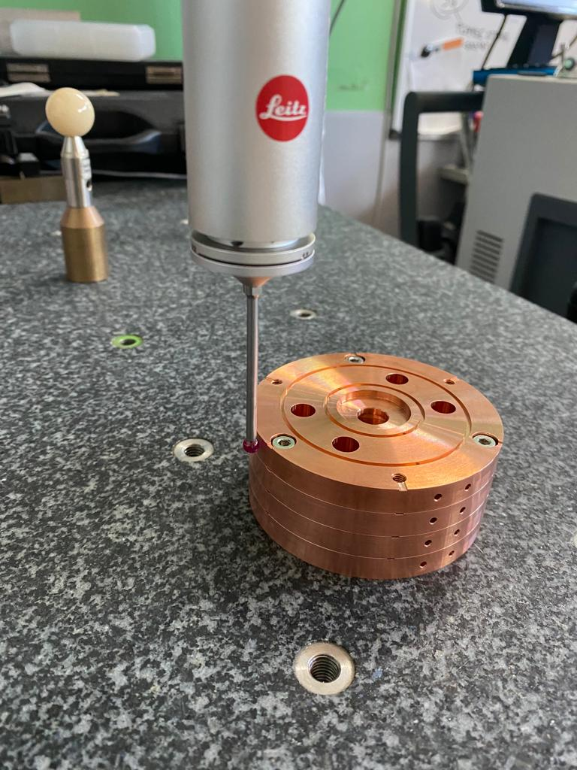
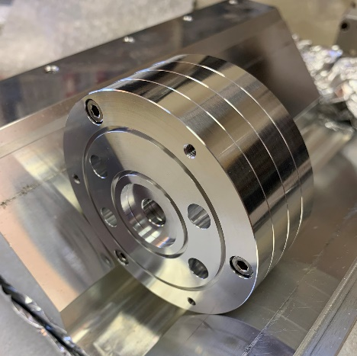
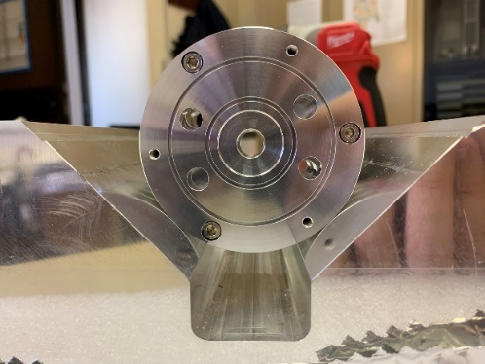
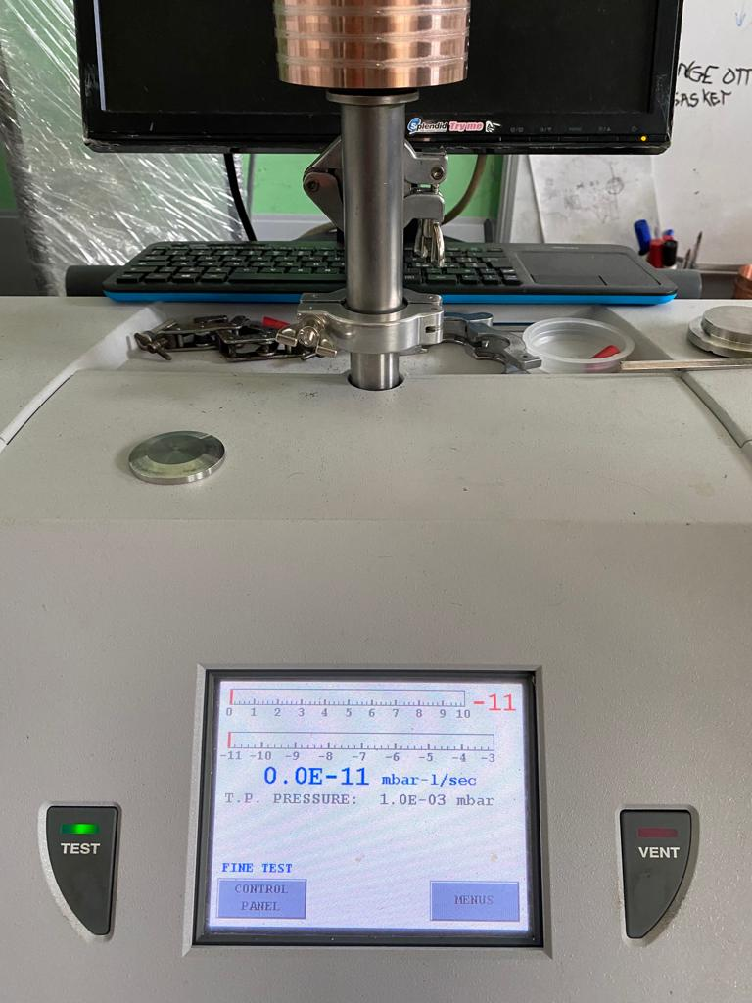
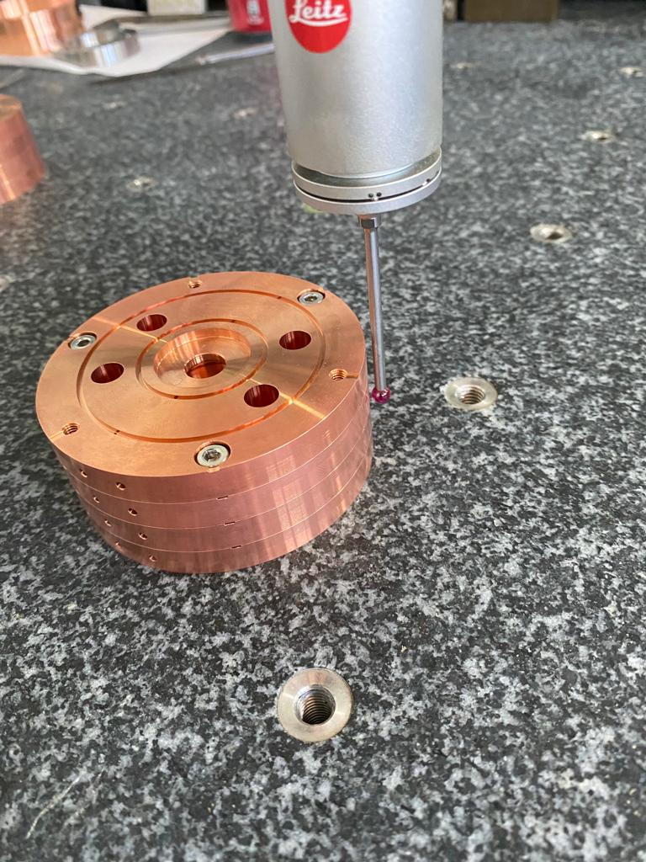
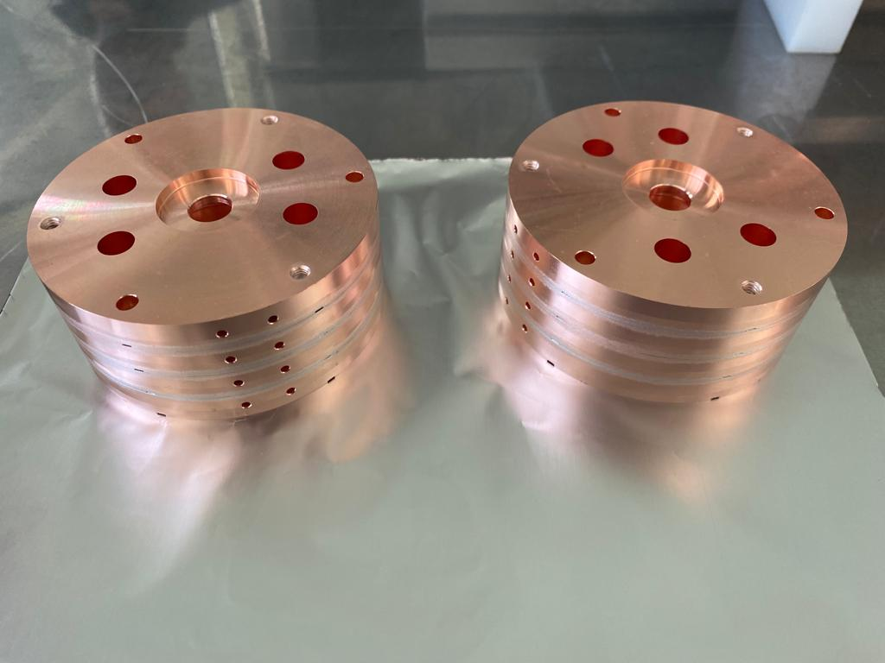
X-band Structure Prototyping Activities: REALIZATIONS
Characterization CMC
Realization
Assembly
Vacuum test
Characterization CMC
Brazing
<+/-5 μm alignment (before/after brazing)
Realizations in parallel to all LNF activities…

Slide 15
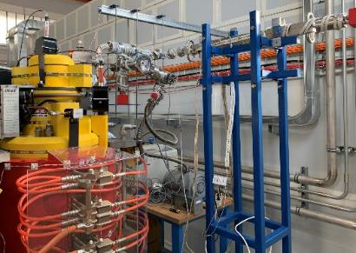
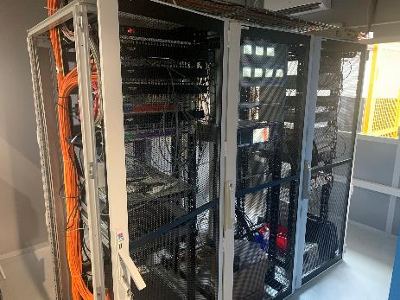
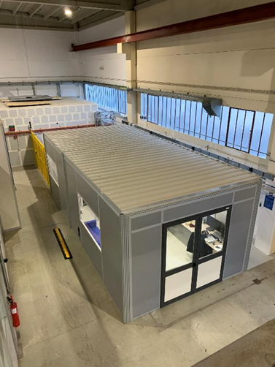
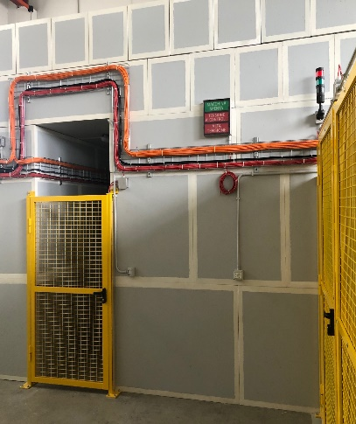
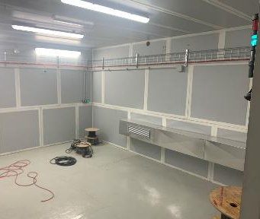
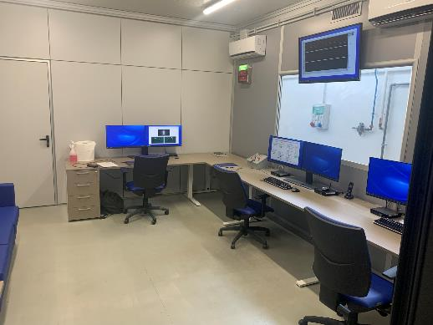
TEX facility – TEst stand for X-band at Frascati
TEX is a facility conceived for R&D on high gradient X-band accelerating structures and waveguide components for Eupraxia@SPARC_LAB
It has been co-funded by Lazio regional government in the framework of the LATINO project .
The setup has been done in collaboration with CERN and it will be also used to test CLIC structures.
The actual TEX setup is based on: K400 ScandiNova Modulator, CPI VKX8311 Klystron provided by CERN, Microwave Amplifier 1300 W solid state driver amplifier, Commercial S-band LLRF system (ITech) adapted to work, at 11.994 GHz.
After commissioning the source will be able to deliver 50 MW peak power, 1.5 us RF pulses at 50 Hz rep. rate.
Courtesy F. Cardelli, S.Pioli
Concrete shielded Bunker and Modulator Cage
Control room and Rack room

Slide 16
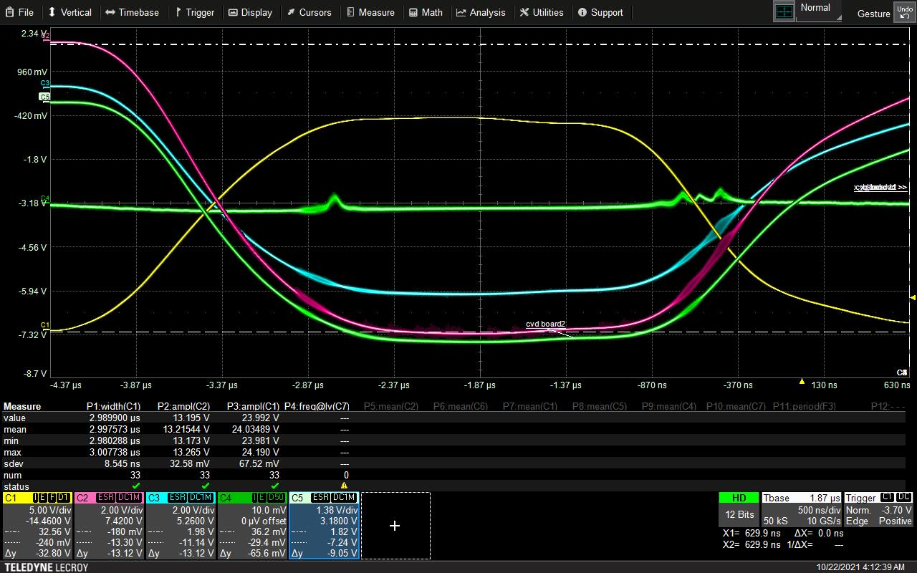
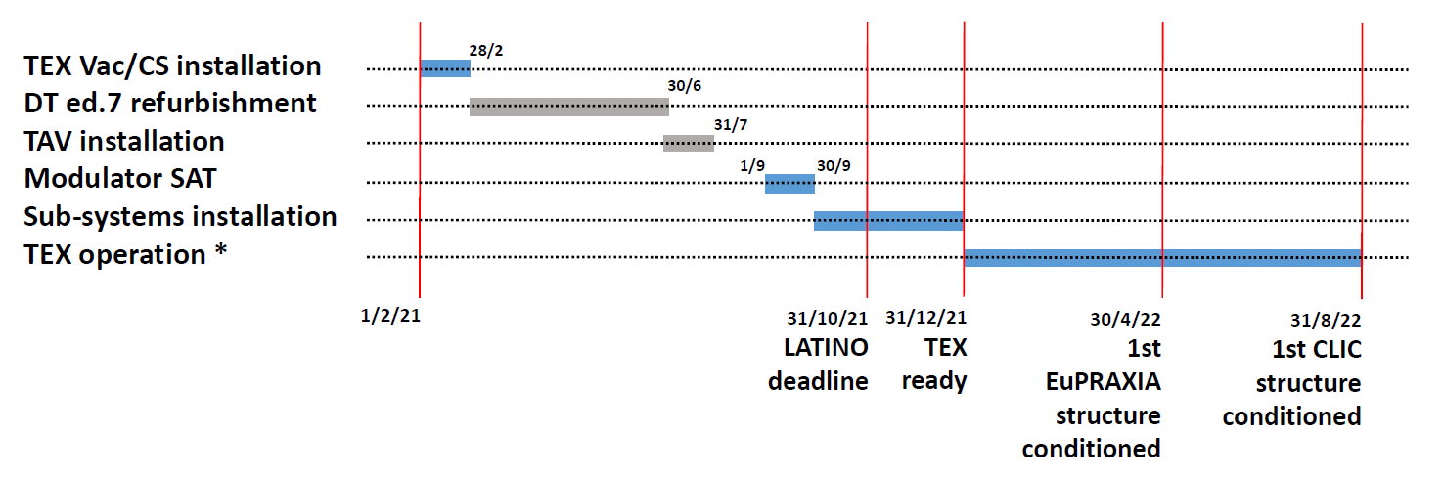
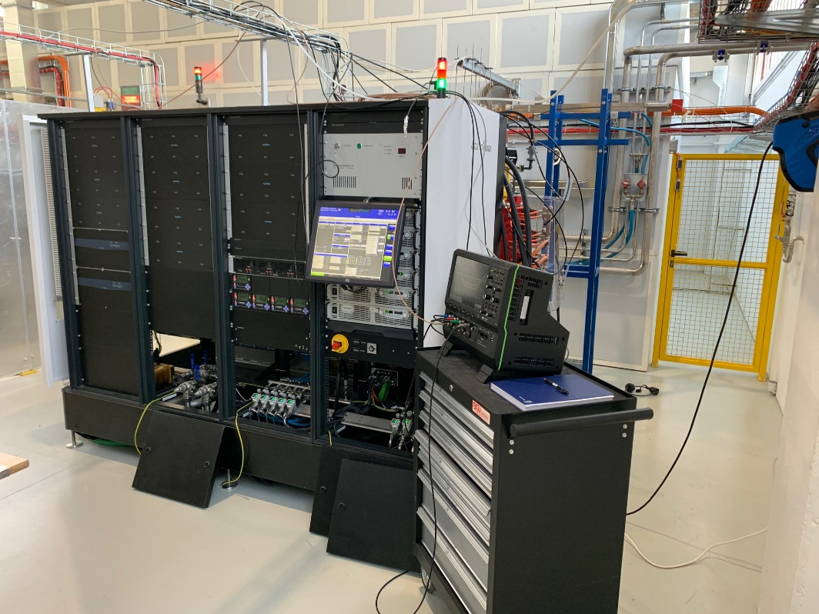
TEX COMMISSIONING/SAT
  18 October – 5 November: Site Acceptance Test of the modulator with ScandiNova staff (currently ongoing).
  Different modulator issues (HW and Control System) have been solved.
  The modulator worked several hours at Vk = 366 kV , Ik = 243 A in diode mode with no relevant interlock.
  The Klystron µperveance have been measured 1,15 A/V^{1.5}
V_{k}
I_{k}
Courtesy F. Cardelli, S.Pioli
Then:
  Conditioning of the Klystron.
  Complete waveguide network installation. Klystron + waveguide conditioning in order to be ready for the beginning of 2022 for Accelerating structures tests.
  Conditioning and test of the first X-band accelerating structure prototype for Eupraxia (starting from April 2022)
  Conditioning and test of the CLIC accelerating structure prototype or the Compact light X-band structure (this can be installed before April 2022)

Slide 17
waveguide component ACQUISITION AND test
1) Waveguide components already tested at CERN at 50 Hz but some of them NOT at the maximum power we need and that will be also tested at TEX:
-pumping units (fabricated, will be installed @ TEX)
-3dB hybrids (to be fabricated, 2023 CRITICAL, high peak power, after compression)
-power Splitter (to be fabricated, June 2022)
-BOC (PSI) (to be acquired, beginning of 2023 CRITICAL, high peak power, after compression)
-RF loads (Spiral loads, water load, under investigation, june 2022)
-DC (fabricated will be installed @ TEX)
-Waveguide line (bends, straigths,…) (fabricated will be installed @ TEX)
2) Waveguide components to be developed (there are some design but needs to be checked) and that will be tested at TEX:
-circular/rectangular mode converter (to be completely designed, end 2023 CRITICAL DESIGN)
-Pumping unit circular waveguide (to be completely designed, end 2023)
-BOC (LNF) (to be completely designed, end 2023)
-Double high waveguide components (CERN coll.)

Slide 18
Financial requests justification
To decrease the outgassing rate of X band structures and components
vacuum pumps (NEG, ion), gauges, portable RGA device
fabrication of flanges, gaskets for RF module (circular, rectangular, double high waveguides) and linacs components
hybrids, splitter, loads, bends
PSI/LNF

Slide 19
Discussion/progress on last RC report
In this context, the completion of the TEX Facility (TEst-stand for X-band) is essential, ….Of particular importance for the operation of the facility will be the jitter in phase and amplitude of the RF stations.
Pulse to pulse stability studies will have to be integrated early on in the TEX program.
Although the R&D program benefits from the CERN collaboration and is clearly integrated in the project schedule, it remains particularly challenging. It is therefore advisable to dene a list of priorities and further investigate fallback solutions and relative costs where proven components and/or technologies already exist.
In addition the RC draws attention to the possible long delivery times of some commercial components such as the X-band klystrons, due to a limited production capacity of the manufacturer.
In progress @ TEX
Timeschedule for RF acquisition and test of RF components is defined
See A. Gallo presentation

Slide 20
THANK YOU

