Slide 1
EuPRAXIA @ SPARC_LAB
Project Management
Antonio Falone
F.Cioeta
M.Iungo
G.Vinicola
TDR Review Committee, 26/10/2021.

Slide 2
Outline
Highlights
Project Management Plan for the TDR - Phased approach.
Project Organization
Project Planning baseline
Project cost baseline
Risk management
Manpower current allocation & estimation of additional resources required.
Project Management & Integration ongoing activities
TDR Review Committee, 26/10/2021. Antonio Falone

Slide 3
Highlights
INCLUDED in the ESFRI 2021 Roadmap —> Big milestone
EuPRAXIA - European Plasma Research Accelerator with Excellence in Applications, a distributed, compact and innovative accelerator facility based on plasma technology, set to construct an electron-beam-driven plasma accelerator in the metropolitan area of Rome, followed by a laser-driven plasma accelerator in European territory
After a long and challenging evaluation process, EuPRAXIA has been included in the ESFRI 2021 Roadmap - ranking HIGH
Application to the preparatory phase on going. 3M€ to support the TDR work. Deadline 20/01/2022
TDR Review Committee, 26/10/2021. Antonio Falone

Slide 4
Highlights
INCLUDED in the ESFRI 2021 Roadmap —> Big milestone
Additional manpower to fill up the Project office - Financial officer is about to be hired.
Project Management Plan, for EuPRAXIA@SPARC_LAB presented to the INFN management board
EuPRAXIA @ SPARC LAB Project Office
Monitoring & Control activities started
Integration activities started (Functional layout, naming convention etc…).
Some update to the Organization Breakdown Structure
TDR Review Committee, 26/10/2021. Antonio Falone

Slide 5
Highlights
Building final design - accomplished
Final review for approval is scheduled tomorrow
Authorization process will start afterwards
Risk mitigation actions implemented (see risk section and U.Rotundo Talk)
Need for re-baselining the project.
A dedicated review meeting with an expert panel will take place by the end of the year
to validate the main technical choices.
TDR Review Committee, 26/10/2021. Antonio Falone

Slide 6
Project Management Plan
INCLUDED in the ESFRI 2021 Roadmap —> Big milestone
Draft version presented in Jan 2021 at this committee
Presented to the INFN management board (GE) in February 2021 and “informally” approved.
Part of TDR funding already allocated for urgent procurement
Comprehensive document for the TDR Phase
TDR Review Committee, 26/10/2021. Antonio Falone

Slide 7
Project Management Plan
INCLUDED in the ESFRI 2021 Roadmap —> Big milestone
Organization Breakdown Structure
Work Breakdown Structure
R&D Cost
High level and detailed schedule
Risk management
Project Control & Methodology
Project Communication Plan
TDR Review Committee, 26/10/2021. Antonio Falone

Slide 8
Organization Breakdown Structure
INCLUDED in the ESFRI 2021 Roadmap —> Big milestone
Few modification w.r.t. last presented version:
Additional working area for Diagnostics
Some WP responsible have been changed
Additional WP: Network, Functional safety.
For each work packages, expected activities and deliverables are reported in a dedicated document - WBS dictionary (to be updated soon).
It follows the matrix structure of the internal LNF organigram.
Aligned w.r.t. the EuPRAXIA consortium expected activities.
TDR Review Committee, 26/10/2021. Antonio Falone

Slide 9
Organization Breakdown Structure
INCLUDED in the ESFRI 2021 Roadmap —> Big milestone
TDR Review Committee, 27/10/2021. Antonio Falone

Slide 10
Project Management Plan
INCLUDED in the ESFRI 2021 Roadmap —> Big milestone
TIME BASELINE
TDR Review Committee, 26/10/2021. Antonio Falone

Slide 11
Roadmap towards TDR - Old Baseline
2021
2022
2023
2024
2025
2026
2027
EuPRAXIA@SPARC_LAB Design Phase
Preliminary layout
EuPRAXIA@SPARC_LAB
Machine design
Intermediate layout
User case defined
Plasma technology validated
Final layout & beam parameters
X-Band technology validated
Final design FEL
TDR Released
TDR Approved
Building design & construction
Final design
Project Validation & Authorization
Executive Design
Tender
Building construction
EuPRAXIA@SPARC_LAB
Building
Utilities executive design
Tender
Implementation
Acceptance
Building ready
Application to prep.phase
Preparatory phase
🇪🇺
Outcome ESFRI application
EuPRAXIA - EU
Eupraxia-EU TDR
TDR Review Committee, 26/10/2021. Antonio Falone

Slide 12
Roadmap towards TDR - new baseline
2021
2022
2023
2024
2025
2026
2027
EuPRAXIA@SPARC_LAB Design Phase
Preliminary layout
Intermediate layout
User case defined
Plasma technology validated
Final layout & beam parameters
X-Band technology validated
EuPRAXIA@SPARC_LAB
Machine design
Final design FEL
TDR Released
TDR Approved
EuPRAXIA@SPARC_LAB Implementation Phase
Planning
Procurement
Building design & construction
Implementation
Final design
Permitting Request
Exec. Design
Tender for Validation
Validation
Tender
EuPRAXIA@SPARC_LAB
Building
Building Construction
Utilities executive design
Tender
Implementation
Acceptance
Building ready
Application
to prep.phase
Preparatory phase
🇪🇺
EuPRAXIA - EU
Outcome ESFRI application
Eupraxia-EU TDR
TDR Review Committee, 26/10/2021. Antonio Falone

Slide 13
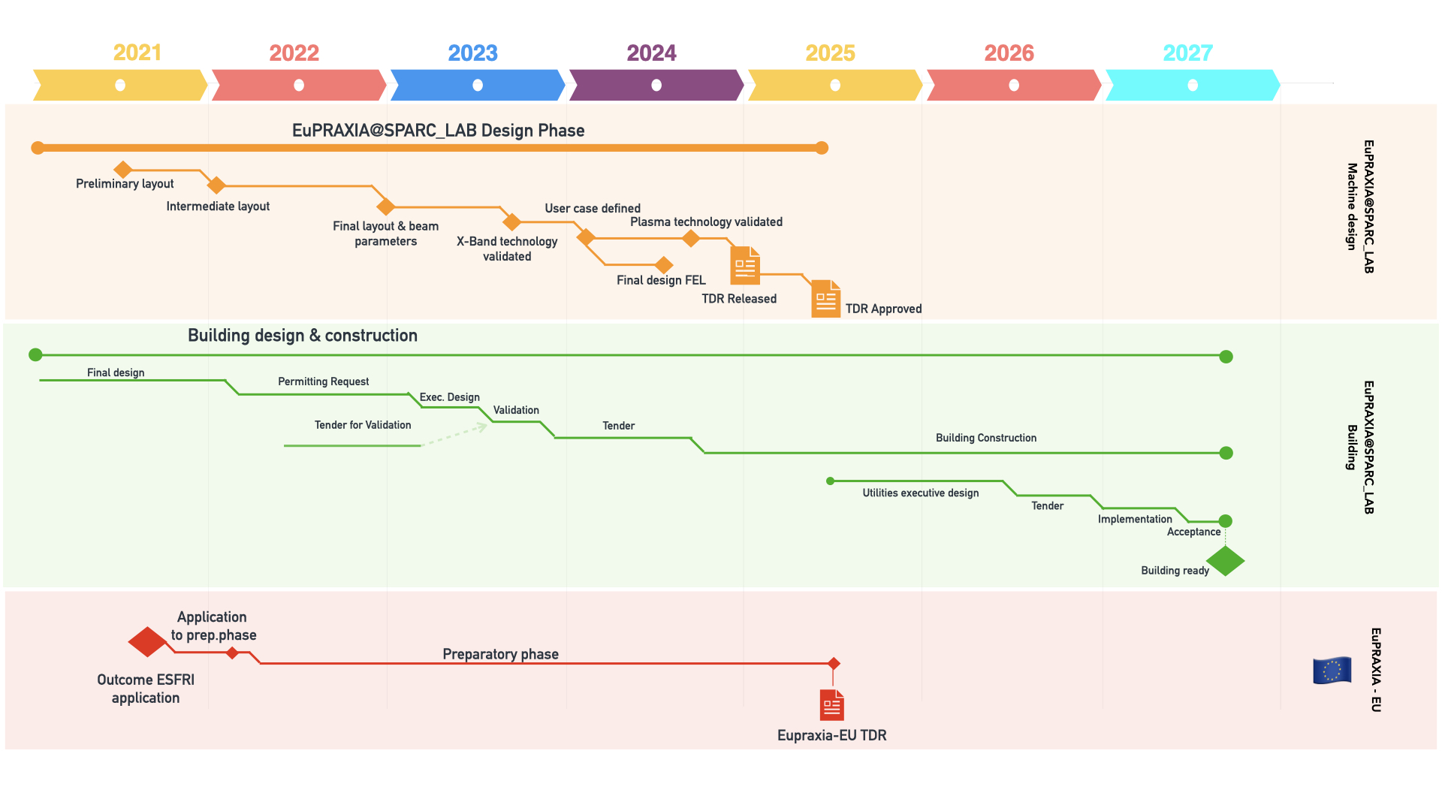
Roadmap towards TDR - new baseline
Start Implementation phase planning
Implementation phase:
Procurement
Pre-assembly
Start of installation
Contingencies allocated for each activity
Schedule compression actions under consideration:
Consider the possibility of a partial handover to start installation before the end of the construction
Preliminary activities to be started well before the indicated data
Based on some assumptions to be refined as long as the process will go forward.
Activities depending on external constraints:
Permitting authorities
Tender procedure (EU tender required)
TDR Review Committee, 26/10/2021. Antonio Falone

Slide 14
Building planning baseline
TDR Review Committee, 26/10/2021. Antonio Falone

Slide 15
Building planning baseline
Critical Internal dependencies:
RF System requirements
Functional Utility Matrix
Critical External dependencies:
Permitting process: 12months with some contingencies. Preliminary works already started.
DED Verification Process: To be outsourced, only 1 Verification tender in order to compress the schedule.
Administrative time for EU Building tender.
TDR Review Committee, 26/10/2021. Antonio Falone

Slide 16
Detailed Planning
The detailed planning considers all the most critical activities organized per Working Area.
Building and ESFRI activities are also considered since they act as external constraints and it is important to make sure that TDR activities are synchronized with the building development and construction and EU initiative (Preparatory phase).
Simplified and compressed version + full detailed planning
BUILDING is on the critical path.
Several intermediate deliverables/milestones to help monitoring & control
TDR Review Committee, 26/10/2021. Antonio Falone

Slide 17
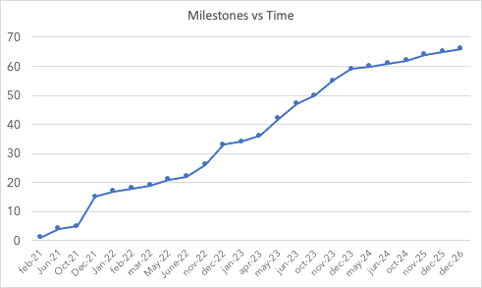
Intermediate milestones
High Level milestones as presented in the high level planning have been broken down to several intermediate deliverables/milestones to help monitoring & control
Upcoming milestones discussed at every WA Meeting.
Several class of intermediate milestones:
Protoype (hardware)
Design
Report
Dependencies are also considered
TDR Review Committee, 26/10/2021. Antonio Falone

Slide 18
Short term outlook - upcoming milestones
Intermediate Milestone | Expected date | Status | Risk
Project Management Plan ready | Feb21 | Accomplished | n.a.
Preliminary layout | Jun -21 | Accomplished | n.a.
Injector preliminary layout | Jun -21 | Accomplished | n.a.
Building final design | Jun -21 | Accomplished | n.a.
Outcome ESFRI Application | Oct-21 | Accomplished | n.a.
2021 Progress Report | Dec-21 | On time | None
Intermediate machine baseline | Dec-21 | Ongoing | Risk of delay HIGH due to lack of manpower
Magnets Specifications | Dec-21 | Ongoing | Risk of delay HIGH due to lack of manpower
S-Band Waveguide design | Dec-21 | On time | None
X-Band Waveguide design | Dec-21 | On going | Depending on the final RF Station choice. It might be delayed
X-Band mech prototype | Dec-21 | On time | To be validated
X-Band RF Prototype | Dec-21 | On time | To be validated
Funcitonal layout and configuration framework | Dec-21 | Accomplished | n.a.
TEX Fully operational | Dec-21 | On time | None
TDR Review Committee, 26/10/2021. Antonio Falone

Slide 19
Project Management Plan
INCLUDED in the ESFRI 2021 Roadmap —> Big milestone
COST BASELINE
TDR Review Committee, 26/10/2021. Antonio Falone

Slide 20
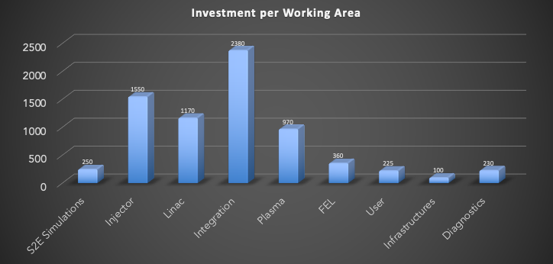
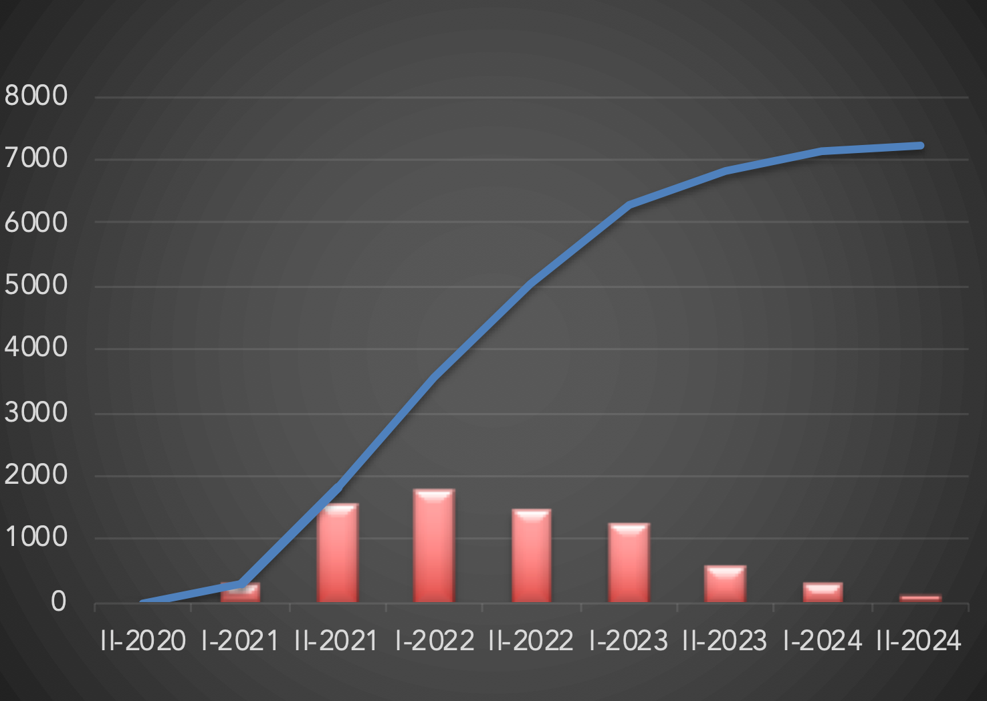
Cost-Baseline
Working Area | Amount (k€)
WA1- Beam Physics | 250
WA2 - Injector | 1550
WA3 - Linac | 1170
WA4 - Integration | 2380
WA5 - Plasma | 970
WA6 - FEL | 360
WA8 - Users | 225
WA9 - Infrastructures | 100
WA.10 - Diagnostics | 230
Subtotal | 7235
Contingencies | 360
TOTAL | 7595
Cost Baseline for TDR already presented at the last meeting. Few modification in the meanwhile.
Presented to the INFN management board (GE) which informally approved but waiting for your final feedback.
Some funds already allocated to cover some urgent procurement.
TDR Review Committee, 26/10/2021. Antonio Falone

Slide 21
Cost-Baseline, shopping cart
Working Area | Item | Expected cost (k€) | Comment
WA.1 - Beam Physics | Computing cluster for 3D Full simulations | 250 | Already procured
WA.2 - Injector | Upgrade PC Laser | 725 | To be performed @ SPARC_LAB
 | Upgrade LLRF | 100 | To be performed @ SPARC_LAB
 | Upgrade Synch System | 100 | To be performed @ SPARC_LAB
 | Upgrade Timing System | 50 | To be performed @ SPARC_LAB
 | RF Gun prototype | 25 | First under testing @ SPARC_LAB
 | S-Band Modulator | 550 | To be defined
WA.3 - LINAC | Heat treatment chamber | 70
 | Vacuum Components | 60
 | Local heater | 10
 | X-Band mech prototype | 60 | Already procured
 | X-Band RF prototype | 80
 | RF - in vacuum component | 50
 | WG Circular mode converter | 80
 | High Power Waveguide component | 150
 | X-Band full prototype | 200
 | BOC Prototype (x2) | 200
 | Magnetic measurement lab upgrade | 130
 | Compact integrated quad prototype | 80
TDR Review Committee, 26/10/2021. Antonio Falone

Slide 22
Cost-Baseline, shopping cart
Working Area | Item | Expected cost (k€) | Comment
WA.4 - Integration | Klystron spare for TEX | 1300 | Under discussion
 | X-Band Solid state amplifier | 100
 | Warranty extension | 35 | Already procured
 | TEX Setup | 195 | Already procured
 | 2nd Klystron full specs | 750
WA.5 - Plasma | Vacuum Chamber & Support | 150 | To be performed @SPARC_LAB
 | Capillary & Supports | 100 | To be performed @SPARC_LAB
 | Plasma diagnostics | 240 | To be performed @SPARC_LAB
 | Discharge laser trigger | 60 | To be performed @SPARC_LAB
 | Gas injection system | 60 | To be performed @SPARC_LAB
 | Pumping system | 120 | To be performed @SPARC_LAB
 | Motorized actuators | 100 | To be performed @SPARC_LAB
 | Electrovalve | 40 | To be performed @SPARC_LAB
 | Discharge pulser and HV generator | 100 | To be performed @SPARC_LAB
TDR Review Committee, 26/10/2021. Antonio Falone

Slide 23
Cost-Baseline, shopping cart
Working Area | Item | Expected cost (k€) | Comment
WA.4 - Integration | Klystron spare for TEX | 1300 | Under discussion
 | X-Band Solid state amplifier | 100
WA.6 - FEL | Prototype Apple X | 100
 | Intraondulator diag prototype | 100
WA.8 - User | Optical elements prototype | 225
WA.9 - Infrastructure | Radioprotection studies | 50
 | High stability cooling skid | 50
WA.10 - Diagnostics | High precision charge measurement | 80
 | Beam loss monitor prototype | 30
 | Stripline BPM prototype | 60 | Already procured
 | Compact diagnostic chamber prototype | 60
TDR Review Committee, 26/10/2021. Antonio Falone

Slide 24
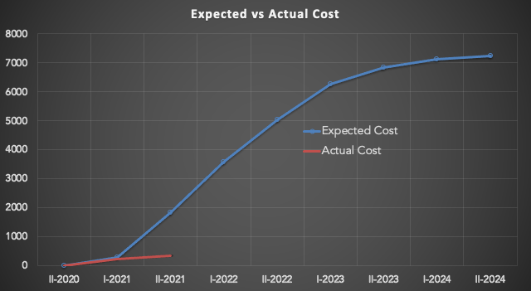
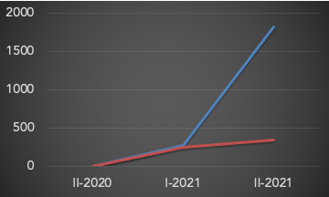
Cost-Baseline, status
Some items already procured thanks to a pre-allocation of money of the GE due to urgent reasons.
Bad Sign!
Under budget at the moment
Essentially due to delays in the negotiation of the spare X-Band Klystron (most expensive item to be purchased). See. A.Gallo’s talk.
Excessive cost of CPI klystron opened the way to different scenarios (negotiations with CPI/CERN and involvement of Canon).
This is a critical choice for the development of the machine. A small delay to get to a wise choice can be considered acceptable and in any case we plan to finalize the decision soon and hence allocate the money in a short term.
X-Band Spare klystron
TDR Review Committee, 26/10/2021. Antonio Falone

Slide 25
Project Management Plan
INCLUDED in the ESFRI 2021 Roadmap —> Big milestone
RISK MANAGEMENT
Risk Management
TDR Review Committee, 26/10/2021. Antonio Falone

Slide 26
Risk management, methodology
LEVEL | DESCRIPTION | PROBABILITY
5 | Very High | 80% - 100% or ever month
4 | High | 60% - 79% or every year
3 | Moderate | 40% - 59% or an event every 2-5 years
2 | Low | 20% - 39% or an event every 5 – 10 years
1 | Very Low | 0% - 19% or an event every > 10 years
Risks defined as: R=PxI. Likelihood x Impact.
Risk matrix and thresholds:
LOW - R< 6 , No actions required
LEVEL | DESCRIPTION | IMPACT
5 | Very High | Failure in the scope or time or cost of the project.
4 | High | Extra-cost of the project that must be allocated through dedicated management (GE) actions. Completion delayed >1year Machine performances significantly reduced
3 | Moderate | Cost increasing but affordable within contingency or with modest extra funding Completion delayed > 6 months Machine performances lightly reduced but within the scientific goals
2 | Low | Moderate increase of the cost affordable with allocated contingencies. Completion delayed < 6 months Marginal impact on the machine performances
1 | Very Low | Some marginal cost increasing Few intermediate milestones delayed (not in the critical path) NO impact on the machine performances
MODERATE - 6<R<10, Some contingencies might be required
HIGH - 10<R<15, Contingencies MUST be allocated & mitigation actions might be required
CRITICAL - R>15, Mitigation actions required
TDR Review Committee, 26/10/2021. Antonio Falone

Slide 27
TDR- Management Risks
EVENT | P | I | LEVEL | TYPE OF RISK | DESCRIPTION | MITIGATION ACTIONS
Extra cost | 3 | 4 | HIGH | COST | Extra cost for prototyping and experimental activities | Close follow up of procurement and authorization process before launch the procurement. Periodical reviews to assess extra cost and potential compensation.
Time delay | 3 | 4 | HIGH | TIME | Time delays | Contingencies allocated. TDR completion is currently NOT in the critical path which is dominated by the building.
Manpower | 4 | 3 | HIGH | TIME & COST | Shortage of manpower | A comprehensive plan to cover required professional profile will be discussed at management level.
Financial resources availability | 2 | 2 | LOW | COST | Financial resources | Funds allocated are sufficient for the TDR and Implementation. Additional funding are expected through different funding agencies (ESFRI preparatory phase, regional funding, other European calls).
TDR Review Committee, 26/10/2021. Antonio Falone

Slide 28
TDR - Technical Risks
EVENT | P | I | LEVEL | TYPE OF RISK | DESCRIPTION | MITIGATION ACTIONS
X-Band Acc-Section | 3 | 3 | MODERATE | Time & Cost | X-Band Acc.section technology is new. | Collaboration with CERN. Prototyping for technology assessment and validation
Manpower | 4 | 3 | HIGH | TIME | Resources under-allocated | A masterplan for additional recruitment should be done at LAB level.
X_Band performances | 2 | 4 | MODERATE | Scope | The performances of the 100Hz High power X-Band klystron are still to be proven | Involvement of other companies with different technological scenarios are under consideration
Plasma development | 3 | 4 | HIGH | Scope | Performances of the PWFA Scheme | R&D and international collaboration
TDR Review Committee, 26/10/2021. Antonio Falone

Slide 29
Building - Management Risks
EVENT | P | I | LEVEL | TYPE OF RISK | DESCRIPTION | MITIGATION ACTIONS
Verification delay | 3 | 3 | Moderate | TIME | Design verification steps might be time consuming | Make only 1 tender only for the executive design. Out of the critical path.
Authorization delays | 3 | 3 | MODERATE | TIME | Time delays due to the authorization process which is still unkown | Reasonable contingencies. Some preliminary activities already started.
Tender | 4 | 3 | HIGH | TIME | Time needed to issue a multimillion tender might become longer than expected | To be carefully monitored. Prepare tender in advance and implement reasonable contingencies.
Construction cost | 3 | 2 | MODERATE | COST | Extra cost during construction | Contingencies are usually considered in the tender.
Construction delays | 4 | 4 | CRITICAL | TIME | Time delays due to building construction. | 1. Compress verification and tender phase as much as possible. 2. Consider the possibility to have some areas available before the completion of the building. 3. Contingencies already allocated
TDR Review Committee, 26/10/2021. Antonio Falone

Slide 30
Project Management Plan
INCLUDED in the ESFRI 2021 Roadmap —> Big milestone
RISK MANAGEMENT
Resource management
TDR Review Committee, 26/10/2021. Antonio Falone

Slide 31
Current resources allocation [FTE]
INCLUDED in the ESFRI 2021 Roadmap —> Big milestone
 | Accelerator Division
 | Diag. | Magnets | Mech Eng | Linac | RF | Controls | Vacuum | Laser | STAFF | Secret. | TOT
Staff | 3 | 1,5 | 2 | 2 | 2 | 2 | 3 | 2 | 7 | 1 | 25,5
Technician | 2 | 1 | 2 | 3 | 2 | 1 | 3 | 1 | 0 | 0 | 15
 | Technical Division
 | Civ.eng. | HVAC | Electrical | Gen.Serv | Warehouse | Mech. | TOT
Staff | 1 | 1 | 1 |  |  |  | 3
Technician | 0 | 1 | 1 | 0,5 | 0,25 | 0,25 | 3
 | Others
AdR / Post-Doc | 6
INFN-MI | 2
UniRoma1 | 1
UniRoma2 | 2
ENEA | 2
TOT | 13
First estimation to evaluate the current FTEs allocated to the project.
TDR Review Committee, 26/10/2021. Antonio Falone

Slide 32
Current resources allocation [FTE]
INCLUDED in the ESFRI 2021 Roadmap —> Big milestone
60 FTE currently allocated
EuPRAXIA@SPARC_LAB
Acc.Div
Tech.Div
R&D
Design
Sparc_LAB
30% of total resources available for the Acc.Div
5% of the total resources available for the Tech.Div
DOES NOT INCLUDE Building design activities
TEX
TDR Review Committee, 26/10/2021. Antonio Falone

Slide 33
Estimation required additional manpower
INCLUDED in the ESFRI 2021 Roadmap —> Big milestone
WP | Description | Staff * | Post-Doc | Technician | Comment
1 | Beam Physics |  | 2
2 | Plasma Physics | 1 | 1
3 | FEL Physics |  | 1 |  | INFN-MI
6 | Plasma Module |  | 1
8 | RF-Gun & Acc.Structures
10 | Vacuum |  | 1 | 2
11 | Laser & Cathodes | 1 | 1
14 | Diagnostics | 1 | 1
15 | LLRF & Synchronization | 1
16 | Controls | 2 |  | 2
17 | Magnets & PS |  | 1
18 | Undulators |  | 2 |  | 1 @ ENEA
19 | Mech Engineer | 1
20 | Electrical Installation |  |  | 2
21 | Cooling & Ventilation |  |  | 1
22 | Civil Engineering |  |  | 1
23 | Radioprotection | 1
24 | Conventional Safety | 1
25 | Network | 1
PO | Project Office | 1 | 2
 | TOTAL | 11 | 13 | 8
 | TOT. FTE | 32
This would bring up to 90FTE allocated
This does not take into account PhD students (around 10).
Estimated cost/year = 1M€
These FTEs could come from different sources:
Already present in the Lab but working on other topics
Turnover
New hiring
In-kind contribution
Request to be submitted at the INFN-Management.
Strategy to be decided at Management level
TDR Review Committee, 26/10/2021. Antonio Falone

Slide 34
Project office update
INCLUDED in the ESFRI 2021 Roadmap —> Big milestone
Project Office Activities
TDR Review Committee, 26/10/2021. Antonio Falone

Slide 35
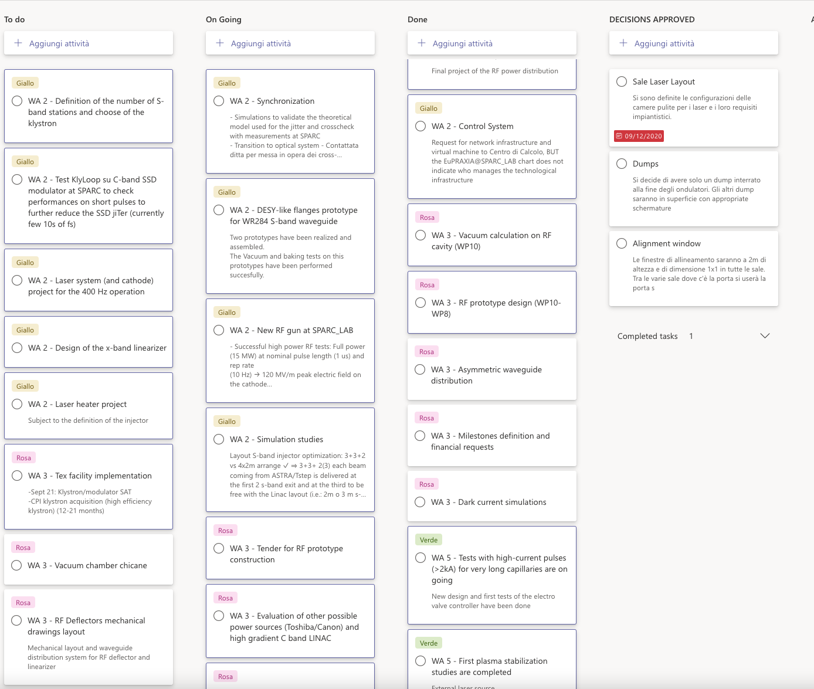
PM and Integration activities
Follow up of the activities through dedicated follow up meetings as specified in the PMP:
WA Summary and general communications
Template for reporting the status
Kanban for open actions (to do, ongoing, done, decisions approved)
Upcoming milestones discussed and monitored.
M.Iungo
TDR Review Committee, 26/10/2021. Antonio Falone

Slide 36
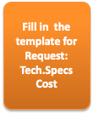
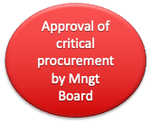
PM and Integration activities
Implementation of a DMS and authorization process for critical procurement (in order to minimize the risk of extra-cost and implement proper quality assurance processes)
Internal cost tracking (in addition to the LNF usual procurement portal).
Reference documents made public
Project Management Plan
Schedule
Intermediate milestone list
Cost breakdown
OBS
WBS
Naming Convention
F.Cioeta
TDR Review Committee, 26/10/2021. Antonio Falone

Slide 37
System engineering
Beam Optics
Functional Layout
Project Breakdown
Mechanical Layout
Production of a functional layout as main input for the Project Breakdown Structure
F.Cioeta
Baseline for machine configuration database
Functional layout for the RF distribution is already ongoing
TDR Review Committee, 26/10/2021. Antonio Falone

Slide 38
System engineering -Functional Layout
See A.Ghigo’s Talk
F.Cioeta
TDR Review Committee, 26/10/2021. Antonio Falone

Slide 39
System engineering -Functional Layout
See A.Ghigo’s Talk
F.Cioeta
TDR Review Committee, 26/10/2021. Antonio Falone

Slide 40
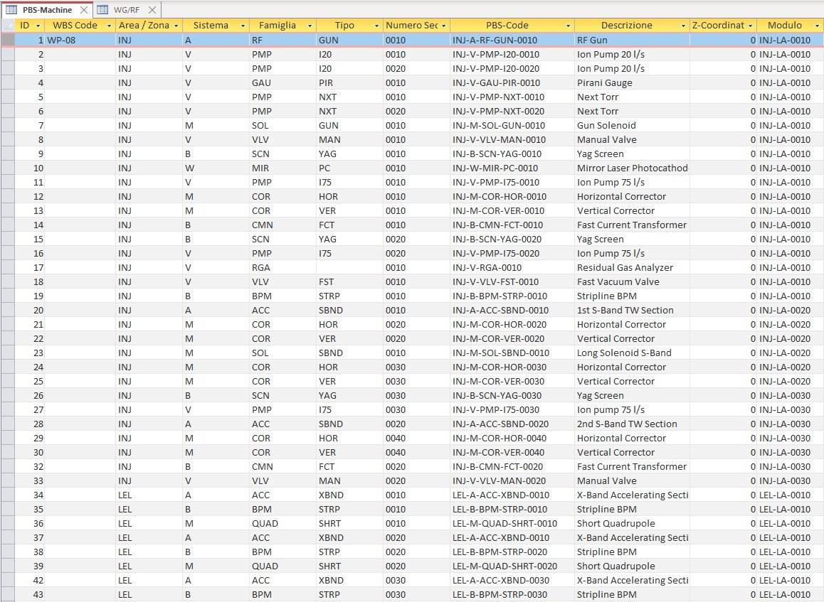
System engineering
The functional layout is approved by the project leader and by the management board and must be considered as the baseline of the machine development — Iterative process.
Project Breakdown database - framework is now fixed, to be filled up according with the progress in the design.
Main tool to freeze the machine configuration and system engineering issues (interfaces, utilities, type of connectors, etc..)
Naming convention defined in a dedicated document
It includes also the RF System (RF stations and waveguide network)
F.Cioeta
TDR Review Committee, 26/10/2021. Antonio Falone

Slide 41
Conclusions
ESFRI 2021 Roadmap inclusion
Application preparatory phase on-going
Project Management Plan finalized
Manpower issues are being addressed at management level
Cost Baseline for the TDR phase refined and partially already ongoing.
Re-baselining of the building under discussion with possible mitigation and time compression actions
PM Activities on-going: monitoring and control of the upcoming milestones, activities and cost&schedule follow up
Integration activities on-going: functional layout, machine configuration and naming convention
TDR Review Committee, 26/10/2021. Antonio Falone

