Slide 1
bTagging @ CMS (HEP)

Slide 2
Aim of the hackathon
Use realistic CMS@LHC@CERN data samples (from Monte Carlo simulation) to prepare a DL system able to “categorize” the flavour of the quark generating a jet of particles
But first, a few wider range explanations
Largely based on the work by Leonardo Giannini (formerly INFN, now UCSD)
First seen here

Slide 3
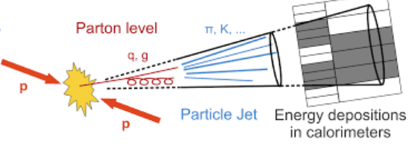
CMS- Compact Muon Solenoid
One of the 4 major LHC(CERN) experiments
Collects data from proton proton collisions @ 7-13 TeV
In particular, when you collide 2 bunch of protons, quarks tend to be expelled; due to QCD confinement, they cannot stay “naked”, and vest themselves with additional quarks and particles.
Some of the quarks are unstable (t) or generate unstable particles (b, c, s and sometimes u and d), which generate even more particles close to the direction of the initial quark
Here we try to recognize jets from b quarks from jets originating from other flavours
Knowing (statistically) the favour if the initial high energy quark is very important in HEP
Many models of New Physics
Higgs physics (H decays preferentially to b quarks)
...

Slide 4
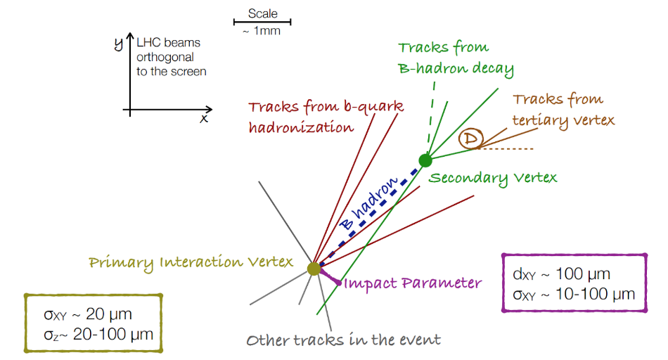
Which are our handles?
B hadrons have a “sizeable lifetime” (ctau = 500 um) so with the typical Lorentz boost @ LHC they “decay”~ mm from the pp interaction point
Light quarks (u, d) and gluons either much closer or much farther
B hadrons have a decay multiplicity (number of daughter particles) ~5, higher than lighter quarks
B hadrons have a higher fraction of decays containing leptons
B hadron mass is ~ 5 GeV, higher than other quarks
So we can search for
Tracks incompatible from coming from the pp interaction point
Presence of “more tracks”
Presence of leptons
Set of tracks with large invariant masses
...

Slide 5
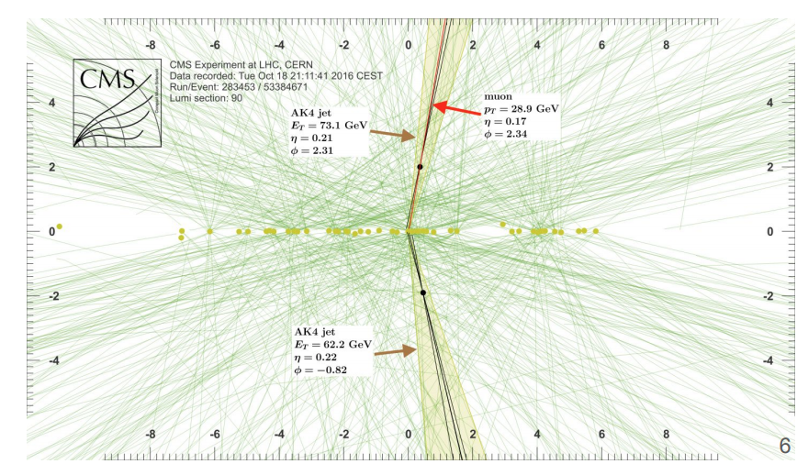
Btagging @ CMS
The CMS detector has been designed with capabilities targeted (also) at optimally finding b quark decay jets:
Efficient particle tracking to reconstruct charged tracks
Capability to reconstruct decay vertices with < 100 um resolution
Electron and muon systems to spot leptons
… even in the complex LHC scenario

Slide 6
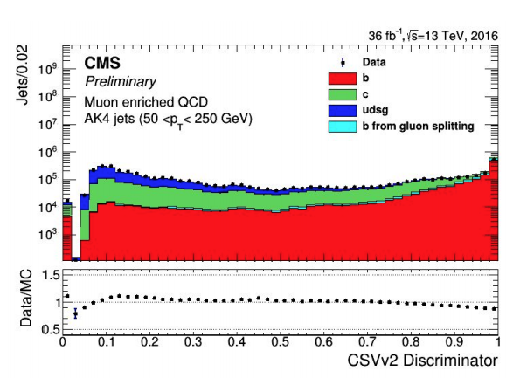
Btagging algorithms
Simple algorithms look for leptons, tracks incompatible from coming from the pp vertex, secondary vertices
They have a limited sensitivity and were used in the initial data taking periods
Today’s algorithm try to combine all the available info in order to have a more performant and stable result
Probabilistic, Likelihoods, MVA, BDT, … all used in the past. Now it is ML/DL turn!
In the CMS framework, the output of an algorithm is called “discriminator”: it is just a variable which, when tested on Monte Carlo Simulated samples, tends to be different when the algorithm is applied to jets coming from b quarks … or not.
You can see here that most b quarks populate the “high value region” (it is on log scale!!!), while light quarks (uds) and gluons mostly the low value
The higher the separation, the better you can be at selectin / categorizing / reducing the udsg background in the analysis

Slide 7
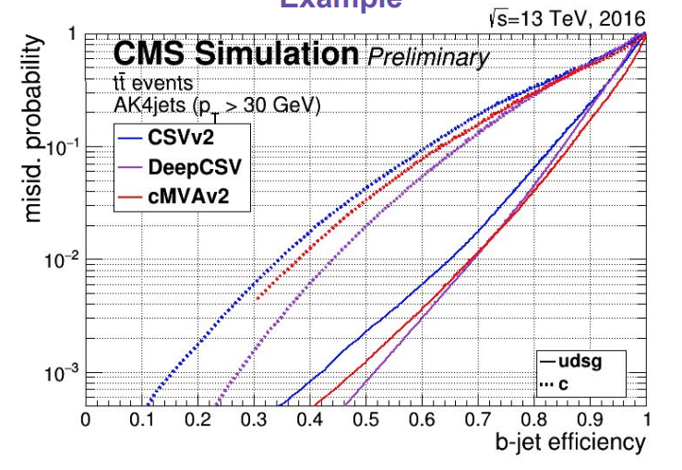
How to evaluate how good is an algorithm?
You need to tune the selection on the “discriminator” in order to select more/less efficiently b quark Jets, with more/less selected events from lighter jets
These can be inferred from the ROC curve:
You scan the discriminator cuts, and doing so you plot a line in a (X,Y) plot
Given a point, you can get the efficiency on signal on the X axis, and on background on the Y axis
“This algorithm, with a given discriminator cut, is able to select 60% of the jets from b which selecting just 0.6% of jets from lighter quarks”

Slide 8
The exercise
3 parts, 2nd and 3rd are there just if you are very fast
First part:
Consider some Jet variables and the output of some already existing complex features
Build a ROC curve using some of them
Assuming that “the more the info, the better the result”, try to prepare a DL system which has in input many of the info, to see if you can do better than standard algorithms
Better: plot a new ROC curve
Second and third part (probably not today):
Instead of using only jet related quantities, try and add jet constituent quantities (like the tracks inside the jet), with 2 different DL technologies
Is that even better? → ROC curve

Slide 9
The notebook ..
You will find in the collabshared area the notebook btaggingTom_May26_nocelloutput_students.ipynb
It contains already a lot of code, especially those to load the data samples and do some lower level actions (plots, ROC curve, …)
You will need to complete parts, mostly DL related
You will have some questions, hints for improvements, ideas …
For the afternoon session, we would like to see some results and / or if it was impossible to solve the problem.
Please use the template HERE (make one copy per group!) for guidance

Slide 10
The tutors
Group 7: Saverio Mariani; INFN Firenze, PhD-epsilon with UniFi
LHCb fixed target programme
Group 6: Belle-2 PostDoc in Marseille; former PhD with CMS in Pisa

